Slide 1
1. High-level requirement 2. R & V table
Prof. Jing Jiang, Sohpie Liu

Slide 2
Problem statement & High-level requirements

Slide 3
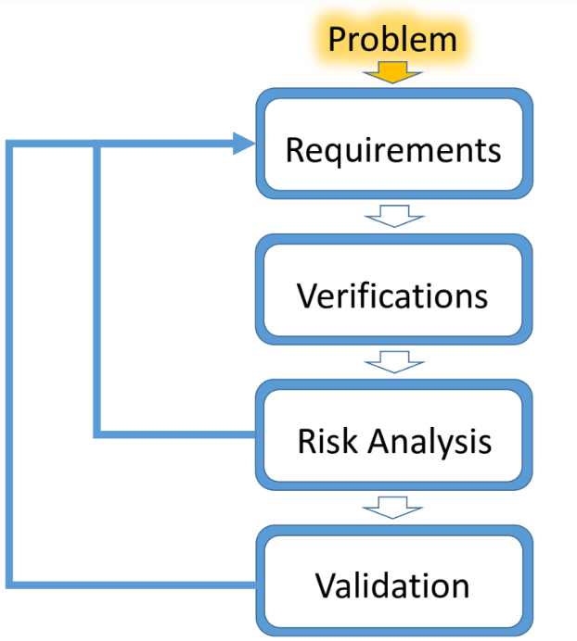
Problem statement
“Often, and very often in 445, we design something without the MOST important people in mind... ”
“The customers and the users.”
-- Quote from ECE398 PSC

Slide 4
Problem statement
What you are trying to solve and why.
Brief
Clear
Unambiguous

Slide 5
Problem proposition
Keep customer in mind in your design!
30-sec pitch: follow this template, pitch in DDC, design review, demo, presentation, and all the time!
I build ___A___ (my core product) for ___B___ (my core customer who pays money to my company).
My customer has a problem, and it is ___C___ (describe the customer’s pain point)
My product solves my customer’s problem by ___D___ (how do you solve the problem?)

Slide 6
High-level (customer) requirement
problem

Slide 7
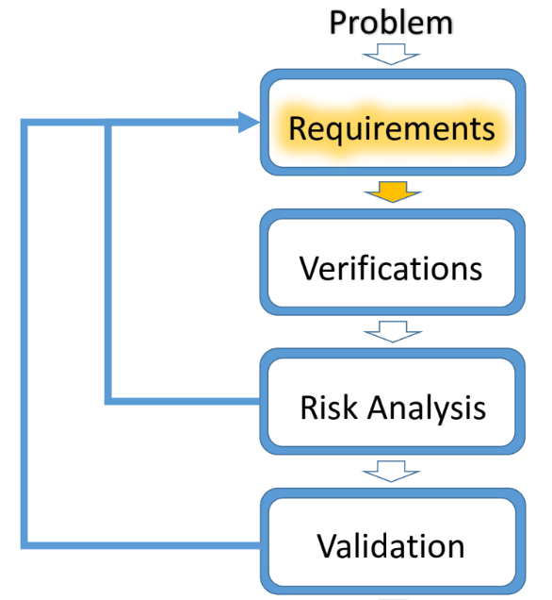
Formulate high-level (customer) requirement
problem
High-level requirement
Recall: My product solves my customer’s problem by ___D___ (how do you solve the problem?)
Notes:
Not think about design yet. But what you want the thing to do.
Focus on one or two problems.

Slide 8
What are high-level requirements and why we care
Short statements that address a technical need of the design
What
a blueprint for your customer
help you to plan out modular units
... and of course, to pass the class : )
Why
Abstract
Verifiable
Unambiguous
Traceable
How
For Senior Design purpose you want three high-level requirements
Notes:
!!!! Def of high level
Abstract: what the system will do, not how it’ll be implemented. Transport across the river vs building a bridge. Could be ferry.
Verifiable: a way to measure the req is met.
Unambiguous: single meaning
Traceable: Traceable marketing requirements. Satisfy customer’s need.

Slide 9
Write high-level reqmts using top-down approach
Taking one step back: Who is the most important person for a senior design project?
Your Customer !
DO
Problem
“Available seats detection”
Reqmts*
“Monitor
people”
Verification
“RPI -> vision”
Validation
“I have a spare RPI”
DON’T
Notes:
!!!! Def of high level
Abstract: what the system will do, not how it’ll be implemented. Transport across the river vs building a bridge. Could be ferry.
Verifiable: a way to measure the req is met.
Unambiguous: single meaning
Traceable: Traceable marketing requirements. Satisfy customer’s need.

Slide 10
High-level (customer) requirement
Example: which one do you like better?
The robot must have an average forward speed of 0.5 feet/sec, a top speed of at least 1 foot/sec, and the ability to accelerate from standstill to the average speed in under 1 sec.
The robot must employ IR sensors to sense its external environment and navigate autonomously with a battery life of 1 hrs.

Slide 11
High-level (customer) requirement
Example: which one do you like better?
The robot must have an average forward speed of 0.5 feet/sec, a top speed of at least 1 foot/sec, and the ability to accelerate from standstill to the average speed in under 1 sec.
The robot must employ IR sensors to sense its external environment and navigate autonomously with a battery life of 1 hrs.

Slide 12
High-level (customer) requirement
Example
The robot must employ IR sensors to sense its external environment and navigate autonomously with a battery life of 1 hrs.
Not Abstract

Slide 13
High-level (customer) requirement
Example
The robot must employ IR sensors to sense its external environment and navigate autonomously with a battery life of 1 hrs.
Not Abstract
Ambiguous
How about this:
The robot must navigate autonomously, with the aid of only landmarks in the specified environment, for a period of at least 1 hr.

Slide 14
High-level (customer) requirement
If you don’t satisfy your all your high-level requirements (in the demo):
As a company, you’ll lose money.
As a product manager, you’ll lose job.
As an ECE445 student, you’ll …

Slide 15
How to design good high-level requirement?
Interview customer
Customers pay for the product
Users use or break products
Users should be involved in the design process
Role-playing game
Customer: I have pain in XXX. I want to solve my problem and pay reasonable price for it. I don’t understand technical details.
Manager: I want to get the max gain from this project, which is the potential income (sales price * quantity) minus expense (labor, BOM, R&D cost).
Engineer: …

Slide 16
How to design good high-level requirement?
Context Free Process Questions
Who is the client for the XXX project?
What is a highly successful solution really worth to this client?
What is the real reason for wanting to solve this problem?
How much time do we have?
Where else can the solution to this problem be obtained? Can we copy an existing solution?
Context Free Product Questions
What problems does this system solve?
What problems could this system create?
What environment is this system likely to encounter?
What kind of precision is required?
Notes:
Explain context free: Questions independent from what your project is.
These need to be thought about.
Takes all these into account.
Not really answers to all.

Slide 17
A good high-level requirement fulfills 4 criteria
DO
Team 9, 2019 fall Electronic Response System for Assisted Braking
(ERSAB)
DON’T
The speed sensor is able to sample at 5000 samples/sec and send data to the microcontroller in order to enable the motor to activate the braking system for the bike.
A motor is able to provide sufficient torque to activate the brake ≦ 10-hole increments.
The PCB is designed compactly with the intention of integrating the power, control, and braking systems without adding too much weight.
ERSAB decreases at least 50% jerk (the derivative of acceleration).
ERSAB has shorter or equal braking distance compared to the original brake system (50-100%).
The control unit is designed compactly with the intention of integrating the power, control, and braking systems and lighter than 1kg.
The speed sensor is able to sample at 5000 samples/sec and send data to the microcontroller in order to enable the motor to activate the braking system for the bike.
A motor is able to provide sufficient torque to activate the brake ≦ 10-hole increments.
The PCB is designed compactly with the intention of integrating the power, control, and braking systems without adding too much weight.
ERSAB decreases at least 50% jerk (the derivative of acceleration).
ERSAB can shorten braking distance by at least 10% compared to the original brake system.
The control unit is designed compactly with the intention of integrating the power, control, and braking systems and lighter than 1kg.
Team 9, 2019 fall Student's version (Electronic Response System for Assisted Braking): ● The speed sensor is able to sample at 5000 samples/sec and send data to the microcontroller in order to enable the motor to activate the braking system for the bike. ● A motor is able to provide sufficient torque to activate the brake in within less than 10 hole increments. ● The PCB is designed compactly with the intention of integrating the power, control, and braking systems without adding too much weight.
ERSAB decreases at least 50% jerk (the derivative of acceleration).
ERSAB has shorter or equal braking distance compared to the original brake system 50-100%.
The control unit is designed compactly with the intention of integrating the power, control, and braking systems and lighter than 1kg. (edited)
Notes:
!!!! Def of high level
Abstract: what the system will do, not how it’ll be implemented. Transport across the river vs building a bridge. Could be ferry.
Verifiable: a way to measure the req is met.
Unambiguous: single meaning
Traceable: Traceable marketing requirements. Satisfy customer’s need.

Slide 18
R & V table (Requirements and Verification)

Slide 19
What is a R&V table and why we care
A two-column table with requirements on the left, and verification on the right
What
A checklist for both modular goals and modular debugging
If all requirements have been verified by your verification for every module, you should have a fully functioning project.
... and of course, to pass the class : )
Why
For Senior Design purpose you want a R&V table for each block in your block diagram
Notes:
!!!! Def of high level
Abstract: what the system will do, not how it’ll be implemented. Transport across the river vs building a bridge. Could be ferry.
Verifiable: a way to measure the req is met.
Unambiguous: single meaning
Traceable: Traceable marketing requirements. Satisfy customer’s need.

Slide 20
How to write a R&V table
Requirements
Verifications
Technical definitions of what each and every module in your system block diagram must be able to do
A set of procedures that you will use to verify that a requirement has been met
Quantitative
Thorough and detailed
Driven by project goals
Design requirements ≠ purchase requirements
Derived from your HL requirement!!!
Equipment
Test Procedures
Presentation of results
Explicit
(Specify what mock object(s) to use)
Notes:
!!!! Def of high level
Abstract: what the system will do, not how it’ll be implemented. Transport across the river vs building a bridge. Could be ferry.
Verifiable: a way to measure the req is met.
Unambiguous: single meaning
Traceable: Traceable marketing requirements. Satisfy customer’s need.

Slide 21
Write R&V table using top-down approach
Overall
Iterative
High level
Sub-Problems
Module-level
1-level
deeper
Notes:
sub

Slide 22
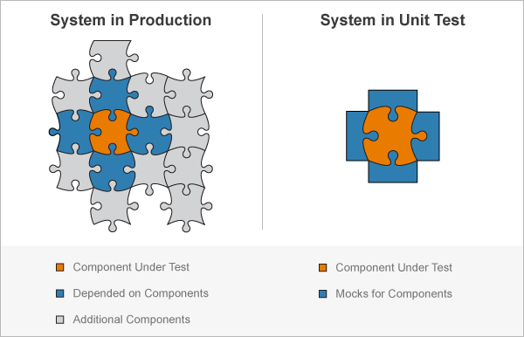
The system would work if each module works
Each module is a unit.
R: attributes your system must have
V: tests you will perform (w. mock object)
Each module works | system works
Key words:
Unit test
Mock object
System test
Stages for building:
Bread board
PCB: TPs, jumpers
Notes:
R: A set of statements that describe the attributes your system must have to solve your problem.
V: A set of statements that describe tests you will perform to make sure that your system meets the requirements.
PCB: testing points, jumpers

Slide 23
Bad RV Example
Voltage Regulator
Requirements | Verification
1. Step down battery to 3.3VDC | 1. Take oscilloscope measurements to make sure that voltage output is 3.3V.

Slide 24
Bad RV Example
Voltage Regulator
Requirements | Verification
1. Step down battery to 3.3VDC | 1. Take oscilloscope measurements to make sure that voltage output is 3.3V.
What is battery voltage?

Slide 25
Bad RV Example
Voltage Regulator
Requirements | Verification
1. Step down battery to 3.3VDC | 1. Take oscilloscope measurements to make sure that voltage output is 3.3V.
Do I fail if the output is 3.25V?

Slide 26
Bad RV Example
Voltage Regulator
Requirements | Verification
1. Step down battery to 3.3VDC | 1. Take oscilloscope measurements to make sure that voltage output is 3.3V.
Do we miss any requirements? e.g, current draw?

Slide 27
Bad RV Example
Voltage Regulator
Requirements | Verification
1. Step down battery to 3.3VDC | 1. Take oscilloscope measurements to make sure that voltage output is 3.3V.
How to measure?

Slide 28
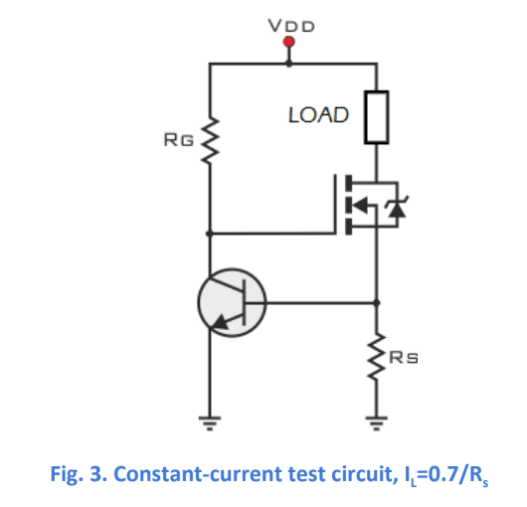
Good RV Example
Voltage Regulator
(adapted from SP16 Wireless IntraNetwork)
Requirements | Verification
Provide 3.3V +/- 0.5% from a 3.7V-4.2V source Can operate current within 0 -300mA Maintain thermal stability below 125°C Efficiency should be higher than 80%. | 1A. Measure the output voltage using an oscilloscope, ensuring that the output voltage stays within 5% of 3.3V. 2A. Connect the output of the voltage regulator to VDD node in the constant-current test circuit in Figure 3. 2B. Adjust Rs in Figure 3 to deliver at most 300mA to the load, measured by a multimeter. 2C. Measure the output voltage using an oscilloscope, ensuring that the output voltage stays within 5% of 3.3V. 3A. During verification for Requirement 1 and 2, use an IR thermometer to ensure the IC stays below 125°C.

Slide 29
Good RV Example
Voltage Regulator
(adapted from SP16 Wireless IntraNetwork)
Requirements | Verification
Provide 3.3V +/- 0.5% from a 3.7V-4.2V source Can operate current within 0-300mA Maintain thermal stability below 125°C Efficiency should be higher than 80%. | 1A. Measure the output voltage using an oscilloscope, ensuring that the output voltage stays within 5% of 3.3V. 2A. Connect the output of the voltage regulator to VDD node in the constant-current test circuit in Figure 3. 2B. Adjust Rs in Figure 3 to deliver at most 300mA to the load, measured by a multimeter. 2C. Measure the output voltage using an oscilloscope, ensuring that the output voltage stays within 5% of 3.3V. 3A. During verification for Requirement 1 and 2, use an IR thermometer to ensure the IC stays below 125°C.
Quantitative measurable ranges

Slide 30
Good RV Example
Voltage Regulator
(adapted from SP16 Wireless IntraNetwork)
Requirements | Verification
Provide 3.3V +/- 0.5% from a 3.7V-4.2V source Can operate current within 0-300mA Maintain thermal stability below 125°C Efficiency should be higher than 80%. | 1A. Measure the output voltage using an oscilloscope, ensuring that the output voltage stays within 5% of 3.3V. 2A. Connect the output of the voltage regulator to VDD node in the constant-current test circuit in Figure 3. 2B. Adjust Rs in Figure 3 to deliver at most 300mA to the load, measured by a multimeter. 2C. Measure the output voltage using an oscilloscope, ensuring that the output voltage stays within 5% of 3.3V. 3A. During verification for Requirement 1 and 2, use an IR thermometer to ensure the IC stays below 125°C.
Very detailed and thorough
requirements

Slide 31
Good RV Example
Voltage Regulator
(adapted from SP16 Wireless IntraNetwork)
Requirements | Verification
Provide 3.3V +/- 0.5% from a 3.7V-4.2V source Can operate current within 0-300mA Maintain thermal stability below 125°C Efficiency should be higher than 80%. | 1A. Measure the output voltage using an oscilloscope, ensuring that the output voltage stays within 5% of 3.3V. 2A. Connect the output of the voltage regulator to VDD node in the constant-current test circuit in Figure 3. 2B. Adjust Rs in Figure 3 to deliver at most 300mA to the load, measured by a multimeter. 2C. Measure the output voltage using an oscilloscope, ensuring that the output voltage stays within 5% of 3.3V. 3A. During verification for Requirement 1 and 2, use an IR thermometer to ensure the IC stays below 125°C.
Step-by-step procedure

Slide 32
Good RV Example
Voltage Regulator
(adapted from SP16 Wireless IntraNetwork)
Requirements | Verification
Provide 3.3V +/- 0.5% from a 3.7V-4.2V source Can operate current within 0-300mA Maintain thermal stability below 125°C Efficiency should be higher than 80%. | 1A. Measure the output voltage using an oscilloscope, ensuring that the output voltage stays within 5% of 3.3V. 2A. Connect the output of the voltage regulator to VDD node in the constant-current test circuit in Figure 3. 2B. Adjust Rs in Figure 3 to deliver at most 300mA to the load, measured by a multimeter. 2C. Measure the output voltage using an oscilloscope, ensuring that the output voltage stays within 5% of 3.3V. 3A. During verification for Requirement 1 and 2, use an IR thermometer to ensure the IC stays below 125°C.
Equipment

Slide 33
Good RV Example
Voltage Regulator
(adapted from SP16 Wireless IntraNetwork)
Requirements | Verification
Provide 3.3V +/- 0.5% from a 3.7V-4.2V source Can operate current within 0-300mA Maintain thermal stability below 125°C Efficiency should be higher than 80%. | 1A. Measure the output voltage using an oscilloscope, ensuring that the output voltage stays within 5% of 3.3V. 2A. Connect the output of the voltage regulator to VDD node in the constant-current test circuit in Figure 3. 2B. Adjust Rs in Figure 3 to deliver at most 300mA to the load, measured by a multimeter. 2C. Measure the output voltage using an oscilloscope, ensuring that the output voltage stays within 5% of 3.3V. 3A. During verification for Requirement 1 and 2, use an IR thermometer to ensure the IC stays below 125°C.
Explicit set-up/configuration

Slide 34
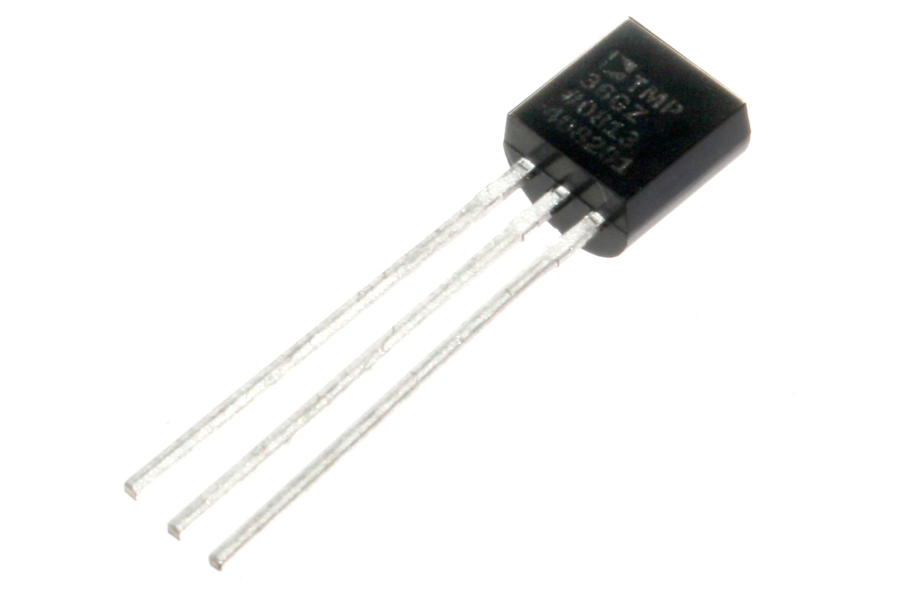
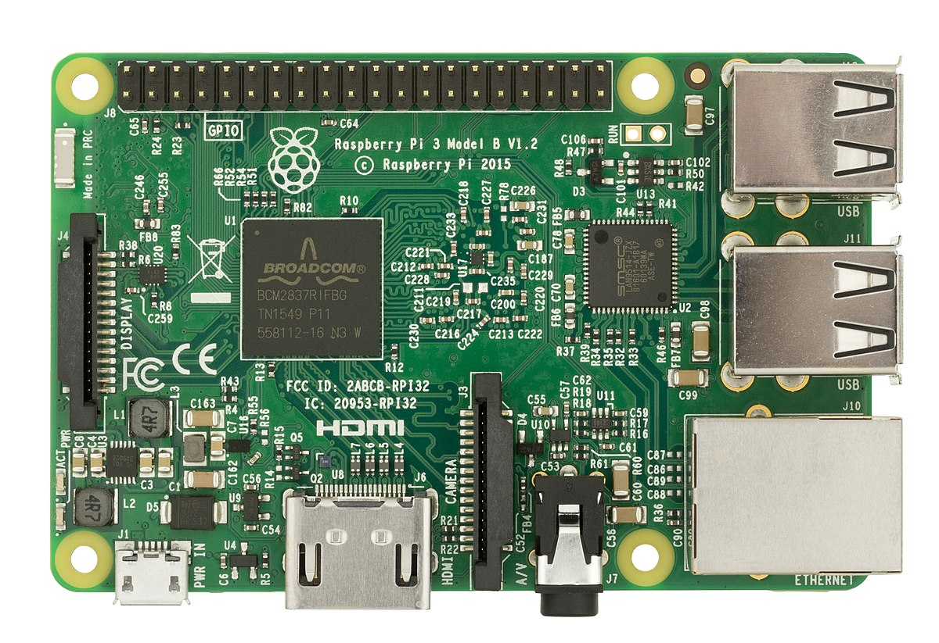
Bad RV Example #1
It is raining; put on a jacket.
Personal Rain Detector
Requirements | Verification
Raspberry Pi is functional. Raspberry Pi GPIO pins can produce outputs. Speaker produces sound when powered. Moisture sensor can survive manufacturer-specified weather conditions. | 1A. Provide 5V power to Raspberry Pi. Inspect status lights to ensure it is operating. 2A. Toggle GPIO pins and measure with oscilloscope. 3A. Drive speaker with 9V power supply and listen for sound to ensure it works. 4. Put sensor outside on a rainy day and test that it works after.
What is bad?

Slide 35
Bad RV Example #1
It is raining; put on a jacket.
Personal Rain Detector
Requirements | Verification
Raspberry Pi is functional. Raspberry Pi GPIO pins can produce outputs. Speaker produces sound when powered. Moisture sensor can survive manufacturer-specified weather conditions. | 1A. Provide 5V power to Raspberry Pi. Inspect status lights to ensure it is operating. 2A. Toggle GPIO pins and measure with oscilloscope. 3A. Drive speaker with 9V power supply and listen for sound to ensure it works. 4. Put sensor outside on a rainy day and test that it works after.
ISSUE: Padding your RV table.
Each of these is “guaranteed” by the manufacturer.
You aren’t testing any new designs of your own.

Slide 36
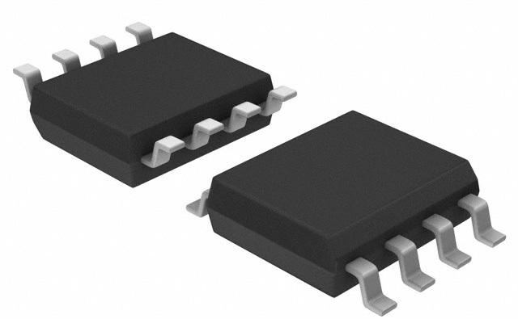
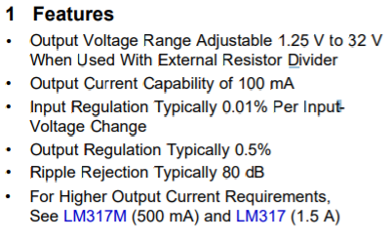
Bad RV Example #2
Power module
Requirements | Verification
Output Voltage Range 4.9-5.1 V Output Current Capability of 100 mA Input Regulation Typically 0.01% Output Regulation Typically 0.5% Ripple Rejection Typically 80 dB | …
LM317 datasheet
ISSUE: design → requirement → parts, not the opposite
Look at what power module you really need: V, I, ripple, efficiency, etc
Select parts satisfying the requirement later.

Slide 37
R&V summary
Requirement:
Requirements of modules or sub-block
Derived from high-level requirement
Be specific
Verification:
Grab another 445 student, he/she can test that module for you based on your writing.
What R&V is not:
Copy the specs of parts (Parts are based on requirement)
Laundry list of parts
Requirements of parts (vs purchasing requirement)

Slide 38
Tips to succeed

Slide 39
Tips to succeed
1. Top-down approach
2. Check out good projects from previous semesters
3. Ask your TAs

