Slide 1
The Smart Fitness Coach
Weekly Progress
03/28
Sponsor: Bruce Xinbo Yu
TA: Xiaoai Wang
Members: Xinyu Li, Yuxuan Lin, Lishan Shi, Tianheng Wu

Slide 2
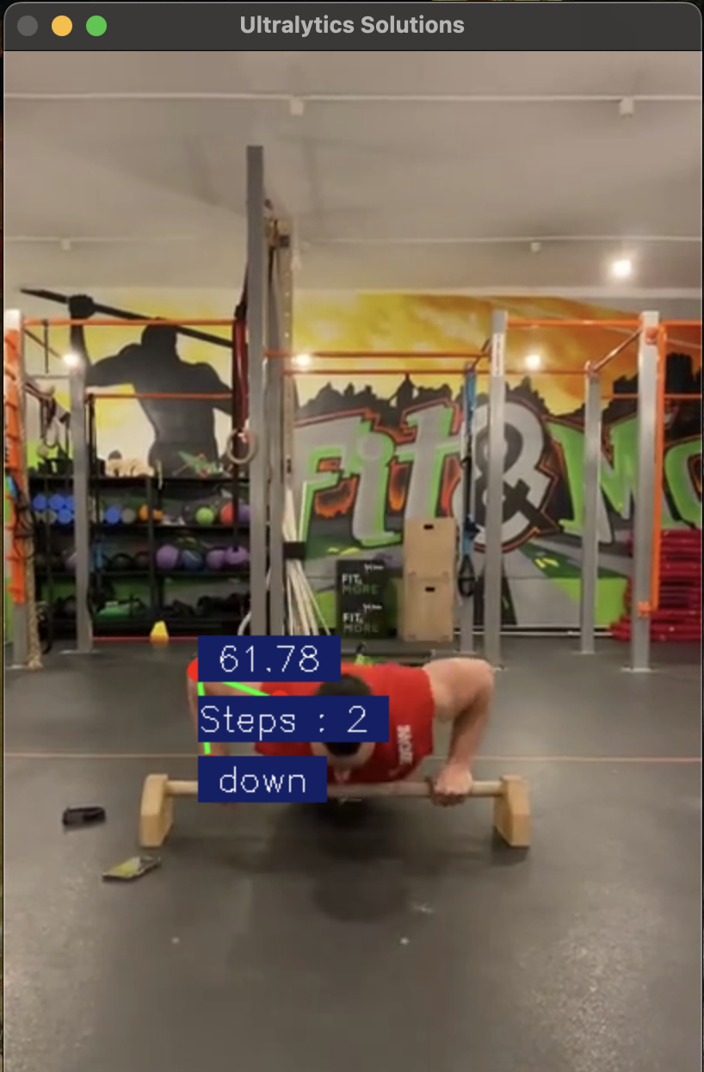
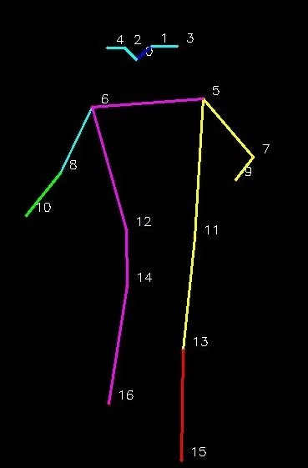
Technical investigation
YOLO Application and Advantages
YOLO11 is the latest iteration in the “You Only Look Once” series of real-time object detection models
More precise object detection. Its optimized design achieves faster processing speeds while maintaining a balance between accuracy and performance.
Additionally, YOLO11 supports a broad range of computer vision tasks, including object detection, instance segmentation, image classification, pose estimation, and oriented object detection, and can be seamlessly deployed across various environments, from edge devices to cloud platforms.

Slide 3
Technical investigation
Uniapp (Vue)
UniApp simplifies development by significantly reducing code redundancy, allowing developers to deploy apps simultaneously to multiple platforms. It offers excellent performance, close to native apps, and seamlessly integrates with various platform-specific APIs, accelerating the development process and reducing costs.
OpenCV (Open Source Computer Vision Library) is an open-source software library designed for real-time image and video processing, analysis, and computer vision applications.
OpenCV
OpenCV offers a wide range of efficient, optimized algorithms for tasks like object detection, face recognition, image segmentation, and augmented reality. Its cross-platform compatibility and support for multiple programming languages (including Python, C++, and Java) simplify the development process. The library is widely used in industry and academia due to its robust functionality, extensive documentation, and active community support.
UniApp is a popular cross-platform framework enabling developers to create mobile apps, mini-programs, and web applications using a single codebase built primarily on Vue.js.

Slide 4
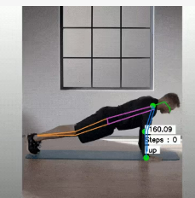
Function Realization
Real-time video action recognition
We are able to identify the specific type of fitness now.
Bone critical point covering
Based on YOLO11 model, the key points of bones are covered, and 14 nodes such as shoulder, hip, knee and ankle are accurately positioned, providing accurate data for fitness movement analysis. Through the example diagram, the effect of bone superposition is visually displayed, and users can clearly see the position of key points, real-time posture correction, and improve the fitness effect.
Preliminary counting mechanism
According to the angle between the critical point, we realize the counting.

