Slide 1
ECE 445 FALL 2014:
Laser Harp MIDI Controller with Musical Articulations
Group #4: Hanze Tu, Yingxi Hai

Slide 2
Introduction
A visually appealing music instrument
An innovative way to play music

Slide 3
Objectives
Wanted to incorporate:
-Ability to play different tones
-Plucking at slower speeds result in softer sound
-Different audio filters and effects

Slide 4
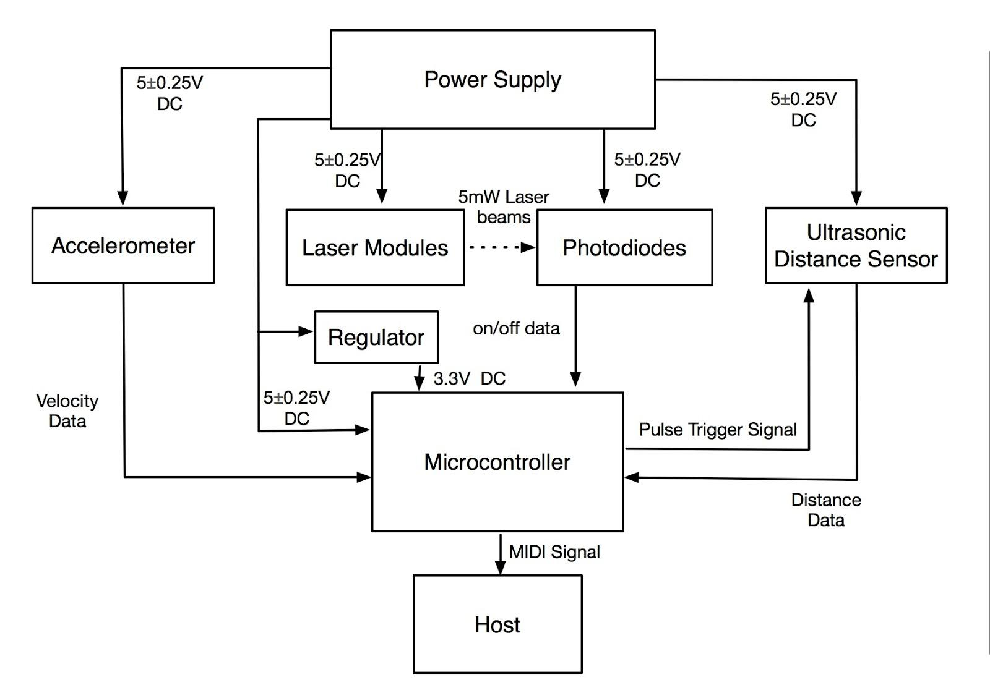

Slide 5
Accelerometer - Data Mapping
Input: converted acceleration value in g
Output velocity range: 25-127
Map 0-1g to 25-85
Map 1.01-4g to 86-127
Map >4g to 127

Slide 6
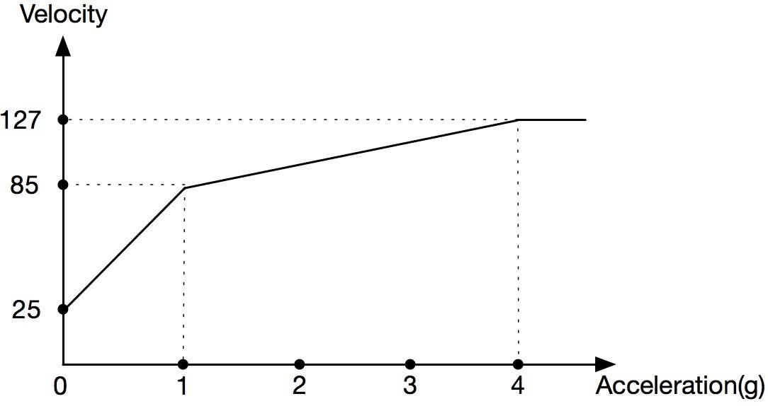
Accelerometer - Data Mapping

Slide 7
Conclusions and Further Work
Accelerometer tested and verified
Integrate accelerometer with microcontroller
Test distance sensor and photodiodes
Future work: vibration motor for tactile feedback

Slide 8
Thank you!

