Slide 1
ILLINOIS STATE POLICE
TRAFFIC RELATED CRASHES & FATALITIES

Slide 2
ISP HISTORY
What can be determined from our historical data?
65 Line of Duty Deaths
47 deaths involving a vehicle
11 by gunfire / 1 by stabbing
Statistically, we are more likely to die in the line of duty in a vehicular crash and between August and November. The month of May has a spike, also.
July has seen the FEWEST LOD Deaths

Slide 3
TRIALS AND TRIBULATIONS

Slide 4
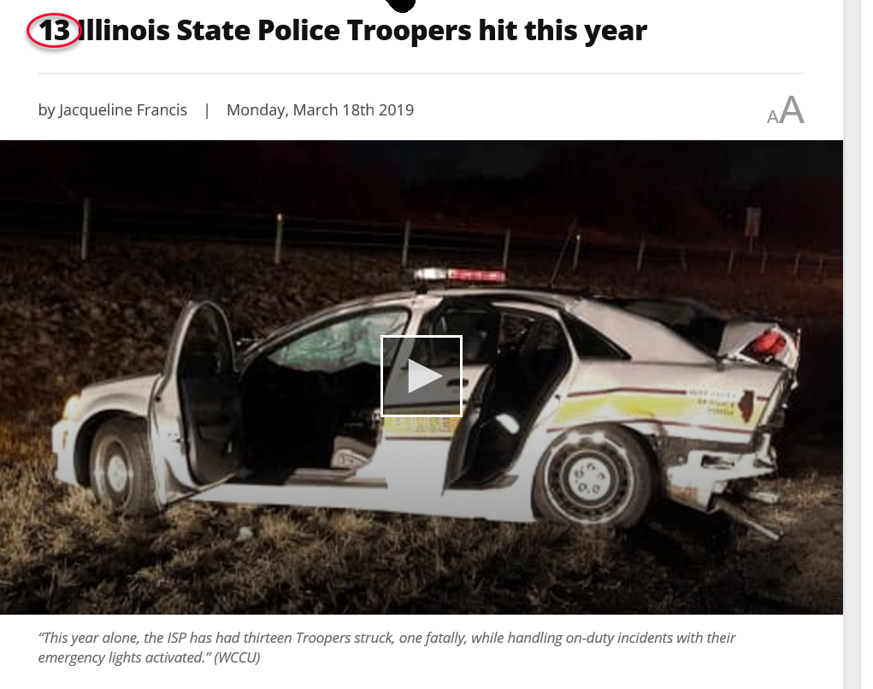
DEVASTATION
Notes:
Illinois State Police saw unprecedented increase in Officers killed in the line of duty in 2019. Of the 4 officers killed, 3 died as a result of injuries sustained in traffic crashes. Illinois State Police Troopers were involved in a total of 71 motor vehicle crashes; 27 were a result of Scott’s Law (move over law) violations. Since its formation, the ISP has experienced the deaths of 47 Troopers involving a vehicle / motorcycle.

Slide 5
TRAGEDY
Notes:
ISP rear end

Slide 6
CATASTROPHE
Notes:
Unknown crash

Slide 7
DISASTER
Notes:
District 11 Crash

Slide 8
FORD POLICE INTERCEPTOR
Notes:
We have a 21st century police fleet….outfitted with some of the finest equipment in safety, yet first responders are still being killed by traffic on the Interstates and Highways.

Slide 9
CHEVROLET POLICE TAHOE

Slide 10
DODGE POLICE DURANGO

Slide 11
SAFETY THREATS

Slide 12
TRAFFIC
HEAVY TRAFFIC
LIGHT TRAFFIC
Notes:
Heavy Traffic and Light Traffic pose their own separate, yet serious set of consequences for failures to observe and react.

Slide 13
VIOLENT OFFENDERS

Slide 14
FACTORS CONTRIBUTING TO INCREASED RISK

Slide 15
DISTRACTIONS
Notes:
Law Enforcement Officers have additional distractions inside the vehicle causing a further division of attention to the already long list of tasks.

Slide 16
DISTRACTIONS

Slide 17
DISTRACTIONS

Slide 18
DISTRACTIONS

Slide 19
CRASH SCENE SAFETY MEASURES

Slide 20
SQUAD USED TO BLOCK TRAFFIC AT CRASH
Notes:
The following are some of the common ways CRASH SCENES are managed by today’s law enforcement and other first responders.

Slide 21
ROAD FLARES

Slide 22
CONES W/ REFLECTIVE TAPE

Slide 23
DECOMISSIONED BLOCKER VEHICLES

Slide 24
ARROW BOARDS / CRASH BUMPERS
Notes:
These are great but take time to set up.

Slide 25
TRAFFIC STOP SAFETY MEASURES

Slide 26
ACADEMY TRAINING
Notes:
Officers are generally taught different approaches to vehicles and avenues of escape

Slide 27
TRAFFIC STOPS / INITIAL CRASH SCENES
Notes:
What you see in this picture is what you get. Overhead light bar or covert light bar with directional capacity…strobes in tail lamps / backup light housing

Slide 28
AUTO ADVANCEMENTS

Slide 29
Tech Advancements in Auto Industry
Notes:
Over the years we have seen automotive technological advancements like:
Road sign detection
Intelligent Speed Assistance (ISA)
Autonomous Emergency Braking (AEB)
Cross-traffic assist
Blind Spot Detection
Lane Departure Warning
Pedestrian Detection

Slide 30
Tech Advancements in Auto Industry
Notes:
Some of the progress has been recent; within the last few years.

Slide 31
Vehicle Safety Systems
ACTIVE

Slide 32
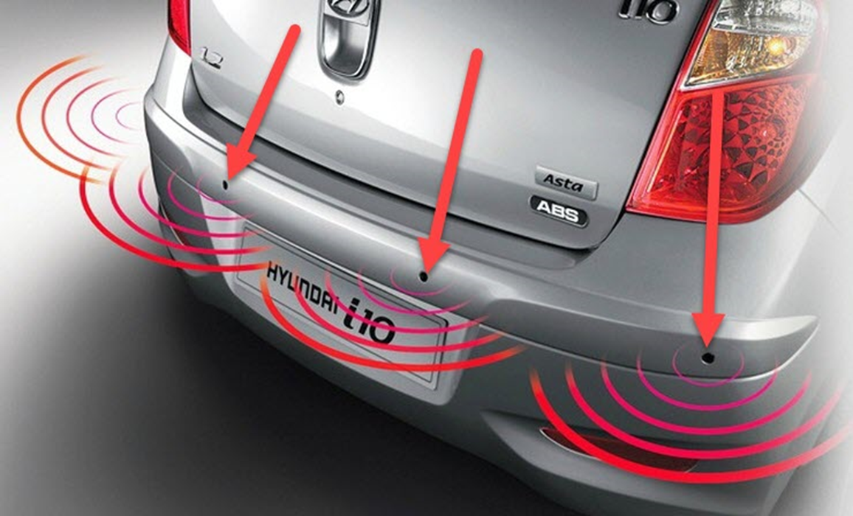
Electromagnetic / Ultrasonic Proximity Detector

Slide 33
ULTRASONIC Attributes

Slide 34
CAMERA VISUAL DETECTION

Slide 35
Passive Visual Attributes
Notes:
CAMERA IS LIMITED IN INCLEMENT WEATHER, BUT ALLOWS FOR INTERPRETATION BY A COMPUTER. GREAT FOR VEHICLES IN MOTION

Slide 36
TECHNOLOGICAL ADVANCEMENTS IN POLICING

Slide 37
Tech Advancements in Law Enforcement LIDAR

Slide 38
LIDAR Attributes
Notes:
Positives: Sensors have good range – over 2000 feet, works in darkness and in daylight, detects speed
Negatives: Sensors have limited use in inclement weather and offer little proximity detection

Slide 39
Tech Advancements in Law Enforcement RADAR

Slide 40
RADAR Attributes
Notes:
Positives: Good range, good speed detection, good in all weather and lighting conditions, just as good as lidar / just as fast as speed of light
Negatives: Not target specific (radar / doppler effect and waves)

Slide 41
BRIDGING THE GAP BETWEEN TECHNOLOGICAL ADVANCEMENT AND SAFETY

Slide 42
ENTER: LANDSLIDE

Slide 43
LANE ADVANCE WARNING SYSTEM (LAWS)
Notes:
An Active Safety System

Slide 44
LAWS PROPOSAL

Slide 45
VESELAGO - 1967
Notes:
Victor Georgievich Veselago (13 June 1929 – 15 September 2018) was a Russian physicist. In 1967, he was the first to publish a theoretical analysis of materials with negative permittivity, ε, and permeability μ. He published his seminal work in a paper entitled "The Electrodynamics of Substances with Simultaneously Negative Values of ε and μ". It was first published in Russian (1967), and was later translated into English (1968). His published paper was key to the advancement of physics research in electrodynamics and optics. It has been cited 3915 times by other scientific works, according to Cross ref
Read more

Slide 46
CONCAVE LENS
Notes:
Concave lenses generally radiate input like the spokes of a bicycle tire using REFRACTION.

Slide 47
MIT - 2012

Slide 48
MIT - 2012
Notes:
MIT’s metamaterial uses NEGATIVE REFRACTION to converge the radio waves.

Slide 49
SUPER LENSES
Notes:
9 INCHES BY 10 INCHES BY 1.5 INCHES THICK

Slide 50
LAWS CONCEPT

Slide 51
LAWS CONCEPT
RADIO WAVES
METAMATERIAL
ELECTROMAGNETIC RADIATION
3kHz to 3THz
WAVELENGTH FROM 100 MICROMETERS TO 100 KILOMETERS
SPEED OF LIGHT
ENGINEERED
NOT FOUND IN NATURE
REPEATING PATTERNS
Notes:
Radio waves are a type of electromagnetic radiation with wavelengths in the electromagnetic spectrum longer than infrared light. Radio waves have frequencies from 3 THz to as low as 3 kHz, and corresponding wavelengths ranging from 100 micrometers (0.0039 in) to 100 kilometers (62 mi). Like all other electromagnetic waves, they travel at the speed of light.
Metamaterials are materials engineered to have properties that have not yet been found in nature. They are made from assemblies of multiple elements fashioned from composite materials such as metals or plastics. The materials are usually arranged in repeating patterns, at scales that are smaller than the wavelengths of the phenomena they influence

Slide 52
LAWS CONCEPT
RADIO WAVE OUTPUT DEVICE
FOCUSED BY METAMATERIAL
AIMED TO THE REAR
LANE OF TRAVEL NEXT TO STOP
DOPPLER SHIFT
HORN / SIREN TRIGGERED
ADDITIONAL HIGH-OUTPUT EMERGENCY LIGHTING ACTIVATED
Notes:
UTILIZING A STANDARD OR MODIFIED RADIO WAVE OUTPUT DEVICE;
RADIO WAVES WILL BE FOCUSED BY AN APPROPRIATELY DESIGNED METAMATERIAL AND AIMED TO THE REAR OF THE VEHICLE, TO INCLUDE THE LANE OF TRAVEL NEAREST THE SHOULDER STOPPED UPON.
UPON THE “BREAKING OF THE PLANE” OR DOPPLER SHIFT, THE DEVICE WILL TRIGGER THE VEHICLE’S HORN TO DRAW THE OFFICER’S ATTENTION TO APPROACHING TRAFFIC
ADDITIONAL HIGH-OUTPUT EMERGENCY LIGHTING WILL BE TRIGGERED TO GET ATTENTION OF ONCOMING VEHICLE’S DRIVER.

Slide 53
PROXIMITY ADVANCE WARNING SYSTEM (PAWS)
Notes:
An Active Safety System

Slide 54
PAWS PROPOSAL
Notes:
POLICE OFFICERS ACROSS THE NATION HAVE CONSISTENTLY RELIED UPON OUR FURRY FRIENDS FOR ASSISTANCE IN COMPLETING THE LAW ENFORCEMENT MISSION: APPREHENDING THE BAD GUYS, DETECTING NARCOTICS, BRIDGING THE GAP BETWEEN POLICE AND COMMUNITY (K9 DEMONSTRATIONS), AND SERVING AS A LOYAL PARTNER; BOTH IN THE VEHICLE AND AT HOME. THEY ARE FAMILY. THIS NEXT CONCEPT PAYS HOMAGE TO OUR FOUR LEGGED PARTNERS WHO ALWAYS HAVE OUR BACK AND ARE WILLING TO LAY DOWN THEIR LIVES JUST LIKE THEIR HANDLER; FOR A STRANGER OR FOR A MEMBER OF THEIR FAMILY. NOW EVERY OFFICER CAN EXPERIENCE THE SAFETY AND SECURITY OF HAVING MAN’S BEST FRIEND; AN OFFICER’S BEST FRIEND TO WARN THEM OF DANGER.

Slide 55
PAWS CONCEPT
Notes:
UTILIZING ELECTROMAGNETIC PROXIMITY SENSORS INSTALLED ON THE VEHICLE’S BUMPER AND SIDE PANELS; COUPLED WITH CROSS-TRAFFIC ASSIST, BLIND SPOT DETECTION, AND PEDESTRIAN DETECTION WE WILL EFFECTIVELY CREATE A SAFETY UMBRELLA AROUND THE VEHICLE WHICH WILL PREVENT INTRUSION WITHIN THE ZONE WITHOUT AN ALERT BEING ISSUED TO THE OFFICER.

Slide 56
PAWS CONCEPT
PROXIMITY SENSOR DEVICES
TUNING
AMPLIFY USING METAMATERIAL LENS (CONICAL SWISS ROLL)
360° UMBRELLA COVERAGE
ON/OFF CONTROLLED BY OFFICER
HORN TRIGGERED / RECORDED BARKING DOG TRIGGERED
CORRESPONDING WHITE LIGHTS ON LIGHT BAR TO ILLUMINATE APPROACHING SUBJECT
Notes:
NORMALLY, ELECTROMAGNECTIC SENSORS HAVE AN EFFECTIVE RANGE BETWEEN 4’ AND 10’. POSSIBILITY FOR TUNING TO INCREASE MAXIMUM RANGE / HAVE MANUFACTURER CHANGE INSTALLATION CONFIGURATION FOR POLICE FLEET.
This compact in-ground sensor works on the same principle as any other radar. High frequency RF pulses are transmitted, bounced off a target object, and measured by a time-gated return RF mixer. RF reflections are analyzed to produce presence, distance, and motion measurements. MicroRadar can precisely detect the onset of parking events and the clearance of cars from spaces. The radar is tuned for offset, minimum range, and maximum range based on installation configuration.

Slide 57
IN REMEMBRANCE

Slide 60
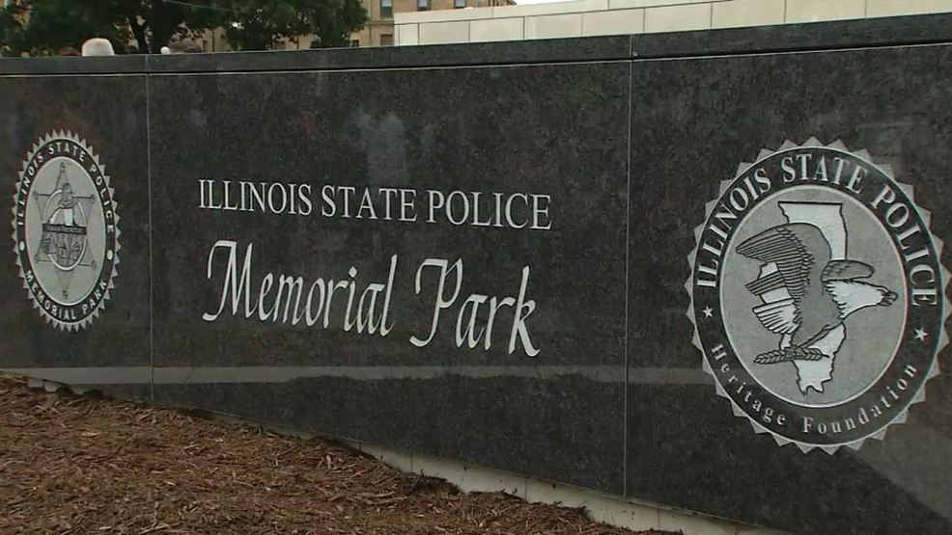

Slide 61
INTEGRITY
TROOPER
KYLE DEATHERAGE
EOW: 11/26/2012
Notes:
Kyle William Deatherage
Trooper Kyle Deatherage was struck and killed by a tractor trailer while making a traffic stop on I-55, at mile marker 62, near Litchfield. He had parked his motorcycle on the shoulder and was speaking with the driver of the vehicle when the collision occurred. Trooper Deatherage had served with the Illinois State Police for three years. He is survived by his wife, 4-year-old daughter, 10-month-old son, father, mother, sister, and two brothers.

Slide 62
SERVICE
TROOPER
JAMES SAUTER
EOW: 03/28/2013
Notes:
James Michael Sauter
Trooper James Sauter was killed when a semi-trailer truck struck his cruiser on I-294, south of Willow Road, shortly after 11:00 p.m. He was stopped in the left shoulder of the south-bound lanes when the semi rear-ended his cruiser, causing both vehicles to burst into flames. He was pronounced dead at the scene. On January 22nd, 2016, the tractor trailer driver was sentenced to two years in prison after pleading guilty to several felony commercial vehicle violations in connection to the crash. Trooper Sauter had served with the Illinois State Police for five years. He is survived by his wife, parents, and brother.

Slide 63
PRIDE
TROOPER
CHRISTOPHER LAMBERT
EOW: 01/12/2019
Notes:
Christopher Lambert
Trooper Christopher Lambert was struck and killed by a vehicle while investigating the scene of a prior crash on I-294 near Willow Road in Northbrook. He was en route home when he encountered the three-vehicle crash on the left shoulder and stopped to render aid. He was standing outside of his vehicle when he was struck by another vehicle that failed to slow down or move over. A nurse who was on the scene performed CPR until rescue personnel arrived. He was transported to Glenbrook Hospital where he was pronounced dead a short time later. The investigation revealed that the driver who struck him was attempting to pass the accident scene by using the left shoulder and had admitted to smoking THC oil the previous day. He was charged with reckless homicide. Trooper Lambert was a U.S. Army veteran and had served with the Illinois State Police for five years. He is survived by his wife, 1-year-old daughter, and parents.

Slide 64
SACRIFICE
TROOPER
BROOKE JONES-STORY
EOW: 03/28/2019
Notes:
Brooke Jones-Story
Trooper Brooke Jones-Story was struck and killed by a tractor-trailer while conducting a traffic stop on U.S. Route 20 near State Route 75 in Freeport. She had stopped another tractor-trailer and was conducting an inspection of it when another truck ran off the road, striking her patrol car before striking her and the truck she was inspecting. The driver of the truck that struck her was charged with several traffic citations. Trooper Jones-Story had served with the Illinois State Police for 12 years and was assigned to District 16 in Pecatonica. She is survived by her husband.

Slide 65
NO MORE

Slide 66
NO MORE

Slide 67
NO MORE

