Slide 1
Hip Hop Xpress
Double Dutch Boom Bus

Slide 2
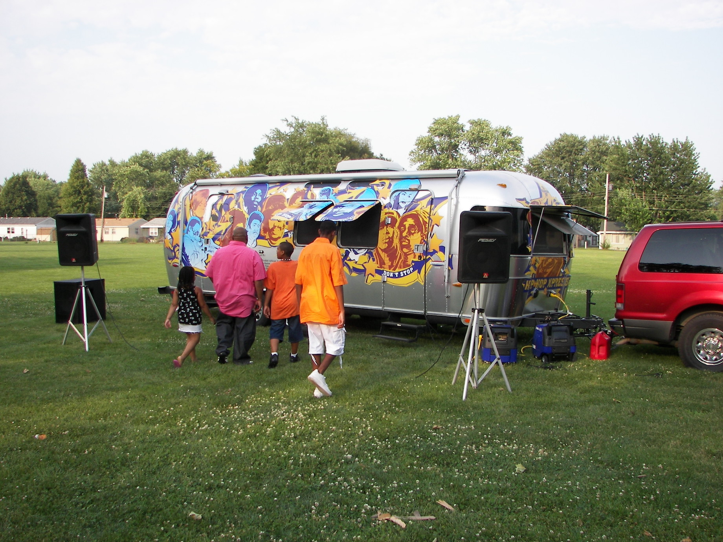
HIP HOP XPRESS PHASE I “THE PROTOTYPE”
Remixed an Air Stream Trailer for use as a community history archiving field lab.
Introduced emerging technology to under-resourced communities
Wrapped the trailer with art reflective of the African American experience.
Integrated external pro audio system for DJ and Band entertainment.

Slide 3
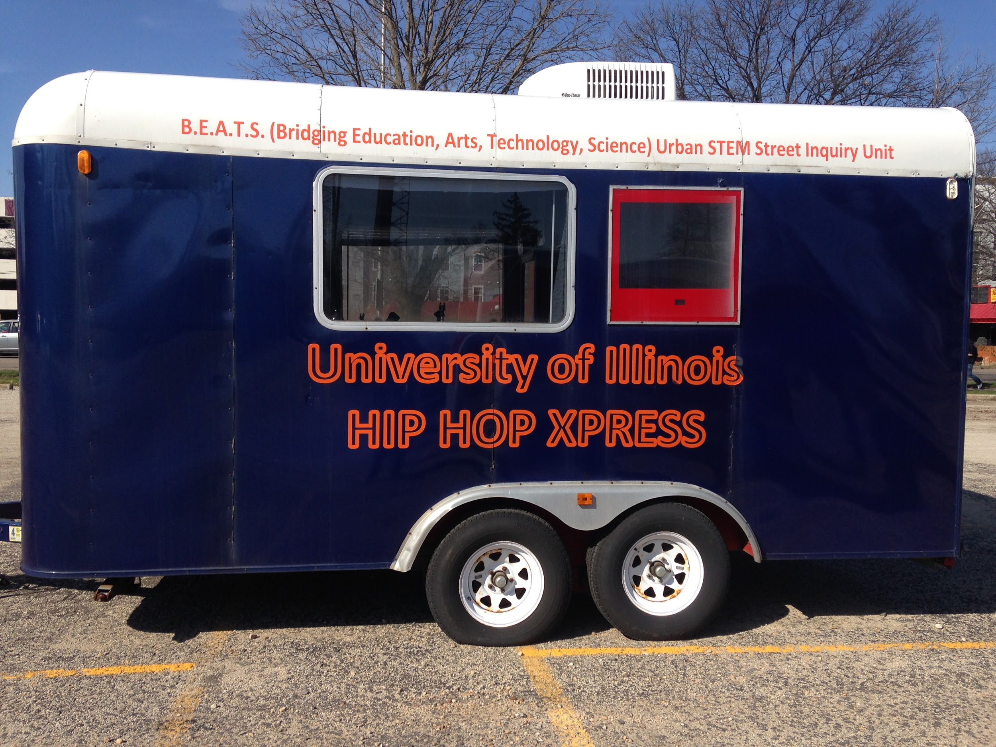
HIP HOP XPRESS PHASE II “THE BOOM BOX”
Worked with Senior Design students to remix the technology an old mobile recording studio to demonstrate sustainable energy projects and concepts in underresourced communities.
Pulled trailer to Chicago to participate in Chicago Ideas week at Blue1647.
Built schematic plan to convert trailer to solar powered recording studio.

Slide 4
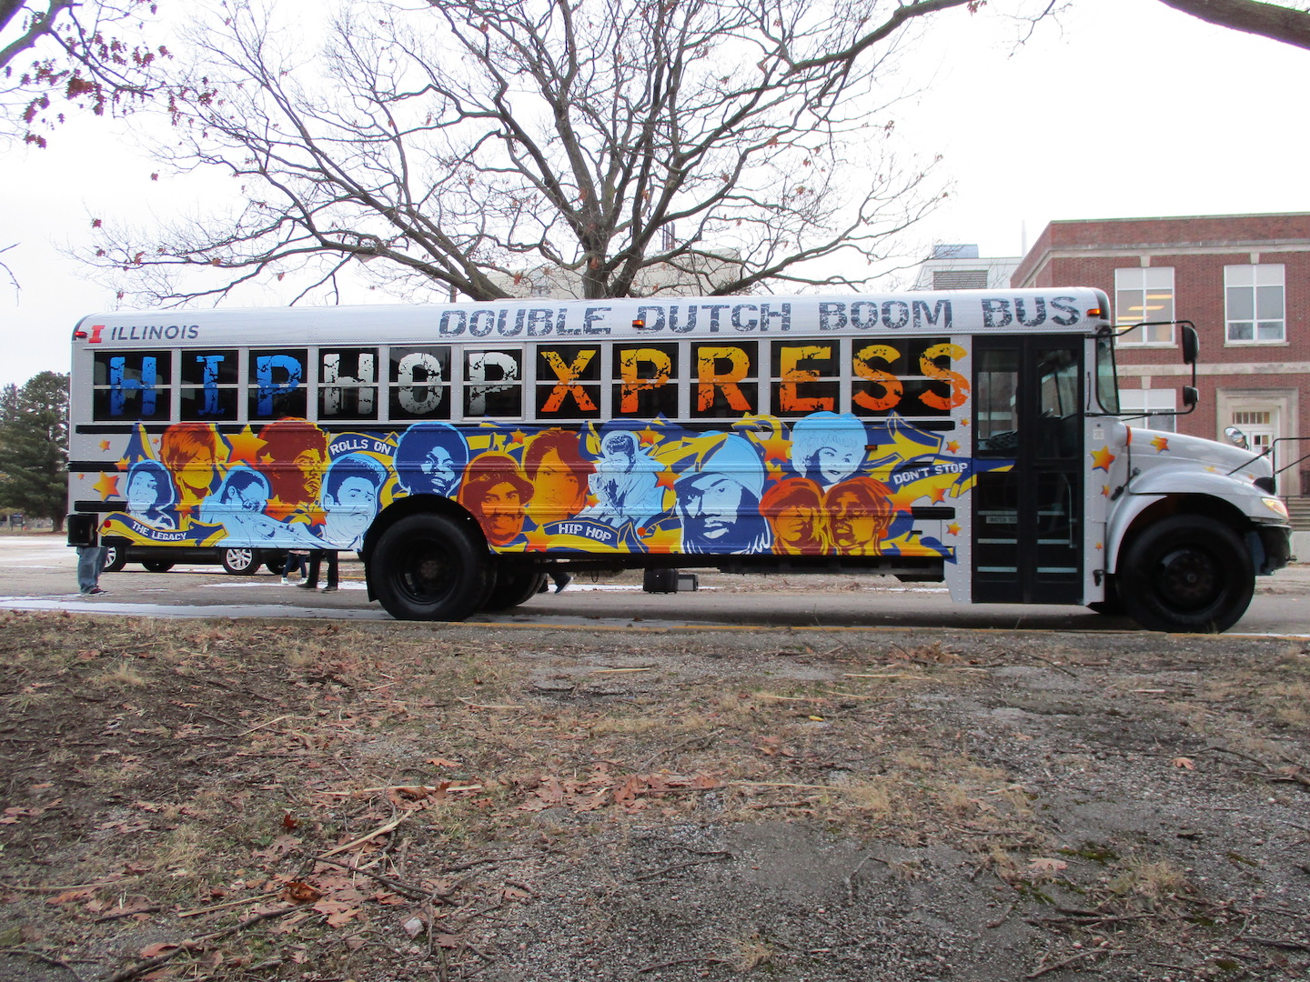
HIP HOP XPRESS PHASE III “DOUBLE DUTCH BOOM BUS”
Engineering Plan
Design, build, and install Dj controller to operate lighting internal and external.
Work on solar sustainability
QR Coding for external art graphic on side of the bus
Design electrical grid to power the bus internal and external, AC to DC.

Slide 5
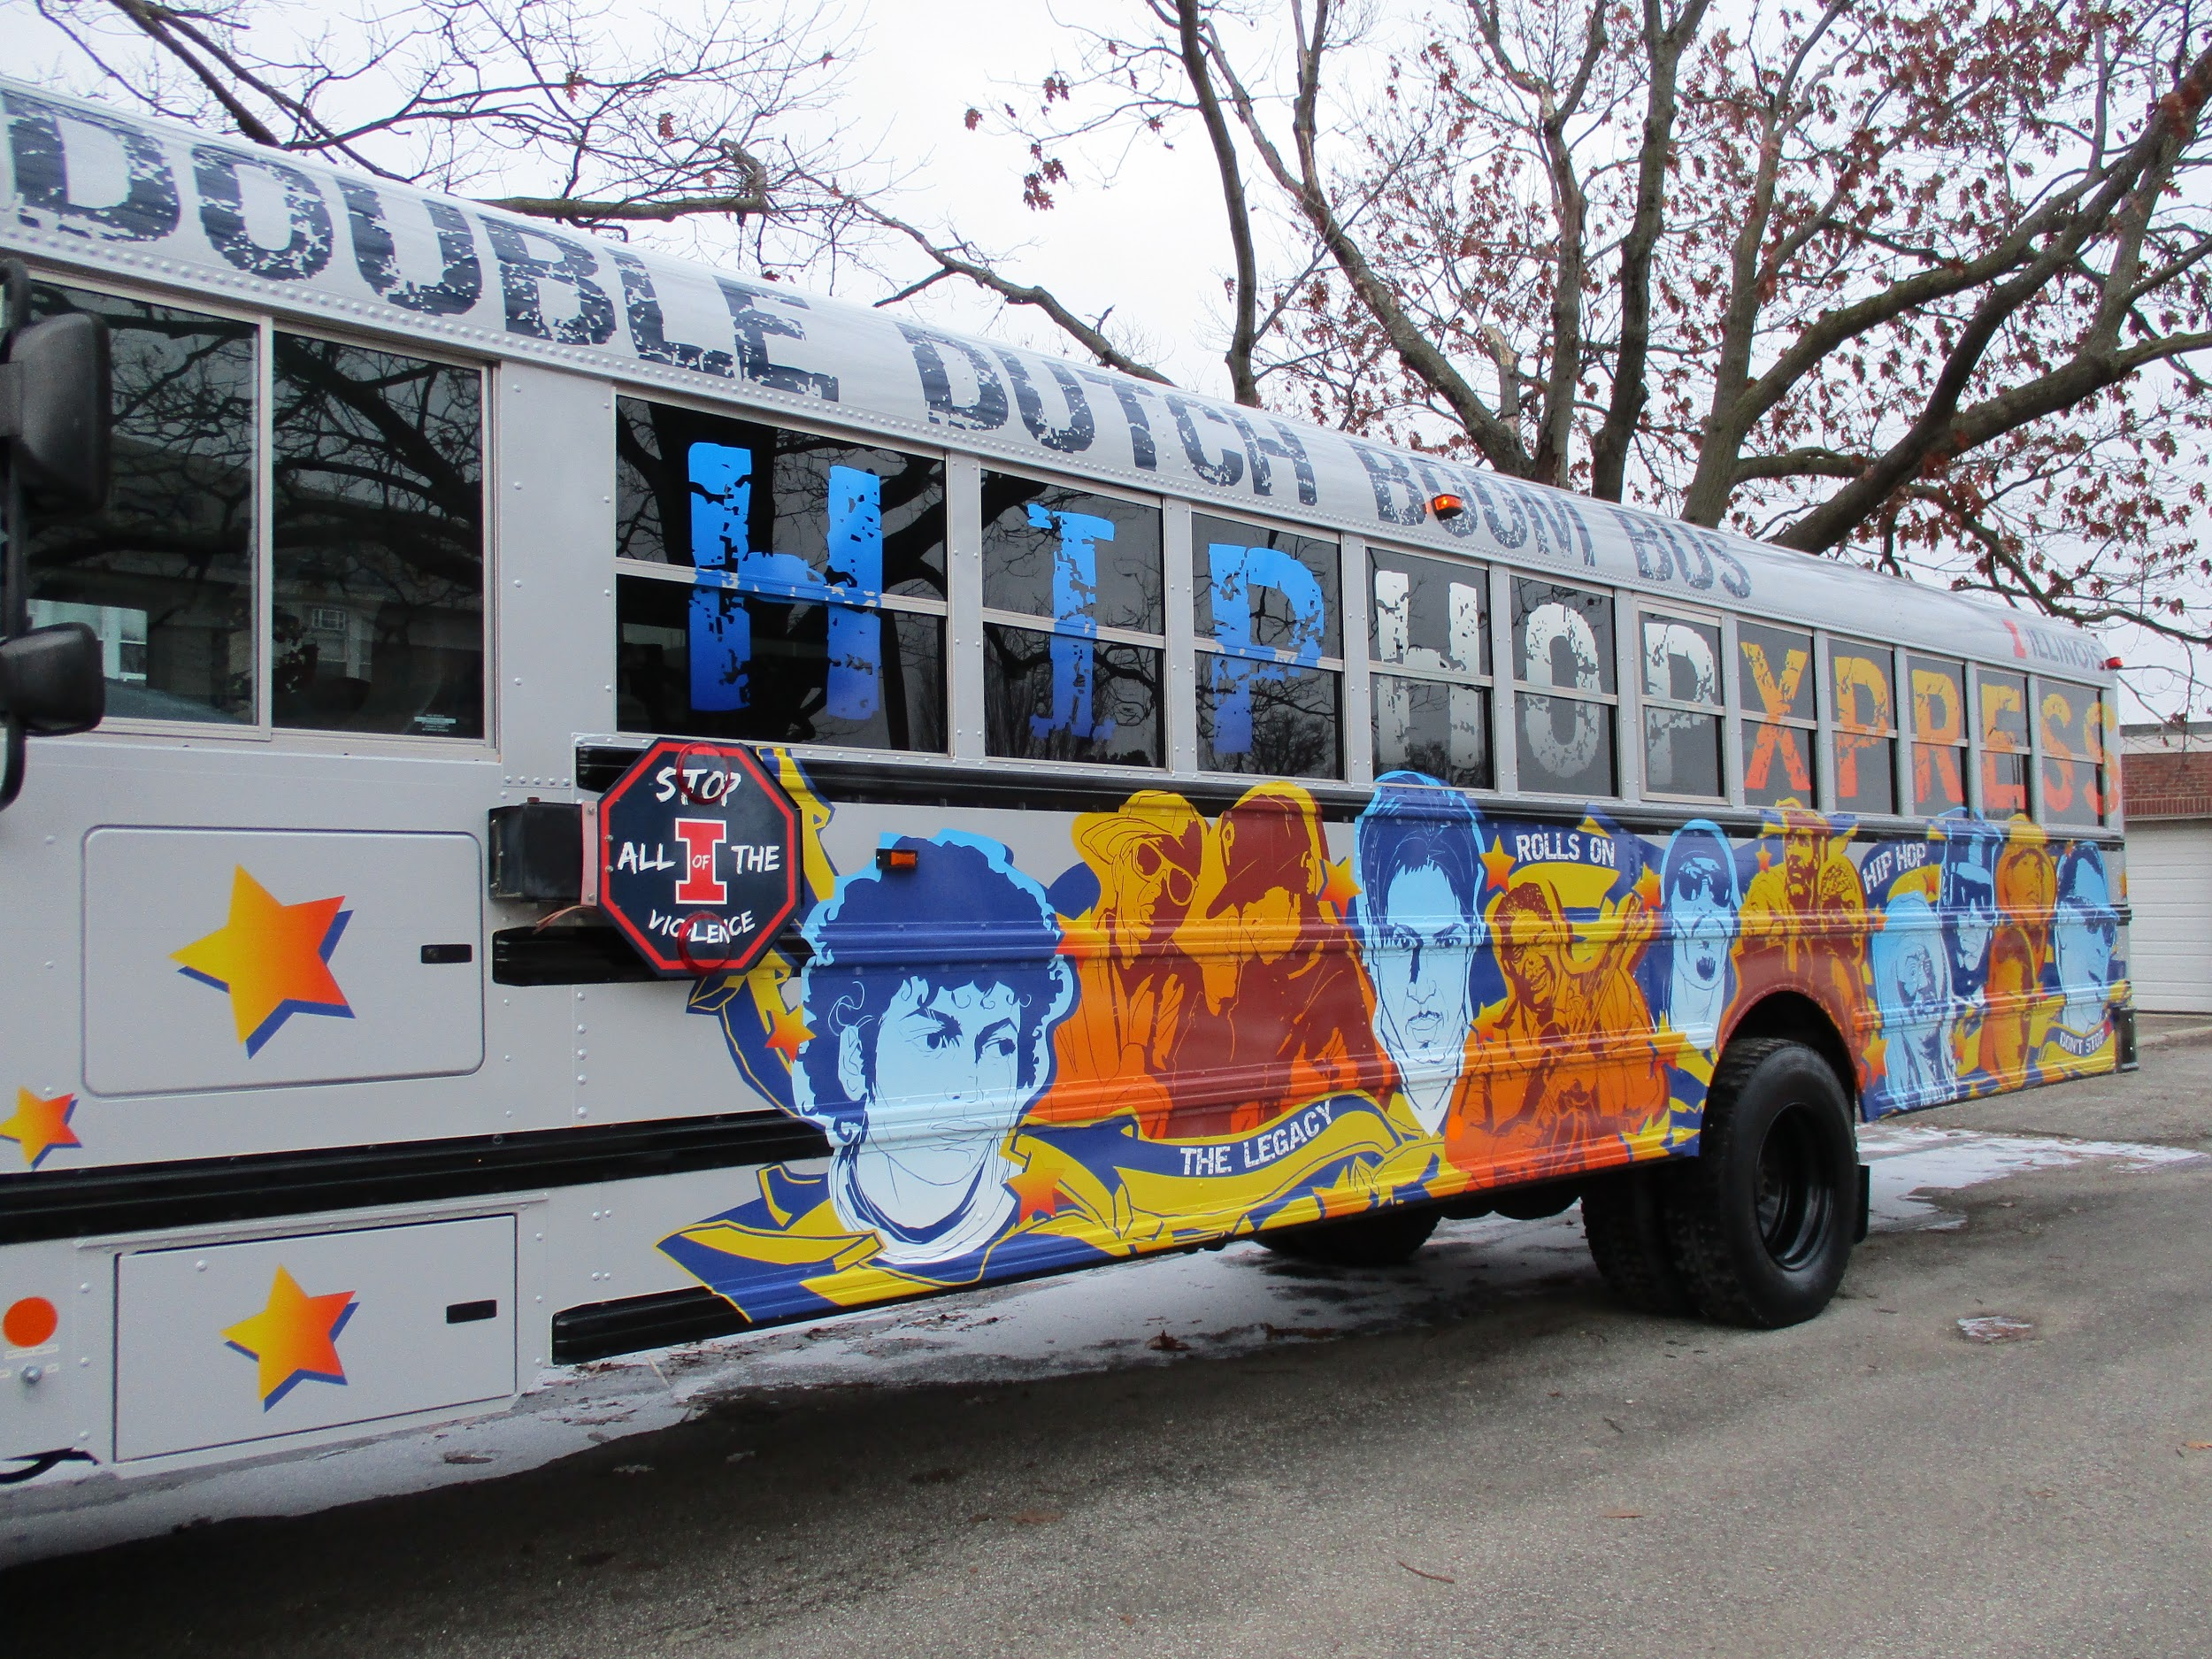
HIP HOP XPRESS DOUBLE DUTCH BOOM BUS Cont.
Engineering Plan Cont.
Develop app to operate lights and selfie recording
Integrate train horn system
Develop speaker cabinet mounting or bracing system.
Integrate emergency light system to flow with music on beat.
Propose ideas to make it cooler.

Slide 6
Puerto Rico bus
https://www.youtube.com/watch?v=5tNvA7nA2D0
https://www.youtube.com/watch?v=2NjpQdZLH6A

