Slide 1
Design Process
Jonathon Schuh
ECE 445

Slide 2
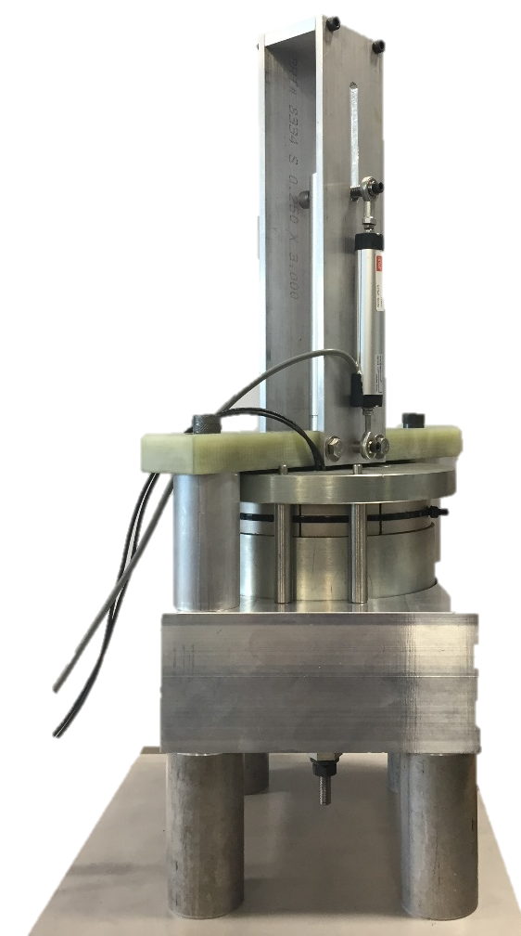
Design vs. Analysis
Analysis
Formulation
Properties
Performance
https://www.google.com/url?sa=i&source=images&cd=&ved=2ahUKEwilj-HtiprnAhVIVs0KHa8qBE0QjRx6BAgBEAQ&url=https%3A%2F%2Fwww.worldsteel.org%2Fabout-steel.html&psig=AOvVaw1whvkttEljgkU3xr1_742F&ust=1579881341124223
https://www.google.com/url?sa=i&source=images&cd=&ved=2ahUKEwie_9mbiprnAhWZKM0KHVg5B74QjRx6BAgBEAQ&url=https%3A%2F%2Fen.wikipedia.org%2Fwiki%2FMagnetic_hysteresis&psig=AOvVaw1i4v7VesXVLI-H05TzWybr&ust=1579881182349140
Analysis and Design are linked! Need to determine if your design meets your requirements.
Design

Slide 3
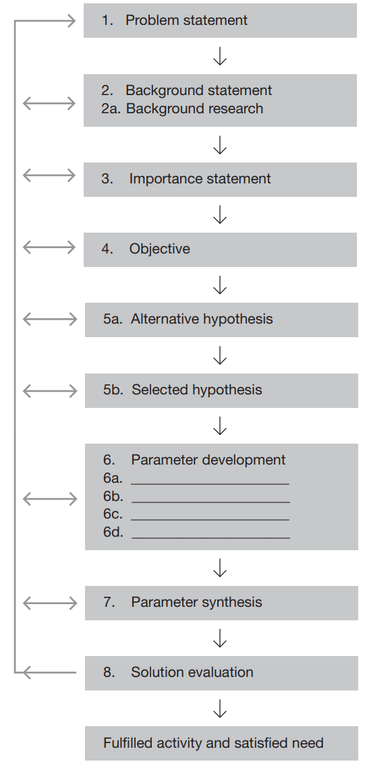
What are you trying to solve?
Steps in the
Design process
What has been tried?
What are goals of design?
Your method
What can we design? What are constraints?
Building
Testing
H. Dubberly, How do you design? A Compendium of Models, Dubberly Design Office, 2008.

Slide 4
Example: Flow Batteries for Energy Storage
Problem statement: How to build a flow battery to store excess energy produced by renewables?
Background research: What has been done before: water solvent, non-water solvent?
Objective: high conductivity, high cycle lifetime, low cost
Alternative hypothesis: aqueous system, monomers, colloids
Selected hypothesis: acetonitrile solvent, polymer
Parameters: polymer concentration, background salt
How do objectives change as these parameters change?

Slide 5
Activity: Automated fire prevention system for buildings
Problem statement:
Objective: Keep building from burning down, provide ample warning for occupants to vacate building
Alternative hypothesis:
Selected hypothesis:
Parameters:
How do objectives change as these parameters change?

Slide 6
Competing Objectives
Objectives were increasing one decreases the other
For example: conductivity and cost
  High conductivity- high polymer concentration
  High polymer concentration- thicker solution, larger pumps
Keep competing objectives in mind during your design
Need to determine which objectives are more important

Slide 7
Example: Competing Objectives
Xbox 360
Objectives: slim, high graphic output
Competing objectives:
  Slim designs not as good for heat transfer
  High graphic output-high heat
Result: red ring of death
Cost Microsoft ~$1 billion
https://media.gamestop.com/i/gamestop/10107525/Xbox-360-System---White-with-Wireless-Controller-GameStop-Premium-Refurbished?$zoom$

Slide 8
Modular design
A design that can be easily broken apart
Transform a problem into a system

Slide 9
Why Use Modular Design?
Makes complexity manageable
Enables parallel work during the design phase
Enables modular debugging during the testing phase
Easily replaceable
Accommodates future uncertainties

Slide 10
Modular Design steps
Define problem at “system” level
Divide into “subsystems” and “blocks”
  Allows reader to see what your design does
  Inputs and outputs are per block (make sure numbers and units match)
  Think about functionality of each block!
Will formalize into a block diagram for the proposal

Slide 11
Modular Design: Automated fire prevention system for buildings
Write out key modules for system
Draw how they would connect

Slide 12
Modular Design Example
Design of an irrigation controller.
Provide user with a set of pressure sensitive buttons to open and close irrigation valves.
What would a modular block diagram for the system look like?

Slide 13
Bad Modular Design

Slide 14
Bad Modular Design
How exactly does the power subsystem interact with the individual blocks? Is power provided to the sensor subsystem?

Slide 15
Bad Modular Design
Is `Main Electronics’ broken down into the appropriate blocks?

Slide 16
Bad Modular Design
What individual blocks do the pressure sensors actually connect to?

Slide 17
Better Modular Design

Slide 18
Better Modular Design
The block diagram is neatly divided into appropriate subsystems

Slide 19
Better Modular Design
The inputs and outputs (both data and power) to each part of the design are known and clearly labeled.

Slide 20
Better Modular Design
It is clear how power is provided to every block. It is clear what the power source is.

Slide 21
Better Modular Design
A key helps us understand what we are looking at.

Slide 22
Things to consider when designing
  Separation of work
  Communicating your design to others
  How to verify according to requirement
  Schematics and PCB design
  Debugging
You need to be thinking about modularity in design from day one!

Slide 23
Division of Labor
Separation of work:
  Blocks are “packets” of work
  Responsibility for block or subsystem
  Scheduling of work
Notes:
Example of responsibility /neq workload

Slide 24
Communication
Communicating your design to others (i.e. team members and Professors/TAs):
  Goes hand in hand with block diagram
  Explain design by function of various parts
  Easy to draw “blocks” on a napkin

Slide 25
How to verify according to requirement
Requirements and Verification:
  Group requirements into subsystems and blocks
  If all requirements are fulfilled for a block or subsystem, the block or subsystem should be guaranteed to work.

Slide 26
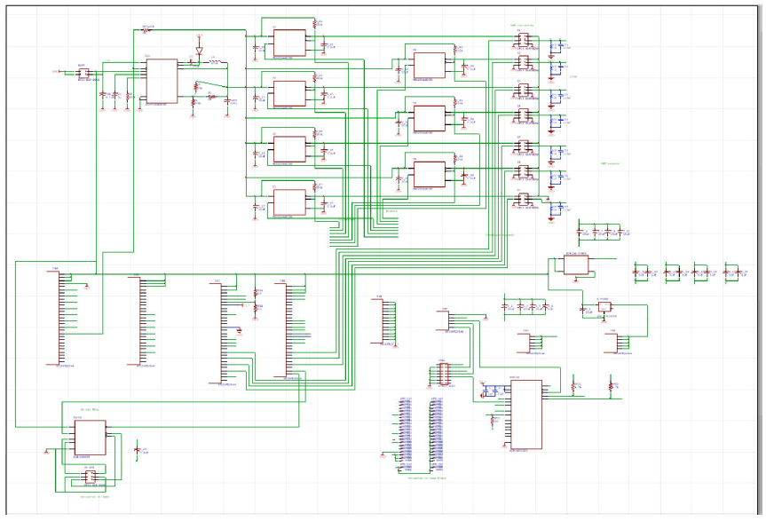
Schematic
Group components together to avoid clutter

Slide 27
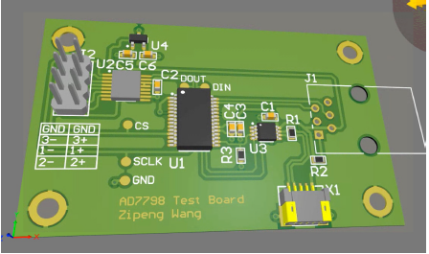
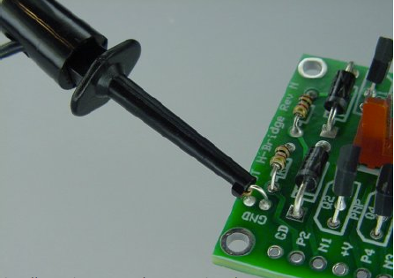
PCB
Use several PCBs to begin with
Testing each block separately
  Easier to troubleshoot than entire system at once
  Requires well defined block diagram to be useful
Test points
  Places on circuit where you can easily hookup test probes to verify your design

