Slide 1
PowerBox Technology
Proposal for:
Fall 2024 - ECE 445 Senior Design Project Laboratory.

Slide 2
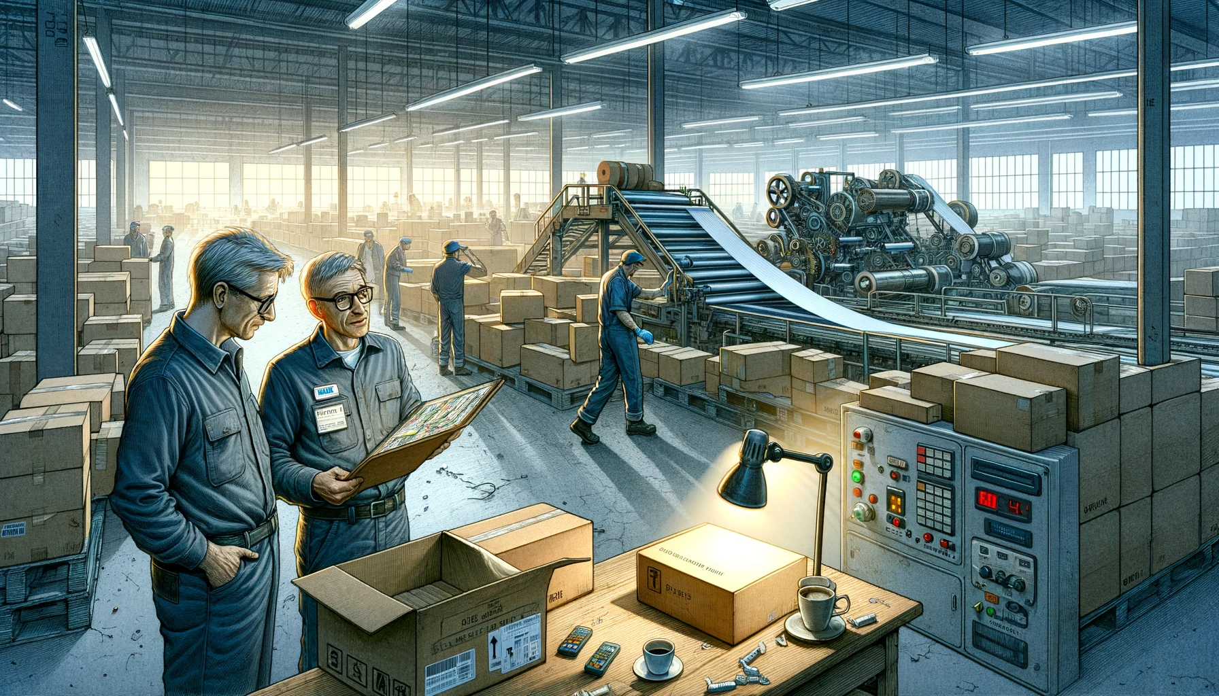
A day in the Life of a Factory Manager
Arturo, the double backer stopped working at 5 am!
Double backer machine
Fresh cup of coffee
Image source: Created using DALL-E by OpenAI, June 2024.

Slide 3
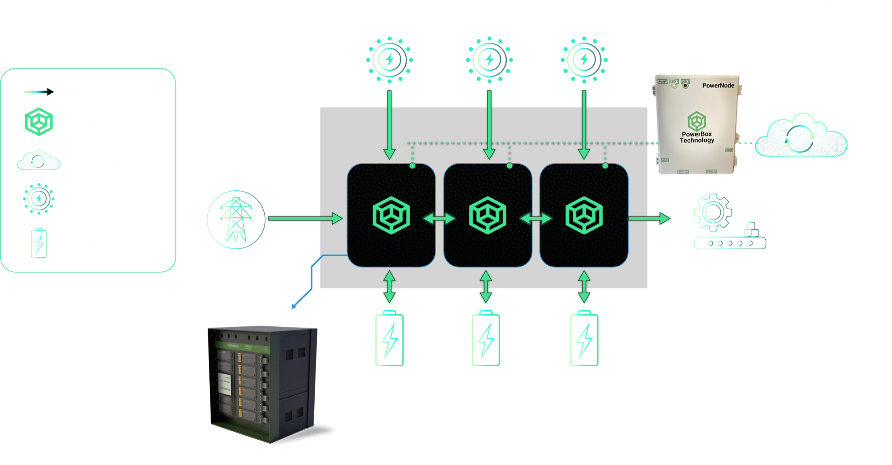
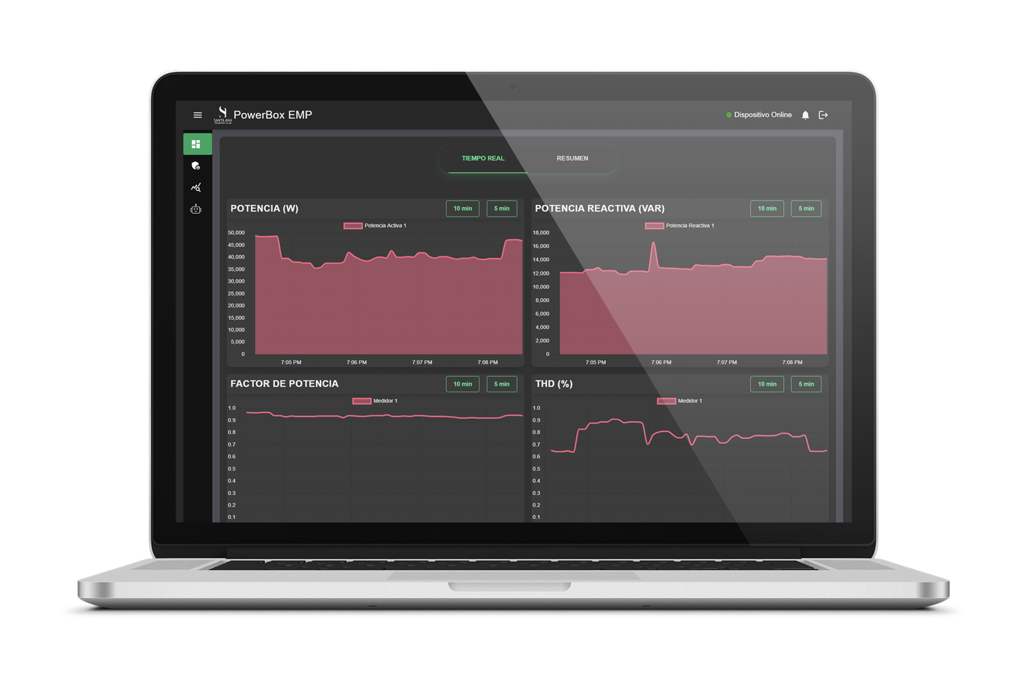
We help Factory Operators modernize their Electrical Systems.
And we do it through the PowerBox Energy System.

Slide 4
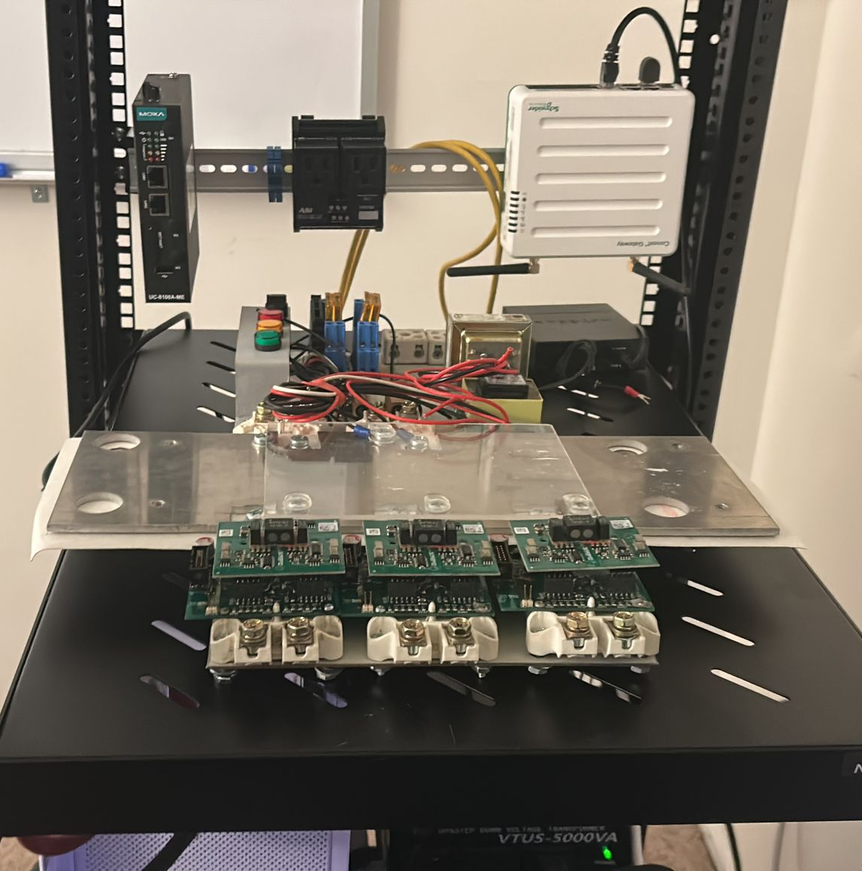
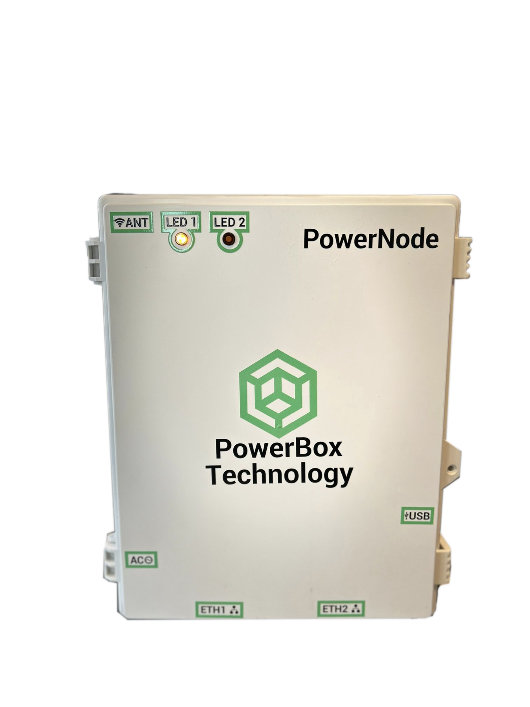
Help us build the PowerBlock!
Inverter Subsystem
DC power supply
AC (480 V)
DC (0-60V)
DC
Battery Simulator
DC (46 - 52 V)
AC
Rasp Pi + Industrial IO
3-phase AC load
4

Slide 5
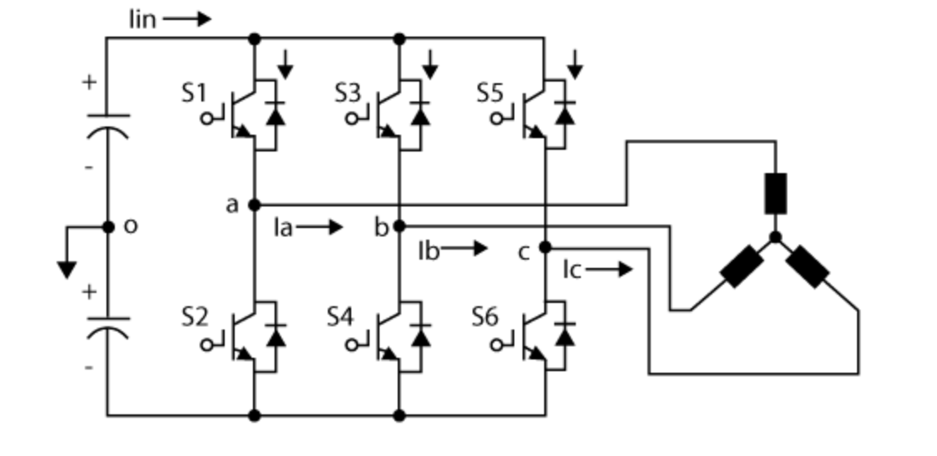
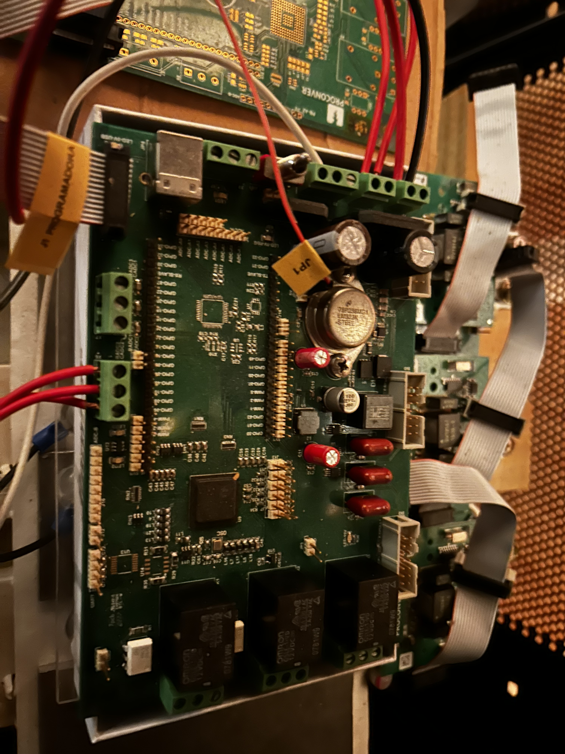
What we have...
Inverter Subsystem
PowerBox inverter control board
IGBT drivers
5

Slide 6
What we need...
Inverter Subsystem
RMS voltage measurement circuit
PowerBox inverter control board
CT
CT
CT
IGBT drivers
AC Current measurement circuit
6

Slide 7
PowerBox Technology
Join the world’s energy revolution with us!
oscar.azofeifa@powerboxtech.com

