Slide 1
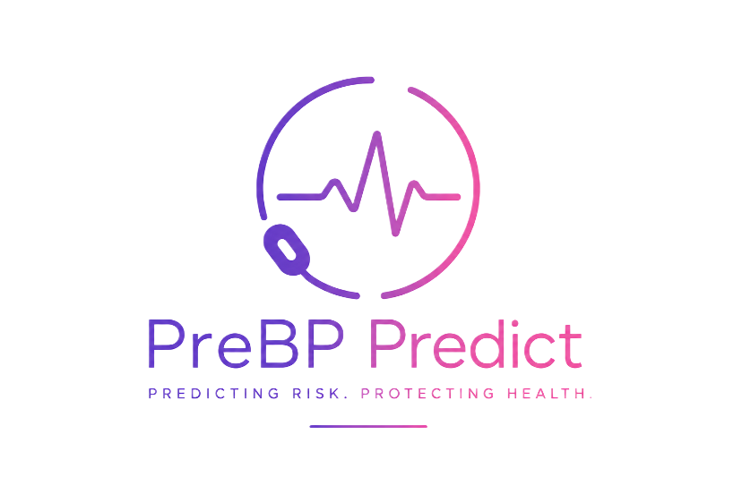
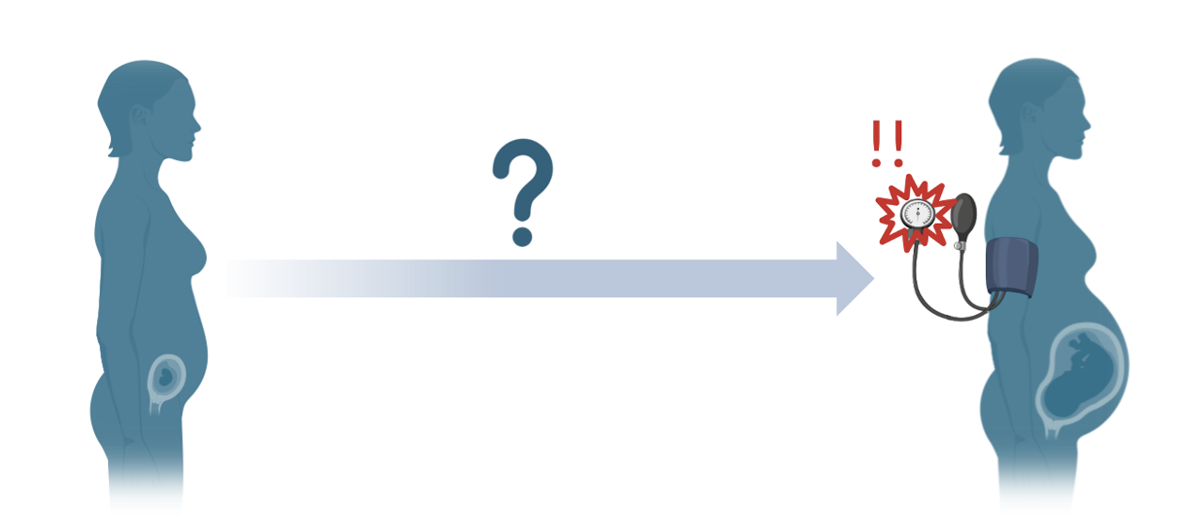
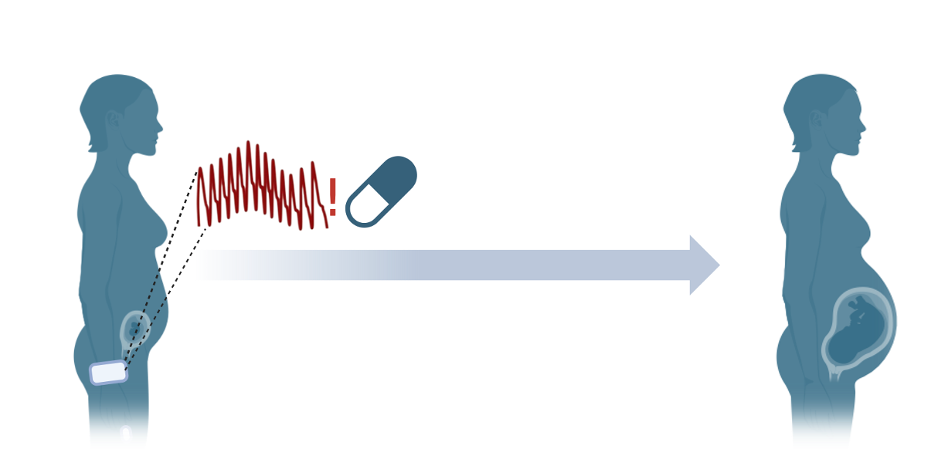
PreBP Predict
Team 2
Madeline Graham, Brandon Taylor, Preethi Prem
iMBA students: Zaima Choudhry, MD, Robyn Yonn
Notes:
Make it very visual and story based, not technical

Slide 2
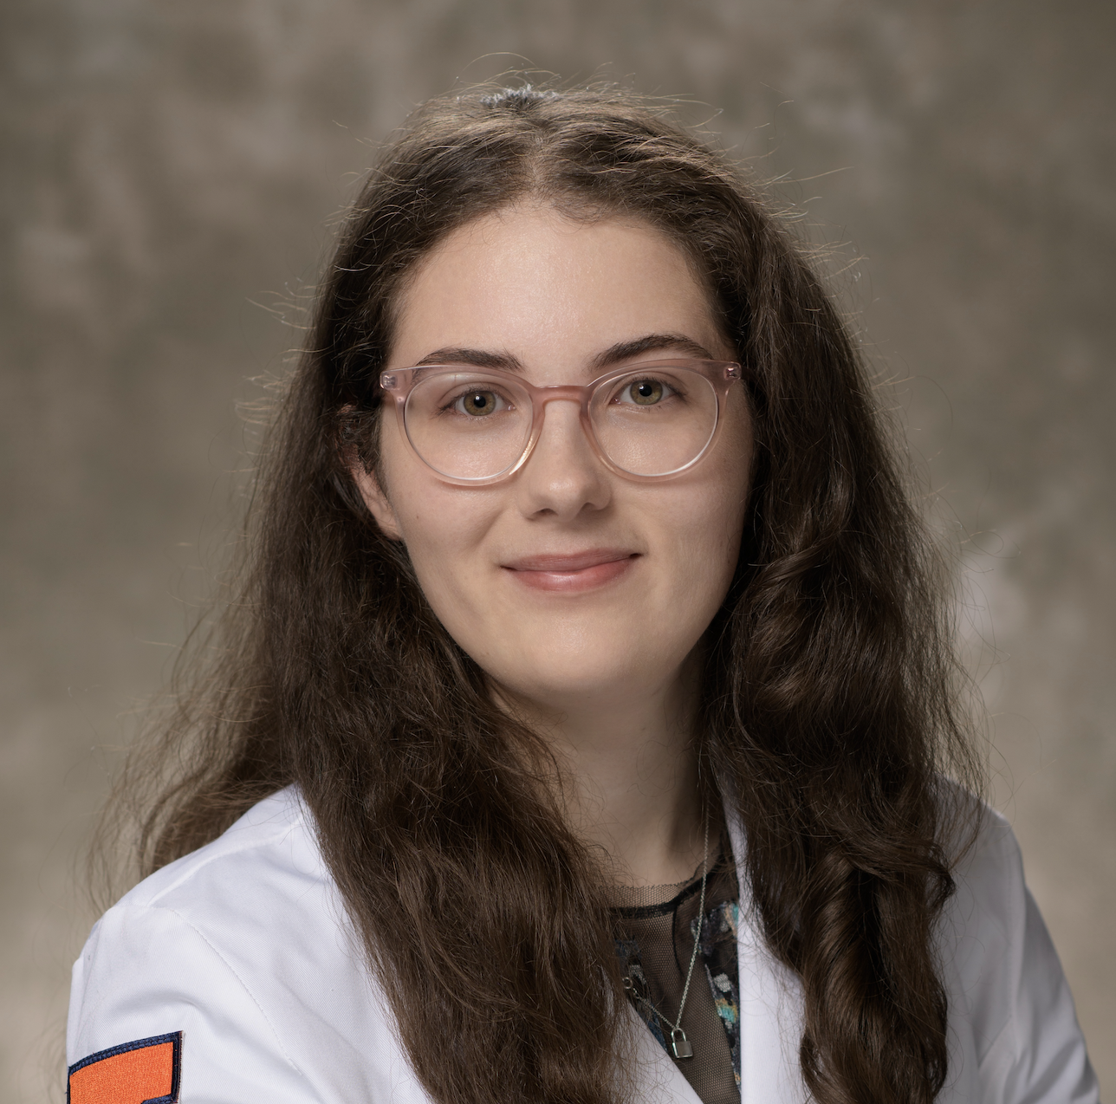



Meet our team
CIMED Students
Madeline
Graham
Preethi Prem
Brandon
Taylor
iMBA Students
Zaima
Choudhry, MD
Robyn
Yonn
Brandon Taylor

Slide 3

Kylla’s story

Slide 4
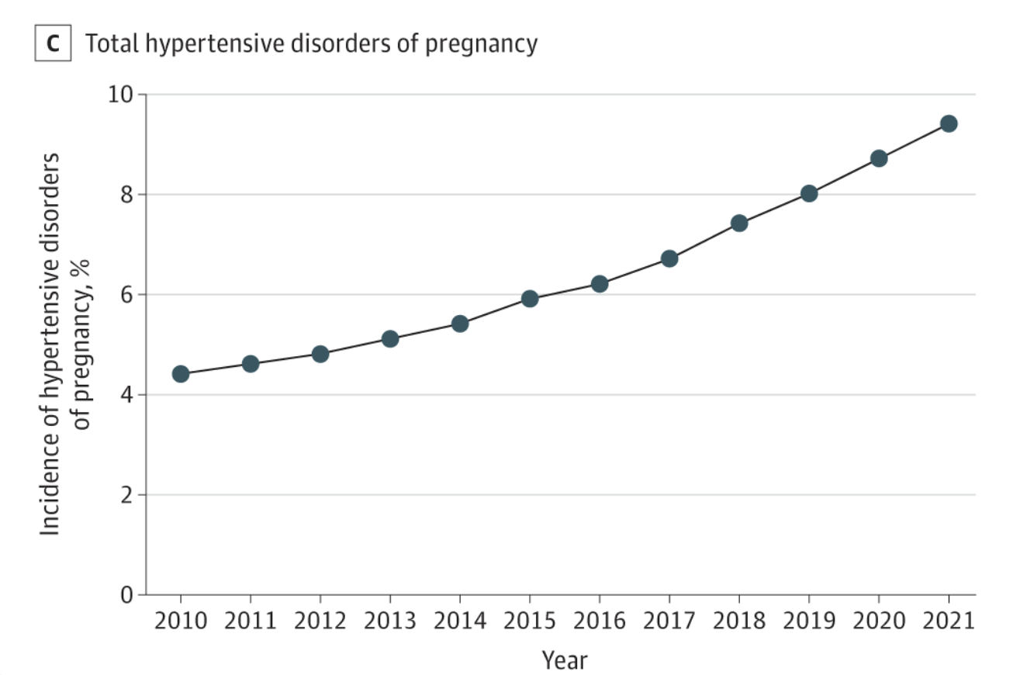
A growing need for earlier preeclampsia detection
Hypertensive disorders of pregnancy have nearly doubled over the past decade [1]. Preeclampsia currently affects roughly 8% of pregnancies in the US and is projected to rise [2].
Screening relies on intermittent measurements that can miss hypertension, often detecting disease after it has developed, and after the optimal window for intervention.
Current methods for risk stratification and early detection are not effective, unlikely to lead to intervention for majority at risk [3, 4].
Trends in hypertensive disorders of pregnancy [1].
Notes:
Kylla’s story

Slide 5
Other solutions vs. PreBP Predict
Existing solutions | Cost (or estimate) | Captures Longitudinal Trends | Predictive earlier in pregnancy
Mirvie Encompass Cell-free RNA test [5] | $$$ | ❌ | ❌
LabCorp tests [6] | $ | ❌ | ✅
Emerging AI-based platforms using retinal imaging [7] | ? | ? | ?
PreBP Predict | $ | ✅ | Likely
Notes:
Mirvie Encompass – cfRNA transcriptomics assay, $5k cost per test, offered only to 35+ y/o after 20 weeks, provides a snapshot of risk at single timepoint [5]
Emerging AI based platforms that integrate clinic appointment measures + retinal imaging, which have yet to be validated and involve specialized imaging [6]
PreBP Predict offers continuous monitoring of hemodynamics, focusing on nocturnal blood pressure, captures trends often missed at clinic visits or periodic home BP checks. Paired with an algorithm that analyzes trends and can help stratify risk + inform intervention.

Slide 6
Current screening detects thresholds—not trajectories
Routine prenatal care may only provide one blood-pressure snapshot every four weeks during much of pregnancy—potentially missing evolving hypertension between visits.
Notes:
Blood pressure tells us whether a patient has crossed a diagnostic threshold at that moment. But a measurement every few weeks cannot capture the cardiovascular trajectory between visits. That creates an opportunity for longitudinal monitoring.
So, can we detect that trajectory earlier?

Slide 7
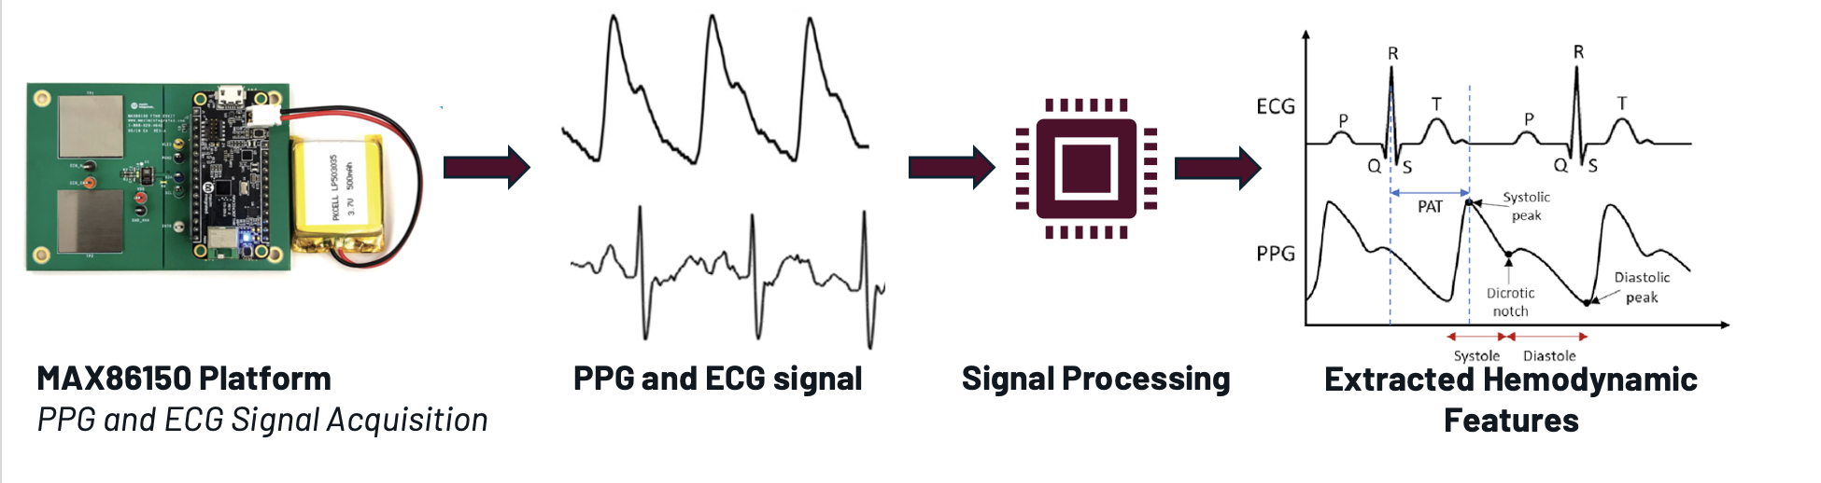
Can longitudinal PPG detect that trajectory earlier?
Notes:
PPG can measure blood pressure and is good for tracking trends, requires calibration with a sphygmomanometer
We may build one using available PPG and 1 lead ECG with Bluetooth and power here: https://www.analog.com/en/resources/evaluation-hardware-and-software/evaluation-boards-kits/max86150evsys.html#eb-overview
Ready to use wearable option included here: https://us.hilo.com/products/hilo-core but requires membership, https://www.samsung.com/latin_en/support/mobile-devices/measure-your-ecg-with-the-galaxy-watch-series/
Noninvasive beat-to-beat blood pressure monitoring is more difficult to achieve. There is a device that is rather cumbersome and may not be wearable while sleeping: https://www.biopac.com/product/noninvasive-blood-pressure-amplifier/

Slide 8
Project goals
Measure synchronized PPG and ECG signal using module, capture features with good fidelity
Quantify response to exercise, handgrip, posture, and paced breathing against reference measurements
Develop a wearable system with ECG/PPG unit
Develop an algorithm to identify trends*
Notes:
Purely ECE team

Slide 9
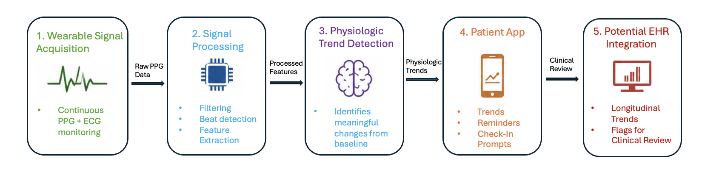
Research platform to longitudinal monitoring device
Initial Project
Future Development

Slide 10
Where we need help from an ECE team
1
2
3
4
Characterize and implement module to record quality PPG and ECG signal
PPG+ECG signal processing
Wearable development with reliable PPG+ECG signal
Development of an algorithm to identify trends*
Notes:
Purely ECE team

Slide 11
Thank you!
Can longitudinal cardiovascular signals
help detect preeclampsia earlier?
Madeline Graham • meg13@Illinois.edu
Brandon Taylor • bst5@Illinois.edu
Preethi Prem • pprem3@Illinois.edu
Questions or interest in joining our team?
Notes:
Make it very visual and story based, not technical

Slide 12
References
Ayyash MK, McLaren R Jr, Shaman M, Al-Kouatly HB. Trends in Preeclampsia Risk Factors in the US From 2010 to 2021. JAMA. 2024;332(2):167-169. doi:10.1001/jama.2024.8931
Fink DA, Kilday D, Cao Z, et al. Trends in Maternal Mortality and Severe Maternal Morbidity During Delivery-Related Hospitalizations in the United States, 2008 to 2021. JAMA Netw Open. 2023;6(6):e2317641. doi:10.1001/jamanetworkopen.2023.17641
McElrath TF, Jeyabalan A, Khodursky A, et al. Utility of the US Preventive Services Task Force for Preeclampsia Risk Assessment and Aspirin Prophylaxis. JAMA Netw Open. 2025;8(7):e2521792. doi:10.1001/jamanetworkopen.2025.21792
Krishnamurti T, Davis AL, Rodriguez S, Hayani L, Bernard M, Simhan HN. Use of a Smartphone App to Explore Potential Underuse of Prophylactic Aspirin for Preeclampsia. JAMA Netw Open. 2021;4(10):e2130804. doi:10.1001/jamanetworkopen.2021.30804​
https://encompasstest.com/encompass-blog/how-common-is-preeclampsia-in-the-u.s
Wu, Y., Shen, L., Zhao, L. et al. Noninvasive early prediction of preeclampsia in pregnancy using retinal vascular features. npj Digit. Med. 8, 188 (2025). https://doi.org/10.1038/s41746-025-01582-6

Slide 13
Proposed workflow with task allocation
Wearable Development
Signal Processing and Algorithm Development
Software Development**
Aug
Aug-Sep
Sep–Oct
Oct-Nov
Nov-Dec
Dec-Feb
Feb-Mar
Build team, explore continuous BP/B-t-B sensor options
Select BP sensor approach, define device architecture
Adapt wearable*, establish continuous signal acquisition + transmission
Refine wearable design, improve performance
Demonstrate sensor data acquisition
Further refinement and improvement of recording reliability and quality
Integrated wearable prototype
Build team, define data needs
Define data structure, processing pipeline + longitudinal metrics
Adapt pipeline* with simulated or recorded data
Connect real sensor data – periodic signal change detection, implement longitudinal analysis
Demonstrate processing, trend analysis
Refine longitudinal analytics and baseline comparison
Integrated data processing prototype
Build team, define app/dashboard needs
Design patient-facing app, clinician platform, wireframe, and backend
Build functional app profile and dashboard based on identified need, potentially integrate simulated data
Connect interfaces to analytic platform (ideally)
Continue to develop
Refine patient-facing app and clinician platform profiles
Prototypes for patient app and clinician dashboard
*Scope will depend on device selection - multiple options we are considering have signal processing integrated
**feasibility will depend on scope of wearable and data analysis pipeline

