Slide 1
ECE 445 Lecture 1 Fall Semester 2026
Prof. Arne Fliflet (afliflet@illinois.edu)
Prof. Viktor Gruev (vgruev@illinois.edu)
Prof. Cunjiang Yu (cunjiang@illinois.edu )
Notes:
ECE Main Slide

Slide 2
Lecture-1 Agenda
4:00 Course Overview – A. Fliflet
4:30 Conflict Workshop – Prof. O. Mironenko
5:00 Pitched Projects
  PreBP Predict – Madeline Graham, Brandon Taylor, and Preethi Prem (meg13@illinois.edu)
  ​
5:05 Summer is Coming – A. Fliflet
Notes:
A capstone course means it is a demonstration of your newly acquired capabilities as electrical and computer engineers
Think about the courses you found particularly interesting
How could the material be used to solve an interesting problem?
We want you to come up with novel solutions to problems
There needs to be a sufficient amount of complexity
There has to be an EE hardware element to the project – a circuit implemented on a PCB.
Project needs to be compatible with time and resource constraints
We fully expect that you will undertake challenging projects
One of the best parts of teaching this course comes at the end when we decide on which are the best projects
The slide shows some recent successful projects.
The Illini Voyager was a balloon project that had as it’s objective to avoid gaining altitude until it popped, which is the normal fate of such balloons. It was quite successful and was recovered in West Virginia after being launched in Champaign.
CHARM: CHeap Accessible Resilient Mesh for Remote Locations and Disaster Relief. The objective was to create a set of meshing, cheap, lightweight, and self-contained wireless internet access points, deployable via drone. The project was successfully demonstrated on the quad outside and included a half-dozen well-engineered PCBs.
Classroom Clarity: This is a portable teacher support hub that enables students to submit questions wirelessly via Bluetooth and has a teacher alert function. Has some advantages compared to commercial systems.
CO2ffee: Measures coffee bean CO2 emission to monitor freshness of coffee beans.

Slide 3
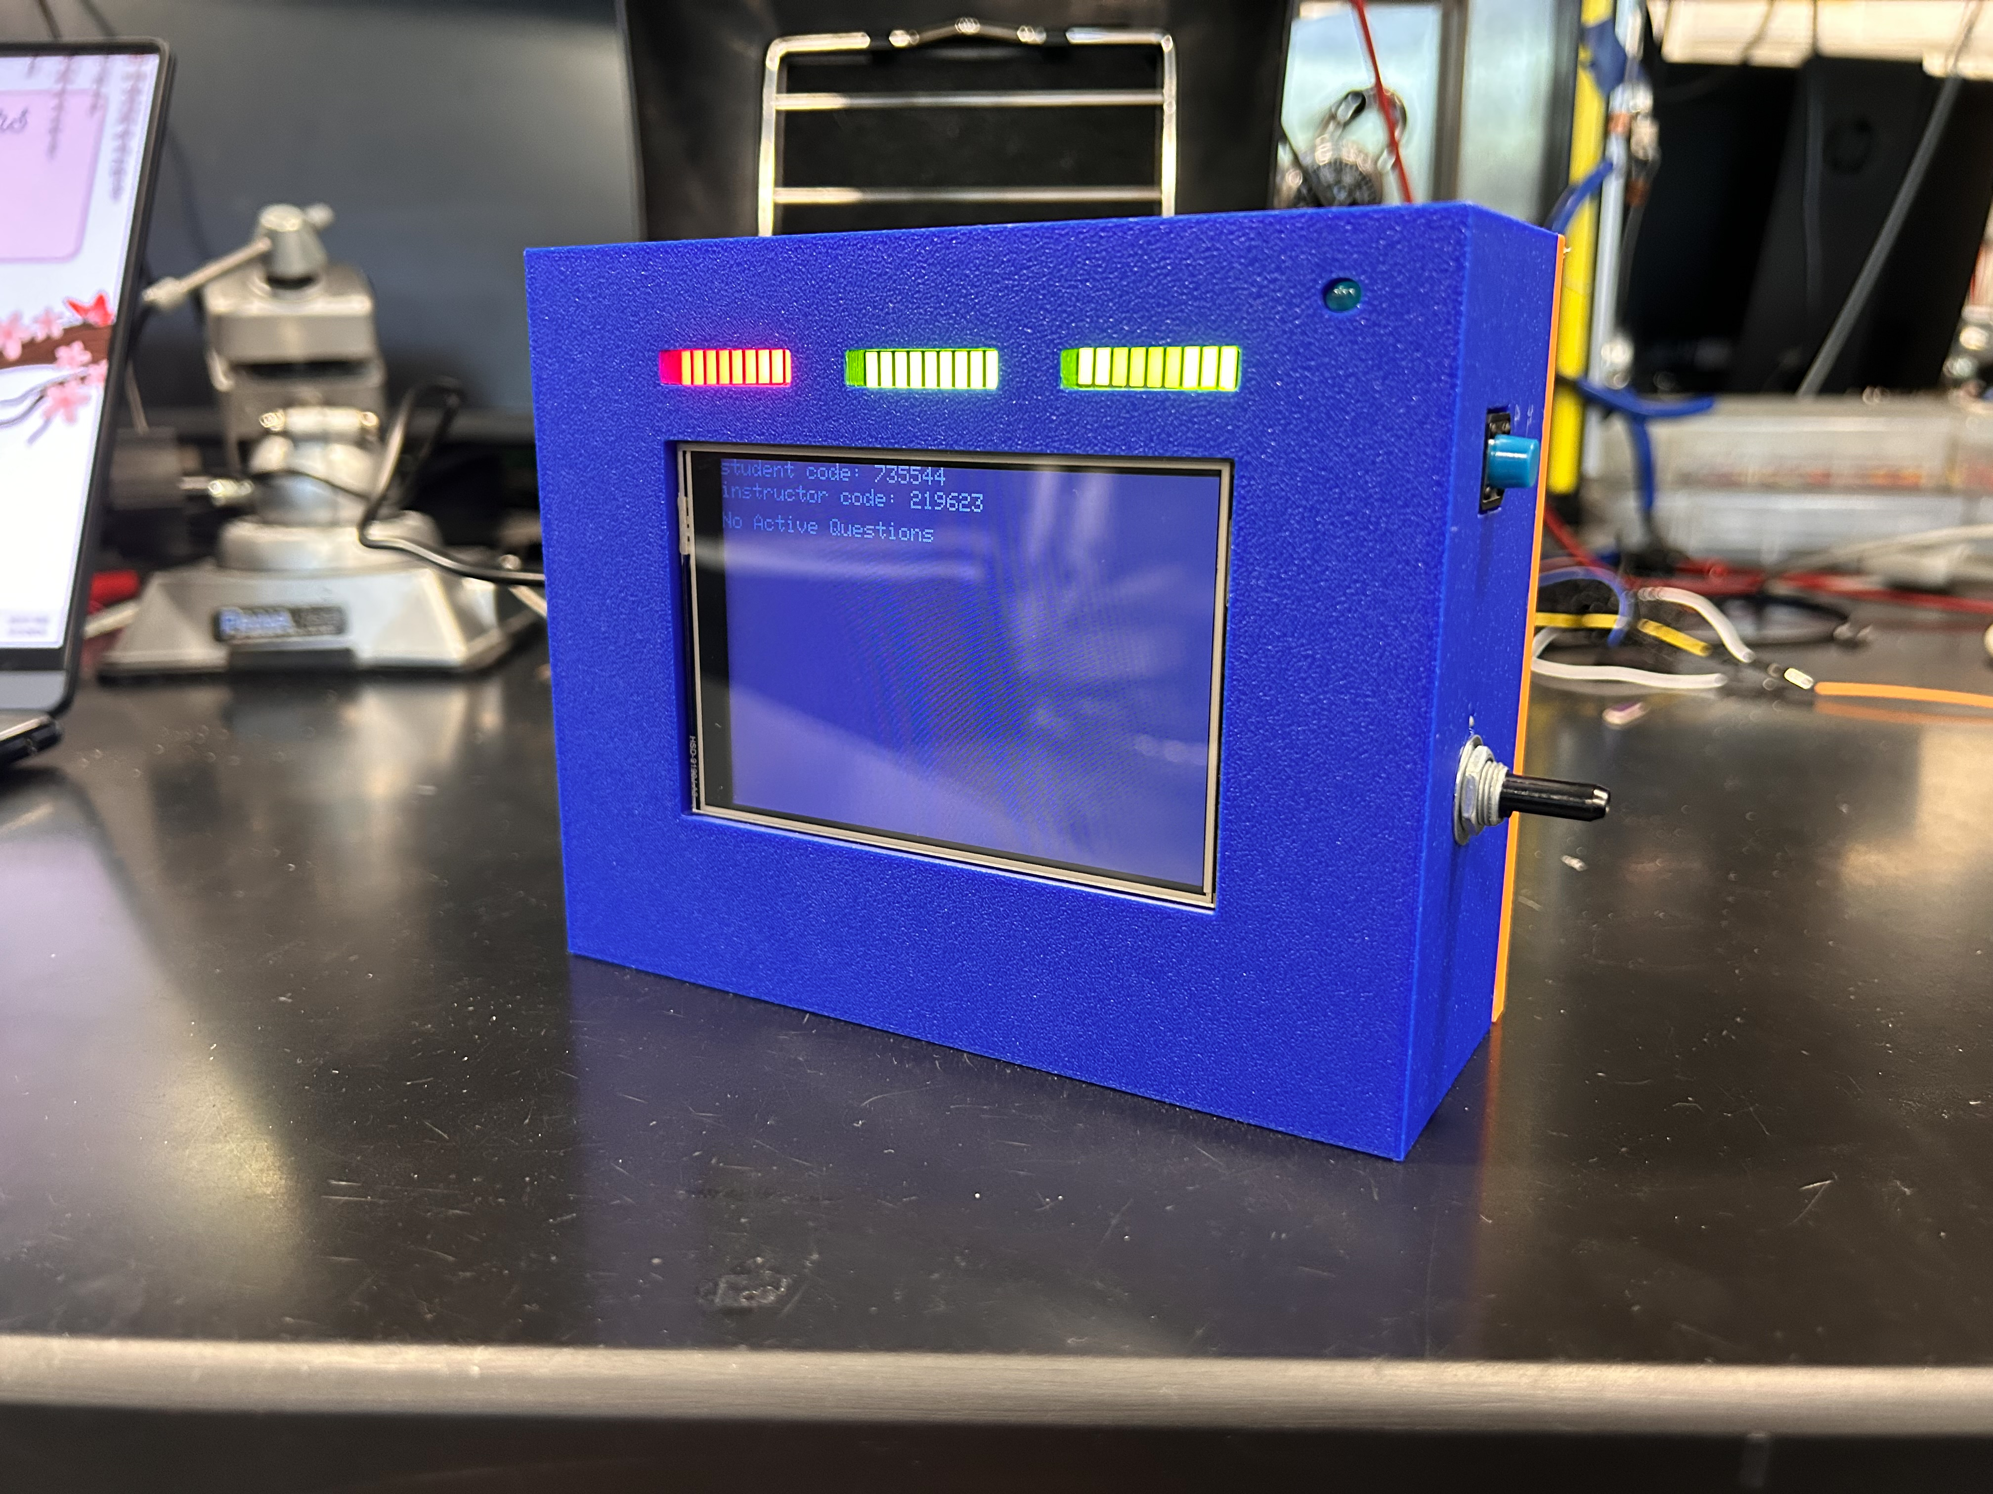
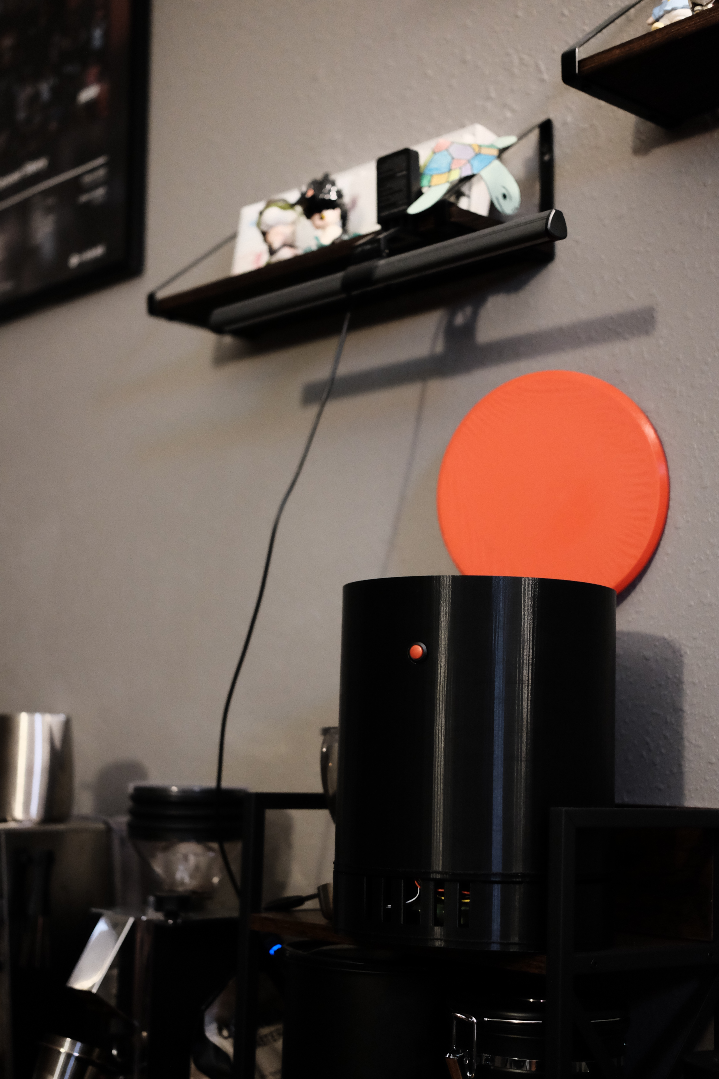
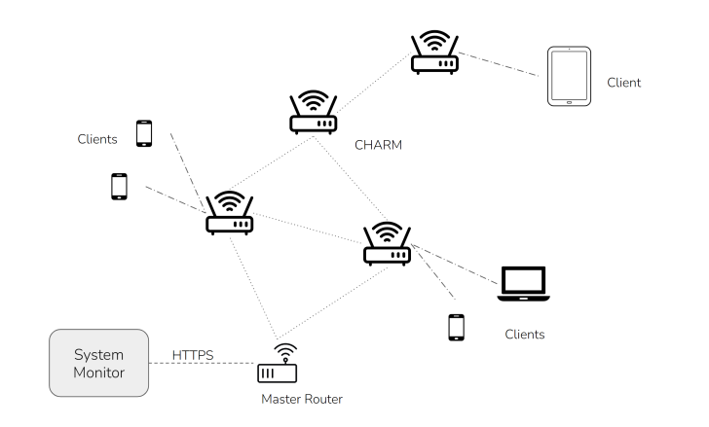
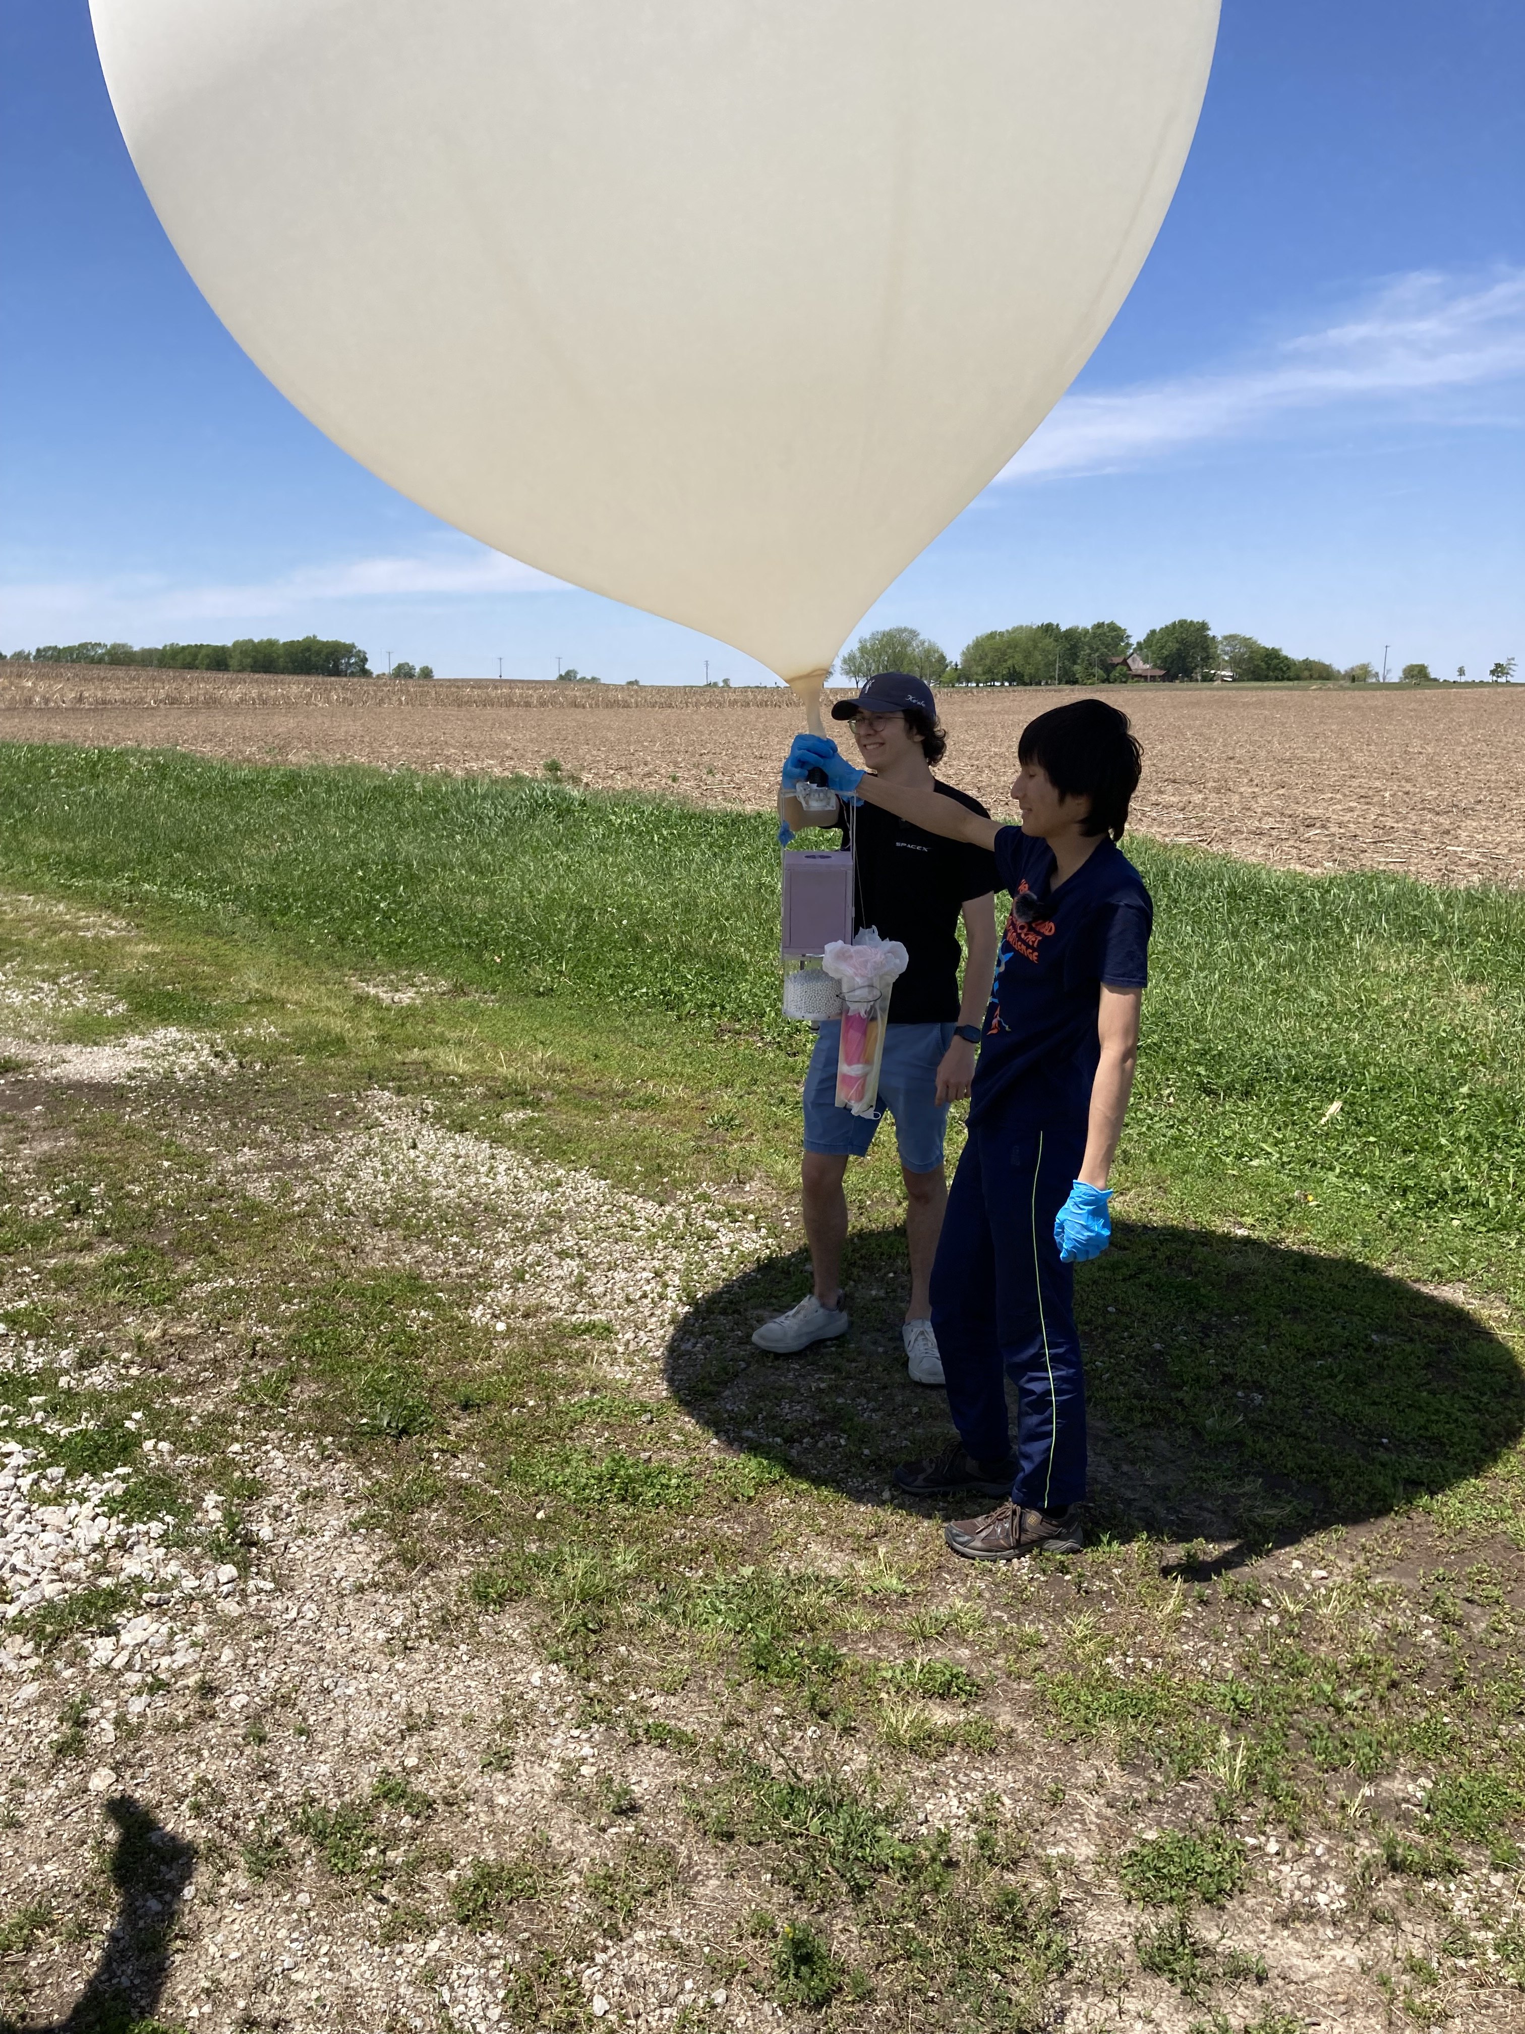
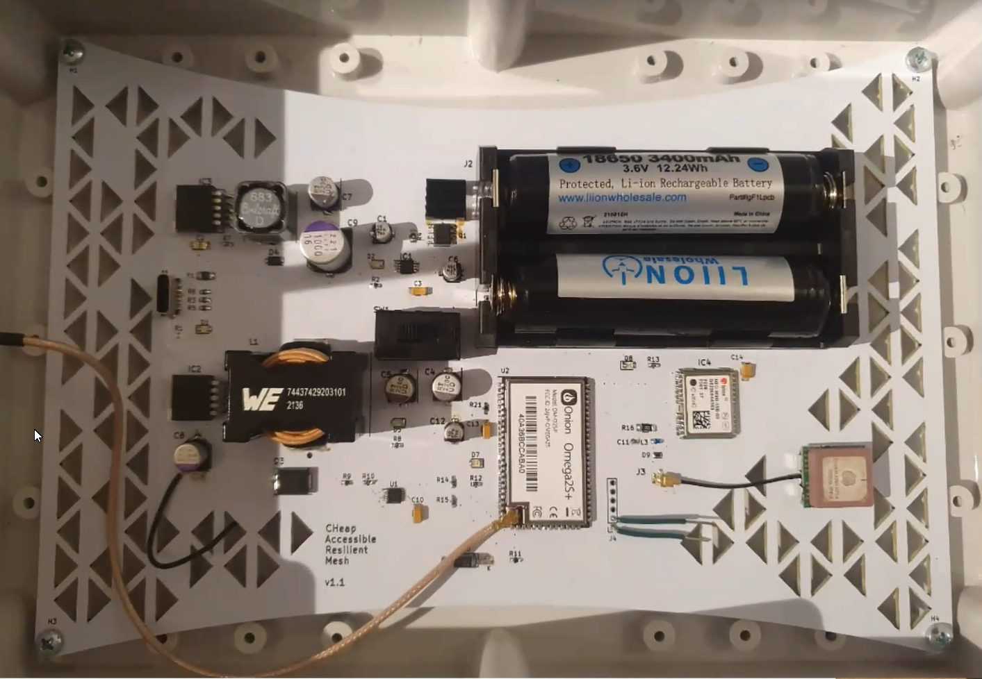
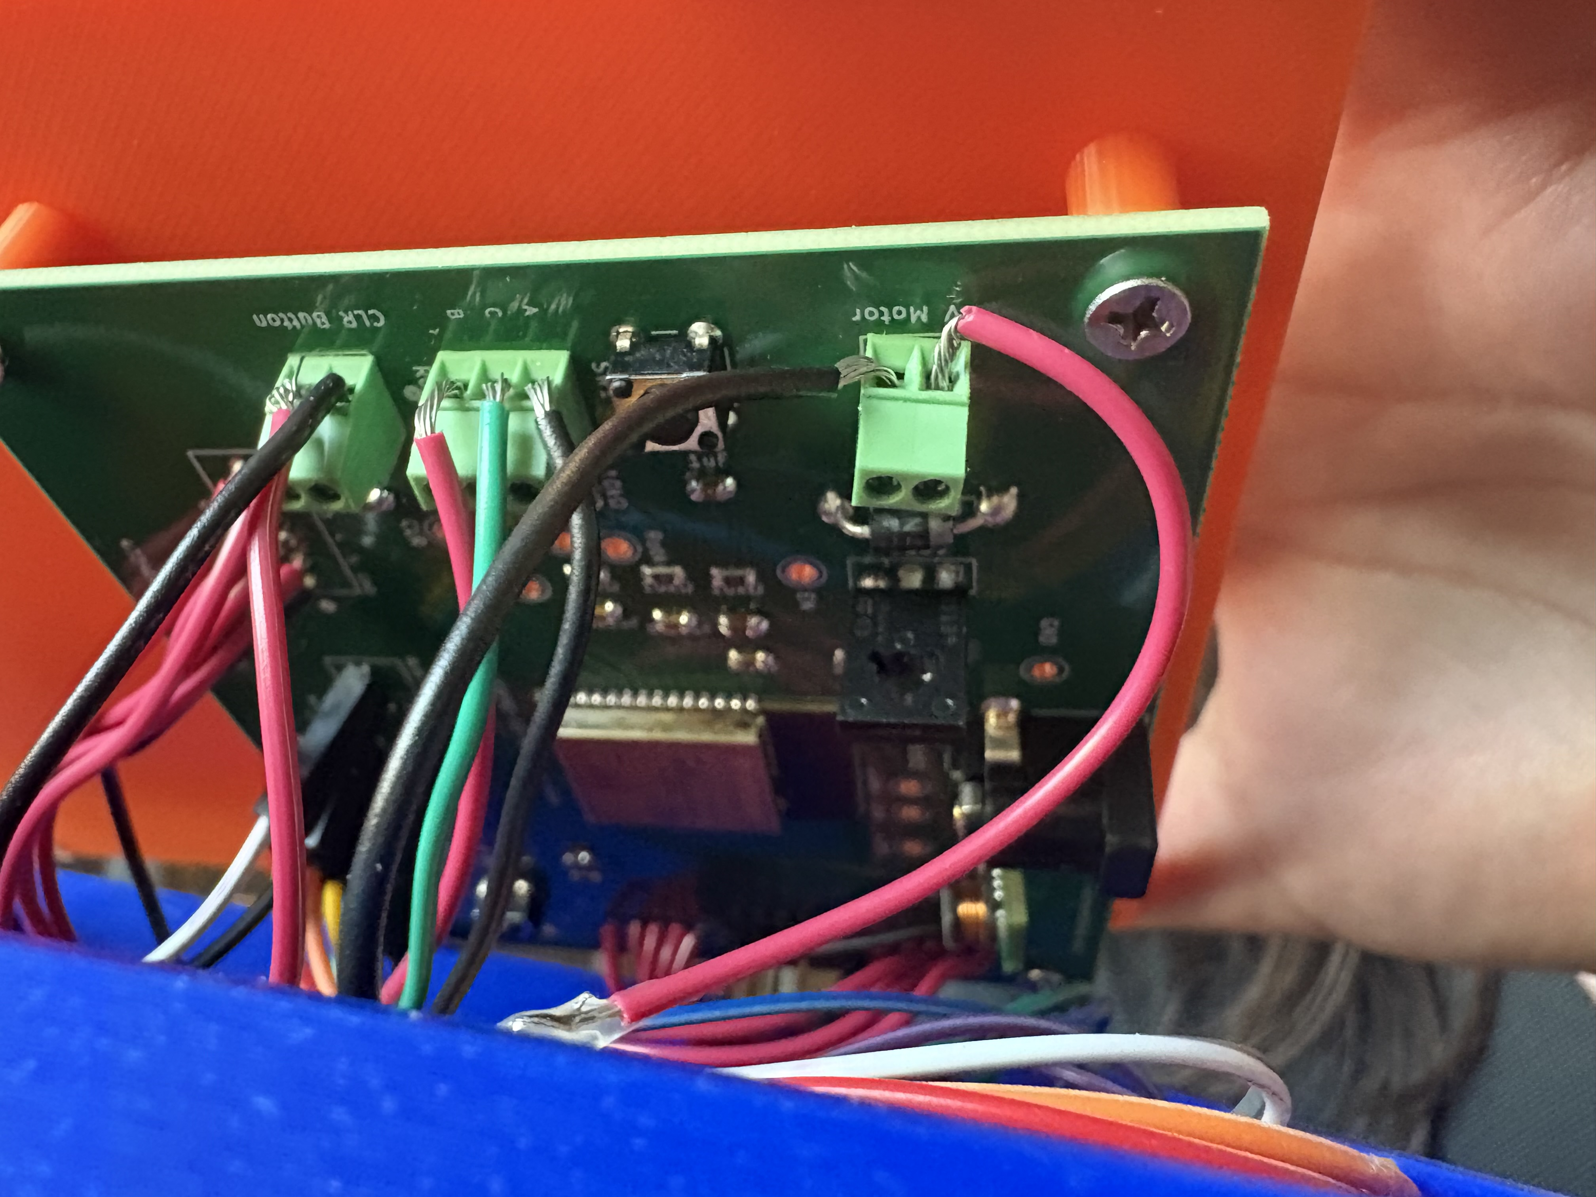
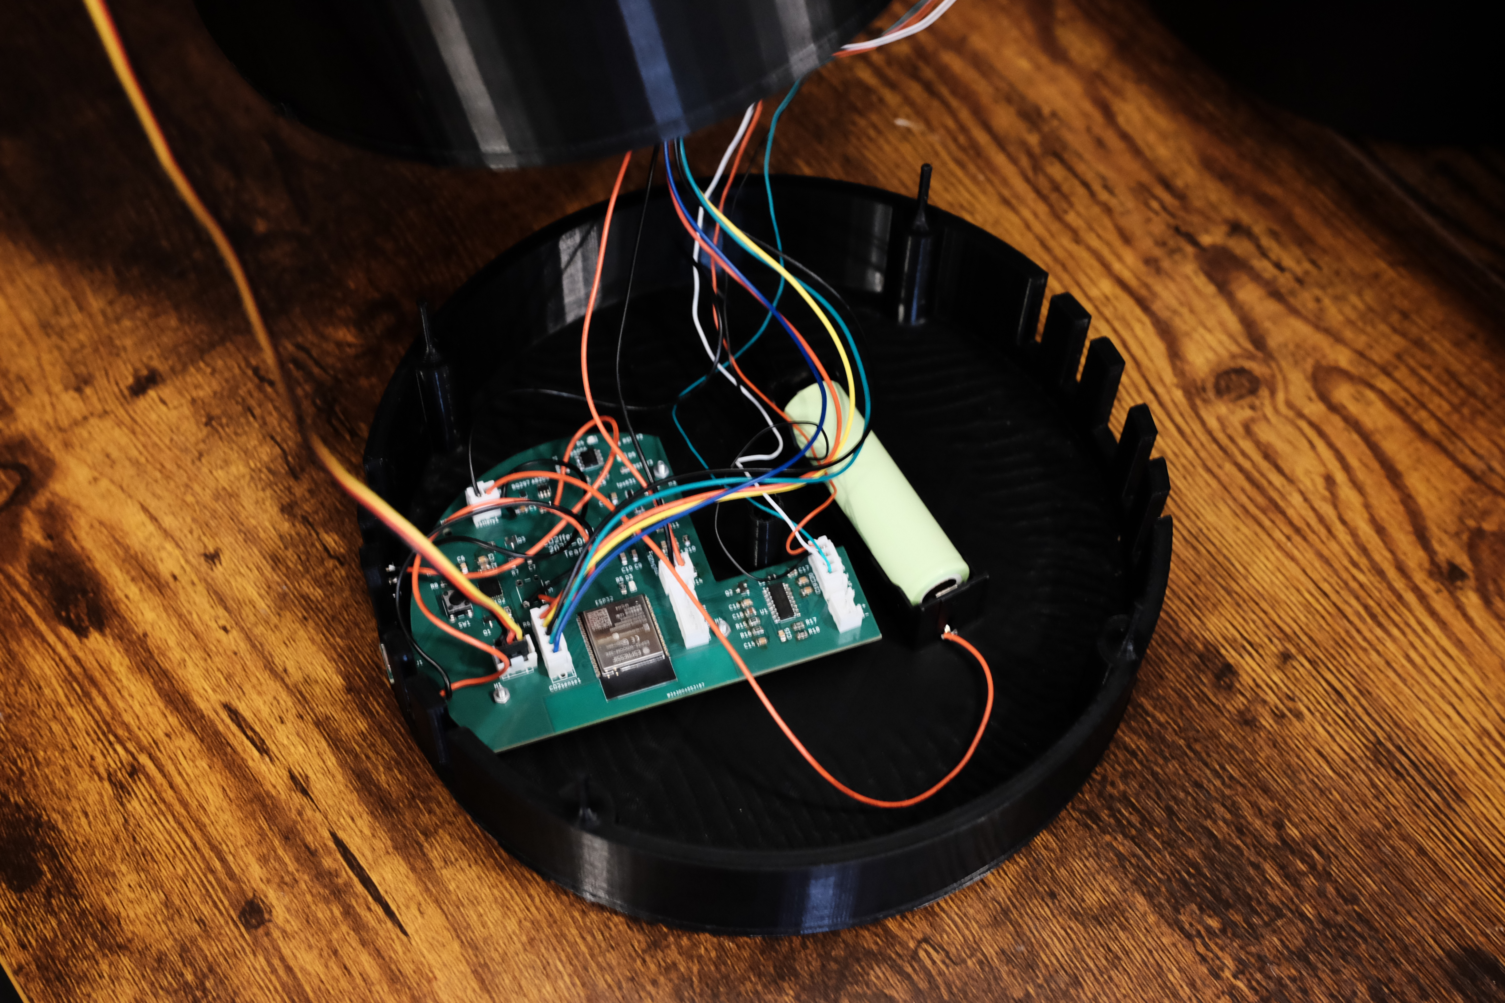
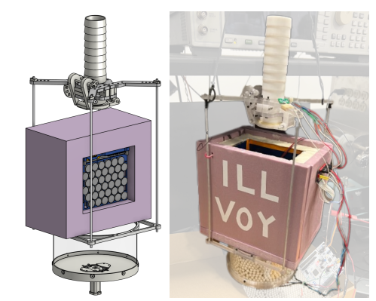
Introduction
Welcome to ECE 445, Senior Design Project Laboratory, the department’s capstone course
We expect you to carry out projects that are unique, technically challenging, and completable within the semester.
Illini Voyager (SP23)
CHARM (FA22)
Classroom Clarity (SP25)
CO2ffee(Sp25)
Notes:
A capstone course means it is a demonstration of your newly acquired capabilities as electrical and computer engineers
Think about the courses you found particularly interesting
How could the material be used to solve an interesting problem?
We want you to come up with novel solutions to problems
There needs to be a sufficient amount of complexity
There has to be an EE hardware element to the project – a circuit implemented on a PCB.
Project needs to be compatible with time and resource constraints
We fully expect that you will undertake challenging projects
One of the best parts of teaching this course comes at the end when we decide on which are the best projects
The slide shows some recent successful projects.
The Illini Voyager was a balloon project that had as it’s objective to avoid gaining altitude until it popped, which is the normal fate of such balloons. It was quite successful and was recovered in West Virginia after being launched in Champaign.
CHARM: CHeap Accessible Resilient Mesh for Remote Locations and Disaster Relief. The objective was to create a set of meshing, cheap, lightweight, and self-contained wireless internet access points, deployable via drone. The project was successfully demonstrated on the quad outside and included a half-dozen well-engineered PCBs.
Classroom Clarity: Portable teacher support hub that students can submit questions to wirelessly and has a teracher alert.
CO2ffee:

Slide 4
Important Sites on Course Website
Calendar
Lectures and Pre-Lectures
Guidelines
  Assignments and Grading
Web Board

Slide 5
Course Outline
Introductory lectures, Q&A sessions, and class exercises (weeks 1-4)
Project identification, team formation, and project approval (weeks 1-3)
  Propose a project idea or respond to a project pitch on the class web board
  Form a project team
  Prepare a Request For Approval (RFA)
  Approved projects are assigned a TA and instructor
PCB training assignment (weeks 1-4)
  Training assignment is now a team assignment
  Complexity is comparable to project PCB
  Learn to use KICAD to design a microprocessor-based PCB ready for fabrication
  Solder components onto this PCB using reflow oven, download software, and demo operation
Notes:
In this talk I’m going to focus on information you need to get started in the course
The course schedule is very compressed, so we want to get you started on your project as soon as possible.
Your first task will be to decide on a project and get it approved. Everyone will need to be on an approved project by the end of the first three weeks of class. You must do this but there are several ways you can reach this point.
Since being able to implement your project’s circuit on a PCB is a requirement for the course, we provide PCB training assignments at the beginning of the course. There is more PCB information on the course website Wiki page. Here you will find PCB designs that you can use as a starting point for your own PCBs.
Once you’re on an approved project team, you start working on the project proposal which is your first graded team document and is due during the fourth week of the course. This course satisfies the Advanced Composition Requirement so you must follow our guidelines for these documents. In the fifth week we will hold Proposal Reviews in which you present your proposal to your Instructor and TAs and peers.

Slide 6
Outline continued
Project Proposal, Design Document, and Design Review (weeks 3-7)
  The proposal is a plan for your project, and its prescribed structure basically determines how you will describe and characterize your project.
  Design Document adds design and project information and should be a complete manual for your project
  Design Reviews of all projects are held in Week 7.
Project Design, fabrication, testing, and analysis (weeks 4-14)
  Circuit design, breadboard tests, PCB design and tests, software development, system integration

Slide 7
Course Outline continued
Breadboard Demo and Progress Demo (weeks 8 and 11))
  Team presents hardware-update on project to instructor and TA
Throughout the project each student records work in their Lab notebook (10% of grade)
Demo, Final Presentation and Final Report (weeks 14-15)
  Team demonstrates a fully functioning, complete device with a working PCB
  Final presentation gives project overview, highlights and conclusions
  Final Report completes project documentation.
  External judges will select award winning projects
Notes:
After presenting your proposal at the Proposal Review and getting final project approval, you will have about 10 weeks to fabricate hardware, develop software, assemble, and test your project.
Each student maintains a lab notebook in which all project activities are documented. (worth 50 points)
A Design Document with additional project information is due in the 7th week of the course (2 weeks after proposal)
Breadboard demos of the projects will be held in the 8th week of the course.
In the final two weeks of the course. you will demonstrate your project, give a formal presentation on it, and submit a Final Report.

Slide 8
Course Grading
Students receive a team grade for major assignments
(Proposal, Design Doc, Demo, Presentation, Final Report)
Students receive an individual grade for many assignments (initial post, lab notebook, IPR, peer reviews)
Demo scores are used to determine A-level projects.
Both individual and team scores contribute to the final grade and are weighted equally.
Total points determine grades but percentages tend to be high and do not correspond conventionally to letter grades, i.e., a 95% point-percentage may not be an A.
Notes:
Replacing Design Review with Proposal Review is intended to give you more time in the lab.
Having the Design Doc as an update reduces writing requirements. Documentation is cumulative: Proposal, design doc, final report
Breadboard Demo is an early indication of how your project is proceeding
The course has many types of assignments. All are important but demo is used to select A-level projects.
Total point percentages in Canvas don’t correspond to letter grades.

Slide 9
Staff and Support Structure
Each project will have three students, one TA, and one instructor
Project teams meet weekly with their TA – the TA is the primary guide and point of contact for your project. Several projects may be mentored by ECE alumni.
Instructors
  Arne Fliflet, Viktor Gruev, Cunjiang Yu
TAs
  TBD
ECE Alumni Mentors:
  Jack Blevins – [217-390-1734, jacklouisblevins@gmail.com ]
Course Directors
  Professors Viktor Gruev and Michael Oelze
Notes:
Once a project is approved it is assigned a TA and an instructor. Jack Blevins, an ECE alumnus with 50 years experience in computer engineering, will mentor some of the projects.

Slide 10
Getting a project approved
All projects start on the Web Board
  Each idea must first be presented on the Web Board
  Professors, TAs, and other students critique and discuss each idea
  The first student to pitch an idea is the owner of that idea
  After sufficient discussion, an idea can become a Request for Approval (RFA)
RFAs will be evaluated by staff and either approved or rejected
  Projects must meet our criteria for complexity, uniqueness, and scope
  Deadline for RFA approval is September10.
  This is not when you submit the RFA, but when it is accepted.
  5 points extra credit: Early RFA approval by September3

Slide 11
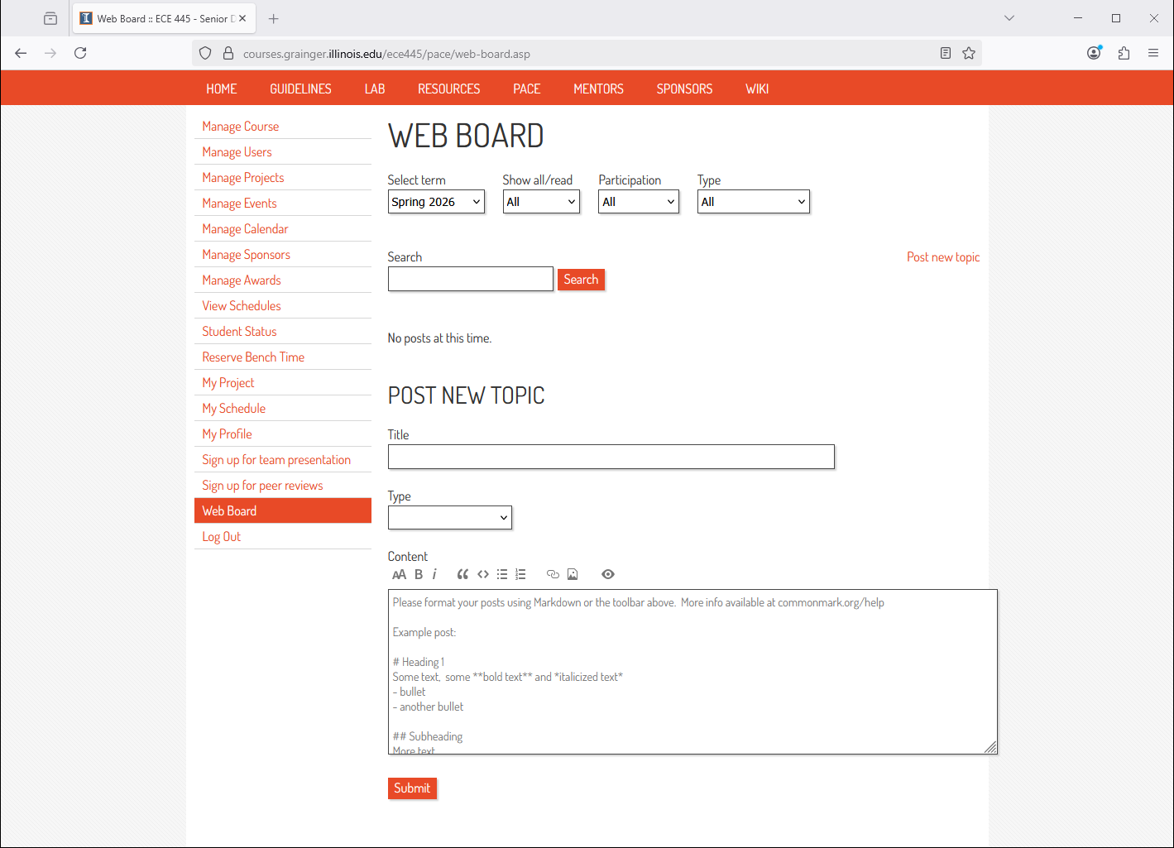
Select “Idea”

Slide 12
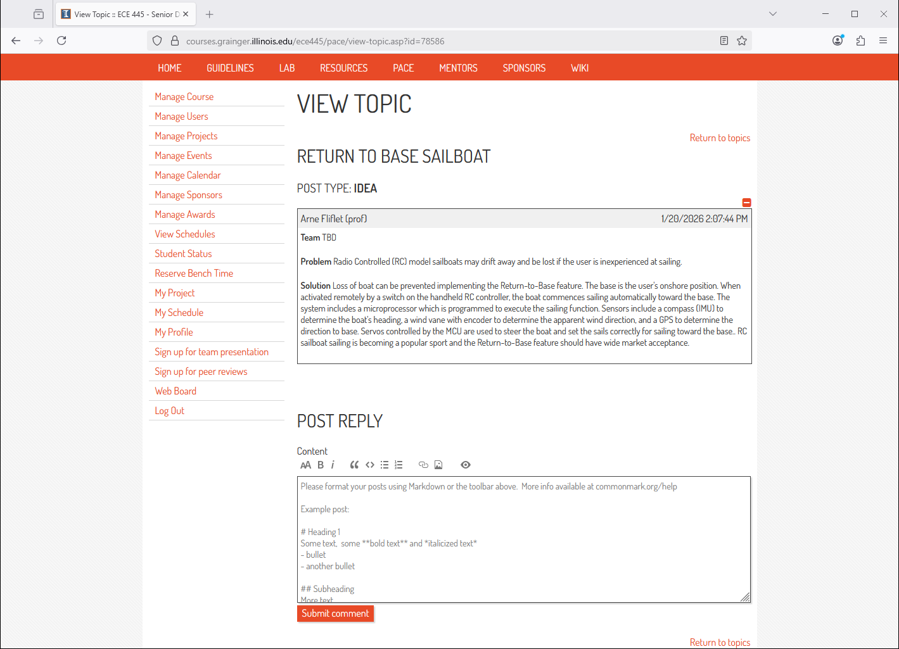

Slide 13
Important Approaching Deadlines
First Web Board Posting: Thursday, August 27, 11:59 PM
  This is an individual assignment
Project approval: Thursday, September 10,
11:59 PM
  This is a team assignment
Laboratory safety training is also due during this time period (needed to access lab)

Slide 14
Winter is Coming
Arne Fliflet

Slide 15
Consequences of Lagging Behind and Resources for Seeking Help
If you haven’t got project approved by the 3rd week…
  Although you seem to only have lost 5 / ~500 points
  You will have a tight time getting RFA approved, and proposal finished in the 4th week, when 25 / ~500 points at stake
  The effect is cumulative, all other times will be shortened
If you haven’t got project approved by the 2nd week…
  Talk to TA and professors to clarify the scope
  Talk to project sponsors
  Join approved teams
  We will help you succeed but don’t wait until the last minute

Slide 16
How to succeed in ECE 445
Get familiar with the course web site and watch the videos
  Watch videos on group project formation and practice brainstorming
  RFA, project proposal, lab notebook, modular design, ethics, ...
Use the PCB assignments and course Wiki page to prepare for designing and soldering your project PCB
Use course calendar to anticipate deadlines
Understand the grading process – 25 grades large and small
  Proposal Review, lab book, demo, final presentation & report
  Idea post and PCB assignments
  Team evaluation, individual progress report, peer review assignments
Focus initially on getting a project approved
Participate in web board discussions, go to office hours.
Can’t find a project?
  Respond to project pitches
  Look for teams needing complementary expertise
Notes:
The course Wiki page contains PCB designs that can be used as a starting point for your design.

Slide 17
How to succeed in ECE 445, continued
Get started on your PCB as soon as your project is approved – have a design ready for the first-round orders on September 29 (during 6th week of course).
Work with your teammates to build a strong team
  Hold regular meetings
  Communicate and be transparent with your teammates and TA
  Discuss problems as soon as they arise
Spend time frequently documenting your work in your lab notebook
Get help solving problems - a lot of expertise is available including AI
Keep the project moving during the build and test phases

Slide 18
Initial Post Deadline
Thursday August 27 11:59pm
RFA Early Approval Deadline
(5 pts extra credit)
Thursday, September 3 4:45pm
RFA Final Approval Deadline
Thursday, September 10 11:59pm

Slide 19
Relation of AI to Course
Use as a resource but don’t be overly dependent on it
Can help with project formulation
Problem: A radio-controlled RC model sailboat may be lost if the user is inexperienced at sailing. I want to add a capability to the sailboat that enables it to return to the user. My proposed approach is to add an autonomous Return-to-base capability.
Geminai answer: To make an autonomous Return-to-Base (RTB) system work for a sailboat, the system must handle the fact that a boat cannot sail directly into the wind. It must dynamically choose between sailing a straight line or zig-zagging (tacking) to get back. [1, 2]
Here is a practical framework to design and implement your RTB capability.
System Architecture
The sailboat needs a small onboard brain to read sensors and take control of the servos when the RTB mode activates.
And so on

