Slide 1
Using LLMs in ECE 445
From idea, to feasibility, to schematic, to code — and where it breaks
ECE 445 Senior Design · Prof. Viktor Gruev · University of Illinois Urbana-Champaign
Notes:
Open: this is not a lecture about AI. It is a lecture about how to run a design process when a very fast, very confident, occasionally wrong assistant is sitting next to you. About 12 minutes. (~40s)

Slide 2
Four ground rules
These hold for every slide that follows.
1
Use it to go faster, not to skip the learning.
You are still expected to leave 445 knowing how the design works.
2
You design the workflow. The LLM does subtasks.
You decide the architecture and the order of operations. It fills in blocks you have scoped.
3
Understand what it produced before you use it.
If you cannot explain a line of code or a net on your schematic, it is not yours yet.
4
LLMs make mistakes. That is not an excuse.
A wrong answer you did not check is your error at design review, not the tool's.
Notes:
Read rule 2 and rule 4 slowly. Rule 4 is the one that shows up in grading disputes: 'ChatGPT told me' is not a defense at design review. Everything after this slide is evidence for these four. (~70s)

Slide 3
One project, nine conversations
This is the actual sequence I ran. Each step narrows the design; each answer gets verified before the next step.
1
Ideate
2
Feasibility
3
Architecture
State the idea, ask if it is feasible
Let it push back on your framing
Turn the concept into a parts list
4
Interfaces
5
Part selection
6
Power
How the parts actually connect
Pick the specific MCU, justify it
Budget the rails before you route
7
Block diagram
8
Schematic check
9
Code
A picture you can redraw and own
Give it the datasheet, ask what is wrong
Point it at the docs, then verify
Notice: no step asks it to design the project. Each one asks a bounded question I already know how to check.
Notes:
Point at step 8 — that is the one that saved me real time, and we will spend the most time on it. Say out loud: the numbering matters more than the tool. Same sequence works with any model. (~60s)

Slide 4
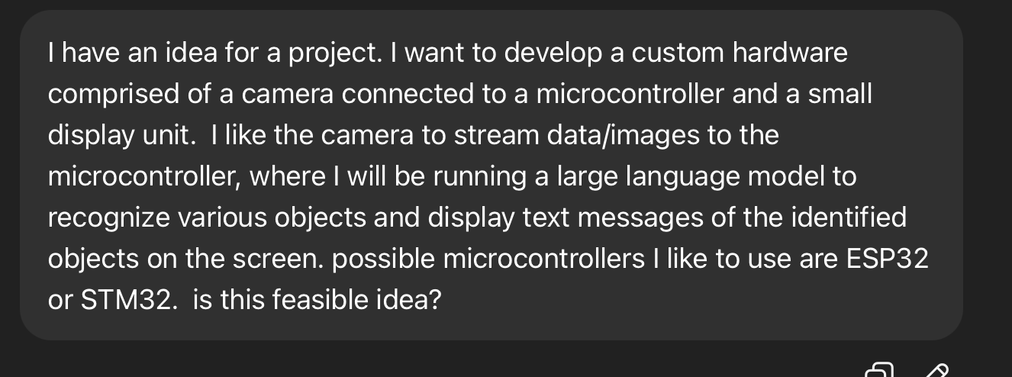
1
Ideate: state the idea, ask whether it is feasible
Why this prompt works: it names the parts, names the candidate MCUs, and ends with a question that can be answered NO.
Notes:
Walk through what is in the prompt: concrete parts, two candidate MCUs, and a yes/no question. Contrast with 'give me a cool 445 project' — that returns a paragraph of nothing. Ask the room: what is wrong with the idea as I stated it? Let someone spot the LLM-on-MCU problem before the next slide. (~60s)

Slide 5
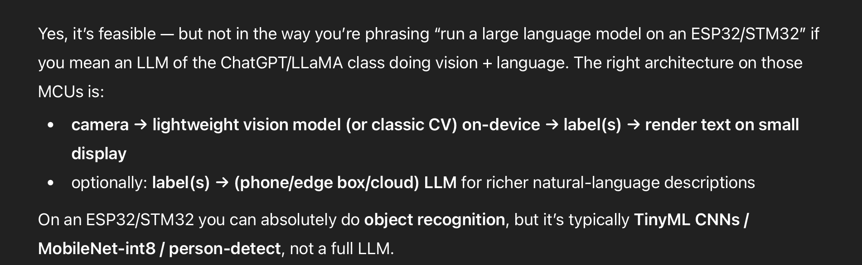
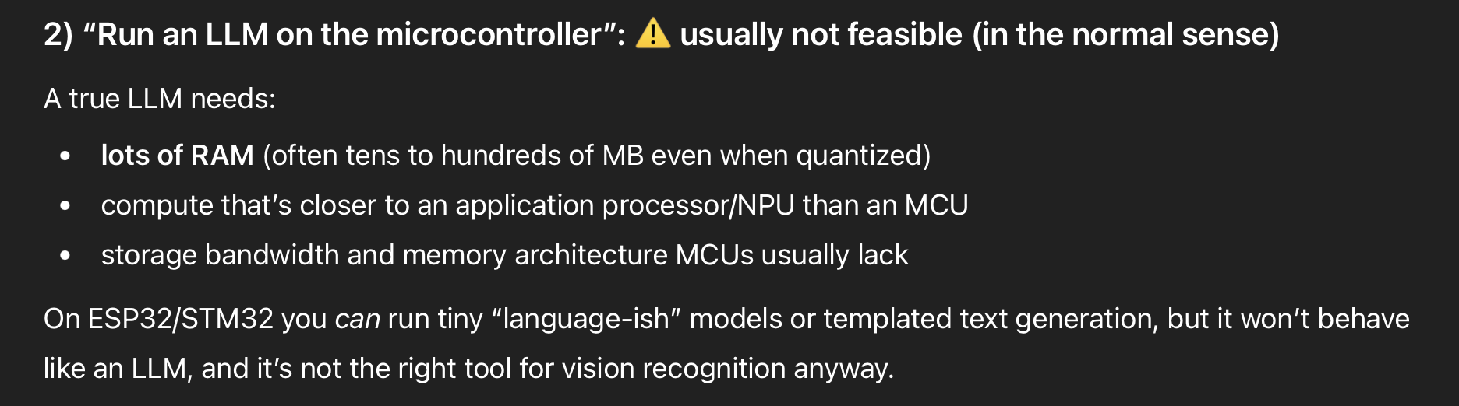
2
Feasibility: it pushed back on my framing
It corrected the vocabulary, not just the design: what I called an LLM is a quantized CNN. Ask early, before you have a BOM.
Notes:
This is the highest-value moment in the whole session and it cost thirty seconds. I asked for something incoherent — a ChatGPT-class model on a microcontroller — and it separated the two things I had conflated. If I had found this out in week 9 it would have cost the project. (~60s)

Slide 6
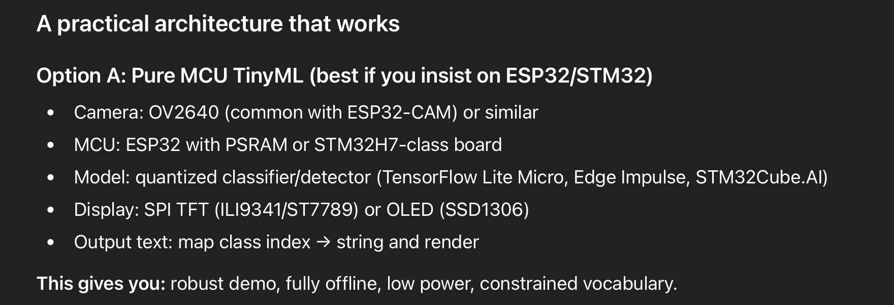
3
Architecture: a concept becomes a parts list
Treat this as a list of things to verify, not a decision. Every part number here still needs a datasheet, a price, and a stock check.
Notes:
Note it gave specific part numbers — OV2640, ILI9341, SSD1306. That is useful and dangerous. Useful because you now have something to search. Dangerous because they are only plausible: it has no idea what is in stock or what the shop already has. (~55s)

Slide 7
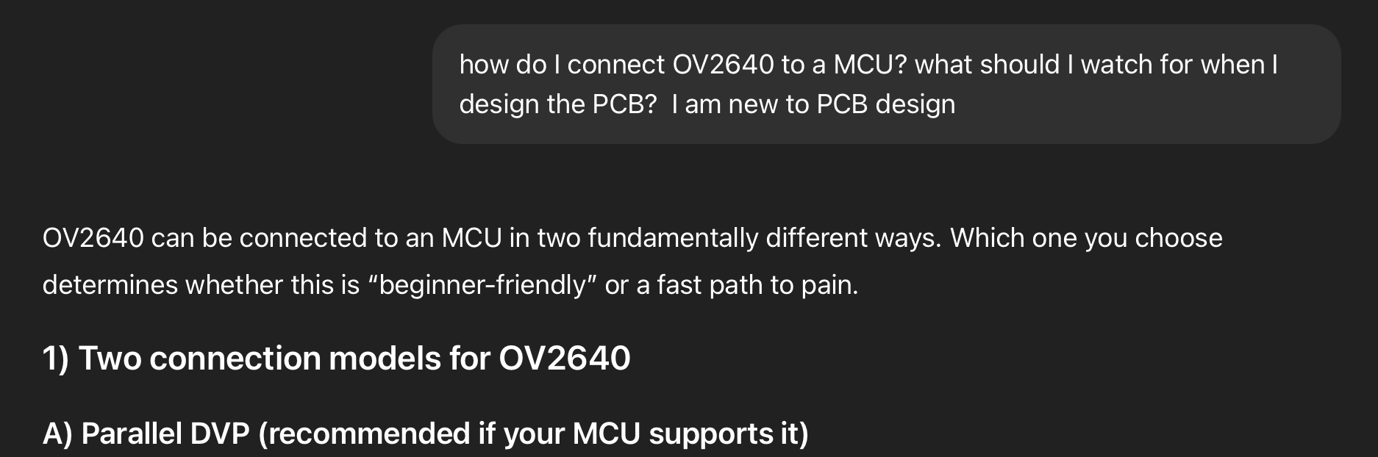
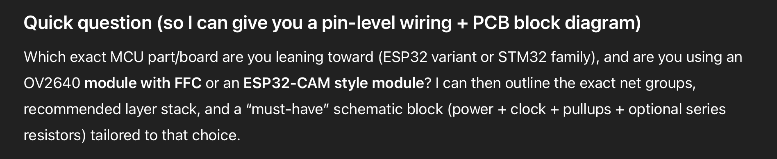
4
Interfaces and PCB: it asked me a question back
Answer the clarifying question. A vague prompt gets a hedged, generic design back — which is worse than no answer.
Notes:
Two things here. First, saying 'I am new to PCB design' changed the register of the answer — it started flagging what is beginner-friendly versus a fast path to pain. Second, it asked me which exact part I was leaning toward. Students skip past that and take the generic answer. Do not. (~55s)

Slide 8
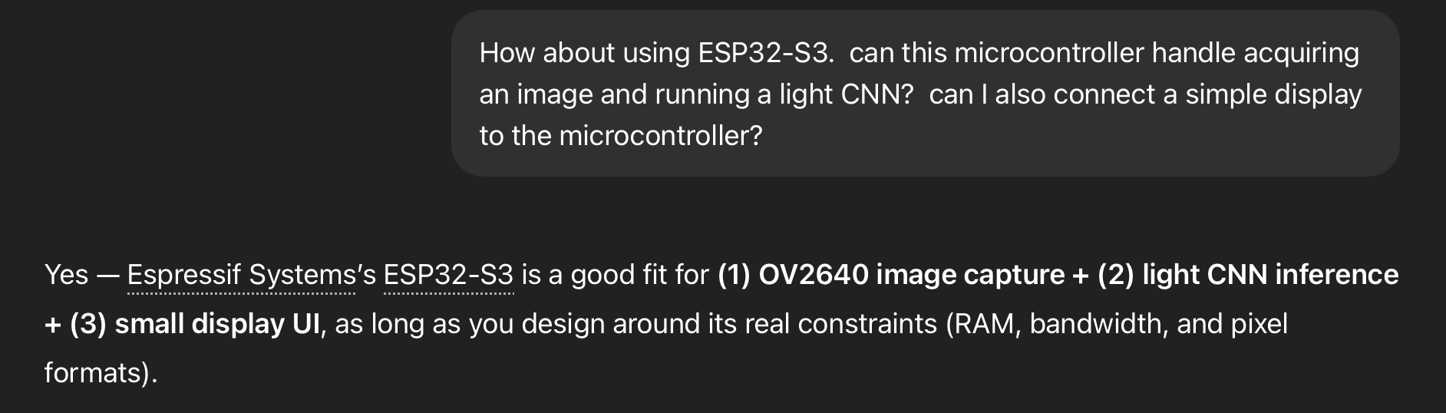
5
Part selection: does the ESP32-S3 actually clear the bar?
Ask about a specific part, in terms of a specific workload. "Can it do X and Y at the same time" is checkable; "is this a good MCU" is not.
Notes:
The answer is conditional — yes, IF you design around RAM, bandwidth and pixel format. That conditional is the useful part. It just told you the three things that will bite you, which is your list of risks for the design document. (~50s)

Slide 9
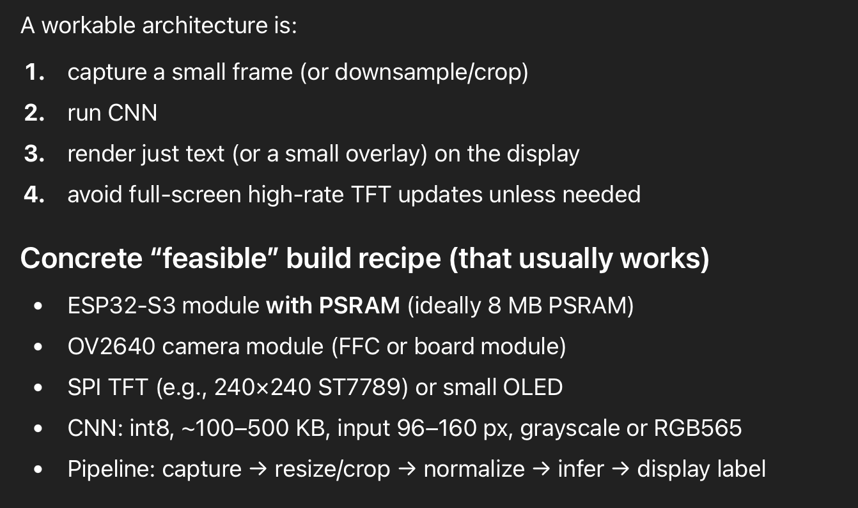
5
...and the build recipe that comes out of it
Now every line is a checkable claim: 8 MB PSRAM, int8 at 100-500 KB, 96-160 px input. Go confirm each one in the datasheet.
Notes:
Read one line out loud — 'CNN: int8, roughly 100 to 500 KB, input 96 to 160 pixels.' That is a specification you can test against your actual model. This is the level of concreteness you want before you commit to a part. (~50s)

Slide 10
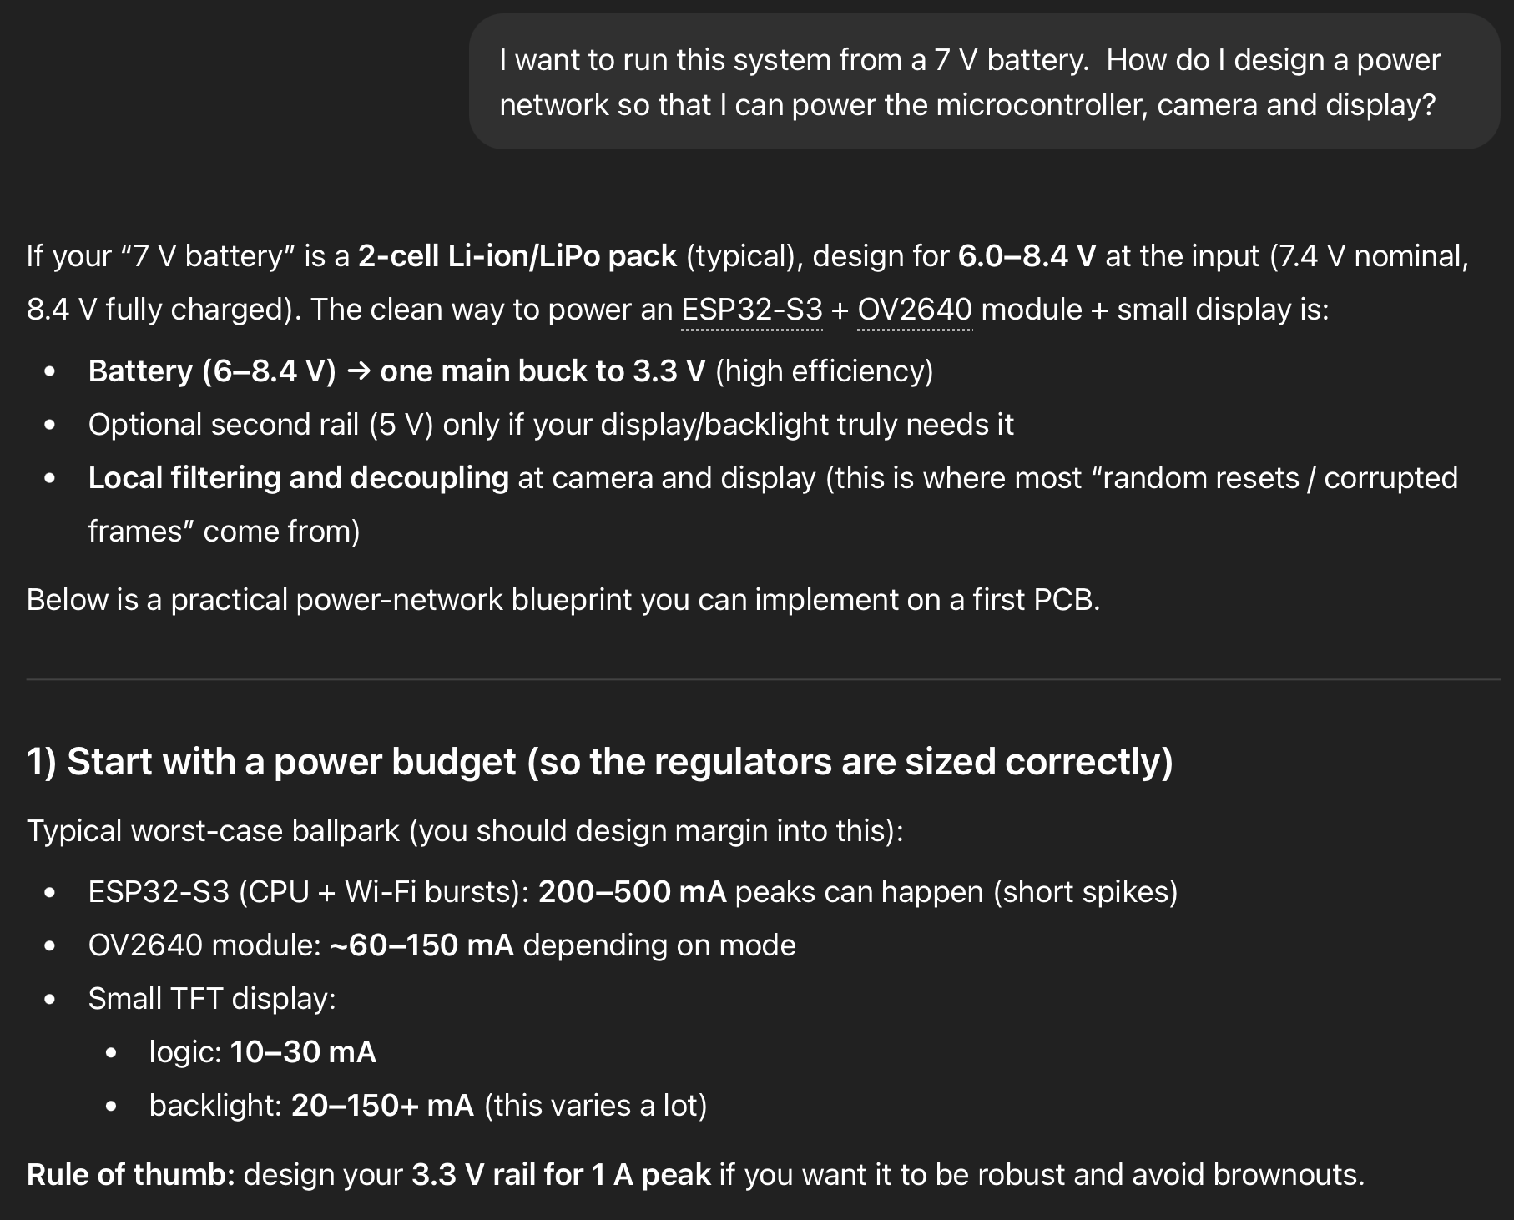
6
Power: budget the rails before you route anything
Read what it is hedging
It says "typical worst-case ballpark" and tells you to design margin in. That is the tool telling you it is not authoritative.
Peak current, not average, sizes the regulator. The 1 A rule of thumb is a starting point, not a result.
Backlight current "varies a lot" — that is the single number most likely to be wrong for your display.
Replace every range on this list with a number from your part's datasheet before it goes in the design document.
Ranges are a research plan. Anything you cannot trace to a datasheet page is an assumption, and assumptions get labelled as such.
Notes:
This slide is the honest one. The model hedged, in writing, and students read straight past the hedge to the numbers. Tell them: highlight every range you see in an LLM answer, and each highlight is one datasheet lookup you owe. (~65s)

Slide 11

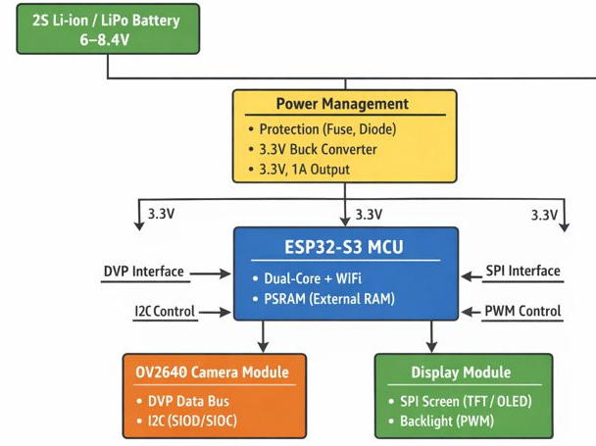
7
Block diagram: a first draft you then redraw yourself
Useful as a starting point, not as a deliverable. Your Design Document block diagram has to be yours, with your interfaces and your rails.
Notes:
Compare against the 445 block diagram requirement: yours needs the actual signal names and the actual rails, and it needs to match your schematic. This one is close but generic. Use it to find what you forgot, then draw it again. (~50s)

Slide 12
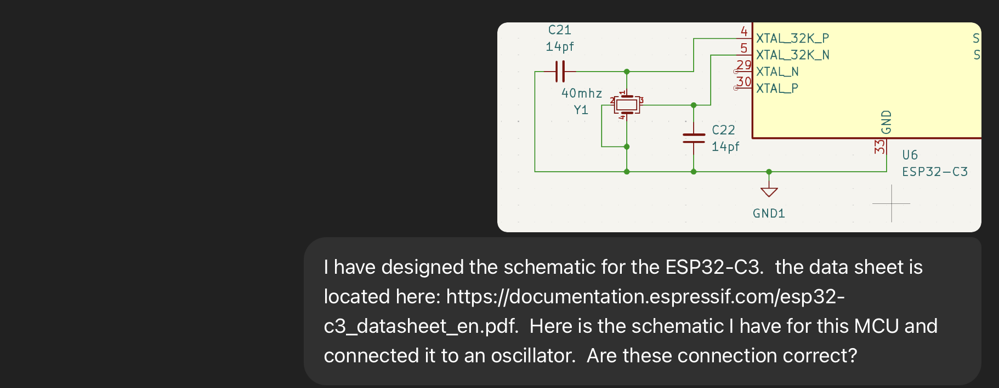
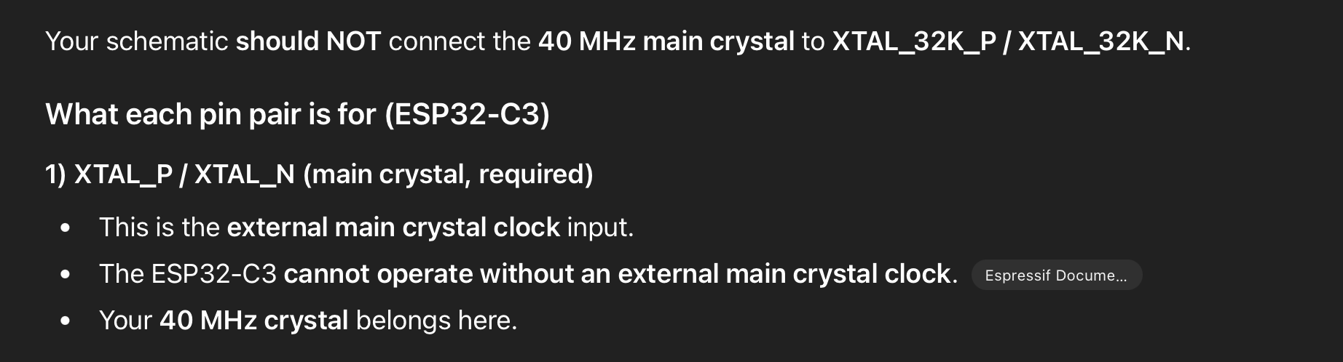
8
Schematic review: this is where it earns its keep
It caught a real error: a 40 MHz crystal wired to the 32 kHz pins. I gave it the datasheet link, so it checked the document, not its memory.
Notes:
Slow down here. Three things made this work: I uploaded the schematic image, I gave the datasheet URL, and I asked a narrow question — are these connections correct. Ten minutes of my time; that mistake survives into a fabricated board very easily. Note the board here is a C3, not the S3 from the earlier example — different project, same technique. (~80s)

Slide 13
Where it will fail you
Every one of these has shown up in a 445 project. Assume they will show up in yours.
!
Pins it "remembers"
!
Parts that no longer exist
!
Confident numbers
Package variants differ. Check the pinout table, not the answer.
No live stock or lifecycle data. Check the distributor and the NRND list.
Currents and timings are ballpark. Your margin comes from the max column.
!
Errata it has never read
!
Anything physical
!
Two runs, two answers
Silicon bugs live in a separate document that is rarely in the training data.
It cannot see your board. It will not catch a wrong land pattern or a thermal problem.
Ask again. If the pin assignment changes, neither answer was verified.
The pattern: it is strong on structure and vocabulary, weak on anything specific, physical, or recent.
Notes:
This slide is the counterweight to the previous eight. The failure mode is not that it lies — it is that it is fluent about things it cannot know. Structure and vocabulary: excellent. Your exact part in your exact package with your exact stock: no. (~70s)

Slide 14
9
Writing code: point it at the documentation first
PROMPT
Four things this prompt does
I have an ESP32-C3 Zero board. The full documentation is here: https://www.waveshare.com/wiki/ESP32-C3-Zero
This board has an RGB LED. Look up the pin on the MCU that is connected to the RGB LED, and then generate code that will cycle through all possible colors quickly.
Names the exact board
1
Not "an ESP32" — the variant and the vendor board.
2
Links the authoritative doc
It reads the page instead of recalling a pin.
3
Asks it to look it up first
Separates the fact from the code generation.
4
Specifies behaviour, not code
You keep the implementation decisions.
Then verify before you flash: does the pin it chose match your schematic, does it compile, and did it invent an API that does not exist?
Notes:
Contrast with 'write me code for an RGB LED', which produces something for a board you do not have on a pin you do not have. The fix is one URL. Then verify — every one of those three checks has caught something for me. (~65s)

Slide 15
What we expect in 445
1
You own every net and every line.
Design review is a defense, not a demo. If you cannot explain it, do not submit it.
2
"The LLM suggested it" is not a justification.
Cite the datasheet page, the reference manual section, or the measurement.
3
Document how you used it.
In your Design Document, say what you asked, what you kept, and what you changed.
4
Verify against primary sources.
Datasheet, reference manual, errata, and the vendor's own dev-board schematic.
The grade is on the design, not on the prompt. Use the tool to get further — then be able to defend where you got.
Notes:
Close on this. Confirm these four against the current course and department policy before you present — this is the slide students will screenshot and quote back at you. Then take questions. (~60s)

