Slide 1
Senior Design and Lab Safety
Casey Smith
Associate Director for Instructional Support
August 29, 2023

Slide 2
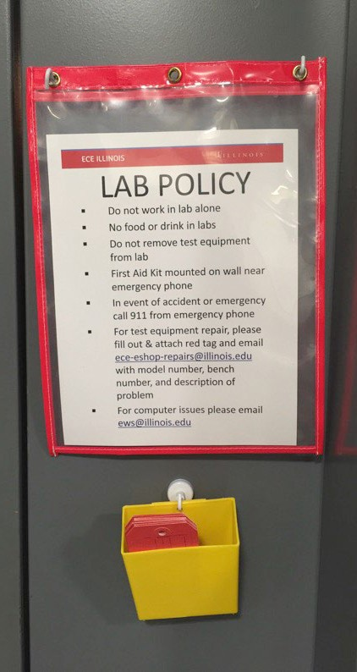
Lab Policies
No working alone!
TA or Lab monitor must be present
No food or drink
Do not remove equipment from lab
When AC wall potential is used an instructor or TA must be present.

Slide 3
What happens in Senior Design...
Minimize use of instructional labs
ADSL - ECEB 2076 is used only by ECE 395.
Power Lab - ECEB 4024 is not to be used without special permission.
Wireless Lab - ECEB 5080 is not to be used without special permission.
Open Lab – ECEB 2024 – No coursework.
Complete online laboratory safety training for 2070 access

Slide 4
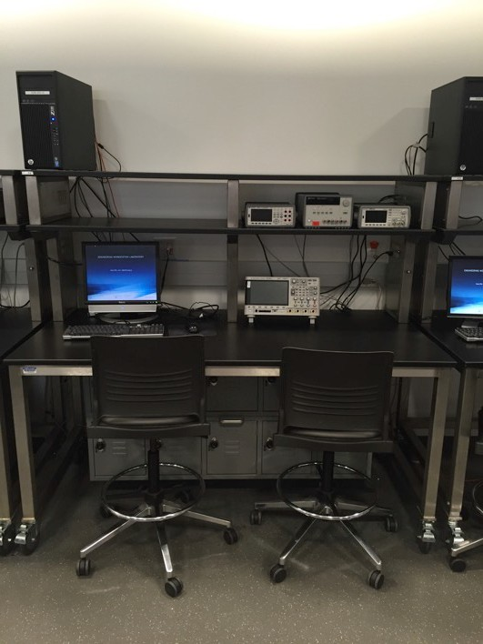
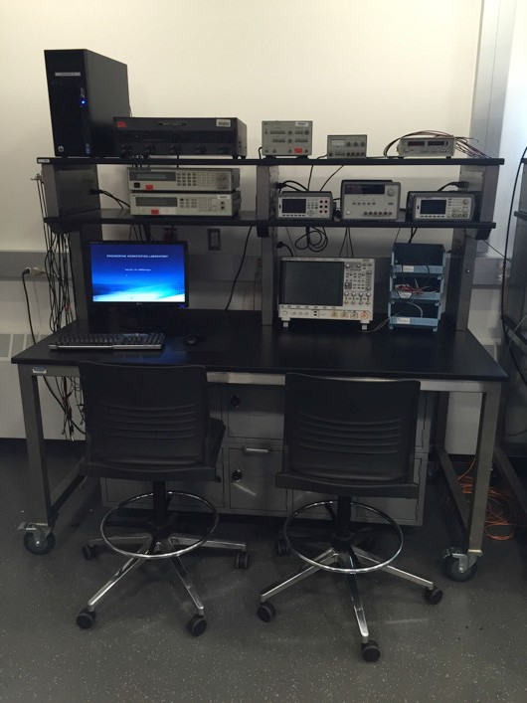
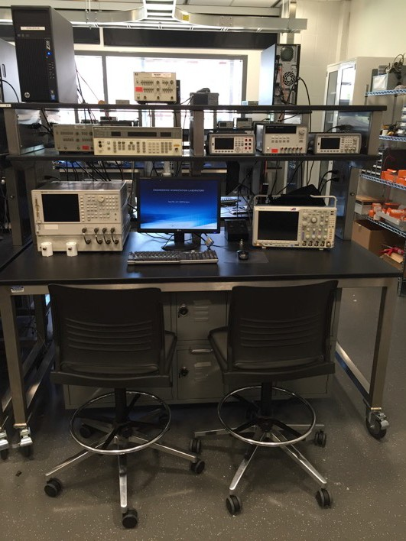
Bench Setups
Typical
Power
RF
$8,500
$16,500
$35,500

Slide 5
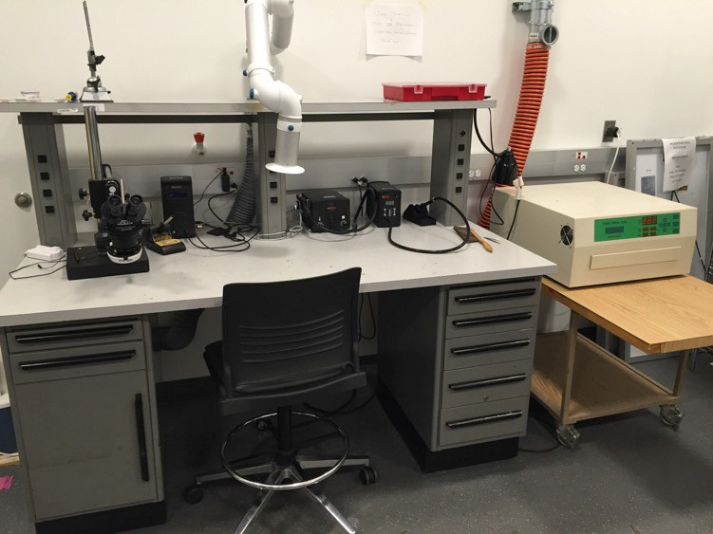
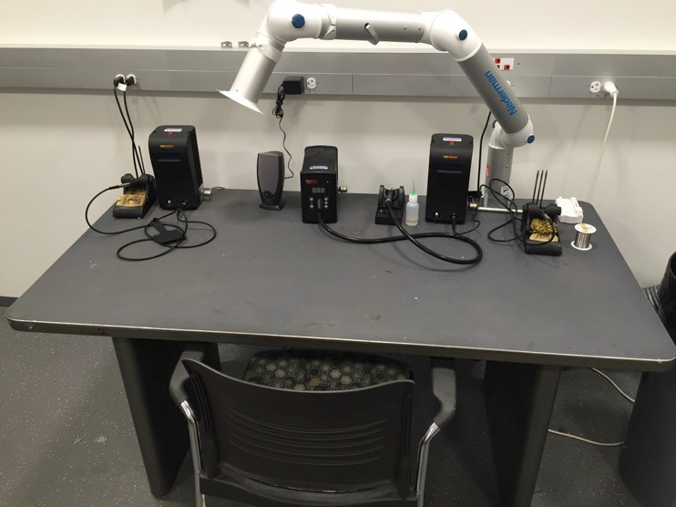
Soldering Stations
SMD General

Slide 6
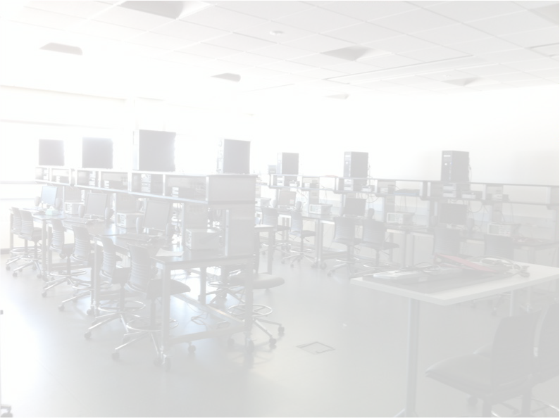
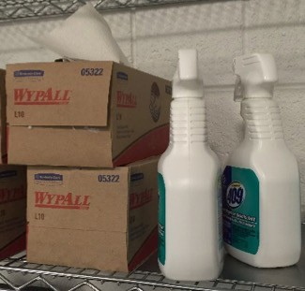
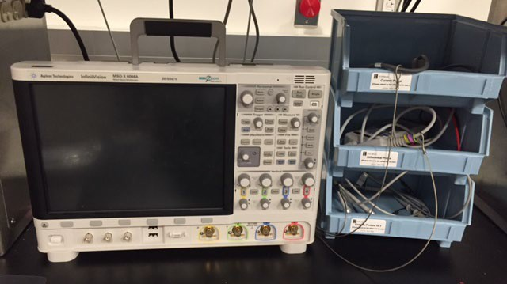
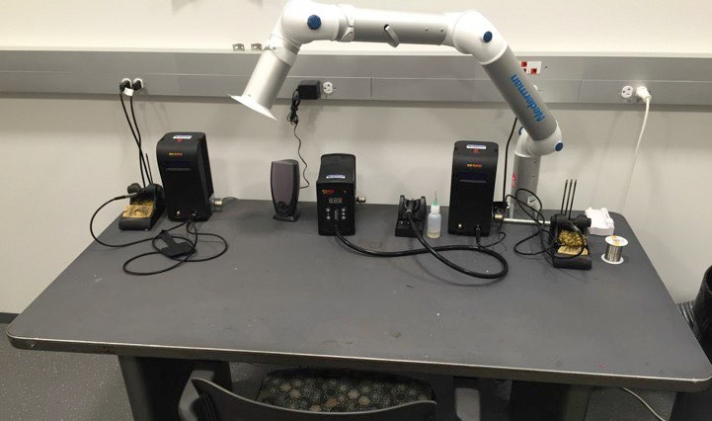
Keep it clean
NO FOOD OR DRINK IN LABS!
Keep lab clean
Clean benches after sessions.
Cables on hangers / Probes in Bins
Kits and components put away
Email if you need clearing supplies.
No-tolerance lab policy
If lab is a mess it will be locked
End of Semester Cleanup
As part of your final checkout you will be responsible for cleaning your work area.

Slide 7
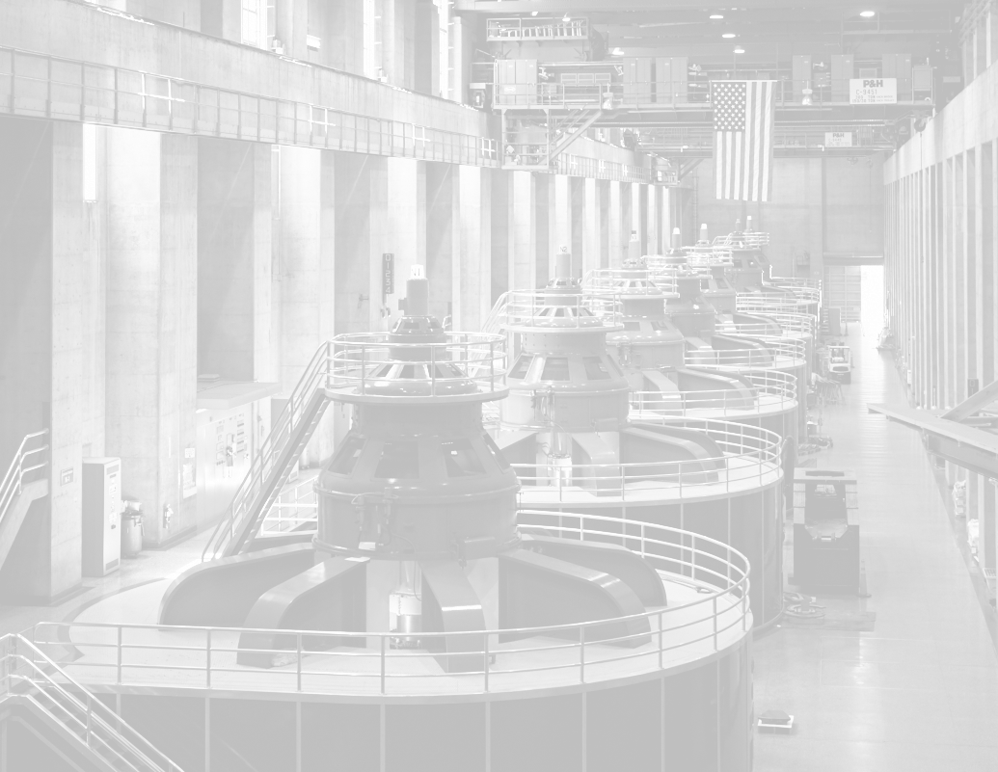
Power Hazards
Electrocution
Don’t make changes to a circuit when power is applied. Always treat cases as electrically live & do not leave circuits exposed.
Avoid presenting body as ground path. One Hand Rule.
Capacitors can hold charge a long time after power is removed and deliver that charge very rapidly.
Current cannot change in inductors instantly. Don’t forget motors are inductors!
Burns
Use wiring of appropriate length and gauge. Does it smell hot?
Fires
Do not use a battery when a bench power supply will do.
Cover battery terminals to avoid shorts. High short circuit currents!
Store batteries in yellow lockers. No unattended charging.

Slide 8
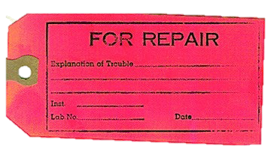
Equipment Damage
Check Ratings
Does the function and ratings of the instrument match the signals you are attempting to measure?
If in doubt ask!
Understand how probes and sources are grounded
Do not to cram too much into lockers. Items pressing against lock make lockers very
difficult to get open.
Report malfunctioning equipment
E-mail ece-eshop-repairs
‘Red Tag’ equipment

Slide 9
If a Problem Occurs
Tend to your immediate safety first! Leave area if necessary and get help!
Shut off power
Locate problem before power is restored
If circuit breaker is tripped, report to ece-eshop-repairs to reset
If help is needed contact me or electronics shop for assistance
In event of an accident or emergency call 911

Slide 10
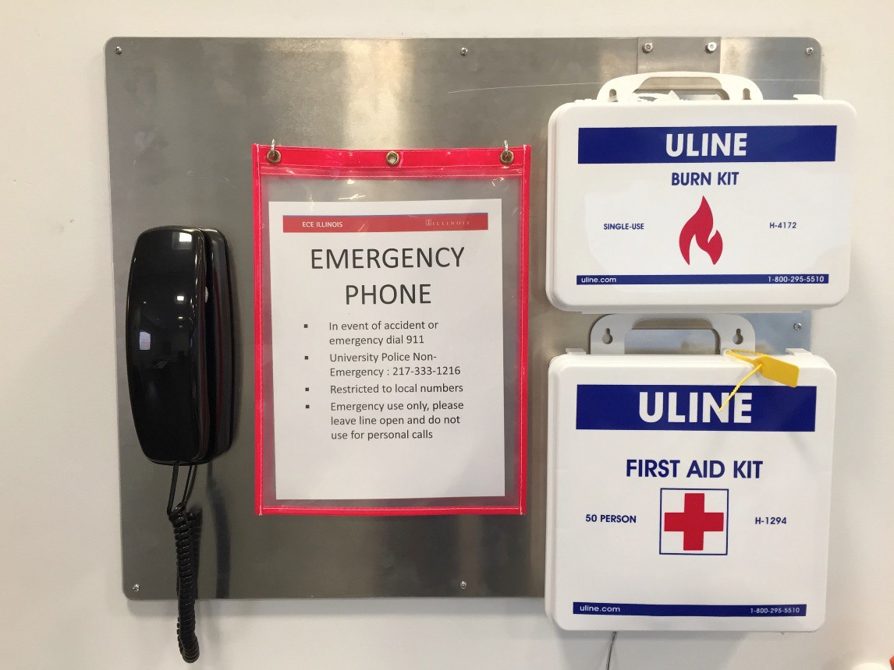
First Aid Stations
First Aid Kits considered single use. Report all use to me for restock.
Report all injuries to ece- safety & course staff immediately.
Land-Line phone works in event of cell phone or power interruption.
In event of an accident or emergency call 911

Slide 11
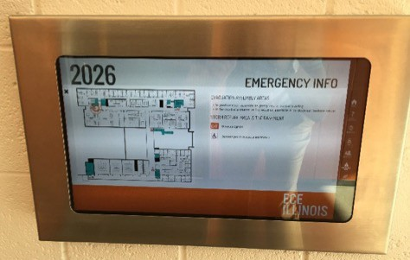
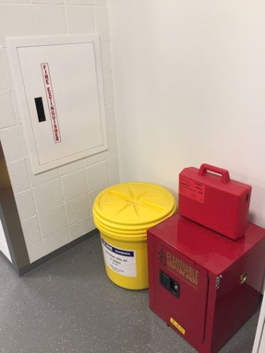
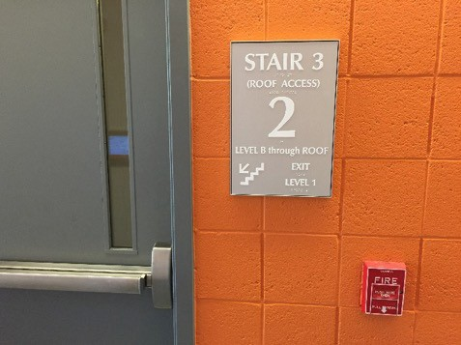
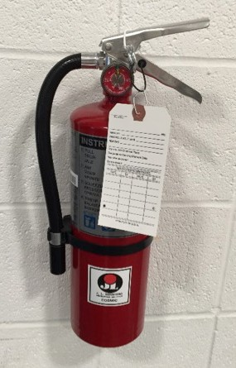
Fire Safety
Shut off soldering irons!
Plan ahead: Identify closest alarm pulls and exits.
Identify location of fire extinguishers in your lab. (If equipped)
Personal safety comes first. Pull alarm, and evacuate building.
Assemble in grassy area East of ECEB

Slide 12
BEAP
Building Emergency Action Plan
Each floor has floor coordinator.
Areas of rescue assistance with marked call boxes.
SW Stairwells on floors 2-3.
E & W Stairwells on Basement and floors 2-5.
Get Out / Run
Fire, Earthquake, Finals Week, Etc
Evacuation assembly areas are grassy area E of ECEB outside main lobby or inside Beckman Institute Atrium in bad weather.
Stay In / Hide
Storms
Refuge areas in basement and interior hallways and bathrooms.
Security Threat
Secure your classroom or lab.
Run / Hide / Fight

Slide 13
HELP!?
TAs – This should always be the first stop.
Lab Support - ECEB 2044 - cjsmith0@illinois.edu
Electronics Shop – ECEB 1041 - eshop.ece.illinois.edu
Talk to Margie, Lilli, Jordan, or Jose ! - ece-eshop@illinois.edu
ECE Machine Shop – ECEB 1047
Talk to Gregg! – gbenntt@illinois.edu
Mechanical Fabrication
ECE Supply Center – ECEB 1031
Talk to Josh! - ece-stores@illinois.edu
Electronic Components

