Slide 1
Autonomous Sailboat
ECE445 Pitch Fall 2023
Arne Fliflet
afliflet@Illinois.edu

Slide 2
Autonomous or robotic sailboats - large and small - have been under investigation for over 20 years
Autonomous sailing represents an challenging control problem
Given a destination and wind direction, a course must be determined
Sails must be trimmed according to course, wind and boat heading directions, and and wind strength
Course to destination must be known
Based on this information, the boat rudder and sail trim must be continuously adjusted to sail the boat to the destination.
Complex maneuvers such as tacking or jibing are needed.
Roland Stelzer, Autonomous Sailboat Navigation, PhD thesis, Centre for Computational Intelligence De Montfort University, Leicester, UK.

Slide 3
Project motivation and overview
Radio Controlled (RC) sailboat racing has become a popular sport even for experienced sailors
Big-boat regattas often include an RC sailboat event.
The World Robotic Sailing Championship (WRSC), held yearly, is an autonomous sailboat racing competition that aims at stimulating the development of autonomous marine robotics
The long-term goal of this project is to develop an autonomous sailboat capable of competing in the WRSC.
The near-term goal is to develop a dual-mode sailboat capable of switching between sailing under radio control and sailing autonomously.

Slide 4
Key features of a dual-mode RC-Autonomous Sailboat
The sailboat is controlled by servos for the sail winch and rudder
Situation awareness is provided by compass sensor, wind vane sensor, heeling indicator, and GPS (other sensors possible)
Remote controlled sailing and mode switch capability is provided by 2.4 GHz, 5-channel Flyway transmitter and receiver
Onboard MCU records sensor output and servo settings for RC and autonomous modes
Software on MCU processes the the sensor input and determines the optimum rudder and sail winch servo settings needed to maintain a prescribed course for the given wind direction.

Slide 5
Points of Sail
Beating
Sailing upwind
(must be able to tack)
Reaching
Sailing downwind
(must be able to jibe)
R. Stelzer, ibid.

Slide 6
Criteria for Spring 2022project success (Project 2, Spring 2022)
Upwind Mark
Implement dual mode capability
Boat can maintain a given course after being switched to autonomous mode
Boat can record and transmit servo, sensor, and position data back to base
Return to base capability (added by team)
Wind
tack
Jibe
Start and Finish

Slide 7
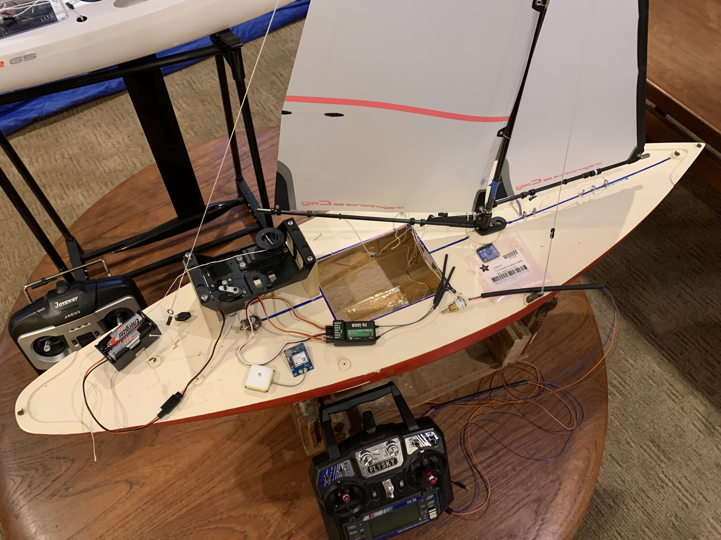
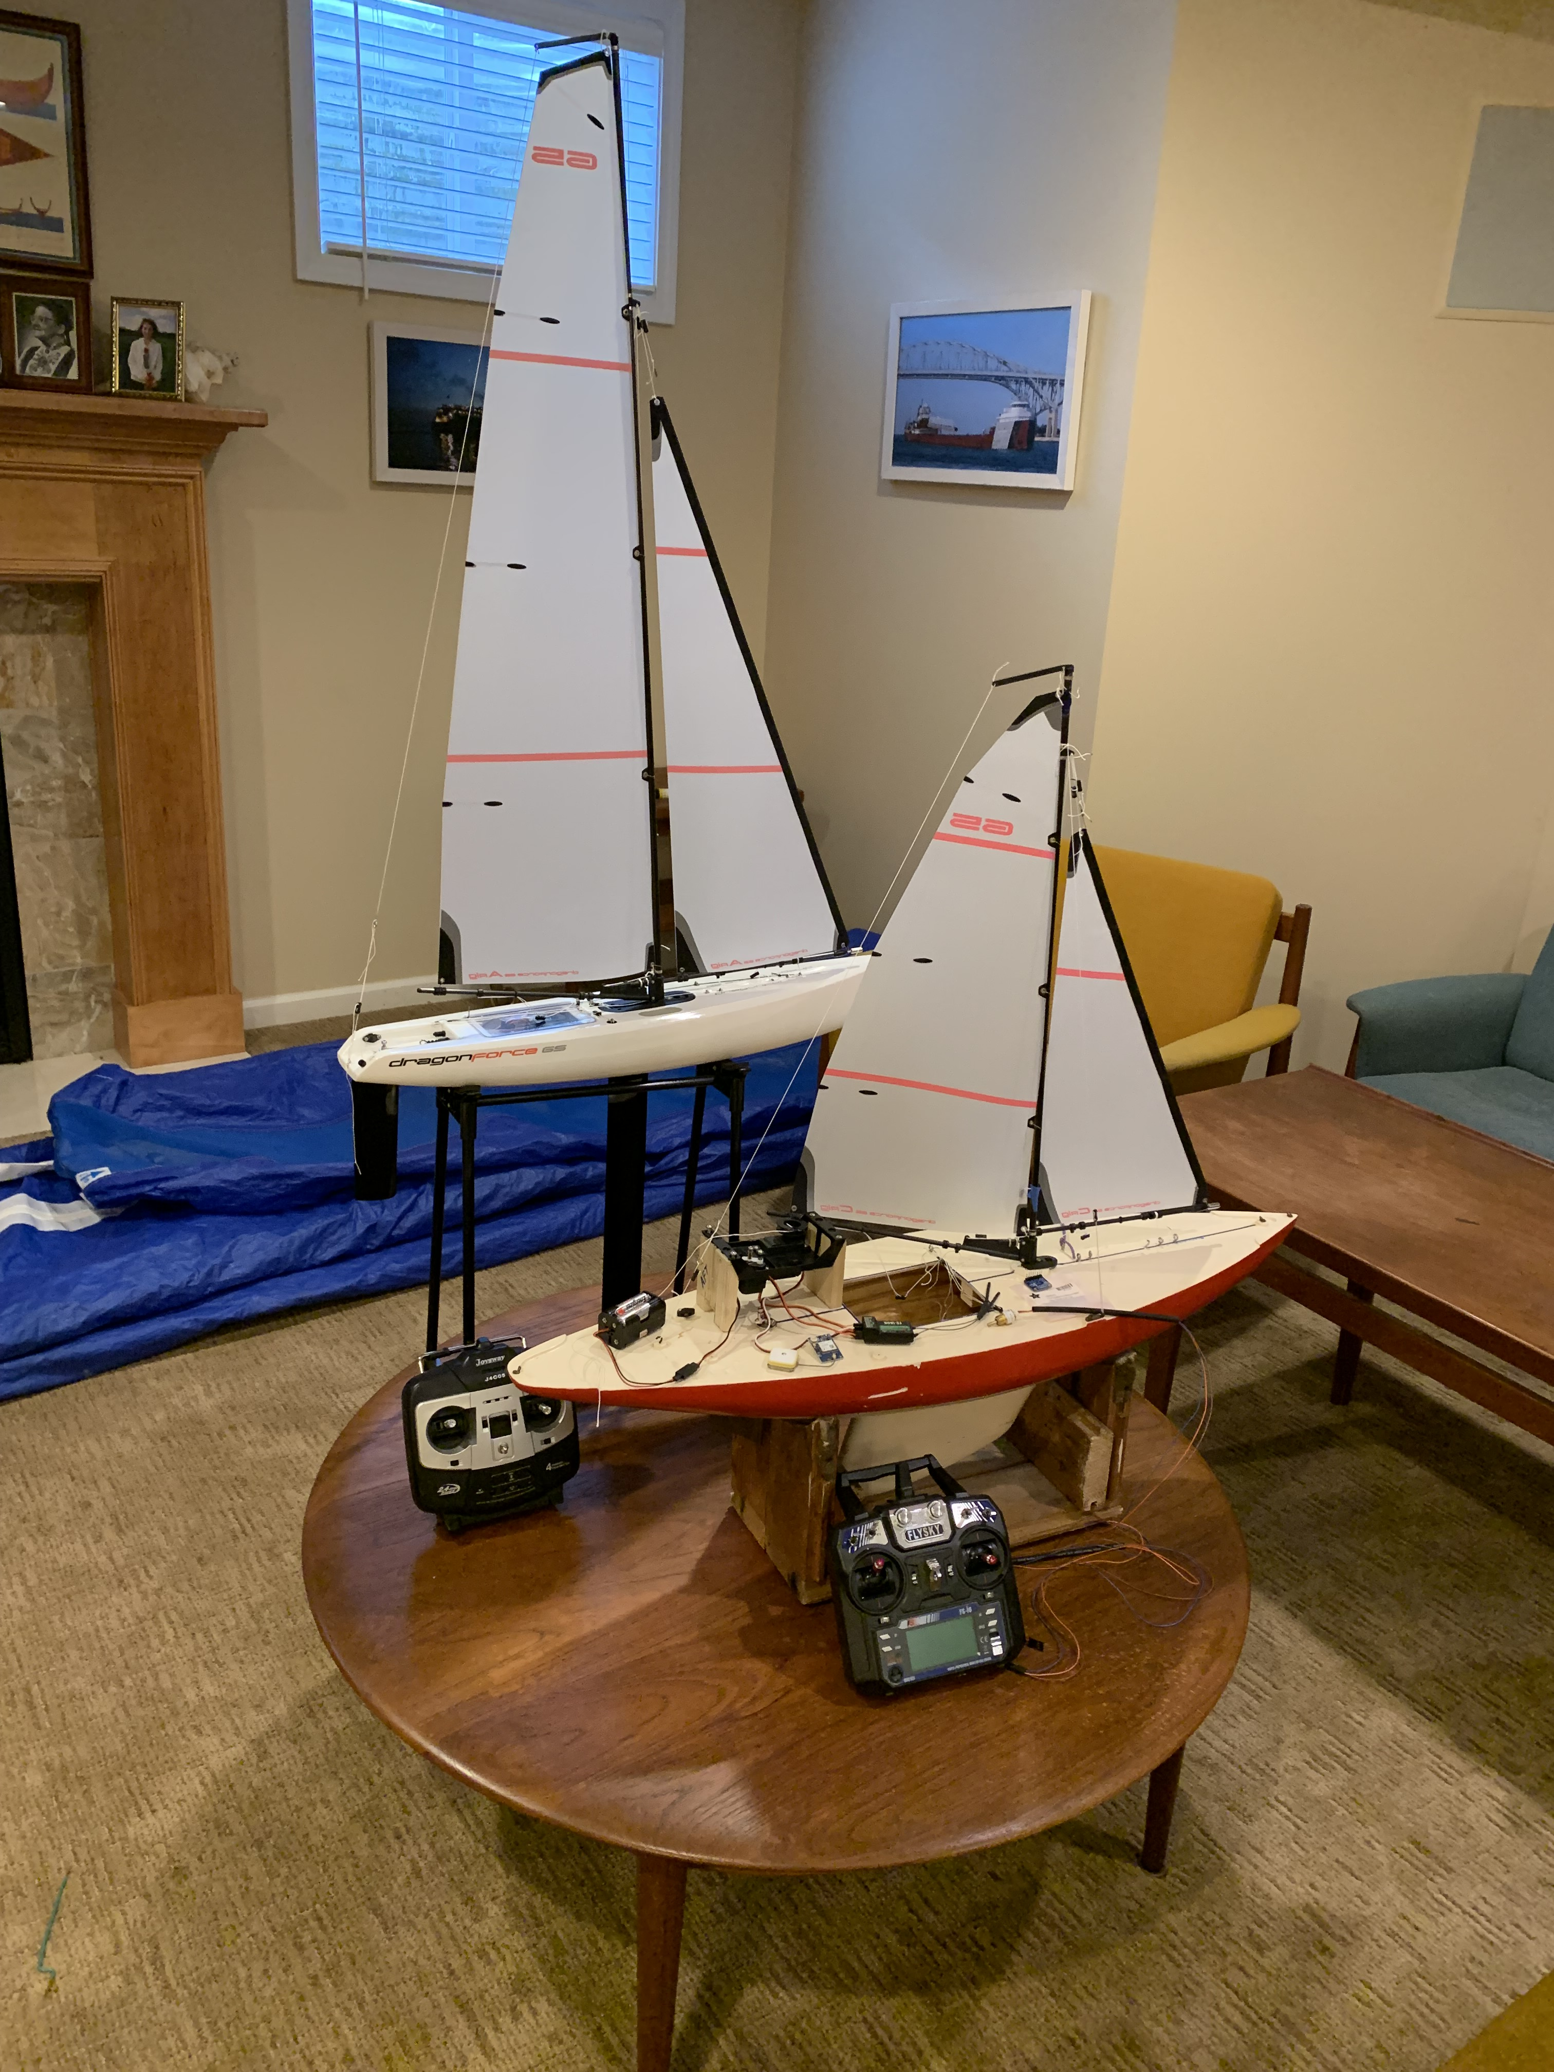
Autonomous Sailboat Project Resources
Dragonforce65
Sail winch servo
compass
Test
Boat
Rudder
servo
Shaft decoder for wind vane
5 chl, 2.45 GHz receiver
GPS
Dragonforce65 racing RC
sailboat and test boat
5 chl, 2.45 GHz transmitter
Test boat uses same sail rig (with smaller sails) and controls as Dragonforce65

Slide 8
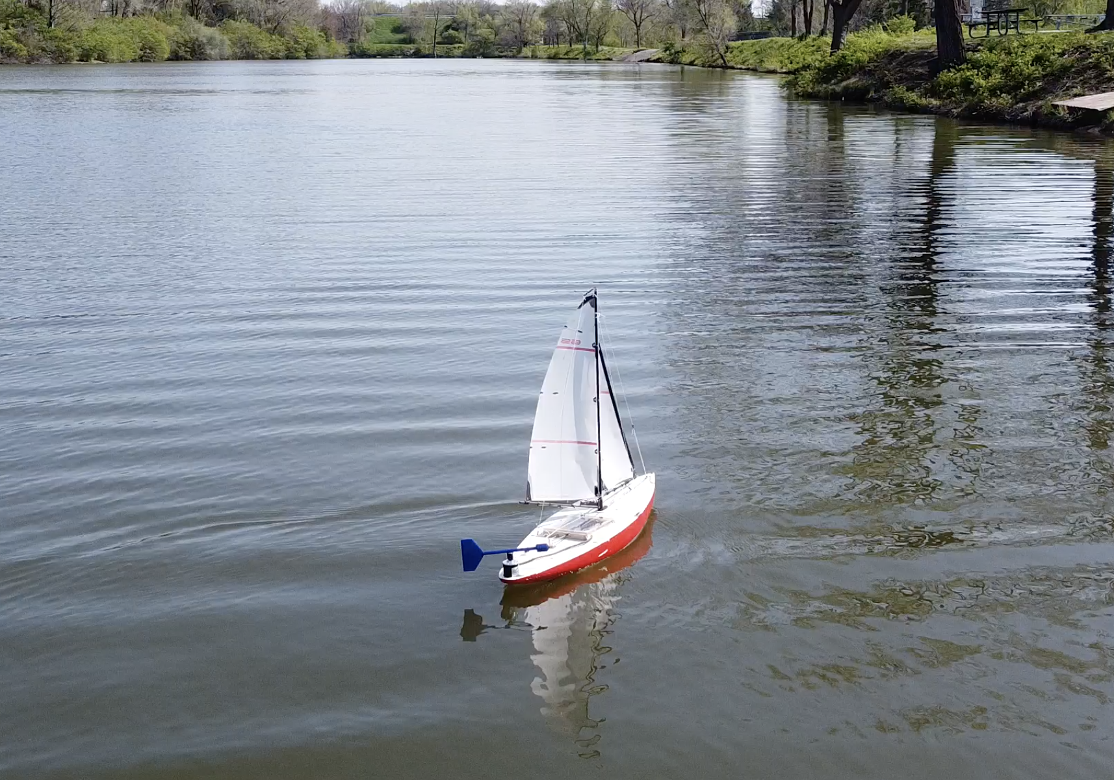
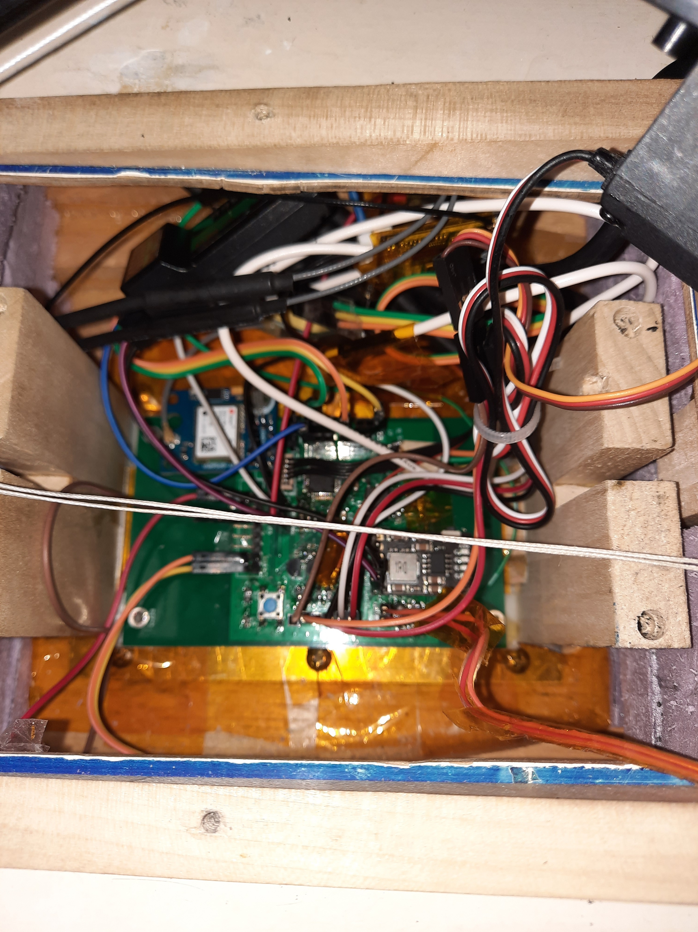
Project 2 boat sailing autonomously
Project 2 boat PCB

Slide 9
Criteria for new project success
Dual mode (RC or autonomous) capability
Can sail effectively up wind by optimizing sail trim and rudder response
The boat can sail a given course autonomously that was previously sailed under remote control
Boat can sail to an upwind or downwind GPS location including base
Boat battery can be recharged via a USB port and there is a low-voltage indicator

Slide 10
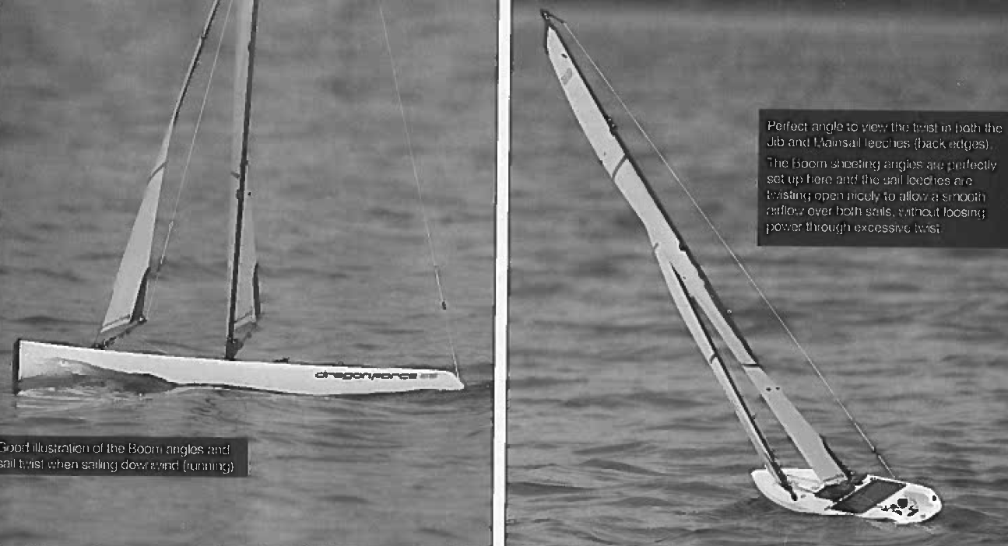
Photos of Dragonforce 65 under sail
Sailing Down Wind
Sailing Up Wind

Slide 11
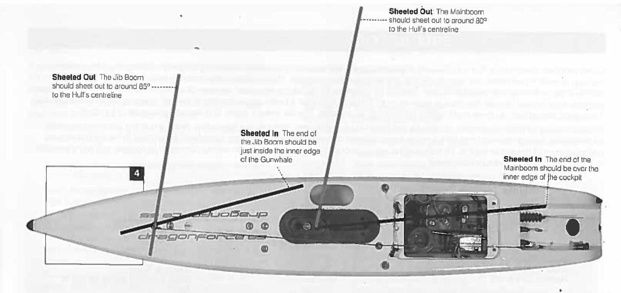
Top view of DF65 showing schematic of sheeted-in (upwind) and sheeted-out (downwind) sail positions
Both sails are controlled by one winch
Servo for sail rudder control
Servo-controlled winch for sail control

Slide 12
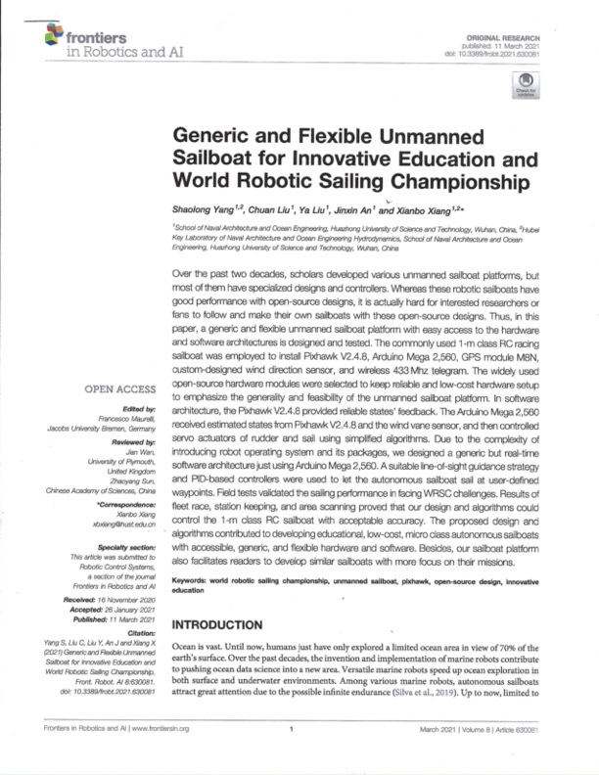
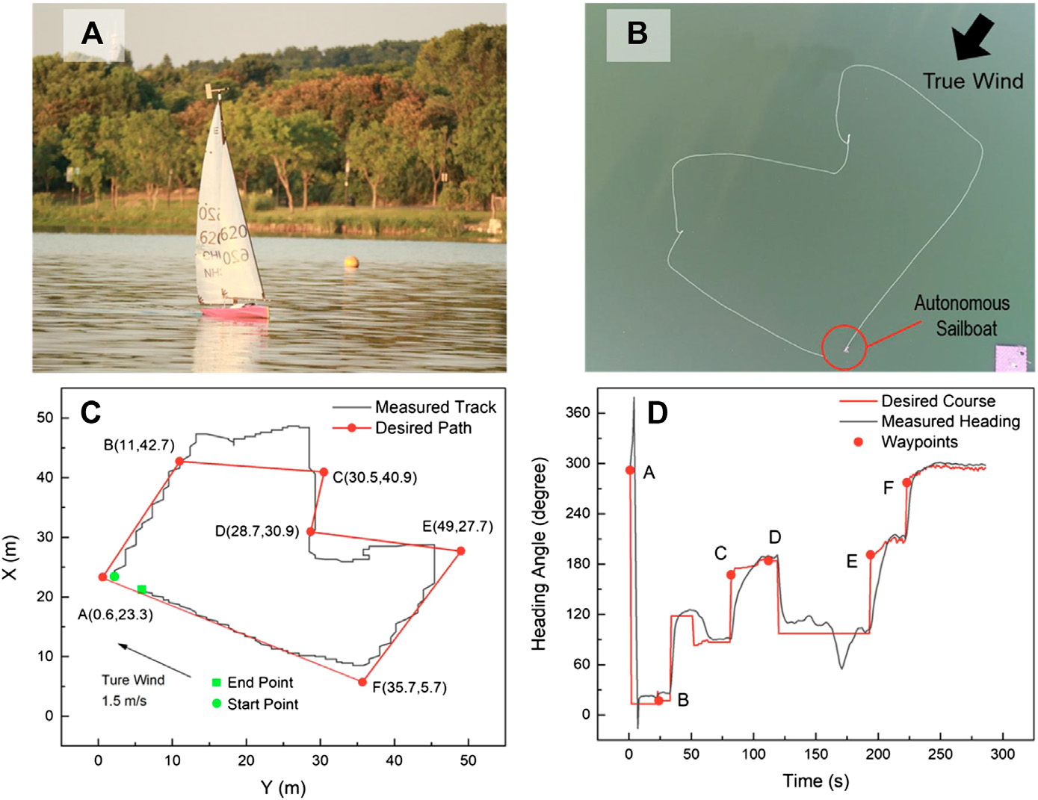
Good resource for information about this project
Available online: https://www.ncbi.nlm.nih.gov/pmc/articles/PMC7990777/
Contact me for more information if you are interested in doing this project afliflet@Illinois.edu

