Slide 1
PCB Design Guidelines and Tips

Slide 2
PCB Design Guidelines and Tips
Every project must have a PCB design.
Think carefully about your project and its PCB design and ask the following questions:
What will be the function of my PCB?
Example: acquire data from sensors, control motors and actuators, communicate with a PC or cloud, display information on a screen/LEDs, acquire inputs from keyboard/switches, etc.
Protype your idea before designing your PCB.
How much time would be required to design, fabricate, solder, test and redesign the PCB?
Every PCB board should have a processor
Typical projects have microcontrollers (ESP, Atmega, STM, PIC, etc).
Raspberry Pi board okay but needs to interface with your custom PCB that also has a microcontroller
FPGA board okay but needs to interface with your custom PCB that also has a microcontroller
Carefully choose PCB components
Size and soldering leads (through hole pins preferred, surface mounts components okay but we careful)

Slide 3
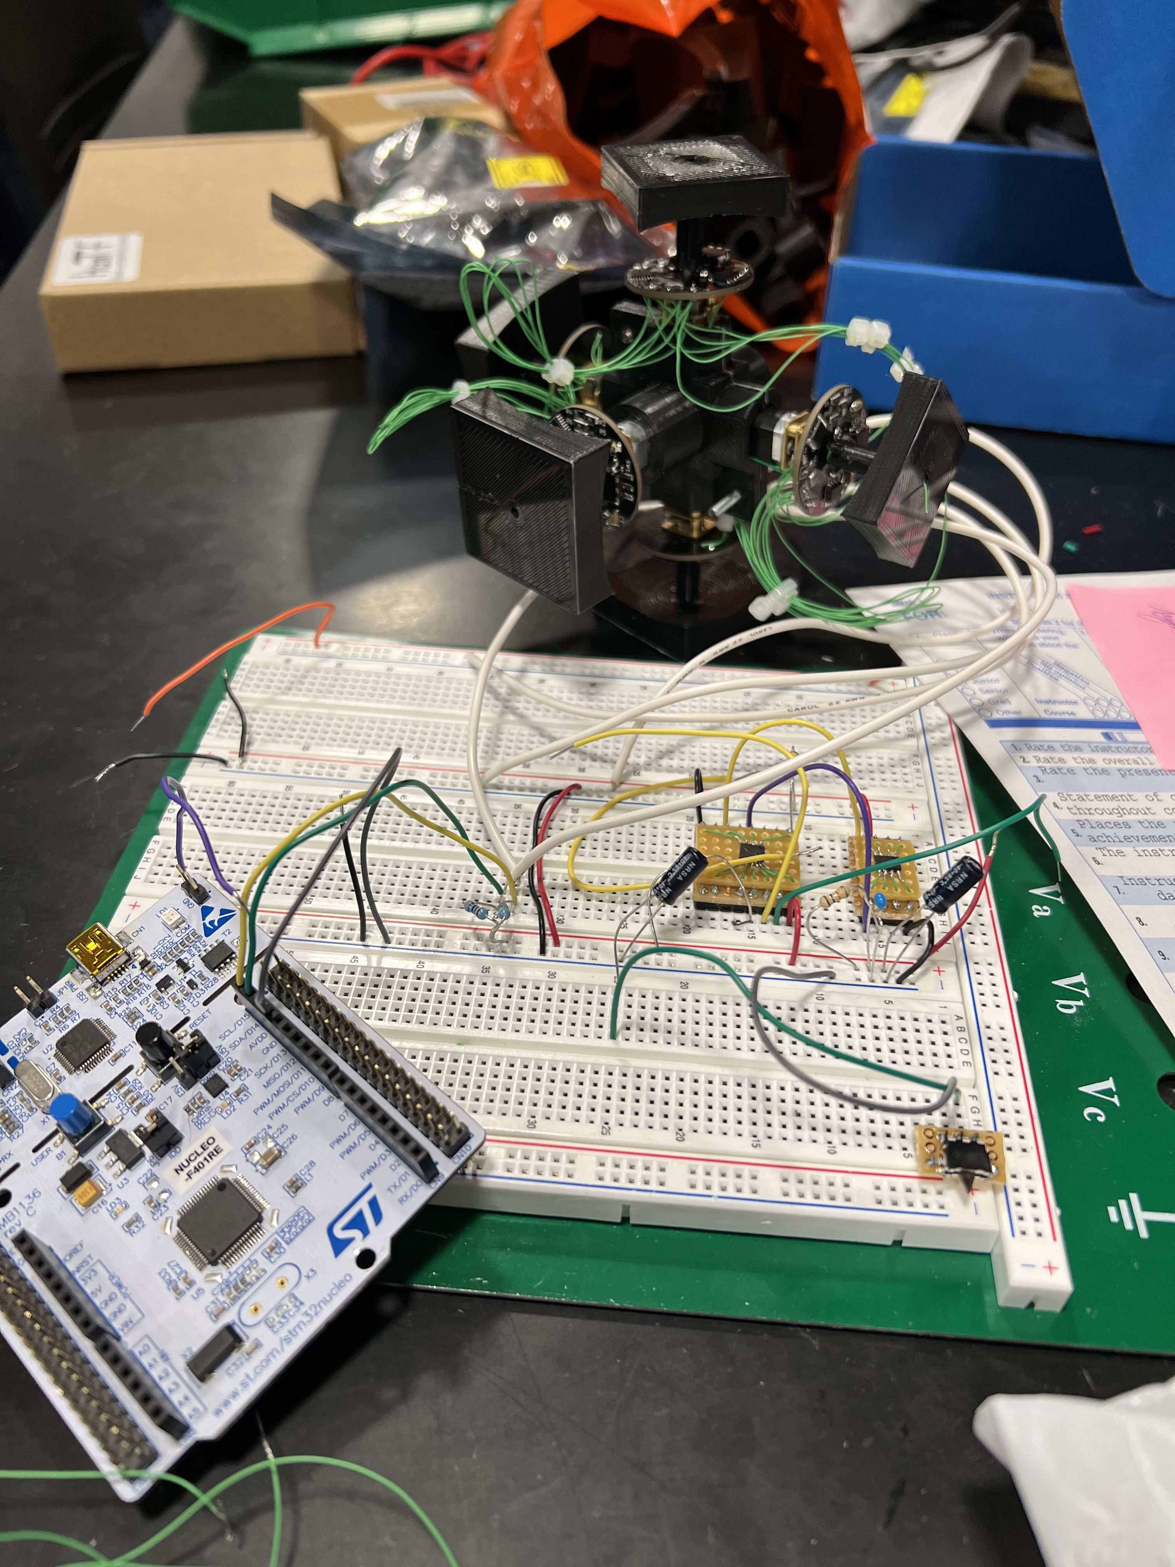
Prototyping Stage
Before designing your PCB, test your idea with discreate components and development boards.
Validate the functionality of your design before designing your PCB.
If your first PCB does not work, trouble shoot it (add, remove wires on your PCB) before refabricating.
Senior design projects, Fall 2022

Slide 4
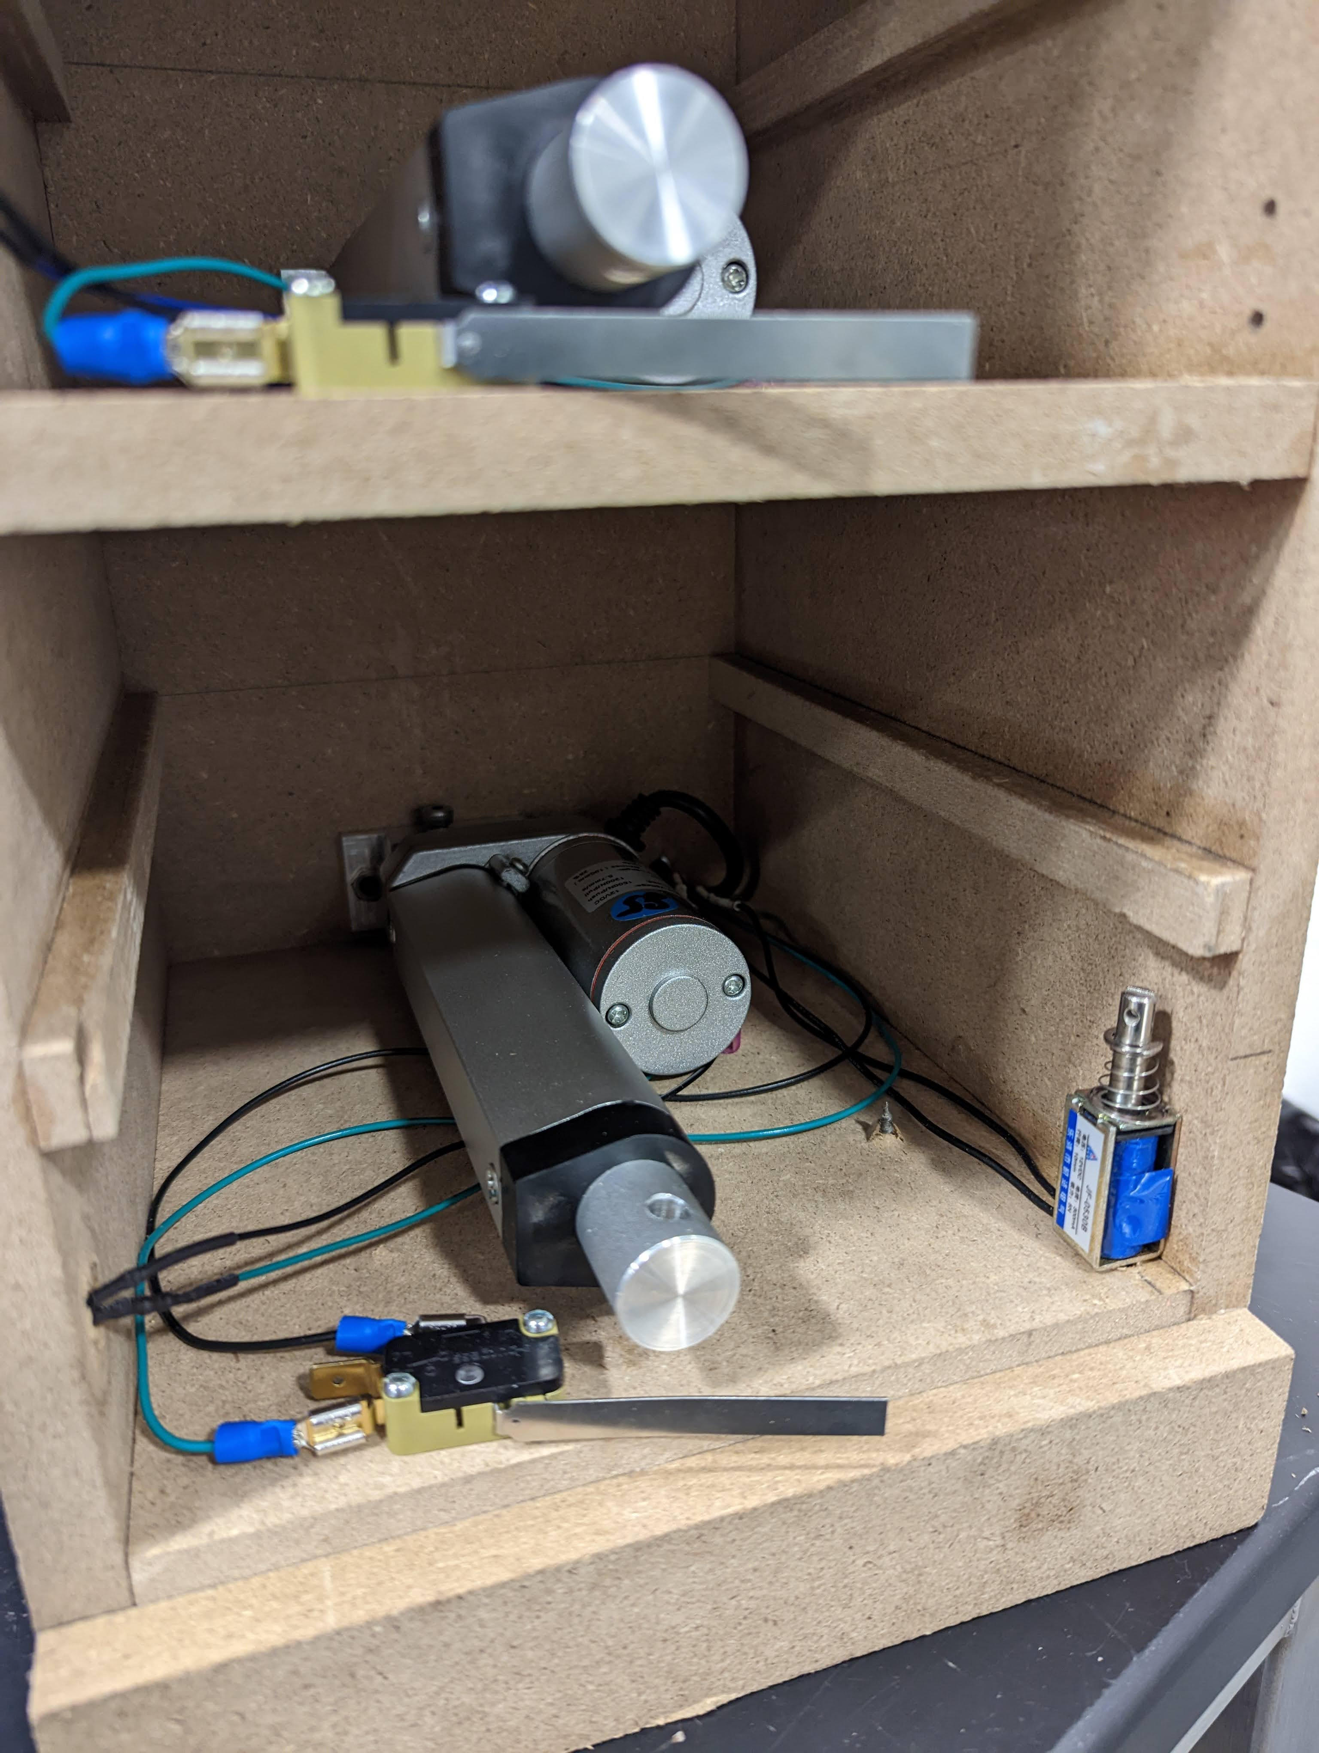
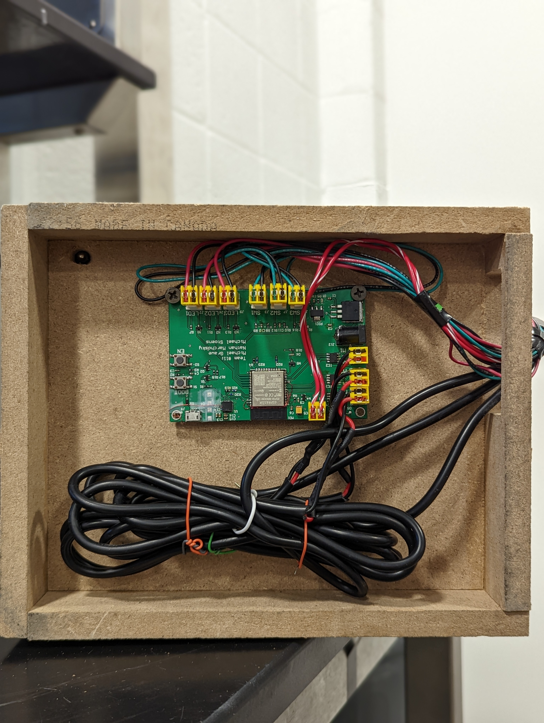
Designing your project with custom PCB
Final Project Demo
Motors and Sensors in each drawer
Custom PCB
Senior design project #11, Fall 2022

Slide 5
Single PCB board design
PCB board has the following parts:
Microcontroller
Microcontroller programmer (don’t forget it)
Power regulator circuits
Sensor (on a separate PCB)
Motor controller (h-bridge)
Buttons and LEDs
Pay attention to the size of the components (print your PCB on a paper)
Pay attention on the types of surface mounts pads
Senior design project #11, Fall 2022

Slide 6
Single PCB board design does and don’t
Very small resistors are very difficult to solder. Avoid them
Voltage regulator – large size which will be easy to solder
Creative debugging. You can remove (cut) and add wires on your PCB
Large connectors and wide wires are necessary for large current drives
Do not forget the programming circuit for your microcontroller
Microcontroller. Pins are on the side and about 1mm in size which will be easier to solder.
Senior design project #11, Fall 2022

Slide 7
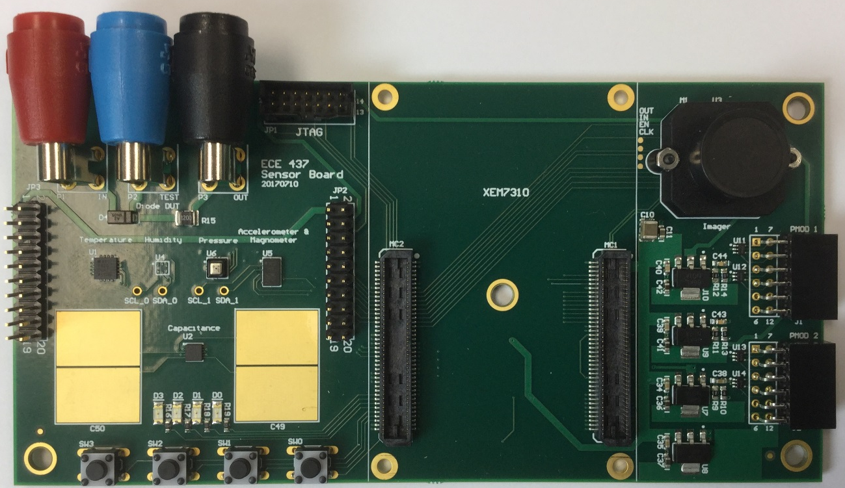
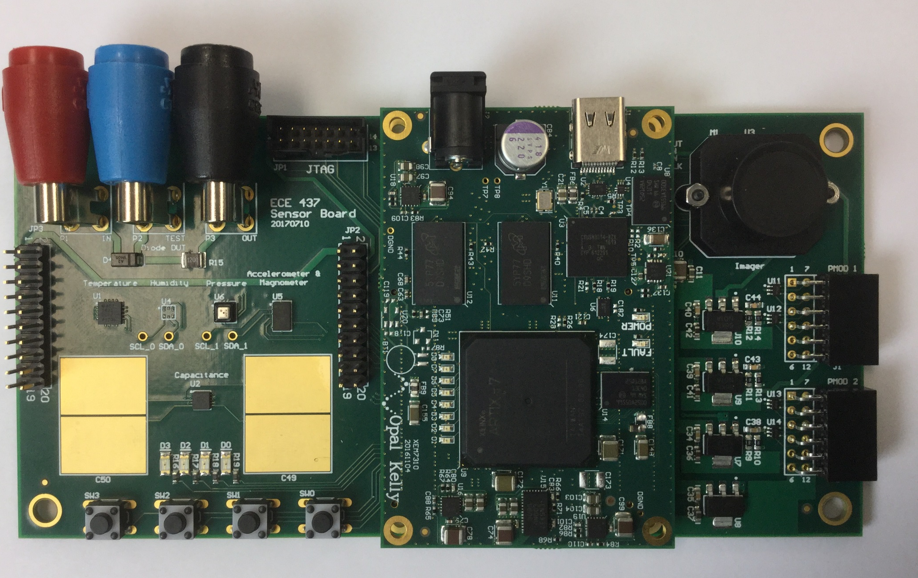
PCB board with Development Board Interface
ECE437 sensors board
camera
FPGA board
from OpalKelly
sensors
Connectors
to FPGA
Main PCB contains many components (sensors, camera, LEDs, buttons).
Main PCB should also contain a microcontroller.
Main PCB has to interface with your development board
In this example, FPGA dev board from OpalKelly is interface with a custom PCB.
The development can be used for image processing or more complex signal processing (for example, machine learning algorithms on FPGA such as mobile net.)

Slide 8
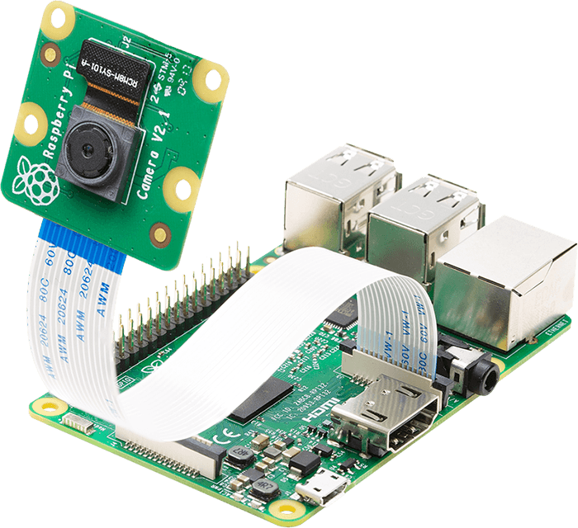
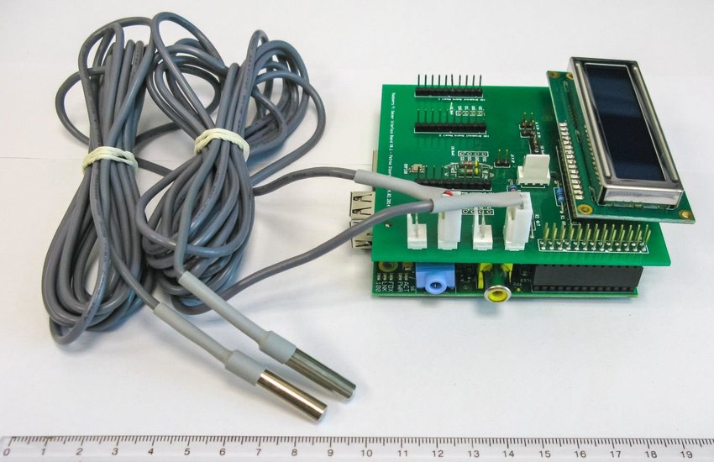
PCB board with Development Board Interface
researchgate.com
arducam.com
Main PCB has an interface with Raspberry PI and display monitor (left image).
You can use Raspberry PI with camera (right image) but you will need a main PCB that interface with the Raspberry PI and has microcontroller.
Main PCB contains many components (sensors, camera, LEDs, buttons).
Main PCB should also contain a microcontroller.

