Slide 1
UIUC ECE445 Project Idea Fall 2023
Corey Wilner – Infineon Fellow FAE
Patrick Kane – Director, Infineon University Alliance

Slide 2
Another Robot Idea! (See Fall 2016 Sr Design Instructor‘s Award Winner)
In 2016, Cypress (now an Infineon company) wanted to build a Robot Kit for hobbyists that illustrated the capabilities of the Cypress PSoC processor
In 2023, now that Cypress is part of Infineon, there is more content that can be provided by Infineon and its multiple divisions. And newer PSoC’s!
Project Goal for 2023:
Develop a robot that can be used in the Infineon University Alliance Program as a demo at events or to encourage other Universities to teach basic electronics and programming skills.
Robot could also be used at trade shows to illustrate the many products that Infineon designs and sells
Student groups could start with a Robot kit available from Amazon and build all the electronics and programming on the wheel/motor base.
Or, students could build their own wheel/motor base and completely “roll your own”

Slide 3
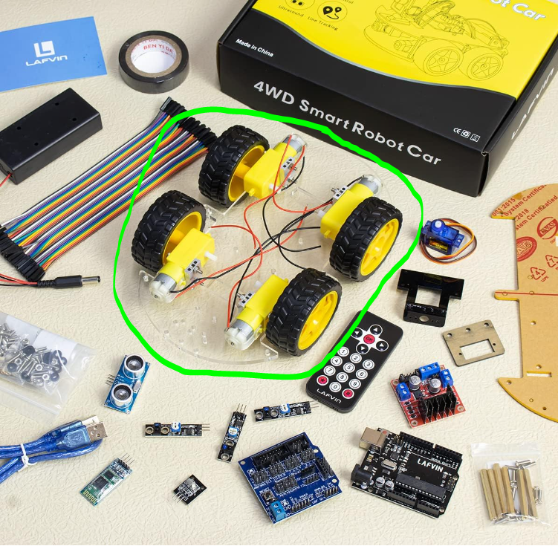
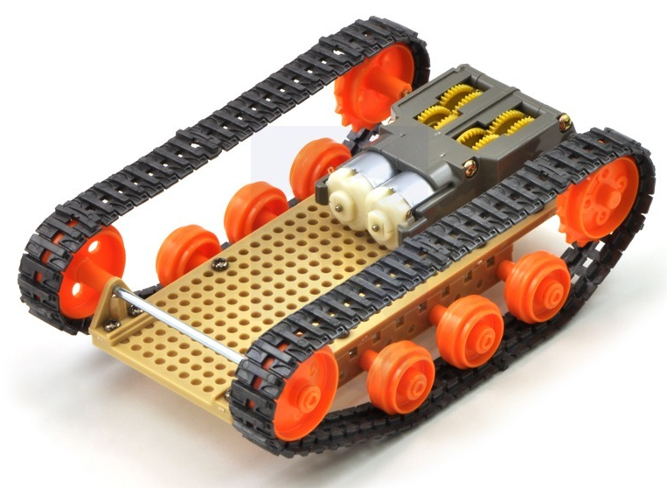
Example Motor/Wheel bases
Smart Robot Car Kit: https://a.co/d/cFoK95p
Only use the circled item as starting point
Tamiya Track and Wheel Set
Tamiya Universal Plate Set
Tamiya Twin-motor gearbox kit

Slide 4
Robot Requirements
Utilize Infineon PSoC 6 microcontroller
Develop your program with ModusToolbox™
Provide local voice control through Machine Learning
Use Infineon MEMS microphones
Use Imagimob (an Infineon ML company) to develop model to recognize keywords
Commands could be: “fast” “slow” “stop” “right” “reverse” etc.
Obstacle avoidance using Infineon 60GHz Radar modules
Example software available on Infineon GitHub
Motor control of the 2-4 motors on the kit
Use Infineon transistors for motor drive, magnetic speed sensors for control feedback
Control algorithms in the PSoC 6
Line following with optical sensing
Non-Infineon, many options are available on-line
Power Supply – onboard batteries, rechargeable preferred.
Use Infineon power products as much as possible
Most are for automotive applications

Slide 5
Bonus Optional Features
Additional “override” control from a phone
Use an Infineon Bluetooth Low Energy uC for communication
CO2 detection using Infineon CO2 detector module
Robot can check for a hazardous environment
Print your own 3D platform for the wheel base/motor housing
…and any other custom pieces
Would allow Infineon to put your design on the Infineon maker web page as a complete project
A different type of robot – does not have to be a vehicle
Must contain local voice control
Must contain motor control
Must have a practical use for the radar module
Propose an idea for approval by Infineon and the course instructors

Slide 6
Notes
If you want to use one of the Infineon Development or Evaluation kits as your microcontroller base, this would be acceptable.
Your electronics on top of the base would have to be your own PCB (I believe this is a course requirement)
Let us know (Corey and Patrick) your BOM ASAP so we can get the parts you need delivered
corey.wilner@infineon.com
patrick.kane@infineon.com

