Slide 1
ECE 445 Fall 2023: Lecture 1
Prof. Arne Fliflet (afliflet@illinois.edu)
Prof. Olga Mironenko (olgamiro@illinois.edu)
Prof. Victoria Shao (yangshao@illinois.edu)
Head TA: Jason Paximadas (jop2@illinois.edu)
Notes:
ECE Main Slide

Slide 2
Today’s Agenda
4:00 Welcome and Overview
4:20 Conflict Management Workshop
5:00 Break
5:05 RFA
5:25 Brainstorming

Slide 3
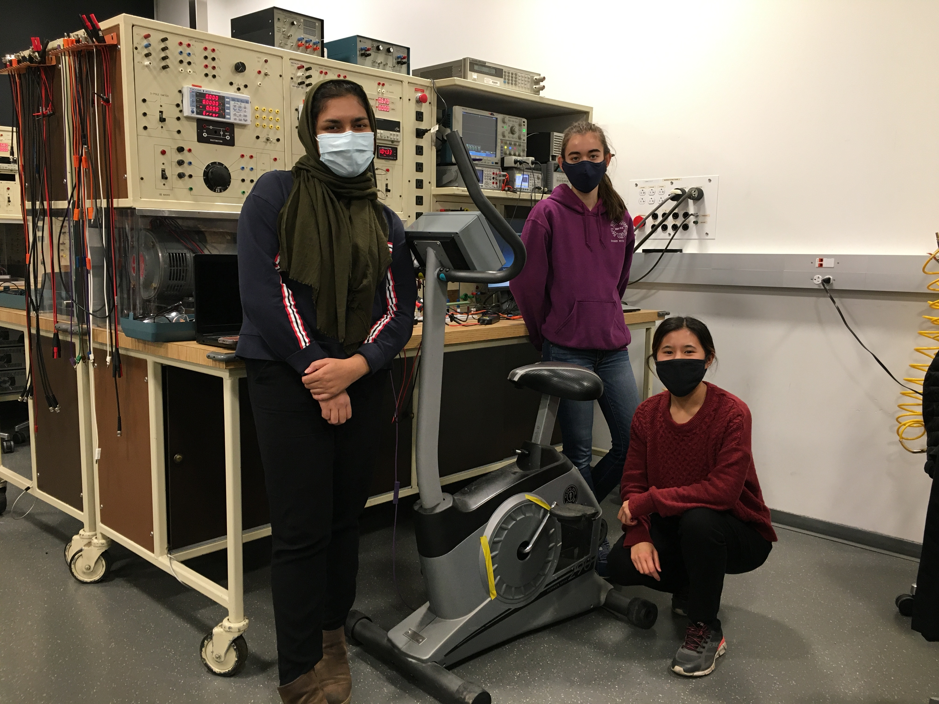
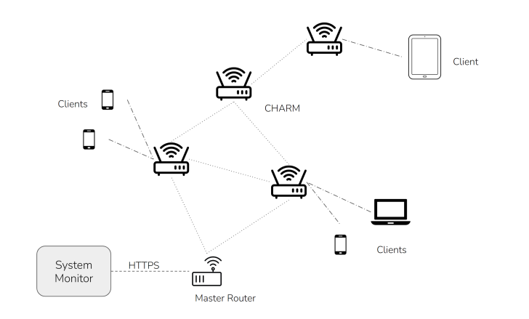
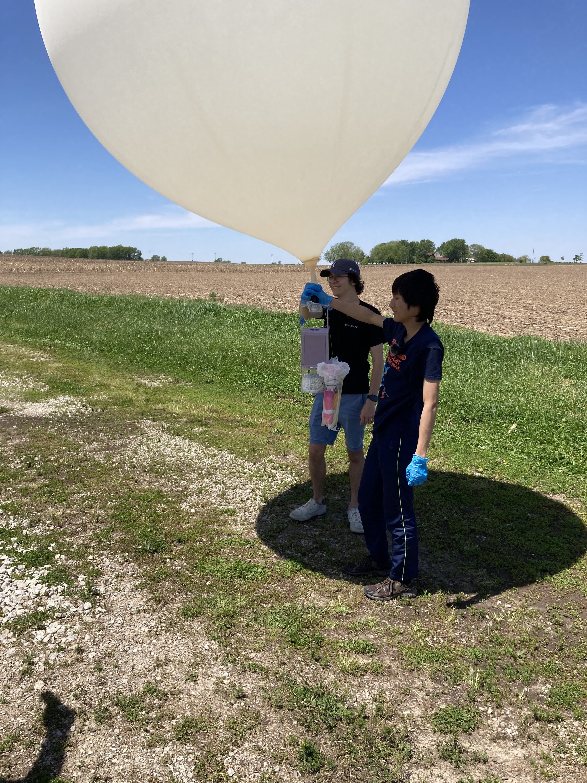
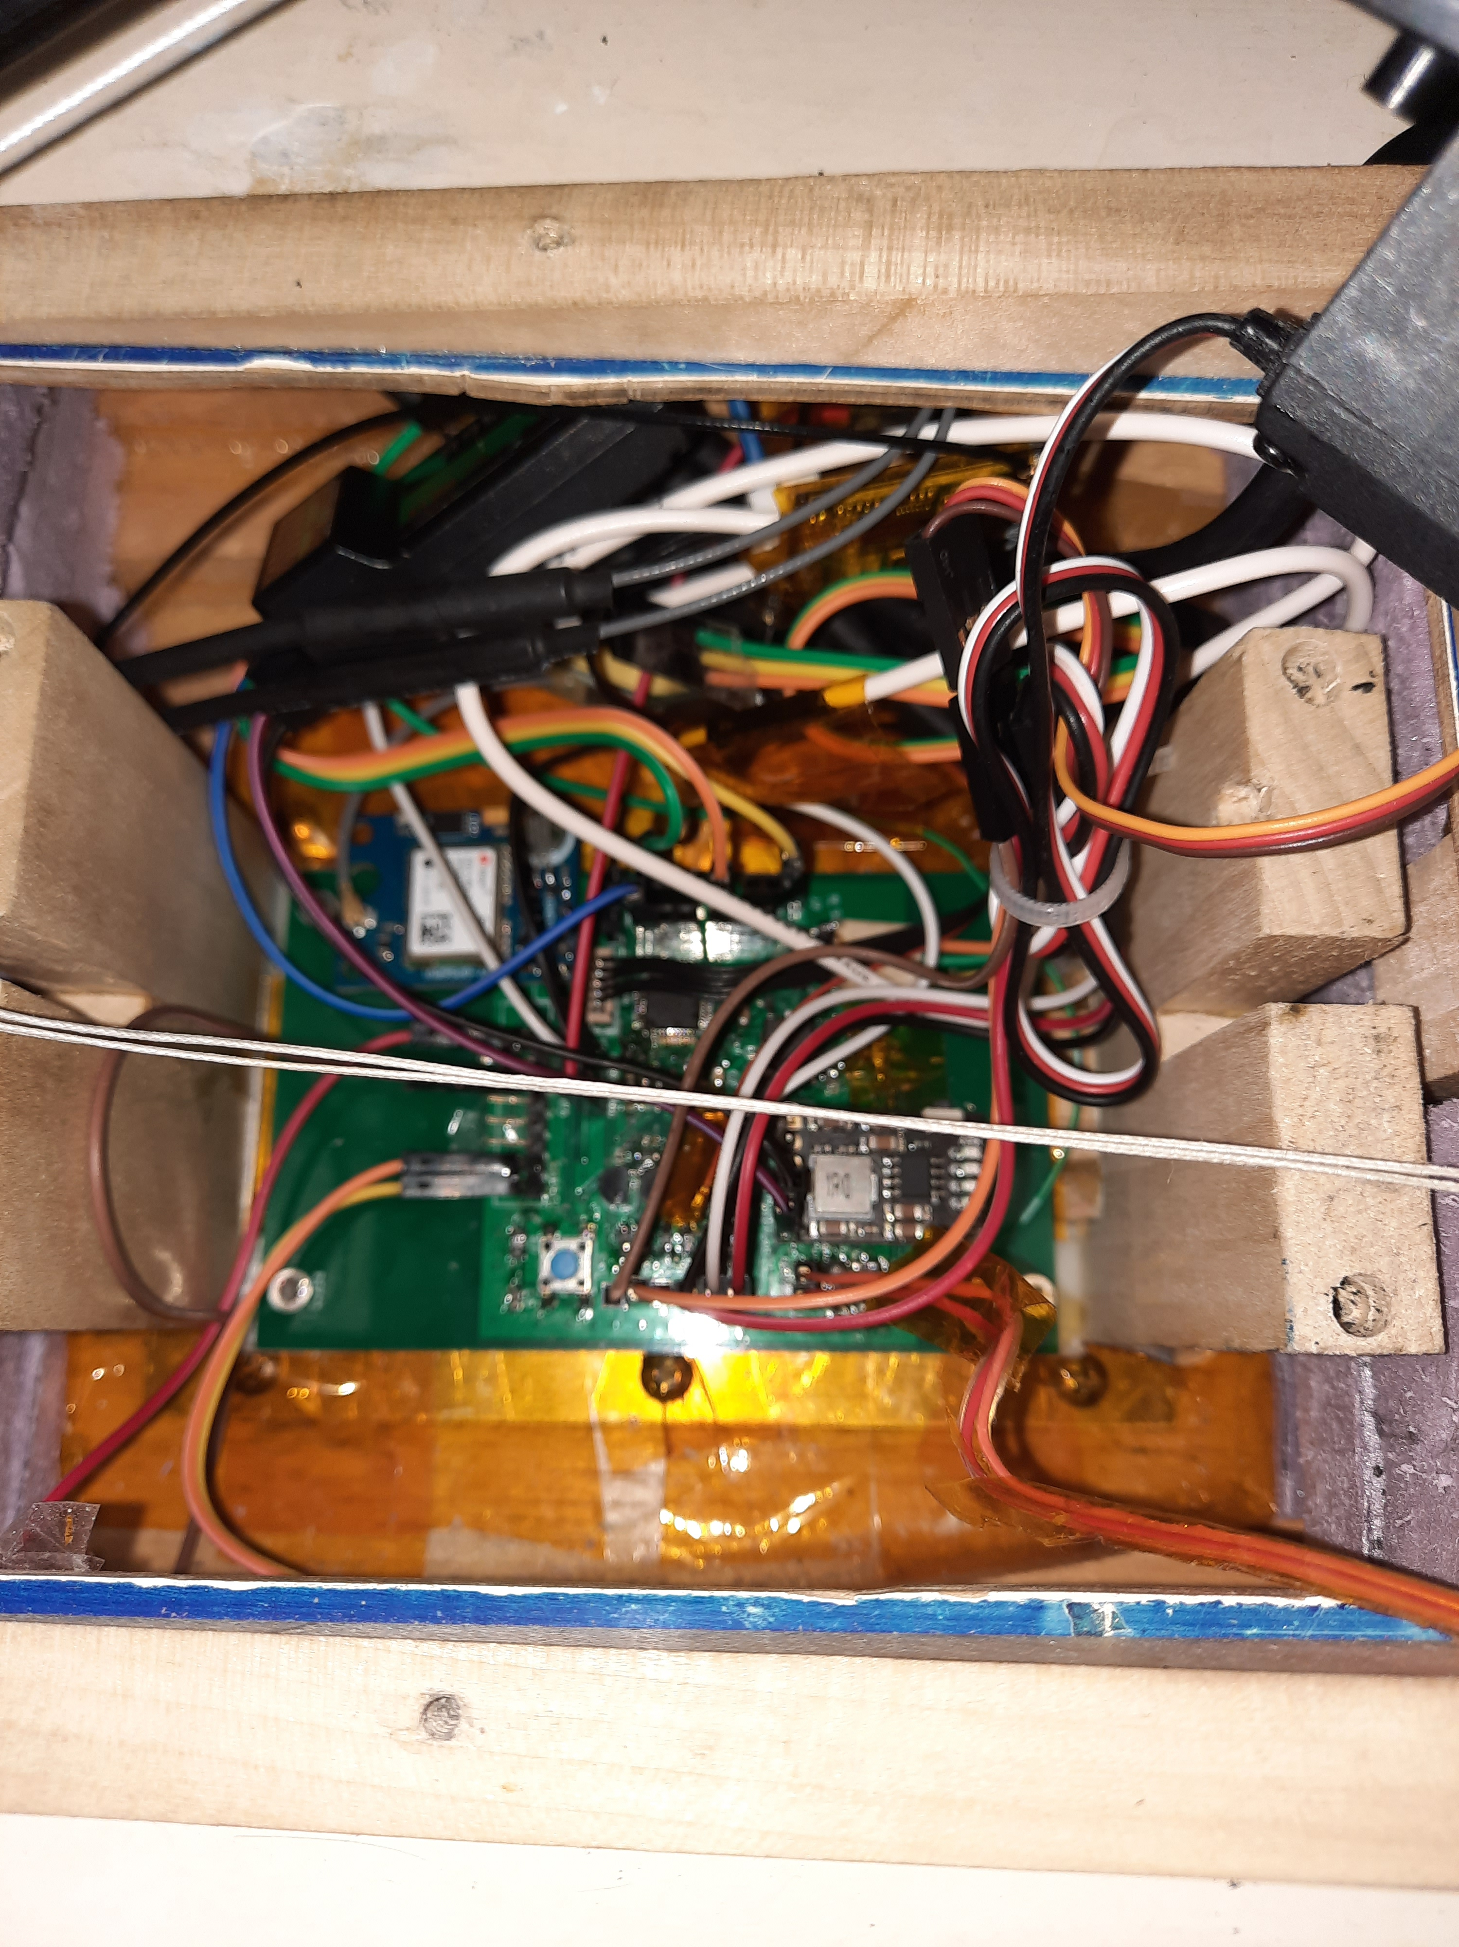
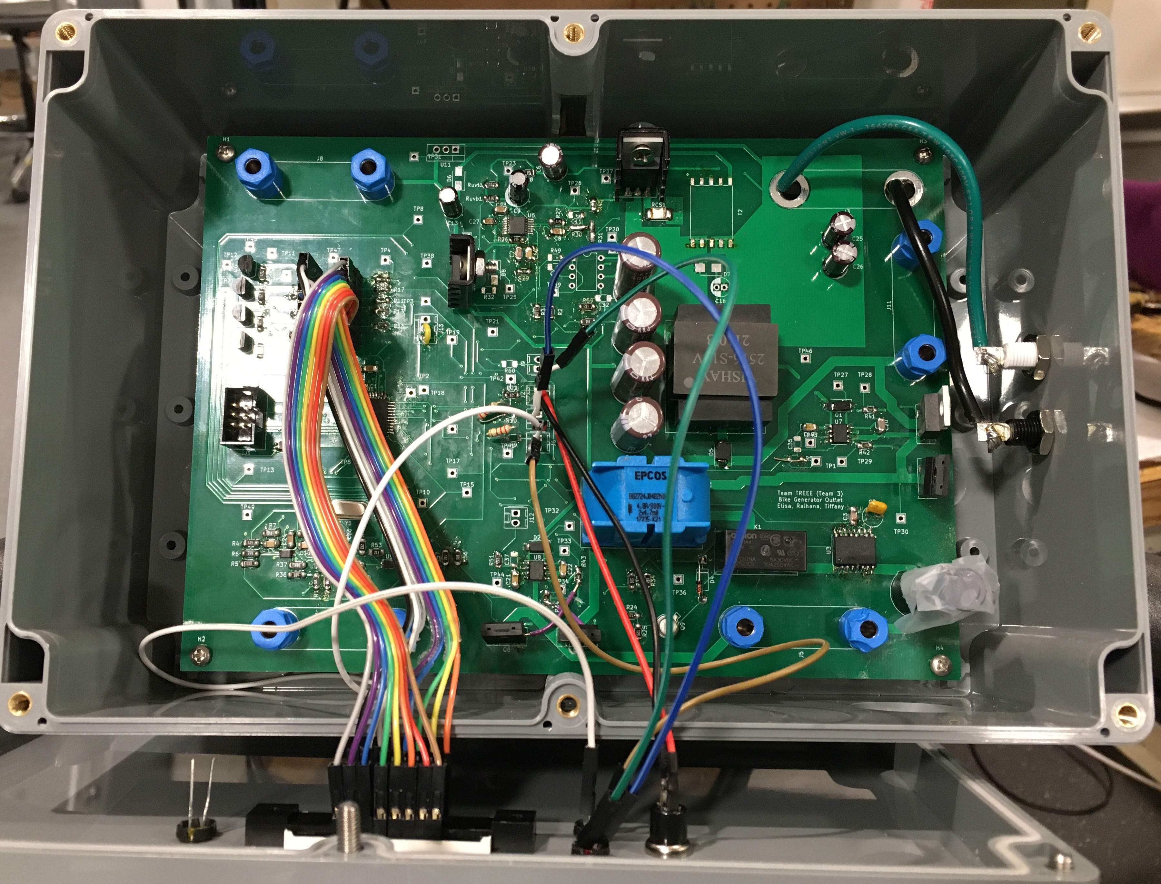
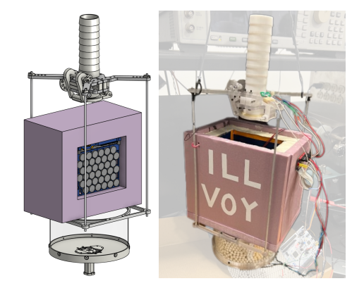
Introduction
Welcome to ECE 445, Senior Design Project Laboratory, the department’s capstone course
We expect you to carry out projects that are unique, technically challenging, and completable within the semester.
Illini Voyager (SP23)
CHARM (FA22)
Autonomous Sailboat (SP22)
Grid-tied Spin Bike (FA21)
Notes:
A capstone course means it is a demonstration of your newly acquired capabilities as electrical and computer engineers
Think about the courses you found particularly interesting
How could the material be used to solve an interesting problem?
We want you to come up with novel solutions to problems
There needs to be a sufficient amount of complexity
Here has to be an EE element to the project
Project needs to be compatible with time and resource constraints
We fully expect that you will undertake challenging projects
One of the best parts of teaching this course comes at the end when we have to decide on which are the best projects

Slide 4
Staff and Support Structure
Each project will have three students, one TA, and one instructor
Project teams meet weekly with their TA – the TA is the primary guide and point of contact for your project
Instructors
Professors Arne Fliflet, Olga Mironenko, and Victoria Shao
TAs
Jason Paximadas (Head TA), Nikhil Arora, Sainath Barbhai, Jeff Chang, Stasiu Chyzewski, Zicheng Ma, Abhisheka Marthur Sekar, David Null, Sanjana Pingali, Jason Zhang, Jialing Zhang, Tianxiang Zheng
Mentors
Jack Blevins
Course Directors
Professors Rakesh Kumar and Michael Oelze

Slide 5
Course Overview
Project Identification and team formation (weeks 1-3)
Form three-person teams
Propose project ideas on the web board and discuss. Ideas may be original or from project pitches.
Make a Request For Approval (RFA)
Project Design (weeks 4-6)
Teams with approved projects meet with TA and begin working on project Proposal and Design Document
Project teams present Design Document at Design Review and receive final project go-ahead.
Project fabrication, testing and analysis (weeks 7-14)
Part procurement, circuit simulation, breadboard testing, programming
PCB design and procurement
Final weeks involve system integration and testing of project device
Demo, Final Presentation and Final Report (weeks 15-16)

Slide 6
Getting a Project Approved (weeks 1-3)
The first student to post an idea is the owner of that idea
Doesn’t apply to pitched projects
An RFA must conform to a specific format
Project ideas should:
address a new problem or be a new approach
include a microprocessor on a custom printed circuit board
be completable within the time-constraints of the course
Notes:
Put words into flow chart
Add text about pitch project, students should individually reach out to pitcher
First-come first serve for projects on web board
Add text about using development board

Slide 7
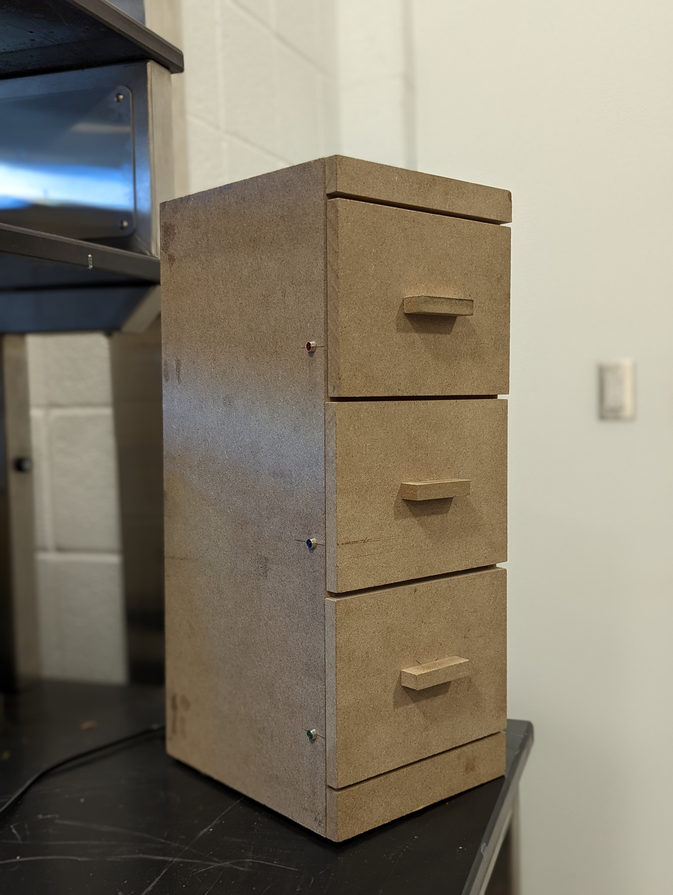
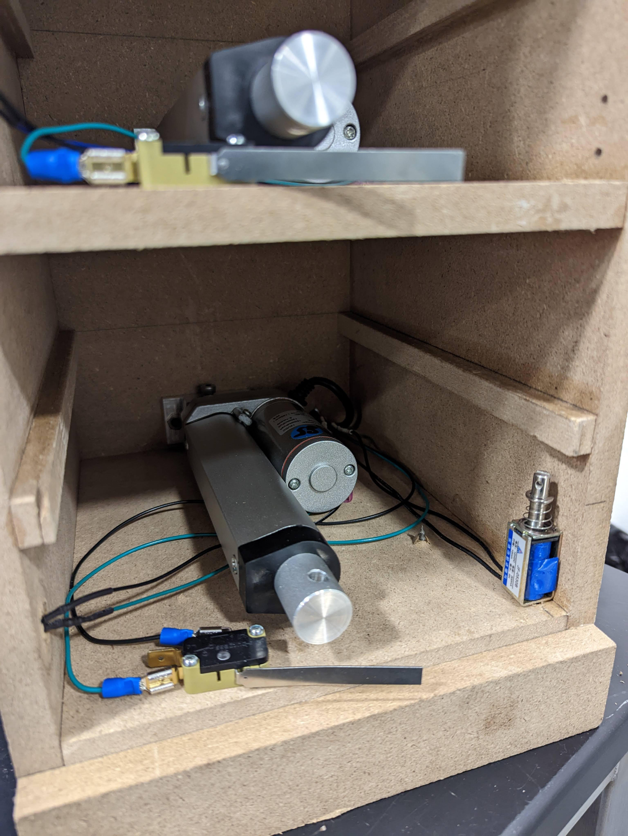
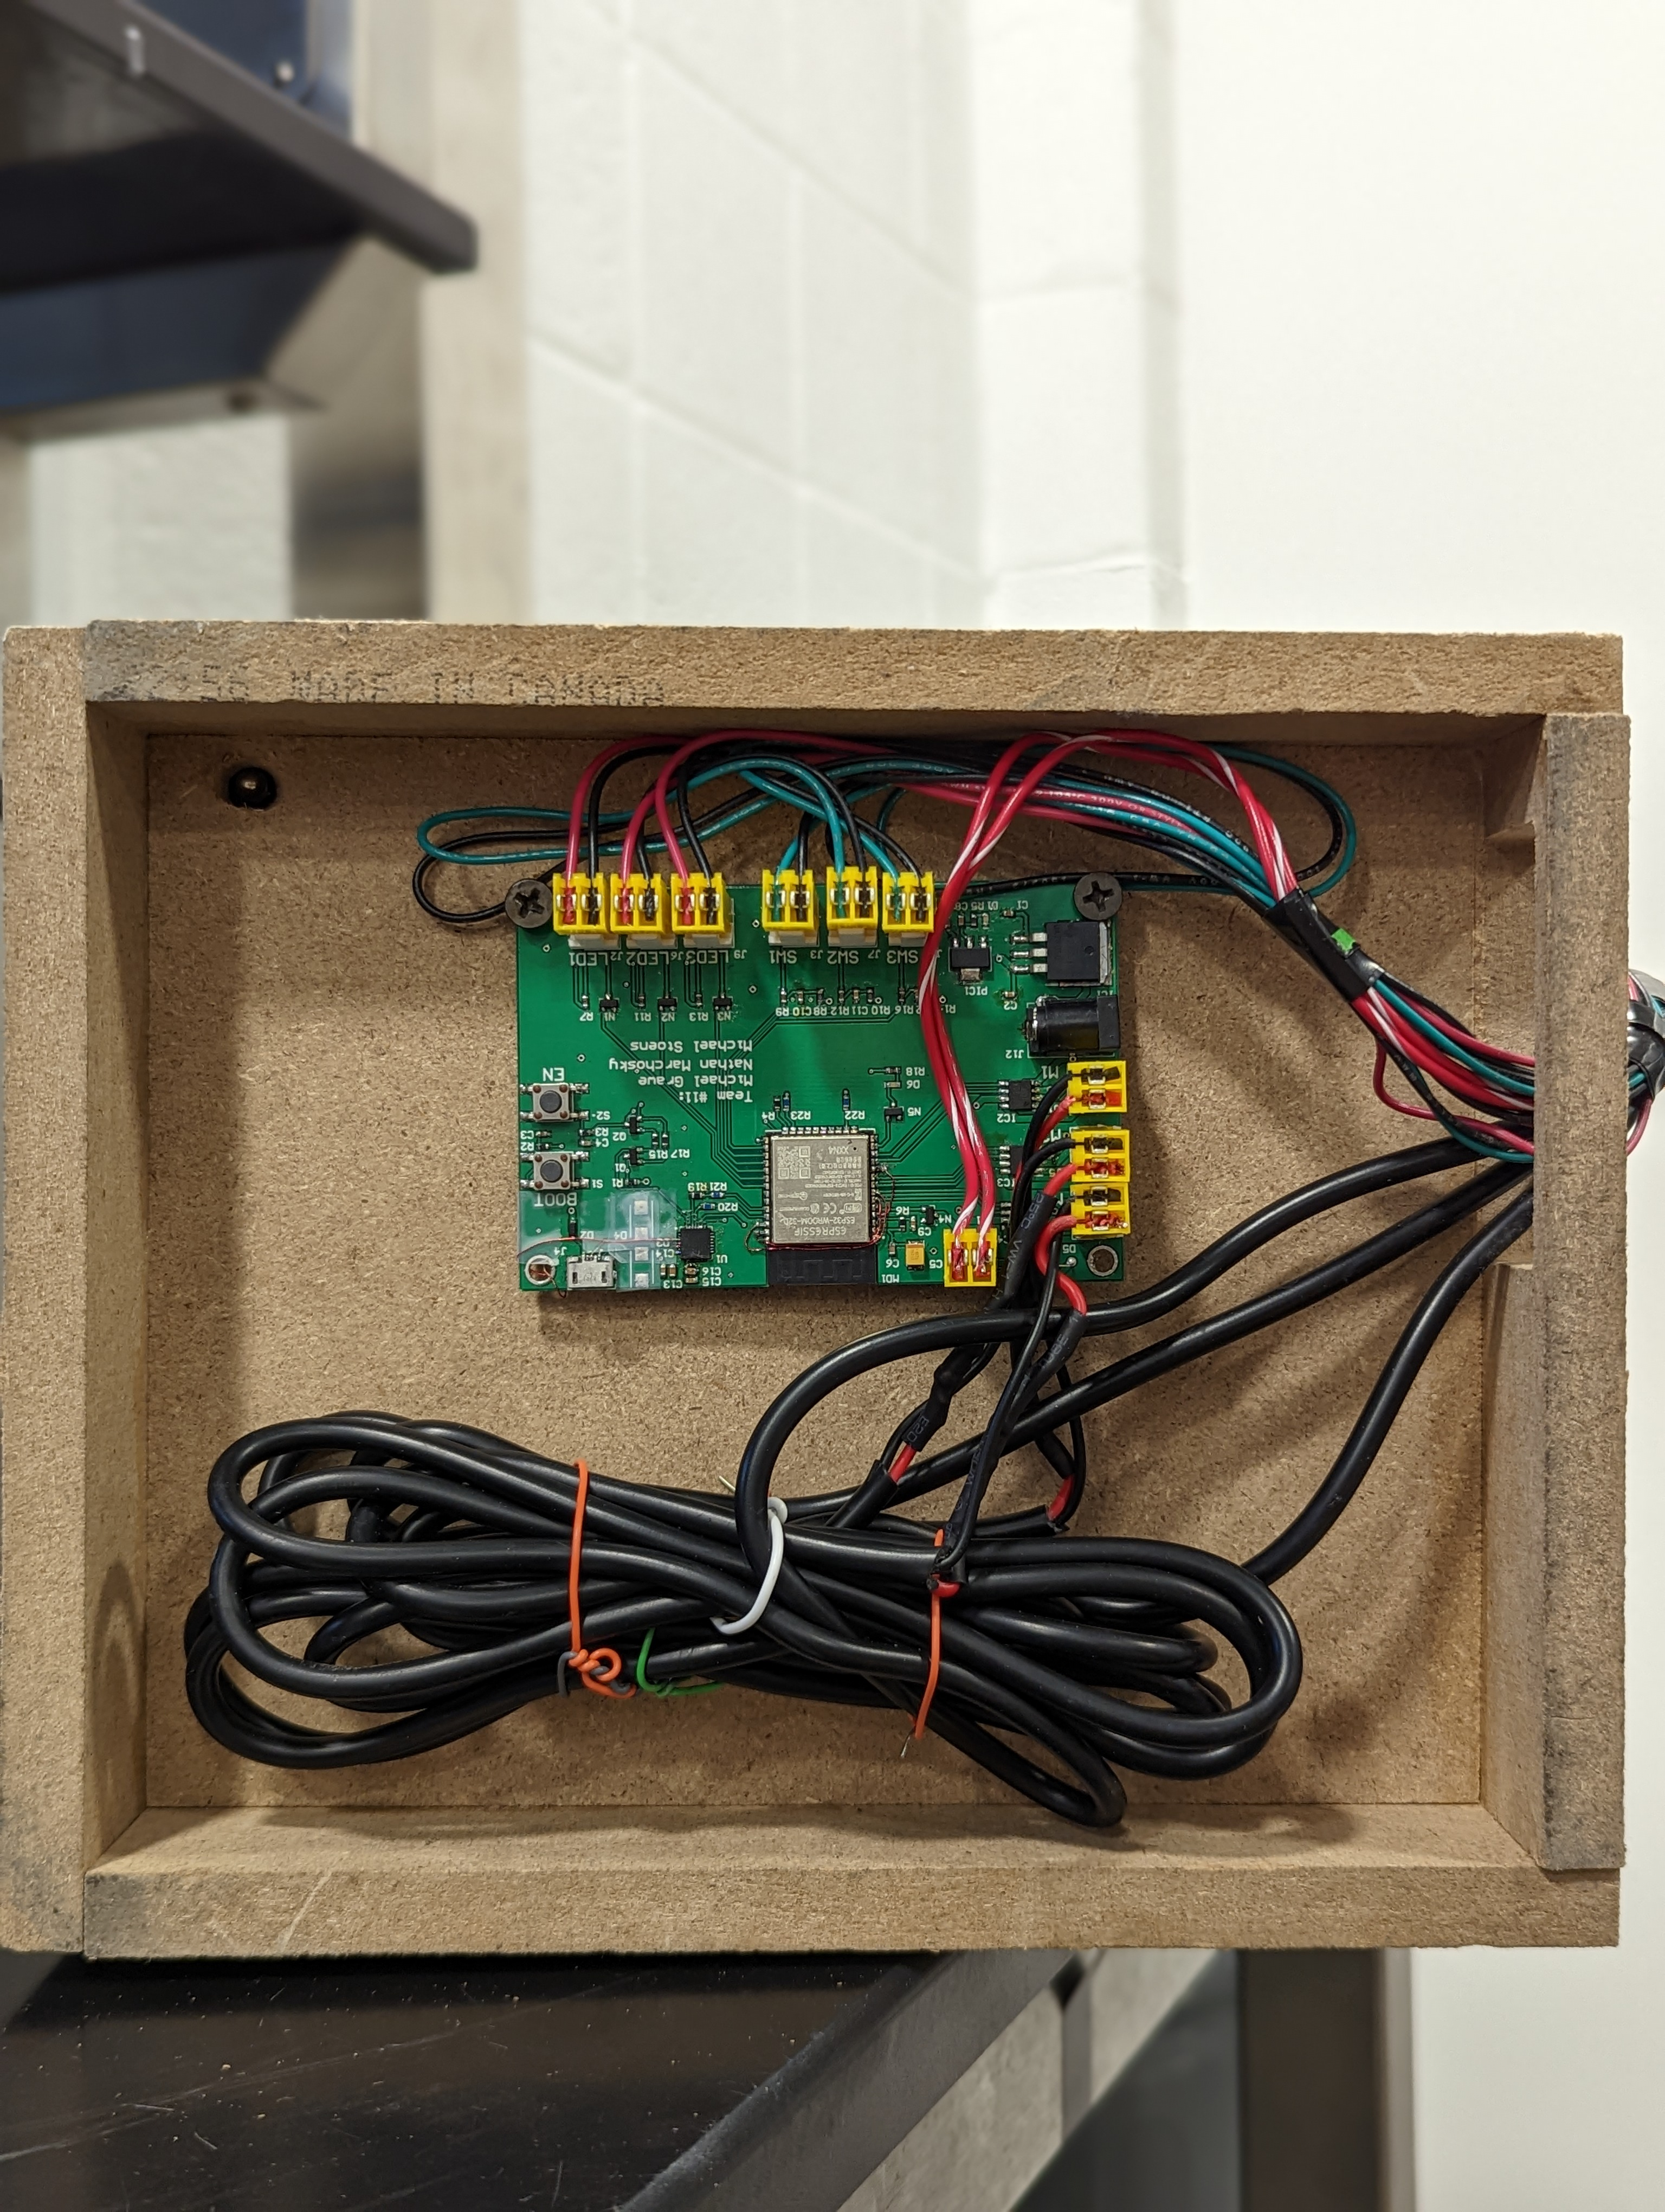
Example Project: Electronic Drawer Organization System
This project was novel, included a custom PCB with a microcontroller, and was completable within the time constraints of the course.
Notes:
Point out machine shop as a resource. Keep physical design simple

Slide 8
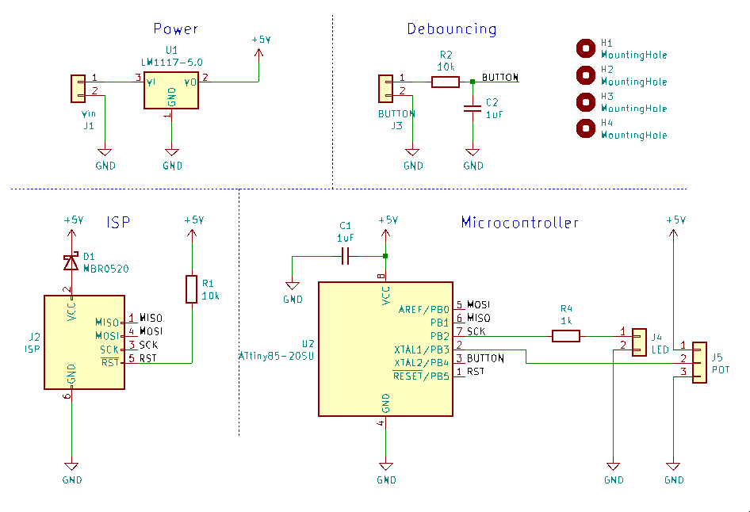
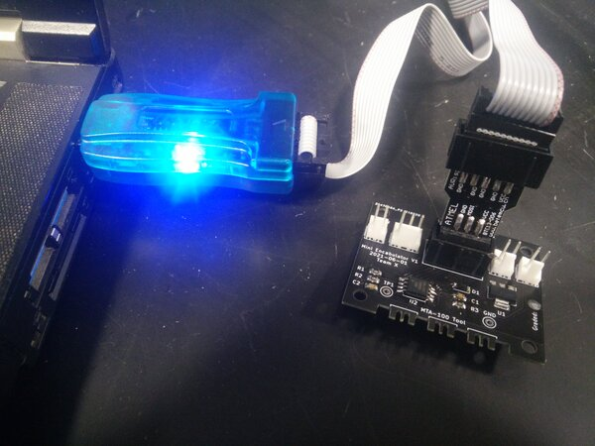
PCB Training (weeks 1-3)
CAD Assignment
Due 9/1
Schematic capture and PCB design with KiCAD
Turn in design files
Soldering Assignment
Due 9/8
Solder THT and SMD parts onto a circuit board
Program a microcontroller
Demonstrate functionality in lab
Notes:
Add due dates
Make pictures bigger, remove words
Add line about utility of these assignments

Slide 9
Project Proposal and Design Document (weeks 4-6)
The sooner your project is approved, the sooner you can begin the design process
The process begins with the Project Proposal
Objective and Background
High-level requirements
Description of design - block diagram, major components
Ethics and safety
The Design Document is an instruction manual for your project
Schematics
Tolerance Analysis
Requirements and Verifications
Define what a successful demo looks like
Etc.
The Design Document is the subject of the Design Review
Notes:
Shorten and update website. Find examples online

Slide 10
Building and Testing (weeks 7-14)
The next 8 weeks are devoted to building and testing your project device
Work in accordance with the schedule laid out in your DR along with guidance from TA’s and professors
Order parts early including spares and begin breadboarding
Make contact with machine shop but keep mechanical design simple
Develop MCU software in parallel with hardware
Finalize circuits and design PCB
Work on tolerance analysis
Identify problems early, make adjustments
Get your PCB ready in time for first-round PCBway order
Integrate subsystems to obtain final product

Slide 11
Demonstration, Final Presentation and Report
Week 15: Demonstrate a fully functioning prototype to your Professor, some TA’s, and other students
This should be the highlight of your course experience
Week 16: Give a formal presentation on your project and submit Final Report
A one-minute project video can be submitted for extra credit
The best projects may win awards.
Students own IP of student-originated projects
Sponsors generally own IP of pitched projects
Main course goal is a successful project experience

Slide 12
Advanced Composition Requirement
To satisfy this requirement the course includes a significant amount of technical writing
The course is designed to help you write polished reports, journal articles, and proposals to funding agencies, etc.
The main documents are the proposal, design document, and final report
You will have the opportunity to rewrite the proposal and design document after the initial grading to earn additional points
The final report will graded on composition by the editorial staff
Maintaining a lab notebook during your project is another important course requirement
Notes:
Mention chance to rewrite documents.
You can get all points back.
Link to rubrics.

Slide 13
Teamwork
Each team member is equally responsible for a successful project
Team member task assignment should recognize that each team member brings a unique skillset and perspectives to the project
Teams will make a “team contract” similar to the one in ECE 110
Team contract will include
Expectations for each member
Roles for each member
Who will set the agenda
Process and penalties for dealing with team issues
Agreement on using final peer assessment for grade adjustment
Team members will evaluate each other’s success in contributing to the project based on expectations at the end of the course
Predicated on giving team members the benefit of the doubt and the opportunity to explain themselves when issues arise
Notes:
Replace with team contract slide

Slide 14
How to succeed in ECE 445
Get familiar with the course web site and watch the videos
RFA, project proposal, lab notebook, modular design, ethics, ...
Use course calendar to anticipate deadlines
Understand the grading process – 21 grades large and small
Design Review, lab book, demo, final presentation & report
Two-part soldering assignment
Team evaluation, individual progress report, peer reviews
Focus initially on getting a project approved
Participate in web board discussions
Can’t find a project?
Respond to project pitches
Look for teams needing complementary expertise
Notes:
Revise power project list

Slide 15
How to succeed in ECE 445, continued
Work with your teammates to build a strong team
Hold regular meetings
Communicate and be transparent with your teammates and TA
Discuss problems as soon as they arise
Spend time frequently documenting your work in your lab notebook
Get help solving problems - a lot of expertise is available
Keep the project moving during the build and test phases

Slide 16
Summary
Due dates (on calendar)
Web board post 8/24
Upload Safety Training to Canvas 8/30 (grants lab access)
CAD assignment 9/1
RFA 9/7
Soldering assignment 9/8 (requires lab access)
This course is like an express train that is now leaving the station

Slide 17
Notes:
Text is too small. Incorporate into flow

