Slide 1
Conflict Management Styles
Prof. Olga Mironenko
Department of Electrical and Computer Engineering
Fall 2023
Adopted from the Conflict Management Workshop ASEE 2023, Engineering Team Dynamics, Department of Engineering Education, Virginia Tech
https://www.engineeringteamdynamics.com/research

Slide 2
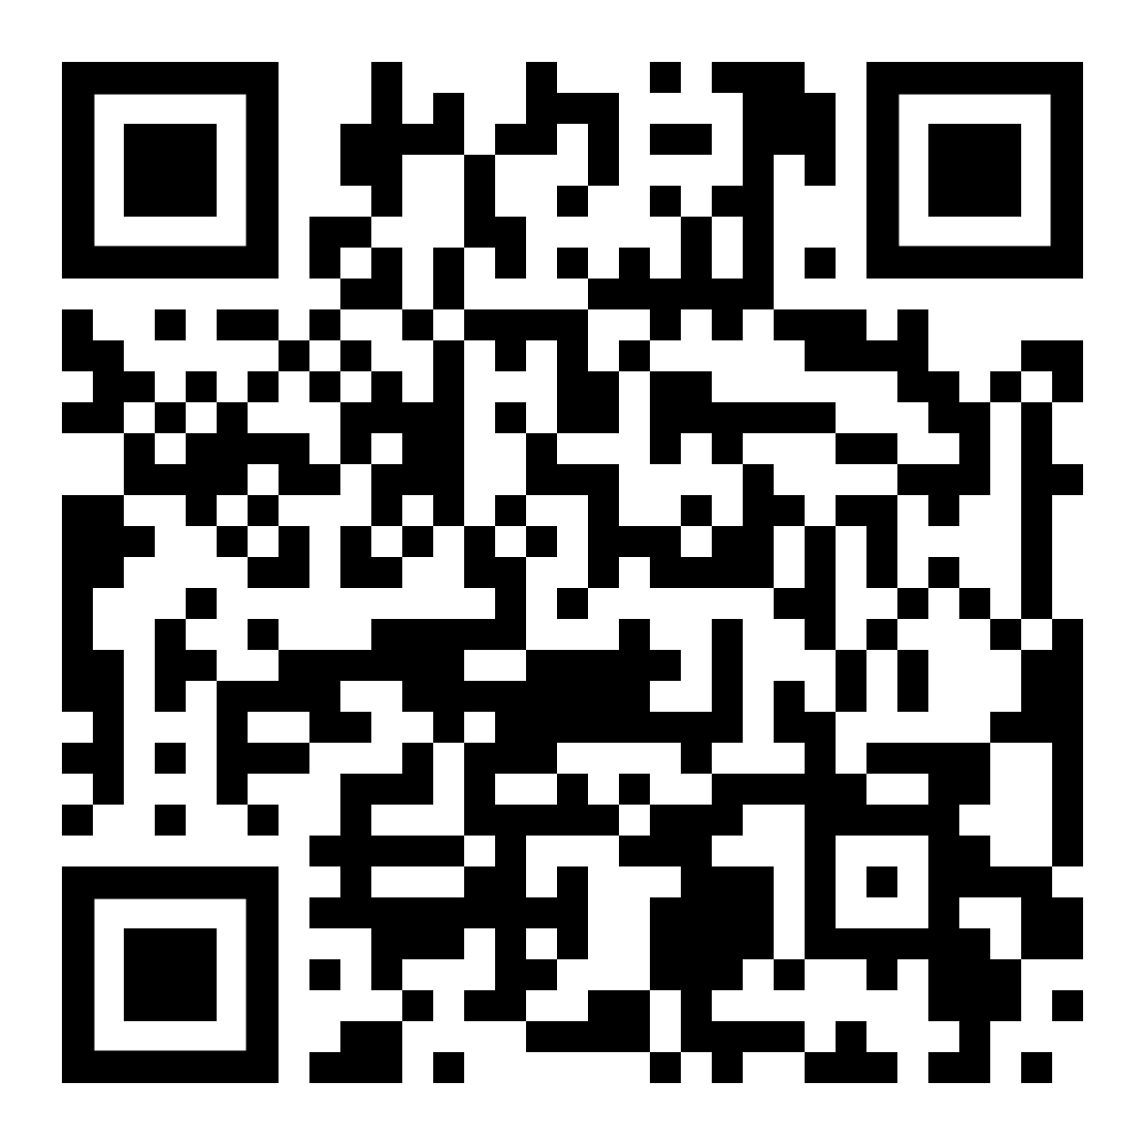
Complete the following survey online:
https://tinyurl.com/dutch2023
If you have any needs in viewing or participating in this workshop, please let us know

Slide 4
An Overview of the Conflict Management Styles from Self-Assessment: Dutch Test for Conflict Handling

Slide 5
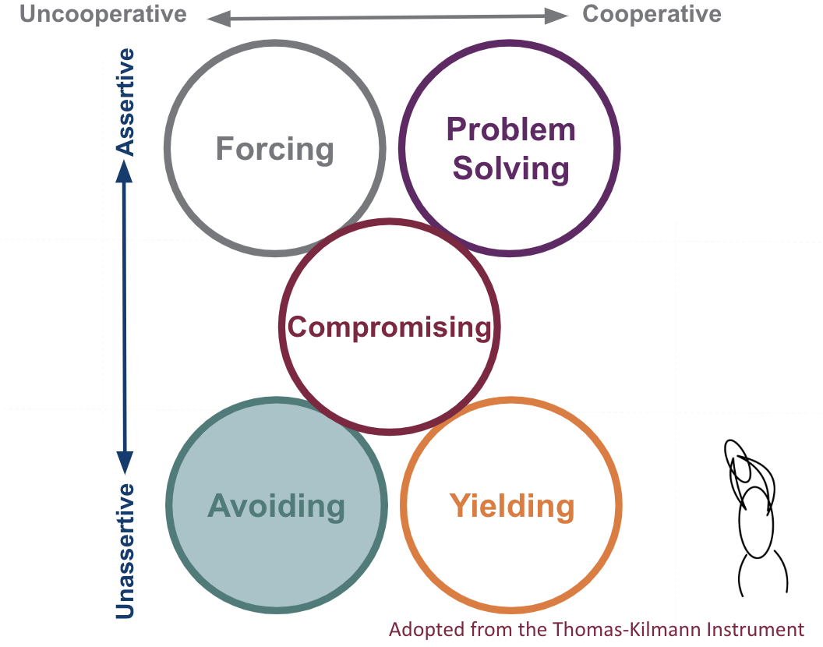
Avoiding
Avoiding tries to smooth over or avoid conflict situations altogether. It represents a low concern for both self and the other party. In other words, avoiders try to suppress thinking about the conflict.
Ex: This style may be used when a member of your team is also one of your roommates. Keeping the peace is more important than the disagreement.

Slide 6
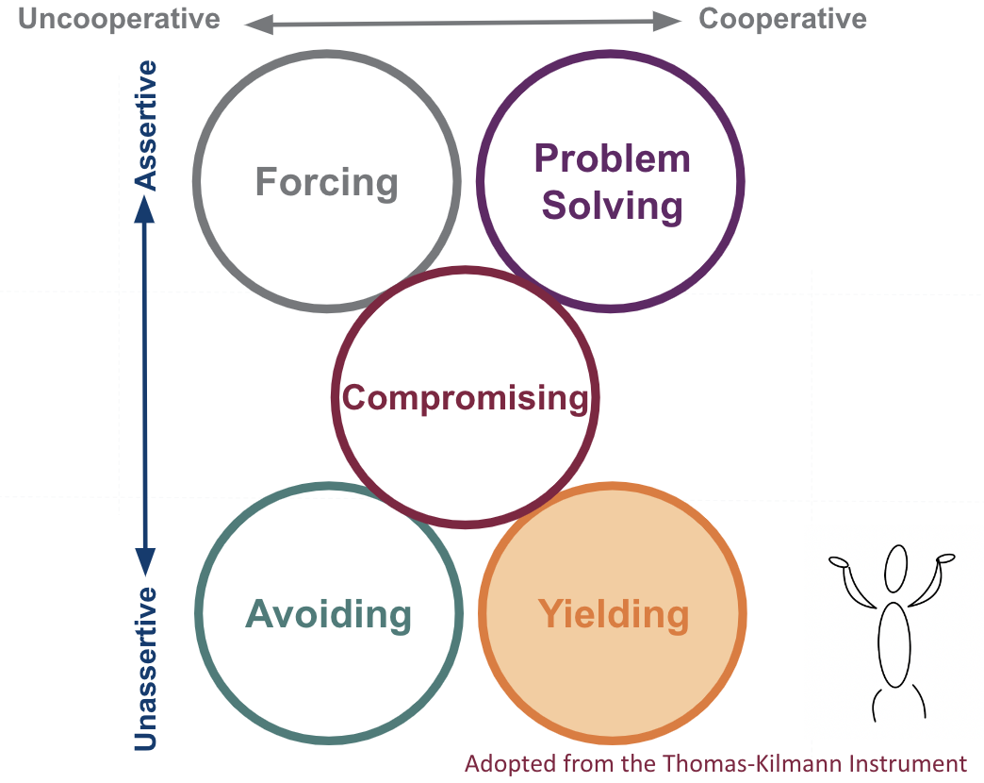
Yielding
Yielding involves giving in completely to the other side's wishes, or at least cooperating with little or no attention to your own interests. This style involves making unilateral concessions, unconditional promises, and offering help with no expectation of reciprocal help.
Ex: This style may be used when a team member of a different expertise area needs to make a decision that is vital to their tasks but does not affect yours.

Slide 7
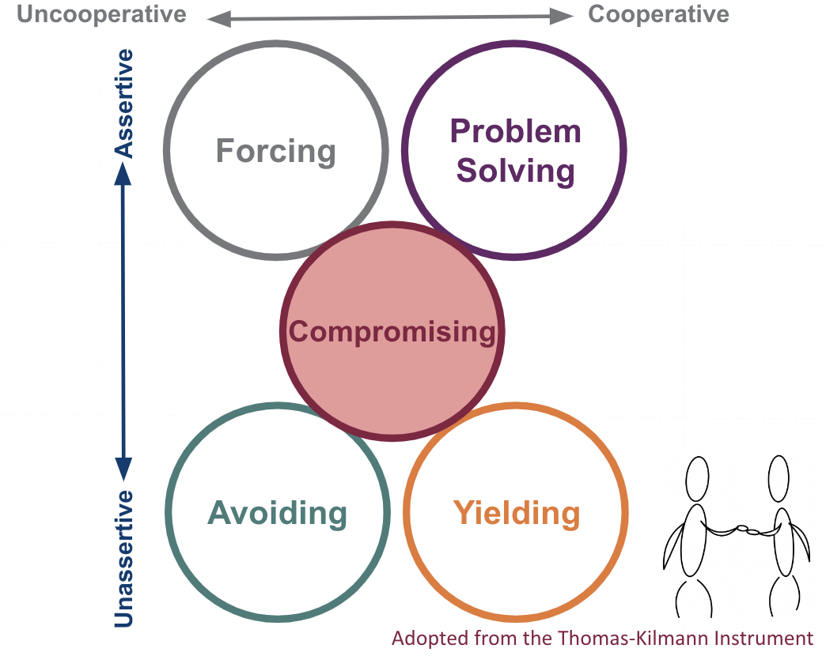
Compromising
Compromising involves looking for a position in which your losses are offset by equally valued gains. It involves matching the other party’s concessions, making conditional promises or threats, and actively searching for a middle ground between the interests of the two parties.
Ex: This style may be used when you are working on a short, small project with others and must compromise on decisions to have a final product.

Slide 8
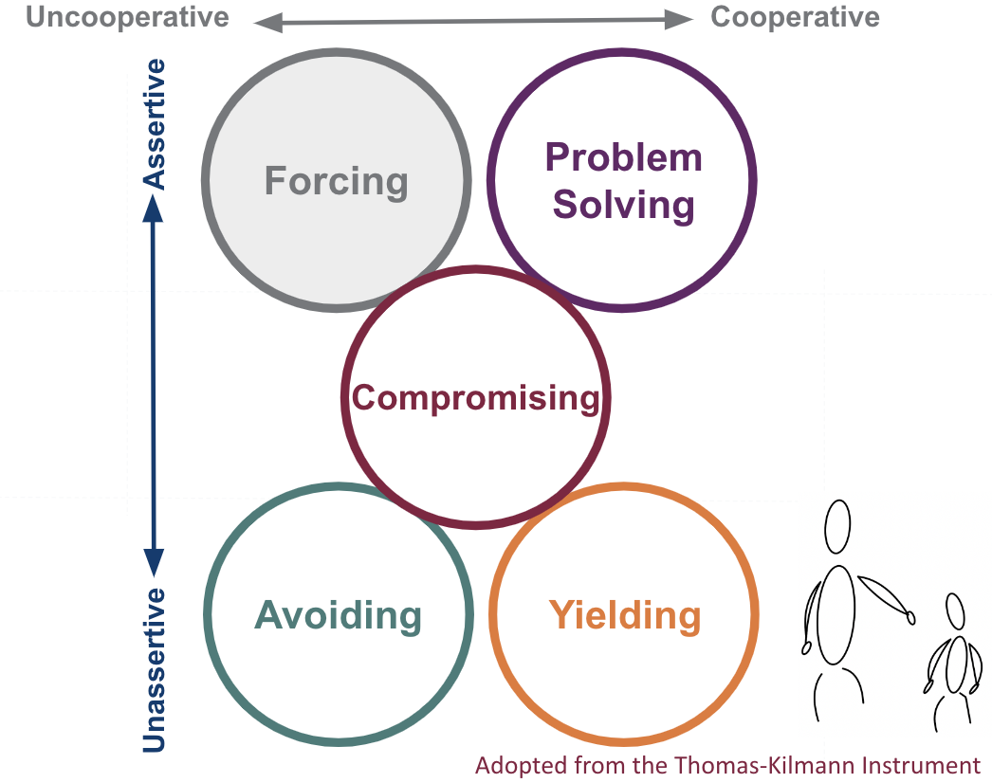
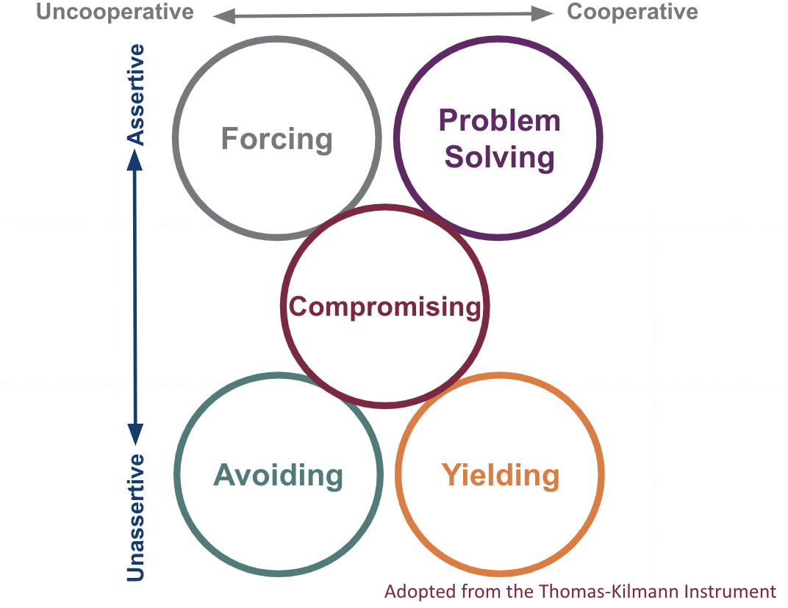
Forcing
Forcing tries to win the conflict at the other's expense. It includes “hard” influence tactics, particularly assertiveness, to get one’s own way.
Ex: This style may be used when you are in charge of a group (club president, team manager, etc.) and need to make tough final decisions.

Slide 9
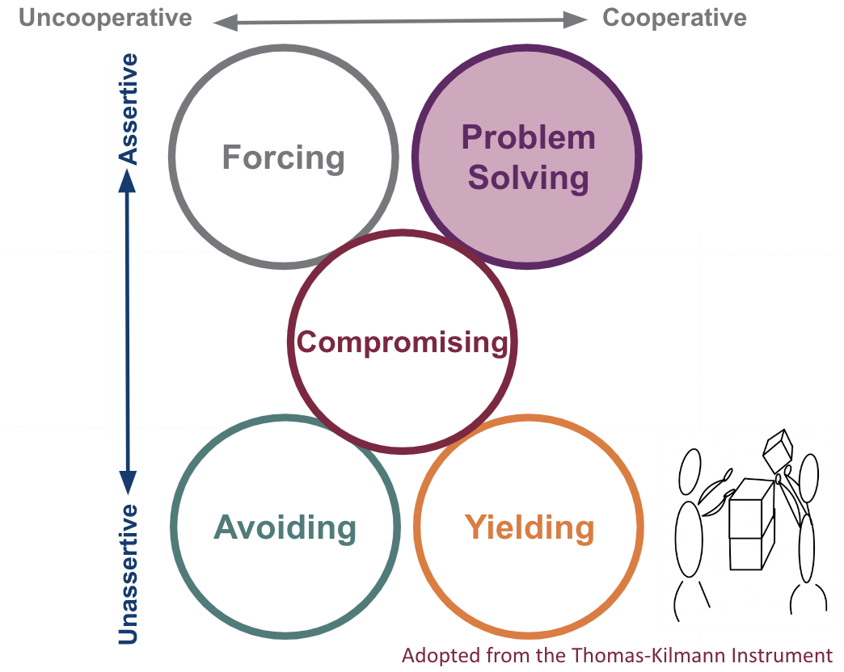
Problem Solving
Problem solving tries to find a mutually beneficial solution for both parties. Information sharing is an important feature of this style because both parties need to identify common ground and potential solutions that satisfy both (or all) of them.
Ex: This style may be used when you are designing a solution and need to meet the needs of multiple team members, stakeholders, and collaborators.

Slide 10
Types of Conflict
Task Conflict
Occurs when there are differences in opinions about how tasks should be completed
Task Conflict
Occurs when there are differences in opinions about how tasks should be completed
Process Conflict
Occurs when there are differences in project execution, responsibilities, and schedules among team members
Relationship Conflict
Occurs when group members have interpersonal tensions

Slide 11
Key Takeaways
Remember, not all conflict is bad!
Not everyone will always agree on the best way to design a solution
Task conflict is a constructive conflict that is essential to performance and innovation
The focus is on effectively handling task conflict
While problem-solving and even compromising are more aspirational, depending on group circumstances, another approach may be appropriate
Regardless of the approach selected, a team should be transparent about the perspective/needs and make collective decisions to minimize process and relationship conflict (destructive types of conflict)

Slide 12
Conflict vs. Bullying
Conflict
Bullying
Disagreement in which both sides express their views
Not planned: in the heat of the moment
Generally stop and change behavior when they realize they are hurting someone
Imbalance of power
Done on purpose: goal is to hurt, harm, or humiliate
Continue behavior when they realize they are hurting someone

Slide 13
Form Groups of 3
Assign each team member a letter A - C

Slide 14
Scenario:
For the first half of the semester, your group worked well together and effectively delegated tasks and completed group assignments. However, one team member has been developing a habit of finishing the assigned parts at the very last minute and showing up late or missing group meetings. This started to create stress for the other group members, who were unsure if the work would get done on time and at a high enough quality. The group has started to receive lower grades on their assignments. How to address the situation, knowing the team still has plenty of work to do to create the final deliverable with a month left in the semester?

Slide 15
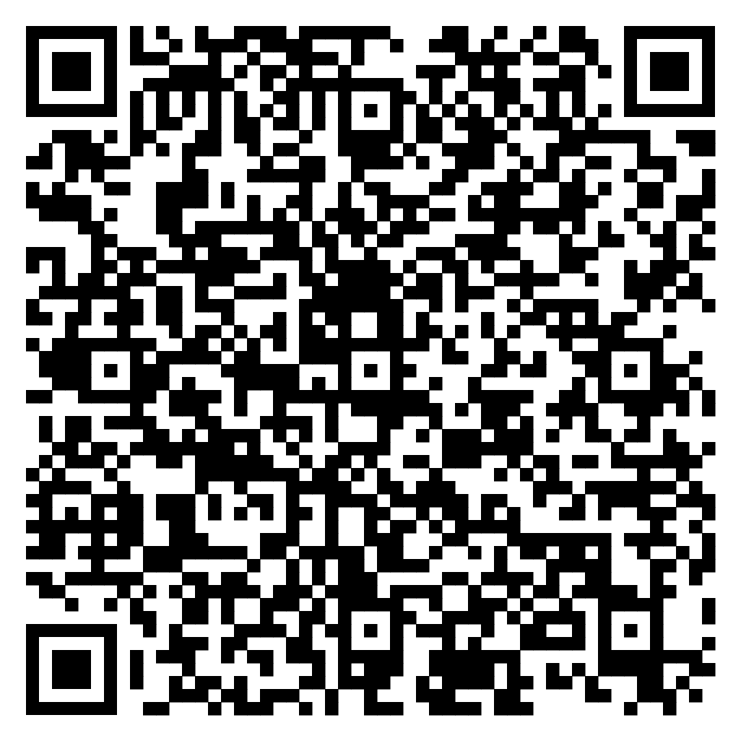
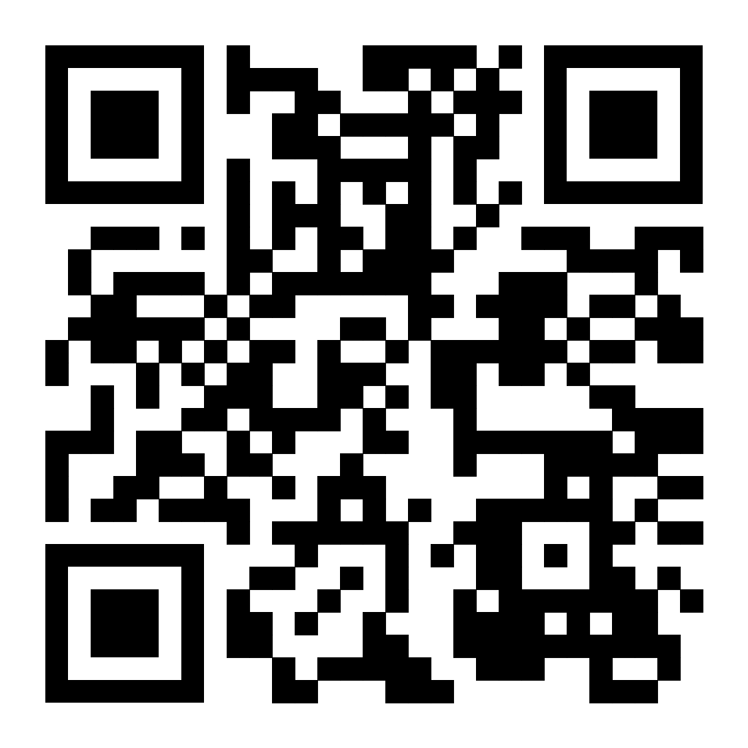
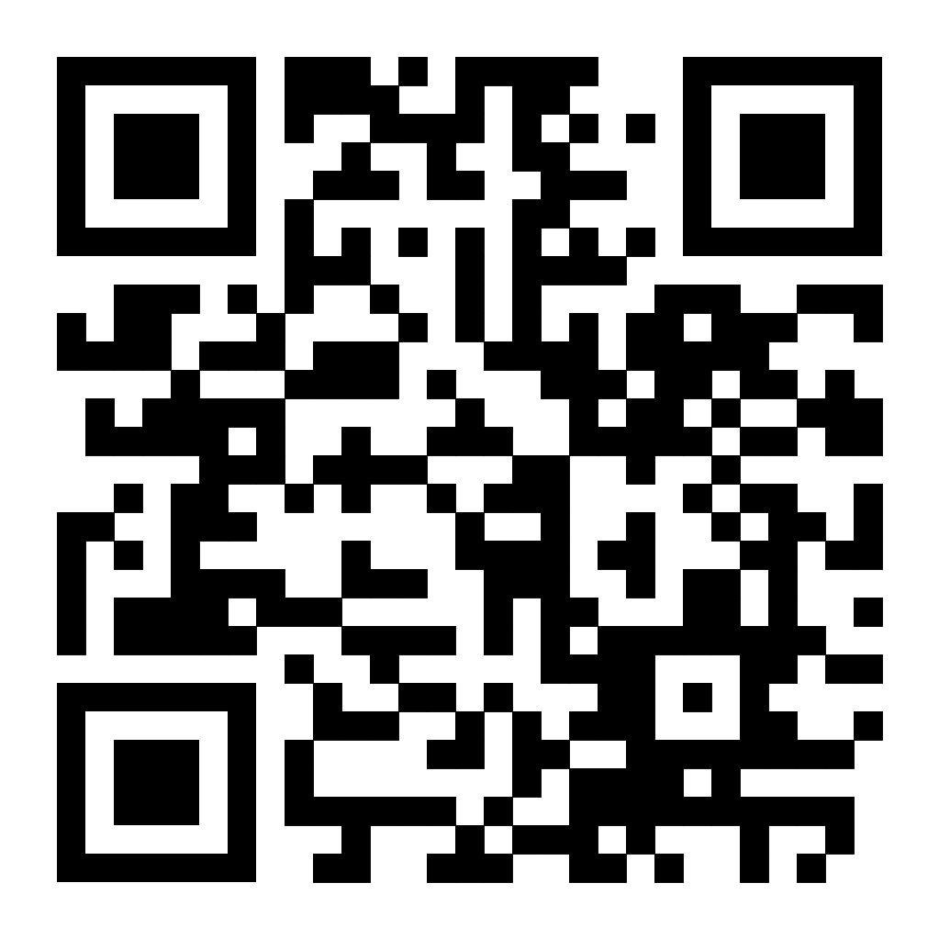
Please scan the QR code to your assigned letter:
Team member A
Team member B
Team member C

Slide 16
Take 5 minutes to act out the situation
Act out your specific role
Try to reach a group consensus

Slide 18
Some potential outcomes based on different conflict handling strategies:

Slide 19
Avoiding
You don’t say anything and continue to miss points on future assignments for the project. But everyone in the group still receives a passing grade and gets along.

Slide 20
Yielding
You acknowledge what your teammate is going through and offer to do everything for the teammate. You no longer miss points on the assignments, but you now have a much heavier workload.

Slide 21
Compromising
You tell your team member to do the tasks since you’re doing yours. The team creates a meeting time that works for everyone’s schedule, but it’s at 9:30 pm on Sunday night.

Slide 22
Forcing
You inform your professor of the situation and that your teammate is not fulfilling the roles. Your grade is protected, but it created tension in the team.

Slide 23
Problem Solving
As a team, you discuss what everyone's needs are: skill set, meeting time, academic support, virtual/in-person collaborations, etc. You make a plan to meet everyone's needs so everyone feels like they are contributing, and the work is done to the best of the group's ability. However, getting the new norms in place has taken a long time, and there are only 2 weeks left in the semester.

Slide 25
Key Takeaways
Process conflicts can quickly evolve to relationship conflict if not addressed
If a process conflict is negatively impacting group performance, and there is time to resolve it, it is likely best to address it directly with the team
Open communication and empathy are important
Be transparent about your needs - especially if you are going through a challenging time
Don’t make assumptions about team members without first trying to understand their circumstances

Slide 27
Key Takeaways
Not all conflict is bad
Each conflict management styles has tradeoffs
Communication among team members is important
Don’t make assumptions
Different conflict management strategies are appropriate in different situations

