Slide 1
Requirements and Verification
ECE445

Slide 2
What is RV table?
A two-column table with requirements on the left, and verification on the right
A checklist for both modular goals and modular debugging
If all requirements have been verified by your verification for every module, you should have a fully functioning project.

Slide 3
Requirements
A technical definition of what each and every module in your system block diagram must be able to do
Quantitative (tolerance range)
Thorough and detailed
Driven by project goals
Design requirements ≠ purchase requirements

Slide 4
Verification
A set of procedures that you will use to verify that a requirement has been met
Equipment
Test procedures
Presentation of results
Explicit

Slide 5
Bad RV Example
Voltage Regulator
Requirements | Verification
1. Step down battery to 3.3VDC | 1. Take oscilloscope measurements to make sure that voltage output is 3.3V.

Slide 6
Bad RV Example
Voltage Regulator
Requirements | Verification
1. Step down battery to 3.3VDC | 1. Take oscilloscope measurements to make sure that voltage output is 3.3V.
What is battery voltage?

Slide 7
Bad RV Example
Voltage Regulator
Requirements | Verification
1. Step down battery to 3.3VDC | 1. Take oscilloscope measurements to make sure that voltage output is 3.3V.
Do I fail if the output is 3.25V?

Slide 8
Bad RV Example
Voltage Regulator
Requirements | Verification
1. Step down battery to 3.3VDC | 1. Take oscilloscope measurements to make sure that voltage output is 3.3V.
Do we miss any requirements? e.g, current draw?

Slide 9
Bad RV Example
Voltage Regulator
Requirements | Verification
1. Step down battery to 3.3VDC | 1. Take oscilloscope measurements to make sure that voltage output is 3.3V.
How to measure?

Slide 10
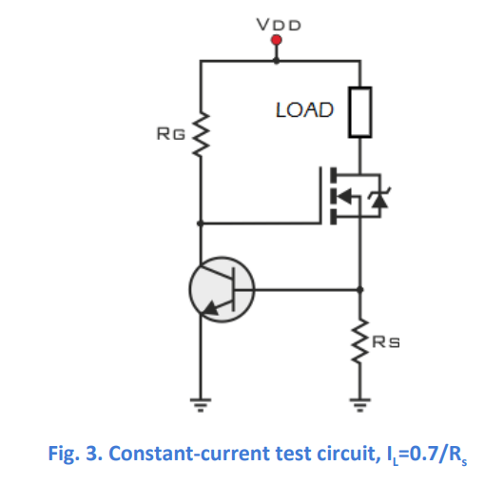
Good RV Example
Voltage Regulator
(adapted from SP16 Wireless IntraNetwork)
Requirements | Verification
Provide 3.3V +/- 0.5% from a 3.7V-4.2V source Can operate current within 0 -300mA Maintain thermal stability below 125°C | 1A. Measure the output voltage using an oscilloscope, ensuring that the output voltage stays within 5% of 3.3V. 2A. Connect the output of the voltage regulator to VDD node in the constant-current test circuit in Figure 3. 2B. Adjust Rs in Figure 3 to deliver at most 300mA to the load, measured by a multimeter. 2C. Measure the output voltage using an oscilloscope, ensuring that the output voltage stays within 5% of 3.3V. 3A. During verification for Requirement 1 and 2, use an IR thermometer to ensure the IC stays below 125°C.

Slide 11
Good RV Example
Voltage Regulator
(adapted from SP16 Wireless IntraNetwork)
Requirements | Verification
Provide 3.3V +/- 0.5% from a 3.7V-4.2V source Can operate current within 0-300mA Maintain thermal stability below 125°C | 1A. Measure the output voltage using an oscilloscope, ensuring that the output voltage stays within 5% of 3.3V. 2A. Connect the output of the voltage regulator to VDD node in the constant-current test circuit in Figure 3. 2B. Adjust Rs in Figure 3 to deliver at most 300mA to the load, measured by a multimeter. 2C. Measure the output voltage using an oscilloscope, ensuring that the output voltage stays within 5% of 3.3V. 3A. During verification for Requirement 1 and 2, use an IR thermometer to ensure the IC stays below 125°C.
Quantitative measurable ranges

Slide 12
Good RV Example
Voltage Regulator
(adapted from SP16 Wireless IntraNetwork)
Requirements | Verification
Provide 3.3V +/- 0.5% from a 3.7V-4.2V source Can operate current within 0-300mA Maintain thermal stability below 125°C | 1A. Measure the output voltage using an oscilloscope, ensuring that the output voltage stays within 5% of 3.3V. 2A. Connect the output of the voltage regulator to VDD node in the constant-current test circuit in Figure 3. 2B. Adjust Rs in Figure 3 to deliver at most 300mA to the load, measured by a multimeter. 2C. Measure the output voltage using an oscilloscope, ensuring that the output voltage stays within 5% of 3.3V. 3A. During verification for Requirement 1 and 2, use an IR thermometer to ensure the IC stays below 125°C.
Very detailed and thorough
requirements

Slide 13
Good RV Example
Voltage Regulator
(adapted from SP16 Wireless IntraNetwork)
Requirements | Verification
Provide 3.3V +/- 0.5% from a 3.7V-4.2V source Can operate current within 0-300mA Maintain thermal stability below 125°C | 1A. Measure the output voltage using an oscilloscope, ensuring that the output voltage stays within 5% of 3.3V. 2A. Connect the output of the voltage regulator to VDD node in the constant-current test circuit in Figure 3. 2B. Adjust Rs in Figure 3 to deliver at most 300mA to the load, measured by a multimeter. 2C. Measure the output voltage using an oscilloscope, ensuring that the output voltage stays within 5% of 3.3V. 3A. During verification for Requirement 1 and 2, use an IR thermometer to ensure the IC stays below 125°C.
Step-by-step procedure

Slide 14
Good RV Example
Voltage Regulator
(adapted from SP16 Wireless IntraNetwork)
Requirements | Verification
Provide 3.3V +/- 0.5% from a 3.7V-4.2V source Can operate current within 0-300mA Maintain thermal stability below 125°C | 1A. Measure the output voltage using an oscilloscope, ensuring that the output voltage stays within 5% of 3.3V. 2A. Connect the output of the voltage regulator to VDD node in the constant-current test circuit in Figure 3. 2B. Adjust Rs in Figure 3 to deliver at most 300mA to the load, measured by a multimeter. 2C. Measure the output voltage using an oscilloscope, ensuring that the output voltage stays within 5% of 3.3V. 3A. During verification for Requirement 1 and 2, use an IR thermometer to ensure the IC stays below 125°C.
Equipment

Slide 15
Good RV Example
Voltage Regulator
(adapted from SP16 Wireless IntraNetwork)
Requirements | Verification
Provide 3.3V +/- 0.5% from a 3.7V-4.2V source Can operate current within 0-300mA Maintain thermal stability below 125°C | 1A. Measure the output voltage using an oscilloscope, ensuring that the output voltage stays within 5% of 3.3V. 2A. Connect the output of the voltage regulator to VDD node in the constant-current test circuit in Figure 3. 2B. Adjust Rs in Figure 3 to deliver at most 300mA to the load, measured by a multimeter. 2C. Measure the output voltage using an oscilloscope, ensuring that the output voltage stays within 5% of 3.3V. 3A. During verification for Requirement 1 and 2, use an IR thermometer to ensure the IC stays below 125°C.
Explicit set-up/configuration

Slide 16
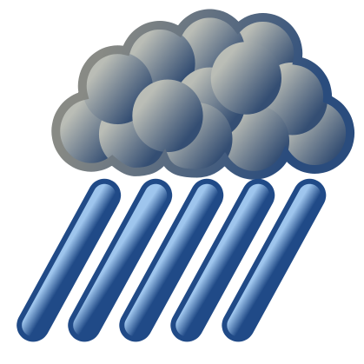
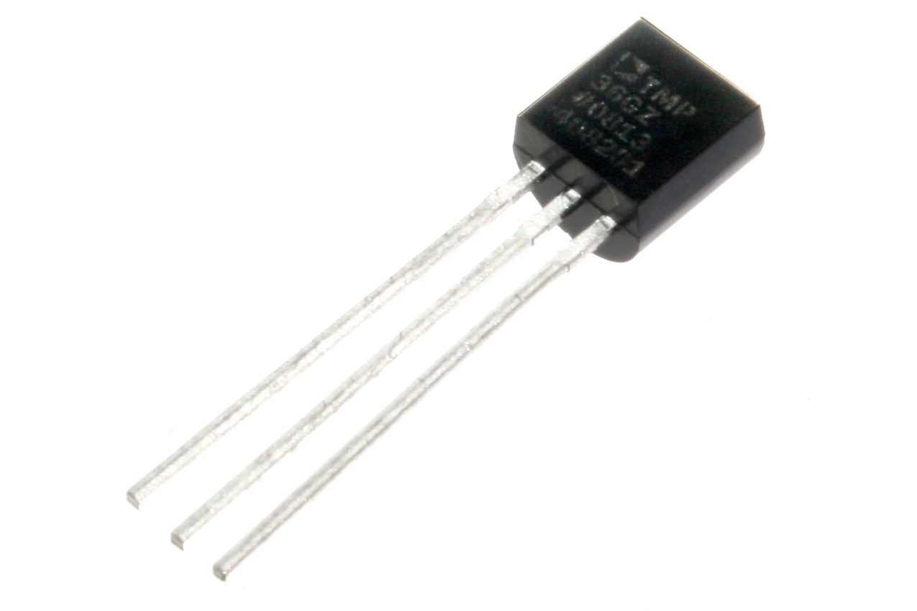
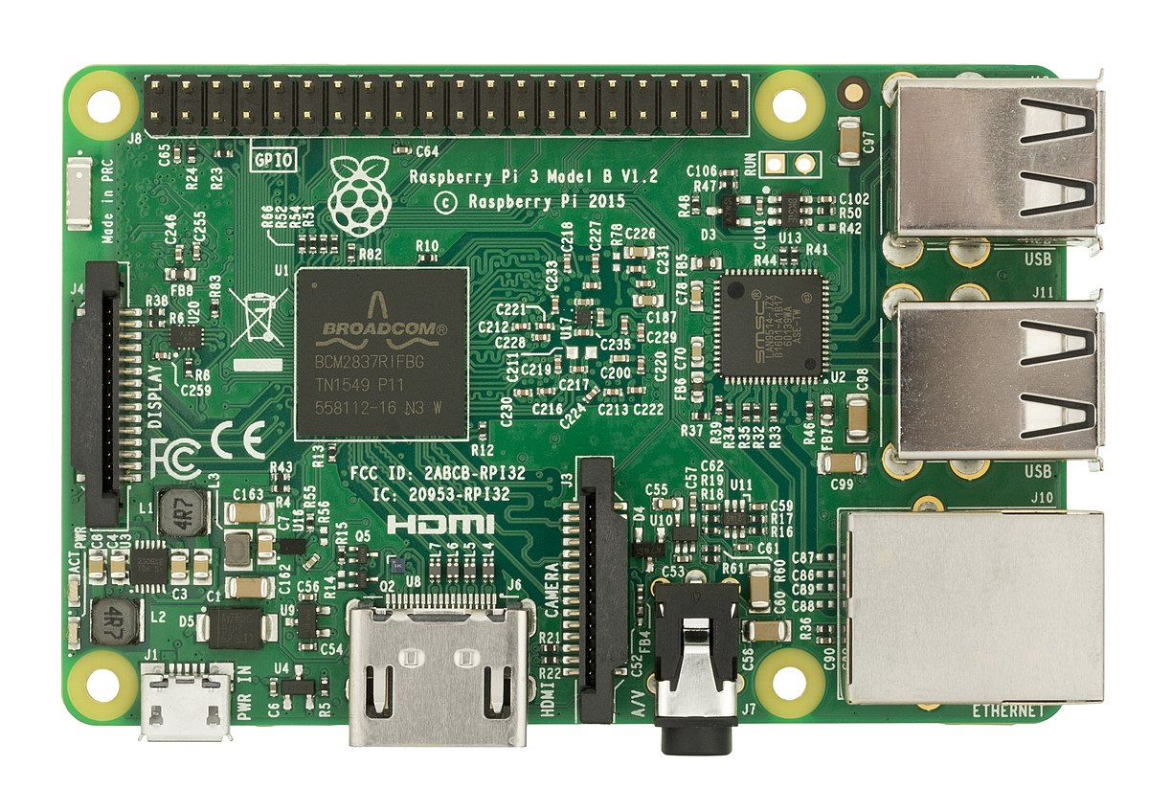
Bad RV Example
It is raining; put on a jacket.
Personal Rain Detector
Requirements | Verification
Raspberry Pi is functional. Raspberry Pi GPIO pins can produce outputs. Speaker produces sound when powered. Moisture sensor can survive manufacturer-specified weather conditions. | 1A. Provide 5V power to Raspberry Pi. Inspect status lights to ensure it is operating. 2A. Toggle GPIO pins and measure with oscilloscope. 3A. Drive speaker with 9V power supply and listen for sound to ensure it works. 4. Put sensor outside on a rainy day and test that it works after.

Slide 17
Bad RV Example
It is raining; put on a jacket.
Personal Rain Detector
Requirements | Verification
Raspberry Pi is functional. Raspberry Pi GPIO pins can produce outputs. Speaker produces sound when powered. Moisture sensor can survive manufacturer-specified weather conditions. | 1A. Provide 5V power to Raspberry Pi. Inspect status lights to ensure it is operating. 2A. Toggle GPIO pins and measure with oscilloscope. 3A. Drive speaker with 9V power supply and listen for sound to ensure it works. 4. Put sensor outside on a rainy day and test that it works after.
ISSUE: Padding your RV table.
Each of these is “guaranteed” by the manufacturer. You aren’t testing any new designs of your own.

Slide 18
If you have any questions, contact your TA!

