Slide 1
Isolated Voltage Sensor
Team 74
Laureano Salcines
Jevin liu

Slide 2
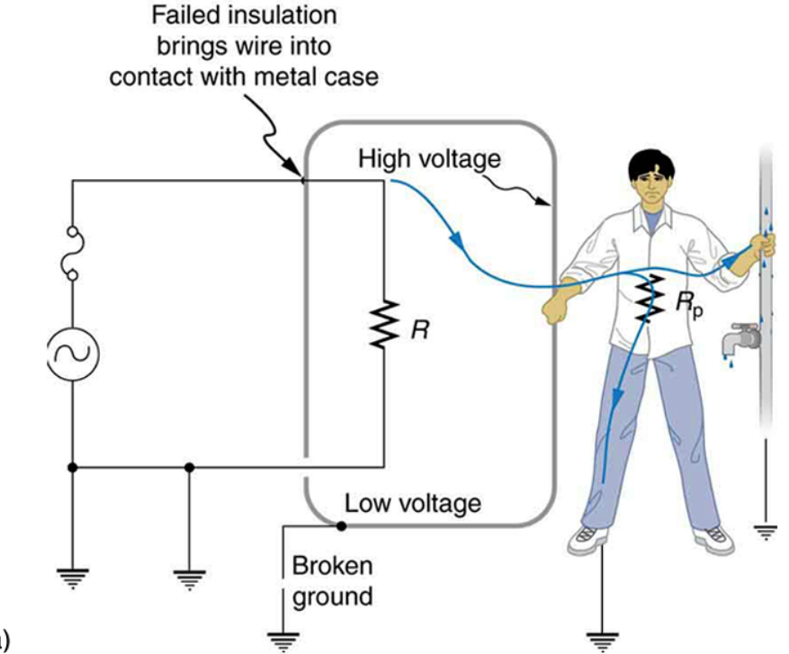
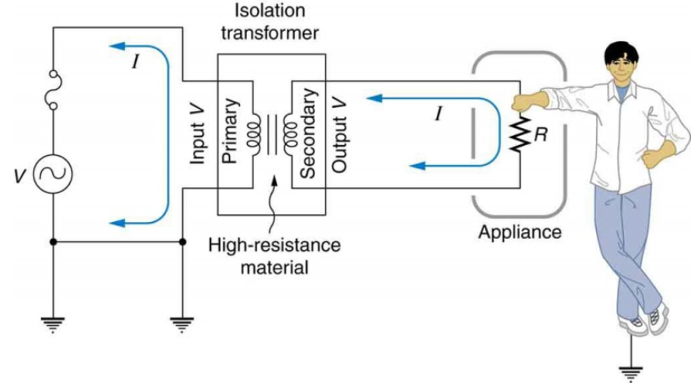
Objective
- Safety

Slide 3
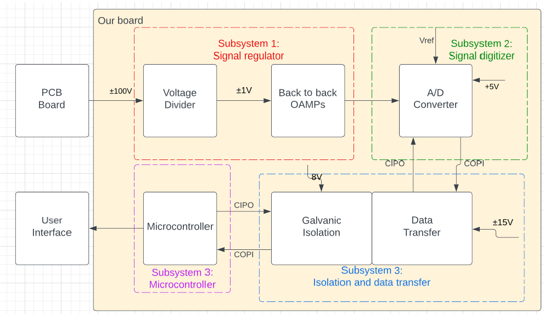
Design change

Slide 4
Design change

Slide 5
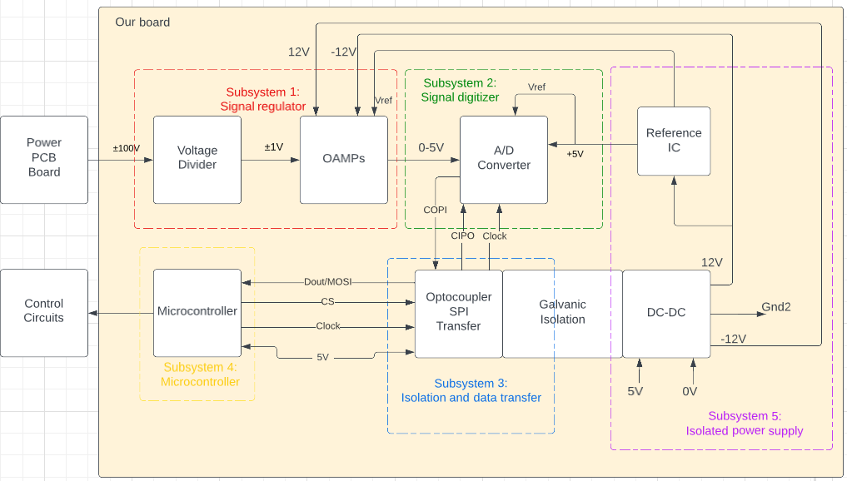
Design change

Slide 6
Ki-Kad design
Subsystem 2:
Signal digitizer
Subsystem 3:
Isolated data transfer
Subsystem 1:
Voltage regulator
Subsystem 4:
Isolated power supply
Subsystem 5:
Microcontroller

Slide 7
High level requirements
Voltage: The isolated voltage sensor should be able to measure voltages up to ±100 volts, with a tolerance of 100 millivolts, 0.05% error from value to actual reading.
Impedance: To not affect the power circuits that much, input impedance should at least be 10 megaohms.
Sampling Rate: To provide an accurate measurement at any particular time, the sensor needs to sample at at least 10 kilo samples per second.

Slide 8
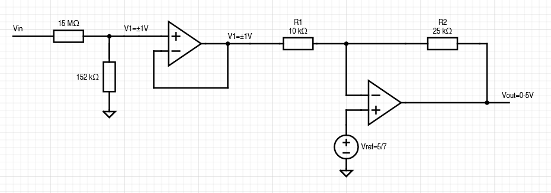
Subsystem 1: Voltage regulator
Voltage divider
Unity gain buffer
Regulating OP-AMP

Slide 9
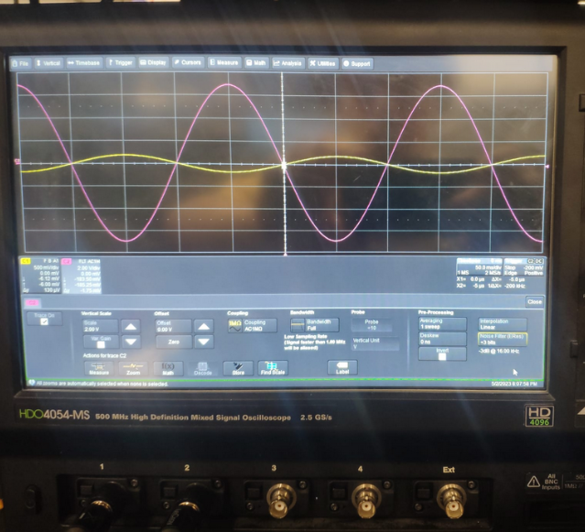
Vinput vs Voutput from subsystem 1

Slide 10
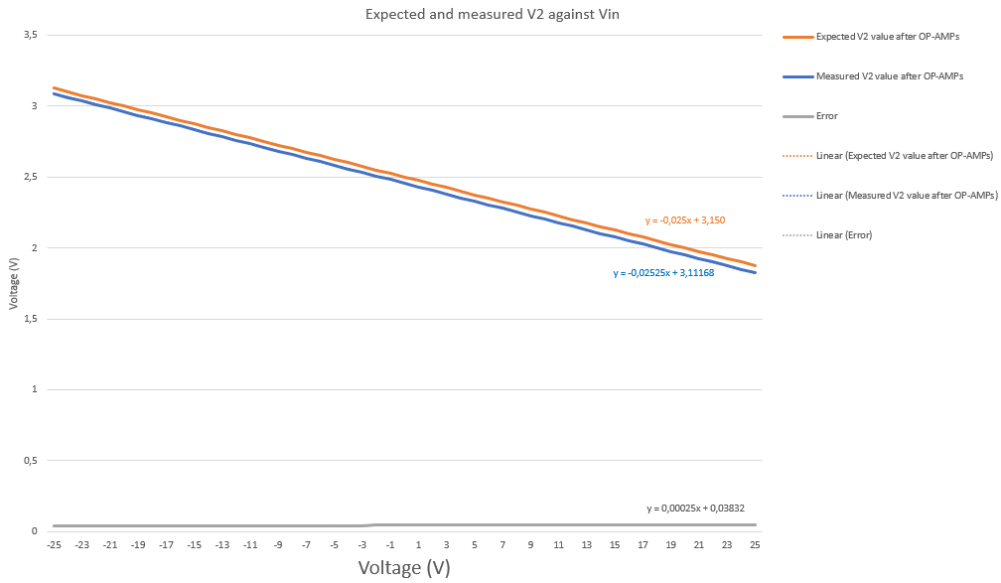
Subsystem 1: Voltage Regulator
We need high precision to meet the accuracy high level requirement.

Slide 11
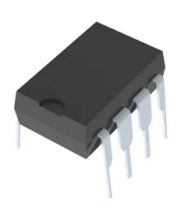
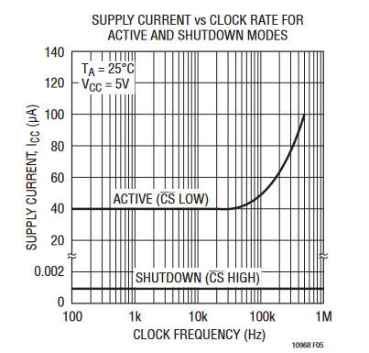
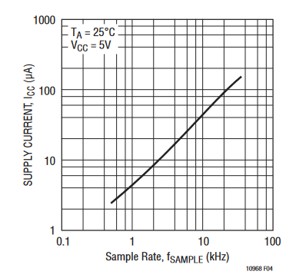
Subsystem 2: Signal digitizer
Serial 8-Bit ADC.
Error = 0.39%
Sampling rate
Schottky diodes

Slide 12
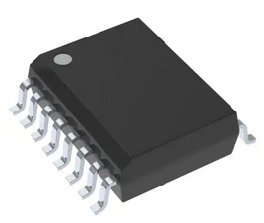
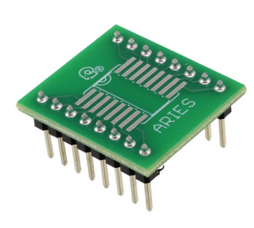
Subsystem 3: Isolated data transfer
Serial digital isolator
Breakout board
Low-delay data transfer

Slide 13
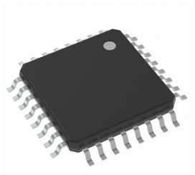
Subsystem 4: Microcontroller
ATmega328A microcontroller
Running at 16Mhz
Arduino

Slide 14
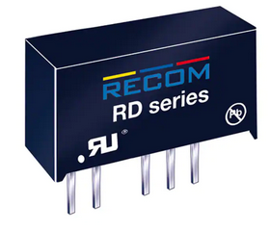
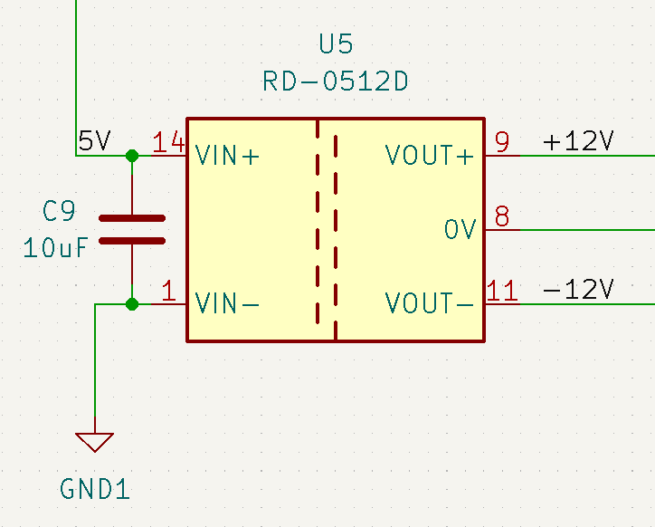
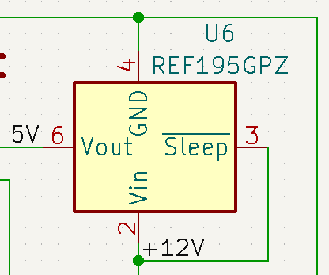
Subsystem 5: Isolated power supply
DC-DC converter
IC voltage reference

Slide 15
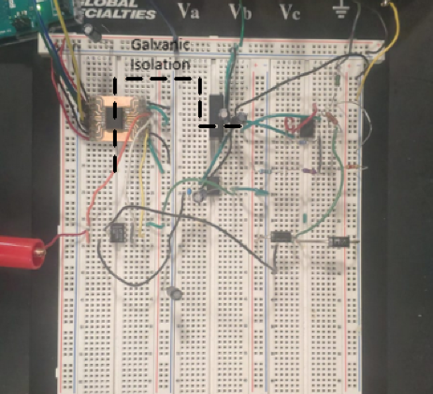
Breadboard

Slide 16
Requirements checklist
Able to withstand a +/-100V input voltage
Accuracy
Error =
Subsytem1 error + Subsystem2 error = 0,52%
Input impedance
15,154 Mohms
Sample rate
14KHz
Isolation
Measured infinite impedance

Slide 17
Functioning video

Slide 18
Successes and challenges

Slide 19
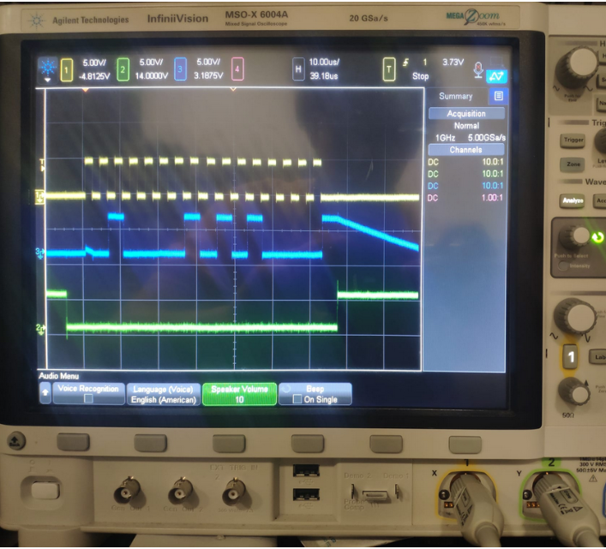
ADC signaling

Slide 20
Conclusion and takeaways
THANKS

