Slide 1
Supercapacitor Module for Illini-Robomaster Robot
Haoyuan You, Team 79

Slide 2
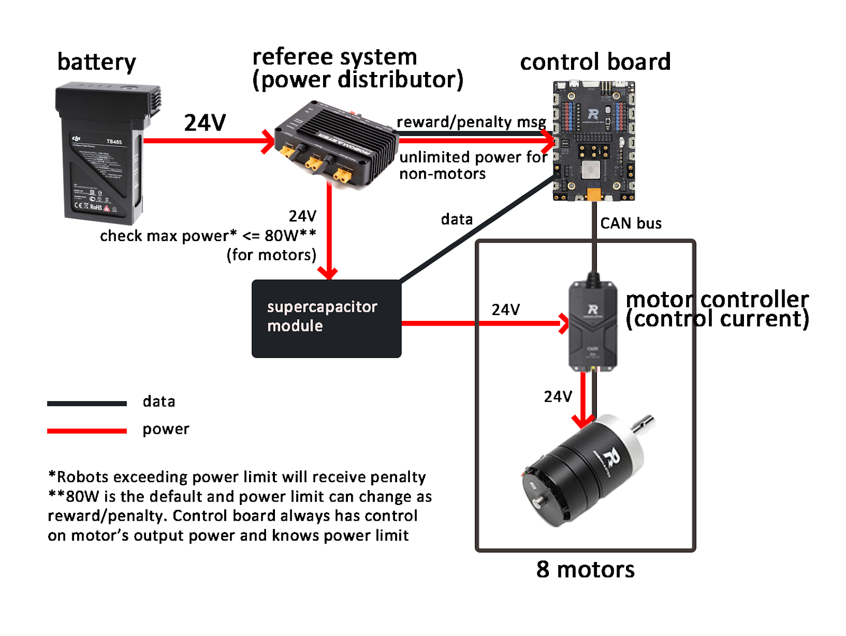
Problem and solution

Slide 3
Problem and solution
Without Supercap (limited at 80W)
With Supercap (unlimited)

Slide 4
Solution overview
Power Switching Subsystem (Select power source)
Control the power bus configuration with switches
Super Capacitor Charging Subsystem (Store energy)
Charge the capacitor with a constant current
Super Capacitor Discharging Subsystem (Release energy)
Convert capacitor voltage to load voltage

Slide 5
Result and Reason: Result
Most subsystems work partially:
Charging Subsystem:
Can only charge capacitor with certain current value points
(expected 0 – 10A, get 800mA)
Discharging Subsystem:
Output voltage not as high as expected
(expected 24V, get 15V)
Fail to integrate
Power Switching Subsystem
Hardware and software behave as expected, but not integrated
Drivers
All drivers completed, but no hardware to run on

Slide 6
Result and Reason: Reason
Poor time management
Our design is a complex hardware system
(Probably the most crowded PCB layout in course)
Not enough experience on how to develop complex hardware efficiently
Efforts are made but not good enough
Examples:
Missed the first round of PCB order and had to wait the entire spring break.
Didn’t have time to iterate PCB with better design.
More during discussions for subsystems.
More on these later

Slide 7
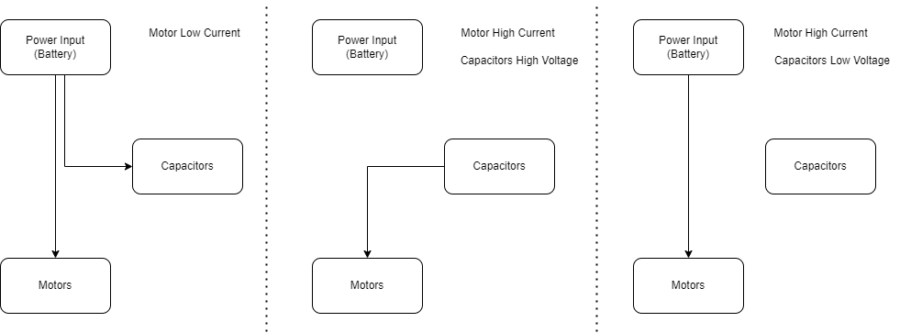
Power Switching Subsystem (Overview)
MOSFETs with controllers controlled by MCU GPIOs

Slide 8
Power Switching Subsystem (Result)
Hardware and software behave as expected
Didn’t have time to integrate:
Apr.9:
Populated and tested that hardware worked.
Lost one controller during populating. Need to wait for parts to arrive.
Apr.20:
Software (driver) completed
Apr.25:
Tried to integrate but couldn’t replicate the hardware test. Integration failed
Apr.26 (demo day):
Found out that the PCB fried.
Hardware working again right before final demo. No time to integrate.

Slide 9
Super Capacitor Charging Subsystem
Overview:
Built upon the BQ24640 supercapacitor charger chip (I2C protocol)
Can charge capacitor with any current from 0 – 10A
Work as expected
Result:
A potentiometer was missing on the demo day. Only demoed with certain current.

Slide 10
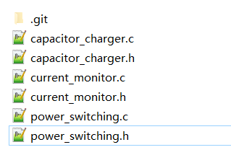
Drivers
MCU on PCB doesn’t work.
Power switching drivers tested on dev boards
Capacitor chargers and current monitors are I2C based and not tested

Slide 11
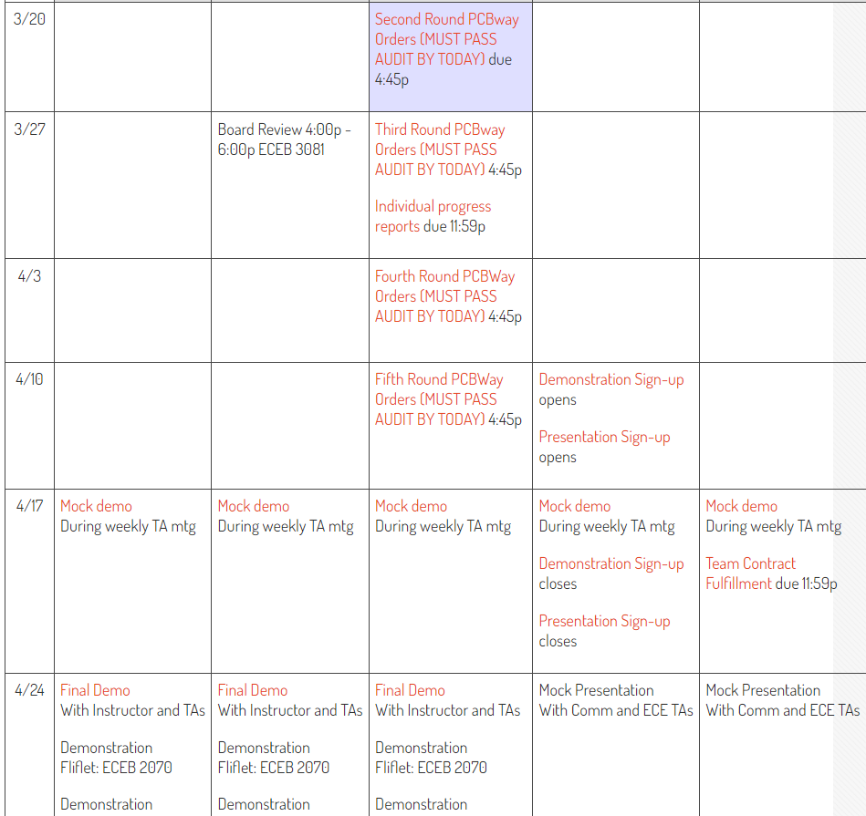
Time is the biggest limit
Project timeline
PCB arrived
Parts arrived
Some parts ordered through myECE were not ordered, and we were never informed.
Stencil went missing once
Demo day right after midterm weeks
We only have 2 members with minimal experience in hardware design
Stencil we left in 2072 went missing
-Power switching subsystem worked
-Some parts we ordered were never purchased
Programming for drivers -----------------
--------------- Programming for drivers
Midterm weeks
The part that myECE didn’t order arrived
Power switching didn’t work because PCB fried
Got all subsystems partly working in the 12 hours before demo

Slide 12
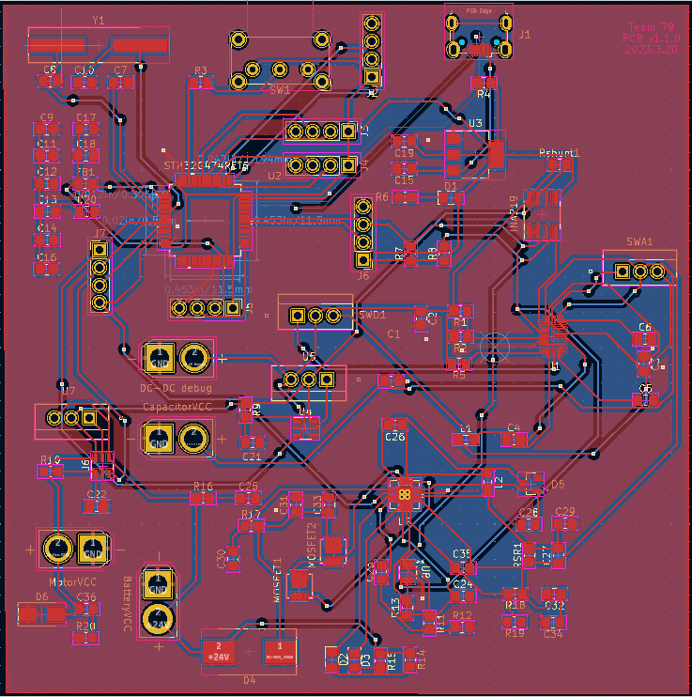
Lesson learned
Never underestimate the difficulty for populating a PCB
Used 2 QFN packaging parts and a STM32 1mm pin MCU
Time cost for modular test is too high even with stencils.
Even modular tested, populating can introduce bugs during integration.

Slide 13
Lesson learned
Avoid single point of failure
Much time was spent on debugging the power switching subsystem
We designed debug pin for signal, but that is not enough.
We should have made the entire subsystem replaceable.

Slide 14
Recommendations for further work
Complete the project with a better design
The project is requested by a RSO so we will keep working on this.
Incorporate more modular test:
Leave debug pins for interfaces between submodules
Make each submodule a separated PCB and integrate them
Place breakers between submodules to isolate during testing

