Slide 1
Smart Stair Gate
Electrical & Computer Engineering
Alexander Chin, Brandon Lau, Zeyad Irsheid
Team No.37
12/4/2023

Slide 2
Outline
Introduction
Objective
Subsystems
Challenges
Successes
Future Work
Conclusion
ELECTRICAL & COMPUTER ENGINEERING
GRAINGER ENGINEERING

Slide 3
Introduction
ELECTRICAL & COMPUTER ENGINEERING
GRAINGER ENGINEERING

Slide 4
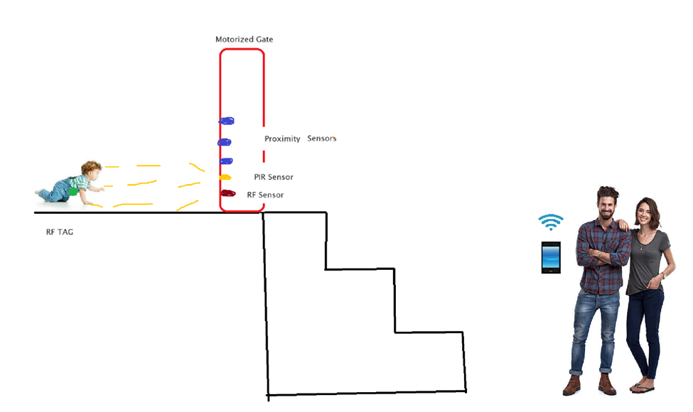
Introduction - Problem and Solution
Children are unpredictable at times especially when unsupervised, and the last thing parents want is their child to be doing something dangerous.
According to researchers, “Every six minutes, a child falls down stairs somewhere in the U.S., experts say. Over 90,000 kids under the age of 5 end up in emergency rooms because of stair-related falls every year”. [1]
We propose to create a smart gate enclosed at the top of a flight of stairs.
ELECTRICAL & COMPUTER ENGINEERING
GRAINGER ENGINEERING

Slide 5
Introduction - Safety and Ethical Considerations
Necessary precautions were taken to ensure compliance with the IEEE ethical code 7.8.1.1 stating “[to] hold paramount the safety, health, and welfare of the public” as well as AMC code 1.2 in which we promise to “Avoid Harm” [2].
Due to allowing the user of the gate to have an app that receives signals from the microcontroller, we will pay great attention to ensure we abide by AMC code 1.6 in which we will “Respect Privacy” [3].
ELECTRICAL & COMPUTER ENGINEERING
GRAINGER ENGINEERING

Slide 6
Objective
ELECTRICAL & COMPUTER ENGINEERING
GRAINGER ENGINEERING

Slide 7
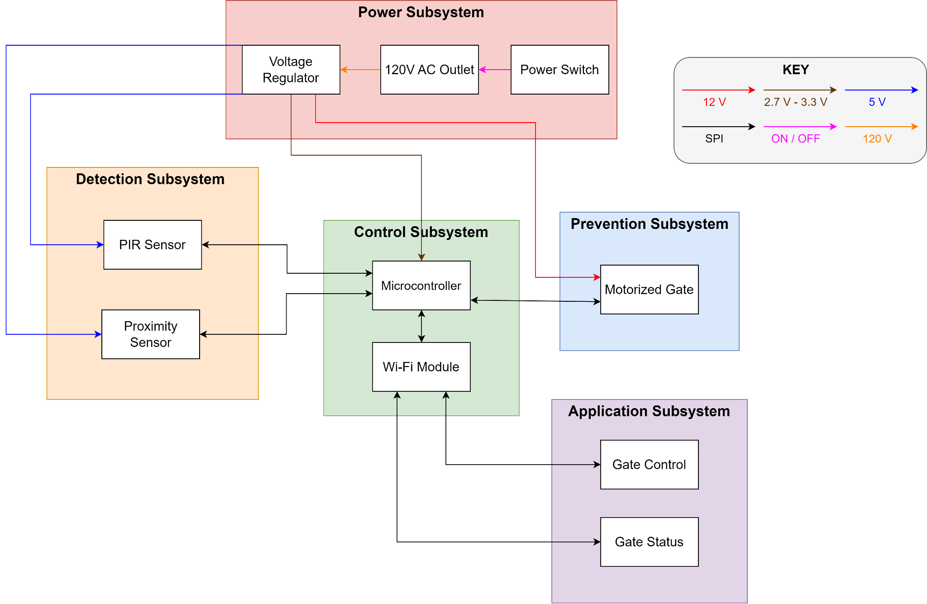
Block Diagram
ELECTRICAL & COMPUTER ENGINEERING
GRAINGER ENGINEERING

Slide 8
Prevention
ELECTRICAL & COMPUTER ENGINEERING
GRAINGER ENGINEERING

Slide 9
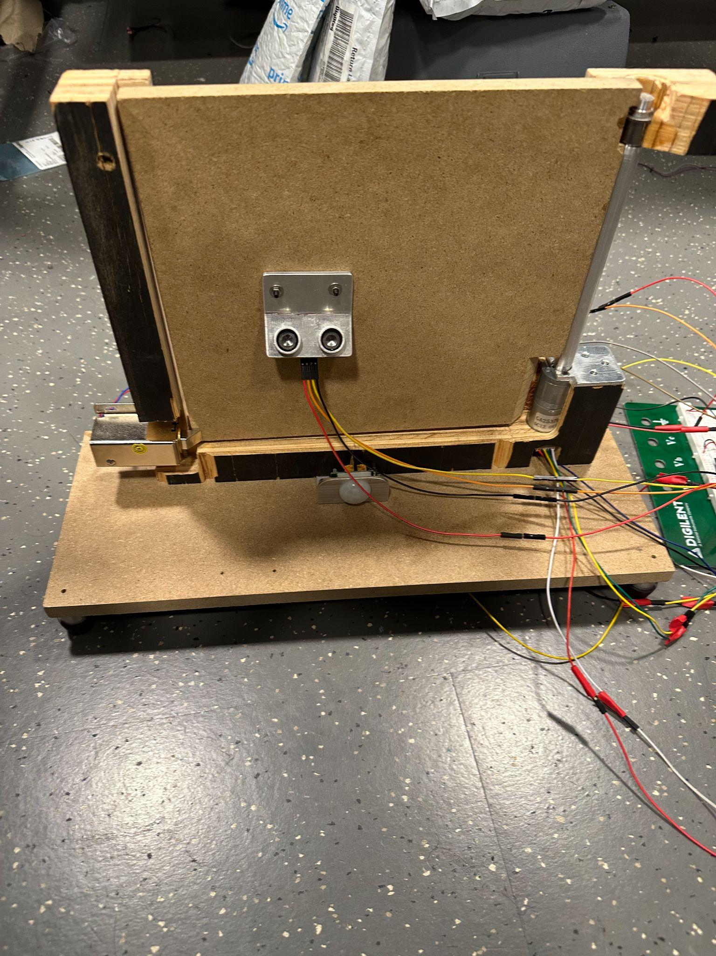
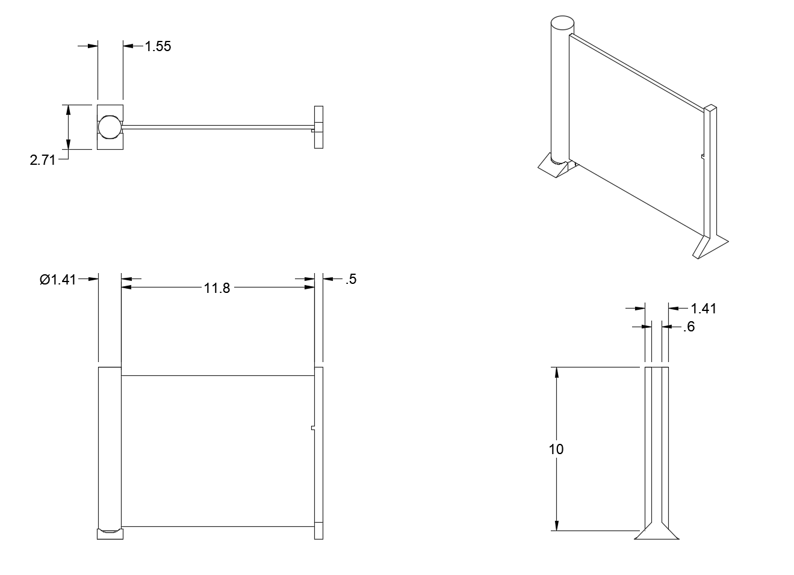
Mechanical Gate
ELECTRICAL & COMPUTER ENGINEERING
GRAINGER ENGINEERING

Slide 10
Power
ELECTRICAL & COMPUTER ENGINEERING
GRAINGER ENGINEERING

Slide 11
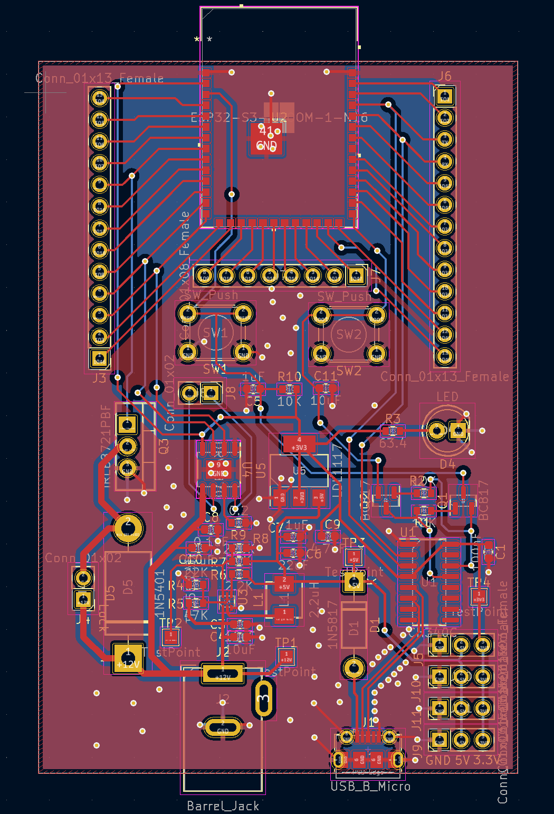
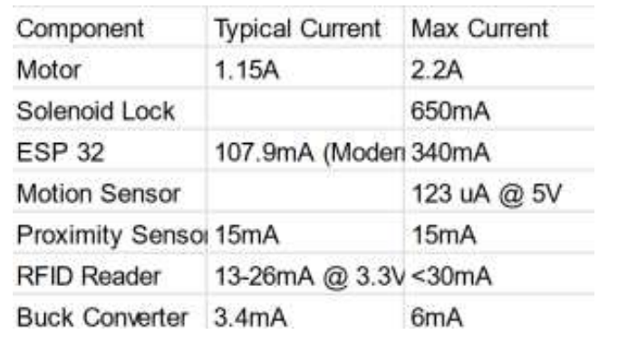
PCB Development and Design
Load requirements
Heat Calculations
Ease of use
Reusability and Modularization
ELECTRICAL & COMPUTER ENGINEERING
GRAINGER ENGINEERING

Slide 12
Control
ELECTRICAL & COMPUTER ENGINEERING
GRAINGER ENGINEERING

Slide 13
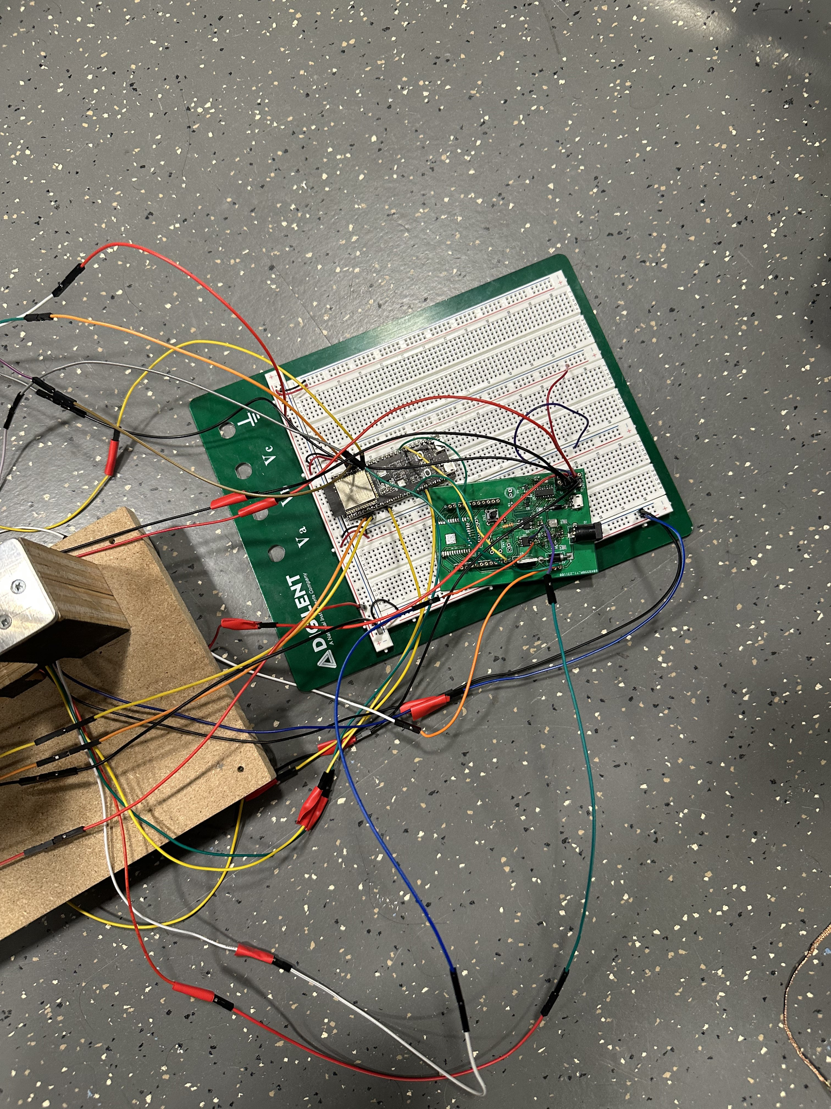
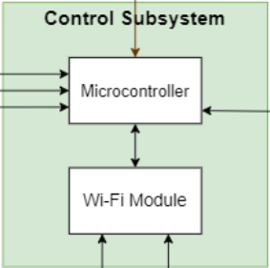
Control Subsystem
Control subsystem provides functionality to all other subsystems
Successful communication between ESP32 microcontroller and sensors using SPI
Motor encoder updates the microcontroller on the gate’s position
ELECTRICAL & COMPUTER ENGINEERING
GRAINGER ENGINEERING

Slide 14
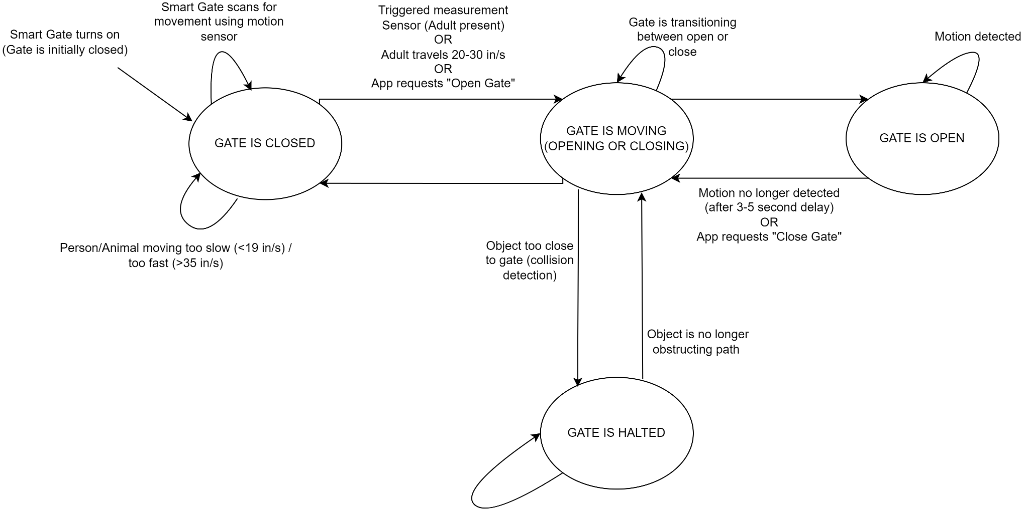
Gate Logic
Gate detection occurs when an object moves within a 3 ±. 5 foot proximity of the gate and sends a signal to the microcontroller
Gate should open when a dog or an adult approaches the gate, but remain closed when a baby is unaccompanied by an adult
Collision prevention should be active while the gate is in motion.
After the object is gone, the gate will resume the former action
ELECTRICAL & COMPUTER ENGINEERING
GRAINGER ENGINEERING

Slide 15
Application
ELECTRICAL & COMPUTER ENGINEERING
GRAINGER ENGINEERING

Slide 16
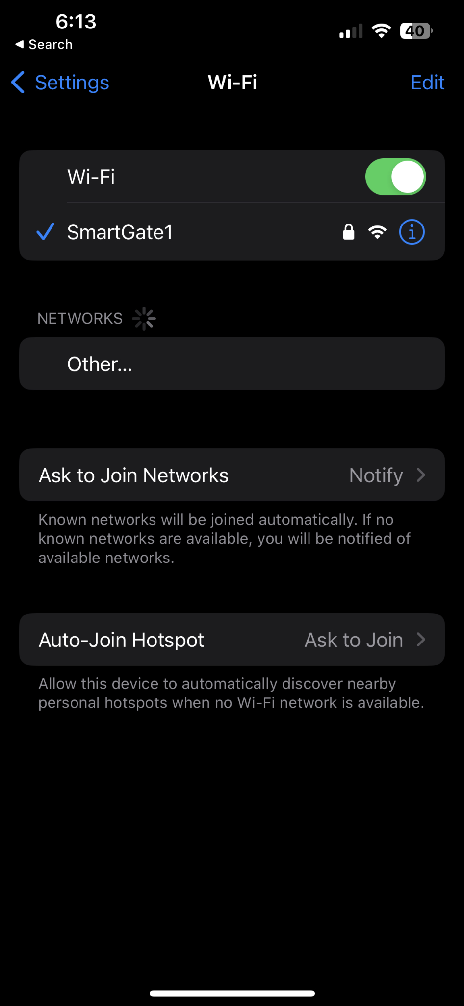
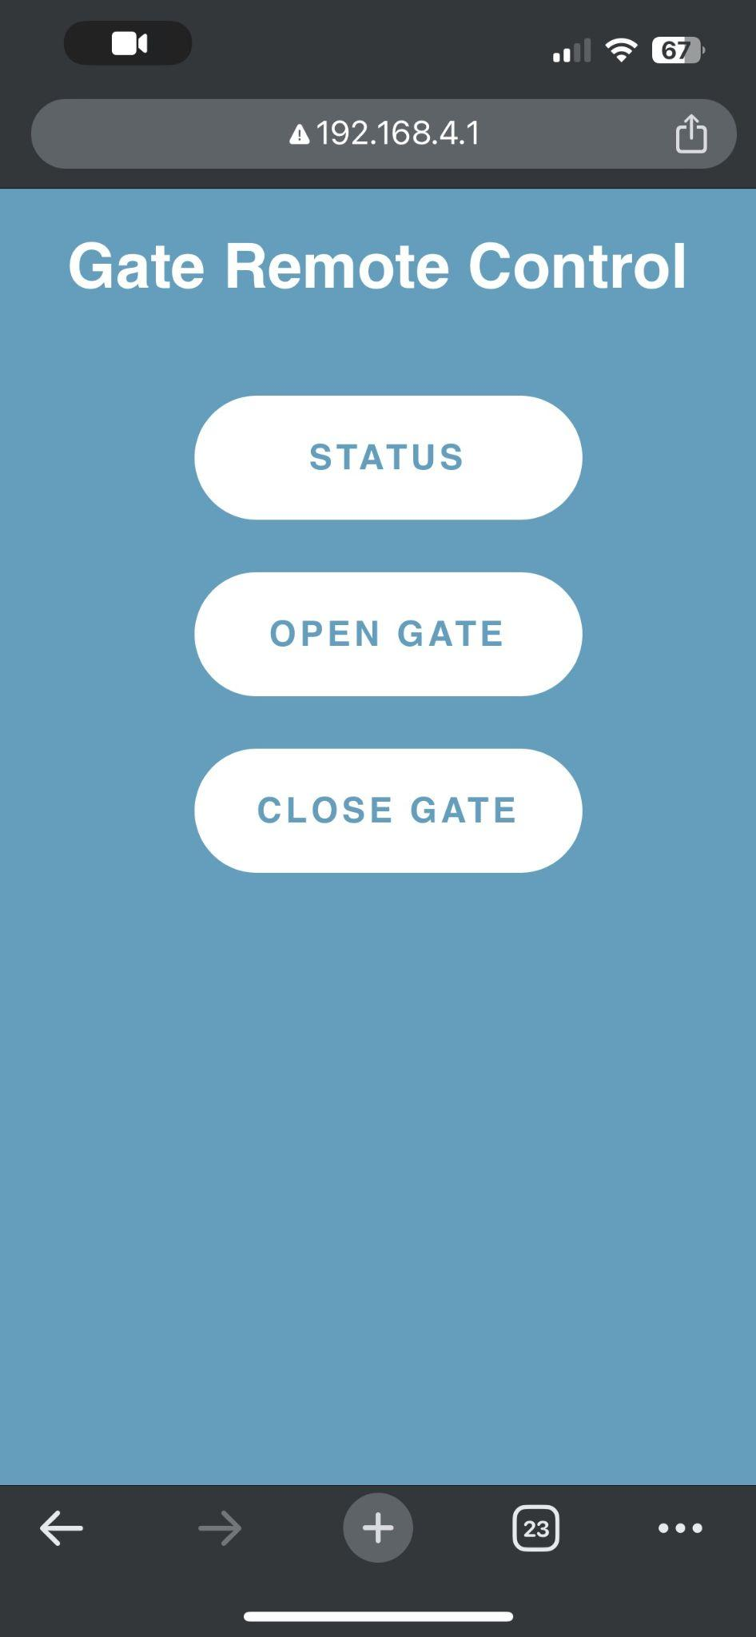
Application Subsystem
Application subsystem allows for mobile interaction
Mobile application notifies current gate status (open/close/moving)
Manual gate override
ELECTRICAL & COMPUTER ENGINEERING
GRAINGER ENGINEERING

Slide 17
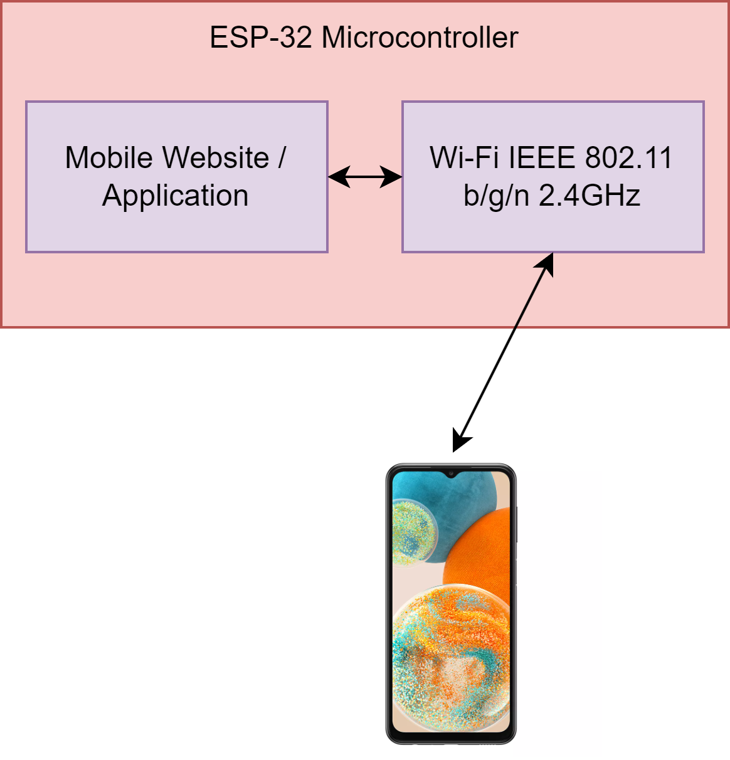
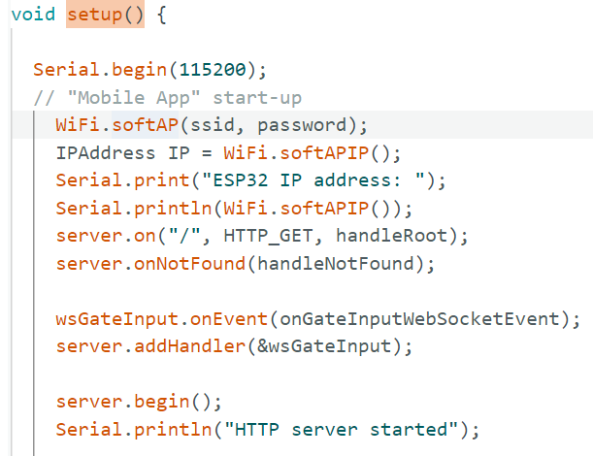
Application Subsystem Implementation
ESP-32 Microcontroller acts as a web server and Wi-Fi router to communicate with mobile devices
Web server connects to Smart Gate through websocket
ELECTRICAL & COMPUTER ENGINEERING
GRAINGER ENGINEERING

Slide 18
Detection
ELECTRICAL & COMPUTER ENGINEERING
GRAINGER ENGINEERING

Slide 19
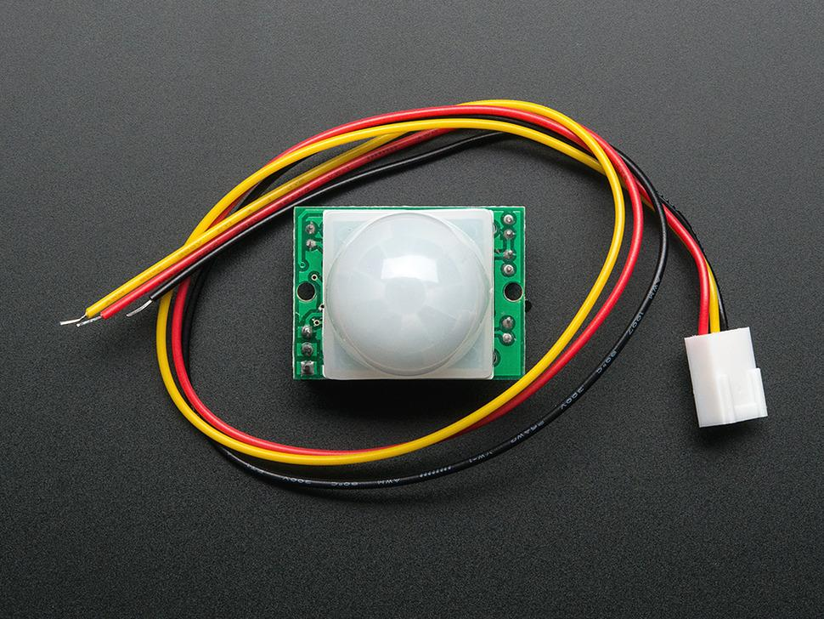
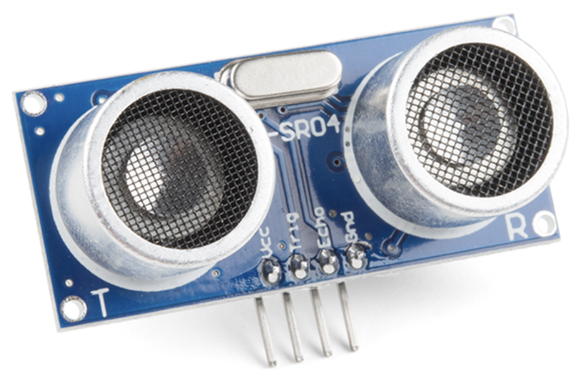
Sensor Selection
PIR Motion Sensors
Ultrasonic Distance Sensors
Adafruit PIR Motion Sensor [5]
Sparkfun HC-SR04 Ultrasonic Distance Sensor [4]
ELECTRICAL & COMPUTER ENGINEERING
GRAINGER ENGINEERING

Slide 20
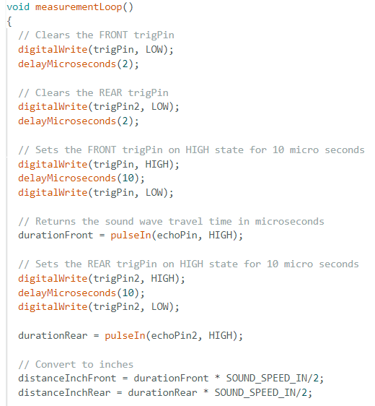
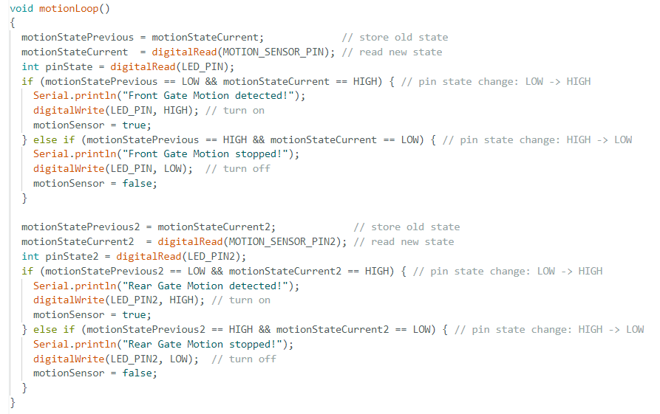
Sensor Operation
ELECTRICAL & COMPUTER ENGINEERING
GRAINGER ENGINEERING

Slide 21
Successes
ELECTRICAL & COMPUTER ENGINEERING
GRAINGER ENGINEERING

Slide 22
Successes
PCB (Mostly)
- Intended voltage outputs at all parts of the pcb were measured.
- PCB successfully reduced current to limit heating of the LDO.
- Microcontroller portion did not work.
Phone Application
- Application connected to microcontroller.
- Displayed current status of the gate.
- Capable of opening/closing the gate.
PIR Sensors
- Detected movement and signaled microcontroller.
ELECTRICAL & COMPUTER ENGINEERING
GRAINGER ENGINEERING

Slide 23
Challenges
ELECTRICAL & COMPUTER ENGINEERING
GRAINGER ENGINEERING

Slide 24
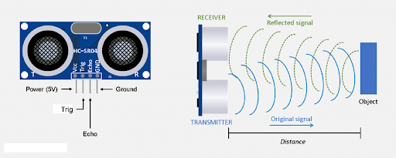
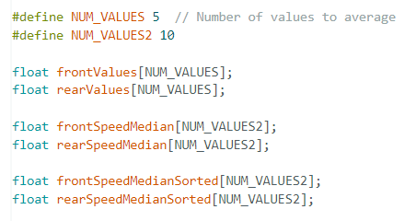
Challenges
RFID sensor didn’t work as expected.
Assumption is that a toddler can’t move as fast as an adult or pet.
Ultrasonic Sensor used to Calculate Distance [6]
ELECTRICAL & COMPUTER ENGINEERING
GRAINGER ENGINEERING

Slide 25
Future Work
ELECTRICAL & COMPUTER ENGINEERING
GRAINGER ENGINEERING

Slide 26
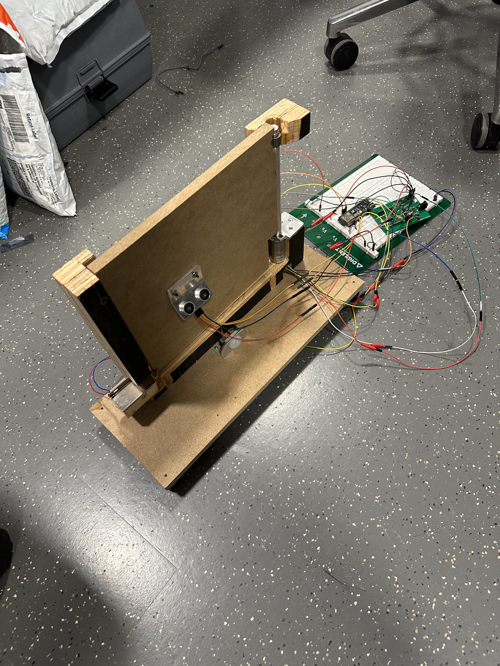
Future Work
Add more measurement sensors
Scale Smart Gate to a reasonable size
Adjustable Smart Gate speed
Detailed log of Smart Gate activity
ELECTRICAL & COMPUTER ENGINEERING
GRAINGER ENGINEERING

Slide 27
Conclusion
ELECTRICAL & COMPUTER ENGINEERING
GRAINGER ENGINEERING

Slide 28
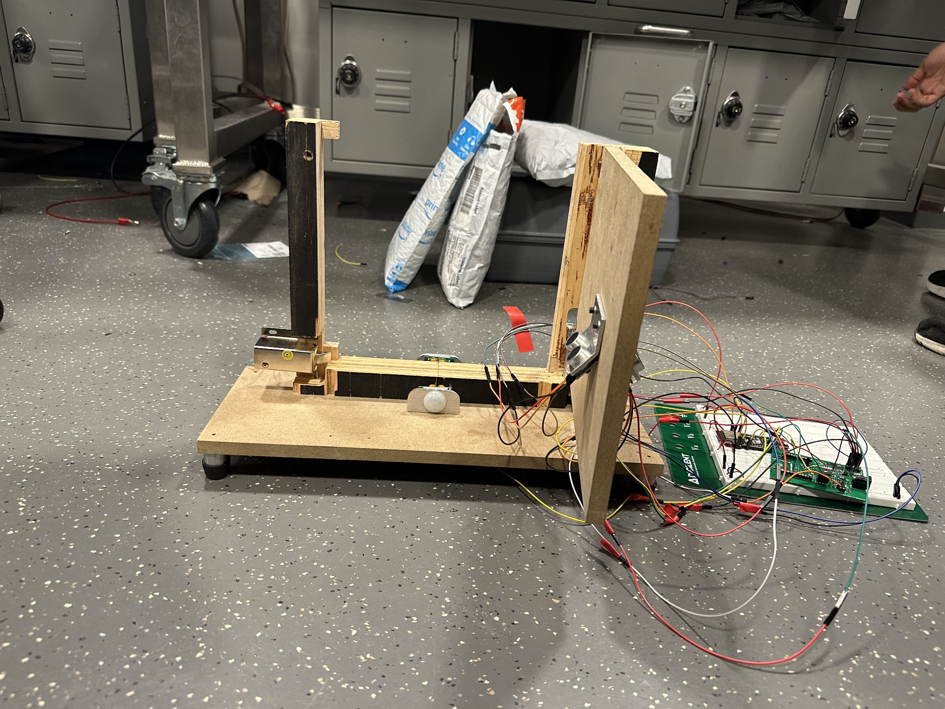
Conclusion - Lessons Learned
Have contingency plans
Ordering delays of PCB and parts
PCB circuit failing
Team expectations
Importance of communication
ELECTRICAL & COMPUTER ENGINEERING
GRAINGER ENGINEERING

Slide 29
Conclusion - Acknowledgement
We would like to thank:
Zicheng Ma (our TA) for support and pointing us in the right direction
Professor Victoria Shao for project feedback
ECE Machine Shop - handling our mechanical design
The rest of the ECE 445 course staff for running the course
ELECTRICAL & COMPUTER ENGINEERING
GRAINGER ENGINEERING

Slide 30
Citations
[1] Iyamba, N. (2012, March 12). Stairs Among Leading Causes of Injury, Death for Kids. KSL.com. https://www.ksl.com/article/19560857/stairs-among-leading-causes-of-injury-death-forkids#:~:text=Every%20six%20minutes%2C%20a%20child,stair%2Drelated%20falls%20every%20year
[2] IEEE. “”IEEE Code of Ethics”.” (2016), https://www.ieee.org/ about/corporate/governance/p7- 8.html
[3] AMC. “”AMC Code of Ethics and Professional Conduct”.” (2018), https://www.acm.org/code-of-ethics
[4] “Ultrasonic distance sensor - HC-SR04 (5V),” SEN-15569 - SparkFun Electronics, https://www.sparkfun.com/products/15569 (accessed Dec. 3, 2023).
[5] A. Industries, “Pir (motion) sensor,” adafruit industries blog RSS, https://www.adafruit.com/product/189 (accessed Dec. 3, 2023).
[6] “Micro bit lesson - using the Ultrasonic module,” Micro bit Lesson - Using the Ultrasonic Module " osoyoo.com, https://osoyoo.com/2018/09/18/micro-bit-lesson-using-the-ultrasonic-module/ (accessed Dec. 4, 2023).
ELECTRICAL & COMPUTER ENGINEERING
GRAINGER ENGINEERING

Slide 31
Thank You
ELECTRICAL & COMPUTER ENGINEERING
GRAINGER ENGINEERING

Slide 32
Questions?
ELECTRICAL & COMPUTER ENGINEERING
GRAINGER ENGINEERING

