Slide 1
Directional Impact Sensing Helmet
(DISH)
Team 5: Ryan Josephson, Patrick Sear, Saathvik Narra

Slide 2
Agenda
Objectives and Functionality
Design Discussion
Data Analysis
Successes and Challenges
Redesign Considerations
Notes:
R

Slide 3
Objectives and Functionality
Notes:
P

Slide 4
The Problem
Head collisions are a hot topic in the NFL
Concussions are common, resultant of repetitive head trauma
Difficult to recognize when an athlete experiences a potentially dangerous hit to the head from the sidelines
No tangible data for medical staff
Notes:
P

Slide 5
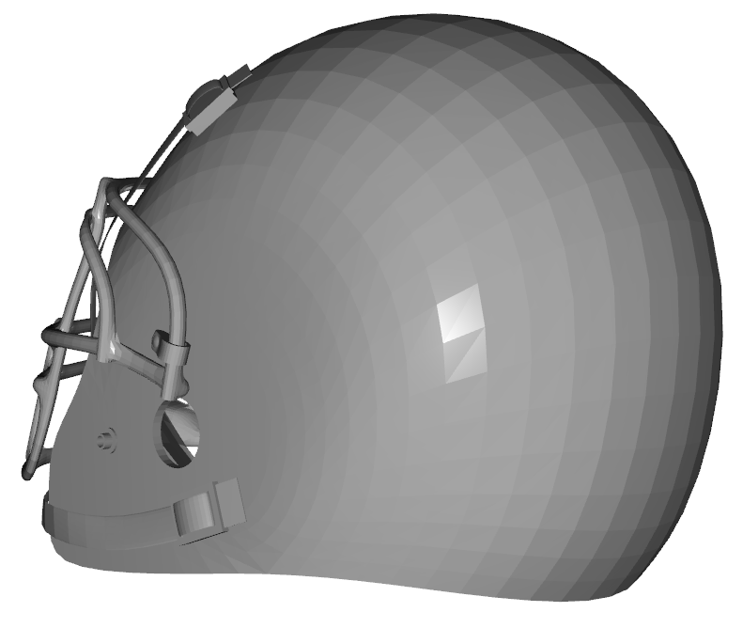
The Solution
Directional Impact Sensing Helmet (DISH)
Eight sensors around the helmet to measure force all around the head
Response to coaching and medical staff on whether a potentially hazardous collision occurred by the time of the next play
Data is saveable for a later analysis
Notes:
P

Slide 6
High Level Requirements
The helmet must track the location and severity of each collision within <20% error.
The receiver must know that a dangerous collision has occurred within 5 seconds of the collision at least 90% of the time.
The in-helmet system must be able to comfortably fit within a standard football helmet.
Notes:
S

Slide 7
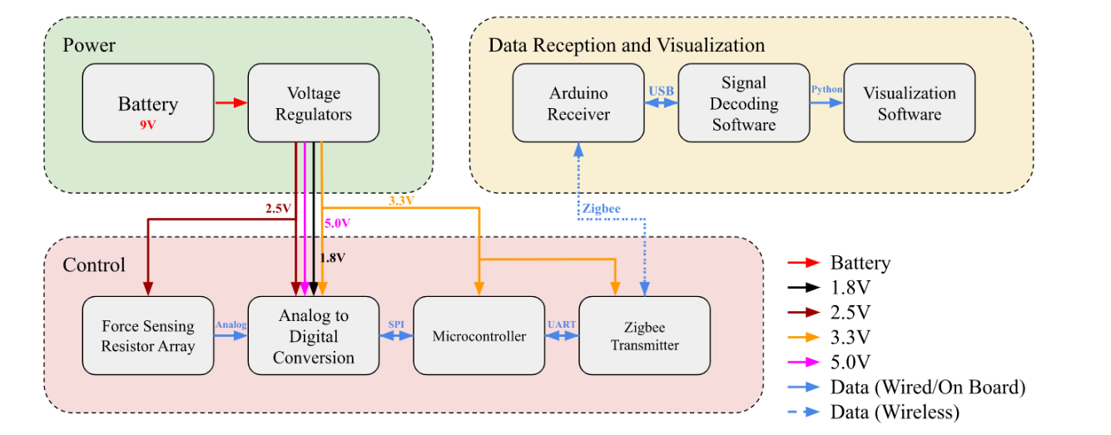
Block Diagram
Notes:
S

Slide 8
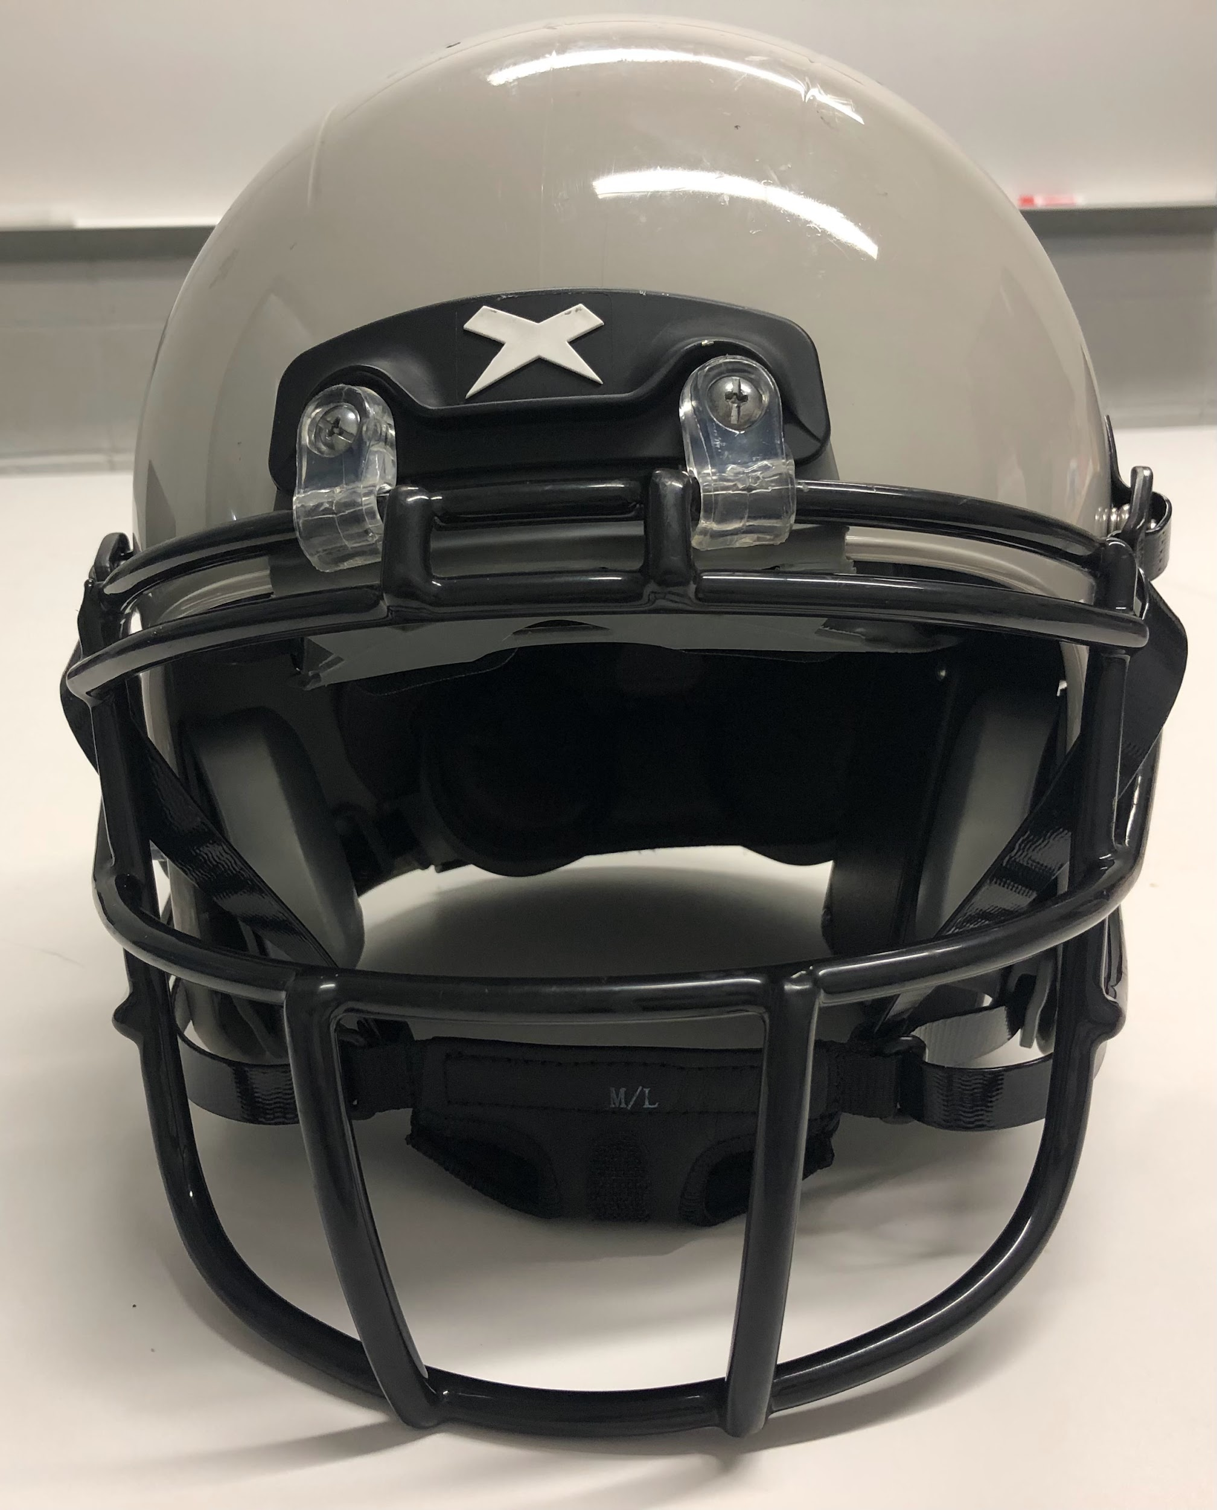
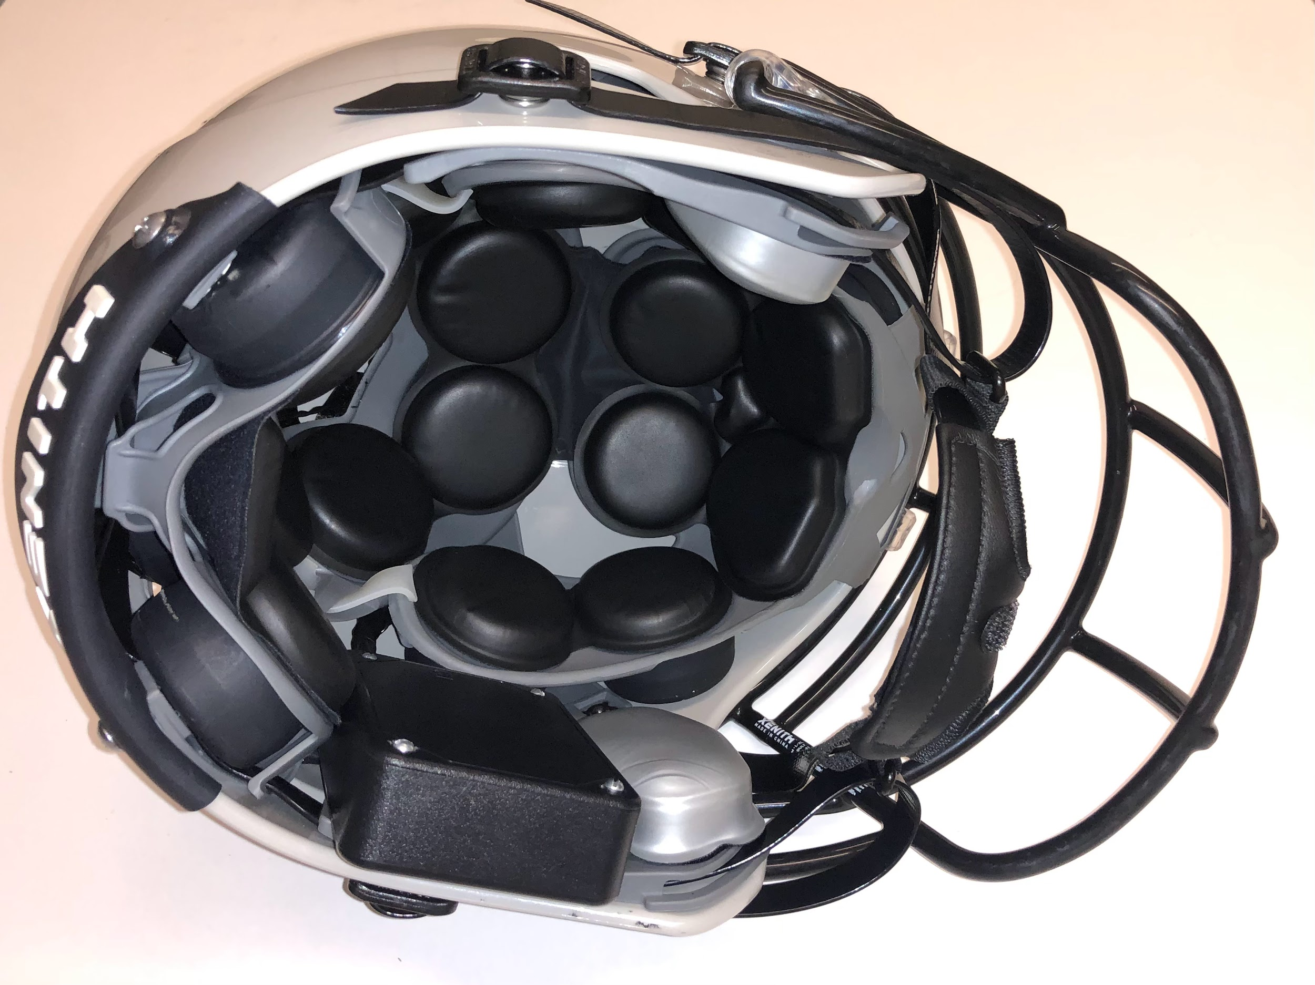
Assembled Helmet
Notes:
R

Slide 9
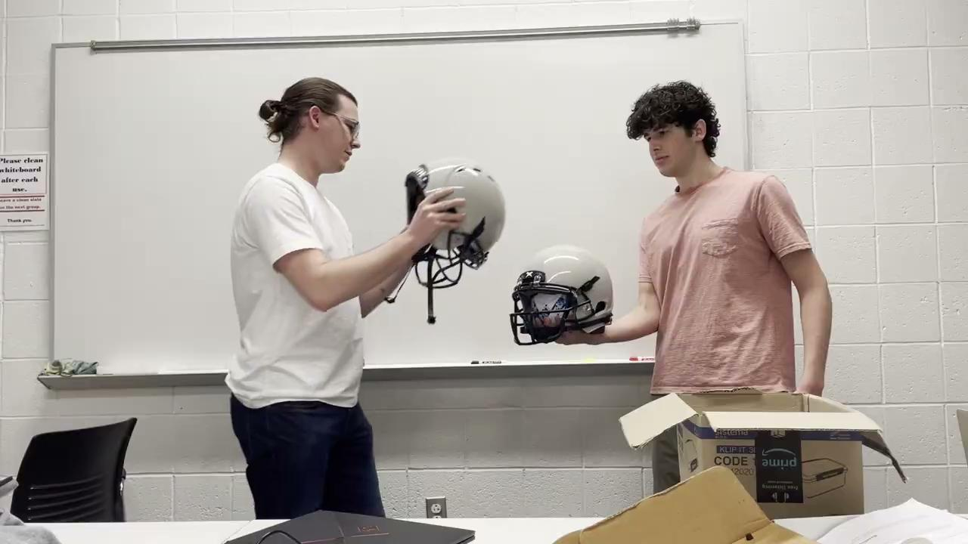
Video of Proper Functionality
Notes:
R

Slide 10
Design Discussion
Notes:
R

Slide 11
Design Discussion
Original Design | Finished Design
ATmega328P Chip | ATmega32u4 Chip
On-board ADC (Multiplexed) | External ADC (Simultaneous-sampling)
Inertial Measurement Unit (IMU) | Force Sensing Resistor Array
Bluetooth | Zigbee
Notes:
R
Original Design
ATmega328P chip, using analog-to-digital converter pins
Not enough channels for meaningful data
Channels aren’t sampled at the same time
Inertial Measurement Unit (IMU)
Expensive, difficult to use
Heavy duty, high accuracy force sensing resistors (FSR)
Expensive, inaccessible, unnecessary for the scope of this project
Bluetooth
Very modern, but is relatively pricey
Low range (10m) for our purposes
Finished Design
External simultaneous-sampling analog to digital converter (ADC)
Up to eight sampling channels, each sampled at the same time at a faster sampling rate
ATmega32u4 microcontroller (MCU)
More input and output pins to control external ADC, more processing power
No IMU used
Overcomplicates the scope of the project
Cheap FSRs
Well within budget, accurate enough for our purposes
Zigbee
Inexpensive
Up to 100m range
Designed with IOT devices in mind
Prior experience

Slide 12
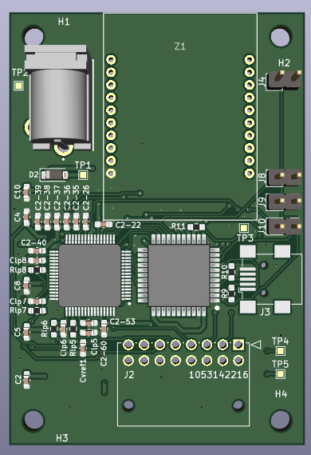
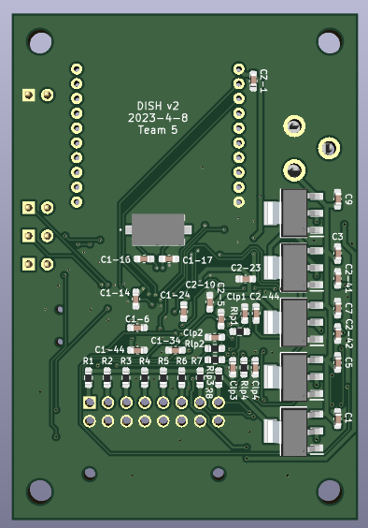
PCB Design
Front
Back
Notes:
R

Slide 13
Power Subsystem RV
The battery must supply a constant voltage between 6.4V and 10V and supports up to 350mA of current draw. | PASS | Voltage maintained in proper range Current draw exceeded 350 mA
The 1.8V rail must maintain a voltage between 1.65V and 1.95V at a current of at least 17mA. | PASS | Voltage maintained in proper range Current draw exceeded 17 mA
The 2.5V rail must maintain a voltage between 2.475V and 2.525V at a current of at least 20mA. | PASS | Voltage maintained in proper range Current draw exceeded 20mA
The 3.3V rail must maintain a voltage between 2.7V and 3.6V at a current of at least 220.5mA. | PASS | Voltage maintained in proper range Current draw exceeded 220.5 mA
The 5V rail must maintain a voltage between 4.75V and 5.25V at a current of at least 91mA. | PASS | Voltage maintained in proper range Current draw exceeded 91 mA
Notes:
R

Slide 14
MCU Control Flow
No
Initialize MCU
Calibrate Sensors
Read Sensors
Collision?
Yes
Collect Data
Zigbee Transmit
Notes:
P
Original Design
ATmega328P chip, using analog-to-digital converter pins
Not enough channels for meaningful data
Channels aren’t sampled at the same time
Finished Design
External simultaneous-sampling analog to digital converter (ADC)
Up to eight sampling channels, each sampled at the same time at a faster sampling rate
ATmega32u4 microcontroller (MCU)
More input and output pins to control external ADC, more processing power

Slide 15
Zigbee
[1]
Notes:
S

Slide 16
Control Subsystem RV
The microcontroller must be able to comprehend data from the analog to digital converter via SPI over 90% of the time. | PASS | Data consistently read correctly
The microcontroller must be able to send and receive signals to and from the remote receiver via the Zigbee transmitter 90% of the time. | PASS | Sent transmissions were properly received
The off-chip simultaneous sampling ADC must be able to measure all signals from the force sensing resistor array concurrently more than 90% of the time. | PASS | ADC measured FSR data concurrently
The Zigbee transmitter must be able to properly send a signal up to 40 meters away through adverse conditions | PASS | Transmission was read at a 40m distance Transmission was read through walls
Notes:
S

Slide 17
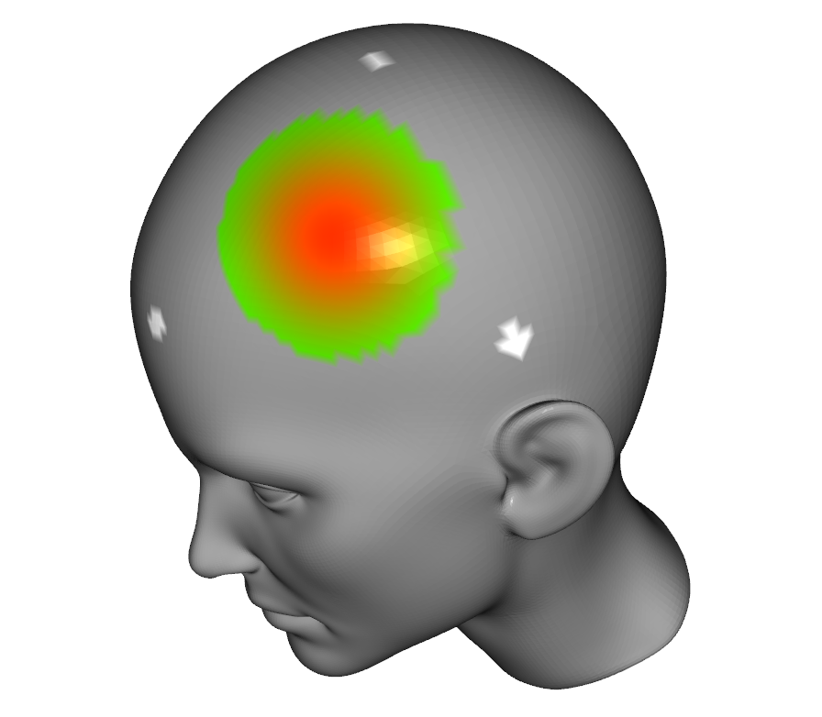
End-User Data Reception
Transmit data through Arduino to Python script
Calculate position data based on forces
Notes:
P
Converting digital signal into meaningful force value
Linear extrapolation by measuring forces on a sensor at different ranges
Visualizing the data
Heat map of force data
Pop-up with forces at top sensors

Slide 18
Data Reception and Visualization Subsystem RV
The receiver must receive packets sent with a maximum error rate of 10%. | PASS | No errors received in the packets
The signal received by the Arduino must be delivered to the serial input exactly as it is seen by the hardware. | PASS | Data transmitted via the serial port matches the data sent from the Arduino
The visualizer must be able to identify the impact within 20% of where it occurred. | PASS | Impact location is properly determined from the provided data
The data must be visualized within 30 seconds of packet reception. | PASS | The data was visualized within 30 seconds
Notes:
P

Slide 19
Data Analysis
Notes:
S

Slide 20
Managing the ADC Sampling Clock
[2]
Notes:
S
ADC is controlled by MCU using Digital IO
SCLK is generated by dividing MCU CLK
DRDY can flip mid-sample, writing over data
Increase SCLK frequency

Slide 21
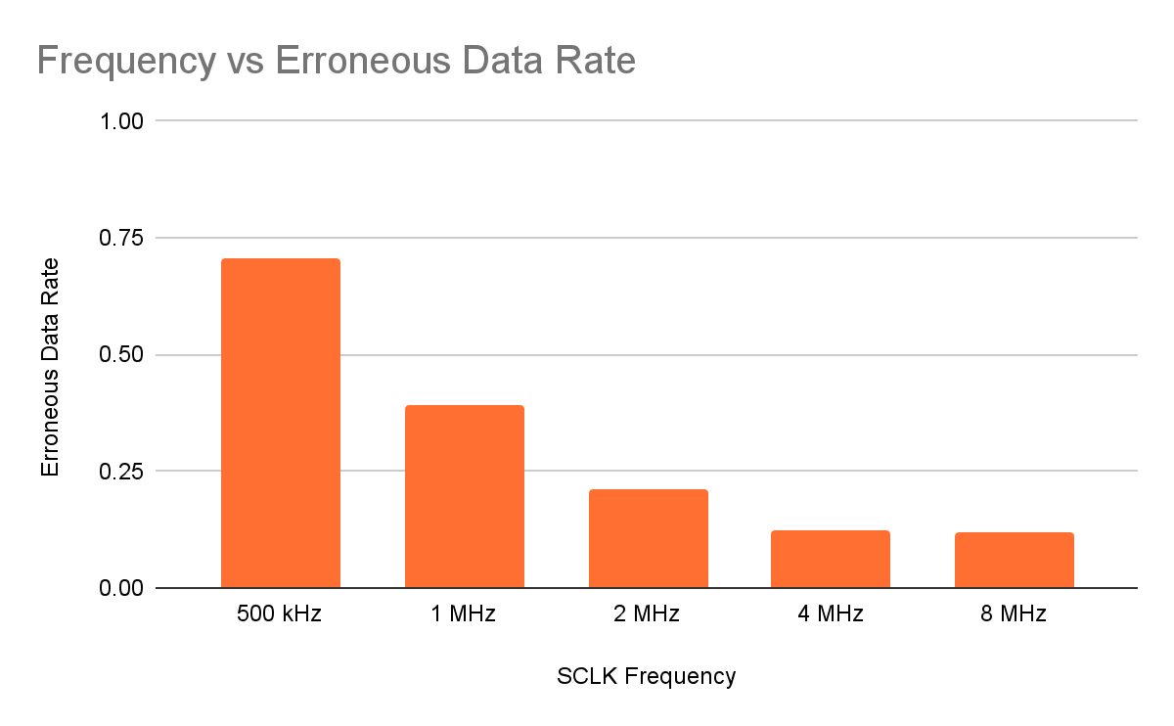
SCLK Management
Notes:
S

Slide 22
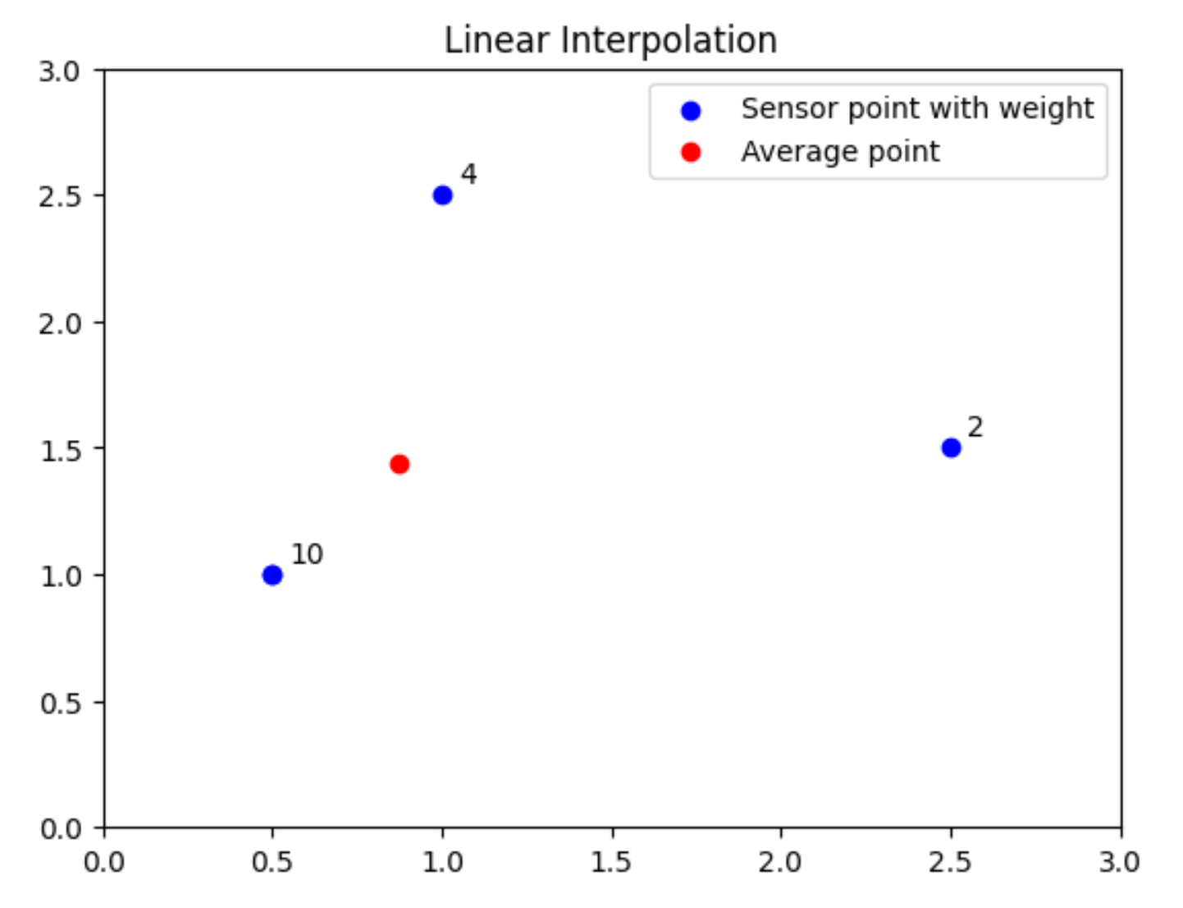
Collision Localization
Notes:
P
Weighted average of 3 most significant data points
Result is projected onto the surface of the model
Accurate for idealized data

Slide 23
Challenges and Successes
Notes:
P

Slide 24
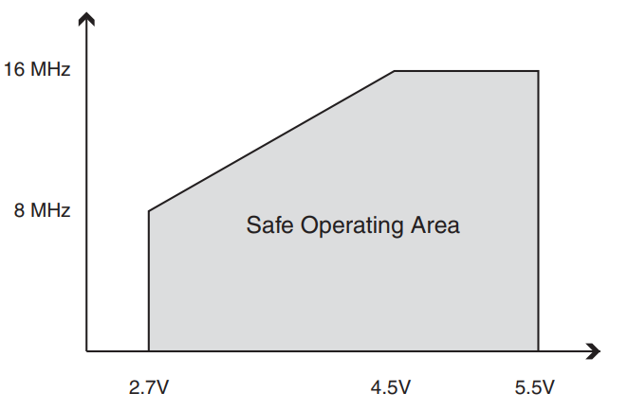
MCU Operation at 3.3V
Brown-out Protection
8MHz Clock Frequency
[3]
Notes:
R

Slide 25
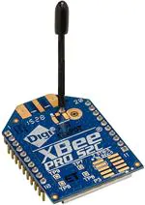
Zigbee UART Communication
Baud Rate at reduced CLK frequency
Addresses too simple
[4]
Notes:
S
RX and TX were flipped on the PCB (point to the 2nd and 3rd pins and be like “these were flipped but was an easy fix since we only needed TX”)
Baud rate needed to be doubled at the halved frequency
x1111 and x2222 were too simple, getting interference on our transmission channel from another project, which was super unlucky

Slide 26
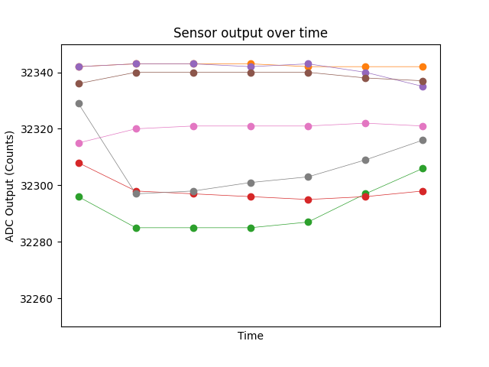
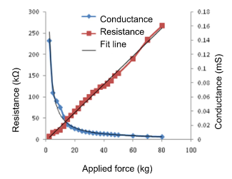
FSR Inaccuracy
[5]
Notes:
P
FSRs are incredibly inaccurate
Filtering the data based on calculated averages

Slide 27
Redesign Considerations
Notes:
P

Slide 28
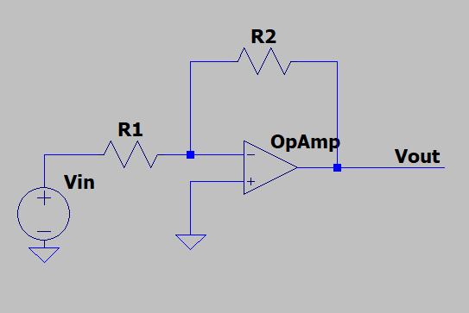
Changes to FSR Circuit
Change from voltage divider to Inverting OpAmp circuit
Vout = -Vin x R2/R1
Perhaps use multiple IMUs instead of FSRs entirely
Notes:
R

Slide 29
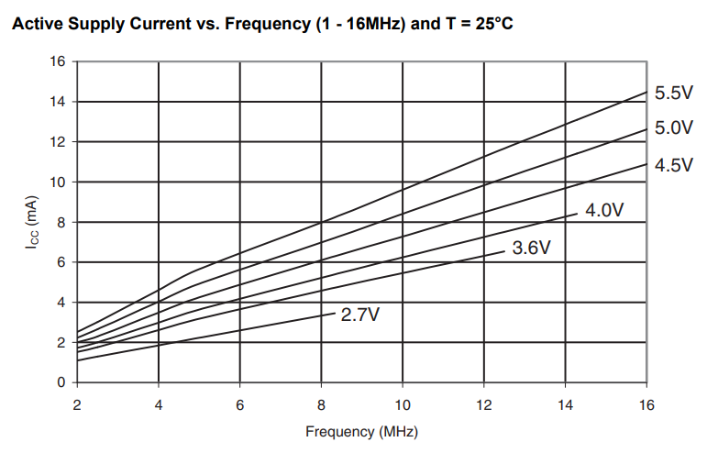
MCU Changes
Use a different MCU, perhaps an STM chip
Operate ATmega32u4 MCU at 5V and 16MHz
[3]
Notes:
R
Use a different MCU, perhaps an STM chip
Easier access to internal signals, such as access to more CLK pins
Operate ATmega32u4 MCU at 5V and 16MHz
Need to add voltage stepping logic between ADC and MCU to interface 5V IO and 3.3V IO
Would reduce risk of bricking MCUs

Slide 30
Thank You
Notes:
R

Slide 32
References
[1] STMicroelectronics, “Introduction to Zigbee,” Wiki by ST, https://wiki.st.com/stm32mcu/wiki/Connectivity:Introduction_to_Zigbee.
[2] Texas Instruments, “Quad/Octal, Simultaneous Sampling, 16-Bit Analog-to-Digital
Converters,” ADS1174/ADS1178 Datasheet, Sept. 2008, https://www.ti.com/lit/ds/symlink/ads1178.pdf.
[3] Atmel, “8-bit Microcontroller with 16/32K bytes of ISP Flash and USB Controller,”
ATmega16U4/ATmega32U4 Datasheet, Apr. 2016, https://ww1.microchip.com/downloads/en/devicedoc/atmel-7766-8-bit-avr-atmega16u4-32u4_datasheet.pdf.
[4] Digi, “XB24CARIS-001,” Mouser Electronics, https://www.mouser.com/ProductDetail/DIGI/XB24CARIS-001?qs=%2FPVulymFwT1eSADmJdbjyA%3D%3D&amp;mgh=1&amp;gclid=Cj0KCQiAorKfBhC0ARIsAHDzsls3IfdkLT7t65gaaT9eU6Dni07qGliqDxDNBRQ8jfrE5-DNa0v5gwUaAgzwEALw_wcB.
[5] “1kg 3kg 5kg 10kg 20kg 30kg 50kg 100kg 150kg Film Pressure Sensor Resistive Force
Sensitive Plantar Flexible Robot Fsr Insole - Sensors - AliExpress,” aliexpress.com. https://www.aliexpress.us/item/2251832774382148.html.

Slide 33
Additional RV Testing Information
Notes:
P

Slide 34
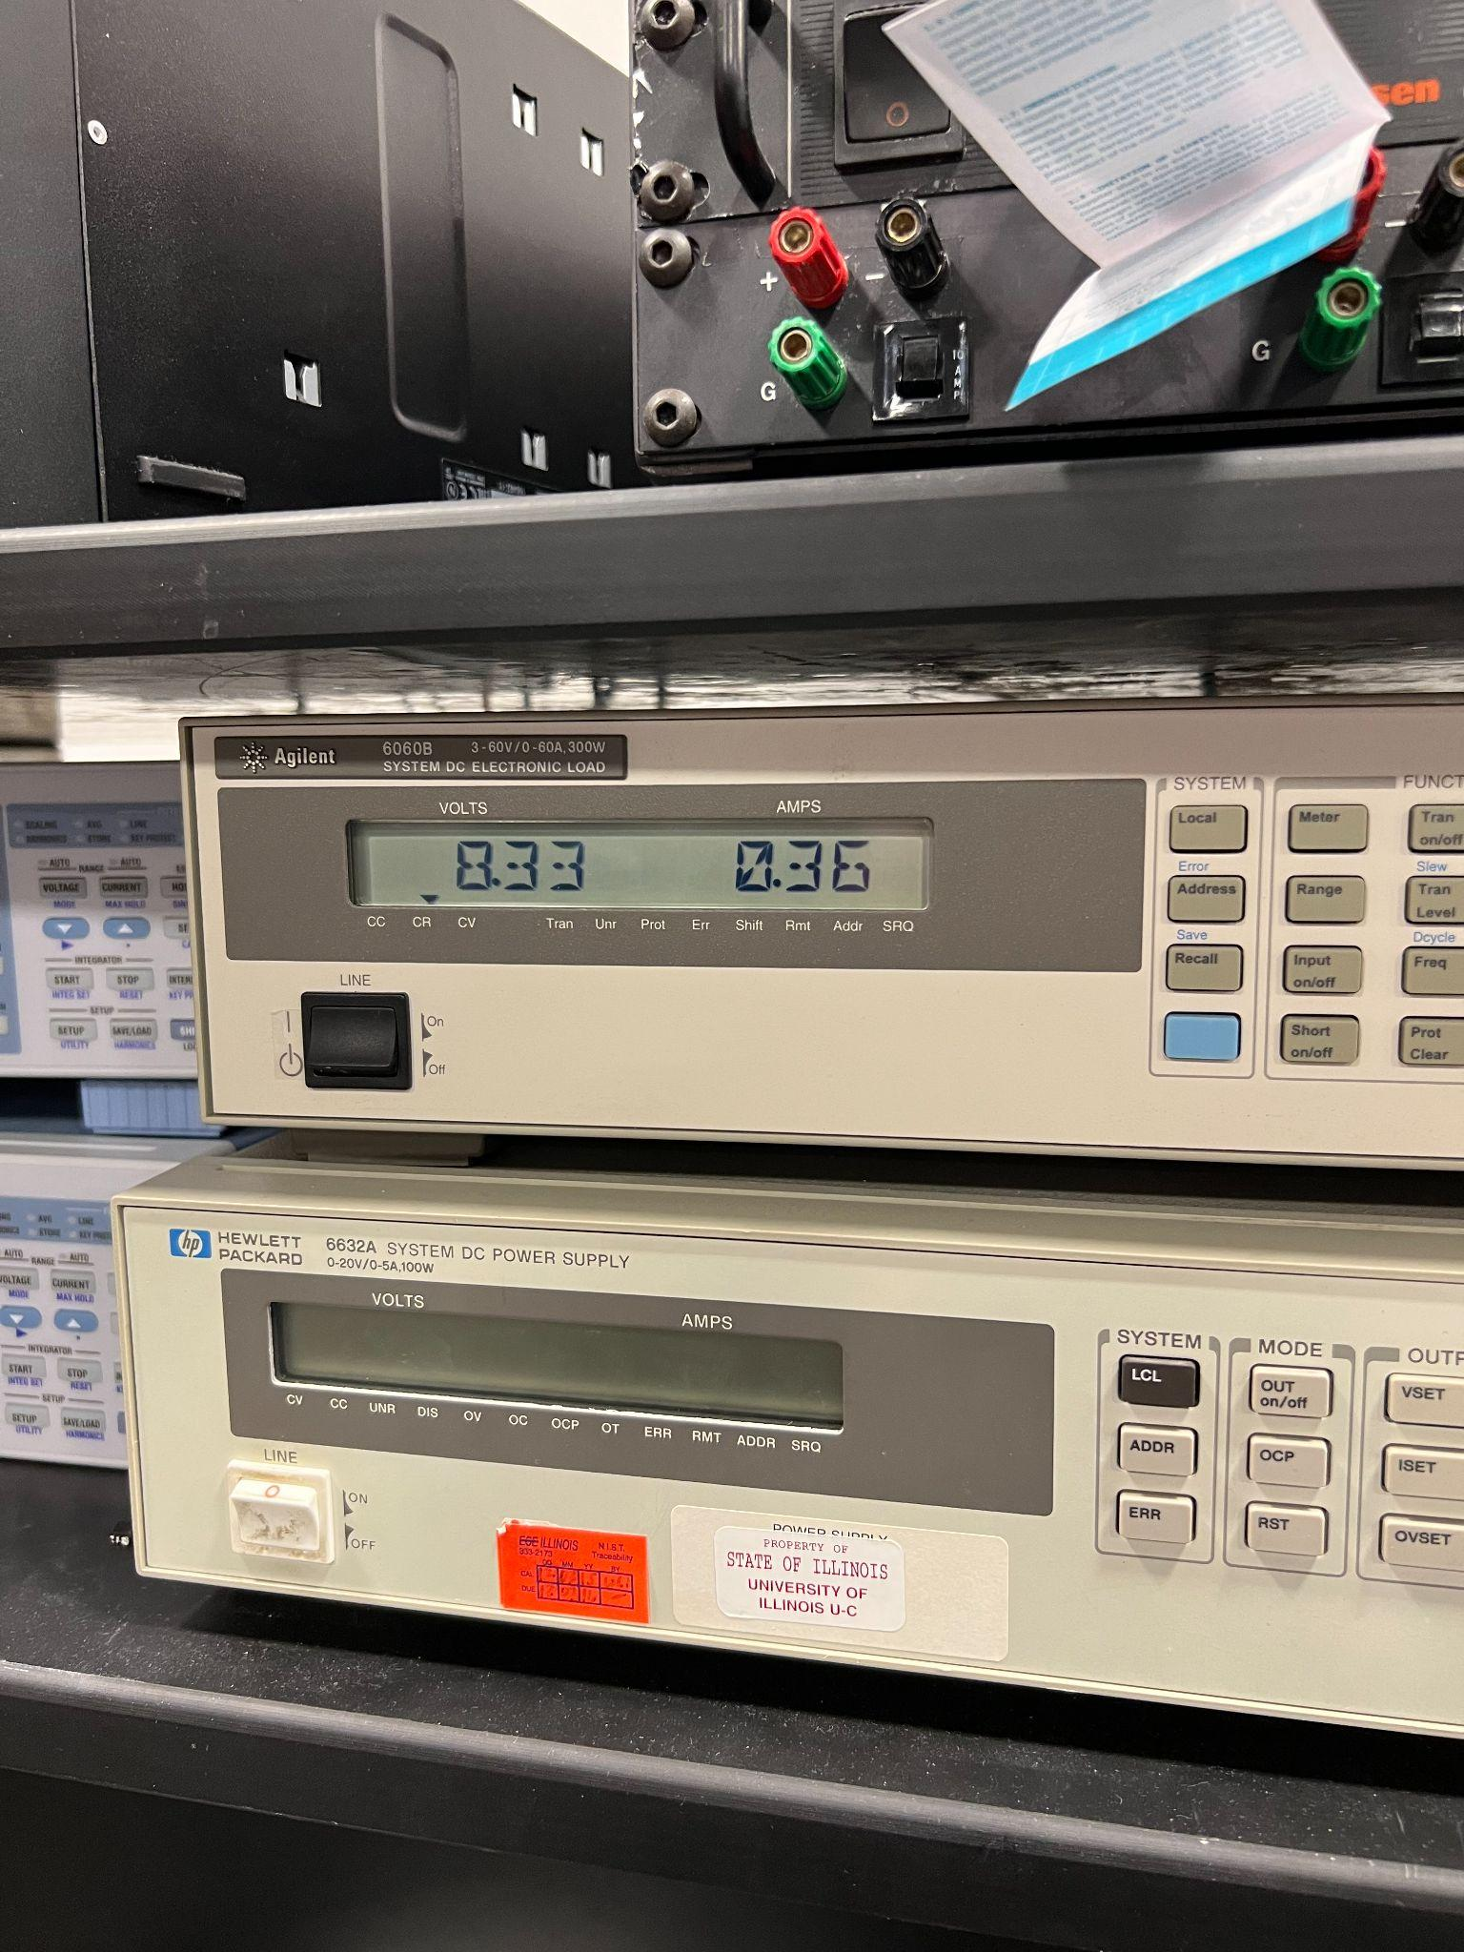
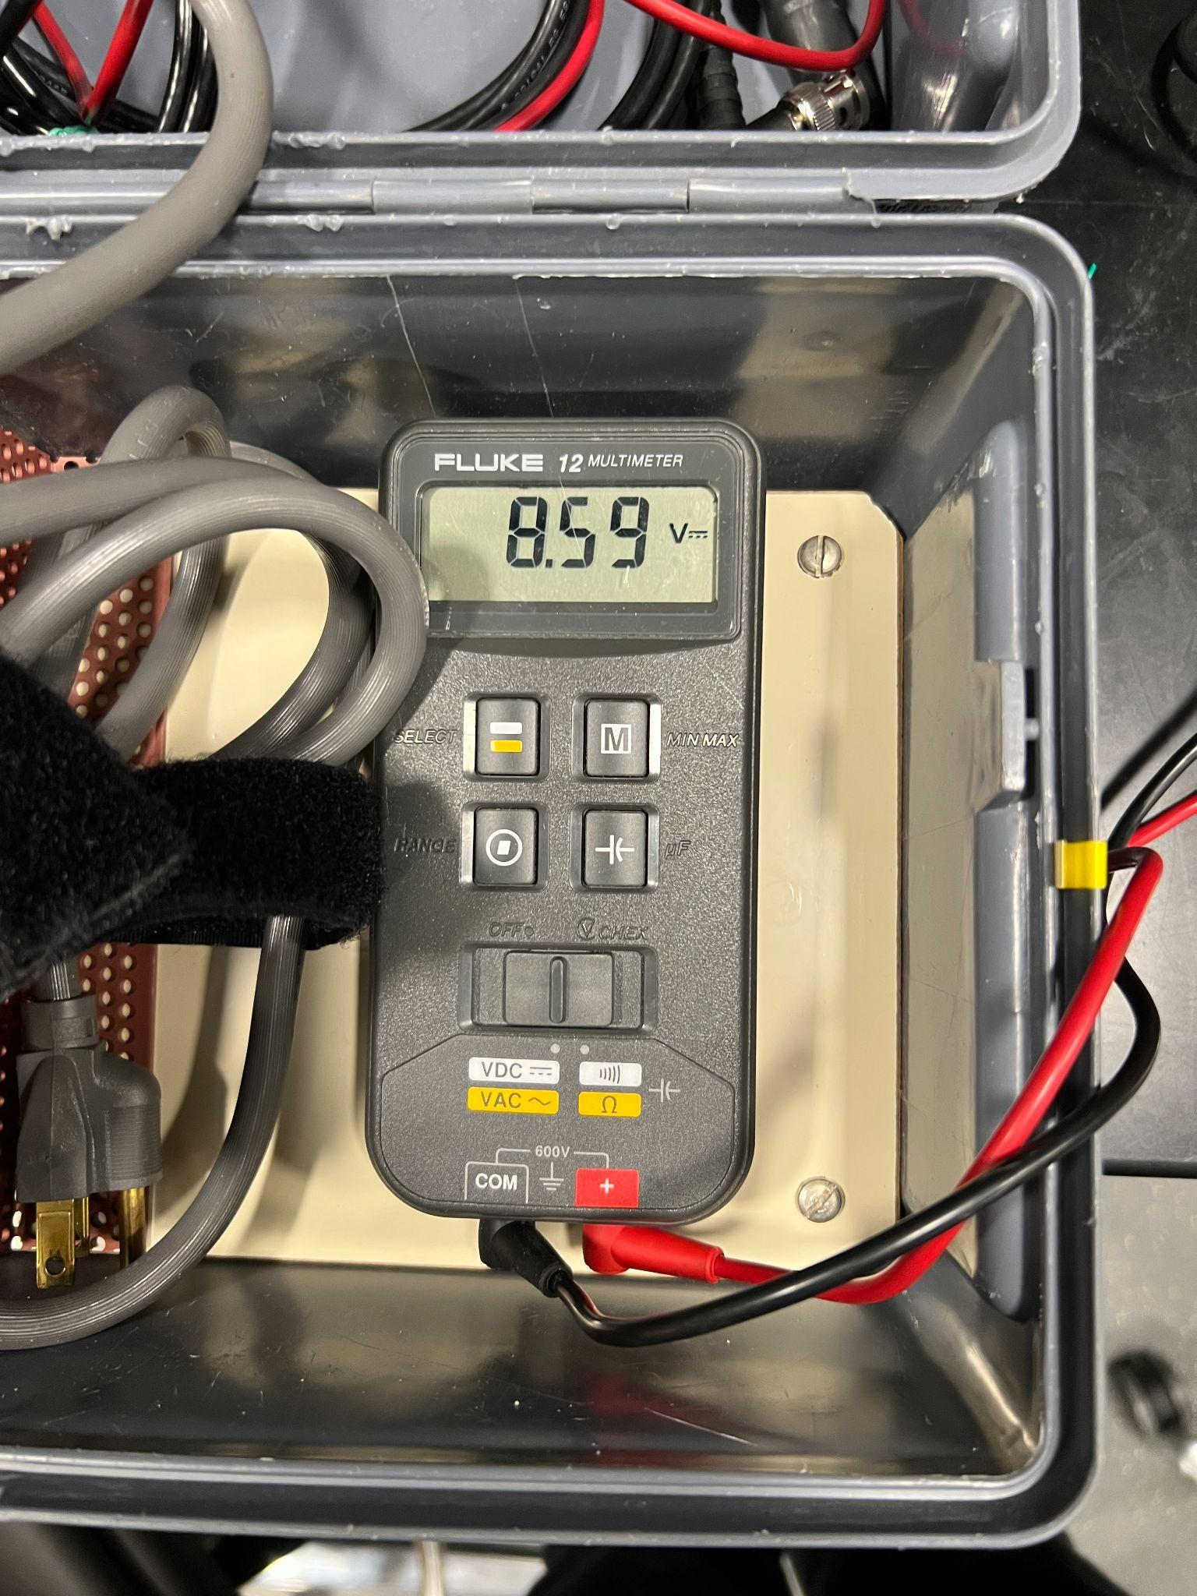
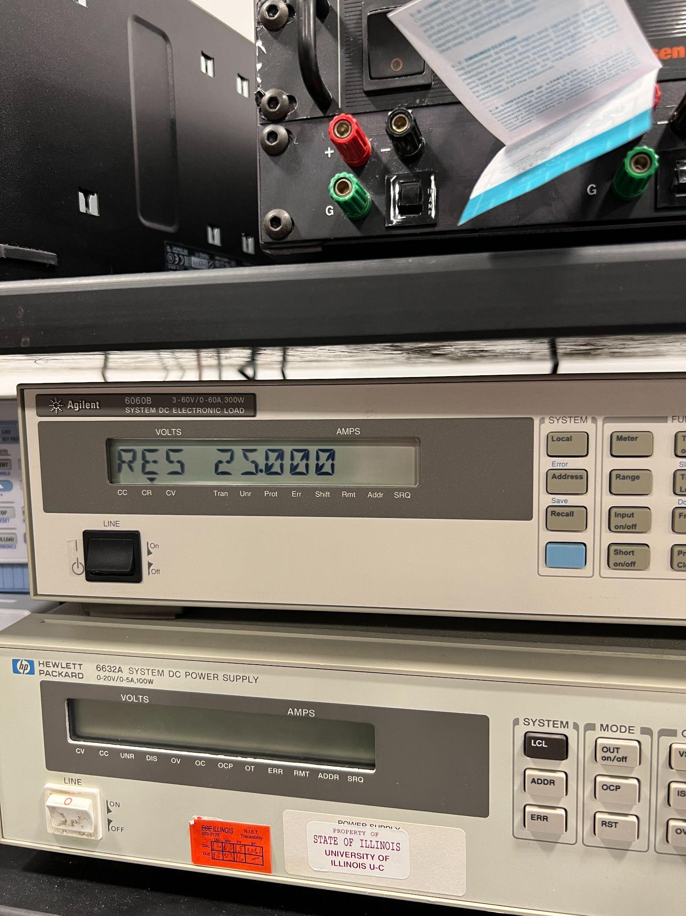
Power Subsystem Verification
1. The battery must supply a constant voltage between 6.4V and 10V and supports up to 350mA of current draw.
Voltage between 6.4V and 10V ✔ Current Draw exceeds 350mA ✔

Slide 35
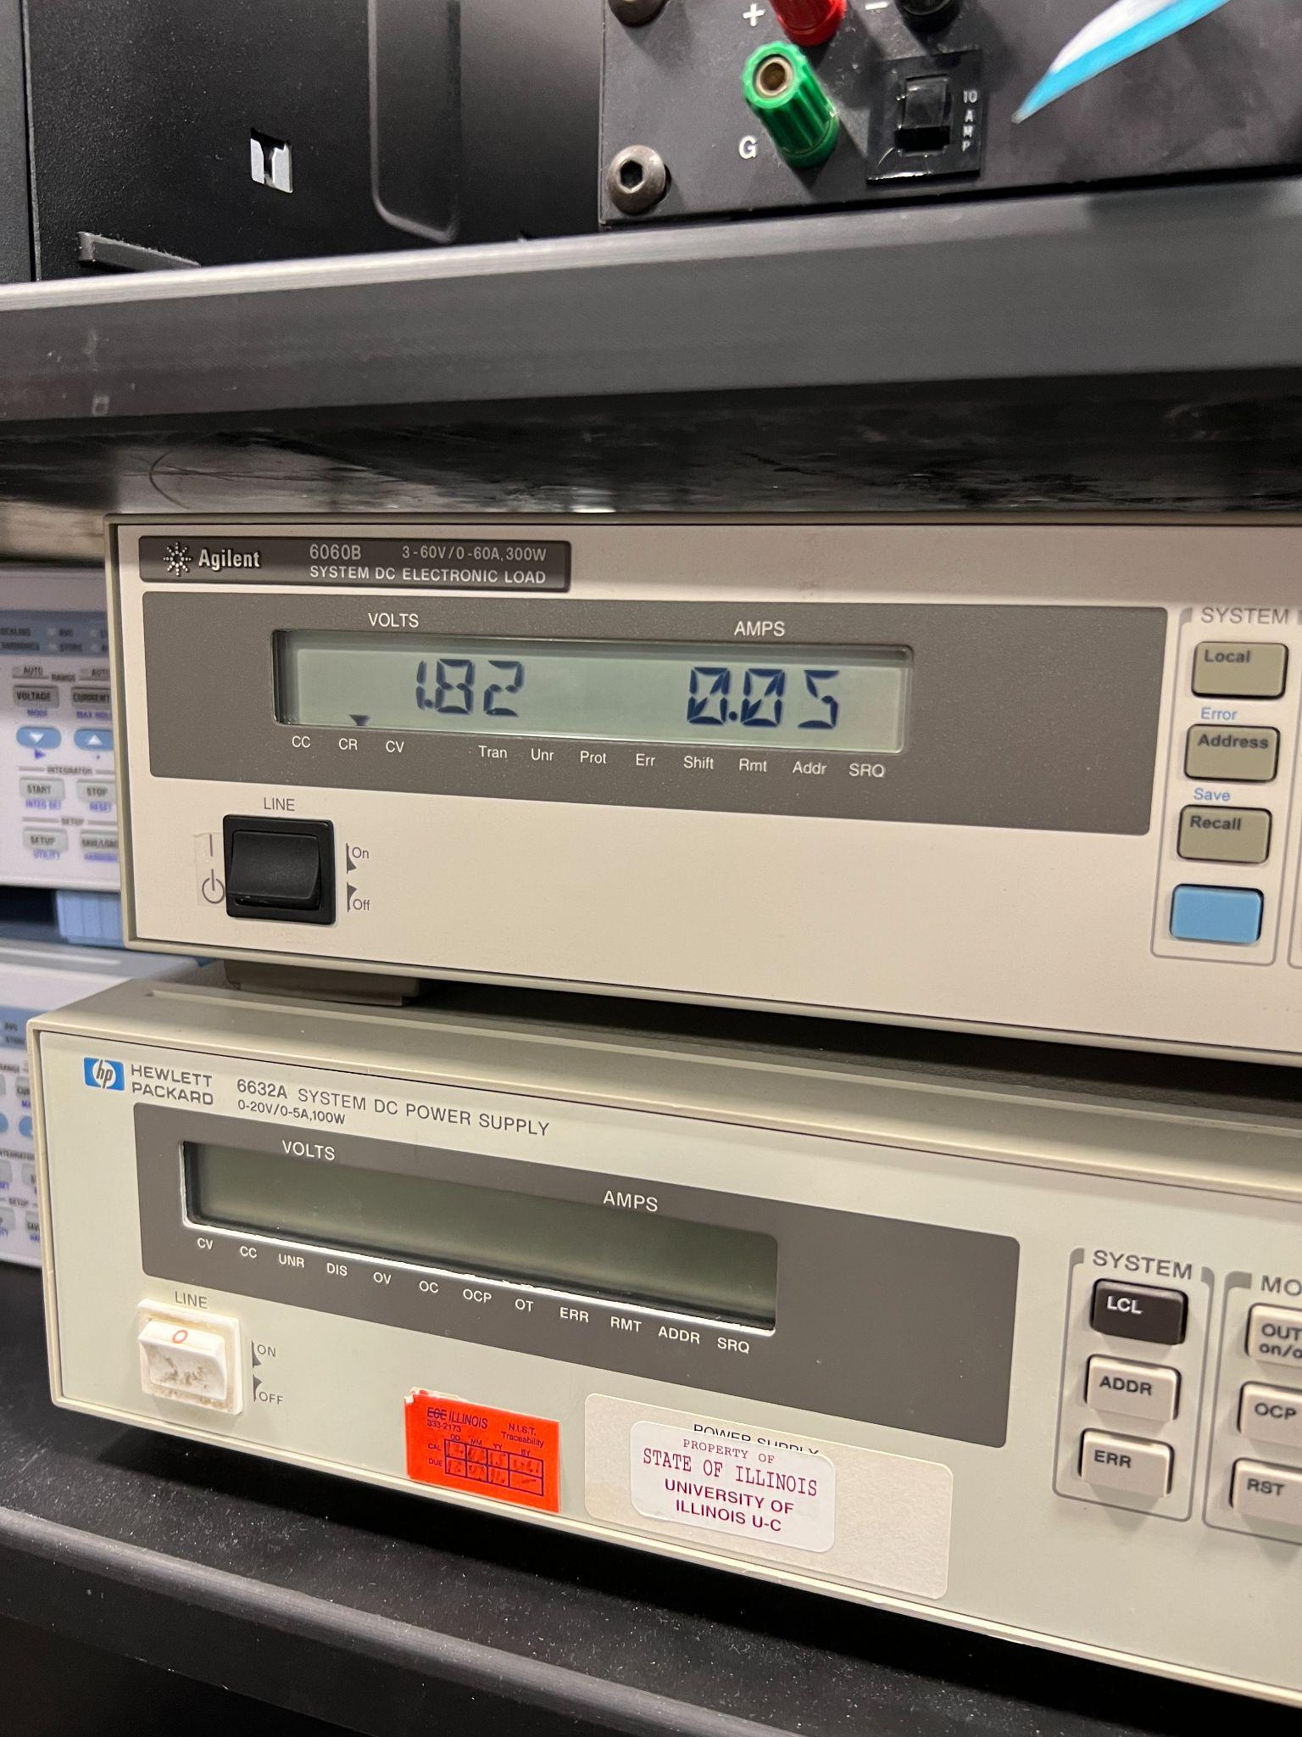
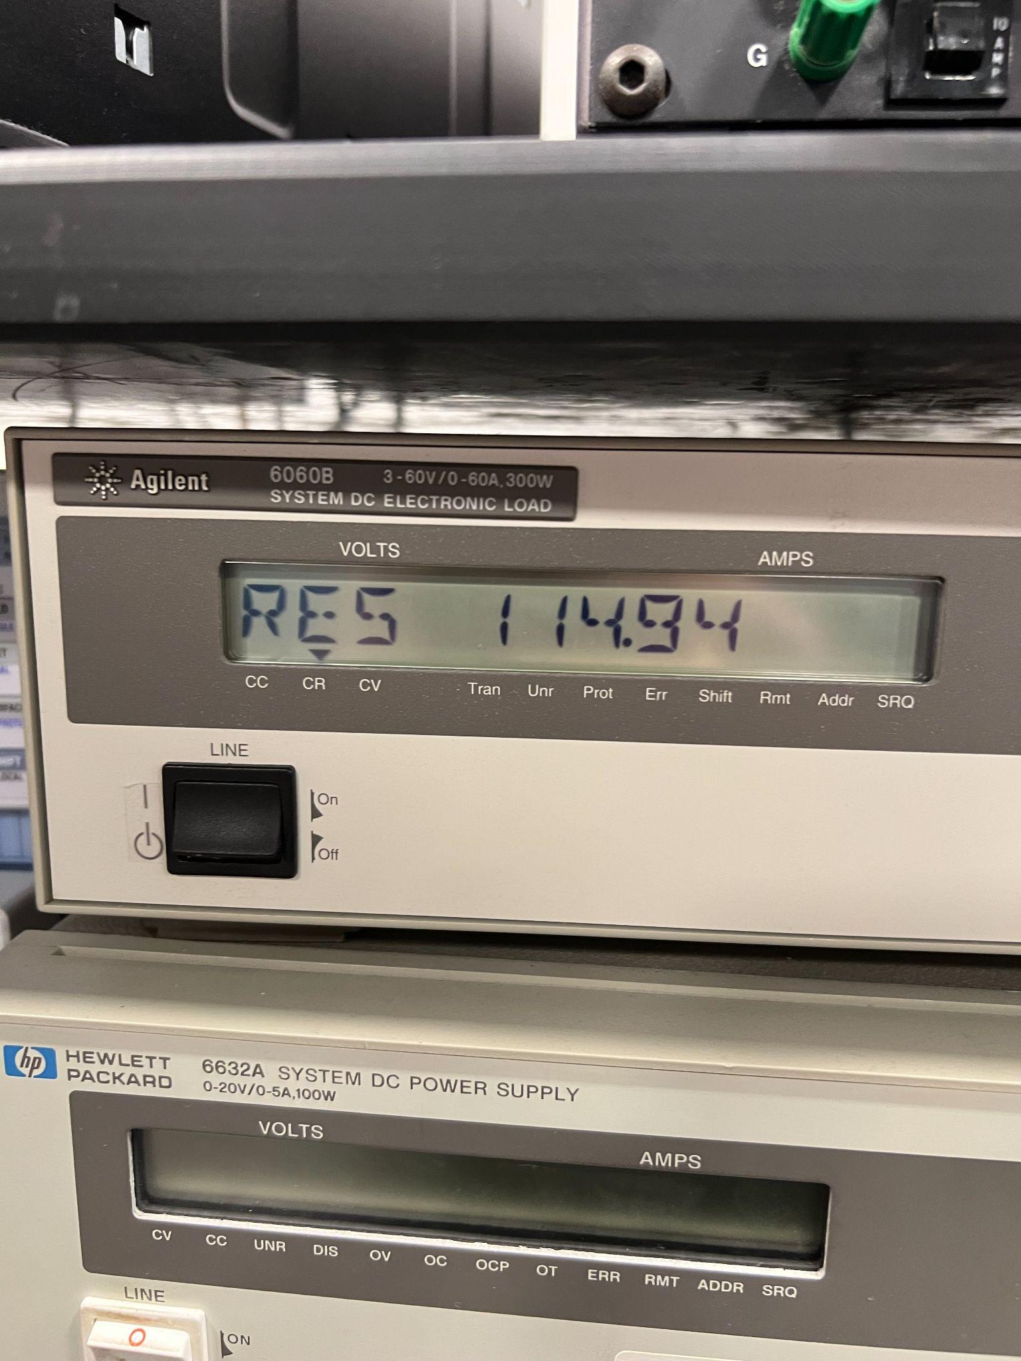
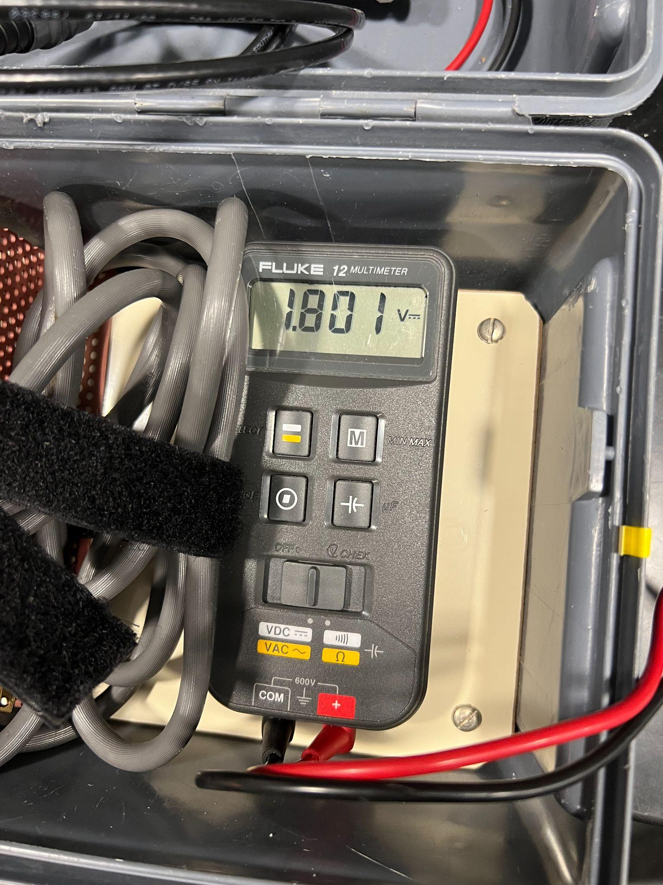
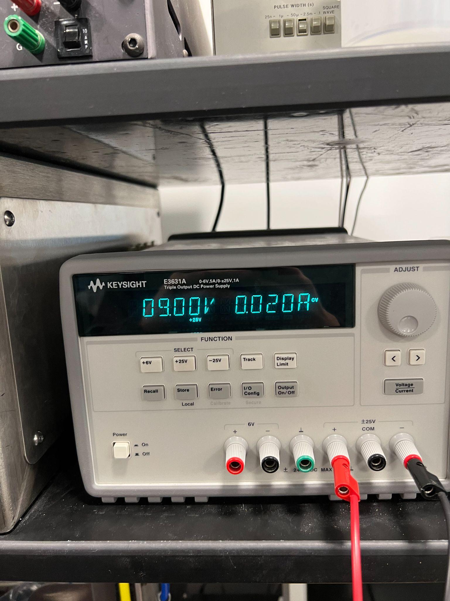
Power Subsystem Verification
2. The 1.8V rail must maintain a voltage between 1.65V and 1.95V at a current of at least 17mA.
Voltage between 1.65V and 1.95V ✔ Current Draw exceeds 17mA ✔

Slide 36
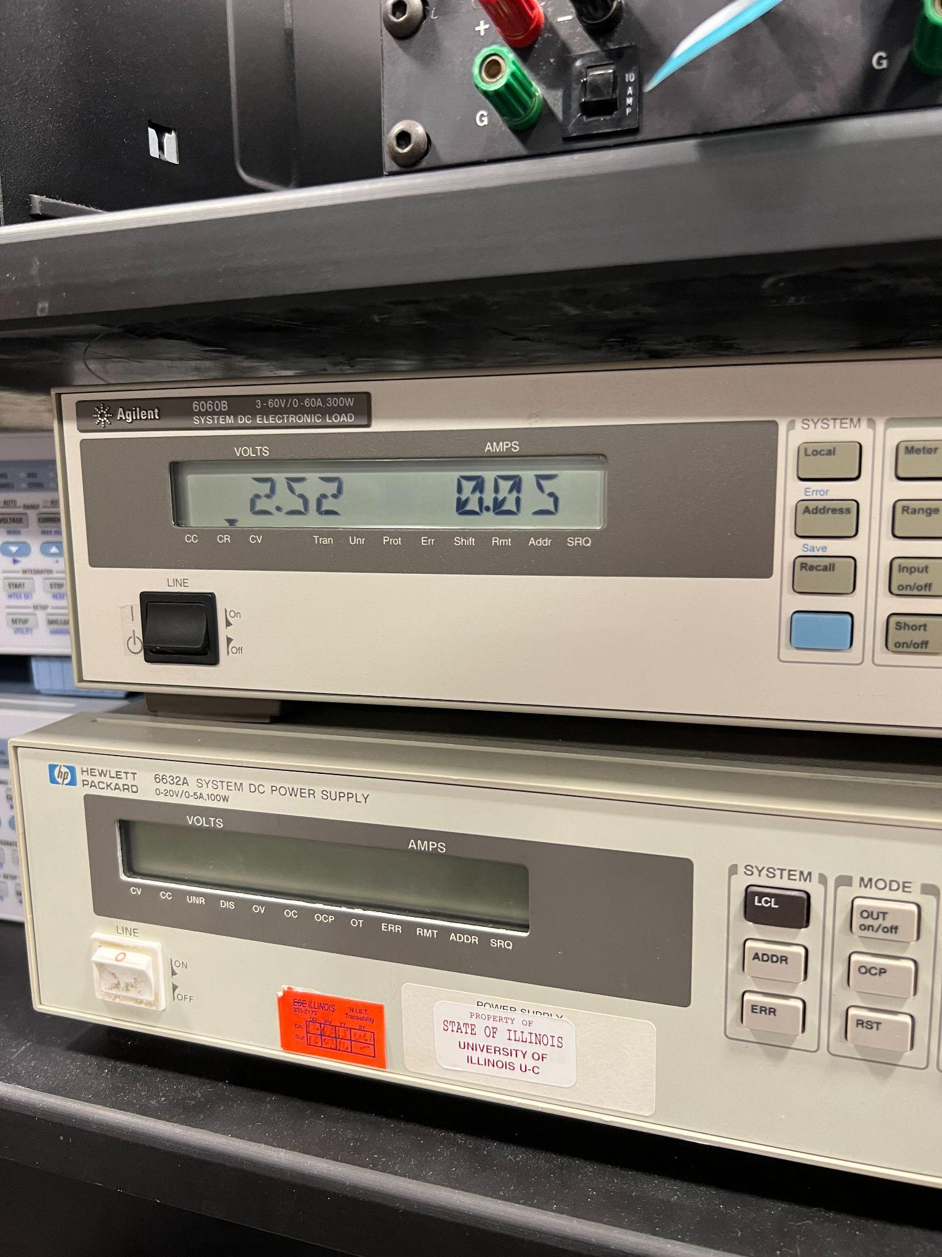
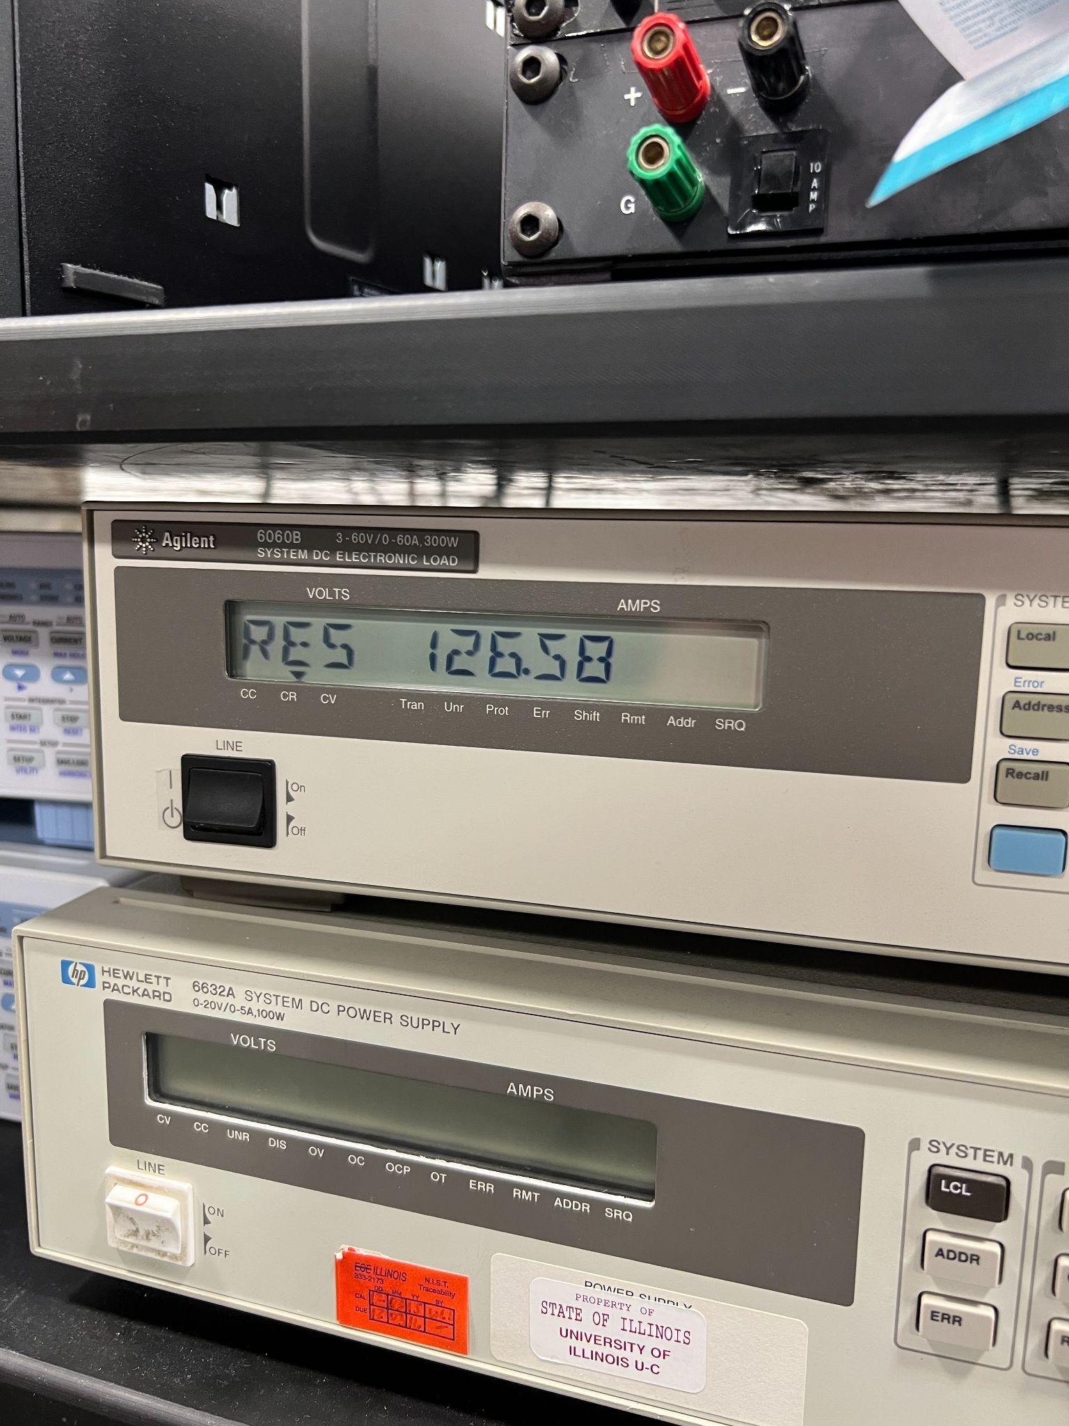
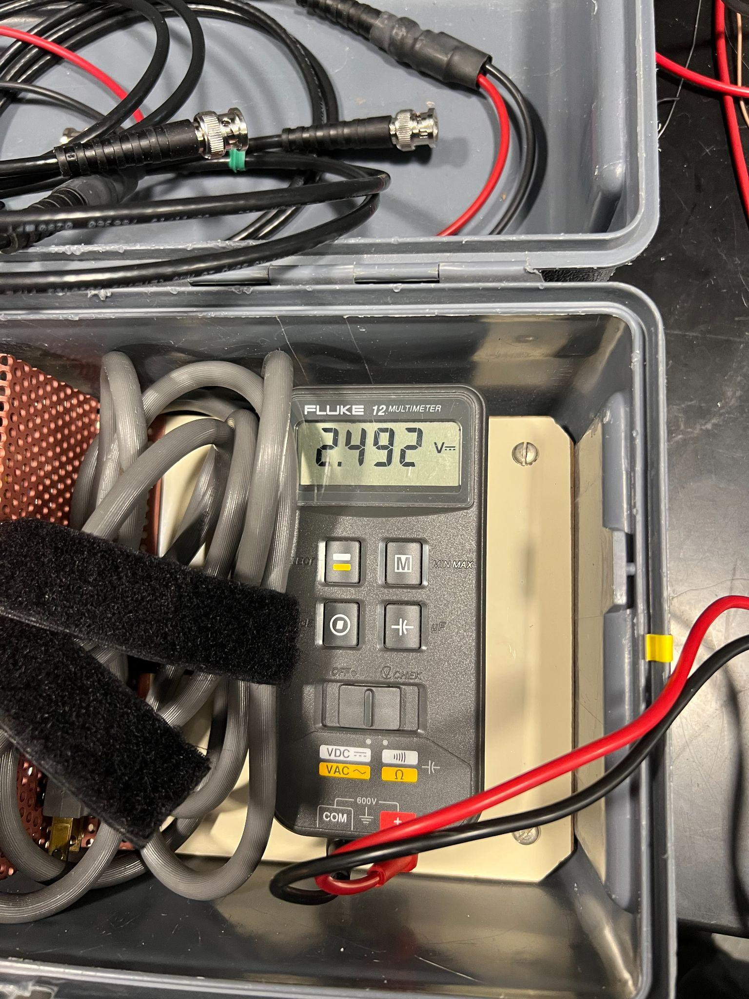
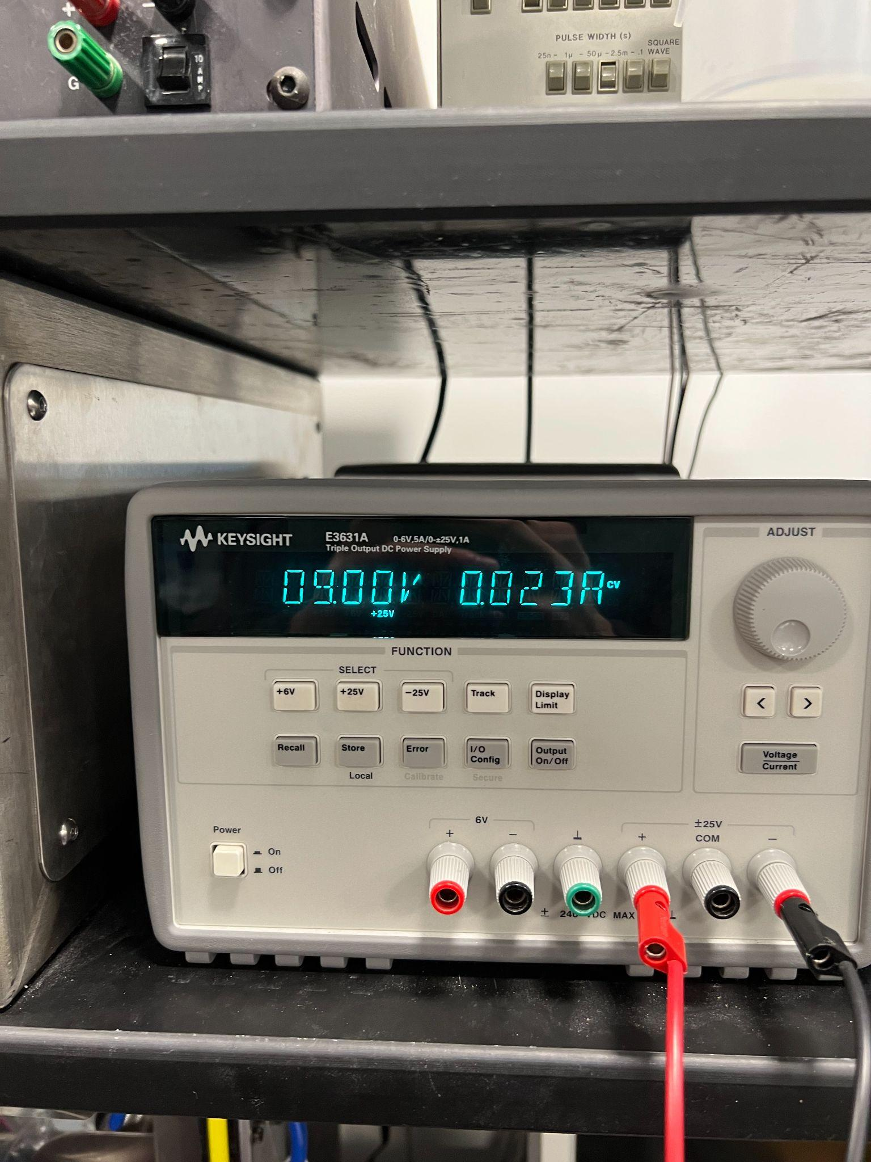
Power Subsystem Verification
3. The 2.5V rail must maintain a voltage between 2.475V and 2.525V at a current of at least 20mA.
Voltage between 2.475V and 2.525V ✔ Current Draw exceeds 20mA ✔

Slide 37
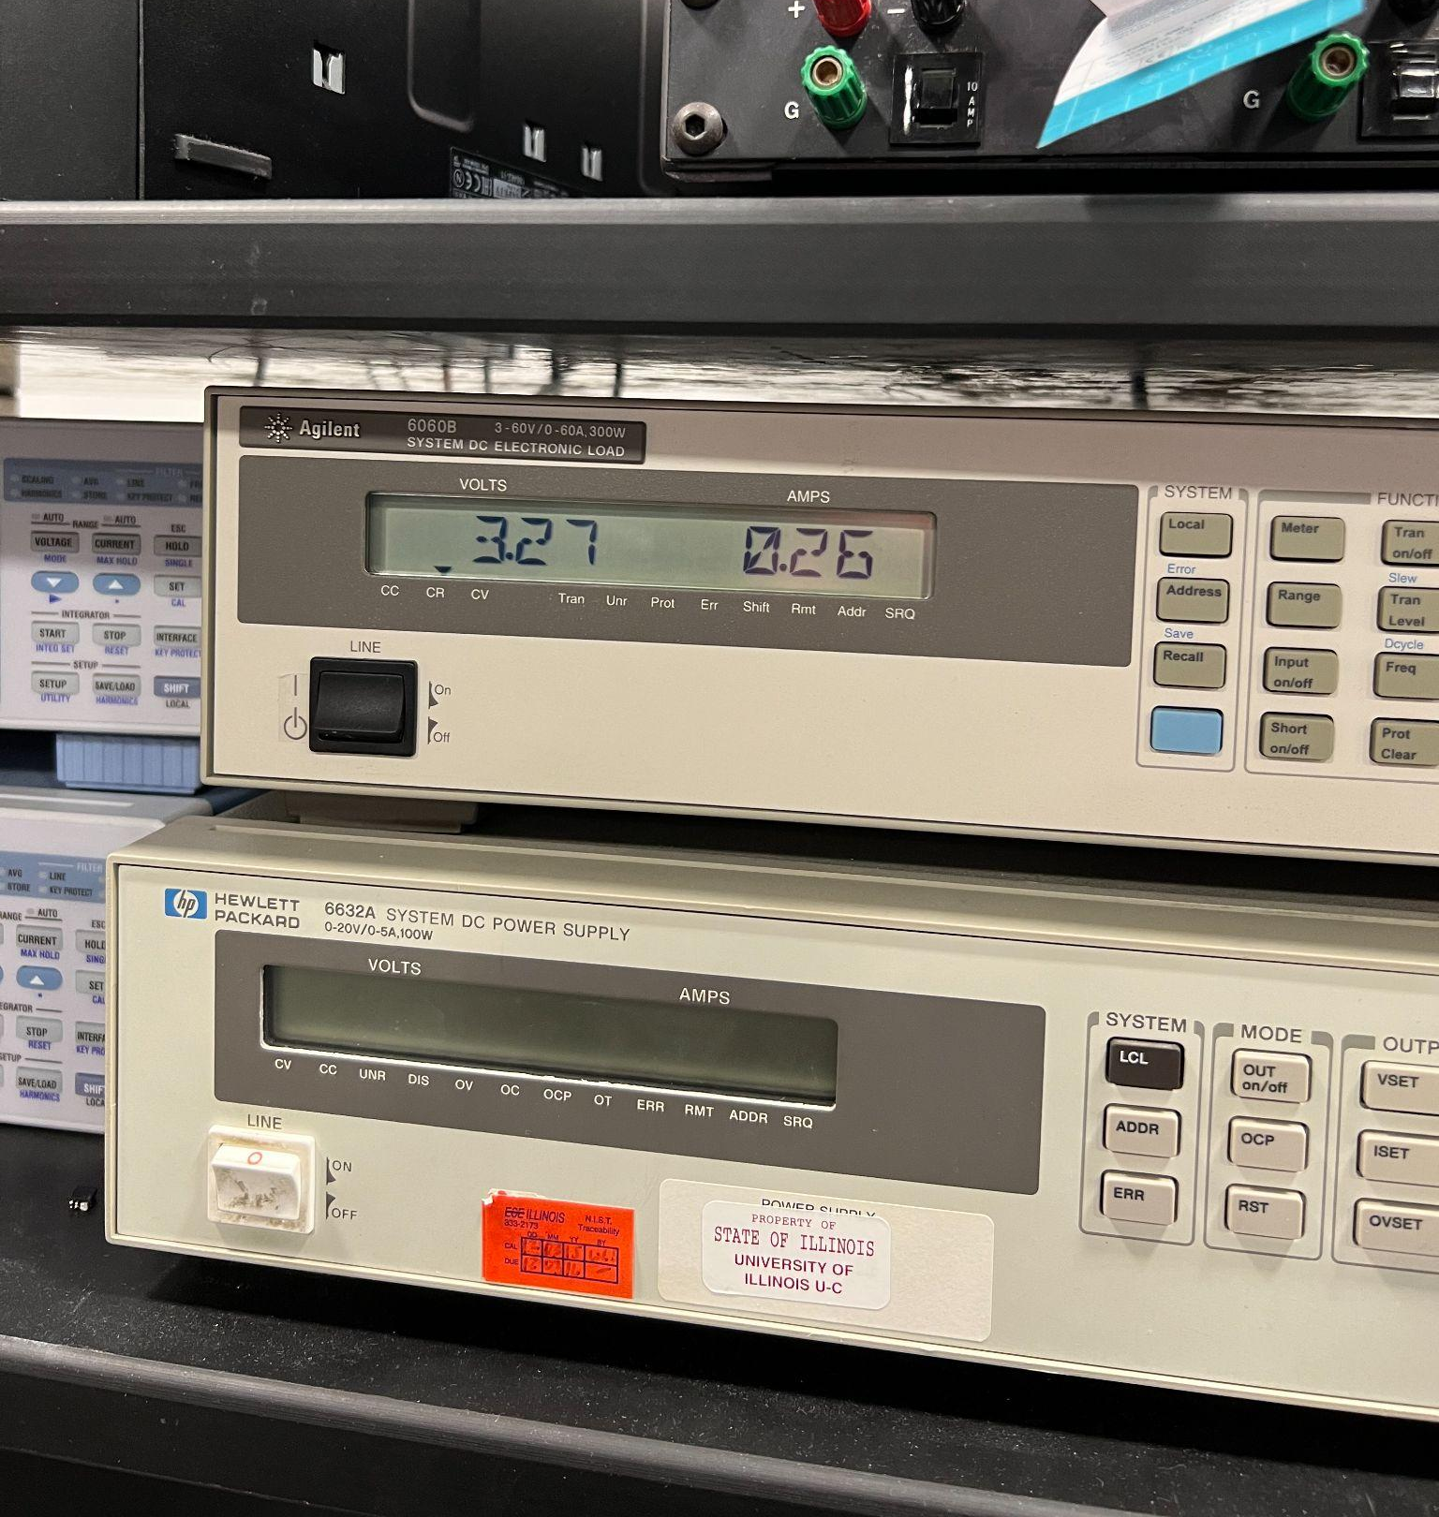
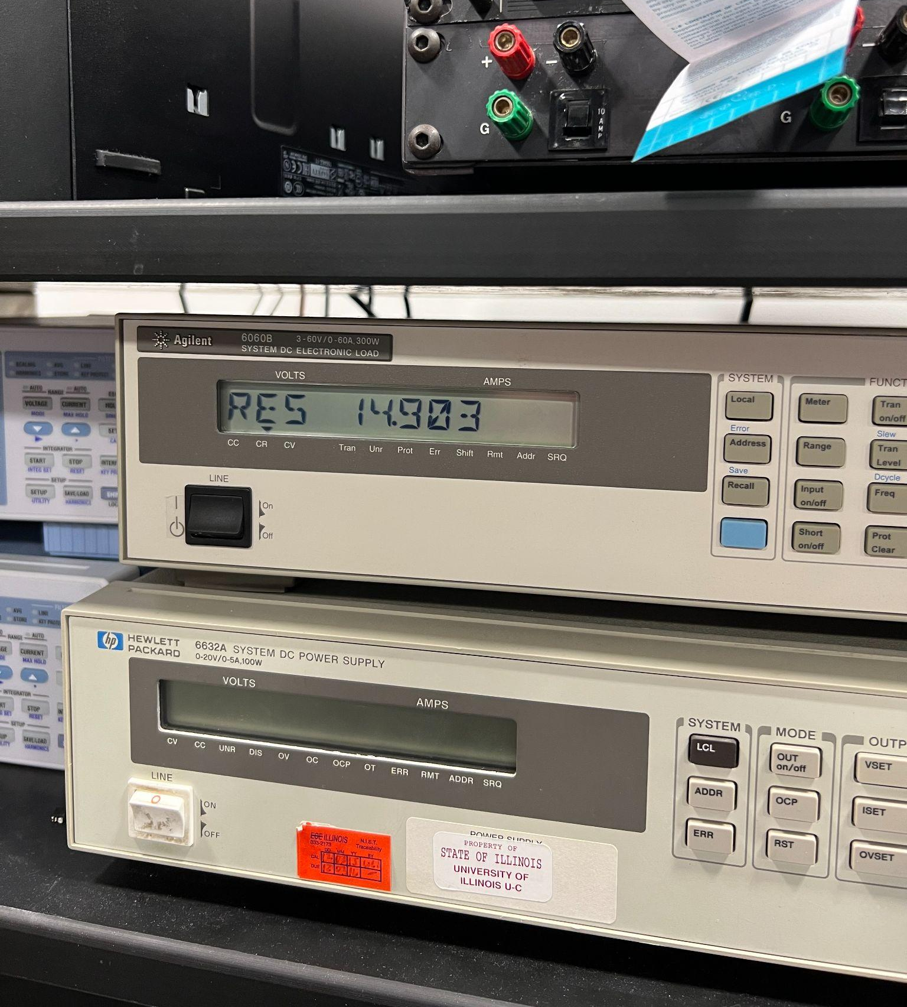
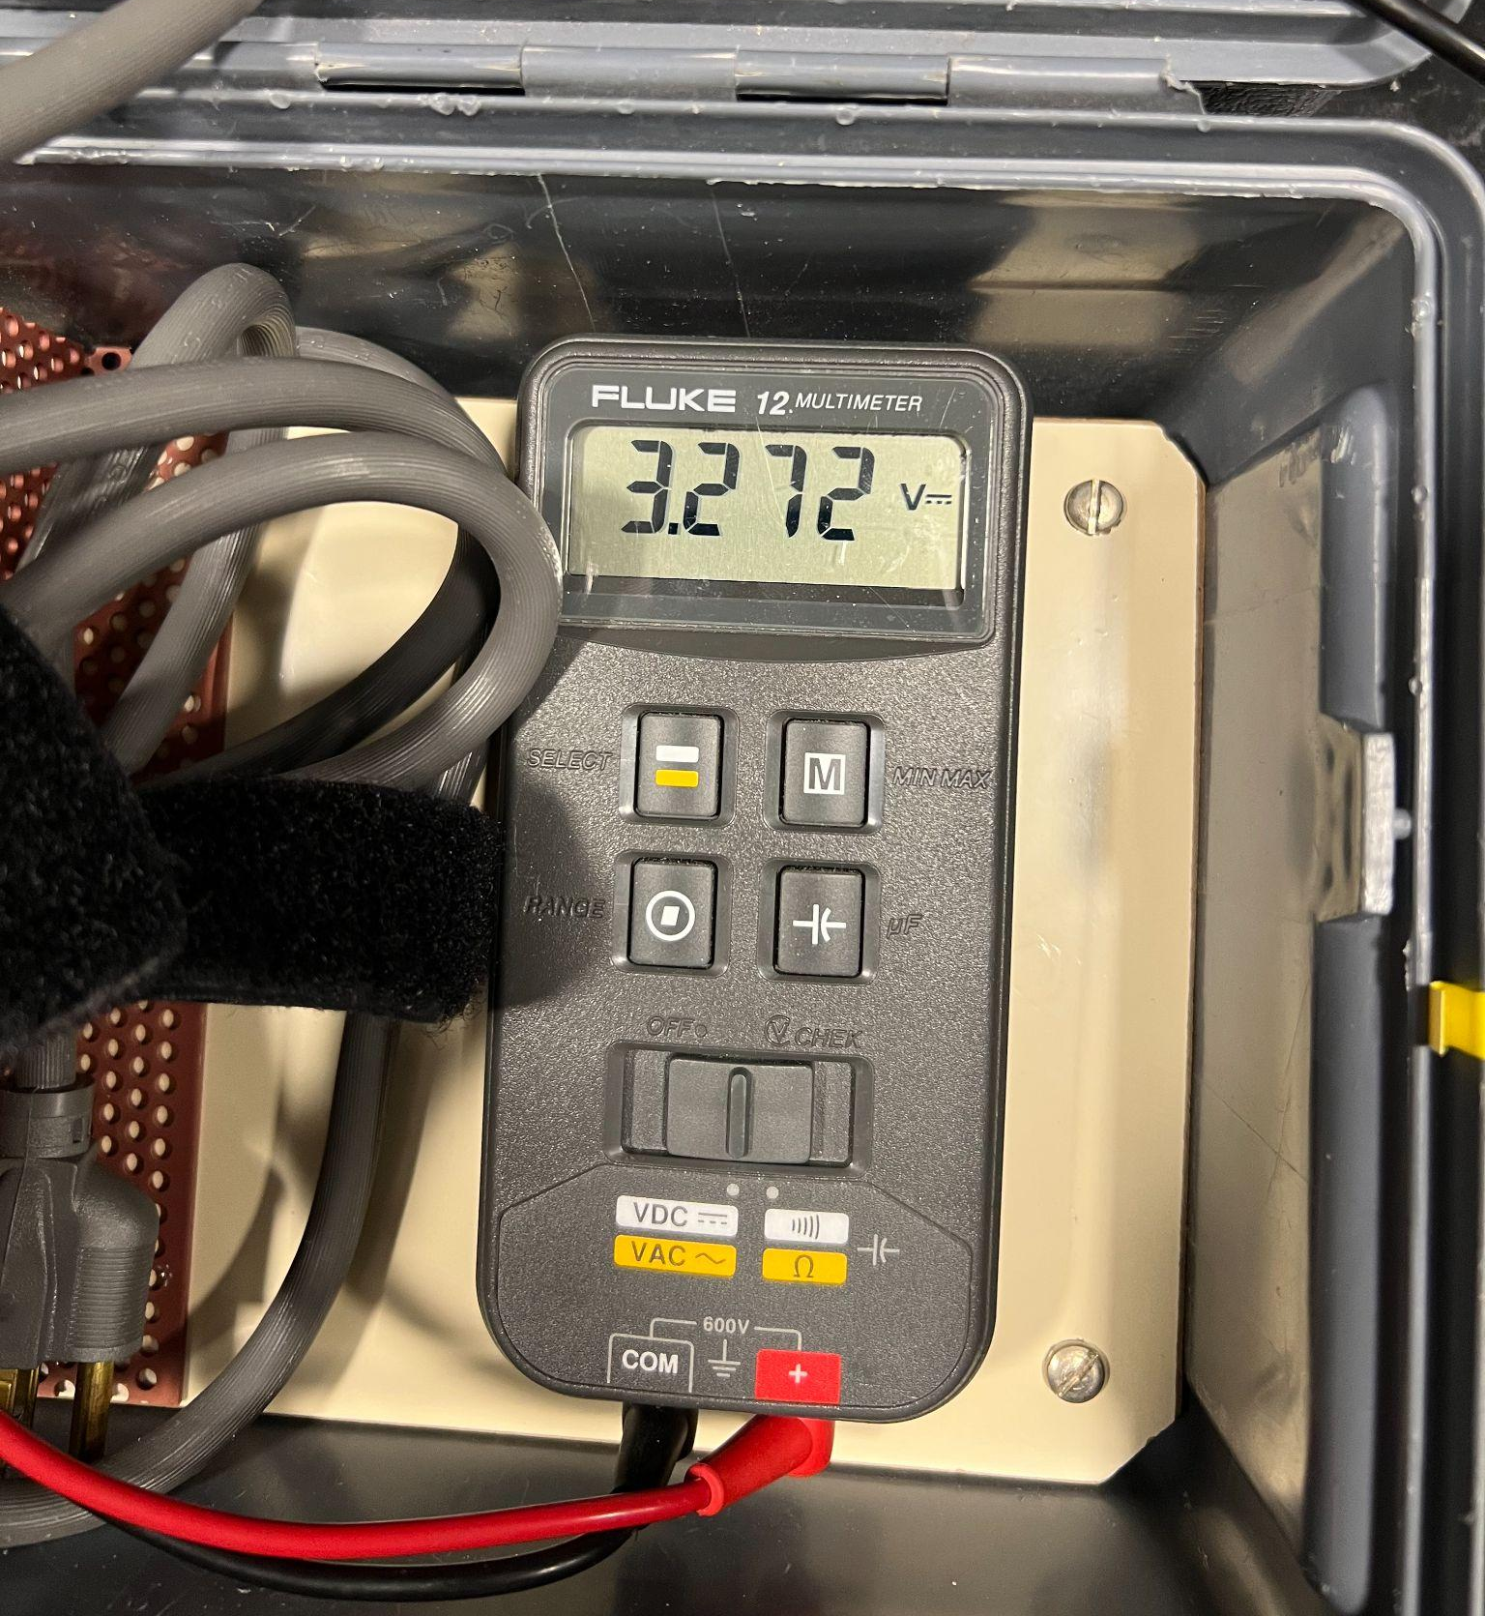
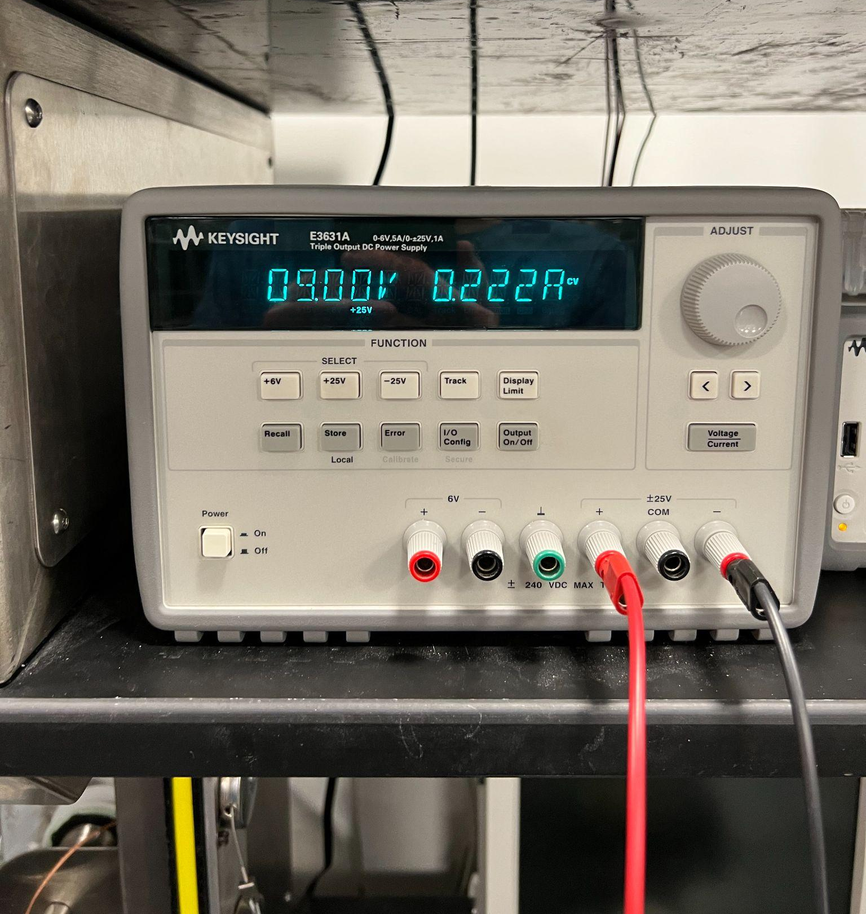
Power Subsystem Verification
4. The 3.3V rail must maintain a voltage between 2.7V and 3.6V at a current of at least 220.5mA.
Voltage between 2.7V and 3.6V ✔ Current Draw exceeds 220.5mA ✔

Slide 38
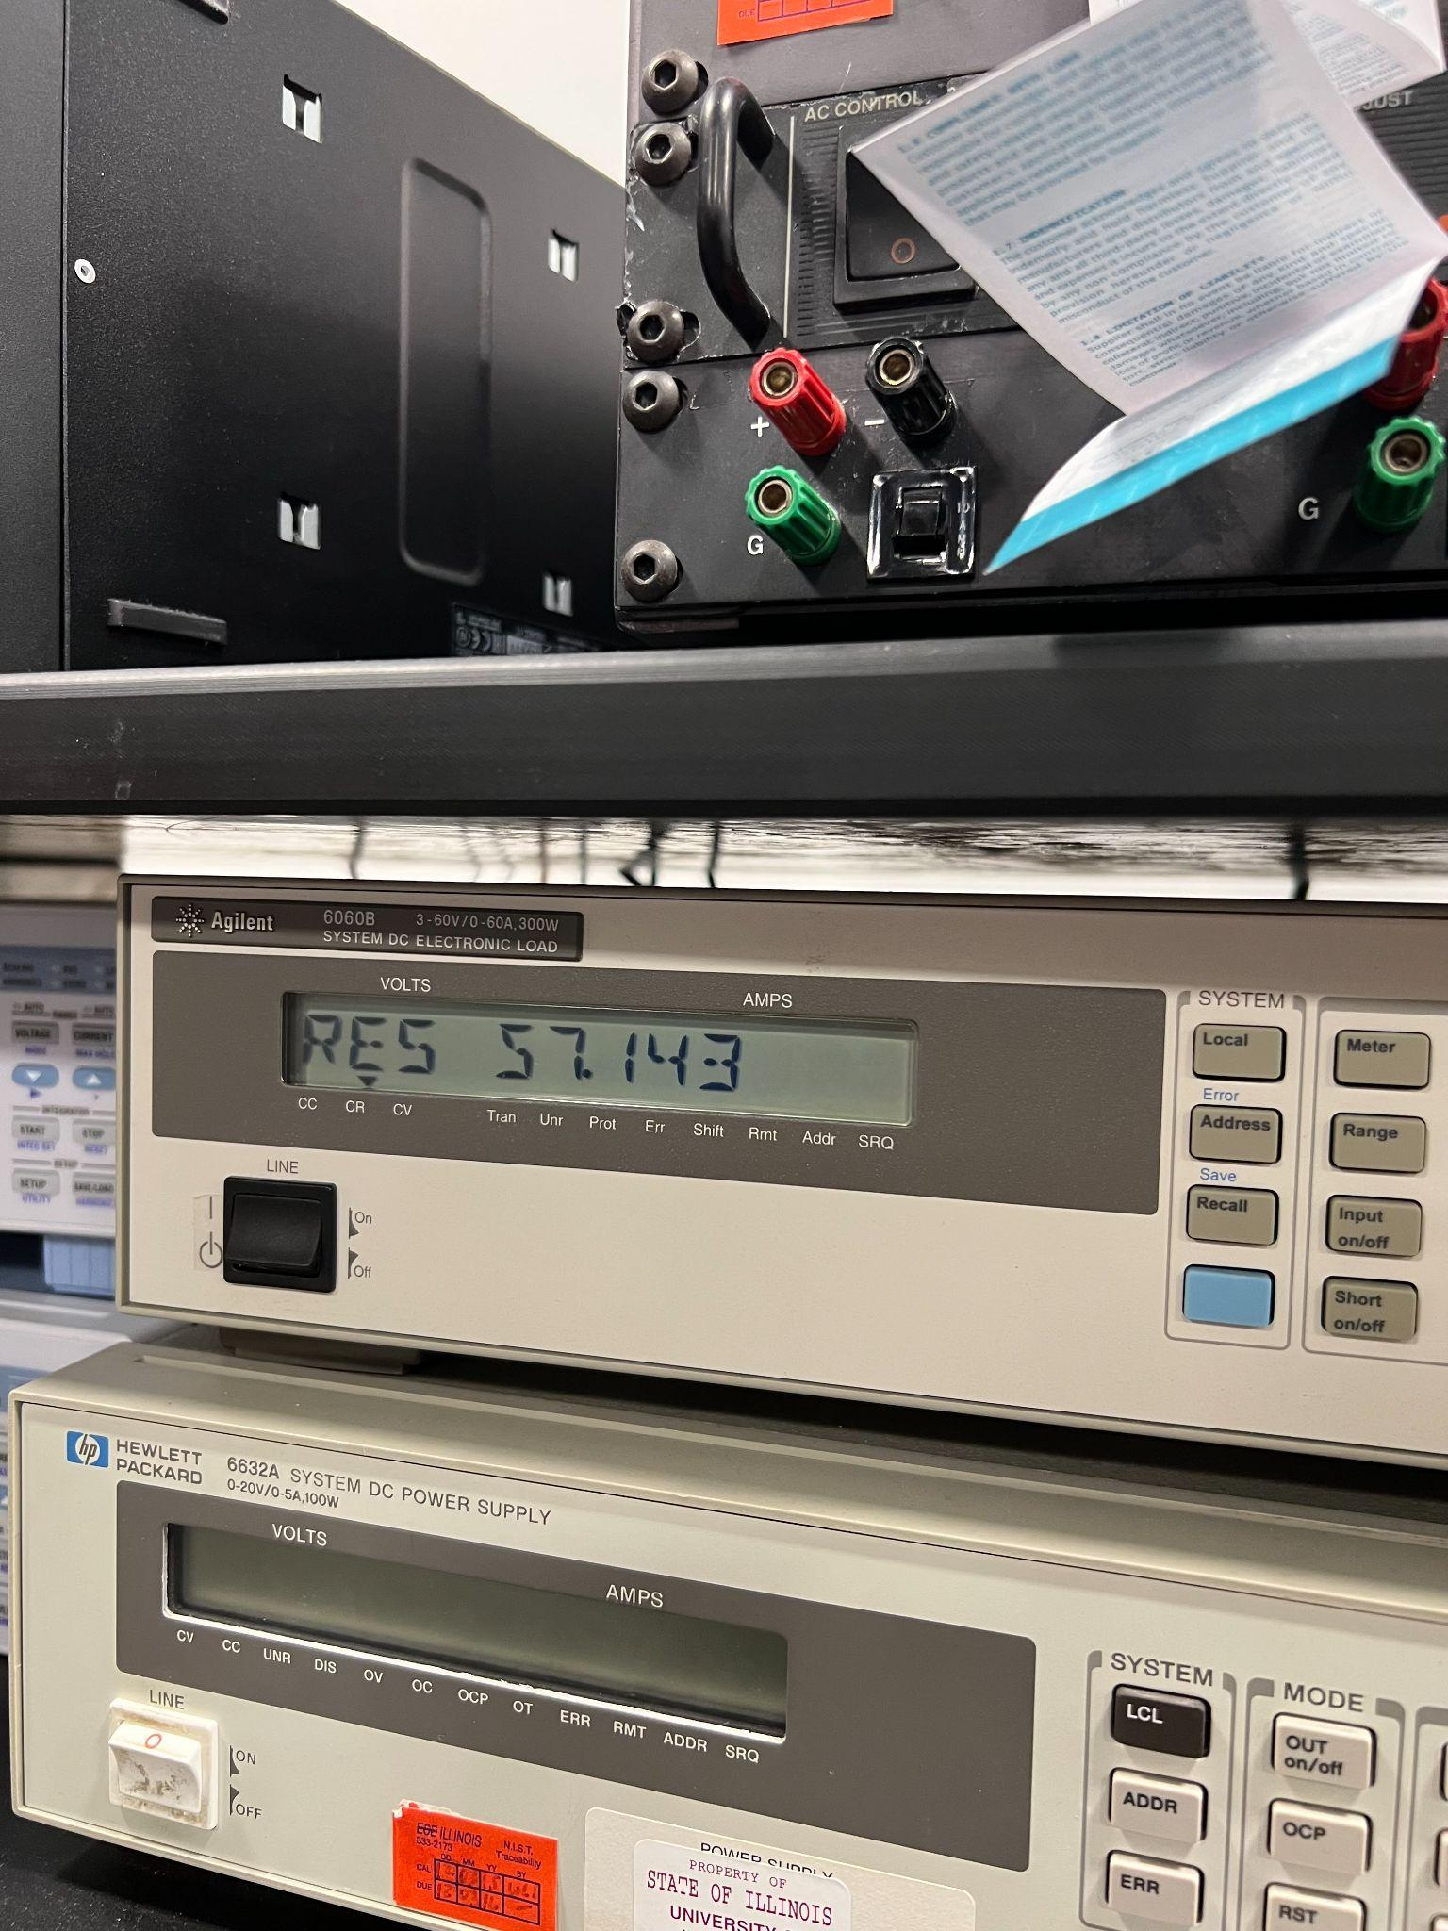
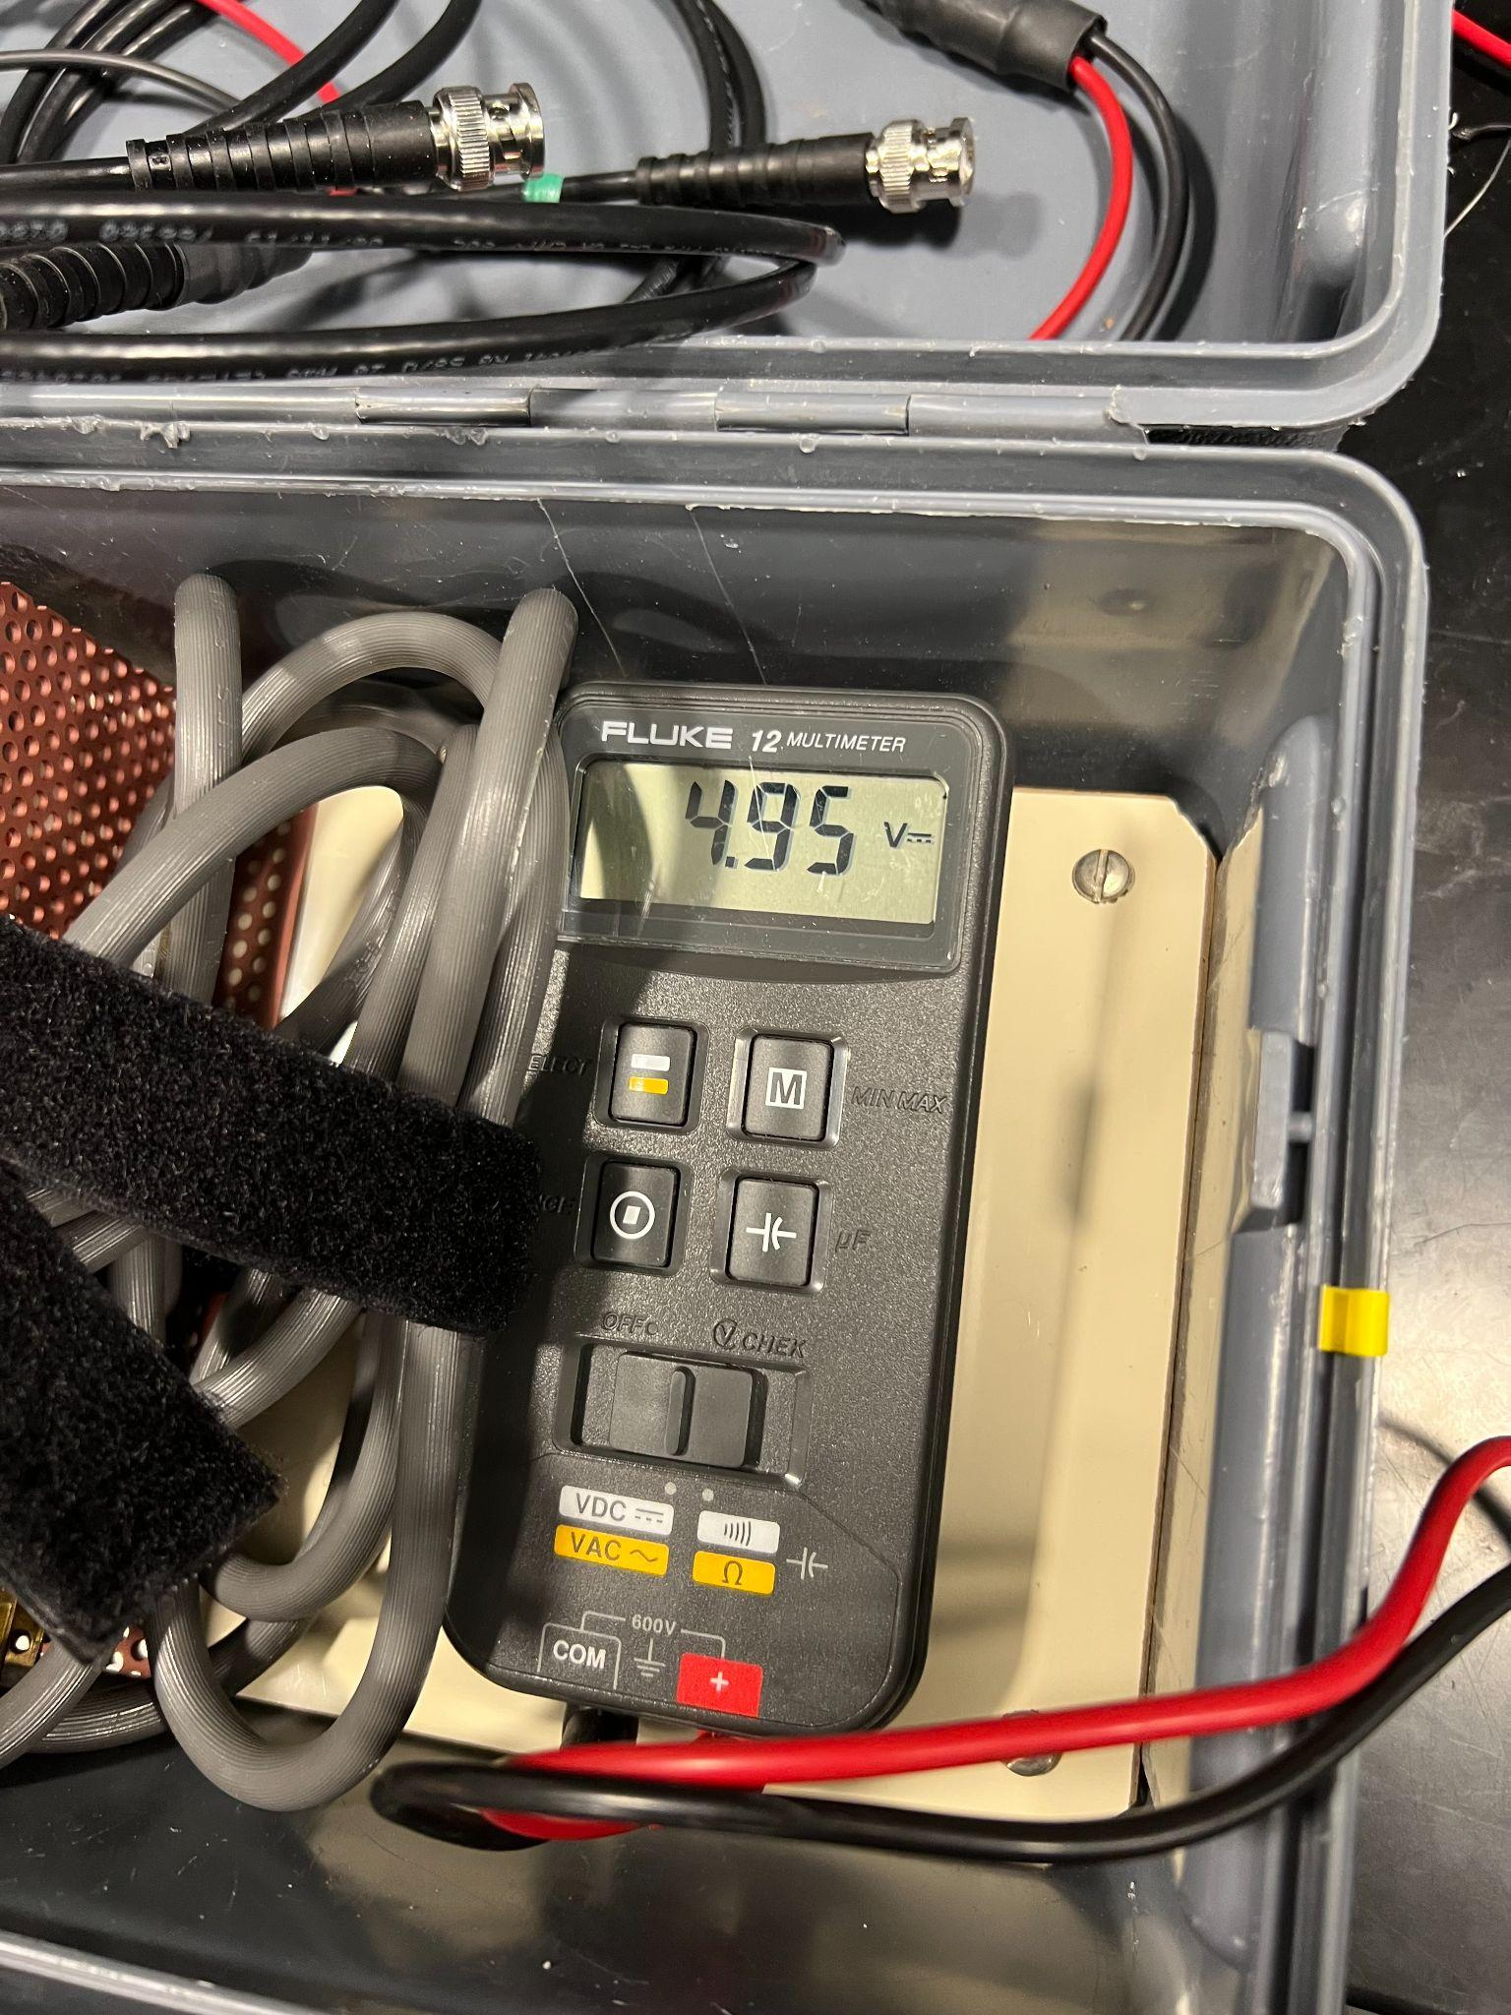
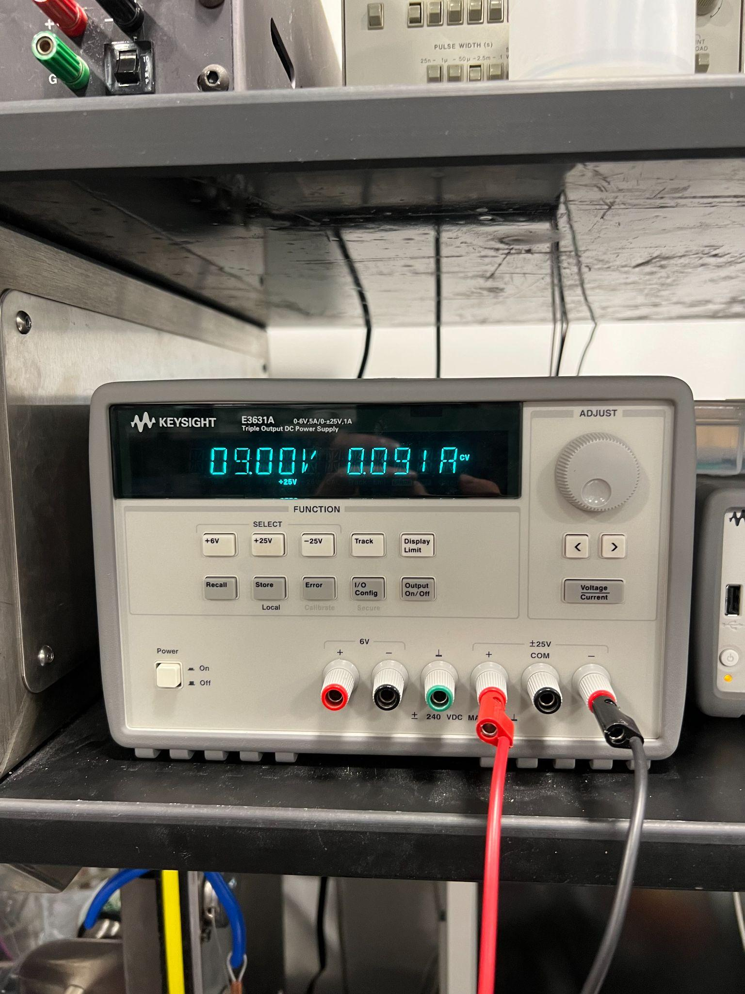
Power Subsystem Verification
5. The 5V rail must maintain a voltage between 4.75V and 5.25V at a current of at least 91mA.
Voltage between 4.75V and 5.25V ✔ Current Draw exceeds 91mA ✔

Slide 39
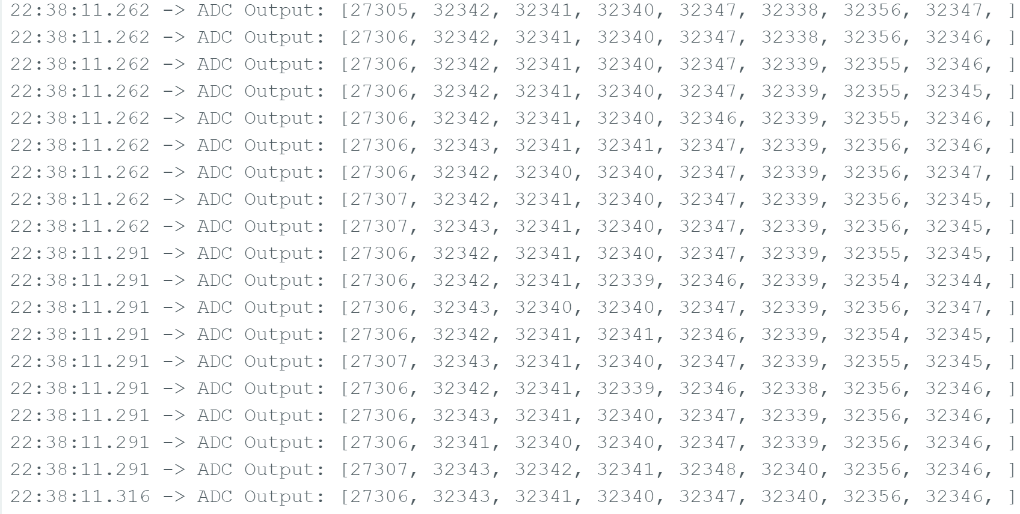
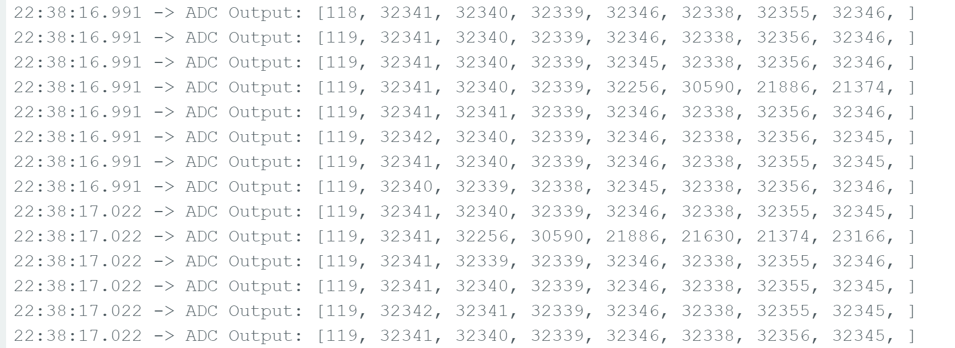
Control Subsystem Verification
1. The microcontroller must be able to comprehend data from the analog to digital converter via SPI over 90% of the time.
Potentiometer set to low resistance
Potentiometer set to high resistance Data read correctly ✔

Slide 40
Control Subsystem Verification
2. The microcontroller must be able to correctly identify when a collision occurs with more than 90% accuracy.
Proven in the video on slide 9.
Collisions are properly detected ✔

Slide 41
Control Subsystem Verification
3. The microcontroller must be able to send and receive signals to and from the remote receiver via the Zigbee transmitter more than 90% of the time.
Sent transmissions are properly received ✔
Transmission sent
Signal received

Slide 42
Control Subsystem Verification
4. The off-chip simultaneous sampling ADC must be able to measure all signals from the force sensing resistor array concurrently more than 90% of the time.
ADC measures FSR data, as seen from MCU ✔

Slide 43
Control Subsystem Verification
5. The Zigbee transmitter must be able to properly send a signal up to 40 meters away.
Transmitter
Receiver
40 Meter Distance ✔ Correct Packets ✔

Slide 44
Control Subsystem Verification
6. The signal must be able to be sent through the helmet and through adverse conditions with an accuracy of over 90%.
Transmitter
Receiver
Through Wall with Correct Packets ✔ Through Water with Correct Packets ✔

Slide 45
Data Reception and Visualization Subsystem Verification
1. The receiver must receive packets sent with a maximum error rate of 10%.
Transmitter
Receiver
No errors in packets received ✔

Slide 46
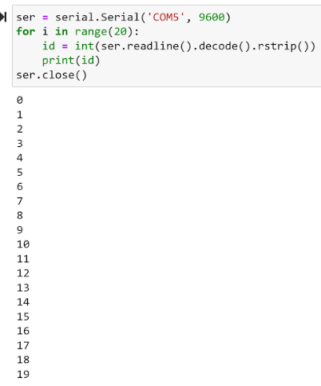
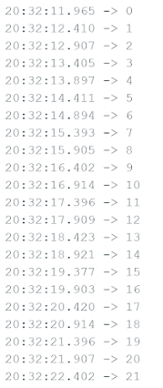
Data Reception and Visualization Subsystem Verification
2. The signal received by the Arduino must be delivered to the serial input exactly as it is seen by the hardware.
Data transmitted through port is same as in IDE ✔
Data is properly visible in Python
Data seen in Arduino serial Monitor

Slide 47
Data Reception and Visualization Subsystem Verification
3. The visualizer must be able to identify the impact within 20% of where it occurred.
Properly determines impact location from given data ✔

Slide 48
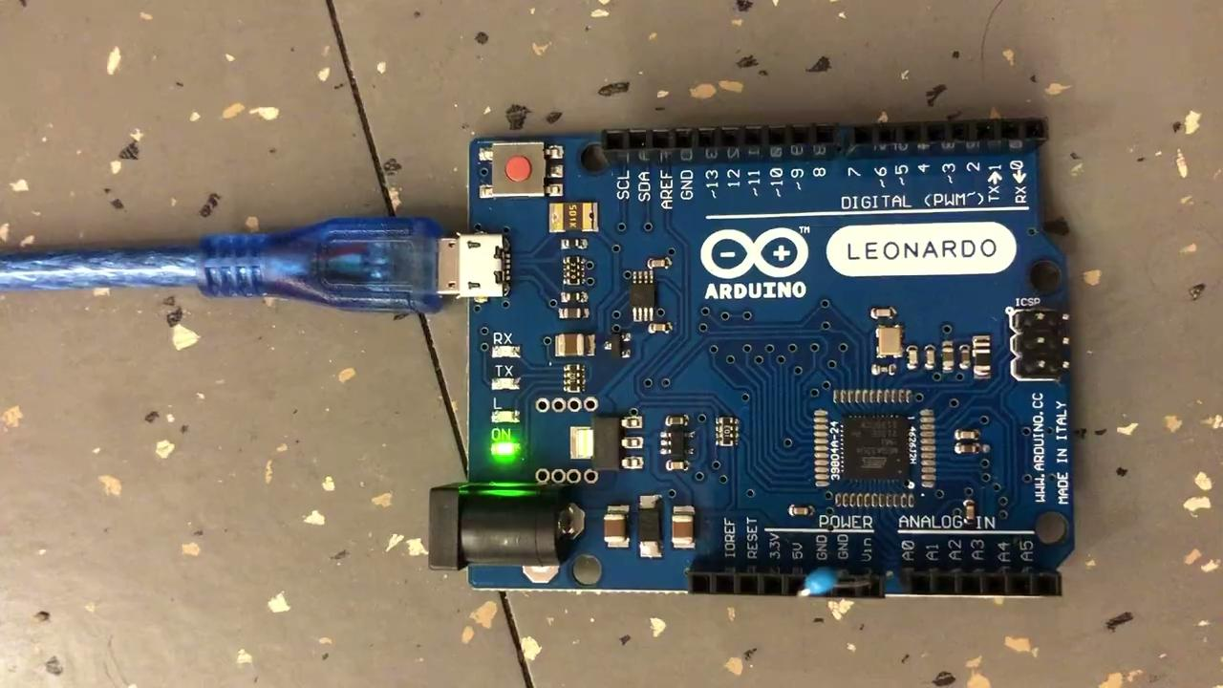
Data Reception and Visualization Subsystem Verification
4. The data must be visualized within 30 seconds of packet reception.
Data visualized within 30 seconds ✔

