Slide 1
RF-based Long-range Motion Recognition and Communication System
Group 45:
Joe Luo (luo42) Zekai Zhang (zekaiz2) James Tian (zeyut2)

Slide 2
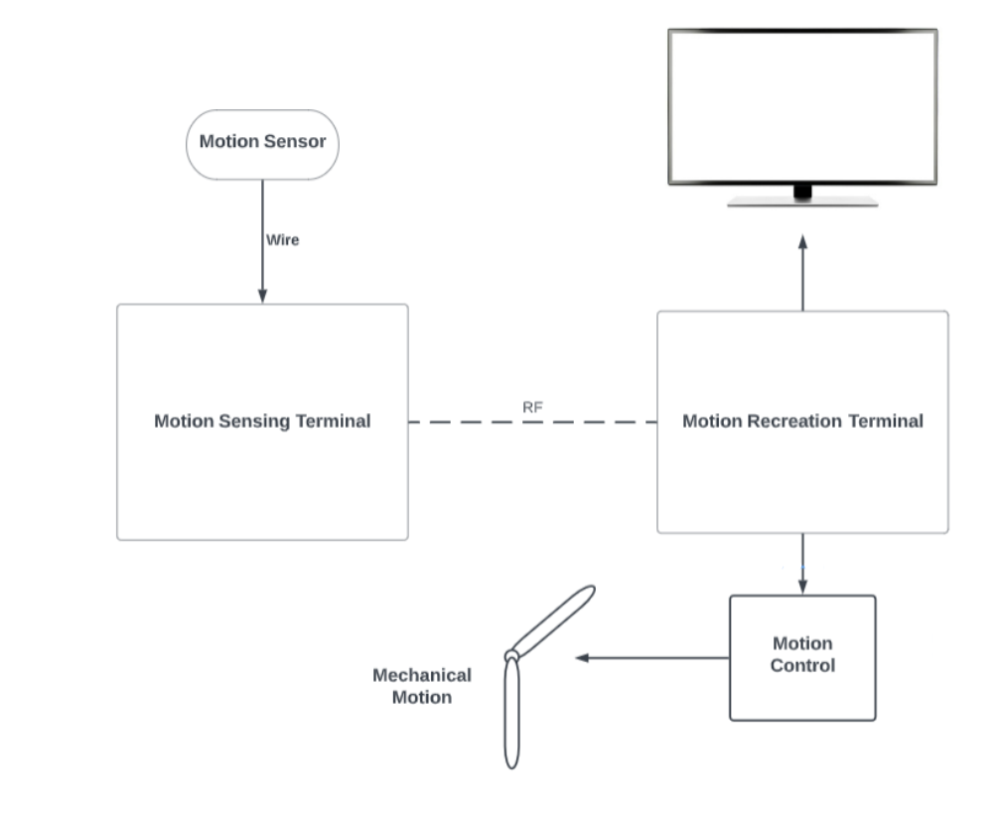
Overview
Problem:
Emergence of VR and AR shows that people want more than text, videos and sounds, and a new way of interaction could be useful in many scenarios.
Solution:
A duo-terminal system that reads motion and transmit through RF communication to another terminal to reproduce the motion in real time with mechanical integration as well as software simulation.

Slide 3
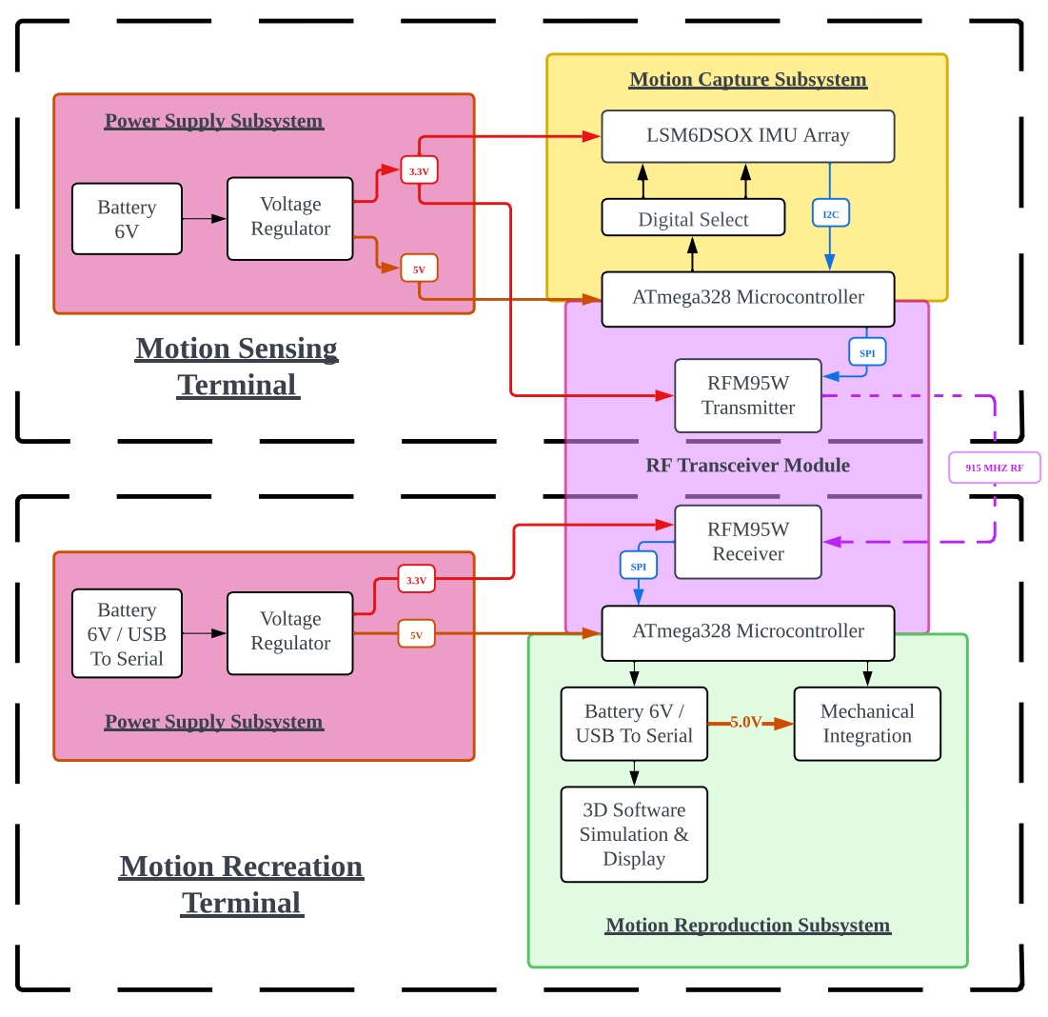
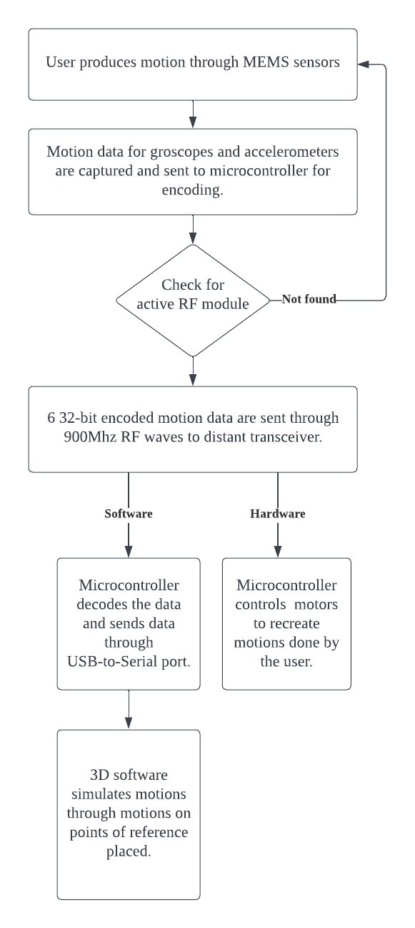

Slide 4
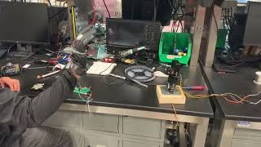
Achieved Result:

Slide 5
Design Philosophy
Portable and Mobile Motion Capture Terminal
IMU
Battery Holder
Microcontroller & RF
- Faithful and Versatile Motion Reproduction Terminal
Microcontroller & RF
Software Simulation
Mechanical Integration

Slide 6
RF Modules
Testing and
Response:

Slide 7
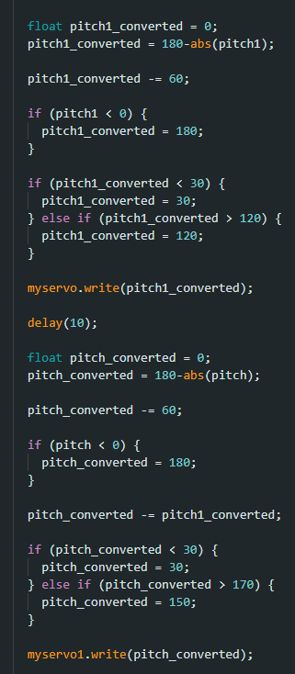
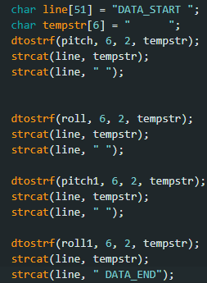
Programming the Chip
IMU_95_TX
Initialization
Frequency Set to 915MHZ
Calculate Pitch and Roll from acceleration measurements
Data Packaging
IMU_95_RX
Initialization
Frequency Set to 915MHZ
Parse Data
Move motor
- Unity 3D

Slide 8
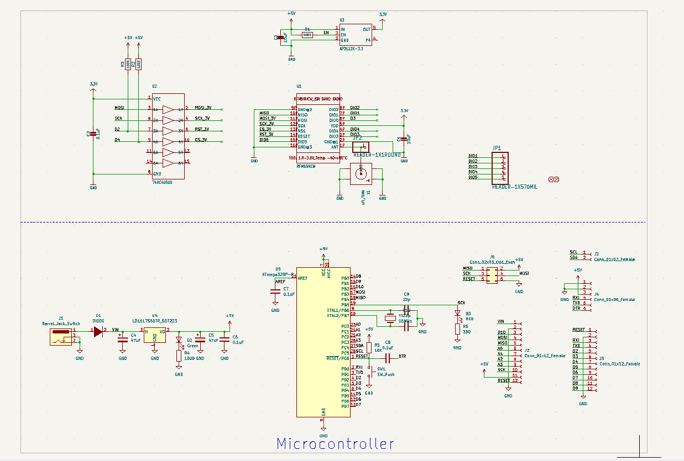
PCB Design
Power supply changed from 3.3V to 5V due to microcontroller.
USB to serial system was replaced with an adaptor.
Add 6 pin header since adaptor is not capable of burning the bootloader.
The RF module is similar to the Adafruit RFM95W[link] (considering switching to RFM69 chip due to code not working)

Slide 9
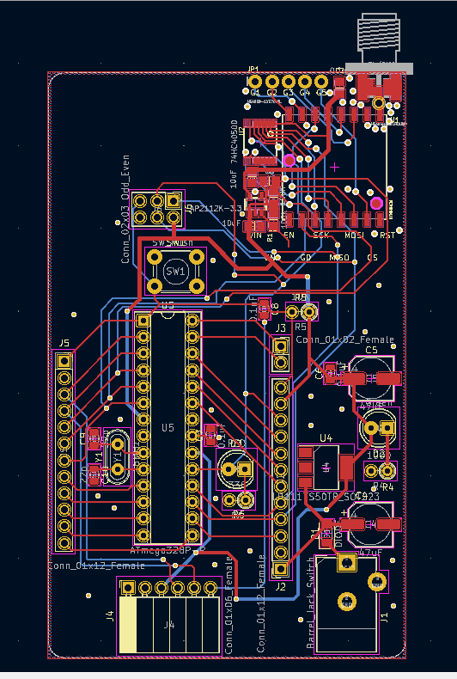
PCB Design
Layout of the PCB is as slim as possible to be able to fit on one’s arm.
Antenna as close to RF chip as possible.
Testing was generally successful with some minor issues on soldering and usb connection to PC which are all resolved in the final Demo.

Slide 10
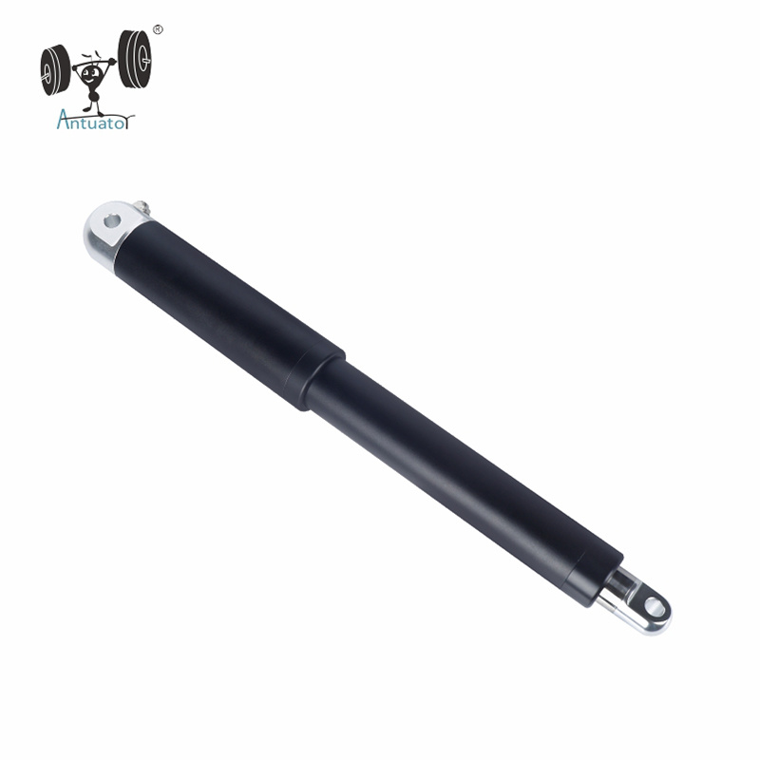
Robot Arm
Goal: simulate motion of a hand
Degree of freedom
Brackets for connection
Develop many designs
Pen motor
Huge thanks to machine shop
Notes:
The goal is to simulate the motion of a hand, which consist of two axis, each having around 90 degrees of freedom
The servo motors have 180 degree of freedom, which fulfill the purpose
A set of bracket is used to limit the range of motion mechanically
For the bottom axis, a design was proposed to make the robot arm move in a linear way; however the plan was found to be impractical because the pen motor significantly increased the cost and the build time. The budget and the timeline forced us to move to a more basic design where we have the same motor at the bottom
Servo motor takes in PWM signal and can be tested with Arduino dev board
huge thanks to machine shop for spending time with us to discuss the possibilities and building the mechanical part of the robot

Slide 11
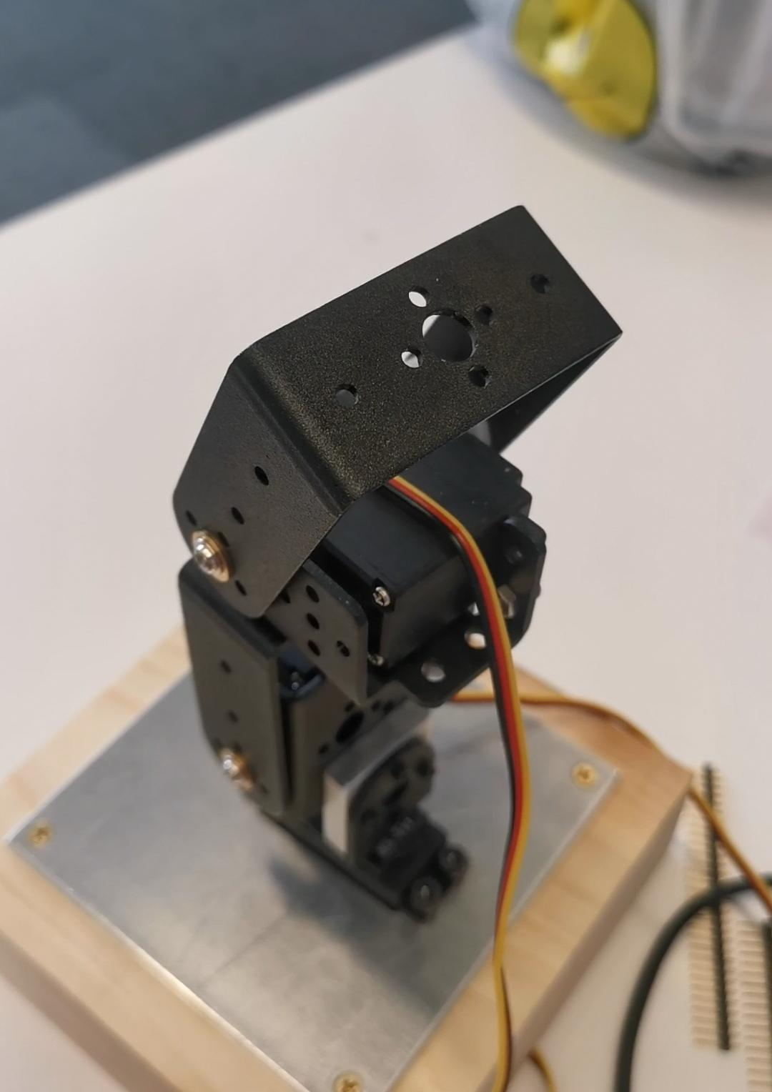
Robot Arm
Difficulty:
Getting parts
Part inconsistency during testing
Conflicting code (SPI and Serial)
Transform and limit motion
Notes:
Getting parts is much more difficult than expected; order usually get approved two weeks after submitting
The dev board used for testing and programmer as well as the final PCB all have different voltages, which hinders the debug process, because we just got our PCB and not sure if it’s a design problem or not
The template used for testing motors is in conflict with the existing rf code, so some code has to be changed
fine tuning: set the direction of motion in accord to the real motion; convert pitch to position, which is a variable more suitable for the motor and easier to understand
fine tuning: The mechanical setup makes the robot arm locked when motors try to turn beyond the mechanical limit -> Set limitation on the turning angle
future work

Slide 12
Thank You!

