Slide 1
Schedulable Automatic Fish Feeder (SAFF) - Team 18
Department of Electrical & Computer Engineering
Colby Steber
Brandon MacIntosh
Jeremy Richardson
May 5th, 2025
Notes:
Introduce everyone and the project - Colby

Slide 2
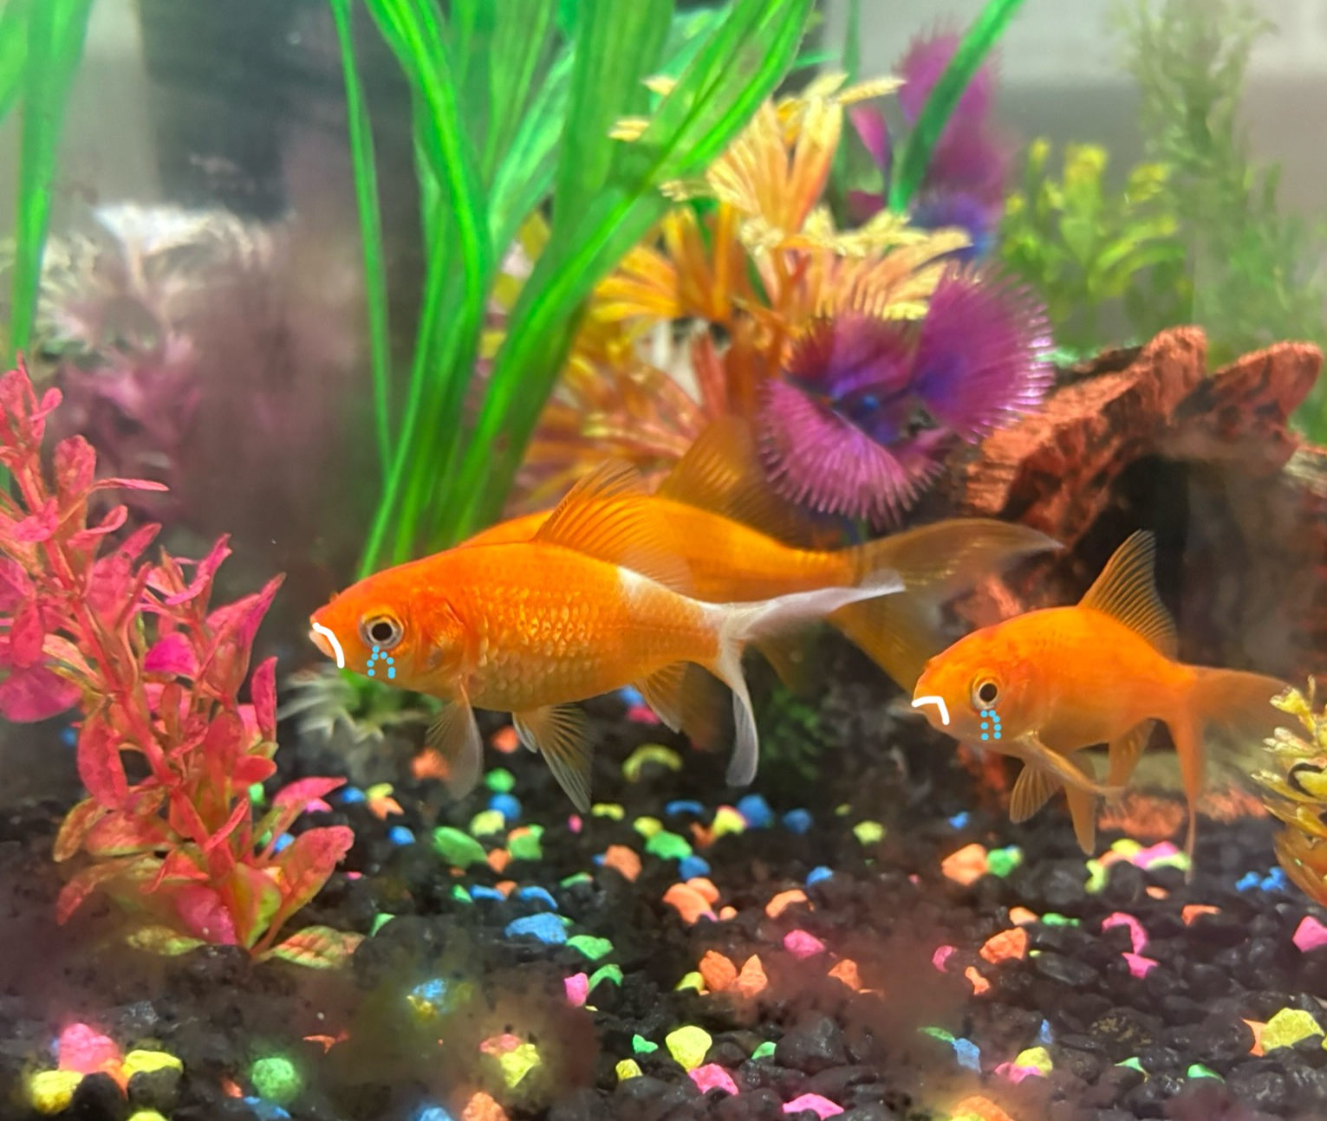
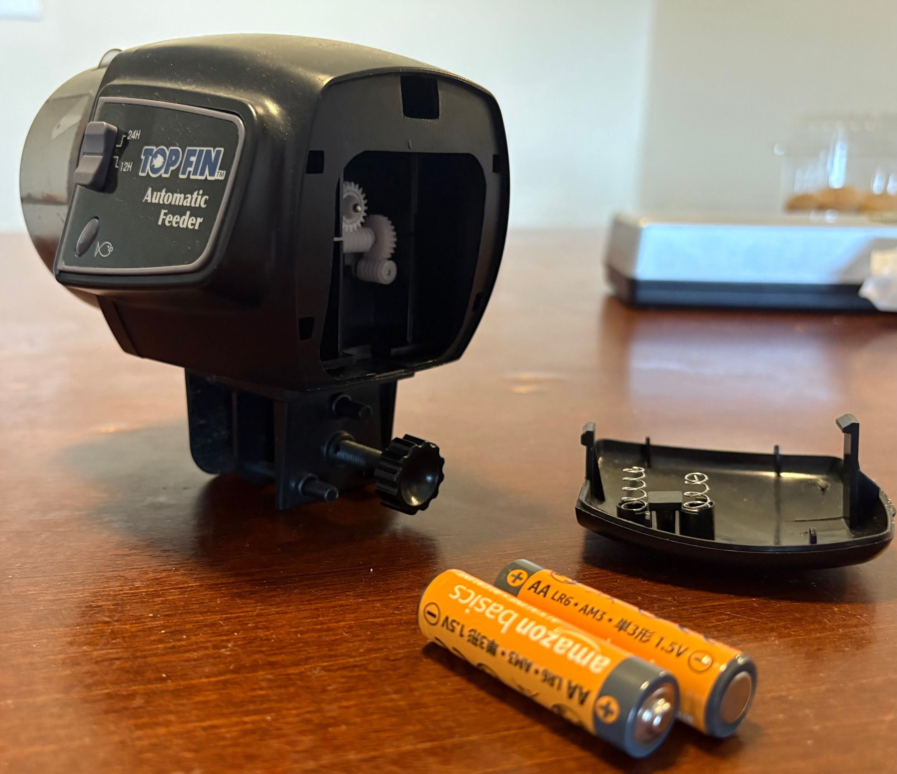
Want to feed your fish from anywhere? TOO BAD
Sad Jerry
Decades old, clanky technology
Limited Features
Sad Jerry
Sad Jerry
ELECTRICAL & COMPUTER ENGINEERING
GRAINGER ENGINEERING
Notes:
Objective and explanation of project - Colby

Slide 3
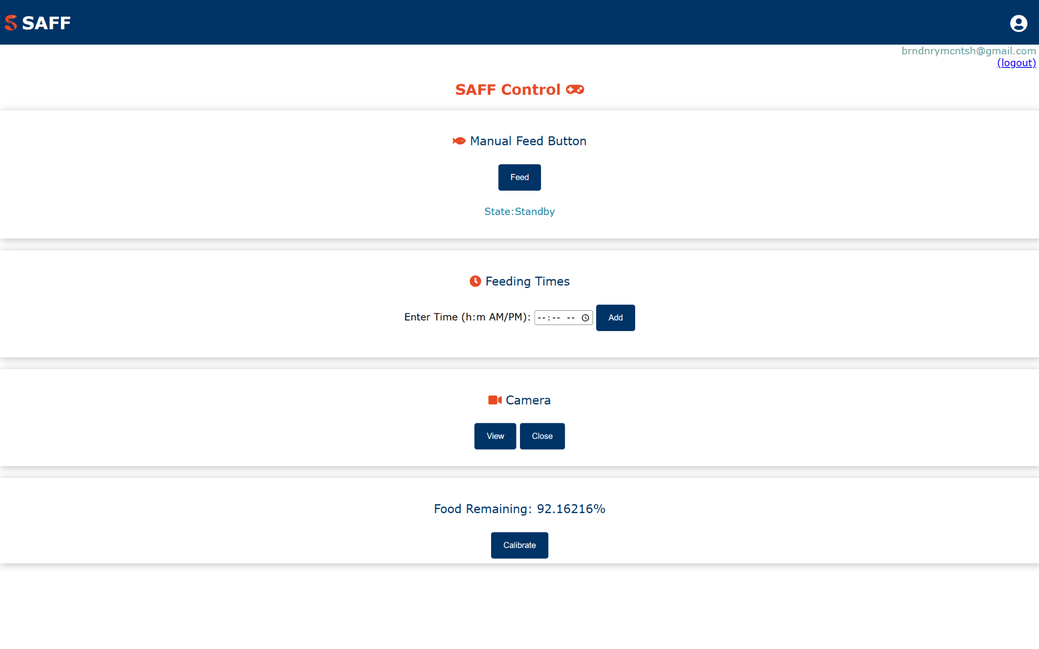
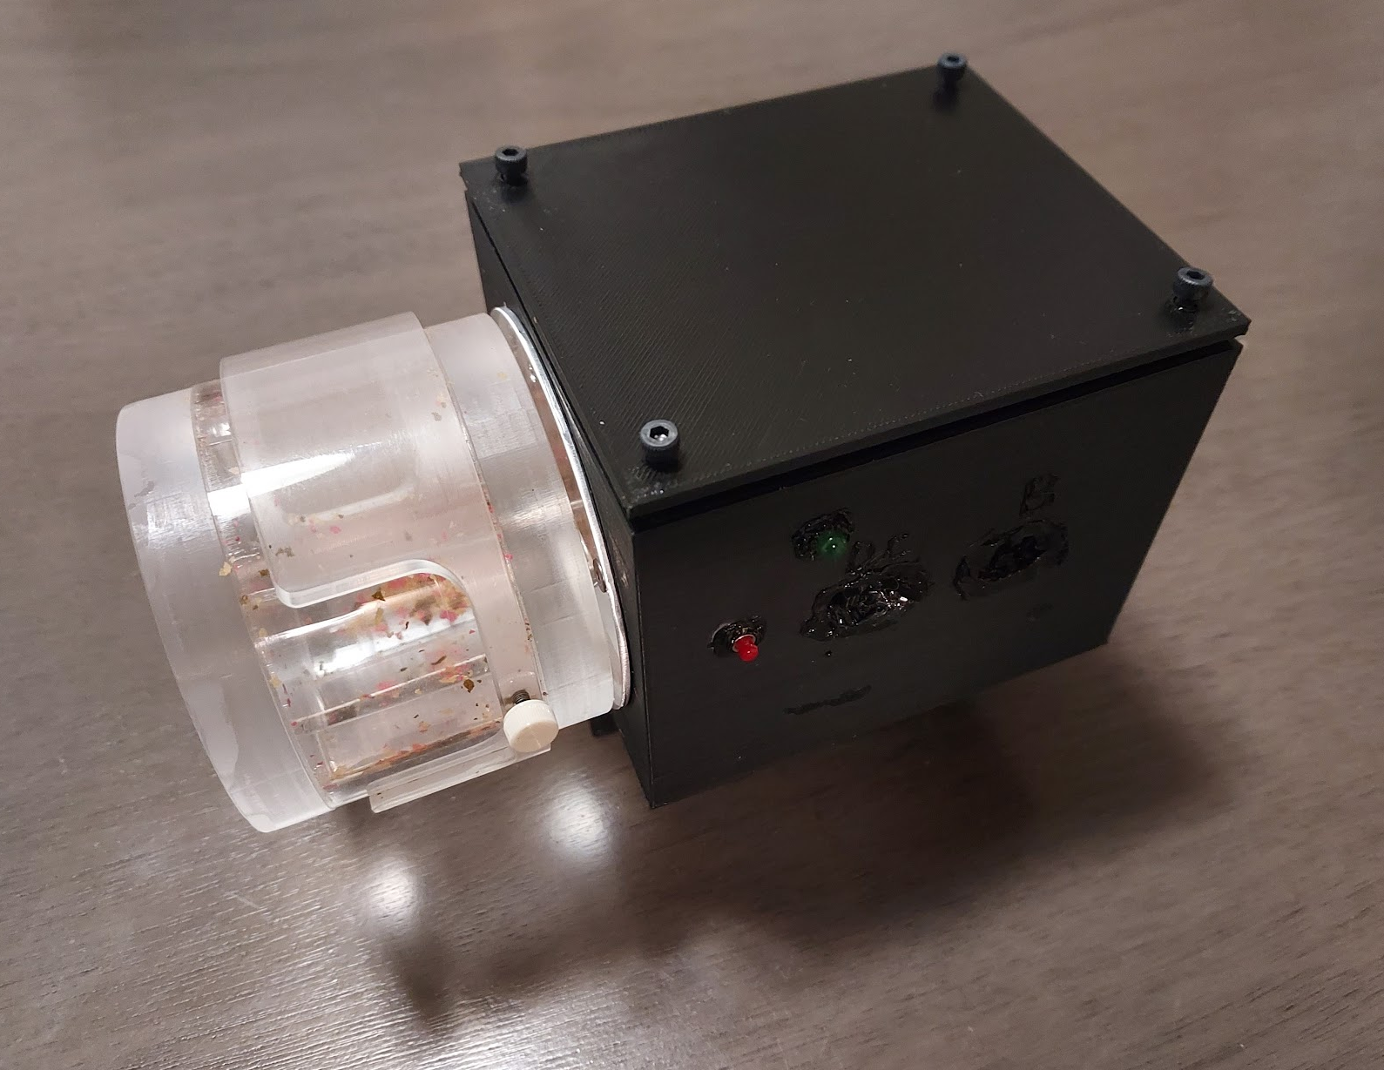
Our Fish Feeder
Feed from Anywhere at Anytime
Web app
Manual Feed Button
Schedule up to 4 feeding times
Notifications
Uses a hall effect sensor
When feeding is complete
Camera
Viewed through the web app
Power
Plug into a wall brick using USB-C
Backup battery power
ELECTRICAL & COMPUTER ENGINEERING
GRAINGER ENGINEERING
Notes:
Brandon - User can feed their fish from any location using a web app, and schedule up to four feeding times, allowing them to feed their fish at any time they want. The feeder can also detect when the food container rotates using a sensor and sends a notification to the user when feeding is complete. The feeder can be plugged into the wall using USB-C to ensure the feeder works for extended periods of time, and if the power goes out or if the feeder is not being supplied with AC power from the wall, it switches to battery power.

Slide 4
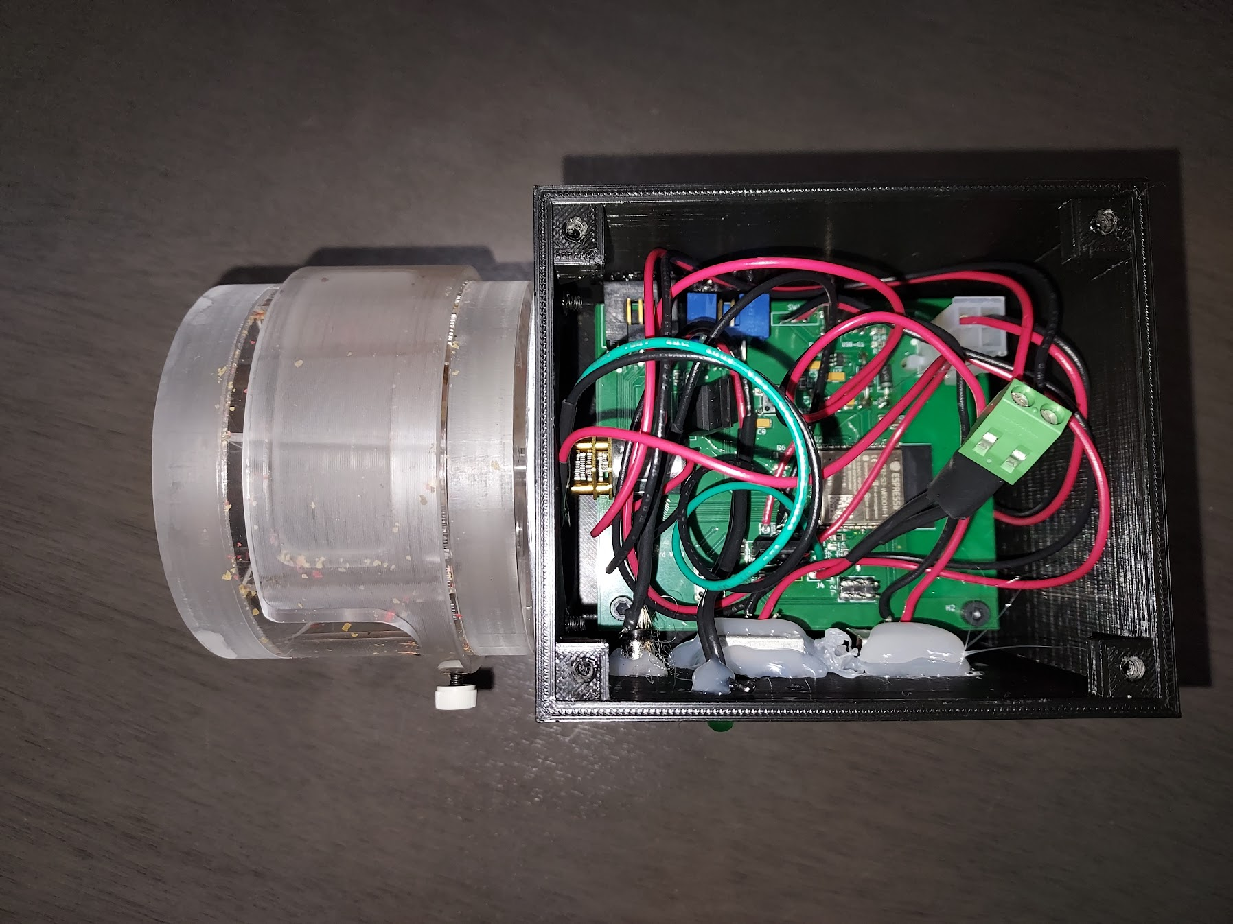
Product Design and Implementation
ELECTRICAL & COMPUTER ENGINEERING
GRAINGER ENGINEERING

Slide 5
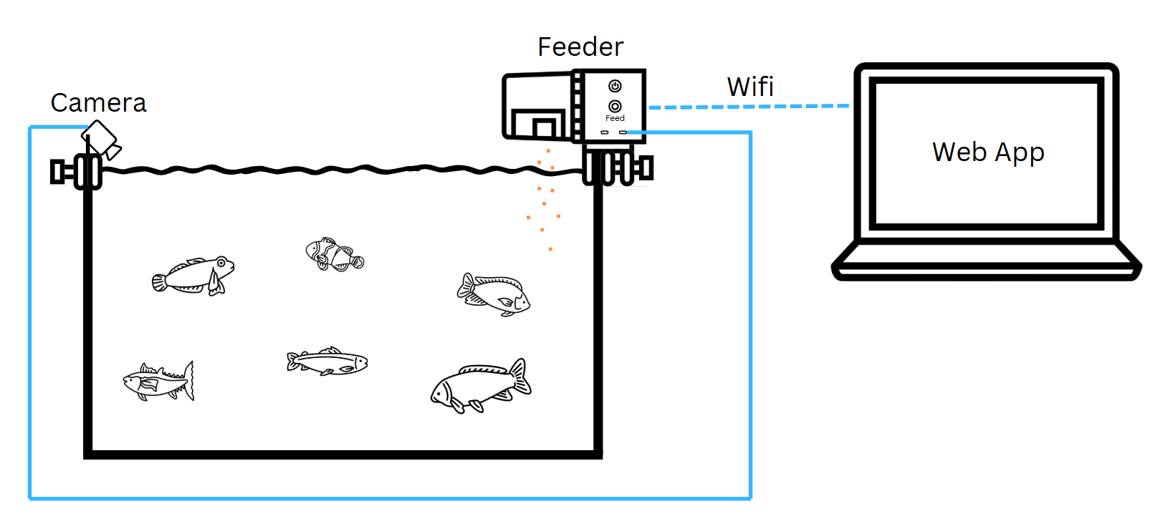
Design Overview
High Level Requirements
Feeding via the button on the feeder and in the app works within 3 seconds of being selected or scheduled.
The magnetic sensor detects that the food is actually dispensed into the tank and sends a notification to the app within 3 seconds of being triggered.
When the camera icon is selected on the app, 3.3 V +/- 0.1 V is delivered to the camera and the feed is displayed in the app.
Visual Aid
ELECTRICAL & COMPUTER ENGINEERING
GRAINGER ENGINEERING
Notes:
Jeremy

Slide 6
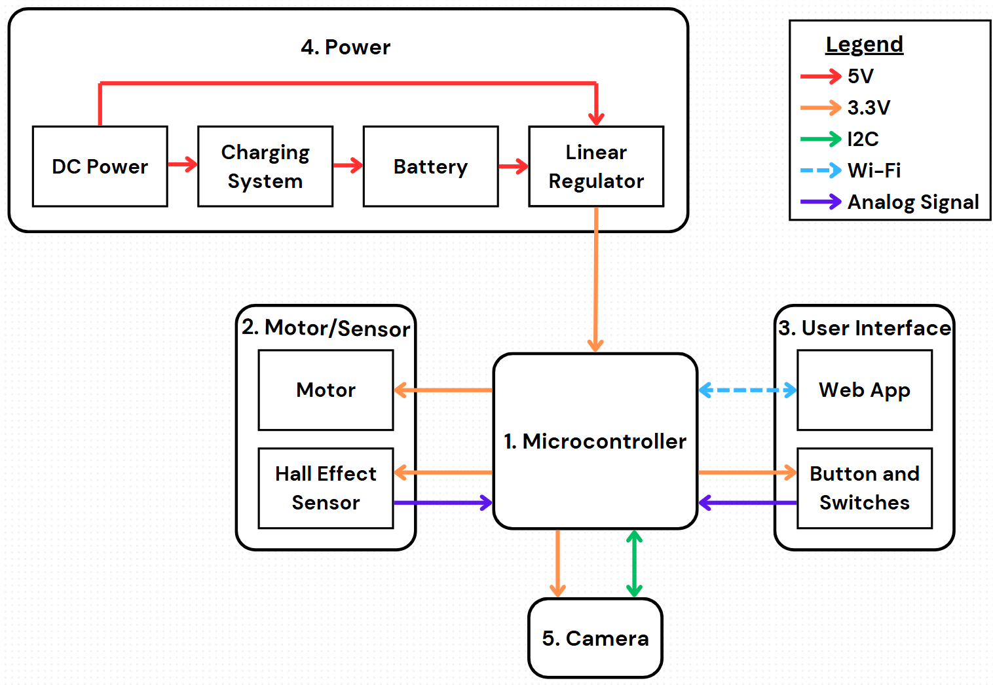
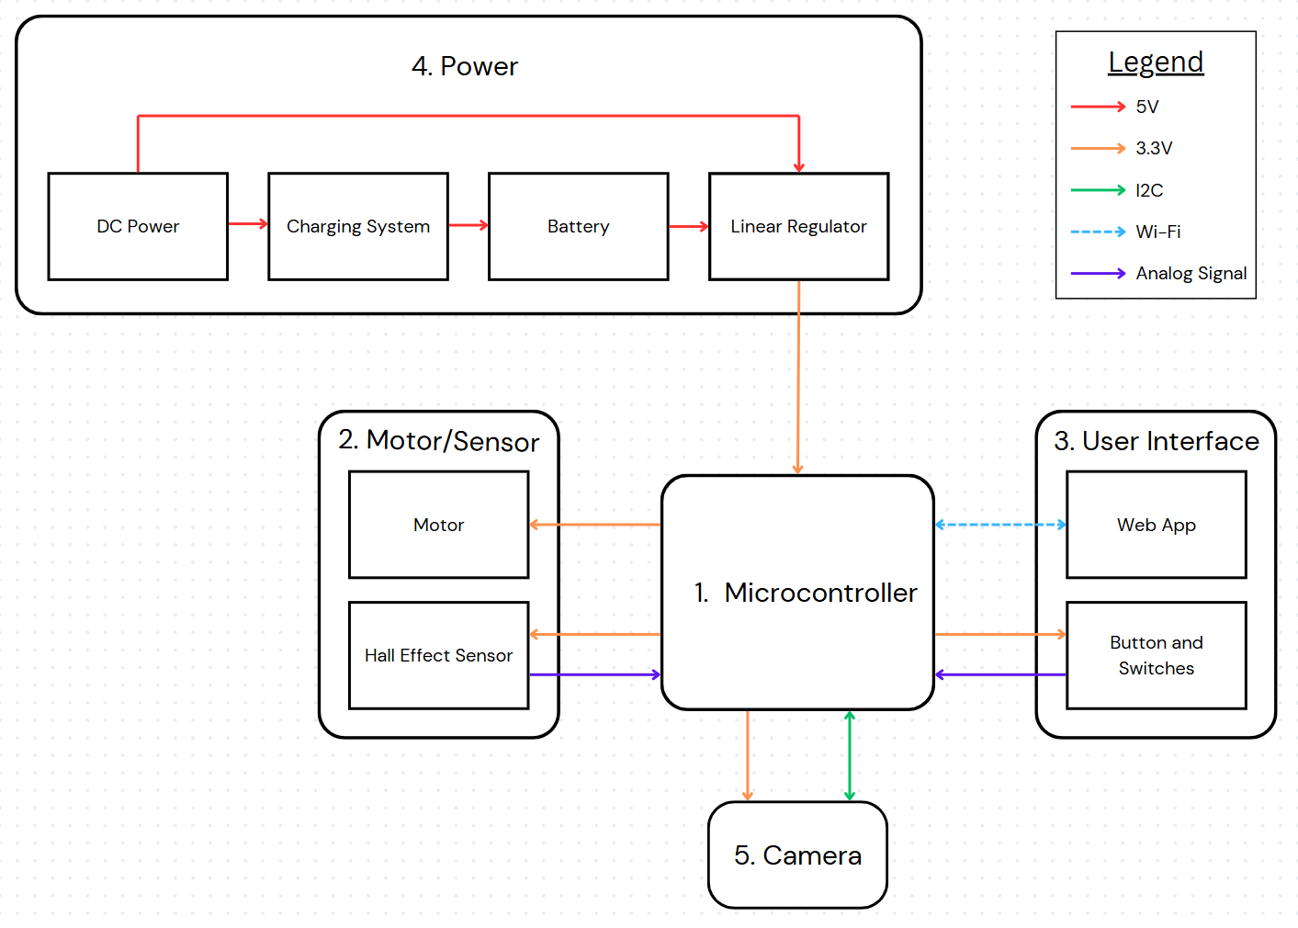
Block Diagram
CHART / GRAPH
ELECTRICAL & COMPUTER ENGINEERING
GRAINGER ENGINEERING
Notes:
Brandon

Slide 7
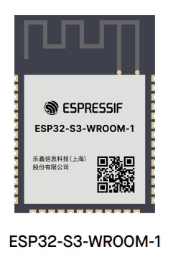
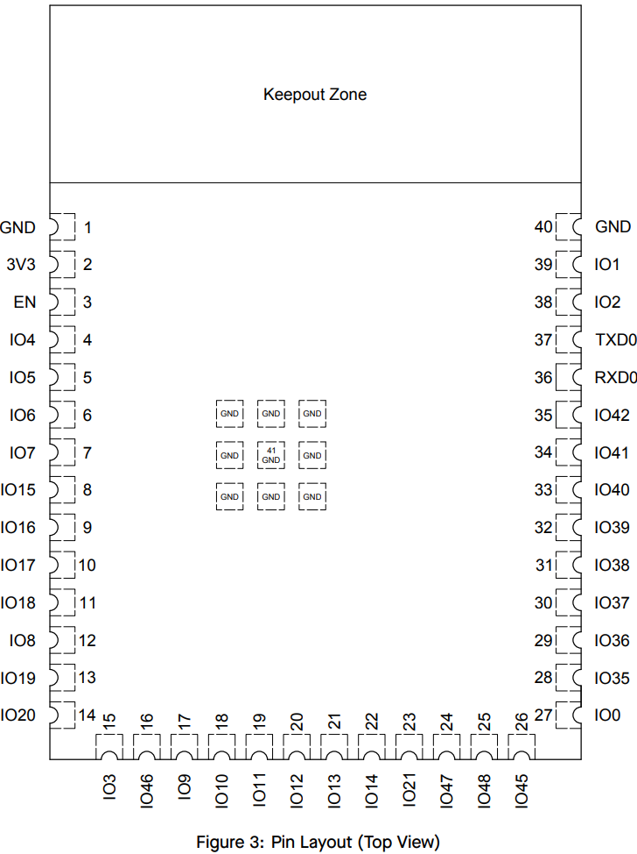
Microcontroller
ESP32
We specifically use the ESP32-S3-Wroom-1
Interactions
Easily available
34 GPIO Pins
Lots of Documentation
ELECTRICAL & COMPUTER ENGINEERING
GRAINGER ENGINEERING
Notes:
Brandon - take out wifi and bluetooth and say because easily availble

Slide 8
Microcontroller: Requirements and Verification
Requirements
The ESP32 microcontroller must be able to communicate over I2C serial protocols with the camera. - Verified
The ESP32 microcontroller must be able to communicate over Wi-Fi to the app. - Verified
The ESP32 microcontroller must be able to communicate through analog signals from the manual feed button and hall effect sensor. - Verified
The ESP32 microcontroller must only send 3.3V +/- 0.1V to the camera when the option is selected on the app. - Verified
ELECTRICAL & COMPUTER ENGINEERING
GRAINGER ENGINEERING
Notes:
Jeremy

Slide 9
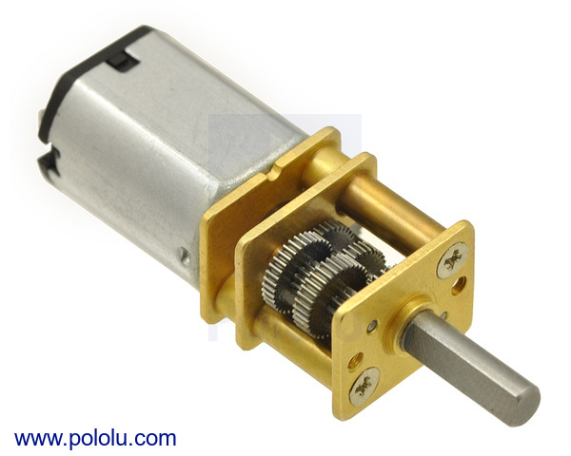
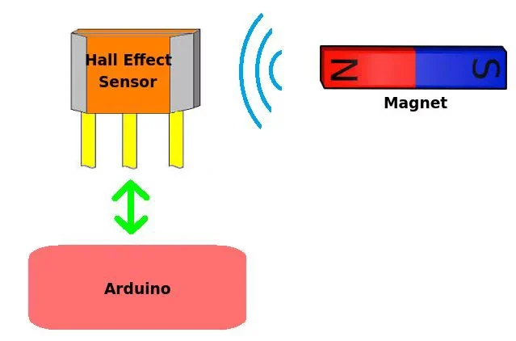
Motor / Sensor
Motor
3 V micro-metal gear motor with a 1000:1 gear ratio drawing up to 60 mA. PMOS transistor used as a “relay”.
Sensor
49E Hall-effect sensor used to calculate food percentage and rotation indication
ESP-32
ELECTRICAL & COMPUTER ENGINEERING
GRAINGER ENGINEERING
Notes:
Colby

Slide 10
Motor and Sensor: Requirements and Verification
Requirements
3.3 V +/- 0.1 V is successfully supplied to the motor from the ESP32 when the feed button is pressed. - Verified
3.3 V +/- 0.1 V is successfully supplied to the motor from the ESP32 when the scheduled feed times are reached. - Verified
The motor successfully completes a minimum rotation of 360-degrees once triggered from the ESP32. - Verified
The motor successfully stops within 2 seconds once the Hall effect sensor is triggered via the magnet inside the rotating cylinder. - Verified
ELECTRICAL & COMPUTER ENGINEERING
GRAINGER ENGINEERING
Notes:
Colby

Slide 11
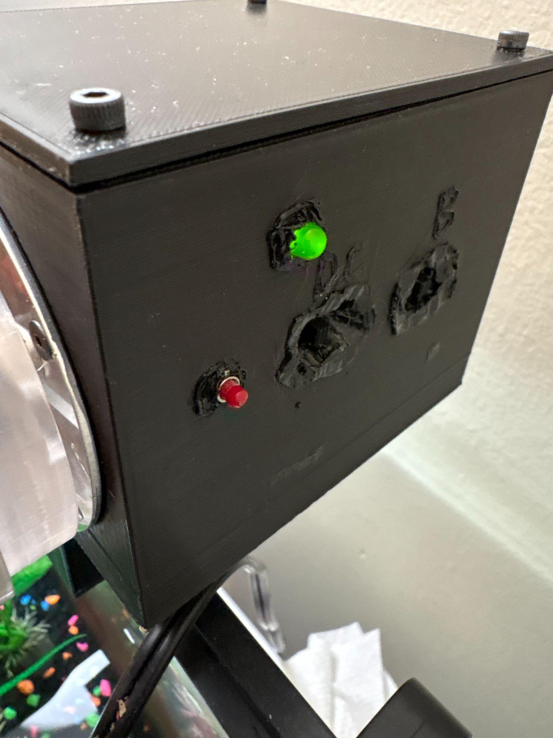
User Interface: Physical Feed Button
Immediately Feed your Fish
Allows you to feed your fish immediately without hassle.
Our Solution
Simply press the button and the feeder will activate.
ELECTRICAL & COMPUTER ENGINEERING
GRAINGER ENGINEERING
Notes:
Brandon

Slide 12
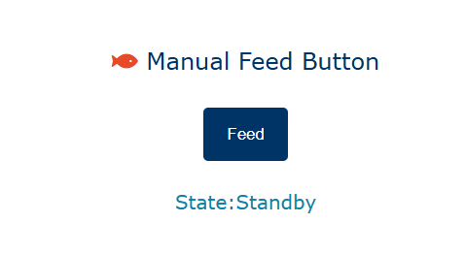
User Interface: Digital Feed Button
Feed your fish even when away
Allows users to feed their fish from anywhere.
Our Solution
Click the button on the web app and the feeder will activate.
Feeder must be connected to WiFi.
ELECTRICAL & COMPUTER ENGINEERING
GRAINGER ENGINEERING
Notes:
Brandon

Slide 13
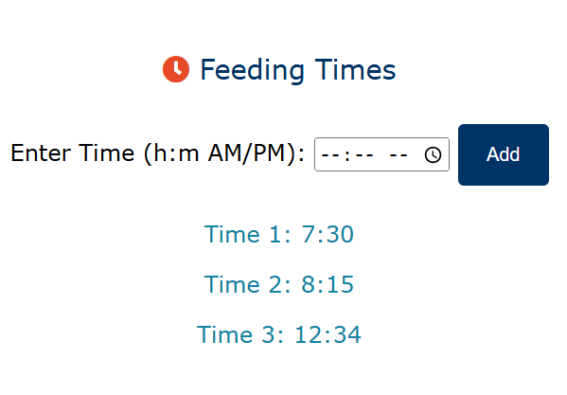
User Interface: Scheduling Feed Times
Scheduling When to Feed the Fish
Gives users flexibility when it comes to feeding their fish, depending on their needs.
Our Solution
Enter exact times you want the feeder to rotate and dispense food
Times that have already been added are displayed and can be removed
IMAGE / GRAPHIC
IMAGE / GRAPHIC
ELECTRICAL & COMPUTER ENGINEERING
GRAINGER ENGINEERING
Notes:
Brandon

Slide 14
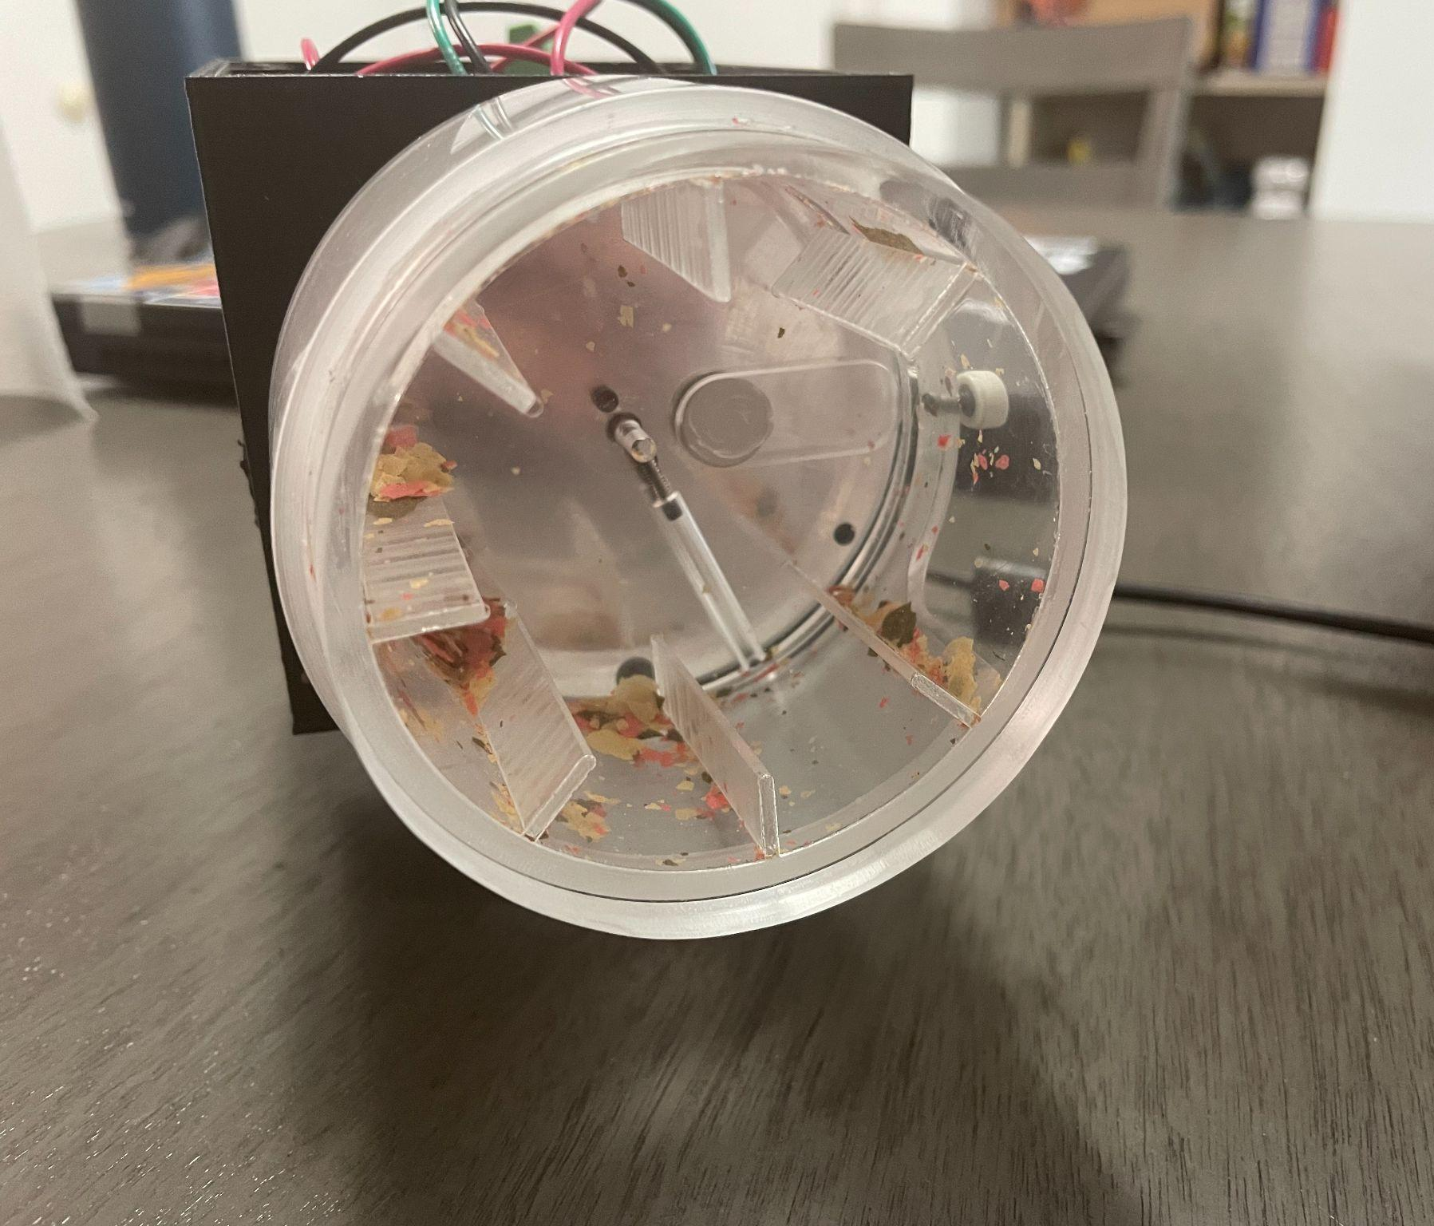
User Interface: Food Remaining in the Feeder
Estimating How Much Food is Left
Easily check how much food is left without going home.
Our Solution
Estimate food levels to improve convenience
Used time and math to calculate remaining capacity
IMAGE / GRAPHIC
ELECTRICAL & COMPUTER ENGINEERING
GRAINGER ENGINEERING
Notes:
Jeremy

Slide 15
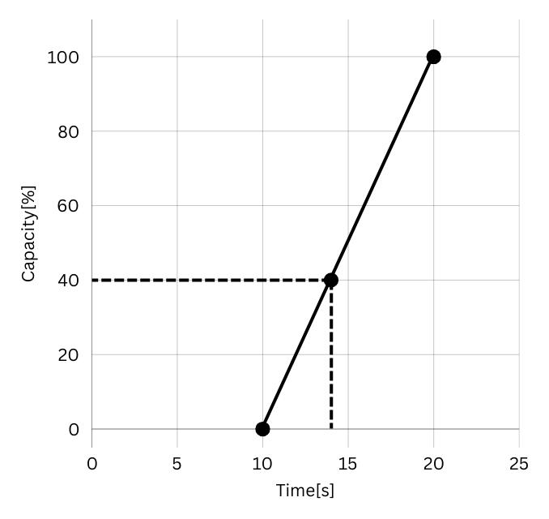
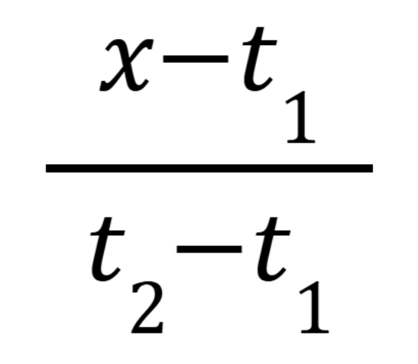
The Math Behind it
Calibration
Pressing “Calibrate” runs the feeder in two states: empty and full.
The motor completes one full revolution in each state to measure timing.
Calculation
App logs how long each revolution takes.
Times are plotted to form a linear equation, which is used to estimate food level.
ELECTRICAL & COMPUTER ENGINEERING
GRAINGER ENGINEERING
Notes:
Jeremy

Slide 16
User Interface: Requirements and Verification
Requirements
Feeder successfully activates within 3 seconds of the manual feed button press on the app via Wi-Fi. - Verified
Feeder successfully activates within 3 seconds of the scheduled time set using the app. - Verified
Feeder successfully activates within 3 seconds of the manual feed button being pressed on the feeder. - Verified
The ESP32 microcontroller must only send 3.3V +/- 0.1V to the camera when the option is selected on the app. - Verified
ELECTRICAL & COMPUTER ENGINEERING
GRAINGER ENGINEERING
Notes:
Brandon

Slide 17
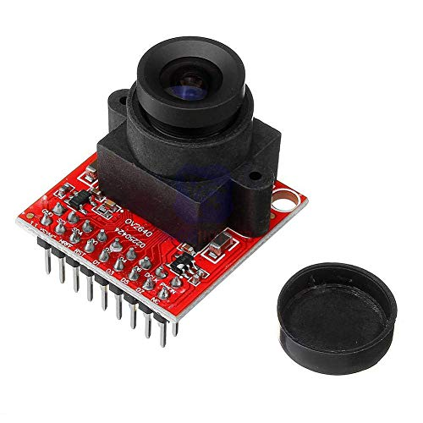
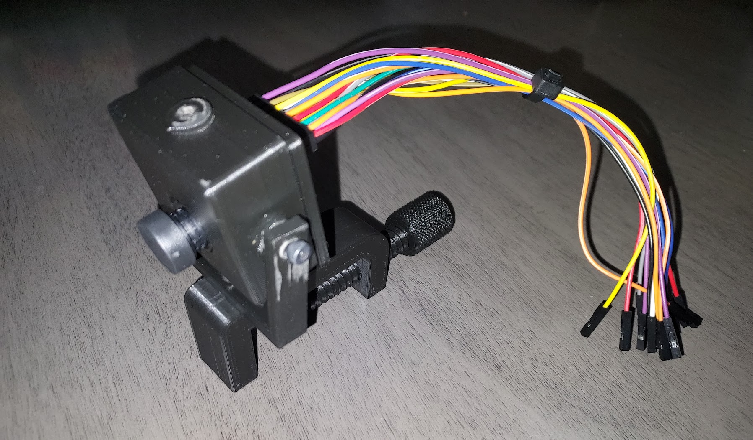
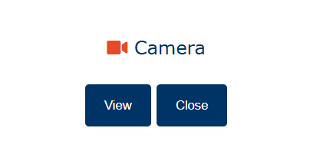
Camera
Viewing the Fish
Switched from OV7670 to OV2640 due to compatibility.
Displaying Camera Feed
Used Google Cloud to set up a virtual machine
ESP32 captures and sends frames to the VM
IMAGE / GRAPHIC
ELECTRICAL & COMPUTER ENGINEERING
GRAINGER ENGINEERING
Notes:
Jeremy

Slide 18
Camera: Requirements and Verification
Requirements
3.3 V +/- 0.1 V is successfully supplied to the camera module from the ESP32 when the camera icon is selected on the mobile app. - Verified
The Camera Feed is displayed in the web app. - Verified
ELECTRICAL & COMPUTER ENGINEERING
GRAINGER ENGINEERING
Notes:
Jeremy

Slide 19
ELECTRICAL & COMPUTER ENGINEERING
GRAINGER ENGINEERING
Notes:
Brandon - say auto-fish.food accessable

Slide 20
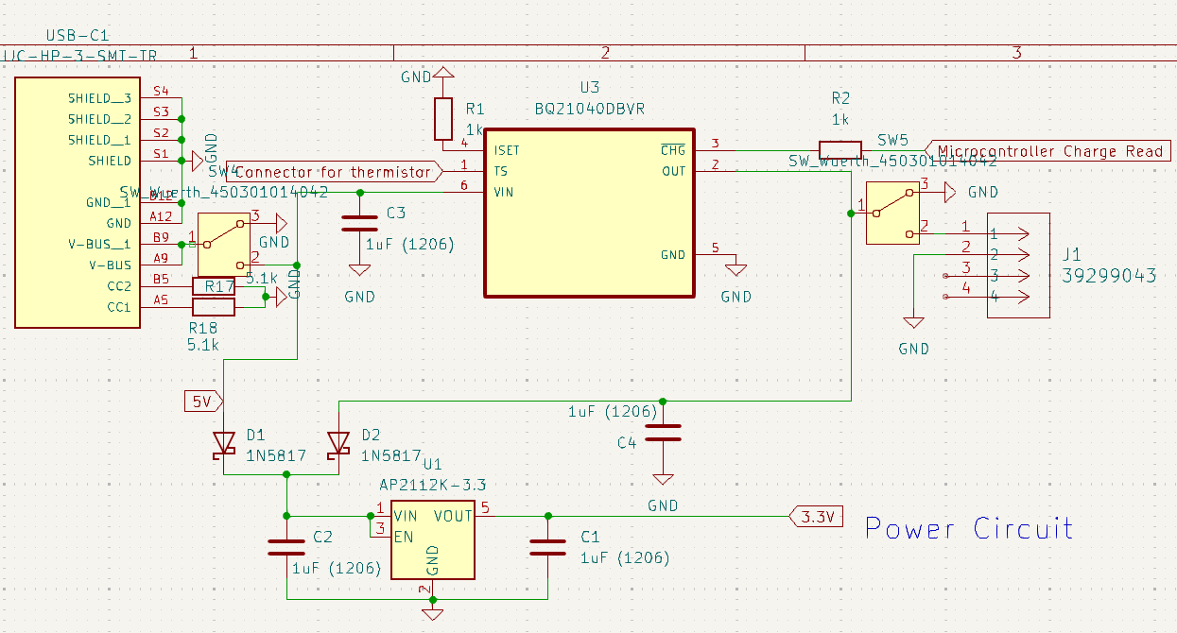
Power: Power Delivery and Charging System
Power system overall
5 V through USB-C connector
5 V to battery charger
3.7 V from backup battery
Switching circuit
Linear regulator to step down 5 V or 3.7 V to 3.3 V
Entire PCB powered by 3.3 V plane
Charging System
U3 IC that is an integrated single-cell lithium battery charger with adjustable charge speed and charge read
ELECTRICAL & COMPUTER ENGINEERING
GRAINGER ENGINEERING
Notes:
Colby

Slide 21
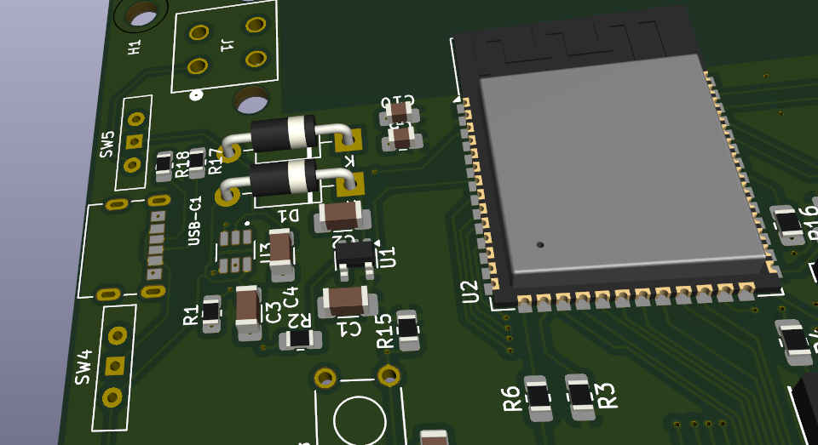
Power: Switching Between Wall and Battery Power
Simple, yet sophisticated
Using 2 schottky diodes, since our input power from the USB-C is 5 V, the single cell lithium is 3.7 V, this is a great implementation.
Why schottky diode? Low voltage drop.
ELECTRICAL & COMPUTER ENGINEERING
GRAINGER ENGINEERING
Notes:
Colby

Slide 22
Power: Requirements and Verification
Requirements
5V drawn from the wall is converted to 3.3V +/- 0.1V after going through the linear regulator. - Verified
When wall power is unavailable, the feeder successfully switches to battery power. - Verified
The power subsystem supplies a stable voltage of 3.3 V +/- 0.1 V to the system, even with the temporary loss of AC power. - Verified
ELECTRICAL & COMPUTER ENGINEERING
GRAINGER ENGINEERING
Notes:
Colby

Slide 23
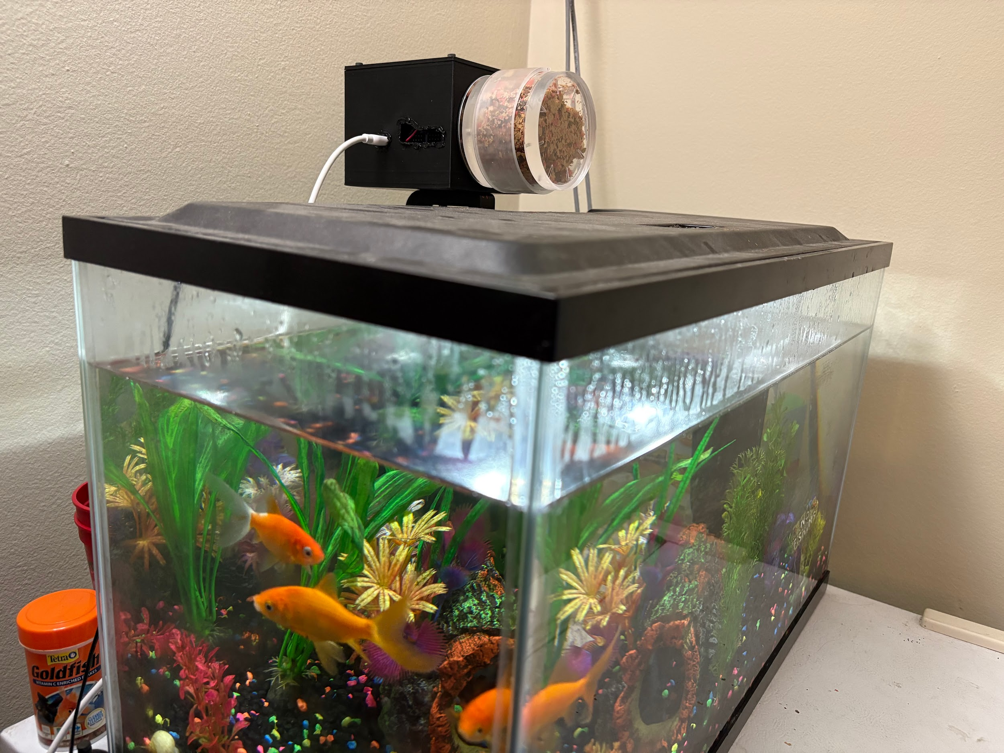
The experience, the process, the change
Knowledge gained
Designing a power system
PCB design with a microcontroller
Setting up a web app
What we would change
Enclosure and rotator
Camera wire loom/connector
Specific ESP32 chip
Utilization of bluetooth
ELECTRICAL & COMPUTER ENGINEERING
GRAINGER ENGINEERING
Notes:
Jeremy

Slide 24
Successes and Challenges of Implementing the SAFF
Successes
High speed power source switching
Long battery backup life ∼10 hours HU
Feeder operates with or without WiFi
Challenges
Poor USB-UART programmers
Soldering of the ESP-32
Programming circuit correctness
ELECTRICAL & COMPUTER ENGINEERING
GRAINGER ENGINEERING
Notes:
Brandon - say 14 hours and subtly shit on programmers and circuit

Slide 25
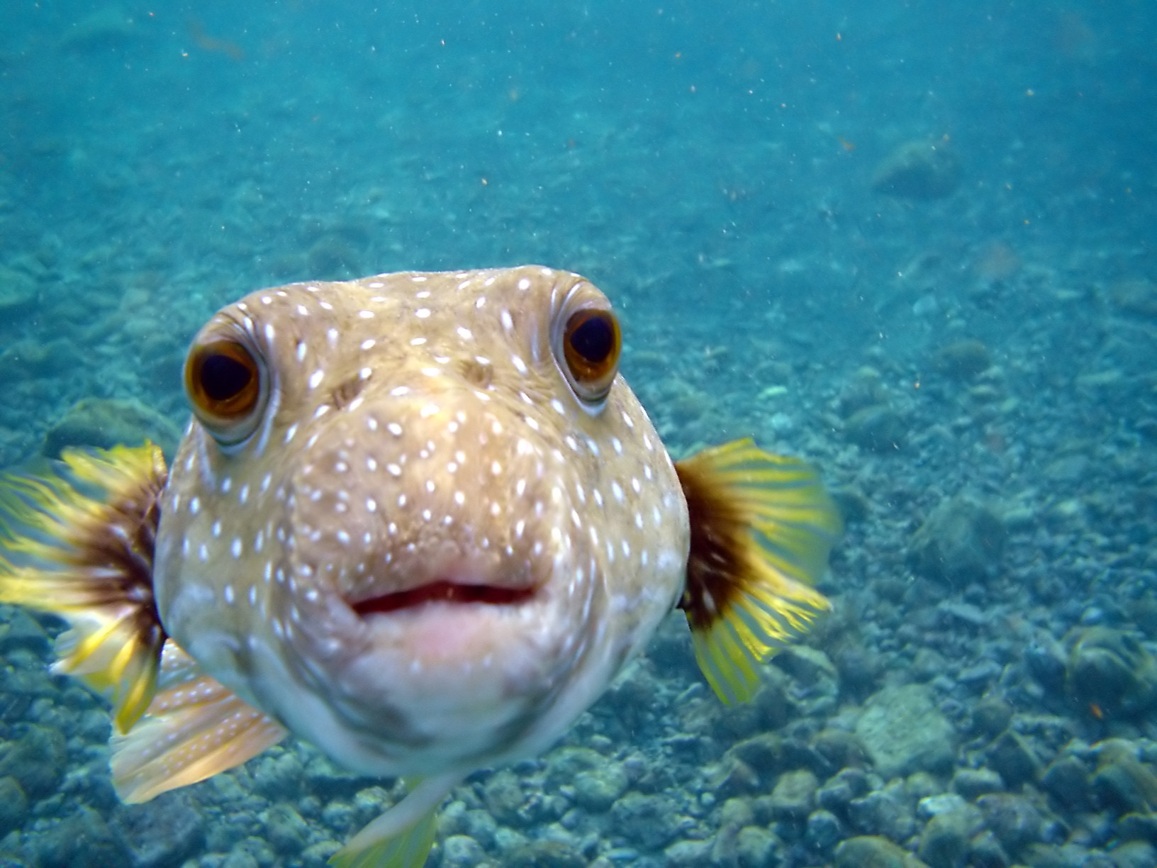
To Commercialize or to Not
The next steps for the SAFF
A Puffer Fish, Arothron hispidus is kissing my camera at Big Island of Hawaii. Brocken Inaglory. CC BY-SA - Mike Jones
ELECTRICAL & COMPUTER ENGINEERING
GRAINGER ENGINEERING
Notes:
Jeremy

Slide 26
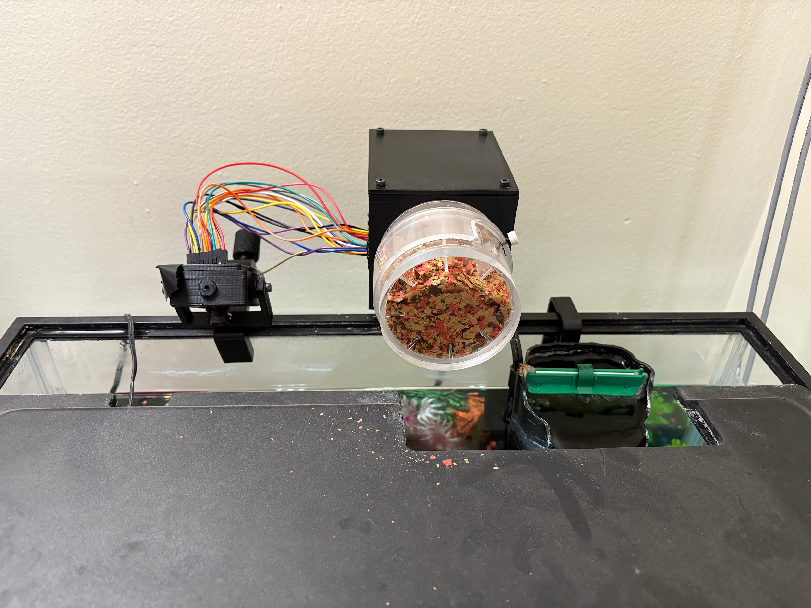
Thank you for listening. Any questions?
Product design showcase
ELECTRICAL & COMPUTER ENGINEERING
GRAINGER ENGINEERING
Notes:
Colby

