Slide 1
Door Knocking Alarm for the Hearing Impaired
Electrical & Computer Engineering
Team 21: Ajay Jayaraman, Pax Kim, Ji Yoon Lee
12/05/2023

Slide 2
Introduction
Problem
Accessibility for the deaf and hearing impaired
Respecting privacy and autonomy
Existing Solutions
Camera doorbells (Ring)
Invasive
Doorbell/front door specific
No solutions for personal bedrooms, dorm rooms, apartments without doorbell, etc.
ELECTRICAL & COMPUTER ENGINEERING
GRAINGER ENGINEERING
Notes:
Problem: Individuals with hearing impairments or deafness face challenges in responding to door knocks, particularly in environments like college campuses where housing lacks dedicated accessibility features such as a Ring system. Our project seeks to address this issue by developing an affordable and easily installable device. This device will notify users through phone alerts when someone is knocking on their door.

Slide 3
Design Overview
ELECTRICAL & COMPUTER ENGINEERING
GRAINGER ENGINEERING

Slide 4
Design Overview
High Level Requirements
The device must be able to detect when someone is knocking on the door
Establish vibration of threshold through testing
The device must be able to reliably communicate with the user when it detects a door knock
LED lights up
Device sends messages to the phone using WhatsApp when connected to the internet
The device should be able to last reliably for the duration of 10 hours
ELECTRICAL & COMPUTER ENGINEERING
GRAINGER ENGINEERING
Notes:
High Level Requirements
The device must be able to detect when someone is knocking on the door. This means that the vibration detection threshold of the device must be attuned to the vibration of a knock, but not of other possible causes of vibrations in the door (specifically non-contact methods of vibrating a door), such as stomping in front of the door. It should be able to detect vibrations in the threshold of 0.2 to 1 kHz, within a 5% margin of error.
The device must be able to reliably communicate with the user when it detects a door knock. For the LED component, that means that whenever the device detects a door knock, the LED will light up. For the phone notification component, this means that the device is able to send messages to the phone using WhatsApp when connected to the internet. By necessity, this means that the device must also be able to connect to a WiFi network. Given good and reliable internet, the message will be sent within 15 seconds of detecting an initial knock.
The device should be able to last reliably for the duration of 10 hours. This means that the battery, once attached to the device, will consistently and continuously power the device such that it is able to meet the previous requirements. Since the time in which a battery is able to power the device is variable depending on the frequency of use, the 10 hour metric assumes that the device detects a knock on the door once an hour. For the sake of testing, we will state that over an hour’s use, the battery’s current as measured by a voltmeter will decrease by a maximum of 10%.

Slide 5
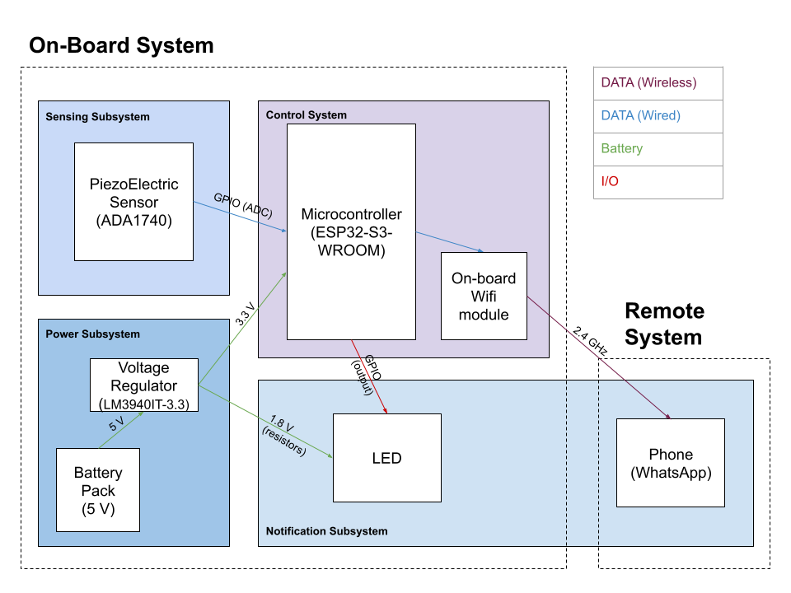
Design Overview
Original Design
Piezoelectric effect
Measures pressure changes from vibrations to generate current (only works with certain materials)
Crystalline materials, ceramics, polymers
On-board WiFi module
Up to 150 Mbps
CallMeBot API
Send messages to phones using messaging services (WhatsApp, Facebook Messenger, etc.)
ELECTRICAL & COMPUTER ENGINEERING
GRAINGER ENGINEERING

Slide 6
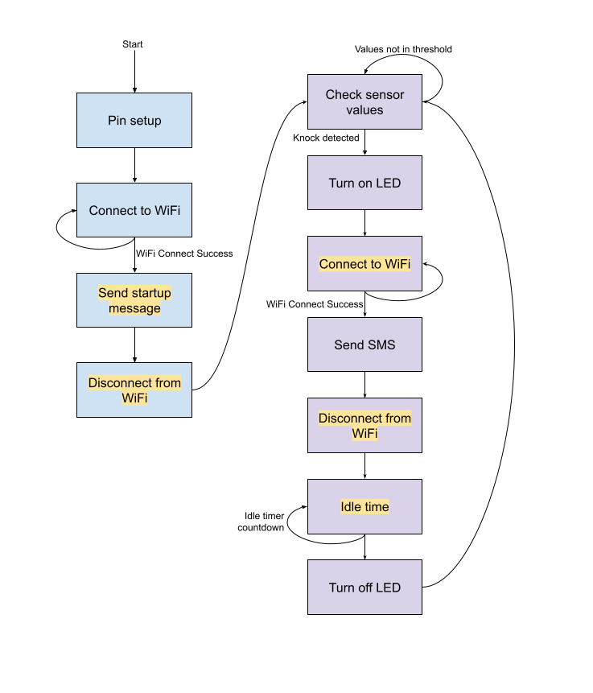
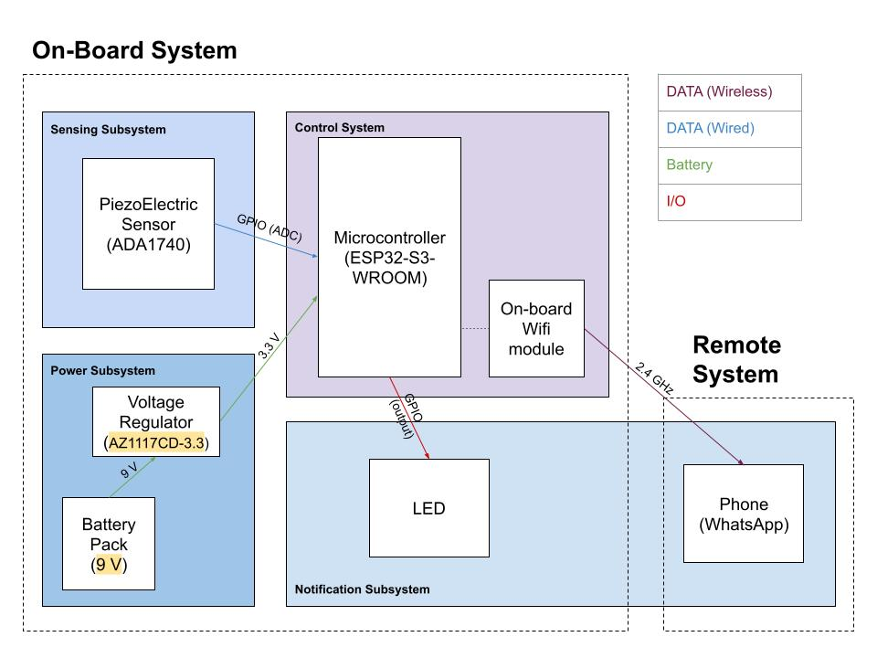
Design Overview
Design Changes
ELECTRICAL & COMPUTER ENGINEERING
GRAINGER ENGINEERING

Slide 7
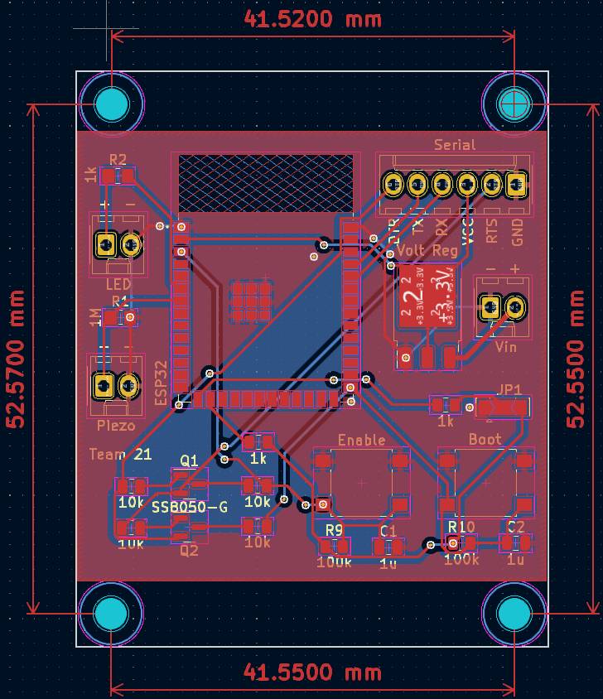
Design Overview
PCB Design
ELECTRICAL & COMPUTER ENGINEERING
GRAINGER ENGINEERING

Slide 8
Requirements & Verifications
ELECTRICAL & COMPUTER ENGINEERING
GRAINGER ENGINEERING

Slide 9
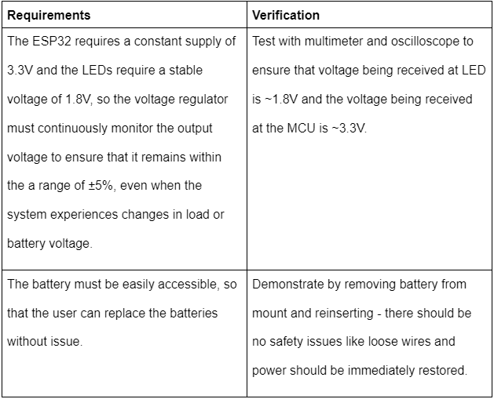
Requirements & Verifications
Power Subsystem
ELECTRICAL & COMPUTER ENGINEERING
GRAINGER ENGINEERING

Slide 10
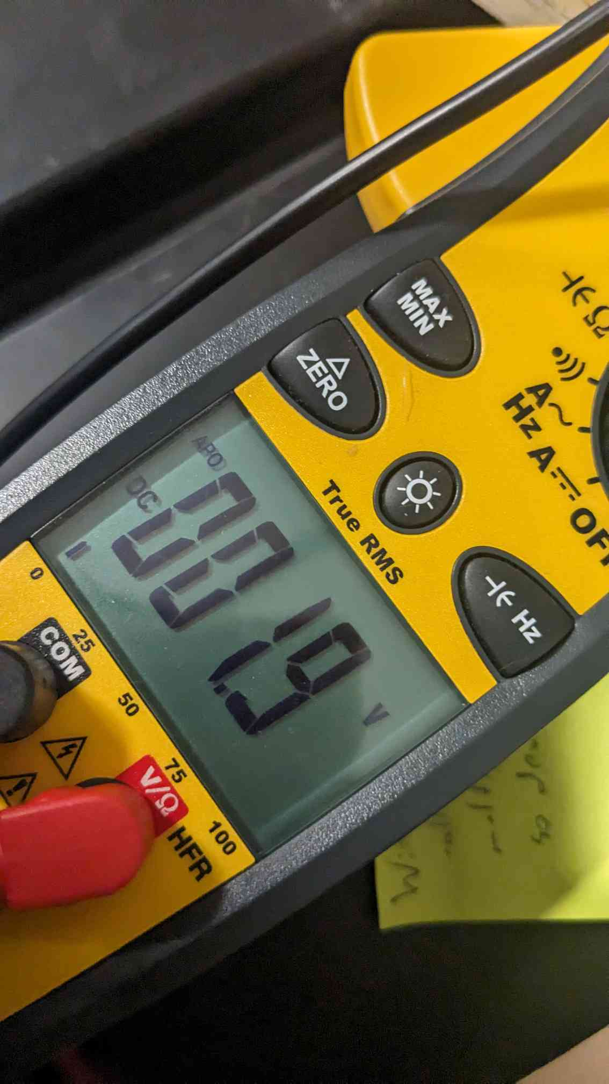
Requirements & Verifications
Power Subsystem
9V battery is fastened with velcro and battery clip for ease of replacement
ELECTRICAL & COMPUTER ENGINEERING
GRAINGER ENGINEERING

Slide 11
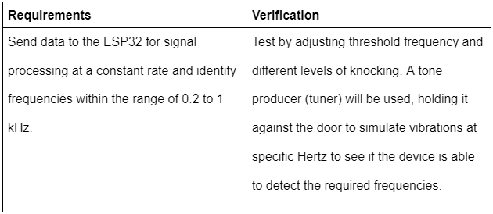
Requirements & Verifications
Sensing Subsystem
Theoretical frequency range is accounted for by threshold determined through testing
Filtering out noise
Verification accomplished with direct testing with sample door and acquiring sensor output values with development board
ELECTRICAL & COMPUTER ENGINEERING
GRAINGER ENGINEERING
Notes:
Rather than testing the specific piezoelectric sensor for its frequency detection range, we tested the sensor directly on our sample door. It was connected to the development board and set to output the read values to the serial monitor. By doing so, we were able to see what level of vibration the sensor would detect.

Slide 12
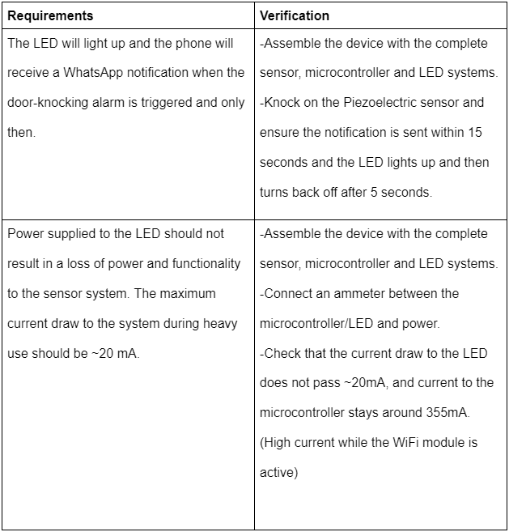
Requirements & Verifications
Notification Subsystem
ELECTRICAL & COMPUTER ENGINEERING
GRAINGER ENGINEERING

Slide 13
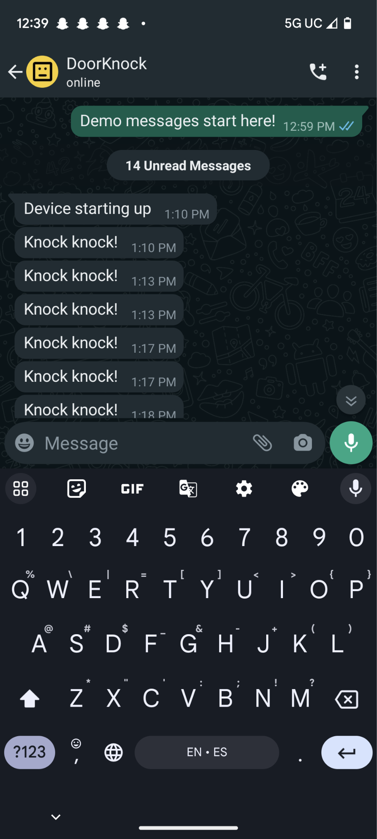
Requirements & Verifications
Notification Subsystem
WhatsApp notification was sent within 10-15 seconds due to the WiFi module being rebooted each time a knock is detected
LED remains on for 15 seconds as opposed to 5 as a more realistic notification window and to allow for the LED to stay lit while waiting for the message
Turns off when message is sent
Current draw to LED did not exceed 20 mA
ELECTRICAL & COMPUTER ENGINEERING
GRAINGER ENGINEERING

Slide 14
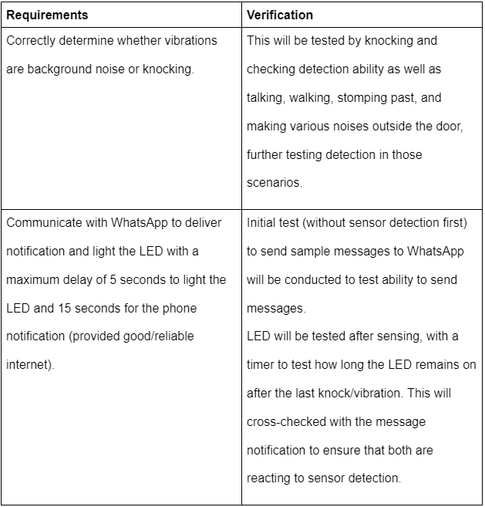
Requirements & Verifications
Control Subsystem
ELECTRICAL & COMPUTER ENGINEERING
GRAINGER ENGINEERING

Slide 15
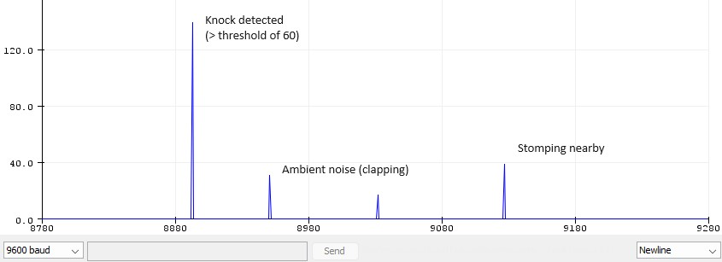
Requirements & Verifications
Control Subsystem
LED lights up the instant a knock is detected (within measured threshold)
LED turns off when message is confirmed sent (all within 15 seconds)
ELECTRICAL & COMPUTER ENGINEERING
GRAINGER ENGINEERING

Slide 16
Conclusions
ELECTRICAL & COMPUTER ENGINEERING
GRAINGER ENGINEERING

Slide 17
Conclusions
Results
Demoed using ESP32 Dev Board
Ordered a simple plastic box that houses all of our components
A wire from the PCB is fed outside the box to the piezoelectric sensor for simple attachment
ELECTRICAL & COMPUTER ENGINEERING
GRAINGER ENGINEERING

Slide 18
Conclusions
Successes
Low power consumption
Long idle times with optimized WiFi module power consumption
Timely notification delivery
Algorithm for preventing excessive pinging
WiFi Module On | WiFi Module Off | Average (6 Knocks a day)
350 mA | 36.8 mA | ~37.0 mA
ELECTRICAL & COMPUTER ENGINEERING
GRAINGER ENGINEERING
Notes:
Successes:
-Our device requires low power due to being in the idle state for the majority of the time.
-When necessary, the WiFi module is enabled and is able to send messages to the user
-Notifications were able to be sent within 10 seconds of knocking, with idle timer built in to send 1 notification per series of door knocks

Slide 19
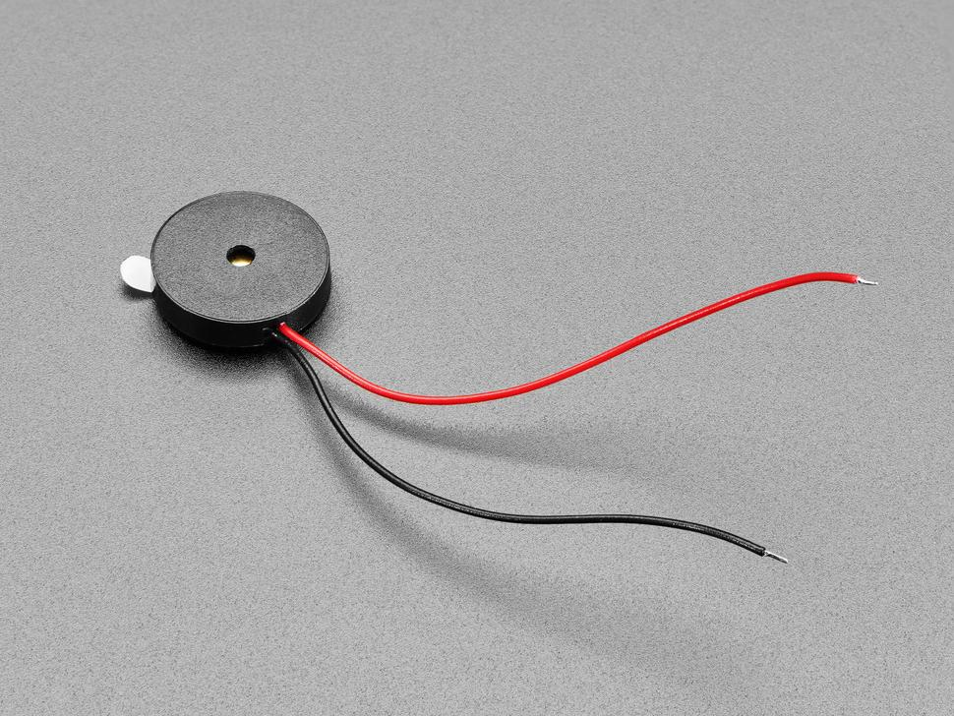
Conclusions
Challenges
Piezoelectric sensor quality
Created lots of lower range noises
Lots of threshold variability based on wiring
Code uploading/flashing issues
No data cable defects
Driver issues on personal devices
PCB bootloader design issue
Programming header (CH340 chip)
ELECTRICAL & COMPUTER ENGINEERING
GRAINGER ENGINEERING
Notes:
Challenges
-We needed to have found an alternative piezoelectric sensor to use as the model we used from AdaFruit was very flimsy and bad at picking up vibrations (10/10 wording ik ill fix l8r)
-Thin wires, low quality piezo (noise at lower ranges)
-Issues with microcontroller programming
Potential routes we thought might have been causing the problems
Driver issues (couldnt use Arduino IDE on our personal computers, used lab machines)
Data cable defects (Not it, tested multiple cables!)
PCB design issue
Boot and Enable
Put in bootloader mode, etc.
Serial programmer issue
Talk abt the model we used, inconsistencies in uploading (rarely without any recreatability it would upload)

Slide 20
Conclusions
What We Learned
Many different possible knock detection implementations (pressure sensors, piezoelectric sensors, etc.)
Accessible designs (easily replaceable battery, no bright flashing lights, etc.)
ELECTRICAL & COMPUTER ENGINEERING
GRAINGER ENGINEERING
Notes:
Rather than reading in the value from the voltage created from the sensor, we could have used signal processing (FFT) to better determine which vibrations were caused by knocking as opposed to other miscellaneous noises.
Using a 9V battery results in a short lifespan and requires constant replacement. A solution to this would be to use a battery pack, which could extend the life of the device up to months.

Slide 21
Conclusions
Recommendations for Future Work
Working on debugging programming issues
Testing with higher quality sensors
Signal processing (Fast Fourier Transform) for frequency threshold detection
Battery pack to extend lifespan
App/Website for user setup (phone number+generating API key, backup WiFi connections with MultiWifi)
ELECTRICAL & COMPUTER ENGINEERING
GRAINGER ENGINEERING

Slide 22
Questions?
ELECTRICAL & COMPUTER ENGINEERING
GRAINGER ENGINEERING

