Slide 1
Automated Frozen Pipe Burst Prevention System
Electrical & Computer Engineering
Group # 22: Neha Vagvala, Benedicta Udeogu, Ethan Zhang
05/02/2023

Slide 2
Problem
How can we automate the process of preventing pipes from bursting due to the expansion of frozen water within them?
ELECTRICAL & COMPUTER ENGINEERING
GRAINGER ENGINEERING

Slide 3
Why Is This Worth Solving?
The Statistics:
An estimated average of over 250,000 families each year will suffer damage from frozen and burst pipes.
The damage is estimated to be up to $400-500 million each year.
To further highlight the fragility of frozen pipes, even a rupture as small as 1/8th of an inch can release up to 250 gallons of water per day.
When Is This Particularly Useful/Applicable?
The resident has left the household for an extended period and forgets to keep the thermostat set to at least 55 °F
The resident forgets to turn on the tap to let a little trickle run through the pipe before leaving
ELECTRICAL & COMPUTER ENGINEERING
GRAINGER ENGINEERING

Slide 4
Solution
2 prevention methods automatically triggered upon crossing 55 °F:
A valve system that opens to allow water to flow through the pipe to prevent the water from being stagnant and freezing
A notification sent to the designated resident's smartphone to alert them of the current water temperature and the potential imminent risk of a pipe burst
ELECTRICAL & COMPUTER ENGINEERING
GRAINGER ENGINEERING

Slide 5
Test Results
Successful Implementation of All 3 High-Level Requirements
Demo Video
ELECTRICAL & COMPUTER ENGINEERING
GRAINGER ENGINEERING

Slide 6
High Level Requirements
System is triggered only when the temperature sensor output reads at or below 13.0 °C/55 °F.
A push notification is sent to the mobile device using Wi-Fi upon Raspberry Pi receiving low temperature reading.
Water is deposited to the pipe over the course of 5 seconds so that the movement from trickling water prevents the pipe from freezing.
ELECTRICAL & COMPUTER ENGINEERING
GRAINGER ENGINEERING

Slide 7
VIDEO
LINK
ELECTRICAL & COMPUTER ENGINEERING
GRAINGER ENGINEERING

Slide 8
Design Overview
Block Diagram
Major Components
Subsystems
ELECTRICAL & COMPUTER ENGINEERING
GRAINGER ENGINEERING

Slide 9
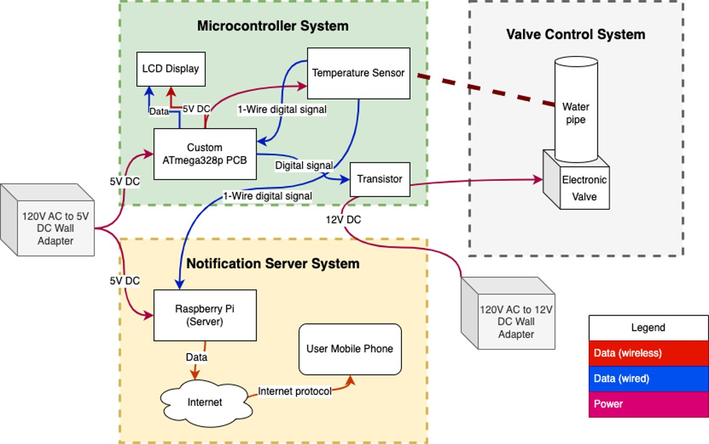
Block Diagram
ELECTRICAL & COMPUTER ENGINEERING
GRAINGER ENGINEERING

Slide 10
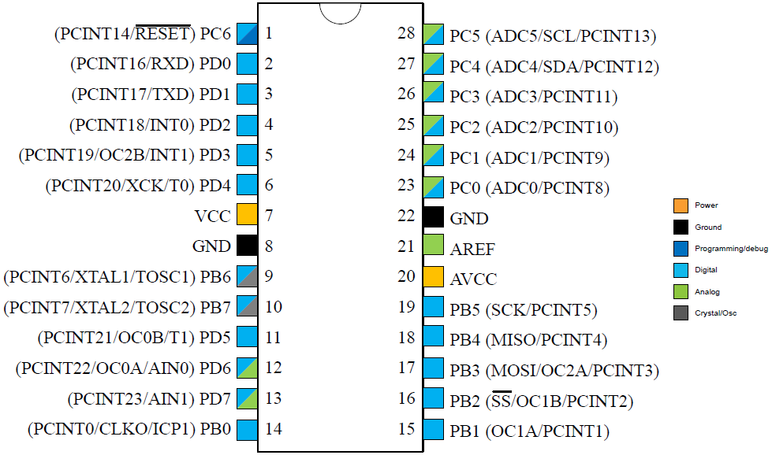
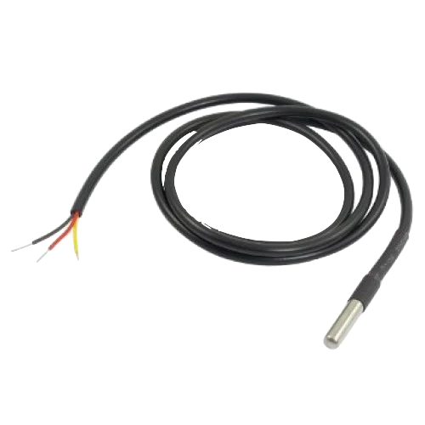
Microcontroller Subsystem
ATMega328P-PU Microcontroller
Interfaces with digital temperature sensor output, LCD display, and raspberry pi 4
Programmed via USB 3.0 Type A port and the Arduino IDE software
Waterproof DS18B20 Digital Temperature Sensor
Waterproof
Usable temperature range:
-55°C to 125°C
-67°F to 257°F
+/- 0.5°C tolerance from –10°C to +85°C
Uses 1-Wire Interface
ELECTRICAL & COMPUTER ENGINEERING
GRAINGER ENGINEERING

Slide 11
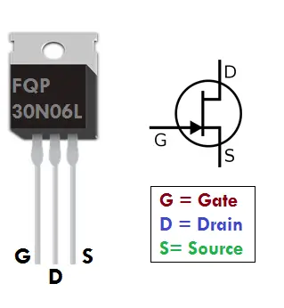
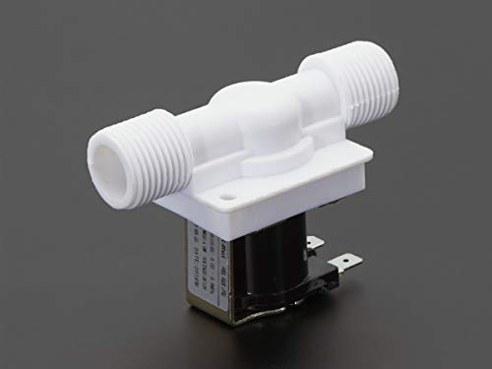
Valve Control Subsystem
Power
12V DC wall adapter
MCU Connection
Transistor gate pin connected to digital I/O of ATmega328
Switch closes for 5s when temperature was 55 °F or lower
12V power
Water flows
ELECTRICAL & COMPUTER ENGINEERING
GRAINGER ENGINEERING
Notes:
Benedicta

Slide 12
Notification Subsystem
Raspberry Pi
Also continuously reads the digital output of the temperature sensor via 1-Wire protocol
Connected to wi-fi network of user's home
Sends a push notification to user's mobile phone when temperature drops below threshold and valve system is activated
User can be anywhere with internet
Python script
requests and w1thermsensor libraries
User token stored in yaml for security
ELECTRICAL & COMPUTER ENGINEERING
GRAINGER ENGINEERING
Notes:
Benedicta

Slide 13
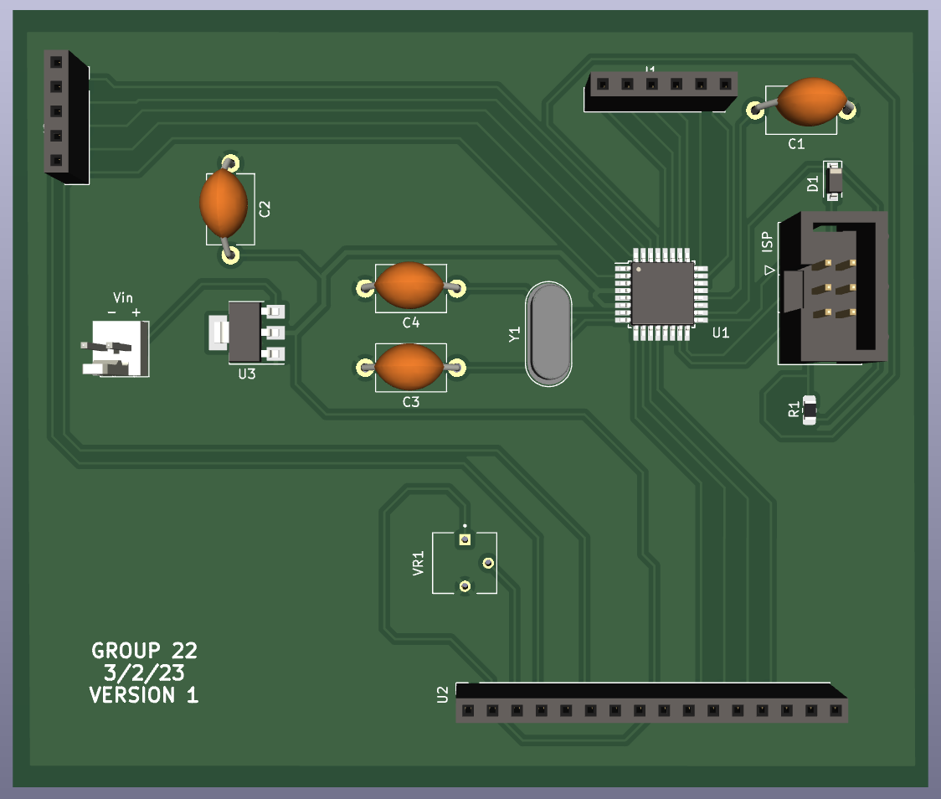
PCB - 1
Complications
Short Circuit
Different thicknesses of routing nets under MCU
Did not use backside of PCB
Lack of knowledge first time around
Use of SMD rather than THT
Faulty connections
Flipped pins
Multimeter suggested voltage was dispersing properly across components
Resistor read correct resistance as well
IMAGE / GRAPHIC
ELECTRICAL & COMPUTER ENGINEERING
GRAINGER ENGINEERING
Notes:
Benedicta

Slide 14
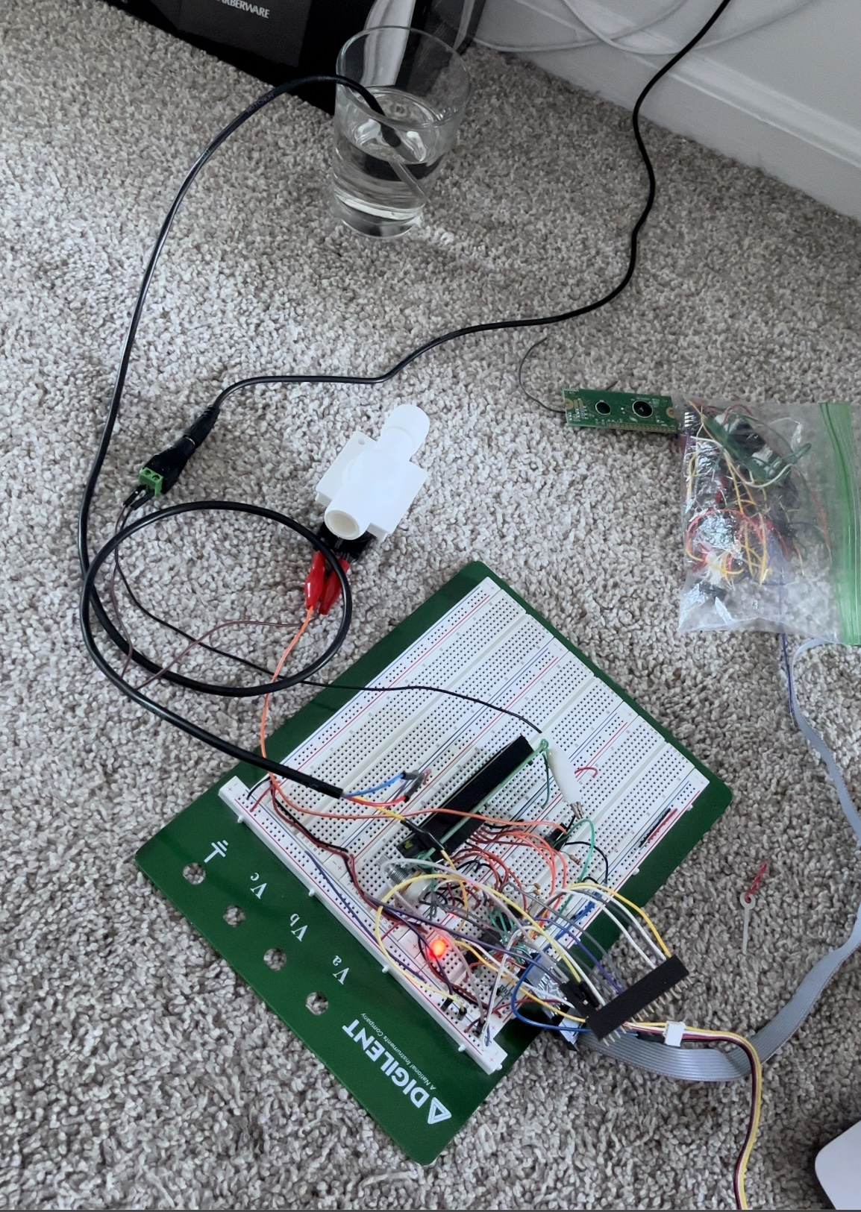
Breadboard Prototype
Hardware consisted mostly of I/O with DS18B20 Sensor
Serial and simple
No major hardware issues
Software
OneWire
DallasTemperature
LiquidCrystal
IMAGE
ELECTRICAL & COMPUTER ENGINEERING
GRAINGER ENGINEERING

Slide 15
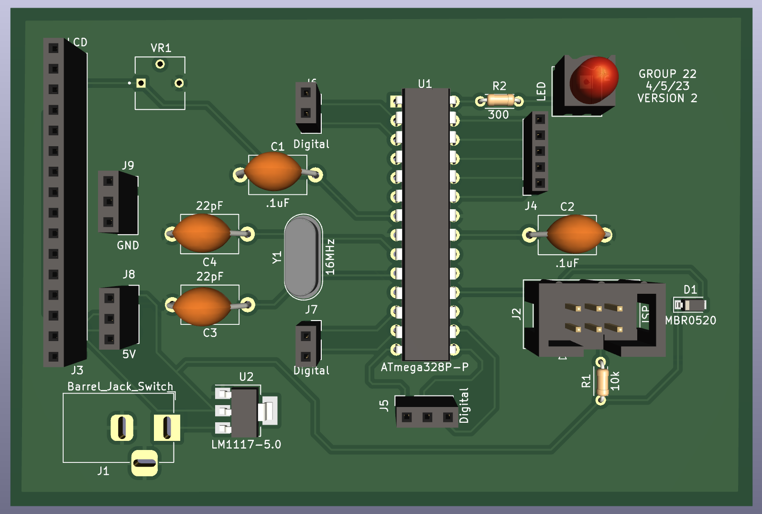
PCB - 2
Changes
Added test points
LED
Used both sides of PCB
Did not route under components
Included more headers
More flexibility
5v header could act as input or output depending on how power was connected
Backup pins if routings were wrong
Minimized SMD parts even more
THT microcontroller and resistors
IMAGE / GRAPHIC
ELECTRICAL & COMPUTER ENGINEERING
GRAINGER ENGINEERING
Notes:
Benedicta

Slide 16
Requirements & Verifications
Component | Requirements | Verification
NMOS Transistor & Solenoid Valve | 1. Provide 12 VDC +/- 10% from a 10.8 VDC to 13.2 VDC solenoid valve regulated by a 5 VDC microcontroller. | 1. Using a NMOS transistor, connect a digital I/O pin from the ATmega328p, set as an output, to the "Gate" pin of the transistor and only close (set pin to HIGH) the gate when the temperature reading reaches threshold. Observe the valve open during this time.
DS18B20 Digital Temperature Sensor Probe | 1. The system should only be triggered between a temperature of 13.0 °C and 14.0 °C, accounting for the +/- 0.5 °C tolerance of the DS18B20 Digital Thermometer. 2. Temp sensor conversion takes 750 s. Atmega328p and Raspberry Pi reading the DS18B20 temperature sensor do not cause read failures. | 1. Measure the temperature of the water in the reservoir using an alternate thermometer and compare the result to the output of the DS18B20 digital thermometer on the LCD. 2. Add a delay (2000) after a read of the temperature sensor to see the removal of read failures as the ATmega328p and the Raspberry Pi attempt to read temperature versus when the delay is not there.
ATmega328p Microcontroller | 1. The MCU burn bootloader works and is able to upload any sketch once flashed. Ability to interact with incoming data signals and sensors. | 1. Connect an LED to an analog pin of the microcontroller. Set the LED to blink every second. After proper programming of the board through USBasp, one should see the LED blink in 1 s intervals.
ELECTRICAL & COMPUTER ENGINEERING
GRAINGER ENGINEERING

Slide 17
Challenges
ELECTRICAL & COMPUTER ENGINEERING
GRAINGER ENGINEERING

Slide 18
Challenges
Sourcing the short in PCB – 1
Dealing with enterprise wifi for notification system
Eliminating interference between the reads of the ATmega328p and the Raspberry Pi
Verifying soldering connections
ELECTRICAL & COMPUTER ENGINEERING
GRAINGER ENGINEERING

Slide 19
Conclusions
ELECTRICAL & COMPUTER ENGINEERING
GRAINGER ENGINEERING

Slide 20
Conclusions
Fully functional demonstration of all three high-level requirements with working PCB
Acquired Skills:
Figuring out which components to use and best suit the needs of our project
Powering components with different voltage requirements
PCB design
Debugging PCB on breadboard prototype
Programming Waterproof DS18B20 Digital Temperature Sensor
Programming LCD Display
Programming solenoid valve
Programming Raspberry Pi to send notification to smartphone
Learning how to integrate subsystems to operate cohesively and in unison
ELECTRICAL & COMPUTER ENGINEERING
GRAINGER ENGINEERING

Slide 21
Future Improvements
ELECTRICAL & COMPUTER ENGINEERING
GRAINGER ENGINEERING

Slide 22
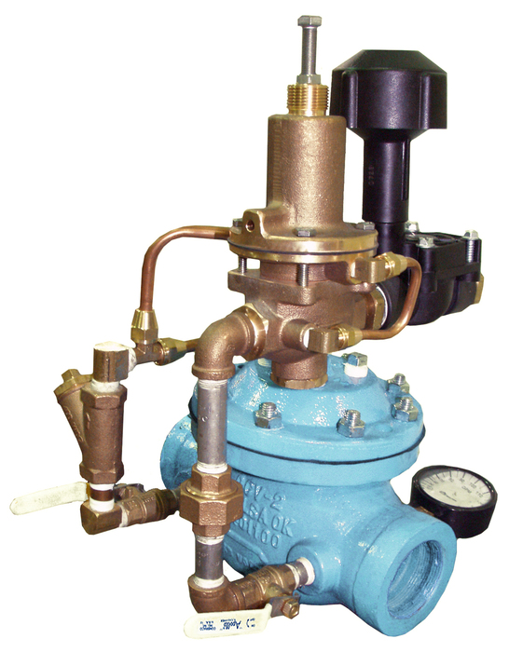
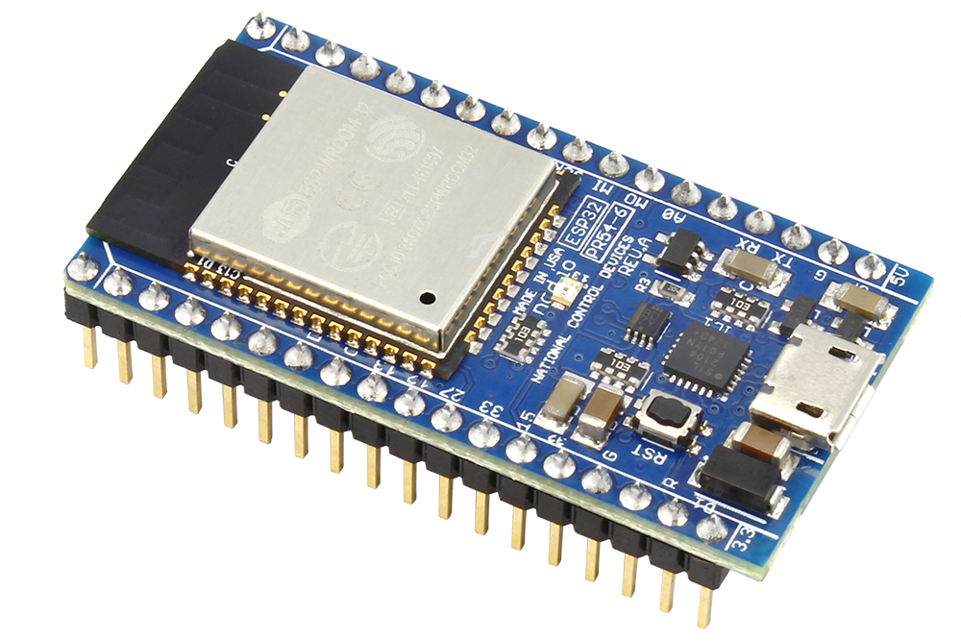
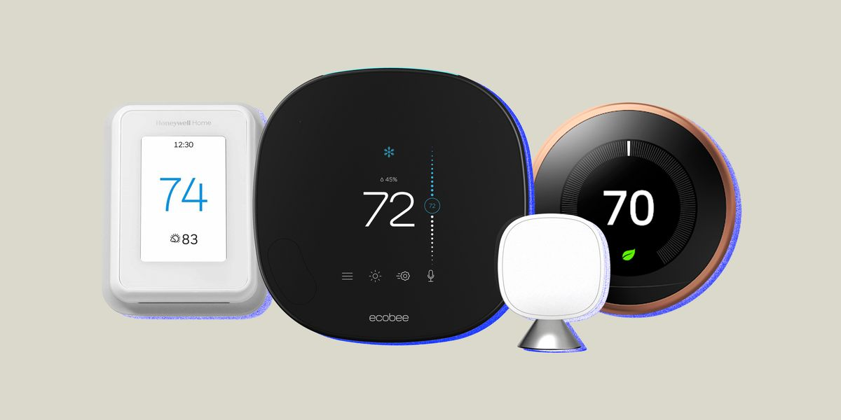
Future Improvements
variable rate of water flow dependent on current pipe water temperature
replacing the Raspberry Pi with a more affordable piece of hardware such as an ESP32 Wi-Fi Module
smart thermostat integration
ELECTRICAL & COMPUTER ENGINEERING
GRAINGER ENGINEERING

Slide 23
Image Links
best-smart-thermostats-refresh-lead-1663969484.jpg
https://www.controlvalves.com/product/model-127fav-flow-control-and-programmable-solenoid-valve/
ESP32 wifi module
https://www.etechnophiles.com/fqp30n06l-mosfet-pinout-datasheet-arduino-project/
https://core-electronics.com.au/plastic-water-solenoid-valve-12v-1-2-nominal.html
ELECTRICAL & COMPUTER ENGINEERING
GRAINGER ENGINEERING

Slide 24
Thank you for watching!
The floor is open for Q/A ☺
ELECTRICAL & COMPUTER ENGINEERING
GRAINGER ENGINEERING

