Slide 1
Footballytics
Electrical & Computer Engineering
Vibhav Adivi, Akshay Bapat, Varun Venkatapathy
TA: Xiangyuan Zhang
Professor Viktor Gruev
Team 16
May 2, 2023

Slide 2
Objective
ELECTRICAL & COMPUTER ENGINEERING
GRAINGER ENGINEERING

Slide 3
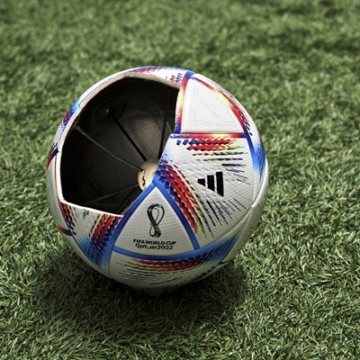
Sports like soccer and basketball have incorporated technology for accurate calls
Football scoring is still done by eye
Goal is to incorporate location tracking and sensors into a football to improve accuracy
IMAGE
https://preview.thenewsmarket.com/Previews/ADID/StillAssets/320x320/618232.jpg
ELECTRICAL & COMPUTER ENGINEERING
GRAINGER ENGINEERING
Notes:
Varun

Slide 4
Original High-Level Requirements
Tracking system locating football within a given space within the length of a football (30 cm).
The football is able to retrieve motion data from the 9-axis inertial measurement unit.
The air pressure of the football is measured and reported.
ELECTRICAL & COMPUTER ENGINEERING
GRAINGER ENGINEERING
Notes:
Akshay

Slide 5
Design
ELECTRICAL & COMPUTER ENGINEERING
GRAINGER ENGINEERING

Slide 6
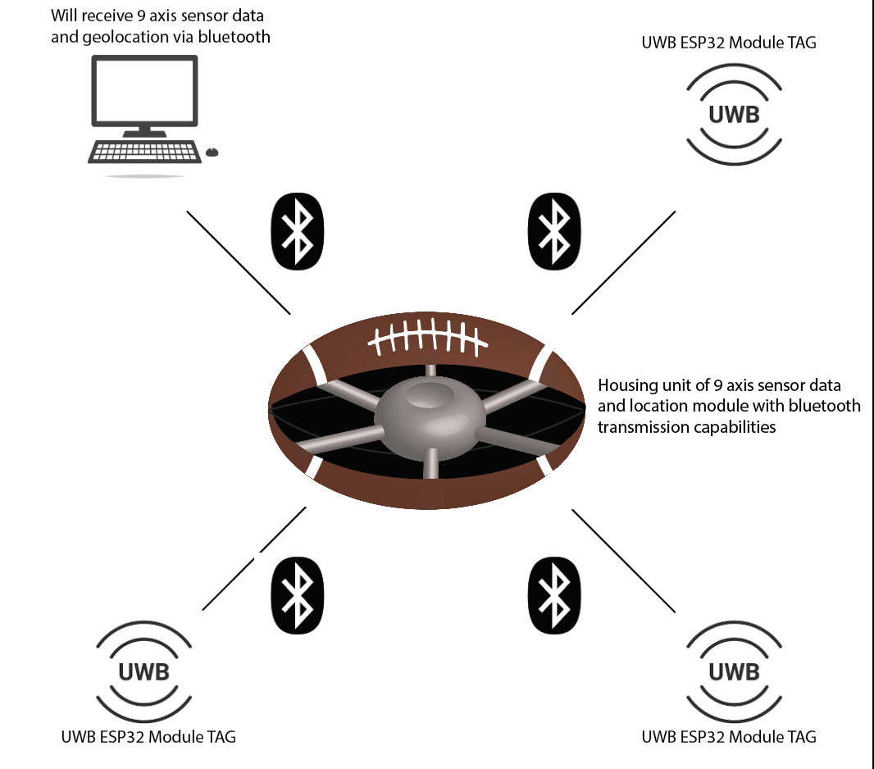
Physical Design
A PCB enclosed in the football, communicating with three anchors via ultra wideband to find its location, and then have that PCB send the location and sensor information to an external receiver via bluetooth.
ELECTRICAL & COMPUTER ENGINEERING
GRAINGER ENGINEERING
Notes:
Vibhav

Slide 7
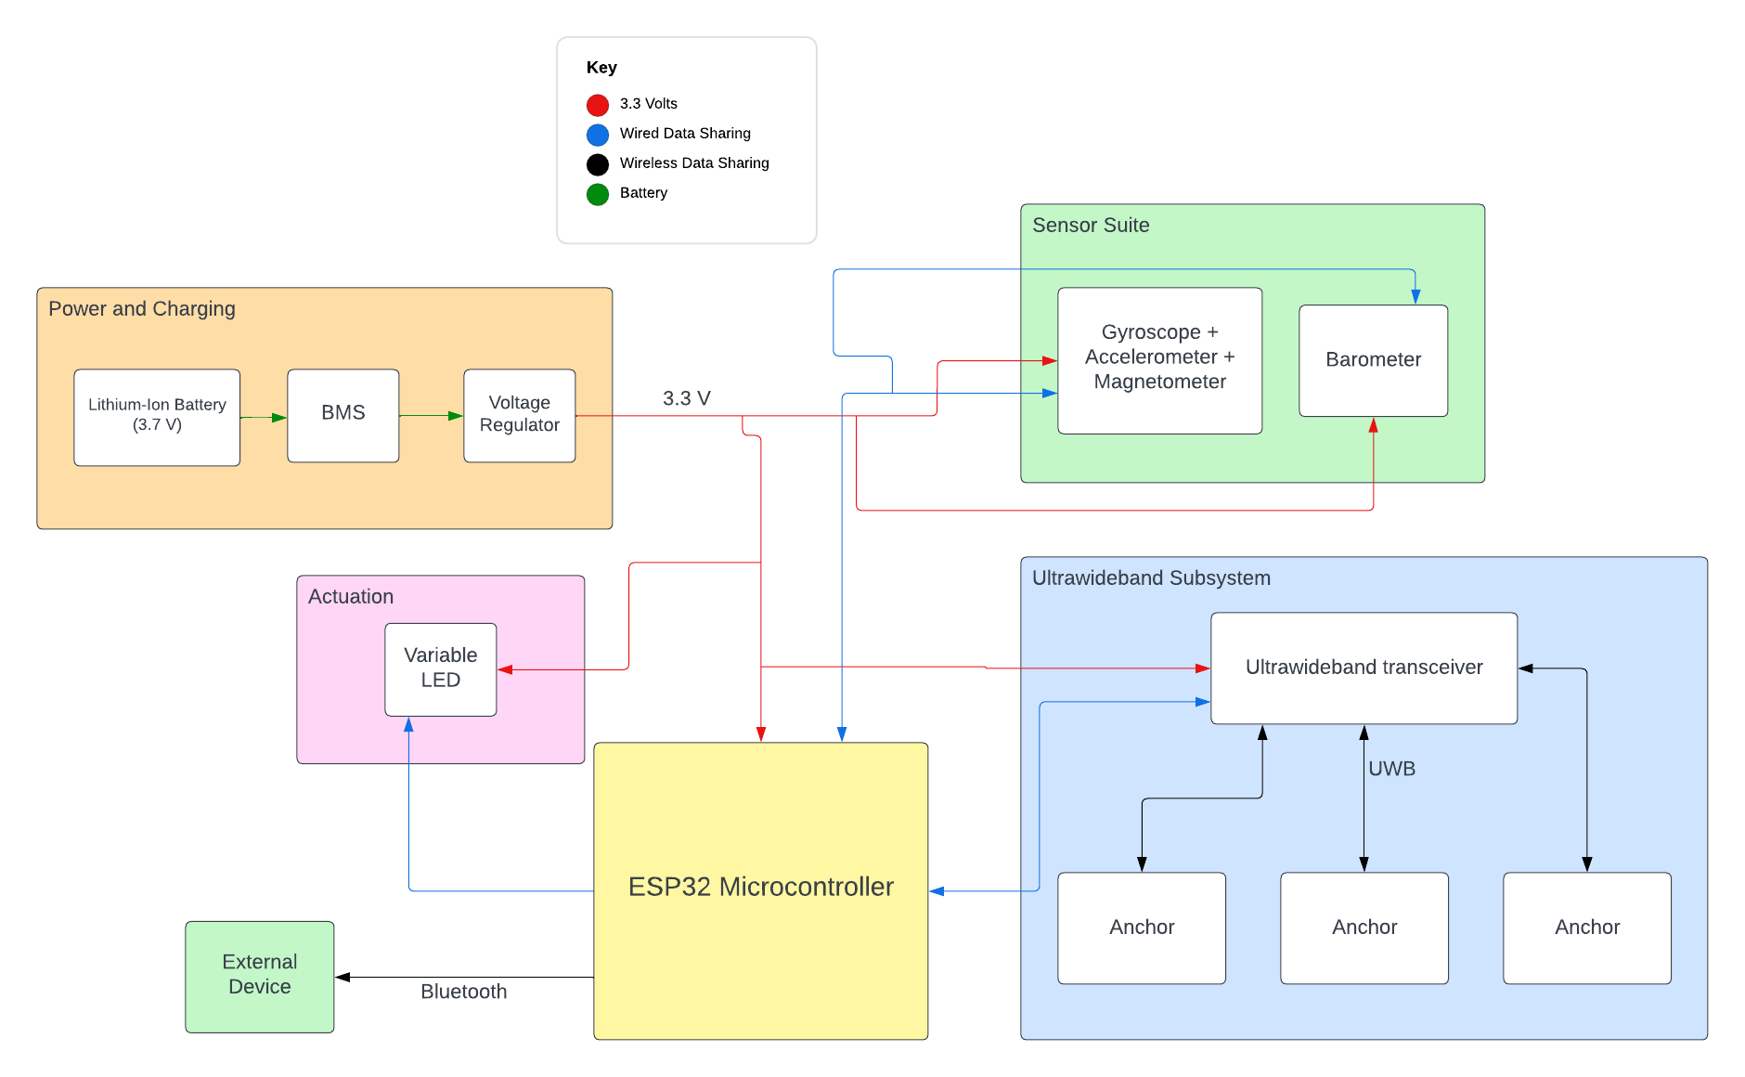
Block Diagram
ELECTRICAL & COMPUTER ENGINEERING
GRAINGER ENGINEERING
Notes:
Vibhav. We’re going to spend a lot of time on this slide walking through this, and we also mention what changed in regards to actuation and opting to not prioritize power and charging.

Slide 8
PCB
ELECTRICAL & COMPUTER ENGINEERING
GRAINGER ENGINEERING
Notes:
Vibhav.

Slide 9
Changes from Original Design
Combined actuation and external device
Improvement to give us more real-time data
Did not implement barometer in the sensor suite
Decided to power the ball and anchors by microUSB power sources instead of making it rechargeable
ELECTRICAL & COMPUTER ENGINEERING
GRAINGER ENGINEERING
Notes:
Varun

Slide 10
Software
ELECTRICAL & COMPUTER ENGINEERING
GRAINGER ENGINEERING

Slide 11
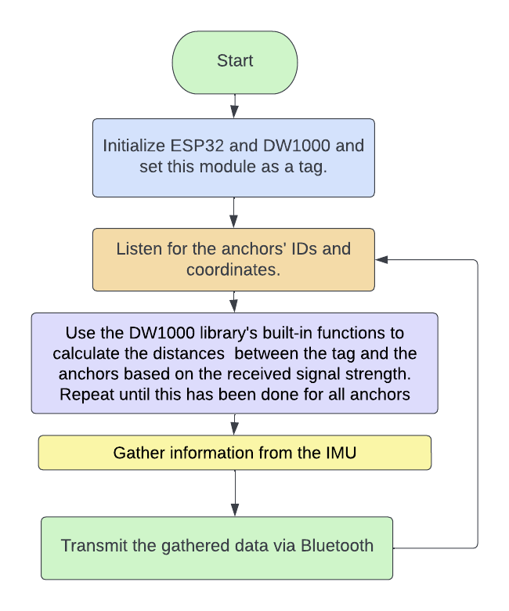
Arduino Code Uploaded to ESP32
ELECTRICAL & COMPUTER ENGINEERING
GRAINGER ENGINEERING
Notes:
Vibhav We’re going to spend a lot of time on this slide walking through this, and we also mention what changed in regards to actuation and opting to not prioritize power and charging.

Slide 12
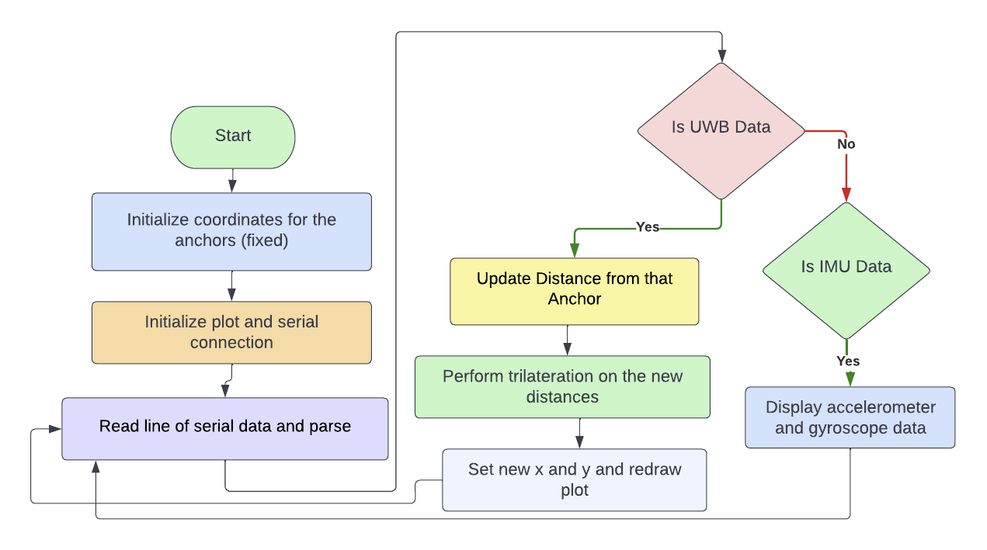
Python Program for Actuation
ELECTRICAL & COMPUTER ENGINEERING
GRAINGER ENGINEERING
Notes:
Vibhav- We’re going to spend a lot of time on this slide walking through this, and we also mention what changed in regards to actuation and opting to not prioritize power and charging.

Slide 13
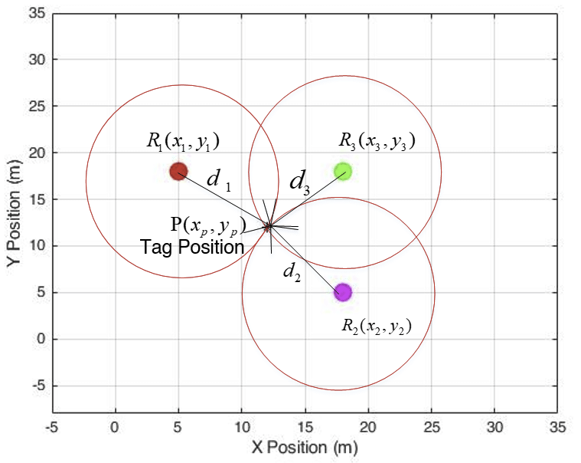
Trilateration for positioning
(x_{p} - x₁)² + (y_{p} - y₁)² = d₁²
(x_{p} - x₂)² + (y_{p} - y₂)² = d₂²
(x_{p} - x₃)² + (y_{p} - y₃)² = d₃²
ELECTRICAL & COMPUTER ENGINEERING
GRAINGER ENGINEERING
Notes:
Vibhav

Slide 14
Requirements and Verification
ELECTRICAL & COMPUTER ENGINEERING
GRAINGER ENGINEERING

Slide 15
Requirement 1
The tag is able to communicate with each anchor
Verification: Upload the Arduino programs to each anchor and the tag. Then connect all the anchors to power and the tag to the computer.
If communication occurs, the tag prints the address of the anchor and the calculated distance to serial. Three addresses should be seen printed.
Verification passed
ELECTRICAL & COMPUTER ENGINEERING
GRAINGER ENGINEERING
Notes:
Akshay

Slide 16
Requirement 2
The distance for each anchor is accurate within 30 cm
Verification: Compare the measured and real distances between the anchor and the tag for different real distances and ensure the difference is less than 30 cm.
Verification passed upto 7.5 m distance
After 7.5 m distance is passed, the measured distance varies by more than 30 cm
ELECTRICAL & COMPUTER ENGINEERING
GRAINGER ENGINEERING
Notes:
Akshay

Slide 17
Antenna Delay Factor
Real Measured(m) | #16587 | #16586 | #16585
0.25 | 0.3 | 0.1 | 0.28
0.5 | 0.37 | 0.46 | 0.46
1 | 1.18 | 1.11 | 1.2
2 | 1.82 | 2.03 | 1.9
3 | 2.97 | 3.08 | 3
4 | 3.76 | 3.96 | 4.04
5 | 5.15 | 5.11 | 5.27
6 | 5.78 | 5.95 | 5.98
7 | 7.09 | 7.09 | 7.03
7.5 | 8.45 | 8.4 | 7.53
ELECTRICAL & COMPUTER ENGINEERING
GRAINGER ENGINEERING
Notes:
Akshay- This should be in results because it’s something we actually tested vs just theoretical

Slide 18
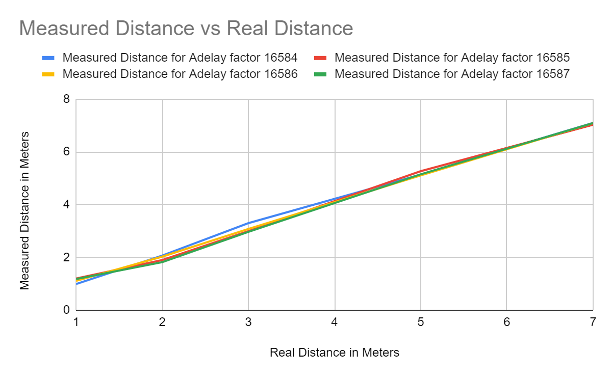
Antenna Delay Factor
ELECTRICAL & COMPUTER ENGINEERING
GRAINGER ENGINEERING
Notes:
AkshayThis should be in results because it’s something we actually tested vs just theoretical

Slide 19
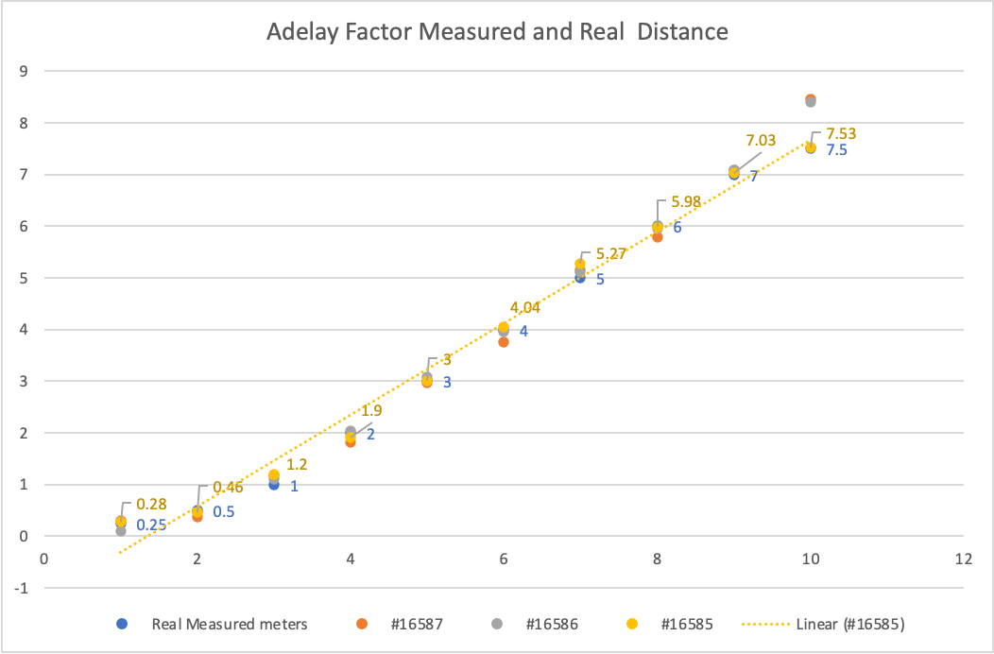
Antenna Delay Factor
ELECTRICAL & COMPUTER ENGINEERING
GRAINGER ENGINEERING
Notes:
Akshay- This should be in results because it’s something we actually tested vs just theoretical

Slide 20
Requirement 3
The football is correctly located.
Verification: Compare the measured and real coordinates of the tag and ensure the distance between the two is less than 30 cm.
Because of noise and unpredictability of the waves, the measurement jumps around, especially when the tag is moving.
To counteract, we take the average of 7 distances before updating the coordinates, making it more accurate, and this distance stays within 30 cm.
ELECTRICAL & COMPUTER ENGINEERING
GRAINGER ENGINEERING
Notes:
Varun

Slide 21
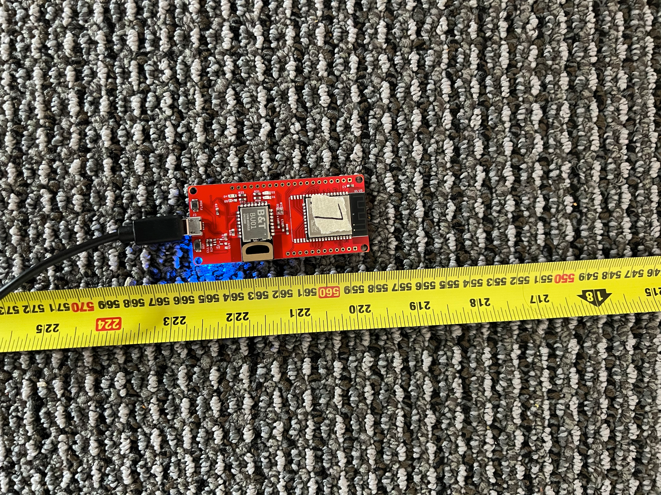
Location Tracking Requirements & Verification: Football Has Correct Location
ELECTRICAL & COMPUTER ENGINEERING
GRAINGER ENGINEERING
Notes:
Varun

Slide 22
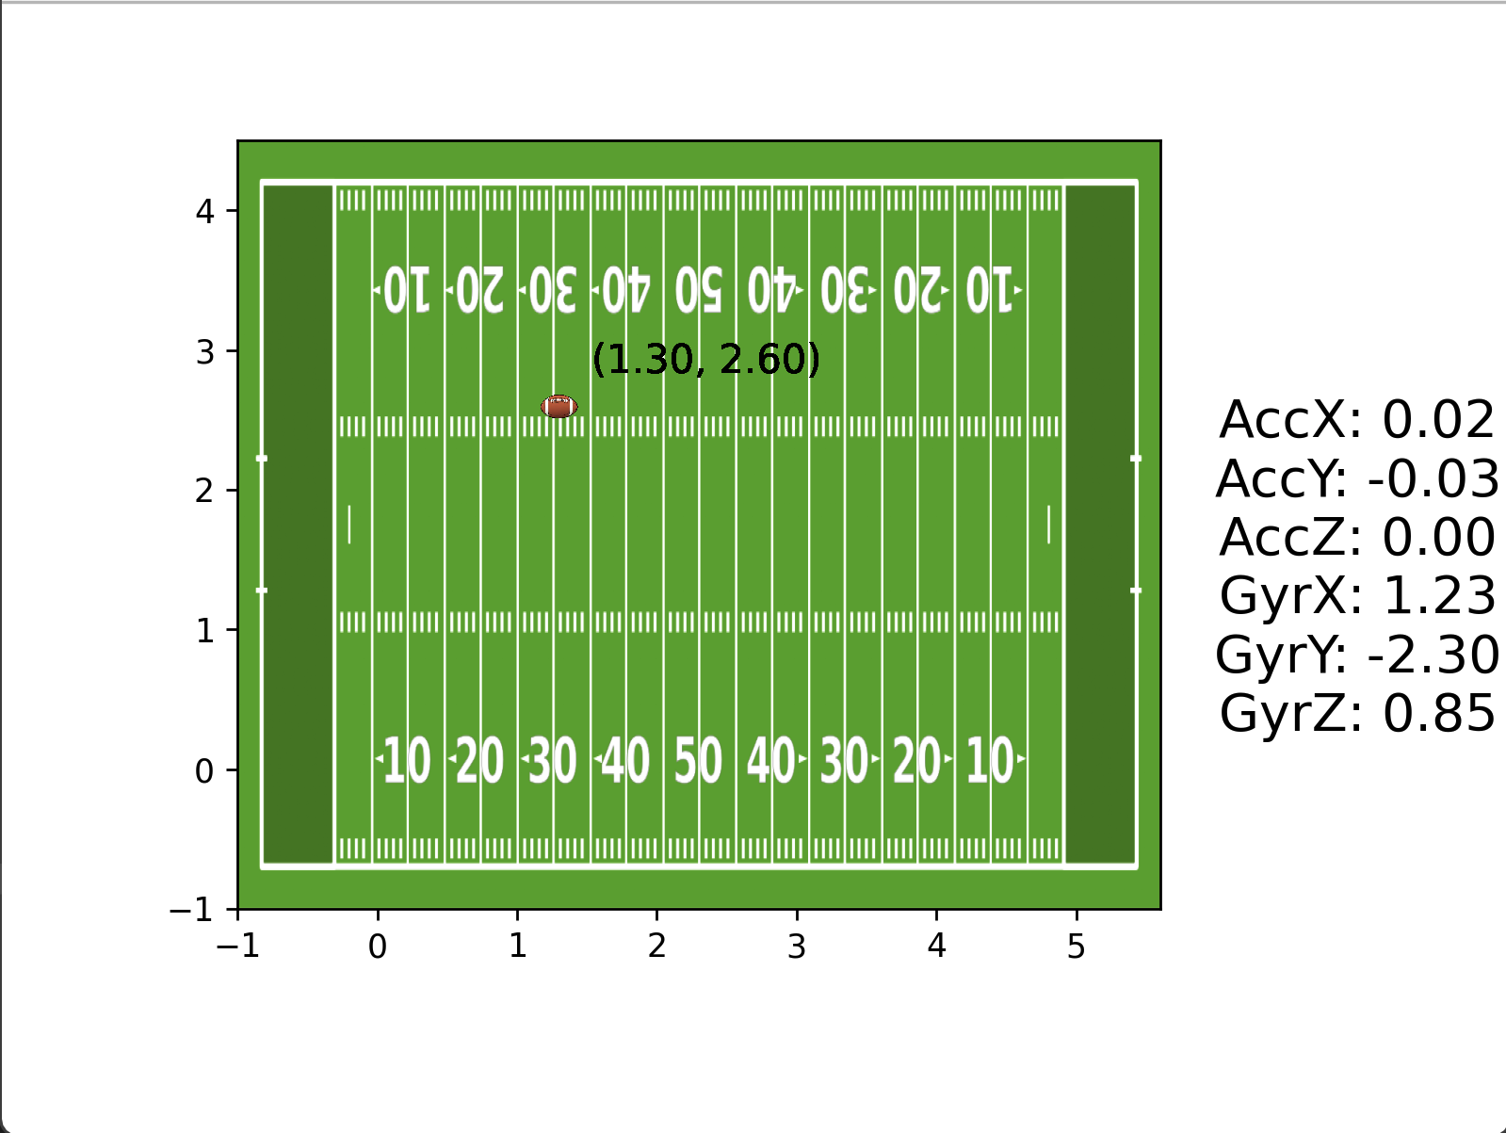
Verifying the Coordinates
ELECTRICAL & COMPUTER ENGINEERING
GRAINGER ENGINEERING
Notes:
Varun

Slide 23
Requirement 4
Accelerometer magnitude is accurate to .05 m/s² to account for noise, and reflects correct direction.
Verification: Move the tag in the x, y, and z direction. After calibrating the sensor, test acceleration by timing the movement of 1 meter.
Verification passed, but the measurements fluctuate constantly within .05 m/s²
ELECTRICAL & COMPUTER ENGINEERING
GRAINGER ENGINEERING
Notes:
Varun

Slide 24
Requirement 5
Gyroscopic sensor reflects correct orientation to within 5 degrees per second and reflects correct direction.
Verification: Tilt the tag 90 degrees in one second to ensure measurement is within 5 degrees per second in the correct orientation.
Verification passed with fluctuating measurements
ELECTRICAL & COMPUTER ENGINEERING
GRAINGER ENGINEERING
Notes:
Varun

Slide 25
Requirement 6
Data is sent back to the computer via Bluetooth.
Verification: Perform the above verifications with the tag communicating with the computer wirelessly, and ensure the results stay the same.
Verification passed.
ELECTRICAL & COMPUTER ENGINEERING
GRAINGER ENGINEERING
Notes:
Varun

Slide 26
Requirement 7
Data can be processed and visualized on the computer screen
Verification: Ensure that the calculated location, acceleration, and rotation are displayed in Python visualization
Changed from original design
Verification passed
ELECTRICAL & COMPUTER ENGINEERING
GRAINGER ENGINEERING
Notes:
Varun

Slide 27
Demo & Build
ELECTRICAL & COMPUTER ENGINEERING
GRAINGER ENGINEERING

Slide 28
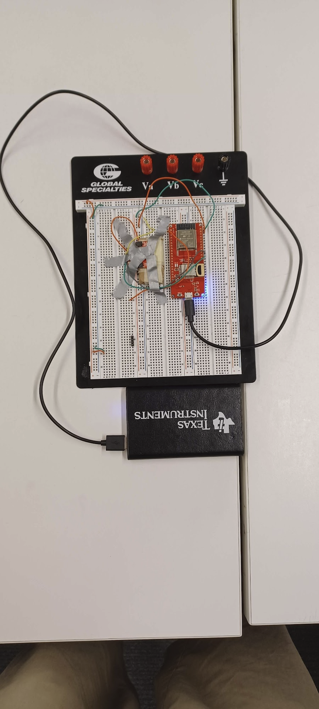
Demo
Anchor
Tag
ELECTRICAL & COMPUTER ENGINEERING
GRAINGER ENGINEERING
Notes:
Vibhav

Slide 29
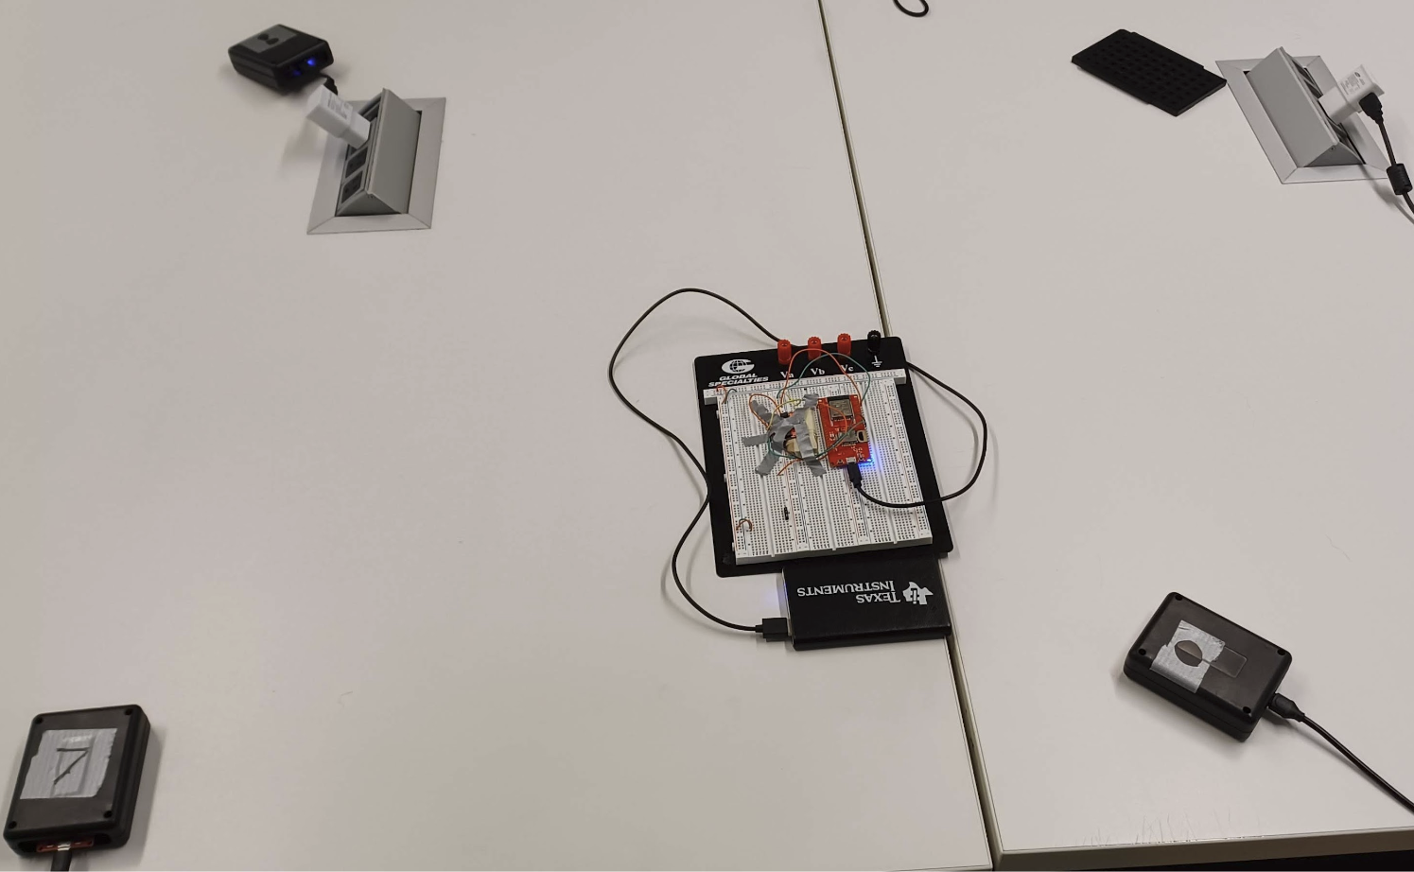
Demo
Setup
ELECTRICAL & COMPUTER ENGINEERING
GRAINGER ENGINEERING
Notes:
Vibhav

Slide 30
Results Video
ELECTRICAL & COMPUTER ENGINEERING
GRAINGER ENGINEERING
Notes:
Vibhav

Slide 31
Conclusions
ELECTRICAL & COMPUTER ENGINEERING
GRAINGER ENGINEERING
Notes:
Say we haven’t made the charts yet but we want to include charts of accuracy and consistency, as well as what exactly failed

Slide 32
Conclusions
Accomplishments
Location tracking accurate to within 30 cm, or the length of a football
Accurate IMU for our purposes, showing when the device is moving in any direction and when it is not
Able to transmit data via Bluetooth, which is important during a game because a football should be completely wireless
ELECTRICAL & COMPUTER ENGINEERING
GRAINGER ENGINEERING
Notes:
Vibhav

Slide 33
Conclusions
Issues
Location tracking only works within 7.5 m, so device has to be scaled for outdoor accuracy
Fluctuation in data
Barometric sensor not implemented
PCB order delay, so we had to order new development boards to work on breadboard
ELECTRICAL & COMPUTER ENGINEERING
GRAINGER ENGINEERING
Notes:
Vibhav

Slide 34
Conclusions
What We Would Do Differently
Order parts better suited for breadboarding
Castellated vias
Use the accelerometer in conjunction with DW1000 to get more accurate location
Use a ten-axis IMU
Make sure our PCB comes in on time
ELECTRICAL & COMPUTER ENGINEERING
GRAINGER ENGINEERING
Notes:
Varun

Slide 35
Next Steps
Future Works
Extended Implementations
Refined PCB design
PCB Enclosure within football
Include Barometer metrics for pressure sensing
Add rechargeable battery to football
Memory Storage and Application
Could include tag based game play and assign metrics with player
Convert PC program into a mobile application to allow for easier access
ELECTRICAL & COMPUTER ENGINEERING
GRAINGER ENGINEERING
Notes:
Akshay

Slide 36
Thank You
Questions?
Contact Information:
Varun Venkatapathy
vcv2@illinois.edu
919-998-9630
Vibhav Adivi
vadivi2@illinois.edu
309-648-6744
Akshay Bapat
aabapat2@illinois.edu
609-964-9695
ELECTRICAL & COMPUTER ENGINEERING
GRAINGER ENGINEERING

