Slide 1
Cat Laser Tower
Electrical and Computer Engineering
12/5/2023
Elisabeth Tricou, Nour Sarikaya, Victor Liu

Slide 2
Agenda
Original Design
Safety
Block Diagram
Power Subsystem
Motor Subsystem
User Interface Subsystem
Sensor Subsystem
LiDAR Sensor
Mapping and Kinematics
Pressure Sensors
PIR Motions Sensor
Control Subsystem
Software
Retrospective
ECE 445
Notes:
Victor

Slide 3
Objectives
Problem
Cat owners are sometimes busy or out of the house, and cats need stimulation
An automatic laser toy that interacts with them and reacts to them would be a useful way to keep them active and mentally stimulated in a safe and healthy way
Solution
Create a cat laser toy that can:
Use LiDAR to map out an area, designated by the cat owner, for furniture and to determine the space in which it can move
Allow for the cat to activate the laser themselves, via a pressure sensor
Select different laser paths and speeds when the cat ‘pounces’ on the laser by using a motion sensor angled at the detection area
ECE 445

Slide 4
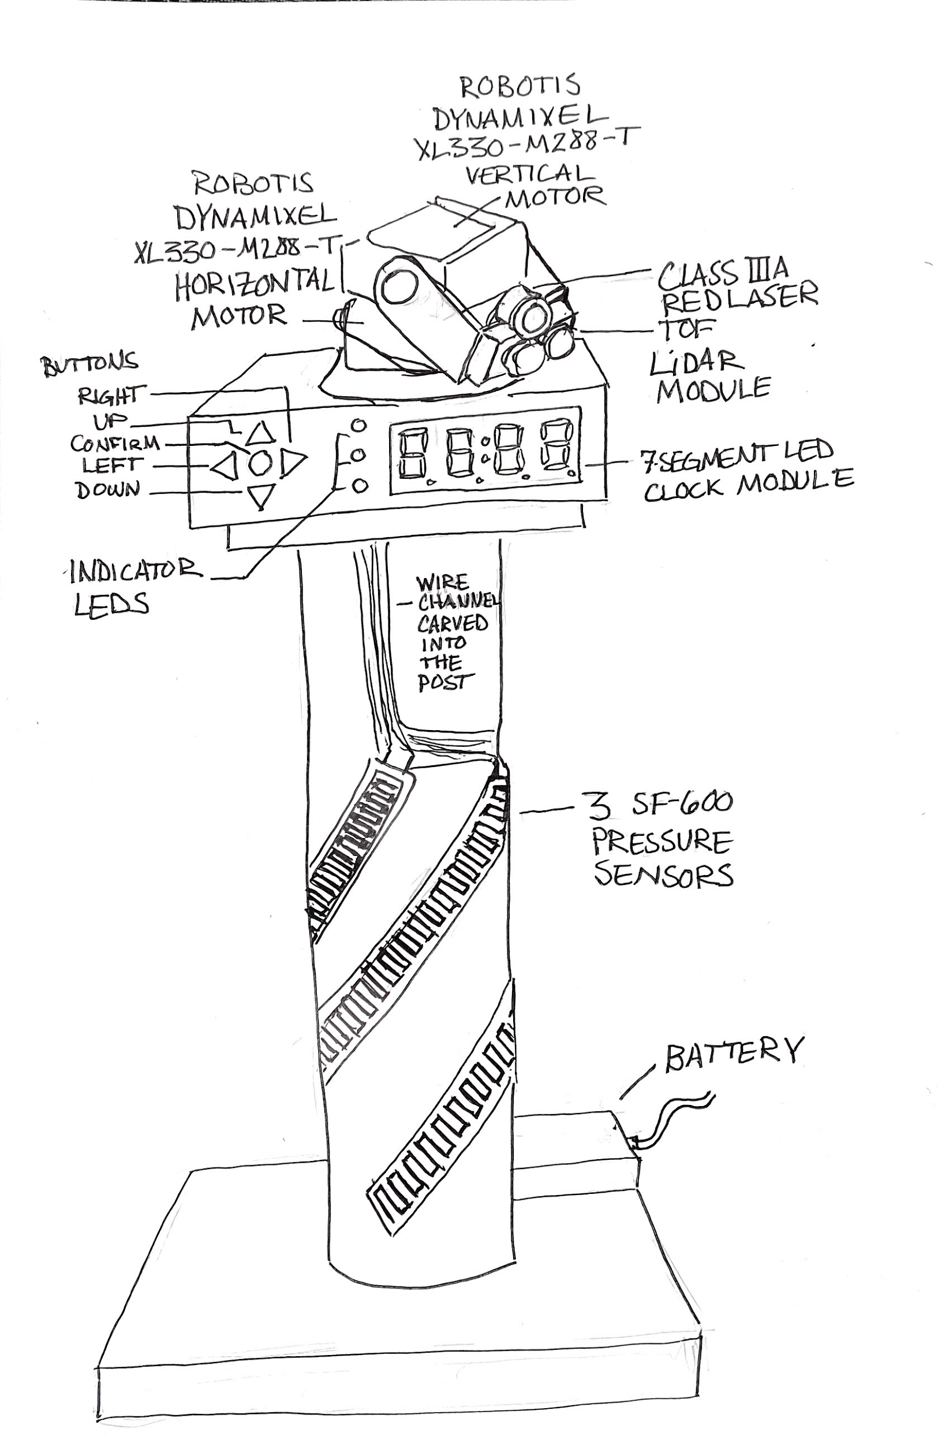
Original Design
High Level Requirements:
The system’s default state should be in low power mode until the pressure sensor triggers or random intervals during the time frame indicated during user set up; or via buttons on the user interface.
The system should be able to create an area map on startup and once the area map is created, the laser module’s range will be within the created area.
The system should be able to detect fast motion and once detected, the control module should respond quickly by changing its pathing algorithm.
ECE 445
Notes:
Elisabeth

Slide 5
Safety
Wires and Lasers
Cats chew on wires
Lasers can damage cat eyes
How to make Laser cat safe?
-Keep it moving
ECE 445

Slide 6
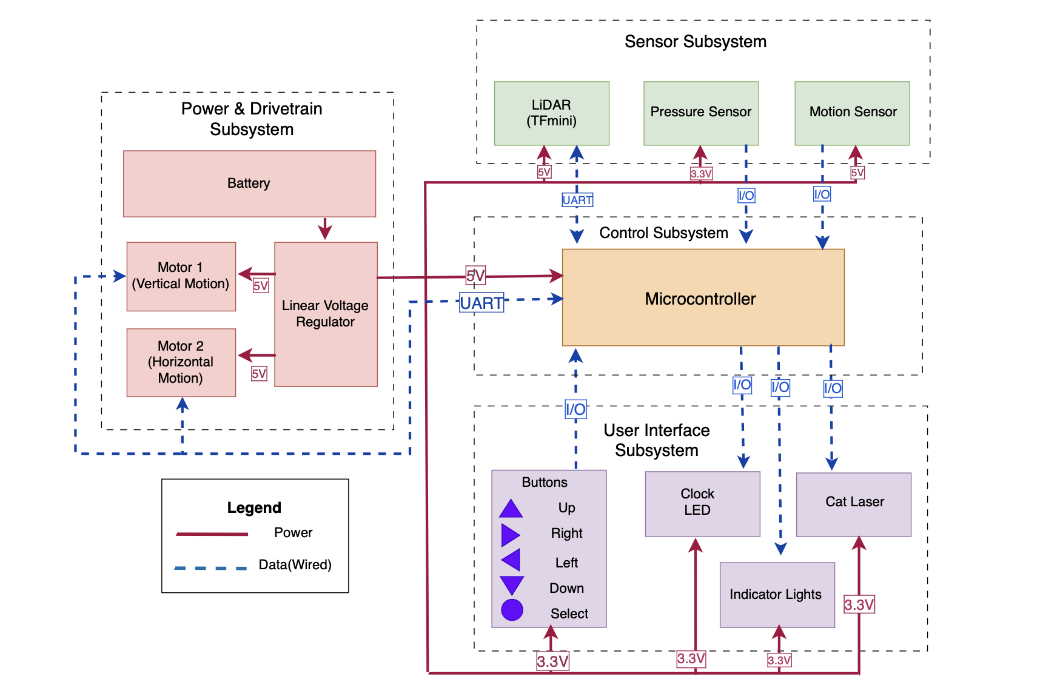
Initial Block Diagram
ECE 445
Notes:
Nour

Slide 7
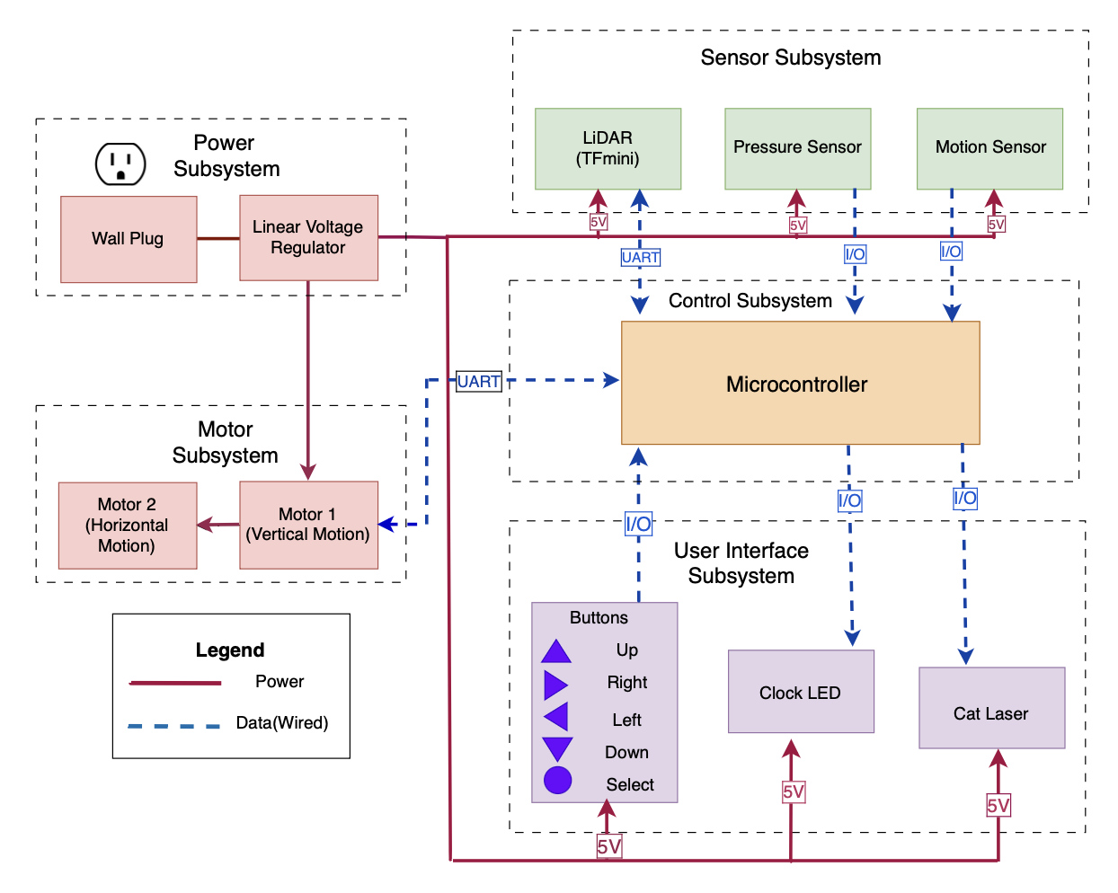
Final Block Diagram
ECE 445

Slide 8
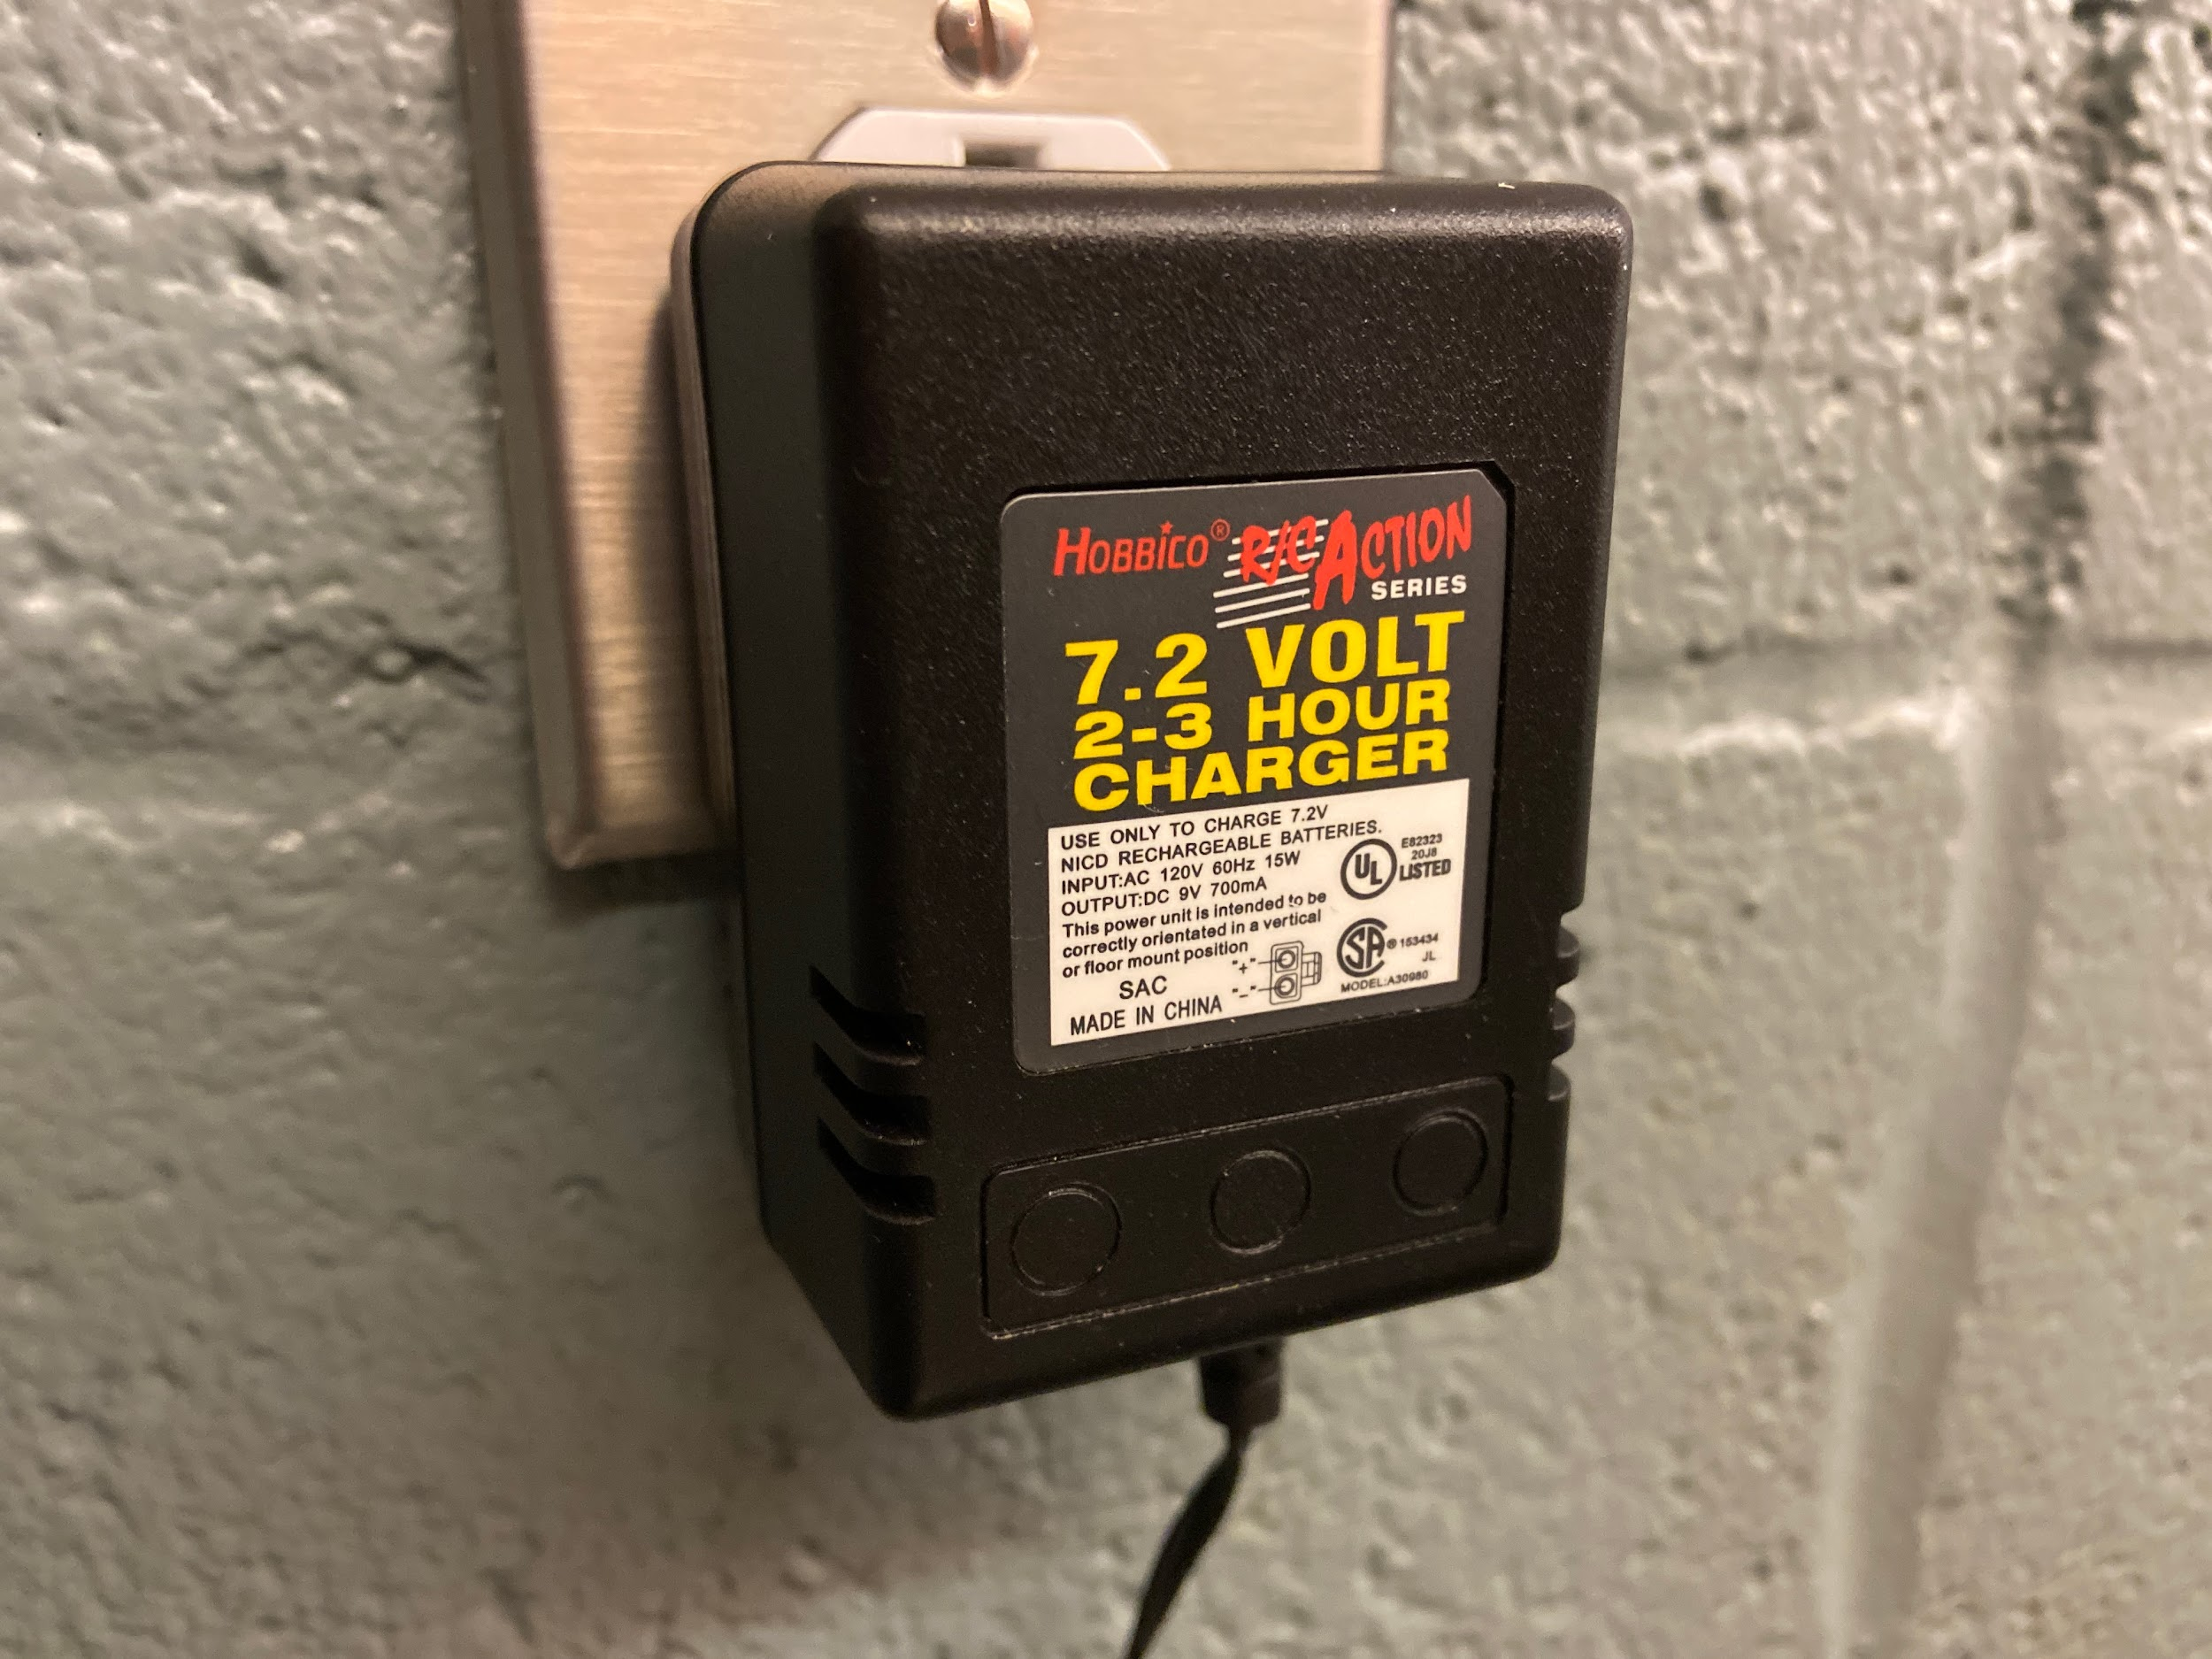
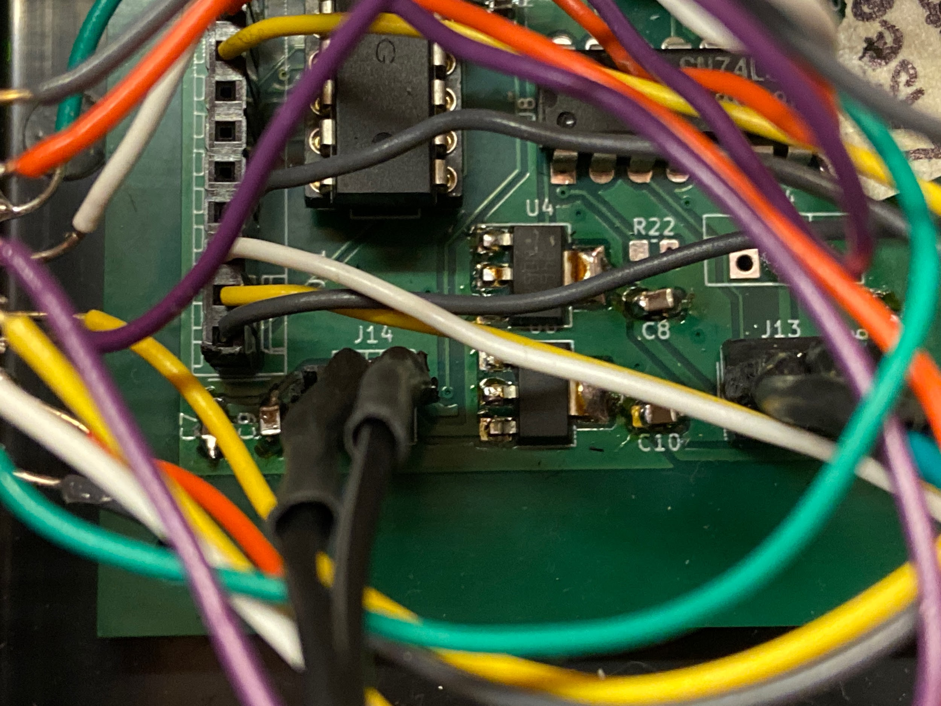
Power Subsystem
Originally imagined that our circuit would utilized both 5 V and 3.3 V
Ended up only using 5
2 LM1117MP-5.0 linear voltage regulators
Capable of 800 mA each
Design called for a 12 V battery
Obtained two batteries for this, but ended up using 13.1 V wall plug.
ECE 445
Notes:
Victor

Slide 9
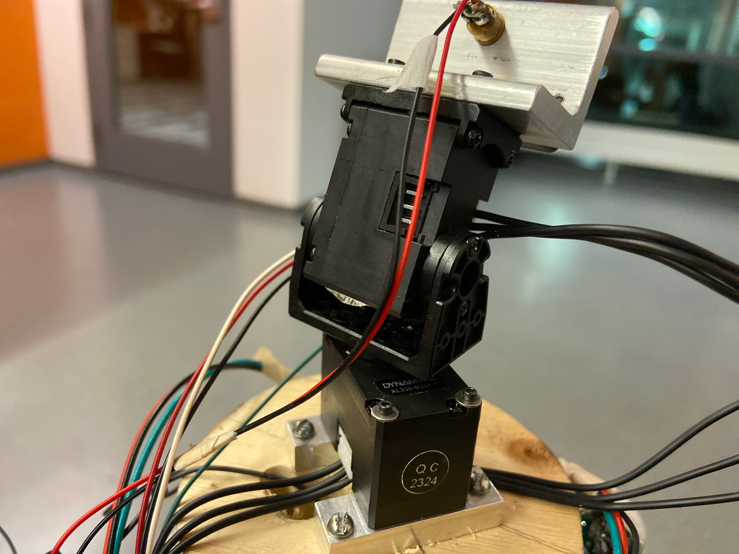
Dynamixel Motors
Motors need to give position feedback data, and move to precise angles
Dynamixel Motors fit design parameters
Use a UART interface, with a TTL Half Duplex Asynchronous Serial Communication connection
Needed to use a Tri-State Buffer to communicate with the Microcontroller
ECE 445
Notes:
Elisabeth

Slide 10
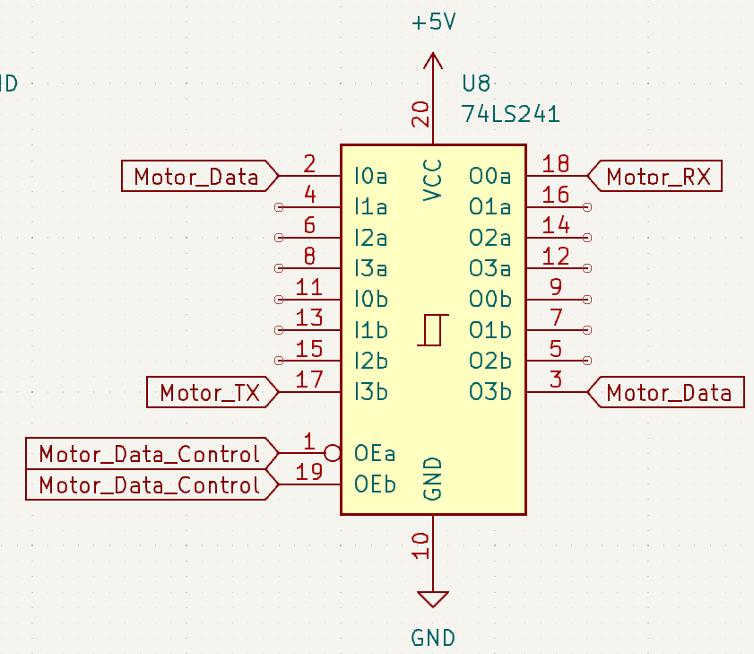
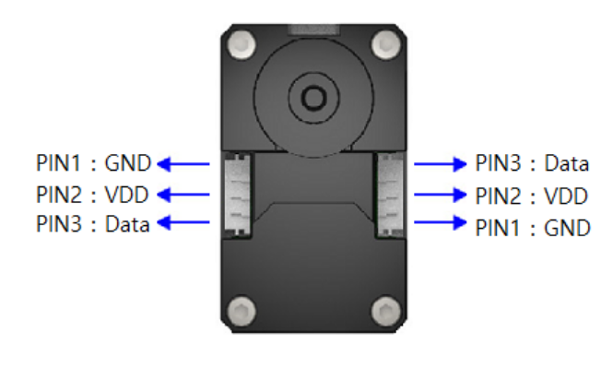
Dynamixel Connection with Tri-State Buffer
ECE 445

Slide 11
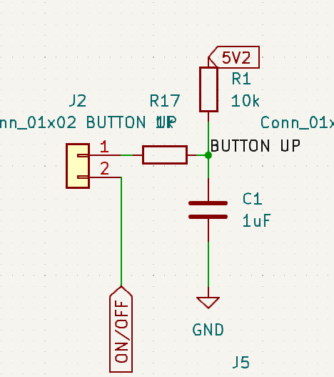
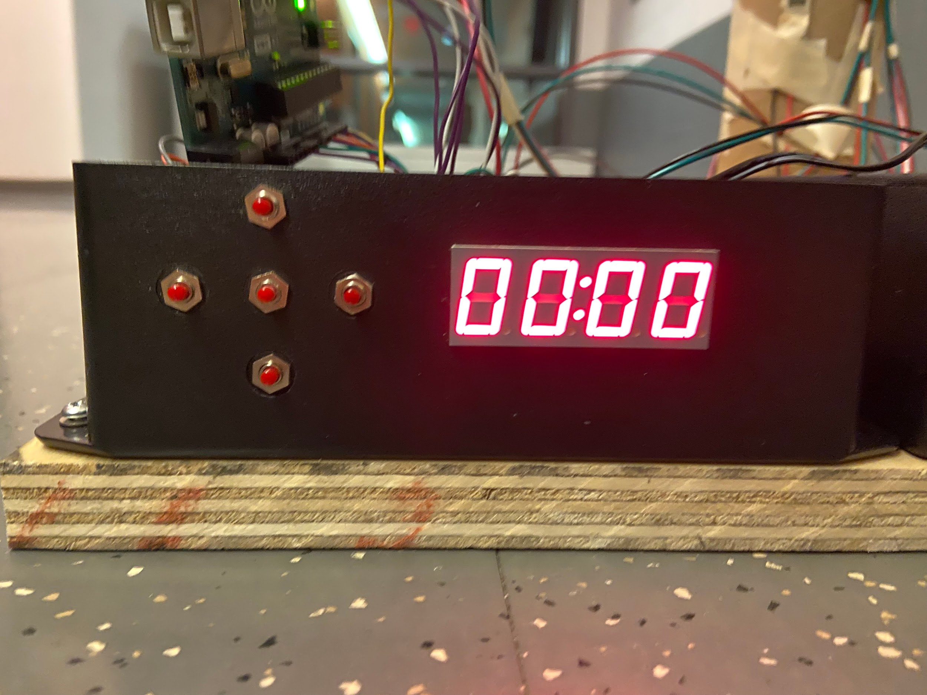
User Interface: Buttons and Display
The user sets the current time, active timeframe, and the ‘play area’
Seven-segment display clock
Displays both time prompts users for calibration information
Problem:
The Seven Segment Display clock needs 12 I/O pins to function
Solution:
Use a MAX7219 LED Display Driver
Rewire for Annode style 7-segment display
ECE 445
Notes:
Victor

Slide 12
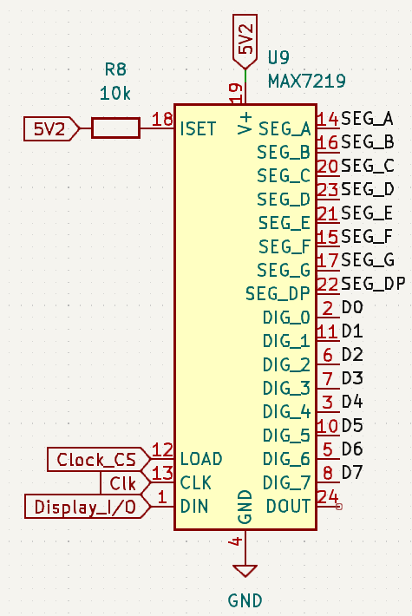
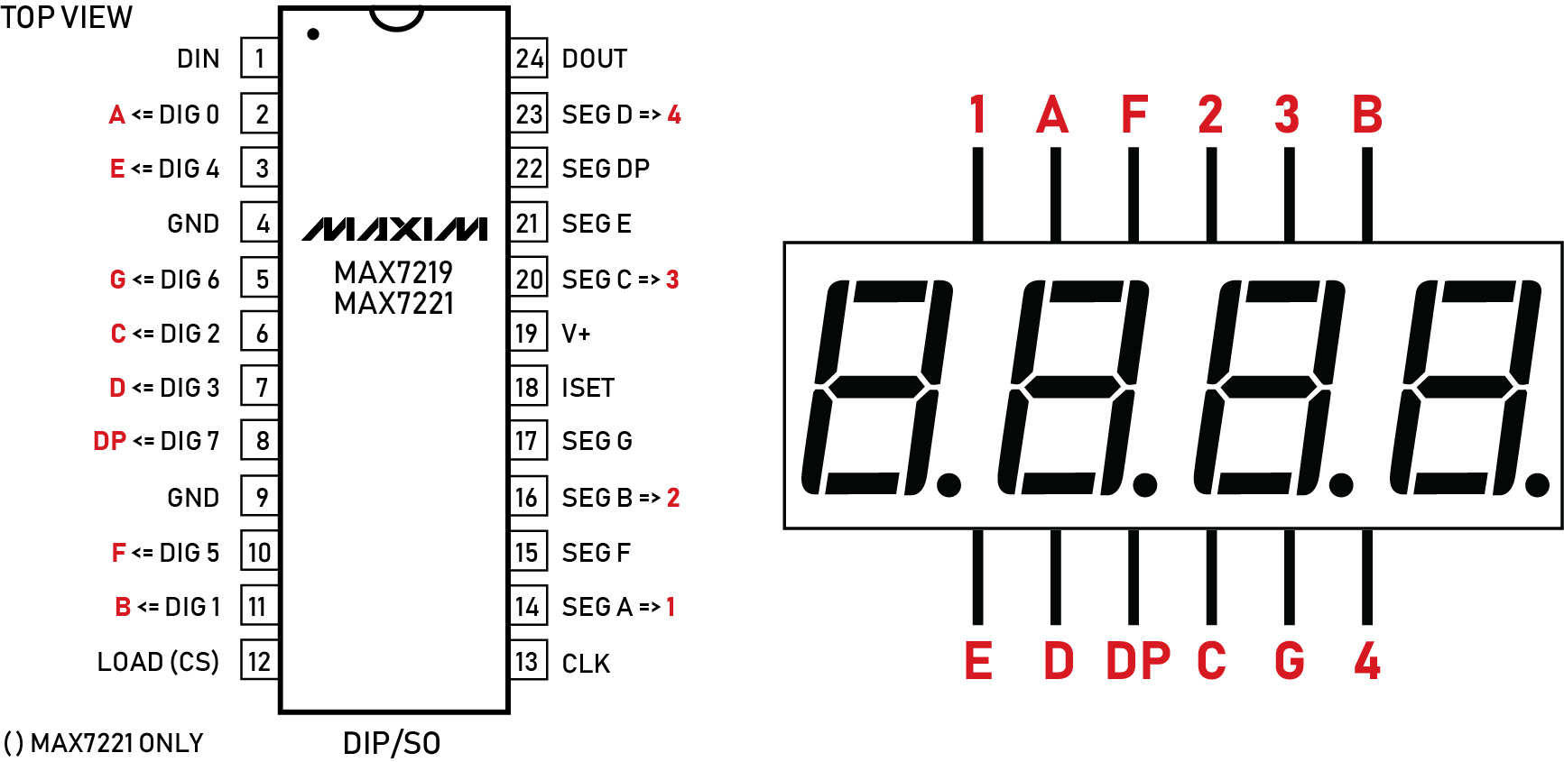
MAX7219 Driver Chip with Anode 7-Segment Display
ECE 445

Slide 13
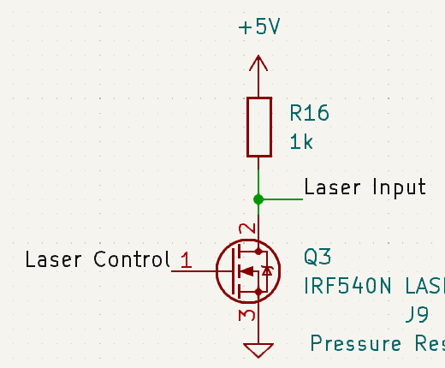
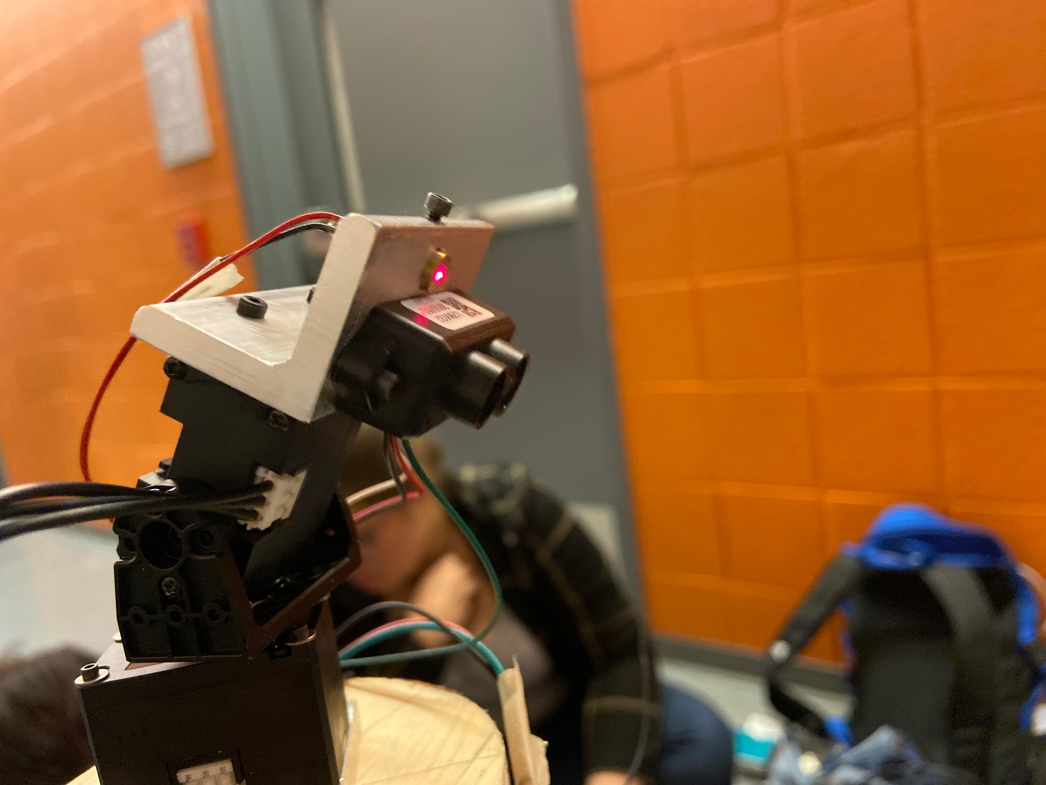
LiDAR and Laser System
UART Connection
Accurate and consistent, but started having issues after 3.5 m
Possibly due to the reflection from the floor at more oblique angles
Cat Laser needed to be a Class IIIa safety Laser
ECE 445
Notes:
Elisabeth

Slide 14
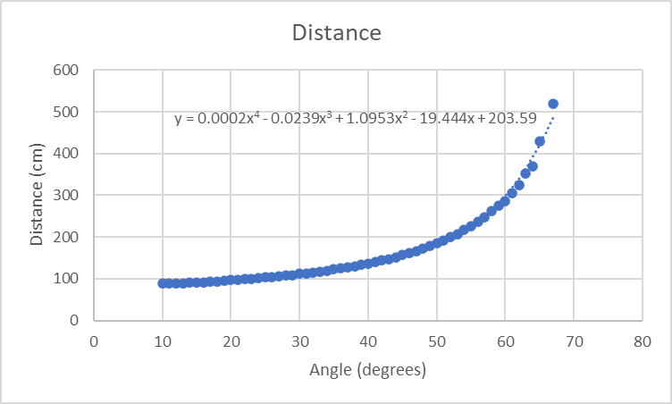
Testing and Results
distances[12] = {88, 91, 96.5,103, 111.5, 122.5, 136.5, 156.5, 185.5, 225.5, 286.5, 429}
ECE 445

Slide 15
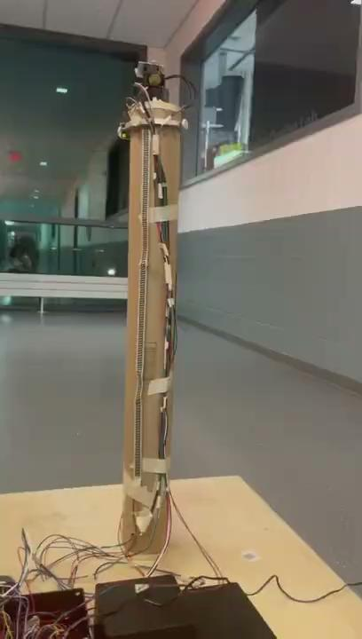
Calibration
User sets close, far, left and right bounds
Area within bounds traced column by column
Calculate expected distance at each point and compare with LiDAR distance
Ended up all together skipping map tracing with LiDAR
ECE 445
Notes:
Nour

Slide 16
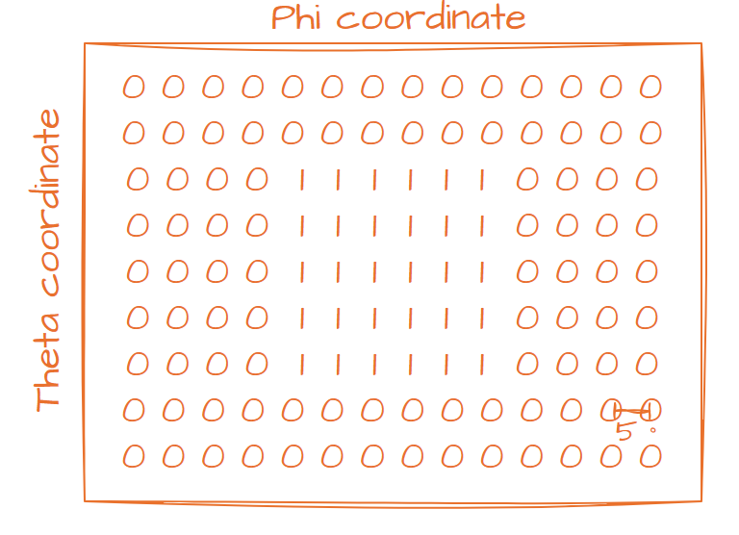
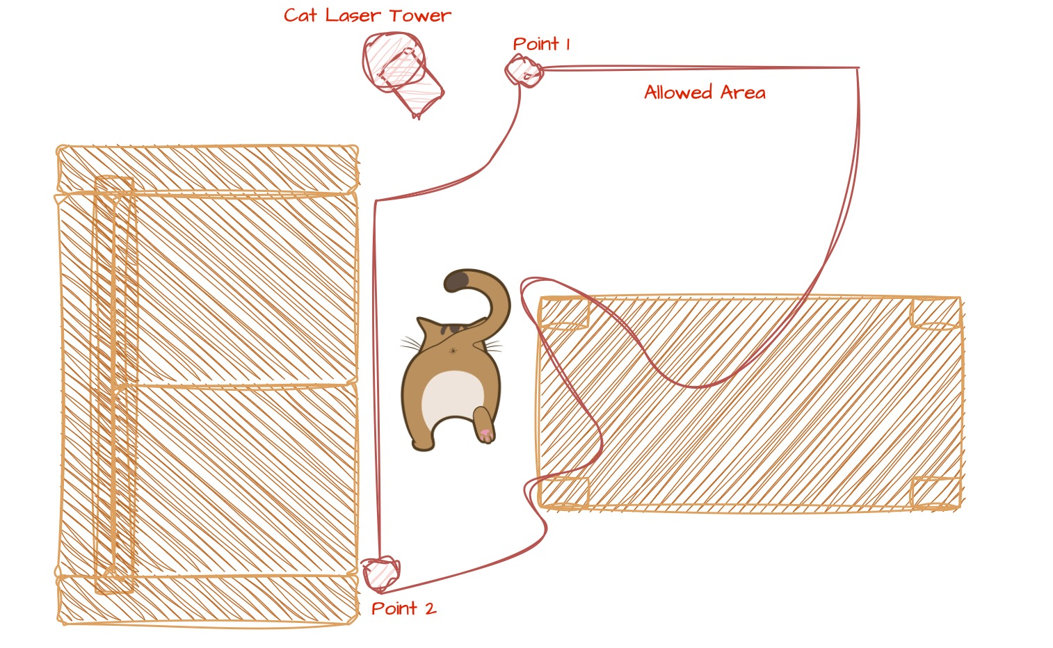
Mapping and Kinematics
Boolean map
Originally had Cartesian coordinates
Later decided on polar coordinates (ϕ, θ) with 5 degrees between each point
Points are stored in EEPROM in a bit array
ECE 445
Notes:
Nour

Slide 17
Pathing Algorithms
Random-Linear Pathing
Randomly picks an initial point
Chooses a direction and moves in that direction linearly
Keeps picking and moving in the new directions until cycle limit is reached
Random-Adjacent Pathing
Randomly picks an initial point
From adjacent points picks the next point in path
Keeps picking adjacent points until cycle limit is reached
ECE 445
Notes:
Nour

Slide 18
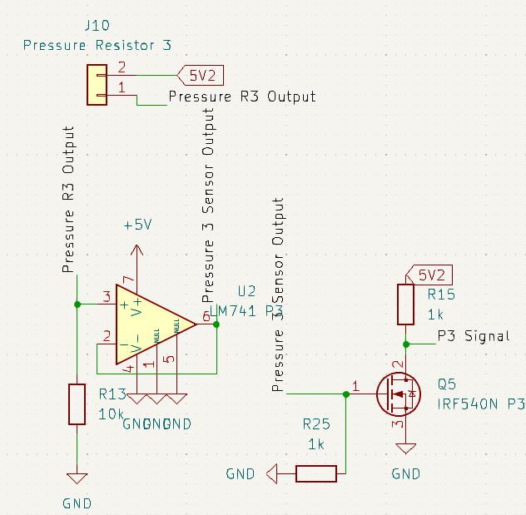
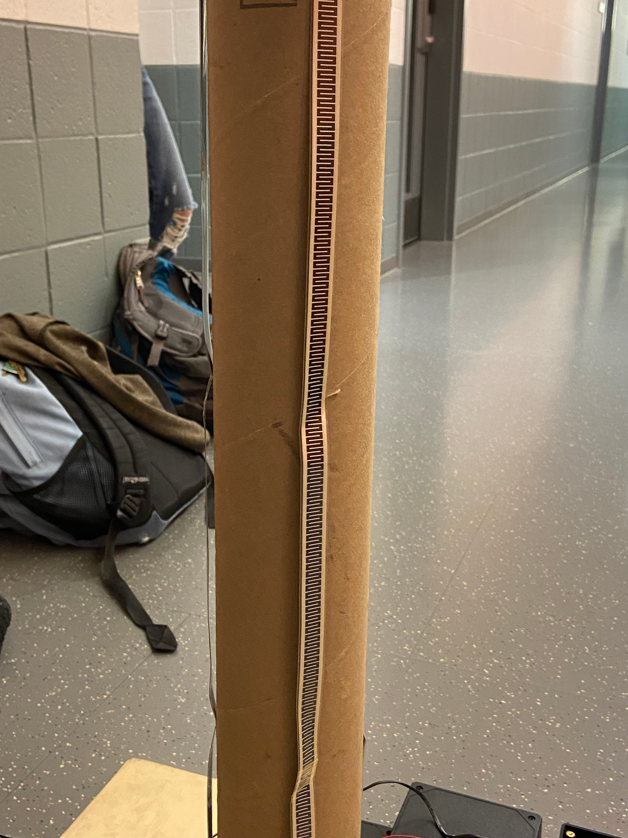
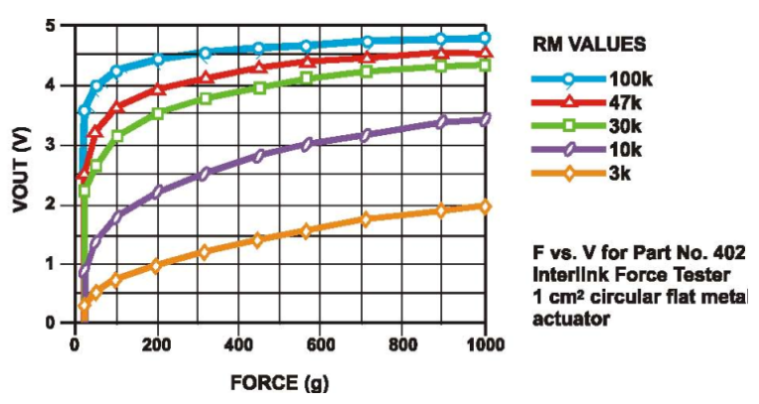
Pressure Sensor
3 pressure sensors signals are combined using a CD4023 NAND Gate
Pressure Resistors with values ~200 kOhms at rest
Decreases to 2 kOhms at maximum pressure
ECE 445
Notes:
Victor

Slide 19
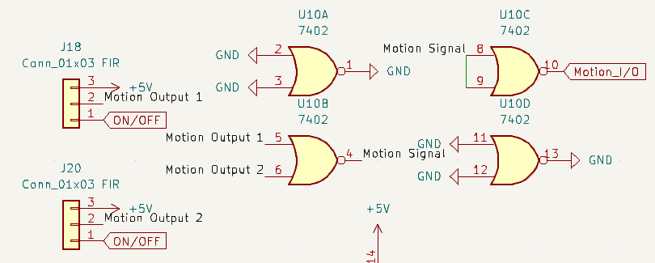
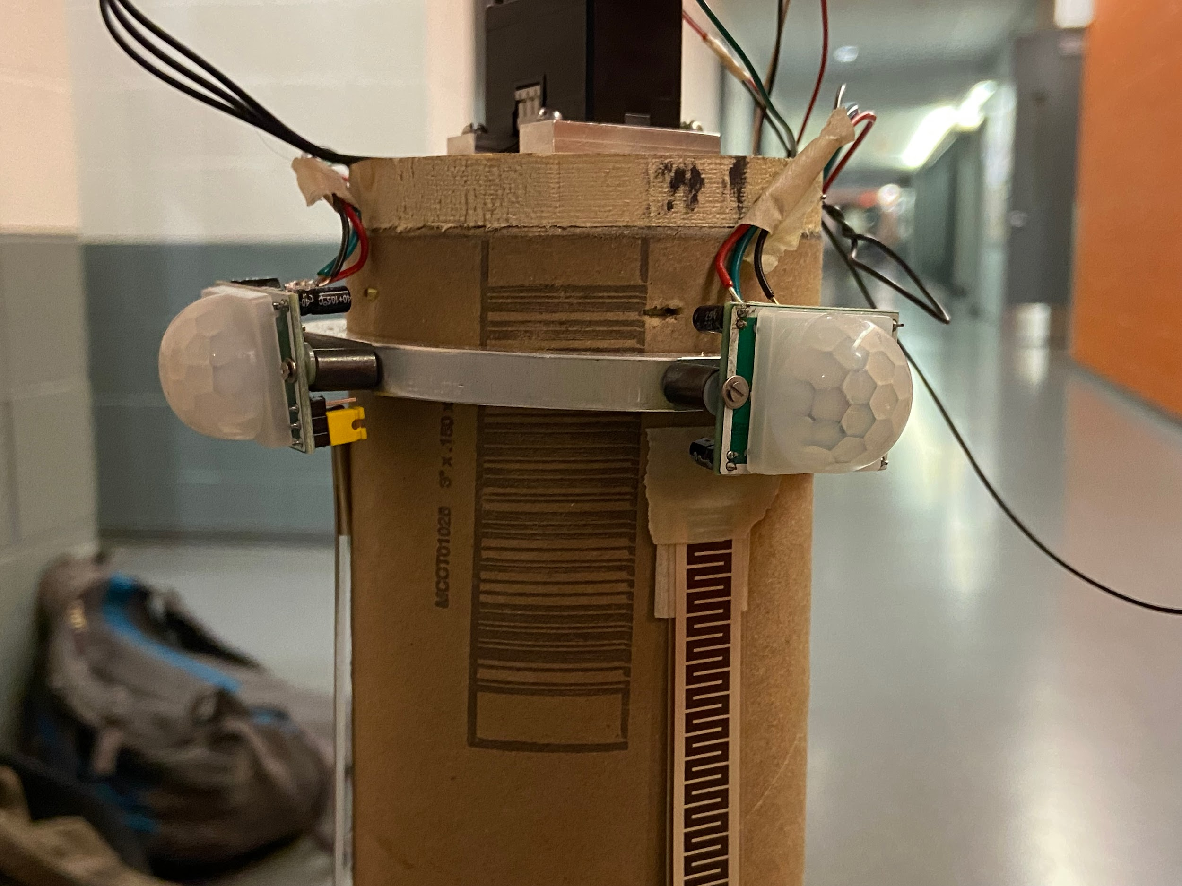
PIR Motion Sensor
Two motion sensors capture motion in play area
5 meter range of detection
Returns a low signal when no motion is detected and high when motion is detected
Two signals combined with 7402 2-input NOR gate into a signal motion signal
ECE 445
Notes:
Victor

Slide 20
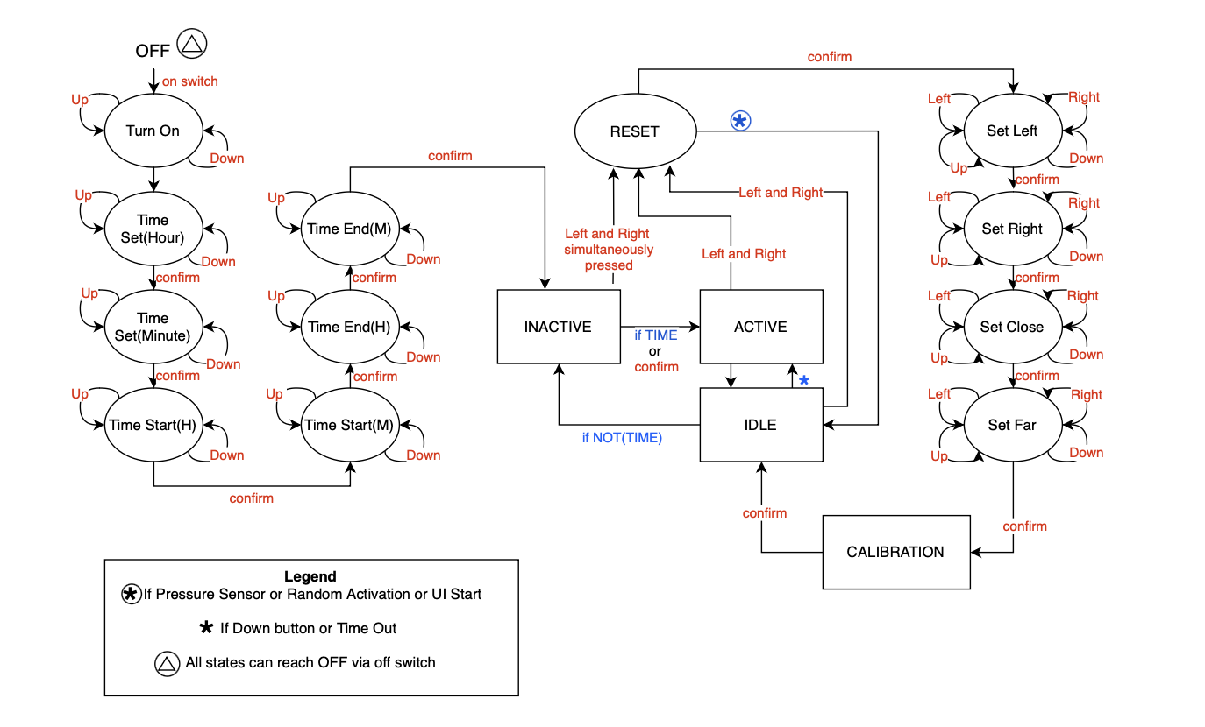
Original State Diagram
ECE 445
Notes:
Elisabeth

Slide 21
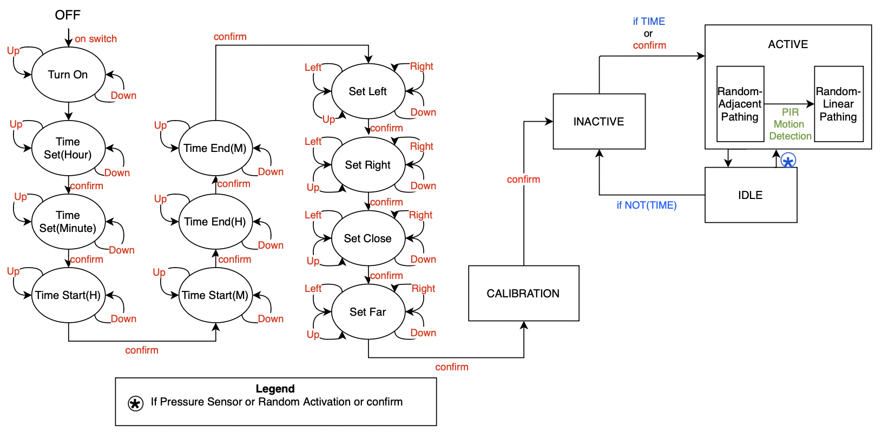
Final State Diagram
ECE 445

Slide 22
Video of Working Project
ECE 445

Slide 23
Successes and Failures
What went right
What went wrong
The Dynamixel Motors
The 7-segment Display clock and Driver
The Pressure Sensors
The Pathing Algorithms
Storing to EEPROM
The User Interface
Laser
Power Distribution on PCB
Power design needed to be changed more than once
LiDAR Module integration into code
Low Power Mode was not implemented
ATMega328P could not sustain UART connection with current set-up
PIR Motion Sensors were too sensitive
ECE 445
Notes:
Elisabeth

Slide 24
Major Design Changes in Retrospective
Power delivery switching from dual 3.3 and 5V rails into two 5V sources
Dropped LED indicators from the design to account for available microcontroller pins
Boolean map now represents polar coordinates rather than an X,Y Cartesian map
Dropped low power mode
Physical design changes
User interface is now on the base
ECE 445
Notes:
Victor

Slide 25
Further Improvements on our Project
A general on/off switch
Working LiDAR code to enable obstacle-detection
PCB design changes to include 16 MHz external crystal and additional capacitors to better enable UART usage with an ATMega328P
Limiting the range of detection for the PIR motion sensor
‘Blinders’
Lowering sensitivity
Low power mode
Ability to recalibrate after program start
ECE 445
Notes:
Nour

Slide 26
Thank You
Cat Laser Tower
Elisabeth Tricou, Nour Sarikaya, Victor Liu
ECE 445

