Slide 1
An Auto-Hand Chasing Lamp With Hand Gesture Control
Team 49
Yiyan Zhang, Jincheng Yu, Feiyang Liu

Slide 2
Agenda
Problem & Objective
Overall Design
Requirements & Verifications
Success & Challenges
Conclusion
ECE445 SP24 Team49

Slide 3
Problem
Solution
Industrial precision work such as hand soldering requires adequate lighting
Hand movement shadow often causes inadequate lighting
Design a smart lamp that could follow hand movement and provide hand gesture controls to increase flexibility of desk lamp
ECE445 SP24 Team49

Slide 4
High Level Requirements
Autonomous Hand Tracking
Accurately follow hand movement
Gesture Recognition
Pointing up or down to change light intensity
Control lamp movement by pointing left or right
Activate tracking mode by showing a fist
Light Adjustment Range
Change between two brightness and two colors
ECE445 SP24 Team49

Slide 5
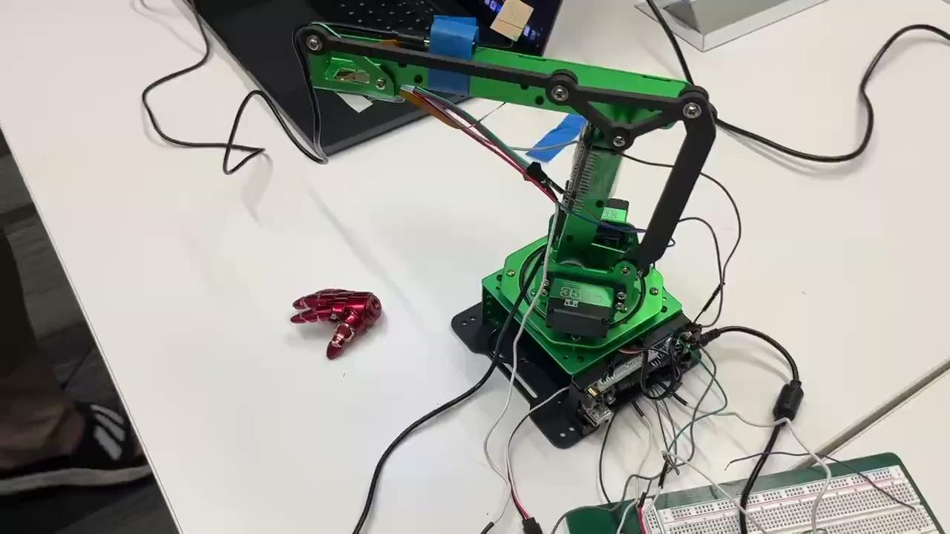
Video Demo
ECE445 SP24 Team49

Slide 6
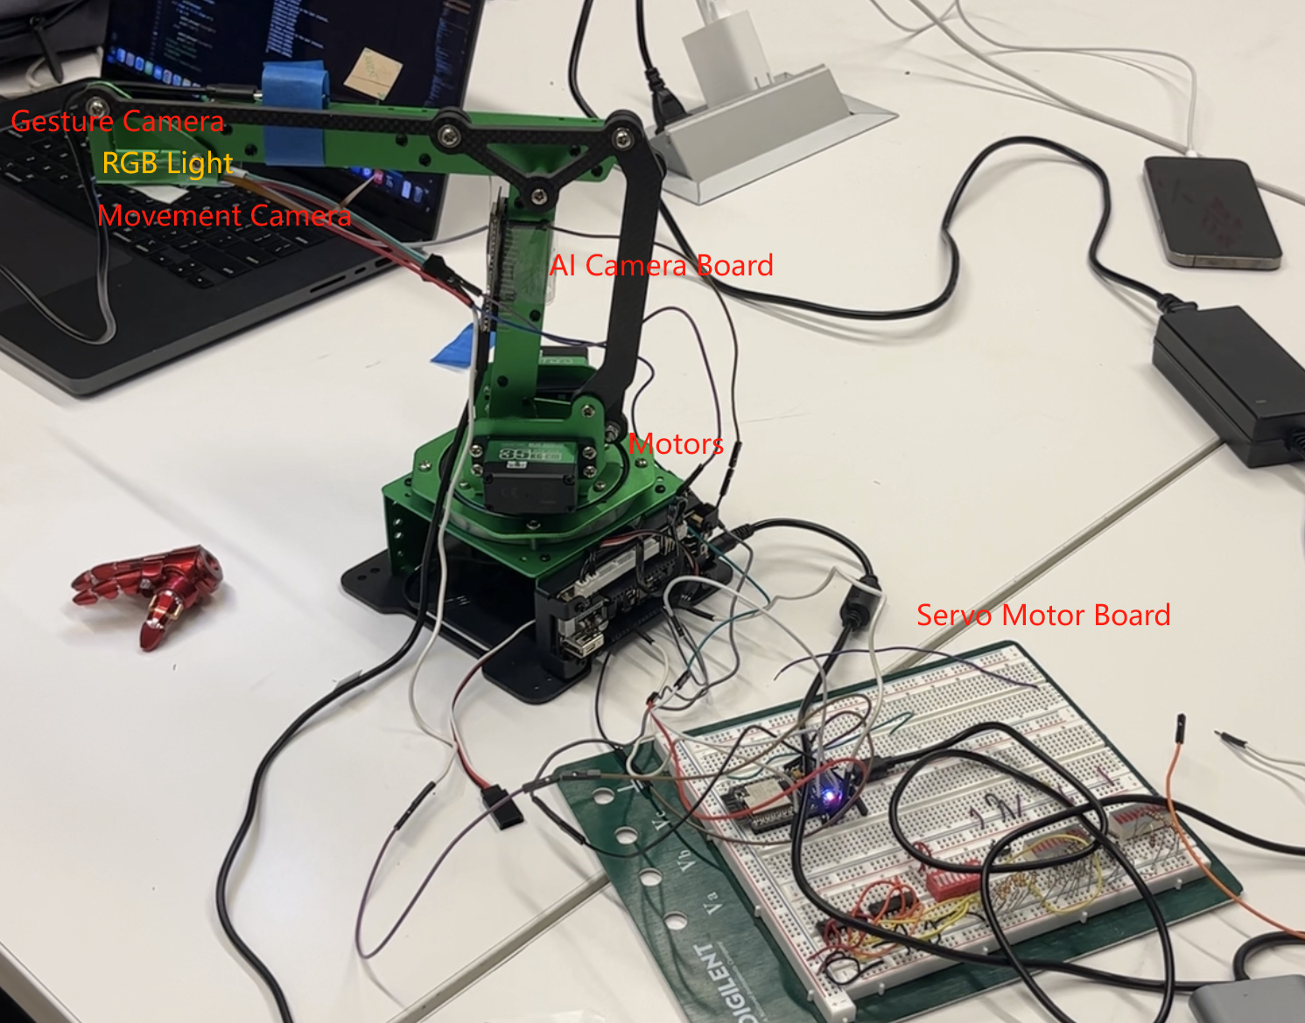
Final Product
Two ESP32 development boards were programmed to control the motors and process hand gestures
Mechanical Lamp Holder could follow hand movements
Hand Gestures can be used to control the lamp movement and change RGB light’s color and brightness
ECE445 SP24 Team49

Slide 7
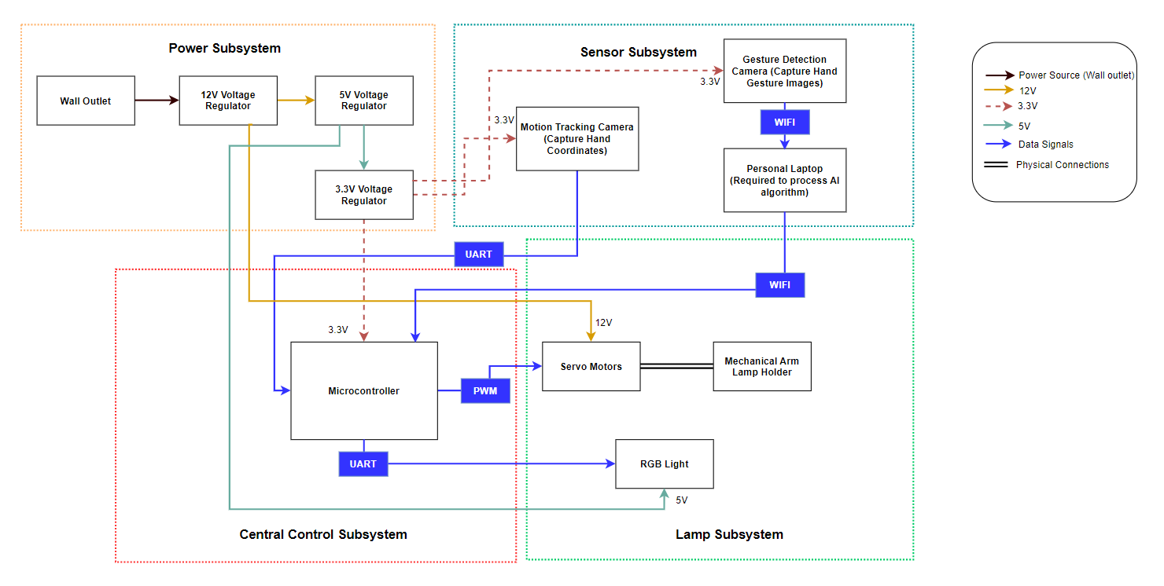
Initial Block Diagram Design
Four Subsystems
Sensor
Central Control (Dev Board)
Lamp
Power (External Power Adapter)
ECE445 SP24 Team49

Slide 8
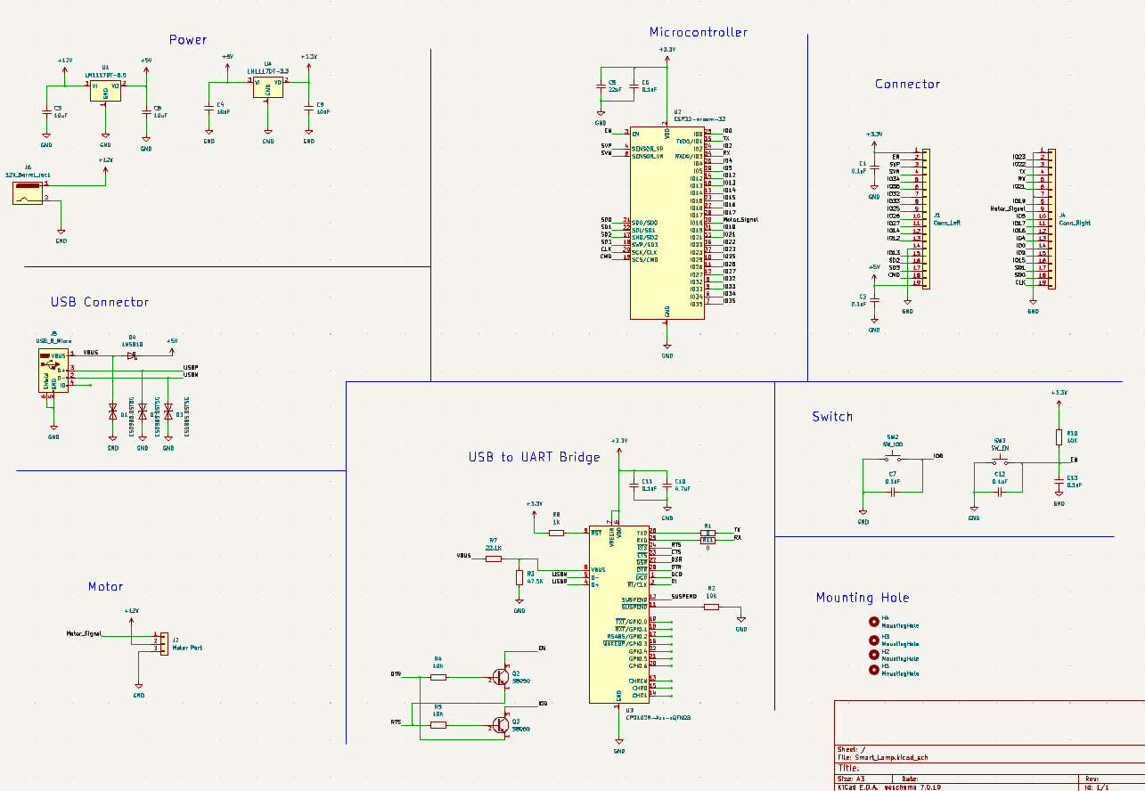
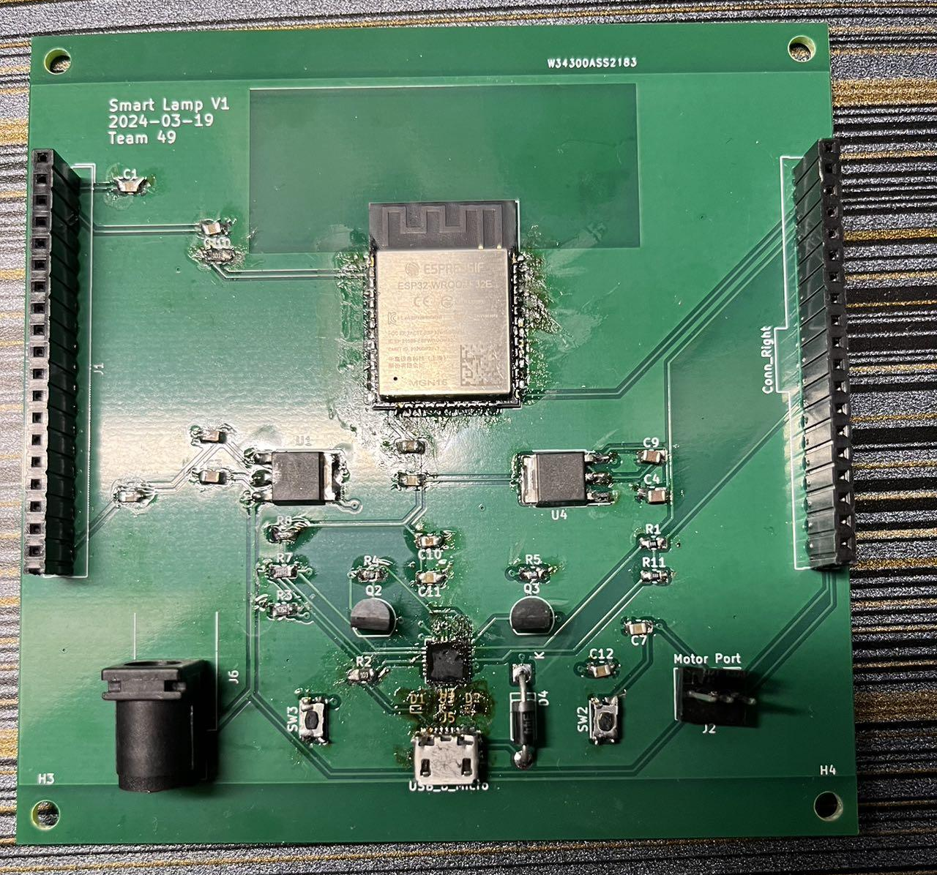
Design Changes
Prototype PCB was burned while testing power module
Replaced Central Control Subsystem with ESP32 Development Board to program
Added two separate ESP32 Board to control the motors and AI Image Processing
Use external power adapter to provide 12V for motors, 5V for RGB Light, and 3.3V for ESP32 Microcontroller
ECE445 SP24 Team49

Slide 9
Object Detection
Obtaining Data
&&
Labeling
Processing
&&
Training
Deployment
ECE445 SP24 Team49
Notes:
"Next, we will embark on a task centered around object detection. We have divided this task into three key phases. The first phase involves acquiring data and labeling it appropriately. The second phase is dedicated to processing and training our model using the labeled data. Finally, the third phase will focus on deploying the trained model on an ESP32 device."

Slide 10
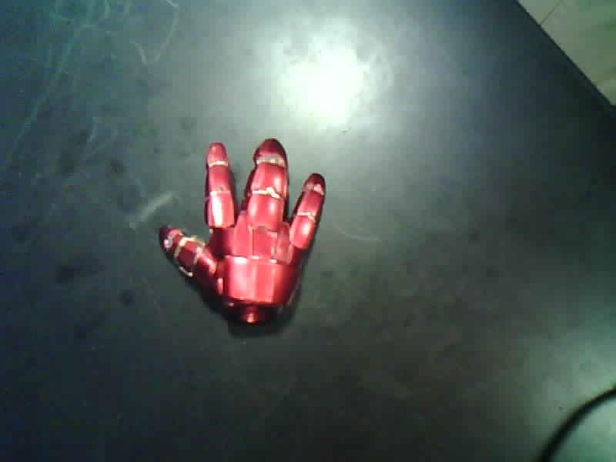
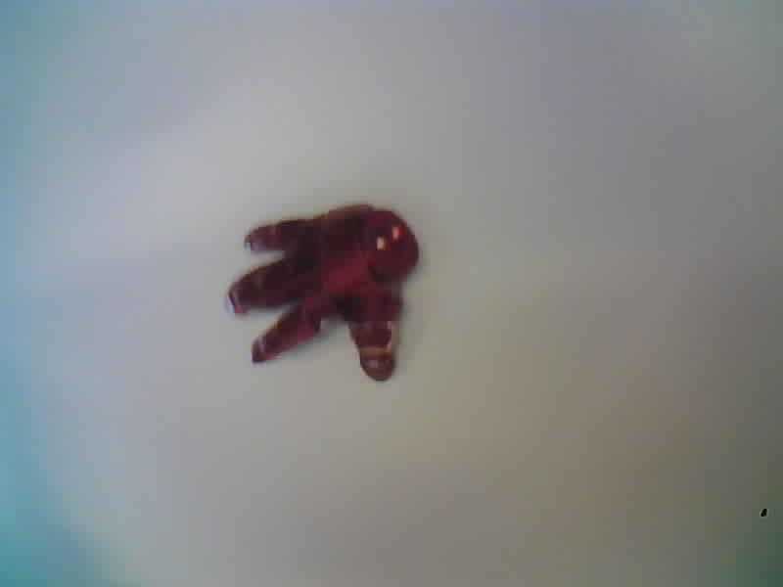
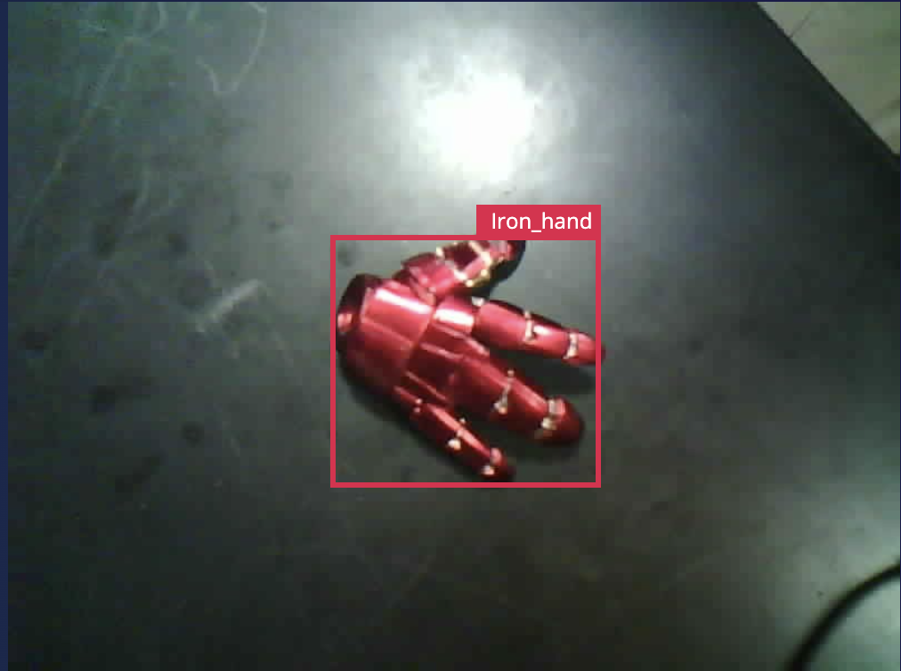
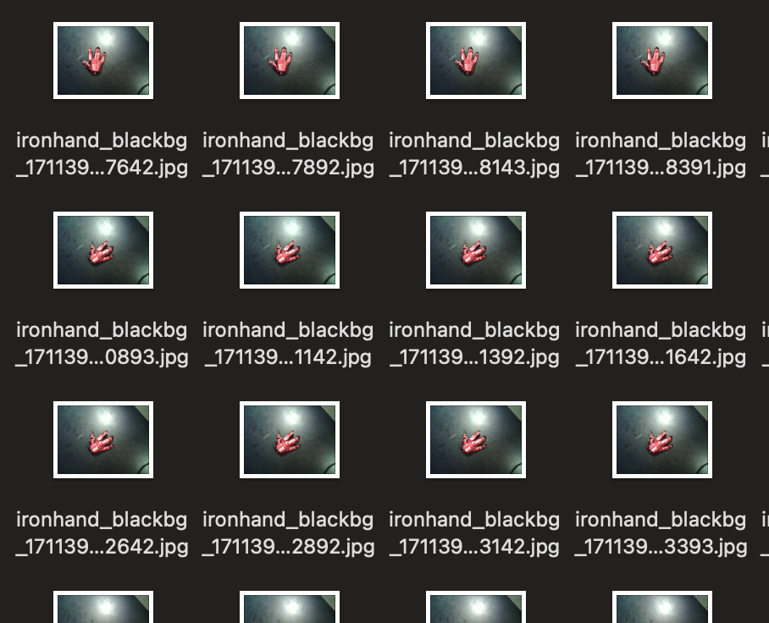
Obtaining Data
Using the web capability of ESP32 to Streaming out pictures
Using data from different background and edge cases(E.g. half the hand in corner of the picture)
Labeling Each hand to contradict with backgrounds
Total of 310 Pictures (Including 30 backgrounds)
ECE445 SP24 Team49
Notes:
First of all, we used the ESP32S3 to establish a server,capture pictures and stream them out. This approach allows us to simulate the visual input that our AI model will process in real scenarios.
To enhance the robustness of our model across different environments, we collected images from diverse backgrounds, such as black and white tables and we use some pictures with edge cases, that half of the hand is presented. After acquiring the images, we annotated the position of each hand to distinguish it from the background. In total, we captured around 310 images, including approximately 30 images with a blank background."

Slide 11
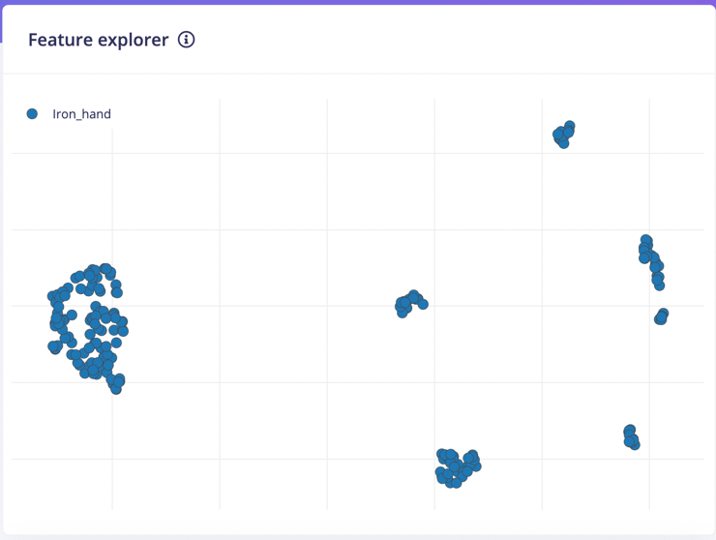
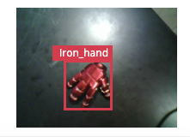
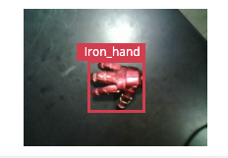
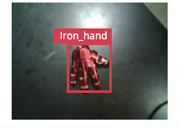
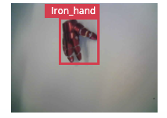
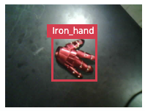
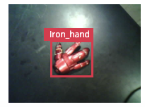
Processing
ECE445 SP24 Team49
Notes:
"Here we have the feature clusters generated after our feature extraction process. As you can see, the data points are grouped into several distinct clusters. For example, the cluster on the far left consists of model hands against a white background, while the cluster on the right features model hands in various orientations against a black background. The density of these points indicates the high precision of our feature extraction."

Slide 12
Processing
FOMO model from EGDE IMPULSE(Fully Convolutional)
Separating Training and Testing data
Setting Training Parameters(input size of 96*96, Learning Rate of 0.001, Learning Cycle of 60)
ECE445 SP24 Team49
Notes:
"After several rounds of evaluation, we decided to utilize the FOMO model from EDGE IMPULSE. This model is fully convolutional and is optimized with advanced compression algorithms, allowing it to run efficiently on low-power chips like the ESP32. We allocated approximately 20% of our dataset for testing to better facilitate the training process. After multiple adjustments to the parameters, we achieved the optimal setting with an input resolution of 96x96, a learning rate of 0.001, and a training cycle of 60 epochs. As a result, our model reached an accuracy of 98.8%."

Slide 13
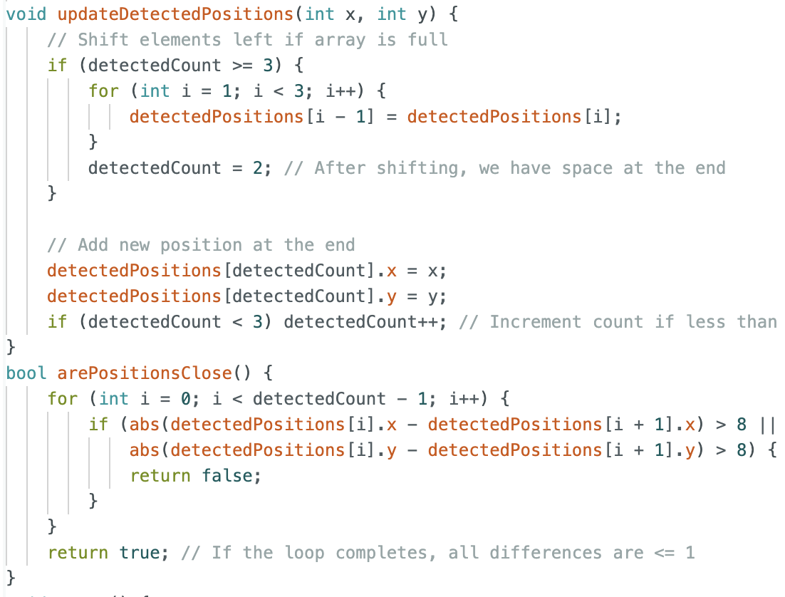
Deployment
Generates an interfacing file Compatible with Arduino Library
Enhancement to optimize the decision-making process
Transferring detected coordinate to the main board through GPIO2.
ECE445 SP24 Team49
Notes:
"Following the model optimization, we proceeded with deployment. The FOMO model produced an interfacing file compatible with the Arduino Library, which could be compiled and flashed onto the ESP32S3. Additionally, we implemented some enhancements to optimize the model’s performance and decision-making process. For instance, we created an array to compare the results of the most recent three detections. If the coordinates from these detections are close to each other, a signal is output; otherwise, it is discarded, and the system continues to wait. Data transmission to the main controller is done through GPIO2, JinChen will discuss it later."

Slide 14
Sensor Subsystem R&V
Requirement | Verification | Result
1. Able to capture the image when the sensor is powered on by 5V +/- 5% | Set up both camera sensors on Arduino IDE and connect them to a 5V power source Use an multimeter on the camera power input to verify that the power input is within the range 5V +/- 5% Check on a personal laptop if Arduino IDE can receive images from the ESP32 sensor | Pass
2. Able to conduct model training for the tracking object | Conduct a model test on ESP32S3, the processing time for each frame should be less than 200ms. | Pass
3. Able to accurately count stretched-out fingers within the range of 0-5 | Use the gesture detection camera to take 20 hand images with stretched-out fingers ranging from 0 - 5. Check all trained images’ properties to verify if the images are correctly tagged with finger numbers within the range of 0 - 5 | Pass
4. Able to identify hand coordinates to enable hand movement tracking | Set up the motion tracking camera to start taking 96 x 96 pixels pictures Set the center coordinate to 48 x 48 pixels to compute offsets with the new coordinate of hands Move one’s hand in front of the camera to observe if the camera can move in the same direction as the hand’s movement | Pass
ECE445 SP24 Team49

Slide 15
Hand gesture Detection
Capture Frame
Gesture Design
Data Transfering
ECE445 SP24 Team49
Notes:
For our gesture recognition task, we have divided the task into three distinct phases. Initially, we focus on capturing and transmitting each frame effectively. Secondly, we design several distinct gestures that our system will need to recognize. Lastly, we consider how to send the processed data to the main controller."

Slide 16
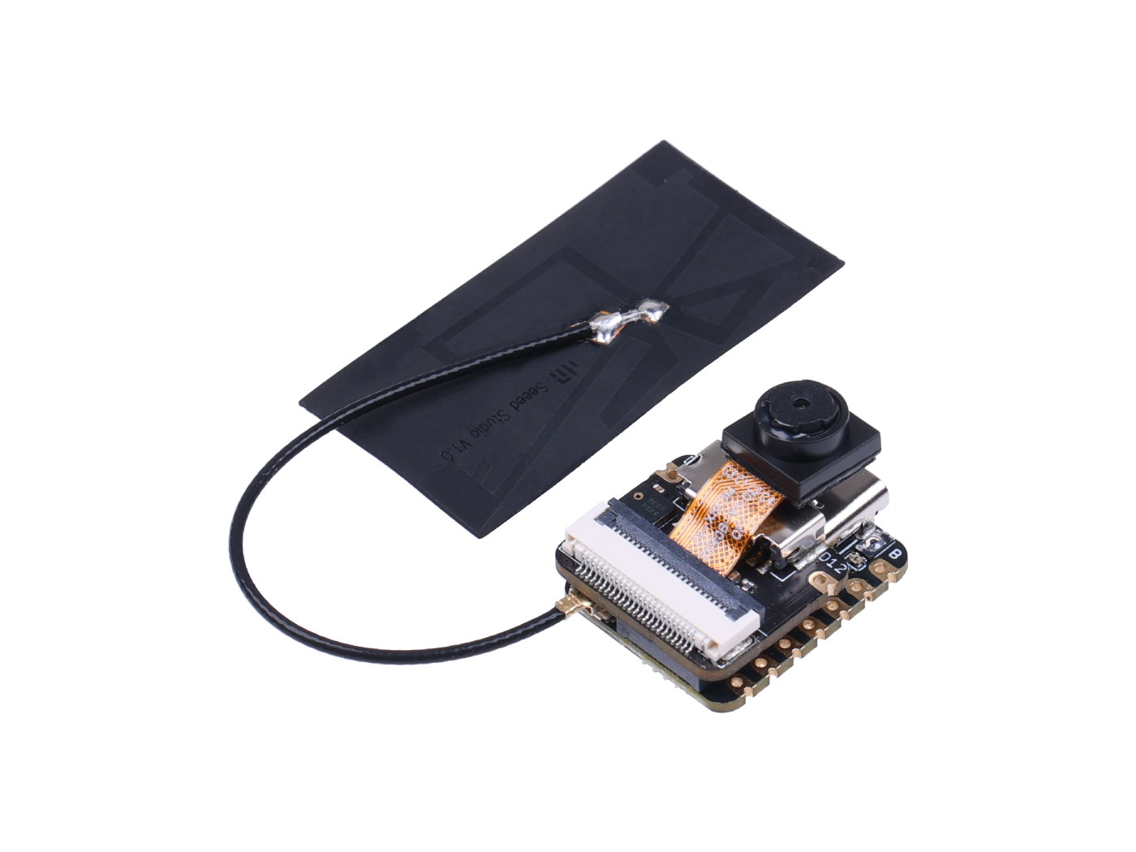
Frame Capture
Xiao ESP32S3 Compatible with MicroPython (Easier Approach to modify and run programs)
Transfer data with UDP socket in local net (IP address get from Computer and port 9090)
Setting Correct time parameters to prevent the Chip from overheat
Using OpenCV on the computer to Analysis the proper image from image buffer
ECE445 SP24 Team49
Notes:
For the frame capture phase, we use the XIAO ESP32S3, which supports MicroPython. This allows us to easily and directly invoke and run Python Programs. We transmit data within a local net using UDP sockets, first by obtaining the IP address of the PC and connecting through port 9090. Additionally, we have set an appropriate interval for capturing images. Capturing images too frequently could lead to inaccuracies in recognition or potentially overheat the chip, posing safety risks. Lastly, we use OpenCV to convert the image buffer into a recognizable format."

Slide 17
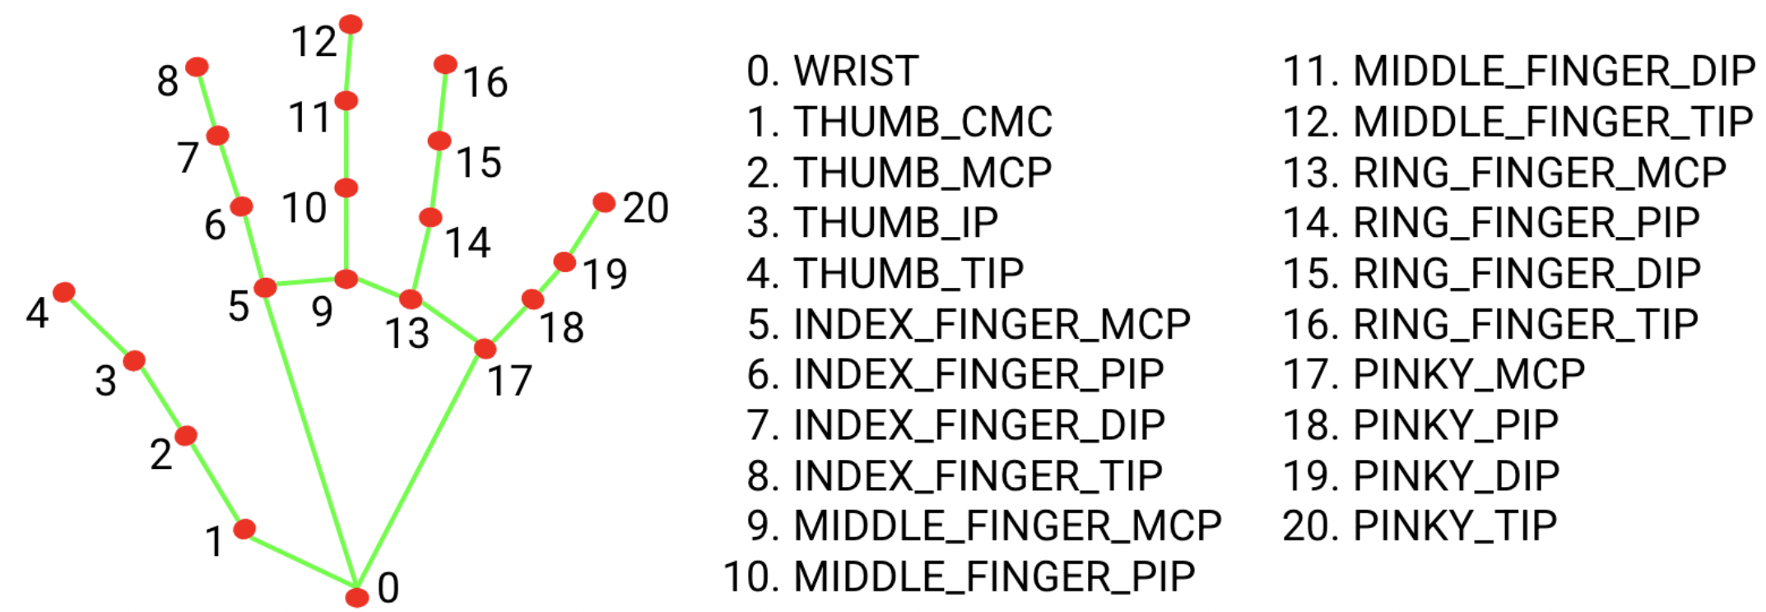
Gesture Design
Hand Landmark analysis from MeidaPipe
Tracking if the figure is active by calculating the distance between fingertip to wrist
Specific Modification for Thumb
Calculating the direction for the Thumb
Hand gestures (Thumb up, down, left, right, palm, fist…)
ECE445 SP24 Team49
Notes:
For gesture design, we have used MediaPipe's hand landmark analysis, which identifies and coordinates each joint in the hand. This approach allows us to recognize gestures based on the calculated coordinates between joints, rather than training the AI for each individual gesture. For instance, to determine if a finger is extended, we calculate the distance from the fingertip and the joint to the wrist. However, the thumb requires special consideration due to its unique mechanics—its length doesn't change significantly between extended and contracted states. Therefore, I devised a method to determine if the thumb is extended by calculating the slope from the fingertip to the joint, from the joint to the wrist, and then the angle between these slopes."

Slide 18
Data Transferring
Try different approaches for data transmission
The ESP32 on the mother board functioning as web server.
Accept Http request from Analyzing Python Program on PC.
Message will be like intensity:80, trackingmode:0, turnleft…
ECE445 SP24 Team49
Notes:
In the data transmission phase, we utilized HTTP requests to handle the communication. Our goal was to explore and implement various transmission methods. Initially, the main controller provides IP information accessible within the local network. We then incorporate this IP information into our HTTP requests. Depending on the gesture detected, we adjust the parameters included in the message. For example, for different gestures, we might include parameters such as 'intensity: 80', 'trackingmode: 0', or 'turnleft'."

Slide 19
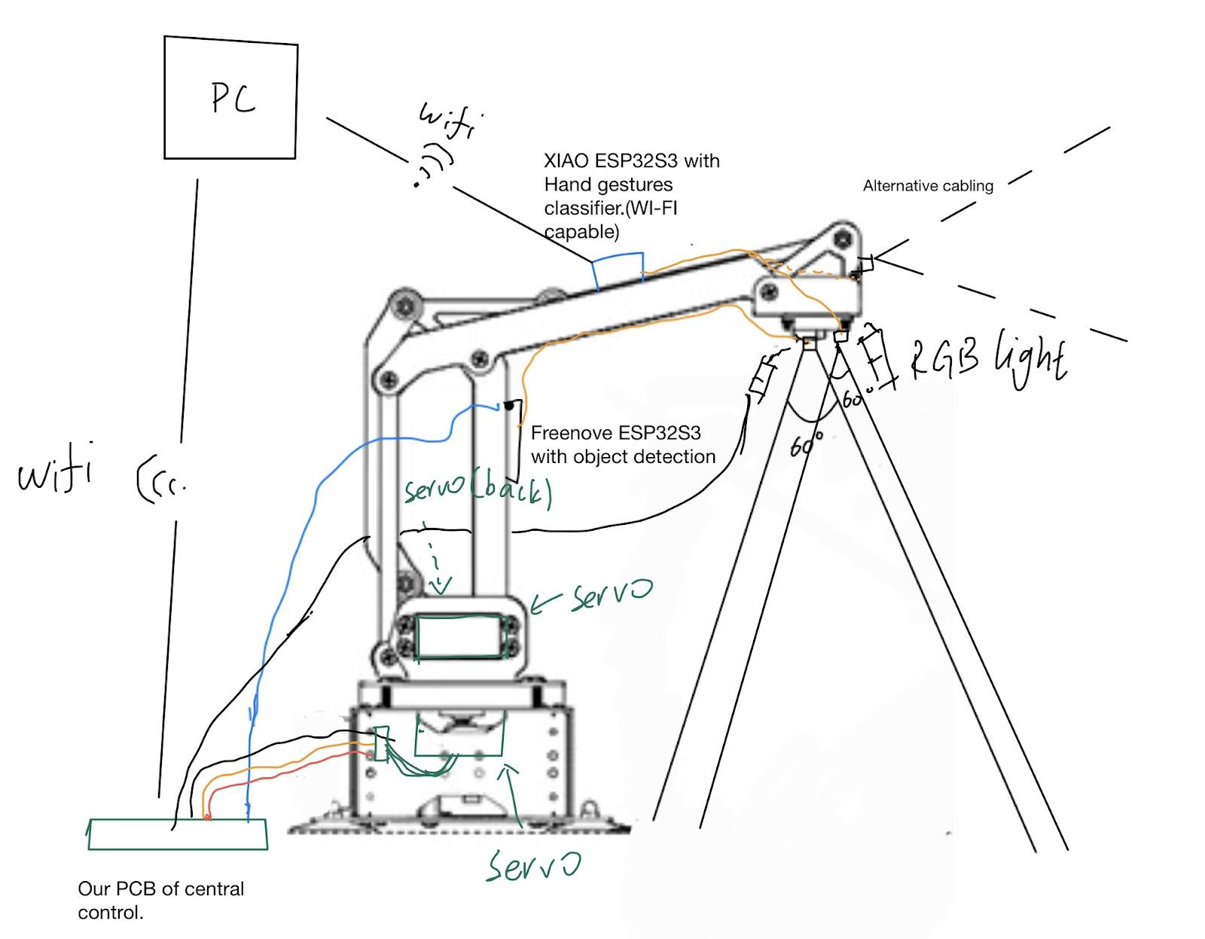
Overview of Mechanical Arm
Multi-Axis Movement:
Programmable Settings
The servo motors are selected for their torque capabilities and response times, to handle the mechanical demands of the arm's movements.
ECE445 SP24 Team49
Notes:
Three servo motors offer a dynamic range of motion. But we mainly uses two servo. The base servo allows for rotational movement, the mid-arm servo enables horizontal extension.
Each servo motor can be individually programmed, allowing for complex movements and patterns to be executed automatically or on demand.

Slide 20
Servo Motors - Core of Motion Control
Servo 1 – Base Rotation
Angle Limits:
0 to 240 degrees
Control Precision:
High-resolution: 0.24 degree precision
Changeable moving speed.
ECE445 SP24 Team49
Notes:
High-resolution encoding ensures that the base rotates to the exact desired angle.
Smooth and consistent rotational speed avoids jerky movements, ensuring steady light positioning.

Slide 21
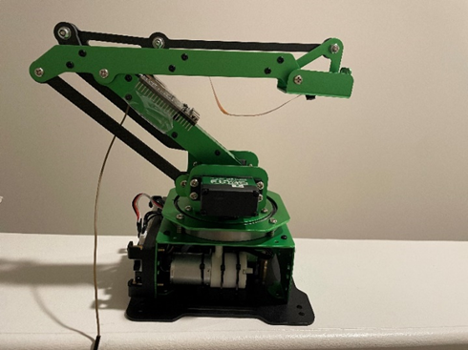
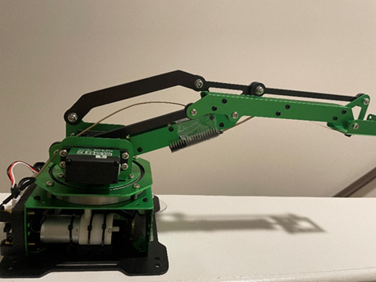
Servo 2 – Mid-Arm Movement
Primary extension and retraction
Range of Motion: 400-750 out of 0-1000
ECE445 SP24 Team49

Slide 22
Mechanism of Mechanical Arm Movement
Coordinate Mapping:
Polar Coordinate System
ECE445 SP24 Team49

Slide 23
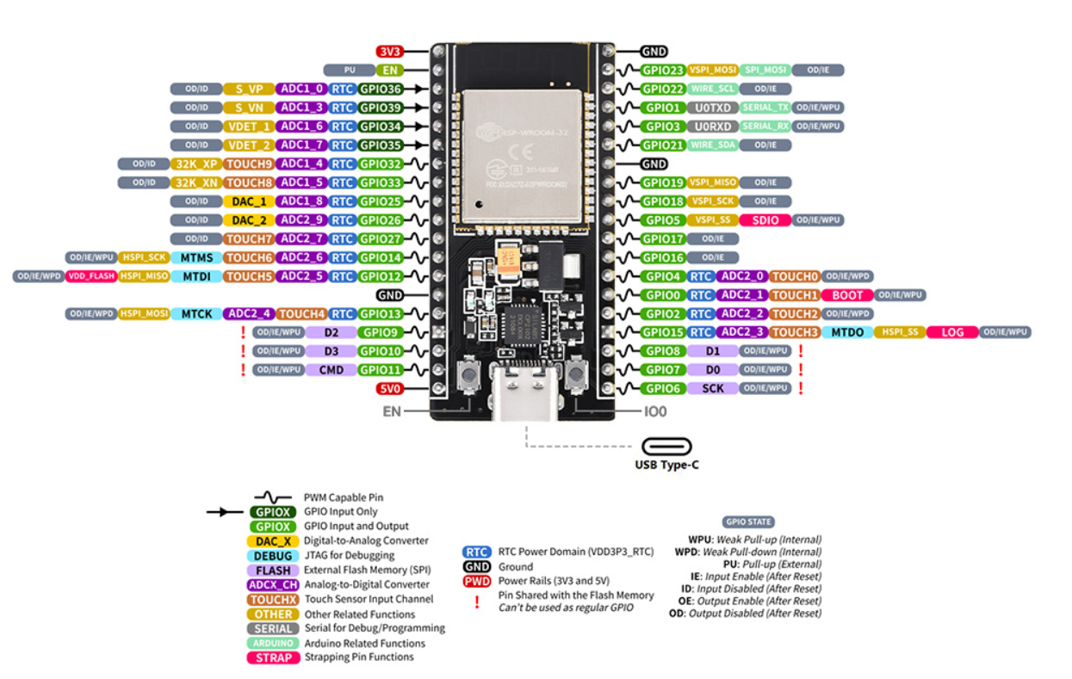
Integrating AI Tracking Capabilities
AI Model Integration:
IO2 communication.
ECE445 SP24 Team49

Slide 24
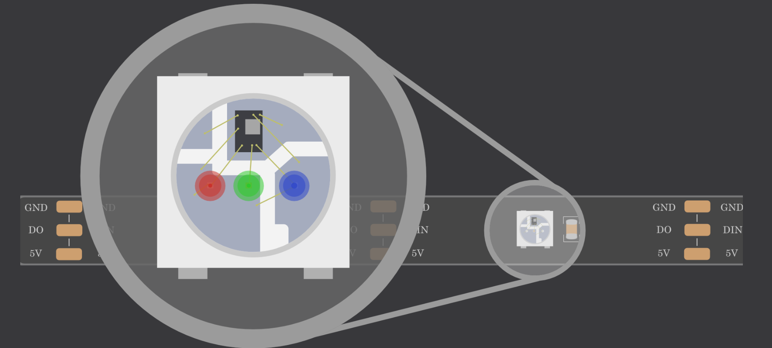
Design and Implementation of Smart LED Control
Smart LED Selection:
WS2812B LED strip
Lighting Control:
Control Library: Adafruit NeoPixel
System Integration:
Real-Time Control
ECE445 SP24 Team49

Slide 25
Lamp Subsystem R&V
Requirement | Verification | Result
1. Servo motors can move the mechanical arm when powered on by 12V +/- 5% | Set up servo motors and mechanical arms and connect servo motors to a 3.3V power source Activate HTS35H motors and observe if mechanical arms can be moved by motors | Pass
2. Mechanical arm can move in x and y directions | Set up servo motors and mechanical arms and connect servo motors to a 3.3V power source Activate the servo motors and observe if the mechanical arm can move in the corresponding x and y directions | Pass
3. RGB Light strip can adjust brightness and temperature when powered on by 5V +/- 5% | Assemble the complete power, sensor, central control, and lamp subsystems and connect an RGB light strip to a 5V power source Stretch out 2-3 fingers in front of ESP32 Cam to verify if the light strip can increase/decrease brightness through dimming Stretch out 4-5 fingers in front of ESP32 Cam to verify if the light strip can change color temperature | Pass
ECE445 SP24 Team49

Slide 26
Central Control Subsystem R&V
Requirement | Verification | Result
1. Able to communicate data through PWM, and UART protocols | Set up and program the ESP-WROOM-32 Microcontroller through Arduino IDE Connect ADALM2000 between the ports used to transfer PWM and UART data to verify if signals are sent to sensor and lamp subsystems | PCB was not programmable, replaced with ESP32 Development Board and passed
2. Communicate with the mechanical arm to follow human hands with a delay < 0.5s | Set up and assemble the complete control, lamp, sensor, and power systems Initiate hand movement in front of ESP32 Cam Use the timer app on your mobile phone to ensure the reaction speed delay of mechanical arm tracking is below 0.5s | Passed
3. Communicate with the light controller to switch on/off and adjust brightness with a delay < 0.5s | Set up and assemble the complete control, lamp, sensor, and power systems Stretch out one finger (turn on light gesture) in front of ESP32 Cam Use the timer app on your mobile phone to ensure the light switching delay is below 0.5s | Passed
ECE445 SP24 Team49

Slide 27
Power Subsystem R&V
Requirement | Verification | Result
1. Primary voltage regulator enables 12V +/- 5% voltage output | Connect a 12V voltage regulator to a wall outlet Use an multimeter on the voltage regulator output to verify if it supports 12V +/- 5% output | Failed on first PCB but was replaced with external adapter
2. Primary voltage regulator enables 5V +/- 5% voltage output | Connect a 5V voltage regulator to a wall outlet Use an multimeter on the voltage regulator output to verify if it supports 5V +/- 5% output | Pass
3. Secondary voltage regulator enables 3.3V +/- 5% voltage output | Connect a 3.3V voltage regulator to a wall outlet Use an multimeter on the voltage regulator output to verify if it supports 3.3V +/- 5% output | Pass
ECE445 SP24 Team49

Slide 28
Success
Challenges
Accomplished object detection and enabled tracking of hand motion
Streamlined communication between mechanical arm, RGB light, servo motors, and ESP32
Achieved gesture recognition to control RGB light and mechanical arm using gestures
Provided usable lamp product for potential users
PCB design encountered several issues and needed to be replaced by ESP32 Development Board
Power module testing burned the initial PCB microcontroller
ECE445 SP24 Team49

Slide 29
Conclusion
What we Learned:
Designing user friendly products
Implementing object detection and gesture recognition
PCB Testing and Assembly
Communication Skills
How we would redesign:
Order assembled PCB board to avoid hand soldering issues
Build a separate power module board to avoid possible burning
Future Recommendation:
Continue refining tracking algorithm for more precise hand motion tracking
Purchase professional camera to increase Field of View of cameras on the lamp
ECE445 SP24 Team49

Slide 30
Thank you

