Slide 1
Gesture Controlled Audio System
Team 37: Ruofan Chen, Kehang Chang (Fred), Ruohua Li

Slide 2
Introduction
During cooking or working, background noise is large
Users’ hands are rarely free
Share music over multiple speakers without pairing

Slide 3
Objective
Gesture Controlled Audio System is an audio sharing and coordination system. This system aims to provide users with a handy way of controlling audio systems by enabling remote control using human gestures.
Our proposed system consists of four subsystems:
human gesture capturing and recognizing system (vision subsystem)
distribution and receiving system (transmission subsystem)
signal processing and output system (audio subsystem)
power regulation system

Slide 4
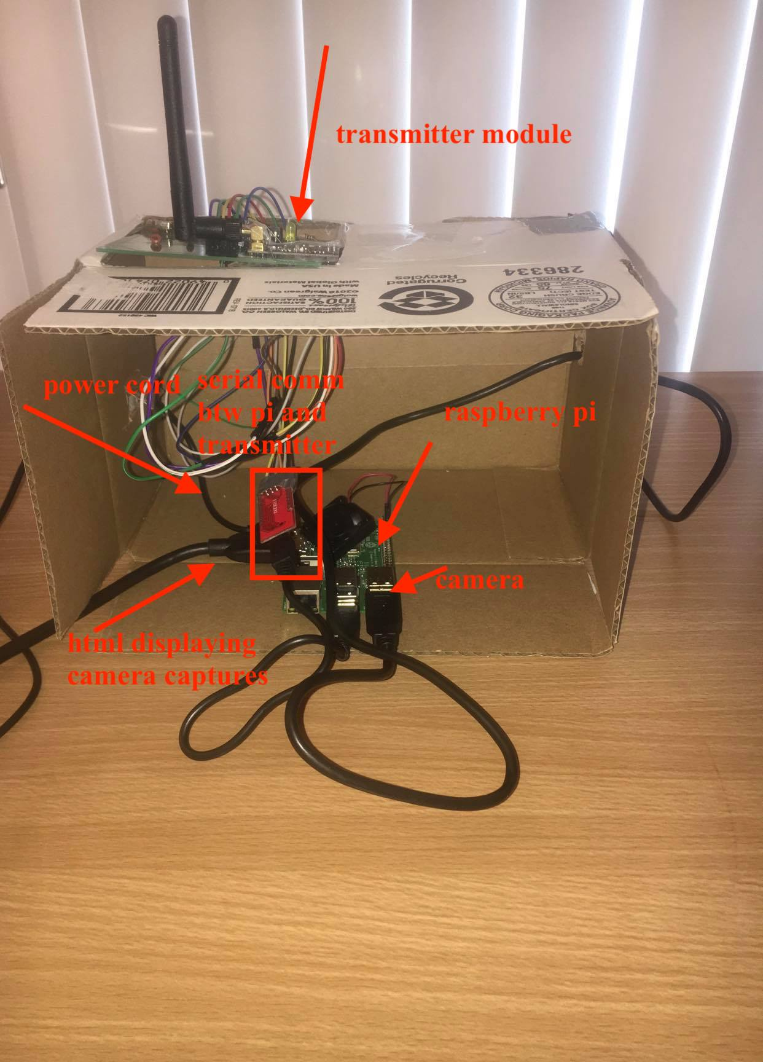
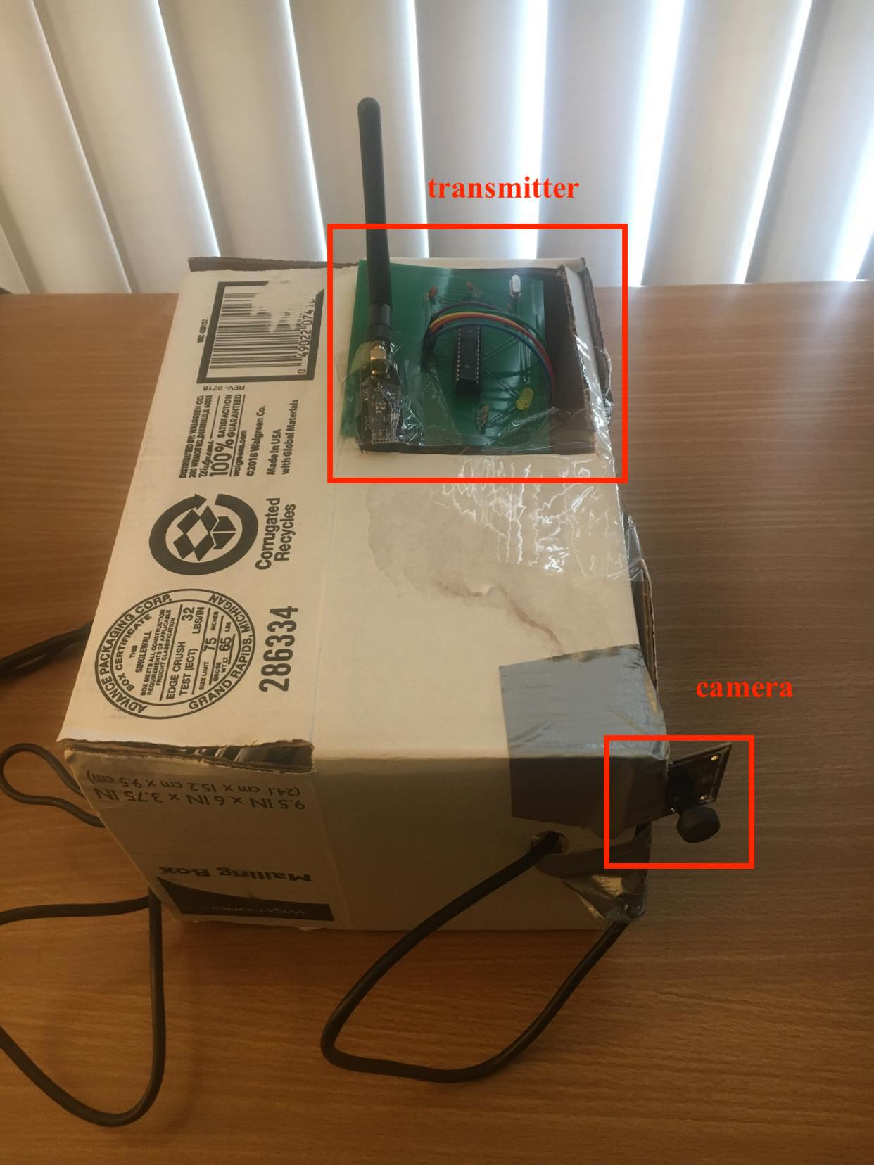
The GCAS (Gesture Controlled Audio System)
Figure 1 transmitter: component breakdown

Slide 5
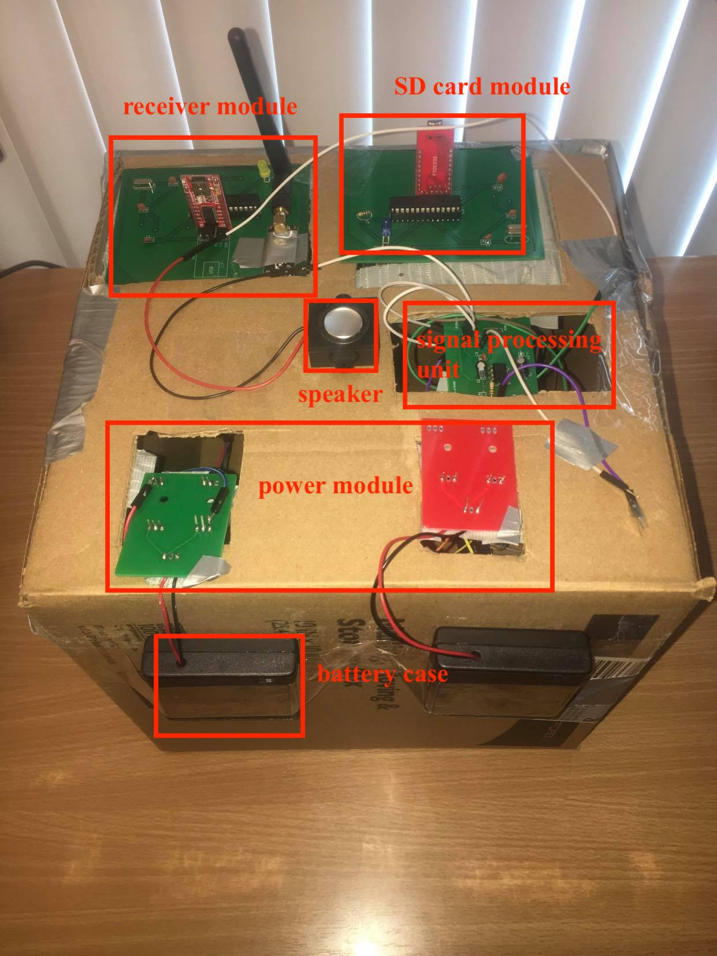
The GCAS (Gesture Controlled Audio System)
Figure 2 receiver: component breakdown

Slide 6
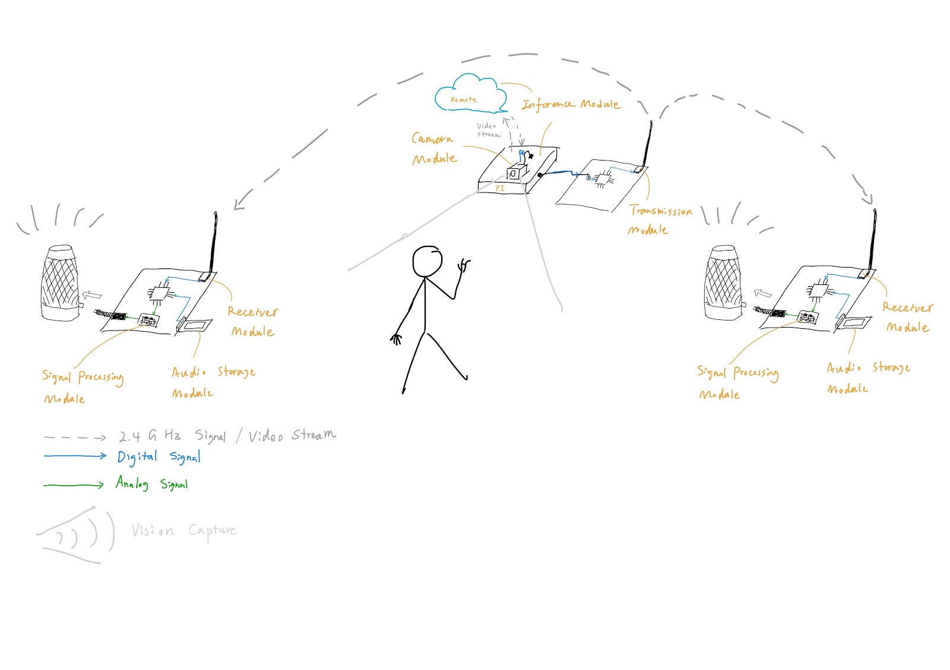
Physical Diagram

Slide 7
System Overview
human gesture capturing and recognizing system (vision subsystem)
distribution and receiving system (transmission subsystem)
signal processing and output system (audio subsystem)
power regulation system

Slide 8
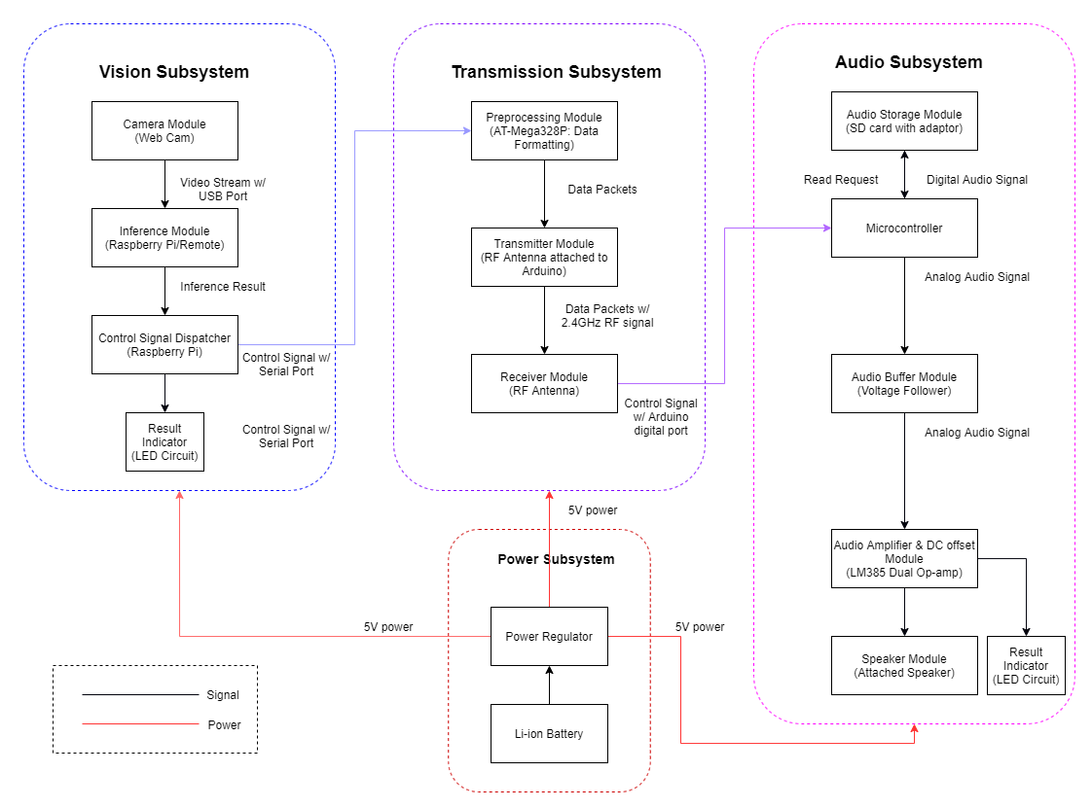
Block Diagram

Slide 9
Vision Subsystem
Camera Module
Inference Module
Control Signal Dispatcher (Transmitter)

Slide 10
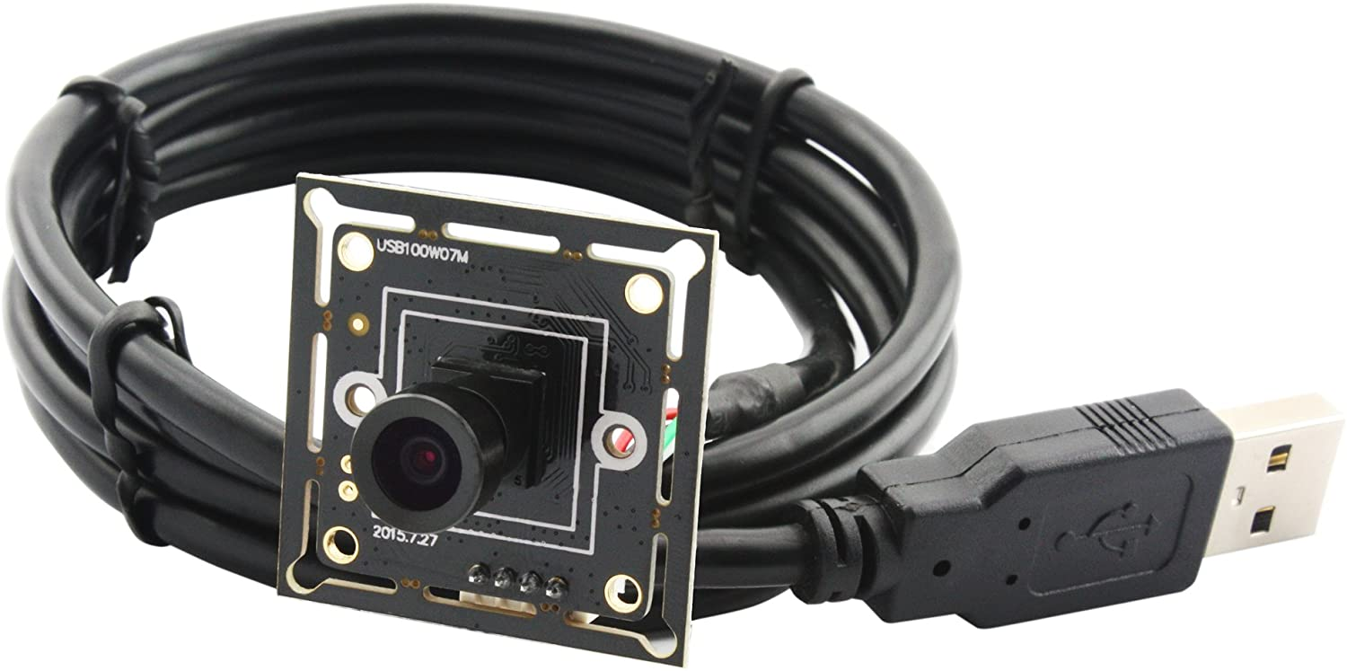
Camera Module
The camera module will capture a video stream at 25fps in 720p resolution. The camera module is mounted on the raspberry pi to feed input into the inference module (either locally on the raspberry pi board or remote server).
Figure 3 ELP megapixel Camera for raspberry pi
Requirement | Verification
The camera is fix-mounted and capture video stream at 25fps | A python script is used to trigger the camera to start to take video inputs

Slide 11
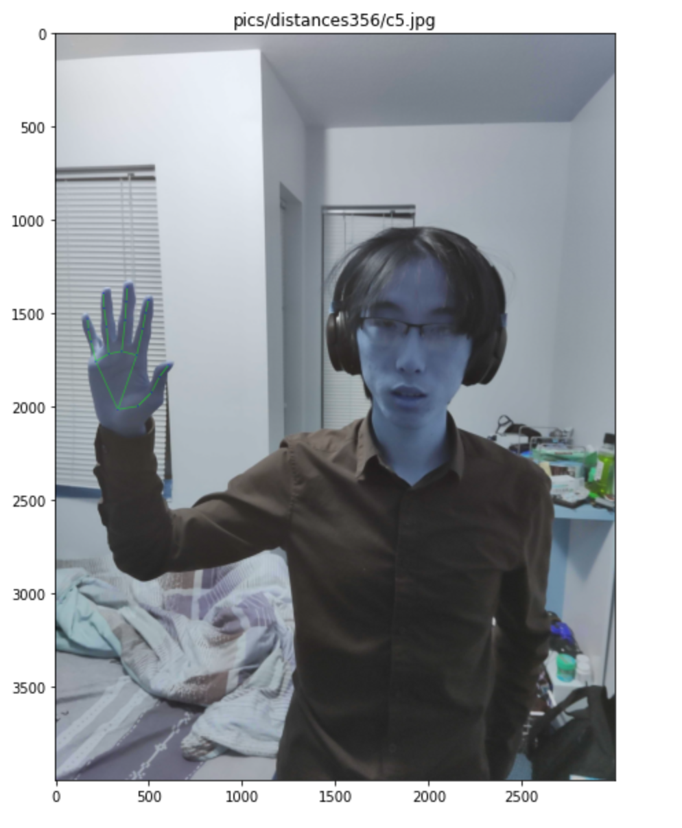
Inference Module
The inference module is either a raspberry pi board or a remote server. The inference module will analyze the images captured by the camera module to output proper control signals based on its recognition of valid gestures.
Requirement | Verification
Detect a valid gesture (pause, resume, next song) based on images captured in a 25fps-capable surface-mounted camera | Do 10 gestures valid gestures, and according to Monte-Carlo method if we can obtain 8/10 correct response for valid gestures, then the model is running as expected.
Figure 4 human hand gesture positioning using mediapipe by google

Slide 12
Control Signal Dispatcher
The control signal dispatcher is handled by a software code running on the Atmega328P microcontroller to interpret the output from the inference module and send out control signals to the transmitter module.
Requirement | Verification
The dispatcher should complete the delivery pipeline in less than a second. | Input valid gestures such as play, pause, next to the camera module, and the delivery process to end device speakers should be less than in a second.
10 $μ$m
Figure 5 Transmitter module with RF antenna mounted

Slide 13
Transmission Subsystem
Preprocessing Module
Transmitter & Receiver Module

Slide 14
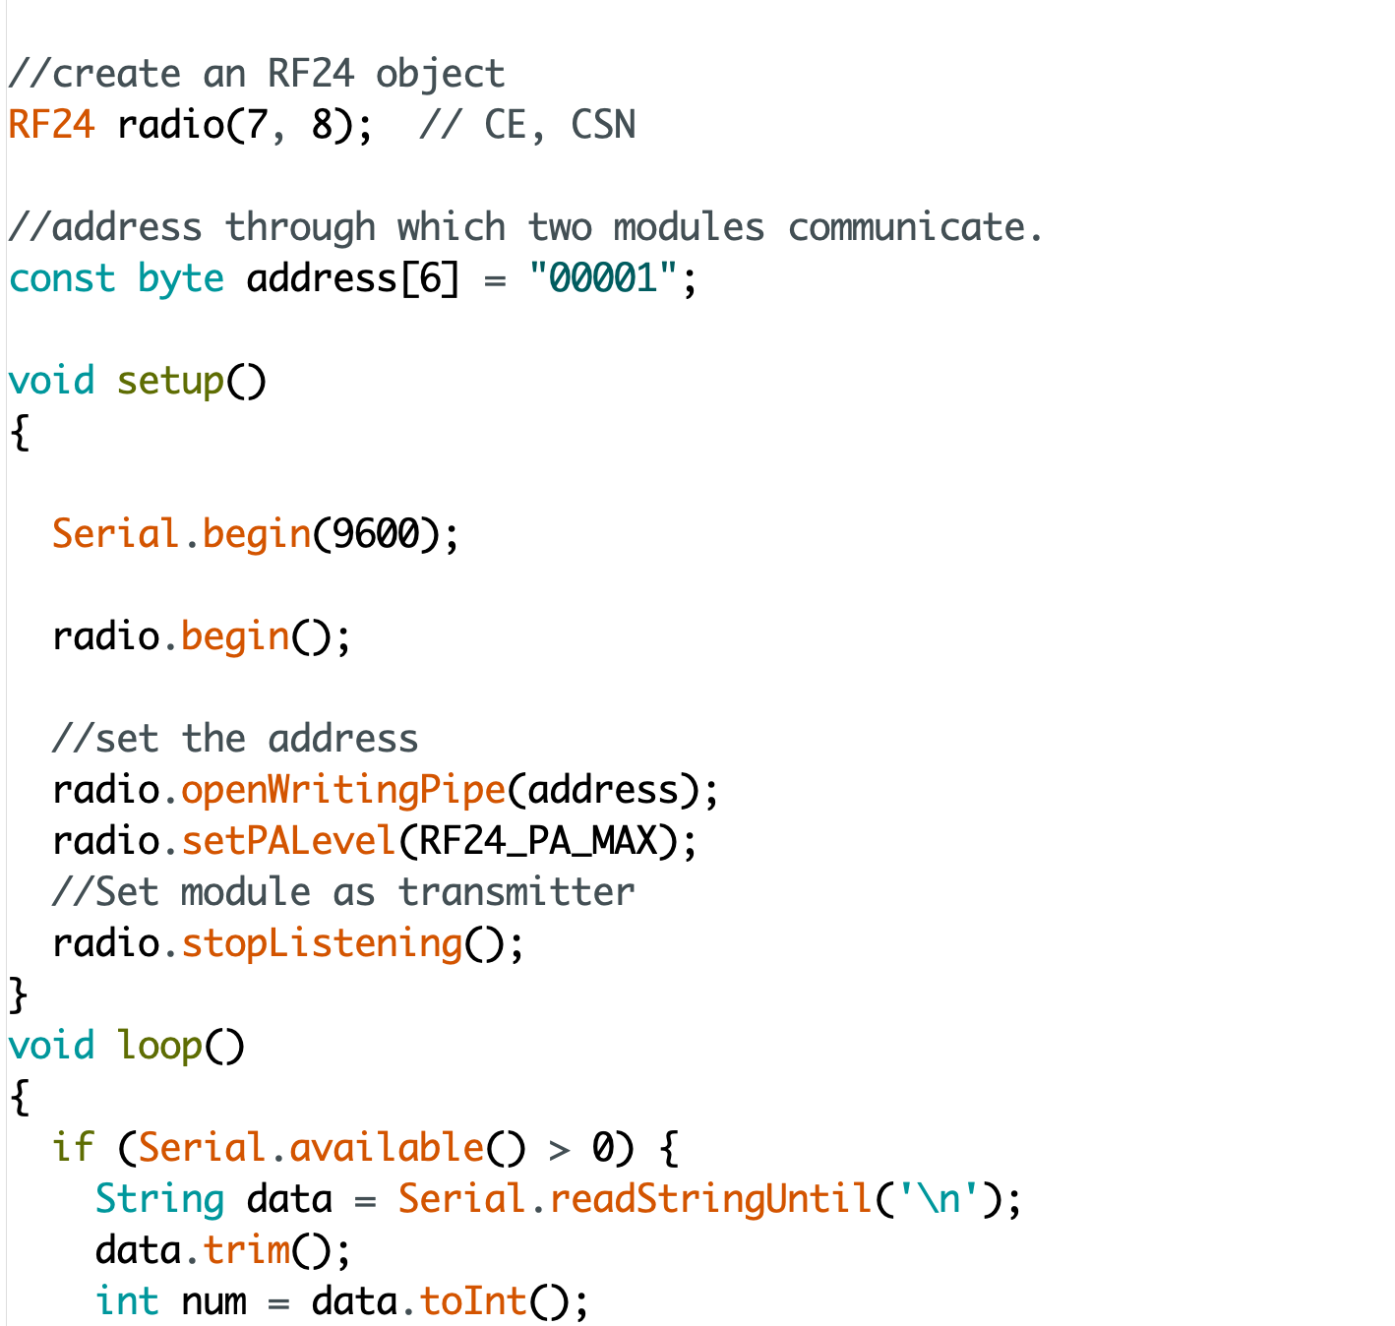
Preprocessing Module
This module is functioning on an Atmega chip which takes in the control signal sent by the control signal dispatcher and reformats it into wireless-transmittable data packets.
Number 0 represents pause
Number 1 represents resume
Number 2 represents next song
Number 3 represents idle
Requirement | Verification
This module will be able to take in serial port data and transmit it into transmittable data packets. | Print out the data sent by the control signal dispatcher and output of this module to see if the functionality is correct.
Figure 6 Arduino hardware code snippet

Slide 15
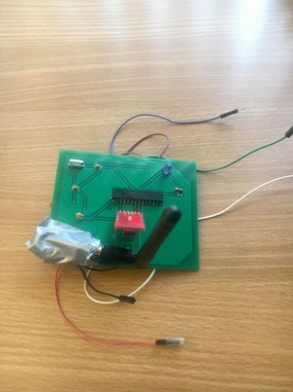
Transmitter & Receiver Module
The transmitter module is a circuit involving a RF antenna that sends control signal wirelessly over to the receiver module which has the same circuit design. It takes signals from preprocessing modules by wires.
Requirement | Verification
This module will be able to send the data packets sent by the preprocessing module via 2.4GHz RF signal. | Print out the data sent by the preprocessing module and received by receiver module to see if the data is correctly sent.
Figure 7 Transmission module

Slide 16
Audio Subsystem
Microcontroller & SD storage Module & Speakers
Signal Processing Module

Slide 17
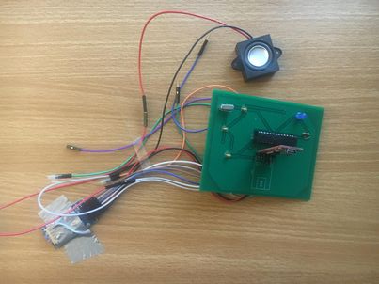
Microcontroller & SD storage Module & Speakers
This module, upon receiving control signals, will process the data packets sent from the transmission subsystem. Then it will perform D/A conversion and output audio analog signals to speakers based on received controlled signals.
Requirement | Verification
This module will be able to read audio files in SD card to perform D/A conversion to output analog audio signal | Check the content of this module and the result of reading by the microcontroller to see if it can be read correctly.
Figure 8 Audio module

Slide 18
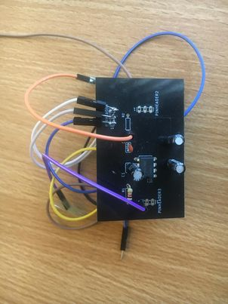
Signal Processing Module
The signal processing module consists an audio amplifier, and a DC offset circuit. The audio amplifier is used to amplify the signal and the DC offset circuit is used to let the audio signal oscillate around 2.5V rather than 0V.
Requirement | Verification
The audio signal coming out from the signal processing module should be without high and low frequency noises and oscillate around 0V. | Probe the PWM port on the Atmega328P board and output connection port from the signal processing module to compare the signals on the oscilloscope.
Figure 9 Signal processing module

Slide 19
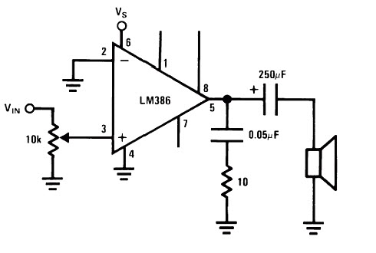
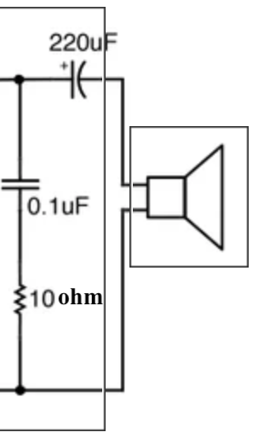
Audio Amplification
Signal Processing module consists of audio amplification unit and DC offset unit. The circuit components are labeled with values in the schematics. DC offset unit sets audio signal to oscillate around 0V by adding a big capacitor with value of 220 microfarad.
Figure 10 Audio amplification circuit & DC offset circuit

Slide 20
Power Subsystem
Power Regulator Module
Li-ion Battery Case

Slide 21
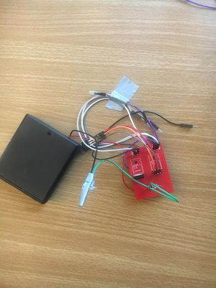
Power Regulator Module
Our power subsystem will source a constant 5V for camera module and microcontrollers and 3.3V for transmission module. The voltage source is provided by a four-pack Li ion battery. The power regulator module should be able to take a voltage supply ranging from 5V~14V and output a steady 5V or 3.3V for any module on the PCB board.
Requirement | Verification
Output a 4.95~5.05V or 3.2~3.3V voltage with a maximum current of 50mA when a 5.5~6.0V input voltage is applied | A. Connect a 4-pack Li-ion battery pack to the power regulator module B. Probe the power line coming out of power regulator module to measure the supply voltage
Figure 11 Power module

Slide 22
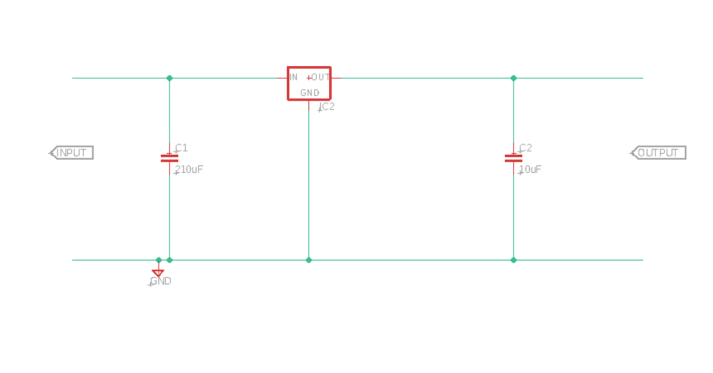
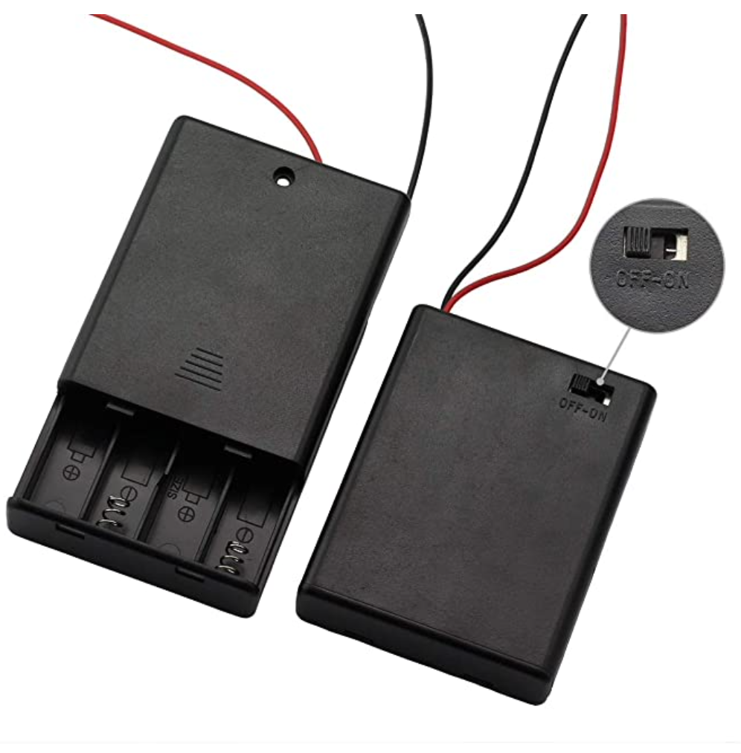
Li-ion Battery
This module is a battery case with 4x1.5V batteries that supply power to all modules.
Requirement | Verification
This module needs to output 5.0V ~6.0V voltage. | Measure the output voltage to check if it is supplying power correctly.
Figure 12 Power regulation schematic & battery case

Slide 23
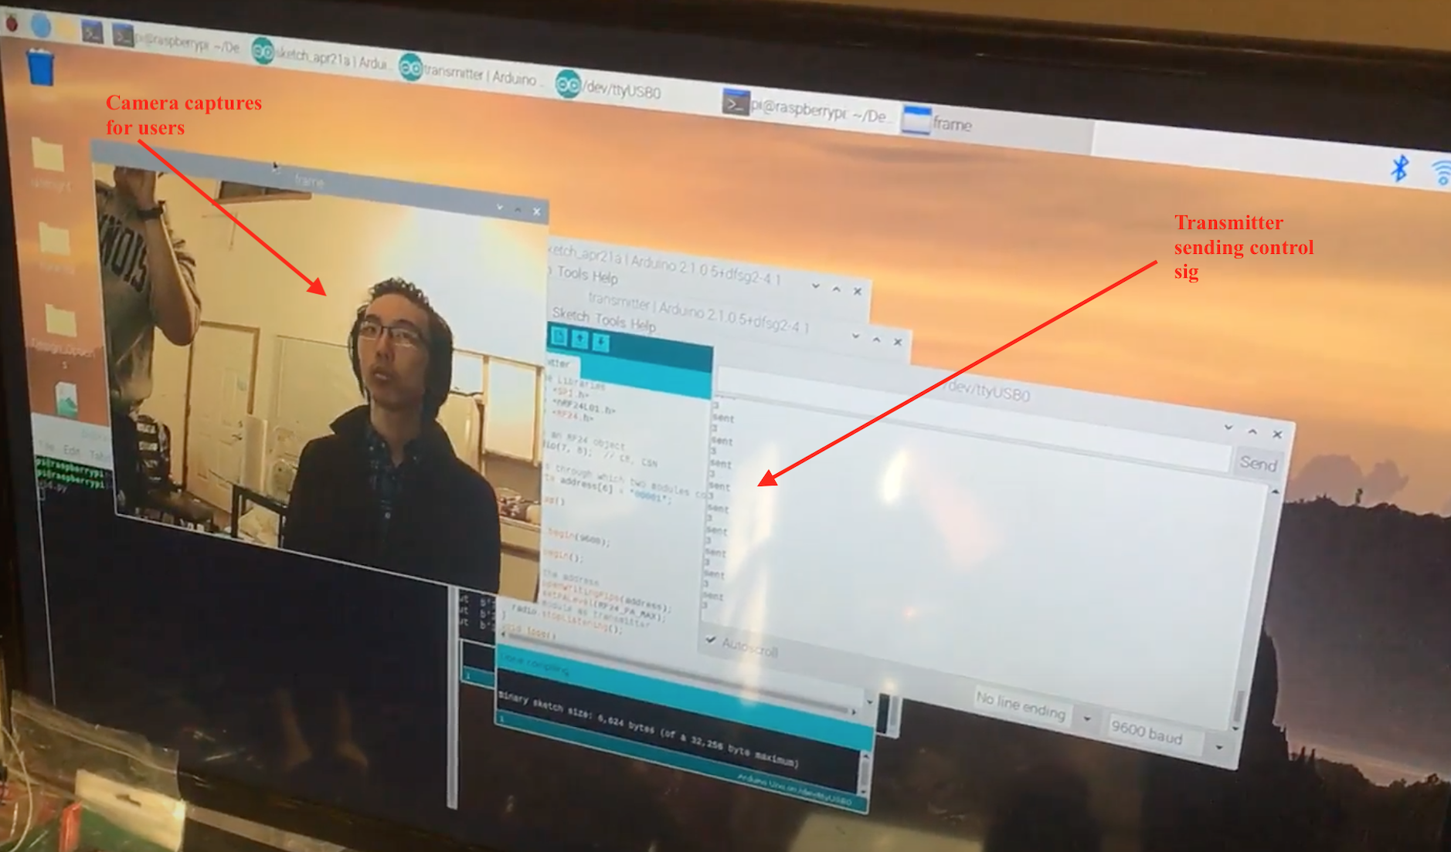
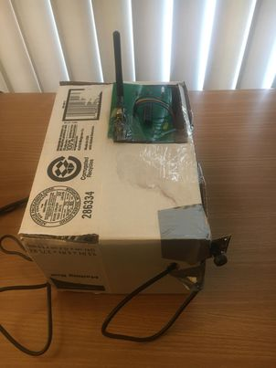
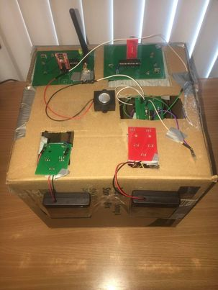
Functional Testing
RF transmission
Monitor captures receiver’s input
Receiver responds to control sig

Slide 24
Success
System Responsiveness
Dual Channel Synchronization

Slide 25
System Responsiveness
camera captures
Inference on the cloud
transmitter
receiver
The system will complete one control cycle from leftmost block to rightmost block in less than 2 seconds.

Slide 26
Dual Channel Synchronization
After both channels are up and antennas are calibrated. Dual channel can be synced by calling next song.

Slide 27
Challenges & Failures
Hardware
Audio Signal Transmission
System Integration
Overreliance on Internet Speed
Noises from RF Antennas
Software
False Positive Rates of Gesture Recognition

Slide 28
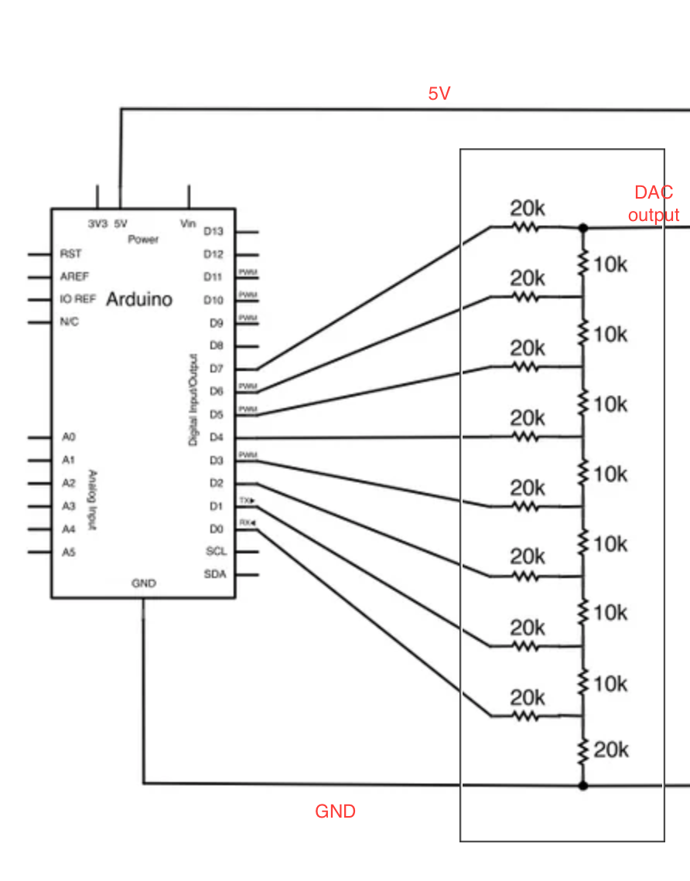
Audio Signal Transmission (Aborted)
Resistors-built DAC for 8 bit music is proved to degrade music quality, thus we aborted the plan.
Figure 13 DAC built by resistors

Slide 29
System Integration
Figure 14 Modularized PCBs
Above PCBs could be integrated together as one PCB design. Modularized PCBs are easy to debug, but not easy to integrate into final product.

Slide 30
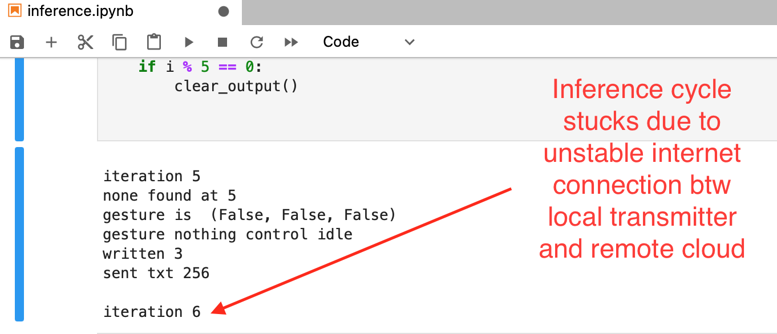
Overreliance on Internet Speed
Figure 15 Stuck Inference Cycle

Slide 31
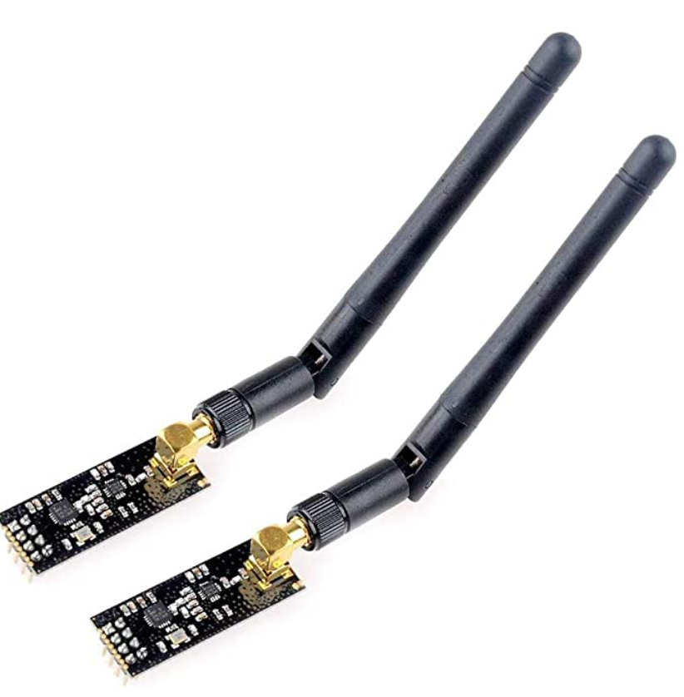
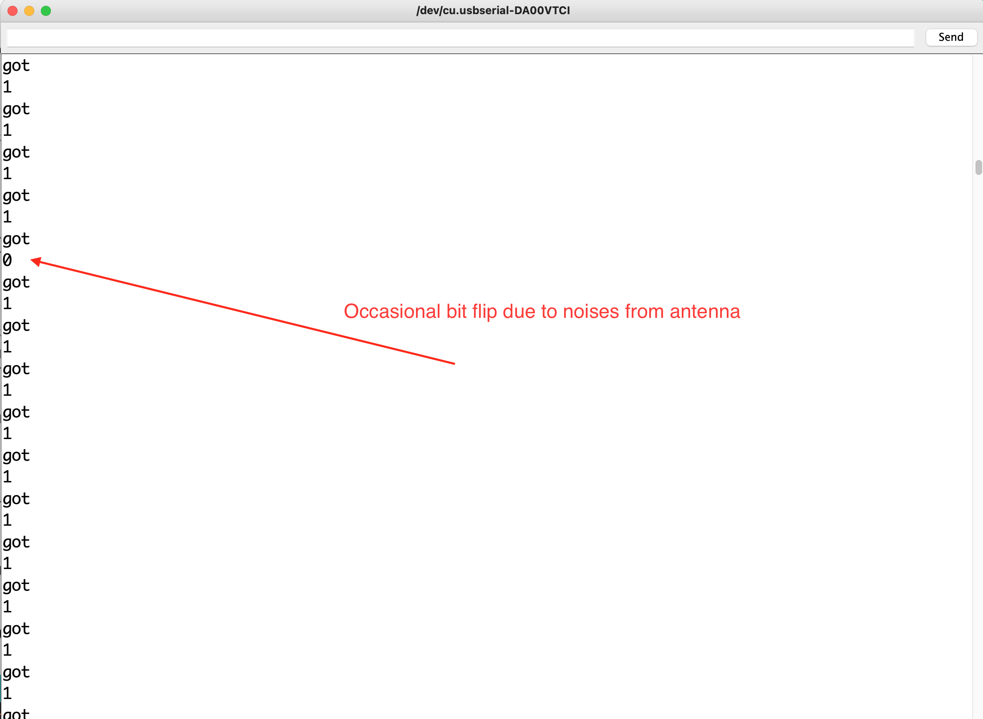
Noises from RF Antennas
Antenna Noises could be caused by physical touch on the antenna or other interactions with antenna.
Figure 16 The Antennas are parts of NRF24L01 wireless pack

Slide 32
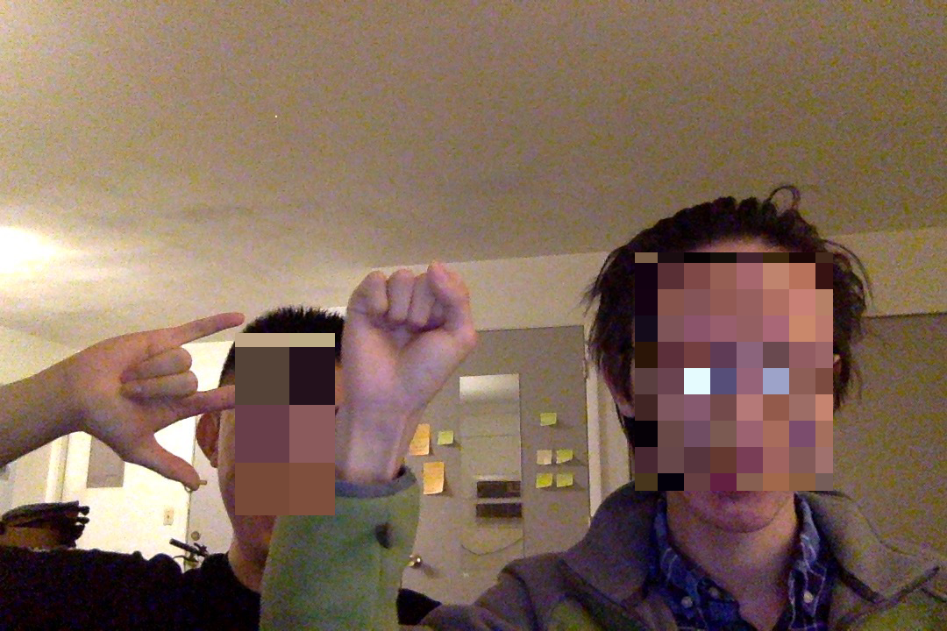
False Positive Rates of Gesture Recognition
Figure 17 Undefined gestures creates undefined control signals

Slide 33
Future Work
Integrate modular PCBs into one single PCB for transmitter and receiver end
Enhance Gesture Recognition Module with Facial Recognition Authentication
Antenna Auto Calibration & Indication
Local Inference Backups
Synchronization of Local Music Storage with Wifi & Bluetooth

Slide 34
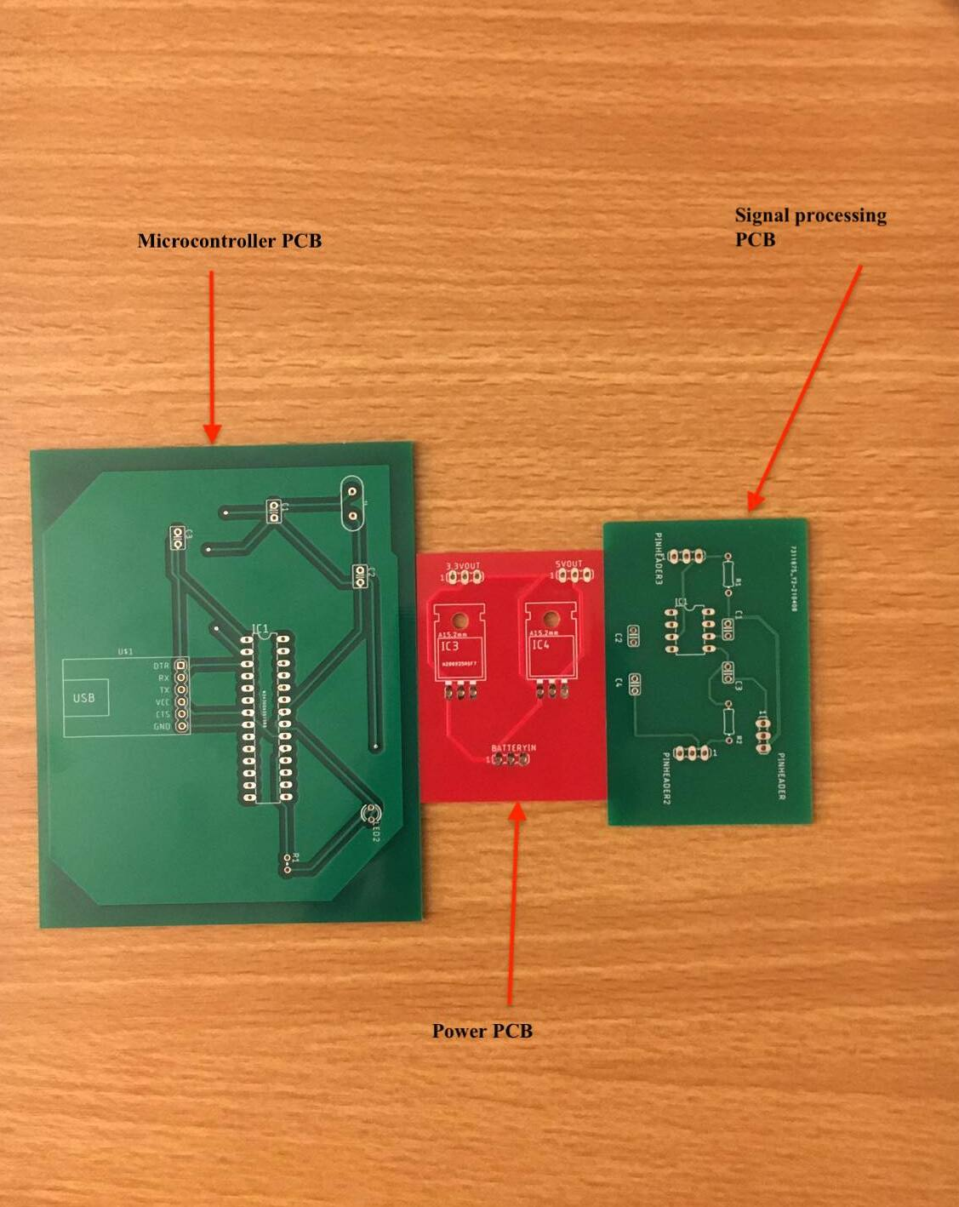
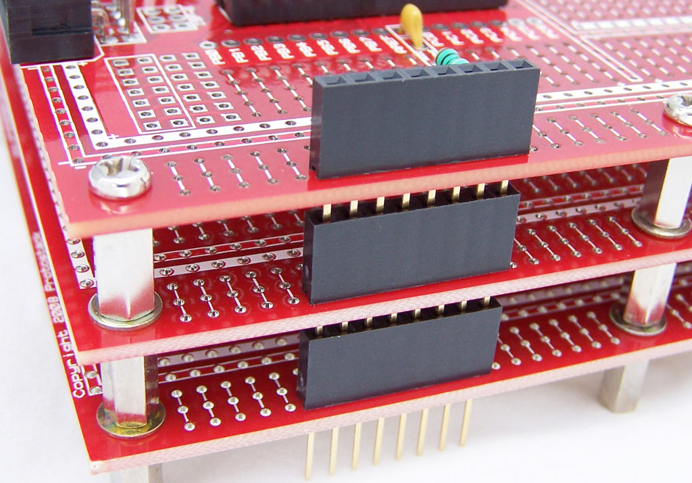
Integrate modular PCBs into one single PCB for transmitter and receiver end
Further Integration
Figure 18 Modularized PCBs

Slide 35
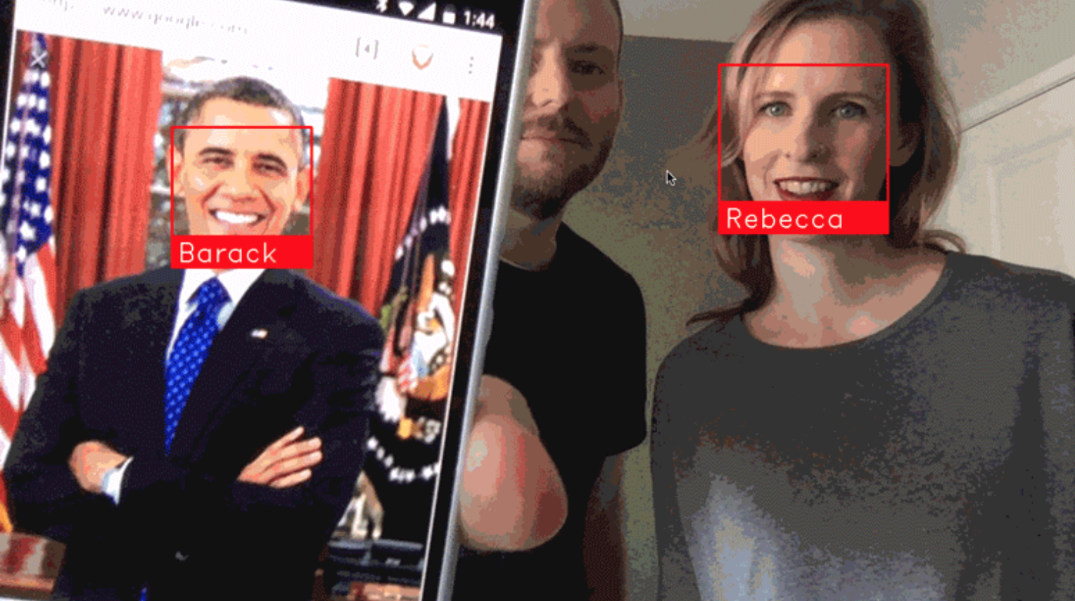
Enhance Gesture Recognition Module with Facial Recognition Authentication
Figure 19 Use deep learning to recognize authenticated user (credits to Ageitgey)

Slide 36
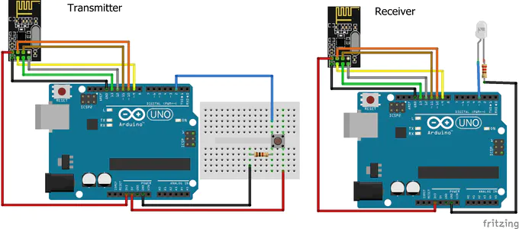
Antenna Auto Calibration & Indication
Figure 20 Use LED for transmission indication

Slide 37
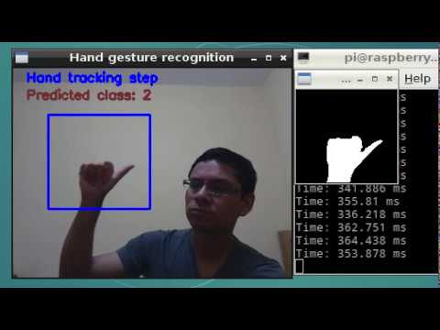
Local Inference Backups
In our final product, inference is entirely done on a remote server. Since the system response is sensitive to internet speed, a low-accurate local inference module can be implemented as a backup during unstable internet.
Figure 21 Use tensorflow lite on raspberry pi

Slide 38
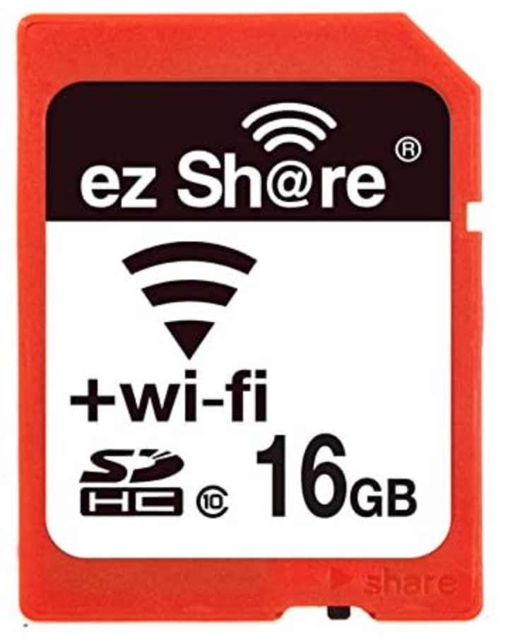
Synchronization of Local Music Storage with Wifi & Bluetooth
Wifi-enabled SD card offers new insights to sync music from a central user device such as the user’s phone or laptop to the distributed receivers’ local storages.
Figure 22 wi-fi-enabled local storage

Slide 39
PCB Design & Soldering
PCBs in the final design are modularized to three kinds:
Microcontroller PCB
Power PCB
Signal Processing PCB

Slide 40
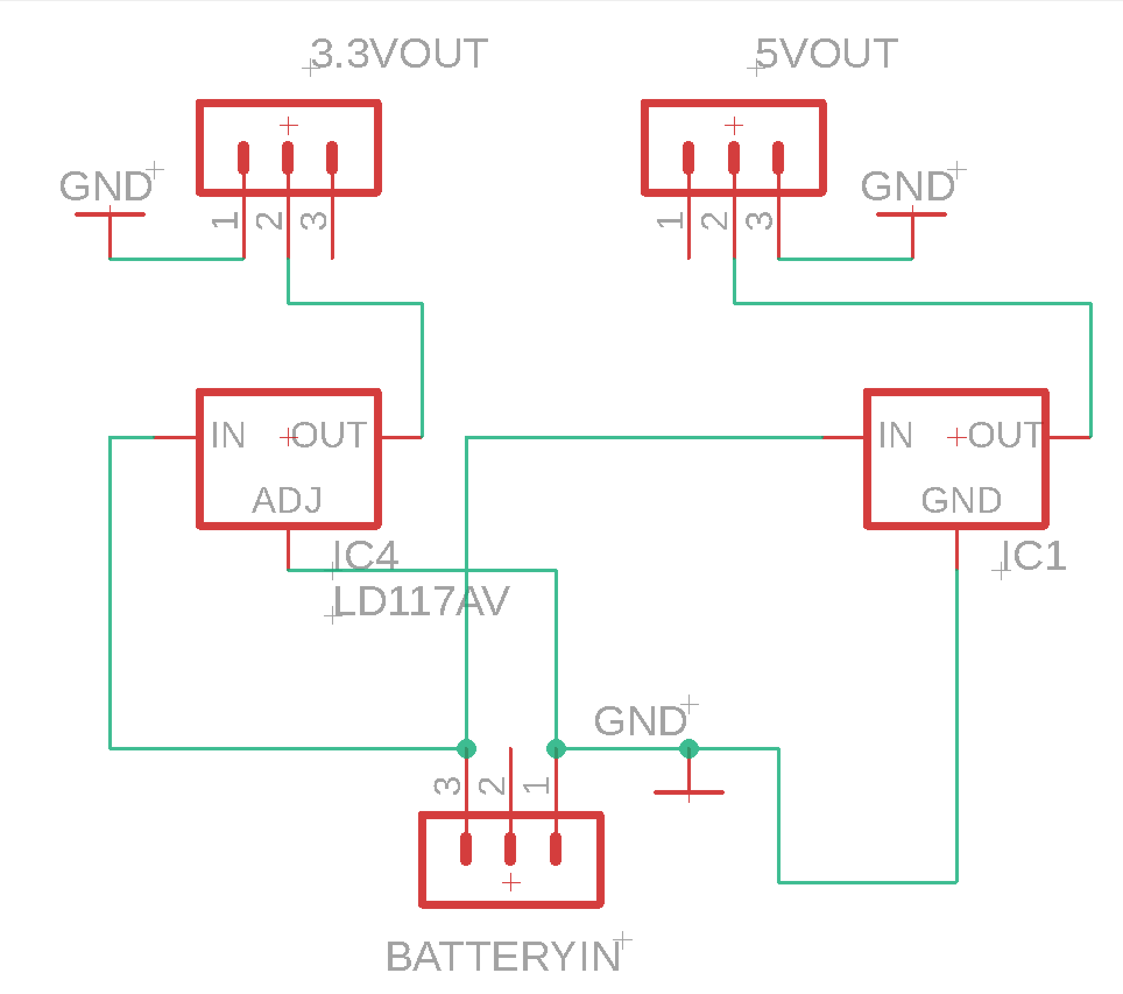
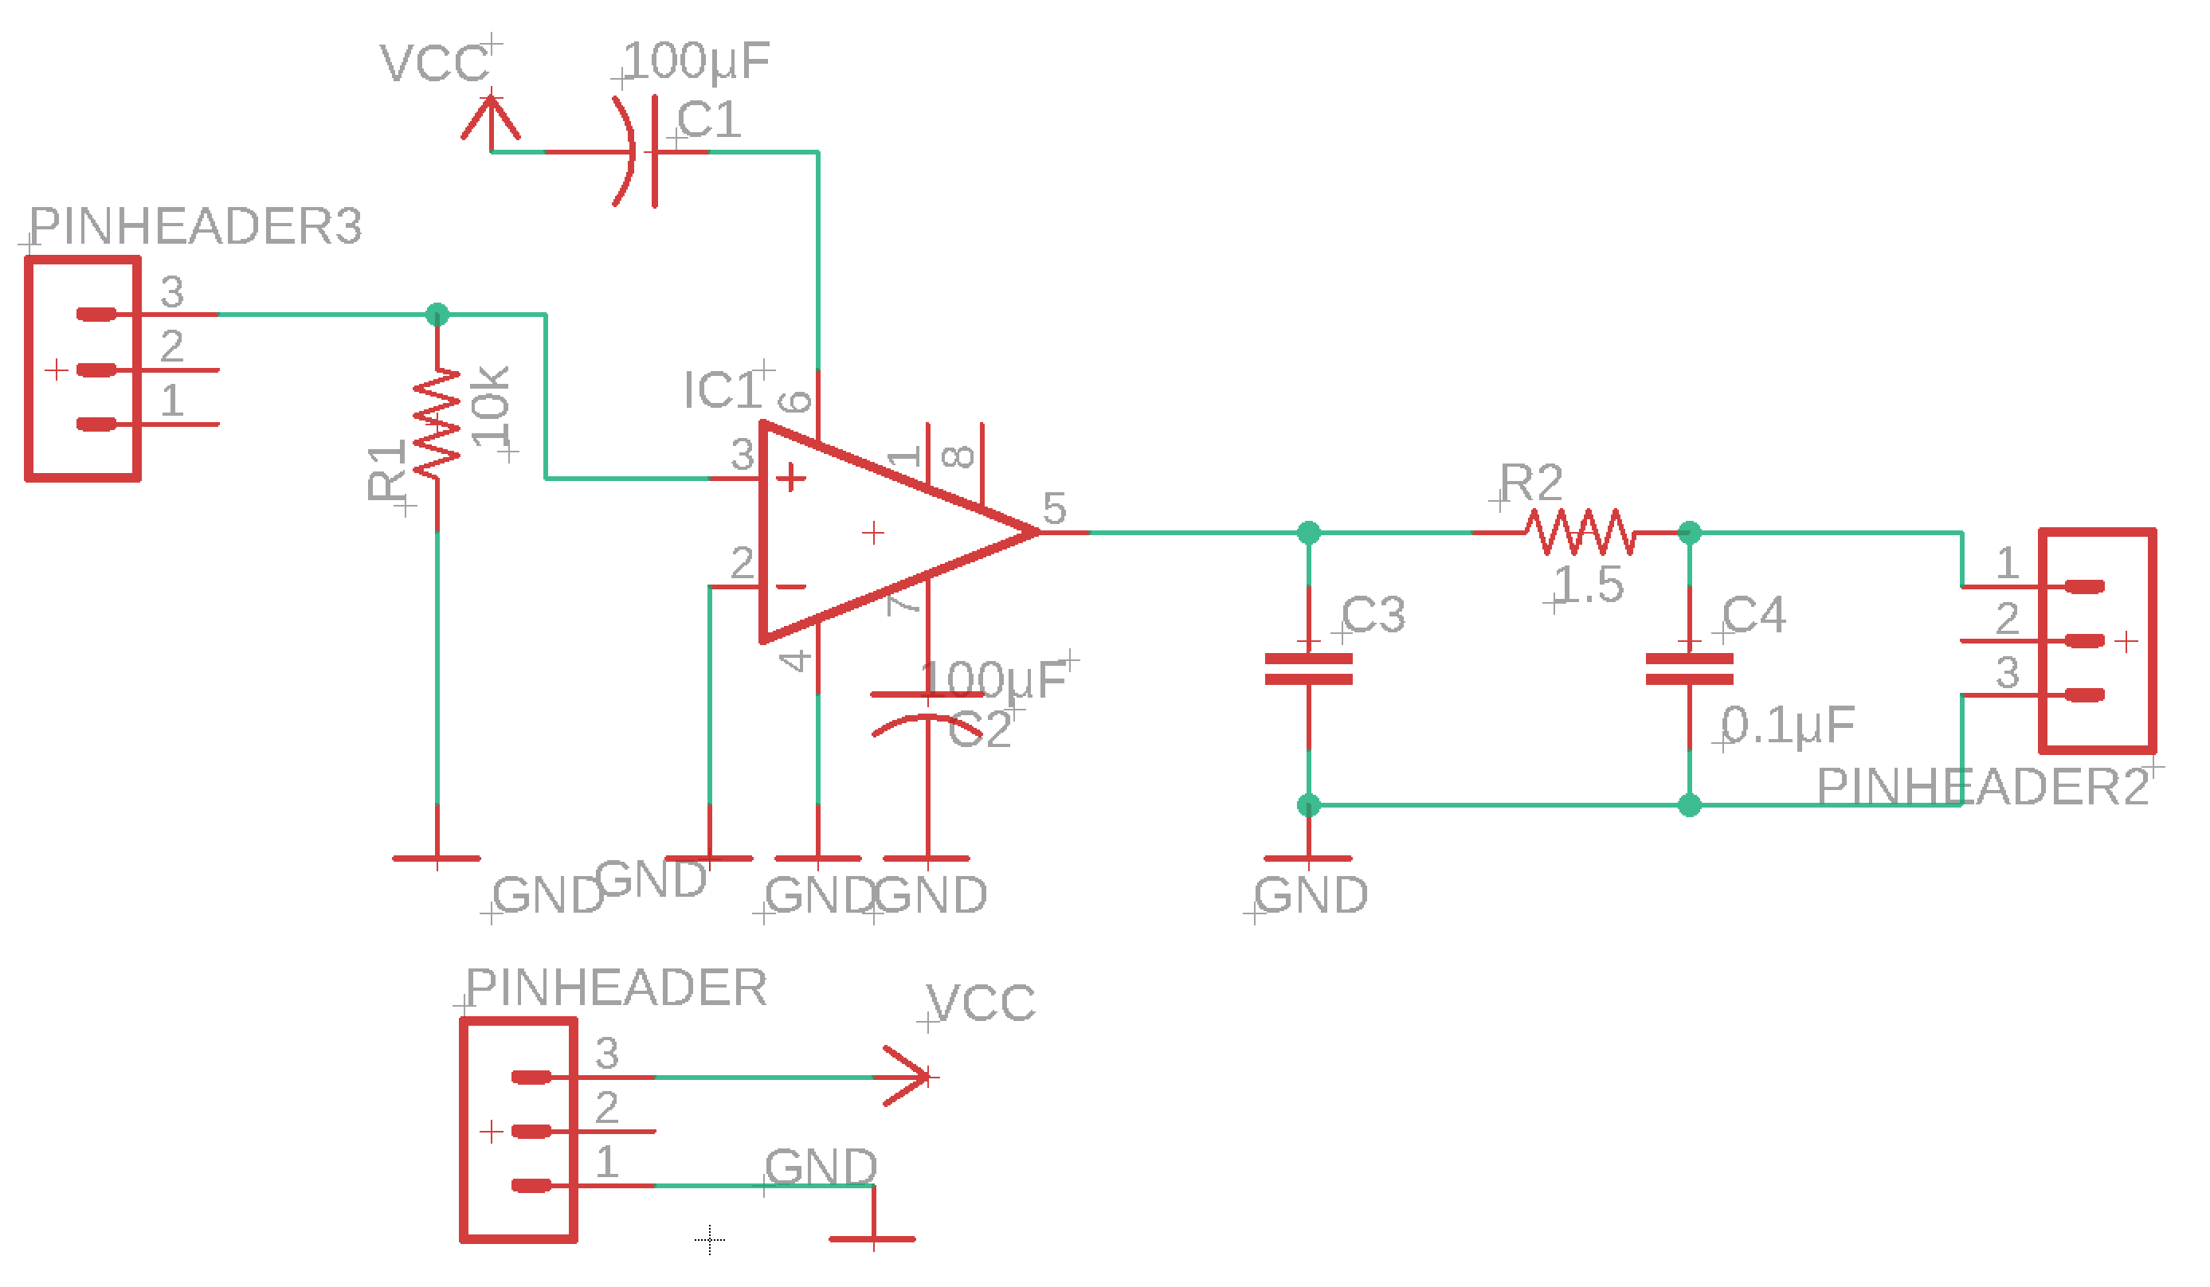
sch files
Figure 23 PCBs from left to right (dsp, power)

Slide 41
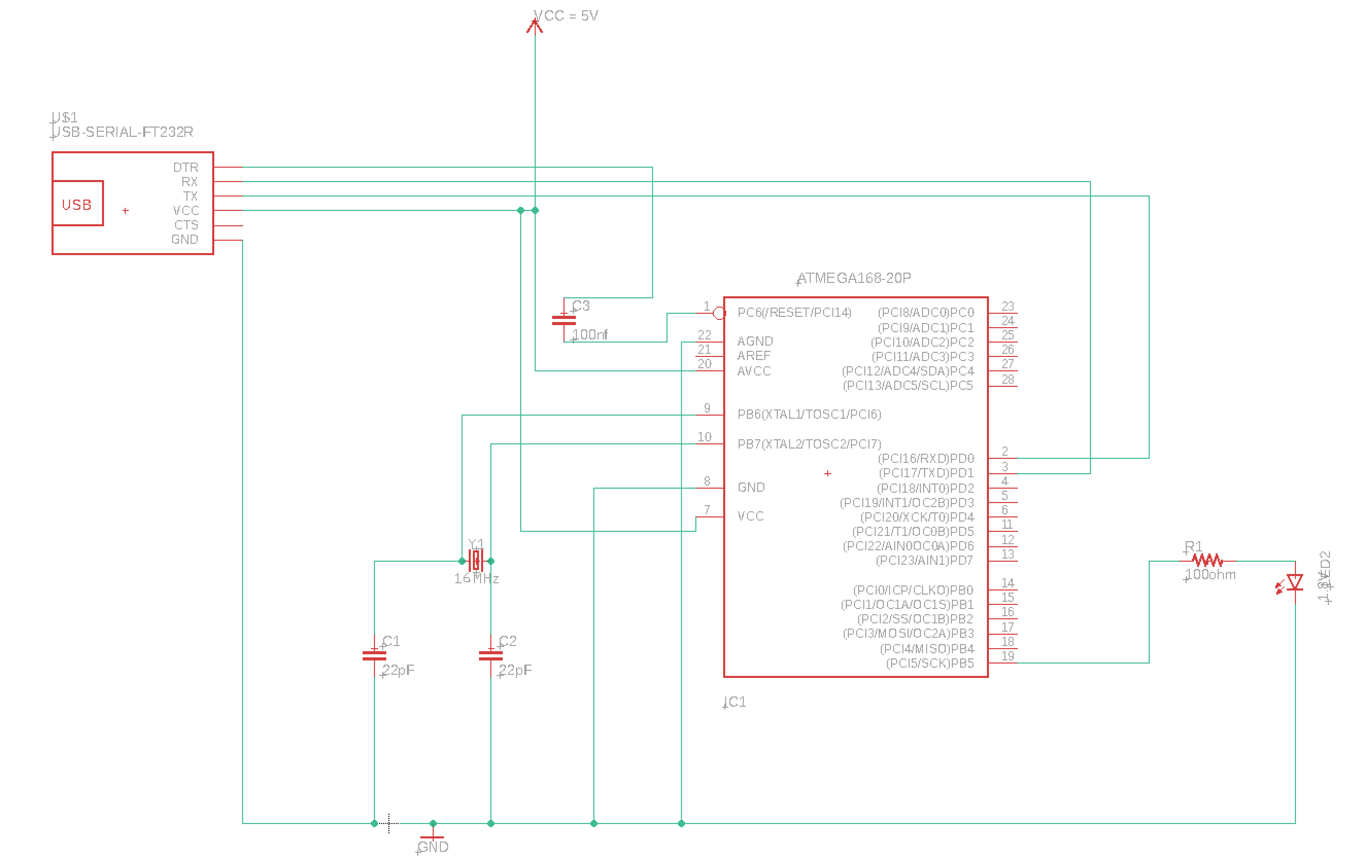
sch files
Figure 24 Microcontroller PCB

Slide 42
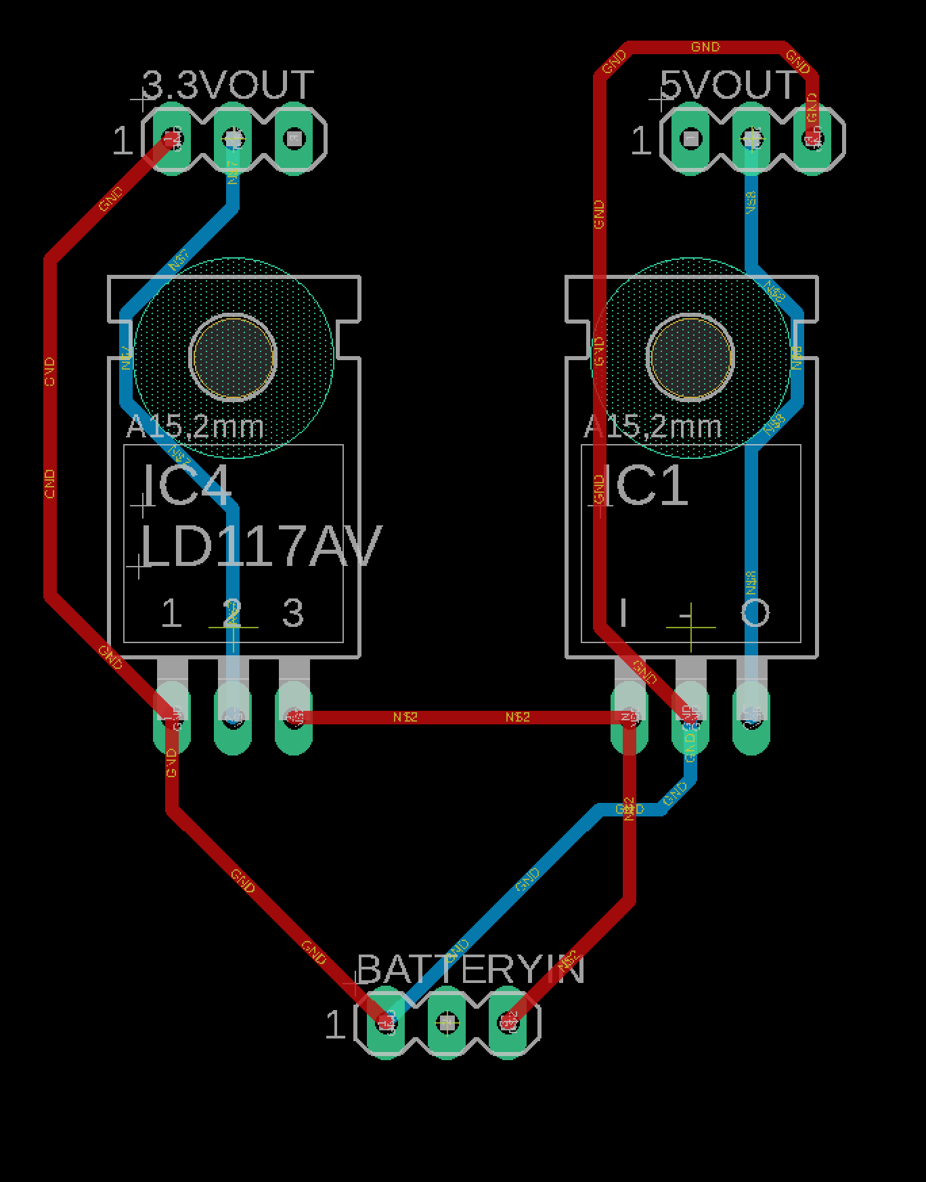
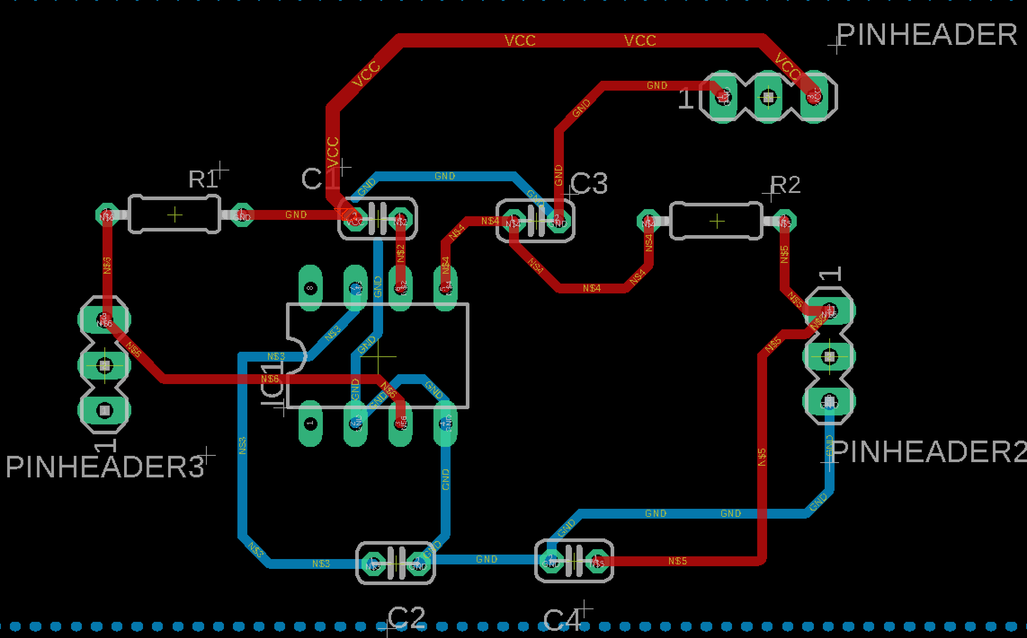
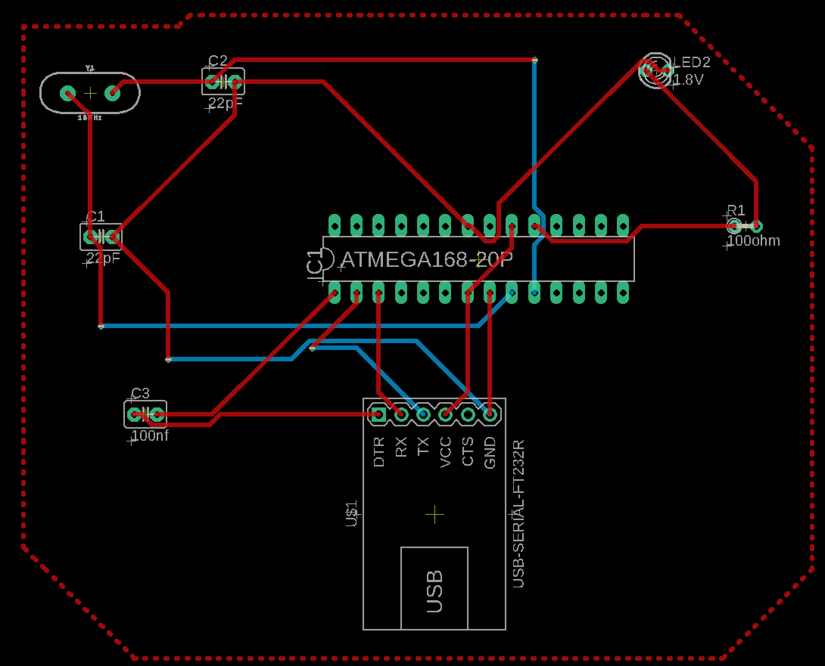
brd files
Figure 25 brd files from left to right (power, dsp, microcontroller module)

Slide 43
Modularized PCBs
Figure 26 PCBs from left to right (microcontroller, power, dsp module)

Slide 44
Ethics
Follow Consumer Data Privacy and Security Act
We plan to provide users the full disclosures about how we handle the user inputs and give users the ability to choose if captured images should be stored temporarily or erased immediately and maintain “security, confidentiality, and integrity of personal data” from malicious usages

Slide 45
Credits
Ageitgey. “Ageitgey/face_recognition.” GitHub, github.com/ageitgey/face_recognition.

Slide 46
Thank You for Listening

