Slide 1
CSAS:
Cyclist Sensing Awareness System
Team #11
Jeremy Arroyo and Hann Diao
05/02/2023

Slide 2
Introduction & Overview
ELECTRICAL AND COMPUTER ENGINEERING
GRAINGER ENGINEERING

Slide 3
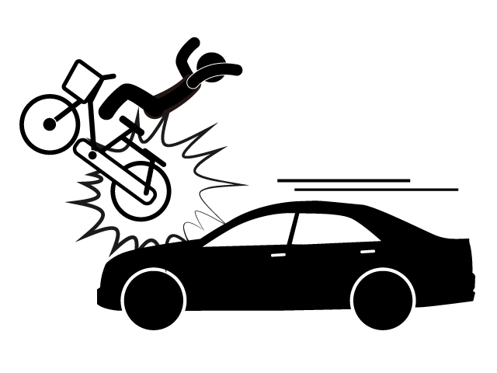
Introduction & Overview
Introduction
In the United States alone, nearly 1,000 bicyclists die, and over 130,000 are injured in crashes that occur on roads in the United States every year. [1]
These accidents occur despite current biking infrastructure expanding.
These collisions include, bike to vehicle collisions as well as bike to pedestrian collisions,
Our goal: Develop a new technology to keep cyclists, drivers and pedestrians safe.
[1] Centers for Disease Control and Prevention. Web-based Injury Statistics
Query and Reporting System (WISQARS). Atlanta, GA: Centers for Disease Control and Prevention, National Center for Injury Prevention and Control. Available at cdc.gov/injury/wisqars.
ELECTRICAL AND COMPUTER ENGINEERING
GRAINGER ENGINEERING

Slide 4
Solution
Illuminated Bike Lanes that both detect and displays the presence of a cyclist to pedestrians and drivers.
High Level Requirements
The system should be able to output approximately 3000 lumens during the day and 2000 lumens during the night.
Determine the speed of a cyclist +/- meters per second
Illuminate and match LEDs to the motion of a detected cyclist
ELECTRICAL AND COMPUTER ENGINEERING
GRAINGER ENGINEERING

Slide 5
Design
ELECTRICAL AND COMPUTER ENGINEERING
GRAINGER ENGINEERING

Slide 6
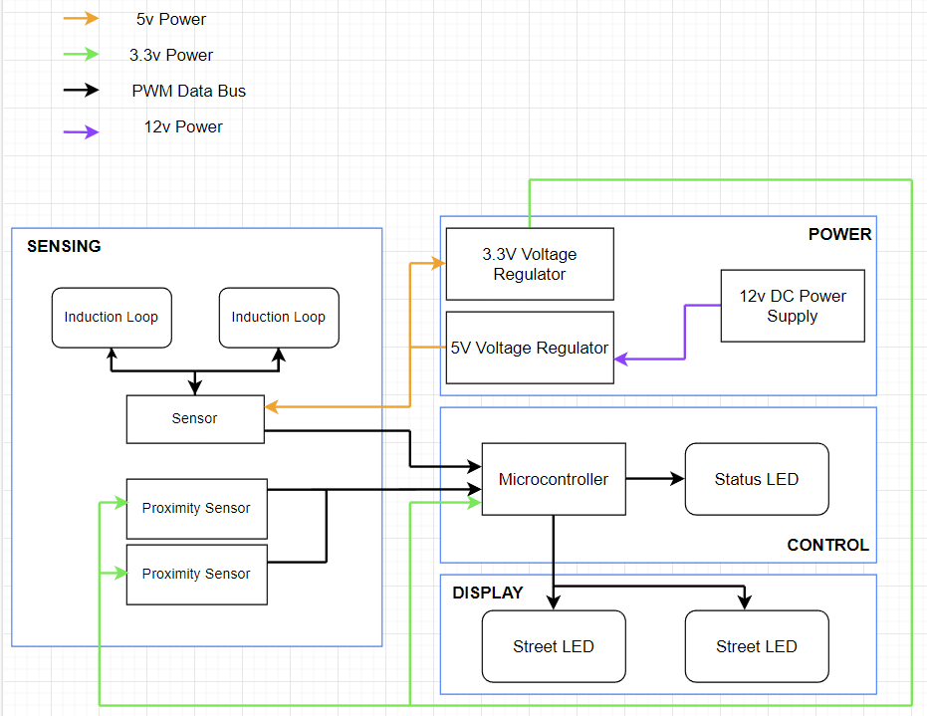
Design
Block Diagram and Requirements
Power:
12V input
2 Linear Voltage Regulators
5V
3.3V
Sensing:
Induction Loop Sensor
IR Sensor
Display:
LED Strips
Control
STM32F4
ELECTRICAL AND COMPUTER ENGINEERING
GRAINGER ENGINEERING

Slide 7
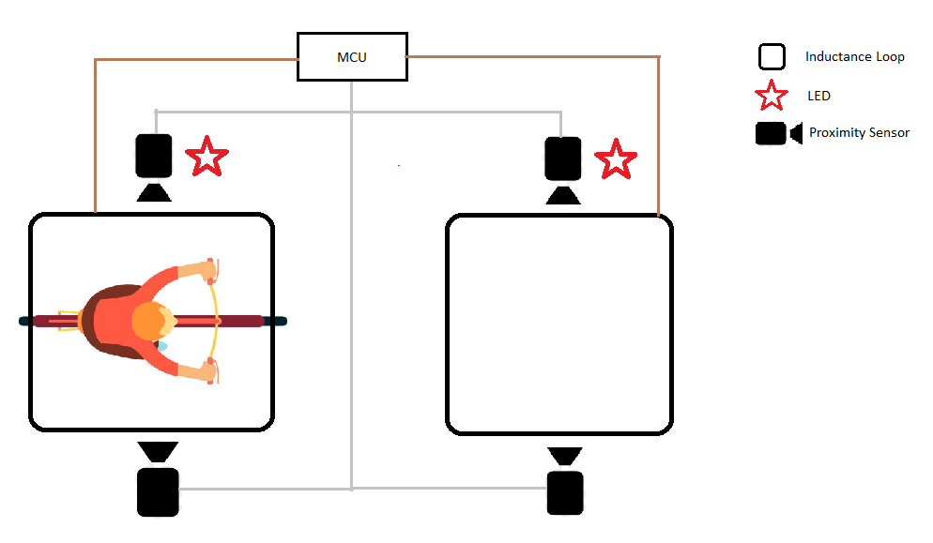
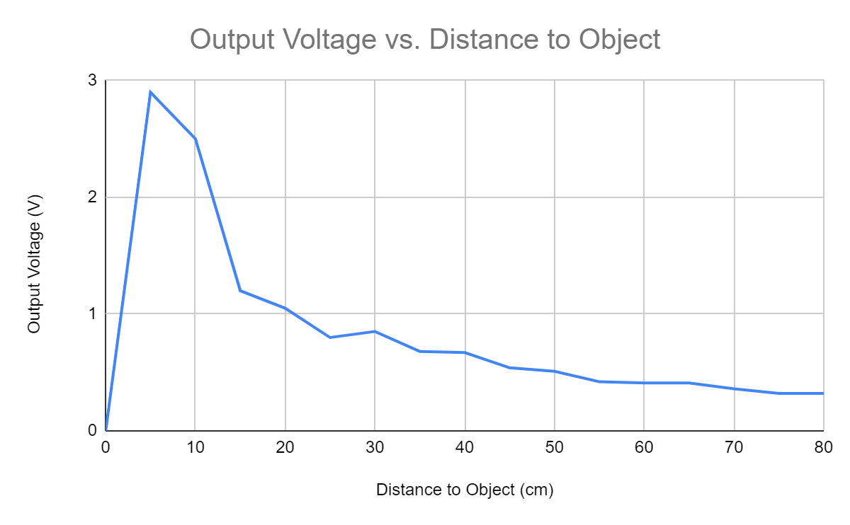
Design
Original Design
Challenges Faced:
Low threshold voltage for IR sensors
High noise output from IR sensors
PCB design issues
Footprint issues
Challenges programing MCU
Induction Loop Sensor Issues
Transistors reaching saturation
Physical Issues
Protecting Sensors from vehicles
ELECTRICAL AND COMPUTER ENGINEERING
GRAINGER ENGINEERING

Slide 8
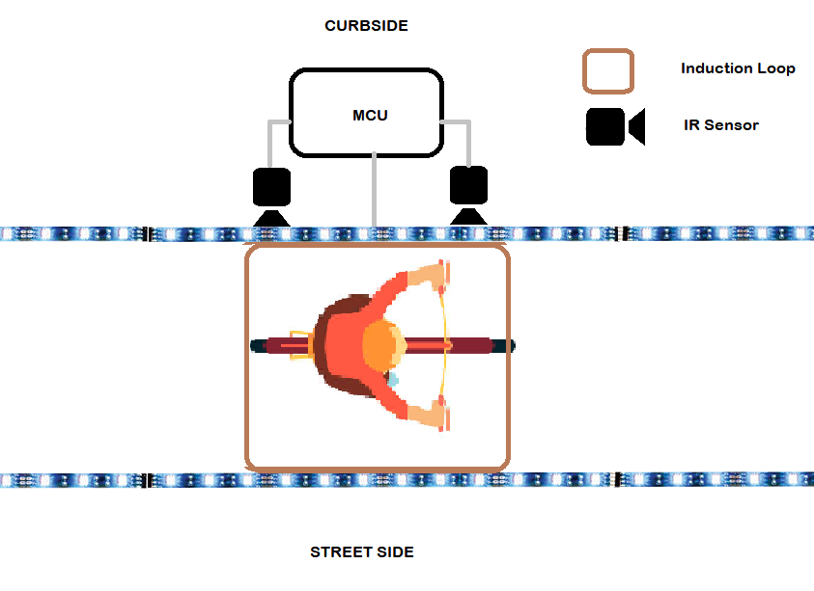
Design
Revisions
Utilized an STM32F4-NUCLEO board
Redesigned physical implementation
Moved IR Sensors
Sensor Safety
Speed Calculations
Induction Loop changed to measure changes in frequency
Added Low-Pass Filter to diminish IR Sensor Noise
ELECTRICAL AND COMPUTER ENGINEERING
GRAINGER ENGINEERING

Slide 9
PCB Design
ELECTRICAL AND COMPUTER ENGINEERING
GRAINGER ENGINEERING

Slide 10
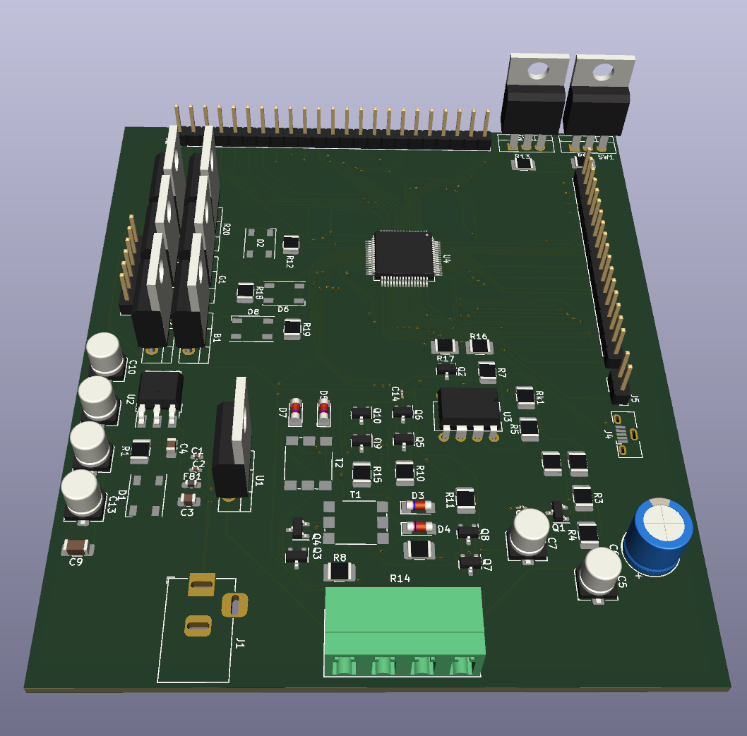
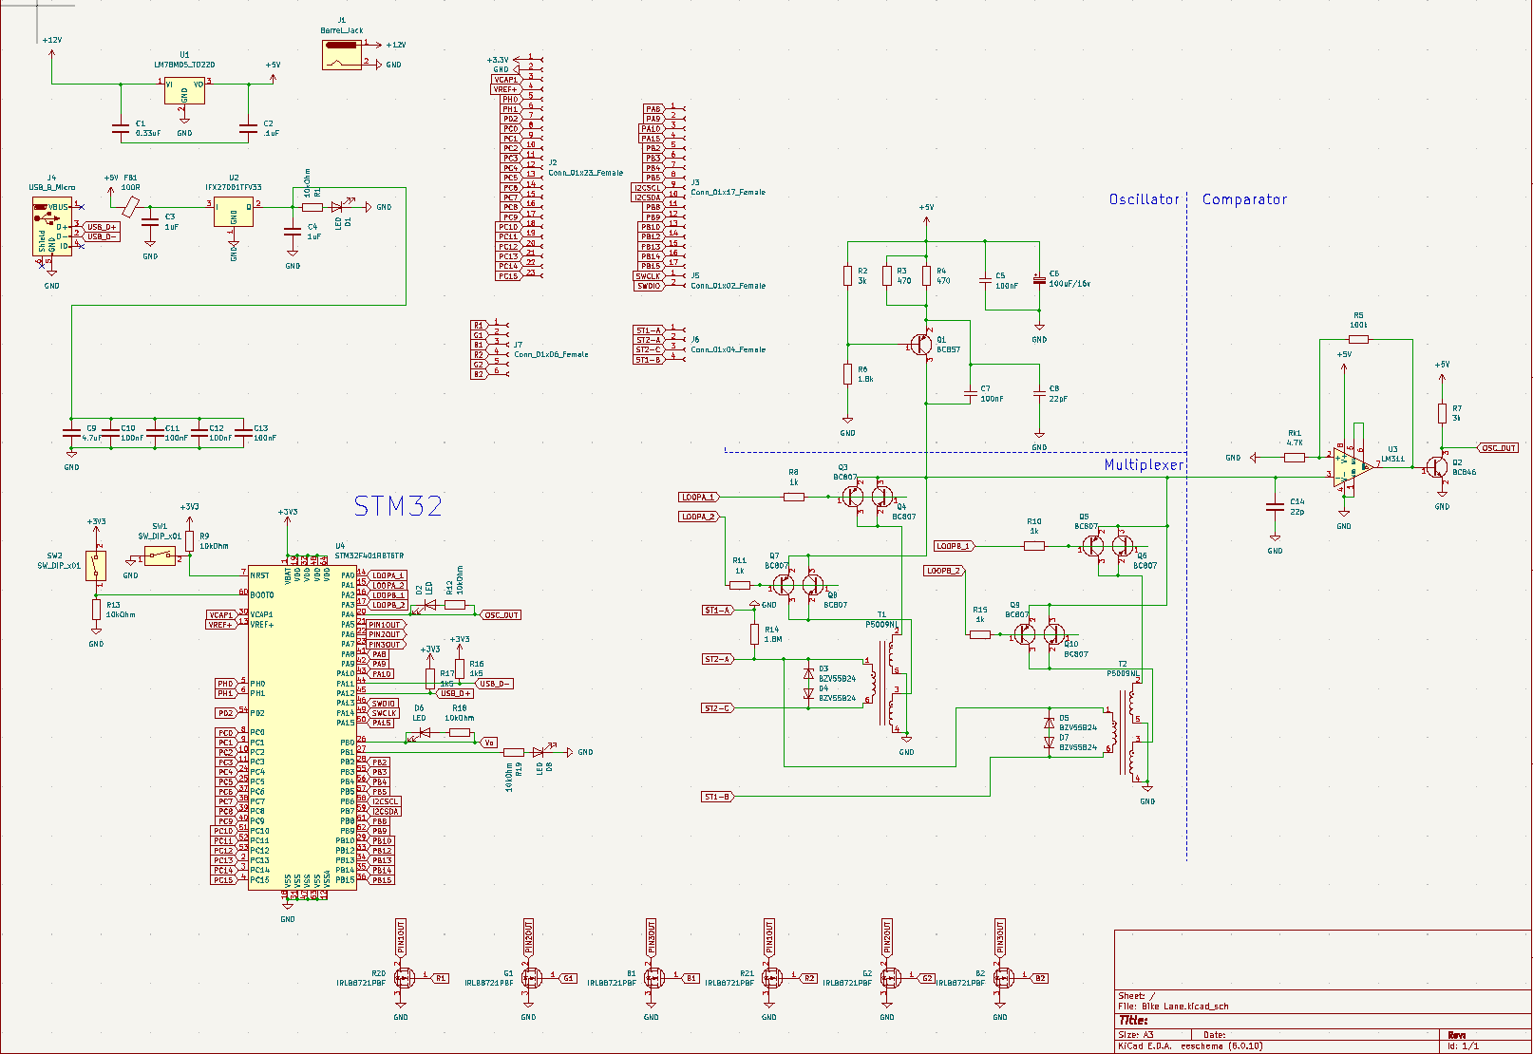
PCB
ELECTRICAL AND COMPUTER ENGINEERING
GRAINGER ENGINEERING

Slide 11
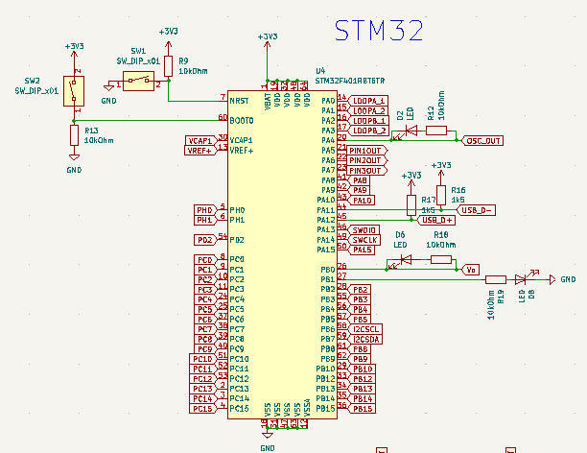
PCB
Microcontroller
STM32F4
ELECTRICAL AND COMPUTER ENGINEERING
GRAINGER ENGINEERING

Slide 12
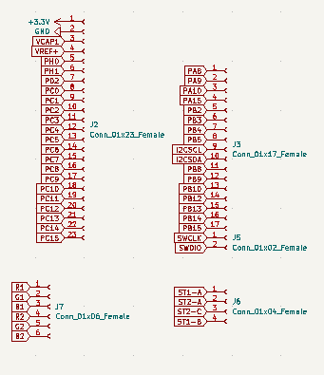
PCB
MISC
Pinout connections for the STM
ELECTRICAL AND COMPUTER ENGINEERING
GRAINGER ENGINEERING

Slide 13
PCB
MISC
MOSFETs to run data to the LED strips
ELECTRICAL AND COMPUTER ENGINEERING
GRAINGER ENGINEERING

Slide 14
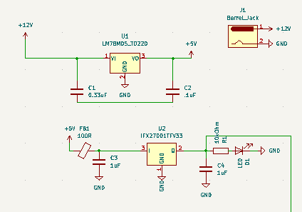
PCB
Power
12V Power supply
Step down 12V to 5V
5V then step down to 3.3V
ELECTRICAL AND COMPUTER ENGINEERING
GRAINGER ENGINEERING

Slide 15
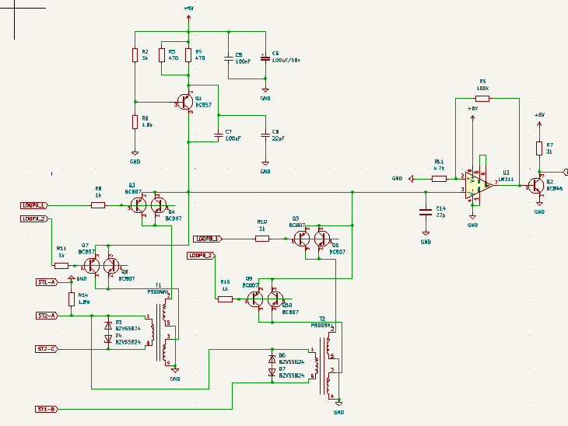
PCB
Induction Loop
Measure voltage and/or frequency changes in the presence of a magnetic object
Measured Inductance approx. 150µH
Measured Frequency approx 150 kHz
ELECTRICAL AND COMPUTER ENGINEERING
GRAINGER ENGINEERING

Slide 16
Results
ELECTRICAL AND COMPUTER ENGINEERING
GRAINGER ENGINEERING

Slide 17
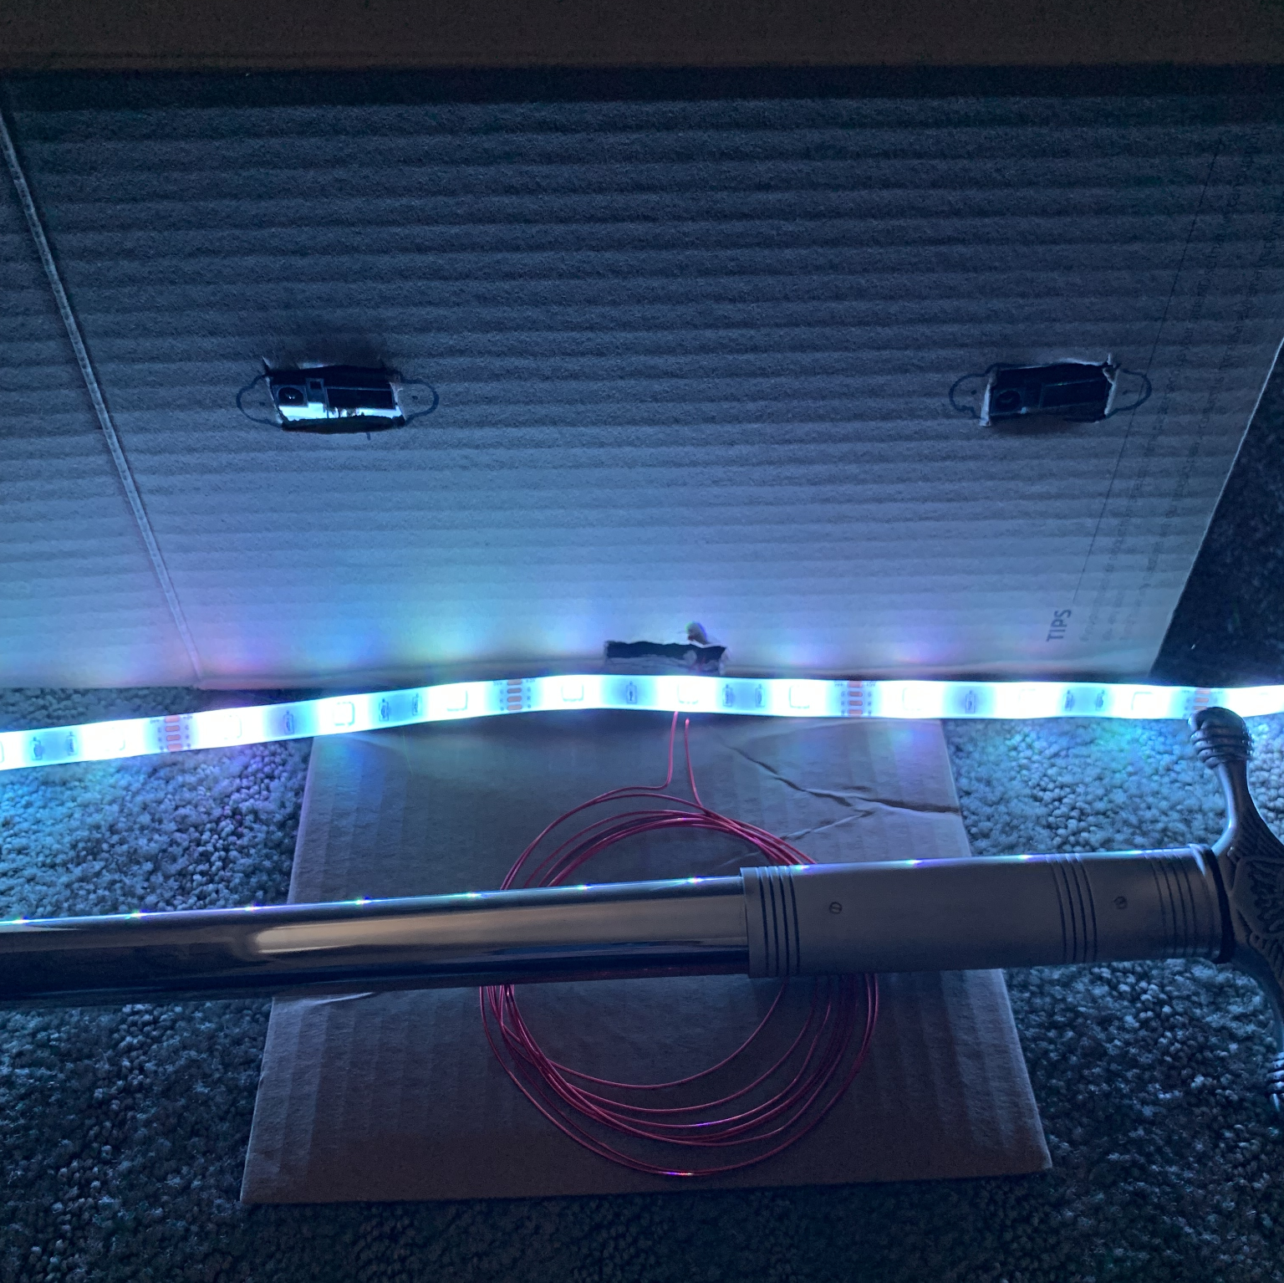
Results
ELECTRICAL AND COMPUTER ENGINEERING
GRAINGER ENGINEERING

Slide 18
Results
Successes
IR Sensor and LED implementation
Most High Level Requirements Fulfilled
Project is a novel solution to a longstanding problem
Challenges
Induction Sensor not fully functional
PCB not fully functional
Final Implementation could be better designed
ELECTRICAL AND COMPUTER ENGINEERING
GRAINGER ENGINEERING

Slide 19
Results
Next Steps?
Re-work PCB
Make it modular
Have all components on PCB work as expected
Re-work Induction Loop
Re-work the system to output expected results
Re-visit Addressable LEDs
Lower Cost of Module
Lower cost per module to ~$20-25
Easier to mass-produce
ELECTRICAL AND COMPUTER ENGINEERING
GRAINGER ENGINEERING

Slide 20
Results
Takeaways
Proactivity
Time Management
PCB Design
Integration
Creation of a Well Balanced Team
Both members had very similar skill sets
ELECTRICAL AND COMPUTER ENGINEERING
GRAINGER ENGINEERING

Slide 21
Questions?
ELECTRICAL AND COMPUTER ENGINEERING
GRAINGER ENGINEERING

