Slide 1
Desk Aid Learning Device
Team 27
Aidan Johnston, Conan Pan, Ethan Ge
Notes:
Aidan

Slide 2
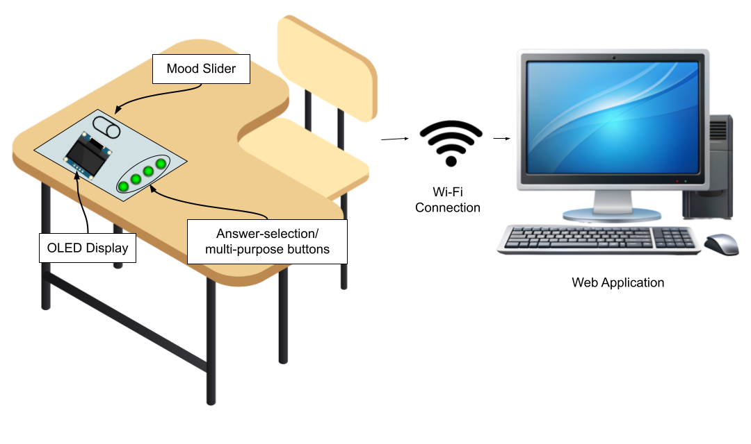
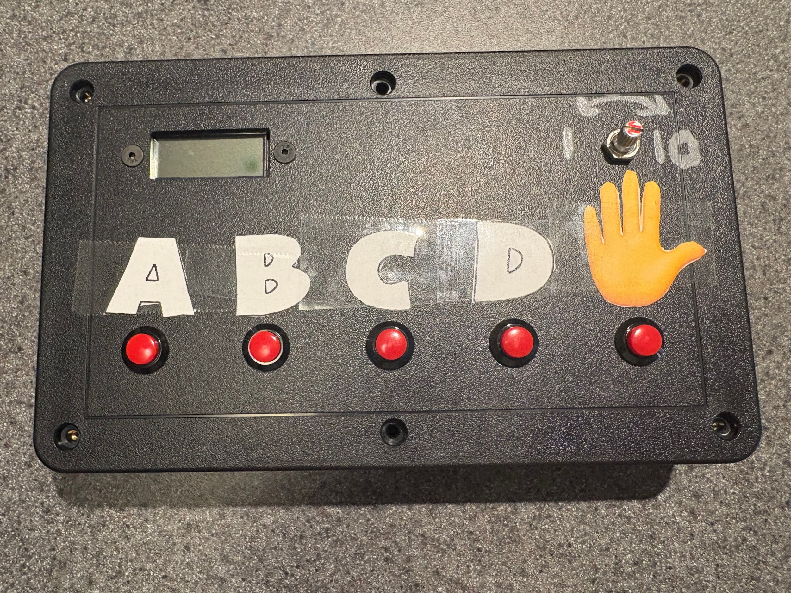
What is the Project?
ELECTRICAL & COMPUTER ENGINEERING
GRAINGER ENGINEERING
Notes:
Aidan
The Desk Aid Learning Device was inspired by assessing the growing relationship between education and technology. Through our teams research and zoom meetings with elementary school teachers we were able to develop a better understanding of what our device should be designed to do. As a result, we decided to create a customized PCB-based desk learning aid. This device is equipped with buttons and a scrollbar to enable students to better engage in the classroom. The device also communicates in real time with a web application for instant feedback on student progress and engagement.
Ethan:
The slide shows what the device actually looks like
Essentially, the electronics are contained within a box to be mounted onto the desk, with the potentiometer and buttons mounted on the surface of the box
The device communicates students’ button presses with the web application, where the data is logged for teacher use

Slide 3
What does this solve?
Our desk learning aid aims to restore in-person engagement and support healthy, focused learning environments
Provides per-student response histories so teachers can identify patterns and adjust instruction individually
Allows students to self-assess and communicate their confidence, fostering metacognitive reflection and self‑regulated learning.
Offers a low-cost, easy-to-deploy solution at each desk—no software setup or question authoring required
ELECTRICAL & COMPUTER ENGINEERING
GRAINGER ENGINEERING
Notes:
Conan

Slide 4
Video Demonstration
ELECTRICAL & COMPUTER ENGINEERING
GRAINGER ENGINEERING
Notes:
Aidan
The following video will clearly demonstrate the functionality of our device and simulate how it could be used in a classroom setting.

Slide 5
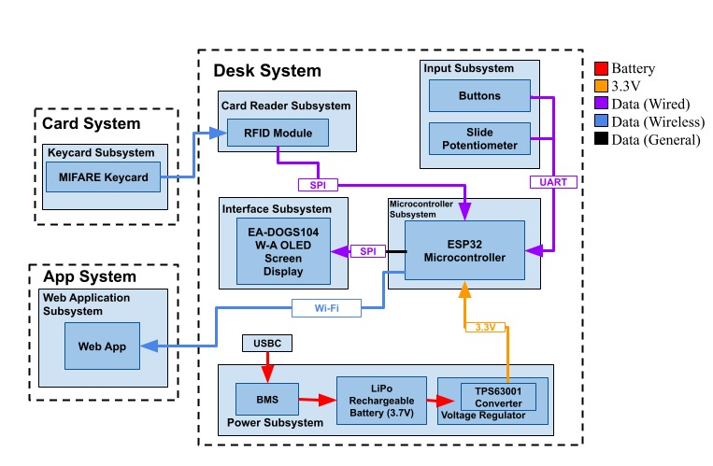
Project Design - Block Diagram
CHART / GRAPH
Desk Aid Learning Device Block Diagram
ELECTRICAL & COMPUTER ENGINEERING
GRAINGER ENGINEERING
Notes:
Ethan
The block diagram shows how all the modules and subsystems work together. The 3 modules that are communicating with each other are the keycard, the desk device, and the web application.
First, the card module, a simple MIFARE enabled keycard, communicates with the card reader subsystem’s PN512 chip through RFID.
The desk module is the most complex and handles most of the functionality. It contains the card reader system as mentioned before in order to sign students into the system. The peripheral subsystems communicate with the ESP32 controller, which processes all the data. It takes input from both the card reader and the input subsystem, which is composed of buttons as well as a potentiometer to log student input. The ESP32 module then can transmit that data via wifi to the web application as well as the interface system to display student answers and such. The final system on the desk module is the power system, which handles powering the device as well as recharging the battery.
The app subsystem is meant for teacher use and displays all data collected from the device as well as analyze it to help the teacher understand student comprehension of material.

Slide 6
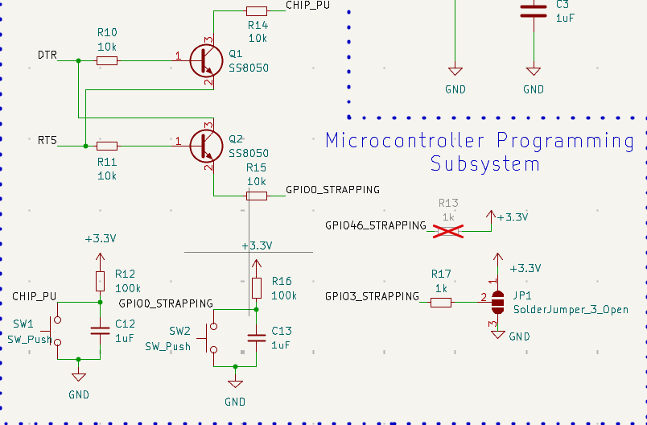
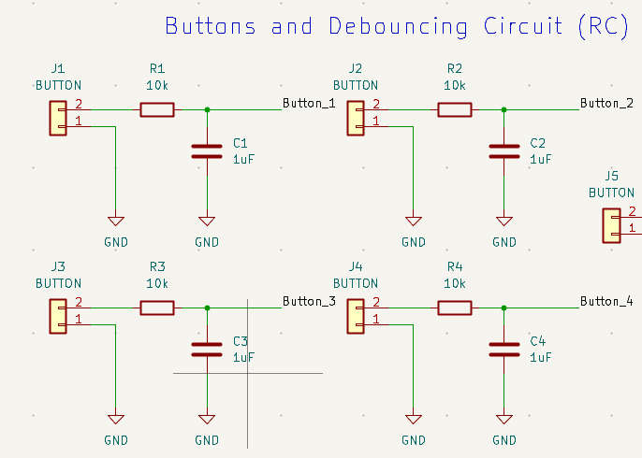
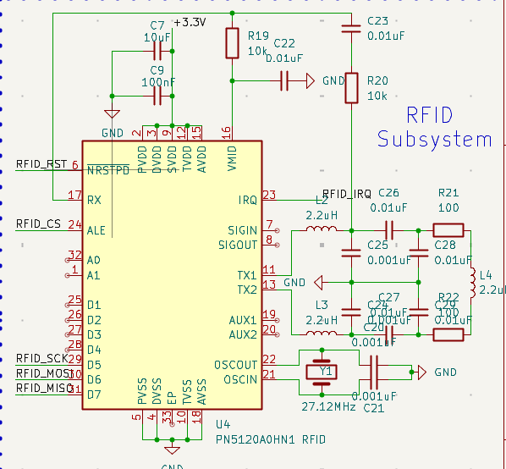
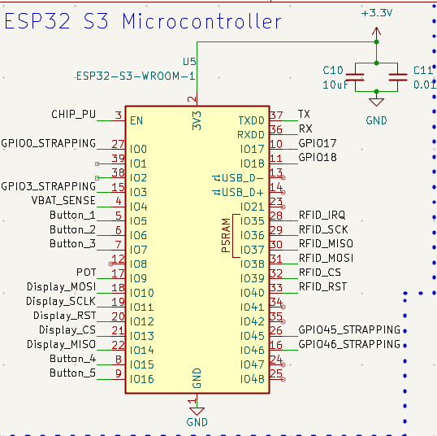
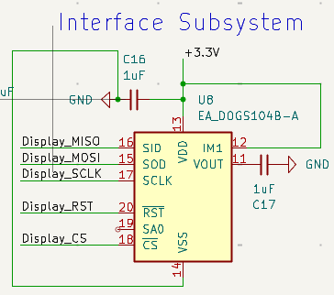
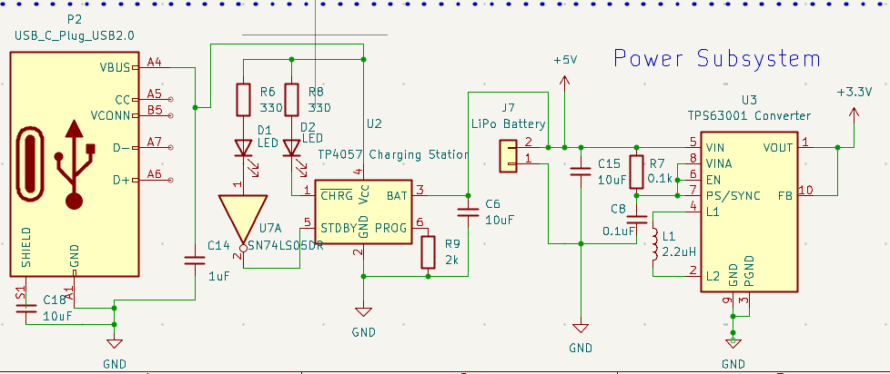
Project Design - PCB Schematic
Input Subsystem
Microcontroller Subsystem
RFID Subsystem
Microcontroller Subsystem
Interface Subsystem
Power Subsystem
ELECTRICAL & COMPUTER ENGINEERING
GRAINGER ENGINEERING
Notes:
Aidan
Our PCB schematic demonstrates how we translated the block diagram Ethan just described into specific electronic subsystems. In particular it highlights how we were able to construct each subsystem and furthermore begin connecting them via pin assignments.

Slide 7
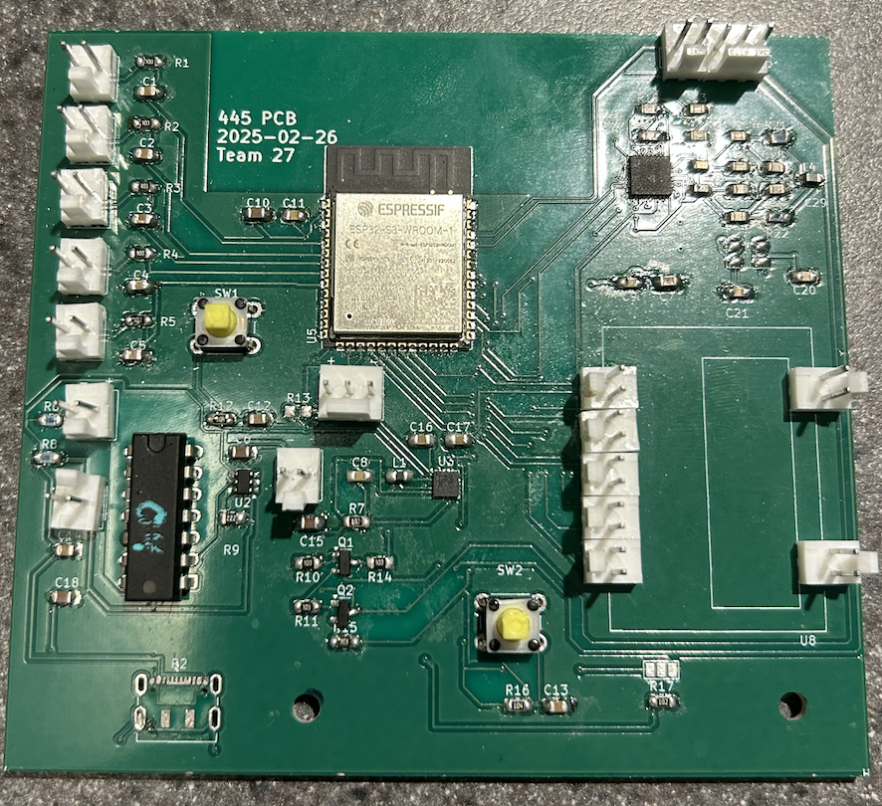
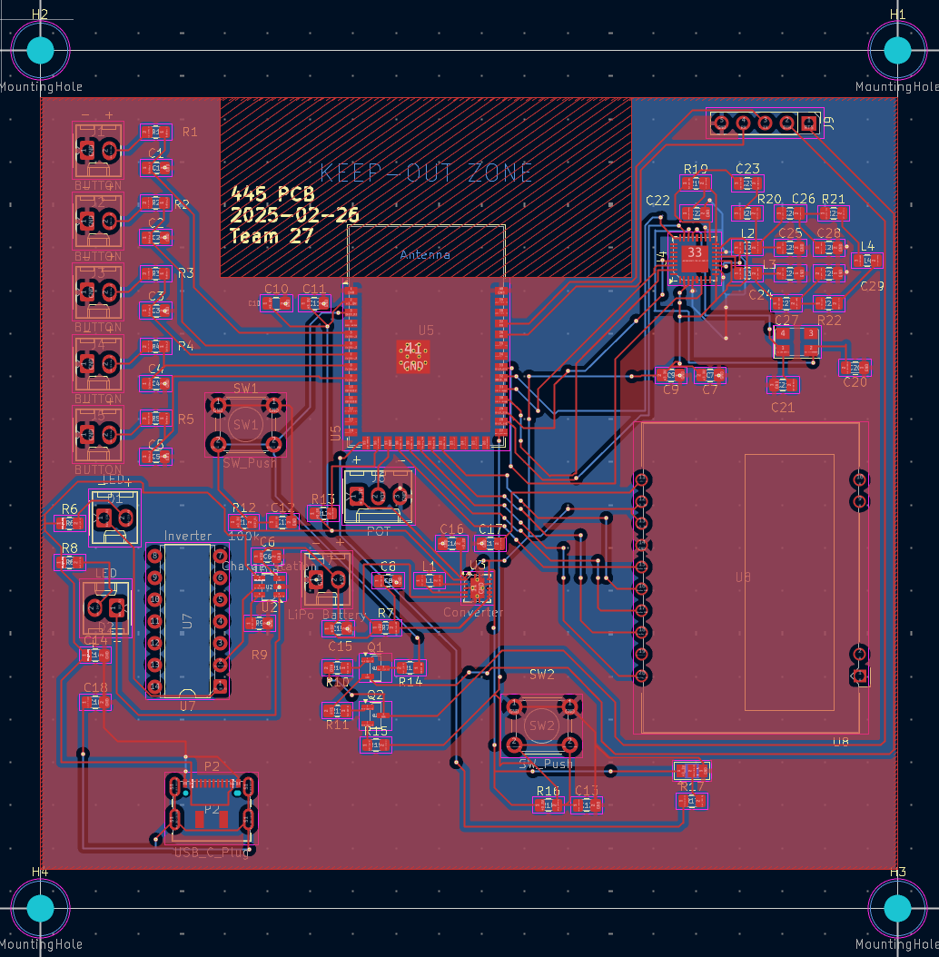
Project Design - Finalized PCB
ELECTRICAL & COMPUTER ENGINEERING
GRAINGER ENGINEERING
Notes:
Aidan
The PCB design on the right demonstrates how we took the PCB schematic and connected it all together.
The finalized PCB on the left shows how we fabricated the design through soldering tools.

Slide 8
R&V - Input Subsystem
The button and scroller data is transmitted with less than 100 ms latency and the subsystem effectively debounces and filters out noisy input
Supports repeated button presses and debouncing
ELECTRICAL & COMPUTER ENGINEERING
GRAINGER ENGINEERING
Notes:
Conan

Slide 9
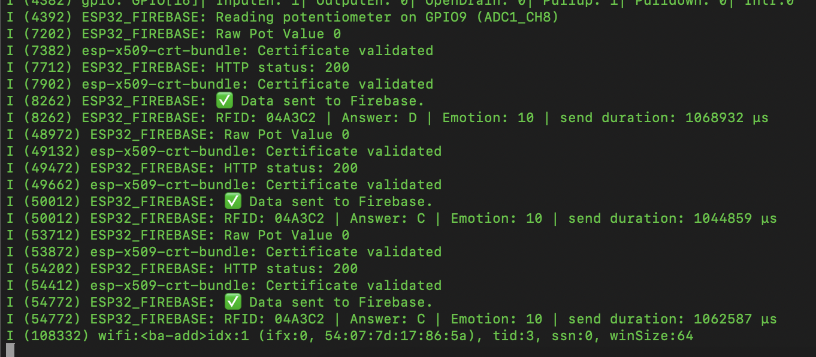
R&V - Microcontroller Subsystem
The microcontroller must process all button and scroller inputs and transmit data to the Web Application within 1500ms.
Operates for full 8 hour school day
ELECTRICAL & COMPUTER ENGINEERING
GRAINGER ENGINEERING
Notes:
Conan

Slide 10
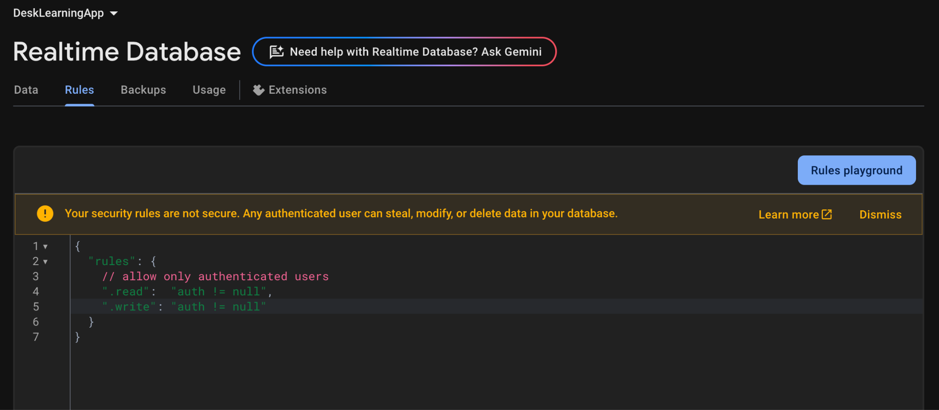
R&V - Web Application Subsystem
The system authenticates users correctly before allowing access to student data, thus ensuring only authorized teachers can view responses
Updates front end within 500ms
Refreshes at least once per second
ELECTRICAL & COMPUTER ENGINEERING
GRAINGER ENGINEERING
Notes:
Conan

Slide 11
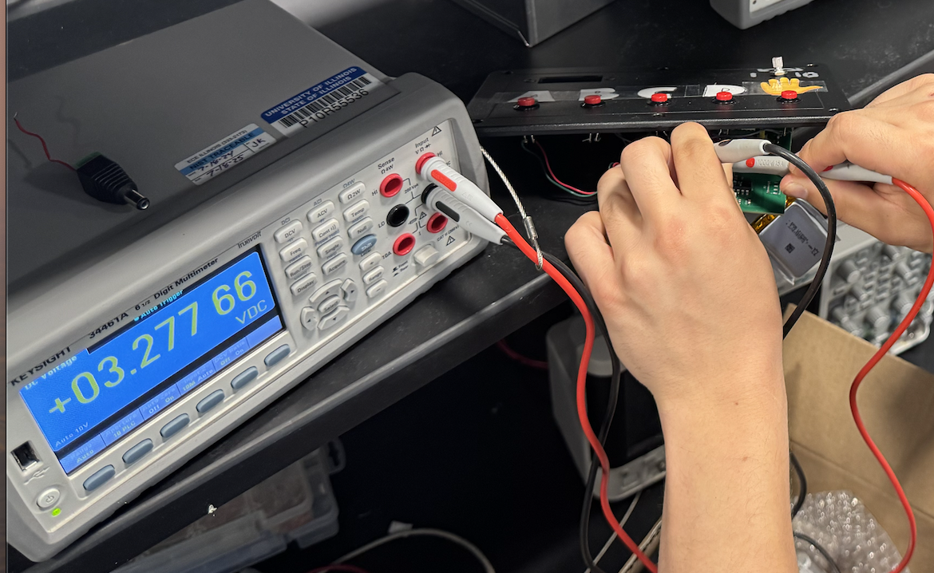
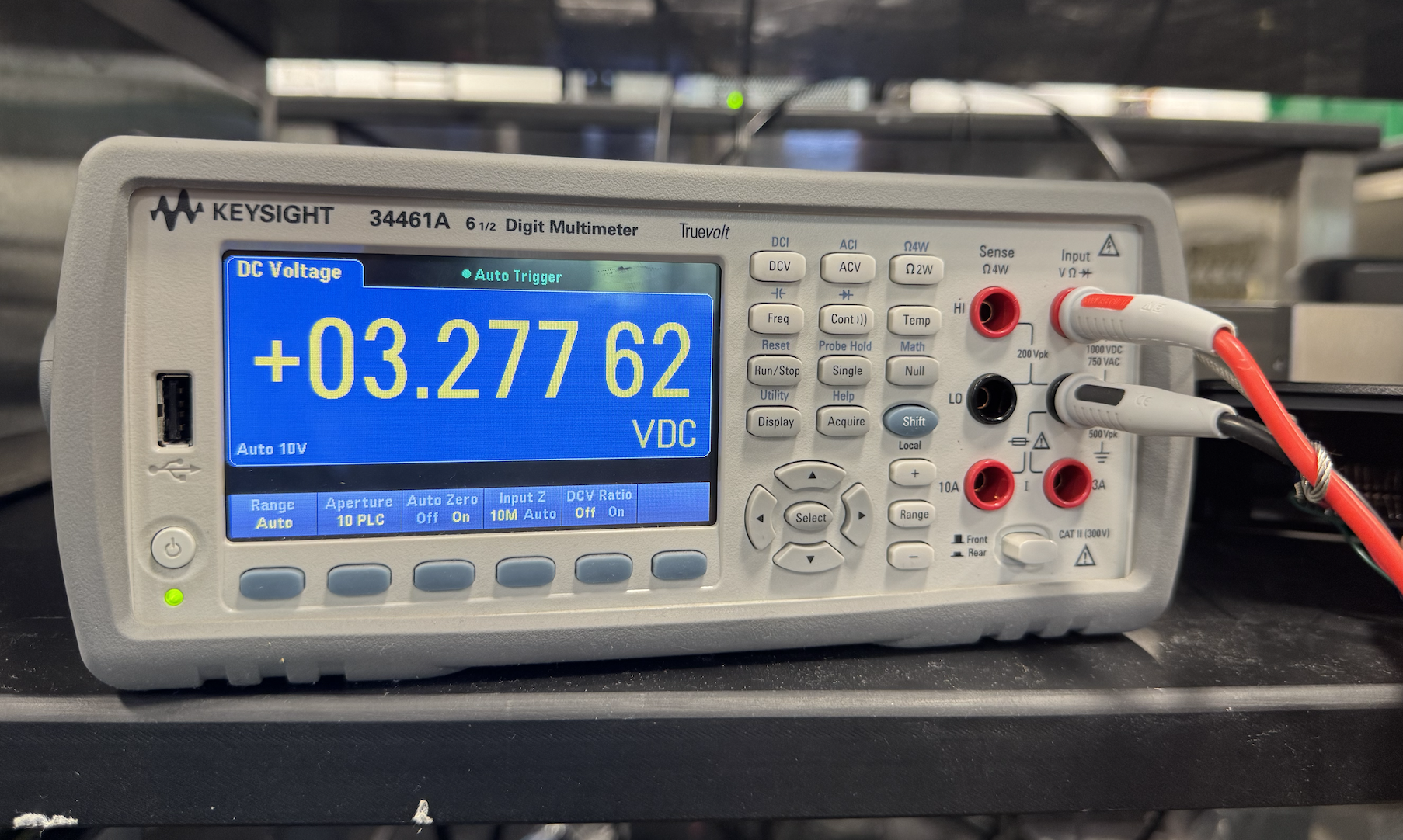
R & V - Power Subsystem
The voltage regulator system maintains the input voltage between 3.0V and 3.6V at exactly 3.277V to supply voltage to the microcontroller
The battery continually provides at least a 3V output over the duration of the school day (8 hours)
ELECTRICAL & COMPUTER ENGINEERING
GRAINGER ENGINEERING
Notes:
Ethan

Slide 12
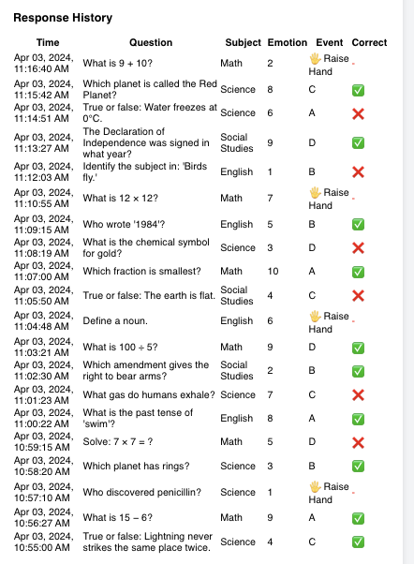
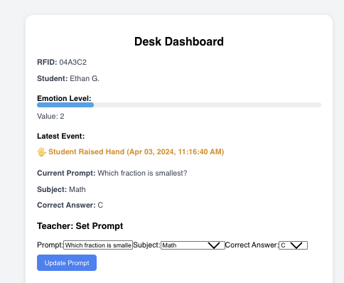
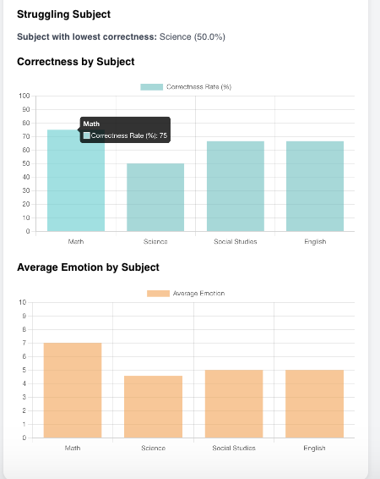
Quantitative Results
ELECTRICAL & COMPUTER ENGINEERING
GRAINGER ENGINEERING
Notes:
Conan

Slide 13
Lessons Learned
High Level Requirements
Research - electrical components and equipment being used
Approach - maintain a methodical rather than trial and error approach
Planning - specifically for the mechanical build of the device
ELECTRICAL & COMPUTER ENGINEERING
GRAINGER ENGINEERING
Notes:
Aidan
Our high level requirements were to establish a low latency and secure wifi connection between microcontroller and web application, to ensure the web application provides complete analysis and feedback, and to utilize the screen to display all necessary information. When we reflect on the lessons we learned we also wanted to evaluate how we were able to complete the first two high level requirements but were unable to complete the last involving the screen. As a result we assessed that we should:
Spend more time crafting a useful R&V so as to properly test and verify the PCB and device
More time planning the build of the device and PCB so as to avoid submitting new orders which takes up time
More time researching the components being used would help us avoid simple mistakes that require large amounts of time to recover from

Slide 14
Future Work
Obtain crystal oscillator to complete the RFID subsystem
Update PCB design to complete the charging and screen subsystems
Add customizable haptic or audio feedback on the device to reinforce positive responses and boost student engagement
ELECTRICAL & COMPUTER ENGINEERING
GRAINGER ENGINEERING
Notes:
Aidan
After addressing the lessons learned the future work becomes very clear.
The USB-C component must be at the very edge of the board
Add an active reset external circuit for the LCD display
Change the port connections for the LCD display to ensure that MISO is connected to SOD and MOSI is connected to SID
After fixing and completing our design, further modifications we hope to add would be to add audio feedback on the device

Slide 15
Ethical Considerations
Data Privacy & Security: Enforce end-to-end encryption and strict access controls so only authorized teachers/parents can view student data.
Transparency & Consent: Clearly communicate what data is collected and how it’s used via the web app’s dashboards and opt-in agreements.
Bias Mitigation: Regularly audit any analytics or ML models for fairness; present data with clear visualizations to avoid misinterpretation.
Accessibility & Inclusivity: Comply with ADA standards; use simple buttons and scrollers so all students—including those with disabilities—can participate.
Hardware & Battery Safety: Design to FCC Part 15, UL 60950-1, ISO 14971, and IEEE 1725 specs; durable casing and anti-tamper enclosure protect young users.
Lab & Development Protocols: Follow UIUC lab safety guidelines—ESD protection, insulated tools, and safe PCB/battery handling during prototyping.
ELECTRICAL & COMPUTER ENGINEERING
GRAINGER ENGINEERING
Notes:
Ethan
Here are just some ethical considerations that we took to account while we were working on designing the device. We wanted to ensure that this system wouldn’t violate ferpa as well as being easy straightforward inclusive and safe to use and develop.

Slide 16
Questions?
ELECTRICAL & COMPUTER ENGINEERING
GRAINGER ENGINEERING
Notes:
Ethan

