Slide 1
Project GreenCan
Electrical & Computer Engineering
Ifesi Onubogu, Matt Wildenradt, Michael Obunike
MAY 2023

Slide 2
Agenda
Introduction
Problem & Objective
Design
Project Build
Test Results
Successes & Challenges
Conclusions
Recommendations for further work
Questions & Answers
ELECTRICAL & COMPUTER ENGINEERING
GRAINGER ENGINEERING

Slide 3
Introduction
Team
Michael Obunike (Senior, CompE)
Ifesi Onubogu (Senior, CompE)
Matthew Wildenradt (Senior CompE)
Project
A can recycling system that takes into consideration it’s immediate users, end recycling agencies and the organization it it deployed in.
ELECTRICAL & COMPUTER ENGINEERING
GRAINGER ENGINEERING

Slide 4
Problem
The average person's method of crushing cans before recycling is neither equipped with a mechanism to stop the crushing of non-empty cans nor a safety guard for its users.
Our solution is a project that takes into consideration it’s immediate users, end recycling agencies and the organization it it deployed in.
ELECTRICAL & COMPUTER ENGINEERING
GRAINGER ENGINEERING

Slide 5
Objective
Goals & Benefits
By protecting people from metal fragments this device offers a user-safe technique of crushing cans for recycling.
Promotes recycling of cans in communities where people do not own can crushers.
Gathers information about can recycling for research when used as a public resource.
Counters the crushing of full cans limiting to only empty cans.
ELECTRICAL & COMPUTER ENGINEERING
GRAINGER ENGINEERING

Slide 6
Design
High-Level Requirements
The system should crush only empty cans placed on the crush platform when the door is shut.
The crushed cans are gathered in a collection bin which is regularly serviced at the point where the collection bin is full as indicated by the system.
The number of cans crushed in between service cycles is recorded by the system.
Subsystems
Can-crushing Subsystem
Control Subsystem (PCB)
Collection Subsystem
ELECTRICAL & COMPUTER ENGINEERING
GRAINGER ENGINEERING

Slide 7
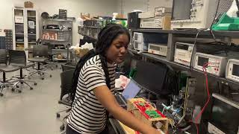
Video Demo
ELECTRICAL & COMPUTER ENGINEERING
GRAINGER ENGINEERING

Slide 8
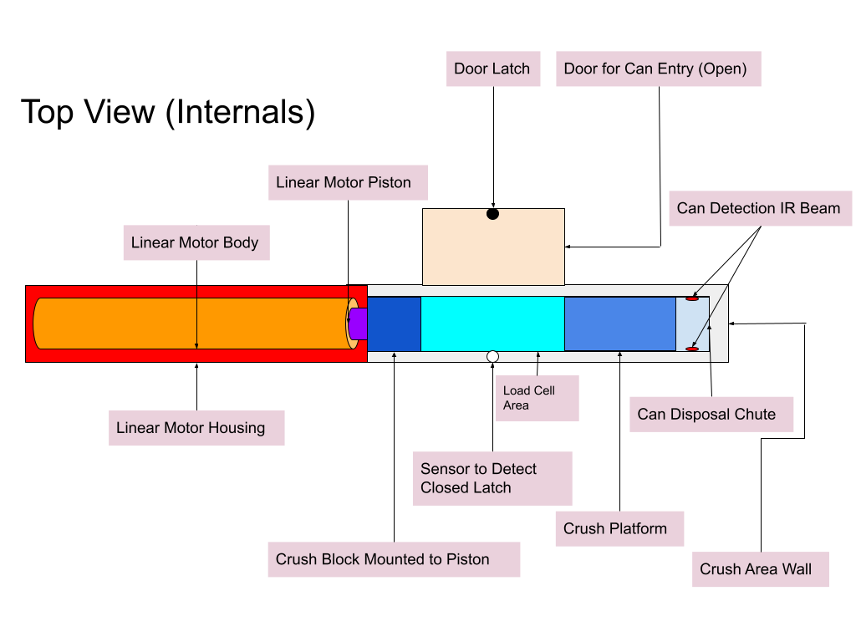
Design
What we thought it would look like
ELECTRICAL & COMPUTER ENGINEERING
GRAINGER ENGINEERING

Slide 9
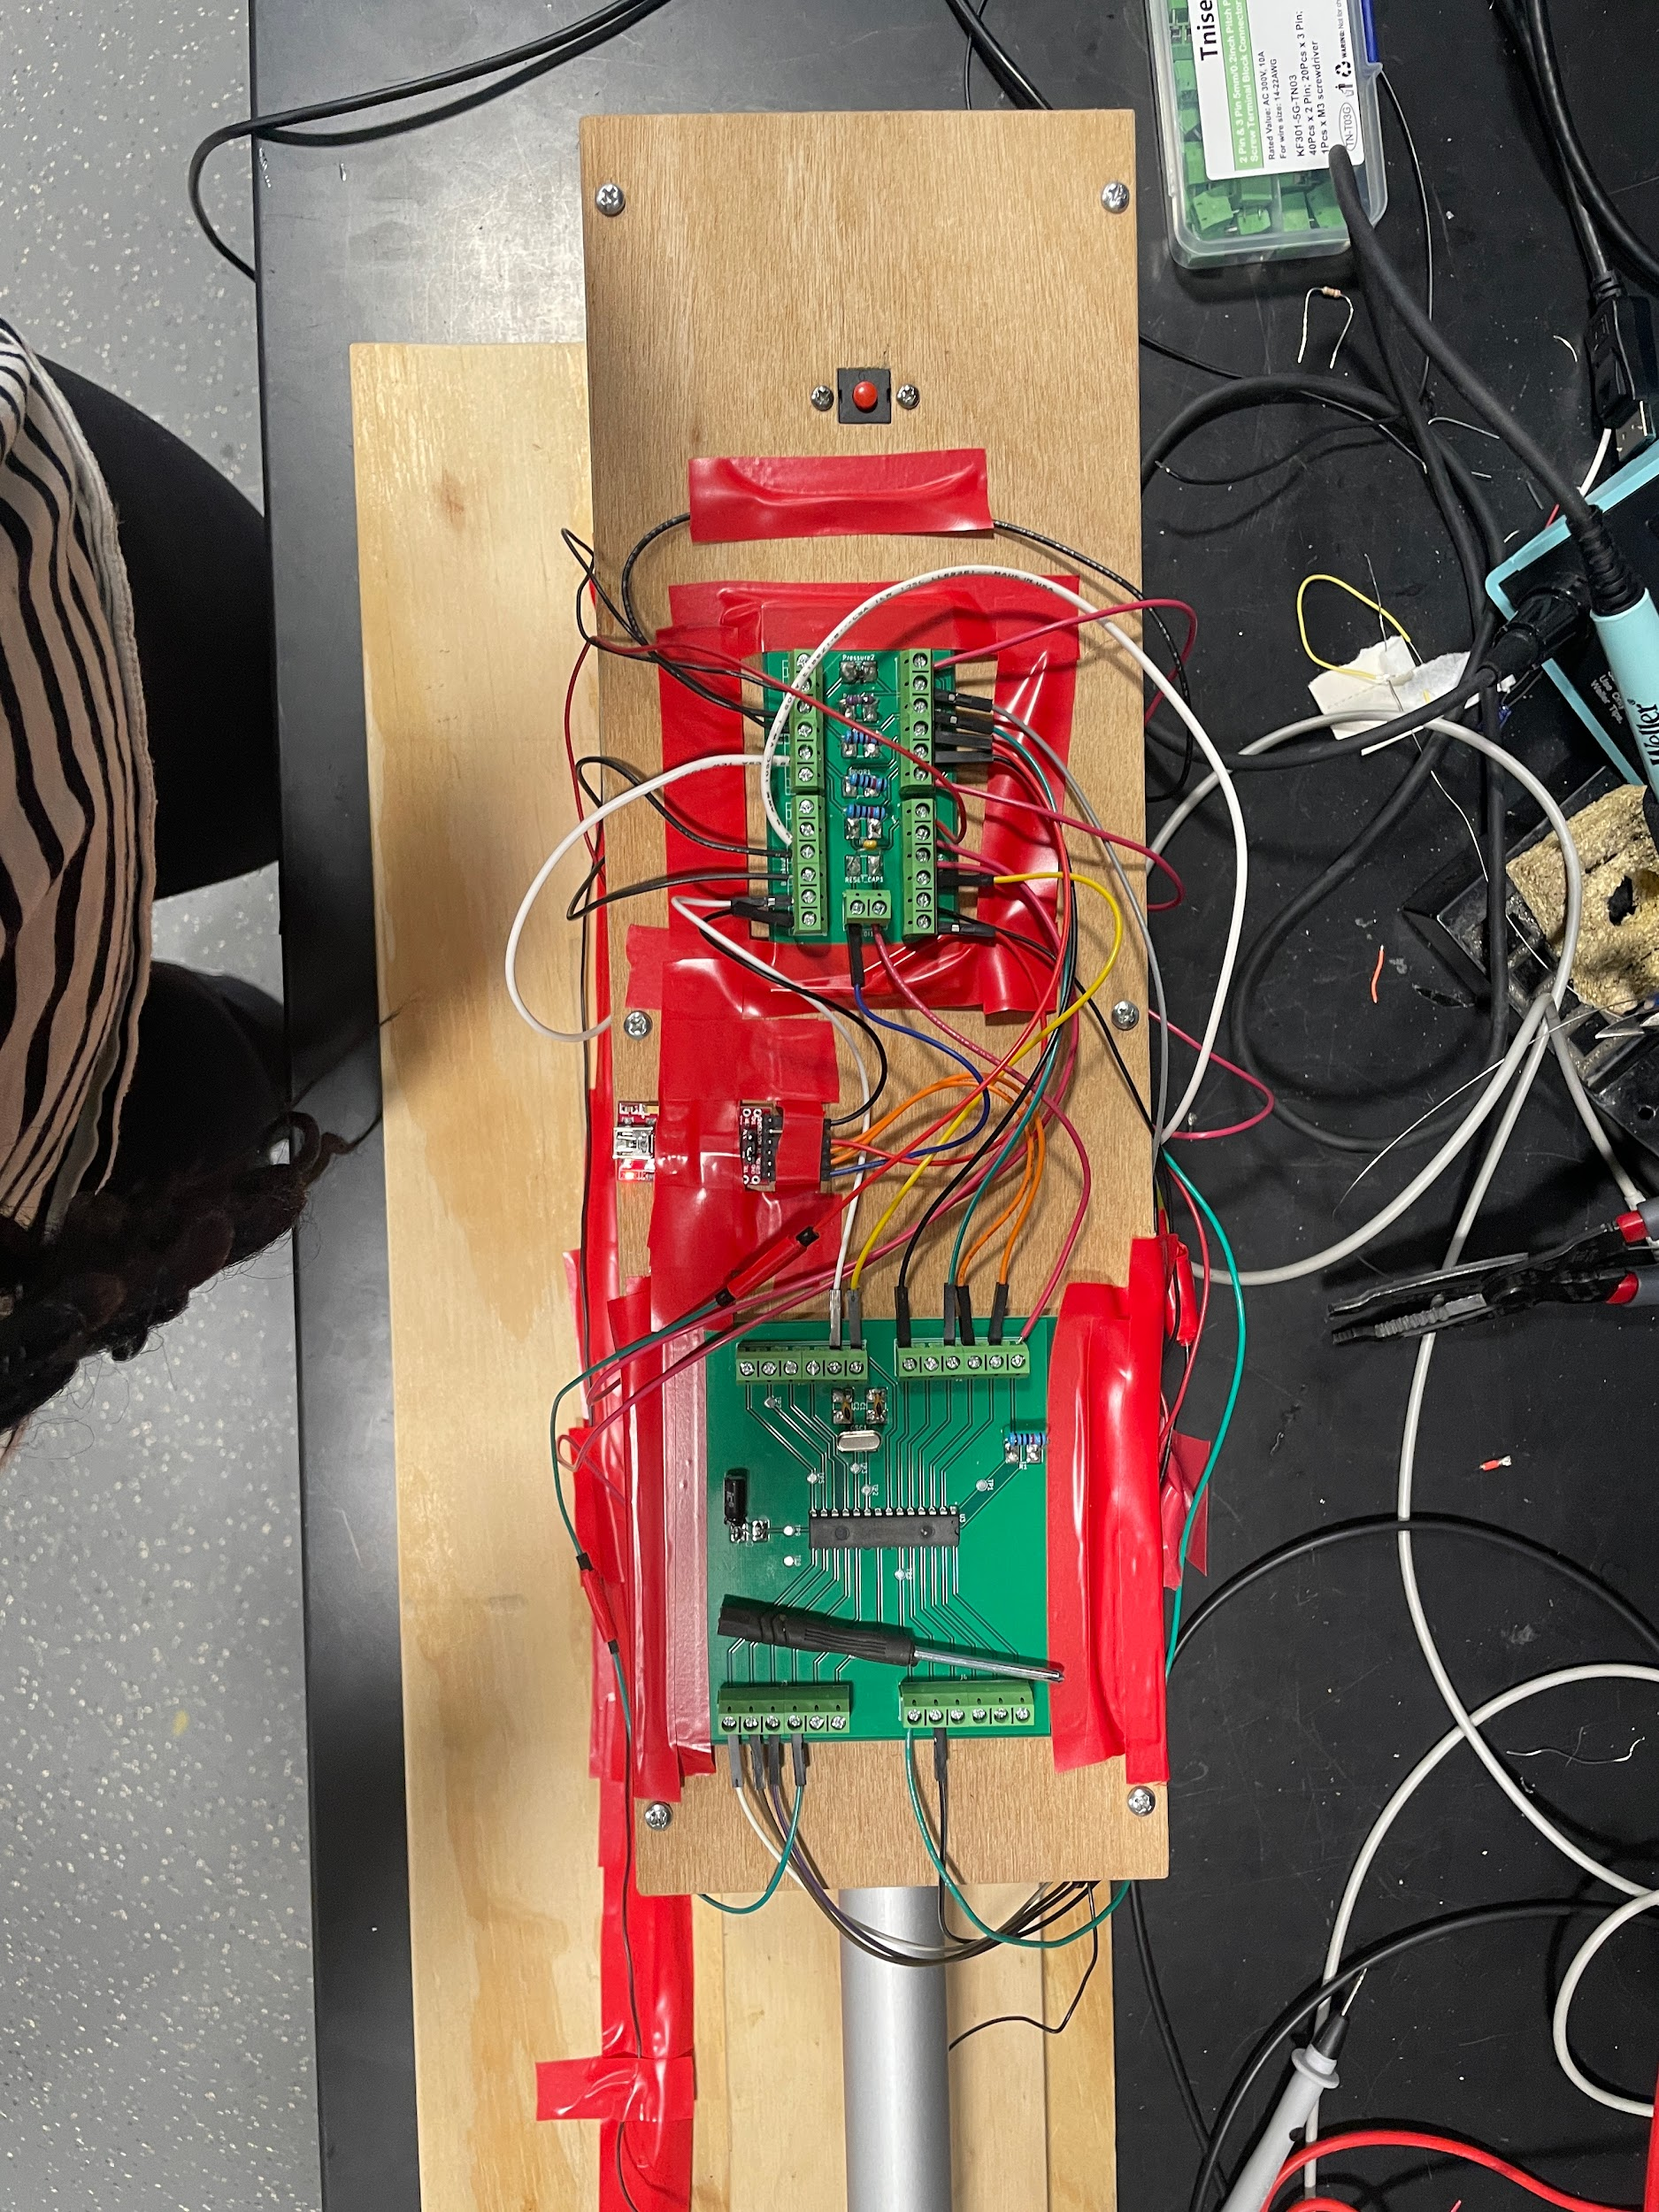
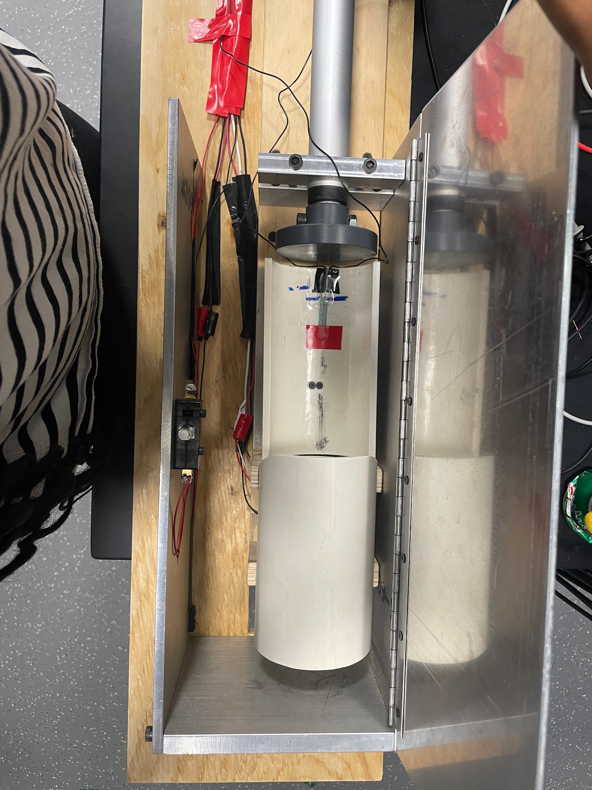
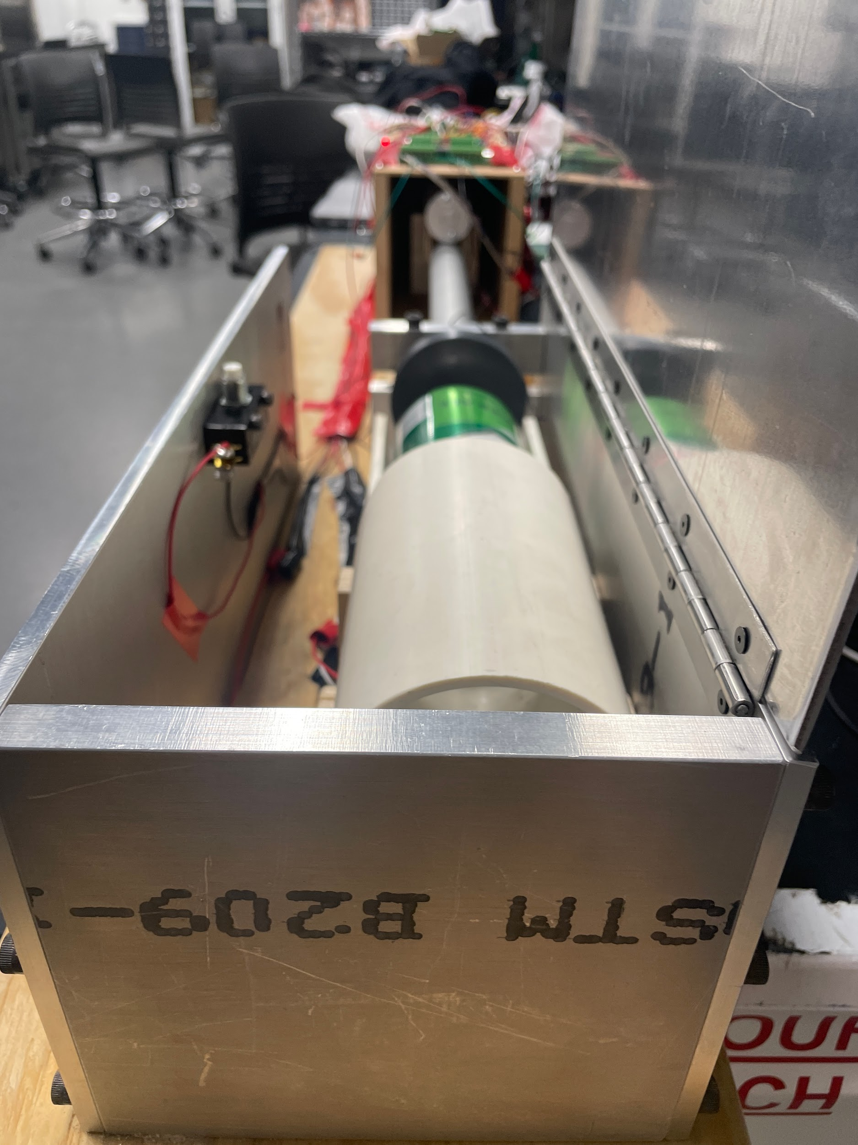
Design
What it actually looked like
ELECTRICAL & COMPUTER ENGINEERING
GRAINGER ENGINEERING

Slide 10
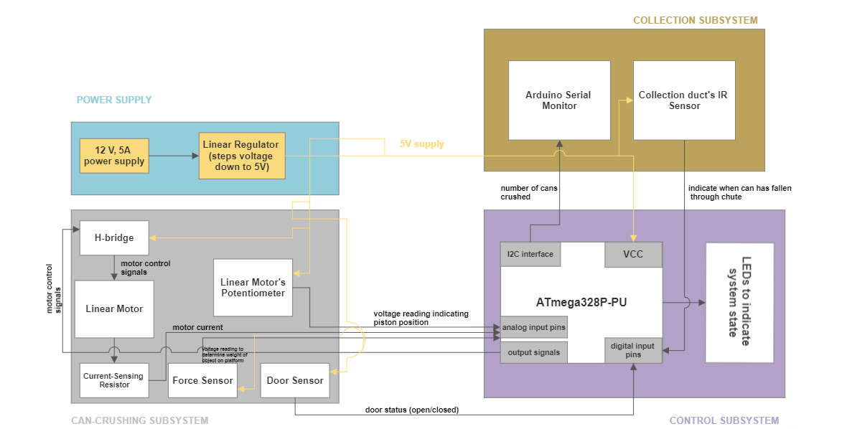
Design
Block Diagram
ELECTRICAL & COMPUTER ENGINEERING
GRAINGER ENGINEERING

Slide 11
Design
Functional Requirements
Can-crushing subsystem - The motor drives the can-crushing platform to be as thin as 0.28cm with a tolerance of 5% to allow for the crushed can to pass through the collection chute. Opening the door should stop the motor while crushing within 5 seconds. Force sensor should correctly ensure that only empty cans are crushed with an accuracy of at least 90 percent.
ELECTRICAL & COMPUTER ENGINEERING
GRAINGER ENGINEERING

Slide 12
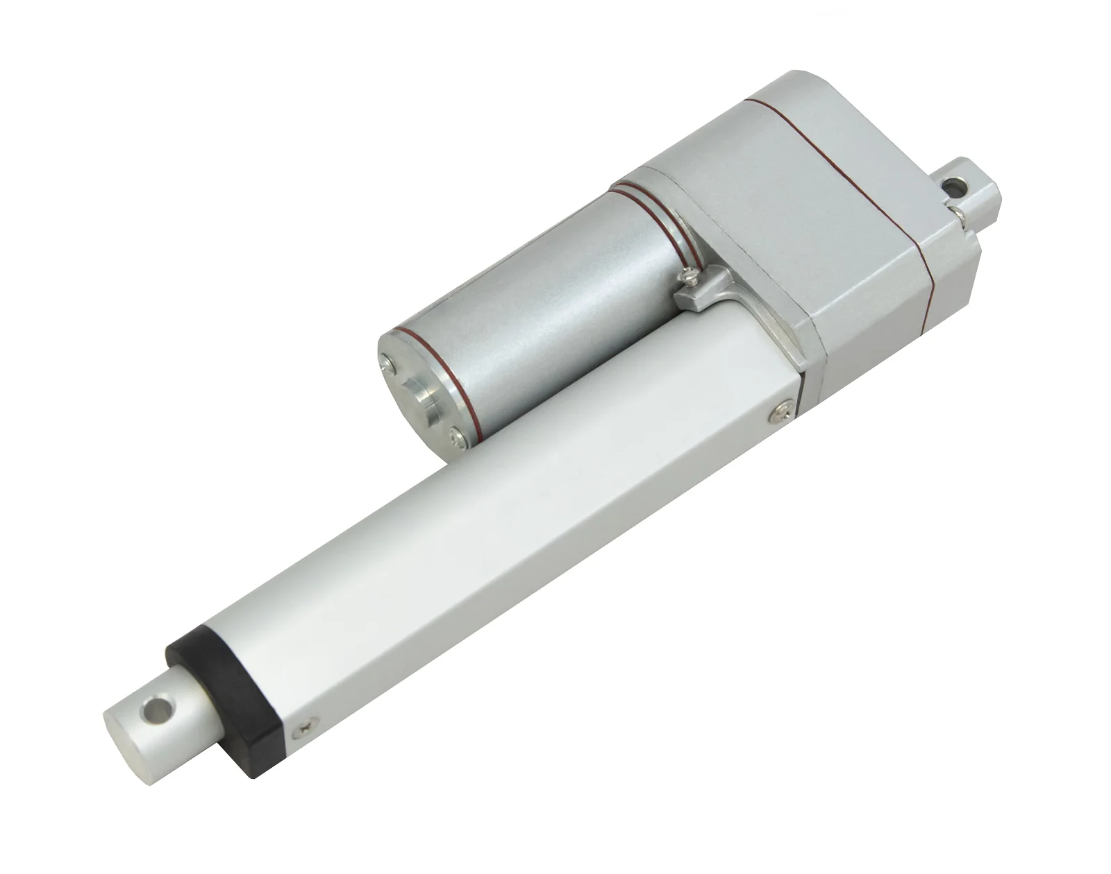
Design
Can-crushing subsystem
ELECTRICAL & COMPUTER ENGINEERING
GRAINGER ENGINEERING

Slide 13
Design
Functional Requirements
Control subsystem - The PCB should stop the motor from running when it is stalling. The system also does not allow the motor to begin crushing if force sensor detects non-empty cans. The PCB should internally keep track of number of cans crushed in current service cycle.
ELECTRICAL & COMPUTER ENGINEERING
GRAINGER ENGINEERING
Notes:
Matt

Slide 14
Design
Control subsystem
ELECTRICAL & COMPUTER ENGINEERING
GRAINGER ENGINEERING
Notes:
Matt

Slide 15
Design
Functional Requirements
Collector subsystem - The system via its IR sensor sends signal to PCB to increase number of cans crushed internally. The system indicates to the PCB when there is a blockage in the collector chute which needs to be serviced before the system accepts subsequent cans.
ELECTRICAL & COMPUTER ENGINEERING
GRAINGER ENGINEERING
Notes:
Michael & Matt

Slide 16
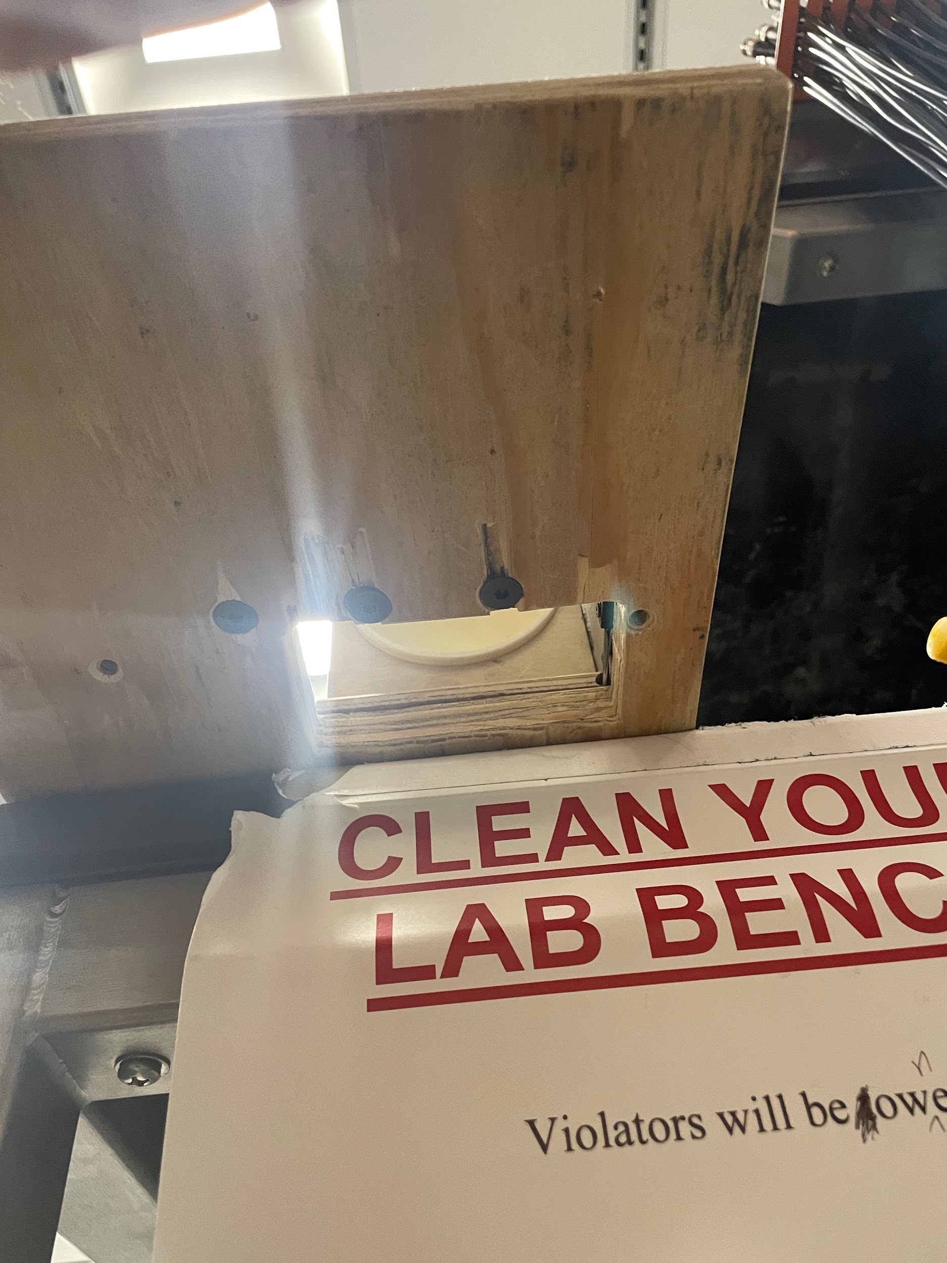
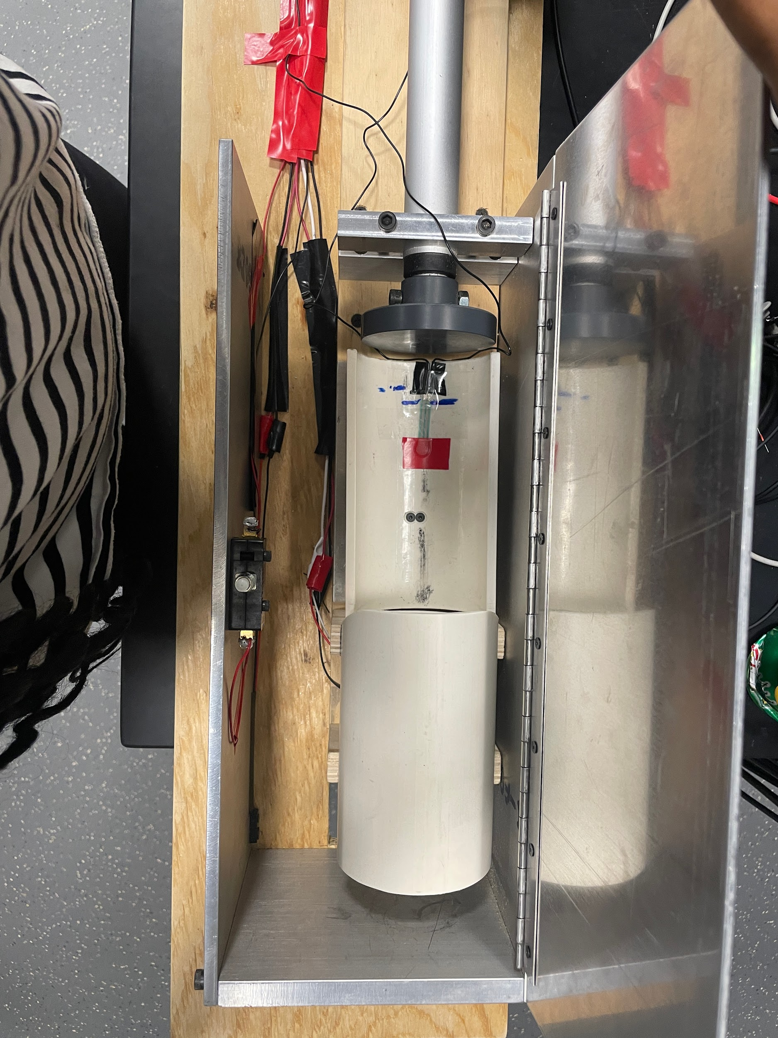
Design
Collector subsystem
ELECTRICAL & COMPUTER ENGINEERING
GRAINGER ENGINEERING
Notes:
Matt

Slide 17
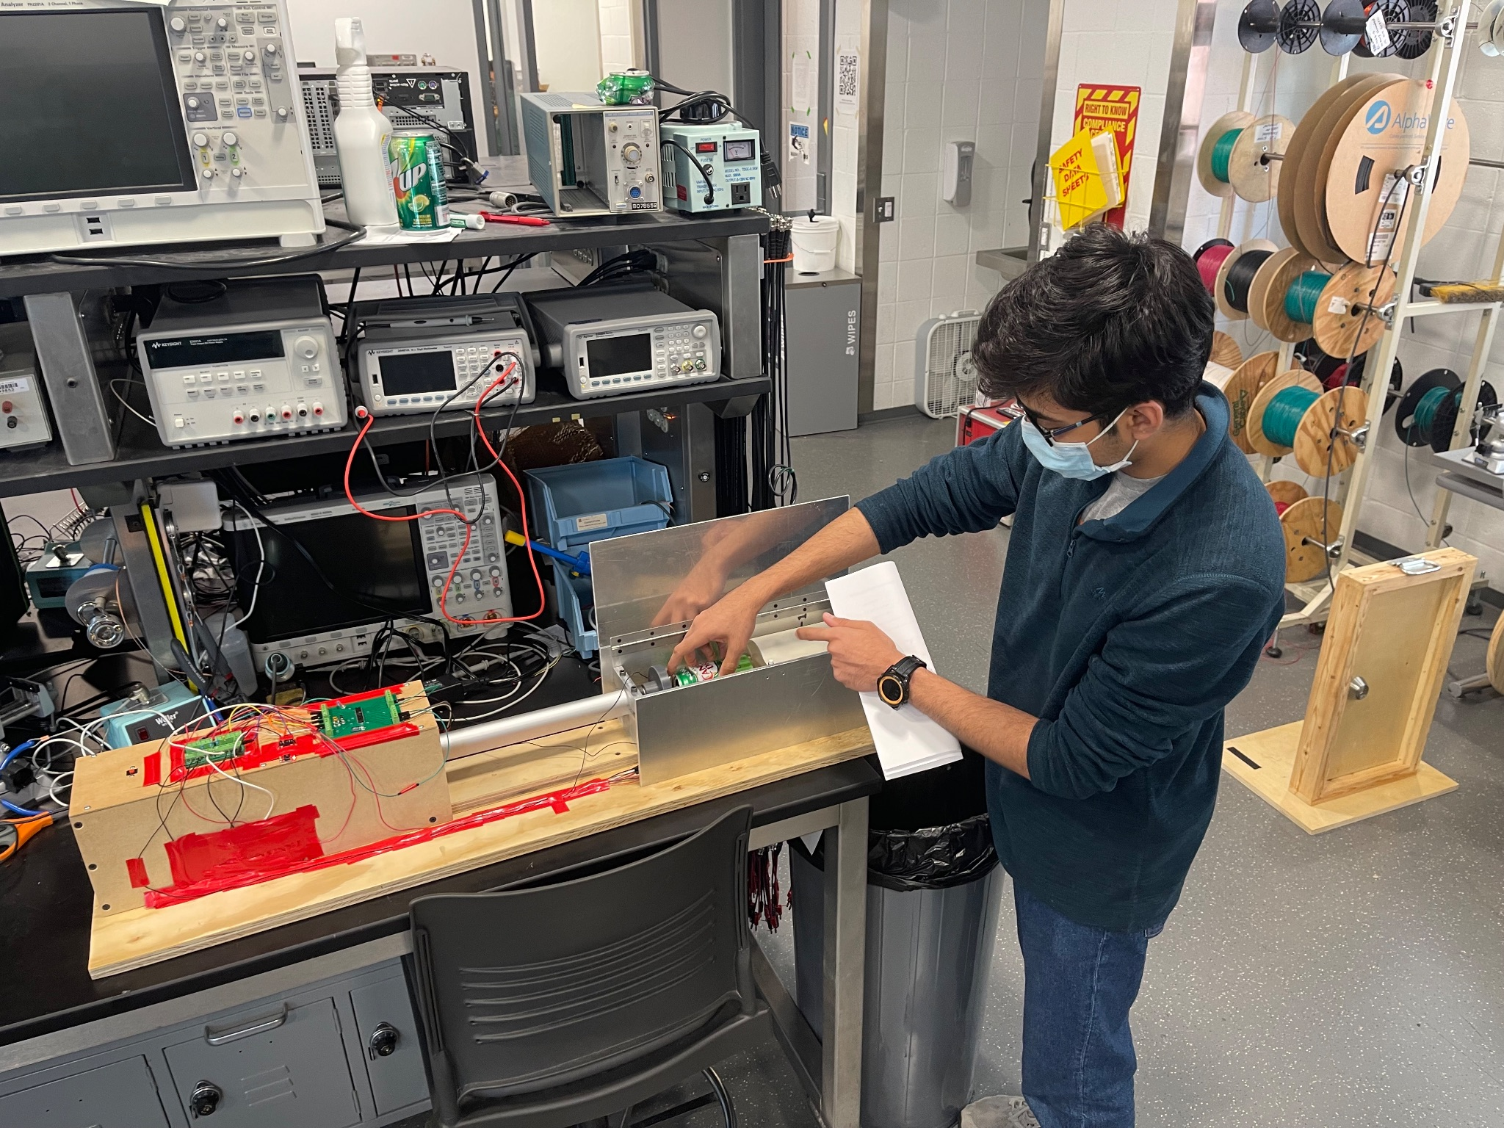
Design
Hardware Design
ELECTRICAL & COMPUTER ENGINEERING
GRAINGER ENGINEERING
Notes:
Main PCB
Conn PCB
HB

Slide 18
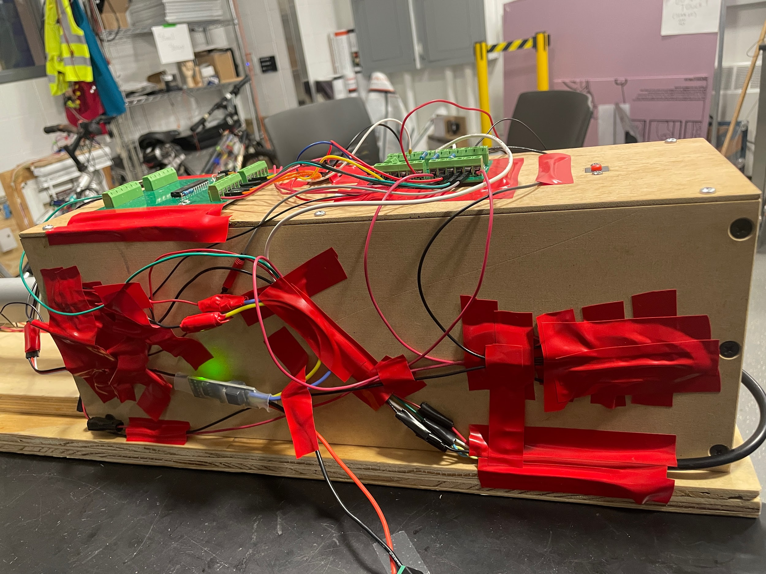
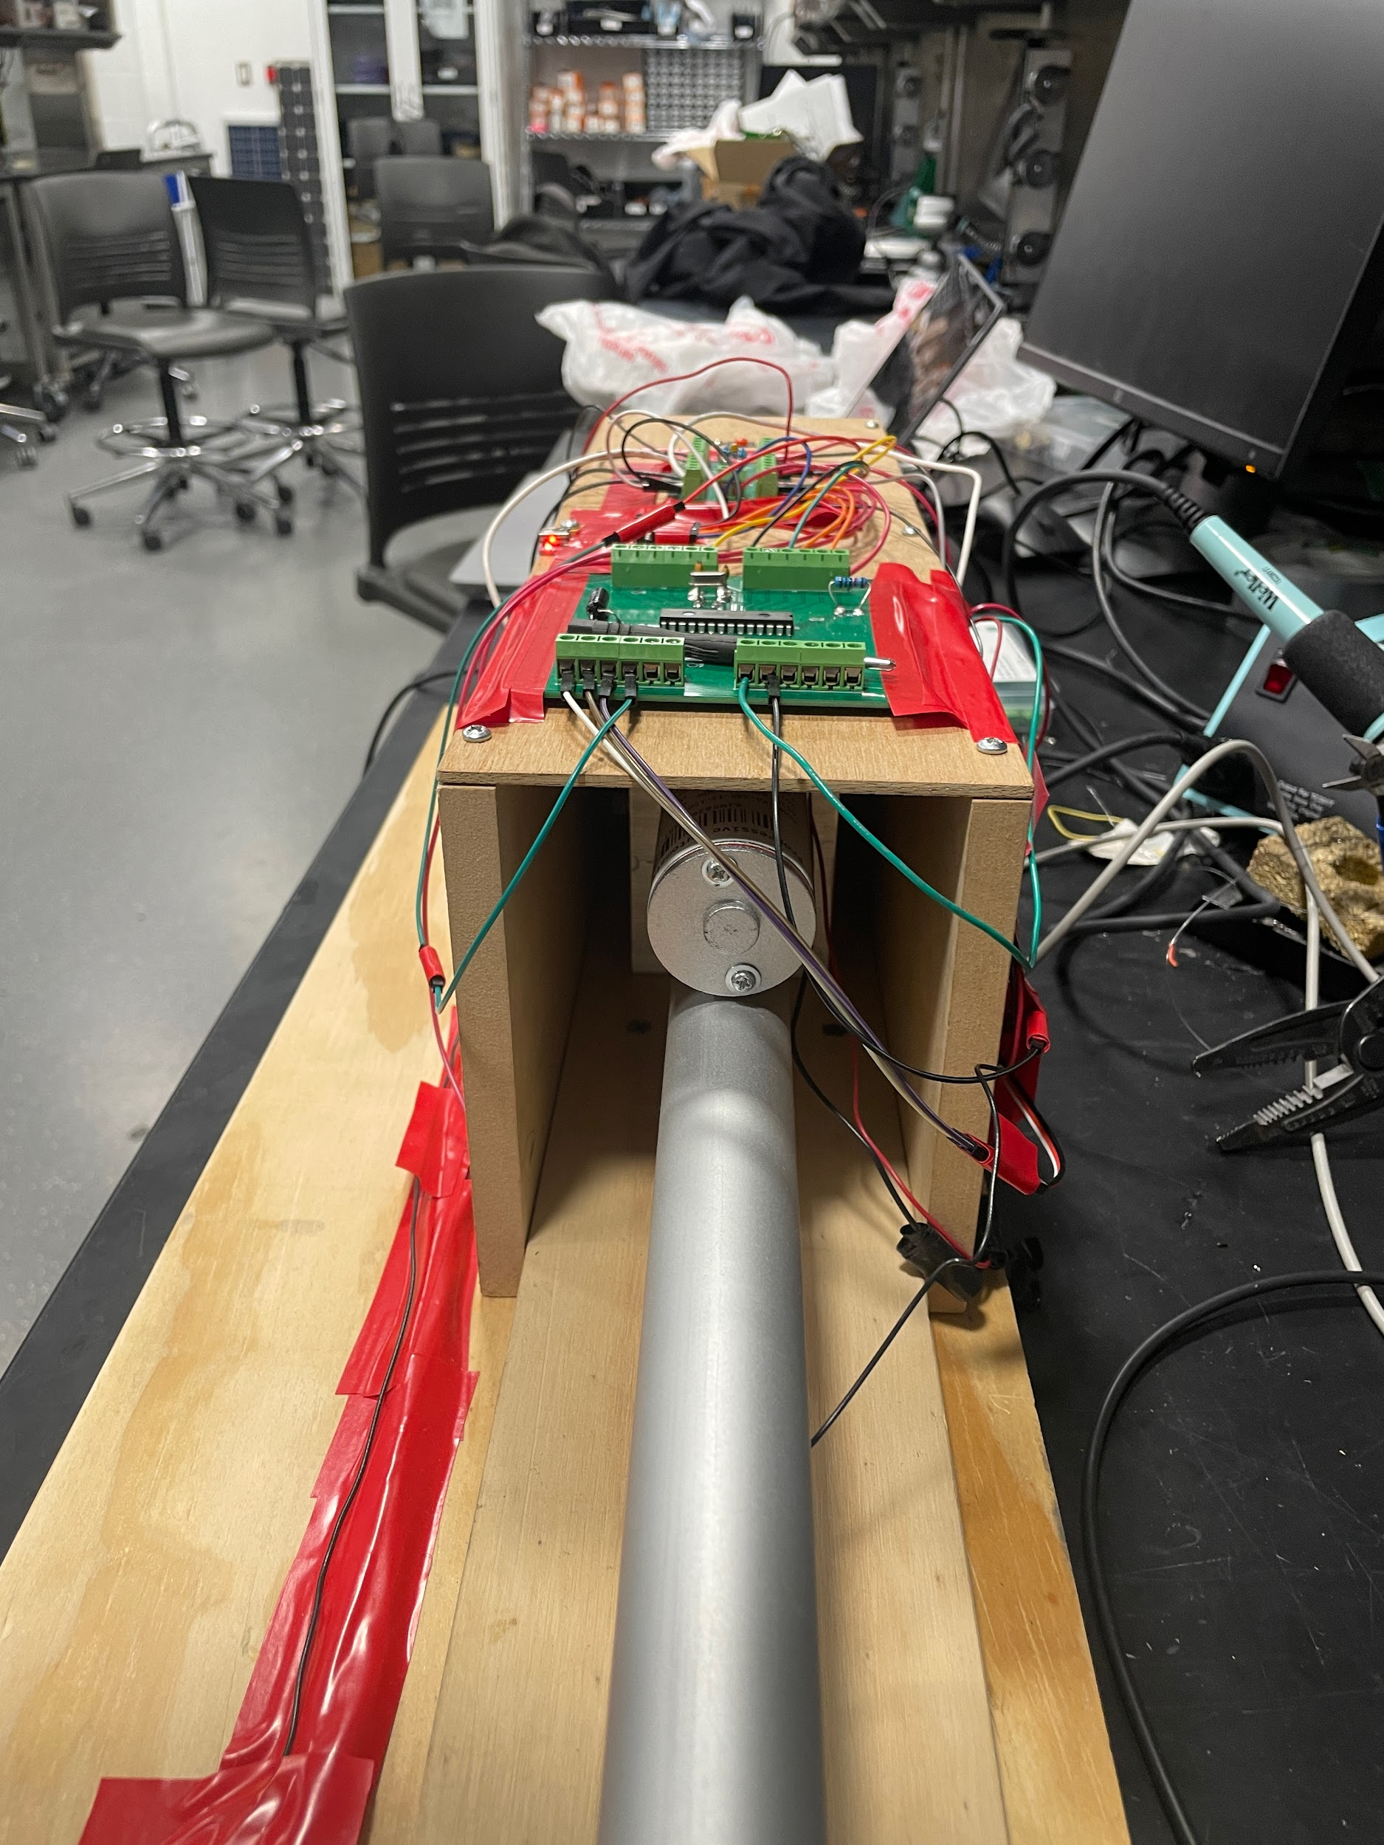
Design
Hardware Design
ELECTRICAL & COMPUTER ENGINEERING
GRAINGER ENGINEERING

Slide 19
Design
Software Design
The PCB will run a program which would execute certain instructions according to the current state of the machine as defined by the state machine. These states include:
WAITING FOR CAN
CRUSHING (MOTOR GOING IN FORWARD DIRECTION)
CRUSHING(MOTOR GOING IN BACKWARD DIRECTION)
COUNTING
SERVICE
RESET
ELECTRICAL & COMPUTER ENGINEERING
GRAINGER ENGINEERING
Notes:
michael

Slide 20
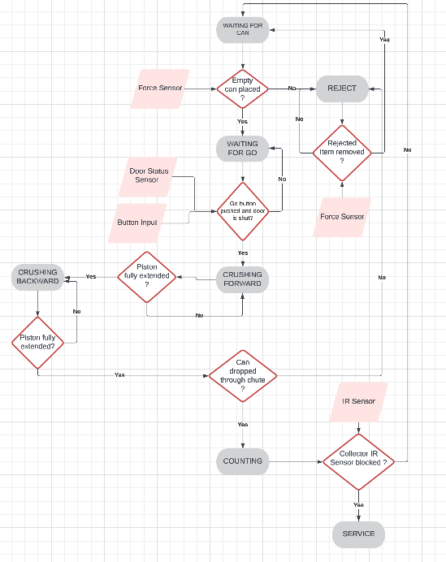
Design
State Machine Diagram of Project
ELECTRICAL & COMPUTER ENGINEERING
GRAINGER ENGINEERING

Slide 21
Design
Design Changes Made
Multiple load cell tests failed so we had to switch that out for a force sensor which produced desired results.
A power saving state was added with the ‘go’ button.
No need to check current drawn manually because the linear actuator already takes care of that.
Introduced logic to detect stalls via the potentiometer.
ELECTRICAL & COMPUTER ENGINEERING
GRAINGER ENGINEERING

Slide 22
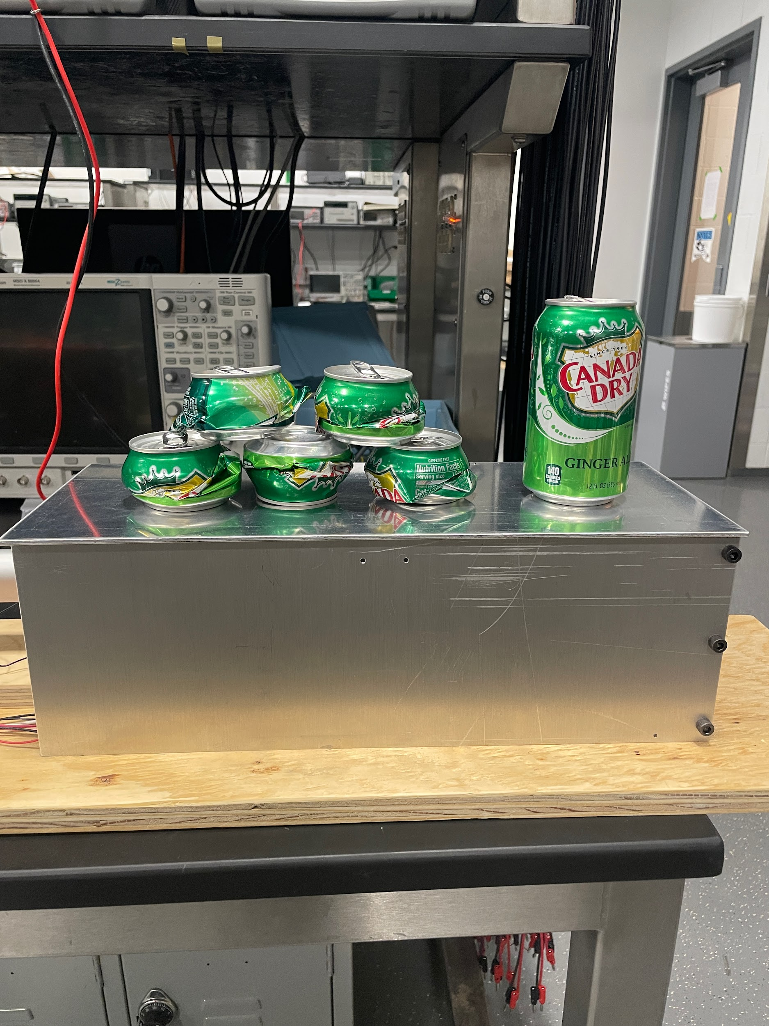
Test Results
ELECTRICAL & COMPUTER ENGINEERING
GRAINGER ENGINEERING
Notes:
matt

Slide 23
Test Results
Test | Outcomes
Crushed 3 cans to the required thickness. | PASSED. The average thickness of the crushed cans was within 0.28cm ± 5%.
Only empty cans crushed | PASSED. Force sensor could detect full cans.
Accurate can-count reading reported | PASSED. correct number of cans crushed was incremented internally and displayed on the serial monitor
Pause crushing when door opened | PASSED. Paused state reached.
ELECTRICAL & COMPUTER ENGINEERING
GRAINGER ENGINEERING

Slide 24
Successes
Successes
Our primary objective to crush 330 ml standard aluminum cans was achieved.
The machine exhibited consistent performance with consistent results while in testing phase.
Challenges
Initially figuring out how to program the microchip for the PCB.
Machine was large and difficult to carry around.
ELECTRICAL & COMPUTER ENGINEERING
GRAINGER ENGINEERING

Slide 25
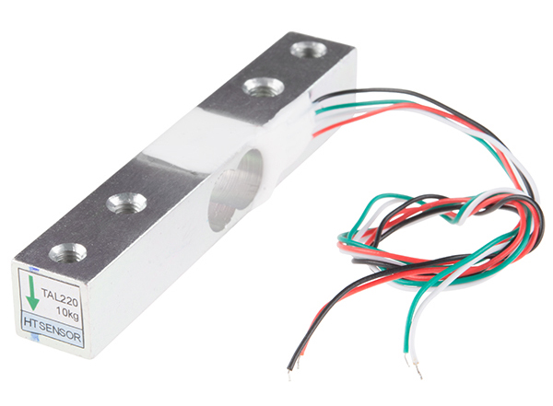
Failed Verification
Load cell sensitivity: The load cell originally picked was not sensitive enough to differentiate empty and full cans.
ELECTRICAL & COMPUTER ENGINEERING
GRAINGER ENGINEERING

Slide 26
Failed Test Results
The table below shows that the load cell’s reading was too small to be registered by the microcontroller, whether the test can was empty or not.
Load Cell Reading | Was the can empty?
0.001 V | YES
0.002V | YES
0.001 V | NO
0.005 V | NO
ELECTRICAL & COMPUTER ENGINEERING
GRAINGER ENGINEERING

Slide 27
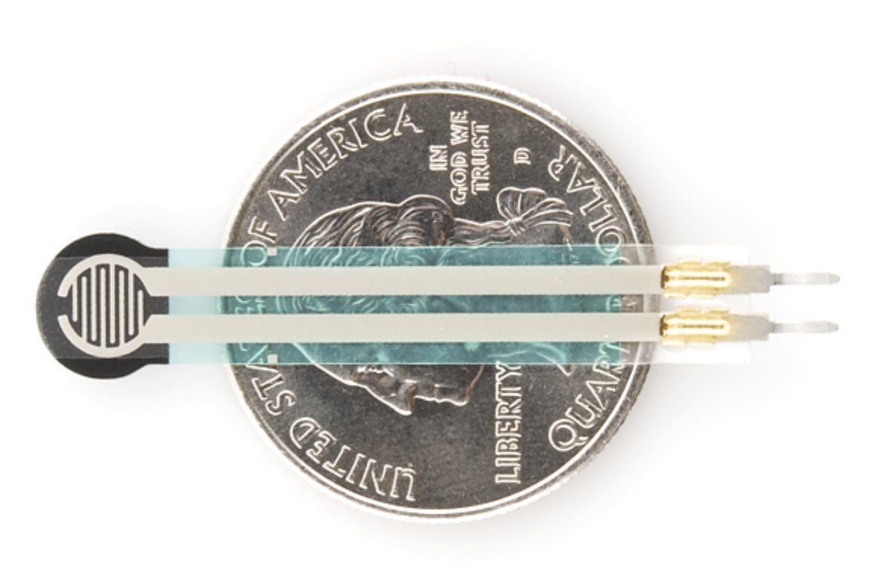
Recovery from Failed Verification
Force sensor sensitivity: The force sensor was sensitive enough to differentiate empty and full cans!
ELECTRICAL & COMPUTER ENGINEERING
GRAINGER ENGINEERING

Slide 28
Successful Test Results
The table below shows that the force sensor can consistently differentiate between empty and full cans.
Trial number | Reading on Arduino
empty | reading of 2
empty | reading of 5
full | reading of 1000
full | reading of 800
ELECTRICAL & COMPUTER ENGINEERING
GRAINGER ENGINEERING

Slide 29
Successful Test Results
The table below shows that the width of the crushed cans were consistently within the allowed range (1.8- 2 inches) on multiple trials.
Trial number | width
1 | 2 inches
2 | 2 inches
3 | 2 inches
4 | 2 inches
ELECTRICAL & COMPUTER ENGINEERING
GRAINGER ENGINEERING

Slide 30
Conclusion
The project worked– that is the immediately pertinent news.
However, we could have gotten it to work more efficiently with better planning.
We got hands-on experience with PCB design and got to work with more low-level code.
ELECTRICAL & COMPUTER ENGINEERING
GRAINGER ENGINEERING

Slide 31
Recommendations for further work
Increase can size compatibility
Optimize energy efficiency
Enhance safety features
Display current state via led bulbs.
ELECTRICAL & COMPUTER ENGINEERING
GRAINGER ENGINEERING

Slide 32
References
"Load Cell Image." SparkFun Electronics, n.d., https://cdn.sparkfun.com/assets/learn_tutorials/3/8/2/13329-01Crop.jpg. Accessed 10th April 2023.
"Linear Actuator Image." Shopify, Progressive Automations, https://cdn.shopify.com/s/files/1/0061/7735/7891/products/PA-14P-1_1_1024x1024@2x.png?v=1670579316. Accessed 10th April 2023.
ELECTRICAL & COMPUTER ENGINEERING
GRAINGER ENGINEERING

Slide 33
Q & A
Time for Questions!
ELECTRICAL & COMPUTER ENGINEERING
GRAINGER ENGINEERING

Slide 34
Thank You.
Thanks for listening!
ELECTRICAL & COMPUTER ENGINEERING
GRAINGER ENGINEERING

