Slide 1
Self Heating Bed
Electrical & Computer Engineering
Siddharth Kaza, Hari Gopal, Amaan Rehman Shah
December 9th, 2024
Notes:
Siddharth

Slide 2
Problem Statement
How can we affordably regulate temperature during sleep?
ELECTRICAL & COMPUTER ENGINEERING
Notes:
The problem we set out to solve is How can we affordably regulate temperature During sleep? When researching the topic, we learned that temperature regulation can add up to an extra hour of REM sleep each night, allowing you to wake up more recovered and better rested.

Slide 3
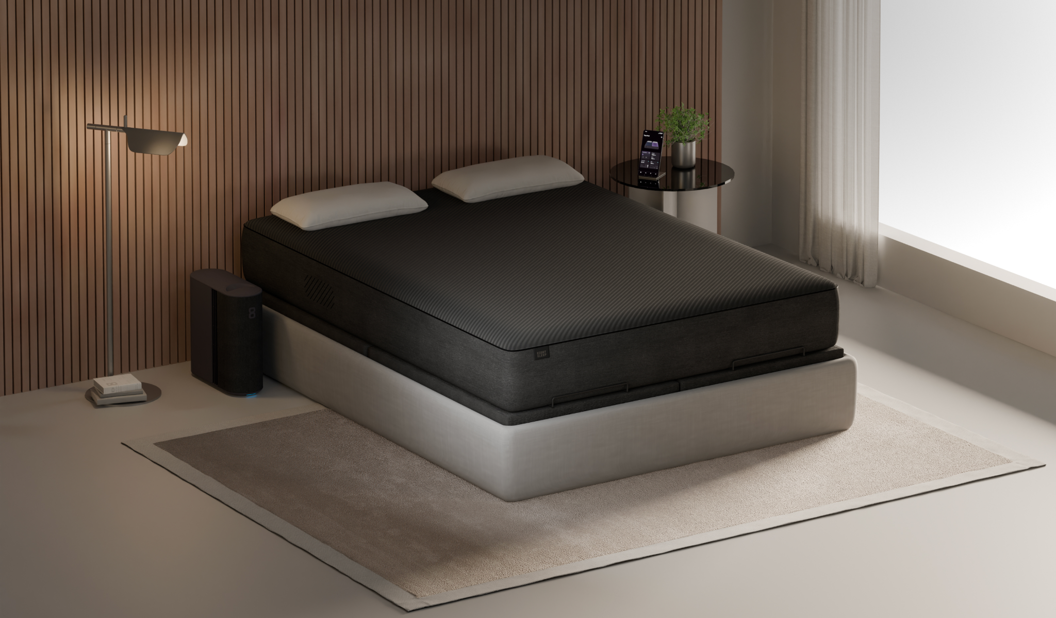
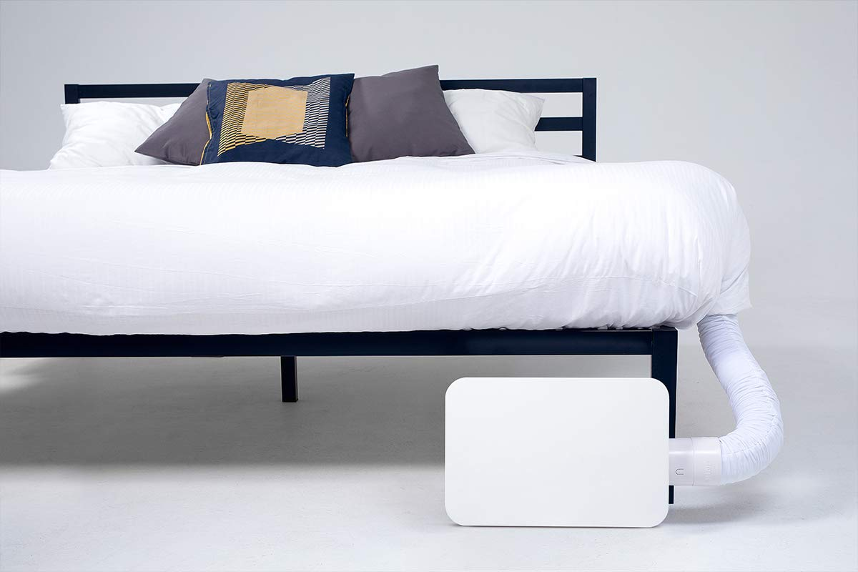
Current Market Competition
Eight Sleep
$5999 + $125/year subscription
Water Based heating/cooling
Leaks can ruin mattress
Bed Jet
$600-$1200
Uses a custom mattress cover to distribute airflow evenly
Notes:
These are the two products on the market with similar goals as us.

Slide 4
High Level Requirements
Be able to modulate the temperature of the air within 3 degrees Fahrenheit of what the user inputs
Have a quiet air ventilation system, measured around 50-60 decibels
Draw < 1000W of power when heater is on, less when in fan mode
Notes:
Siddharth

Slide 5
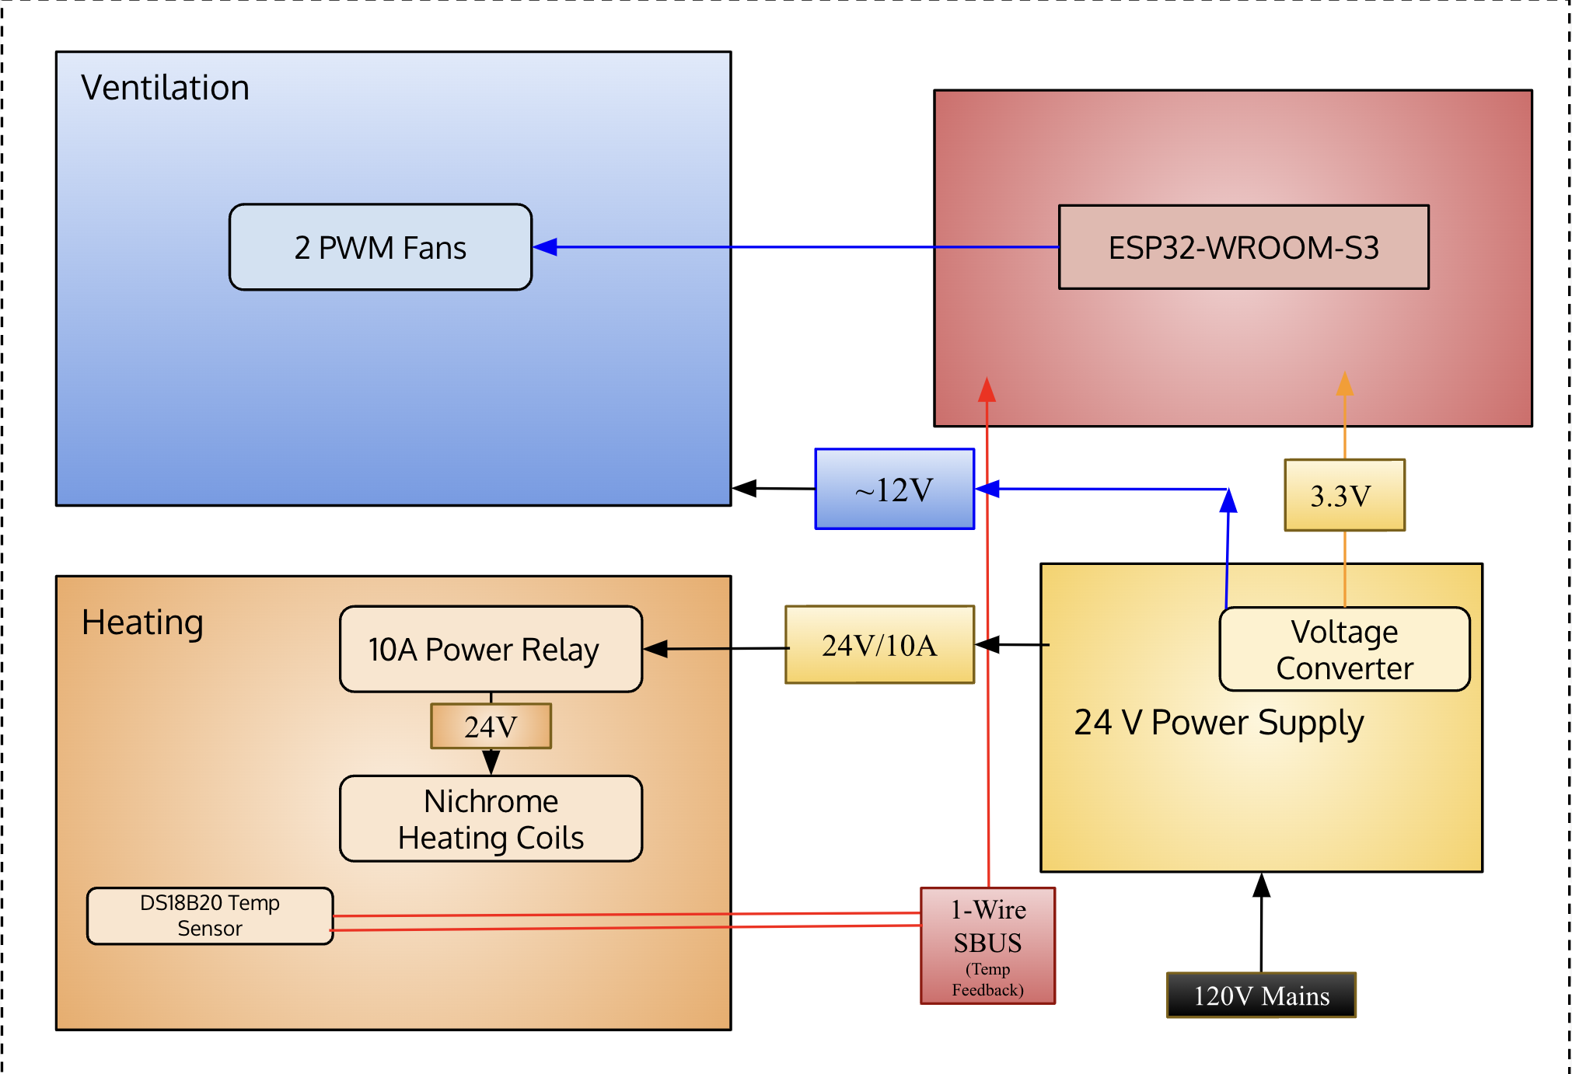
SUBSYSTEM OVERVIEW
Control
ELECTRICAL & COMPUTER ENGINEERING
GRAINGER ENGINEERING
Notes:
Here, we have a overview of our subsystems. WE split it up into three subsystem, Heating, Control, and Ventilation. The Ventilation subsystem is made up of our fans. The Control subsystem is our ESP and voltage converters, mostly based around the PCB. And finally we have our heating Subsystem. This consists of the Nichrome and the 10A relay linked to the ESP. Lastly, we have our temperature sensors that are placed all around the enclosure, allowing us to constantly monitor the environment, and make changes as needed. We will take a deeper dive into each subsystem next.

Slide 6
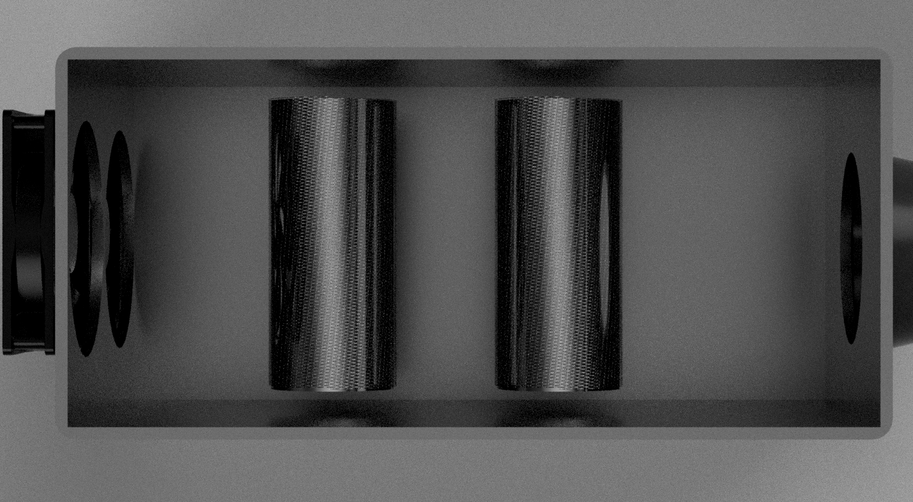
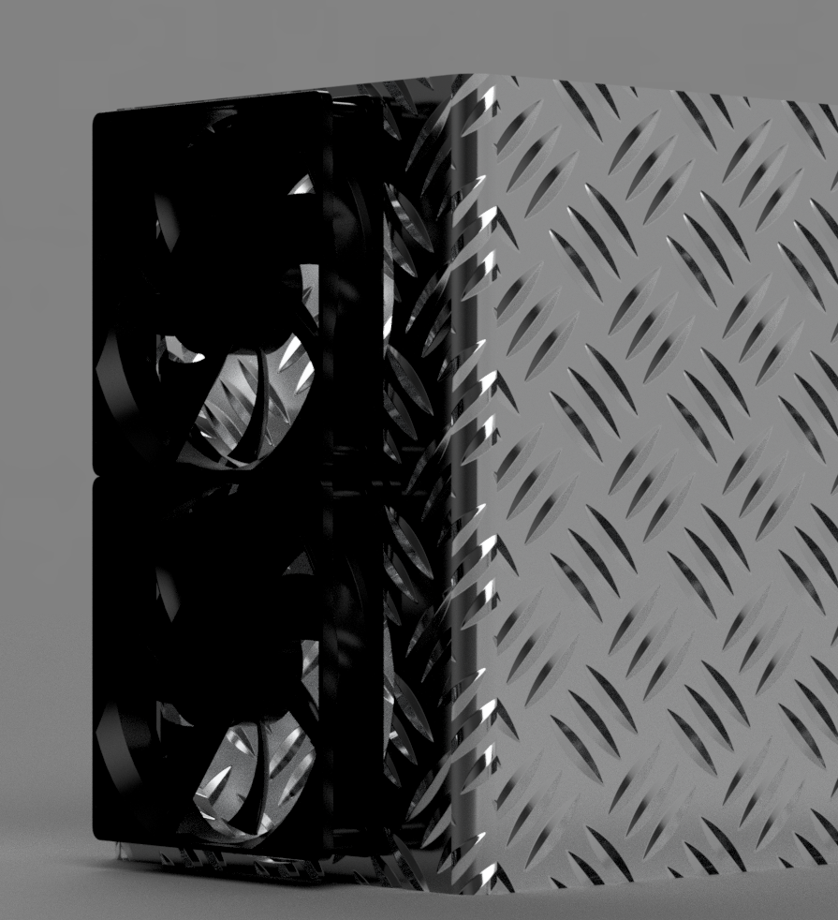
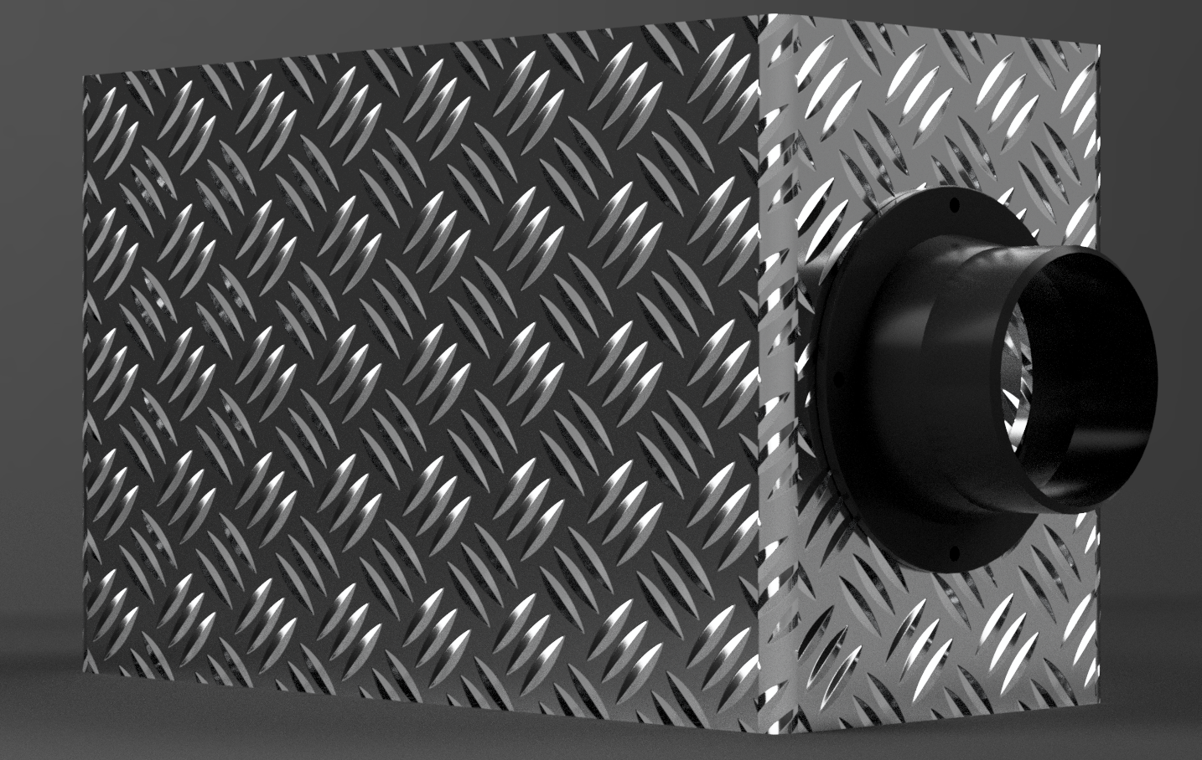
Physical Overview
Notes:
Amaan

Slide 7
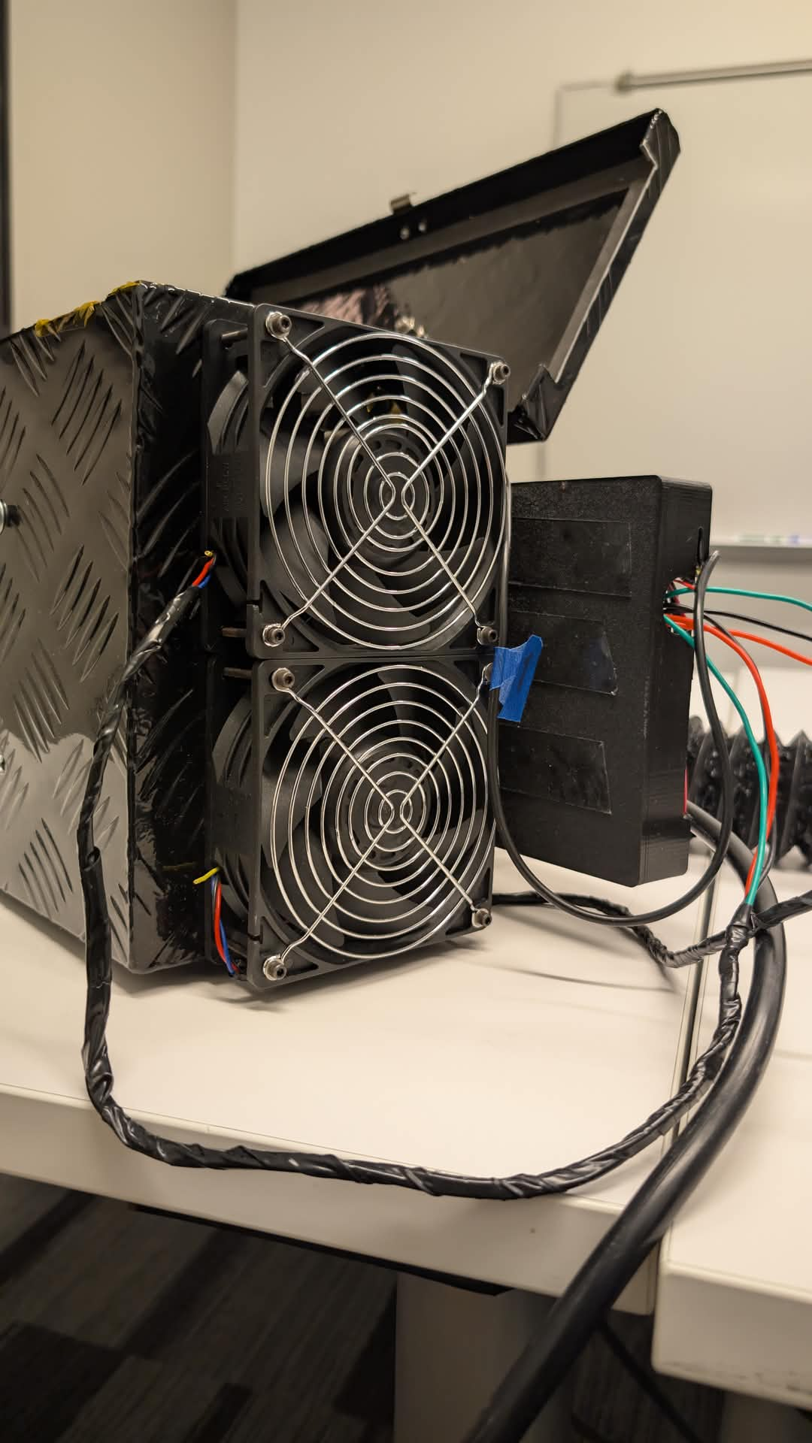
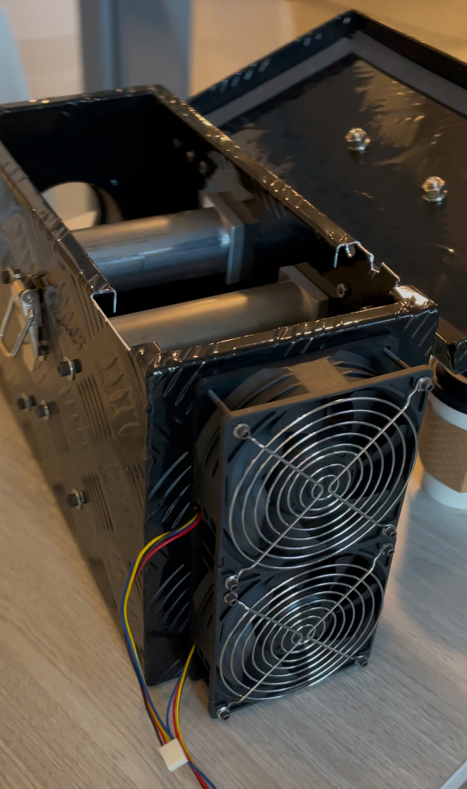
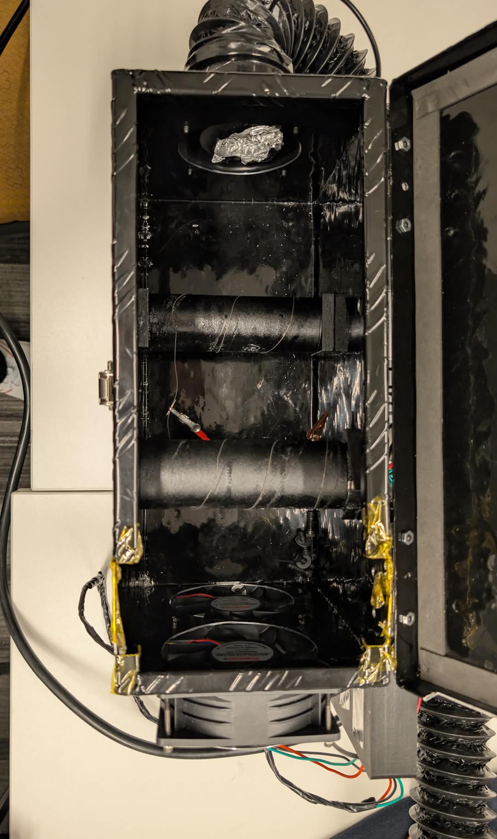

Slide 8
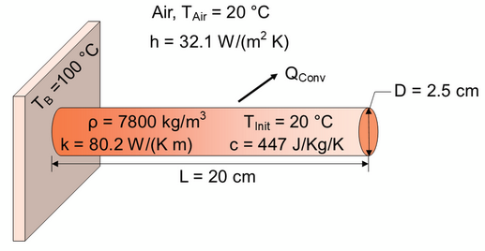
SUBSYSTEM 1: HEATING
Design Considerations
Nichrome: (nickel-chromium alloy) Used to convert electrical energy into heat due to their high resistivity and thermal stability.
Key Material Properties:
Corrosion-resistant, withstanding temperatures up to 1200°C.
High melting point (>1400°C) and electrical resistivity for efficient heating.
Formula: T ∝ V² ∝ 1/L²
ELECTRICAL & COMPUTER ENGINEERING
GRAINGER ENGINEERING
Notes:
Amaan

Slide 9
SUBSYSTEM 1: REQUIREMENTS AND VERIFICATION
Gauge | Length(cm) | Resistance (Ohms) | Heat? | Melted | Amps Drawn | Power Dissipated (W)
18 | 106 | 2.3 | Yes | No | 10.43478261 | 250.4347826
18 | 54 | 0.94 | No | Yes | 20 | 376
18 | 24 | 0.33 | Yes | Yes | 20 | 132
24 | 45 | 1.6 | Yes | No | 10.62 | 254.88
24 | 54 | 3.1 | Yes - limited | No | 7.741935484 | 185.8064516
24 | 106 | 5.83 | Yes - limited | No | 4.116638079 | 98.79931389
ELECTRICAL & COMPUTER ENGINEERING
GRAINGER ENGINEERING
Notes:
Amaan

Slide 10
SUBSYSTEM 1: REQUIREMENTS AND VERIFICATION
Requirements | Verification
Maintain enclosure temperature below 200F Keep circuitry enclosure temperature below 150F Ensure air ducted to the user is capped at 110F Reach user’s desired Temperatures | A precise temperature sensor (DS18B20) was used as a measurement tool to keep track of operating temperatures Relay Control
ELECTRICAL & COMPUTER ENGINEERING
GRAINGER ENGINEERING
Notes:
Amaan

Slide 11
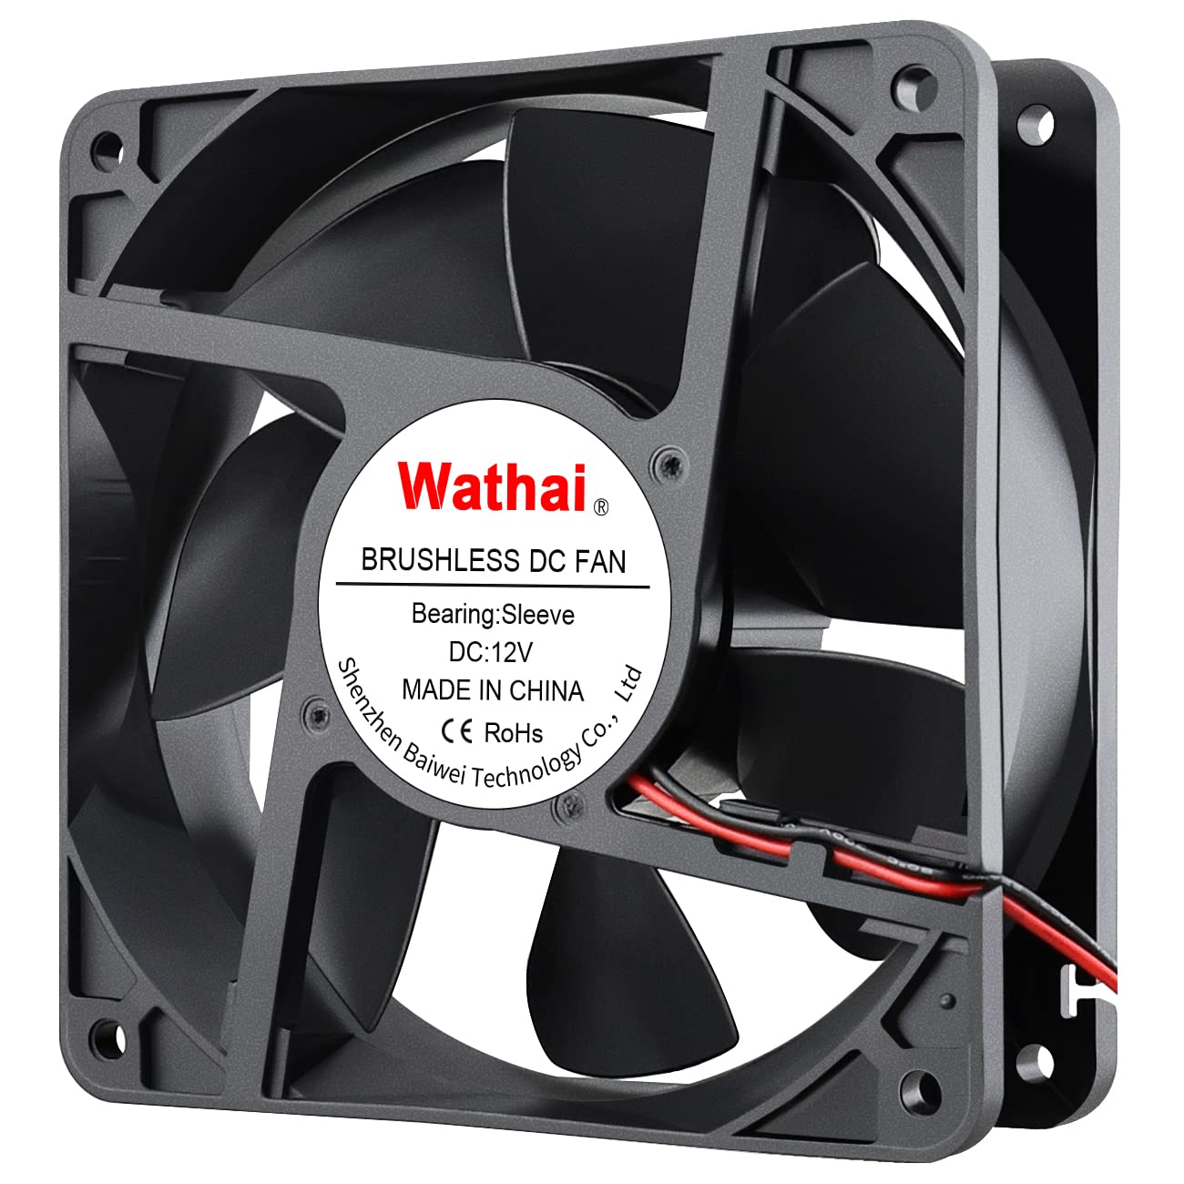
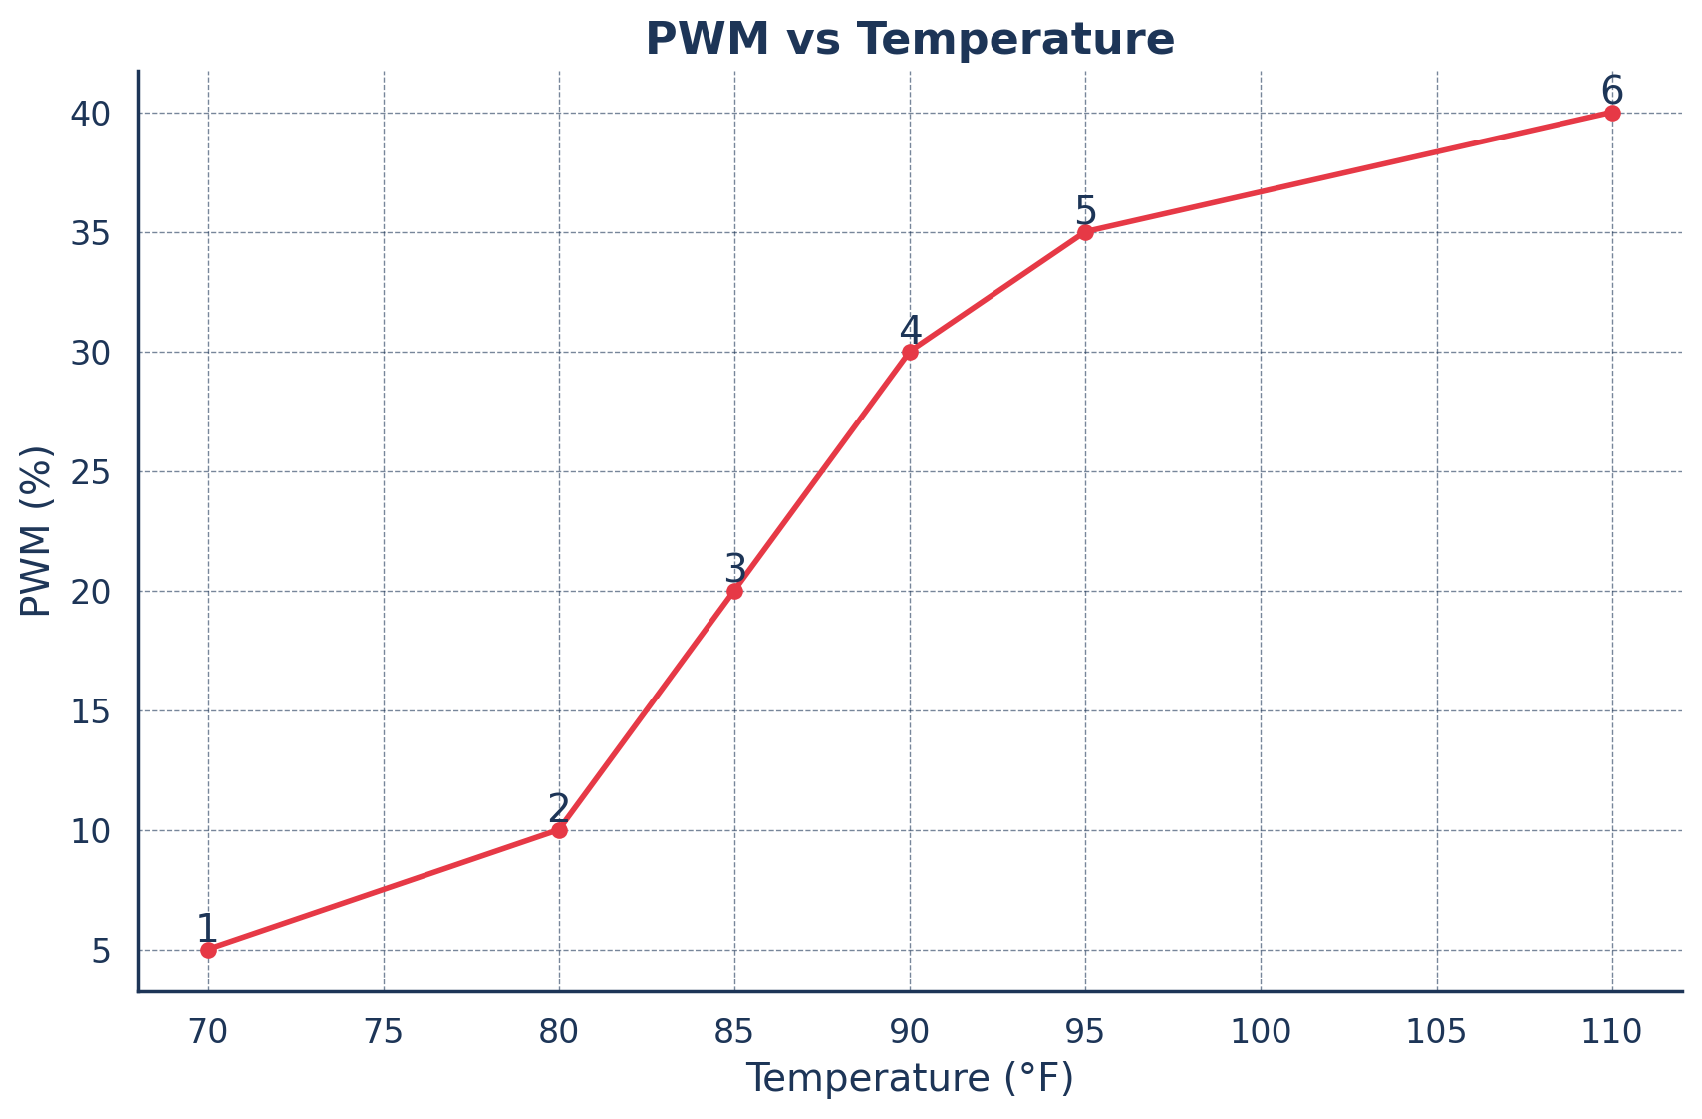
SUBSYSTEM 2: VENTILATION
Design Considerations
Maintain Sufficient Airflow
User feels the air
Nichrome retains heat
Ambient Noise < 60 dB
Low setting: 40dB
Medium-High: 50-60dB
Fan Speed must be Controllable
ELECTRICAL & COMPUTER ENGINEERING
GRAINGER ENGINEERING

Slide 12
SUBSYSTEM 2: REQUIREMENTS AND VERIFICATION
Requirements | Verification
Must be able to observe and monitor changes in temperature Ensure that system operate within safe/desired limits. | Placed sensors at Exhaust Vent Ambient Temperature Fan Intake Constantly read sensors and adjust nichrome to ensure temperature stays within user’s desired range
Ensure that ESP is able to control and modulate PWM Fans in order to control airflow | Measured PWM Output with Oscilloscope Control duty cycle through PWM Fans automatically ramp up and down based on temperature
ELECTRICAL & COMPUTER ENGINEERING
GRAINGER ENGINEERING
Notes:
Siddharth

Slide 13
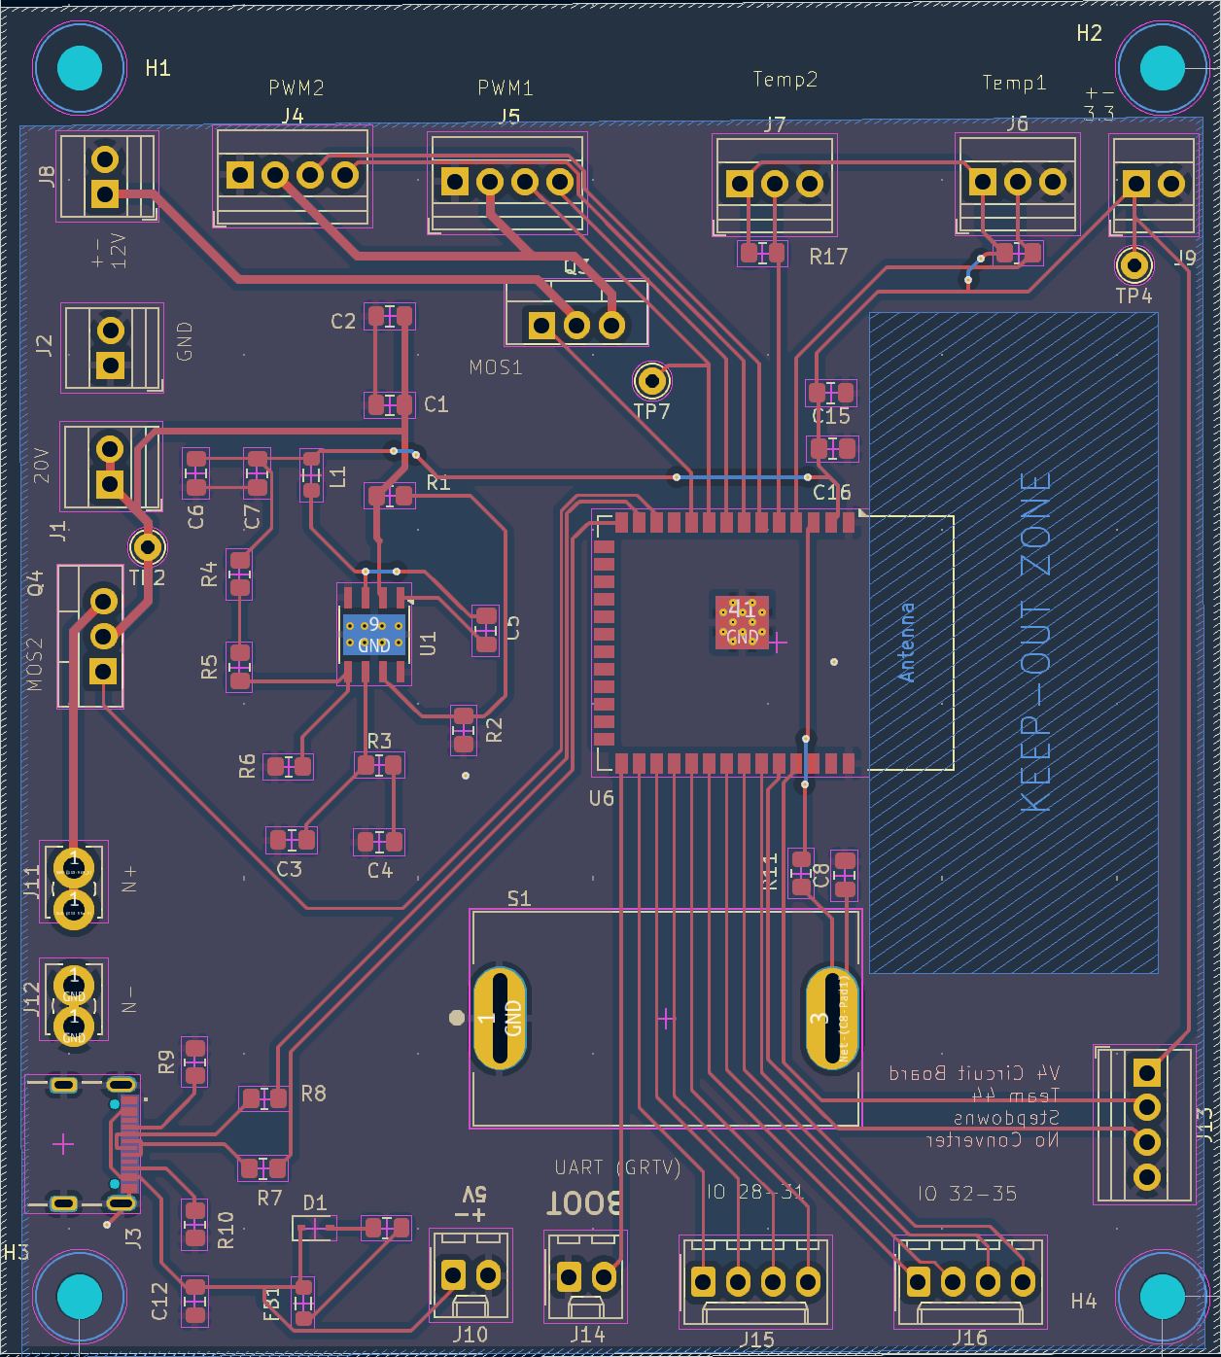
SUBSYSTEM 3: CONTROL
Initial PCB Development
Designing for high power system
Multiple step-downs with efficient translation (power conversion)
Intelligent temperature sensing (heating subsystem)
PWM control (ventilation subsystem)
ELECTRICAL & COMPUTER ENGINEERING
GRAINGER ENGINEERING
Notes:
Hari

Slide 14
SUBSYSTEM 3: REQUIREMENTS AND VERIFICATION
Requirements | Verification
ESP32 serving as MCU Reads sensor inputs Feeds power to other subsystems Power restrained to safe operational limits | Multimeter to measure power supplied to heating coils + fans Verified communication integrity by testing sensors in simulated environment Tested different PWM curves to find ideal curve
ELECTRICAL & COMPUTER ENGINEERING
GRAINGER ENGINEERING
Notes:
Hari

Slide 15
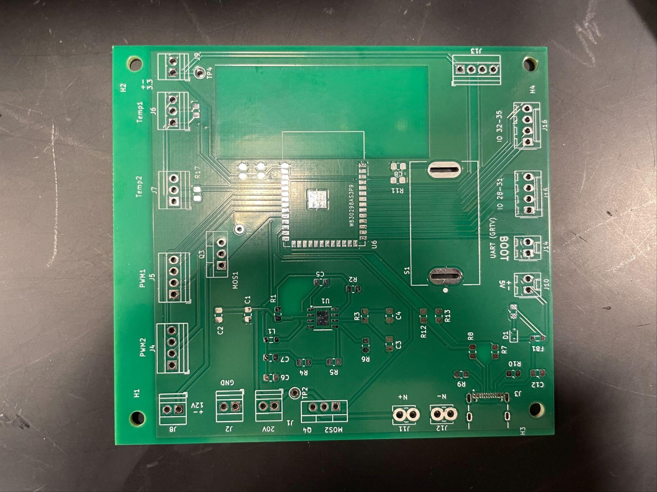
PCB ITERATIONS
v1 | v4
Multiple voltage converters | One voltage converter (3.3)
Serial Converter (USB to UART) | JTAG connector as backup, USB-C connection to ESP
Universal MOLEX connectors | Universal screw terminal connectors
Incorrect footprint used for ESP32 (WROOM-2) | Switch for EN onboard
Iteration 1
Iteration 4 (Final)
ELECTRICAL & COMPUTER ENGINEERING
GRAINGER ENGINEERING
Notes:
Hari

Slide 16
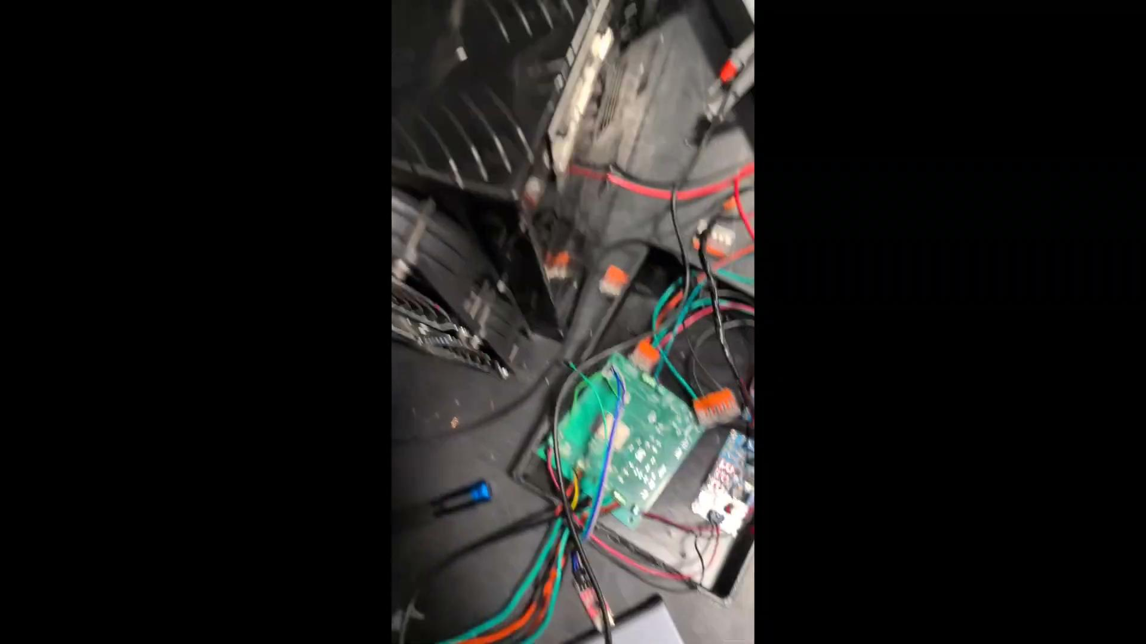
Final Showcase
ELECTRICAL & COMPUTER ENGINEERING
GRAINGER ENGINEERING
Notes:
Sidd

Slide 17
CHALLENGES
Power Supply Limitations:
Lack of power
Material Choice Issues:
Nichrome wrapped around steel pipe
Short-circuited certain parts of the nichrome
Led to uneven heating
Heat transferred to box enclosure
ELECTRICAL & COMPUTER ENGINEERING
GRAINGER ENGINEERING
Notes:
Hari

Slide 18
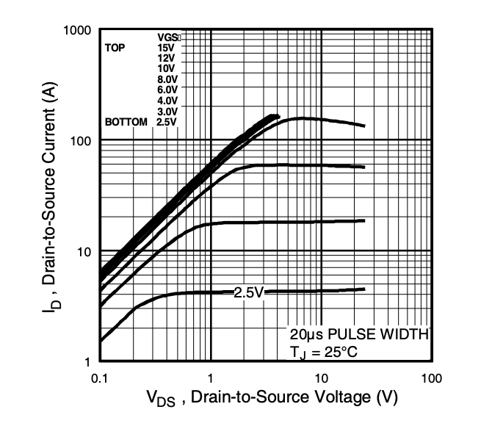
CHALLENGES
MOSFET V_{ds} vs I_{d} Curve
Issues with junction temperature
With V_{GS} = 3.3V, not possible to drive FET without burning at V_{DS} = 24V, I_{Dmax} = 10A
P_{max} of 2.8W < P_{actual}of 3.5W
Switched to 24V 10A relay
ELECTRICAL & COMPUTER ENGINEERING
GRAINGER ENGINEERING
Notes:
Hari (55V 47A)

Slide 19
High Level Requirements
Be able to modulate the temperature of the air within 3 degrees Fahrenheit of what the user inputs
Have a quiet air ventilation system, measured around 50-60 decibels
Draw < 1000W of power when heater is on, less when in fan mode
Notes:
Siddharth

Slide 20
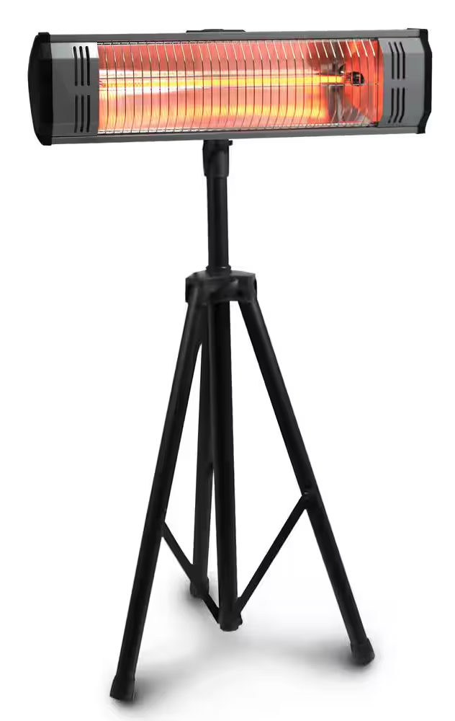
MOVING FORWARD
Design Improvements
Different Heating Elements
Infrared
Highly efficient at heating objects
Electric:
Carbon Fiber Filament + Quartz Tubes
Change orientation of nichrome
Less thermally conductive box
Larger separate relay for nichrome
Isolates high current components
ELECTRICAL & COMPUTER ENGINEERING
GRAINGER ENGINEERING
Notes:
Siddharth

Slide 21
Thank You

