Slide 1
Sensing Instrument for Generating Haptic Touch – SIGHT
Team 30 – John Lee, Dip Patel, Jamiel Abed
ECE 445 Final Presentation – Spring 2023
TA - Dushyant Singh Udawat

Slide 2
Agenda
Team/Project introduction
Project demonstration
Objectives
Design
Project build
Measurements
Successes
Conclusion

Slide 3
We are SIGHT
Team Introductions
Jamiel Abed – Computer Engineering
Dip Patel – Computer Engineering
John Lee – Electrical Engineering
What we built
A modular system that can detect objects, their speeds, their distances, and use that information to deploy a haptic feedback relative to those metrics.
In layman's terms: We built a device that detects objects and alerts the user of them.
It alerts them with a haptic feedback of varying intensities depending on how far the object is and how fast it's approaching.

Slide 4
What does it look like?

Slide 5
Objective
What are we trying to do?
Aid those who are visually impaired using ultrasonic detection
This is not a replacement to walking sticks, this is meant to serve as a supplement
Can detect further than what a walking stick can reach out to
(source: link.springer.com)

Slide 6
Design
Figure 1: Block diagram

Slide 7
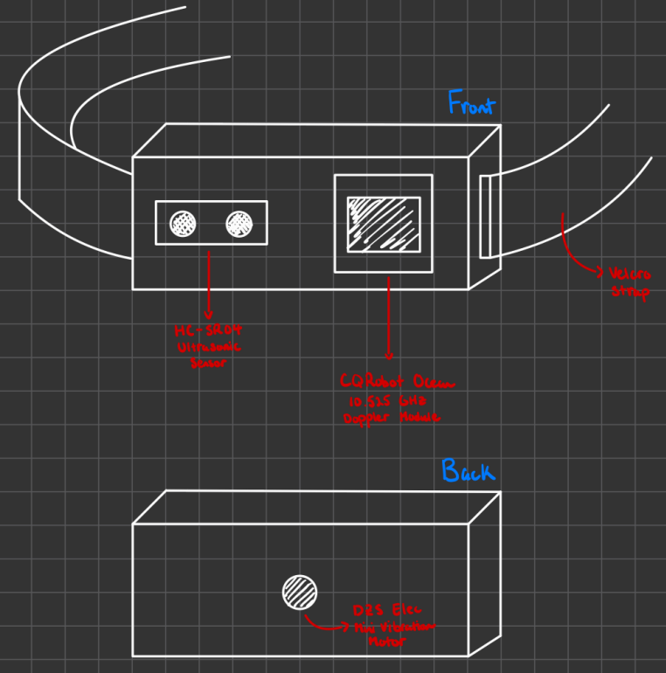
Project Build
Physical Design
Front
HB100 Doppler Module
HC-SR04 Ultrasonic Distance Sensor
Back
Haptic Pad (Mini Vibration Motor)
Inside
Development board containing microcontroller with flashed software
6V- Battery Pack
Figure 2: Physical design schematic

Slide 8
Testing Filtering
Median Filter
We use a median filter to sift through windows of data at a time to minimize noise.
This gives us more accurate readings by disregarding the extremities in each window.

Slide 9
Before Filter
Figure 3: Distance plot before filtering

Slide 10
After Filter
Figure 4: Distance plot after filtering

Slide 11
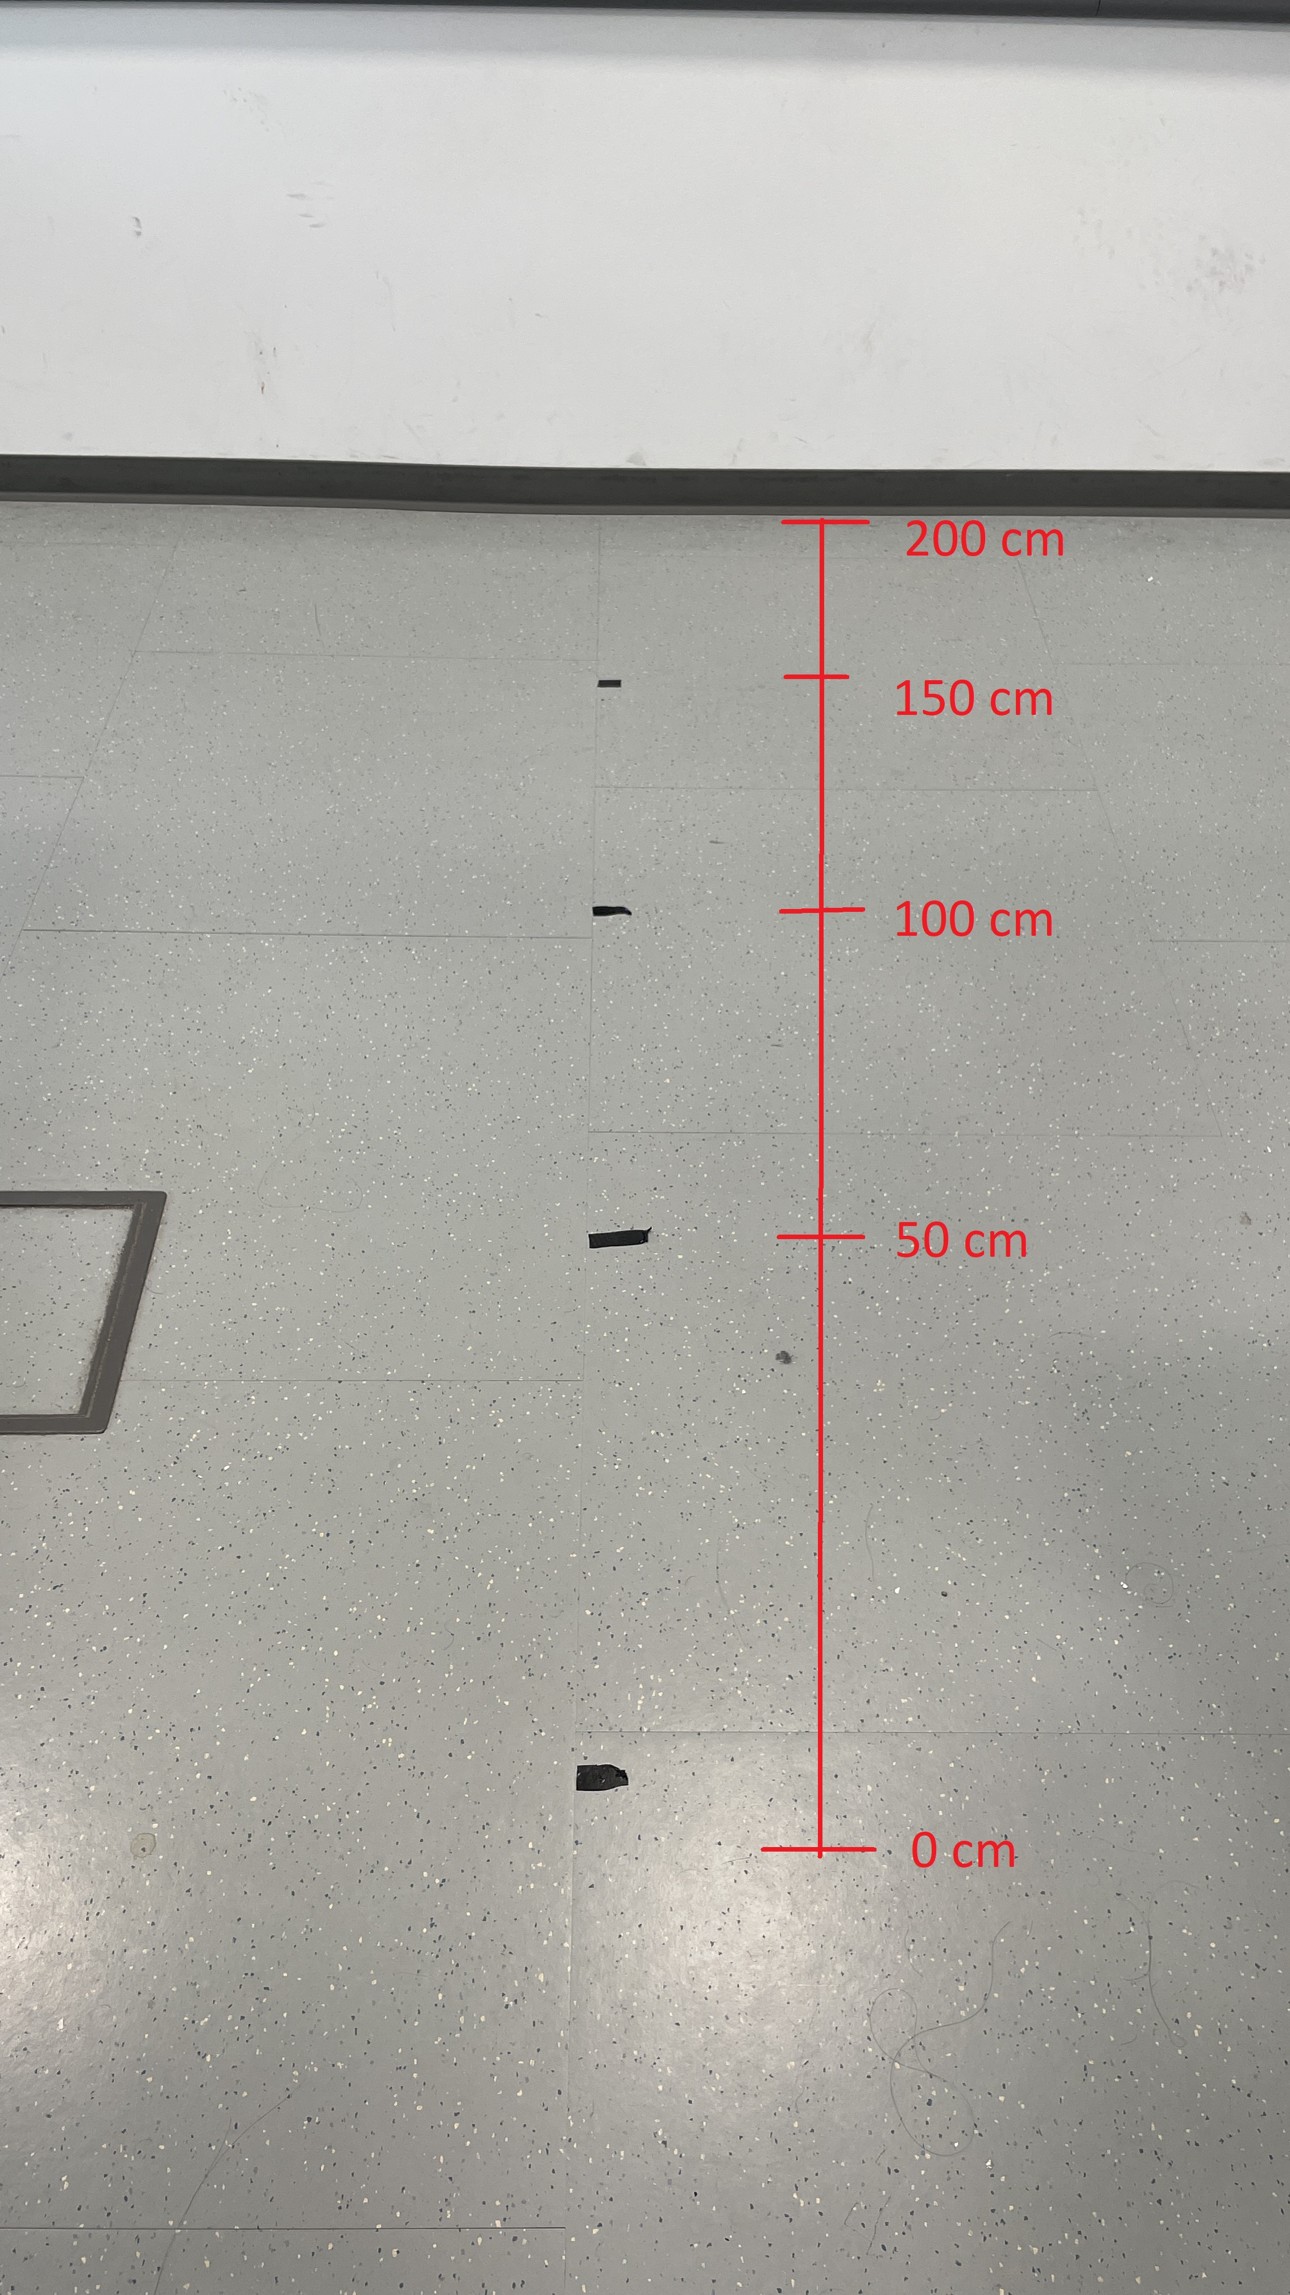
Testing Distance
Measuring Distance Readings
Distance Plot (left)
Distance Values (right)
Figure 5: Distance test setup

Slide 12
Distance Test
Within 2% error must be between 196-204 cm
Real average distance was 199.1 cm which is within the 2% error range
Figure 6: 2-meter distance test

Slide 13
Testing Haptic Intensity
Measuring the intensity of haptic motors
Records zeroes at the start
Gradually spikes up to 100 (max intensity)
Gradually spikes back down to zero (no feedback)
Figure 7: Haptic intensity readings

Slide 14
Sucesses and Challenges
Successes
Our project works as intended with good accuracy
We stayed true to our original design and plan with this project
Challenges
The Doppler Module does not contribute to the overall system as much as we had envisioned
The Doppler Module can only provide data when it detects movement
PCB flashing issues
We also faced some issues getting our project to function on the PCB

Slide 15
Conclusion
Things we have learned...
Working with a microcontroller (STM32)
How to interface and interconnect different systems together
Building and planning a project from scratch (schematics, whiteboarding, ordering parts, etc...)
Making and ordering a custom-built PCB
Writing formal style documentation that captured the entire process
Things we would do differently...
Use a bigger microcontroller (STM32F4 series) and not a nucleo development board (better hardware as well as onboard flashing)
Get better sensors (better ultrasonics or maybe even LIDAR) since sensor reliability was a major obstacle in our project

Slide 16
Future Work
Ideally would want to get better hardware and rethink the sensing algorithm
Work on extending the range as well as capabilities to work in different environments
Design better enclosure and work on miniaturizing components so that it is more ergonomic for the user
Getting this approved by NIH and FDA for public use

Slide 17
Questions?

