Slide 1
Desalination Prototype
By: Seunghwan Hong, Alan Cardiel, Kinjal Dey

Slide 2
About Us
Notes:
Seunghwan/Alan/Kinjal:

Slide 3
About the Project
What does water insecurity around the world and global warming have in common?
The solution to both require fresh water. In order to solve both these problems, Professor Jont Allen of the ECE Department proposed a desalination system to which can service water insecure areas around the world.
Our project is designed to help him out by making his test prototype more user-friendly, and easier to operate.
Notes:
Kinjal:

Slide 4
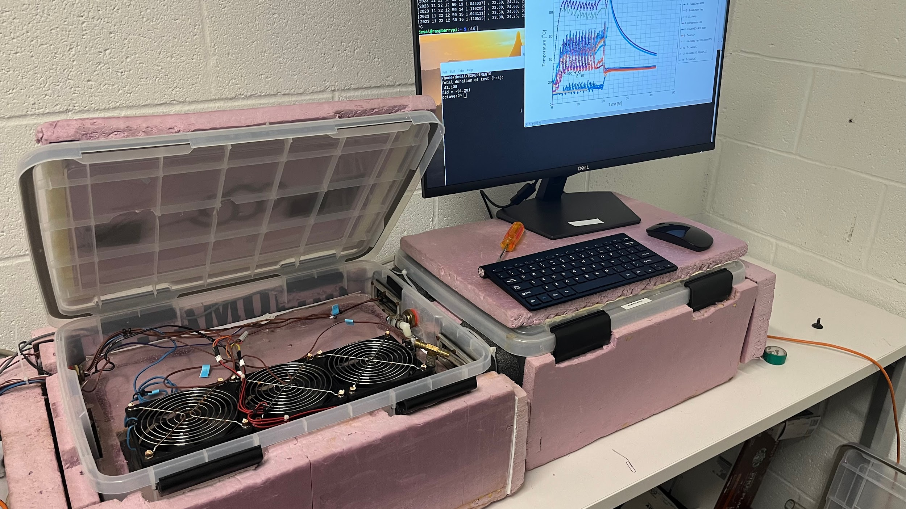
Prototype
Notes:
Alan:

Slide 5
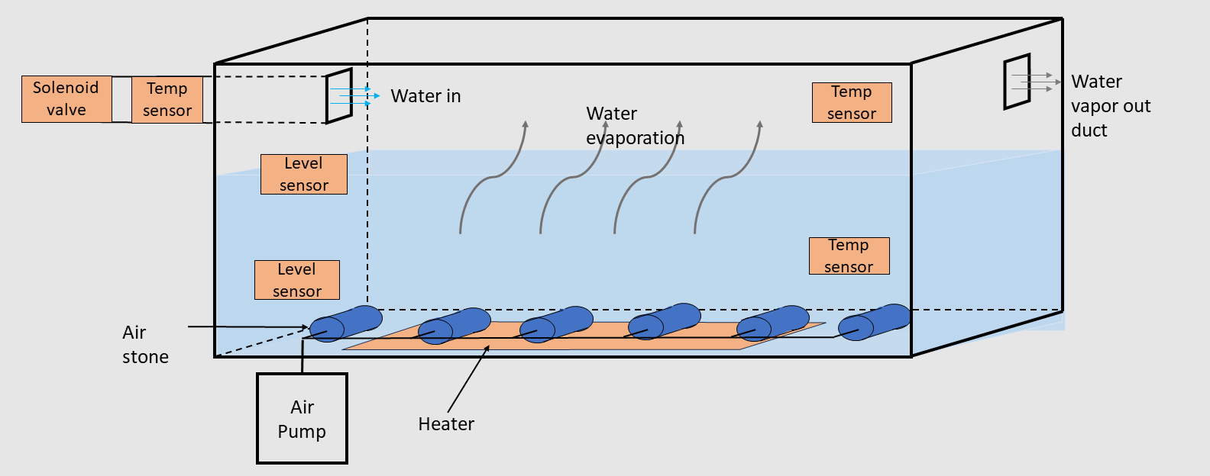
Notes:
Alan:

Slide 6
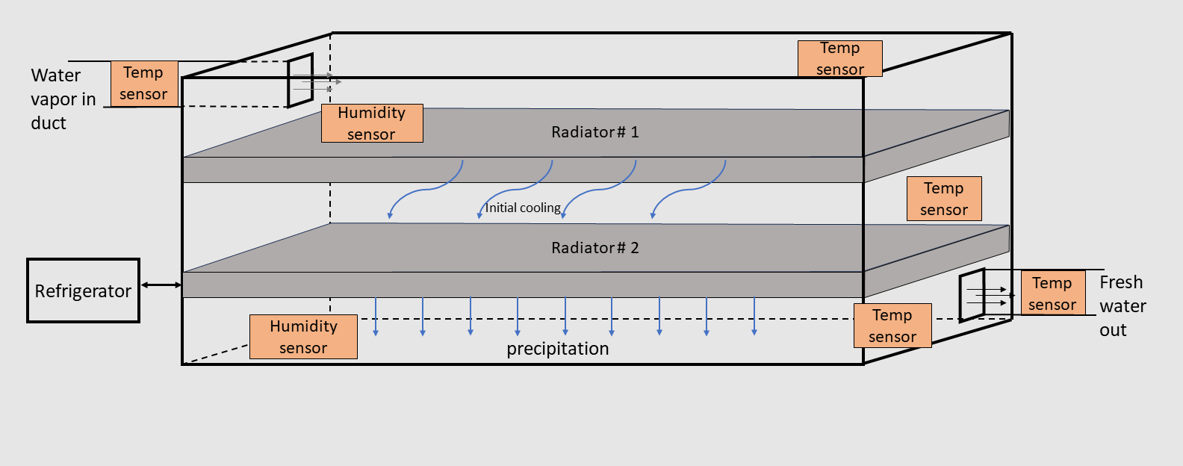
Notes:
Alan:

Slide 7
High Level Requirements
Connect sensors and power devices to our board
Automate the system from our board and collect the data
Make a UI to display graphical representation and store the data in CSV
Notes:
Alan:

Slide 8
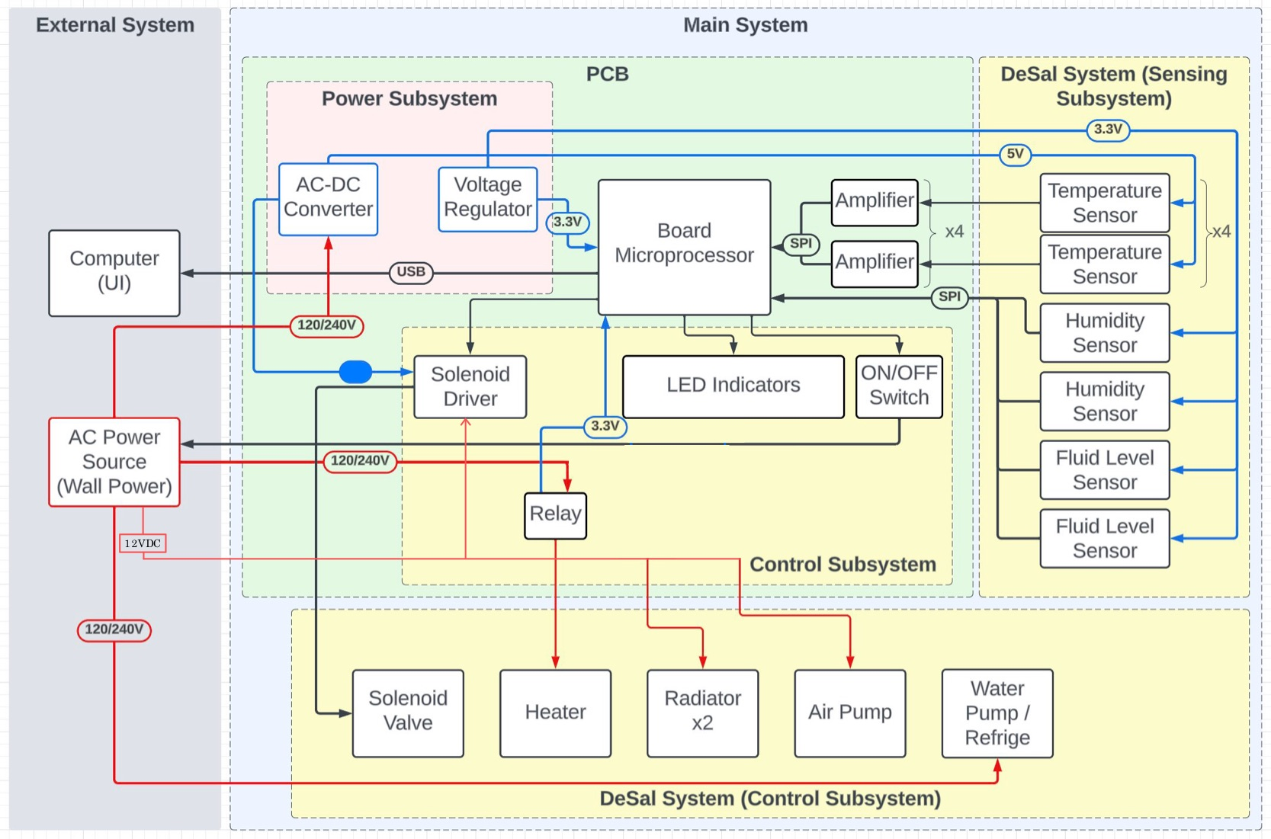
Block Diagram
Notes:
Seunghwan:

Slide 9
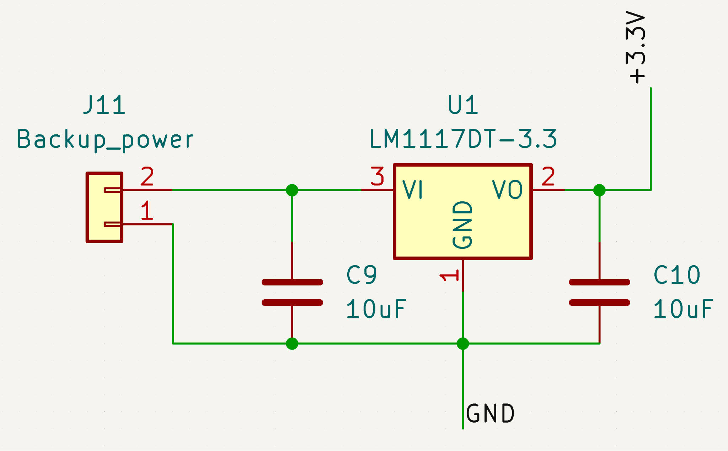
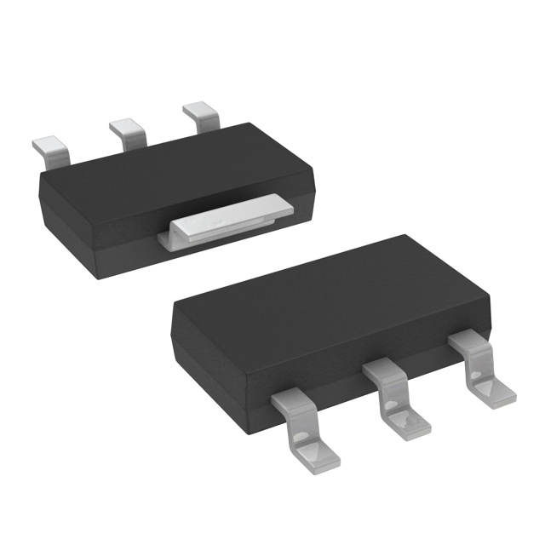
Voltage Regulator
Requirement:
Use the voltage input of 5VDC and set it to a constant level of 3.3VDC to be utilized by humidity sensors/temperature sensors/3:8 MUX/microprocessor.
The output current from the voltage regulator must meet the minimum current requirement of 500mA.
Functional Test Result:
Upon connecting a 5VDC power supply via USB, the voltmeter recorded an output voltage of 3.42VDC.
As per the datasheet specifications, the output current is 800mA, satisfying our requirements.
LM1117IMPX-3.3/NOPBTR-ND
Notes:
Seunghwan: The highlighted one is required values and one in red is actual value measured.

Slide 10
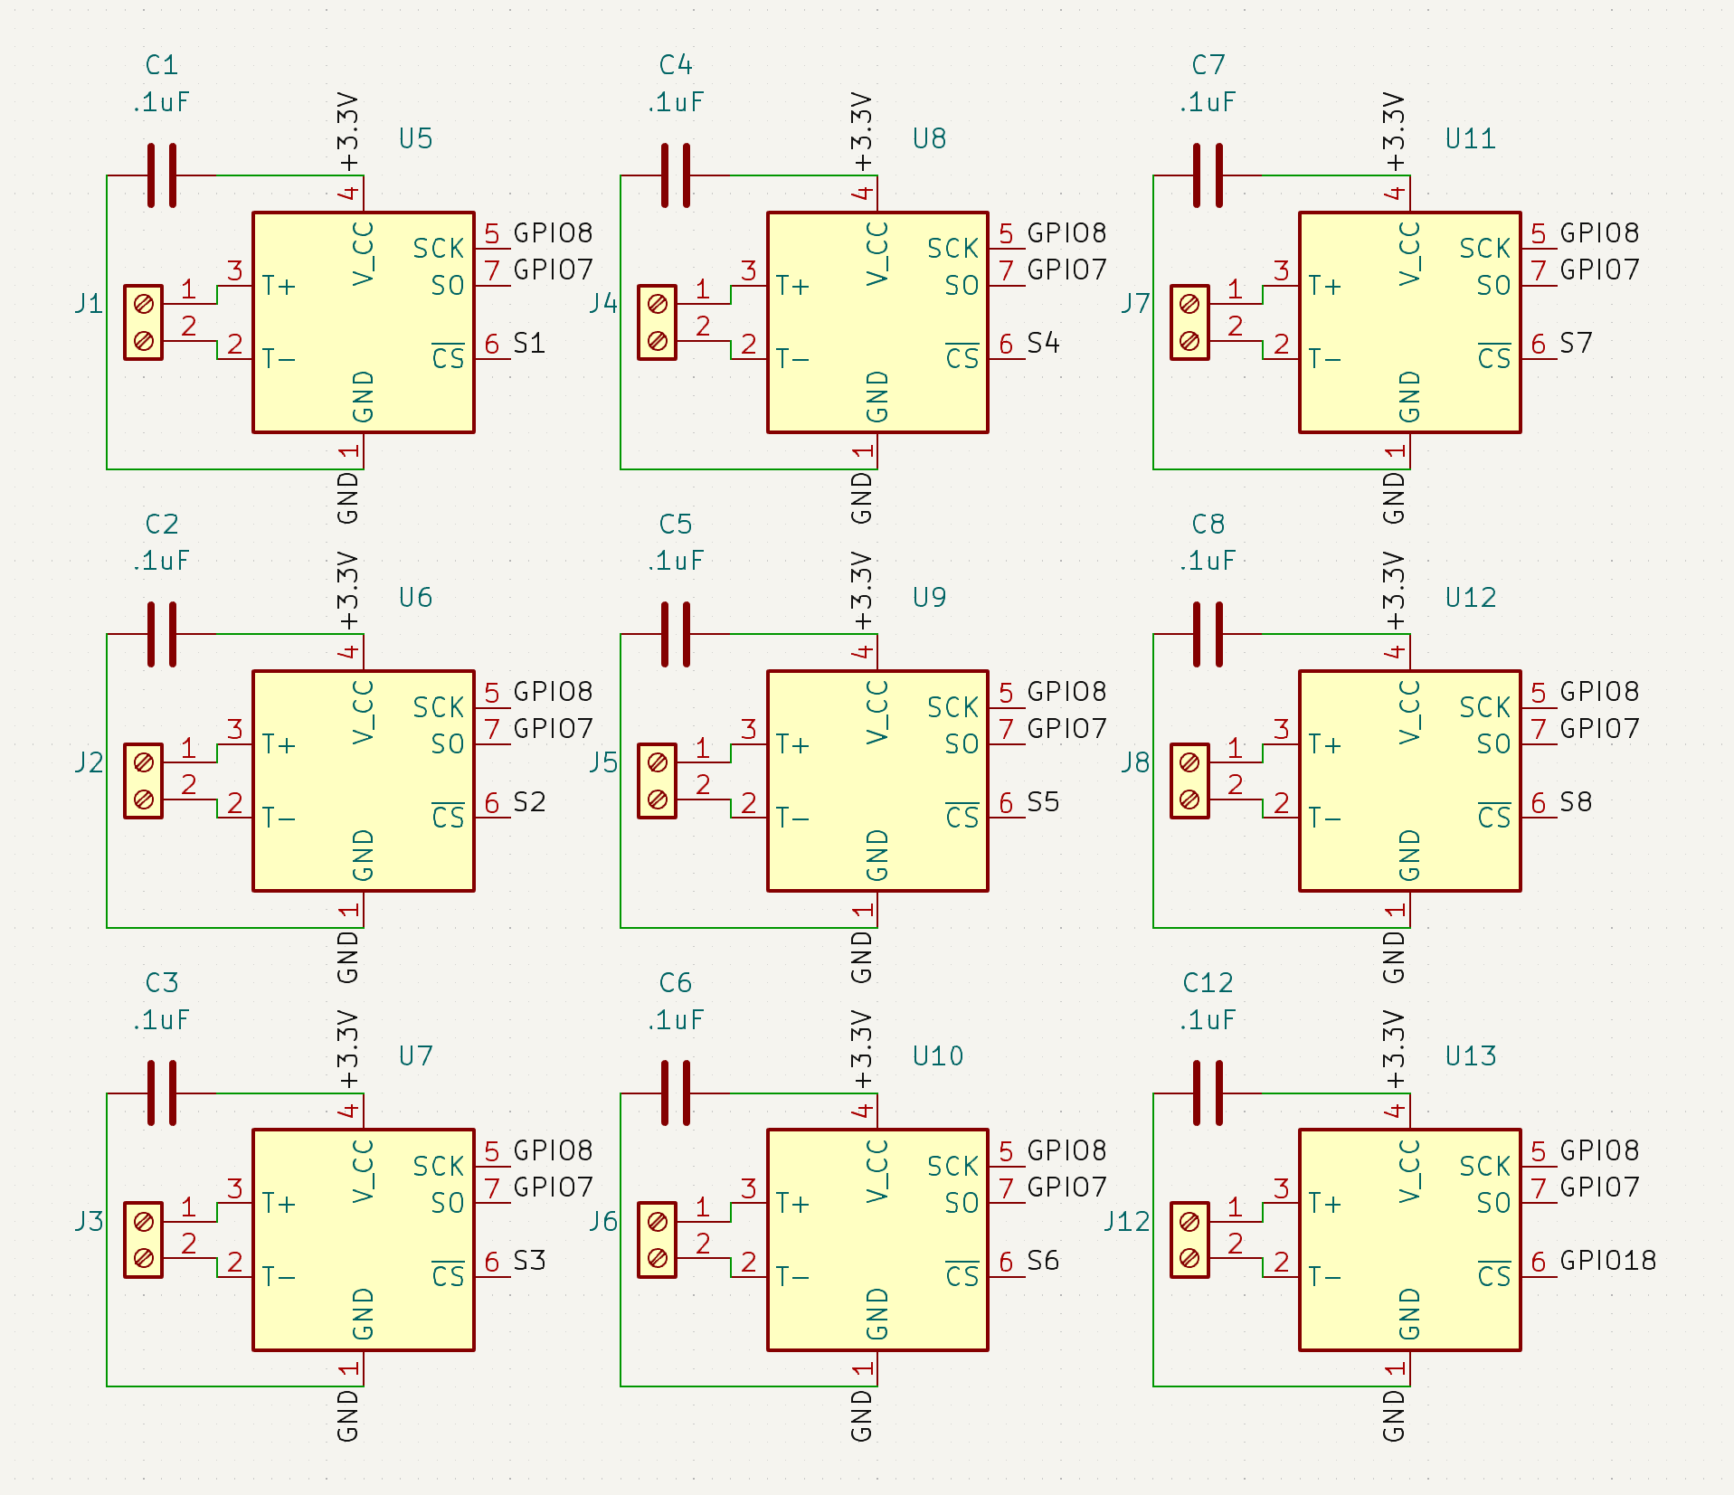
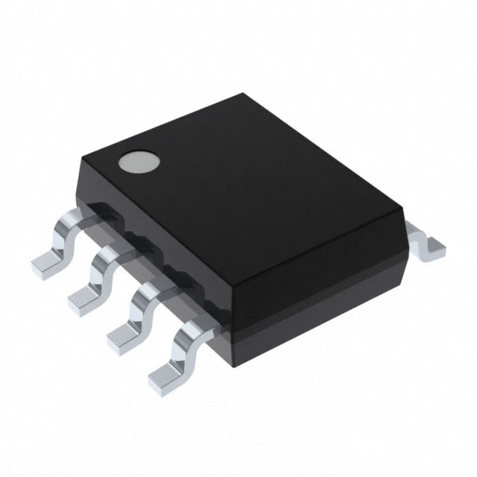
Temperature Sensors
Requirement:
The temperature sensor must operate at a minimum of 3VDC.
Be able to properly read the 14-bit temperature data output of the sensor.
Functional Test Result:
When measuring the voltage between VCC and GND using a voltmeter, the recorded reading was 3.28VDC.
MAX31855JASA+T
Notes:
Seunghwan:

Slide 11
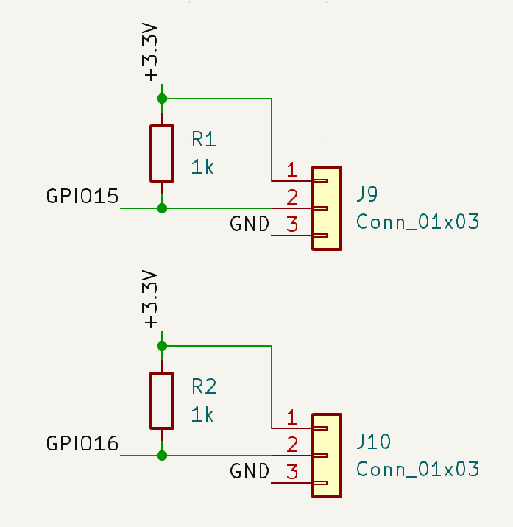
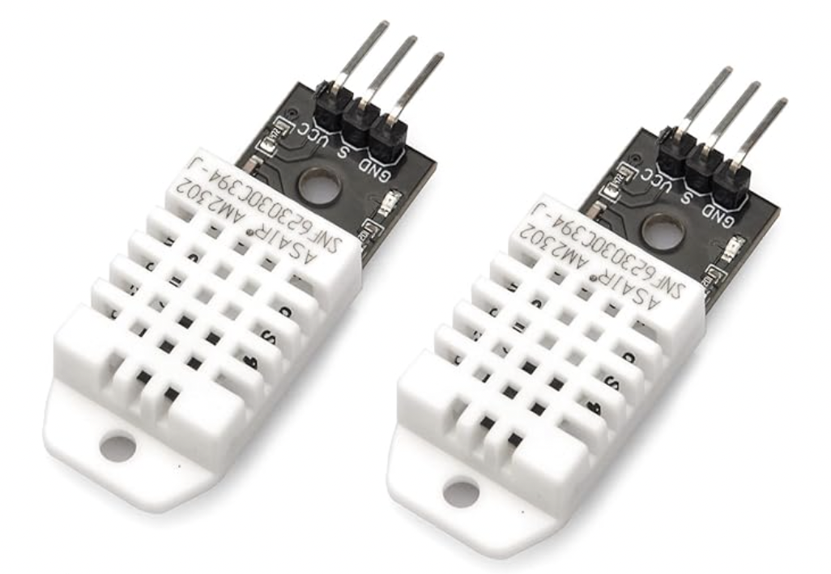
Humidity Sensors
Requirement:
The humidity sensor must operate with a voltage of 3.3VDC.
Read the 16-bit humidity data from the humidity sensor properly.
Functional Test Result:
When measuring the voltage between VCC (pin 1) and GND (pin 3) using a voltmeter, the recorded reading was 3.28VDC.
DHT22
Notes:
Seunghwan:

Slide 12
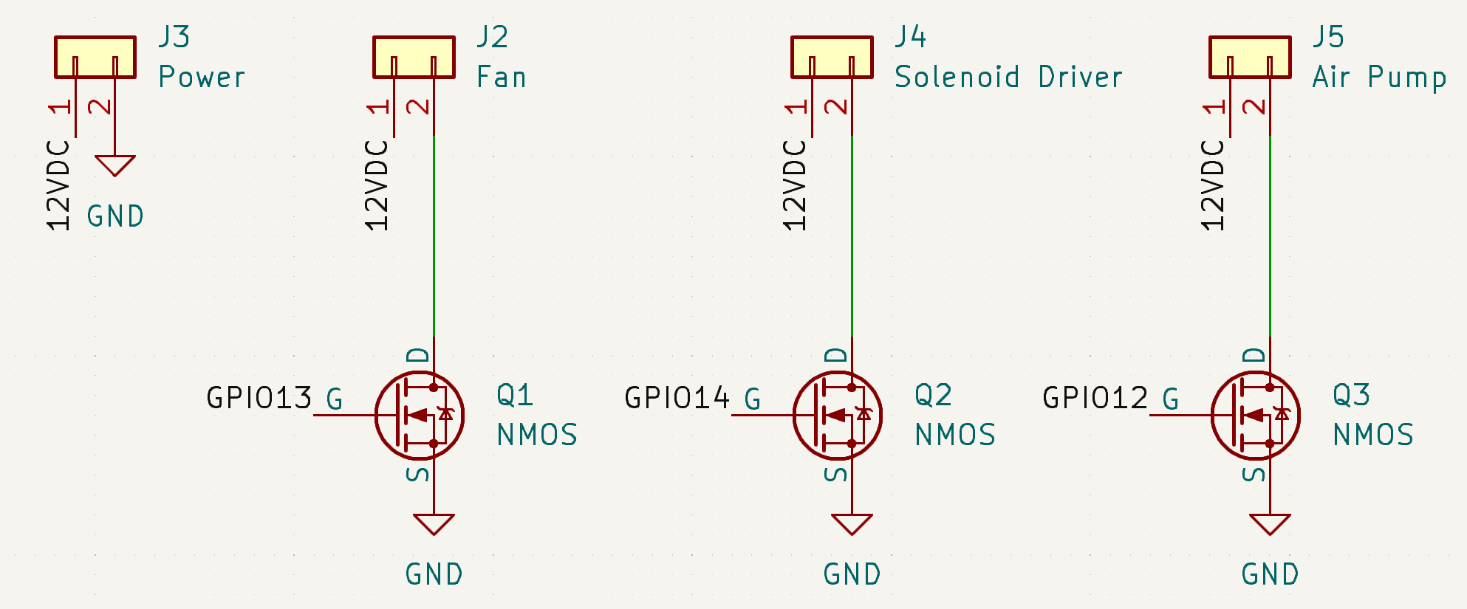
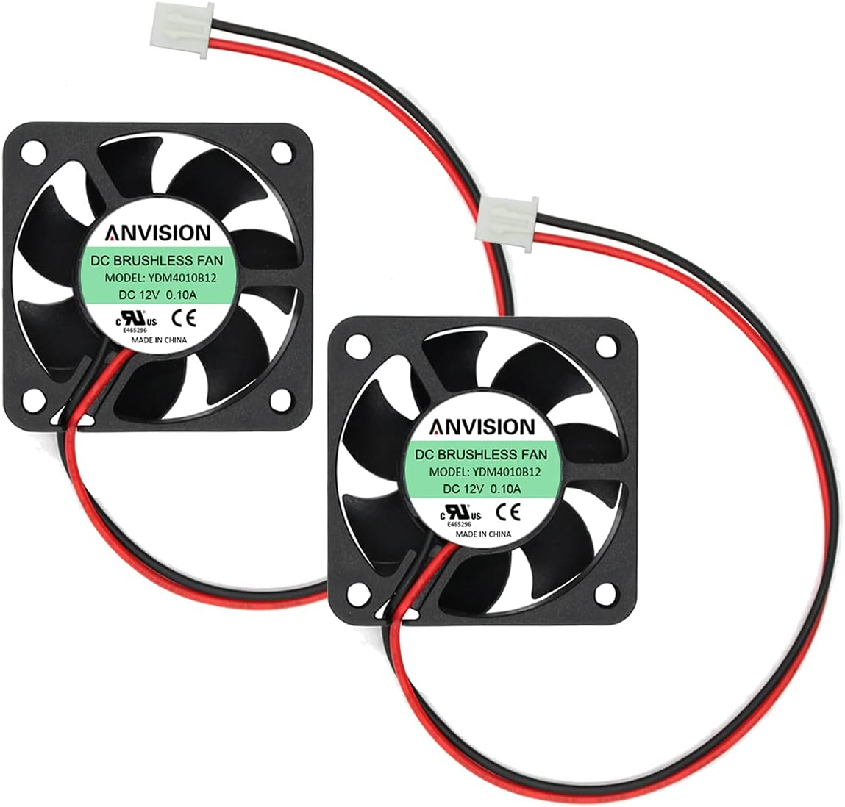
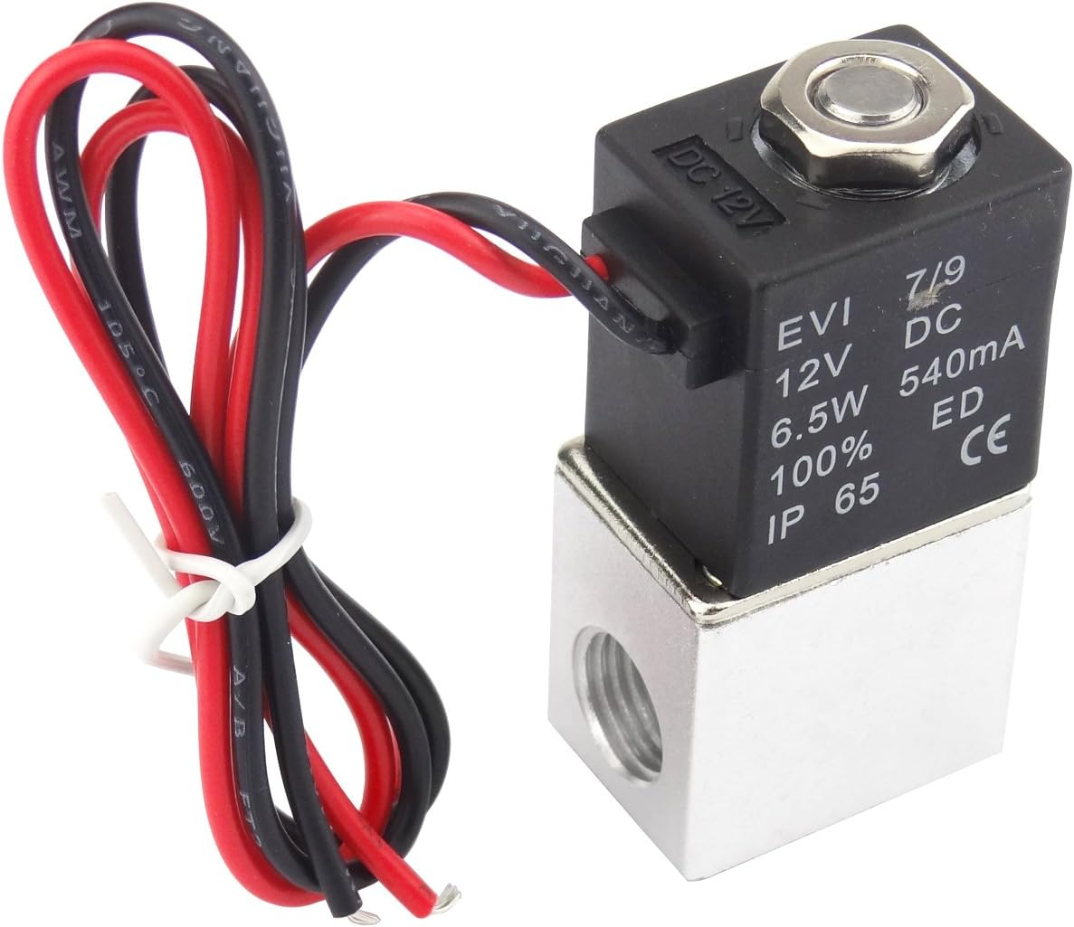
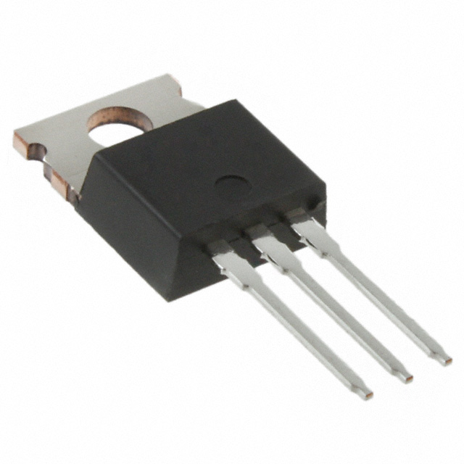
Power Supply/MOSFETs
Requirement:
The fan, solenoid driver, and air pump require a 12VDC operating voltage.
The MOSFET should facilitate the flow of current from drain to source when a 3.3VDC signal is applied at the gate.
Functional Test Result:
Upon setting the GPIO from the ESP32 to a high state and providing 3.3VDC to the MOSFET gate, a current path was established from the drain to the source. This resulted in the supply of 12VDC to the fan, solenoid driver, and air pump when they were linked to the 2-pin connector.
IRF540PBF
Notes:
Seunghwan:

Slide 13
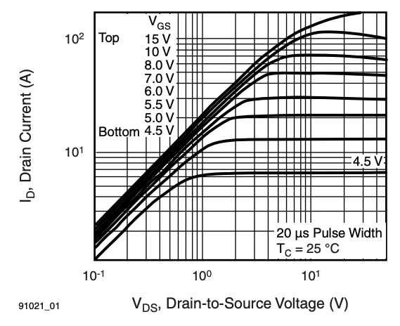
MOSFETs
When the GPIO is set to a high state,
the voltage difference (VGS) between the gate and source is 3.3V.
With a connected 12VDC adapter, the voltage difference (VDS) between the drain and source is 12V.
As a result, the drain current (ID) exceeded 1A, meeting the necessary current requirements for the fan (100mA), solenoid driver (540mA), and air pump (100mA).
Notes:
Seunghwan:

Slide 14
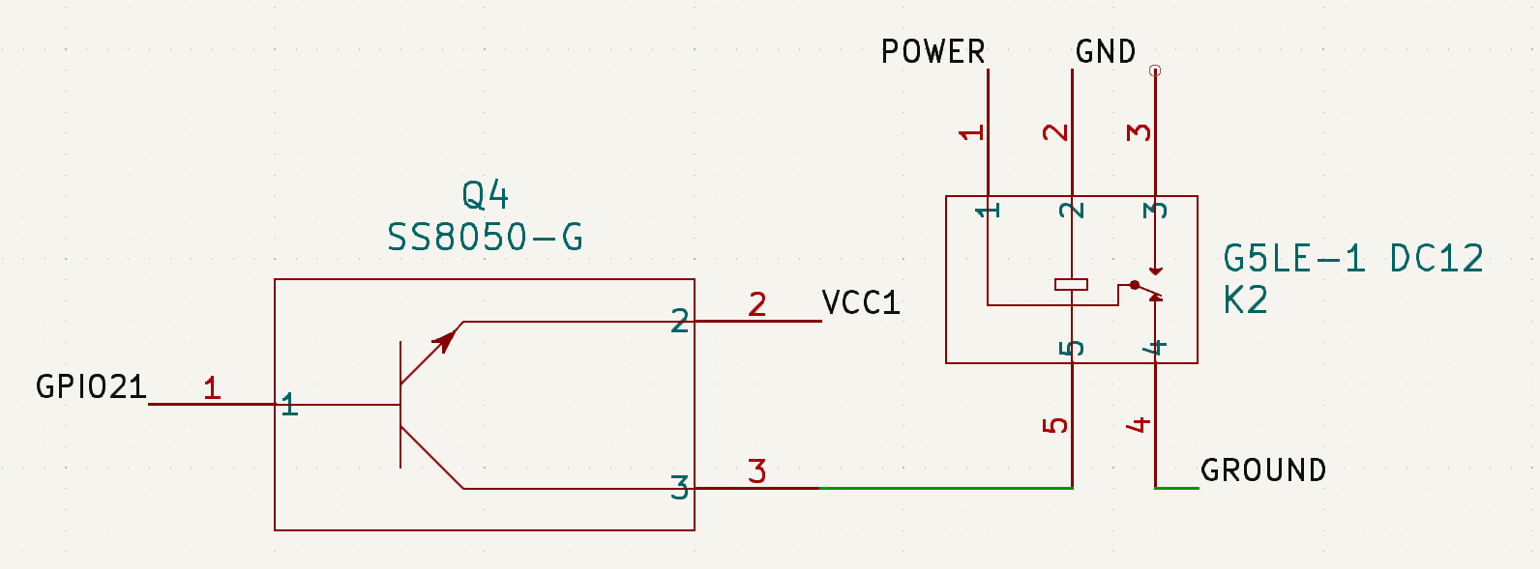
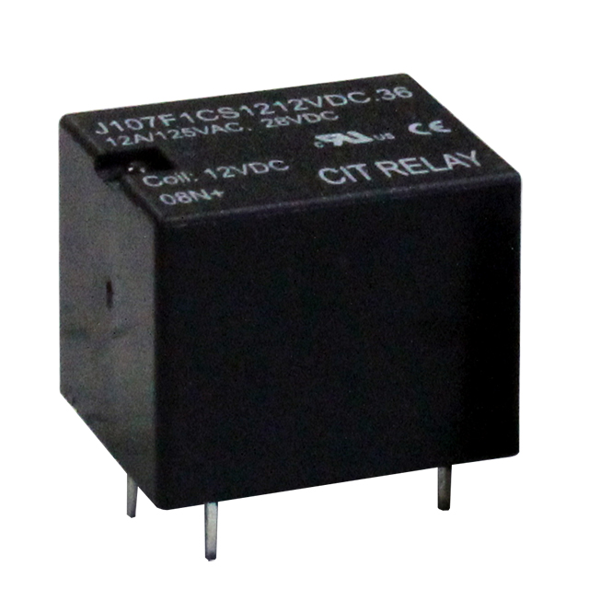
Relay
Requirement:
The voltage difference between pin 5 and pin 2 must be at least 75% of rated coil voltage (2.25VDC) in order to pick up the relay (turning the switch ON).
Functional Test Result:
Our relay's specified coil voltage is 3VDC, necessitating a minimum of 2.25VDC for activation. When a square wave with a peak-to-peak voltage of 3.2VDC, DC offset of 1.6VDC, and a frequency of 0.5Hz was applied, the relay alternated between pick up and release every 1 seconds. The audible clicking noise from the relay distinctly confirmed its ON and OFF toggling.
J107F1CS1212VDC.36-ND
Notes:
Seunghwan:

Slide 15
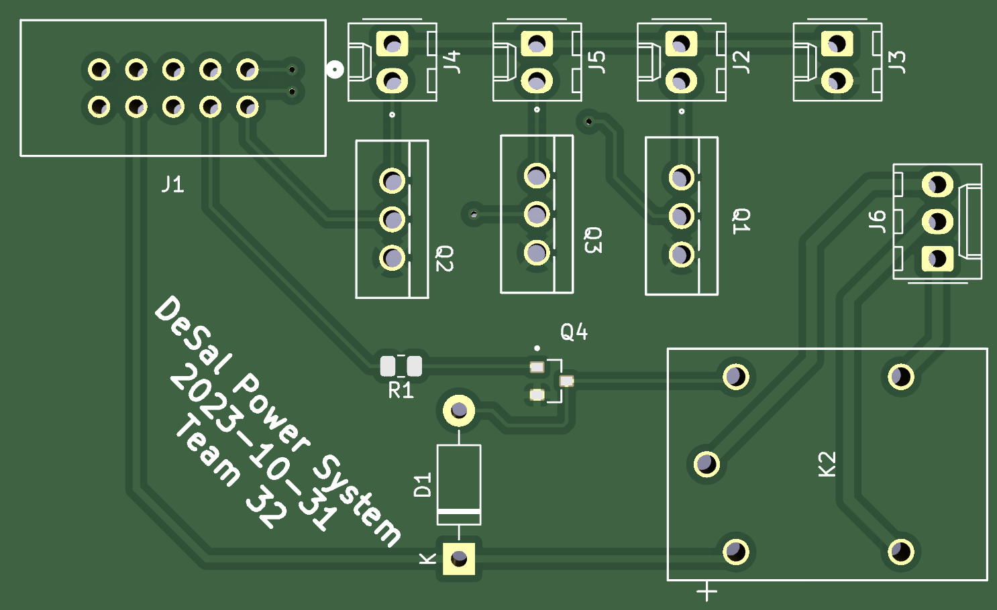
Design - High Power/Control Board
Pin Header: for connecting GIPOs from the motherboard
Power Supply: for supplying 12 VDC for fan/solenoid driver/air pump
Power Supply: for supplying 12VDC for fan/solenoid driver/air pump
Screw Terminal: for connecting AC cord used for heater
2 Pin Connector: for connecting an/solenoid driver/air pump
BJT: for controlling coil voltage on relay with 3.3VDC input from GPIO
MOSFET: for controlling fan/solenoid driver/air pump using GIPOs
Relay: for controlling ON/OFF of the heater
Notes:
Seunghwan:

Slide 16
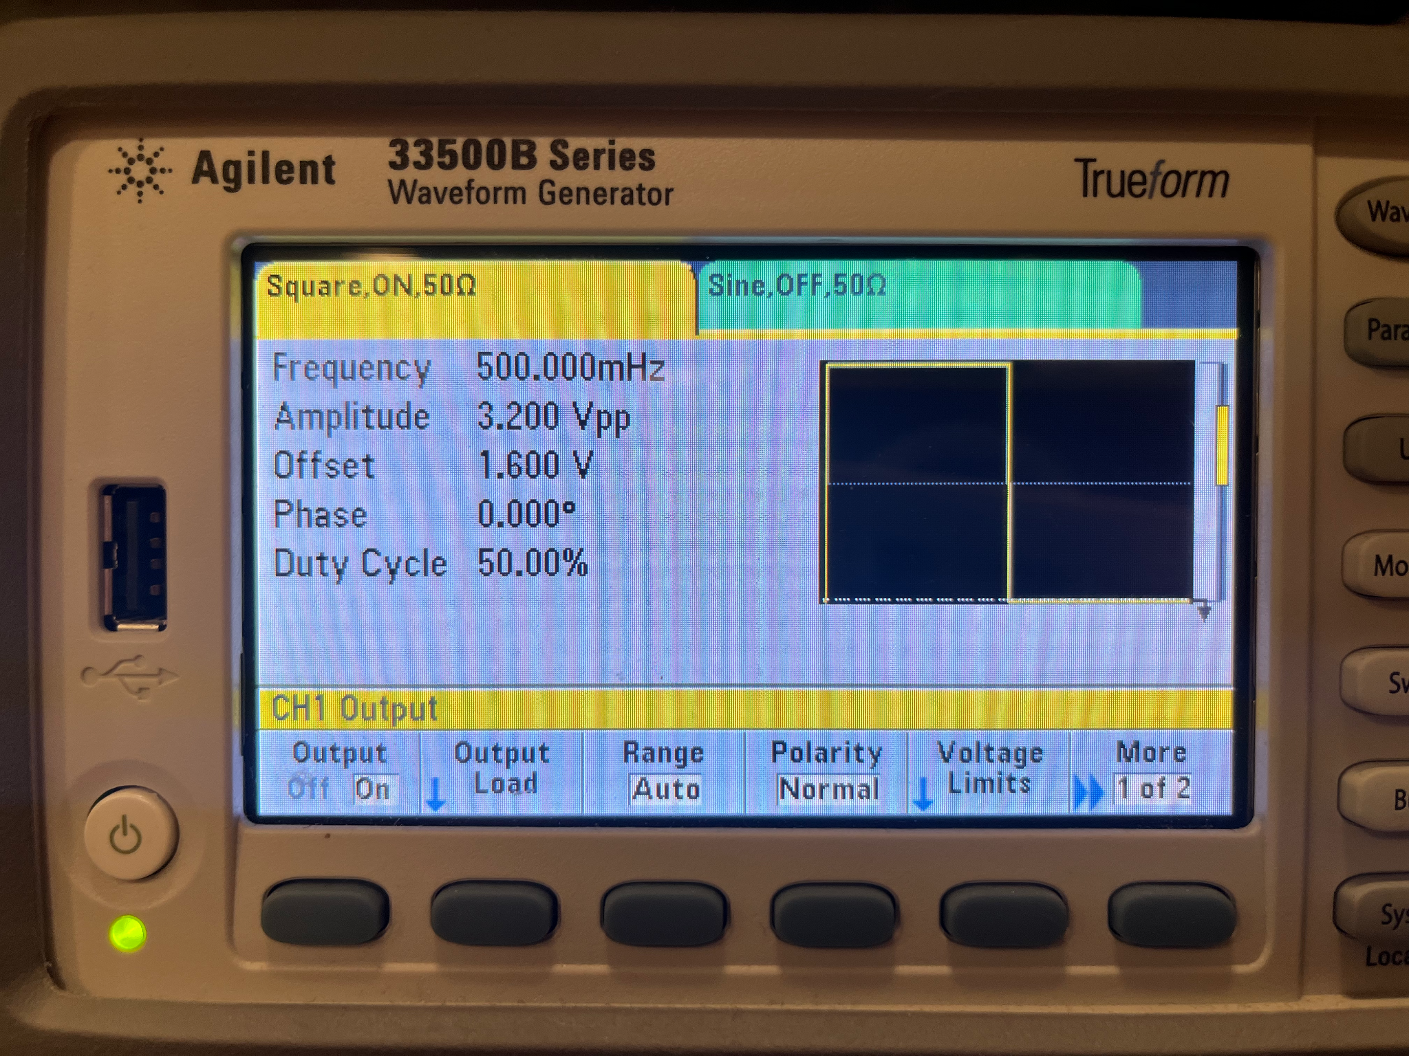
Relay Functionality
Applied Waveform
Notes:
Seunghwan:

Slide 17
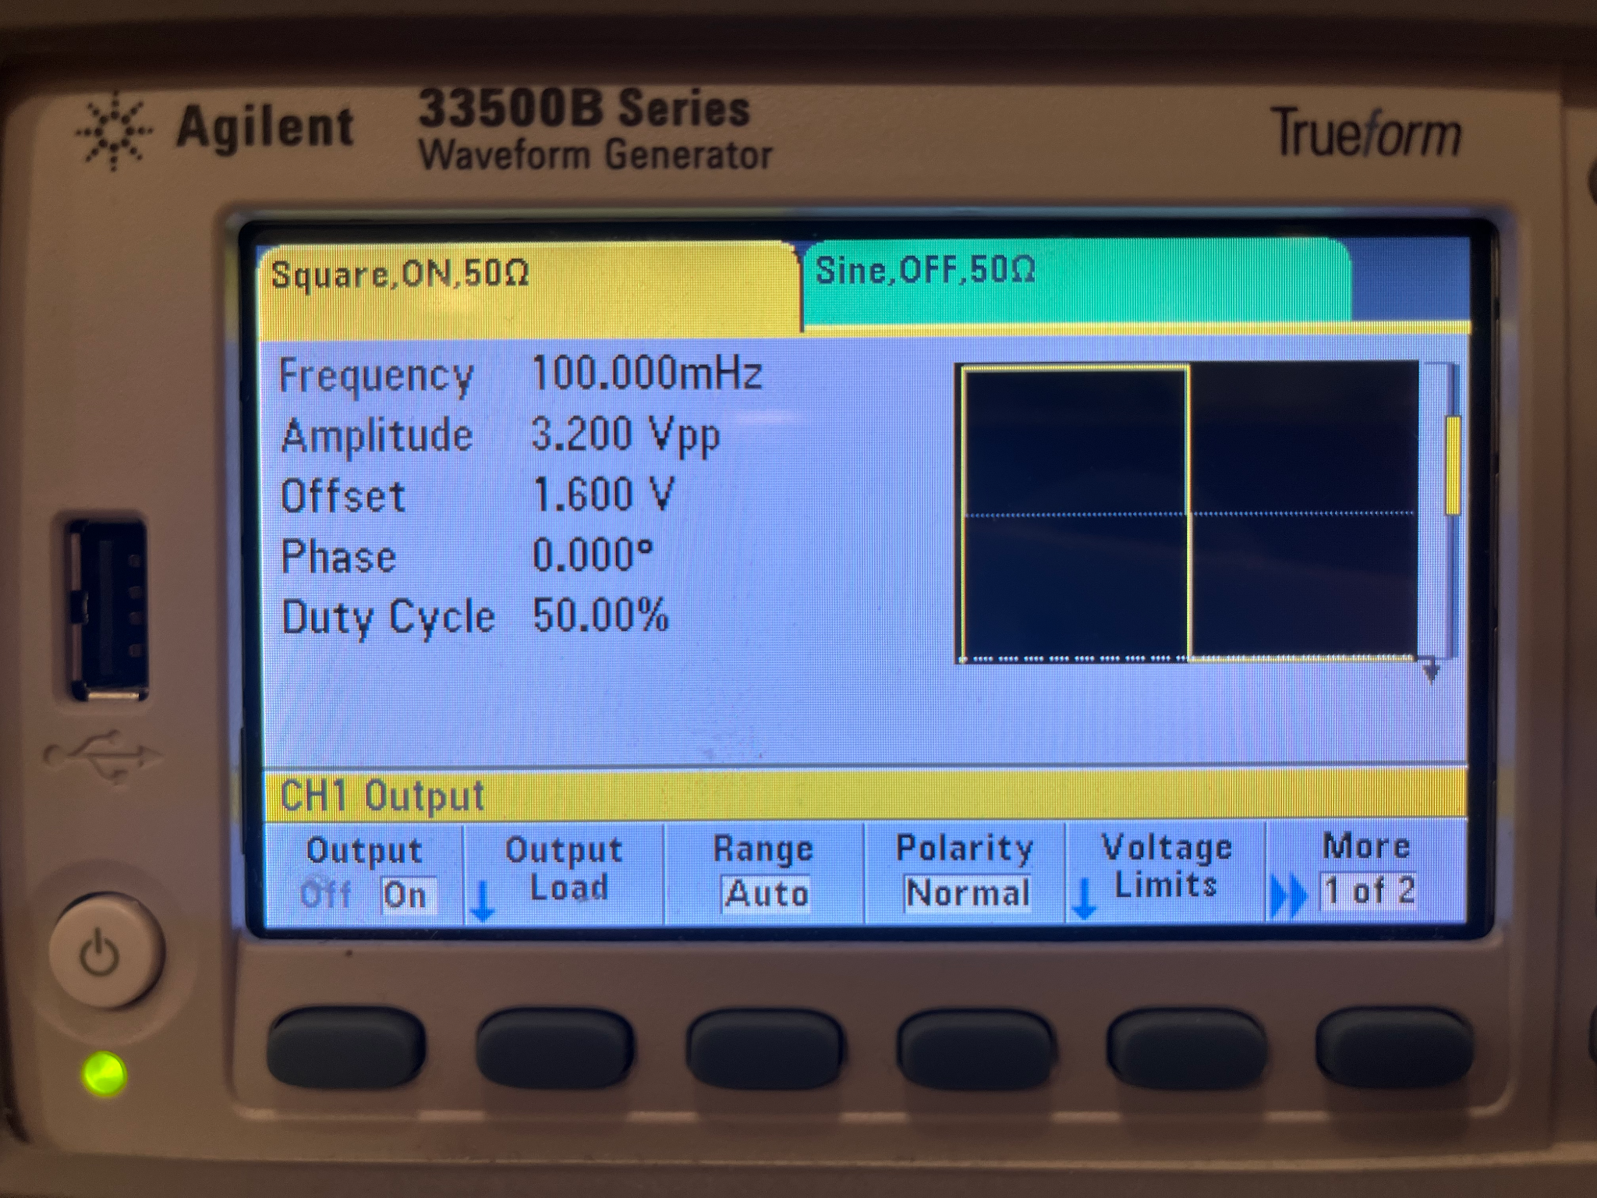
MOSFET Functionality
Applied Waveform
Notes:
Seunghwan:

Slide 18
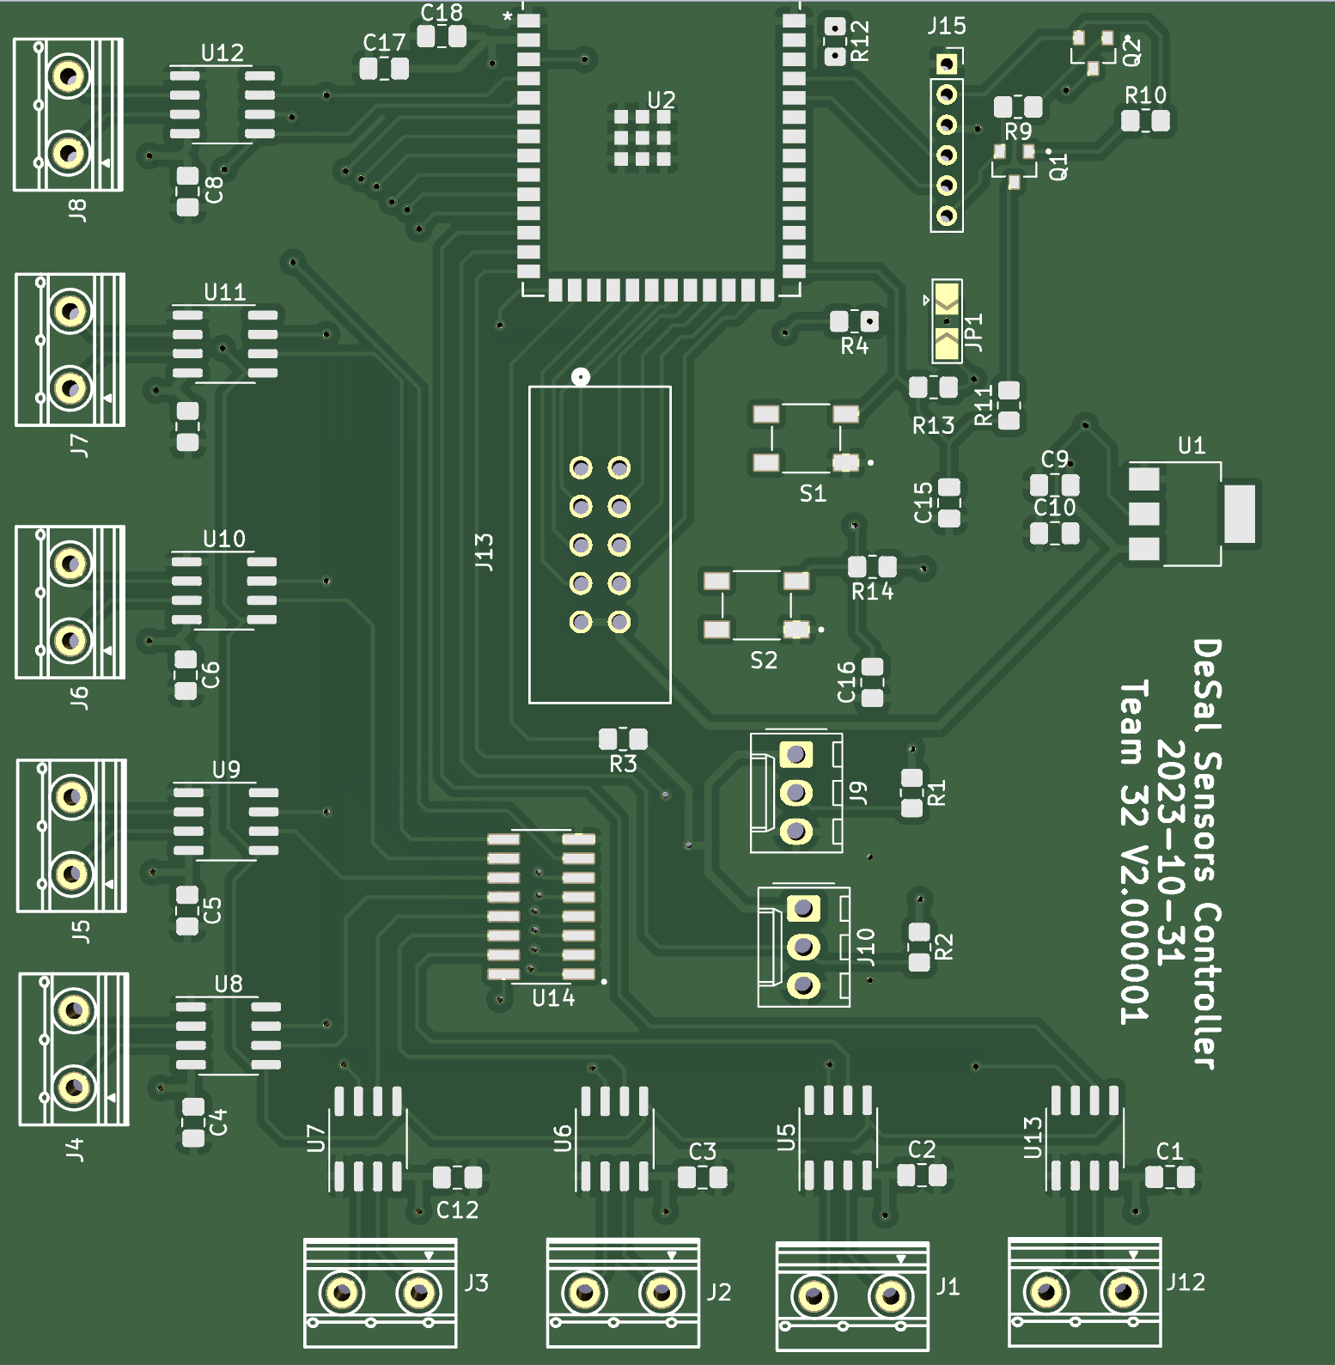
Design - Low Power/Sensing Board
Pin Header: for connecting GIPOs to the daughter board
ESP32: microprocessor for collecting temperature/humidity/water level datas and controlling system
Capacitor: decoupling capacitor for reducing noise
Pin Header: for USB module
Voltage Regulator: for converting 5VDC from USB to 3.3VDC
Buttons: for reset/download boot mode
Humidity Sensors: connected with 3 pin connector for collecting humidity data from various locations on the system
3:8 MUX: for chip select of 8 temperature sensors
Screw Terminal: for connecting thermocouples
Temperature Sensors: amplifier for collecting temperature data from various locations on the system through thermocouple
Notes:
Seunghwan:

Slide 19
Testing & Results - Humidity Sensors
Requirement:
Read the 16-bit humidity data from the humidity sensor properly.
Read if level sensor signal is passed
Functional Test Result:
Using the DHT library we successfully humidity data from the sensor
Correctly read humidity with some error from a know environment
Read a signal we had passed to the level sensor to ensure it worked
Notes:
Alan:

Slide 20
Humidity Sensor Functionality
Notes:
Alan:

Slide 21
Testing & Results - Temp. Sensors
Requirement:
Read from the 12 temperature sensors connected to the 3:8 MUX
Read the lone sensor connected directly to our board
Functional Test Result:
Use Adafruit’s library we can read from the lone Sensor
With modifications to the the same function we were able to read data from at least 2 other sensors connected to the MUX
Notes:
Alan:

Slide 22
Temp. Sensor Functionality
Notes:
Alan:

Slide 23
Testing & Results - Relays & MOSFET
Requirement:
Control the components from our microprocessor
From data reading be able to automate controlling power supply
Functional Test Result:
Successful in being able to turn on/off components
Able to separately control each of the 12VDC components
Didn’t have time to connect to the testing prototype to be able to test the automatic controlling
Notes:
Alan:

Slide 24
Microprocessor Functionality
Notes:
Alan:

Slide 25
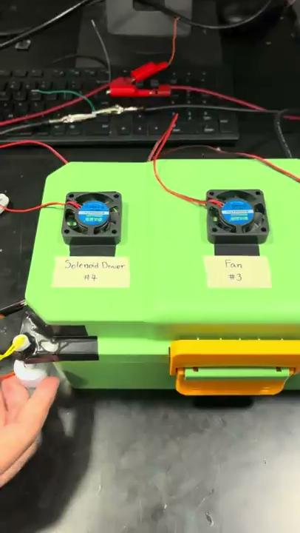
Level Sensor Functionality
Water Level | GPIO | Heater | Solenoid Driver
0 | 0 | 0 | 0
0 | 1 | 0 | 1
1 | 0 | 0 | 0
1 | 1 | 1 | 0
Upper Level Sensor: 0
Lower Level Sensor: X
Upper Level Sensor: X
Lower Level Sensor: 1
Notes:
Alan:

Slide 26
Description - Firmware
Interact and operate with the devices via code over SPI
Communicate through a serial monitor over USB
Errors & efficiency are handled by the previously mentioned libraries
Main challenge was being able to read temperature sensors data connected to the MUX
Most of our code is simply setting up how to interact with our PCB to then connect it to our software and UI
Notes:
Alan:

Slide 27
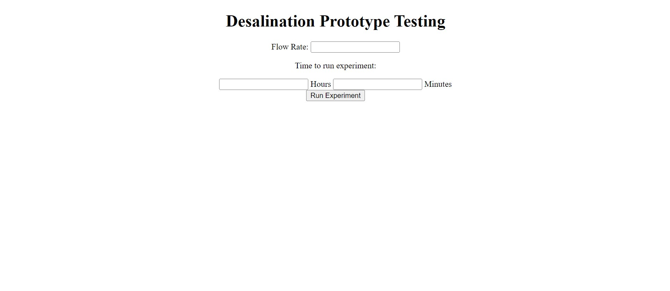
Design - Software
Built an app to run the experiment directly from a computer, and collect and display the data received in a manner that is easy to understand.
Notes:
Kinjal:

Slide 28
Live-Plotting Feature
Notes:
Kinjal:

Slide 29
Description - Software
The app was built with Flask using jinja2 templating. We used the Animation class in the Matplotlib library to plot the data in real time and pyserial to communicate with the ESP32 microcontroller.
Notes:
Kinjal:

Slide 30
Successes and Challenges - Hardware
Footprint VS Real (MOSFET/BJT)
MOSFET: Configuration of Drain/Gate/Source were different Solution: Drain/Gate/Source → Gate/Drain/Source by bending pin (Through Hole)
BJT: Configuration of Collector/Base/Emitter were different Reason for failure: Collector/Emitter were flipped → used insulation tape and wire (Surface Mount) → short circuit Future Solution: Connect GPIO directly to Relay without using BJT
Common Ground (High Power Circuit/Low Power Circuit) Solution: connected GND of both circuit using wire
Strapping Pin Solution: placed resistor between strapping pin and 3.3VDC voltage source
Major Success:
Supplying Sufficient Voltage/Current
Controlling MOSFET
Notes:
Seunghwan:
Thought must turn on voltage is 75% 5VDC , included BJT with external 5VDC voltage source to control voltage between relay with GPIO that outputs 3.3VDC, when VBE (GPIO) is high, IC will flow current through collector supply 5VDC to the relay → however due to difference in configuration between footprint and real component, emitter and collector were flipped → collector was grounded and emitter was connected with relay/5VDC voltage supply → since our BJT was surface mount instead of through hole, easy fix with bending pin was impossible so I used insulation tape to cover collector/emitter and connected to correct configuration by soldering wire directly → failure in BJT/insulation tape must melted and possibly short the circuit. → now that I know 3.3VDC is enough for must turn on voltage, I can directly connect GPIO to relay.

Slide 31
Successes and Challenges - Firmware
Challenges
Temperature Sensor: couldn’t read some sensors
Reading CS from MUX
Data bus clobbering
3:8 MUX: wasn’t connected initially & timing for CS was offset
No connection = no reading
MUX output time < time for reading sensor
Major Success:
Program microcontroller
Read Humidity Sensor & Temperature Sensor one with and one without MUX
Notes:
Alan:

Slide 32
Successes and Challenges - Software
Real-time plotting
We ran into a threading related issue, as multiple processes had to run simultaneously.
We fixed this issue, by using the FuncAnimation function in the Animation class in the Matplotlib package.
Connecting to ESP-32 microcontroller using serial USB
Unfortunately we didn’t have time to figure out the communication between the microcontroller and the app.
We believe the issue lies with the microcontroller not being able to handle requests from Flask due as they were improperly handled in both the firmware and software code.
Notes:
Kinjal:

Slide 33
Conclusions
What did we learn
Prototyping, Testing ,and Iterating are crucial in design
What would we do differently
No BJT for the relay and connect GPIO directly
Design with correct footprint
Mistakes we made
Forgot to connect enable pins for the MUX
Wrong Footprint
Notes:
Kinjal:

Slide 34
Recommendations for future work
Implement our board into the prototype to test if it can fully automate once inside
Figure out connecting the app to the microcontroller through USB.
Notes:
Kinjal:

