Slide 1
Muscle Highlighting Fitness Device
Team 31: Anushka Pachaury, Sreyas Dhulipala, Sangyun Lee
Notes:
-EVERYONE

Slide 2
Problem
Individuals struggle to engage and develop specific muscle groups during workouts
Incorrect form can put excessive stress on joints and muscles, increasing likelihood of strains
Can be demotivating when individuals are unable to see visible results from their workout
Notes:
-ANUSHKA

Slide 3
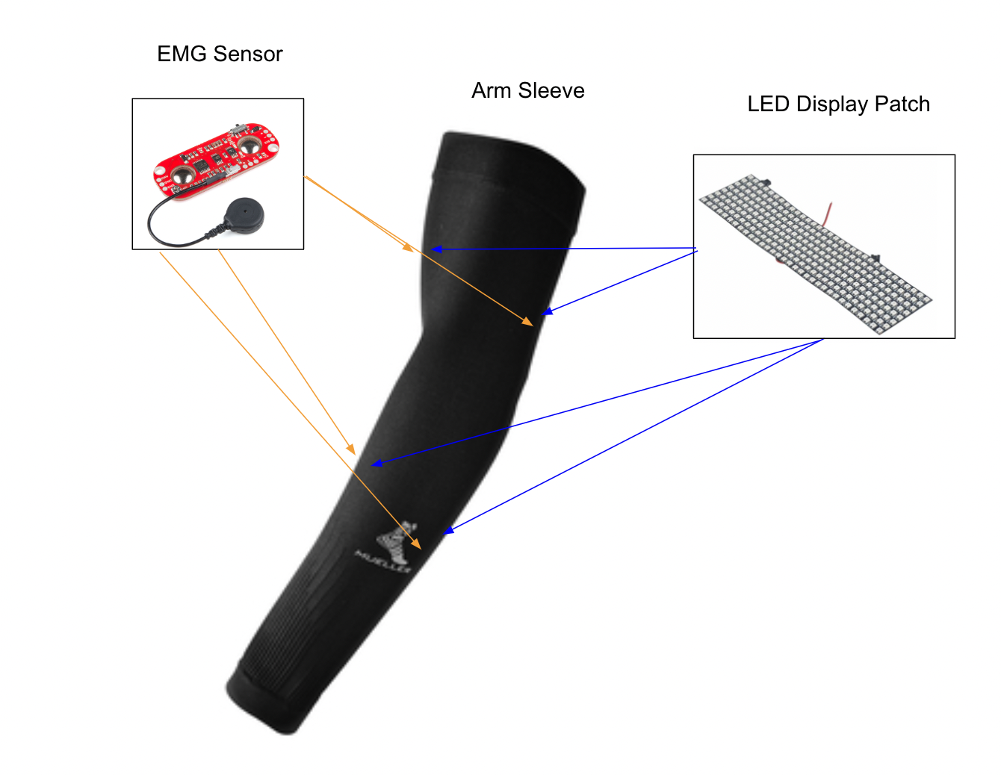
Solution
To create a fitness device in the shape of an arm sleeve that focuses on muscles in the arm including biceps and triceps
Sleeve would contain surface electrodes to detect muscle activity
Each electrode would have an LED corresponding to it and this lights up if the sensor recognizes muscle activity
Arm muscle getting contracted more would have brighter illumination compared to other muscles
Provides real time feedback to the users
Notes:
-ANUSHKA

Slide 4
High Level Requirements
The device should function for minimum one hour while performing fitness exercises
The intensity of muscle contractions should be appropriate displayed through the LED’s for each muscle group
Muscle contractions are able to be detected by the arm sleeve and produce a signal ranging from 0 - 5 V peak to peak and frequencies ranging from 10 Hz - 500 Hz
Notes:
Sreyas

Slide 5
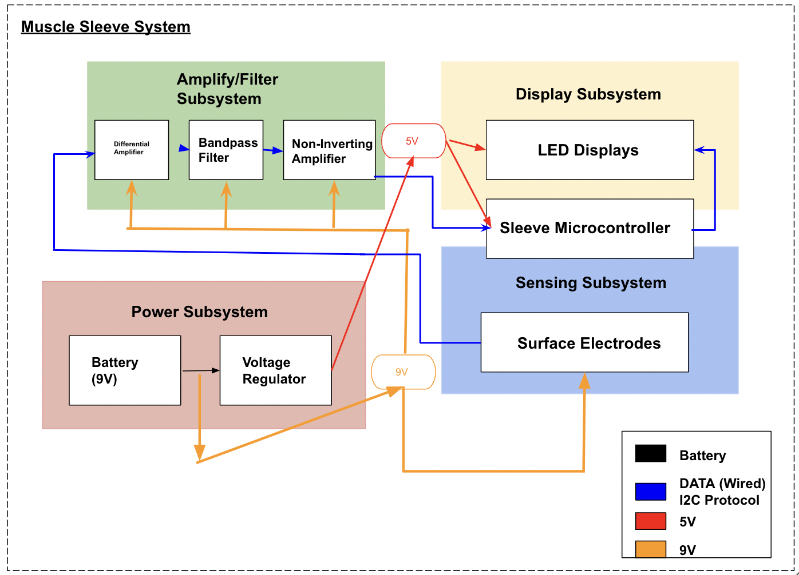
Block Diagram
Notes:
-SREYAS

Slide 6
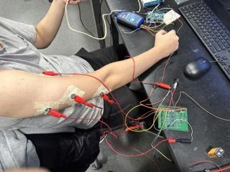
Sensing Subsystem - Overview
Three electrodes are required for each muscle
Electrodes produce a signal with an amplitude ranging from 0-50 mV
Signals have a frequency ranging from 10-500 Hz
Notes:
Sangyun

Slide 7
Sensing Subsystem Requirement and Verification
Requirement | Verification
Surface electrodes should detect muscle contraction signals with amplitudes ranging from 0 - 50 mV Light muscle contractions result in an amplitude close to 0 mV, heavy contractions near 50 mV, the elbow reference electrode near 0 mV Surface electrodes should constantly generate signals within 0 - 50 mV | Place three surface electrodes on the arm: top and bottom bicep, and one near the elbow as the reference Perform bicep curl Measure electrical signals from each electrode using an oscilloscope
Notes:
Sangyun

Slide 8
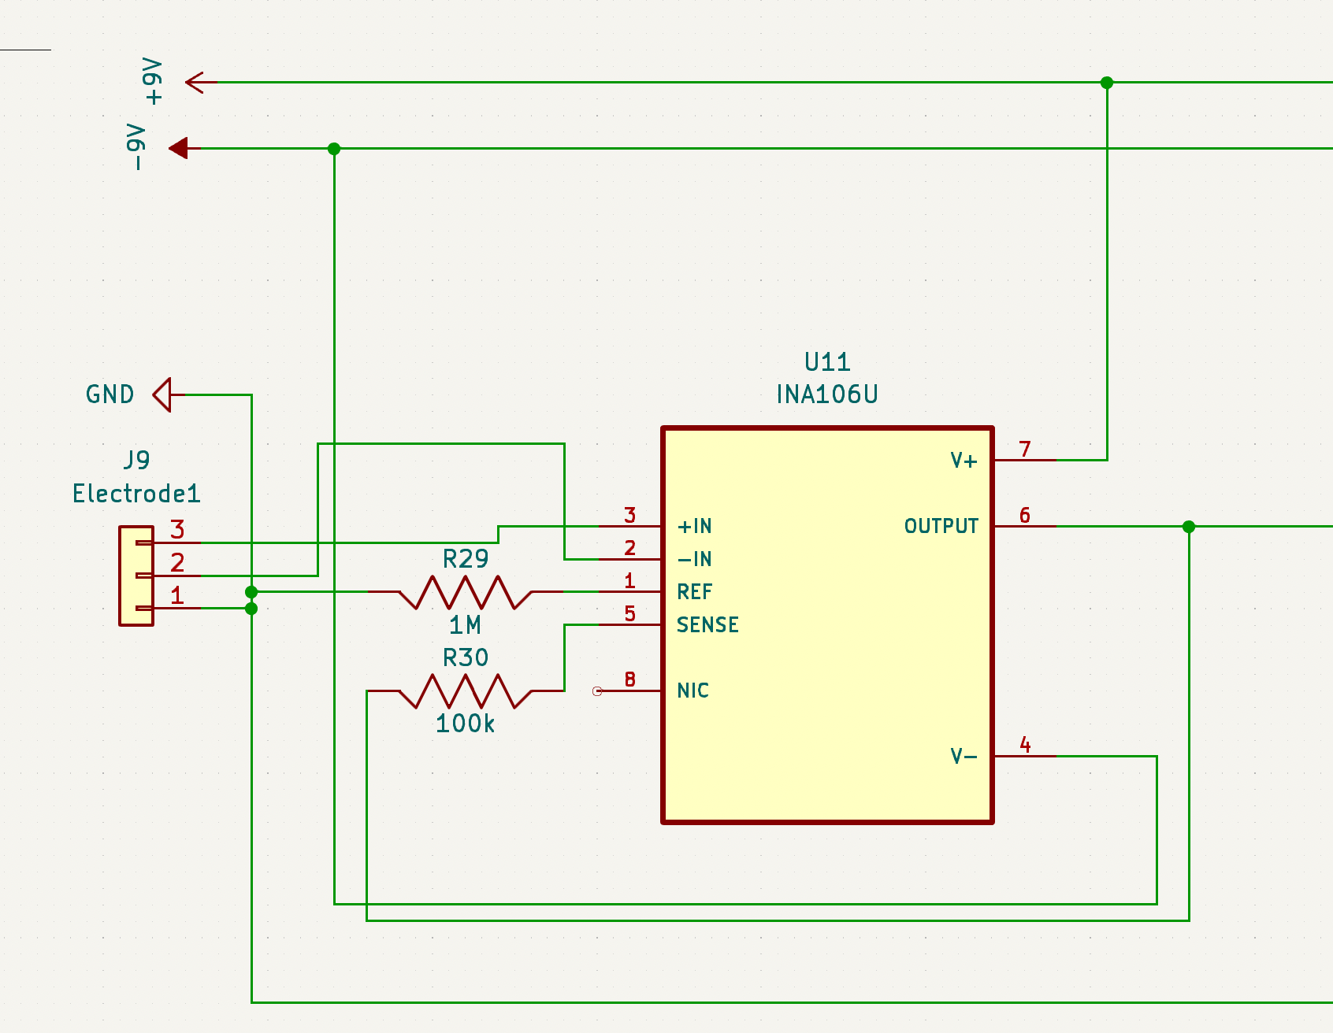
Amplification Subsystem - 1 Schematic and Equations
Used equation: R_ref/R_n = 1M Ohms / 100k Ohms = Gain of 10
Notes:
-Sreyas

Slide 9
Amplification Subsystem - 1 Requirement and Verification
Requirement | Verification
The differential amplifier should have a gain of 10 The differential amplifier takes input signals of 50 mV and 10 mV, computes the 40 mV difference, and amplifies by a factor of 10, producing an output of 400 mV | Test the subsystem by generating signals with amplitudes of 50 mV and 10 mV Connect these two signals to the input pins of the differential amplifier Verify the amplification by a factor of 10 using the oscilloscope to observe the output signal’s amplitude
Notes:
-Sreyas

Slide 10
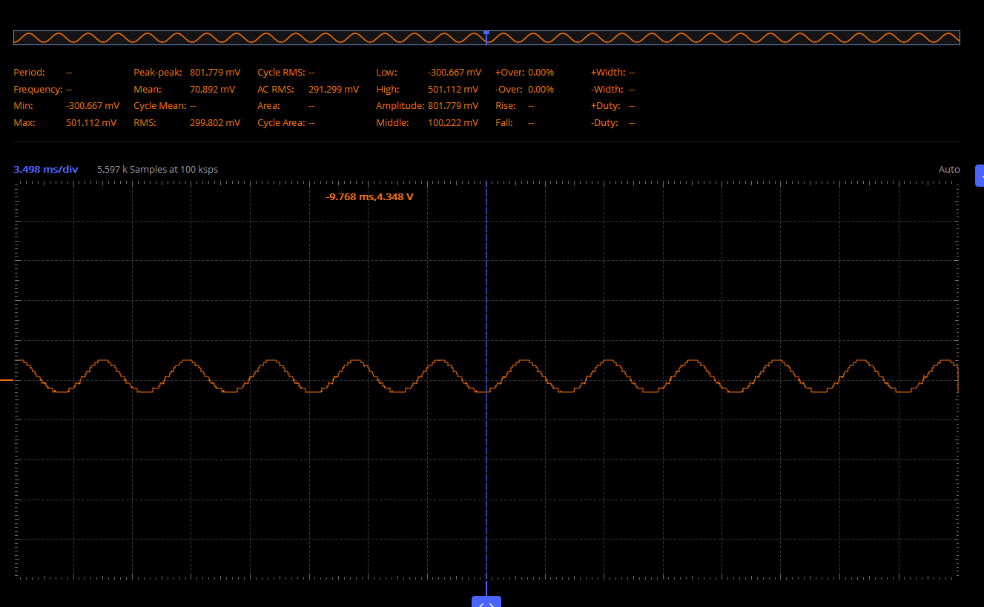
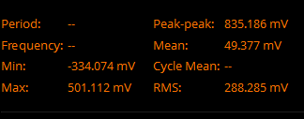
Amplification Subsystem - 1 Results
(200 Hz, Input 1 Amplitude: 50 mV, Input 2 Amplitude: 10 mV):
Notes:
-SANGYUN

Slide 11
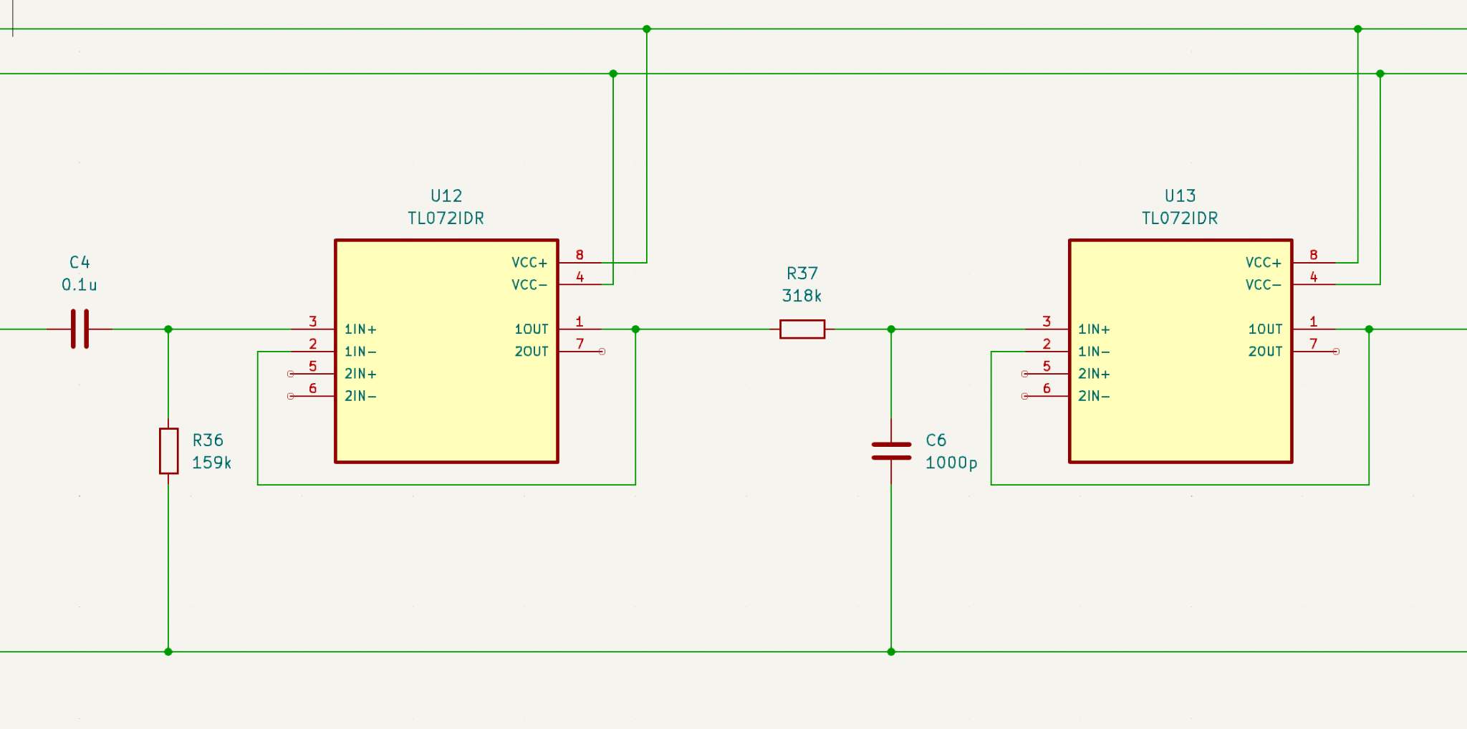
Filter Subsystem Schematic and Equations
Equation Used: 1/(2𝝅RC)
High Pass Filter:
C = 0.1 uF
R = 159k Ohm
Low Pass Filter:
C = 1000 pF
R = 318k Ohm
Notes:
-Anushka

Slide 12
Filter Subsystem Requirement and Verification
Requirement | Verification
The Bandpass filter preserves information in the frequency range of 10 Hz to 500 Hz while attenuating unwanted frequencies | Input a 5 Hz signal into the BandPass filter subsystem - it will be attenuated Increase the frequency by 10 Hz, if it's within 10 Hz - 500 Hz, the output signal amplitude remains unchanged Any signals after 500 Hz should be attenuated which is observed through oscilloscope
Notes:
-Anushka

Slide 13
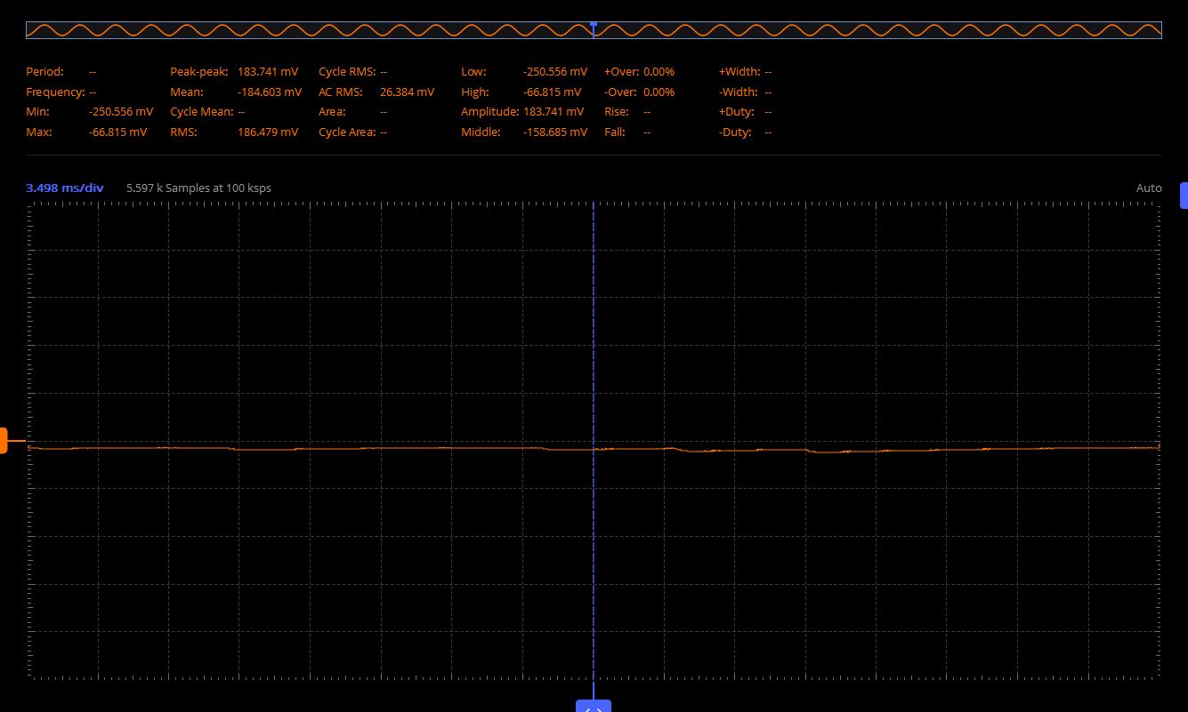
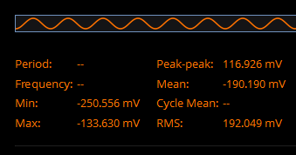
Filter Subsystem Results
(5 Hz, Input peak to peak: 800 mV):
Notes:
--Anushka

Slide 14
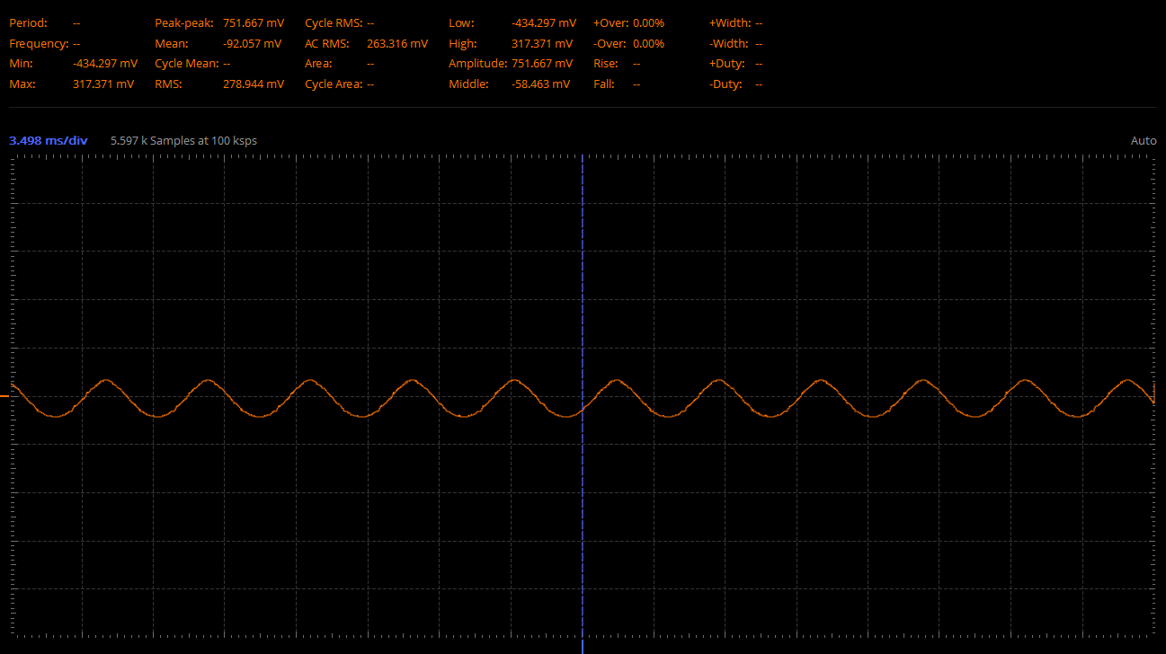
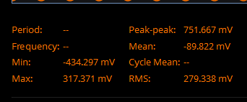
Filter Subsystem Results
(200 Hz, Input peak to peak: 800 mV):
Notes:
-Anushka

Slide 15
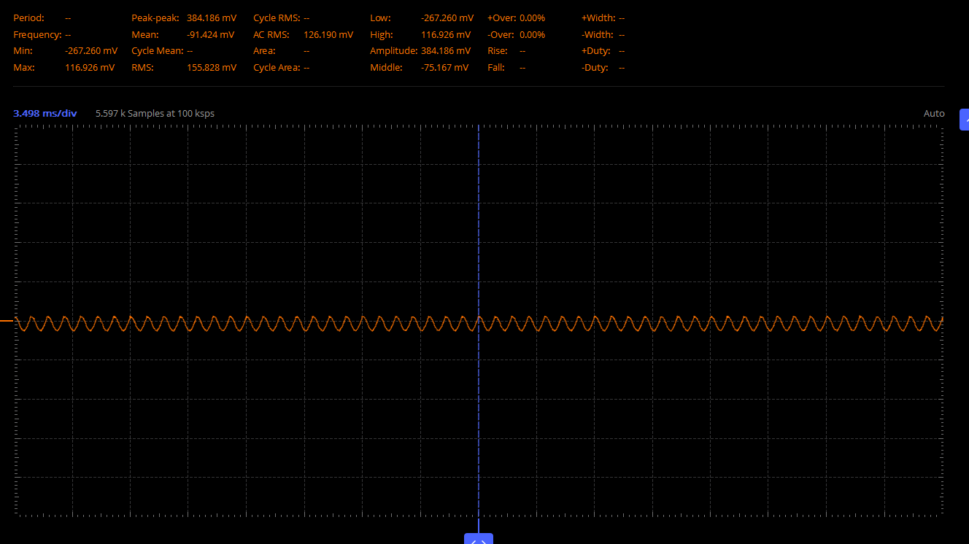
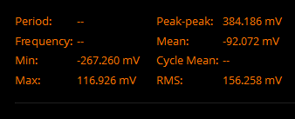
Filter Subsystem Results
(1 kHz, Input peak to peak: 800 mV):
Notes:
-Anushka

Slide 16
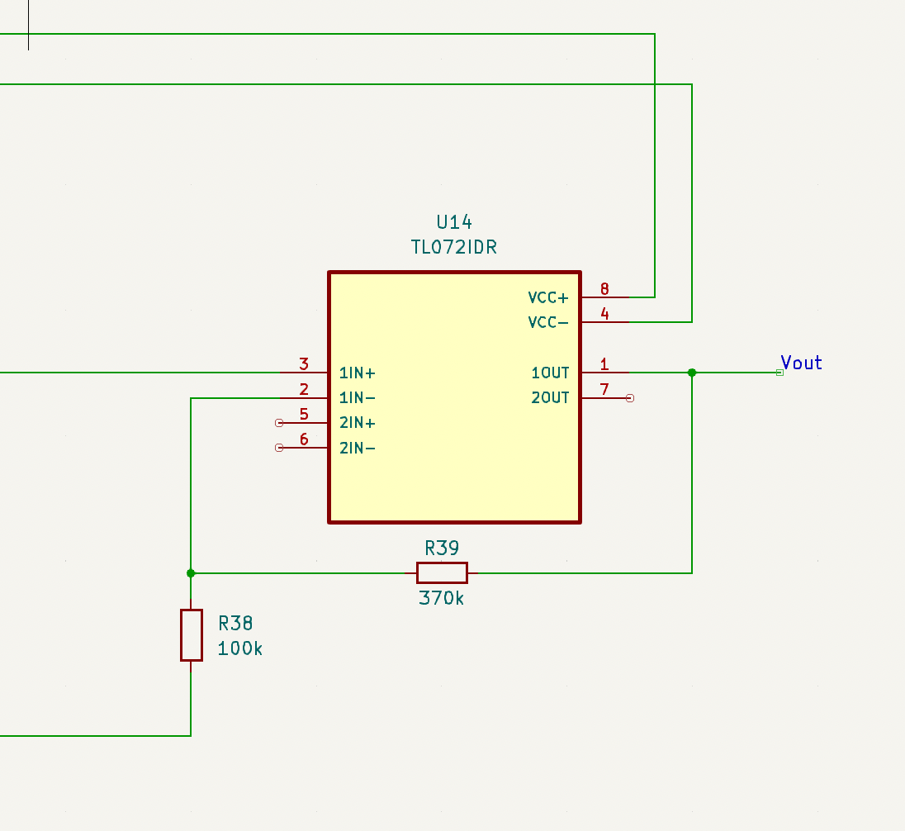
Amplification Subsystem - 2 Schematic and Equations
Gain = R_ref/R_n + 1
5 = R_ref/R_n + 1
4 = R_ref/R_n
R_ref = 370k Ohm
R_n = 100k Ohm
Notes:
-Sangyun

Slide 17
Amplification Subsystem - 2 Requirement and Verification
Requirement | Verification
Non-inverting amplifier should have a gain of 5 The differential amplifier outputs 400 mV, and the non-inverting amplifier with a gain of 5 further amplifies it to 2 V | Test the subsystem with 50 mV and 10 mV amplitude signals from the generator Connect the differential amplifier output to the non-inverting amplifier input Confirm a gain of 5 amplification by observing the output signal amplitude on the oscilloscope
Notes:
-Sangyun

Slide 18
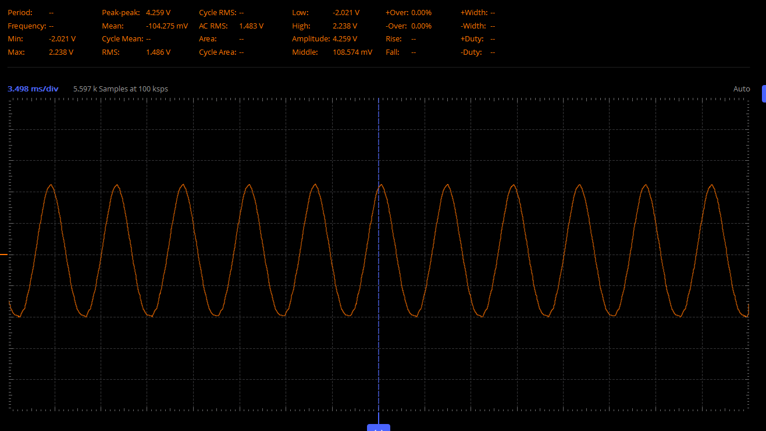
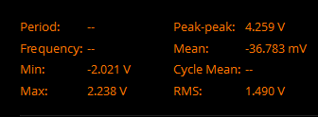
Amplification Subsystem - 2 Results
Amplifier 2 (200 Hz, Input Amplitude: 400 mV):
Notes:
-Sangyun

Slide 19
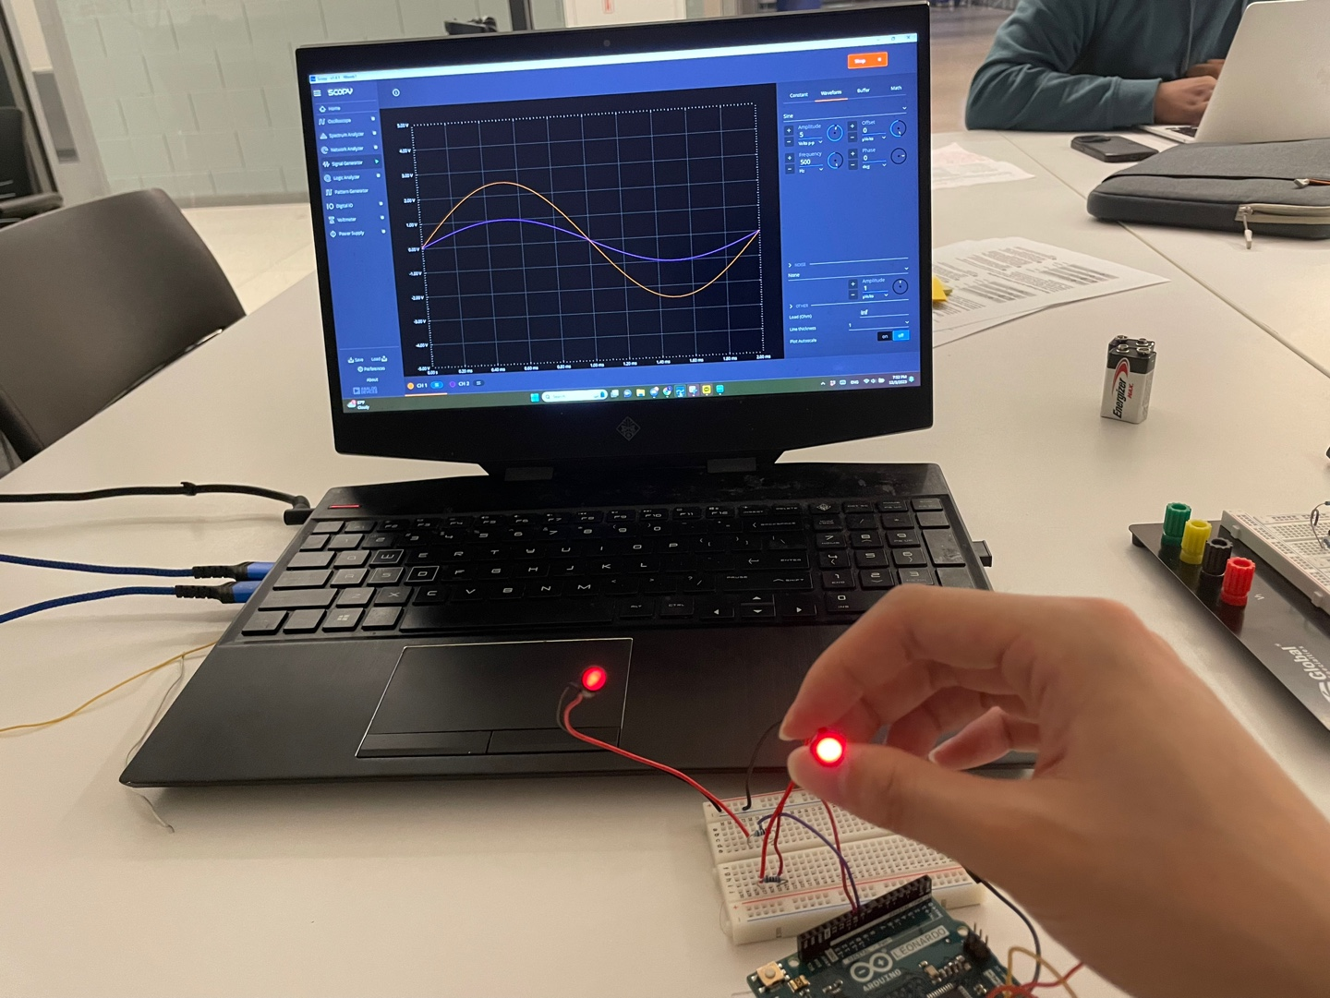
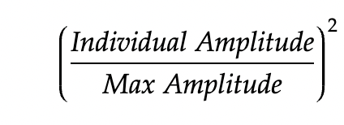
Display Subsystem - Overview
LEDs produce varying intensity based on muscle activity of the corresponding muscle group
Microcontroller outputs a larger voltage to the higher intensity muscle group LED
Formula:
Notes:
-Sangyun

Slide 20
Display Subsystem Requirement and Verification
Requirement | Verification
LEDs vary brightness with signal amplitude. In a close grip chin-up, the bicep (1 V) illuminates at 16% compared to the tricep (2.5 V) | Generate two signals of two different amplitudes using signal generator Connect signals to the Arduino and link its output to the LEDs via resistors Observe: Larger signals result in brighter LED illumination than smaller signals
Notes:
-Sangyun

Slide 21
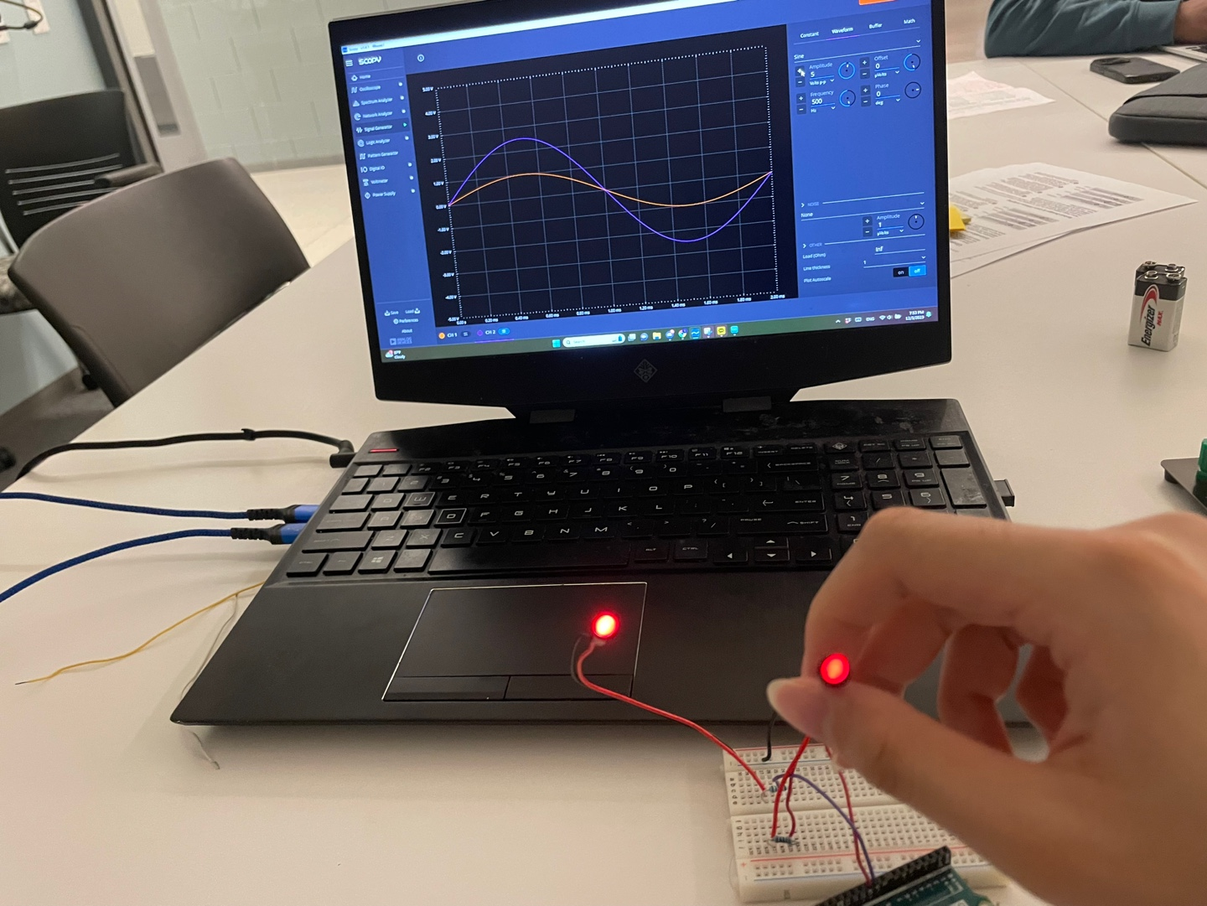
Display Subsystem Results
Signal 1: 1 V, Signal 2: 2.5 V
Signal 1: 2.5 V, Signal 2: 1 V
Notes:
-Sangyun

Slide 22
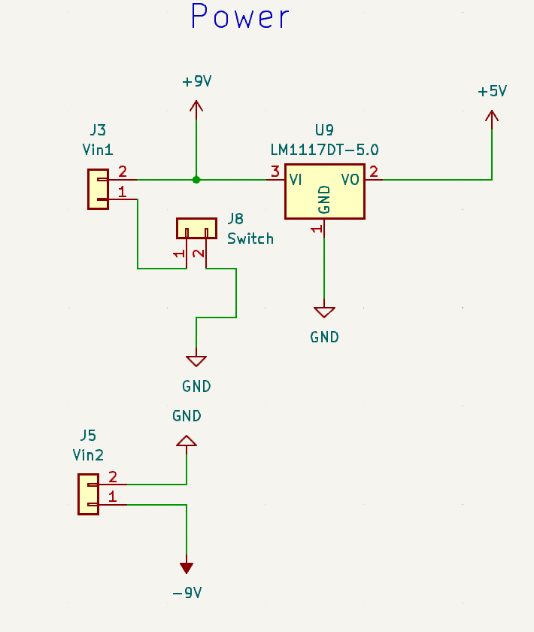
Power Subsystem - Overview
Require two 9V batteries to generate +9V and -9V
Differential of electrode signal amplitudes can be positive or negative, therefore we need +/- 9V
5V linear regulator to power the microcontroller
Switch to control if voltage is running through the circuit
Notes:
-Anushka

Slide 23
Power Subsystem Requirement and Verification
Requirement | Verification
The battery runs for one-hour runtime during workout | Run all components with the battery for an hour, periodically checking voltages with a multimeter to ensure consistent supply during subsystem operations
Notes:
-Anushka

Slide 24
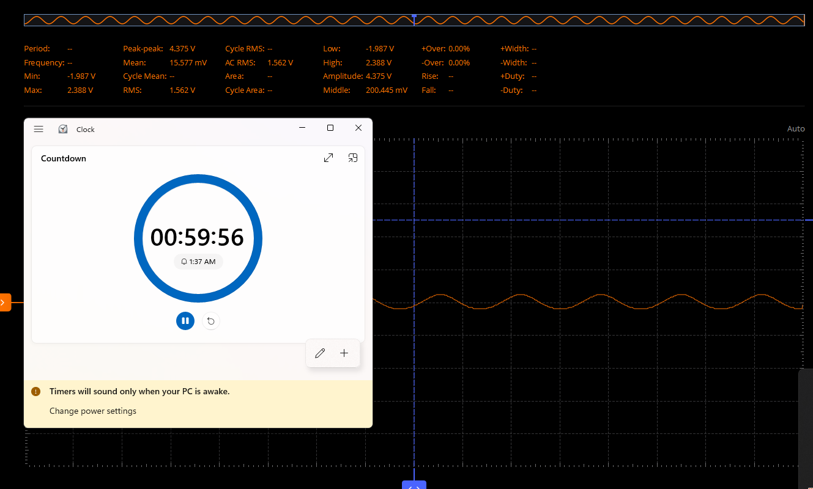
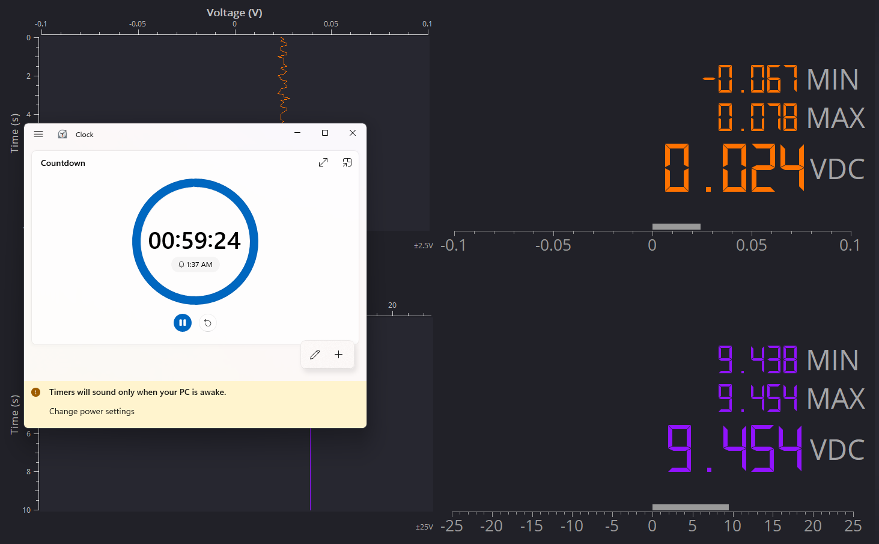
Power Subsystem Results
Notes:
-Anushka

Slide 25
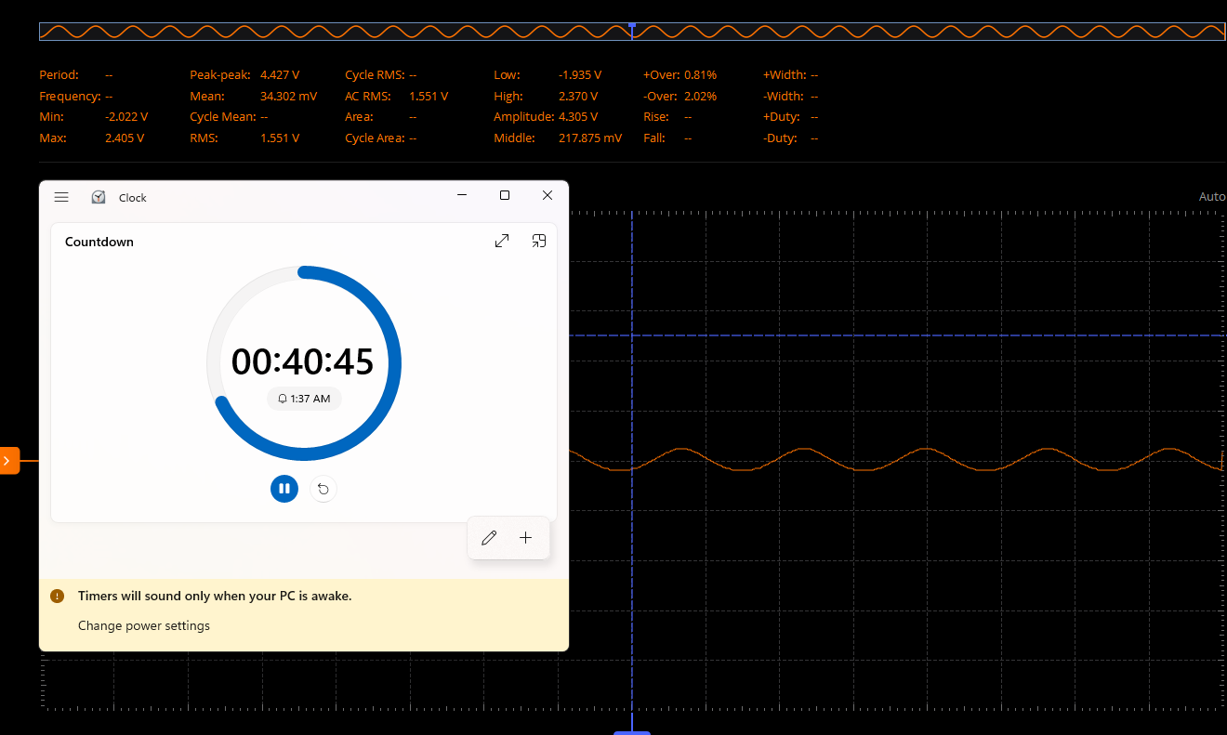
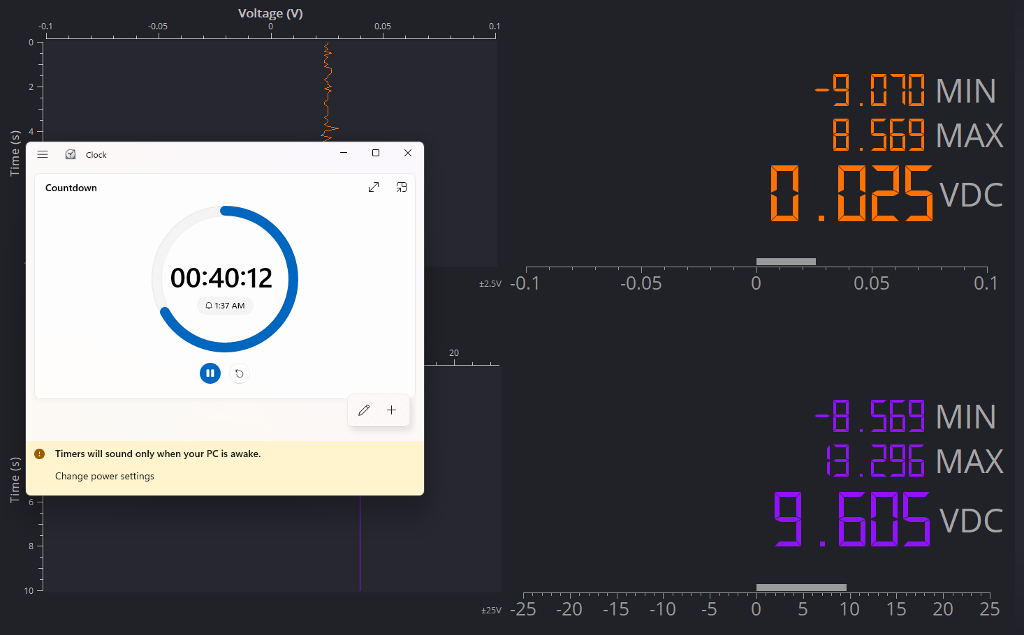
Power Subsystem Results
Notes:
-Anushka

Slide 26
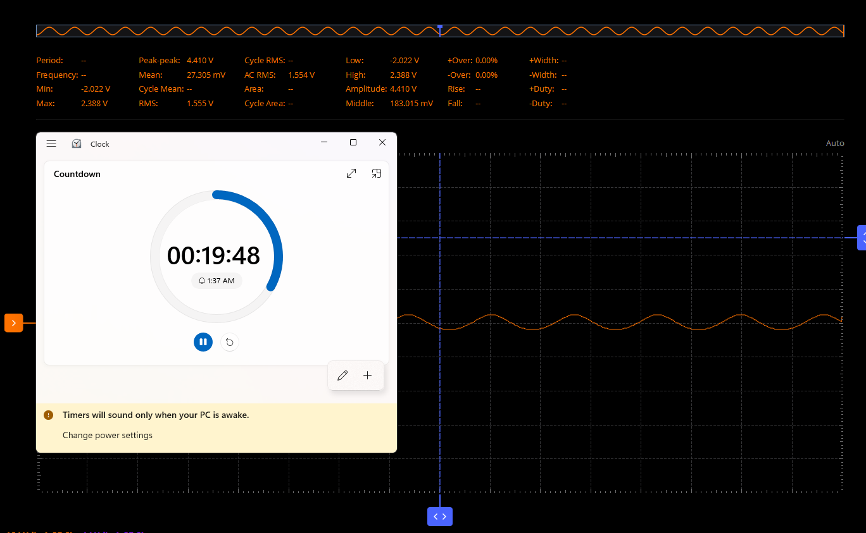
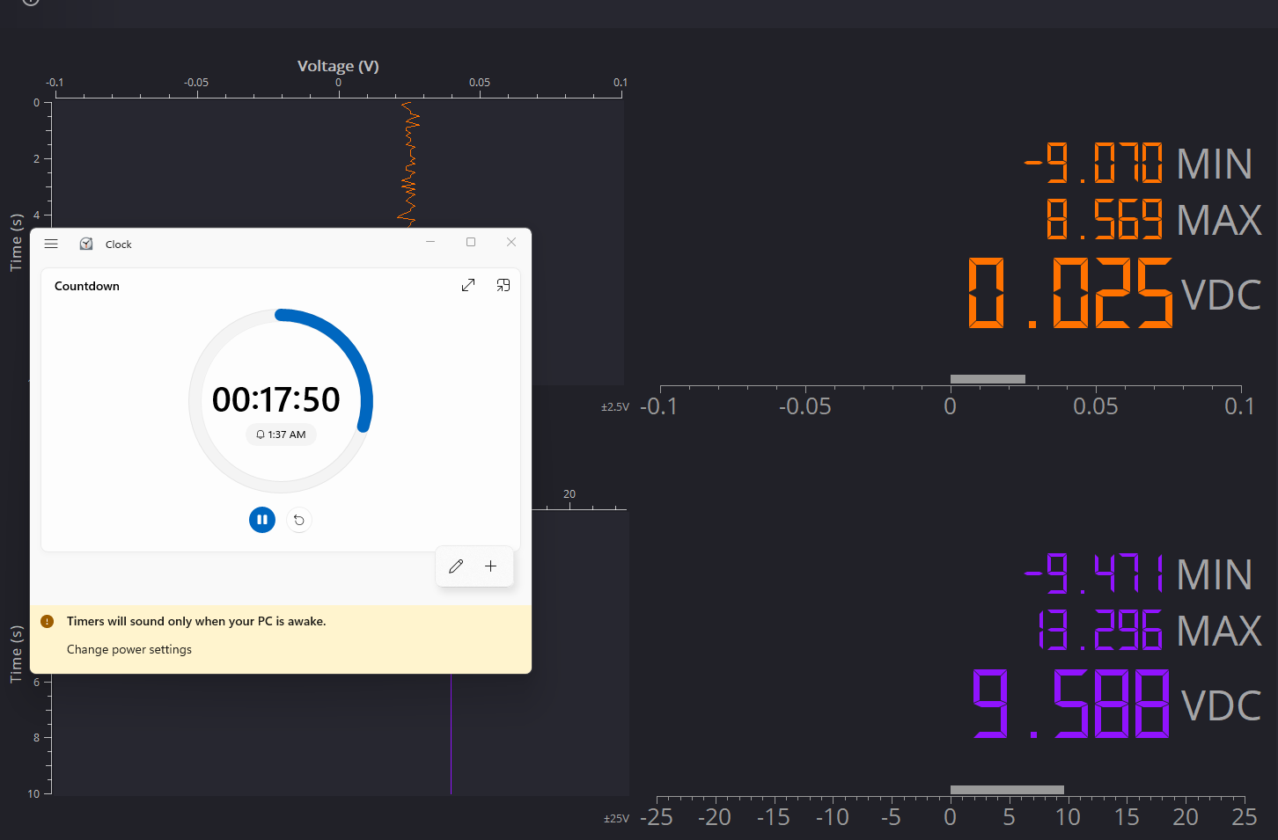
Power Subsystem Results
Notes:
-Anushka

Slide 27
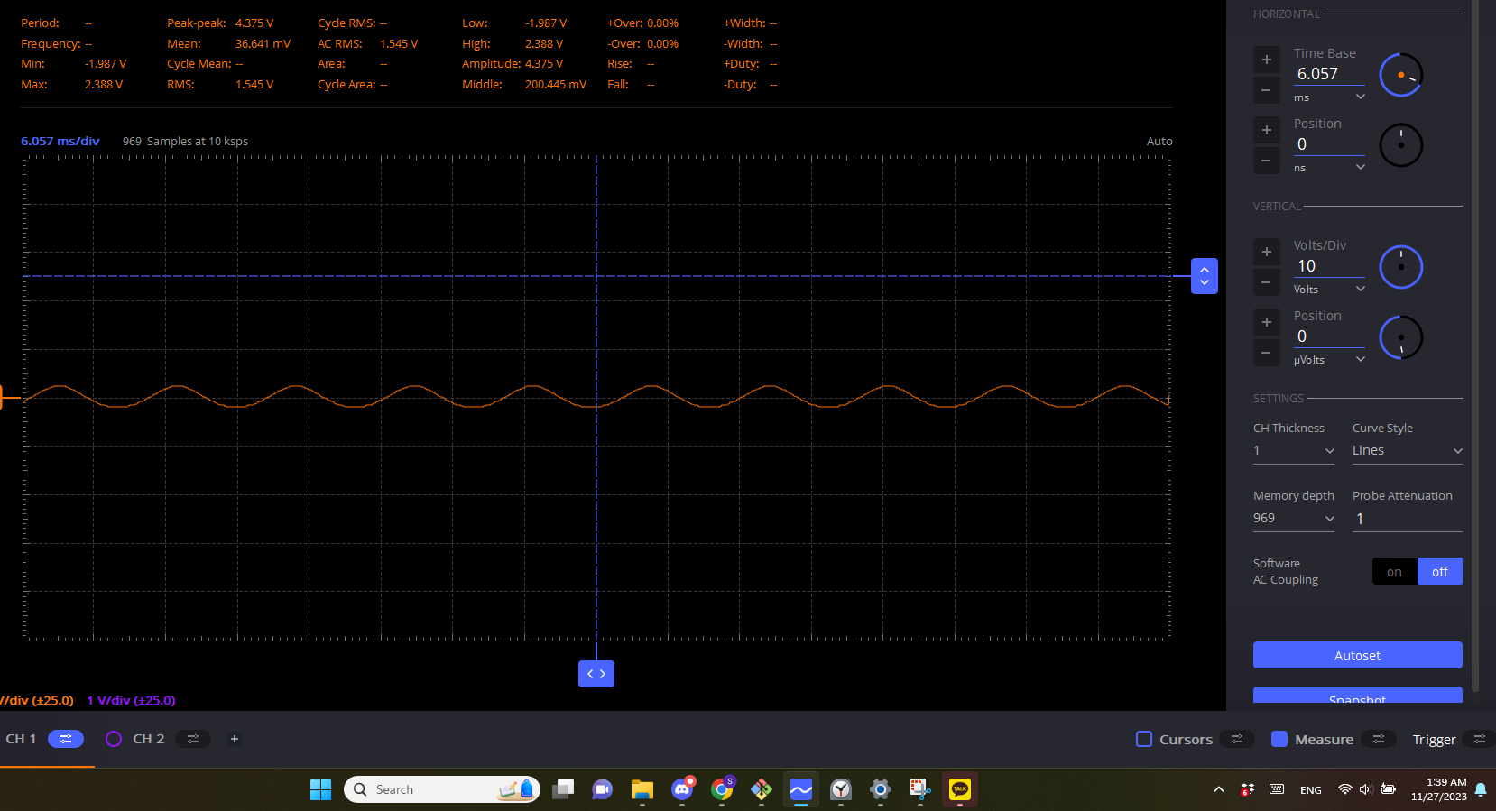
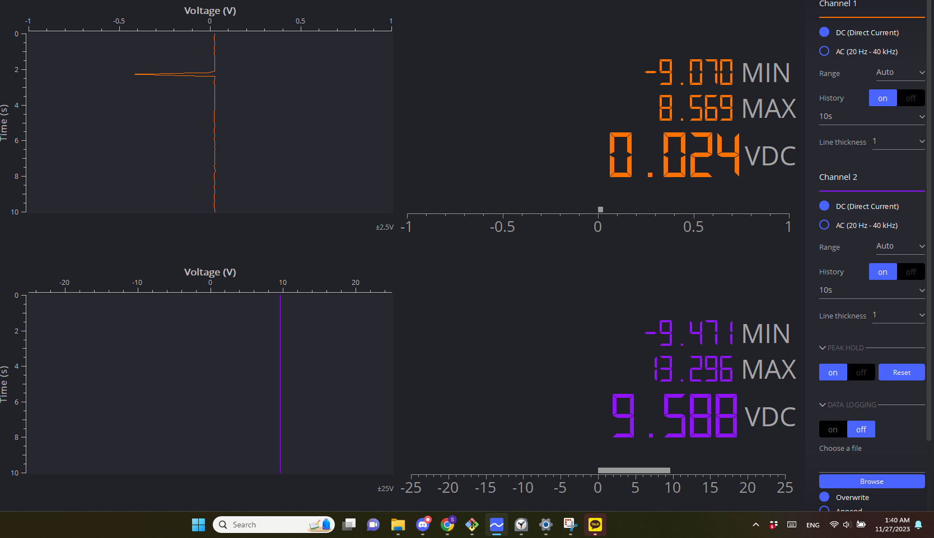
Power Subsystem Results
Notes:
-Anushka

Slide 28
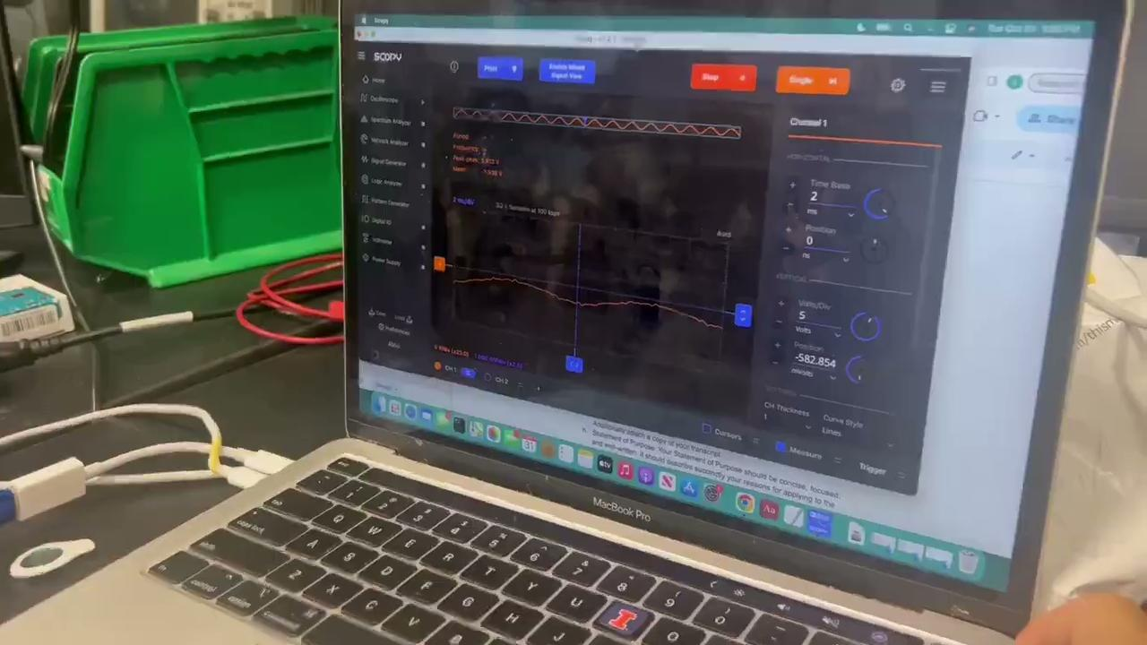
Demo Video
Notes:
-Sreyas

Slide 29
Challenges
Challenge: Microcontroller was not able to be programmed since it required the addition of an external clock
How we overcame: Used a breadboard along with an arduino dev board to test subsystems and software
Challenge: Experienced sensing subsystem failure as the low quality surface electrodes used led to a faster burnout
How we overcame: Used a signal generator to replicate signals produced by the surface electrodes
Notes:
-Sangyun

Slide 30
Future Work
We aim for our surface electrodes on the arm sleeve to be able to target additional muscles, like the forearms
In the future, we plan to extend our device’s capabilities to include other muscle groups, such as leg muscles
We would like to use higher quality surface electrodes to ensure longer lifespan and prevent a quick burnout
Notes:
-Sreyas

Slide 31
Thank You!

