Slide 1
Household Device Ecosystem
Group #33
Ian Goodwin, Sam Atac, John Armgardt

Slide 2
Introduction
System of cheap nodes to monitor household appliances
Washer/dryer
Microwave
Humidity of room
View the nodes from anywhere on a web app
Receive notifications when the appliance changes state
Motivation - Monitor appliances without replacing

Slide 3
High Level Requirements
Nodes must be able to connect to a web server via Wi-Fi module, allowing data to be transmitted to web server at high speed (less than 1 second latency)
Nodes must be able to alert the user in alternative way should the internet connection fail
Nodes must correctly function on a majority (90+%) of the hardware in its class

Slide 4
Objectives
Nodes function on as many appliances as we can test
Web app is easy to use, and works on mobile and desktop
Design is modular, allows for future expansion
Nodes have protective case

Slide 5
Design

Slide 6
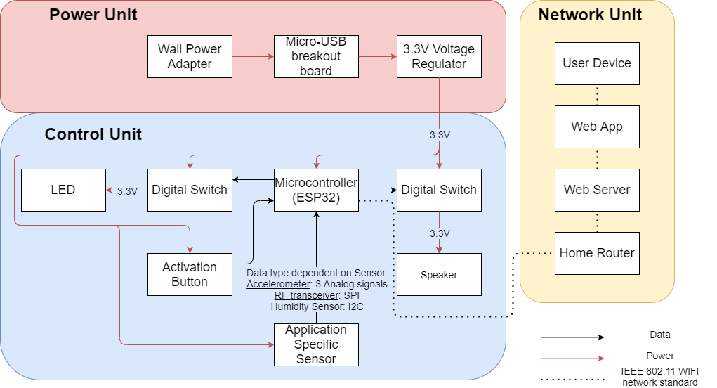
Block Diagram

Slide 7
Hardware Overview
Power Supply
120V AC from wall outlet to 5V DC through Micro-USB AB via wall outlet adapter
5V to 3.3V via voltage regulator on PCB
Microcontroller
ESP32-S2-WROOM
Appliance-Specific Sensor
ADXL335 accelerometer for washer/dryer
nRF24L01+ transceiver for microwave
AHT20 humidity sensor for room’s humidity
Peripherals
LED
Speaker
Digital Switches
Notes:
Our power supply works as follows:
We plug in our wall adapter to a wall outlet which regulates the 120V down to 5V via a wall outlet adapter. This power is then transferred through a Micro-USB AB cable. The cable is plugged into our PCB, and a voltage regulator regulates the voltage from 5V down to 3.3V

Slide 8
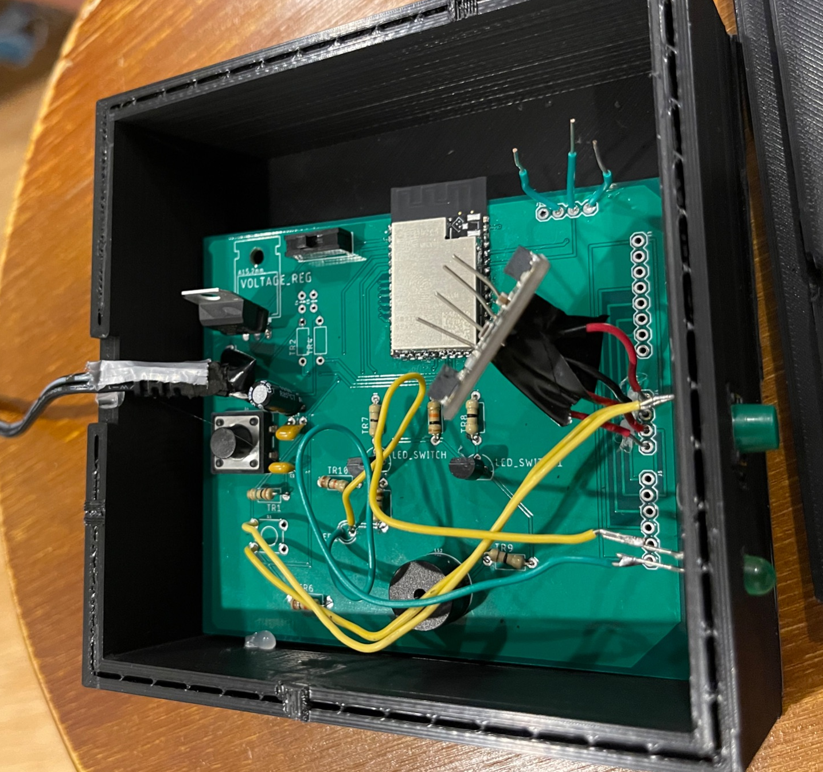
Hardware System
ESP32
UART Port
Download Mode Switch
Appliance-Specific Sensor ports
Voltage Regulator
Micro-USB Cord
Activation Button
Reset Button
Status LED
Speaker

Slide 9
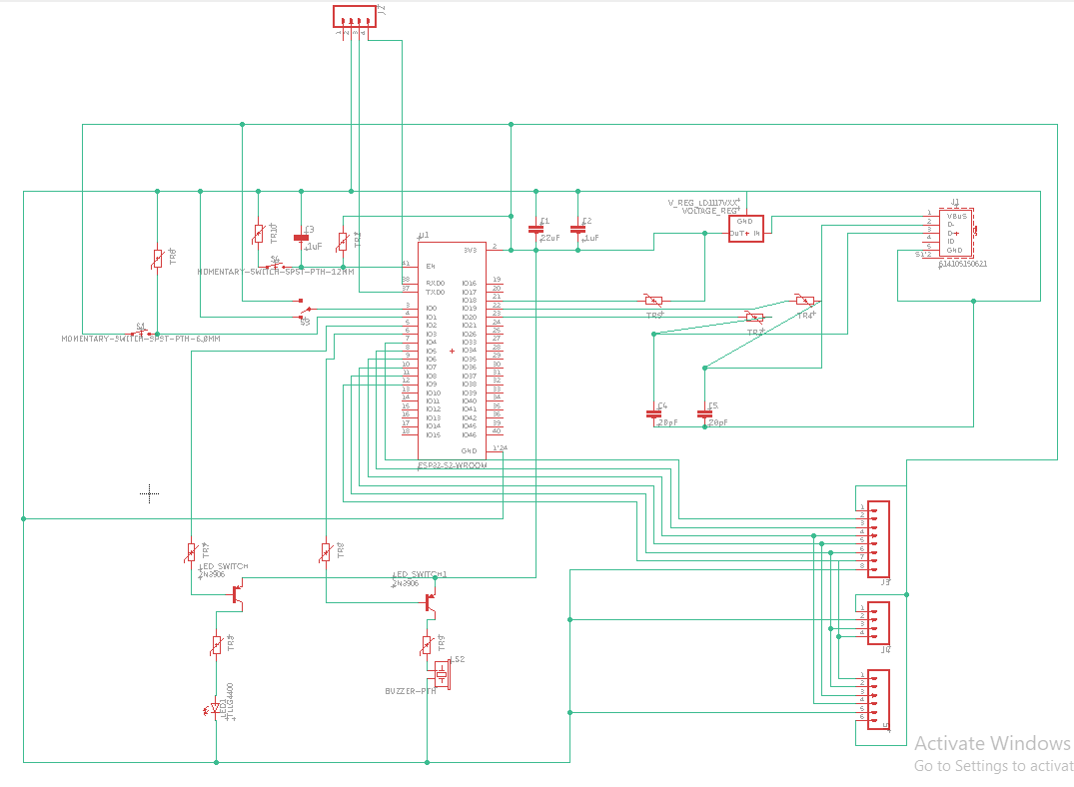
PCB Layout - Schematic

Slide 10
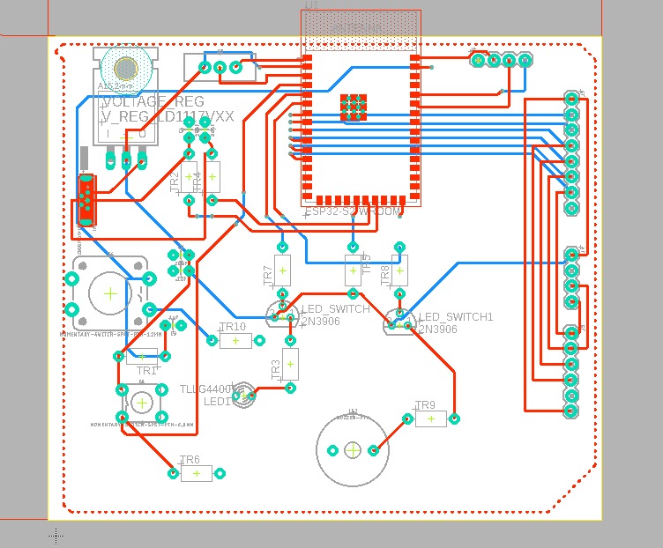
PCB Layout - Board

Slide 11
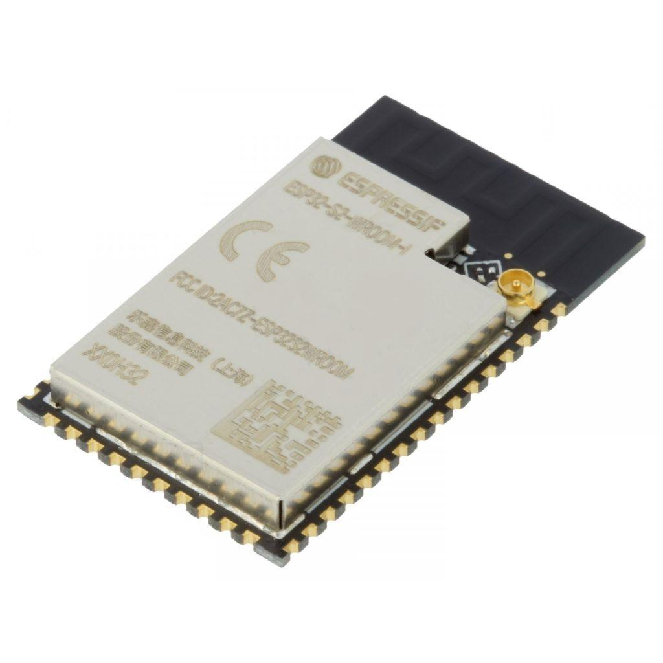
Microcontroller
ESP32-S2-WROOM
WiFi antenna built-in
Wide set of pin interfaces
GPIO
SPI
I2C
ADC
Programmable via UART and USB CDC
GPIO pin current limited to 16 mA

Slide 12
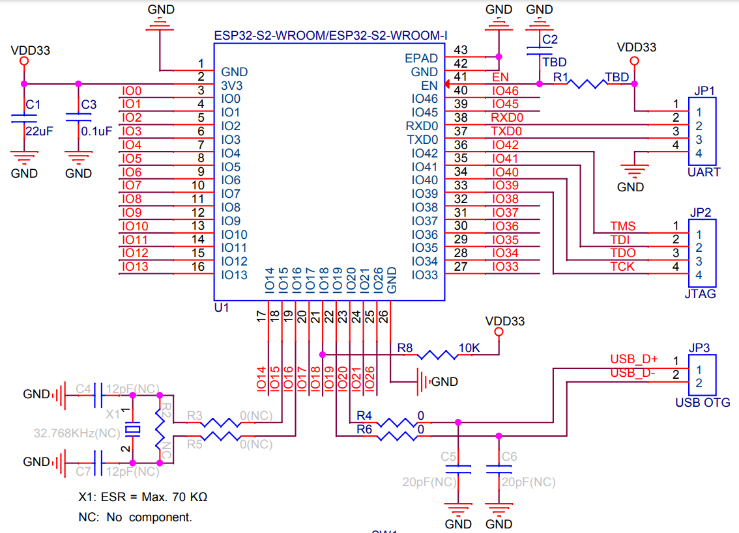
Microcontroller Schematic

Slide 13
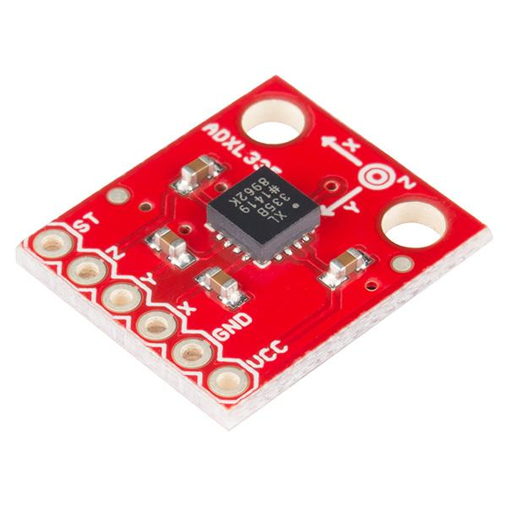
Accelerometer
ADXL335 Breakout Board
Used to measure acceleration data as washer/dryer shakes
Features
3 axis output
± 3g sensing range
.01g measurement resolution
Low power: 3V at 350 μA
Communication protocol: Analog

Slide 14
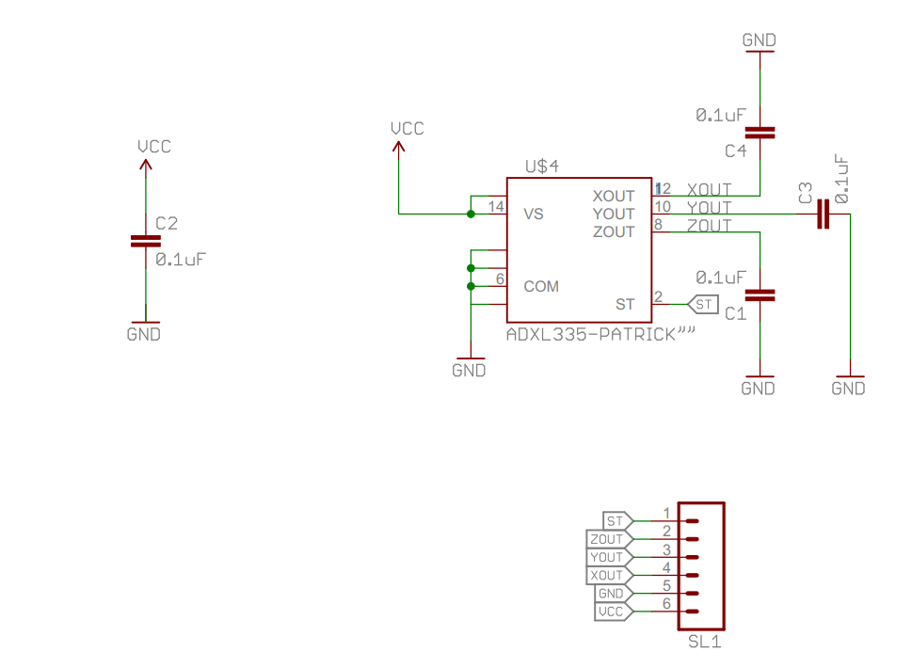
Accelerometer Schematic

Slide 15
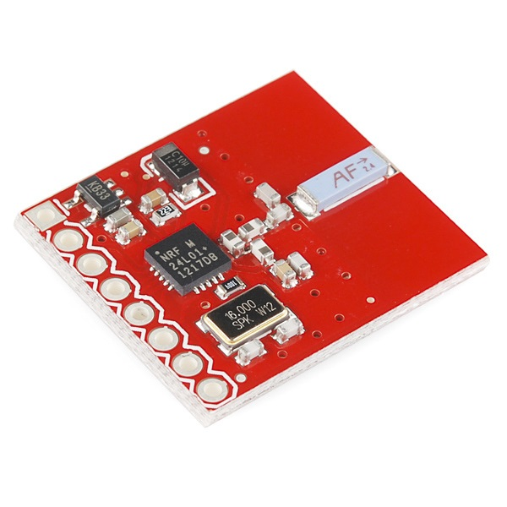
Transceiver
nRF24L01+ Breakout Board
Used to measure RF leakage (2.450 GHz) from microwave door
Features
2.400 GHz - 2.525 GHz operating range
1 MHz measurement resolution
Low power: 3.3V at 13.5 mA
Communication protocol: SPI

Slide 16
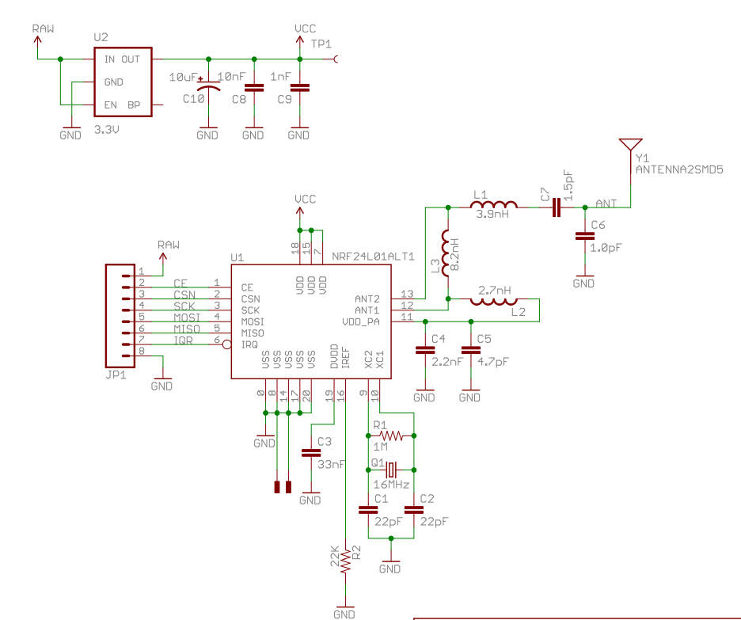
Transceiver Schematic

Slide 17
Humidity Sensor
AHT20 Breakout Board
Used to measure relative humidity inside room
Features
20-80% RH primary sensing range
.024% RH measurement resolution
Low power: 3V at 23 μA
Communication protocol: I2C

Slide 18
Humidity Sensor Schematic

Slide 19
Microcontroller Software Overview
ESP32 controls, interacts with all peripherals on PCB
On state
Measures data, determines state of appliance, updates web server via HTTP
Uses LED and speaker if HTTP fails
Off state
Powers down peripherals
Waits for activation button to turn on node
Calibration state
Takes average of sensor data in on/off states of appliance
Uses averages to determine “on threshold” for appliance

Slide 20
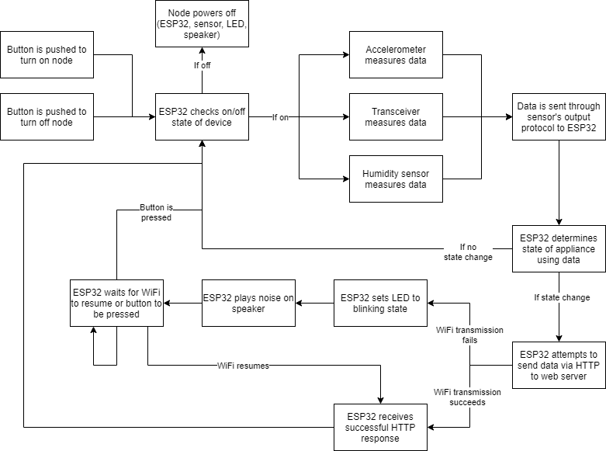
Microcontroller Software System

Slide 21
Web Server Overview
Uses a Node.js Server
Node handles many concurrent connections well
Serves both the web page and API
MongoDB used for server database
Document based data for ease of use
MongoDB is fast for many concurrent edits
Uses Twilio API for notifications
Affordable and reliable texting API

Slide 22
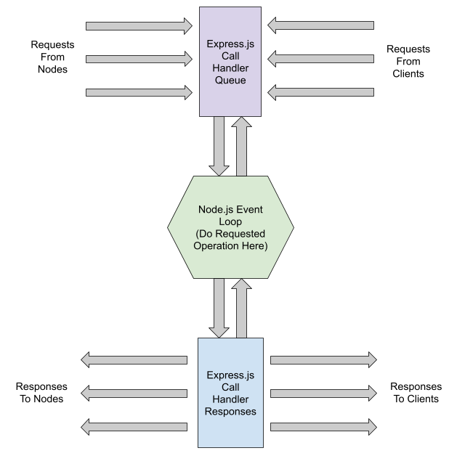
Web Server Flowchart

Slide 23
Web App Overview
Secure
Data is locked behind SessionID and
Simple layout
Easy to use with minimal clutter
Leverages open source
Bootstrap CSS
Chart.js charts
Google material design icons

Slide 24
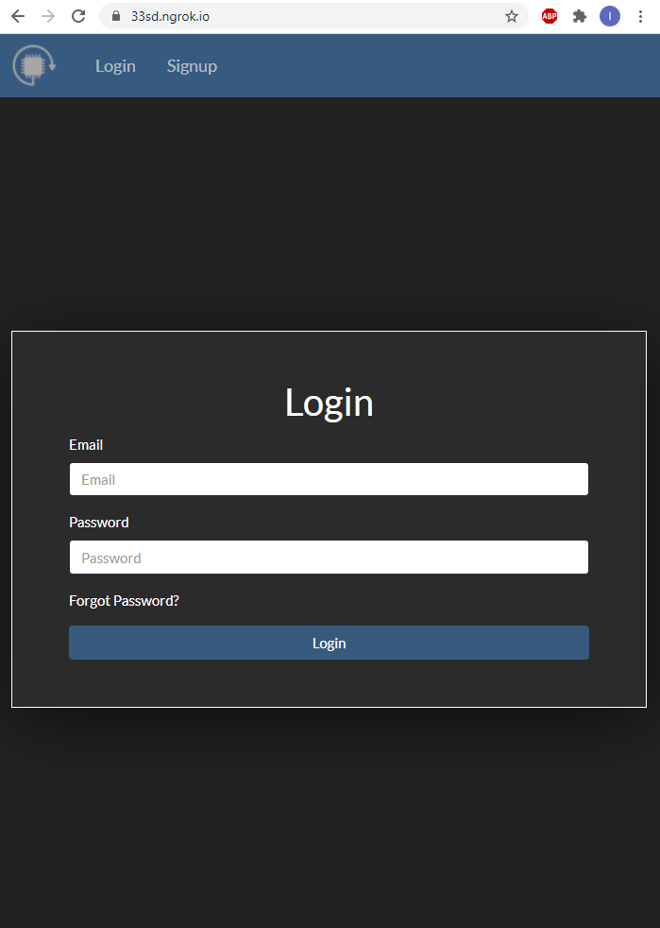
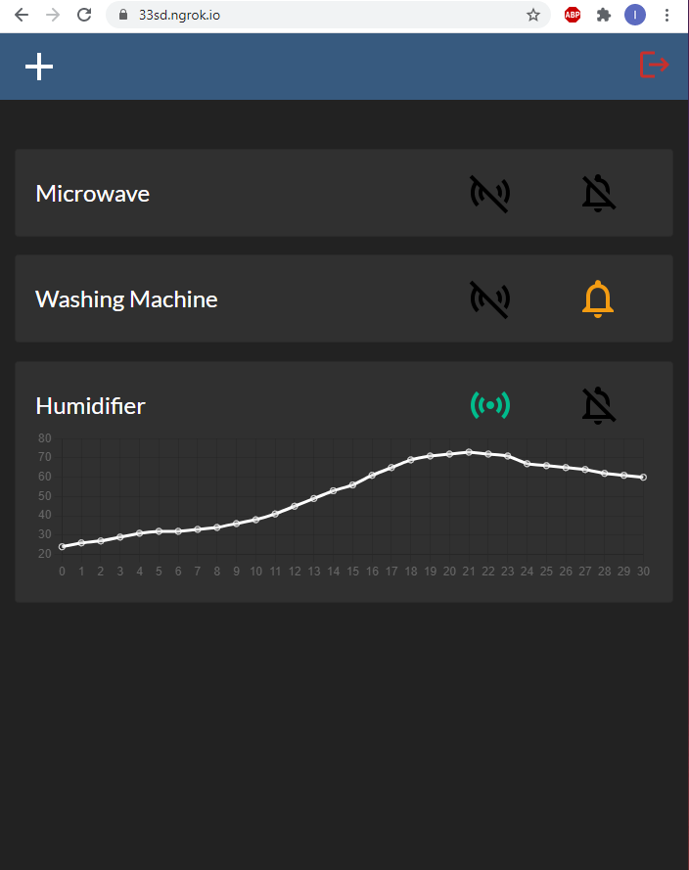
Web App Views

Slide 25
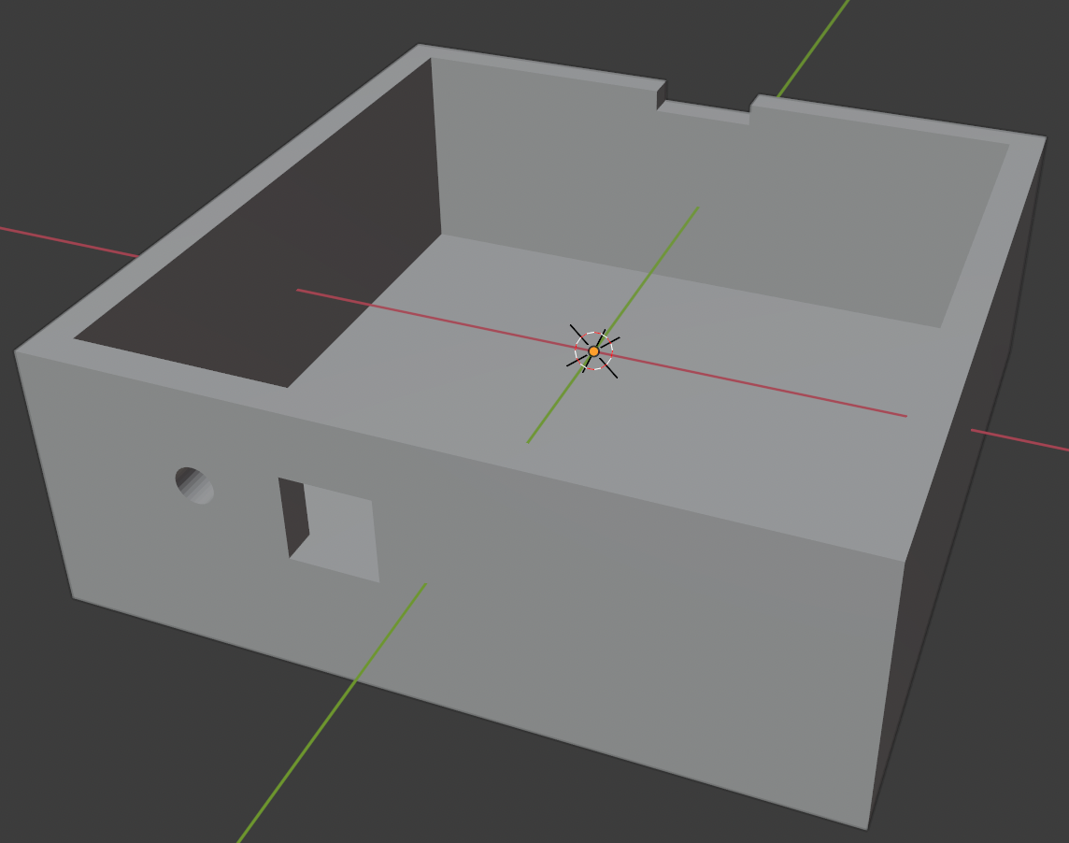
Case Design

Slide 26
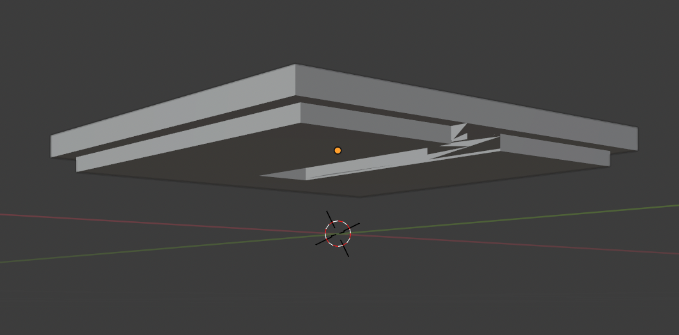
Case Top Design

Slide 27
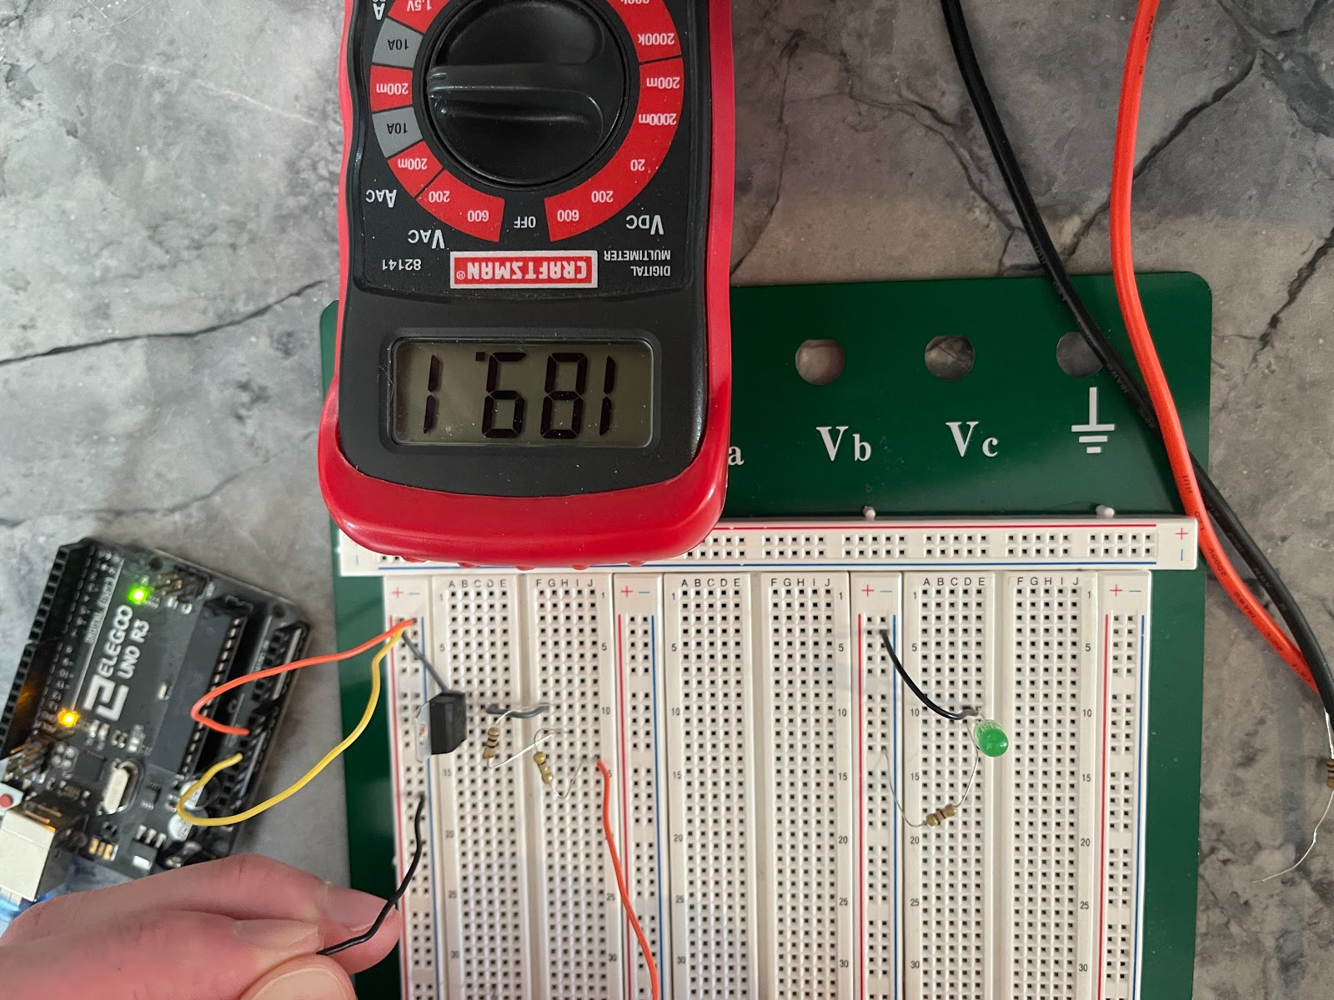
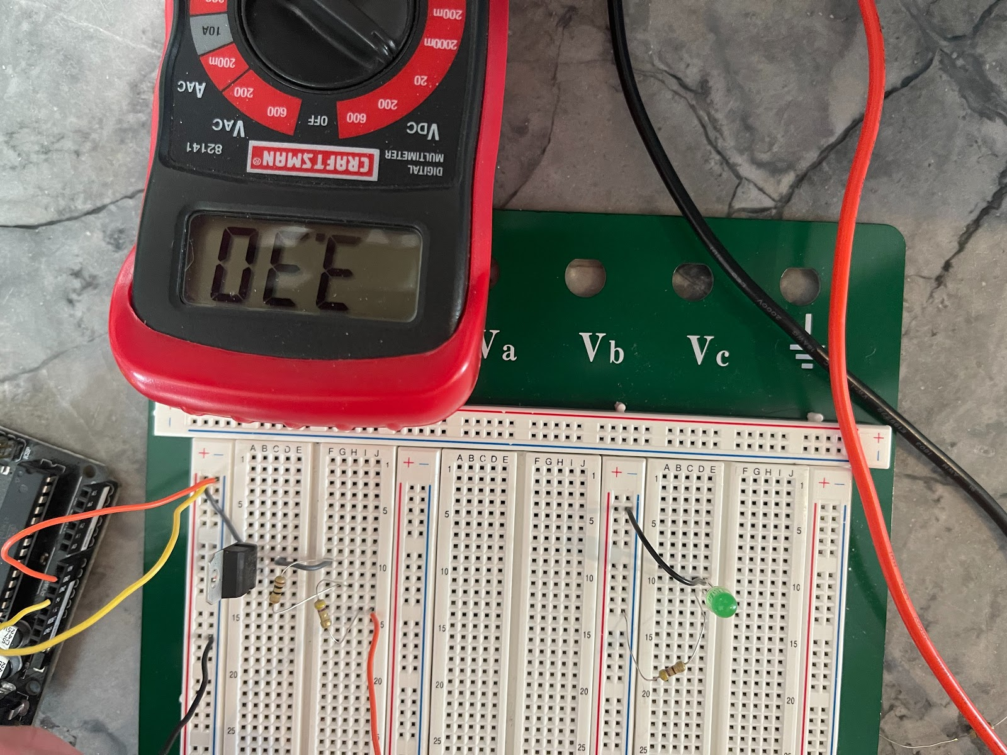
Voltage Regulator Requirements/Verification
Able to Regulate 5V DC to 3.3V DC
Current limit of at-least 200 mA

Slide 28
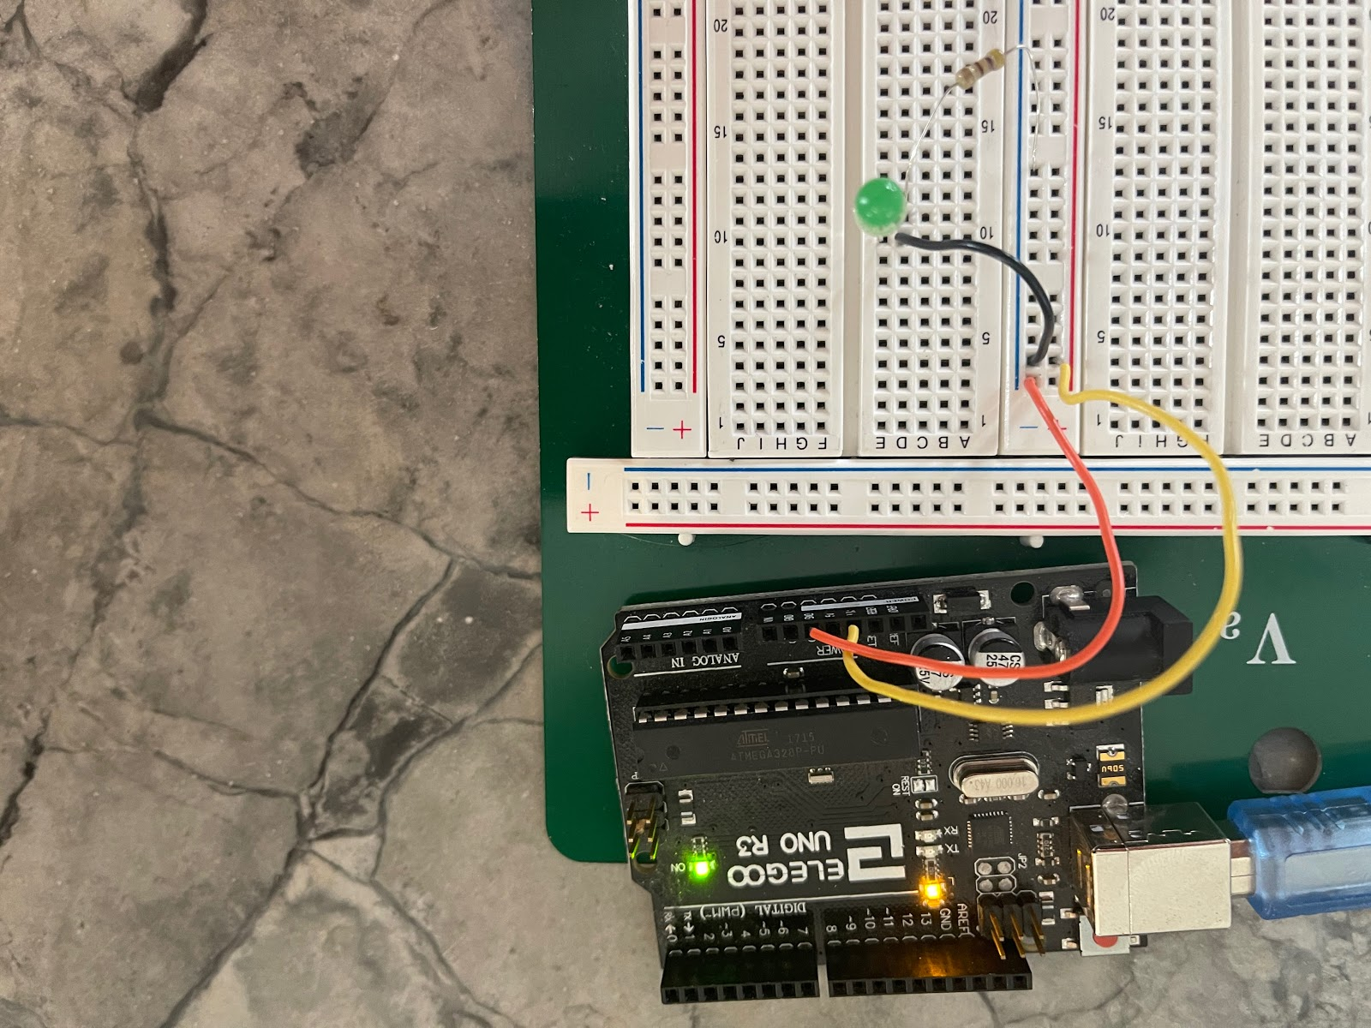
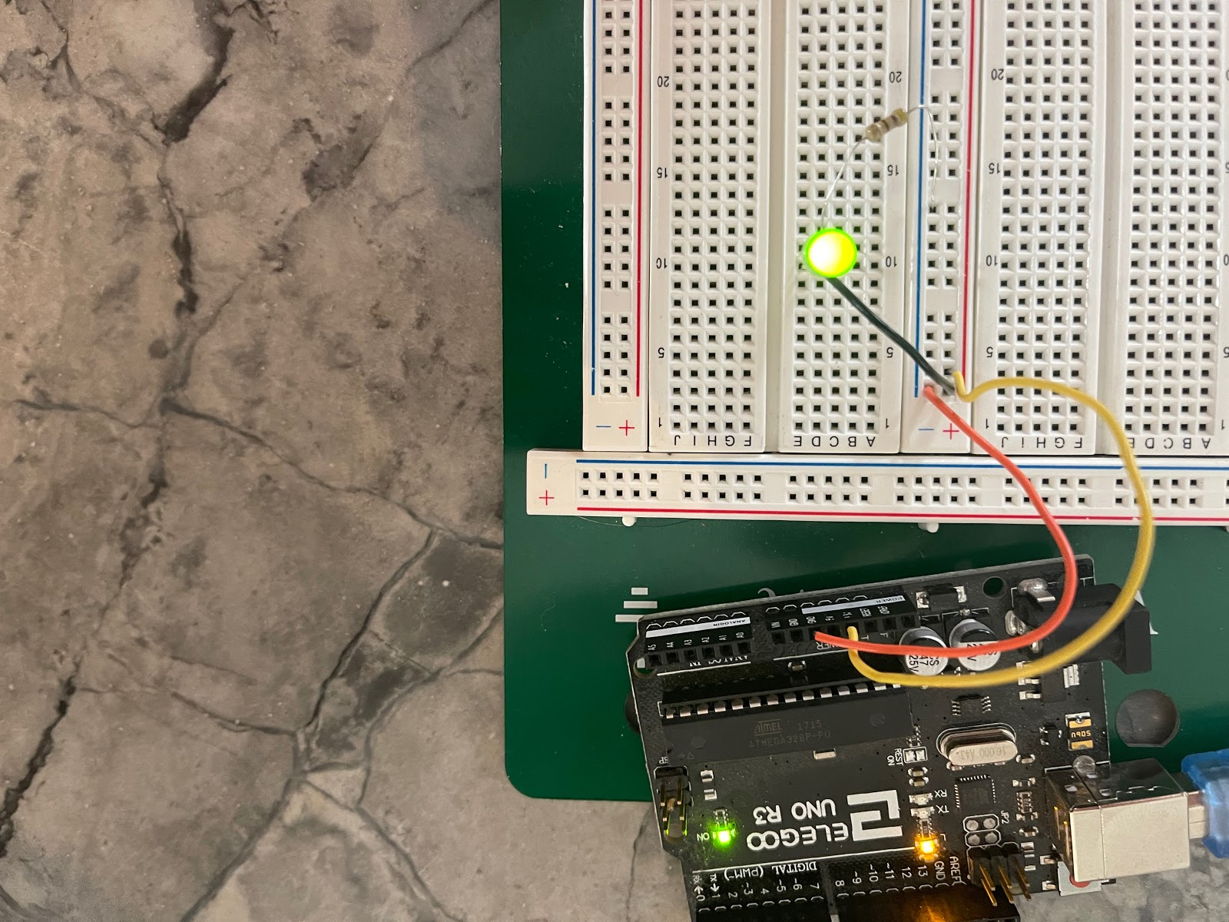
Status LED Requirements/Verification
Powers on and is clearly visible at 3.3V

Slide 29
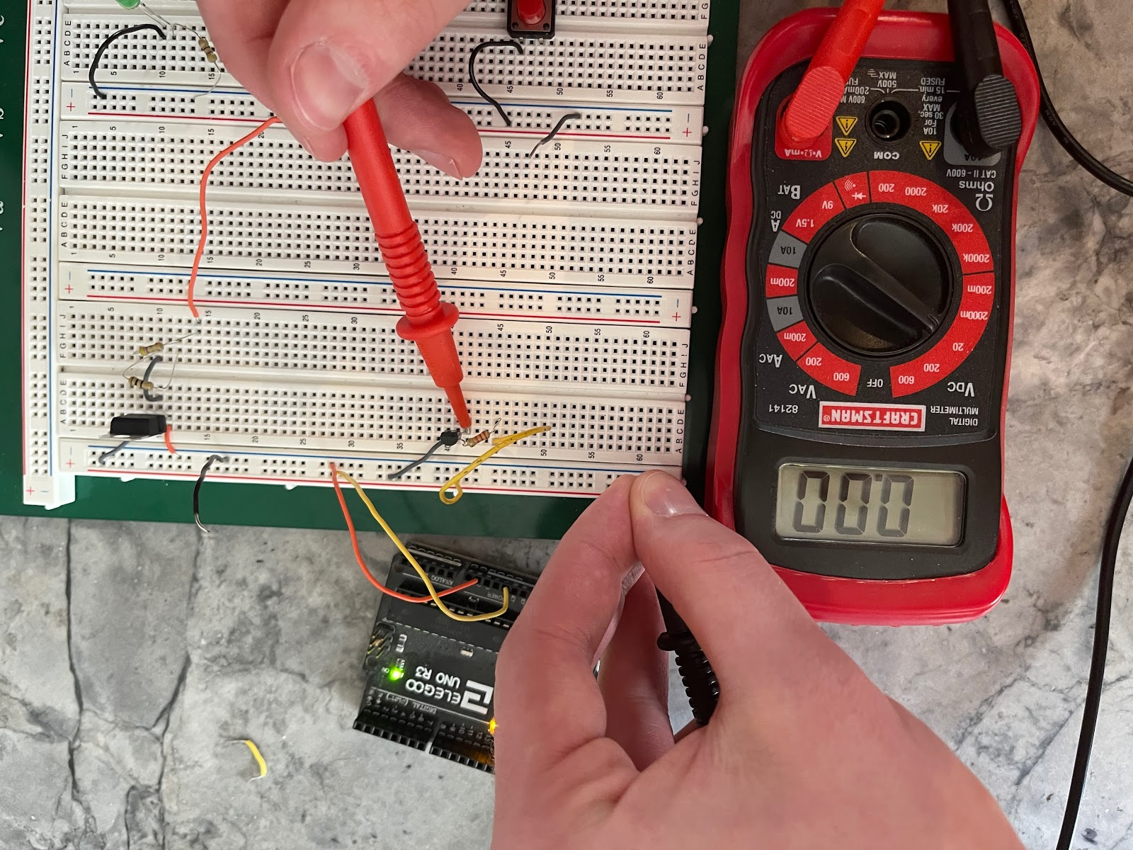
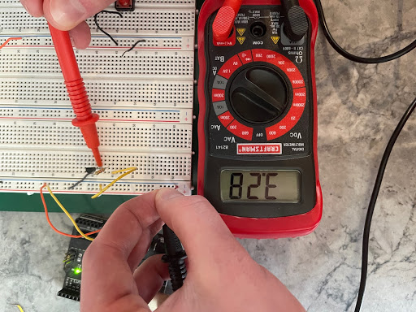
Digital Switch Requirements/Verification
Output 3.3V through the emitter when the base receives no voltage and 0V through the emitter when the base receives current.

Slide 30
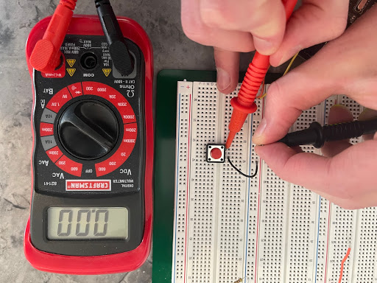
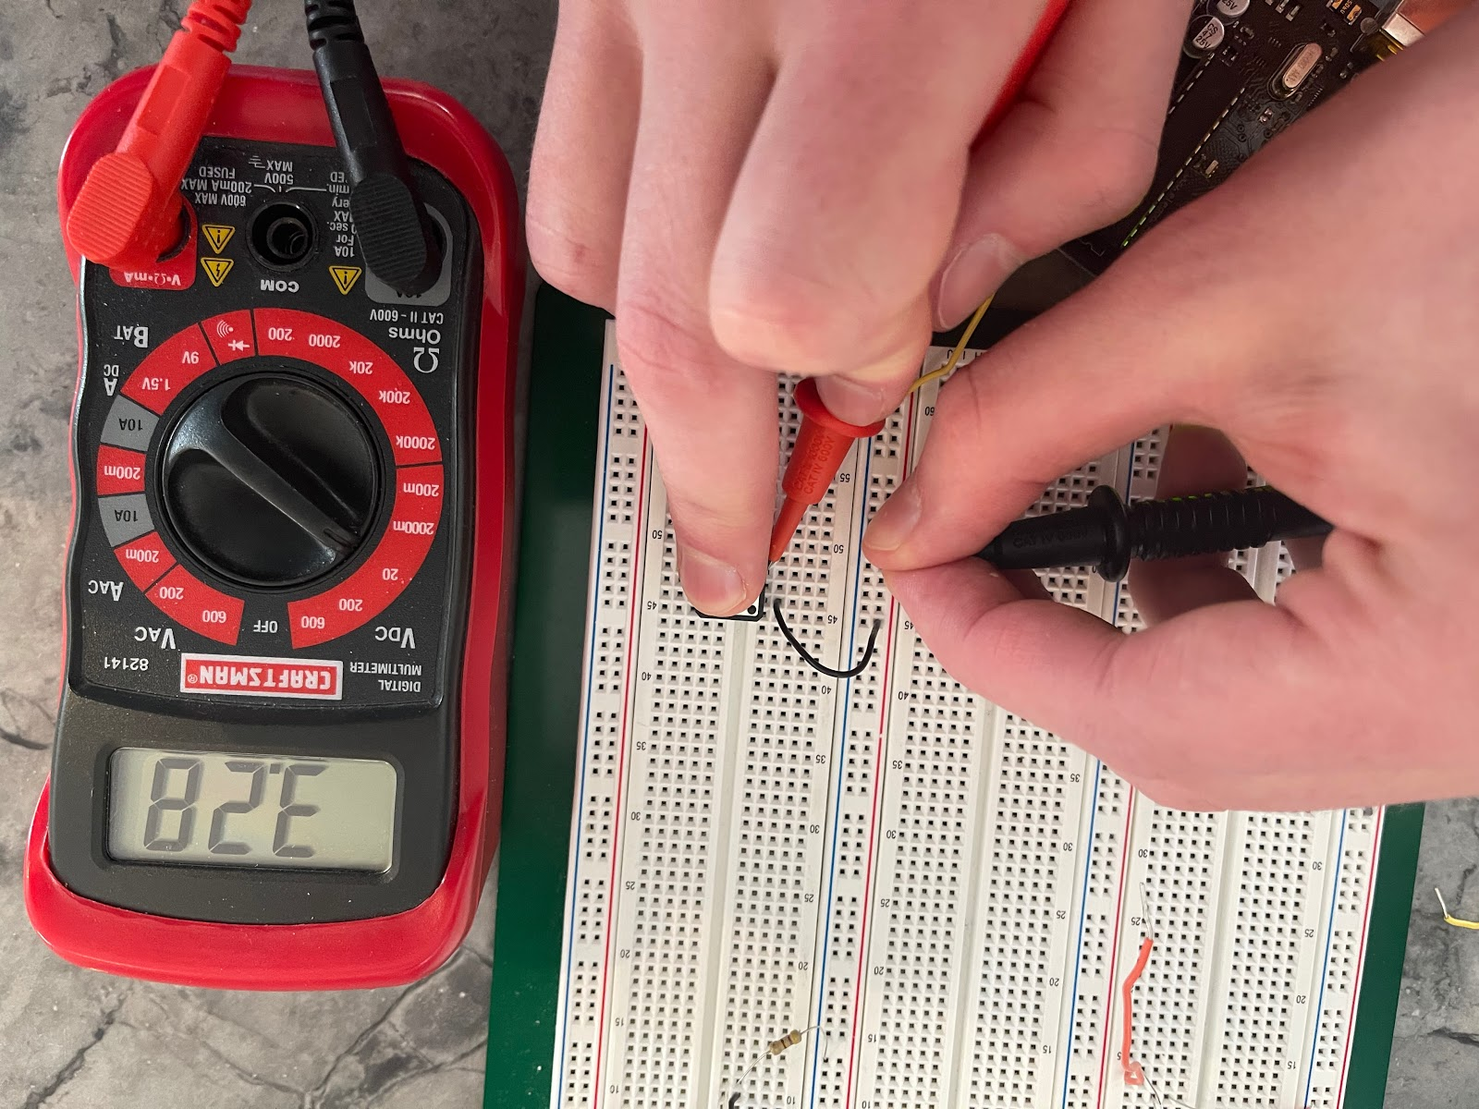
Activation Button Requirements/Verification
Easily Pressable
Allow current to flow when button is pressed but not when it is not

Slide 31
Assembly of Nodes

Slide 32
Changes from Design Review
Microwave sensor
Switched from microphone to transceiver
Speaker volume
90 dB too high, fear of ear damage
Usage of Arduino code
Less pedantic
Libraries available for sensors
Programming/Flashing ESP32
USB CDC to UART

Slide 33
Hardware Construction Challenges
5 iterations of PCB design
Unable to communicate with ESP32 via USB CDC
Switched to UART using Arduino
Broken/missing components
ESP32
Micro-USB breakout

Slide 34
Software Development Challenges
Arduino library integration
Tweaked library code to function properly
Using Home vs Enterprise (IllinoisNet) internet access
Separate libraries and setups required for connection
Two way secure communication to clients
Using web socket emitting on Session ID tagged channels

Slide 35
Results

Slide 36
Overall Results
Nodes connect to internet and can communicate with web server
Nodes read data from sensors and evaluate state of appliance using data
Nodes calibrate to appliance based on on/off state data
Web server updates web app based on received HTTP requests
Web server sends SMS message to phone when enabled

Slide 37
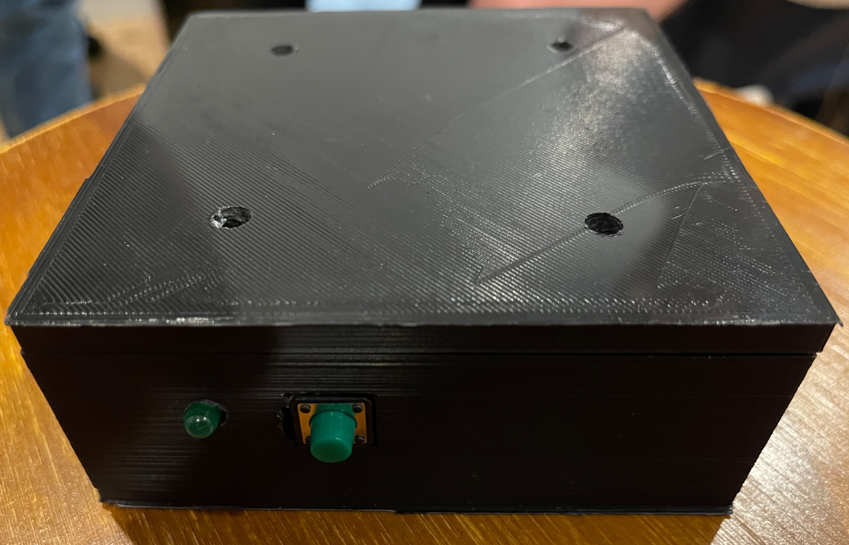
Case
3D printed
Holes for the Status LED, Activation Button and Power Cord

Slide 38
Modularity
PCB has holes for 4/6/7 pin sensors
Allows for different sensors to be swapped in
Calibration setting functionality
Allows for nodes to work across majority of appliances in respective class
Web app allows for additional devices
Allows for many clients holding multiple nodes each
Can also add new devices from the client

Slide 39
Ethical Concerns and Solutions
User safety
Web App houses usernames, passwords, and phone numbers
Nodes send data about house activity
Server privacy/security
Used HTTPS to encrypt traffic from the nodes and clients
Clients are assigned a Session ID on login, needed to make requests

Slide 40
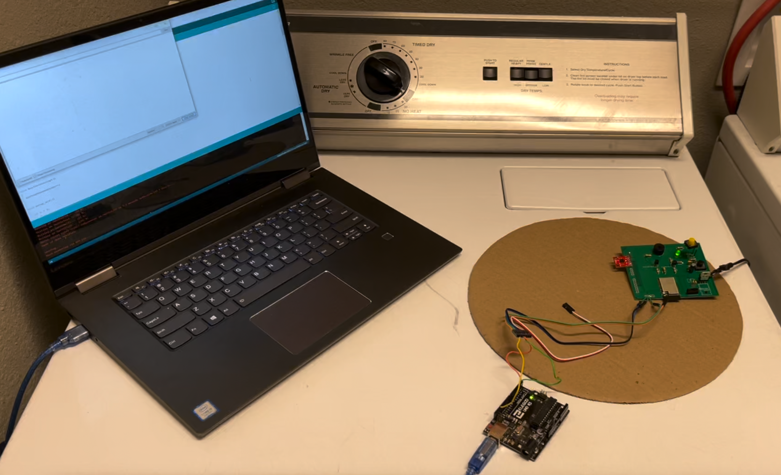
Washer/Dryer Node - Hardware
ESP32 uses ADXL335 Arduino library to communicate with sensor
ESP32 communicates with sensor via Analog reads
ESP32 transmits on/off state to web server via HTTP
ESP32 updates LED and speaker if HTTP fails

Slide 41
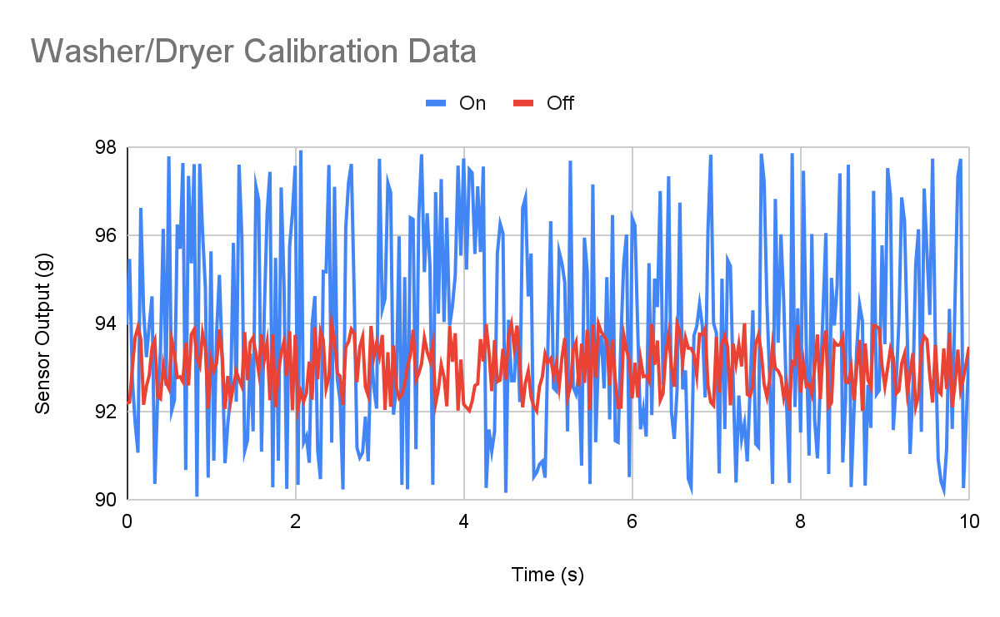
Washer/Dryer Node - Software
ESP32 calibrates to washer/dryer’s on/off states
Web server receives HTTP request from node
Web app updates appliance status

Slide 42
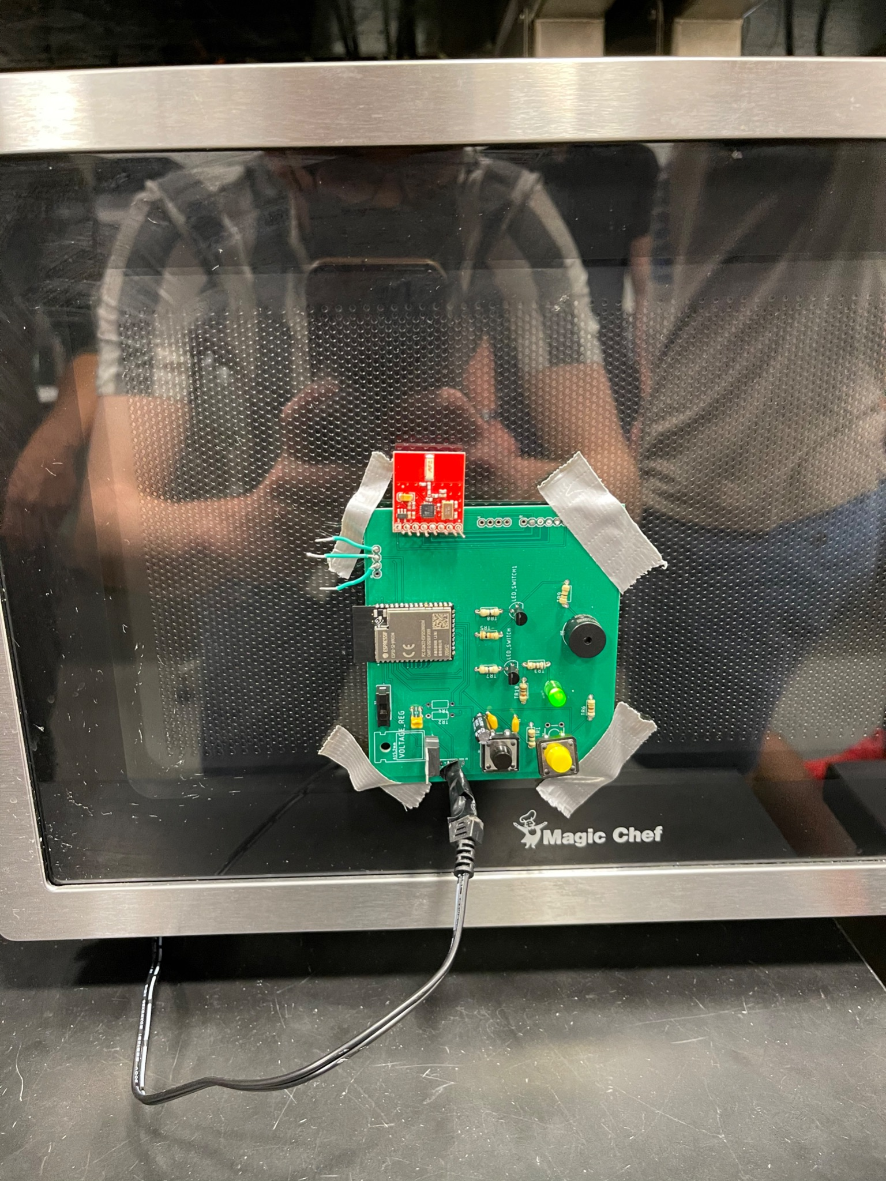
Microwave Node - Hardware
ESP32 uses nRF24L01+ Arduino library to communicate with sensor
ESP32 communicates with sensor via SPI
ESP32 transmits on/off state to web server via HTTP
ESP32 updates LED and speaker if HTTP fails

Slide 43
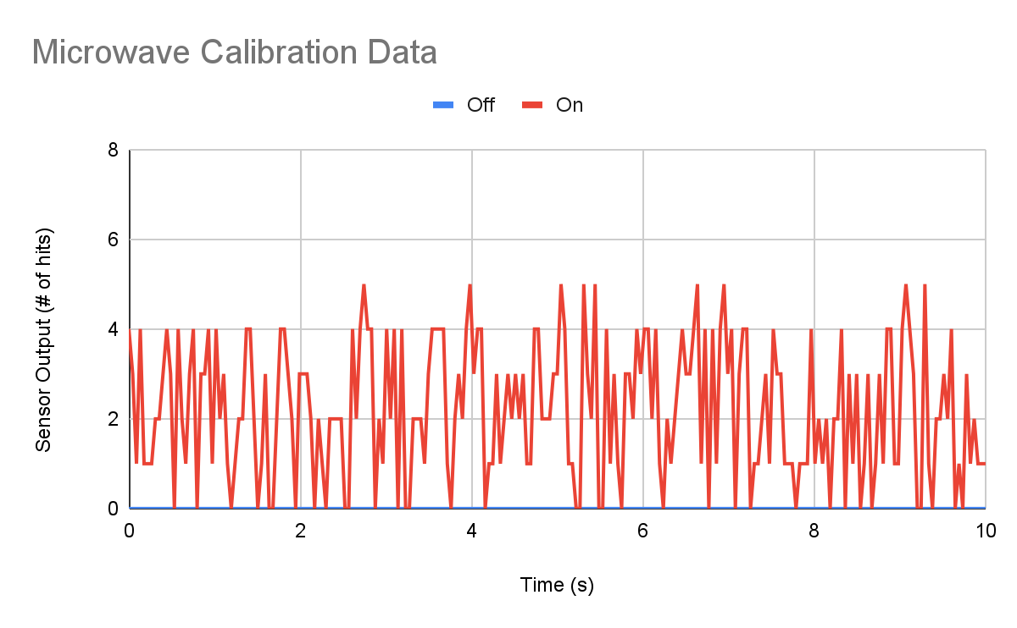
Microwave Node - Software
ESP32 calibrates to microwave’s on/off states
Web server receives HTTP request from node
Web app updates appliance status

Slide 44
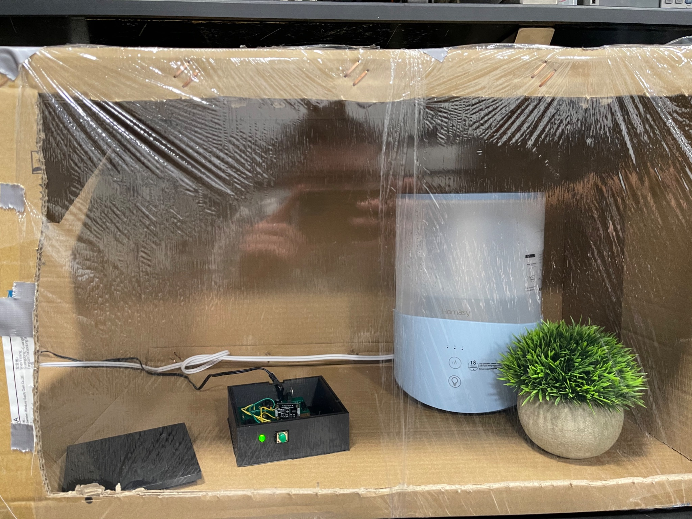
Room Humidity Node - Hardware
ESP32 uses AHT20 Arduino library to communicate with sensor
ESP32 communicates with sensor via I2C
ESP32 transmits humidity value to web server via HTTP

Slide 45
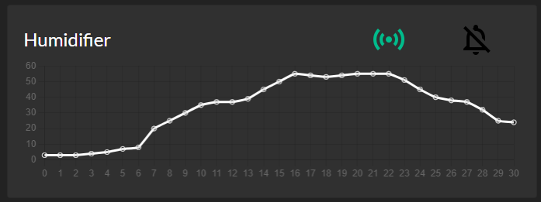
Room Humidity Node - Software
Web server receives HTTP request from node
Web app updates appliance status, adds new value to graph

Slide 46
Conclusion

Slide 47
Conclusions
Three nodes for three different household appliances were fully developed and integrated with web server
Calibration setting allows for functionality on 90%+ of appliances
LED and speaker alert user of status change if WiFi fails
Web server allows for further addition of new nodes

Slide 48
Further Work
Add more nodes for larger household ecosystem
Room temperature node
Oven node
Door lock node
Upgrade microcontroller for more threads
Implement interrupts for activation button push
Allow device to continue operating while HTTP request is being sent

Slide 49
Questions?

