Slide 1
Fiducial Pattern
Tracking Drone
Group #59
Alexander Amiel, Angelos Guan, Umer Belagam
ECE 445 Senior Design
May 4, 2021

Slide 2
Introduction
Hands Free controllable drone
Can track a fiducial pattern, which is similar to a QR code, and keep a distance of 4-5 feet from it

Slide 3
Why Our Project?
Problems:
Most drones use a remote control to pilot a drone
Some hands free controllable drones use hand gestures to control the drone
We want to have a recognition system where it is easy to detect a certain object

Slide 4
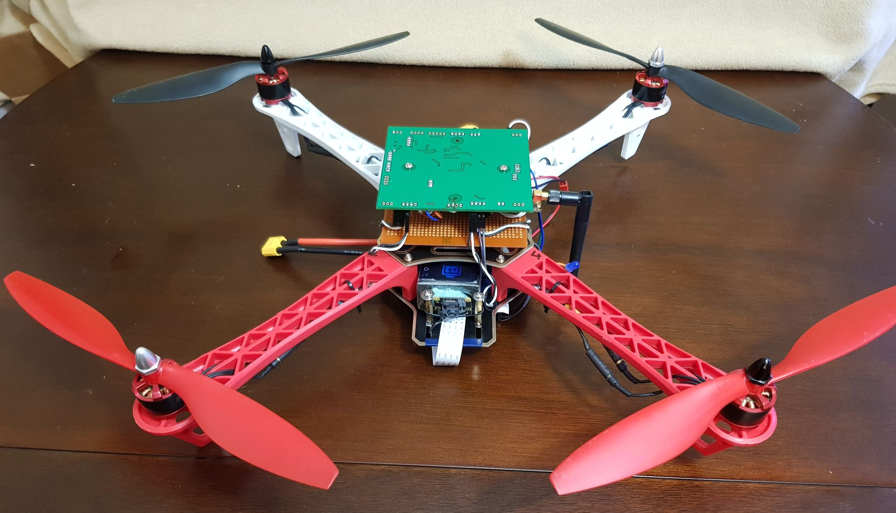

Slide 5
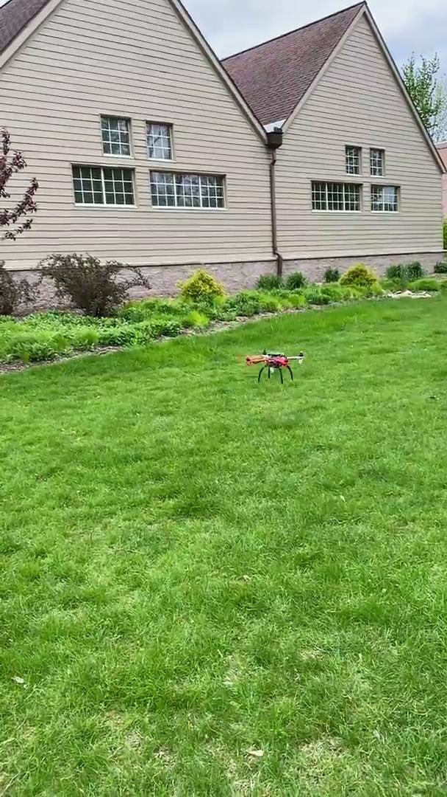

Slide 6
High Level Requirements
Drone must detect AprilTag within 10 feet with a 3% error distance measurement
The drone must be able to fly with an upright orientation and maintain 4-5 feet distance to the detected fiducial pattern within a 5 s response latency.
If a fiducial pattern is not detected, the drone should maintain its current position and ring the buzzer and light up the LED to notify the user.

Slide 7
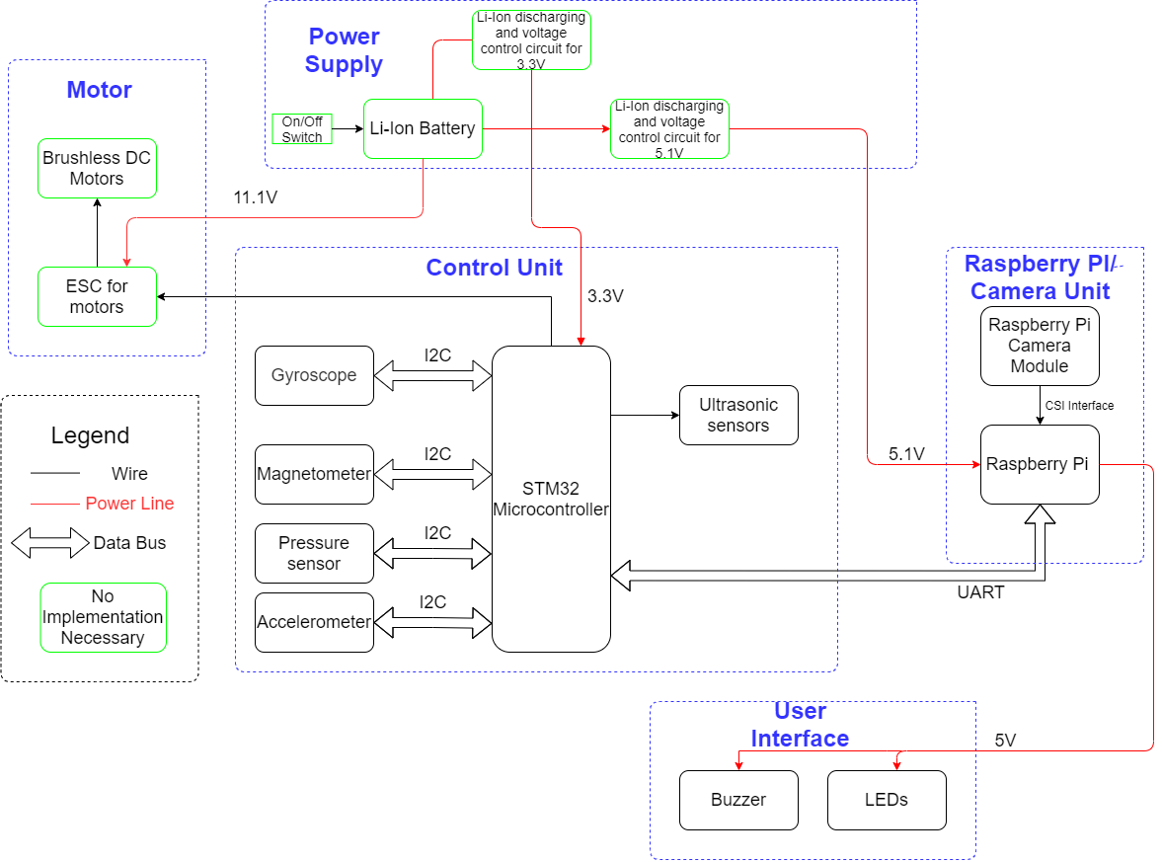

Slide 8
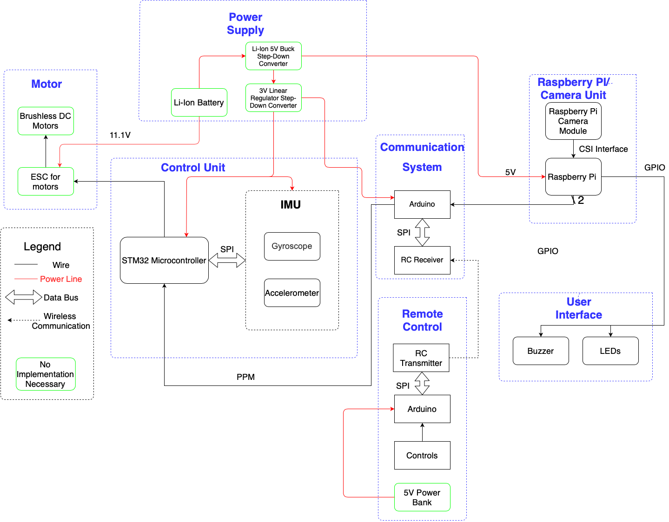
Notes:
Talk about what has changed since the original design. No compass. No ultrasonic sensor. Arduino added. RC rx tx added. External IMU breakout board used

Slide 9
Drone Frame
DJI F450 frame clone
Frame on bigger side for hobbyist sized drone
Bigger frame is more stable during flight
Drone weighs 1.1kg and 1.3kg is the max based on documentation from DJI with the motors we are using

Slide 10
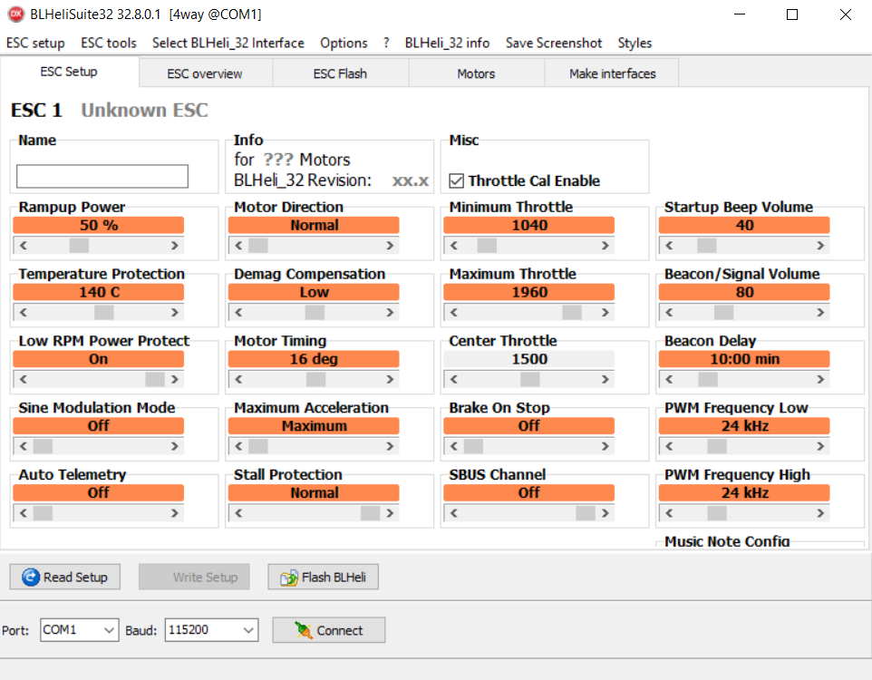
ESCs and motors
We have 4 ESCs and motors that we purchased and have minimal implementation for
Motors on opposite sides spin in the same direction. 2 clockwise and 2 counterclockwise
ESCs use DShot protocol to communicate with the flight controller
ESCs run BLHeli firmware. This software is used to adjust throttle values and set motor direction

Slide 11
Battery
3S li-ion battery. 11.1V nominal voltage. 5200mAh capacity
Based on similar sized drones with most of the flight time spent hovering estimated current draw 25A
5.2Ah * 60min * 80%battery drain * 1/25A = 10 minutes of flight time

Slide 12
Flight Controller
The brains of our drone
Controls the ESCs
Takes input from sensors does processing on that data
Takes commands from the communication system

Slide 13
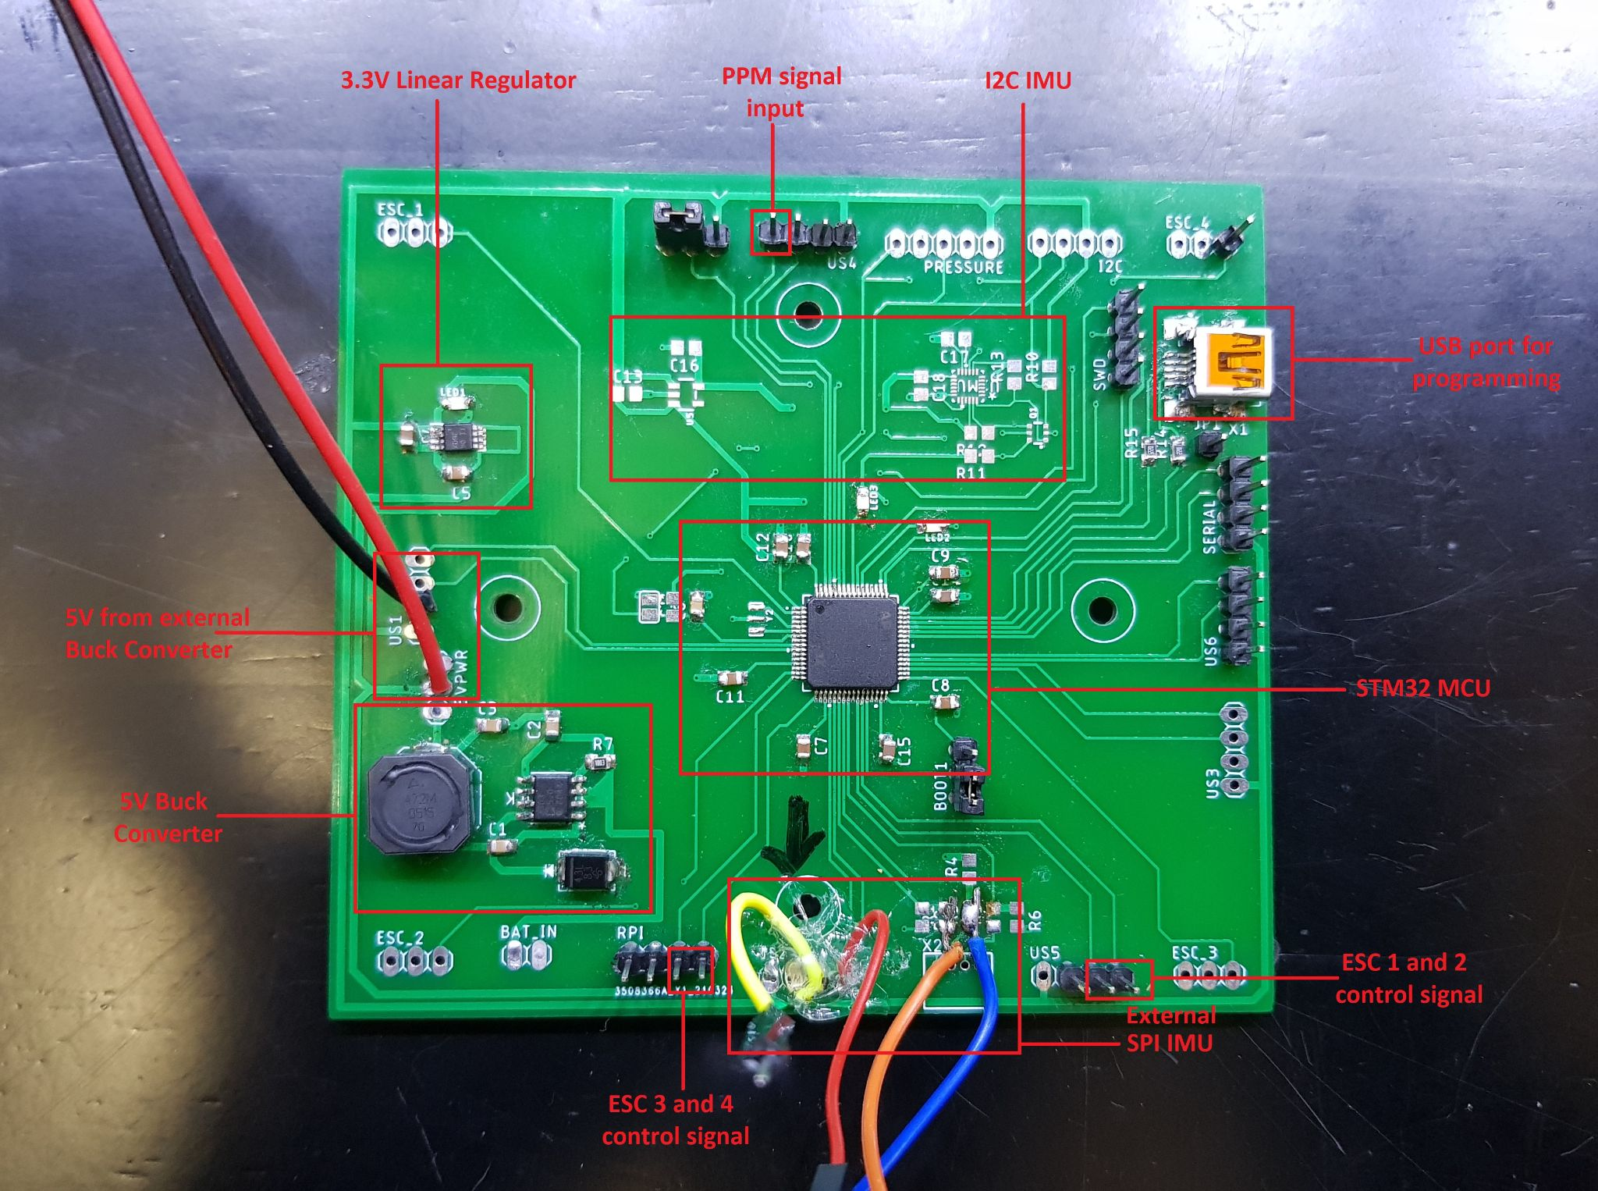
Flight Controller Hardware
STM32F405 microcontroller
FPU
DMA
1MB Flash

Slide 14
Reasons for jumpers on FC pcb
ESCs need to use DMA and timers for the DShot communication protocol which is only available on some STM32 pins
Initially IMU was connected by I2C bus. Betaflight drivers only supported SPI for IMU
Initially RC receiver and RPi were gonna use UART for communication but couldn’t get that working in BF so used PPM which needs to use a timer.
5V buck converter didn’t work

Slide 15
Flight Controller Software: BetaFlight
Open Source flight controller Software
Added custom IMU driver for a gyroscope and accelerometer
Important for drone orientation when in the air, so that it maintains an upright orientation
Has two main operations:
Throttle: power the propellers
Pitch: rotate drone forward or backward
Gets signals from arduino to move the drone forward or backward which is explained later

Slide 16
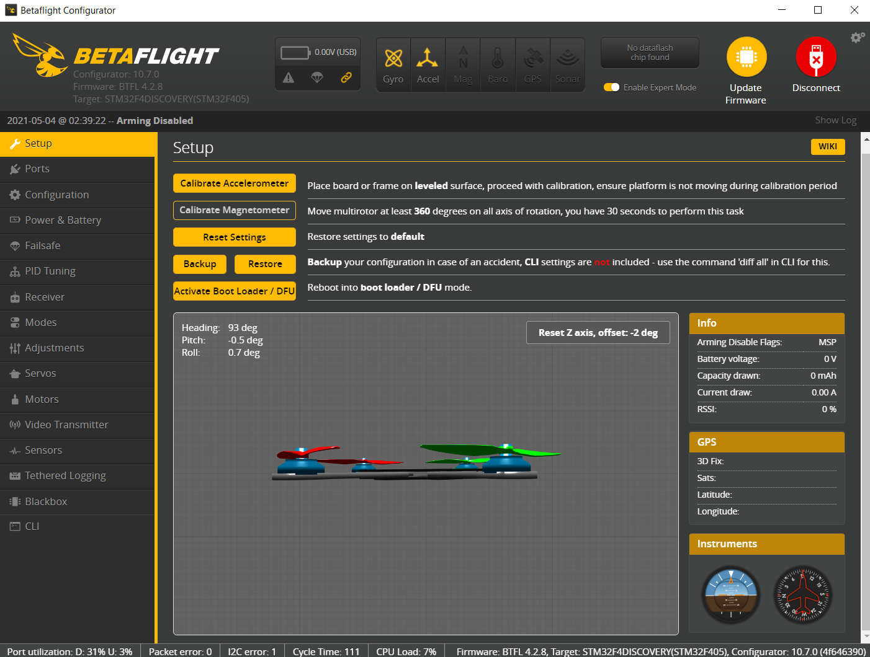

Slide 17
Changes made to Betaflight code
IMU driver code changed
Pins remapped
Features enabled and drivers added

Slide 18
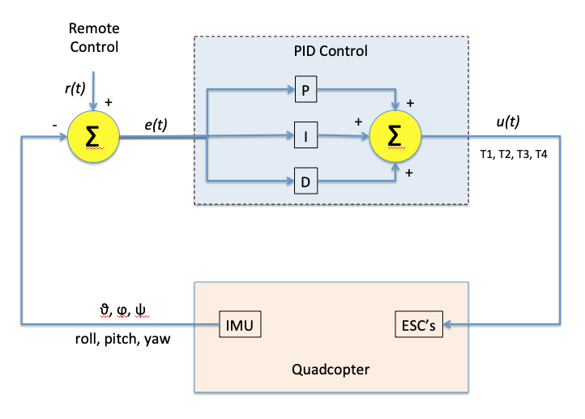
PID

Slide 19
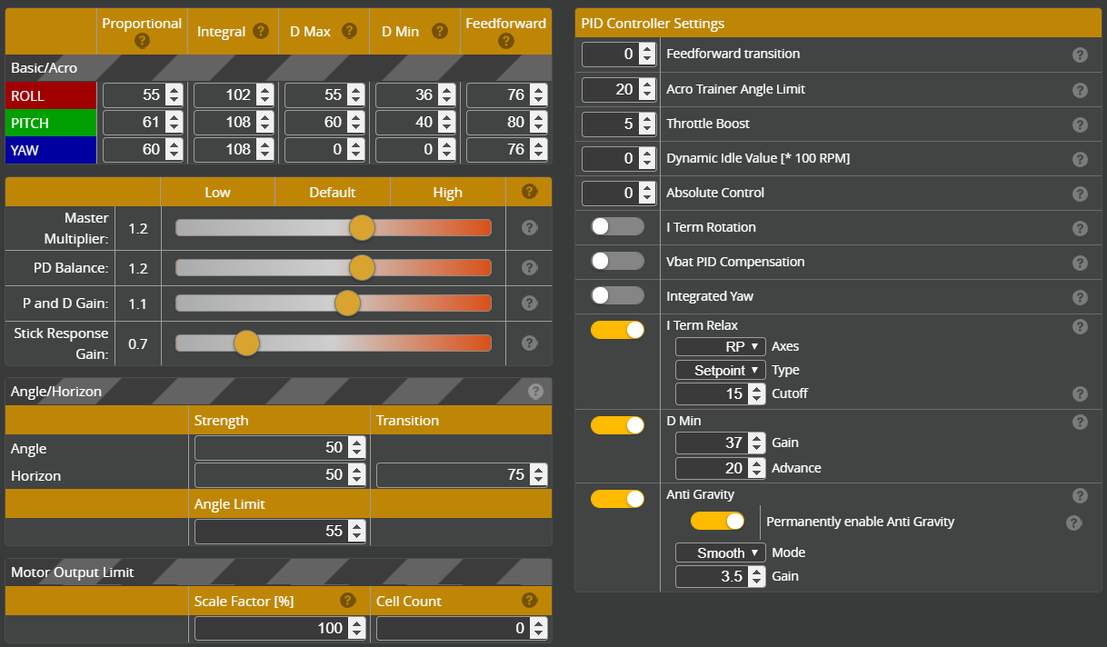

Slide 20
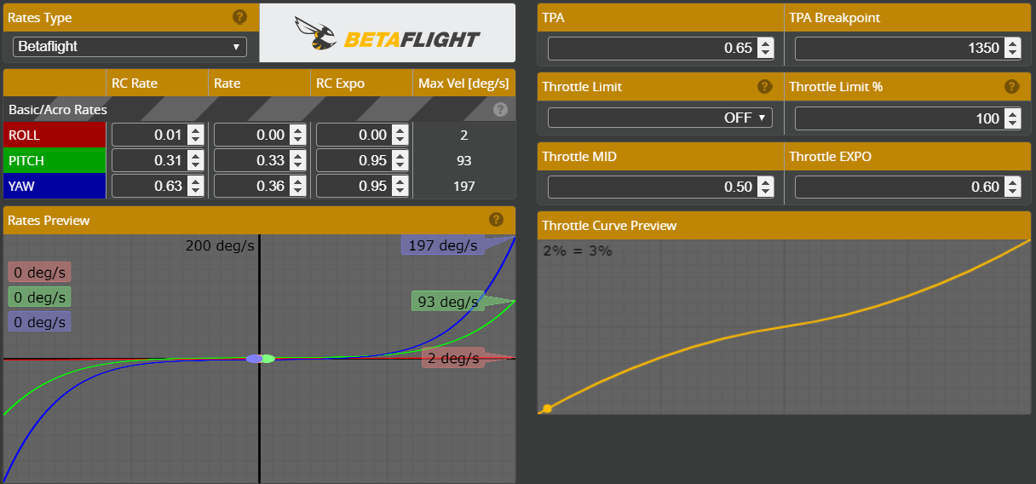

Slide 21
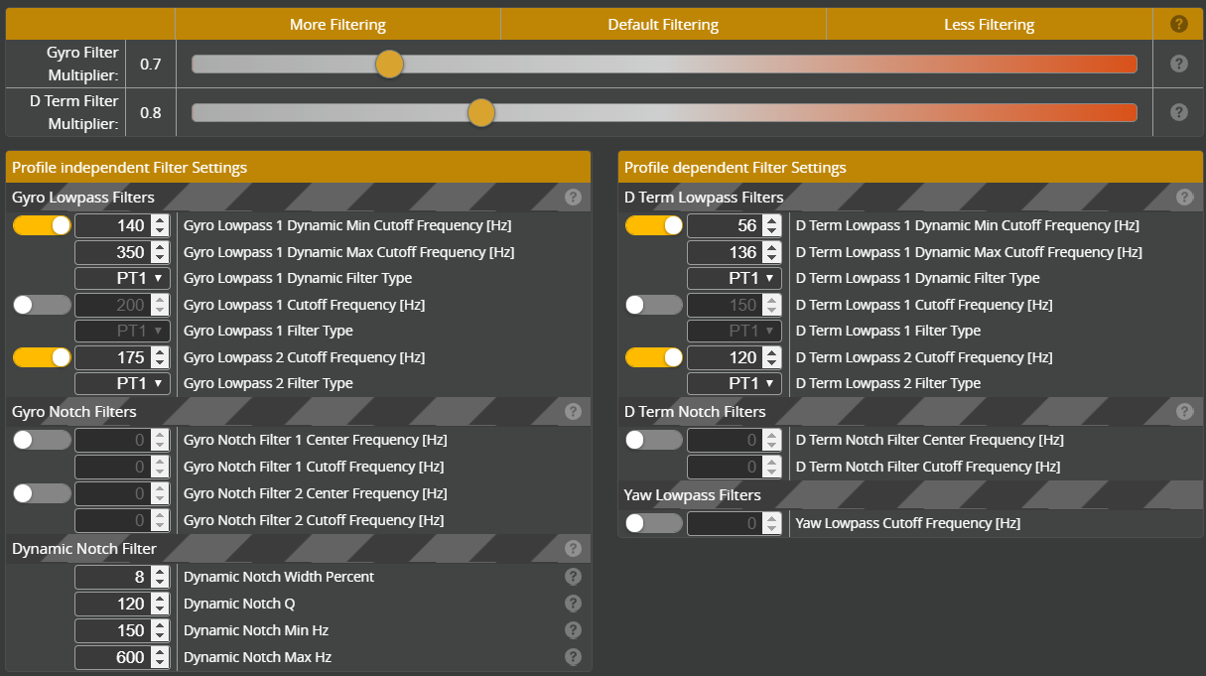

Slide 23
Why IMU didn’t work as expected?
We use the ICM20948 IMU and ICM gyroscopes are known to be noisy
Noise in SPI connection through jumper wires
Bad PID tuning
Bad IMU data filtering
IMU mounted on drone without rubber dampening spacers
Bug in IMU driver initialization code when sensitivity and filtering parameters are set

Slide 24
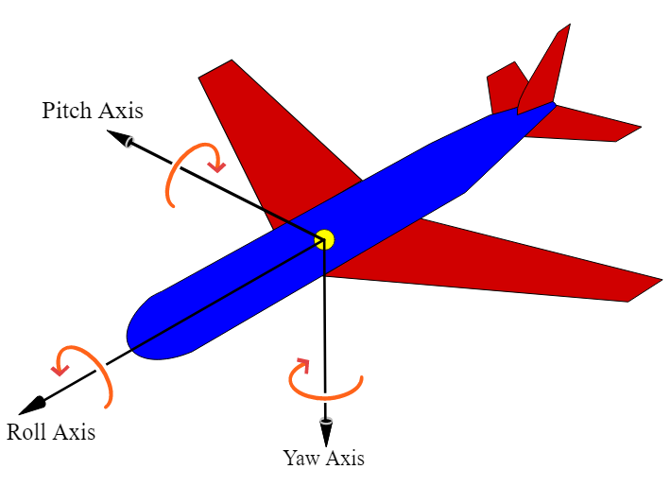
Drone axes of movement
We are mainly concerned with pitch to make the drone move tilt forward and backward making it move that way

Slide 25
Radio Control
2x NRF24L01 transceivers
1 used as transmitter and 1 used as receiver
2.4GHz transmission frequency. 250kbps data rate
100m range
6 bytes data transmitted
1 byte each for throttle yaw pitch roll aux1 aux2

Slide 26
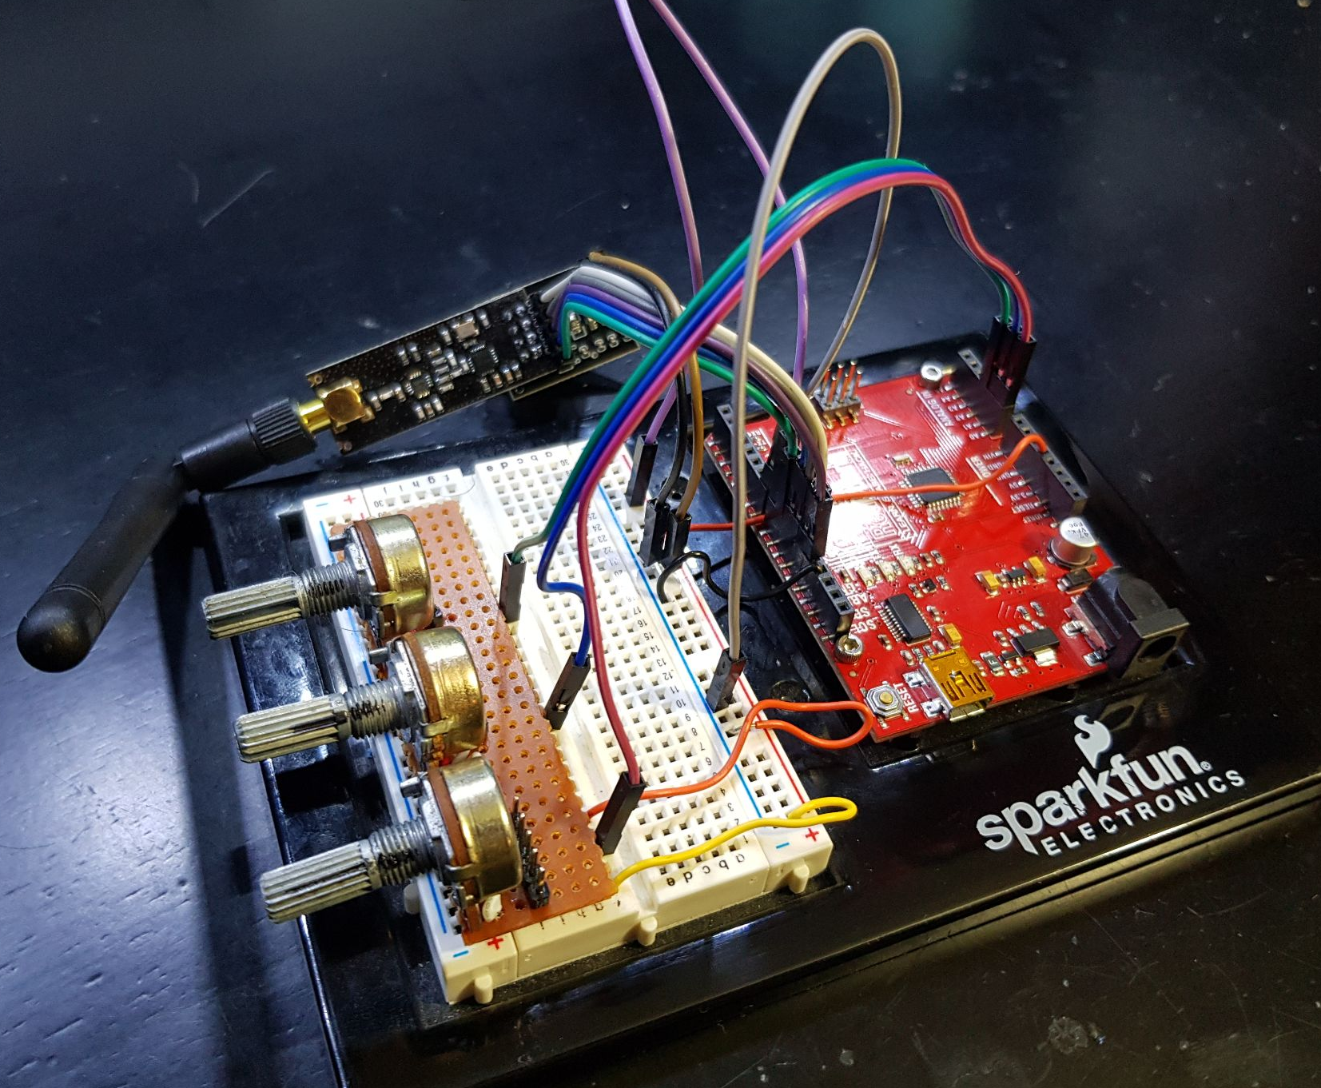
RC TX
Has arduino Uno
Knobs for yaw pitch throttle
Switches for aux1,2

Slide 27
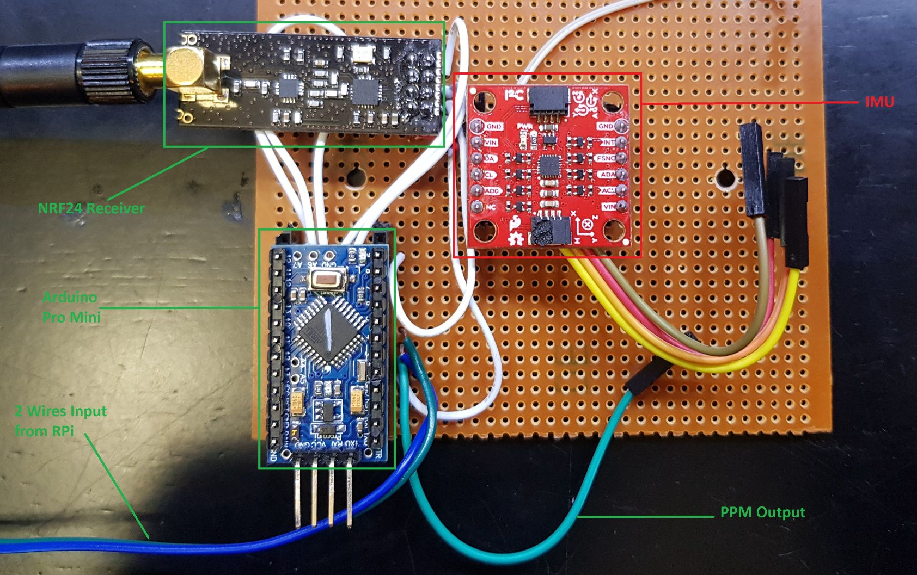
Communication System
Has arduino pro mini
Has RC receiver

Slide 28
Arduino
GPIO
PPM
RPI
STM32 (Betaflight)

Slide 29
Arduino & RC Receiver
Arduino receives signal from RC receiver of a custom designed user controller
Set commands to safe values when signal is lost

Slide 30
Arduino & RPI
Arduino receives two bit digital signals from RPI (GPIO) representing
forward (10),
backward (01)
stay (00)

Slide 31
Arduino & Betaflight
Arduino send commands via PPM to betaflight
Pitch, yaw, throttle from RC receiver
Mapped to value between 1000-2000
Preset pitch & throttle values according to RPI signal
Backward: decrease pitch to below 1500, increase throttle if needed
Forward: increase pitch to above 1500, increase throttle if needed
Stay: set pitch value to 1500

Slide 32
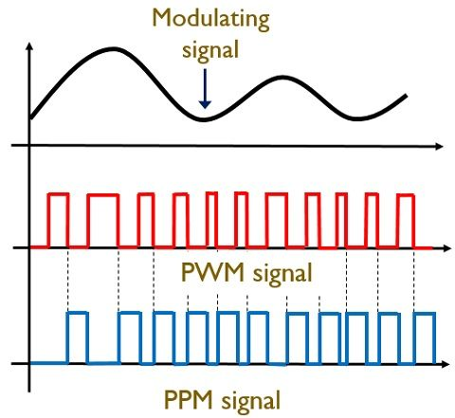
PPM
Pulse position modulation.
M message bits are encoded by transmitting a single pulse in one of 2^M possible required time shifts.
Repeated every T seconds, transmitted bit rate M/T bits per second
1500 center position for yaw pitch roll. Throttle 1000-2000

Slide 34
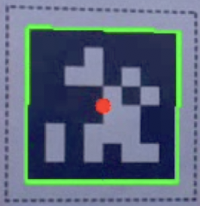
AprilTag Detection Using Raspberry Pi
Input: image frame from video capture of raspberry pi camera
Output: image, distance, and number of tags
Outline the bounding box of the AprilTag detection
AprilTag python package can recognize its corner points and perceived width

Slide 35
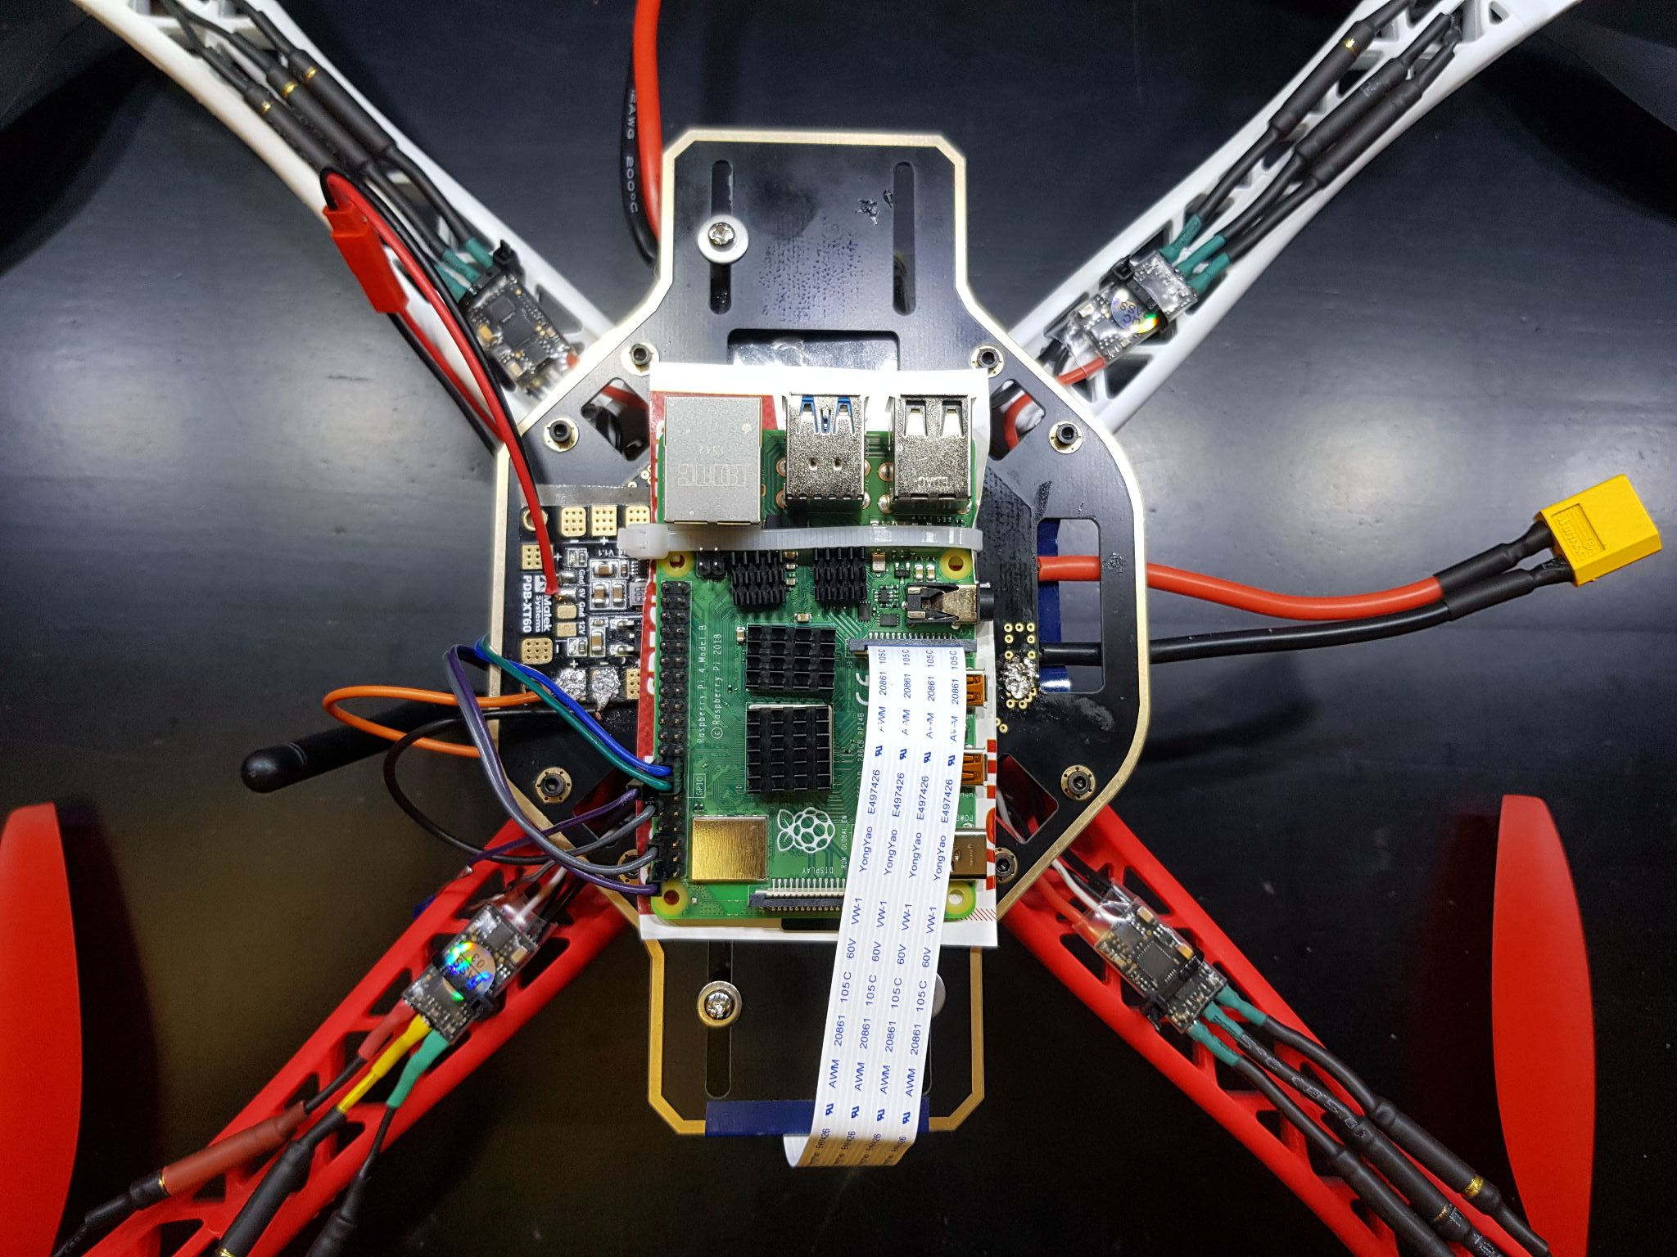

Slide 36
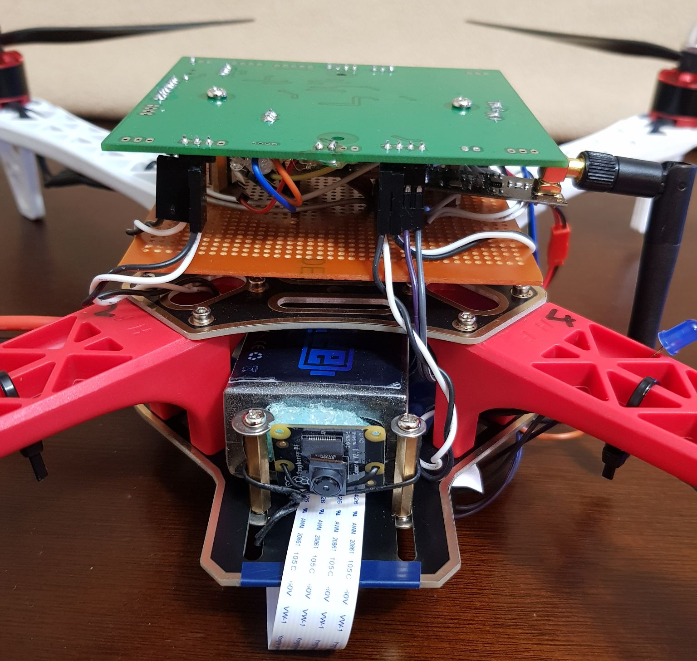

Slide 37
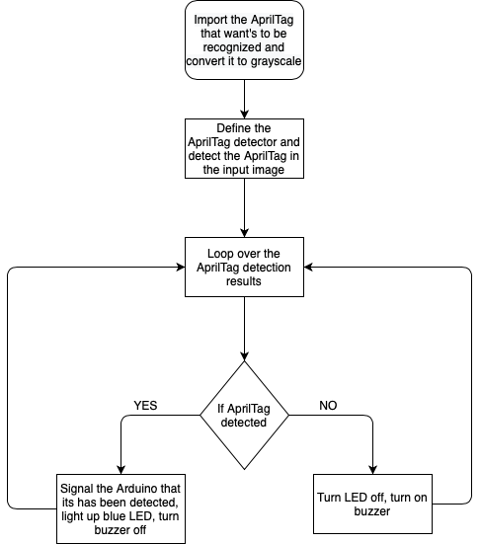
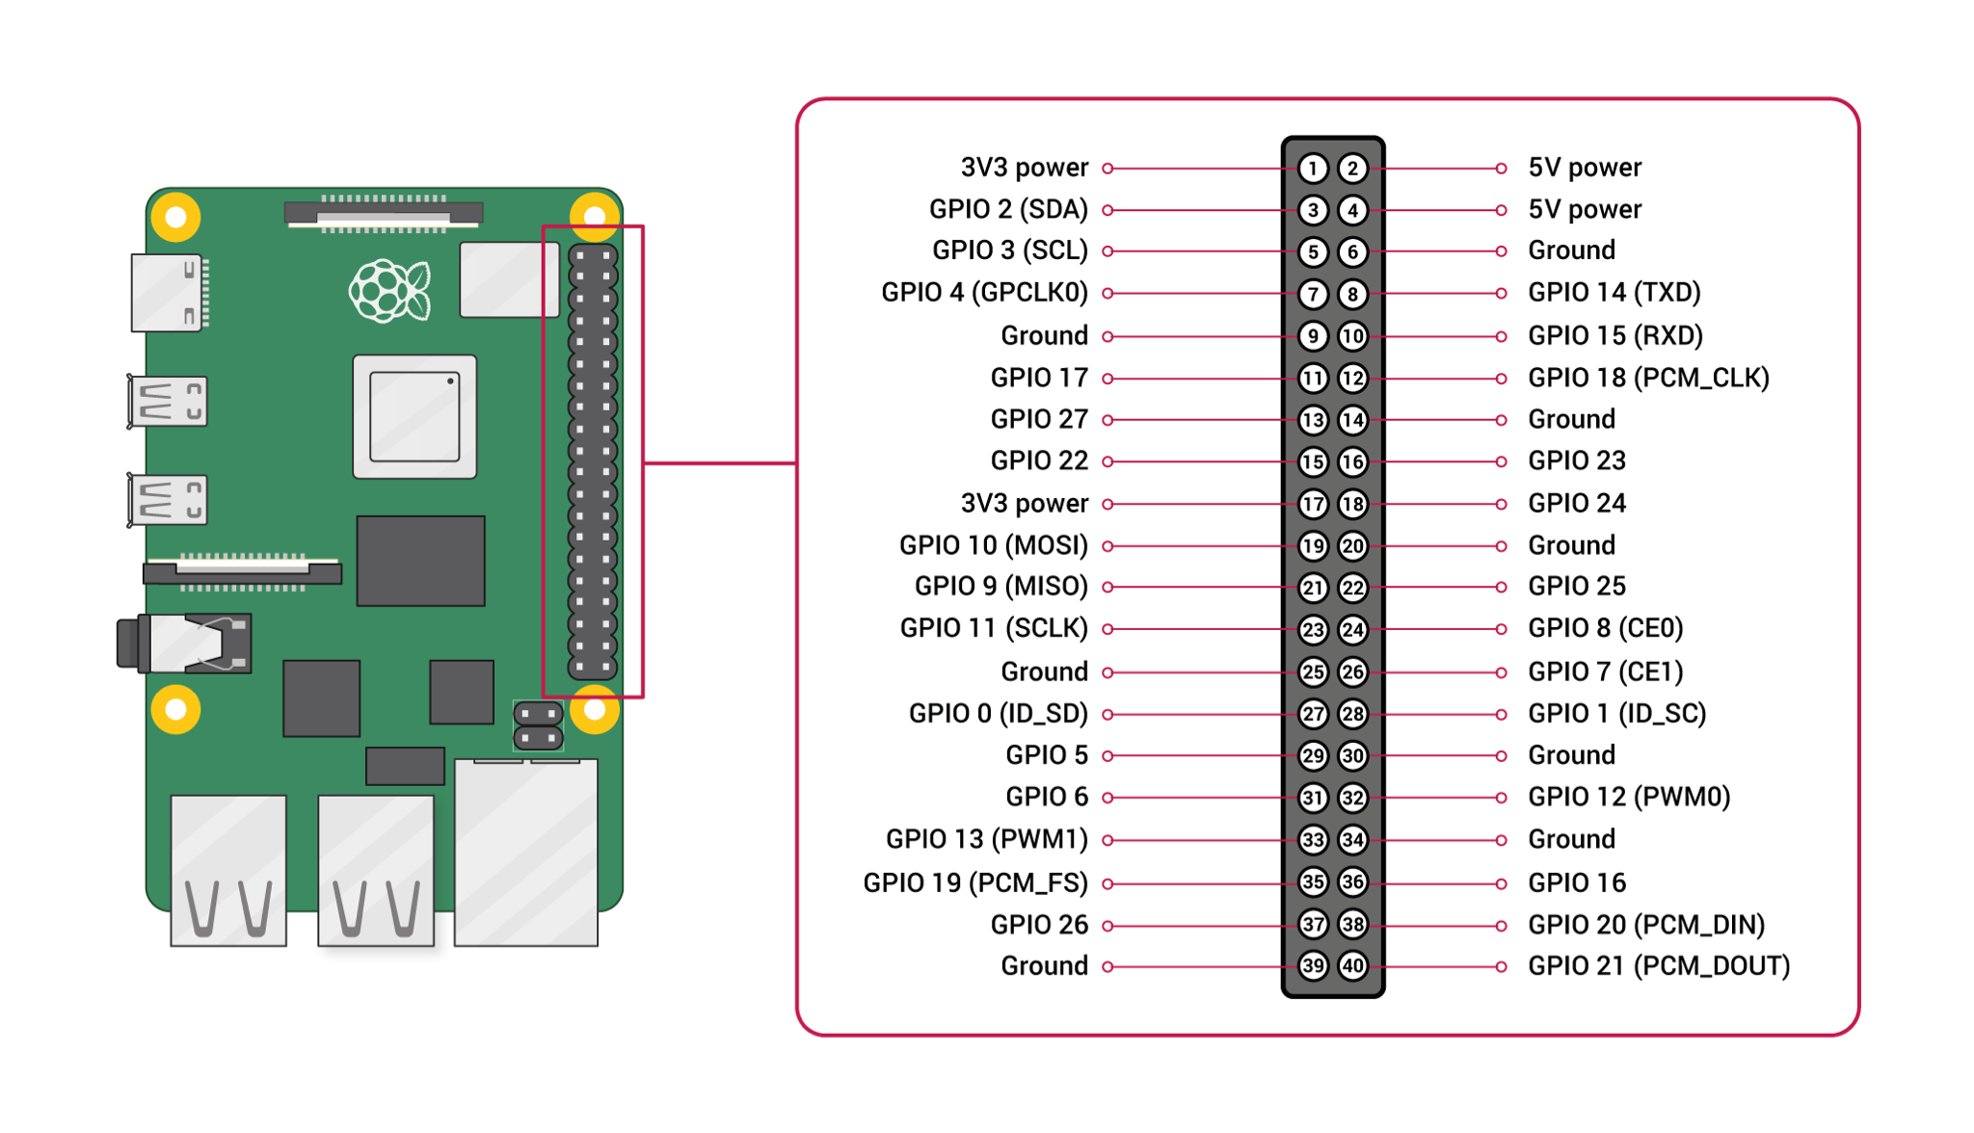
Verify AprilTag is Detected
Using GPIO pins of the Raspberry Pi:
signal an LED to light up if the AprilTag is detected
buzzer goes off when it isn’t detected

Slide 38
Measuring Distance to AprilTag
Calibrate camera focal length using known input image:
Known distance to the camera (D), known width of the bounding box (W), and perceived width in pixels (P)
Perceived width is the average of each bounding box line
Calculation for P: Avg Euclidean distance of each bounding box edge
F = (PXD)/W
Calculate Distance using known focal length, width, and new perceived width
D = (WXF)/new_P

Slide 39
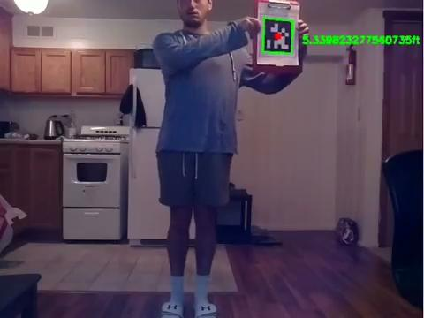

Slide 40
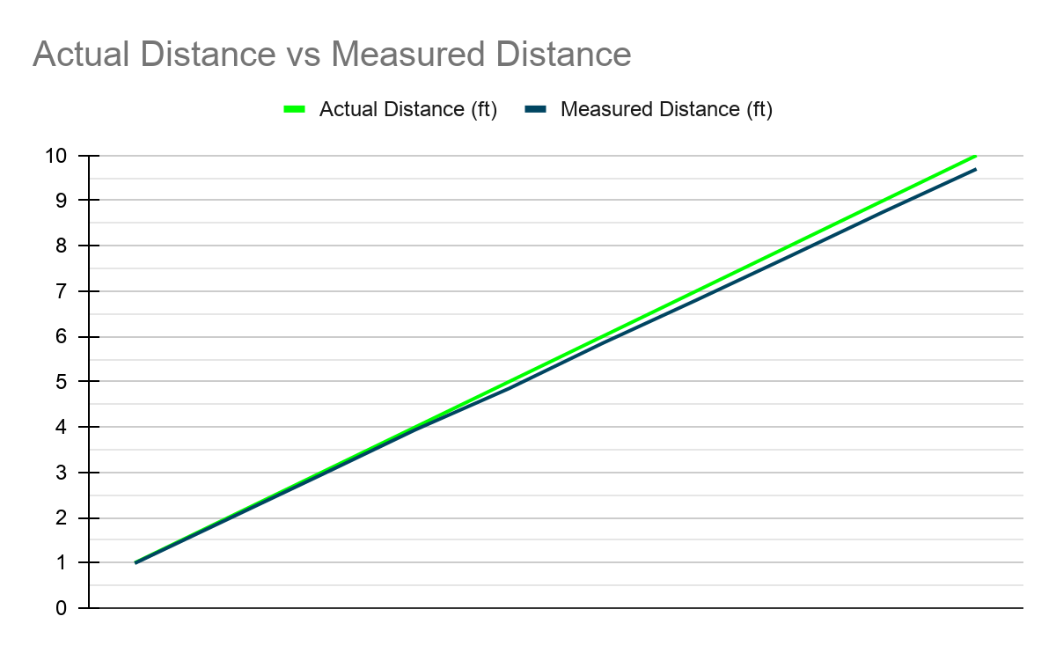
Actual Distance | Measured Distance
1 | 0.99
2 | 1.97
3 | 2.95
4 | 3.94
5 | 4.85
6 | 5.85
7 | 6.80
8 | 7.77
9 | 8.75
10 | 9.70
Error Percentage = (Actual - Measured) / Actual
Within 3% error

Slide 41
Other Distance Tests
Same GPIO test with an LED to determine if the AprilTag is:
4-5 feet from the camera
Greater than 5 feet from the camera
Smaller than 4 feet from the camera

Slide 42
Distance Measured to Move Drone
After measuring the distance, we send commands to an arduino to tell the microcontroller (our own flight controller) to move the drone
If the distance was greater than 5 feet, move the drone forward,
If distance between 4 and 5 feet, don’t do anything
If distance less than 4 feet, move the drone backward
Tested this with an LED and GPIO pins of the raspberry pi
Signal an LED to light up if the distance was greater than 5 feet and another test to light up an LED if the distance was less than 4 feet

Slide 43
Conclusion and Future Work
Integration of raspberry pi detection, arduino, and flight controller (microcontroller, gyroscope, accelerometer) worked
Sometimes the gyroscope wouldn’t start when booting up the flight controller system (maybe something wrong in the code)
Add an ultrasonic sensor system to avoid obstacles when flying the drone
Be able to detect the angle the AprilTag is rotated (from center) to turn the drone
Add additional AprilTags to signal the drone to do different actions

Slide 44
Thank you. Questions?

