Slide 1
TipsyTracker
Group 17 | ECE 445
Akash Patel | Sumedh Vemuganti | Eshrit Tiwary

Slide 2
Overview
Electrical and Computer Engineering

Slide 3
Problem
Irresponsible drinking leads to over 140,000 deaths each year
Need to promote responsible drinking habits to reduce harm caused by this issue
Encouraging individuals to take control of their own actions is key to addressing this problem
We have developed an innovative system that would encourage safe drinking
Electrical and Computer Engineering
Notes:
Eshrit

Slide 4
Solution
TipsyTracker: A system that encourages responsible drinking by keeping individuals informed about their blood alcohol (BAC) levels during events
Electrical and Computer Engineering
Notes:
Akash

Slide 5
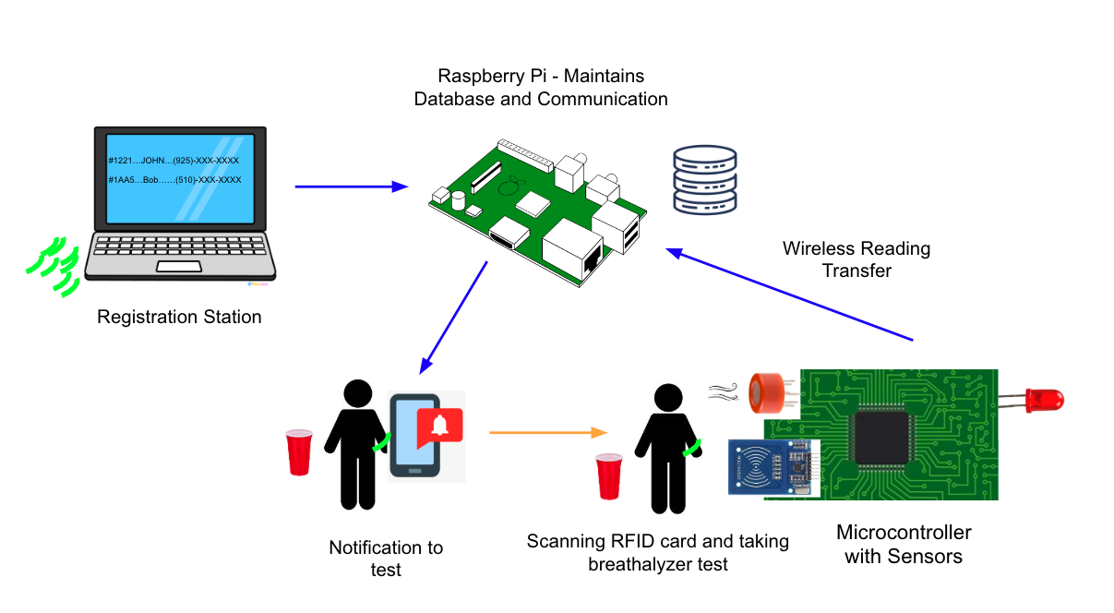
Visual Representation
Electrical and Computer Engineering
Notes:
Akash

Slide 6
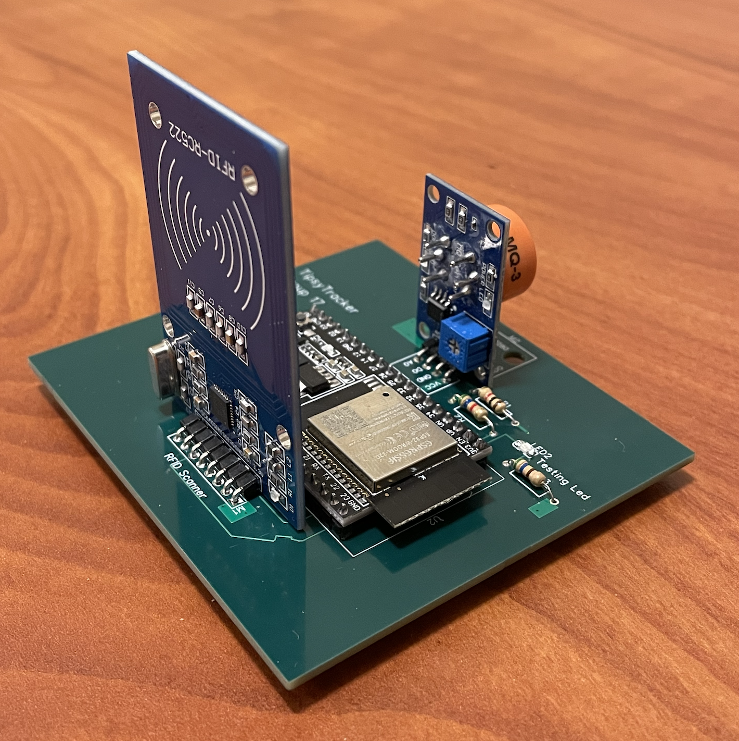
High Level Requirements
Accurate Alcohol Monitoring: system must provide precise and reliable alcohol monitoring, ensuring that Blood Alcohol Content (BAC) readings are accurate
Instant Results: system must enable quick and convenient testing, delivering instant results that are available on the web-portal in less than 10 seconds
User capacity: system must be able to accommodate and store BAC test results for at least 500 partygoers
TipsyTracker PCB
Electrical and Computer Engineering
Notes:
Sumedh

Slide 7
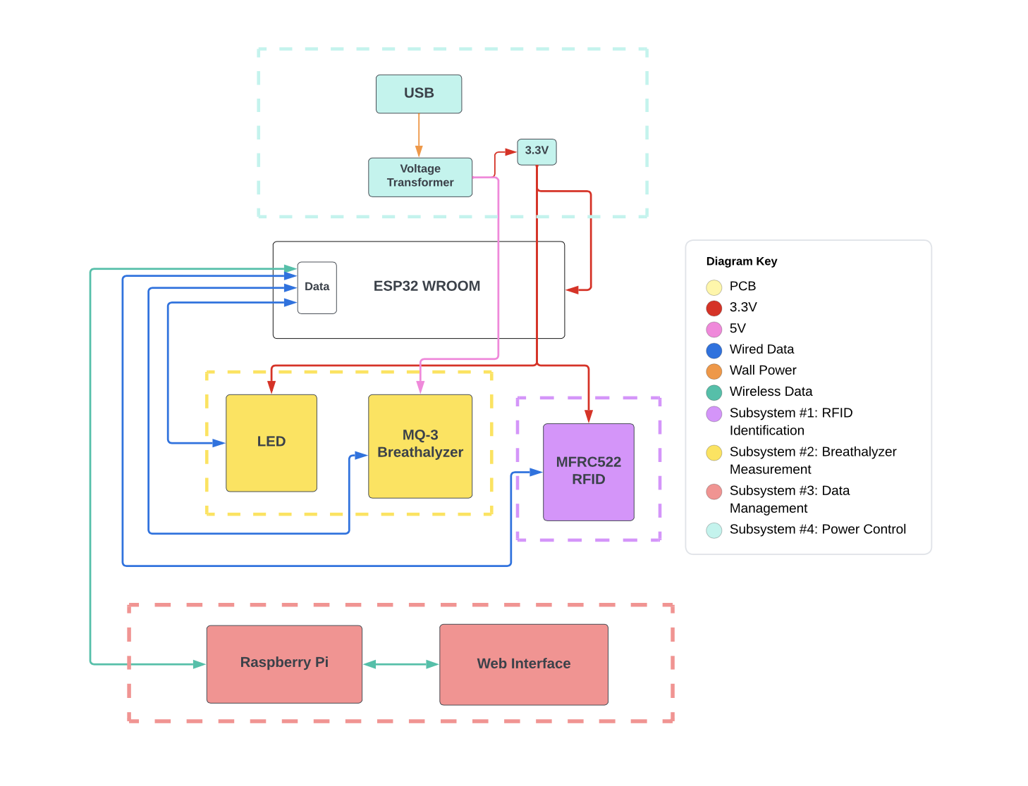
Block Diagram
Electrical and Computer Engineering
Notes:
Akash

Slide 8
Subsystems
Electrical and Computer Engineering

Slide 9
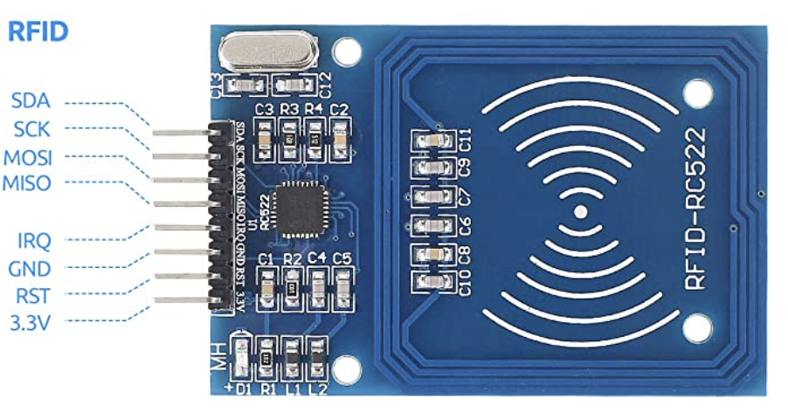
RFID Subsystem
RFID Sensor (MFRC522)
RFID Card
Electrical and Computer Engineering
Notes:
Eshrit

Slide 10
RFID Subsystem (cont.)
The RFID sensor was able to detect tags at a distance at least up to 3 cm
The RFID sensor was able to uniquely identify users and appropriately update their BAC levels on the web portal as their respective notifications were sent
The RFID was reliably polled by the microcontroller/sensor
Unlit LED to show cooldown period
Akash’s updated BAC values (partygoer with RFID of 8057a389 in this instance)

Slide 11
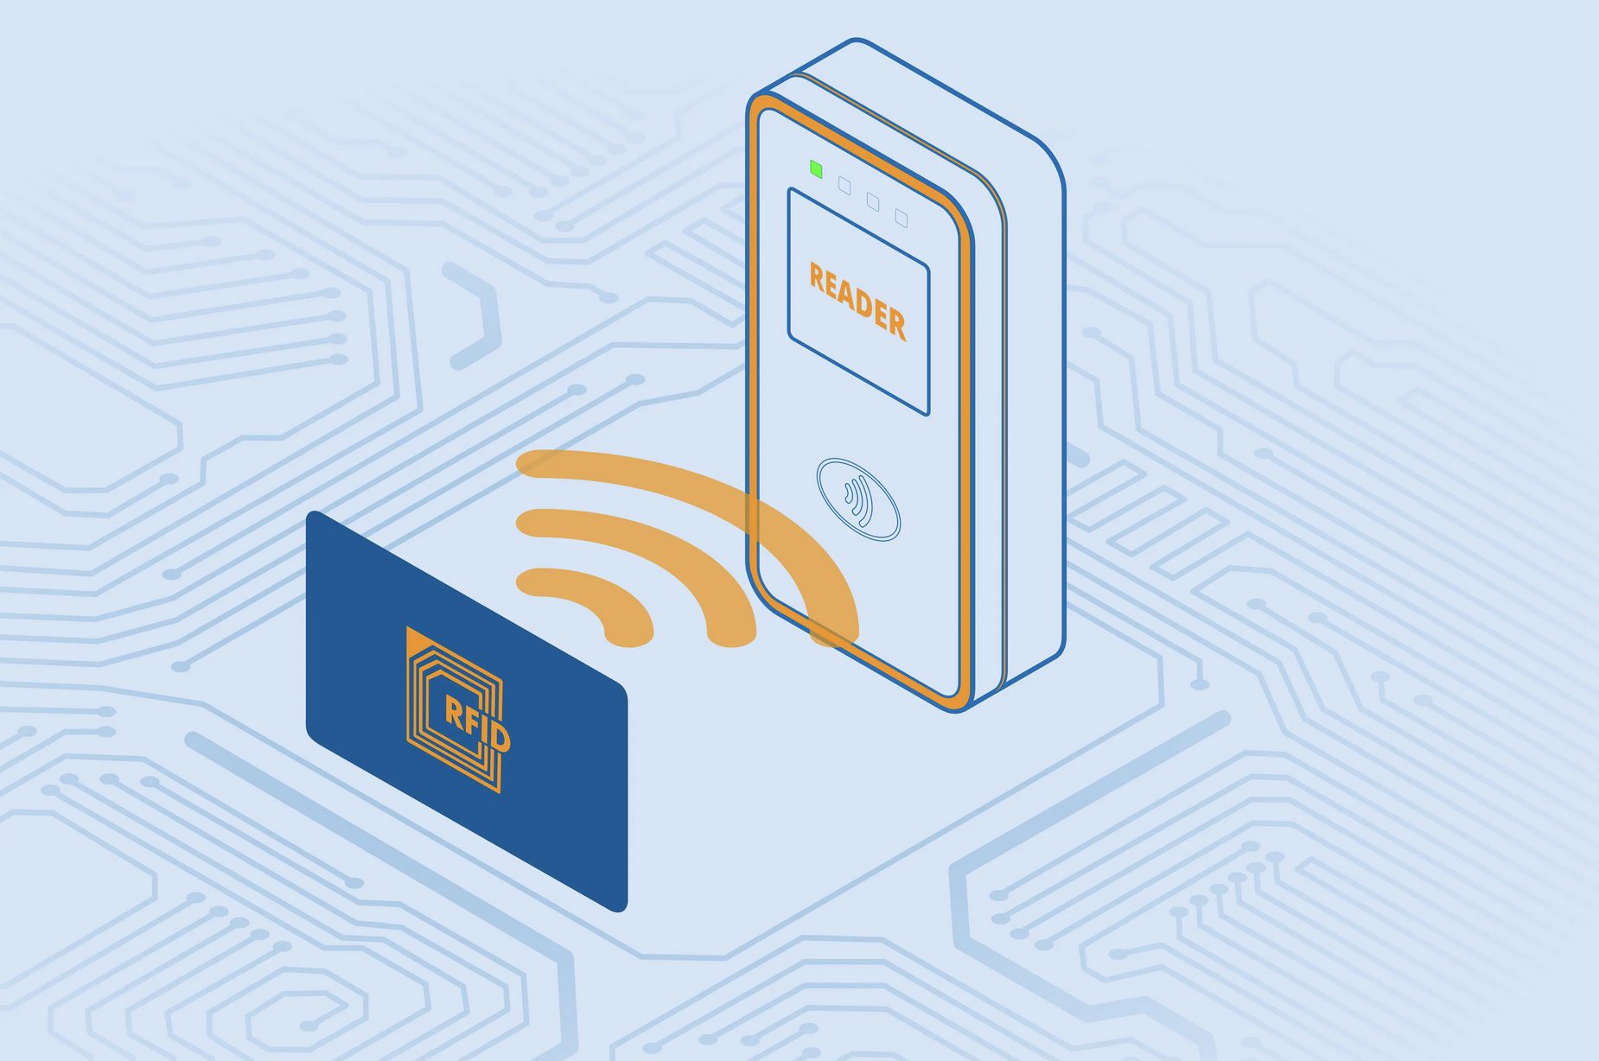
RFID Subsystem Challenges
RFID sensor fully stopped during mock demo
Initial Thoughts: Soldering issues, checked for any visible damage or loose/connections
Theory 1: Unstable power while microcontroller firmware flashing led to erratic power delivered to sensor
Theory 2: RFID sensor was poor quality/cheap and got damaged.
After replacement, RFID subsystem interacted properly with whole system
RFID Reader
Electrical and Computer Engineering
Notes:
Sumedh

Slide 12
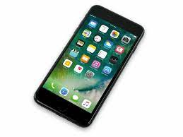
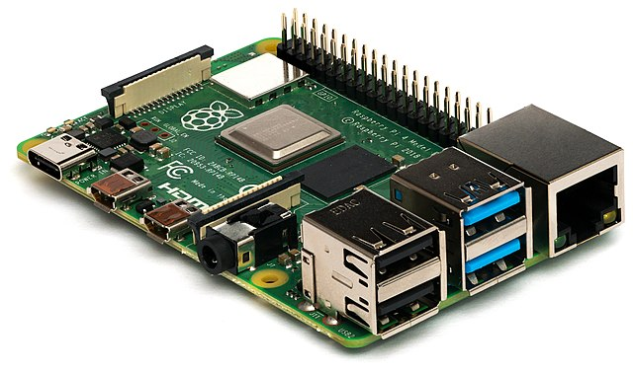
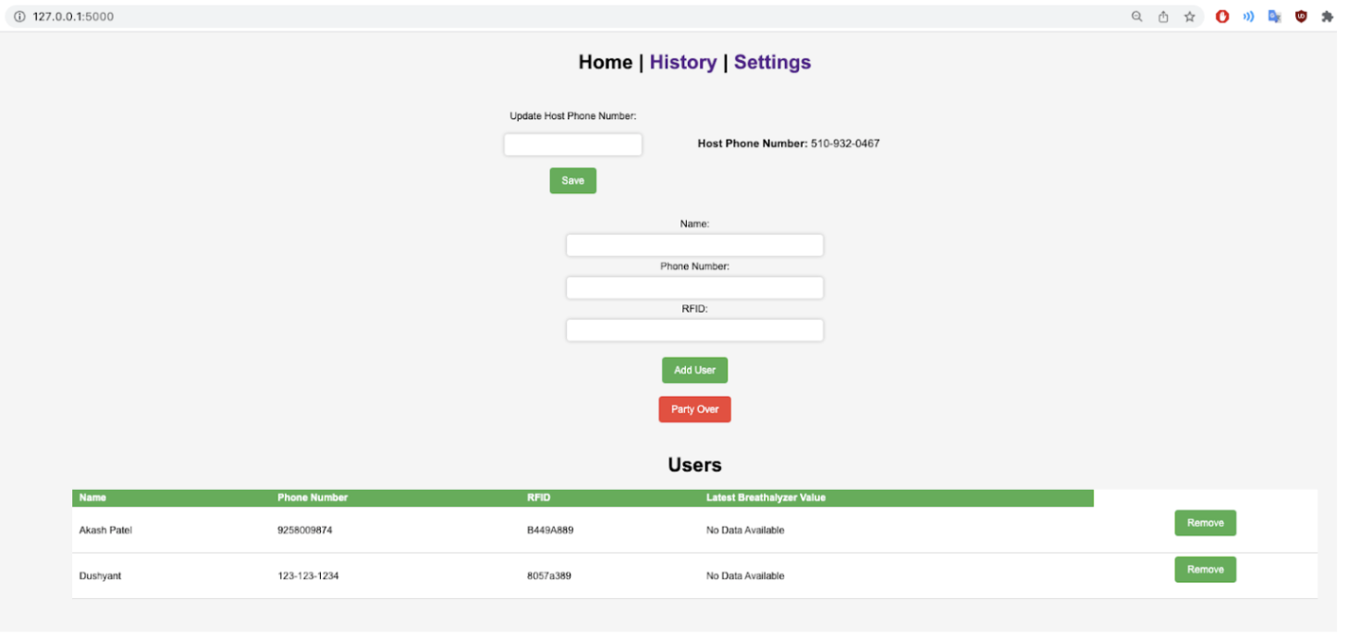
Data Management Subsystem
Partygoer/Host Phone
Twilio API
Hotspot
HTTP
HTTP
ESP32
Raspberry Pi
Host Computer
Electrical and Computer Engineering
Notes:
Akash

Slide 13
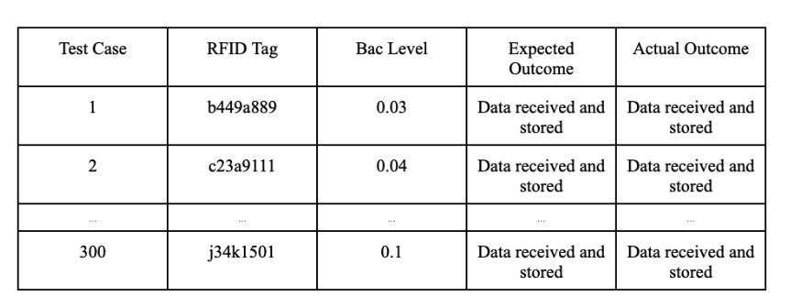
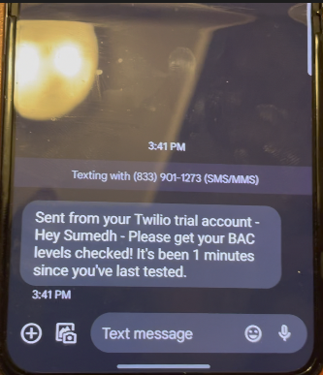
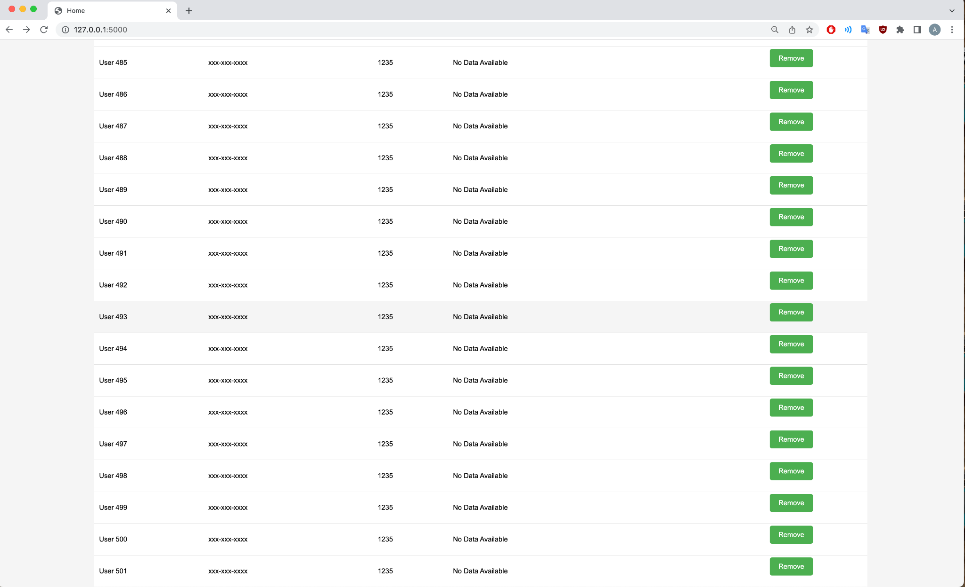
Data Management Subsystem (cont.)
The Raspberry Pi received data from the ESP32 through HTTP
The Raspberry Pi sends notifications to partygoers and the host
​​The device accommodates and store BAC test results for at least 500 partygoers
Original Test Table
Text Message Notification
Bottom of web portal showing 500 users
Electrical and Computer Engineering
Notes:
Akash

Slide 14
Data Management Subsystem Challenge
ECEB has poor cellular reception, leading us to change up our demo
ESP32 created a LAN, connecting all devices
Played a video demonstrating the notifications
Raspberry Pi
ESP32
Host Computer
Electrical and Computer Engineering
Notes:
Akash

Slide 15
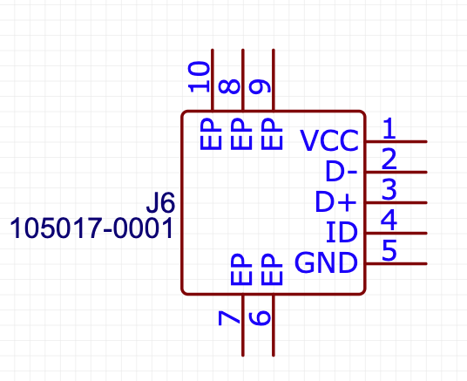
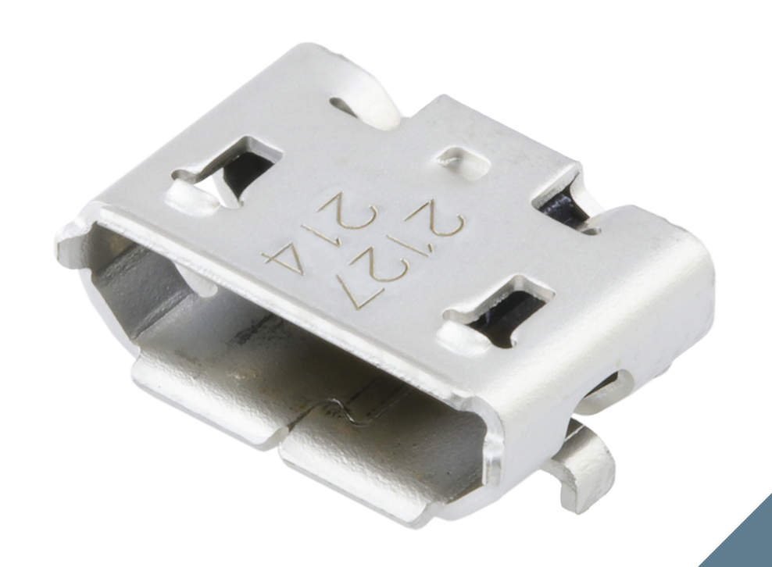
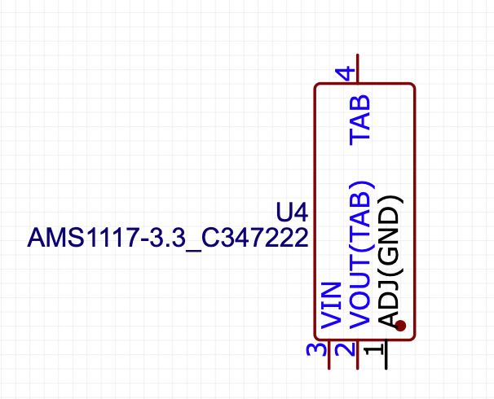
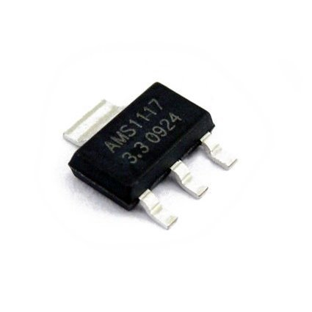
Power Subsystem
Micro-USB B Receptacle
Micro-USB B Schematic
AMS1117-3.3 Linear Voltage Regulator
AMS1117-3.3 Schematic
Electrical and Computer Engineering
Notes:
Akash

Slide 16
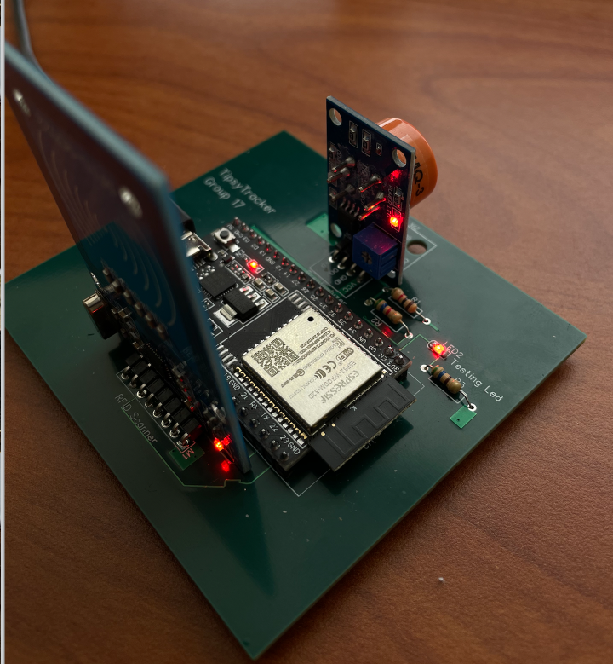
Power Subsystem (cont.)
Supplied the MQ-3 sensor with 5V
Converted 5V to 3.3V to power the ESP32, LED, and RFID sensors
Ultimately utilized dev-board
All sensors are lit up, demonstrating successful power
Electrical and Computer Engineering
Notes:
Akash

Slide 17
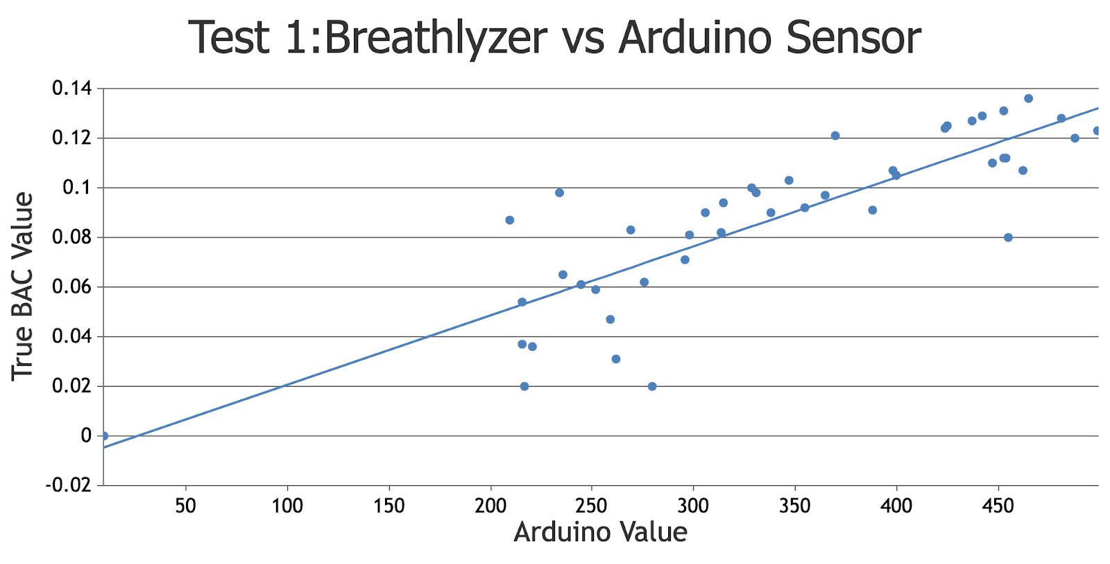
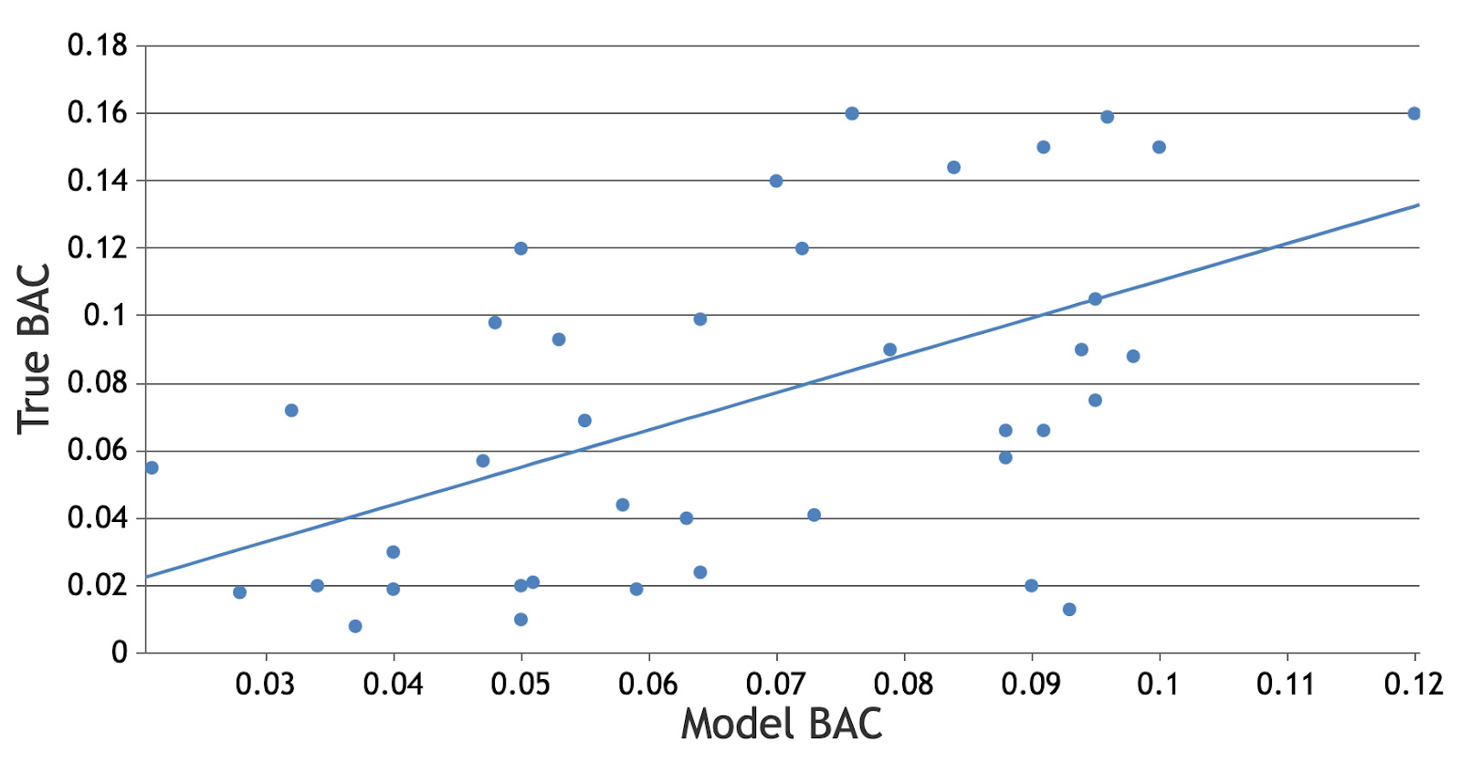
Breathalyzer Subsystem
The MQ-3 sensor measured BAC levels within 22% of standard values
False Pos + False Neg = 22% - a bit higher than intended - but r^2 = 0.7.
Predicted BAC = 0.00028 * Arduino Value - 0.00739
Test 1: Real Breathalyzer vs Analog Out
Test 2: Real Breathalyzer vs Model Value
Electrical and Computer Engineering
Notes:
Sumedh

Slide 18
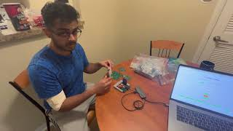
Breathalyzer Subsystem (cont.)
Subsystem synchronizes with the LED timing, ensuring that the ESP32 starts logging BAC levels precisely when the LED illuminates
Video Demo of Led Timing Synchronization
Electrical and Computer Engineering
Notes:
Sumedh

Slide 19
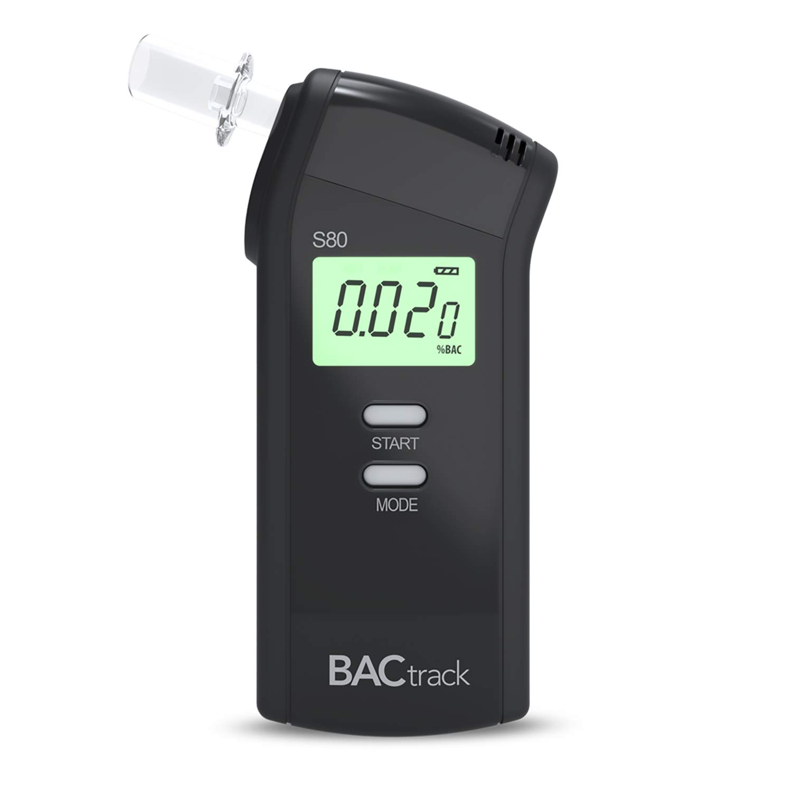
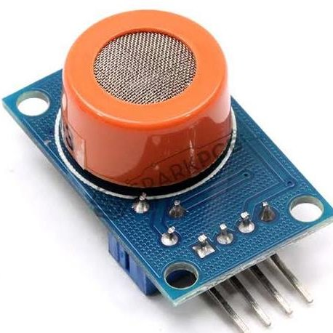
Breathalyzer Subsystem Challenges
Initial calibration issues distorting collected data (noise)
Determining appropriate resistance values
Determining an appropriate cooldown interval
Determining an appropriate cutoff threshold for BAC
MQ3 Sensor
Breathalyzer
Electrical and Computer Engineering
Notes:
Sumedh

Slide 20
PCB Designs
Electrical and Computer Engineering

Slide 21
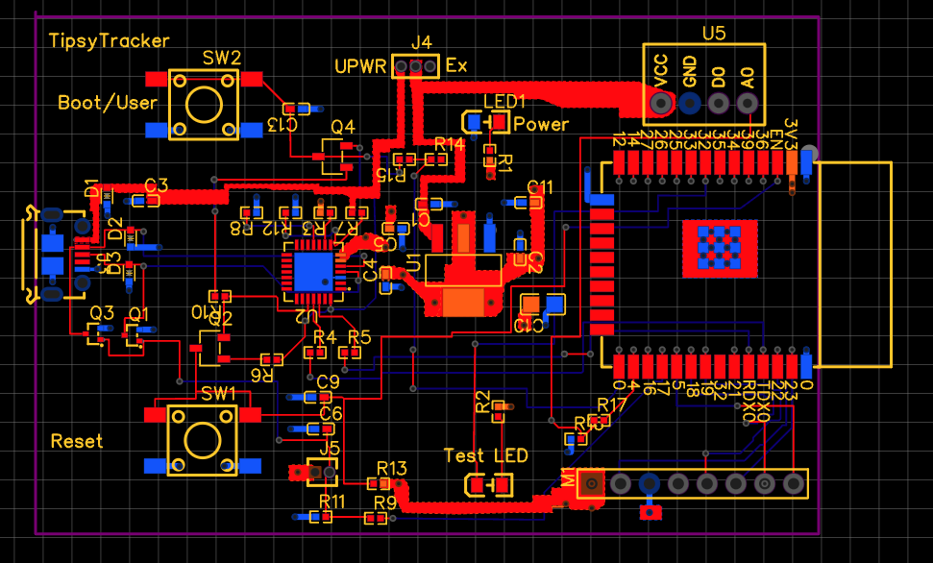
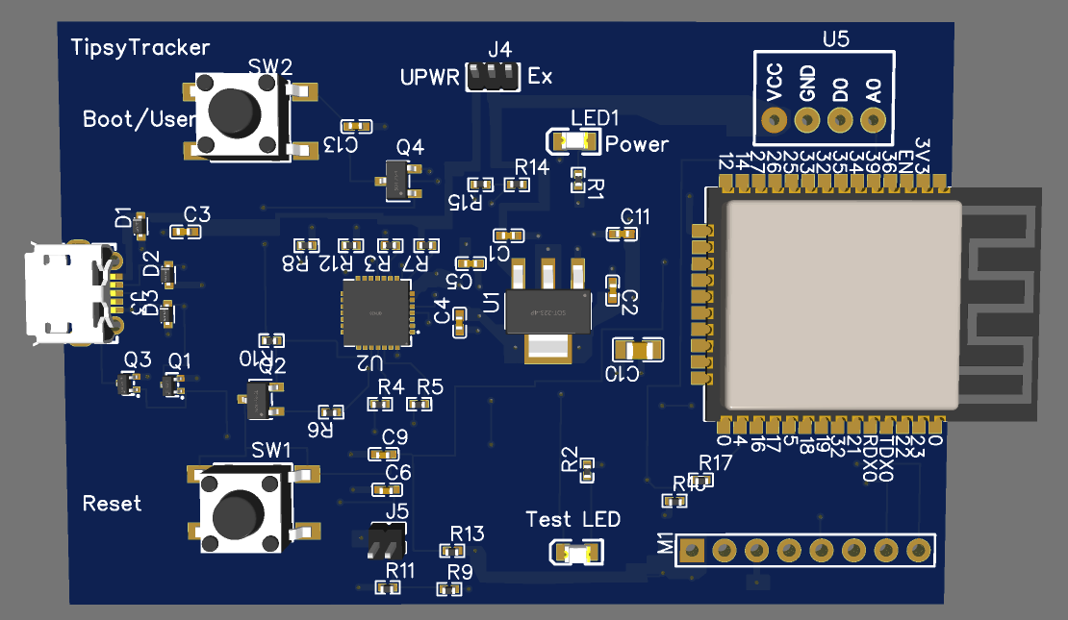
PCB Design One
3D-Model
Layout
Electrical and Computer Engineering
Notes:
This happens because ACD2 pins can not be used when WiFi is used.

Slide 22
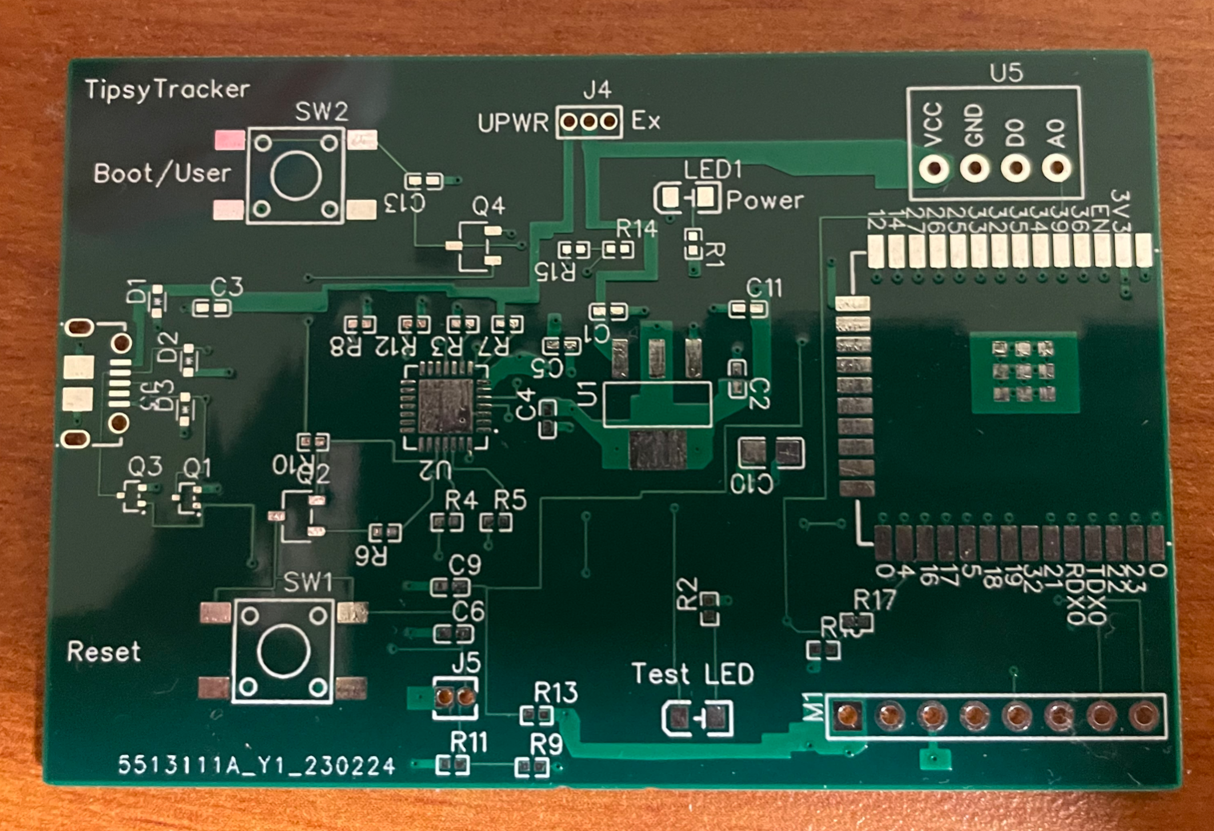
PCB Design One Challenges
PCB Design One
Electrical and Computer Engineering
Notes:
Eshrit

Slide 23
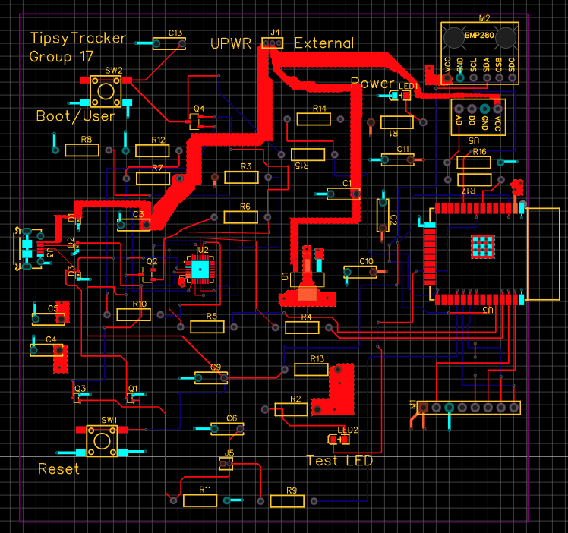
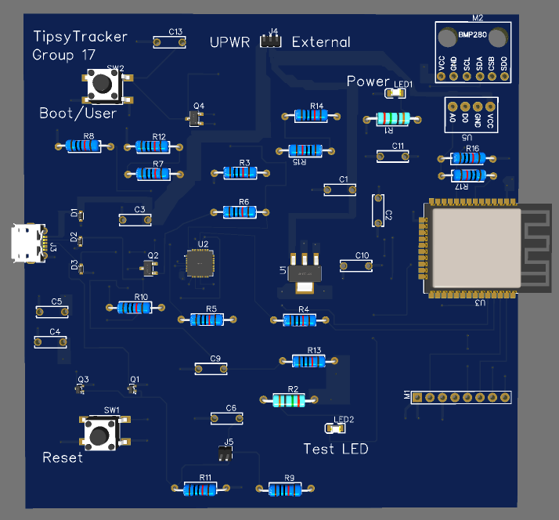
PCB Design Two
Layout
3D-Model
Electrical and Computer Engineering
Notes:
Akash

Slide 24
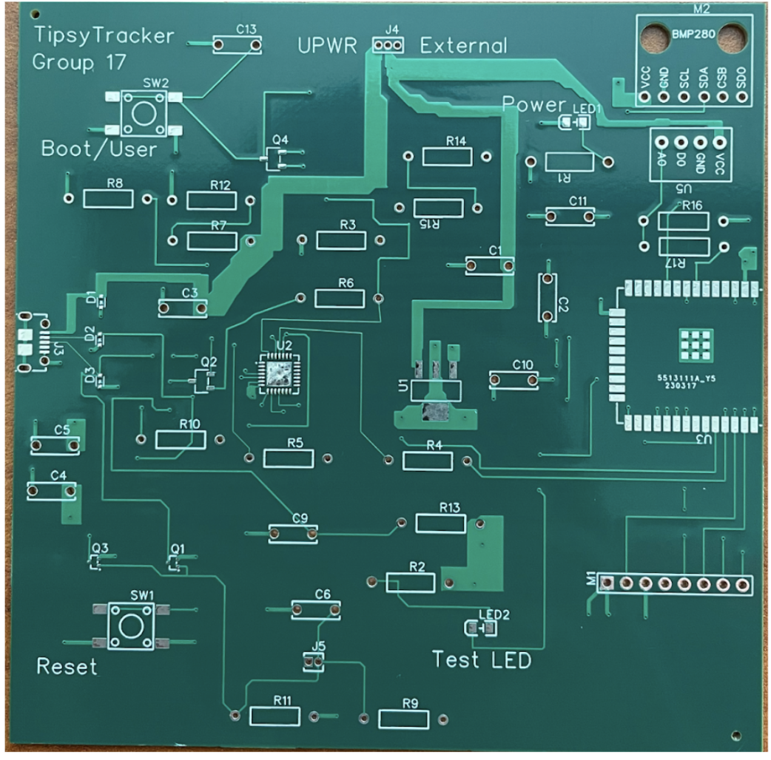
PCB Design Two Challenges
PCB Design Two
Electrical and Computer Engineering
Notes:
Eshrit

Slide 25
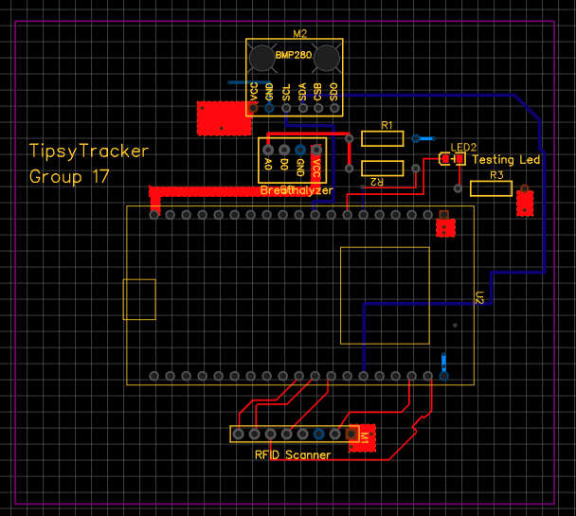
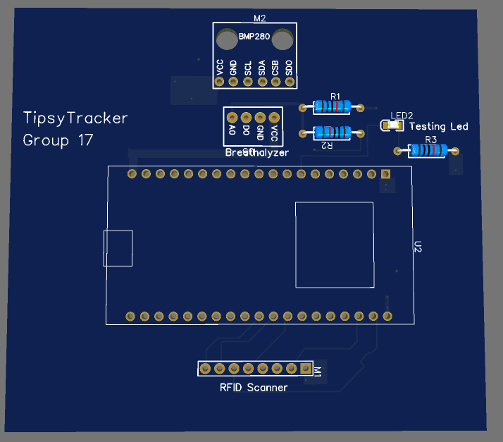
PCB Design Three
Layout
3D-Model
Electrical and Computer Engineering
Notes:
Akash

Slide 26
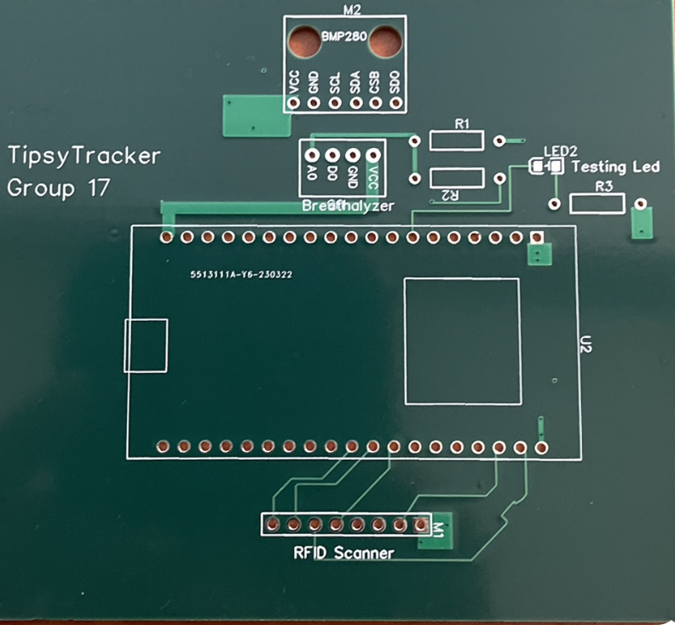
PCB Design Three
Print
Final Solder
Electrical and Computer Engineering
Notes:
Akash

Slide 27
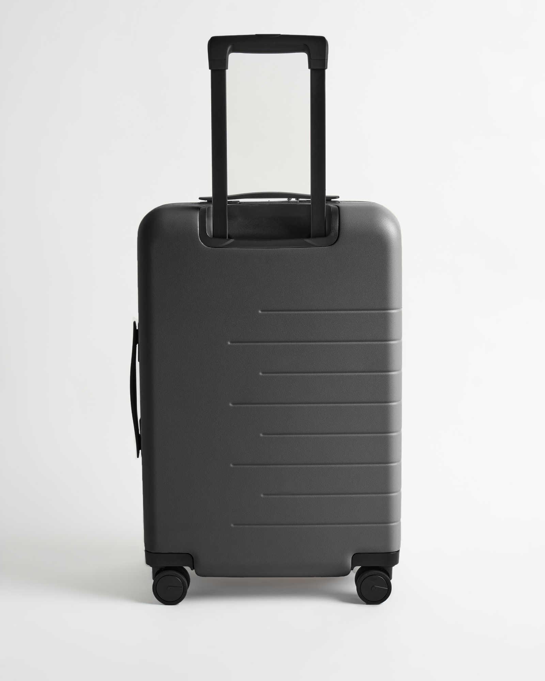
Sumedh’s Suitcase Challenge
Suitcase stolen over spring break during travel
Lost breadboard, dev board, MQ3, and RFID sensors
Lost our PCB design two and components to be soldered
Total Setback ~ 12 days to re-order parts
Photo of suitcase I no longer have
Electrical and Computer Engineering
Notes:
Sumedh

Slide 28
Successes
Electrical and Computer Engineering

Slide 29
Successes
Successful implementation of all subsystems
Successful interaction of all subsystems during final demo
Strong correlation between Tipsy Tracker’s BAC data and a commercial breathalyzer BAC data.
Electrical and Computer Engineering
Notes:
Eshrit

Slide 30
Video Demonstration
Electrical and Computer Engineering
Notes:
Eshrit

Slide 31
Conclusion
Electrical and Computer Engineering

Slide 32
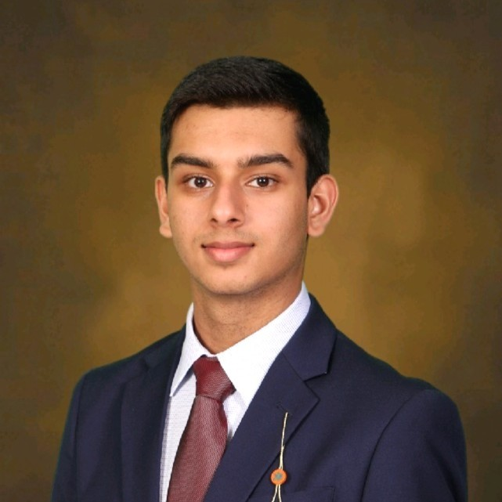
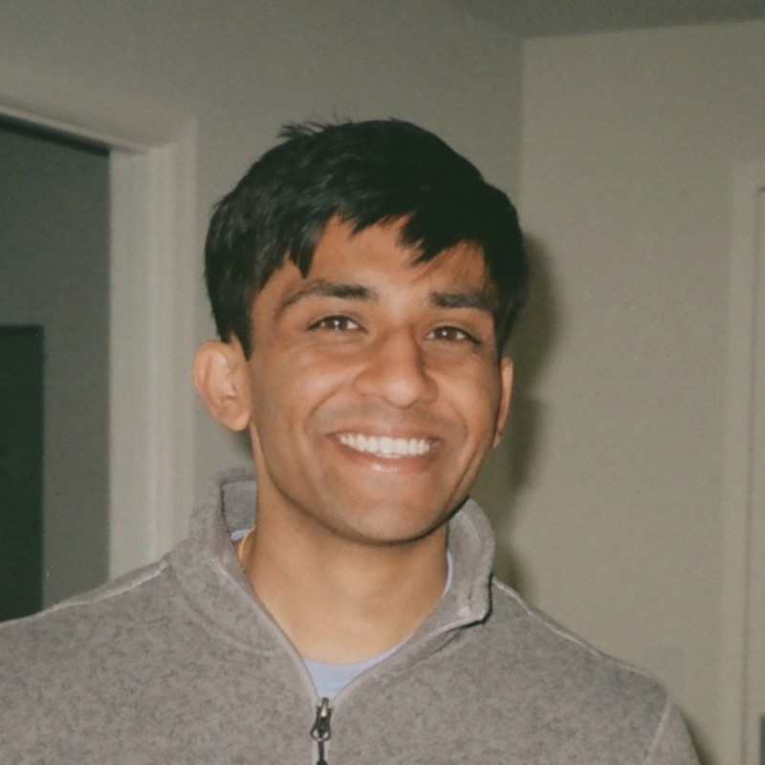
What did We Learn
Carrying out the task of building up from an idea to a product
Adhering to timelines and re-prioritizing dates and tasks
Collaboration skills
Technical Skills
Electrical and Computer Engineering
Notes:
Data flow, integration, complex arduino code, synchronising the subsystems easy eda

Slide 33
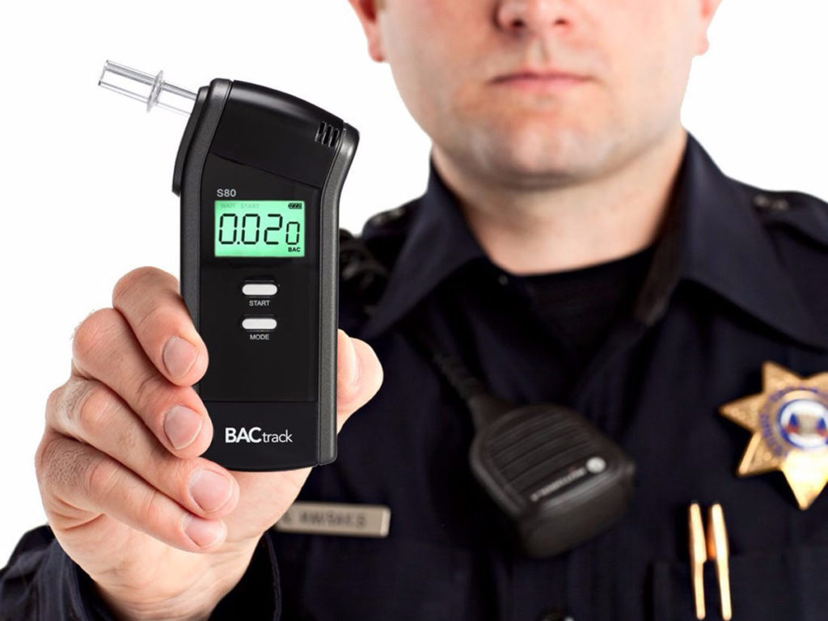
What Would We do Differently
Conduct more tests utilizing a more professional grade breathalyzer
Implement cloud solutions instead of a Raspberry Pi
Stronger final packaging for the PCB
Electrical and Computer Engineering
Notes:
Akash

Slide 34
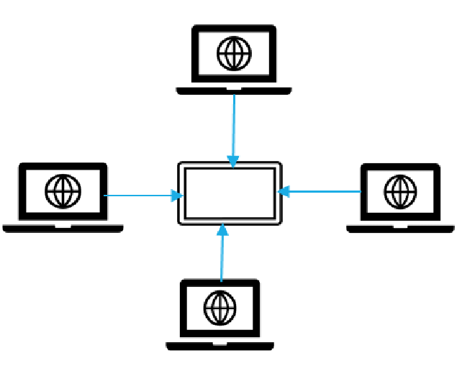
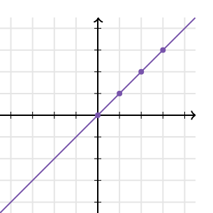
Recommendations for Further Work
Implement a centralized control mechanism for multiple TipsyTracker devices
Implement NFC for mobile identification
Electrical and Computer Engineering
Notes:
Akash

Slide 35
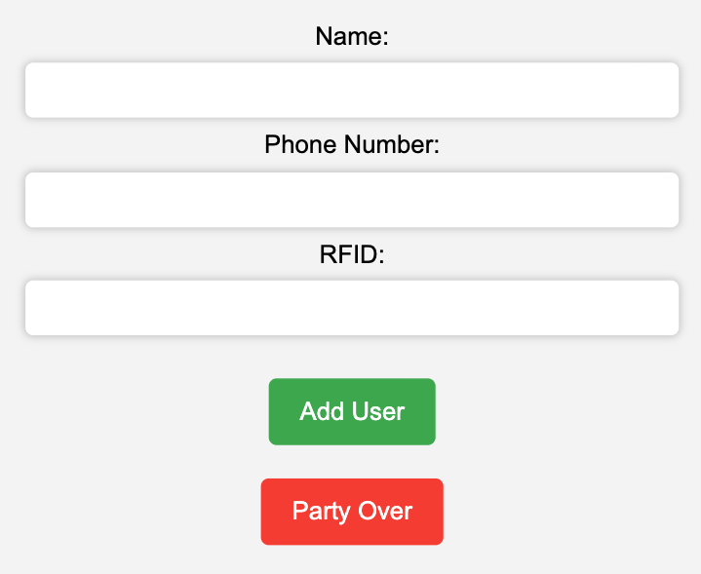
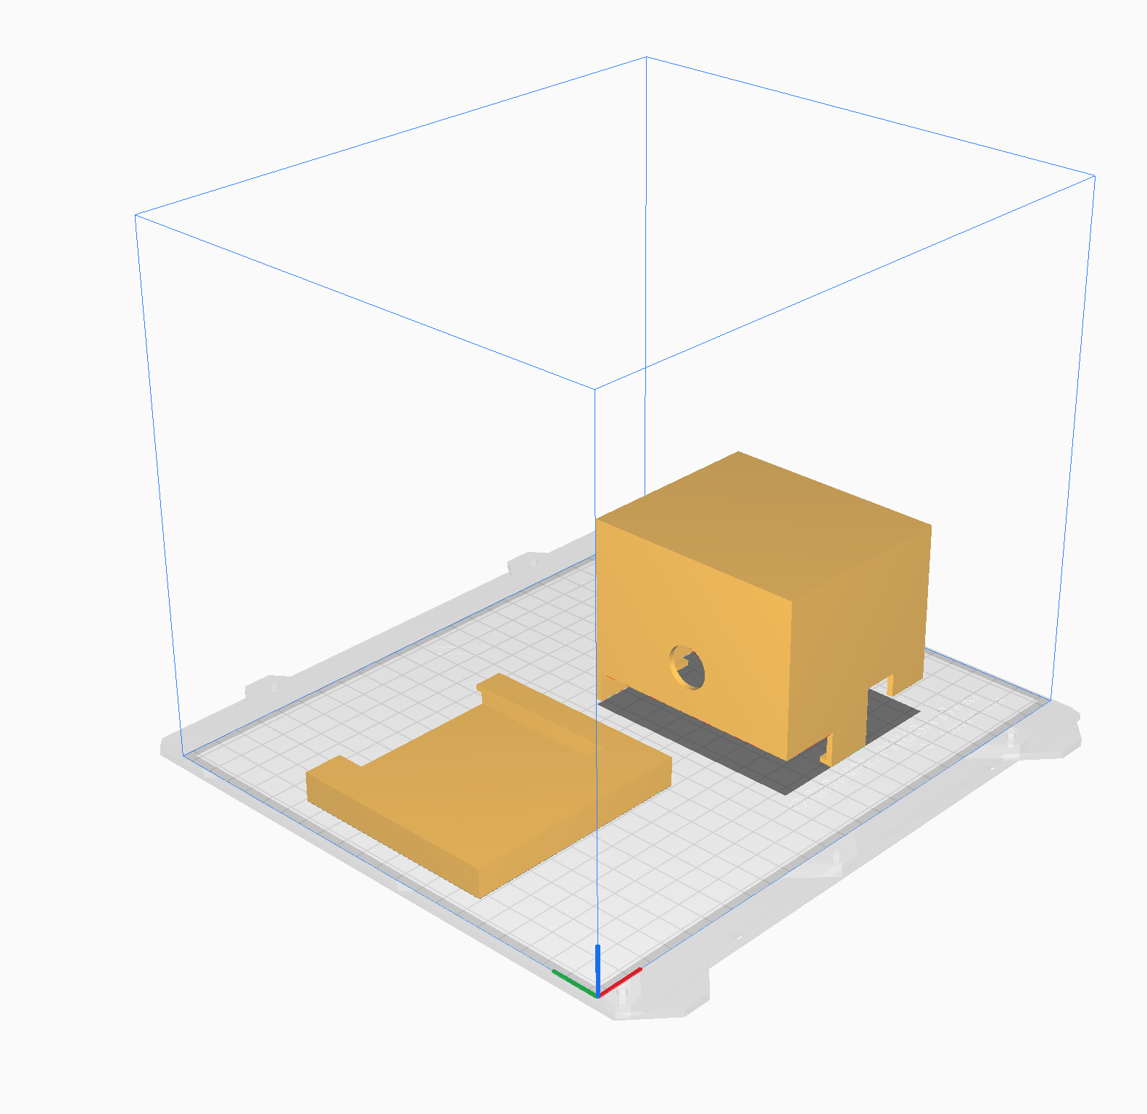
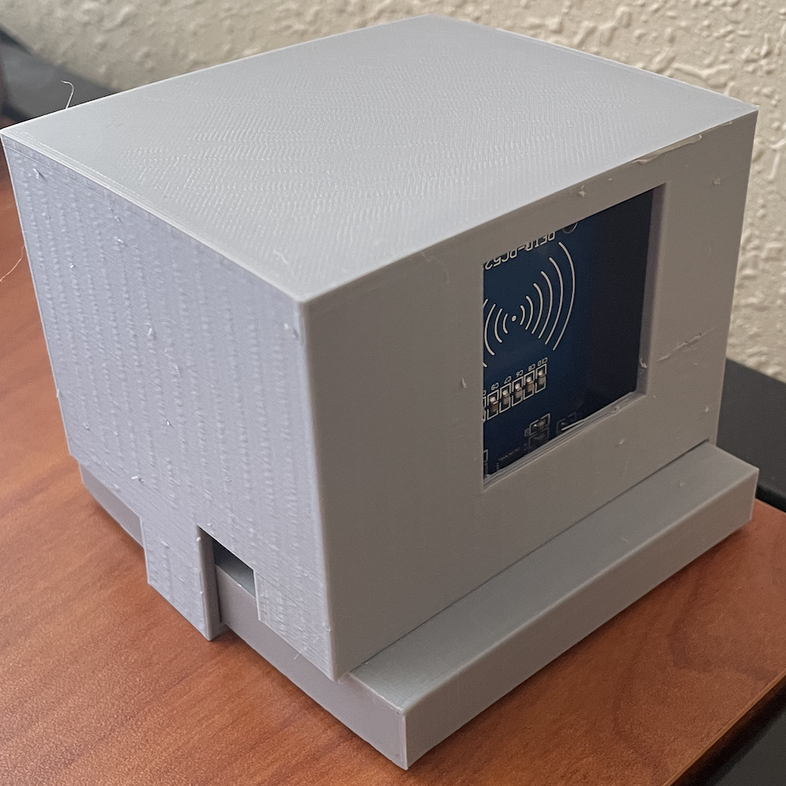
Incorporation of Ethics
“Party Over” button deletes all user data at the end of the party
Casing mitigates shock/electric safety hazards
Notification of system being down
Party Over Button on Web Interface
3D Model of Enclosure Tipsy Tracker
Electrical and Computer Engineering
Notes:
Sumedh

