Slide 1
Oxygen Delivery Robot
Electrical & Computer Engineering
Team 27
Rutvik Sayankar
Aidan Dunican
Nazar Kalyniouk
Tuesday April 30th, 2024
Notes:
Rutvik

Slide 2
WHY?
What was the inspiration?
ELECTRICAL & COMPUTER ENGINEERING
GRAINGER ENGINEERING
Notes:
Rutvik

Slide 3
Children’s Interstitial & Diffuse Lung Disease
A collection of diseases that cause a thickening of the interstitium (the tissue that extends throughout the lungs) due to scarring, inflammation or fluid buildup.
ELECTRICAL & COMPUTER ENGINEERING
GRAINGER ENGINEERING
Notes:
Rutvik

Slide 4
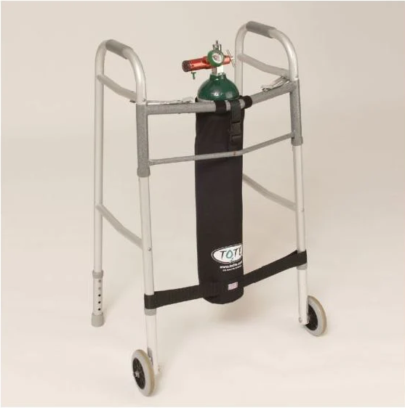
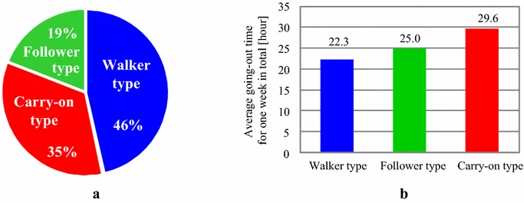
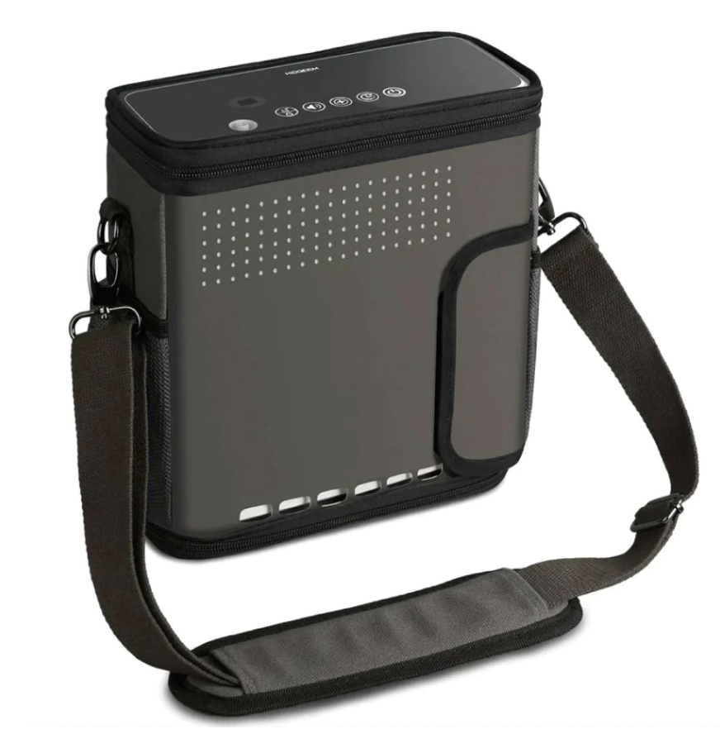
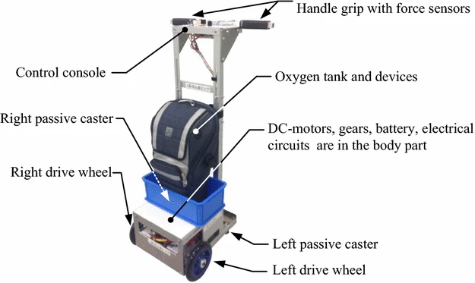
Current Solution & Preferences
Results from Home Oxygen Therapy patients. There is a correlation between the preferred type of cart and the average time spent going out per week.
ELECTRICAL & COMPUTER ENGINEERING
GRAINGER ENGINEERING
Notes:
Rutvik

Slide 5
Our Three Tiered Problem
Indoor Localization?
Accurately need our target’s location at all times.
1
What type of oxygen?
Oxygen tank vs concentrator.
2
How to move around an indoor space quietly and efficiently?
What style of robot?
3
ELECTRICAL & COMPUTER ENGINEERING
GRAINGER ENGINEERING
Notes:
Nazar

Slide 6
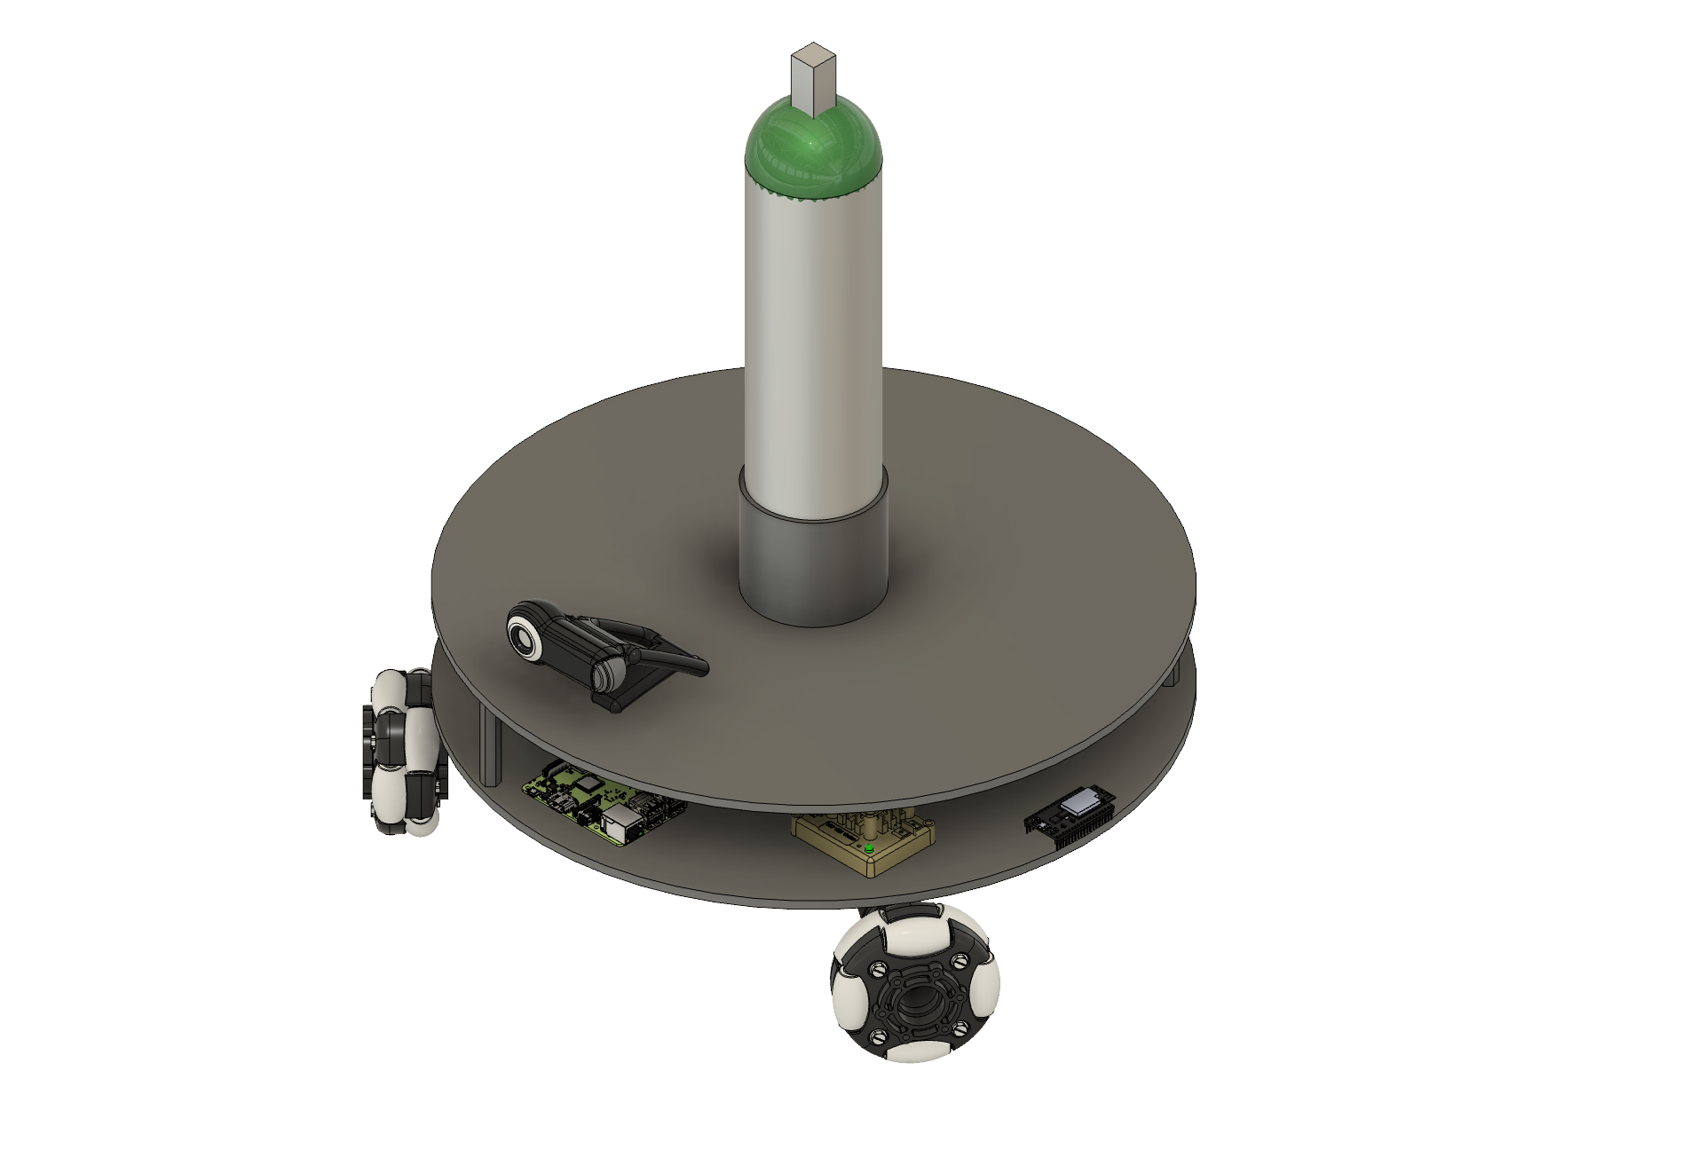
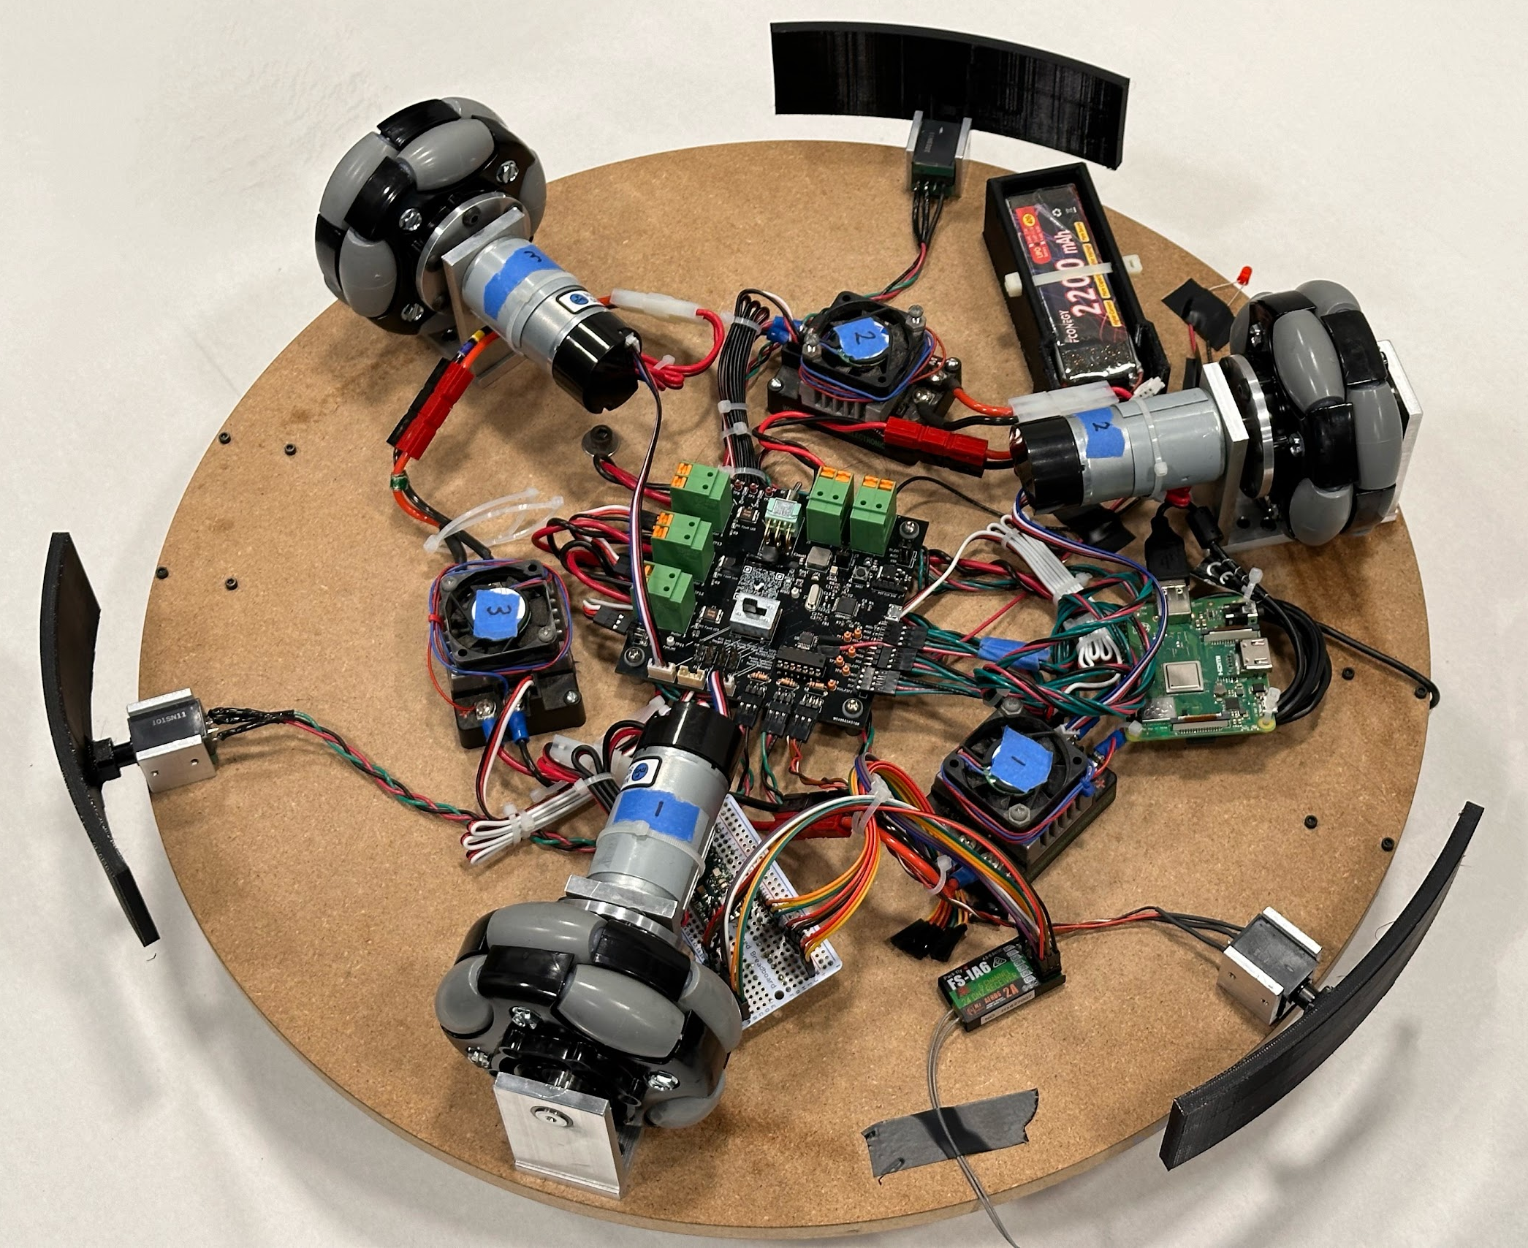
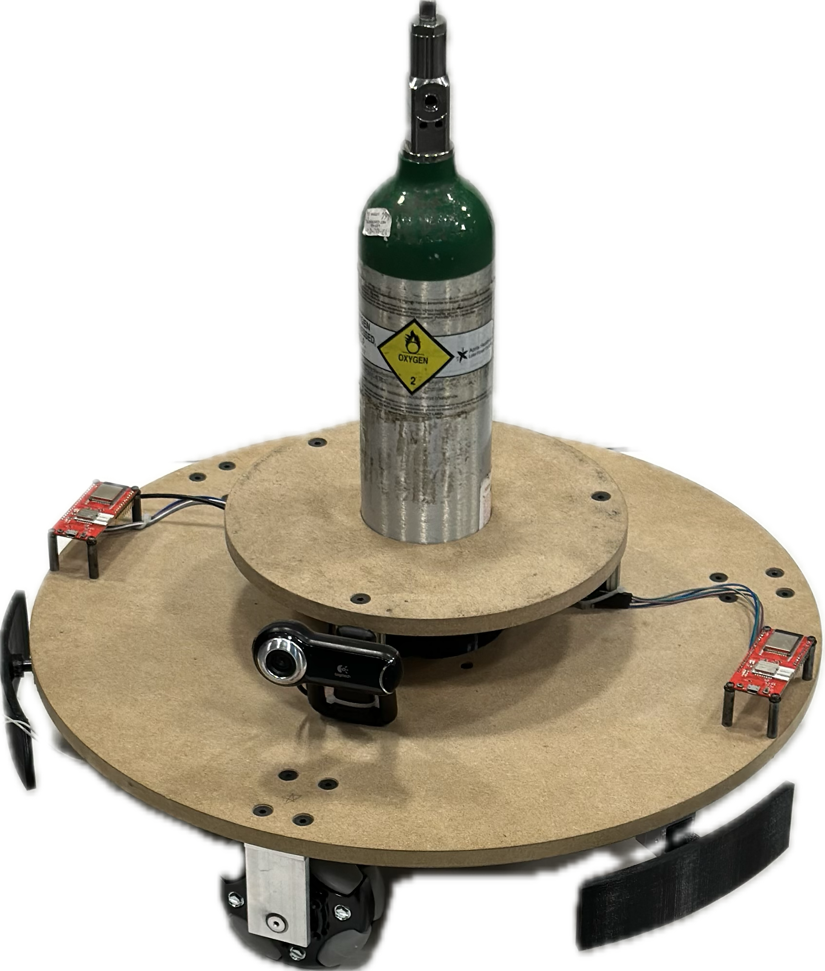
Original vs. Current Design
3 Omni-wheel Drivetrain
2200mAh battery
PCB
Raspberry Pi for Object Tracking
Oxygen Tank Holder
Reused FRC Victor 888 ESCs
Object Detection Bumpers
DW3000 UWB Transceivers
Webcam
4” Omni-wheels
ELECTRICAL & COMPUTER ENGINEERING
GRAINGER ENGINEERING
Notes:
Nazar

Slide 7
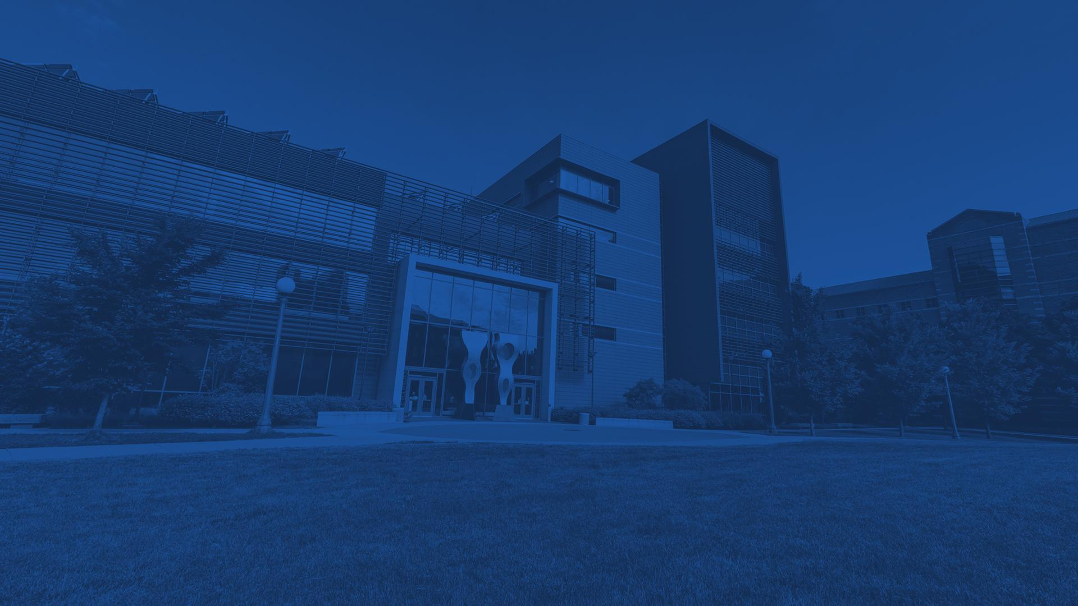
High Level Requirements
Omni-Wheel Drivetrain
Functional drivetrain that can maintain a given direction vector within 500 ms.
Ultra Wideband User Localization
Locate target with accuracy <1 meter.
Close-range Object Detection
Notify users of collisions.
ELECTRICAL & COMPUTER ENGINEERING
GRAINGER ENGINEERING
Notes:
Aidan

Slide 8
Design Modularity
Functions of each subsystem
ELECTRICAL & COMPUTER ENGINEERING
GRAINGER ENGINEERING
Notes:
Aidan

Slide 9
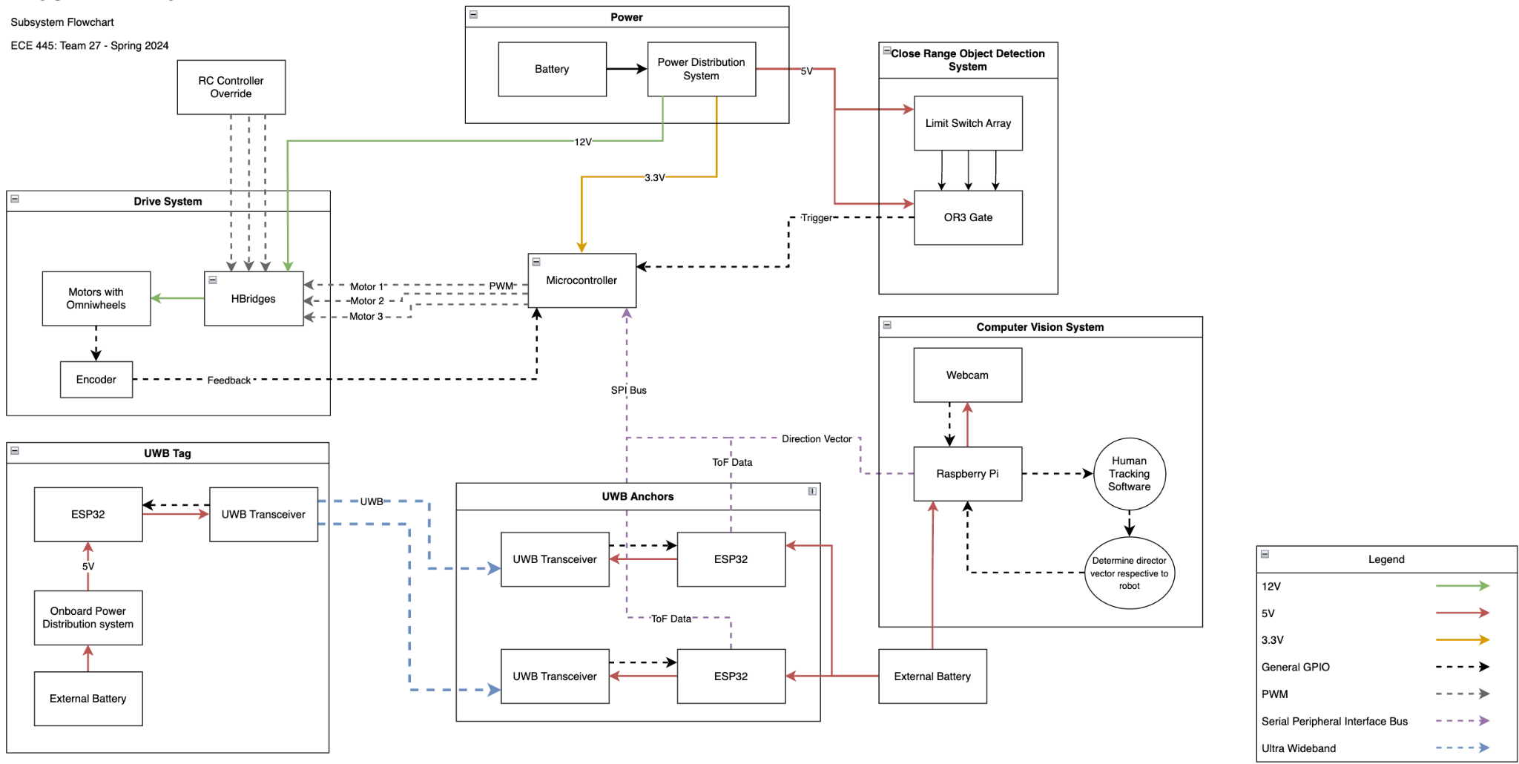
High Level Block Diagram
ELECTRICAL & COMPUTER ENGINEERING
GRAINGER ENGINEERING
Notes:
Aidan

Slide 10
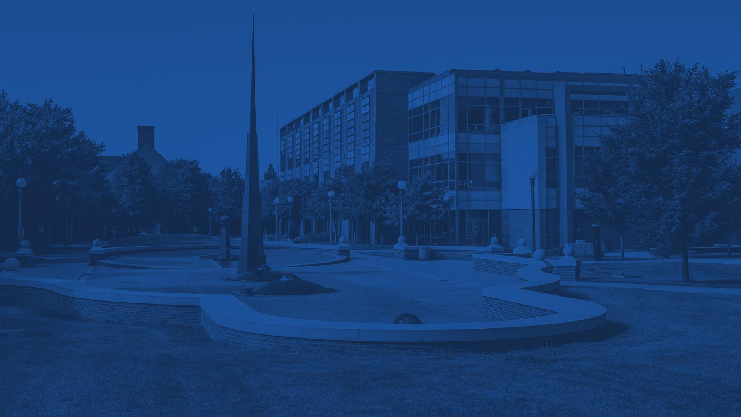
Subsystem Integration
What worked & what didn’t?
ELECTRICAL & COMPUTER ENGINEERING
GRAINGER ENGINEERING
Notes:
Rutvik

Slide 11
Successes
Drivetrain
Ultra Wideband Localization
Close-range object detection
Challenges
Battery Size (Current limitations)
SPI Bus timing
360 degree bumper
Embedded computer vision deployment
ELECTRICAL & COMPUTER ENGINEERING
GRAINGER ENGINEERING
Notes:
Rutvik

Slide 12
Printed Circuit Board
Design Considerations
ELECTRICAL & COMPUTER ENGINEERING
GRAINGER ENGINEERING
Notes:
Rutvik

Slide 13
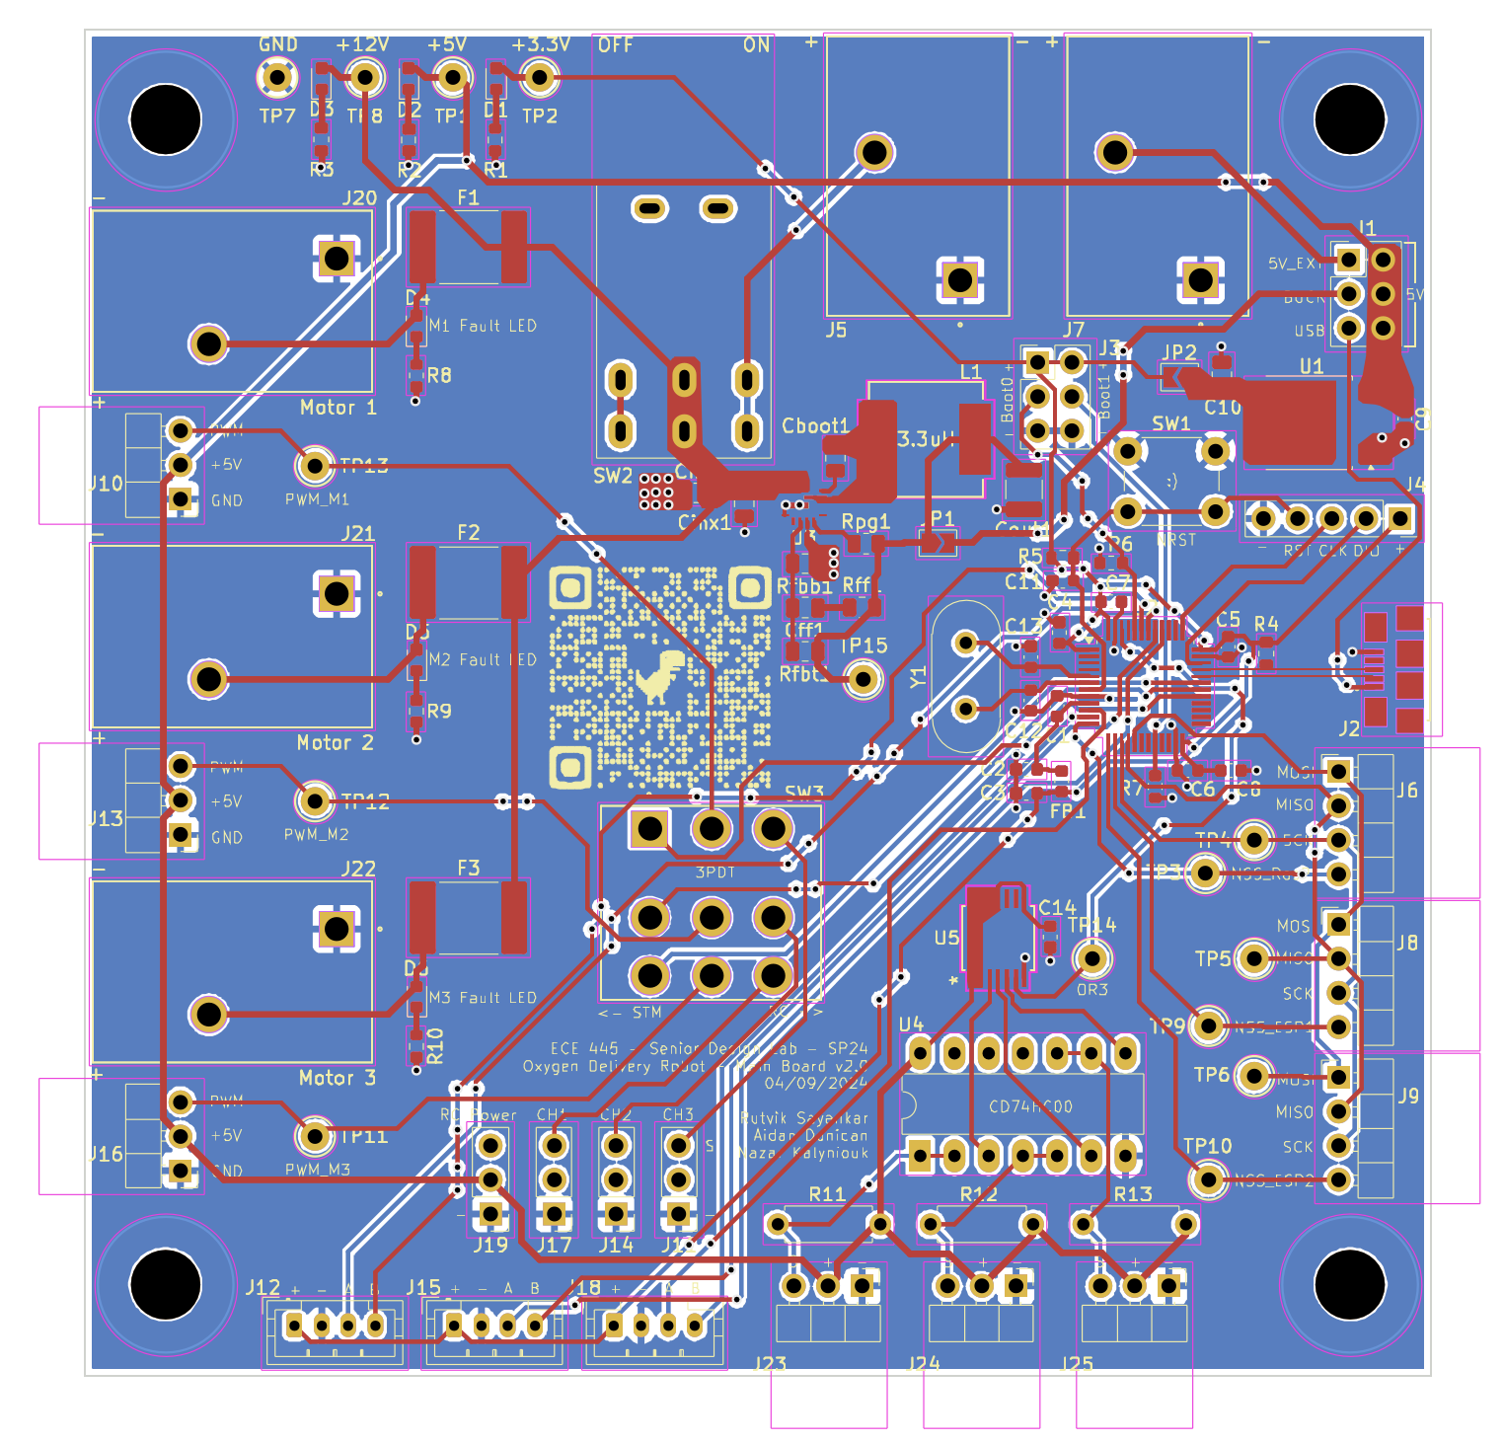
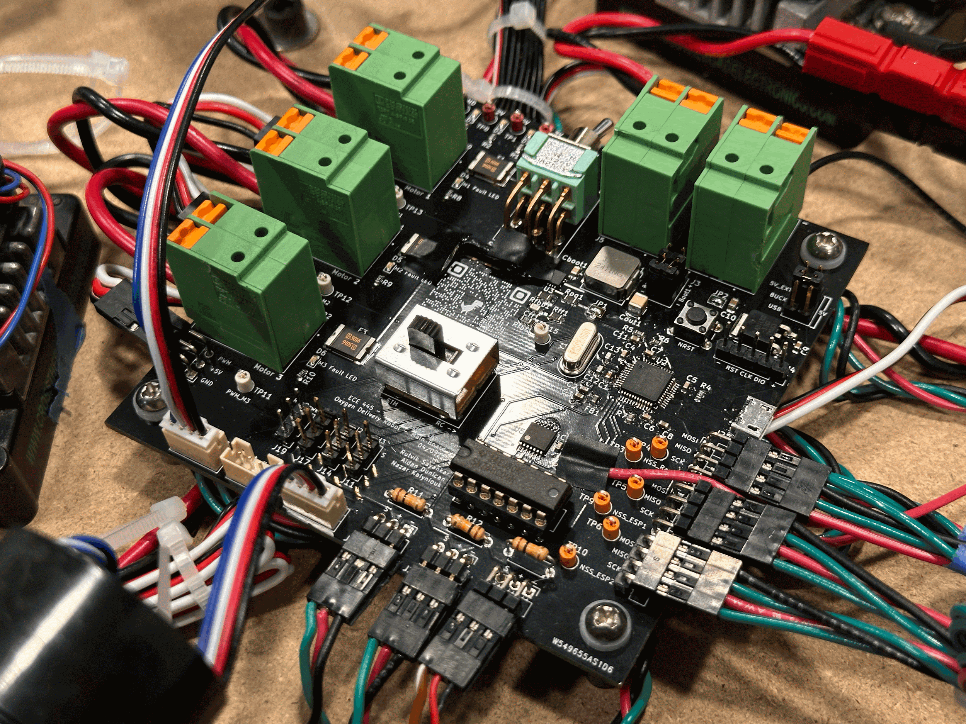
PCB
Blown trace!
Blown trace!
ELECTRICAL & COMPUTER ENGINEERING
GRAINGER ENGINEERING
Notes:
Rutvik

Slide 14
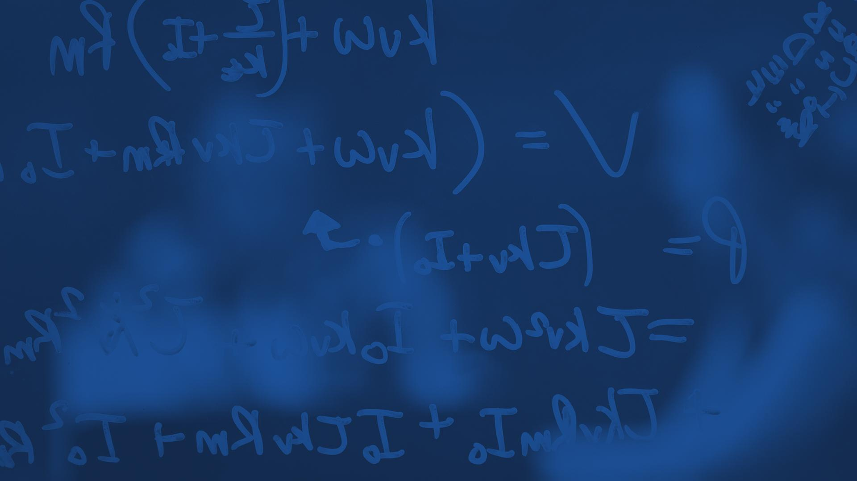
Subsystem Functionality
Requirements & Verifications
ELECTRICAL & COMPUTER ENGINEERING
GRAINGER ENGINEERING
Notes:
Rutvik

Slide 15
Omni Wheel Drivetrain
Requirements
Reliably set the speed & control RPM of motors.
Maintain speed of 3 MPH under full load.
ELECTRICAL & COMPUTER ENGINEERING
GRAINGER ENGINEERING
Notes:
Rutvik

Slide 16
Close Range Object Detection
Requirement
Bumper style limit switch should trigger an alert system and stop motors
ELECTRICAL & COMPUTER ENGINEERING
GRAINGER ENGINEERING
Notes:
Aidan

Slide 17
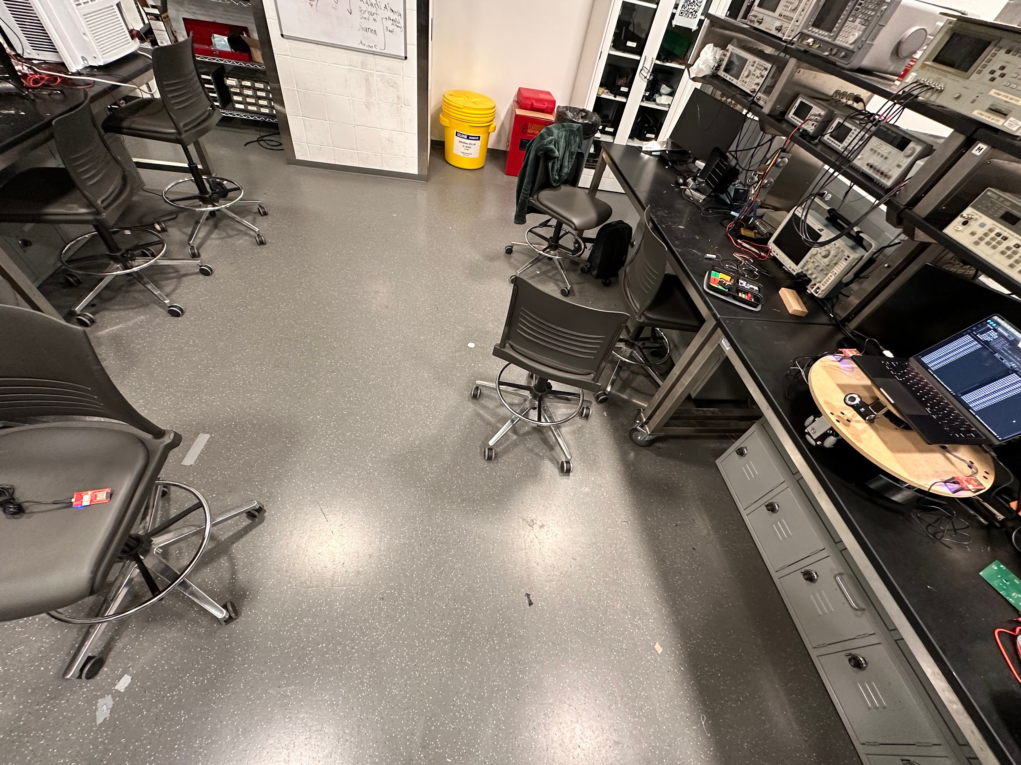
Ultra Wideband Triangulation
Requirement
Utilize Time of Flight to create a triangle of known lengths with vertices defined by each UWB transceiver.
ELECTRICAL & COMPUTER ENGINEERING
GRAINGER ENGINEERING
Notes:
Rutvik

Slide 18
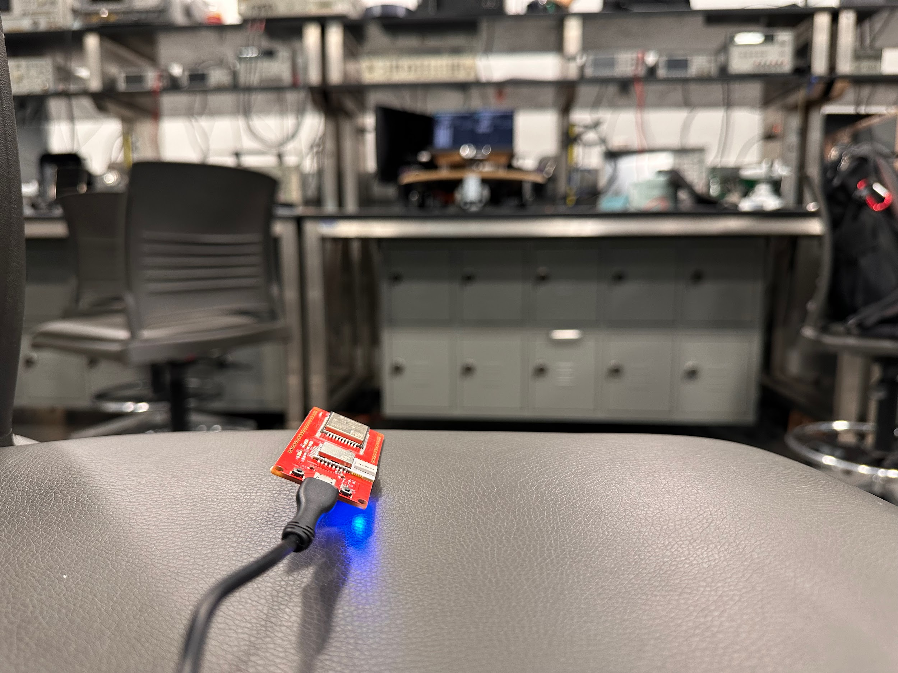
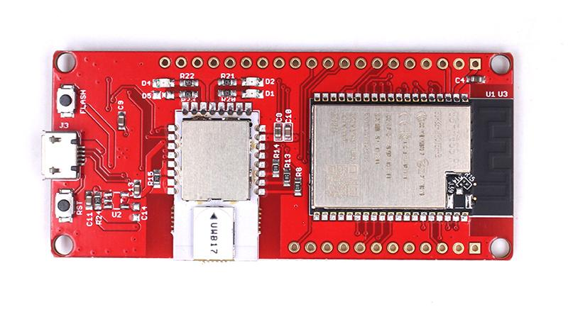
Ultra Wideband Triangulation cont.
2.19m
18”
2.15m
ELECTRICAL & COMPUTER ENGINEERING
GRAINGER ENGINEERING
Notes:
Rutvik

Slide 19
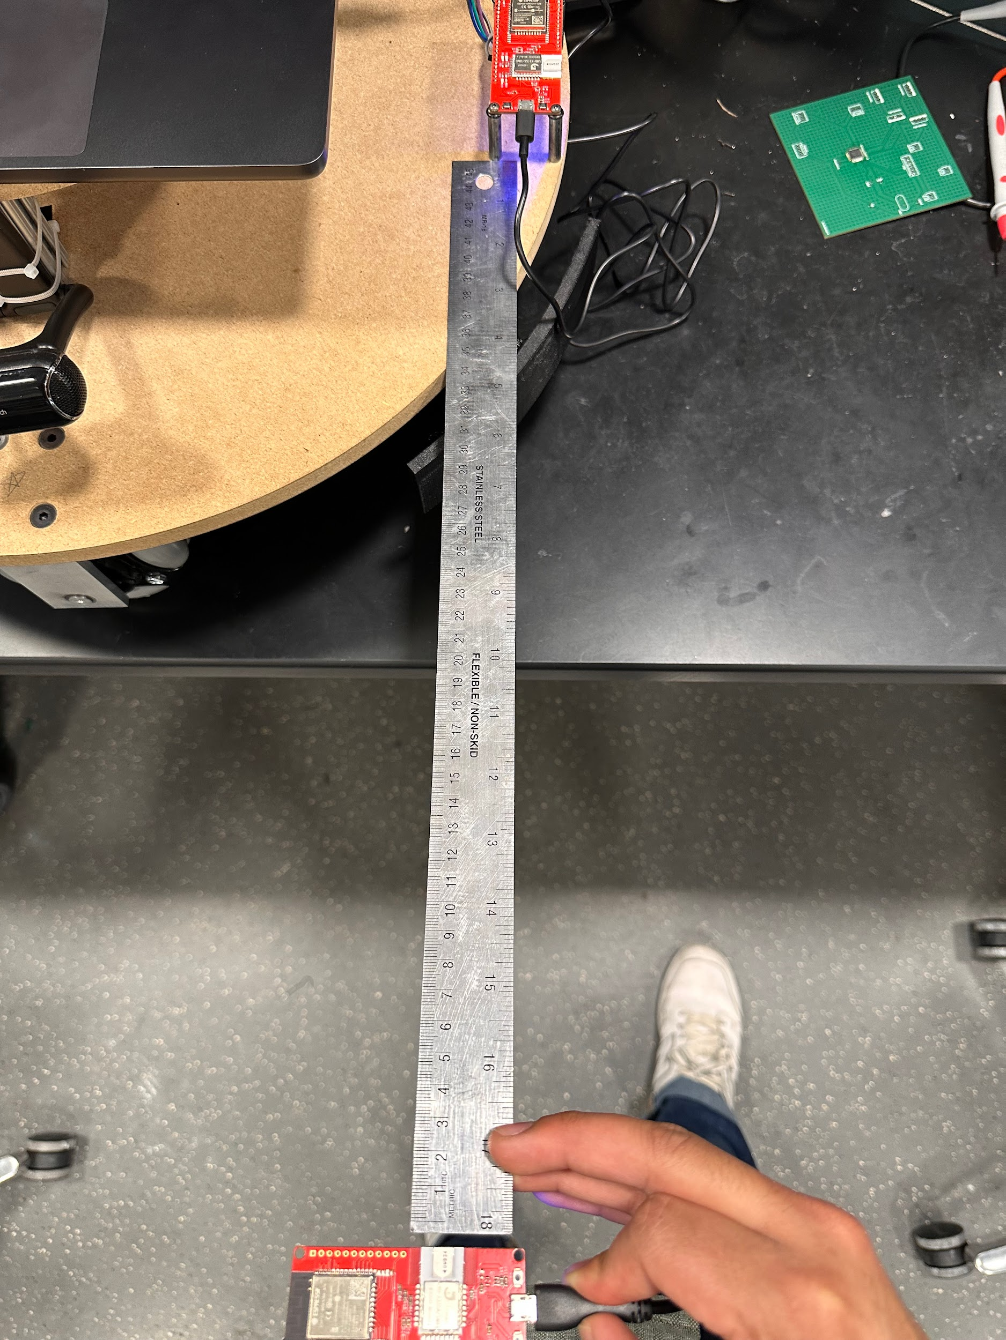
Ultra Wideband Triangulation cont.
Utilizing 45” ruler to measure distance
ELECTRICAL & COMPUTER ENGINEERING
GRAINGER ENGINEERING
Notes:
Rutvik

Slide 20
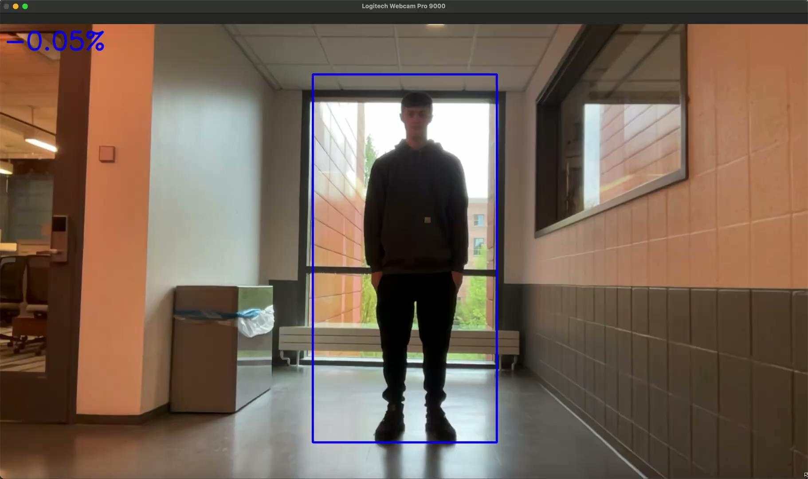
Computer Vision - Degrees off center
Requirement
Determine Δ𝜃 of the user respective to the center of the robot.
ELECTRICAL & COMPUTER ENGINEERING
GRAINGER ENGINEERING
Notes:
Nazar

Slide 21
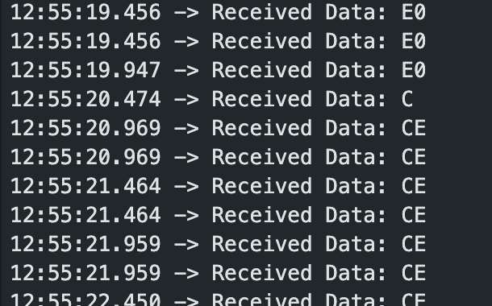
Control System
Requirement
Using direction and angle from UWB system, and angle from computer vision system we should be able to compute a direction vector for the robot to move.
Main Issue
SPI Bus skipping bits
0xCE = 11001110
0x67 = 01100111
0xE0 = 11100000
0xC = 1100
ELECTRICAL & COMPUTER ENGINEERING
GRAINGER ENGINEERING
Notes:
Rutvik

Slide 22
Power System
Requirement
Must be able to regulate battery voltage to power components throughout the whole discharge cycle
Main Issue
Old and small battery, cannot supply enough current for extended drivetrain use.
Actual Power Draw = ~0.112 kW
ELECTRICAL & COMPUTER ENGINEERING
GRAINGER ENGINEERING
Notes:
Aidan

Slide 23
Conclusions / Further Work
Redesign PCB - round PCB to allow for simpler wiring & debugging.
Allocate more time to debug SPI bus timing issues.
Choose more powerful Raspberry Pi.
Higher mAh battery - allows for the robot to operate for a longer duration of time and supply more current to the motors.
ELECTRICAL & COMPUTER ENGINEERING
GRAINGER ENGINEERING
Notes:
Nazar

Slide 25
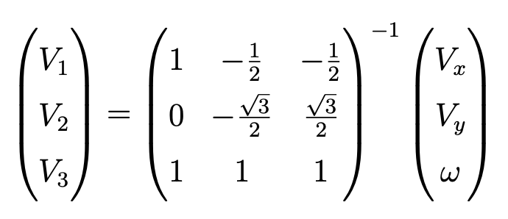
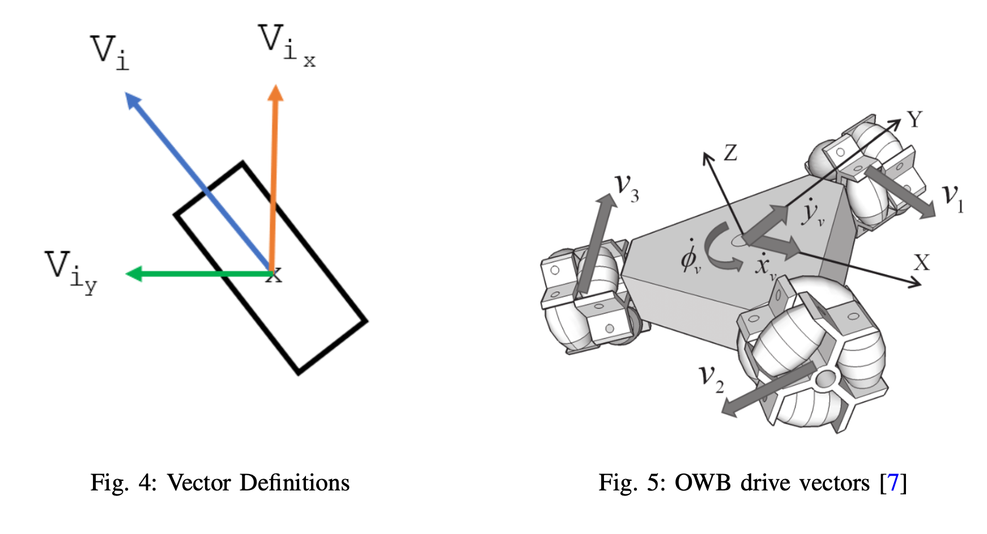
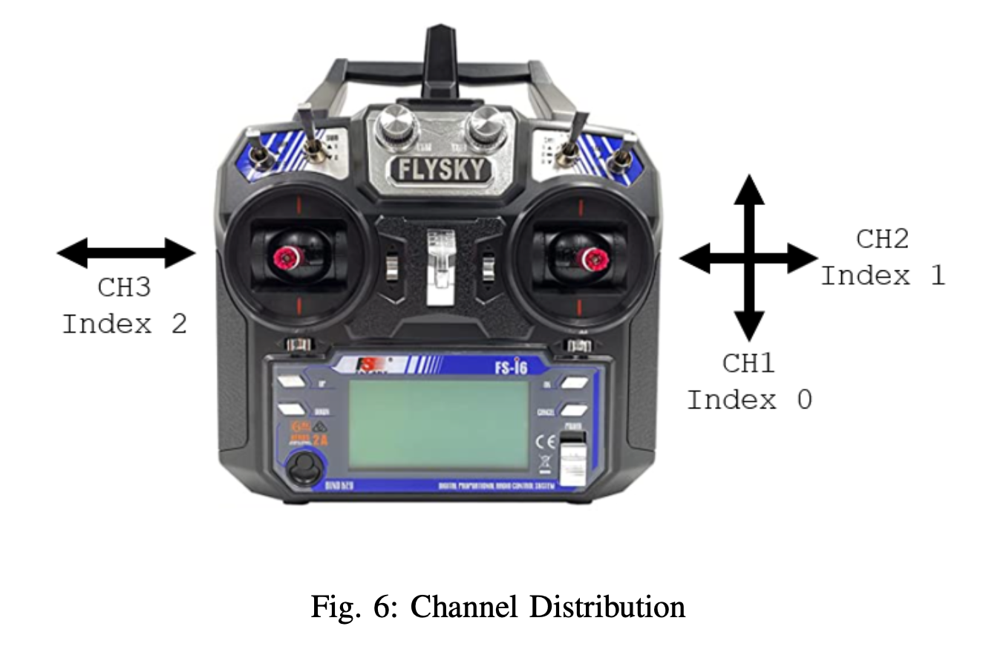
Omni Wheel Drivetrain Vector Calculation
ELECTRICAL & COMPUTER ENGINEERING
GRAINGER ENGINEERING

Slide 26
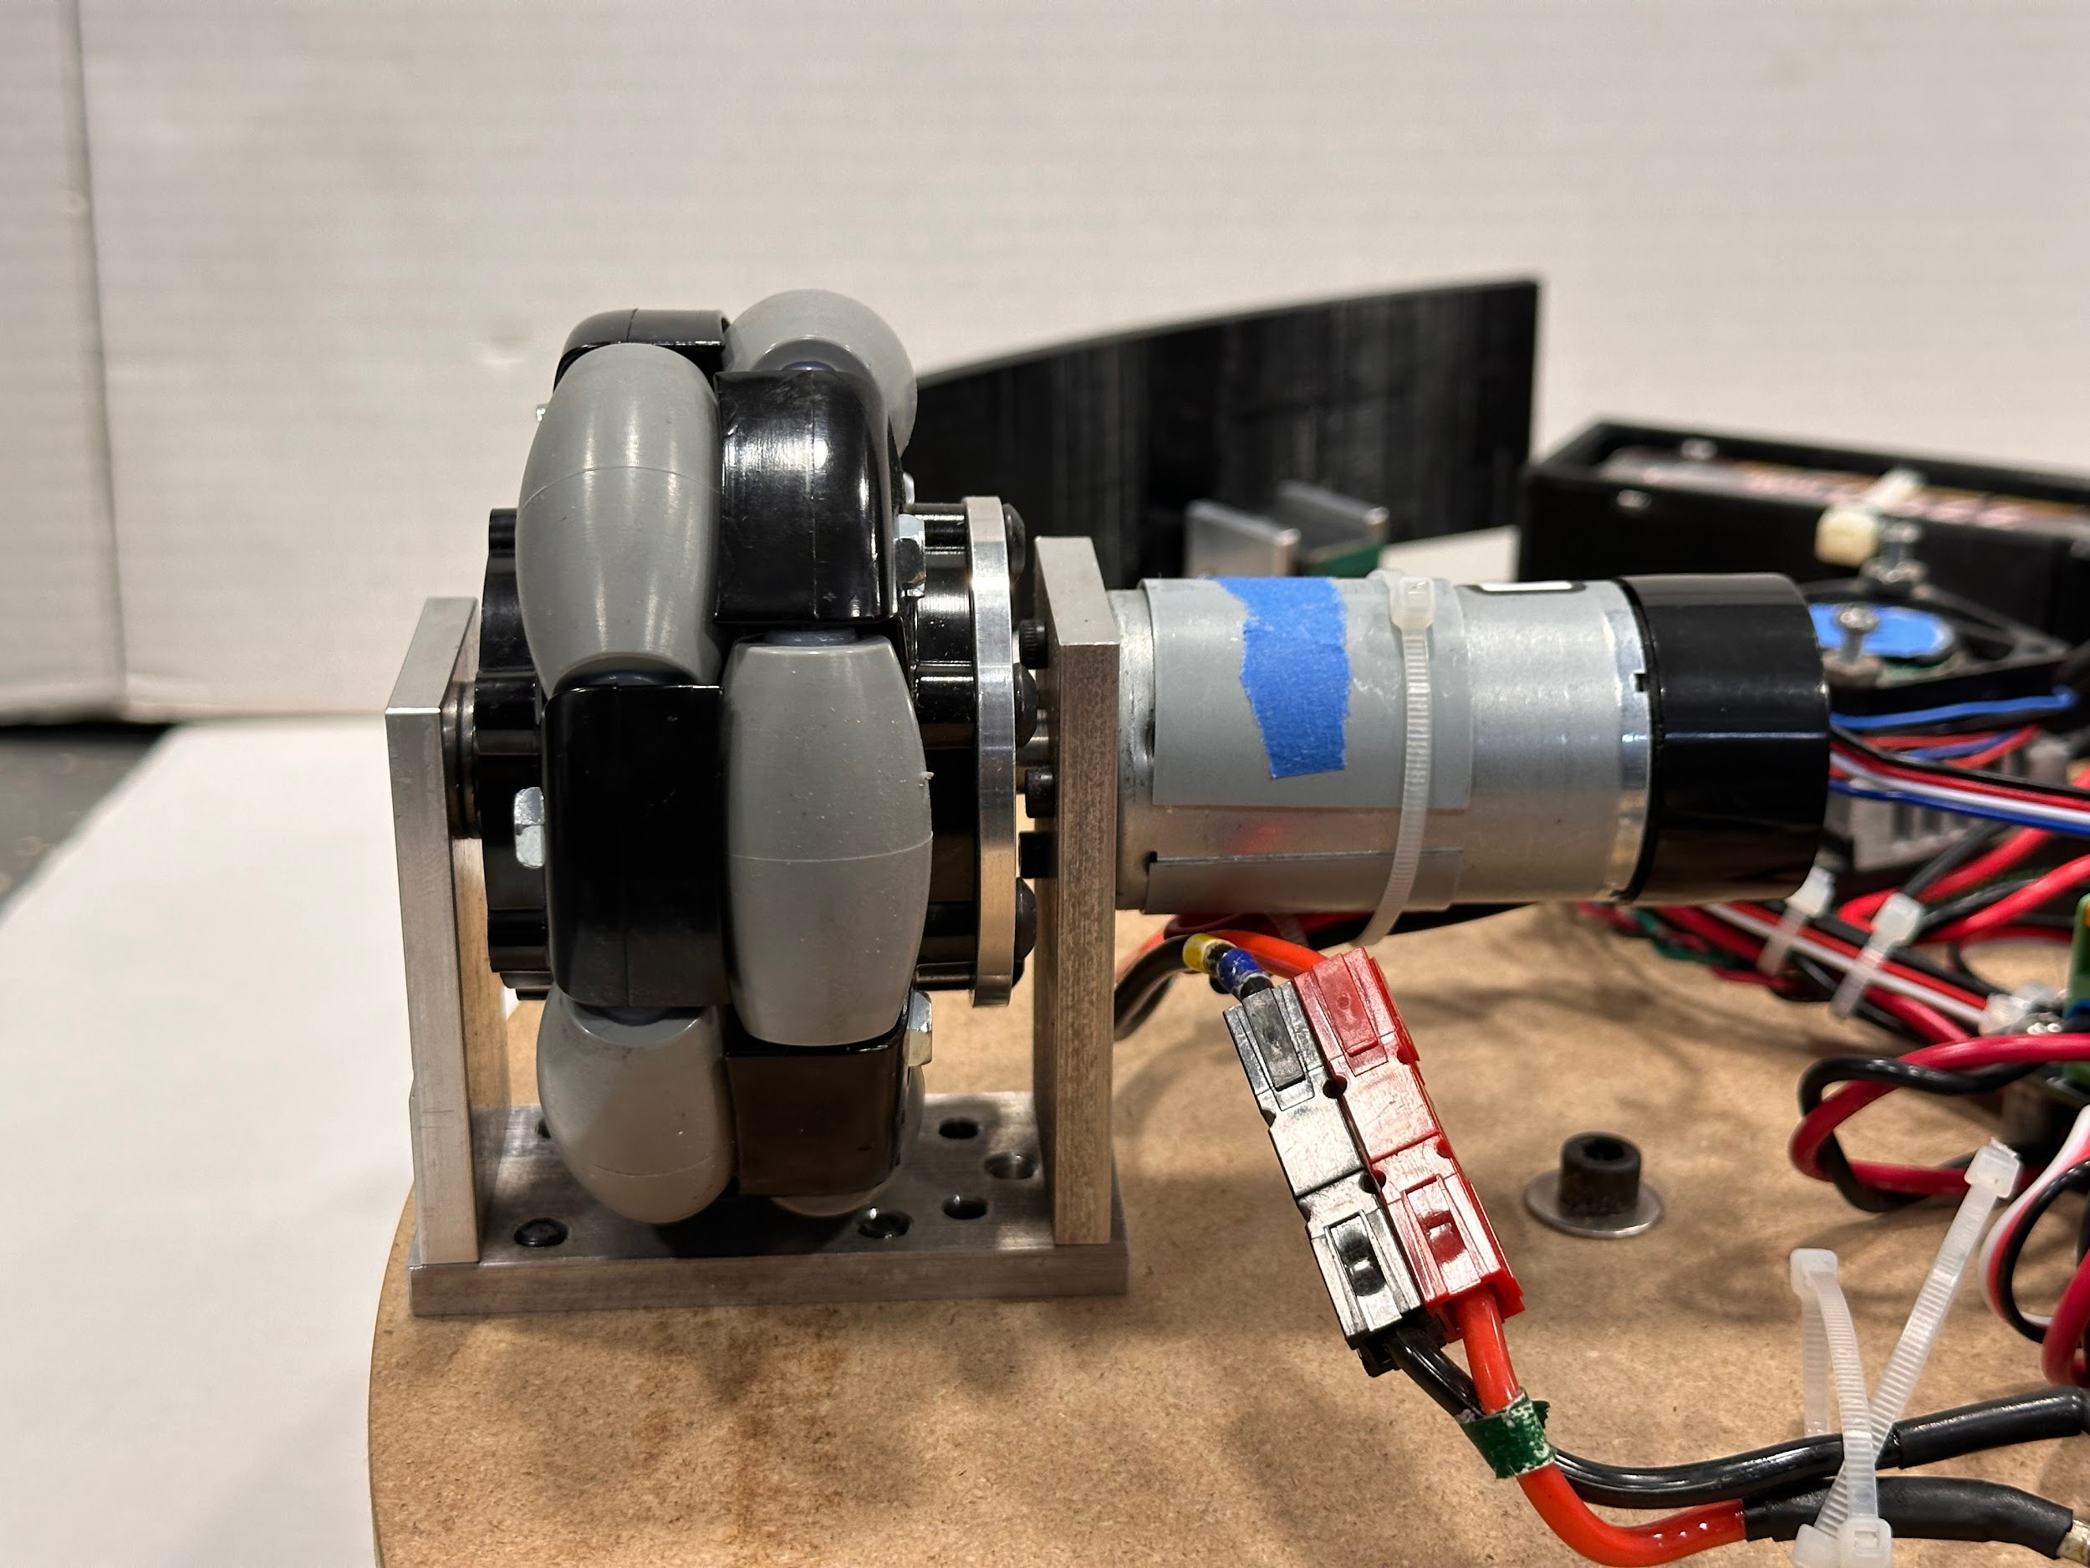
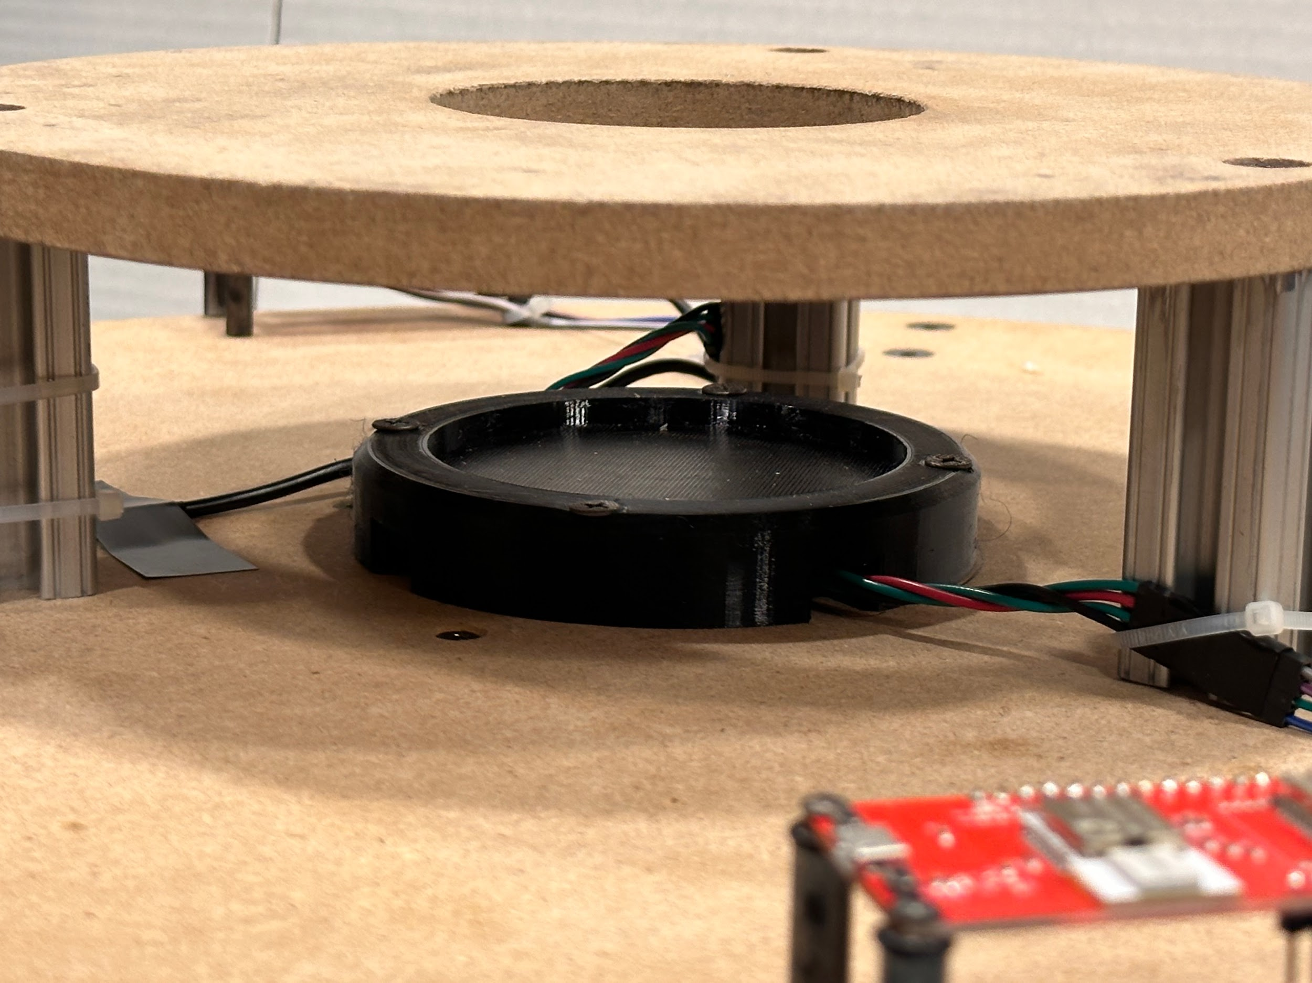
Further Mechanical Design Details
ELECTRICAL & COMPUTER ENGINEERING
GRAINGER ENGINEERING

Slide 27
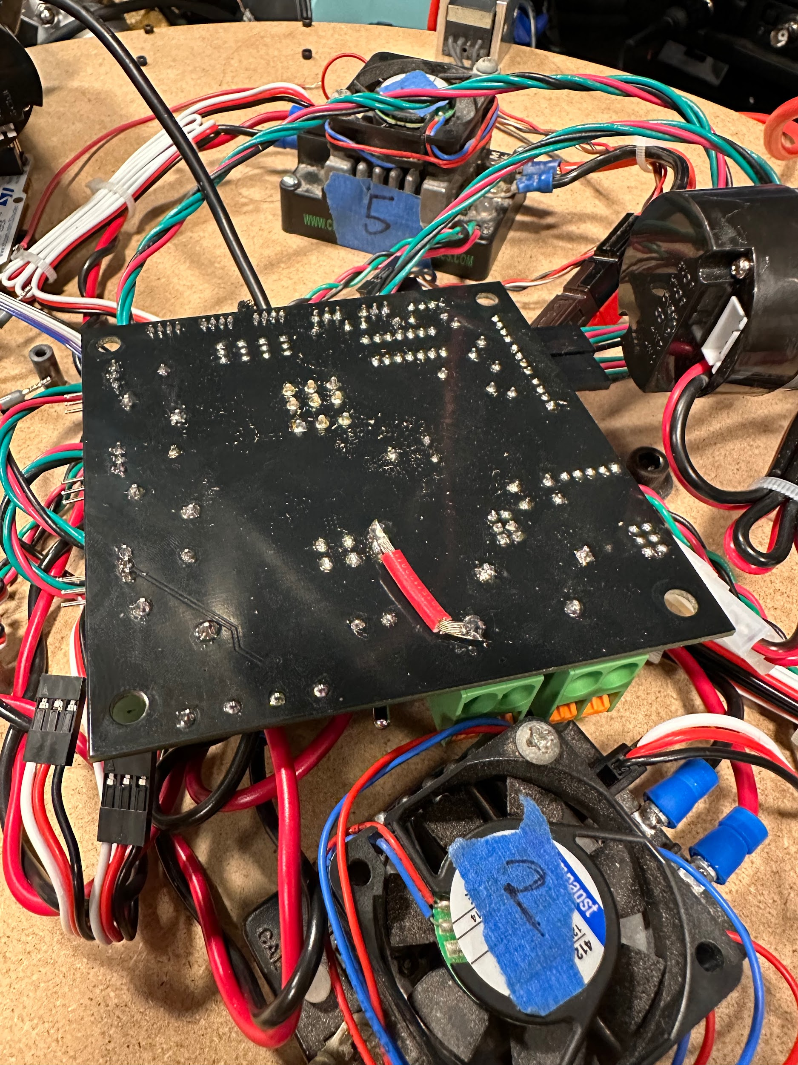
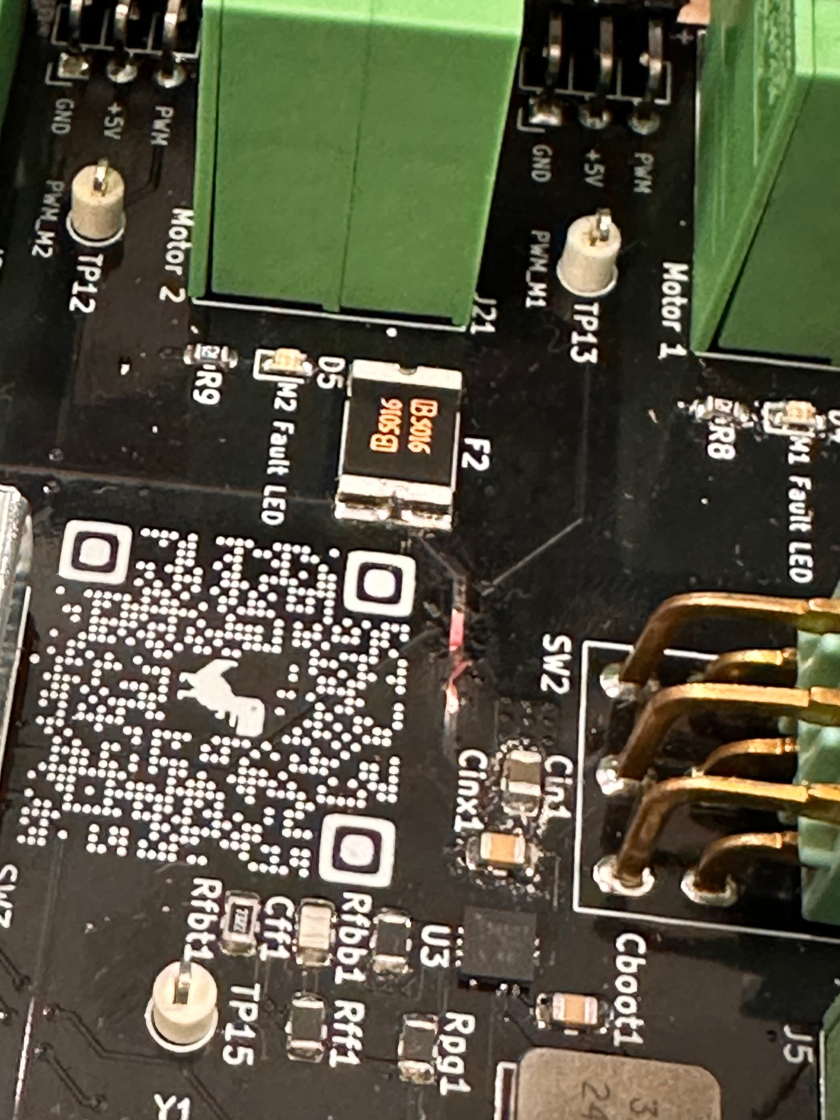
Blown PCB Traces
ELECTRICAL & COMPUTER ENGINEERING
GRAINGER ENGINEERING

Slide 28
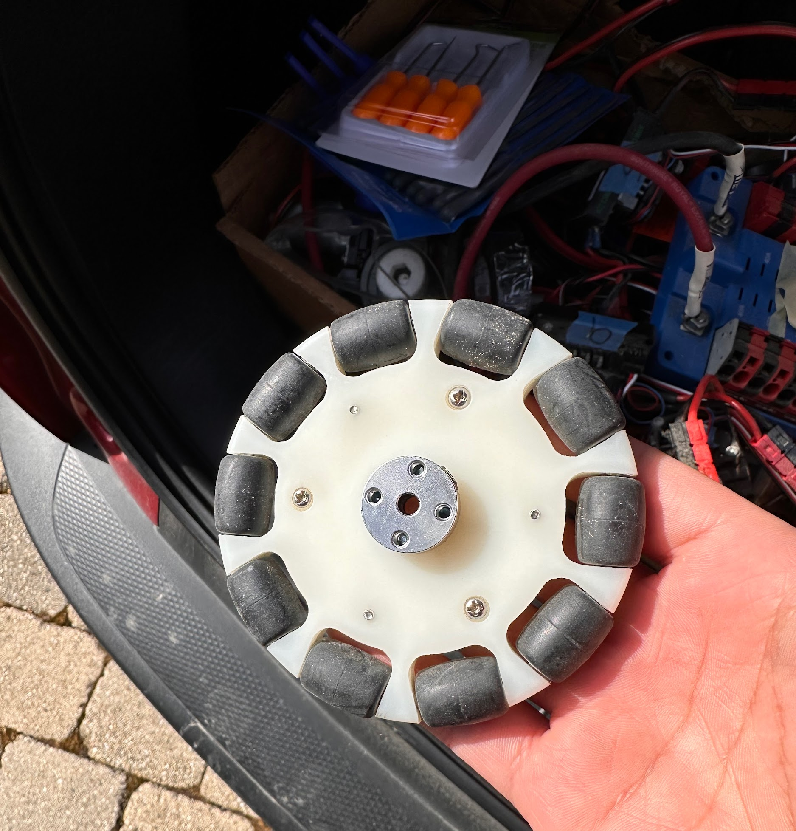
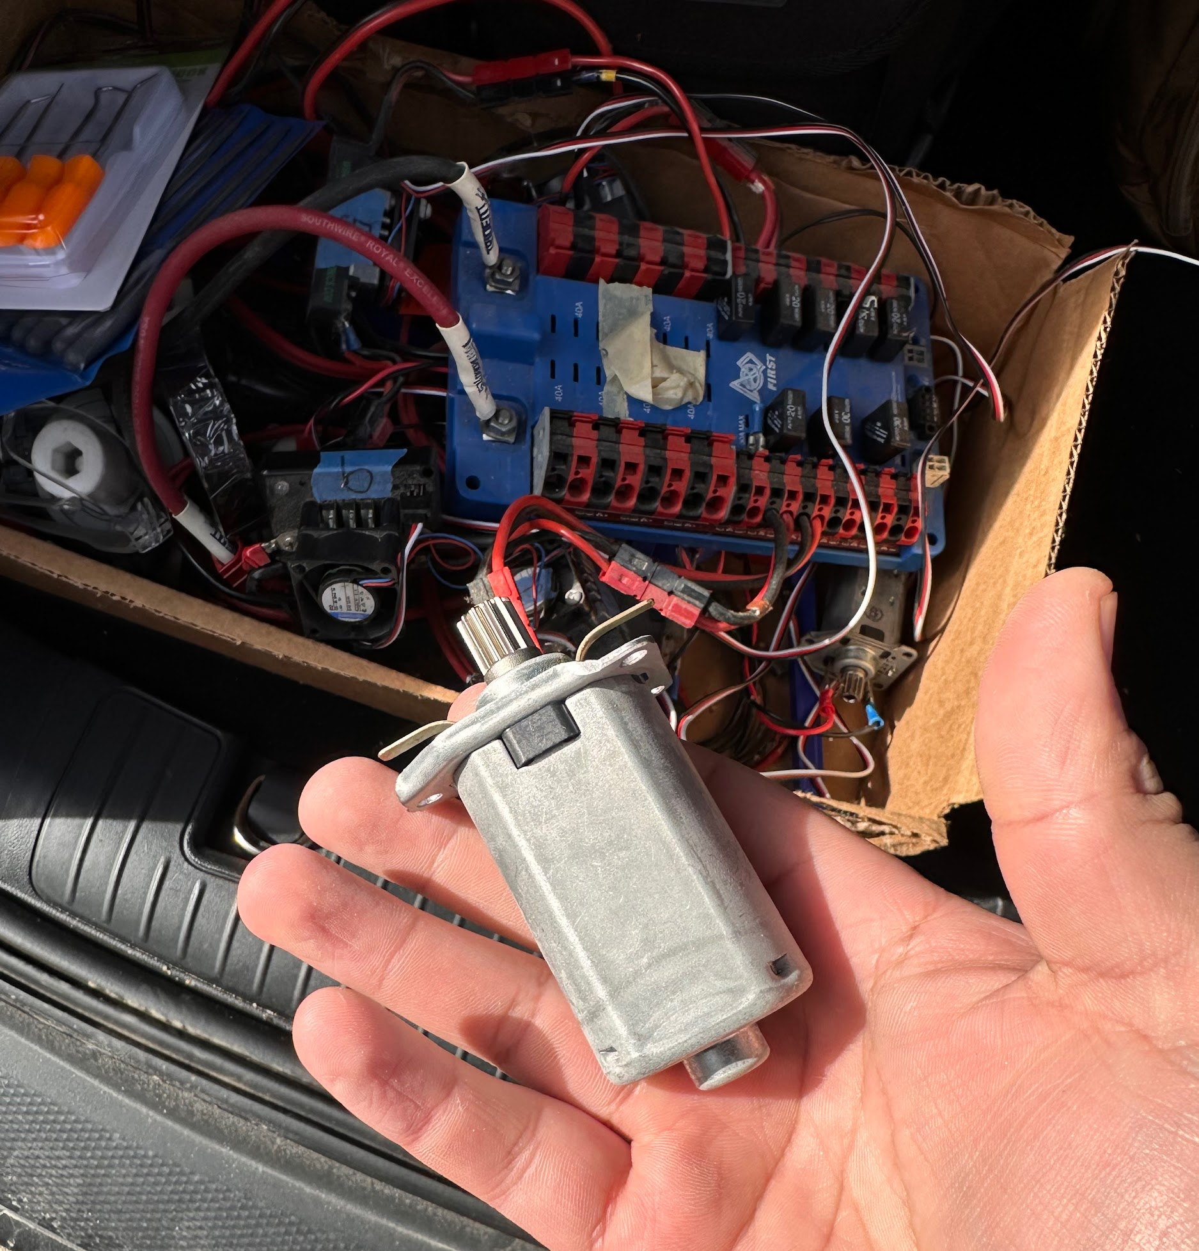
Original wheel and motor choice
ELECTRICAL & COMPUTER ENGINEERING
GRAINGER ENGINEERING

