Slide 1
Distributed Voice Activated Lights
Electrical & Computer Engineering - ECE 445
Anshul Goswami, Anish Naik, Walter Tang
December 4, 2023

Slide 2
Problem Statement
Why aren’t other switches good enough?
Safety concerns
Other smart switches - not good enough of a solution??
Comfort
Help I can’t get up
ELECTRICAL & COMPUTER ENGINEERING
GRAINGER ENGINEERING
Notes:
Light switches can also be flimsy or deteriorate over time

Slide 3
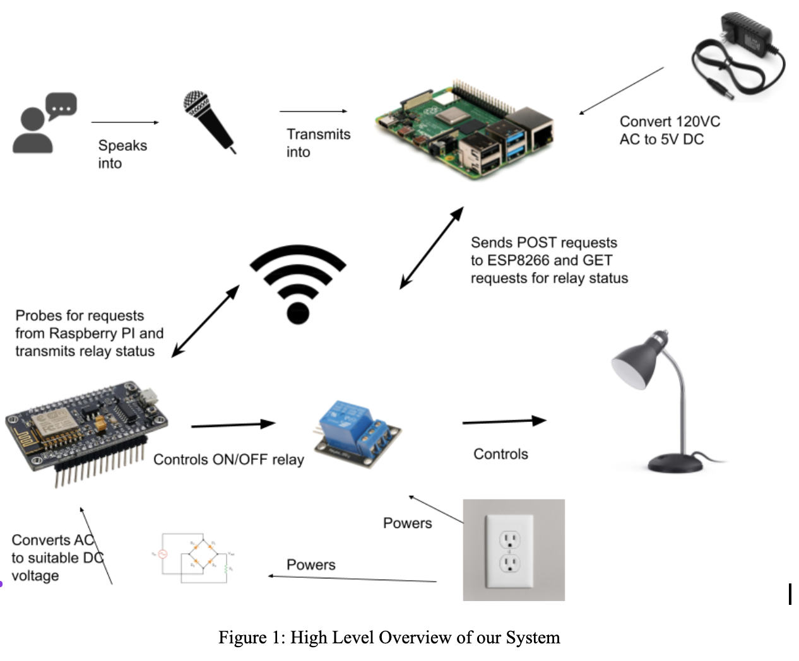
Solution
What can we do to fix those problems?
Distributed, voice activated system that allow you to control different lights around the house!
All outlets off
ELECTRICAL & COMPUTER ENGINEERING
GRAINGER ENGINEERING

Slide 4
High Level Requirements
Our system is able to recognize 6 commands with 75% accuracy from three different voices that are facing the microphone up to 1 meter from the main station box.
Our system supports up to two independent lamp boxes that can communicate with the main station box up to 5 meters away.
There will be visual feedback from the lamp boxes is displayed within 5 seconds of the microphone picking up a command.
ELECTRICAL & COMPUTER ENGINEERING
GRAINGER ENGINEERING

Slide 5
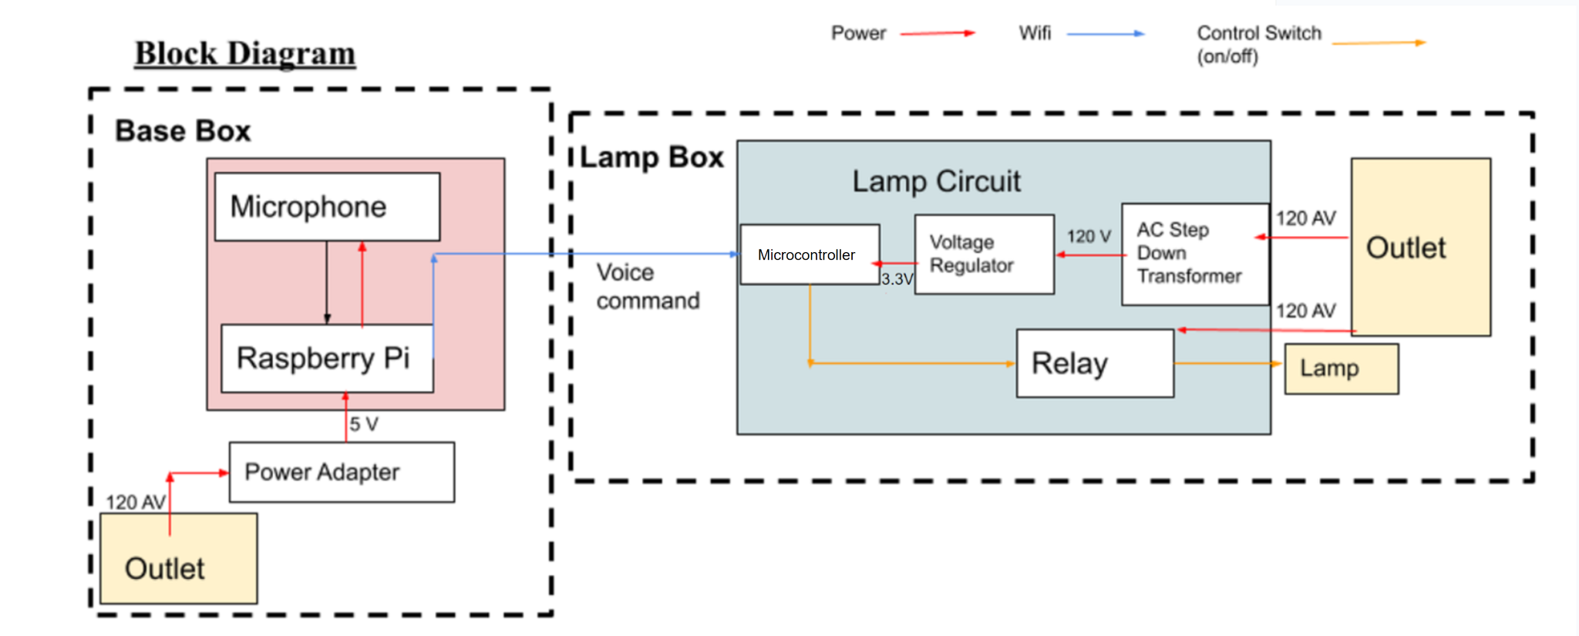
Original Design
Brief Overview
2 Main Submodules
Main Station Box: Controlled by a Raspberry Pi
Lamp Box: Controlled by an ESP32 Microcontroller
Also contains circuitry for controlling an outlet connected to mains voltage
ELECTRICAL & COMPUTER ENGINEERING
GRAINGER ENGINEERING

Slide 6
Main Station Box Subsystem
Design
Communicates with ESP 32 using Wifi
Connects to a Microphone
Runs the Voice Recognition Module
Our Requirements
The Raspberry Pi will be able to power and communicate the microphone via the USB Protocol.
There will be a cooldown of 4 ± 1 seconds between each successful voice command recognized.
Our microphone will detect voices between 20dB to 60dB, which is the average sound intensity of speaking up to one meter away.
Send commands to ESP32-E using Wifi signals on the LAN network using a 2.4 GHZ Hotspot
ELECTRICAL & COMPUTER ENGINEERING
GRAINGER ENGINEERING

Slide 7
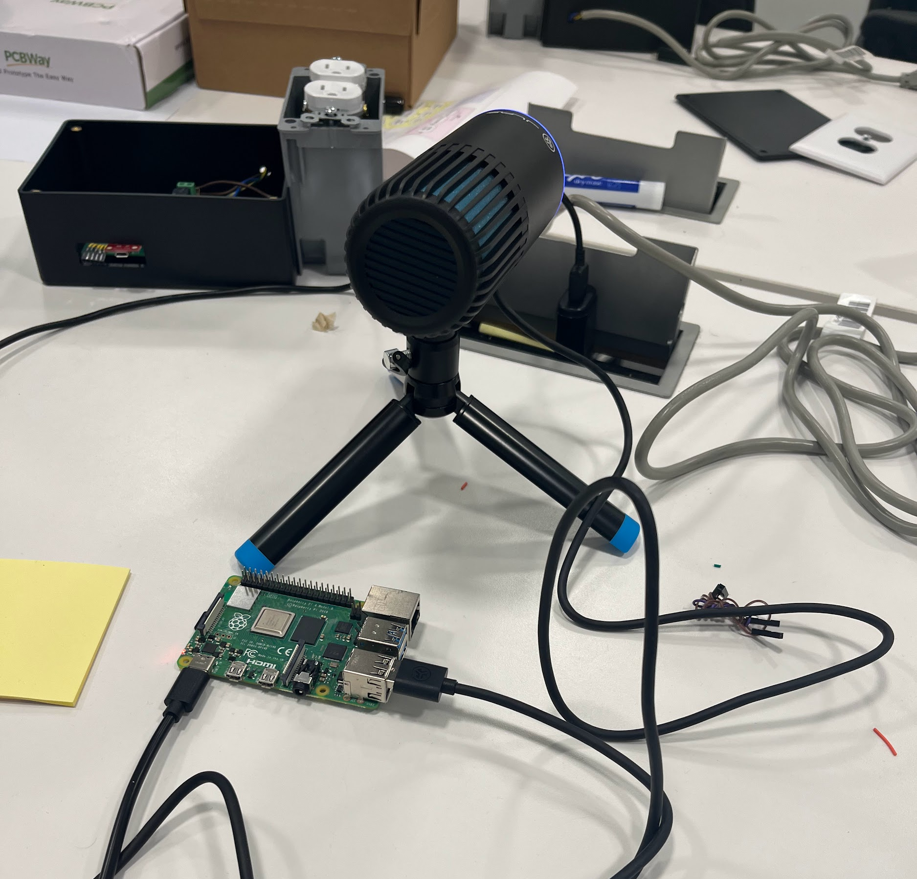
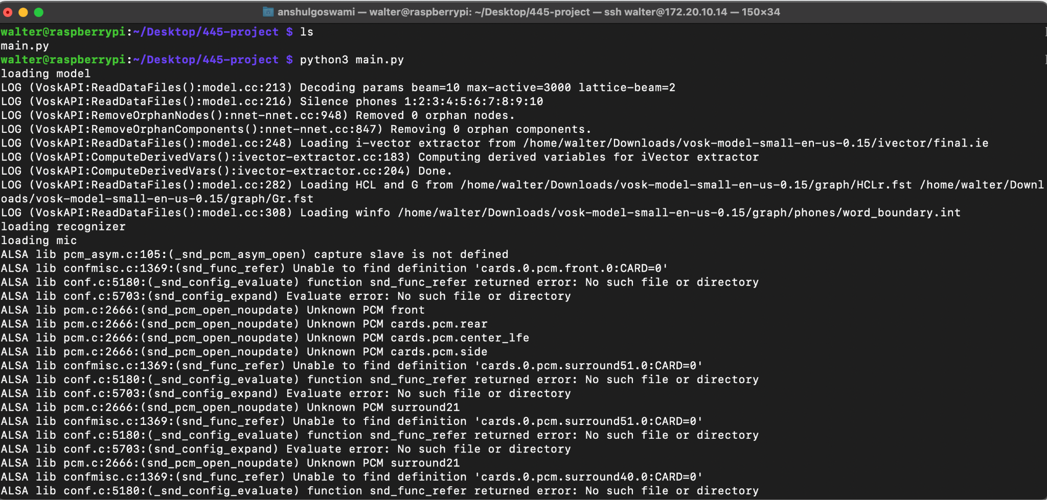
Physical Design of Main Station Box
ELECTRICAL & COMPUTER ENGINEERING
GRAINGER ENGINEERING

Slide 8
Voice Recognition Subsystem
Design
Vosk API
Utilizes Hidden Markov Models on pre-trained data
75% accuracy
Trained on LibriSpeech Dataset - collection of 1000 hours of 16kHz read English speech
Tweaking the data a bit so that it best works for our purposes
Our Requirements
Perform voice recognition using Raspberry Pi and the Vosk API with 75% accuracy.
Can perform voice recognition of the six commands using our three different voices.
ELECTRICAL & COMPUTER ENGINEERING
GRAINGER ENGINEERING

Slide 9
Voice Recognition Verification Data
 | Anish 1 | Anish 2 | Anish 3 | Anshul 1 | Anshul 2 | Anshul 3 | Walter 1 | Walter 2 | Walter 3
outlet one on | TRUE | TRUE | TRUE | TRUE | TRUE | TRUE | FALSE | TRUE | TRUE
outlet one off | FALSE | TRUE | TRUE | TRUE | TRUE | TRUE | TRUE | TRUE | TRUE
outlet two on | TRUE | TRUE | TRUE | TRUE | TRUE | TRUE | TRUE | TRUE | TRUE
outlet two off | TRUE | TRUE | TRUE | TRUE | TRUE | TRUE | TRUE | TRUE | FALSE
all outlets on | FALSE | TRUE | TRUE | FALSE | TRUE | TRUE | TRUE | TRUE | TRUE
all outlets off | TRUE | TRUE | FALSE | TRUE | TRUE | TRUE | TRUE | FALSE | TRUE
Success rate: | 47/54
Was our system able to recognize these six commands?
About 87% accuracy!
ELECTRICAL & COMPUTER ENGINEERING
GRAINGER ENGINEERING

Slide 10
Lamp Box Subsystem
Design
Uses an ESP Chip to receive commands from the Raspberry Pi
Uses a Relay to switch an Outlet on and off
Our Requirements
Our Linear Regulator circuit will take 5V input DC and convert it into a 3.3V DC in order to power the ESP32-E
Receive signals from Raspberry Pi to turn Relay on/off
The PCB should be able to withstand 120V AC without the PCB generating too much resistance, thus generating heat
ELECTRICAL & COMPUTER ENGINEERING
GRAINGER ENGINEERING

Slide 11
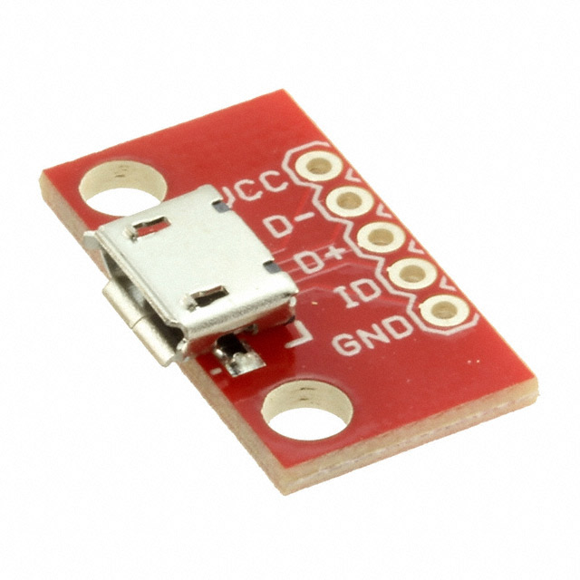
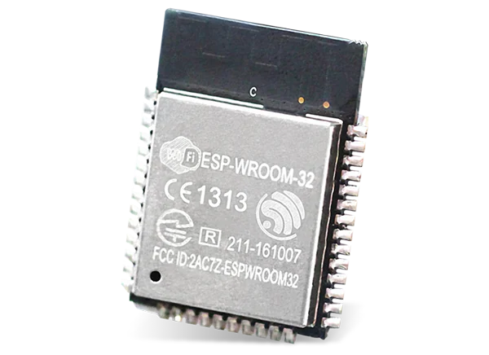
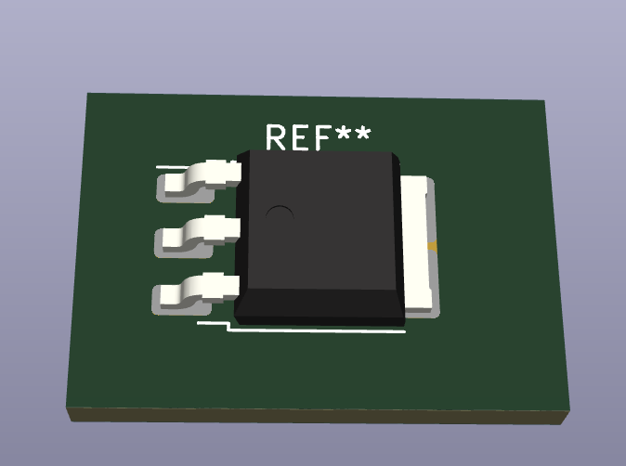
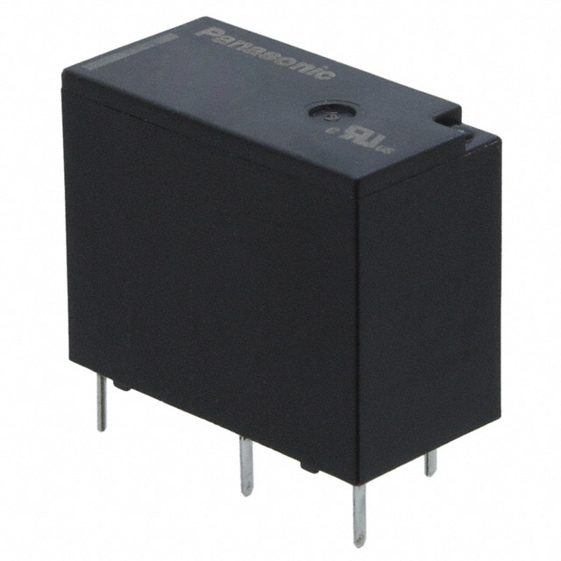
What has changed throughout the design
Major Changes
One major change: Replacing AC Step Down transformer with micro USB module
5V Power
3.3V
Micro USB
Voltage Regulator
Microcontroller
Used a bigger relay that can handle mains voltage
ELECTRICAL & COMPUTER ENGINEERING
GRAINGER ENGINEERING

Slide 12
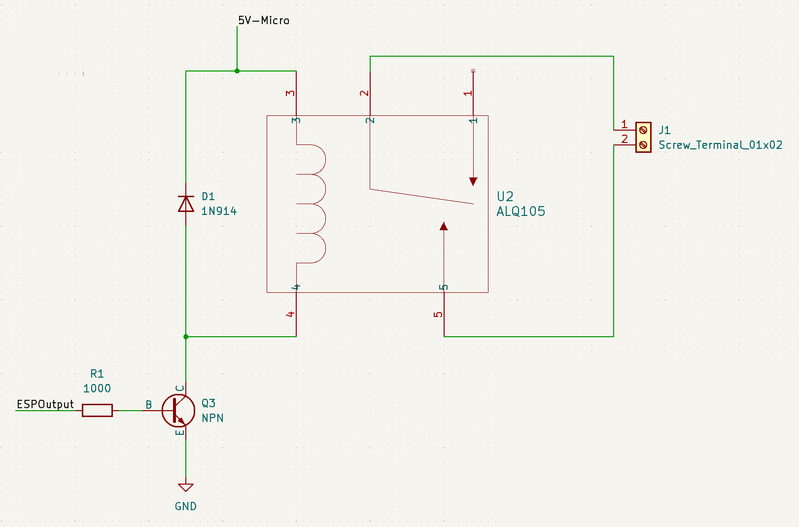
Additional Changes
Programmer
ESP32
Other Changes
Flipping RX and TX connections on PCB (Common Mistake!)
This is because TX is transmit and RX is receive!
RX
RX
TX
TX
Adding additional protection circuitry to relay
Flyback Diode
Transistor
ELECTRICAL & COMPUTER ENGINEERING
GRAINGER ENGINEERING

Slide 13
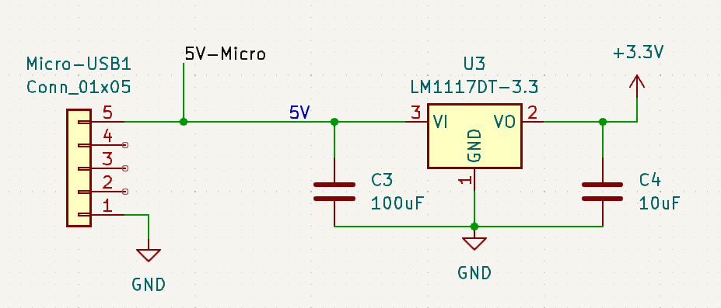
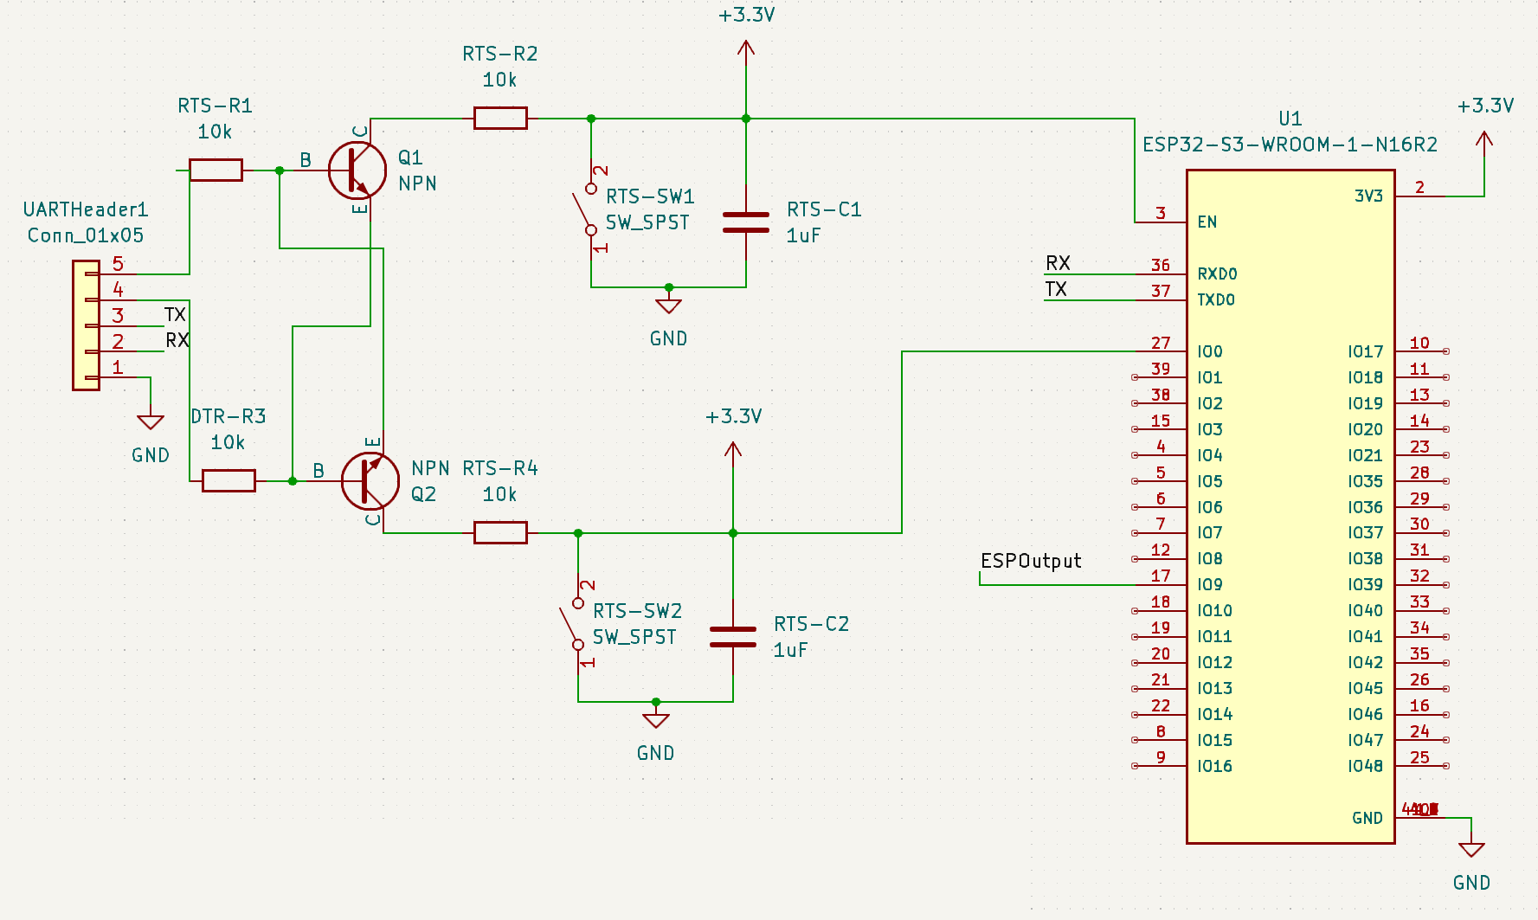
PCB Circuit Design of Lamp Box
Linear Regulator
ESP Programmer
Relay Circuit
ELECTRICAL & COMPUTER ENGINEERING
GRAINGER ENGINEERING

Slide 14
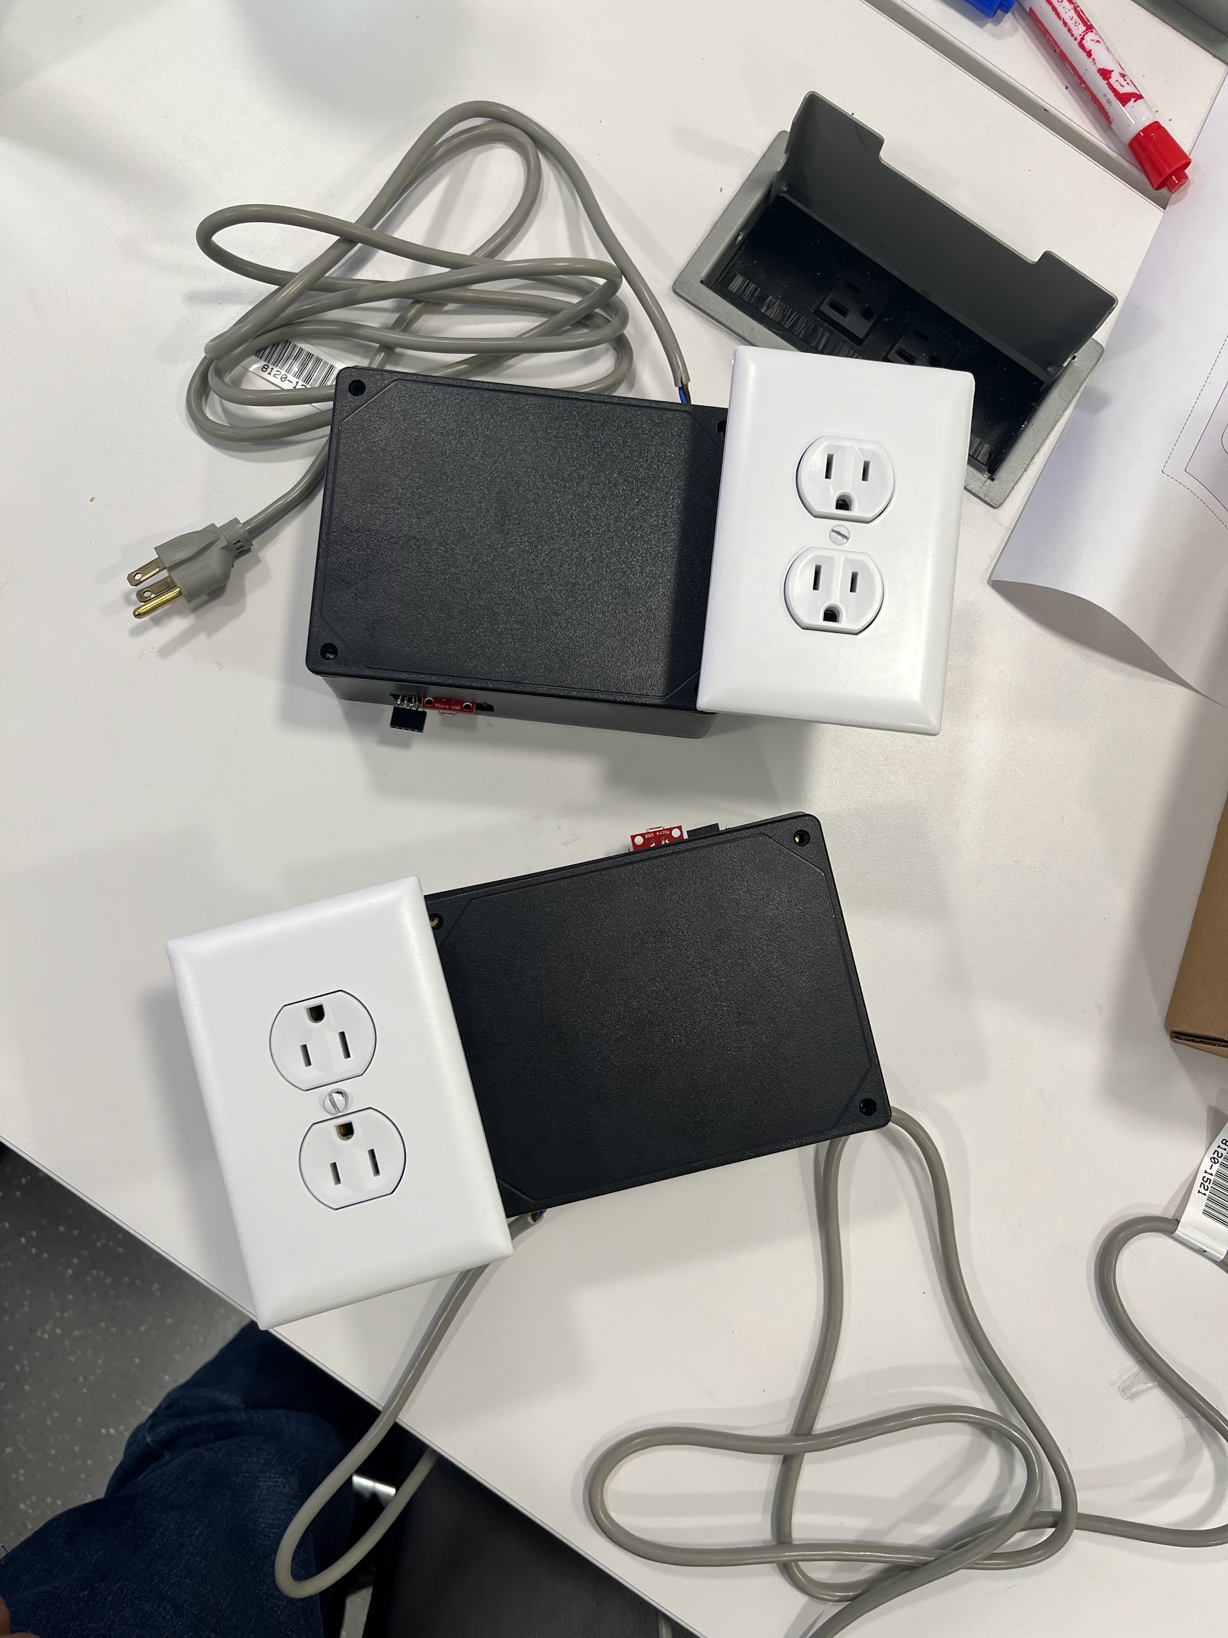
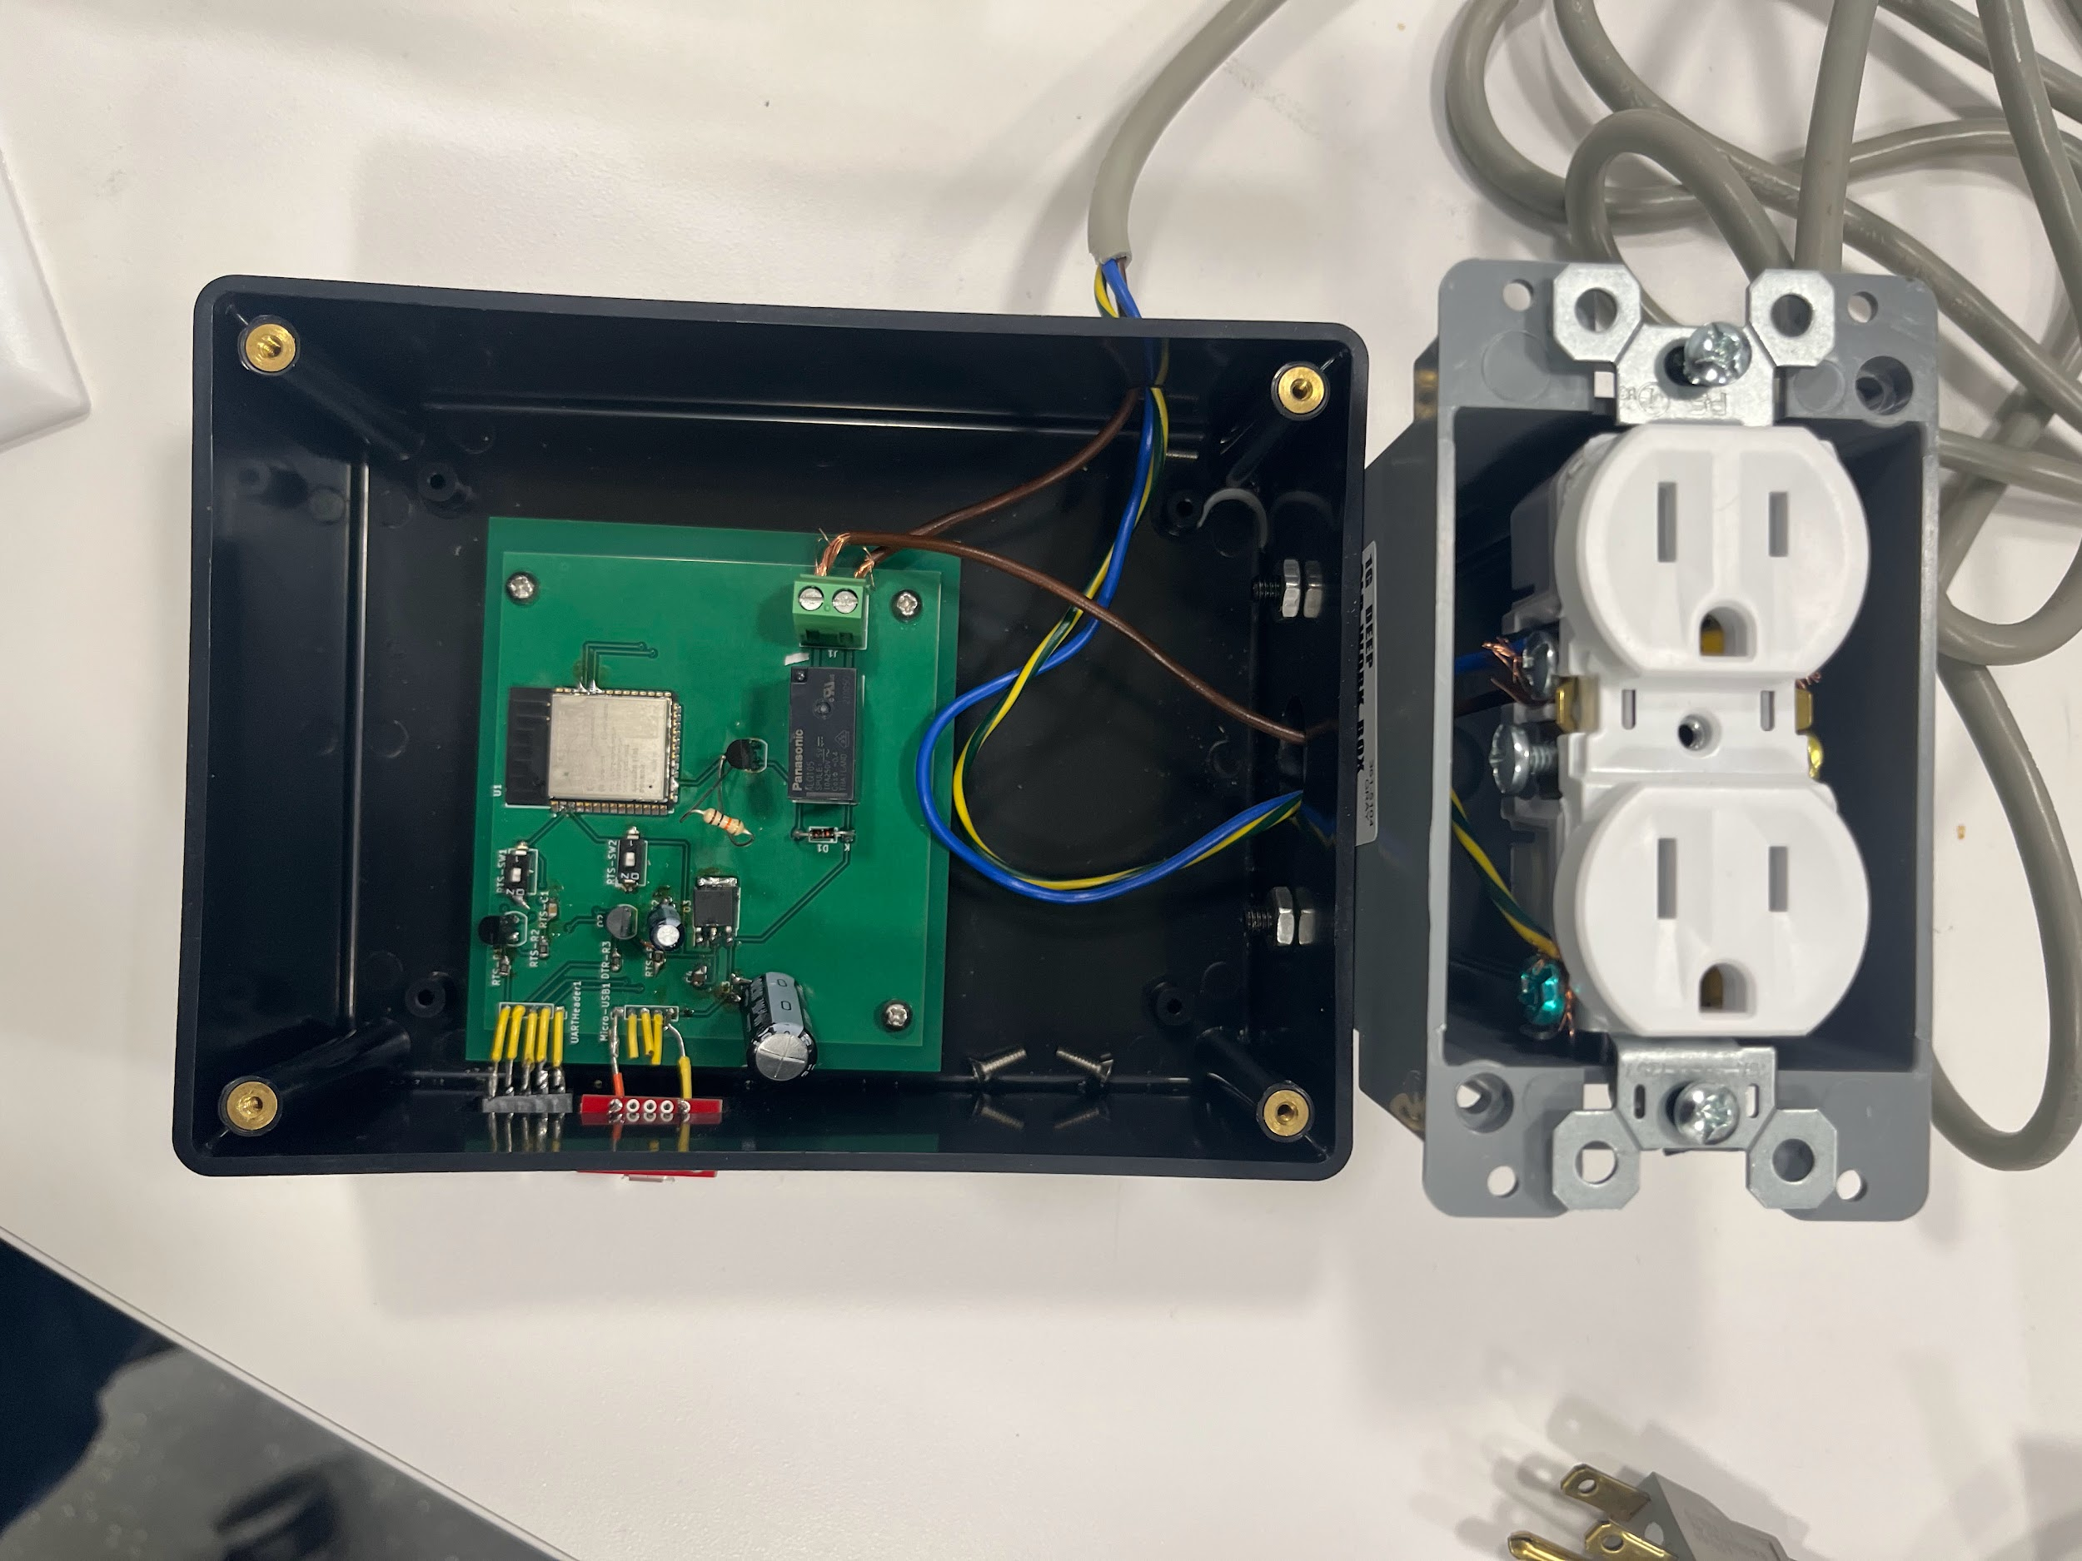
Physical Design of Lamp Box
ELECTRICAL & COMPUTER ENGINEERING
GRAINGER ENGINEERING

Slide 15
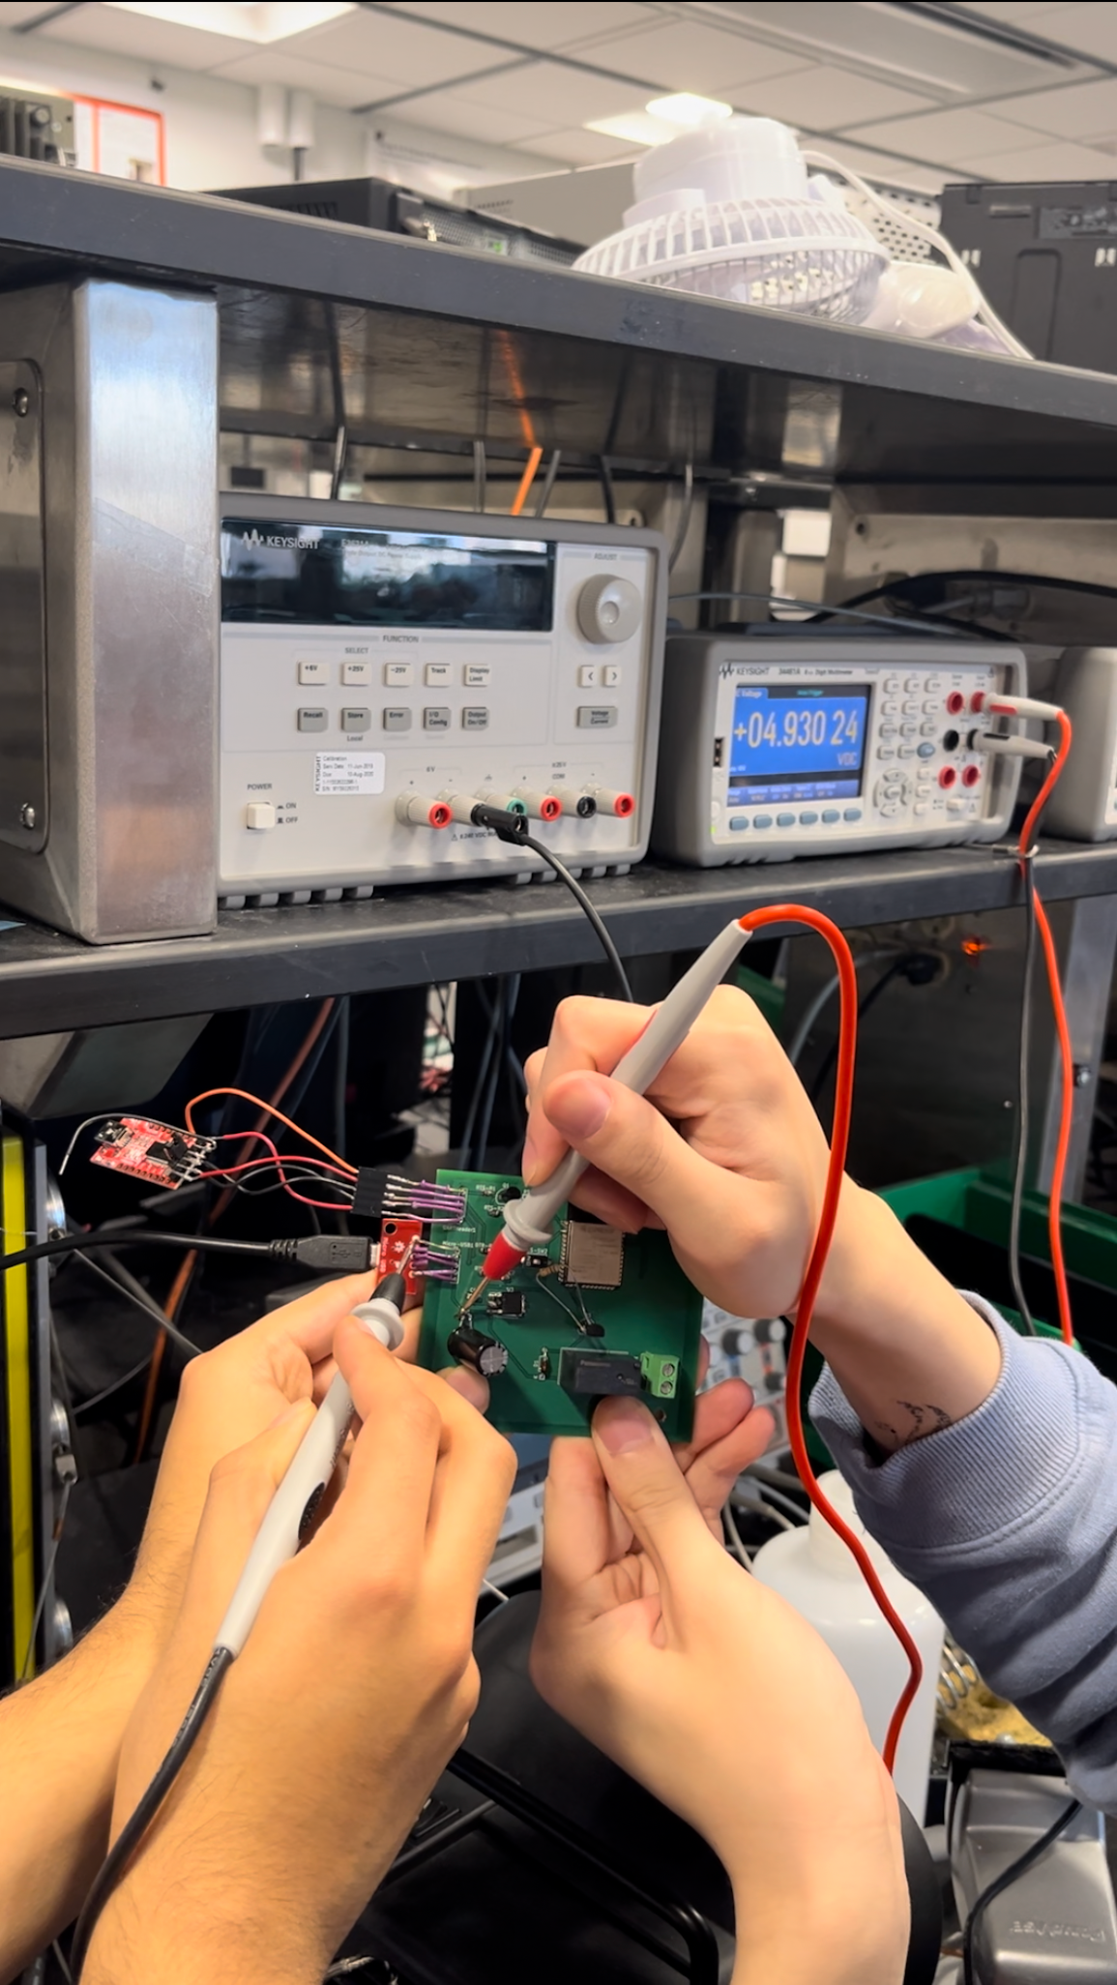
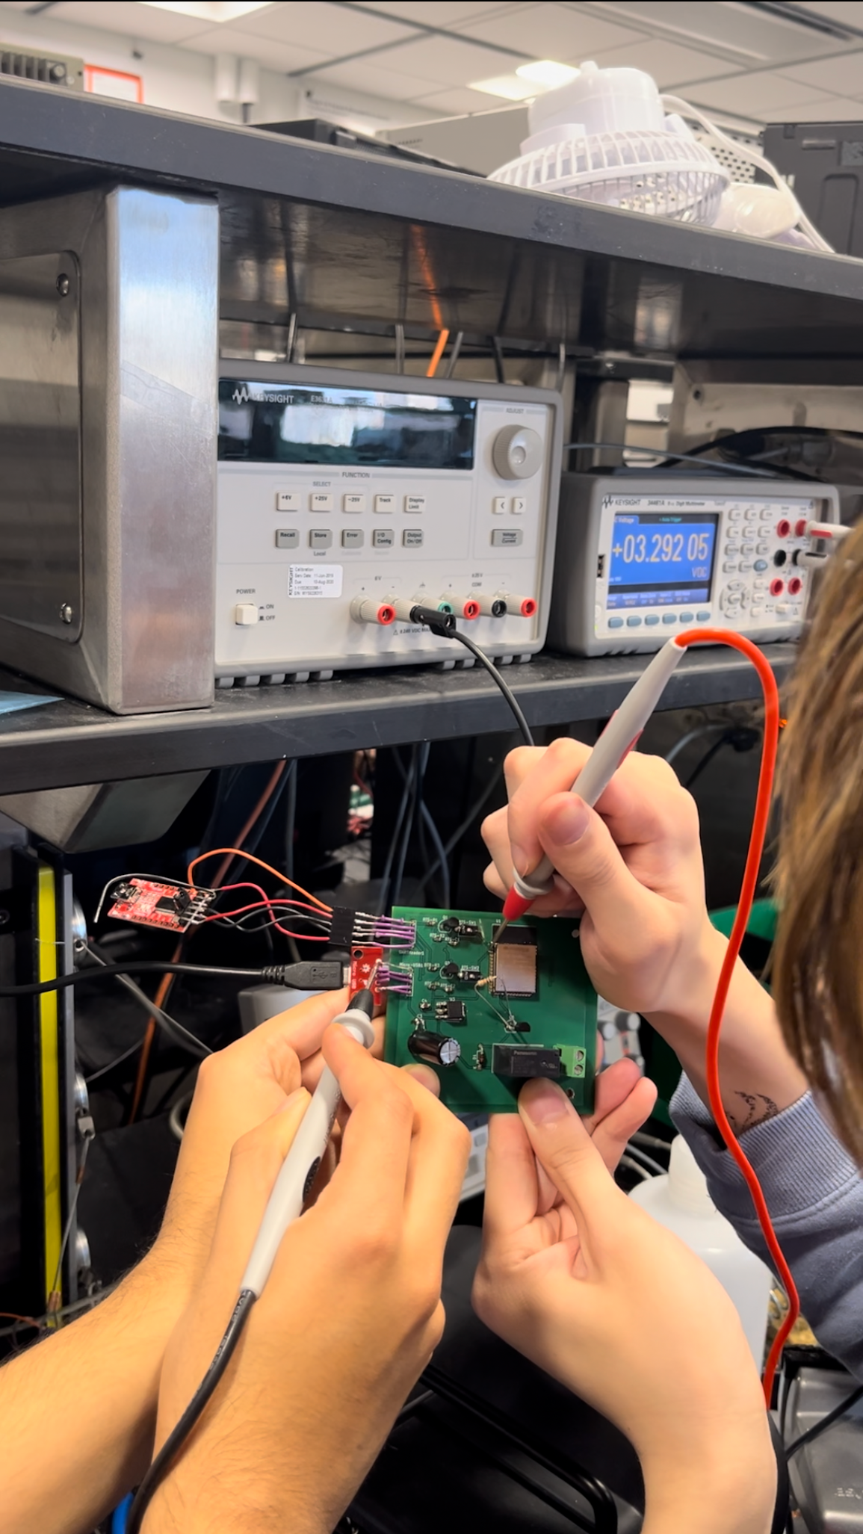
Linear Regulator Verification
ELECTRICAL & COMPUTER ENGINEERING
GRAINGER ENGINEERING

Slide 16
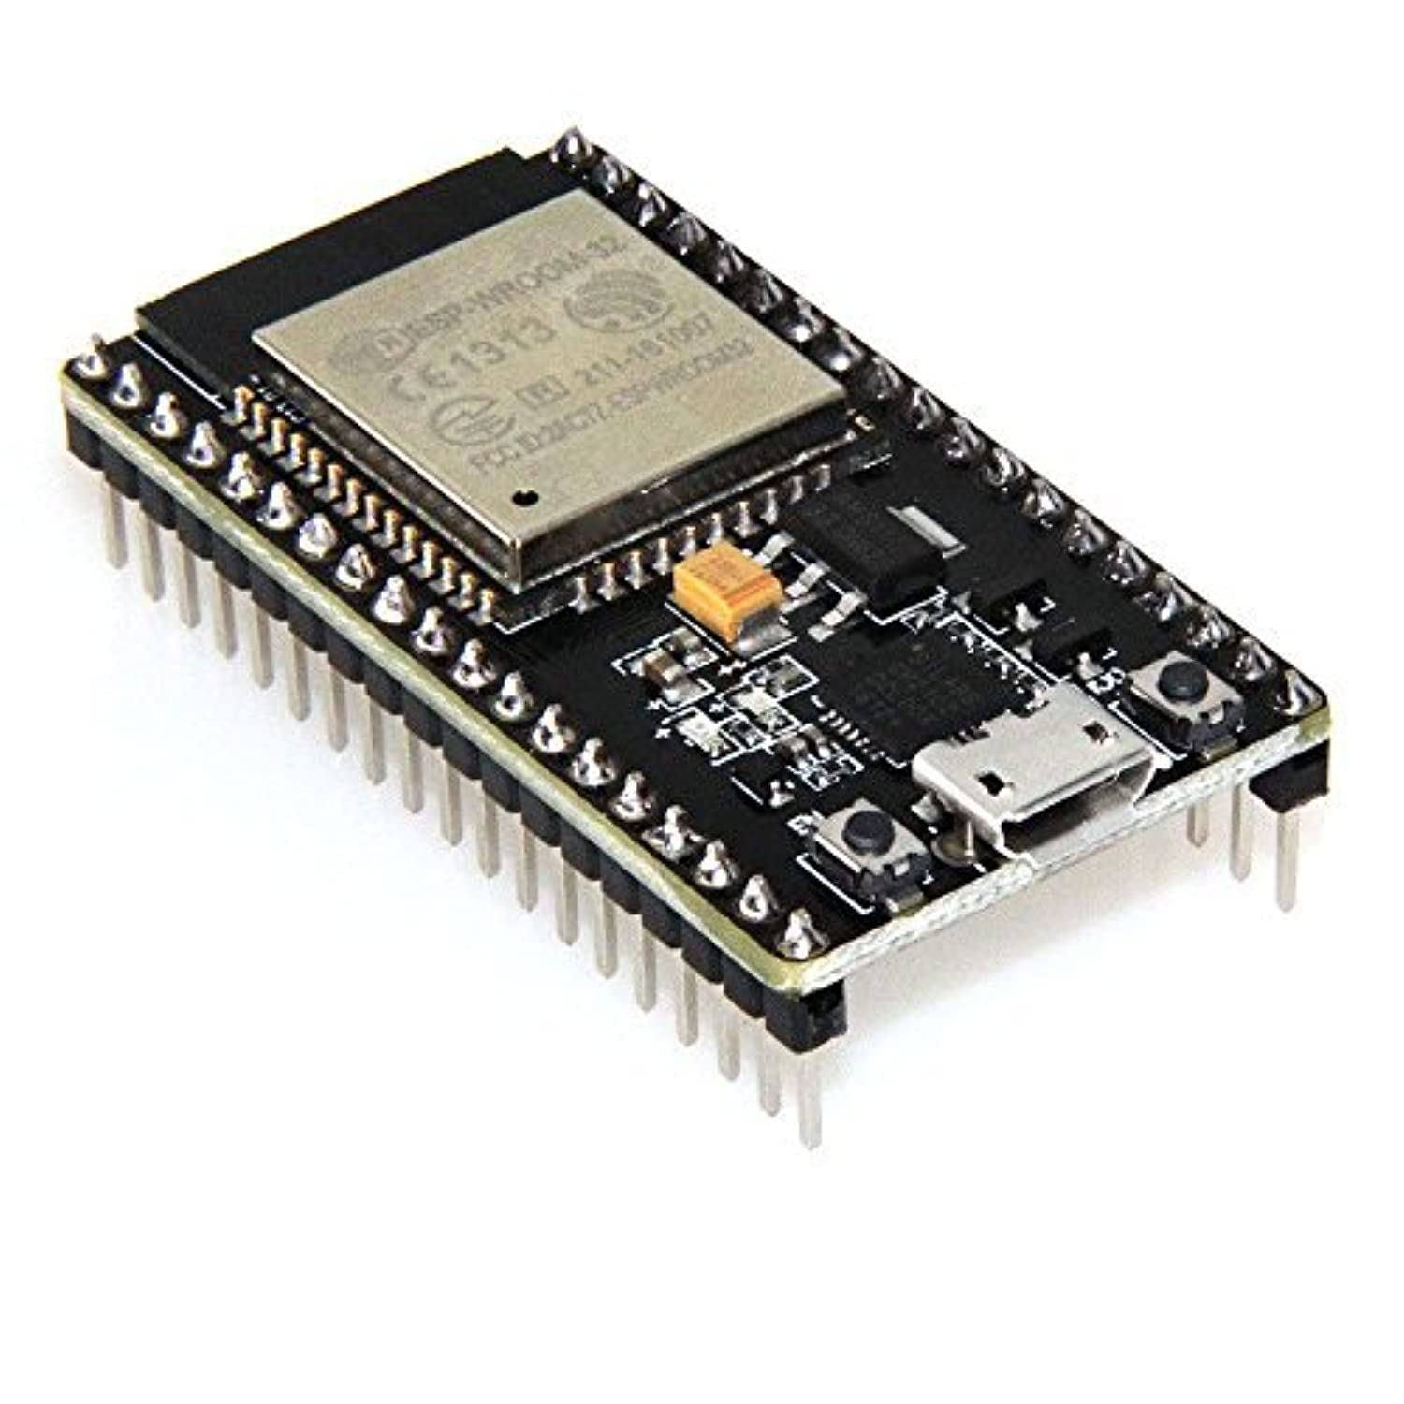
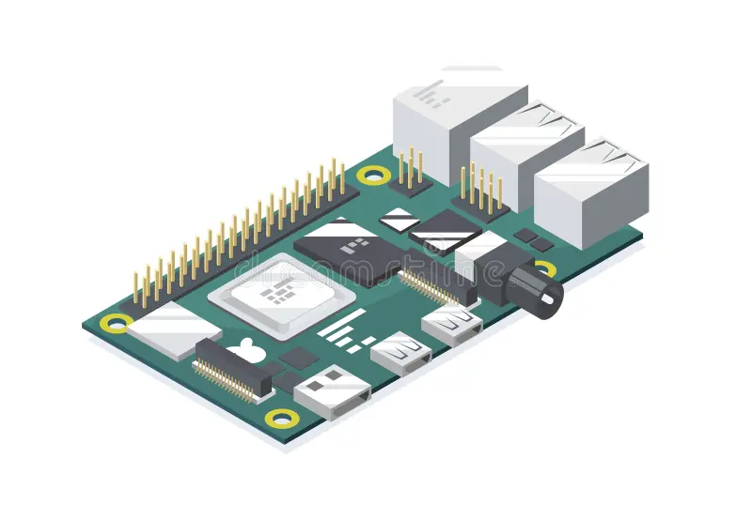
Success and Challenges
Successes
Raspberry Pi and ESP8266 Dev Board can transmit correct commands via TCP/UDP protocol
Voice Recognition Module accuracy
Coordinated with Machine Shop to create a working enclosure and outlet box
GET /outoutOneON
(Request)
HTTP OK “Successful”
(Response)
Voice Data
Translates to Text
ELECTRICAL & COMPUTER ENGINEERING
GRAINGER ENGINEERING

Slide 17
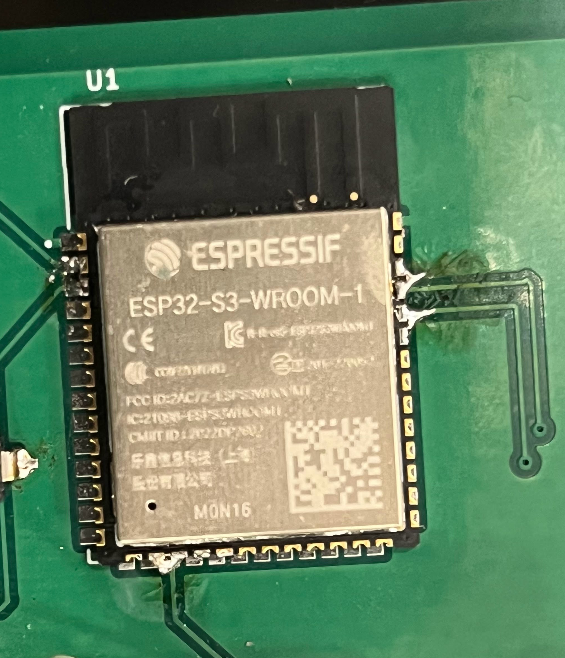
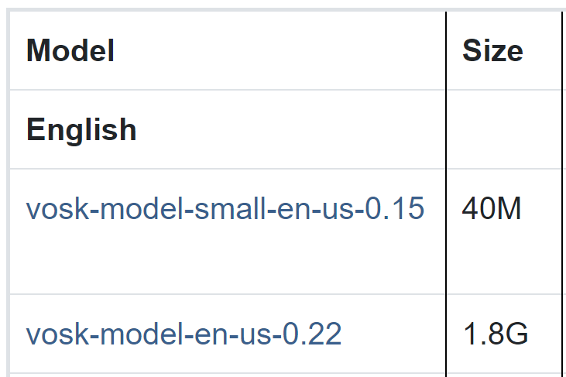
Success and Challenges
Challenges
Couldn't Properly Solder ESP to PCB
Unable to test Functionality of Relay with the Outlet
Had to use a smaller Voice Recognition Model due to Raspberry Pi
ELECTRICAL & COMPUTER ENGINEERING
GRAINGER ENGINEERING

Slide 18
Conclusions
What we Learned
Voice Recognition Models
How to set up a Raspberry Pi
Designing Circuits and PCBs
Working with High Voltage
What we would do differently
Order parts earlier and use those specific footprints while designing the PCB
Use Stencil and design PCB to be easier to Solder
Work in Parallel on multiple systems
Build in ways to test subsystems
ELECTRICAL & COMPUTER ENGINEERING
GRAINGER ENGINEERING

Slide 19
Recommendations for Future Work
Possible Expansions to the Project
More Usable Outlets in each PCB
More Commands that can understood by each of the Lamp Boxes
Connect over longer distances
More Lamp Boxes connected to the Main Station Box
All outlets off
ELECTRICAL & COMPUTER ENGINEERING
GRAINGER ENGINEERING

Slide 20
Ethical and Safety Concerns
Ethical and Safety Issues
Protect the safety and privacy of the public
We will ensure that our project follows any relevant license terms of service for all software used.
When building any physical materials needed for our project, we will follow the required safety guidelines in the OpenLab to ensure the safety of everyone involved.
Since we will be working with AC power, we will ensure that each member completes the High Voltage training and adhere to these guidelines
ELECTRICAL & COMPUTER ENGINEERING
GRAINGER ENGINEERING

Slide 21
Works Cited
[1] Asma Trabelsi, Sébastien Warichet, Yassine Aajaoun, Séverine Soussilane,
Evaluation of the efficiency of state-of-the-art Speech Recognition engines,
Procedia Computer Science, Volume 207, 2022, Pages 2242-2252, ISSN 1877-0509
[2] P. Setiawan and R. Yusuf, "IoT Device Control with Offline Automatic Speech Recognition on Edge Device," 2022 12th International Conference on System Engineering and Technology (ICSET), Bandung, Indonesia, 2022, pp. 111-115, doi: 10.1109/ICSET57543.2022.10010962
[3] Panayotov, Vassil, et al. LIBRISPEECH: AN ASR CORPUS BASED on PUBLIC DOMAIN AUDIO BOOKS.
[4] “VOSK Offline Speech Recognition API,” VOSK Offline Speech Recognition API
[5] “ESP32-S3-WROOM-1 Datasheet v1.2.” Espressif Systems, 2023
[6] IEEE. “”IEEE Code of Ethics”.” (2016), [Online].
ELECTRICAL & COMPUTER ENGINEERING
GRAINGER ENGINEERING

