Slide 1
ECE 445 Team 18 Final Presentation
Self-Charging Automatic Bike Lock
Team Members: Rithik Morusupalli, Paul Jeong, Jake Li
12/01/2023
Notes:
Paul

Slide 2
Agenda
Introduction
Objective
Design
Project Build
Test Results & their Successes and Challenges
Recommendations for Further Work
Conclusions
ELECTRICAL & COMPUTER ENGINEERING
GRAINGER ENGINEERING
Notes:
Paul

Slide 3
Introduction
Team Members
Rithik Morusupalli
Major: Computer Engineering
Focus: PCB Design, PCB Assembly, Project Assembly
Paul Jeong: Computer Engineering
Major: Computer Engineering
Focus: PCB Design, Software Design, Project Assembly
Jake Li: Computer Engineering
Major: Computer Engineering
Focus: PCB Design, Software Design, Circuit Verification
ELECTRICAL & COMPUTER ENGINEERING
GRAINGER ENGINEERING
Notes:
All of us

Slide 4
Objective
Problem
Stolen bikes are a large problem, with an average of 175,000 bikes stolen each year in the US [1]
Normal bike security measures can be tampered with
Solution
A self-charging automatic bike lock with an alarm system
Automatic portion will be achieved using bluetooth connectivity
Self-charging by cycling
[1] The Best Bike Lock. “Bike Theft Statistics in the US (2023)”. thebestbikelock.com. https://thebestbikelock.com/bike-theft-statistics-us/ (Accessed 11/27/23)
ELECTRICAL & COMPUTER ENGINEERING
GRAINGER ENGINEERING
Notes:
Rithik

Slide 5
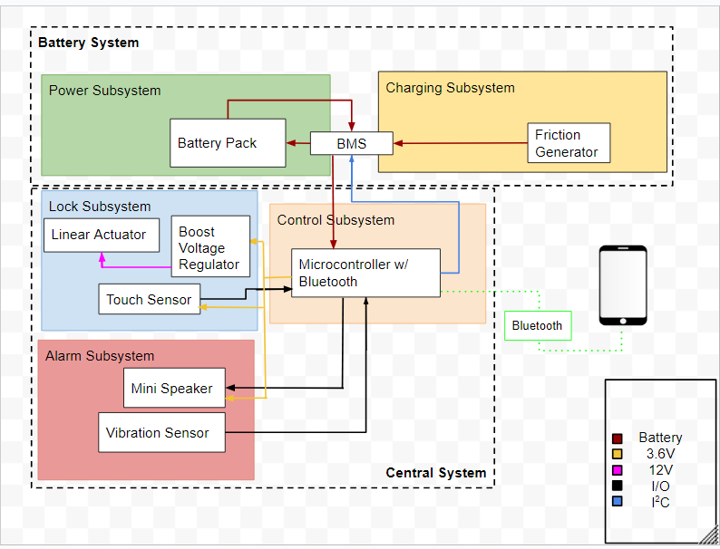
Design
Original Design
ELECTRICAL & COMPUTER ENGINEERING
GRAINGER ENGINEERING
Notes:
Paul

Slide 6
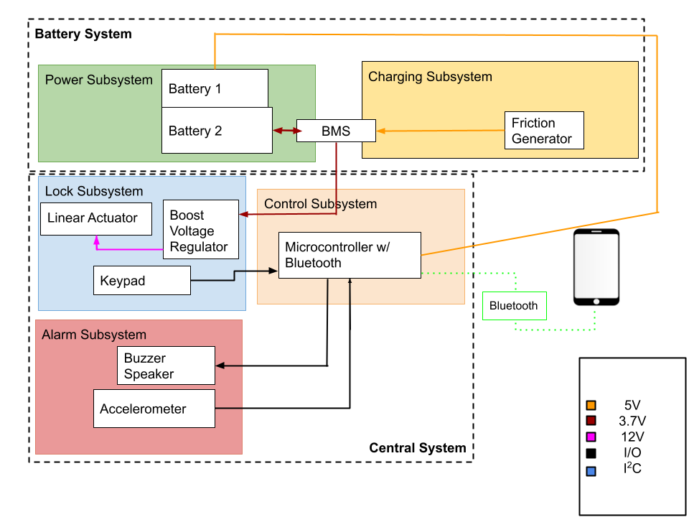
Design
Final Design
ELECTRICAL & COMPUTER ENGINEERING
GRAINGER ENGINEERING
Notes:
Paul

Slide 7
Design
Areas of Design that Changed
Original: microcontroller powers majority of our peripherals
Microcontroller has a limit of 3.3V and 200mA
Change: Power comes from the battery
Power Delivery
One battery -> Two battery
Restriction on charging and discharging simultaneously
Touch sensor -> keypad
Vibration sensor -> accelerometer
ELECTRICAL & COMPUTER ENGINEERING
GRAINGER ENGINEERING
Notes:
Jake
One battery -> Two battery
Since the NUCLEO-68 wouldn’t accept 1.8V-3.3V configuration
Restricted charging and discharging
Battery Management System considers this
Touch sensor -> keypad: Easier attachment
Vibration sensor -> accelerometer: More customization and control for sensitivity

Slide 8
Design
High Level Requirements
The bluetooth range of the device should be limited to about a 1 meter radius from the device, resulting in the ability to change the device by touching any one of the keys on the keypad
The self charging system should be able to generate 6 watts and be able to power the device through multiple trips
If there is not an established bluetooth connection to the device, the device’s state can be changed by inputting the correct pattern into the keypad
When in the locked state, the linear actuator should extend to its full length of 4 inches and prevent the front wheel from spinning, thus preventing someone from stealing the bike
ELECTRICAL & COMPUTER ENGINEERING
GRAINGER ENGINEERING
Notes:
Jake

Slide 9
Design
Control Subsystem Overview
STM32WB55RG with Bluetooth 5.0
Interfaces with the other subsystems:
Receives input from keypad
Receives data from accelerometer, interprets it, and sends signal to buzzer speaker
Sends signal to unlock/lock
ELECTRICAL & COMPUTER ENGINEERING
GRAINGER ENGINEERING
Notes:
Paul

Slide 10
Design
Control Subsystem Requirements
Bluetooth connection should have a reasonable range; ~1 meter
The microcontroller should be receive 3.3 - 3.6 Volts
240m
1m
ELECTRICAL & COMPUTER ENGINEERING
GRAINGER ENGINEERING
Notes:
Paul

Slide 11
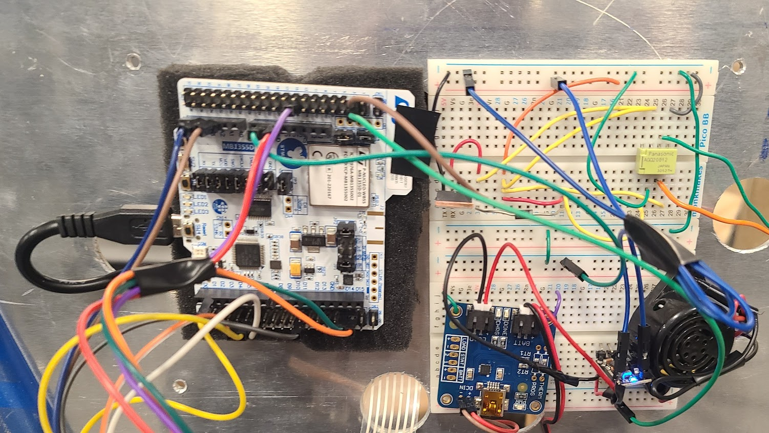
Project Build
Assembly - Control Subsystem
ELECTRICAL & COMPUTER ENGINEERING
GRAINGER ENGINEERING
Notes:
Paul

Slide 12
Test Results
Control Subsystem Test Results
Bluetooth Range Test:
Start 10 meters away
Walk a slowly closer, pausing
Record whenever a secure connection was made
Trial # | Bluetooth Range
1 | 2.5 meters
2 | 2.8 meters
3 | 2.5 meters
4 | 2 meters
5 | 1.8 meters
ELECTRICAL & COMPUTER ENGINEERING
GRAINGER ENGINEERING
Notes:
Paul

Slide 13
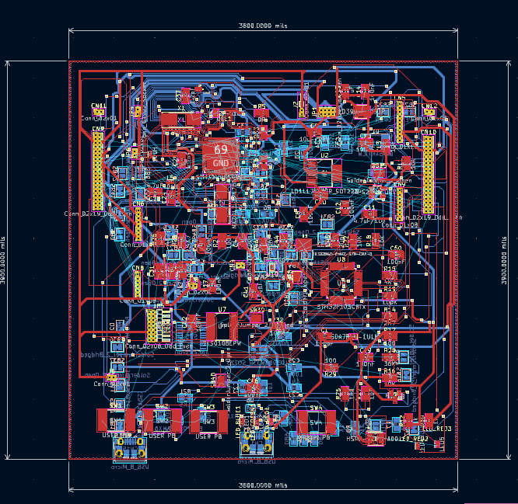
Project Build
Assembly - Control Subsystem - PCB
V1
Direct copy of the NUCLEO-68 development board.
Attempted to place all components of the PCB on two layers
ELECTRICAL & COMPUTER ENGINEERING
GRAINGER ENGINEERING
Notes:
Rithik

Slide 14
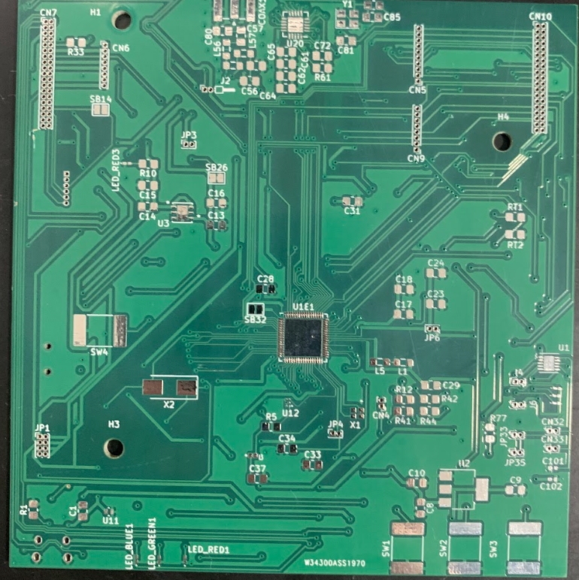
Project Build
Assembly - Control Subsystem - PCB
V2
NUCLEO-68 without the debugger portion
Four-layer design in order to optimize bluetooth functionality
ELECTRICAL & COMPUTER ENGINEERING
GRAINGER ENGINEERING
Notes:
Rithik

Slide 15
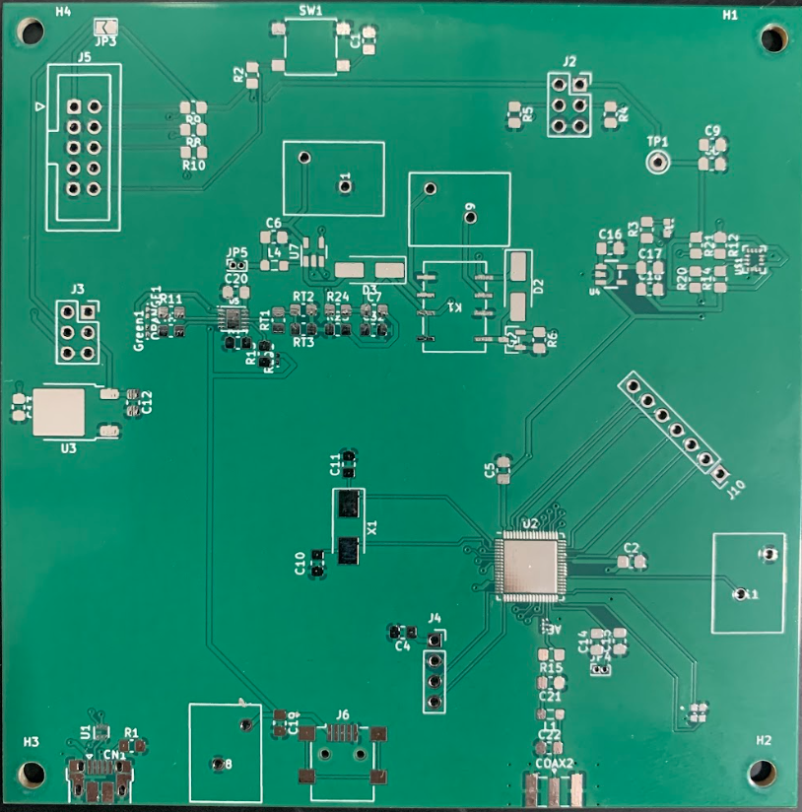
Project Build
Assembly - Control Subsystem - PCB
V3
Full redesign based on the Lora Router example from the ECE 445 Wiki
Reconfigured with necessary pinouts and with modules (BMS and accelerometer)
Debugger Header
Accelerometer
BMS
Relay
Keypad Pins
MCU
USB Power
BLE
ELECTRICAL & COMPUTER ENGINEERING
GRAINGER ENGINEERING
Notes:
Rithik

Slide 16
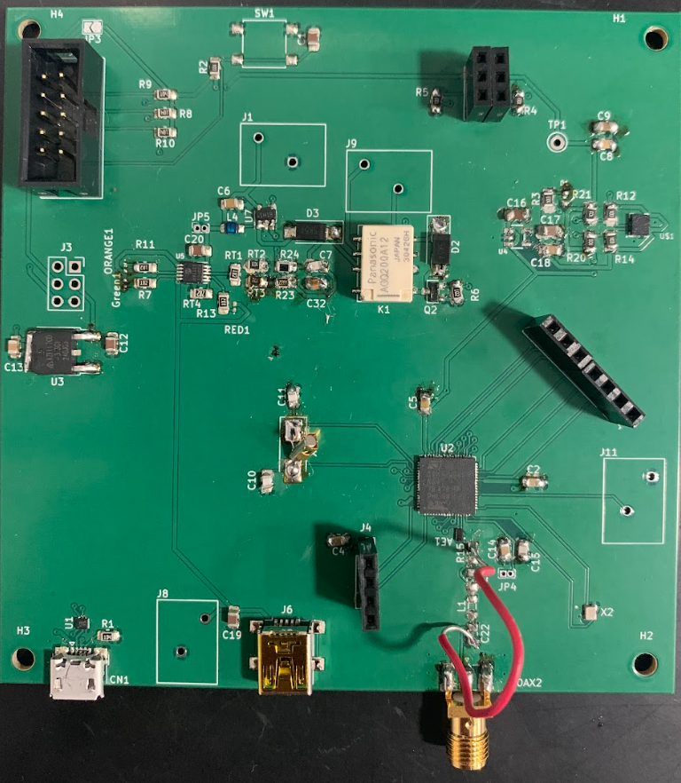
Project Build
Assembly - Control Subsystem - PCB
After some scheduling delays and issues with component logistics we were able to attempt soldering our PCB.
Debugger Header
Accelerometer
BMS
Relay
Keypad Pins
MCU
USB
BLE
ELECTRICAL & COMPUTER ENGINEERING
GRAINGER ENGINEERING
Notes:
Rithik

Slide 17
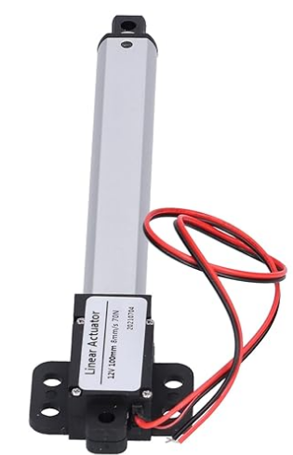
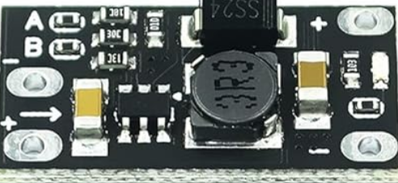
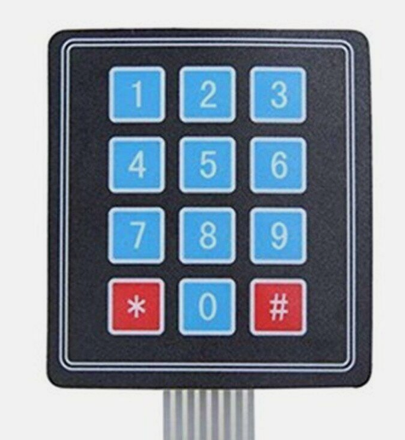
Design
Locking Subsystem Overview
Linear actuator
12V; 4 inch extension;
Boost voltage regulator
3.7V (battery voltage) boosted to 12V (linear actuator voltage)
Keypad
Set valid PIN and poll for entries
ELECTRICAL & COMPUTER ENGINEERING
GRAINGER ENGINEERING
Notes:
Jake

Slide 18
Design
Locking Subsystem Requirements
Boost voltage regulator must convert 3.7V (battery) to 12V (linear actuator)
Lock Operation with Bluetooth
Pressing the ‘#’ key must lock or unlock
Lock Operation without Bluetooth
Entering the valid key sequence and the ‘#’ key must lock or unlock
ELECTRICAL & COMPUTER ENGINEERING
GRAINGER ENGINEERING
Notes:
Jake

Slide 19
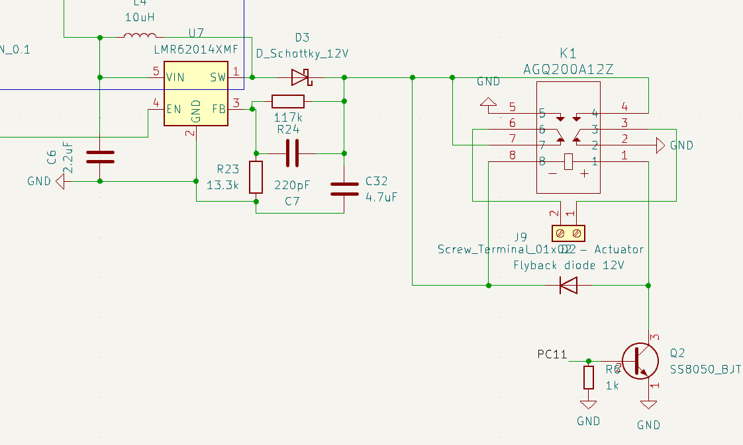
Project Build
Assembly - Locking Subsystem
3.7V
Voltage Booster
12V
Relay
Linear Actuator
Transistor Switch
GPIO Signal->
ELECTRICAL & COMPUTER ENGINEERING
GRAINGER ENGINEERING
Notes:
Jake

Slide 20
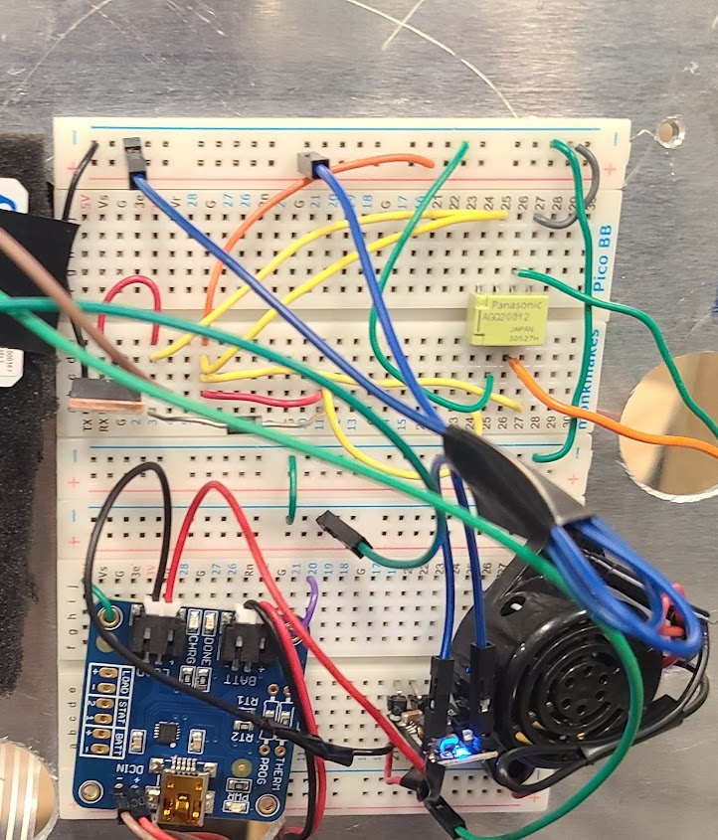
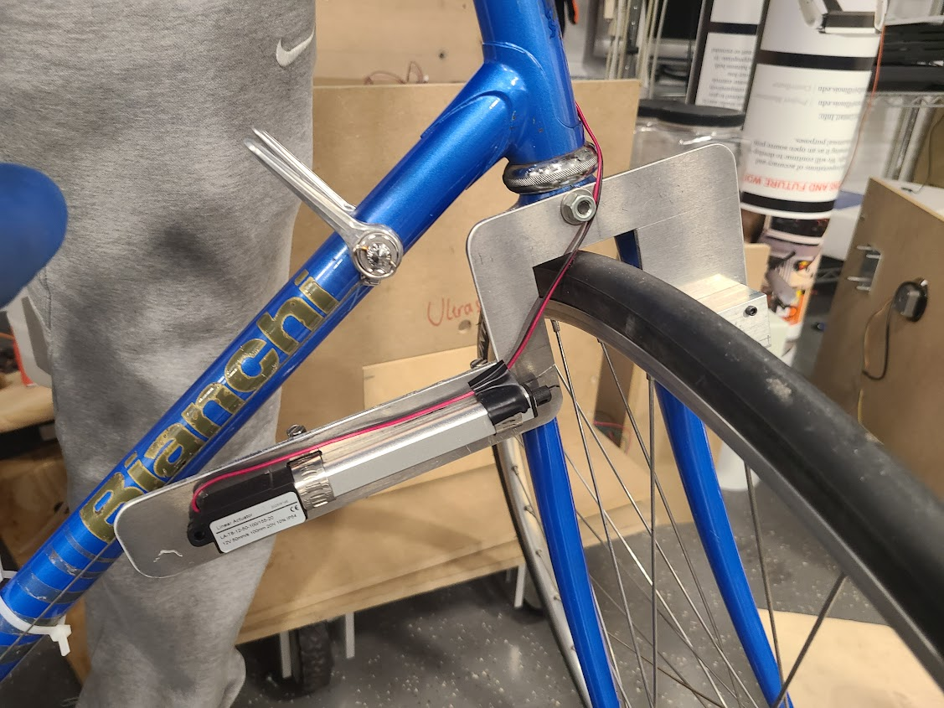
Project Build
Transistor
Relay
Voltage
Booster
Actuator
ELECTRICAL & COMPUTER ENGINEERING
GRAINGER ENGINEERING
Notes:
Jake

Slide 21
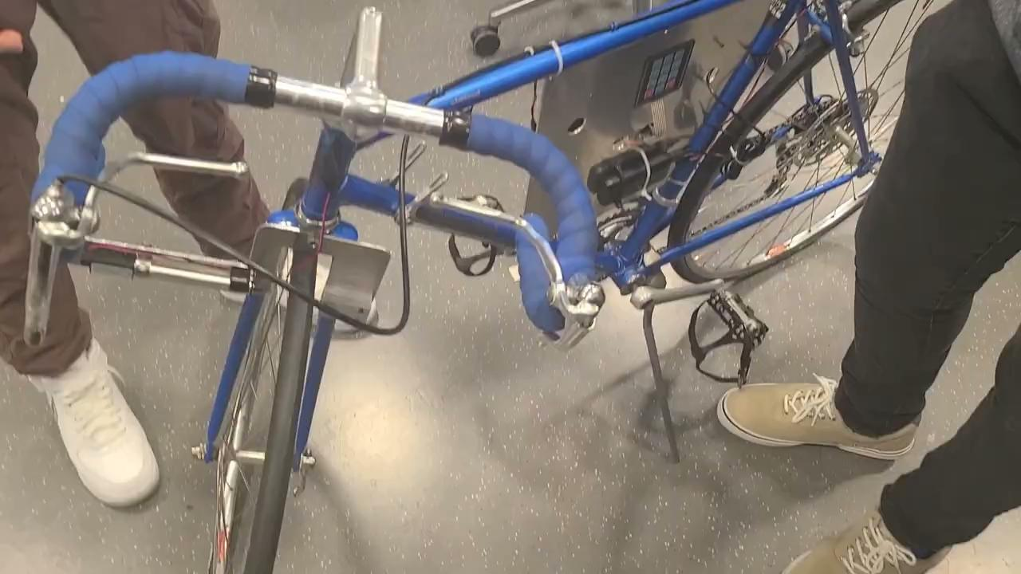
Demo Video
Locking Subsystem (Bluetooth)
ELECTRICAL & COMPUTER ENGINEERING
GRAINGER ENGINEERING
Notes:
Jake

Slide 22
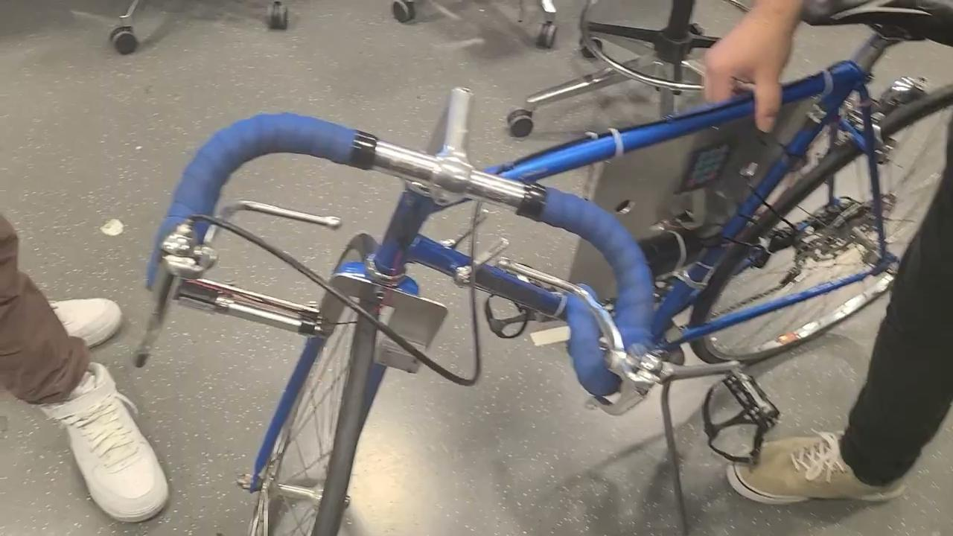
Demo Video
Locking Subsystem (without Bluetooth)
ELECTRICAL & COMPUTER ENGINEERING
GRAINGER ENGINEERING
Notes:
Jake

Slide 23
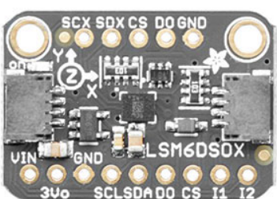
Design
Alarm Subsystem Overview
Accelerometer
measures acceleration data over time intervals
Buzzer alarm
uses a GPIO pin from the microcontroller as power (3.3V)
Alarm Subsystem Requirements
Should not trigger when there is negligible contact
bumping into the bike or wind
Should trigger when there is significant contact
pick up, shake, or fiddle with the bike
ELECTRICAL & COMPUTER ENGINEERING
GRAINGER ENGINEERING
Notes:
Paul

Slide 24
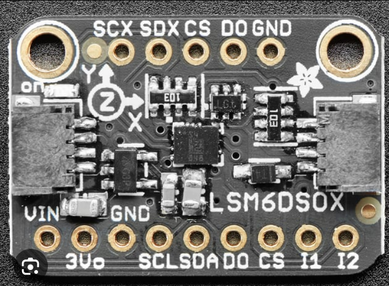
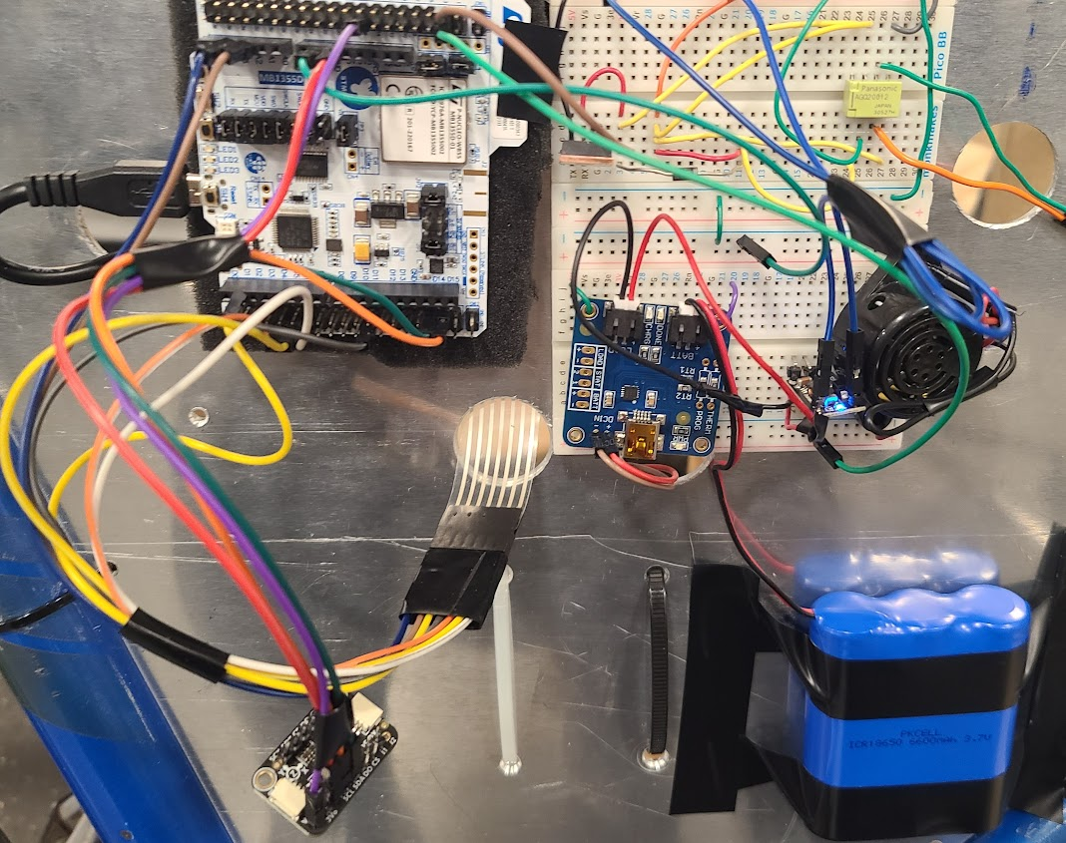
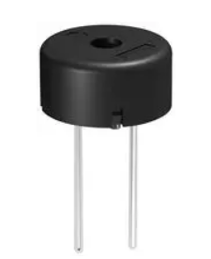
Project Build
Assembly - Alarm Subsystem
-
-
Buzzer Speaker
PB9
PB8
GND
3.3V
I2C
Accelerometer
GPIO GND
ELECTRICAL & COMPUTER ENGINEERING
GRAINGER ENGINEERING
Notes:
Paul

Slide 25
Test Results
Alarm Subsystem Test Results
Case: Slight movement Case: Continuous intense movement
Success Rate = 100%
Trial # | Alarm State
1 | Not Triggered
2 | Not Triggered
3 | Not Triggered
4 | Not Triggered
5 | Not Triggered
Trial # | Alarm State
1 | Triggered
2 | Triggered
3 | Triggered
4 | Triggered
5 | Triggered
ELECTRICAL & COMPUTER ENGINEERING
GRAINGER ENGINEERING
Notes:
Jake

Slide 26
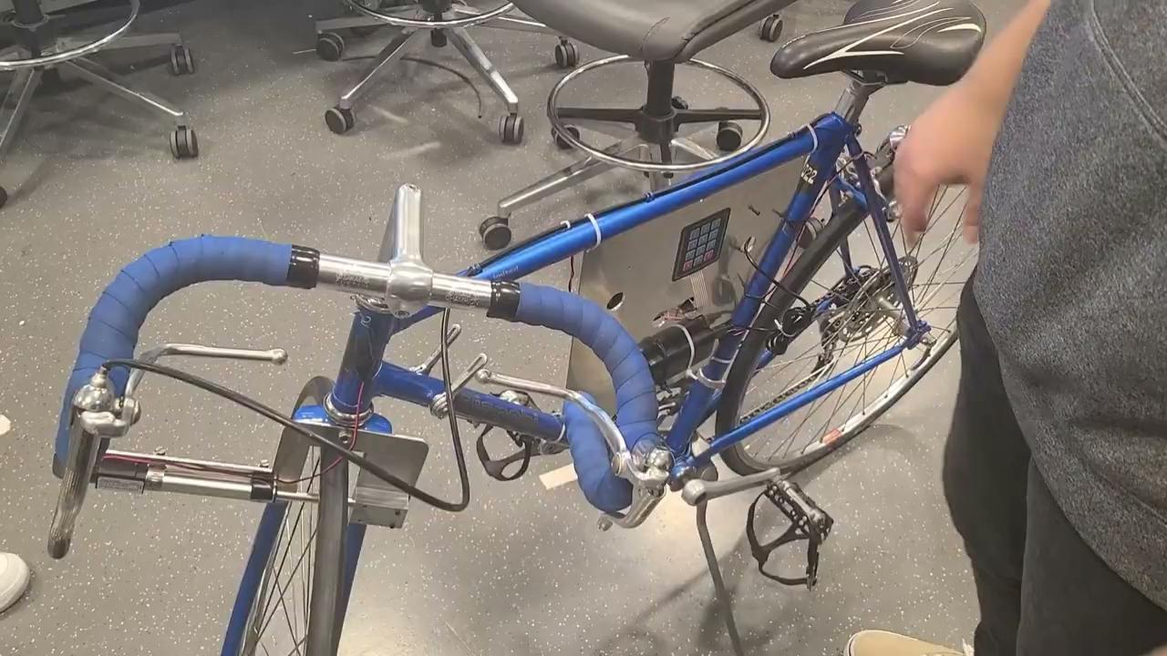
Demo Video
Alarm Subsystem
ELECTRICAL & COMPUTER ENGINEERING
GRAINGER ENGINEERING
Notes:
Jake

Slide 27
Design
Power Subsystem Overview
Friction Generator
Battery Management System Module
Battery Pack (5V)
Battery Pack (3.7V)
NUCLEO-68
ELECTRICAL & COMPUTER ENGINEERING
GRAINGER ENGINEERING
Notes:
Rithik
Friction Generator
Attached to the rear wheel
Battery Management System: USB LiIon/Lipoly Charger
Regulates charging and discharging concurrently
Manages consistent linear charging and discharging
USB charging option
Battery Pack: LiIon 3.7V 6600mAh
Powers the linear actuator mediated by a voltage booster
Also intended to power the PCB/Nucleo

Slide 28
Design
Power Subsystem Requirements
Friction Generator
Supply 6 Watts at 12V and 100mA to 500mA
BMS USB LiIon/LiPoly Charger
Should show adequate charging of the battery pack
Must take inconsistent power input from the friction generator and linearize it
Lithium-Ion Battery Pack
Must adequately power the product
ELECTRICAL & COMPUTER ENGINEERING
GRAINGER ENGINEERING
Notes:
Rithik

Slide 29
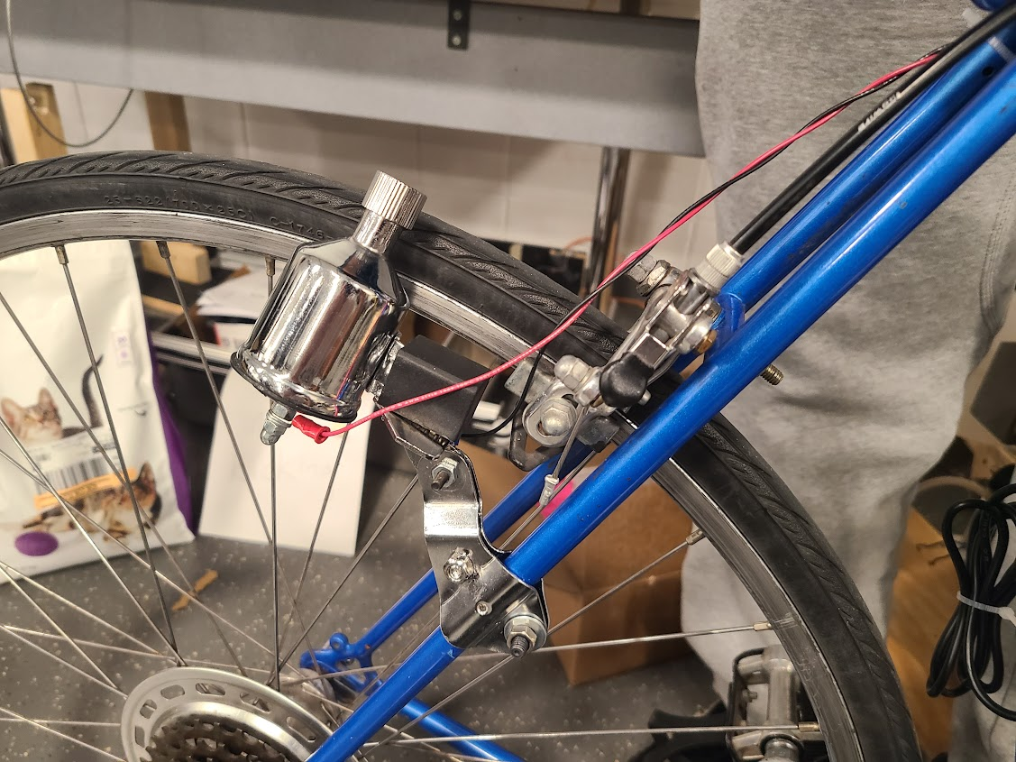
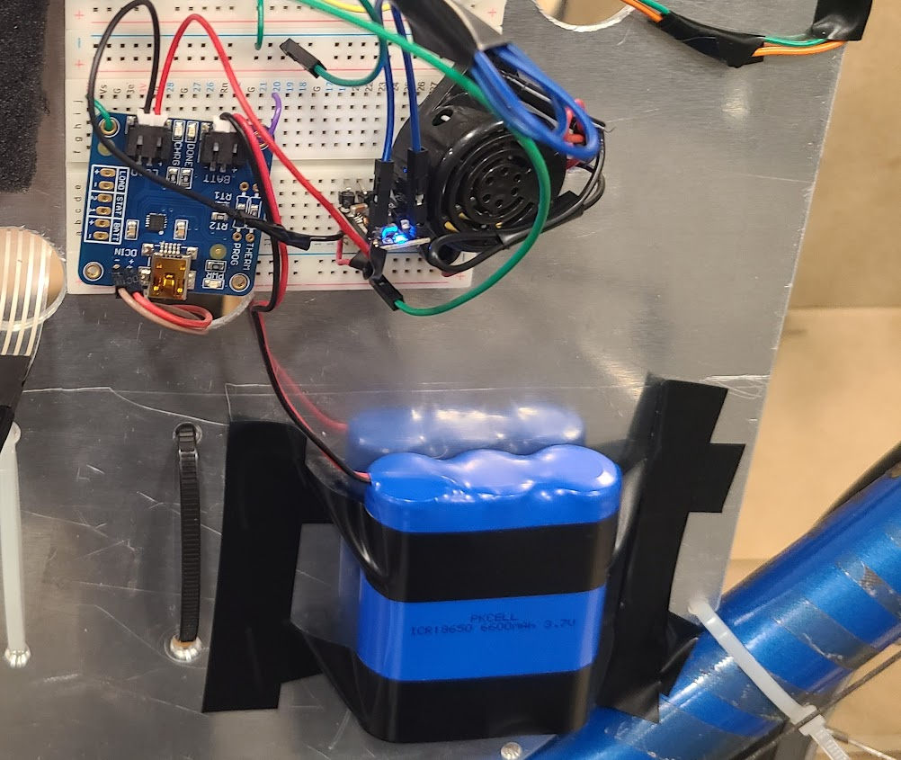
Project Build
Battery Management System
Assembly - Power Subsystem
Friction Generator
Battery
ELECTRICAL & COMPUTER ENGINEERING
GRAINGER ENGINEERING
Notes:
Rithik

Slide 30
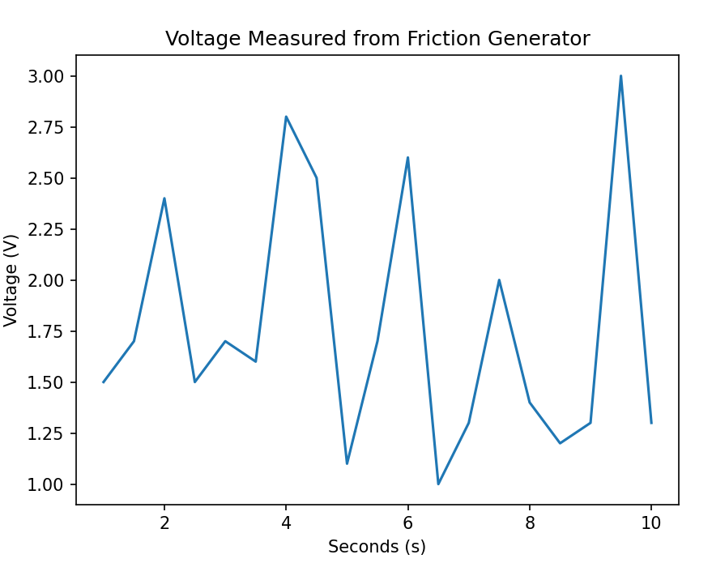
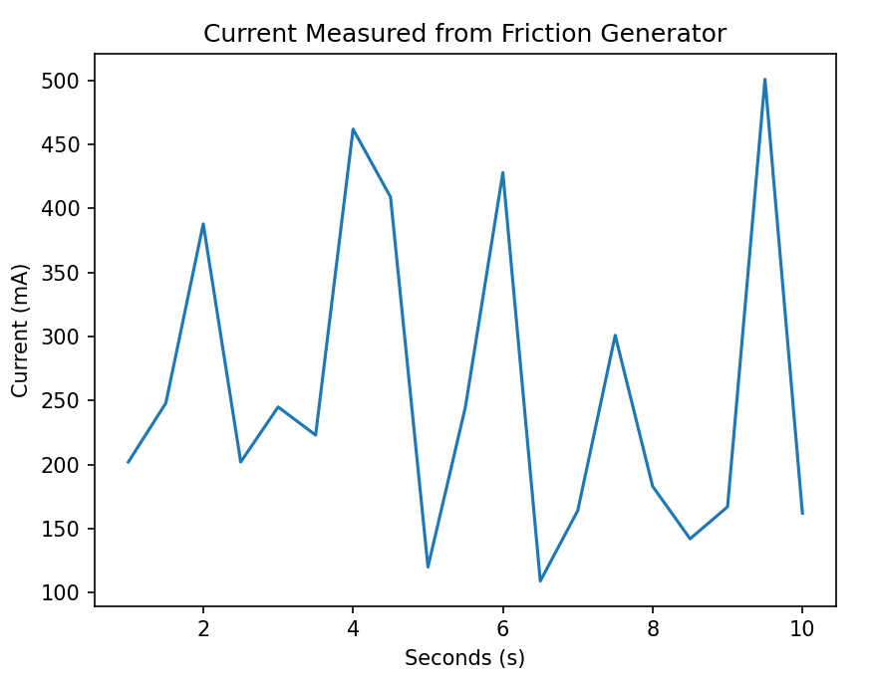
Test Results
Power Subsystem Test Results
ELECTRICAL & COMPUTER ENGINEERING
GRAINGER ENGINEERING
Notes:
Rithik

Slide 31
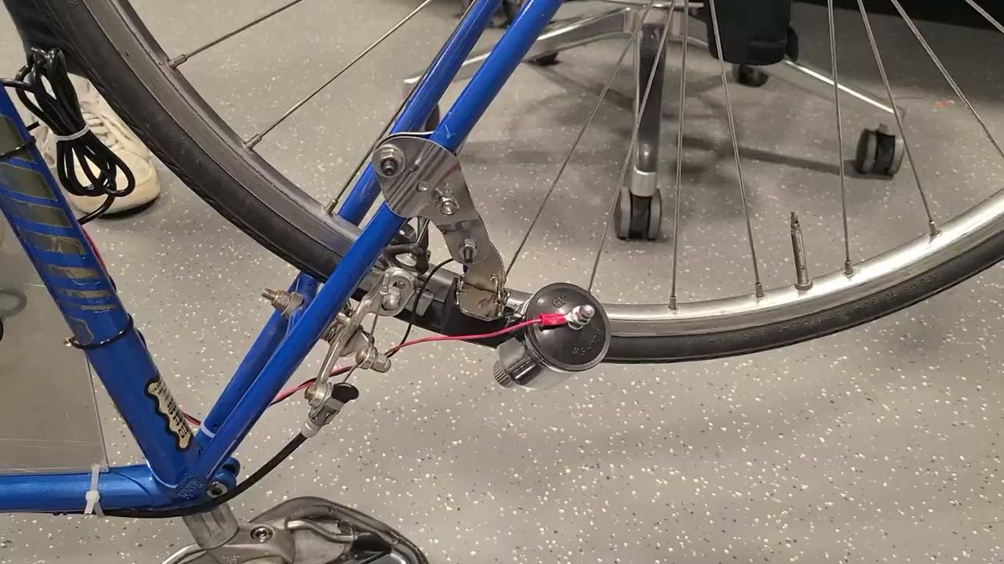
Demo Video
Power Subsystem
ELECTRICAL & COMPUTER ENGINEERING
GRAINGER ENGINEERING
Notes:
Rithik

Slide 32
Recommendation for Further Work
Modular Design
A universal and modular clamping system to attach to bikes
Ease of use for the customer
Software Design
Implement alarm deactivation by BLE connection or correct PIN
Currently the alarm runs for 10 sec
To increase security
ELECTRICAL & COMPUTER ENGINEERING
GRAINGER ENGINEERING
Notes:
Jake

Slide 33
Conclusion - What Did We Learn
Modularity of Design
Researching module and example circuits
Interfacing with software component
PCB Design
Circuit schematic design
Routing, 4-layers, 50 ohm BLE Trace
STM32 Software
STM32CubeIDE (coding environment) and STM32CubeMX (Preset configurations)
Sequencer (STM32’s serial scheduler implementation)
ELECTRICAL & COMPUTER ENGINEERING
GRAINGER ENGINEERING
Notes:
Jake/Rithik/Paul

Slide 34
Conclusion - What Would We Do Differently
PCB Design Reflection
First, design the project on breadboard with MCU and modules
Ensures clarity on what components and connections are necessary
Either integrate modules one by one on the same board or create separate PCBs for modules
Ease of testing, debugging, and revising
Order SMD parts far in advance
Multiple missing and wrong parts on the first order
ELECTRICAL & COMPUTER ENGINEERING
GRAINGER ENGINEERING
Notes:
Jake/Paul/Rithik

Slide 35
Q&A
Any questions?
ELECTRICAL & COMPUTER ENGINEERING
GRAINGER ENGINEERING

Slide 36
Thank you!
Thanks for listening!
We would like to thank our TA Jason Zhang, our Professor Victoria Shao, and head TA Jason Paximadas for providing feedback and advice on our project!
We would also like to thank Jordan and Gregg from the machine shop for helping with the mechanical components of our project!
ELECTRICAL & COMPUTER ENGINEERING
GRAINGER ENGINEERING

