Slide 1
Integrated Brushless Motor Exploration Platform
Alex Roberts, Jason Vasko
Team 17
Notes:
Presenter: Alex
you can just say your name when we intro Jason

Slide 2
Agenda
Problem and Solution
Hardware
BLDC Theory
Design Overview
Subsystem Dive
Software
Motor Control Algorithms
Software Design
Results
Challenges
Further Work
Notes:
Presenter: Alex

Slide 3
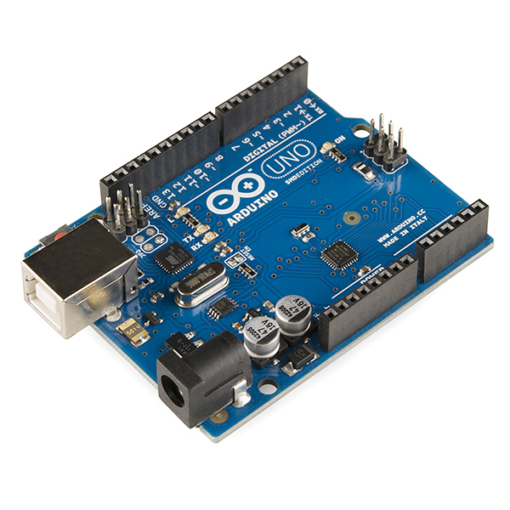
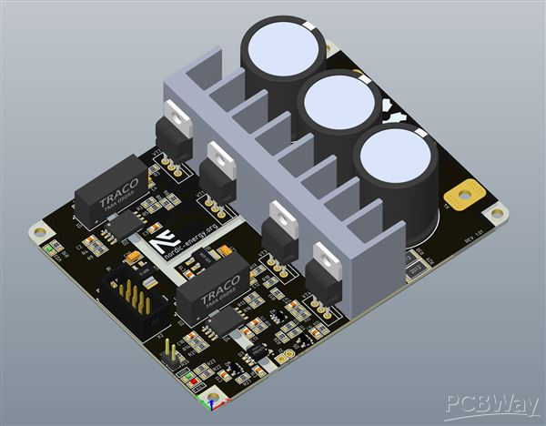
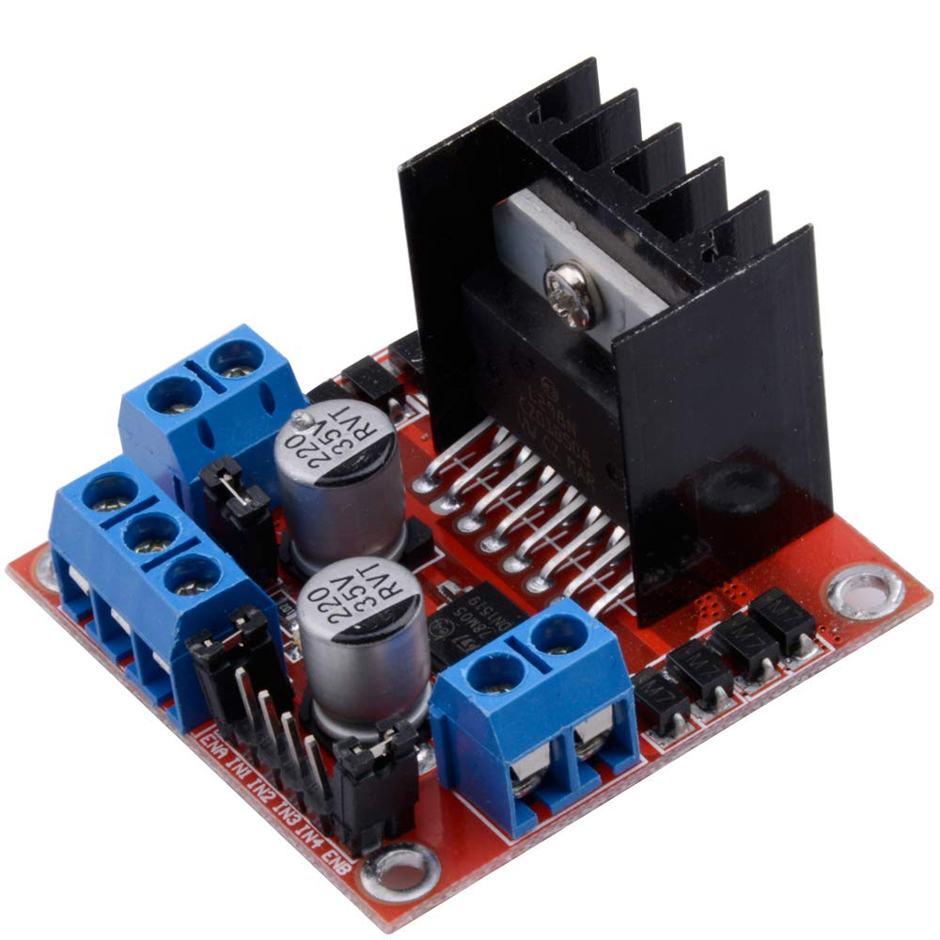
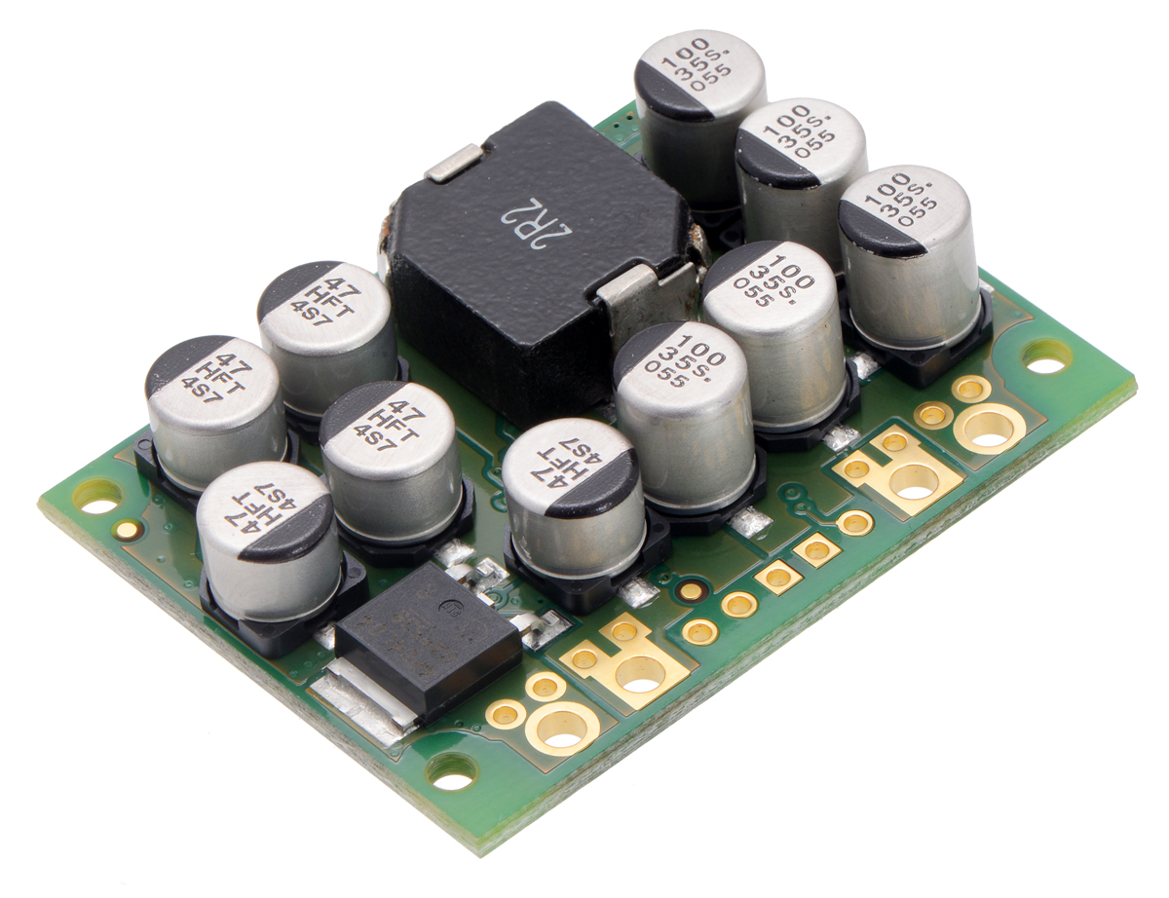
Problem
Motors are becoming more common with robotics, EVs, and automation
Few integrated motor prototyping solutions
Typically need lots of electronics experience to choose and combine modules
Microcontroller
Voltage Regulator
Half-bridge
H-bridge
Notes:
Presenter: Alex

Slide 4
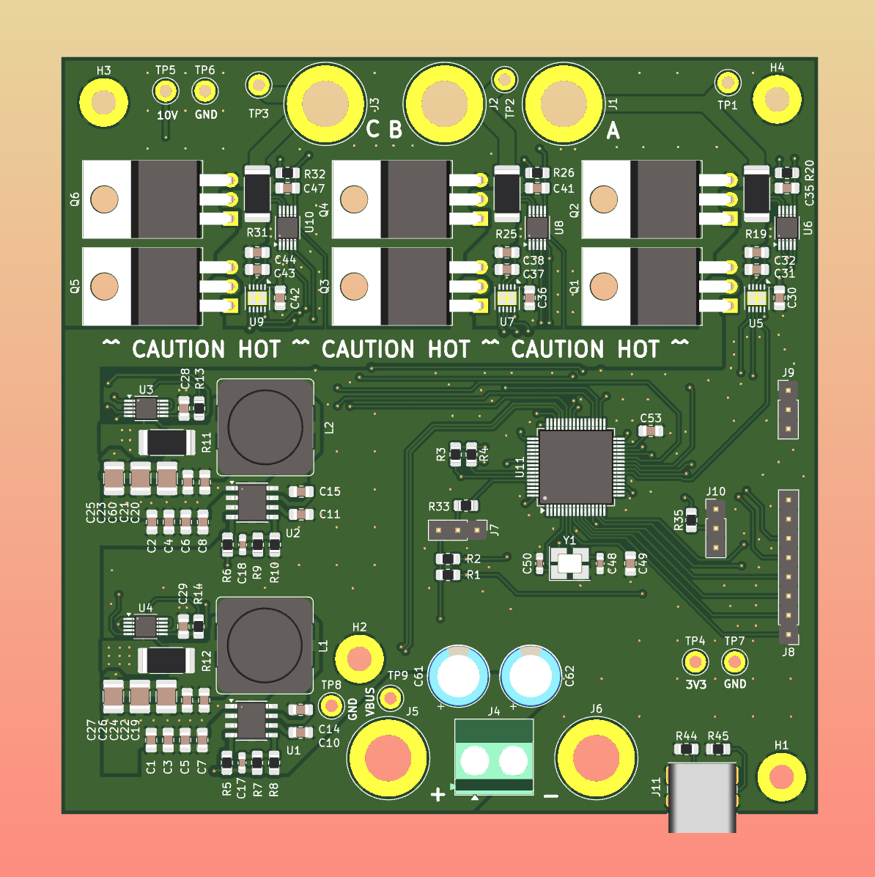
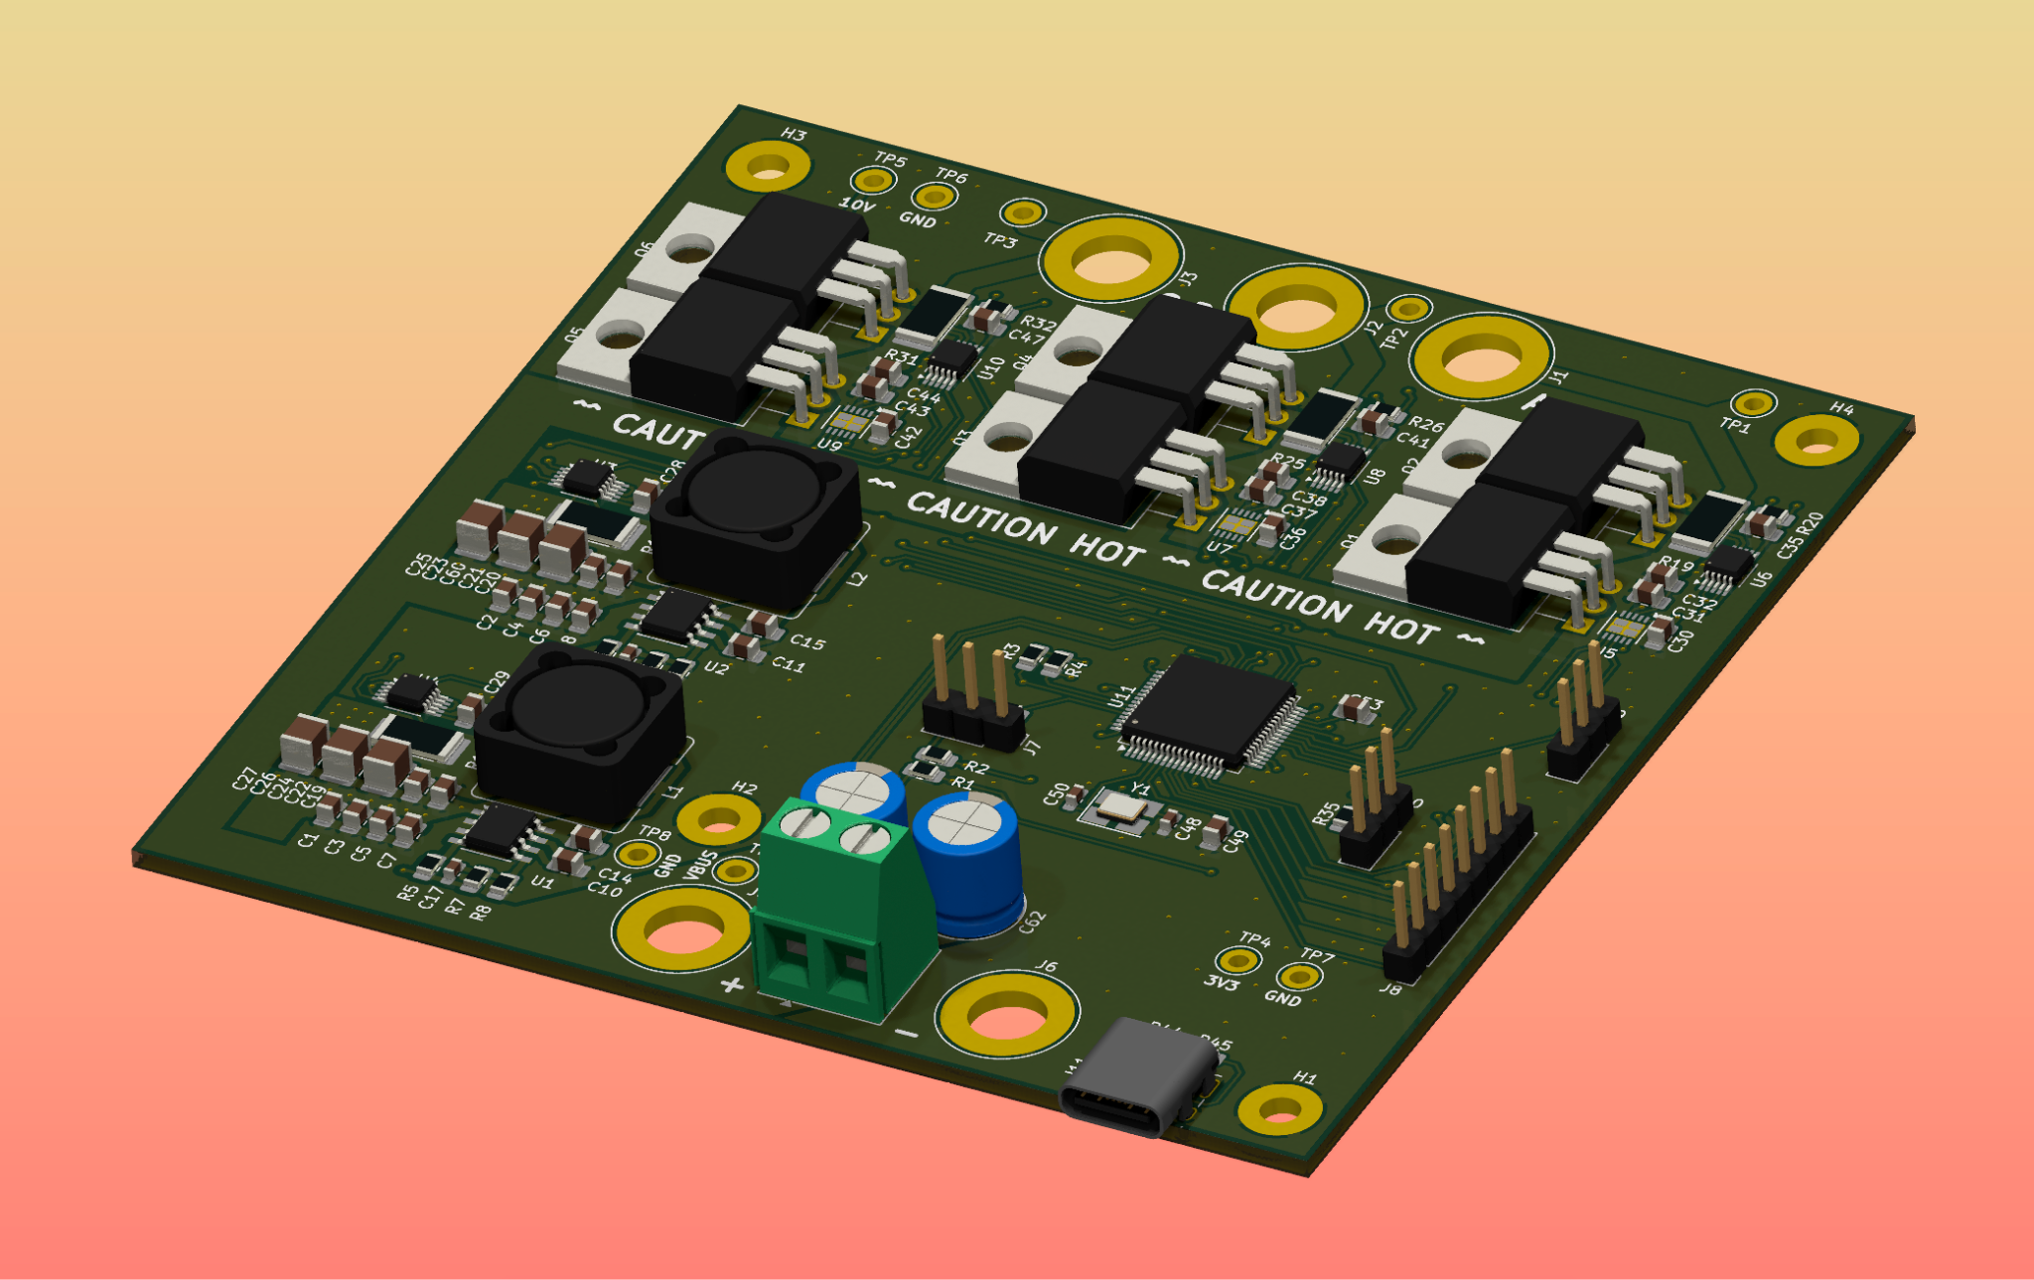
Solution
Integrated platform to drive (BLDC) motors with a single PCB
Sandbox to explore motors and control algorithms
Provides starting point to learn hardware theory second
Notes:
Presenter: Jason

Slide 5
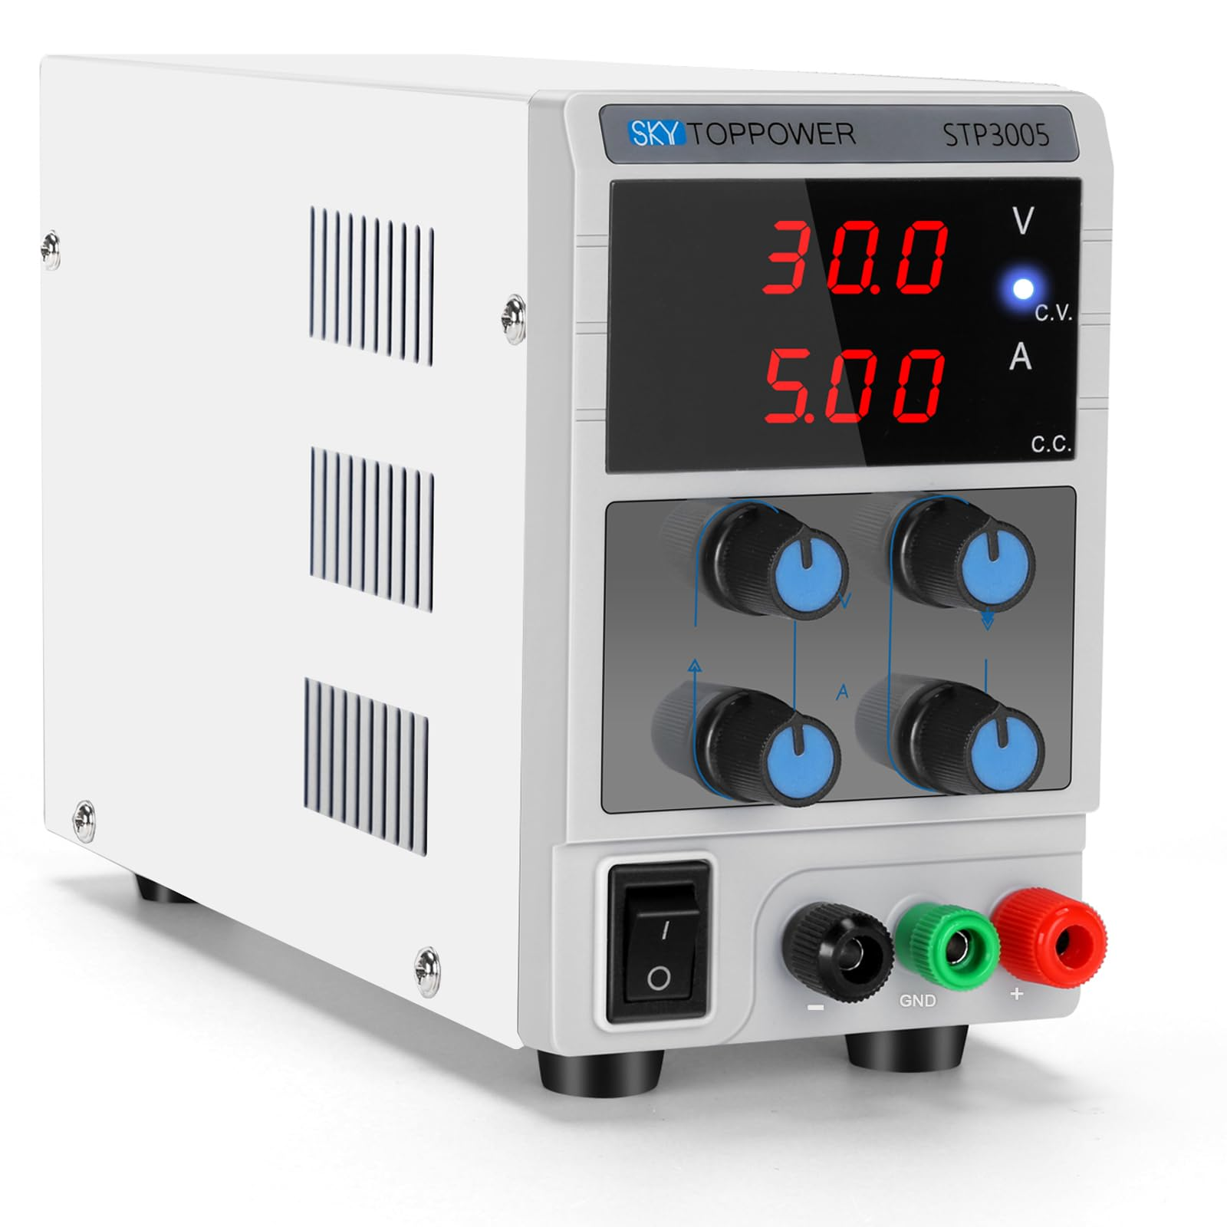
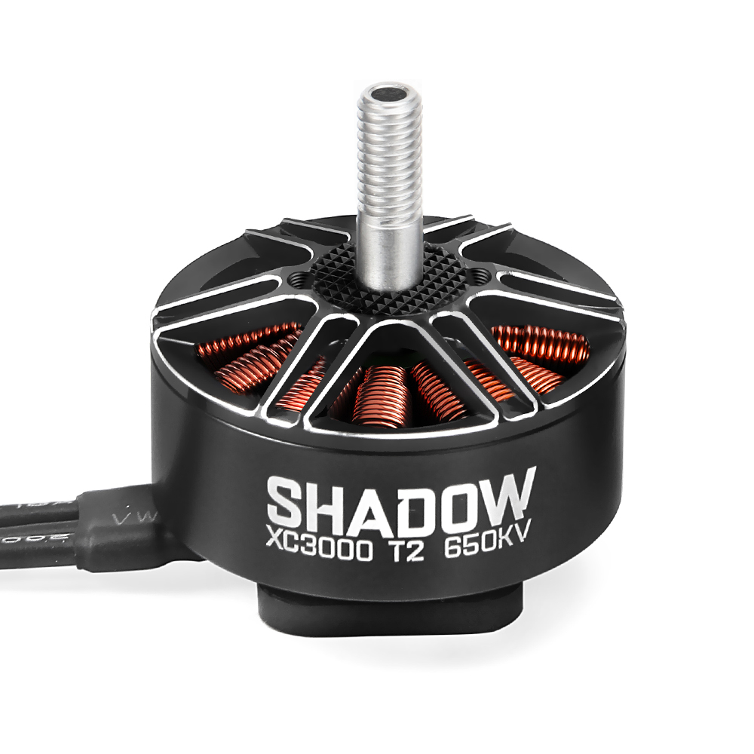
Solution In Use
Power
3 Phases
GUI Software
USB
Notes:
Presenter: Jason
my idea for the slide was to just explain the connections, and emphasize that we try to simplify the connections as much as possible

Slide 6
High-Level Requirements
Motor operation and control
Start, stop, control speed
Configurability
Trapezoidal and sinusoidal algorithms
Motor performance and system health monitoring
Phase voltages/currents, power consumption
Notes:
Presenter: Jason

Slide 7
Hardware
BLDC Theory and System Design
Notes:
Presenter: Alex

Slide 8
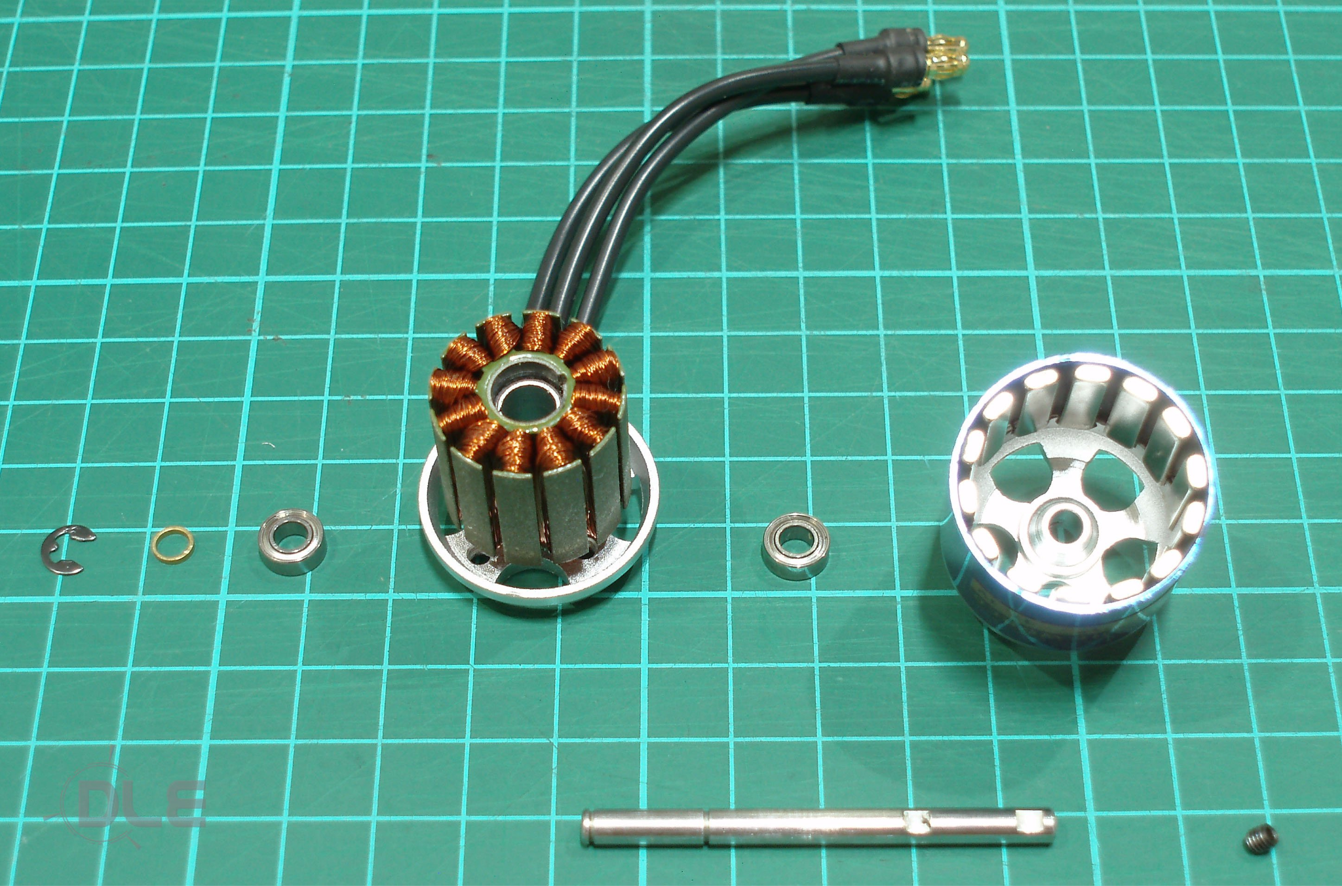
BLDC Motor Construction
Stator -> Stays, has coils
Rotor -> Rotates, has magnets
3 wires are 3 “phases” (A, B, and C)
ROTOR
STATOR
Notes:
Presenter: Alex

Slide 9
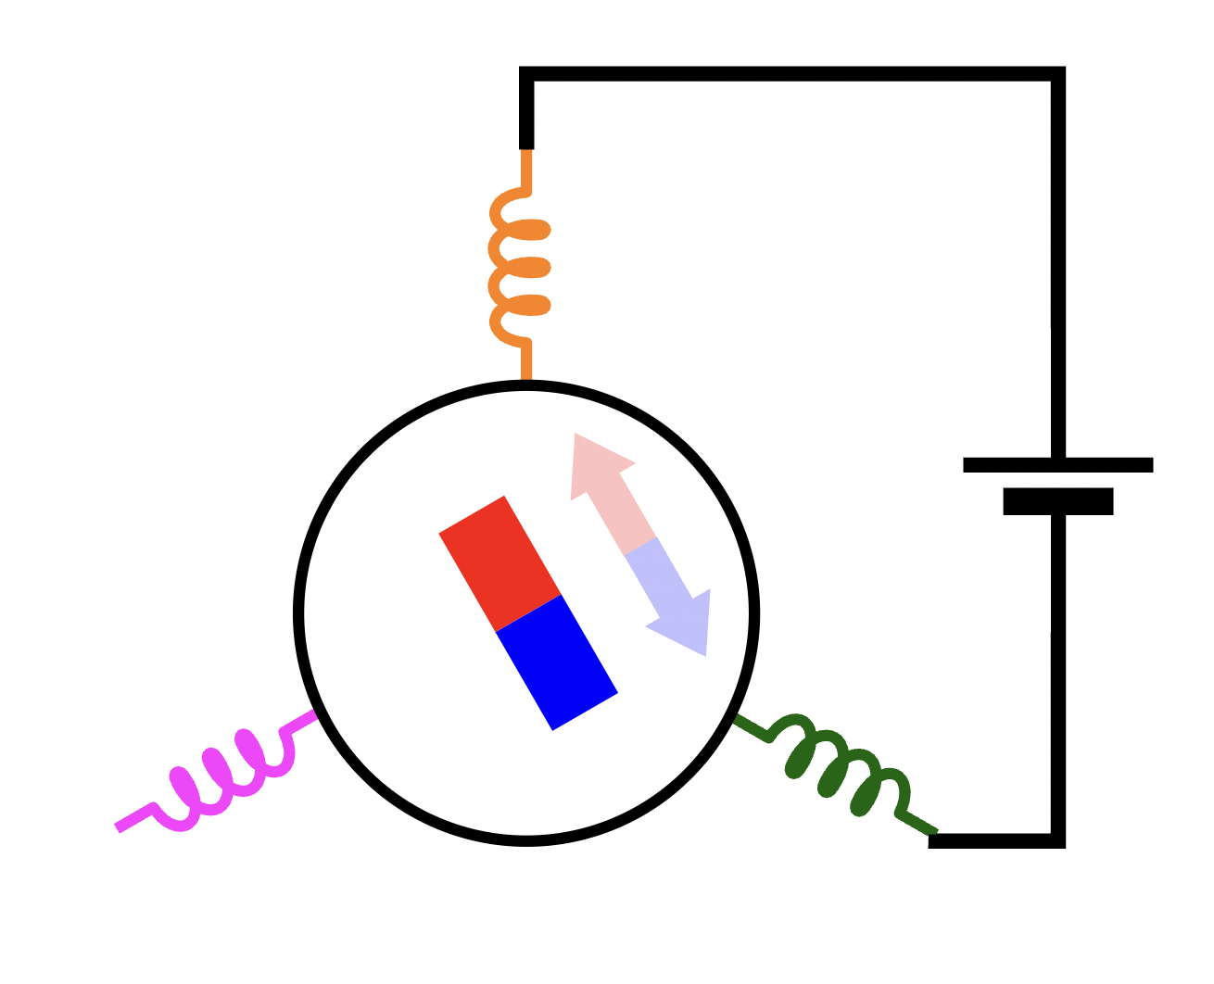
BLDC Motor Theory
Notes:
Presenter: Alex
This and the following slides will be pretty fast

Slide 10
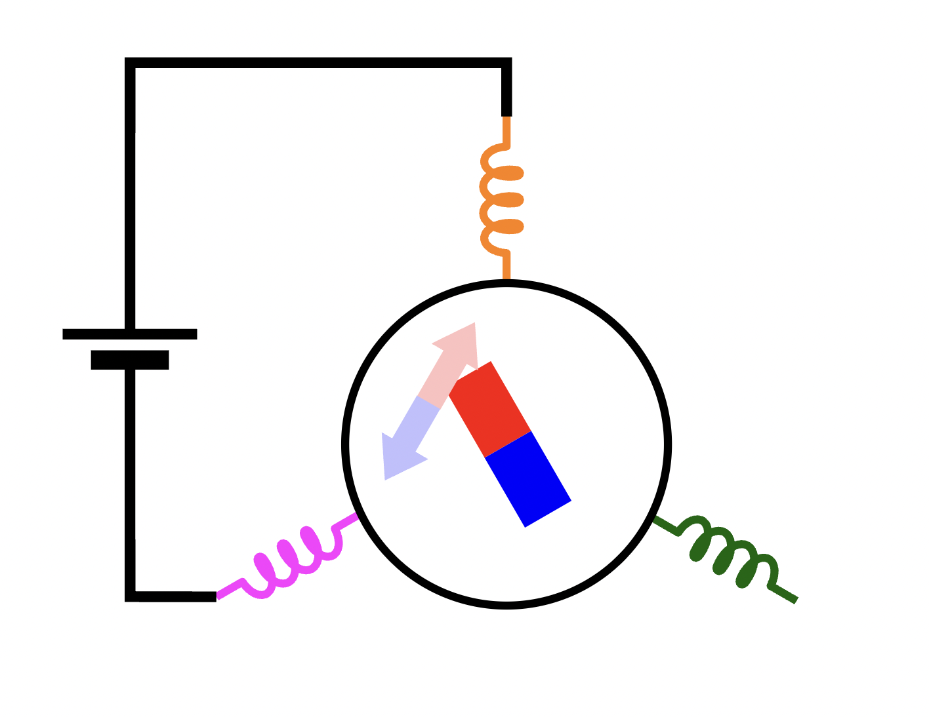
BLDC Motor Theory
Notes:
Presenter: Alex

Slide 11
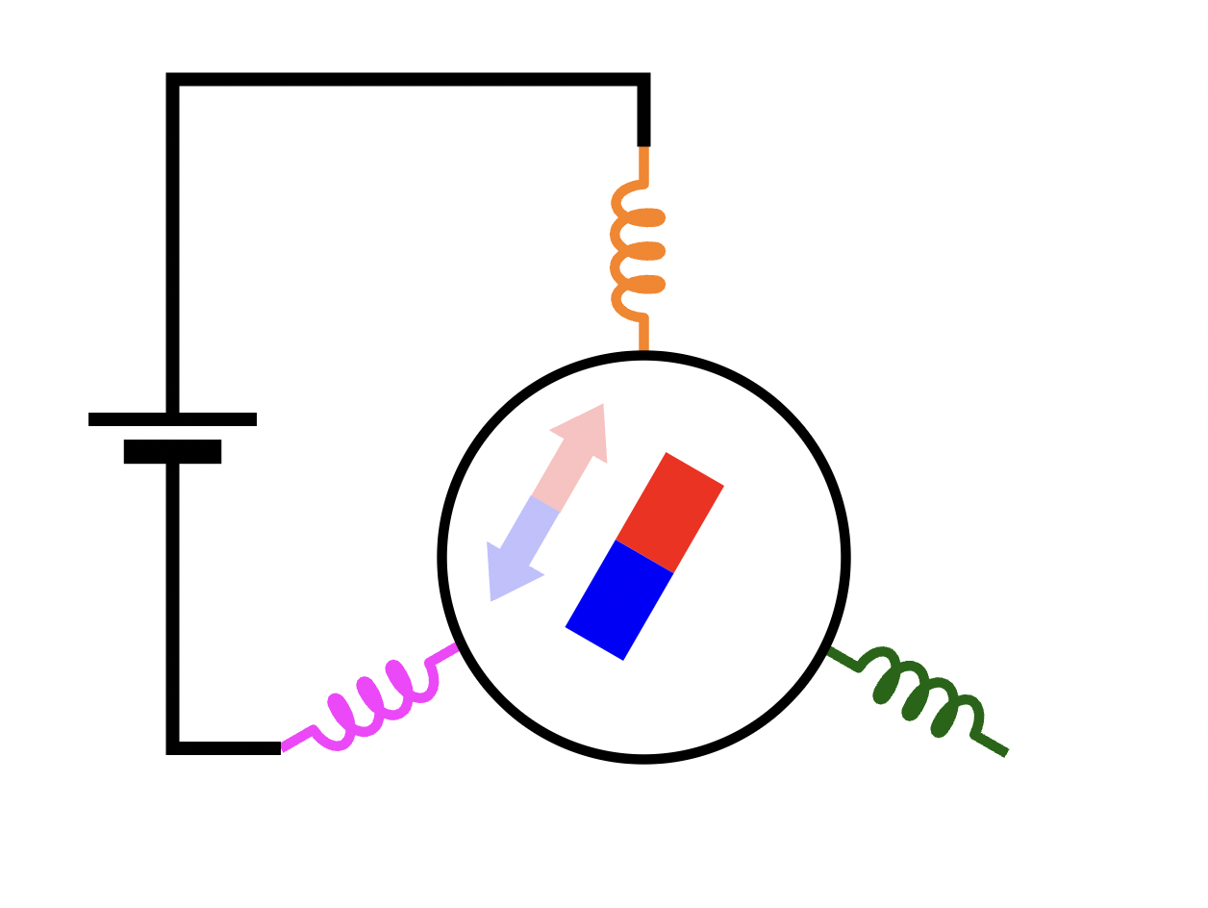
BLDC Motor Theory
Notes:
Presenter: Alex

Slide 12
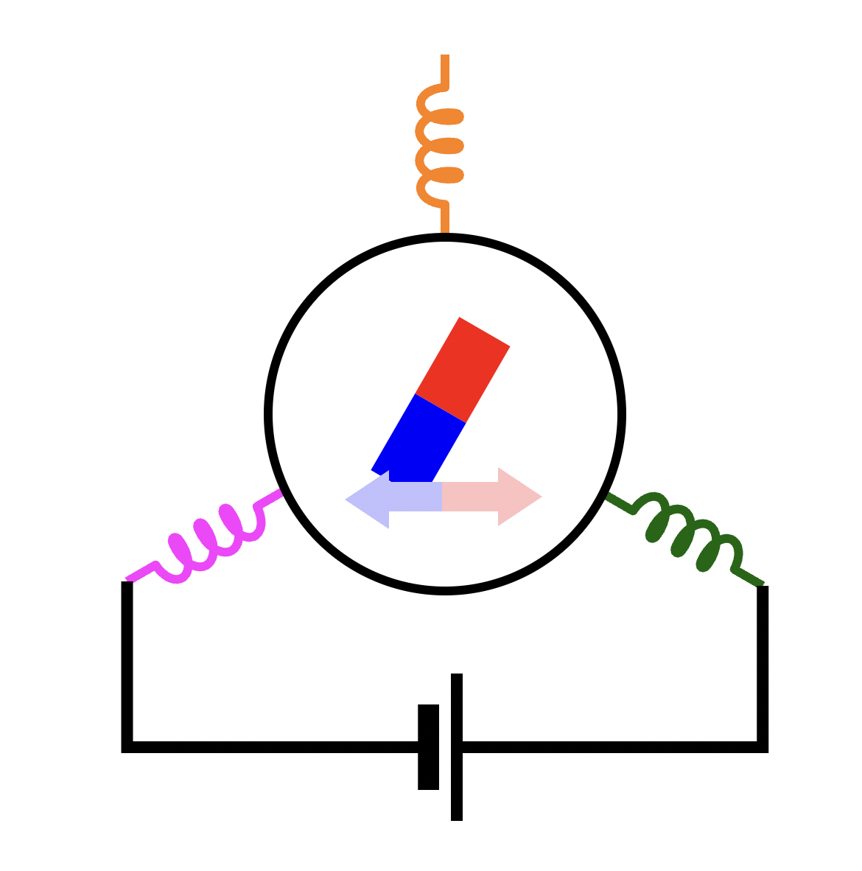
BLDC Motor Theory
Notes:
Presenter: Alex

Slide 13
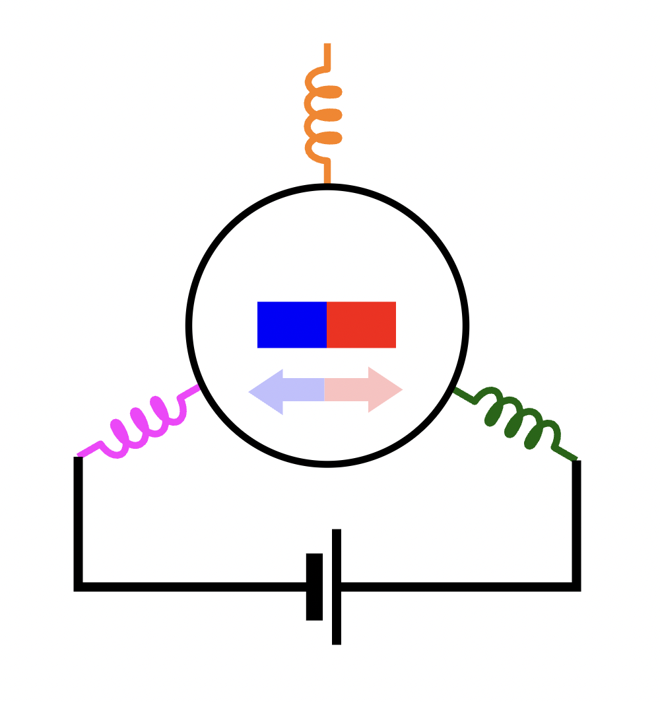
BLDC Motor Theory
Notes:
Presenter: Alex

Slide 14
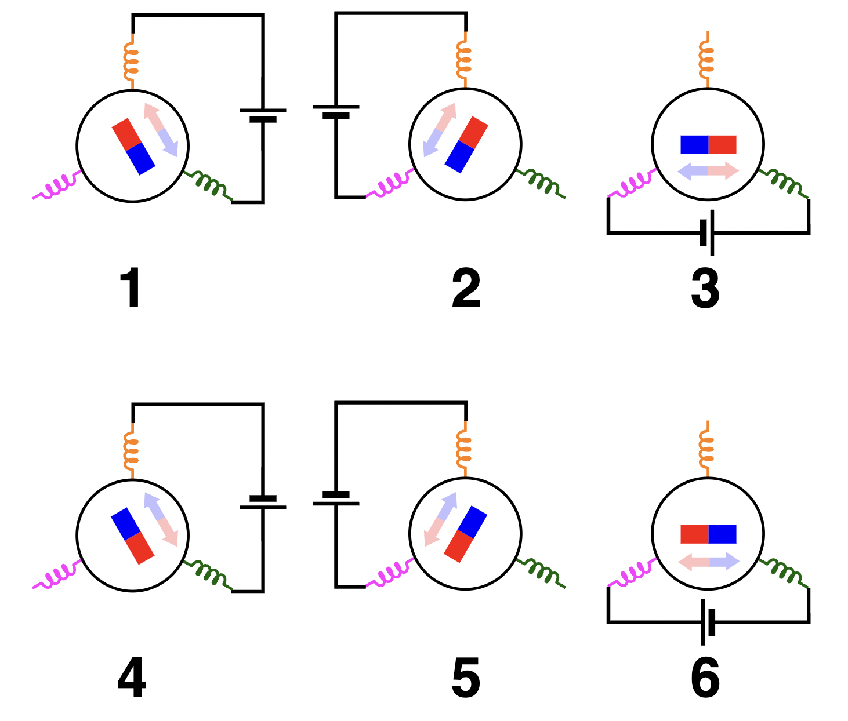
BLDC Motor Theory
Simplest drive (trapezoidal) has 6 discrete states.
Advanced drives typically don’t require vastly different hardware, only control.
Notes:
Presenter: Alex
I’m going to mention that this is trapezoidal drive, which is the simplest control algorithm. There are more advanced algorithms too (which we discuss later), but they only really require better control, not better hardware

Slide 15
BLDC Motor Theory
Takeaways for circuit
Each phase needs these abilities:
Connection to VBUS
Connection to GND
High-Z state
Precise Timing and Synchronization
Each phase is independent -> can parallelize circuit
Notes:
Presenter: Alex

Slide 16
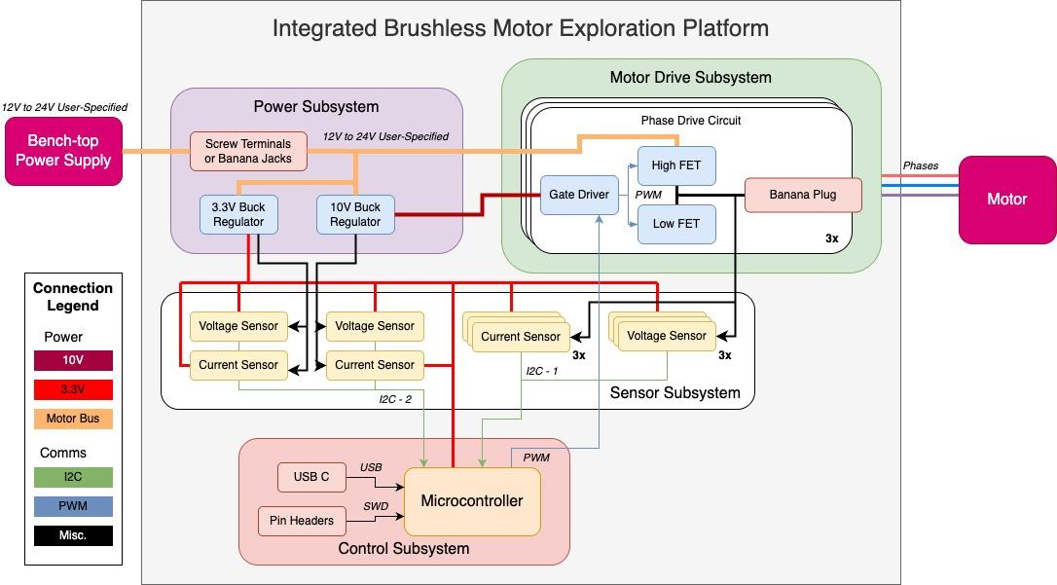
Block Diagram
Notes:
Presenter: Jason?
since I had so many slides in a row can you take this one?
This should just be a quick view of the block diagram, literally just introducing the four main subsystems, like one comment on what they do each, before we dive into the subsystems themselves.

Slide 17
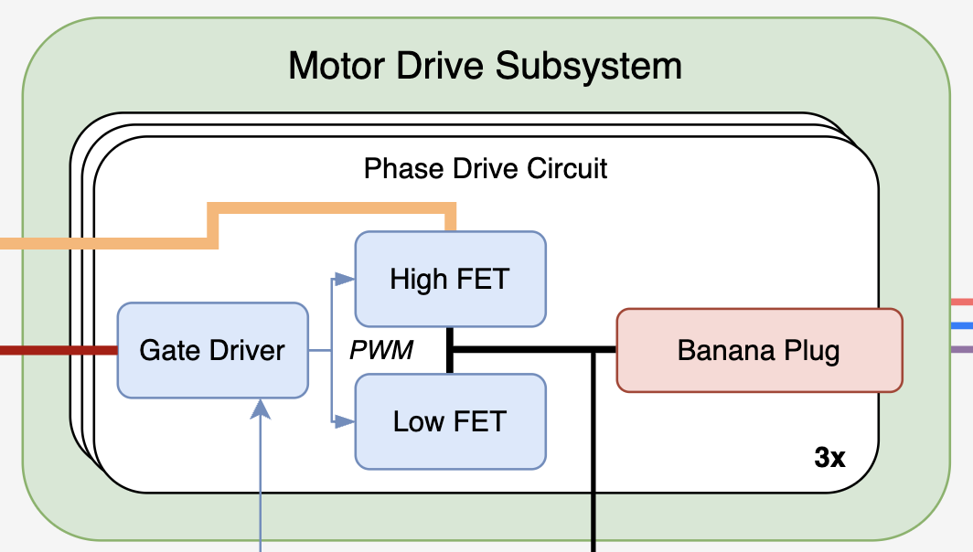
Motor Drive Subsystem
Purpose: to generate the three motor phase waveforms
Requirements:
Operates on 12-24V motor bus input
Can generate trapezoidal and sinusoidal phase waveforms
Prevent MOSFET shoot-through and ensure 2ns of dead time minimum
Phases need >100kHz max PWM frequency
Notes:
Presenter: Alex
I moved this subsystem first since it informs much of the rest of the design

Slide 18
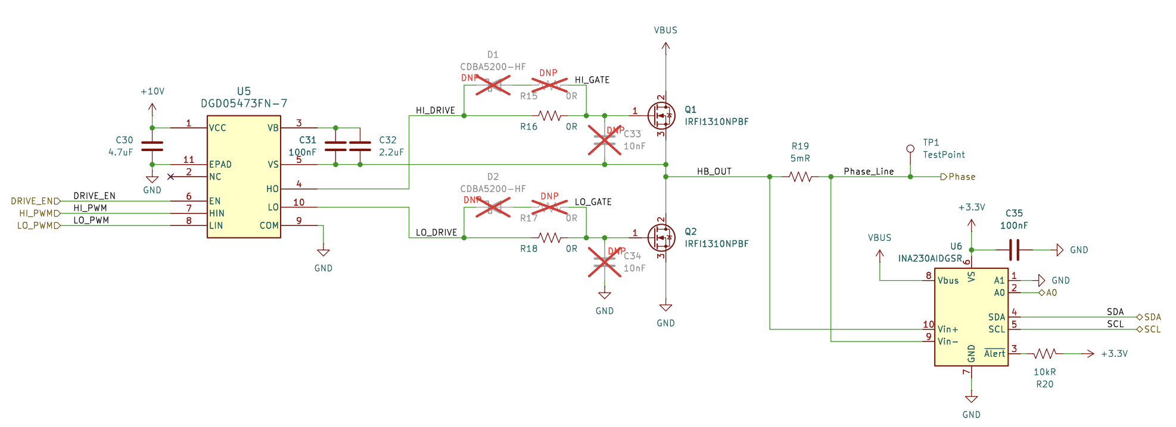
Motor Drive Subsystem
Requirements
12-24V input
Trap and sine output
Shoot-through and dead time
>100kHz max PWM frequency
Notes:
Presenter: Alex
I am going to talk through this more than we did in the mock pres

Slide 19
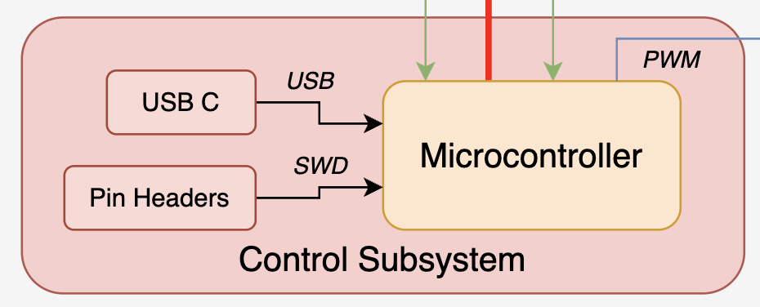
Control Subsystem
Purpose: to control and monitor all other subsystems
Requirements:
Program/debug MCU over SWD
Program MCU over USB-C
MCU reports data to GUI in real time (>1Hz update rate, <500ms latency)
Failed connection between GUI and PCB should stop motor within 2 seconds
Notes:
Presenter: Jason

Slide 20
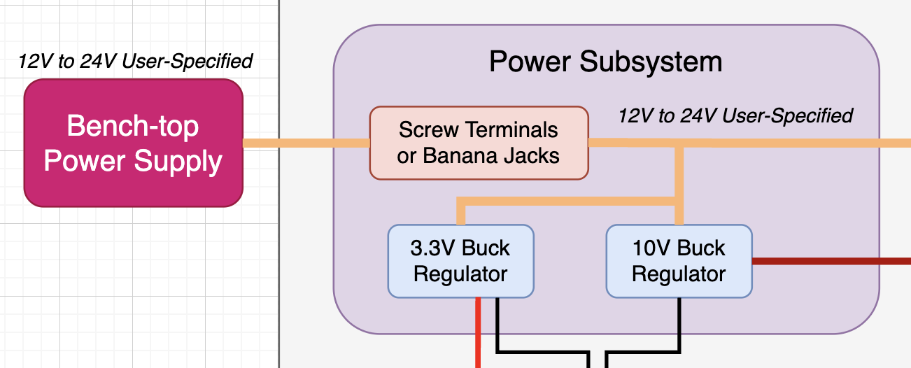
Power Subsystem
Purpose: generate 3.3V and 10V power rails
Requirements:
All voltages generated on PCB
All voltages should have accuracy of +/-5% around their set-point
PCB should accept any input voltage in the range 12-24V
Notes:
Presenter: Alex

Slide 21
Sensing Subsystem
Purpose: to report data related to motor functionality and system health to GUI
3-phase voltage and current measurements within ±150mV and ±100mA
Any voltage rail should have voltage, current, and power reported (±5%)
Motor speed should be collected through an encoder or back-EMF within ±10% of true rpm value
Notes:
Presenter: Jason

Slide 22
Power Subsystem
Notes:
Presenter: Alex

Slide 23
Block Diagram
Notes:
Presenter: Alex
I can reiterate the block diagram now, emphasizing how the subsystems connect to one another and giving a general flow of the PCB

Slide 24
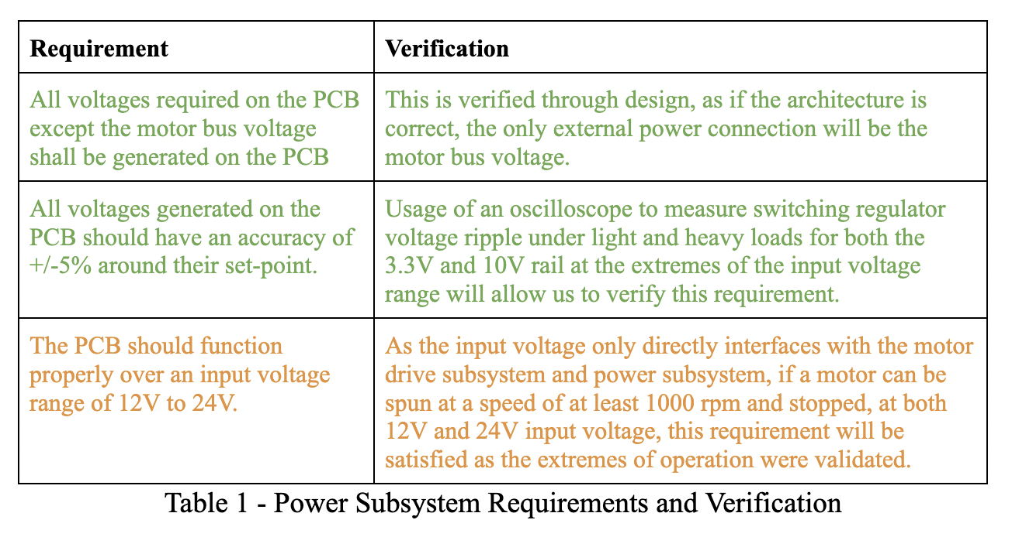
Requirements and Verifications
Notes:
Presenter: Alex

Slide 25
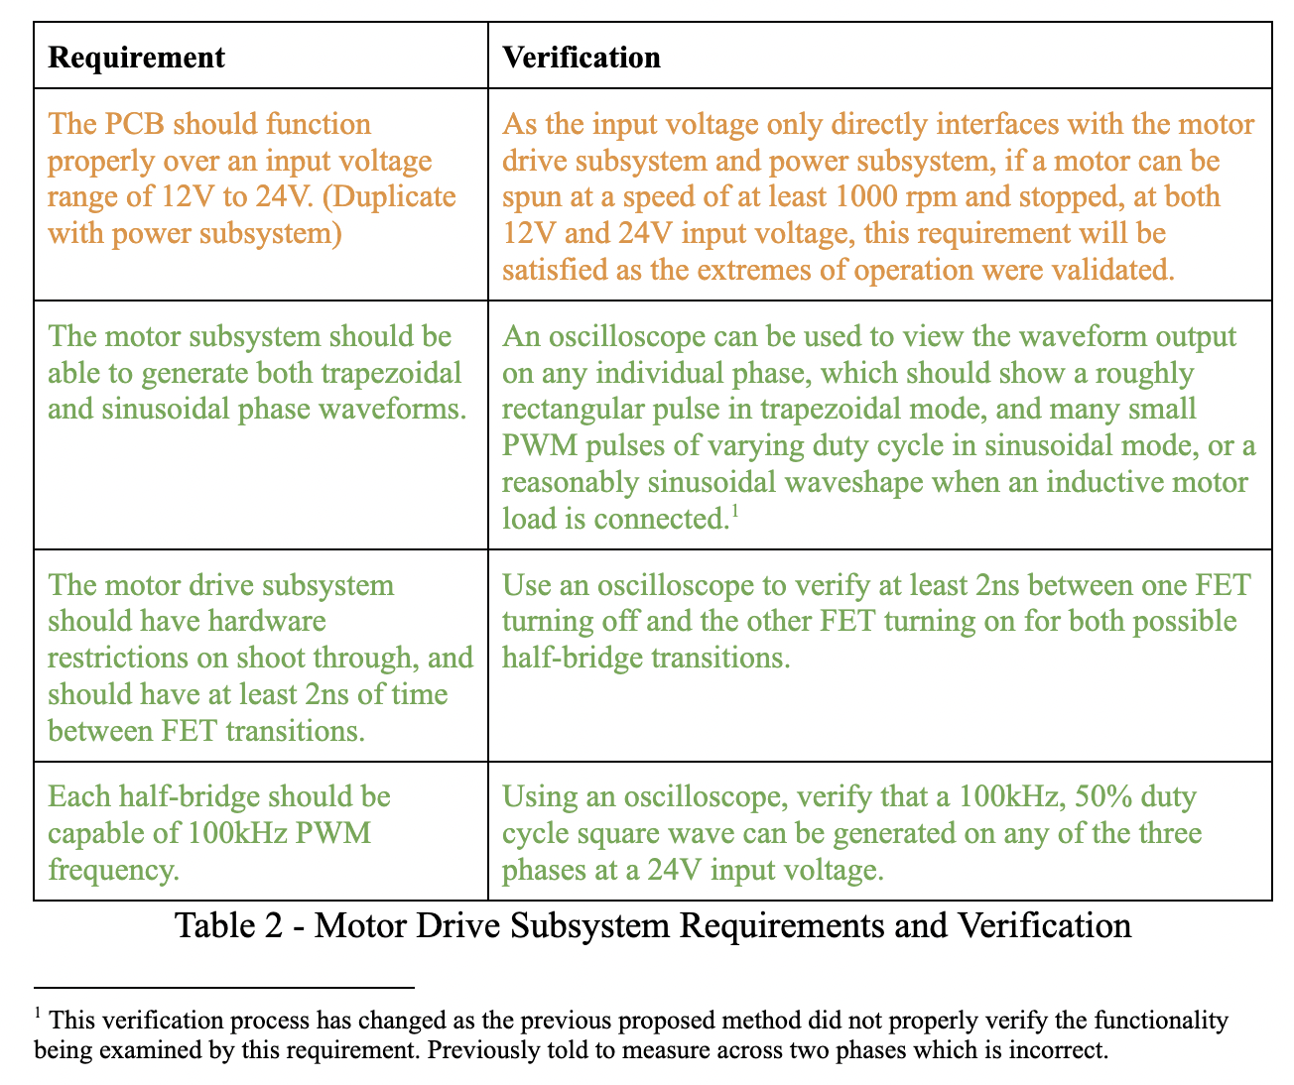
Requirements and Verifications
Notes:
Presenter: Alex

Slide 26
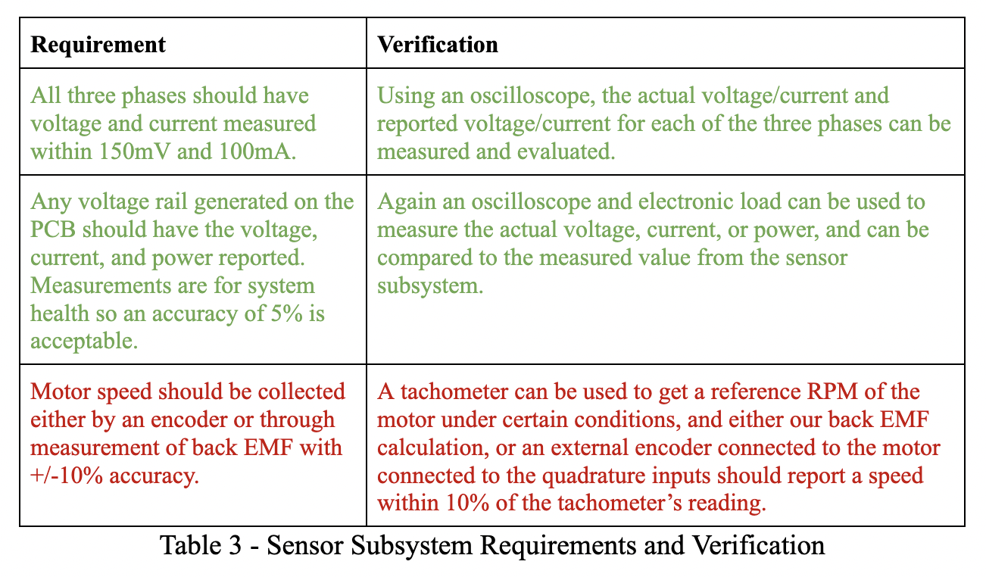
Requirements and Verifications
Notes:
Presenter: Alex

Slide 27
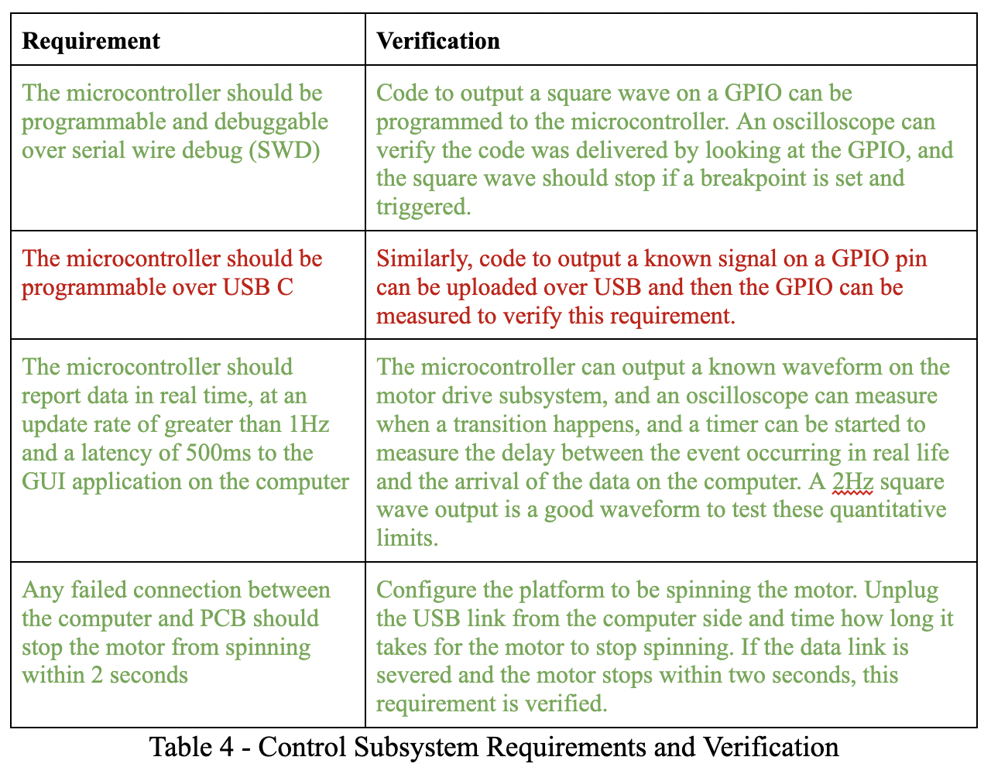
Requirements and Verifications
Notes:
Presenter: Alex

Slide 28
Requirements and Verifications
Notes:
Presenter: Alex

Slide 29
Software Design
Control Algorithms and Communication
Notes:
Presenter: Jason

Slide 30
Software Design
Comms
Serial connection over USB with keepalive messaging convention
Trapezoidal control
Output compare forced output mode, commute through six stages
Sinusoidal control
PWM mode, loop through duty cycle lookup table
Safety
“Debounced” system health flags updated once per main loop (hysteresis)
Notes:
Presenter: Jason

Slide 31
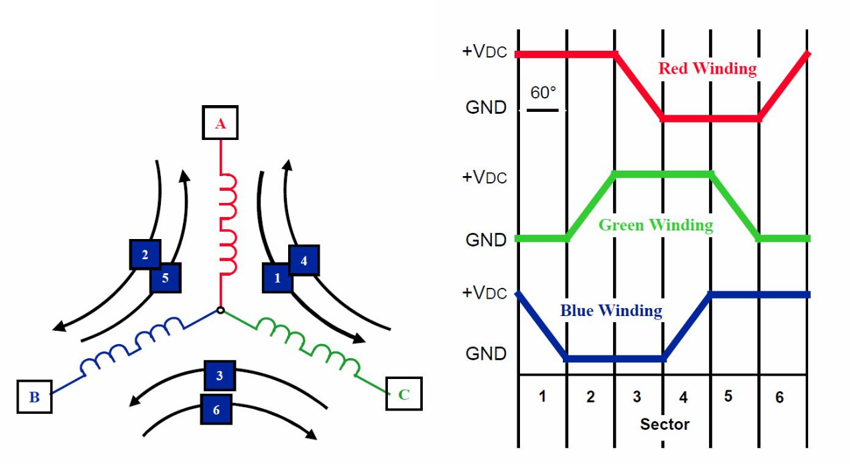
Trapezoidal Control
Notes:
Presenter: Jason

Slide 32
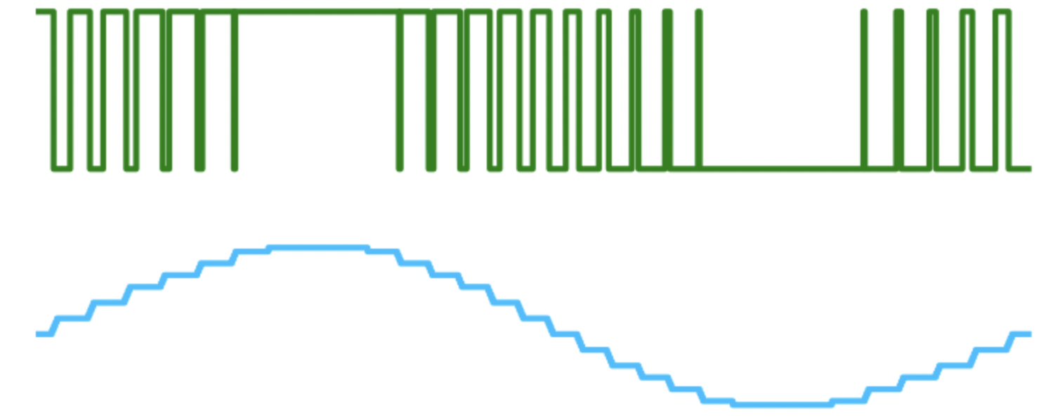
Sinusoidal Control
Notes:
Presenter: Jason

Slide 33
Results (Qualitative)
Motor spun, but not in demo
Gate-drive (hardware) failure meant only 2 phases were working
During testing both trapezoidal and sinusoidal worked
Real-time phase voltage and system health monitoring
Selection of algorithm and speed
Notes:
Presenter: Jason

Slide 34
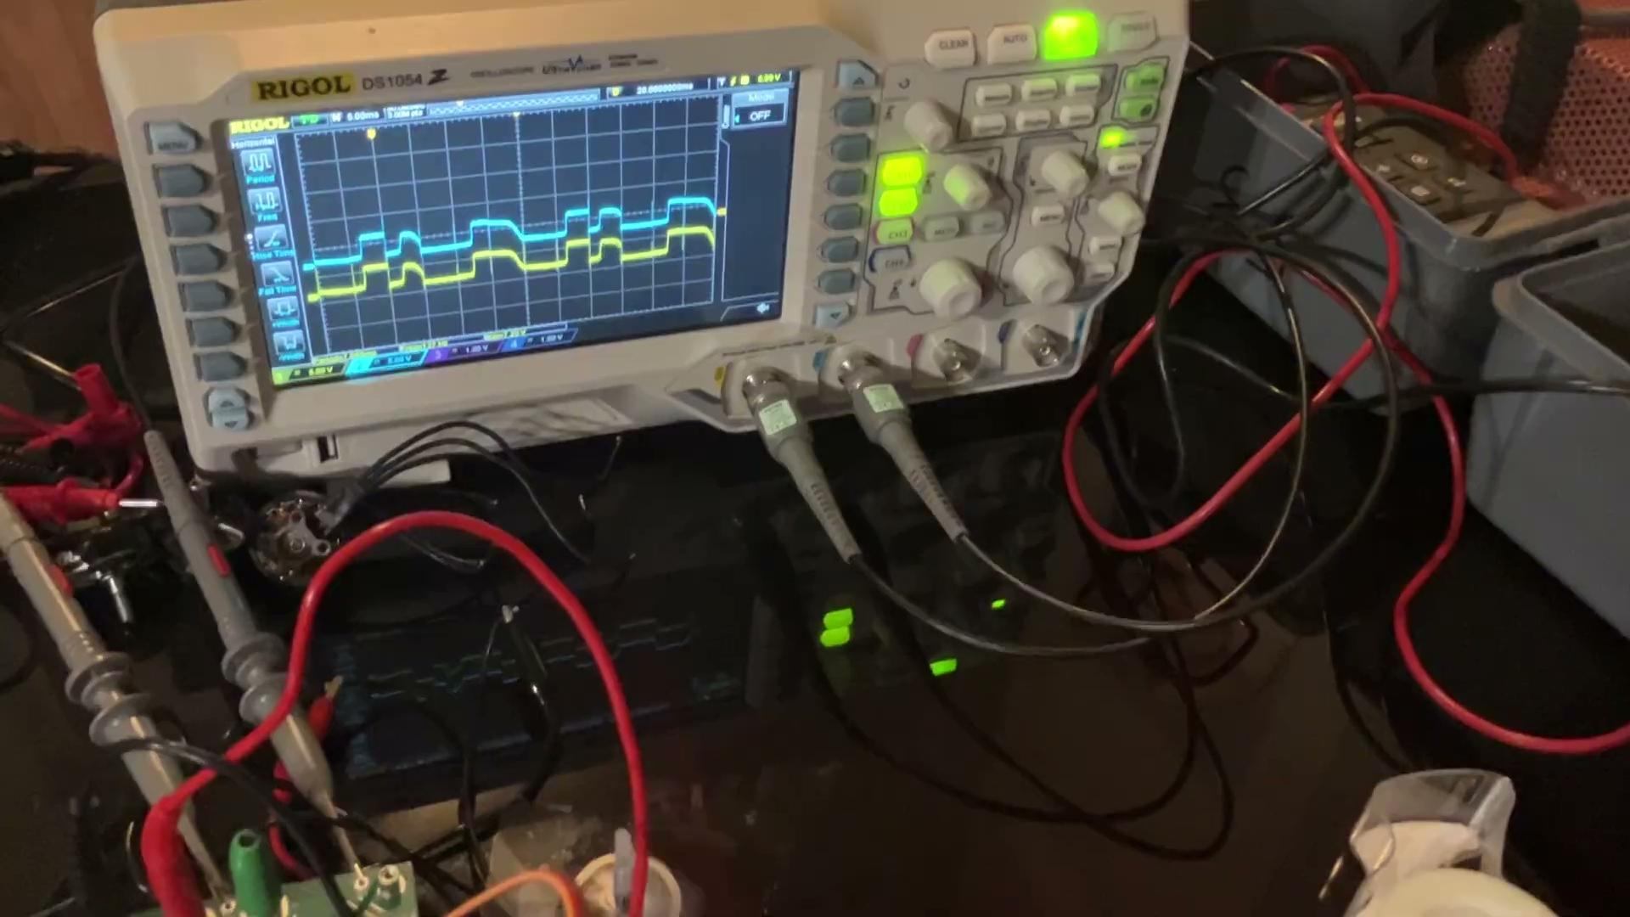
Results
Notes:
Presenter: Alex

Slide 35
Results (Quantitative)
2 Algorithms working
sinusoidal at f_{sw}= 50kHz, 0.3% resolution, 198 divisions
~700rpm max speed (less than desired)
65W maximum output (limited by power supply)
Notes:
Presenter: Alex

Slide 36
Challenges
Unexpected hardware failures
Quality of available benchtop power supplies
Take more videos!!
Different than expected hardware timer functionality
Cannot phase shift individual timer channels
Sensor reading speed
Back-EMF detection basically impossible with current hardware
Notes:
Presenter: Alex and Jason
I can take the first 3 challenges, and you can take the last 2

Slide 37
Further Work
Investigate gate driver failure
Implement accurate motor speed control
Update hardware if necessary for faster sensor communication or to add rotary encoder
Implement more advanced algorithms
Field oriented control, etc.
Integrate AC/DC power supply
Notes:
Presenter: Jason and Alex
I can take the first and last, you can take the middle two

Slide 38
Thank You For Watching
Questions? Comments?

