Slide 1
Knock-Turn Lock
Electrical & Computer Engineering
4/28/2023

Slide 2
Team Introduction
Adam Frerichs
Computer Engineering
Focuses: Microcontroller, Arduino Programming
Jack Kelly
Electrical Engineering
Focuses: PCB Design, Actuator and Power Circuitry
Vishal Rajesh
Computer Engineering
Foci: Sensor Verification, Compliance
ELECTRICAL & COMPUTER ENGINEERING
GRAINGER ENGINEERING

Slide 3
Knock, knock.
Who's there?

Slide 4
Doris.
Doris who?

Slide 5
Doris locked, that's why I'm knocking!​​

Slide 6
Project Objective
How do we maintain access to a space without a physical token? Consider AirBnB rental use case. There should be a secondary information token.
ELECTRICAL & COMPUTER ENGINEERING
GRAINGER ENGINEERING

Slide 7
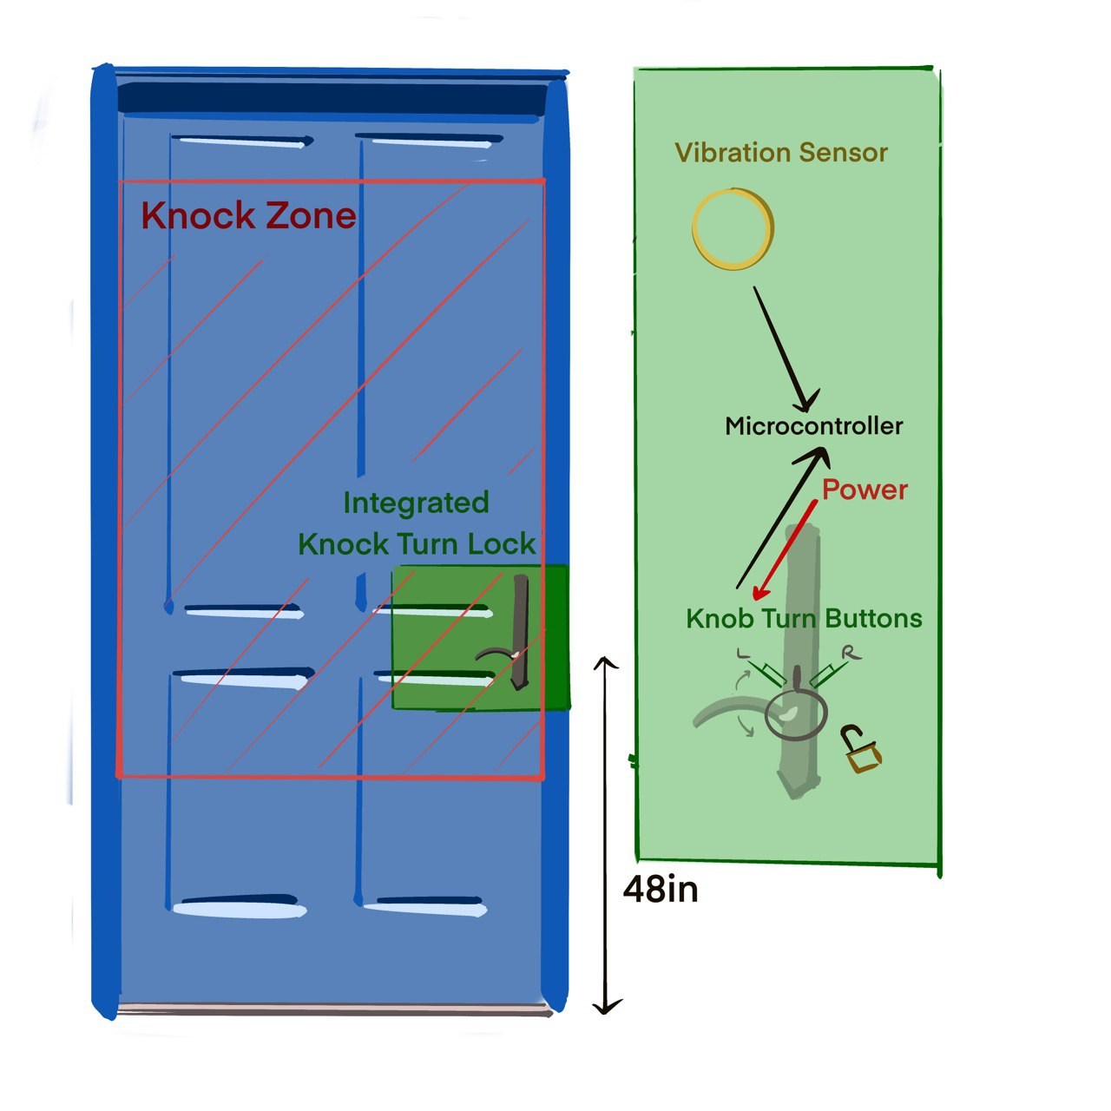
Motivation
Problem:
It is very common to lose access to a space due to lack of physical token -- losing or not bringing a key. Current solutions are either clearly insecure, such as hiding a key, or convey an unsightly and obvious second path of entry, such as keypad lock.
ELECTRICAL & COMPUTER ENGINEERING
GRAINGER ENGINEERING

Slide 8
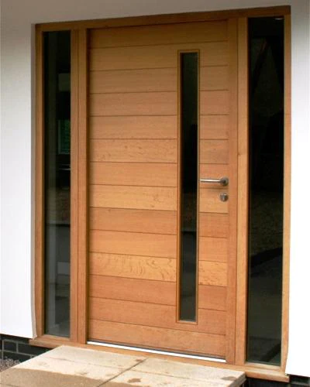
Our Solution
Introducing the Knock-Turn Lock
An auxiliary combination lock based on door knocks and doorknob turns that offers a secure and convenient secondary access alternative.
Hiding the circuit within the door simultaneously maintains the aesthetic and conceals the existence of the secondary combination lock.
ELECTRICAL & COMPUTER ENGINEERING
GRAINGER ENGINEERING

Slide 9
Video Demonstration
ELECTRICAL & COMPUTER ENGINEERING
GRAINGER ENGINEERING

Slide 10
Hardware Design
Getting a handle of things
ELECTRICAL & COMPUTER ENGINEERING
GRAINGER ENGINEERING

Slide 11
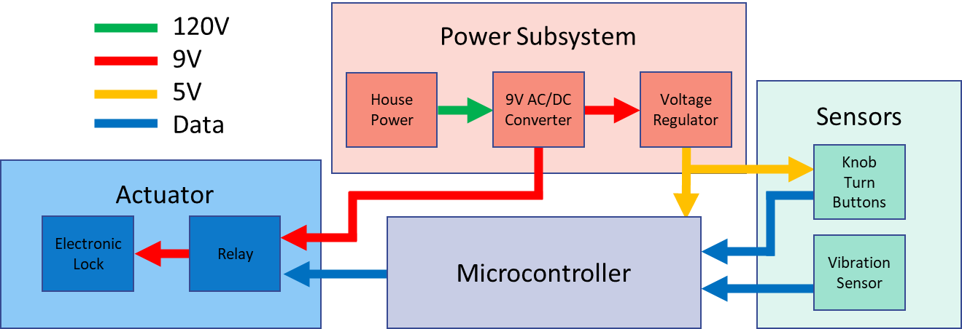
Design Changes
Original Design
Microcontroller is the central hub
Sensors are input
Actuator is the only output
ELECTRICAL & COMPUTER ENGINEERING
GRAINGER ENGINEERING

Slide 12
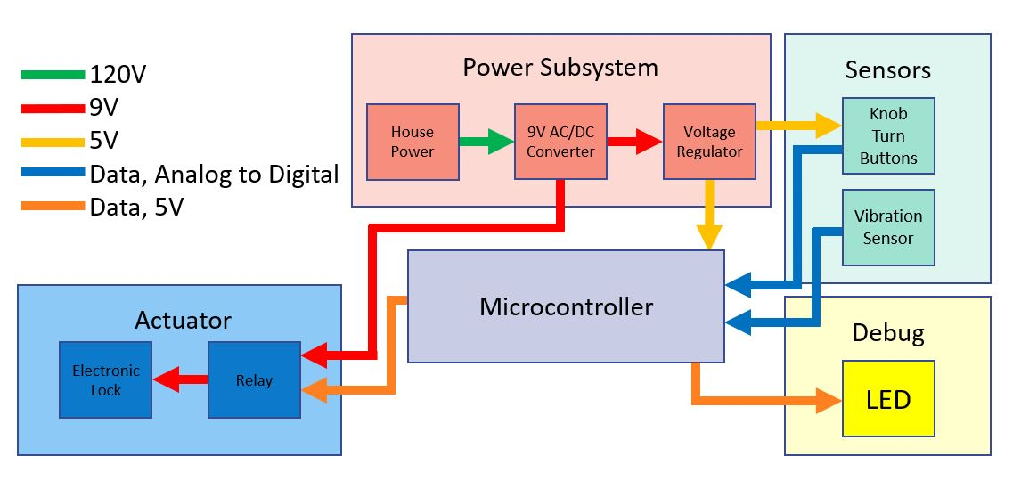
Design Changes
Revised Design:
LED added for debugging
Programming header removed
IC socket added for microcontroller
Software debouncing
ELECTRICAL & COMPUTER ENGINEERING
GRAINGER ENGINEERING

Slide 13
Circuit - Actuator
PCB Final Lock Relay Circuit
MOSFET relay
Flyback diode
ELECTRICAL & COMPUTER ENGINEERING
GRAINGER ENGINEERING

Slide 14
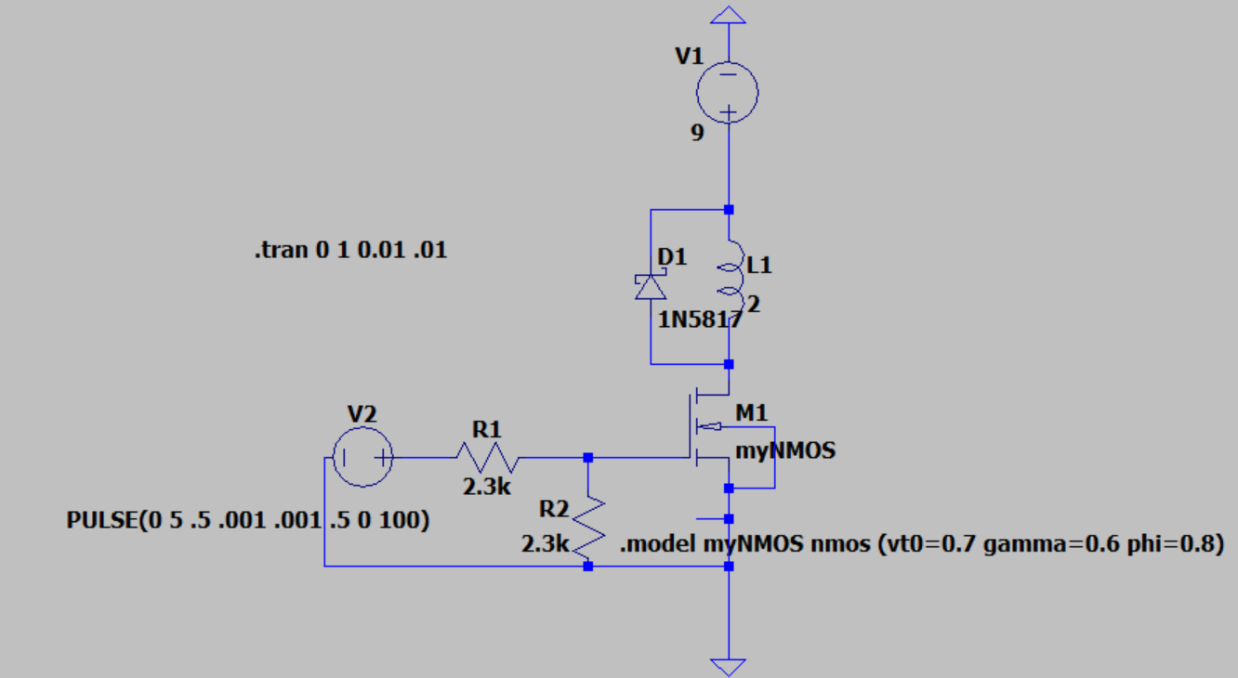
Actuator Simulation
LTSpice Simulation
Lock modeled as inductor
Generic NMOS
ELECTRICAL & COMPUTER ENGINEERING
GRAINGER ENGINEERING

Slide 15
Actuator Simulation
Control Voltage
Current through lock
ELECTRICAL & COMPUTER ENGINEERING
GRAINGER ENGINEERING

Slide 16
Circuit - Power
Power Design
High tolerance for DC stepdown
Low power use in standby
ELECTRICAL & COMPUTER ENGINEERING
GRAINGER ENGINEERING

Slide 17
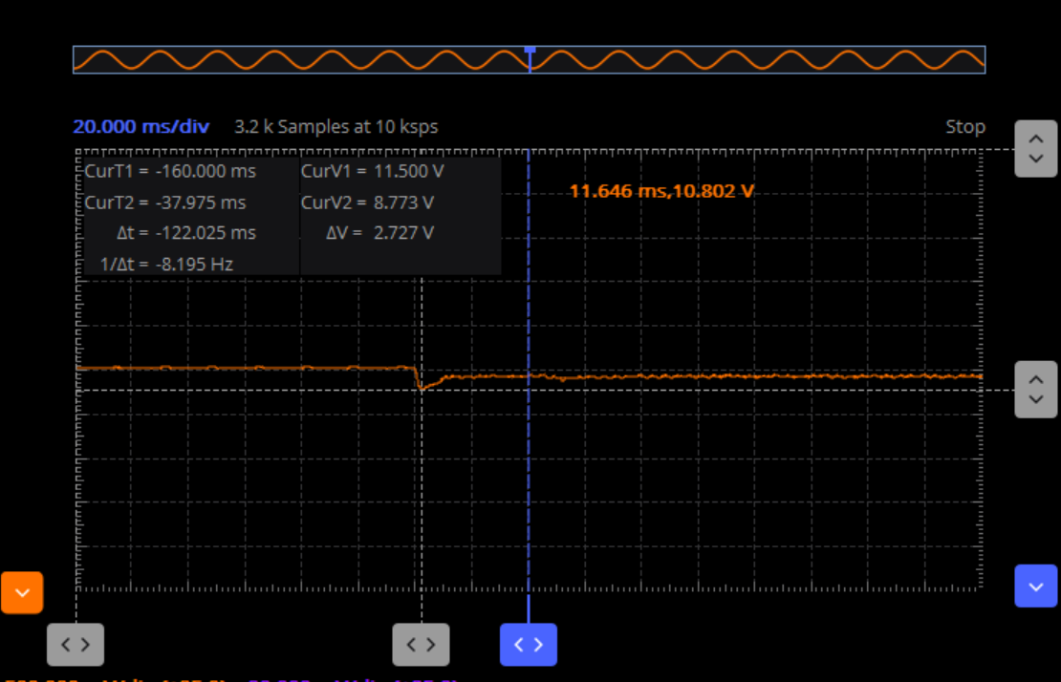
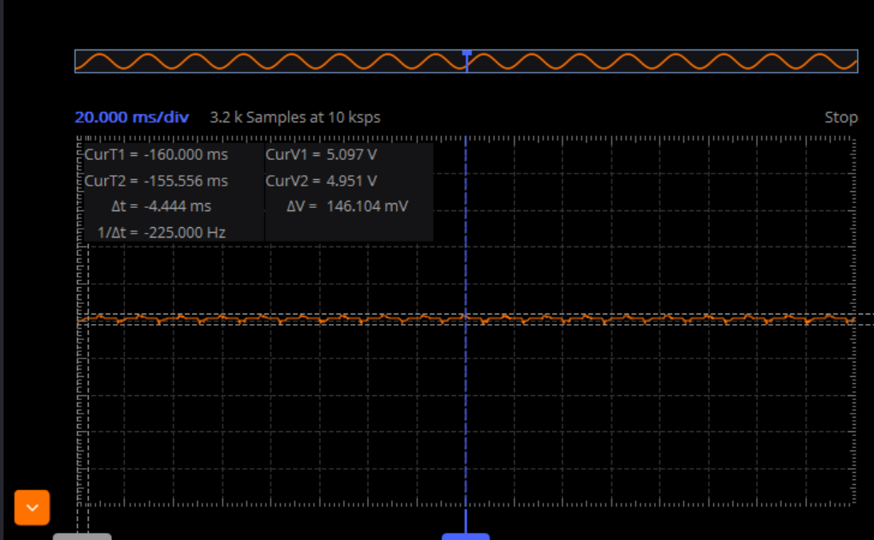
Power Analytics
High Tolerance
1.8-5.5V for microcontroller
Power of 60mW for microcontroller, 2.525mW for sensors
Low Standby Power
Voltage drop on lock unlocking
Low standby due to lock being active on low
ELECTRICAL & COMPUTER ENGINEERING
GRAINGER ENGINEERING

Slide 18
Software Flow
Twists and Turns
ELECTRICAL & COMPUTER ENGINEERING
GRAINGER ENGINEERING

Slide 19
Software Flow
Overview
Setup:
Configure pins
Set initial combination
Main Loop
ELECTRICAL & COMPUTER ENGINEERING
GRAINGER ENGINEERING

Slide 20
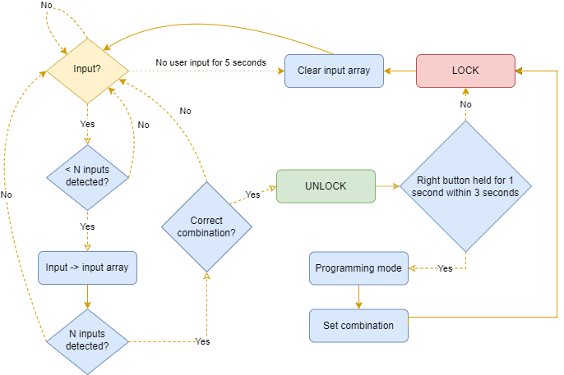
Software Flow
Main Loop
ELECTRICAL & COMPUTER ENGINEERING
GRAINGER ENGINEERING

Slide 21
Software Requirement
Program Size
Program is efficiently written and fits well within the 8kB requirement
ELECTRICAL & COMPUTER ENGINEERING
GRAINGER ENGINEERING

Slide 22
Final Build
Knock on Wood
ELECTRICAL & COMPUTER ENGINEERING
GRAINGER ENGINEERING

Slide 23
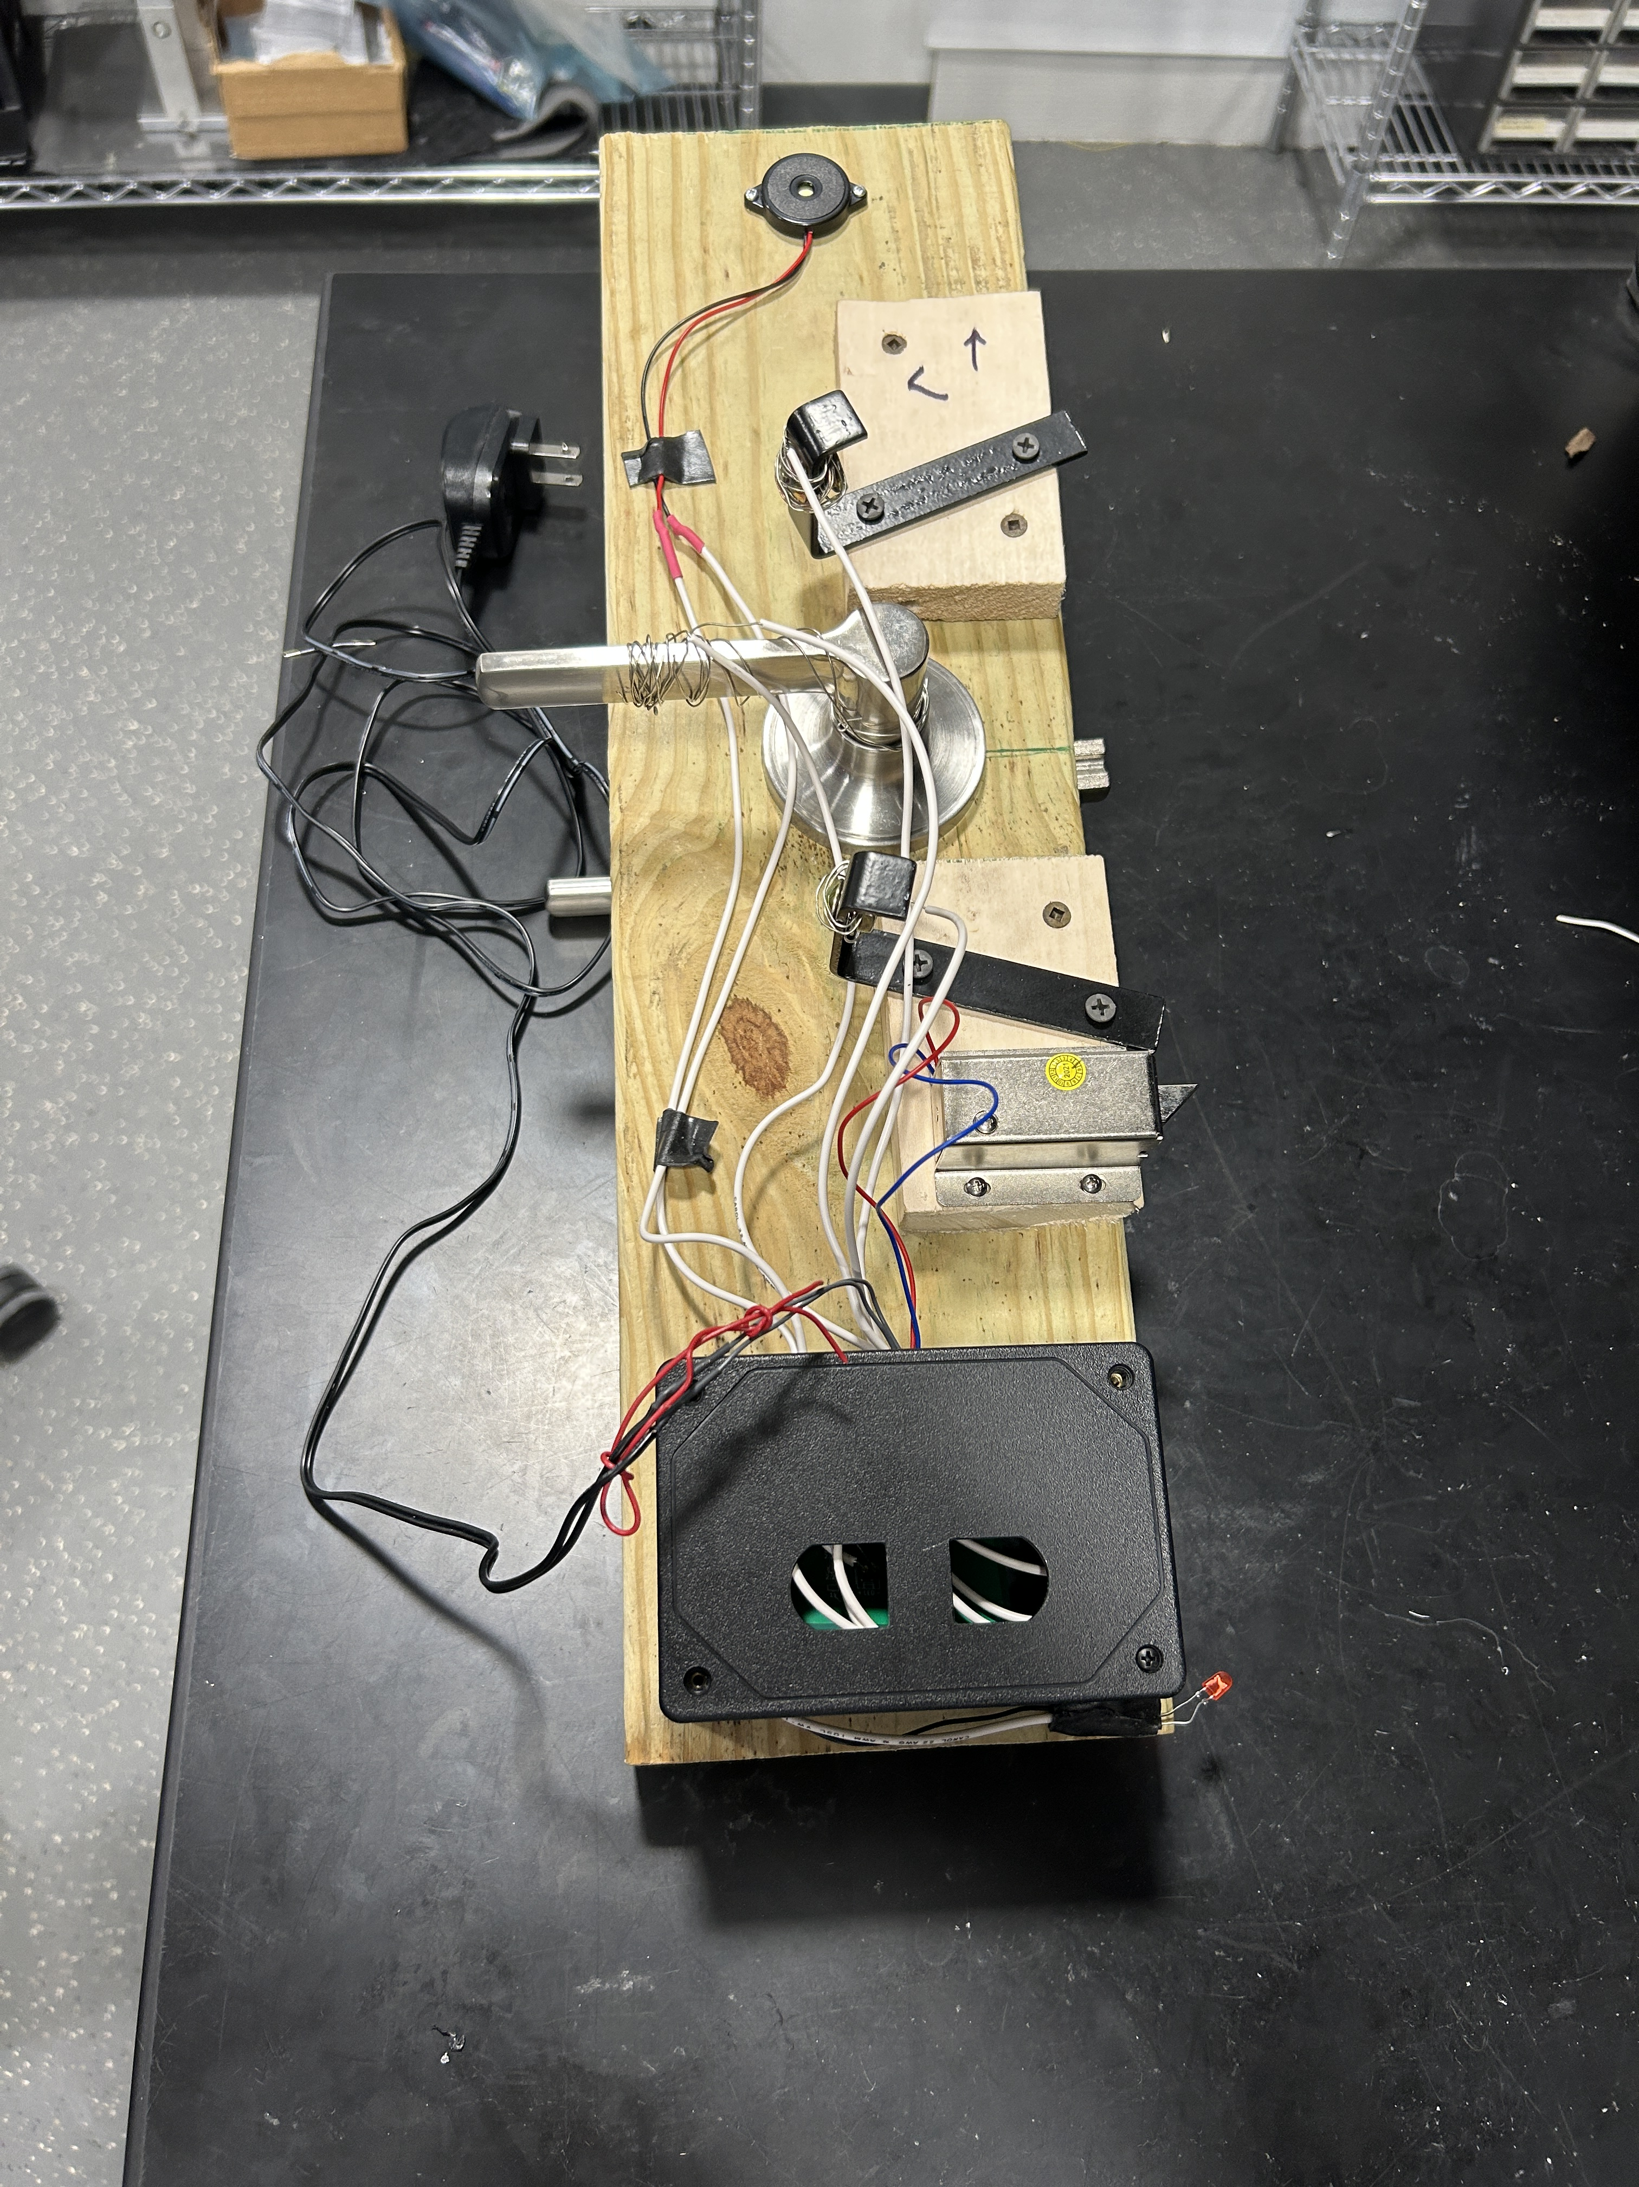
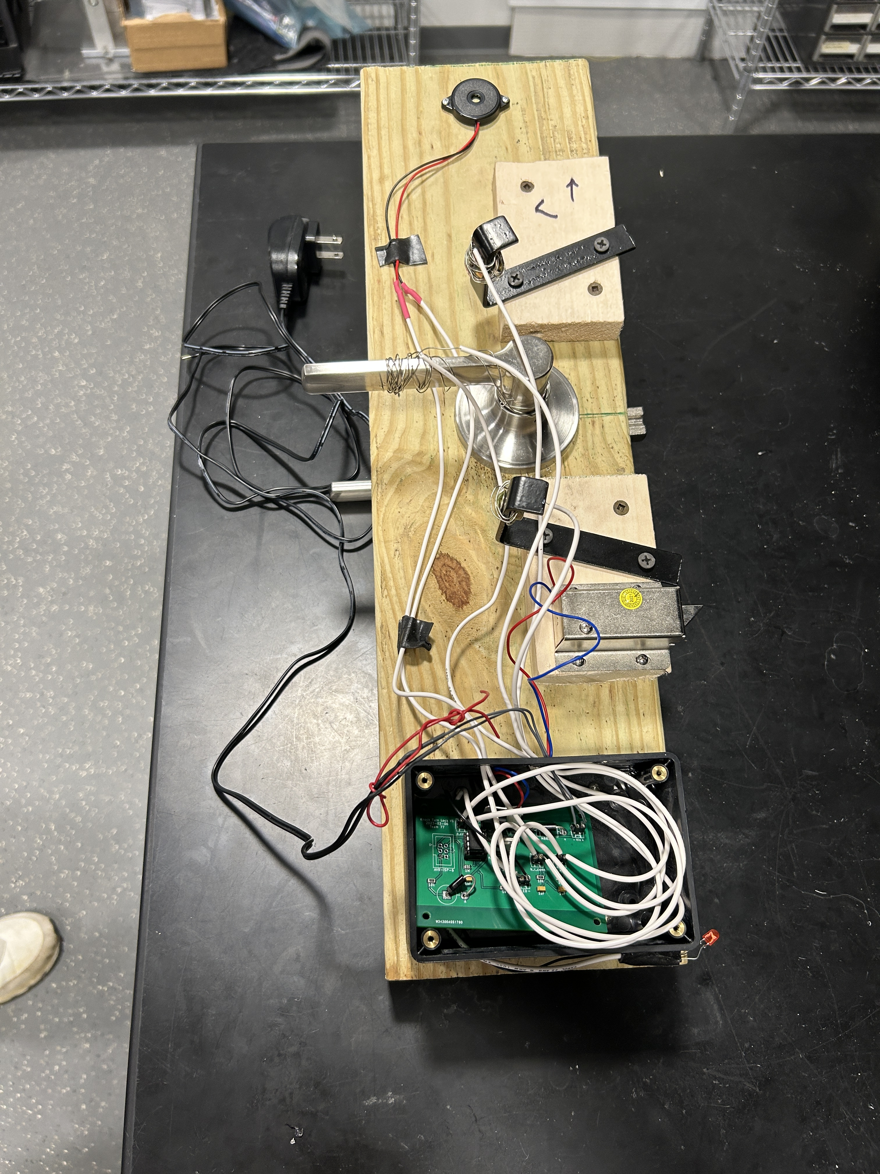
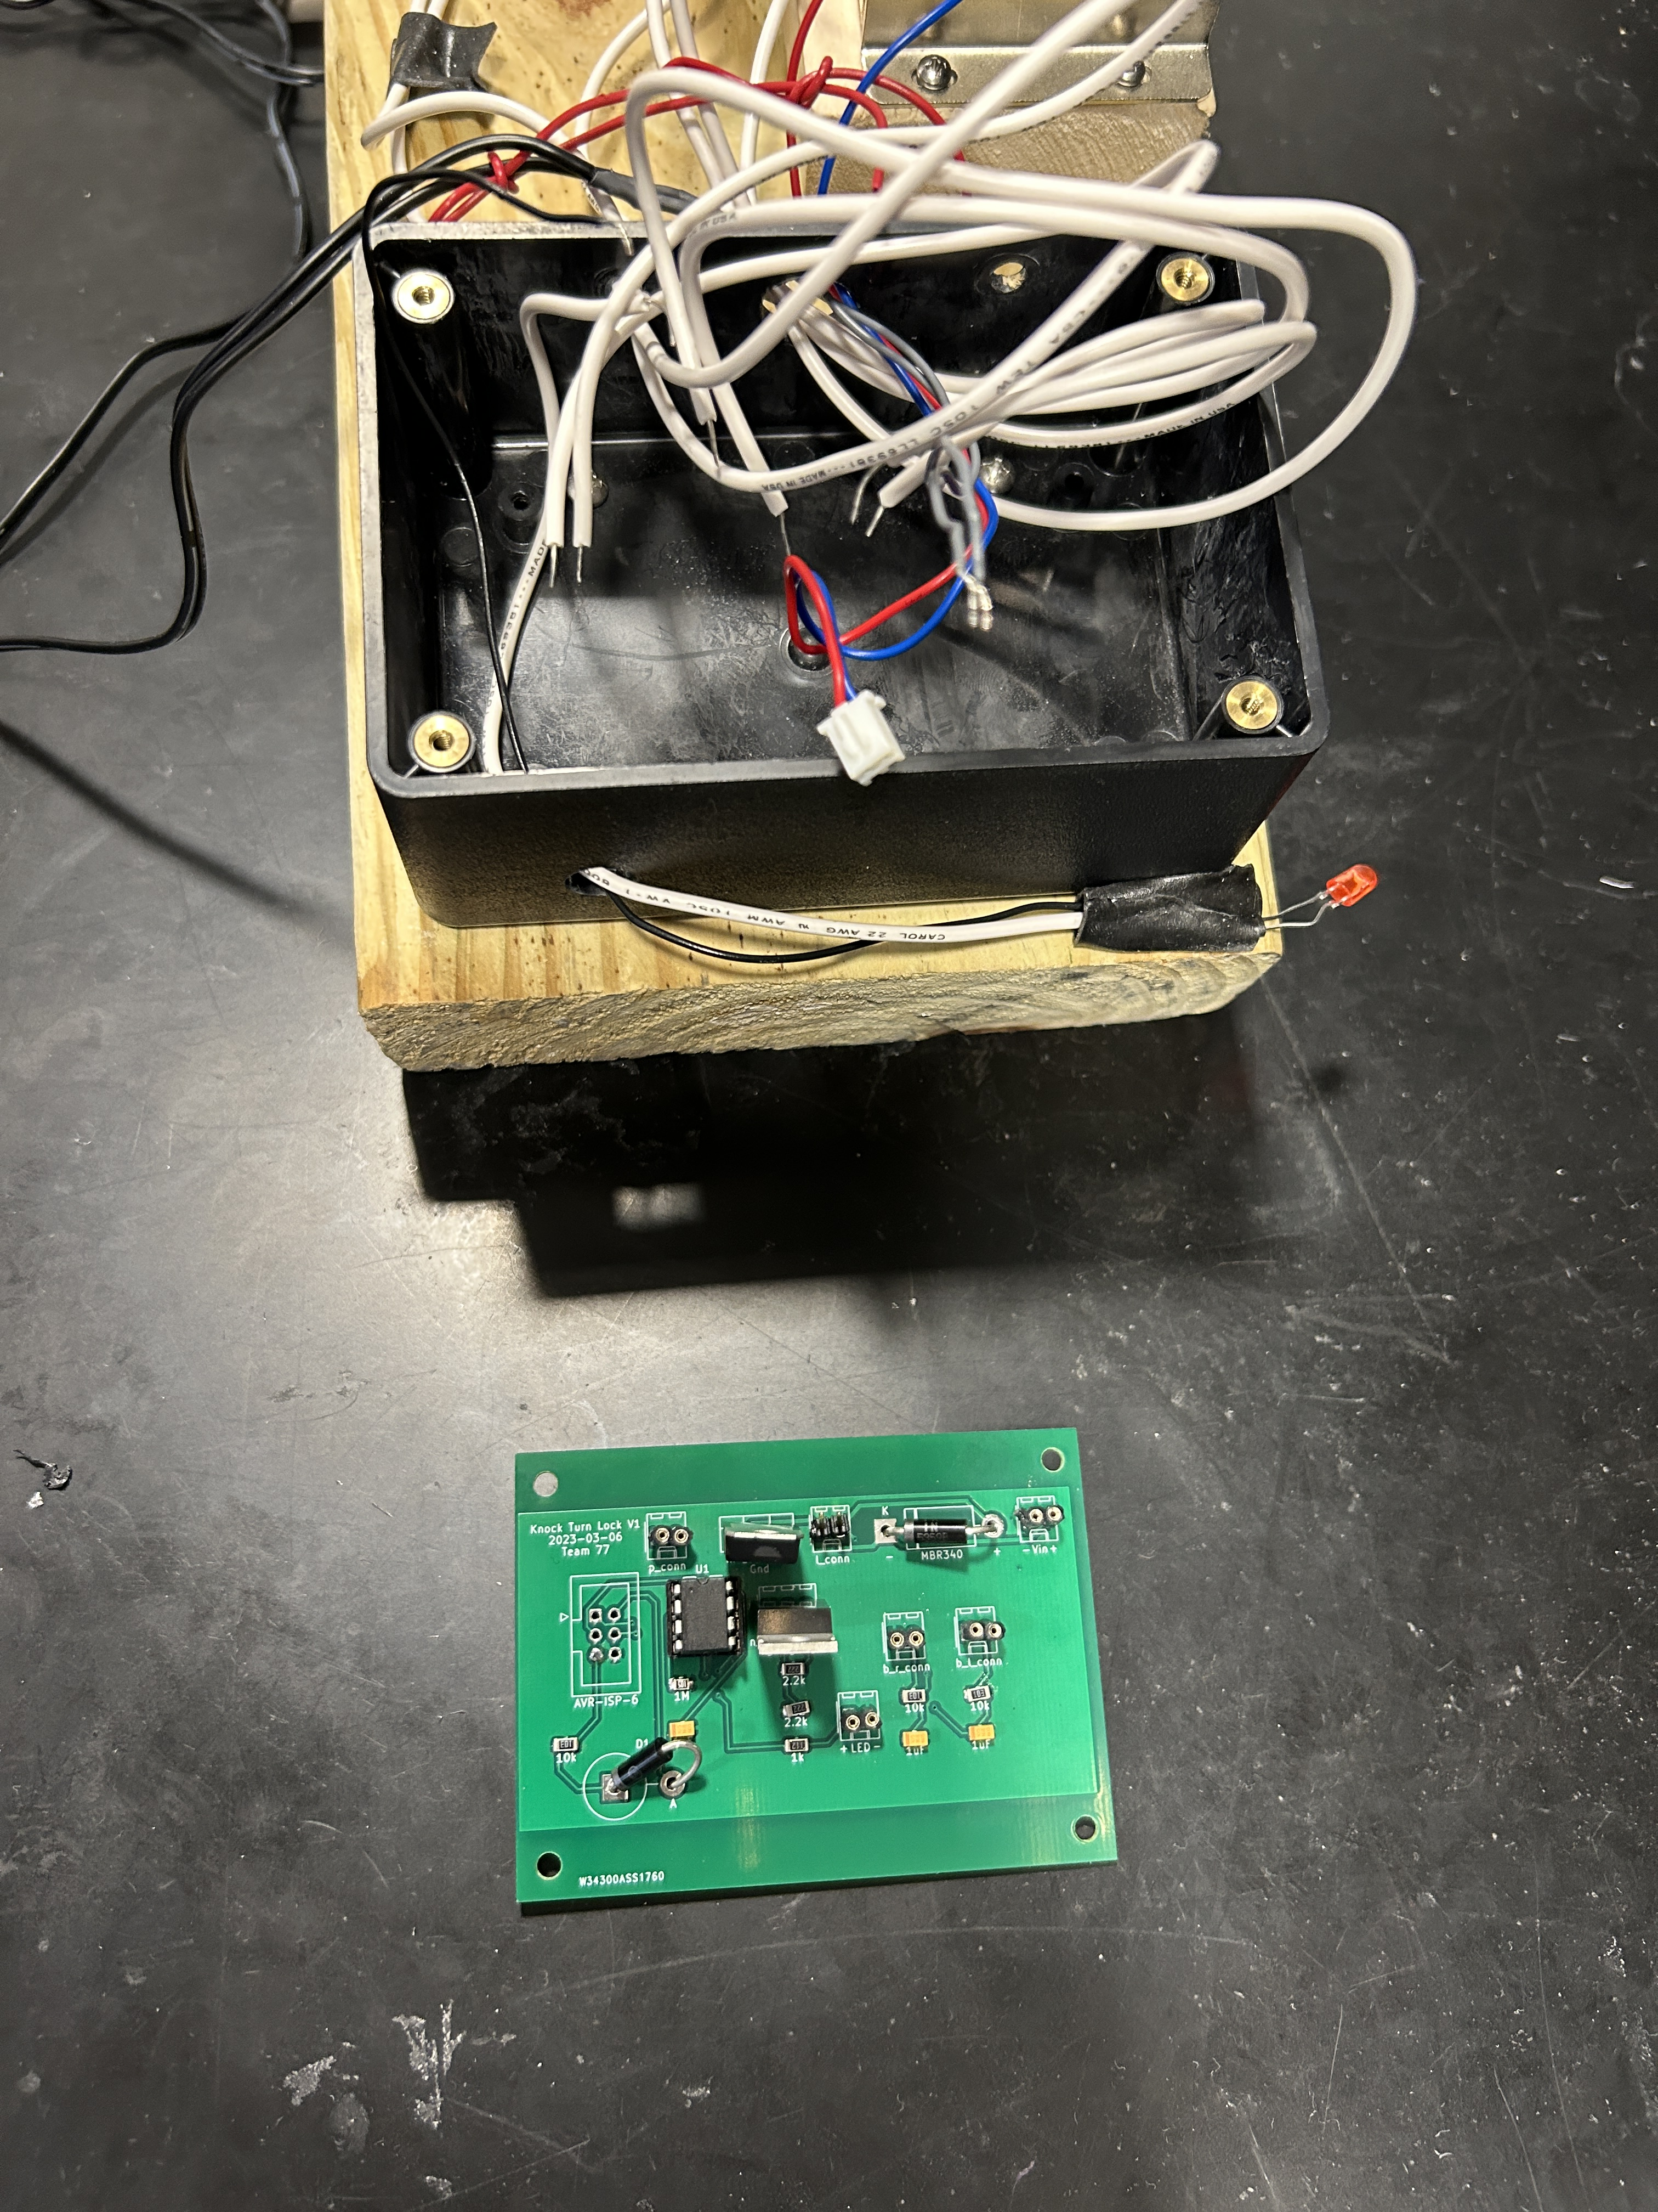
Behind the Door
ELECTRICAL & COMPUTER ENGINEERING
GRAINGER ENGINEERING

Slide 24
Behind the Door
Annotated Electronics
Single Piezo Sensor
Contact wire on door handle
Debug LED
ELECTRICAL & COMPUTER ENGINEERING
GRAINGER ENGINEERING

Slide 25
Behind the Door
Annotated Electronics
Single Piezo Sensor
Contact wire on door handle
Debug LED
ELECTRICAL & COMPUTER ENGINEERING
GRAINGER ENGINEERING

Slide 26
Moving Forward
One door closes ...
ELECTRICAL & COMPUTER ENGINEERING
GRAINGER ENGINEERING

Slide 27
Future Work
Additional Features
Rhythmic knock sequence
Variable sequence length
Advanced door handle design
Integrated contact pads
Integrated key fail safe
Piezo sensor array
Audio user feedback
IMAGE / GRAPHIC
ELECTRICAL & COMPUTER ENGINEERING
GRAINGER ENGINEERING

Slide 28
Conclusions
Locking in a final design
ELECTRICAL & COMPUTER ENGINEERING
GRAINGER ENGINEERING

Slide 29
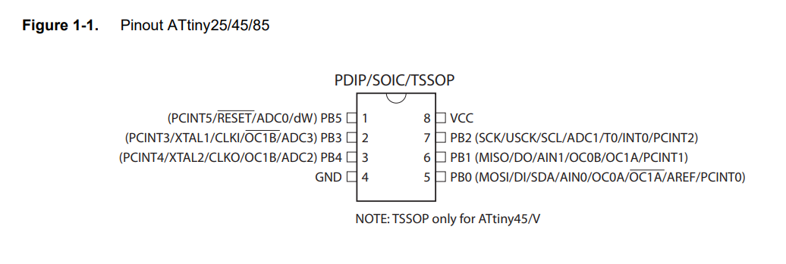
Conclusions
Lessons Learned
Simulate Circuit Conditions
Test, test, test!
Module testing through program hot-swapping
Understand datasheets (RESET active low)
Add test points to PCB
Design Improvements
Hollow Door
Lower threshold for knocks
IMAGE / GRAPHIC
ELECTRICAL & COMPUTER ENGINEERING
GRAINGER ENGINEERING

Slide 30
Questions?
Adam Frerichs (adamdf2@illinois.edu), Jack Kelly (jacktk2@illinois.edu), Vishal Rajesh(vrajesh2@illinois.edu)
ELECTRICAL & COMPUTER ENGINEERING
GRAINGER ENGINEERING

