Slide 1
Smart Home Conditioning System
Haoen Li, Zhaonan Shi, and Shuning Zhang
Team 37
May 3, 2023

Slide 2
Introduction
ELECTRICAL & COMPUTER ENGINEERING
GRAINGER ENGINEERING

Slide 3
Smart Home Conditioning System
Problem that people with disabilities might meet with window & curtain:
Hard to close the window when the outdoor environment is unpleasant
Inconvenient to close or open the curtain
So they might keep the window and the curtain closed even in pleasant days
Which might isolate them from the nature and sunlight
It would be important to develop an automatic window & curtain system!
ELECTRICAL & COMPUTER ENGINEERING
GRAINGER ENGINEERING

Slide 4
Smart Home Conditioning System
Solution:
Automatically open or close the window/curtain base on indoor/outdoor environment
Control module: Analyze input from sensors smartly; Control the motors accurately
Sensor module: Communicate with the environment directly
Motor module：Lift the window quietly and smoothly; Close the curtain quickly and precisely
Power module: Powered through power adapter easily
Safety module: Eliminate any safety issues from unusual touch or obstacles completely
ELECTRICAL & COMPUTER ENGINEERING
GRAINGER ENGINEERING

Slide 5
Build
ELECTRICAL & COMPUTER ENGINEERING
GRAINGER ENGINEERING

Slide 6
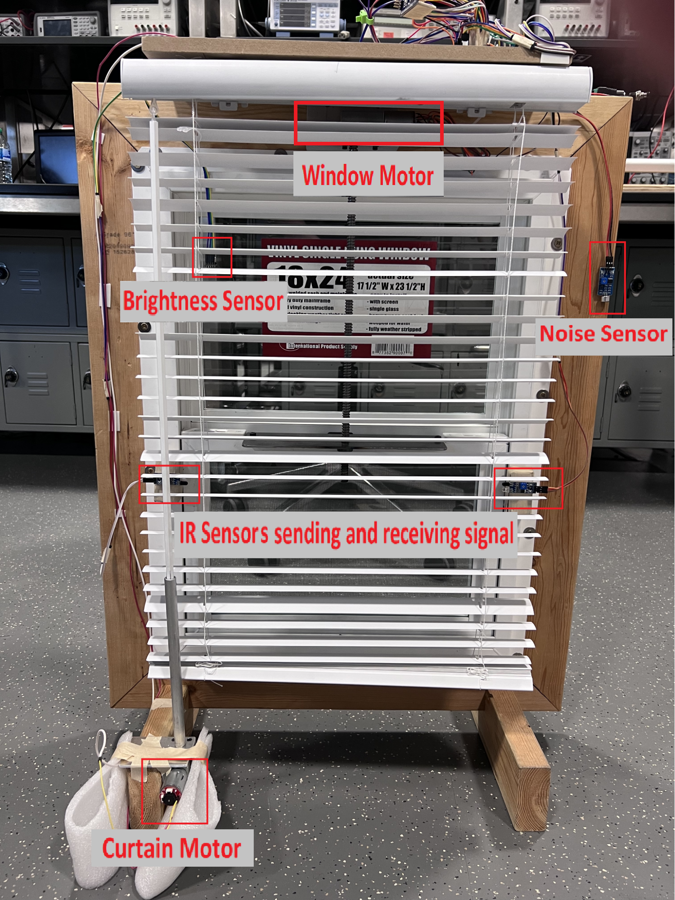
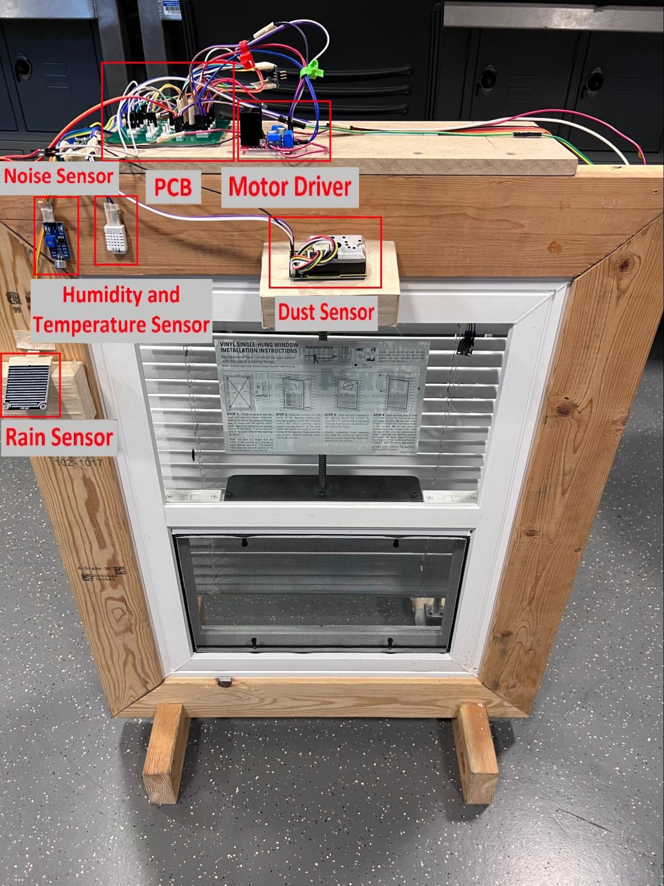
ELECTRICAL & COMPUTER ENGINEERING
GRAINGER ENGINEERING

Slide 7
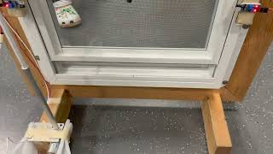
ELECTRICAL & COMPUTER ENGINEERING
GRAINGER ENGINEERING

Slide 8
High-level Design
ELECTRICAL & COMPUTER ENGINEERING
GRAINGER ENGINEERING

Slide 9
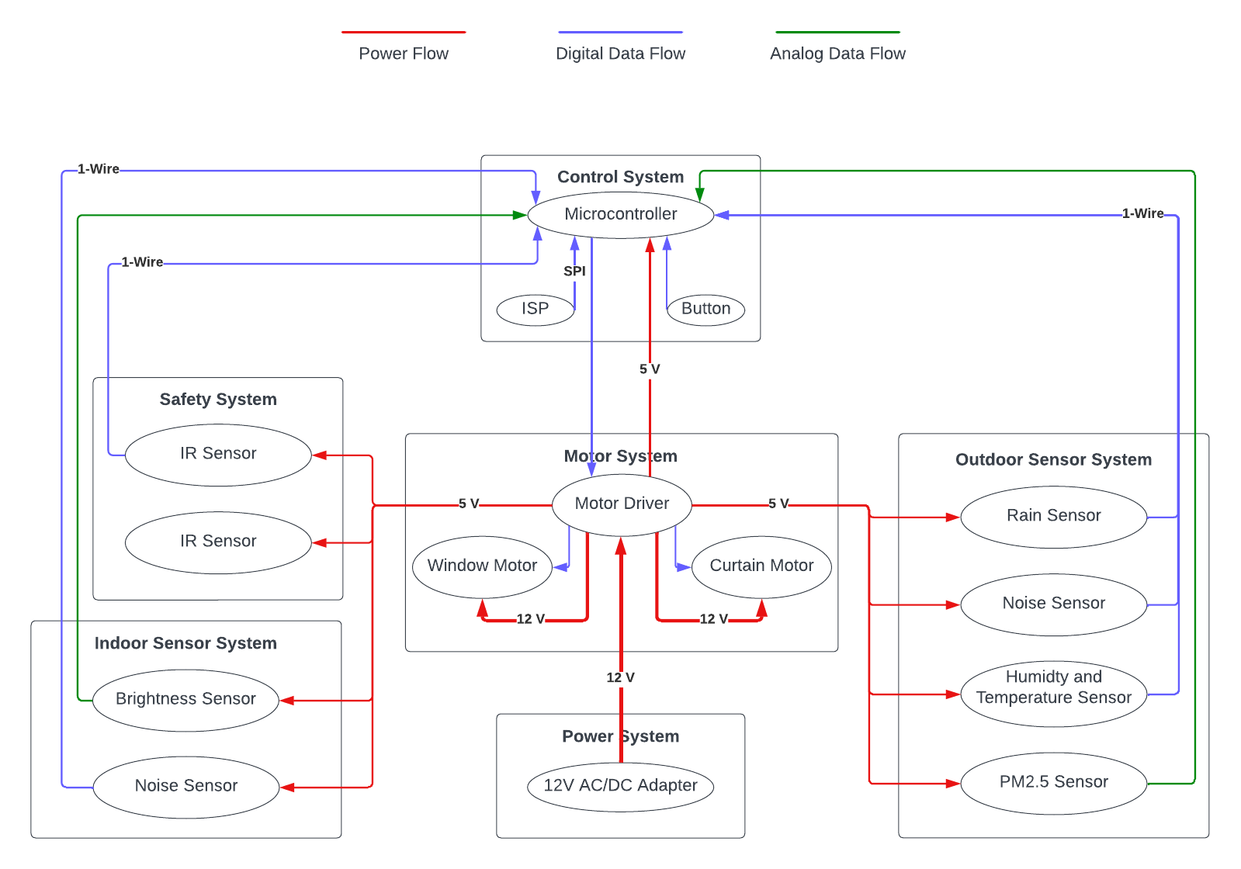
Block Diagram
ELECTRICAL & COMPUTER ENGINEERING
GRAINGER ENGINEERING

Slide 10
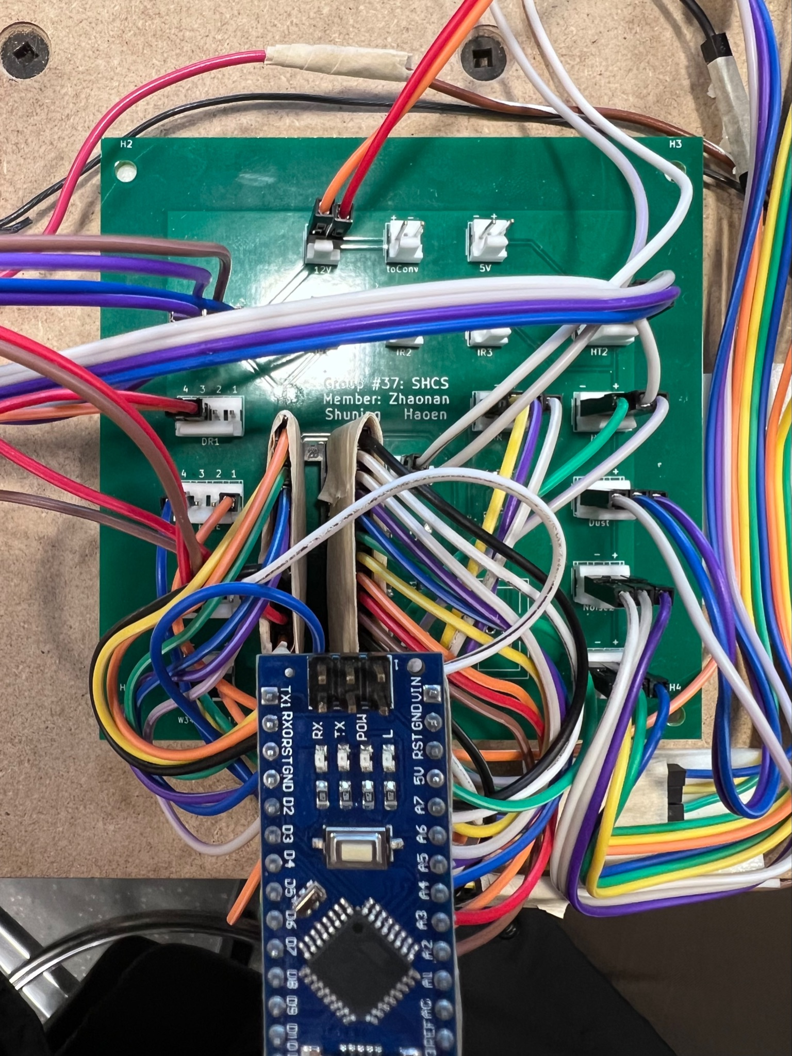
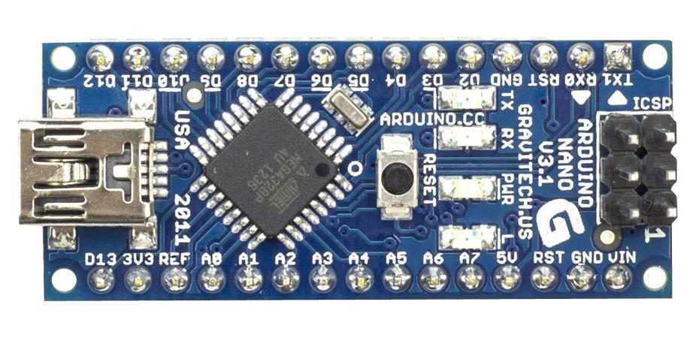
High-Level Design
Control Module
ATmega328 on arduino Nano
23 programmable I/O lines have 6 PWM-capable pins
and 6 analog input pins;
PCB design
build connection between all modules
IMAGE / GRAPHIC
ELECTRICAL & COMPUTER ENGINEERING
GRAINGER ENGINEERING

Slide 11
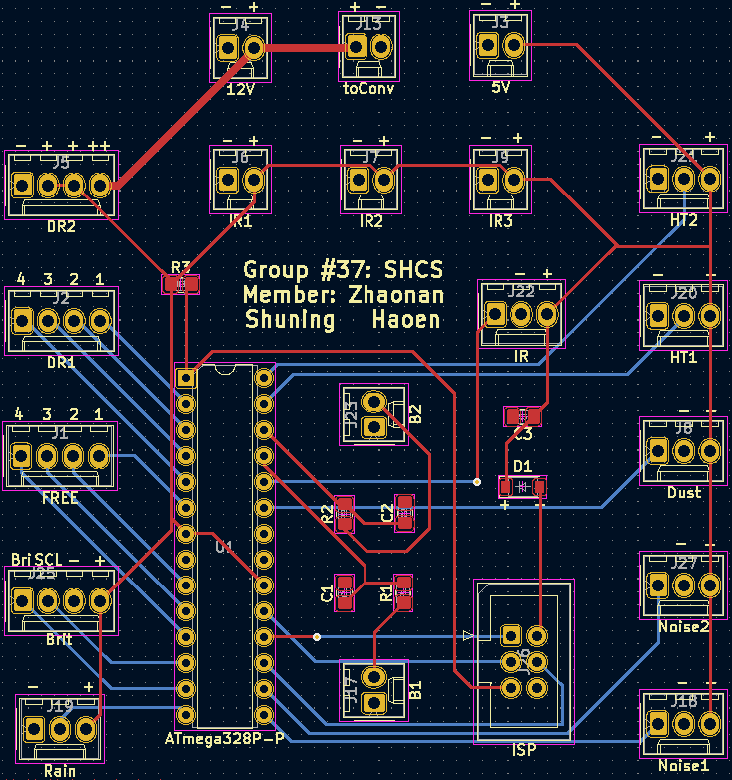
PCB Design
ELECTRICAL & COMPUTER ENGINEERING
GRAINGER ENGINEERING

Slide 12
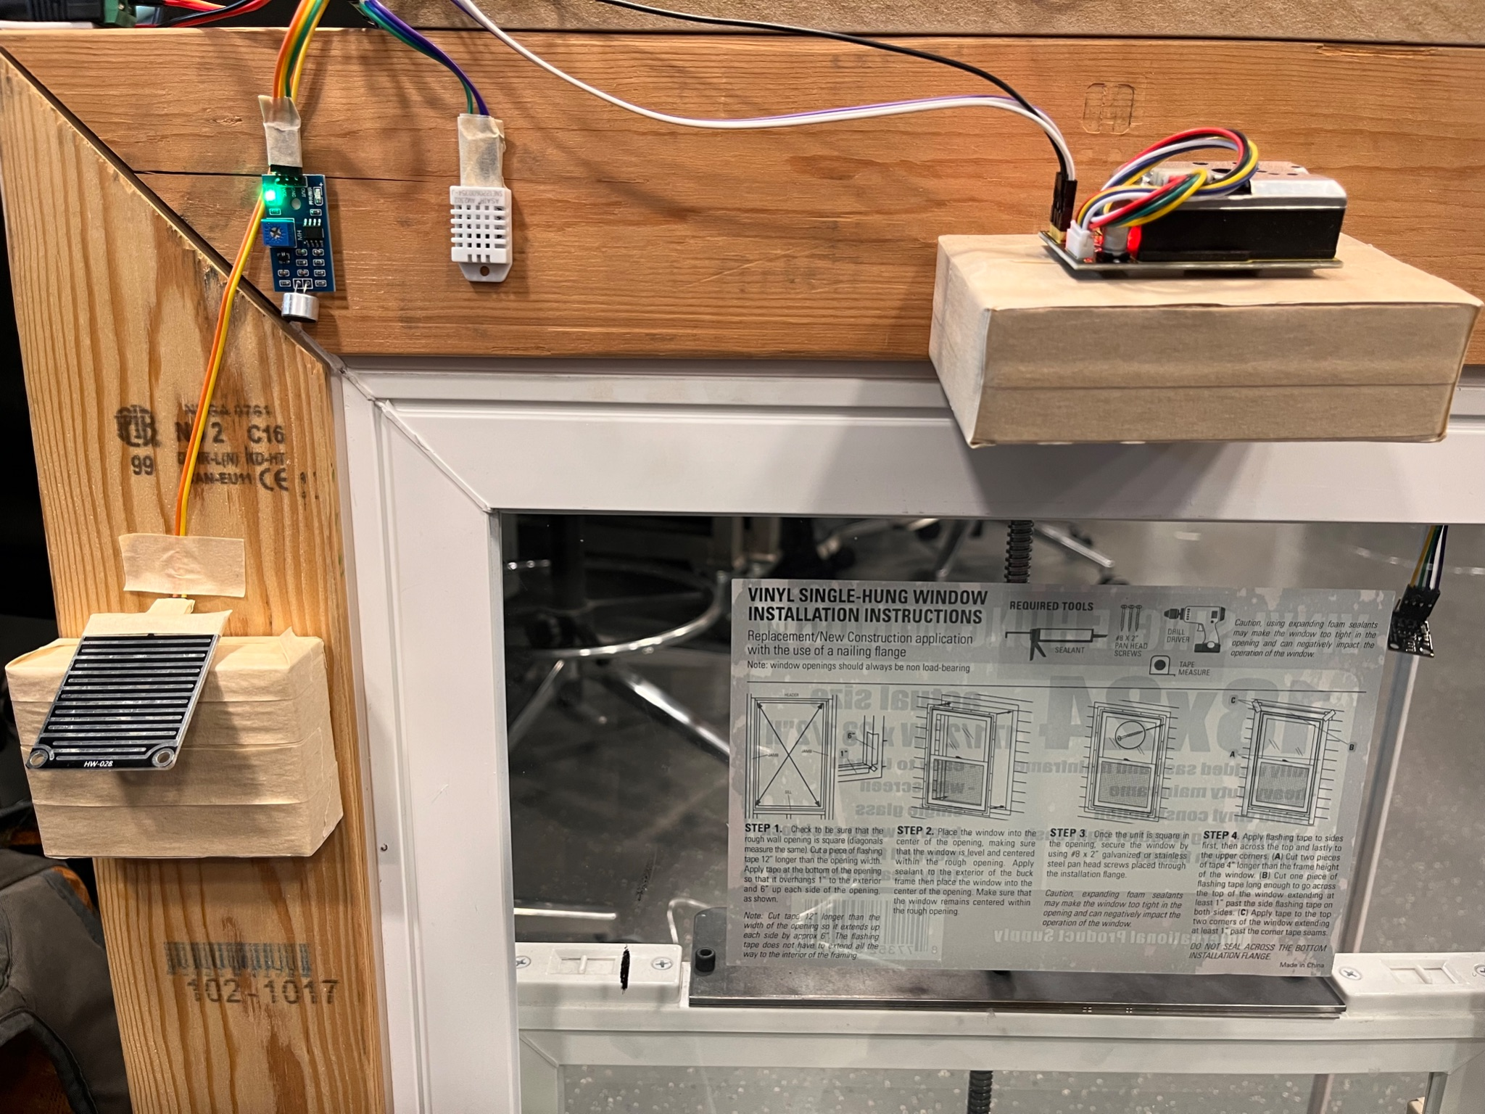
High-Level Design
Outdoor Sensor Module
Window:
Noise sensor
Over 70 db
Rain sensor
Consistent rain for 10 seconds
Humidity and Temperature sensor
Over 70% RH and 23.5 - 27 celsius degree
Dust sensor
Over 300 μg/m³
ELECTRICAL & COMPUTER ENGINEERING
GRAINGER ENGINEERING

Slide 13
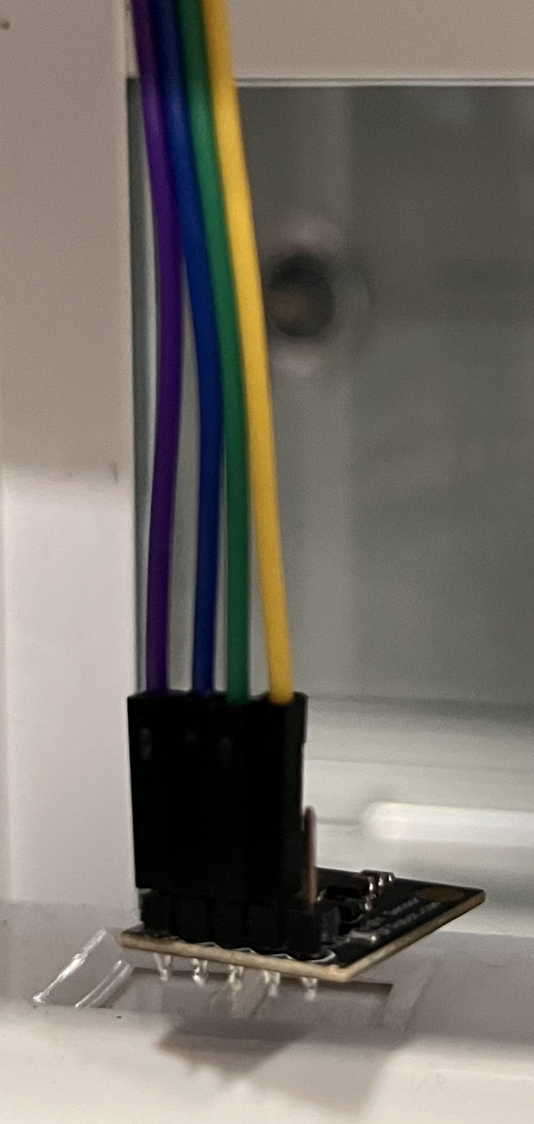
High-Level Design
Indoor Sensor Module
Curtain:
Brightness Sensor
Below 10 lux
Window:
Noise sensor
Over 70 db
ELECTRICAL & COMPUTER ENGINEERING
GRAINGER ENGINEERING

Slide 14
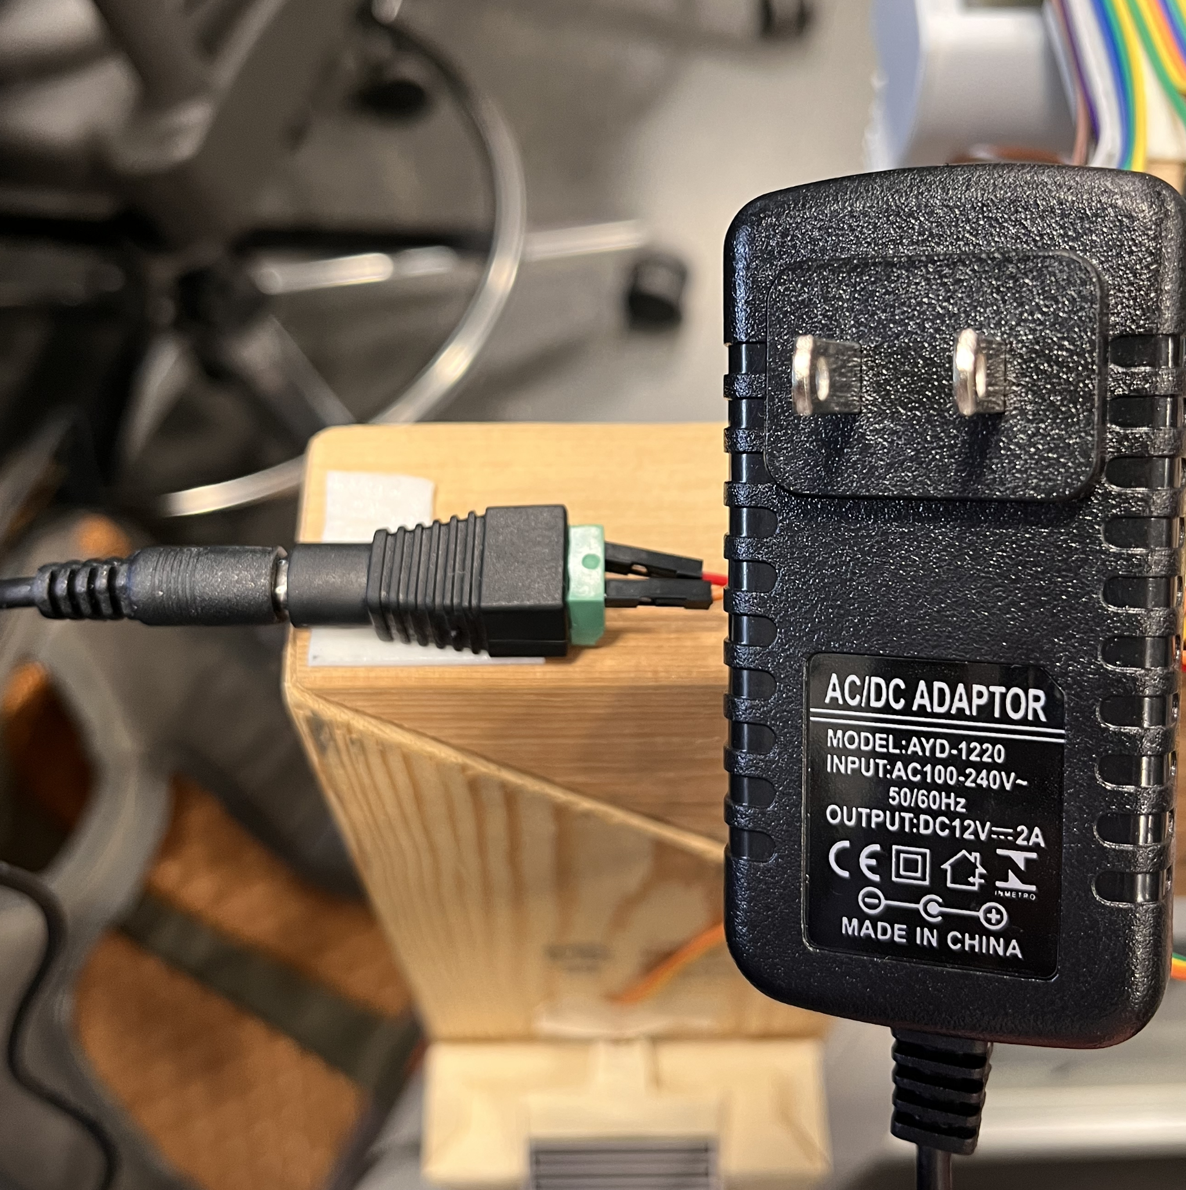
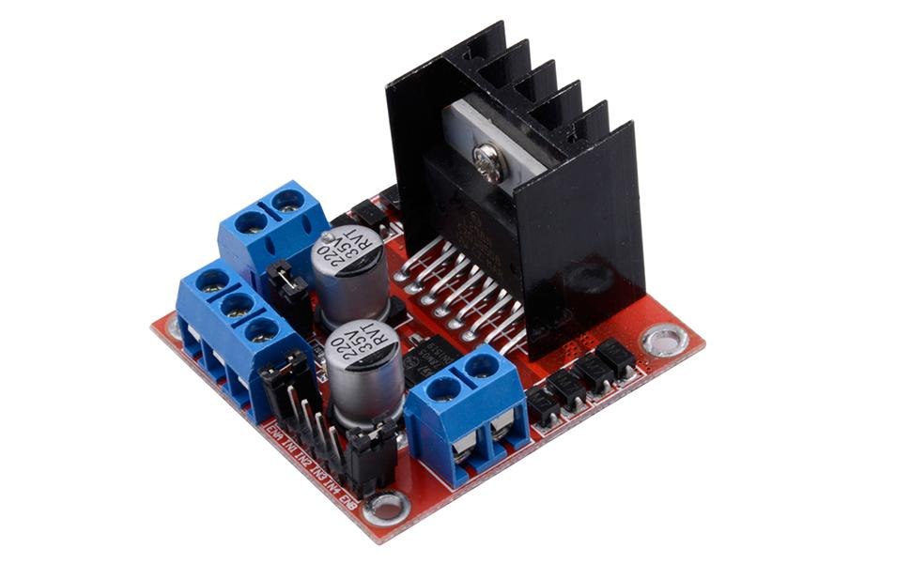
High-Level Design
Power Module
Power Adaptor Converter
110V AC to 12V DC
Motor Driver (5V output)
Provides 5V DC
12V Vcc
GND
5V output
ELECTRICAL & COMPUTER ENGINEERING
GRAINGER ENGINEERING

Slide 15
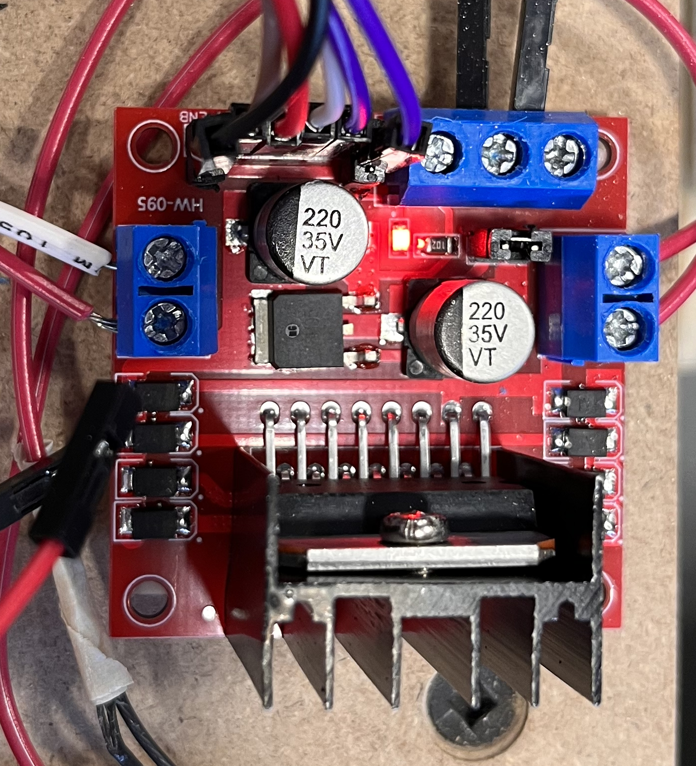
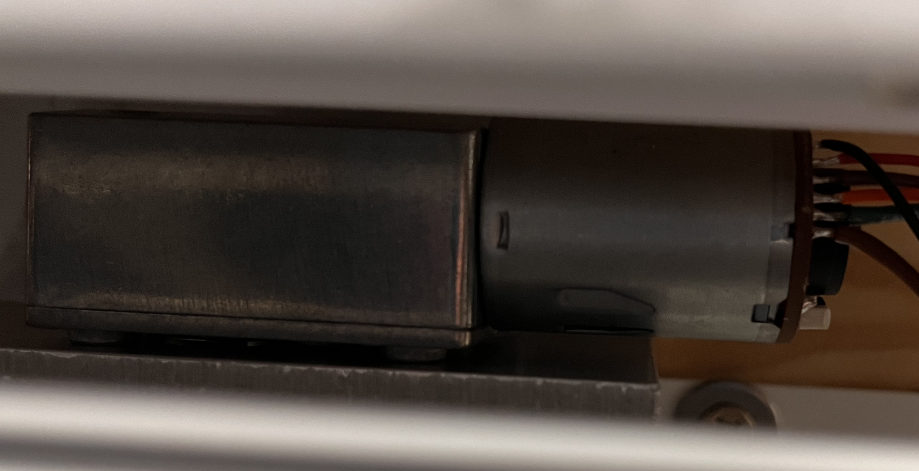
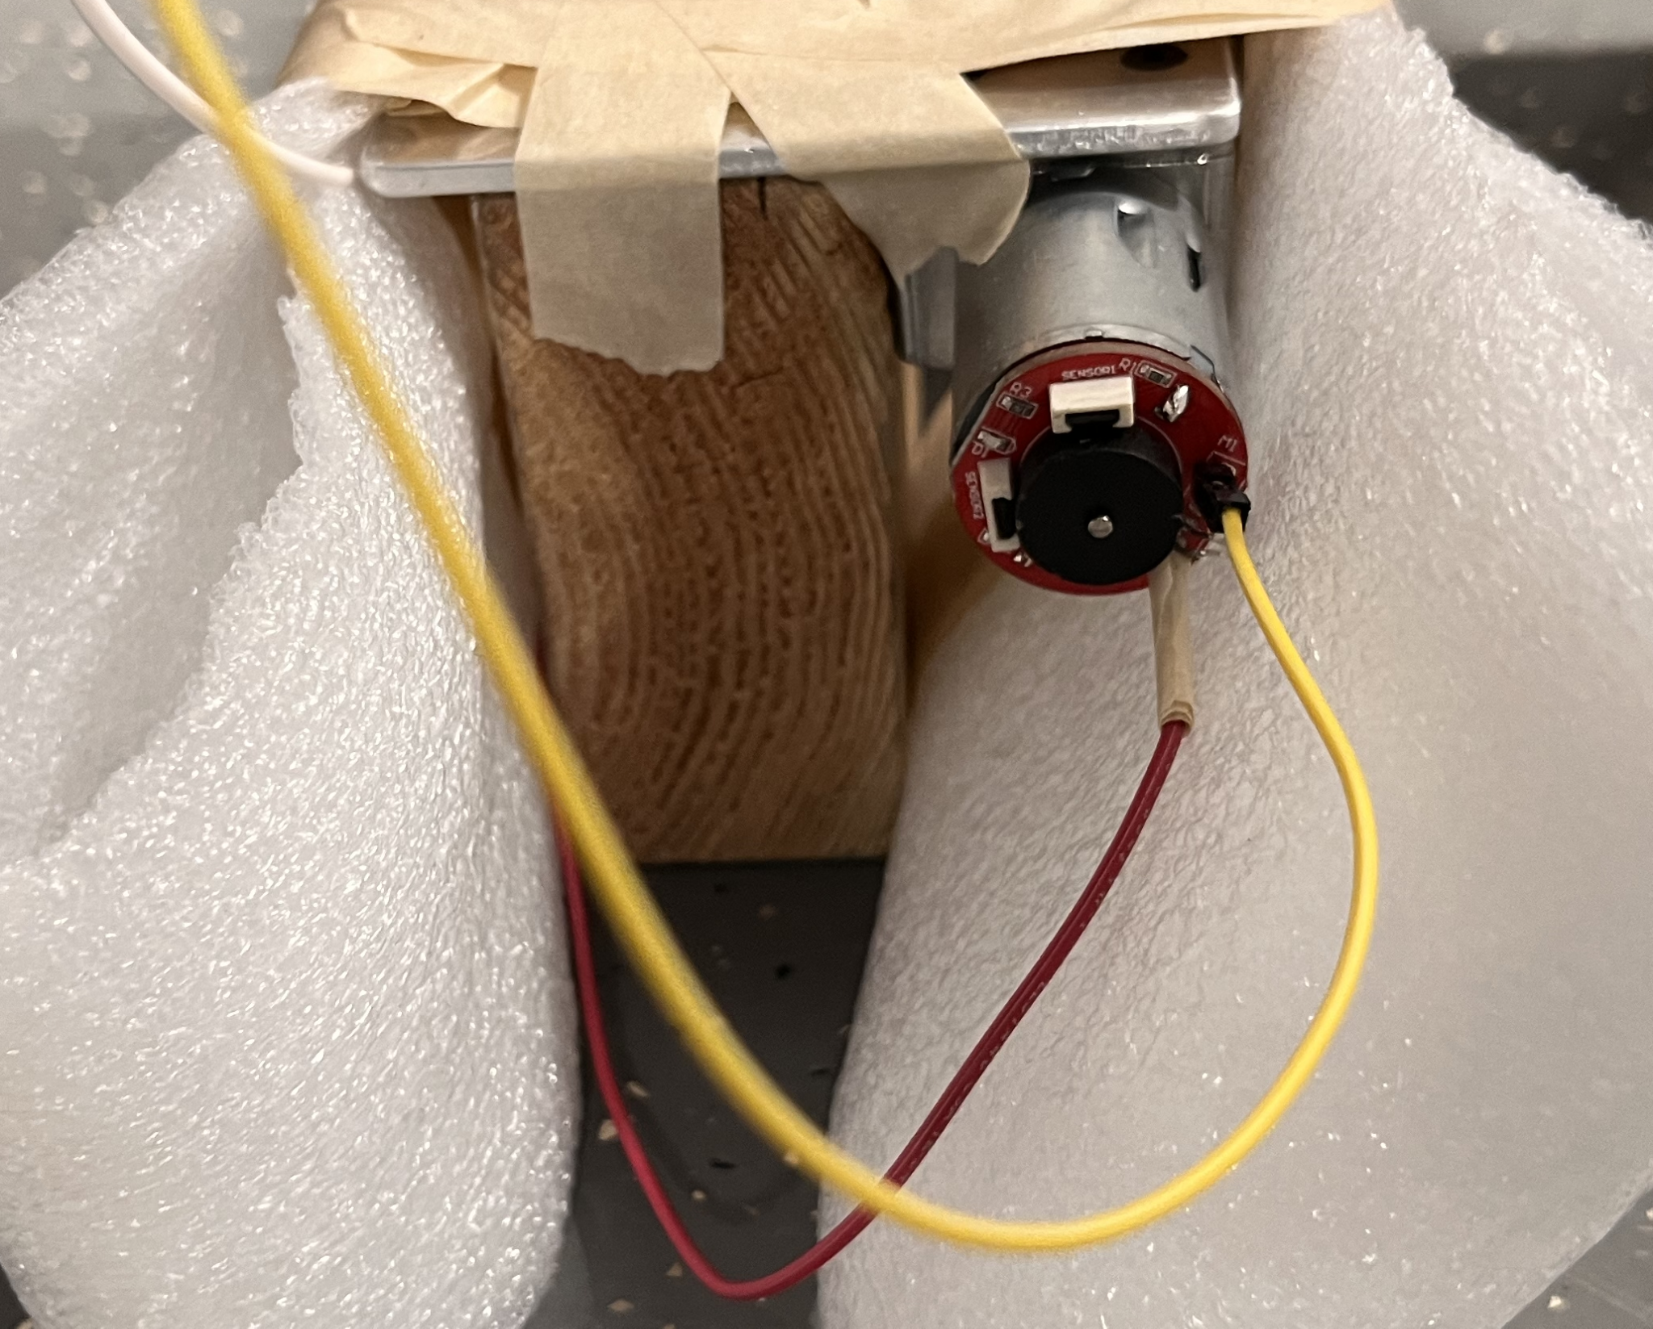
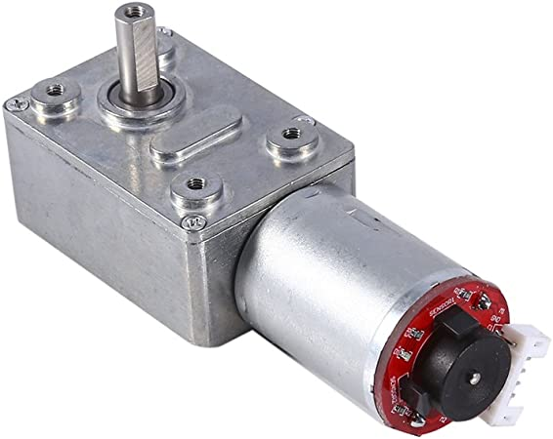
High-Level Design
Motor Module
Motor driver
Control the direction and speed
of the motor
Window / Curtain motor
12V DC 100RPM motor
ELECTRICAL & COMPUTER ENGINEERING
GRAINGER ENGINEERING

Slide 16
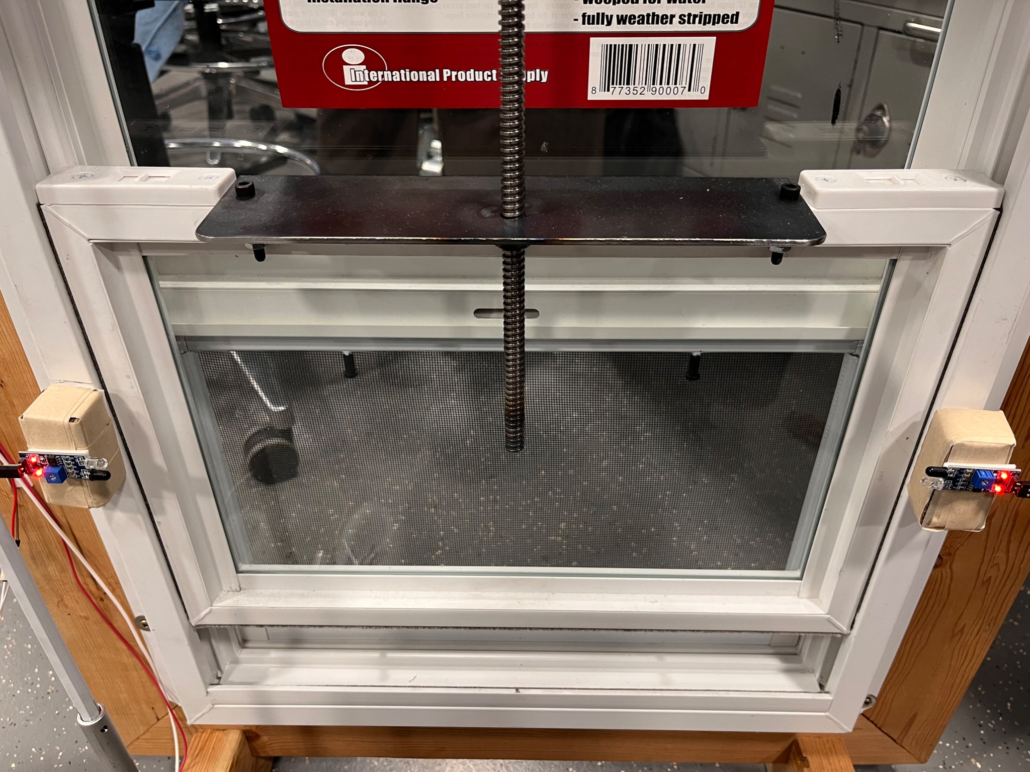
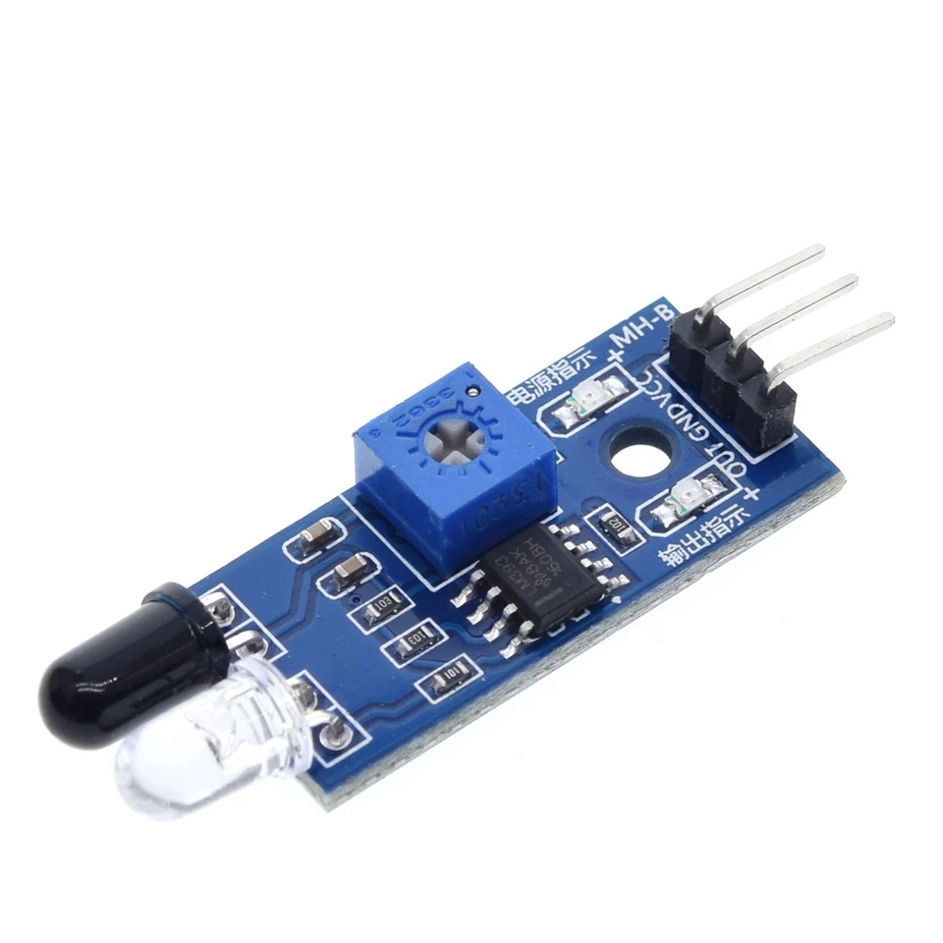
High-Level Design
Safety Module
IR sensors
Responds within 0.5 second
ELECTRICAL & COMPUTER ENGINEERING
GRAINGER ENGINEERING

Slide 17
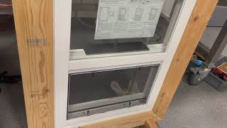
ELECTRICAL & COMPUTER ENGINEERING
GRAINGER ENGINEERING

Slide 18
Success and Challenges
ELECTRICAL & COMPUTER ENGINEERING
GRAINGER ENGINEERING

Slide 19
Success and Challenges
Success
Able to process all sensors’ data input
Close and open the window under correct conditions
Close the curtain when it is dark outside to protect privacy
ELECTRICAL & COMPUTER ENGINEERING
GRAINGER ENGINEERING

Slide 20
Success and Challenges
Challenges
Uploading code to the Microcontroller
Setting the right noise sensor threshold
Motor Control (Direction, Speed)
ELECTRICAL & COMPUTER ENGINEERING
GRAINGER ENGINEERING

Slide 21
Conclusions
ELECTRICAL & COMPUTER ENGINEERING
GRAINGER ENGINEERING

Slide 22
Conclusions
Things We Learn
Analog & digital data
Signal communication protocol
Motor control
What Would We Do Differently
Solar panels with batteries
More Button interaction (we can manually control more!)
ELECTRICAL & COMPUTER ENGINEERING
GRAINGER ENGINEERING

Slide 23
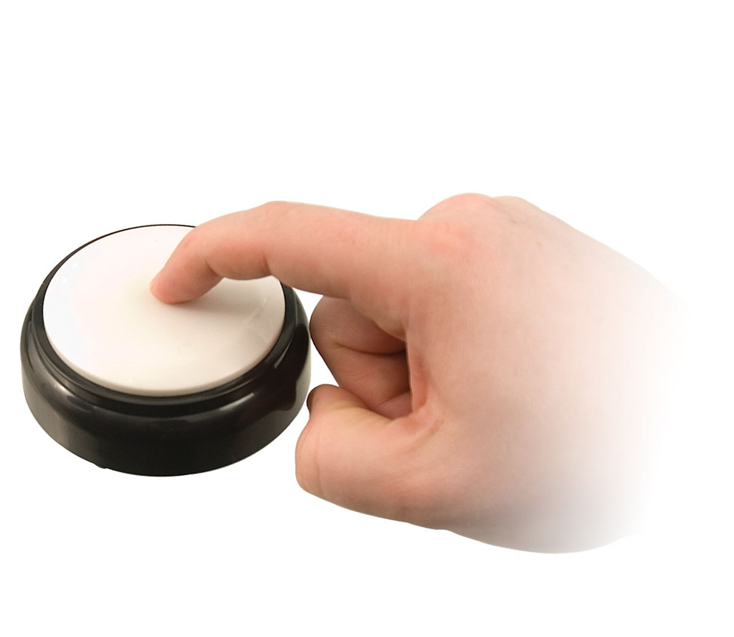
Conclusions
Future Work
With the suggestions from professor and TAs, we have a few improvements that we can implement:
Digital Screen (Allow user interface and user input)
Accessible Button (Bigger one!)
More IR sensor (180 degree well-rounded full window protection)
Well decorated (commercial-level packaging and coloring)
ELECTRICAL & COMPUTER ENGINEERING
GRAINGER ENGINEERING

Slide 24
Questions?
ELECTRICAL & COMPUTER ENGINEERING
GRAINGER ENGINEERING

