Slide 1
AutoLug
An Auto-following Luggage Platform
David Chen
Lyuxing He
05/03/2023

Slide 2
Review - Objective
Problem:
Sometimes luggages are too cumbersome to be carried around.
Solution:
An autonomous luggage carrying platform!
Advantage:
Budget saving
Versatile
Universal
ELECTRICAL & COMPUTER ENGINEERING
GRAINGER ENGINEERING

Slide 3
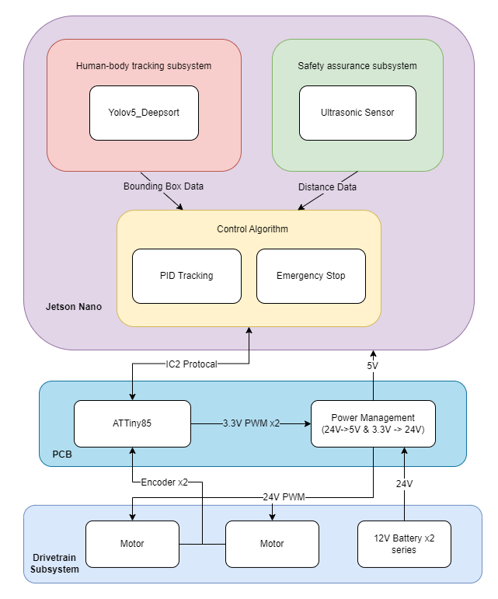
Review - Original Design
Drivetrain
Carry weights up to 20kg and maintain speed of 2-4 mph
Control
Maintain constant set speed + steering according to deviation angle
Human-body identification
Identify the owner and provide bounding box data to Control
Safety assurance
Detect Obstacles in front of the robot and stop vehicle immediately
ELECTRICAL & COMPUTER ENGINEERING
GRAINGER ENGINEERING

Slide 4
Review - Original Design
Drivetrain
Carry weights up to 20kg and maintain speed of 2-4 mph
Control
Maintain constant set speed + steering according to deviation angle
Human-body identification
Identify the owner and provide bounding box data to Control
Safety assurance
Detect Obstacles in front of the robot and stop vehicle immediately
ELECTRICAL & COMPUTER ENGINEERING
GRAINGER ENGINEERING

Slide 5
Review - Original Design
Drivetrain
Carry weights up to 20kg and maintain speed of 2-4 mph
Control
Maintain constant set speed + steering according to deviation angle
Human-body identification
Identify the owner and provide bounding box data to Control
Safety assurance
Detect Obstacles in front of the robot and stop vehicle immediately
ELECTRICAL & COMPUTER ENGINEERING
GRAINGER ENGINEERING

Slide 6
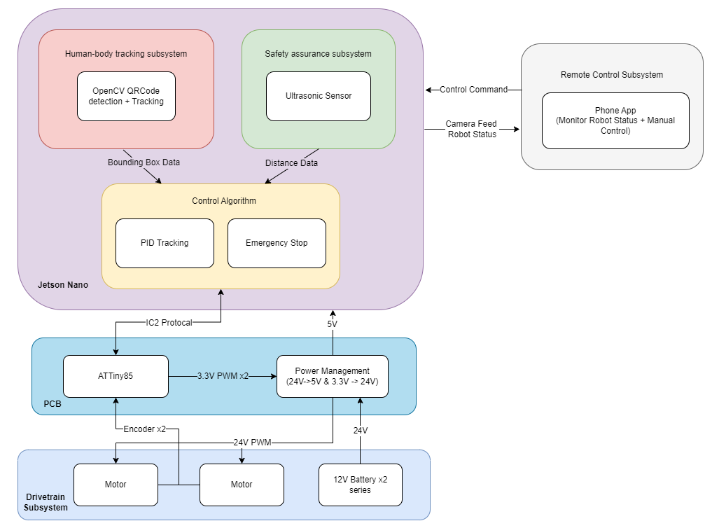
Review - Final Design
Human-body identification
Human Identification too unstable
Changed to QR code tracking
Remote Control
A phone app that communicates with Jetson Nano through WiFi
Allow user to manually drive AutoLug and watch the camera feed.
ELECTRICAL & COMPUTER ENGINEERING
GRAINGER ENGINEERING

Slide 7
Review - Final Design
Human-body identification
Human Identification too unstable
Changed to QR code tracking
Remote Control
A phone app that communicates with Jetson Nano through WiFi
Allow user to manually drive AutoLug and watch the camera feed.
ELECTRICAL & COMPUTER ENGINEERING
GRAINGER ENGINEERING

Slide 8
Review - Final Design
Human-body identification
Human Identification too unstable
Changed to QR code tracking
Remote Control
A phone app that communicates with Jetson Nano through WiFi
Allow user to manually drive AutoLug and watch the camera feed.
ELECTRICAL & COMPUTER ENGINEERING
GRAINGER ENGINEERING

Slide 9
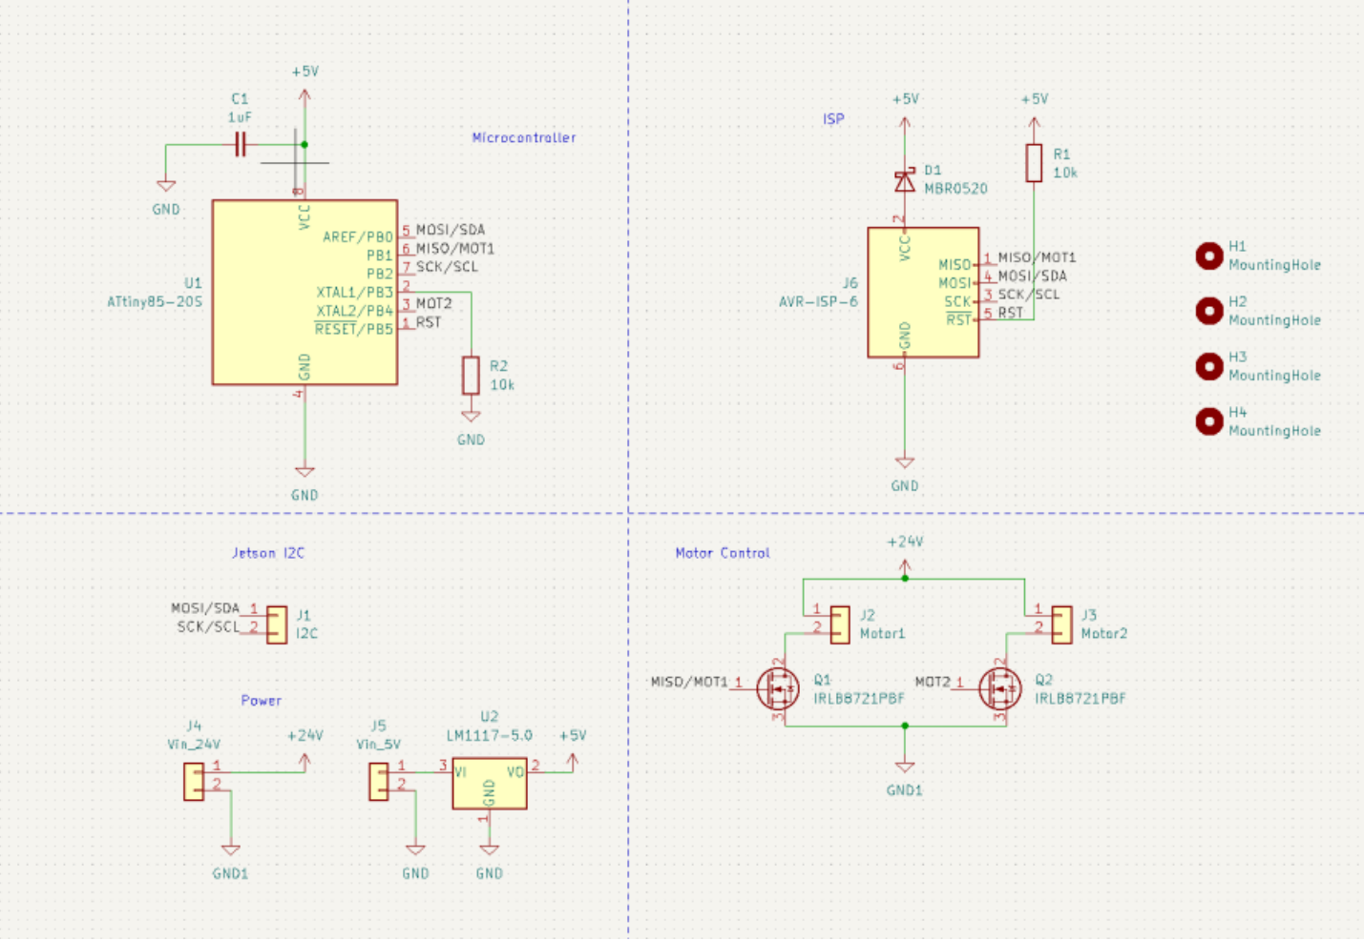
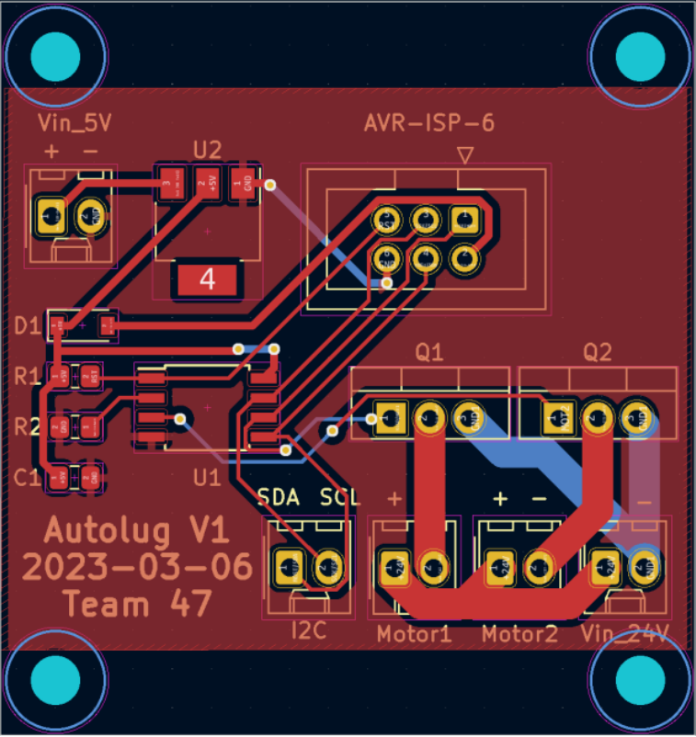
PCB Design
ELECTRICAL & COMPUTER ENGINEERING
GRAINGER ENGINEERING

Slide 10
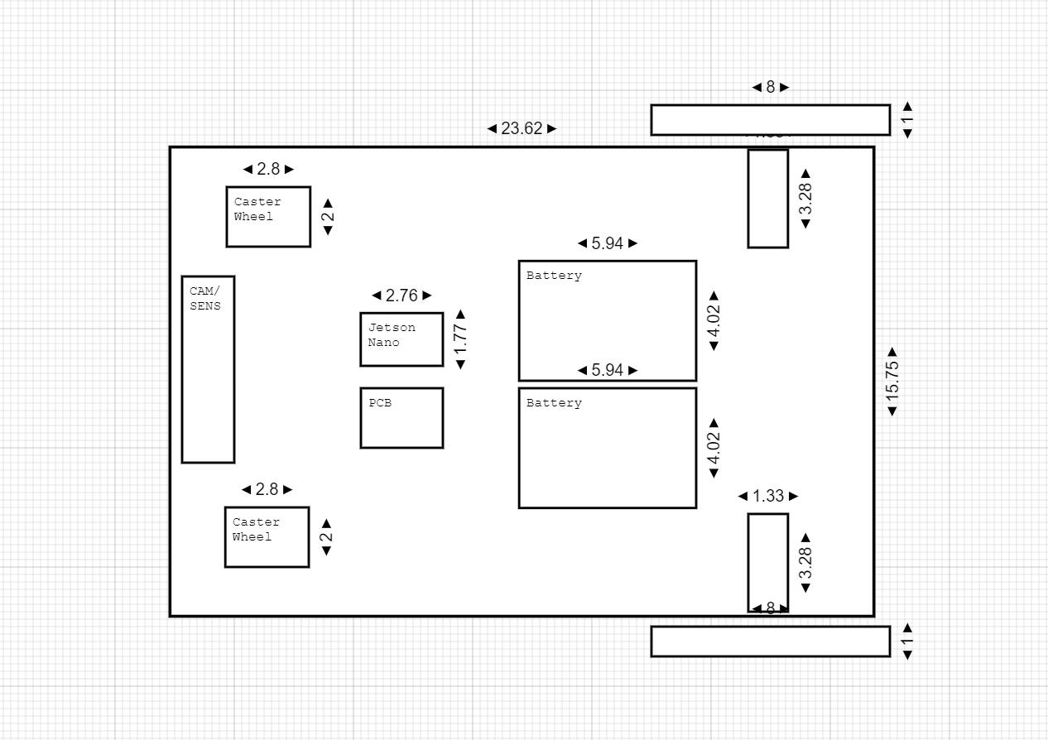
Mechanical Layout
ELECTRICAL & COMPUTER ENGINEERING
GRAINGER ENGINEERING

Slide 11
Robot Build
Jumping straight to our result!
ELECTRICAL & COMPUTER ENGINEERING
GRAINGER ENGINEERING

Slide 12
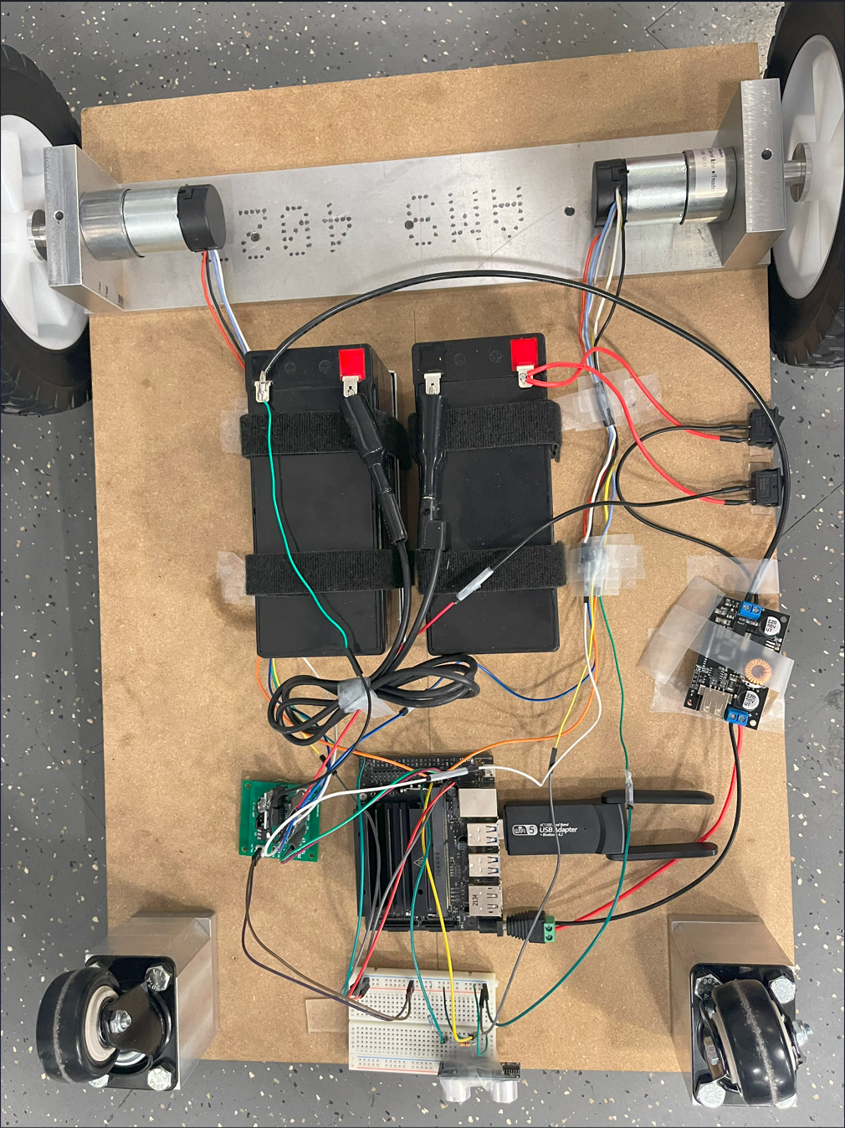
Assembled AutoLug (Bottom View)
ELECTRICAL & COMPUTER ENGINEERING
GRAINGER ENGINEERING

Slide 13
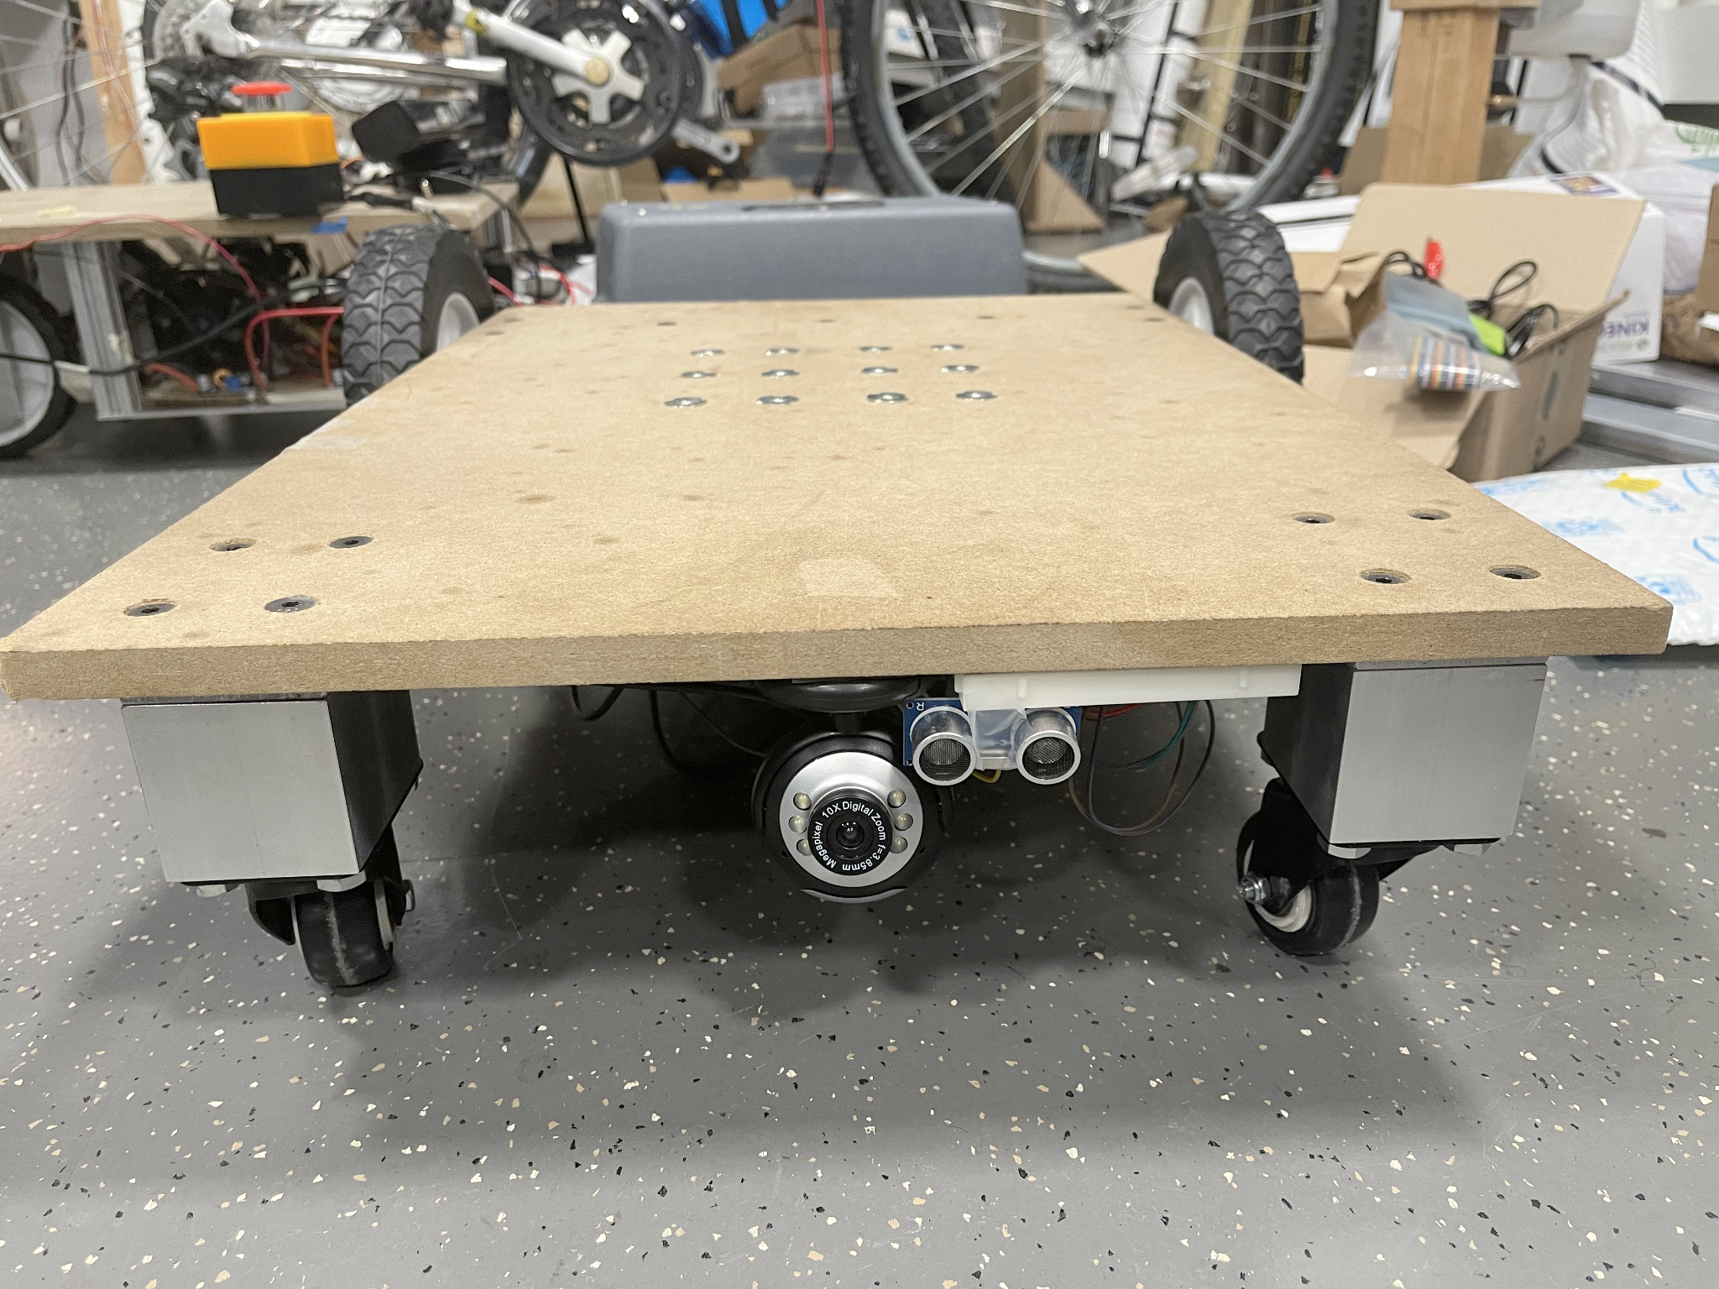
Robot Build
Front View
ELECTRICAL & COMPUTER ENGINEERING
GRAINGER ENGINEERING

Slide 14
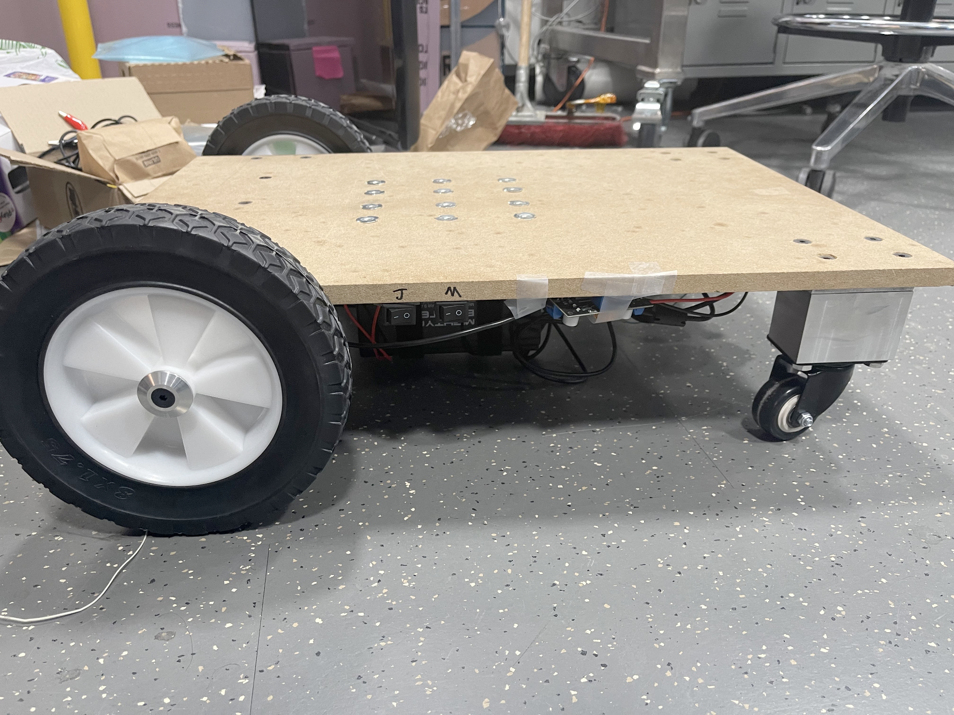
Robot Build
Side View
ELECTRICAL & COMPUTER ENGINEERING
GRAINGER ENGINEERING

Slide 15
Video Demonstration
ELECTRICAL & COMPUTER ENGINEERING
GRAINGER ENGINEERING

Slide 16
Test & Verification
ELECTRICAL & COMPUTER ENGINEERING
GRAINGER ENGINEERING

Slide 17
Drivetrain Verification
Test:
Does the battery have sufficient power to sustain AutoLug for running at least 30 min actively.
Result:
The battery is able to sustain AutoLug when running at 4mph for at least 1 hour without charging.
Note that, according to the manufacturer, the single 12V battery needs to be charged when the voltage reading drops under 11V. (https://www.raiongroup.com/content/RG1290T2.pdf)
Discharge Time (min) | 15 | 30 | 45 | 60
Voltage Reading (V) | 24.21 | 24.06 | 23.96 | 23.87
ELECTRICAL & COMPUTER ENGINEERING
GRAINGER ENGINEERING

Slide 18
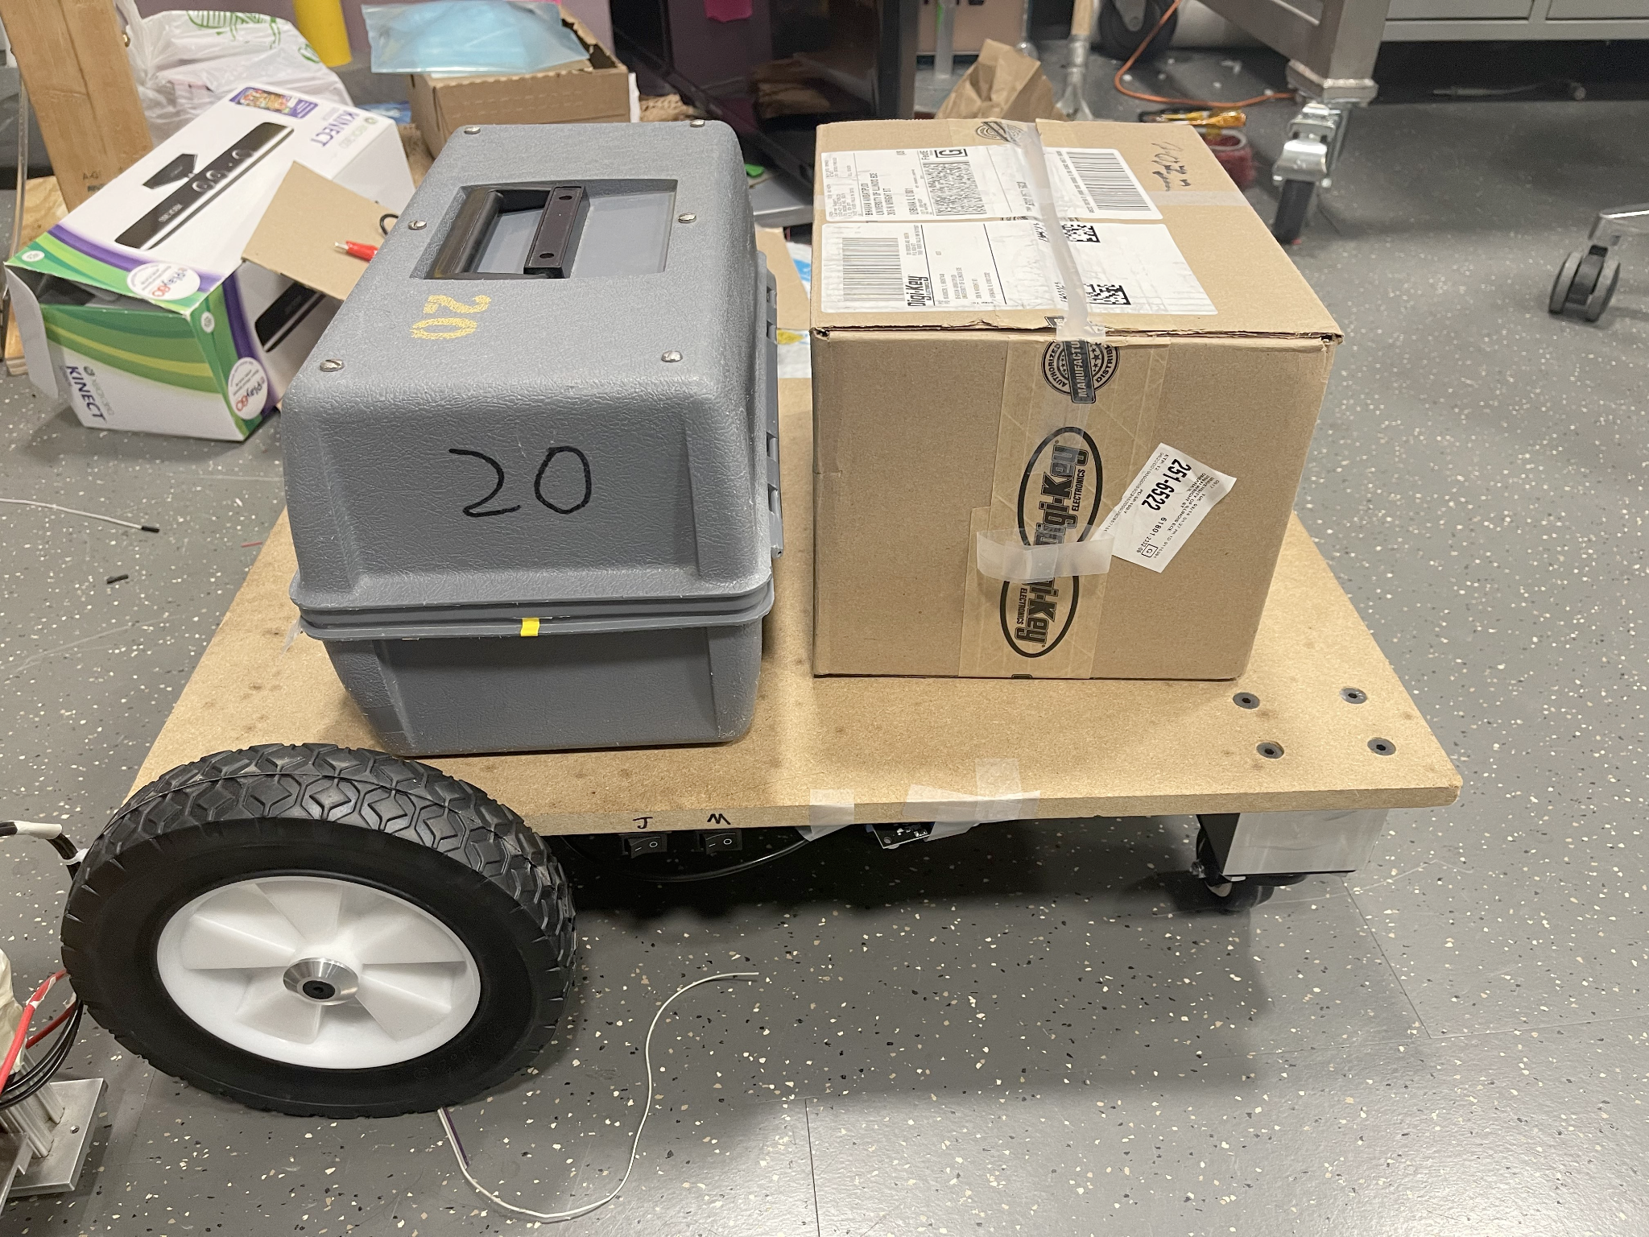
Drivetrain Verification
Test:
Load 20kg of weight on to the platform and let it run at 1m/s
Result:
With the weight loaded, the platform is still able to drive up to 2 m/s (4 mph) under the manual control mode.
ELECTRICAL & COMPUTER ENGINEERING
GRAINGER ENGINEERING

Slide 19
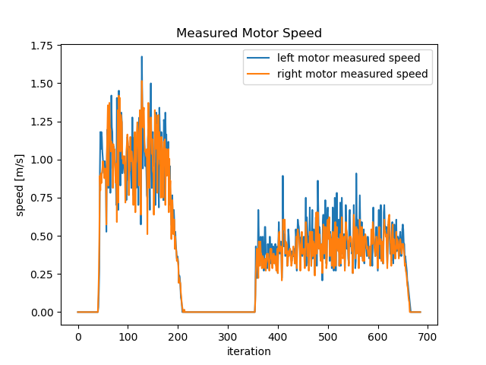
Control Subsystem Verification
Test:
Is set velocity maintained?
Result:
The mean of measured speed when set to 1 m/s is 0.97 m/s, and the mean of measured speed when set to 0.5 m/s is 0.49 m/s. As shown in the plot on the right, the average speed is approximately the set velocity, with some fluctuations in the speed
Set Speed to 1m/s
Set Speed to 0.5m/s
ELECTRICAL & COMPUTER ENGINEERING
GRAINGER ENGINEERING

Slide 20
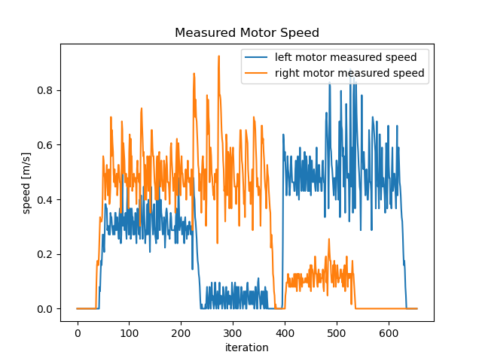
Control Subsystem Verification
Test:
Is left and right motors speed changing according to set deviation angle?
Result:
Motor respond correctly to changing deviation angle.
-17°
-45°
33°
45°
ELECTRICAL & COMPUTER ENGINEERING
GRAINGER ENGINEERING

Slide 21
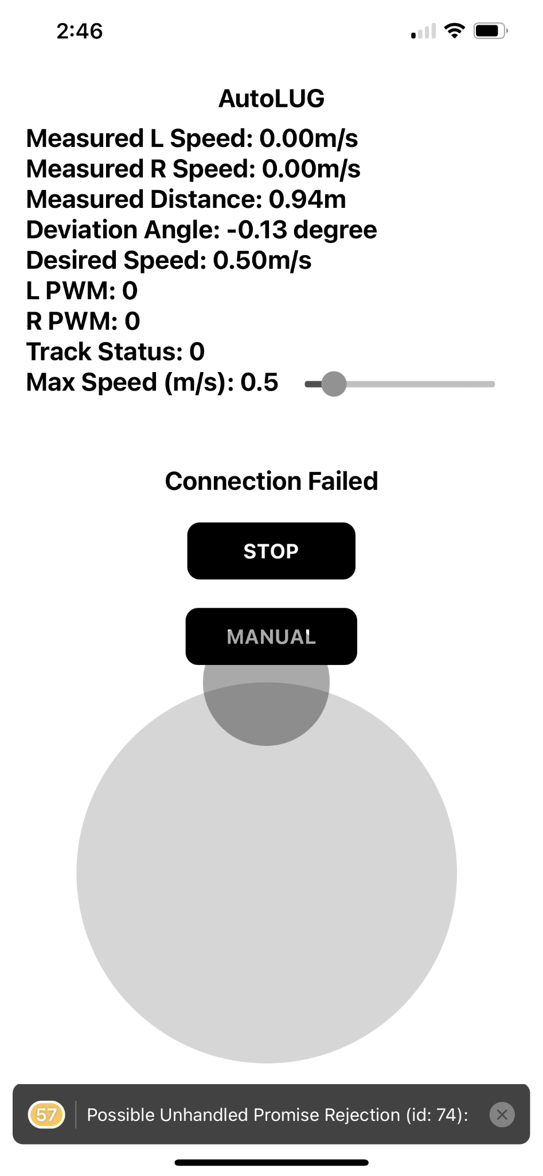
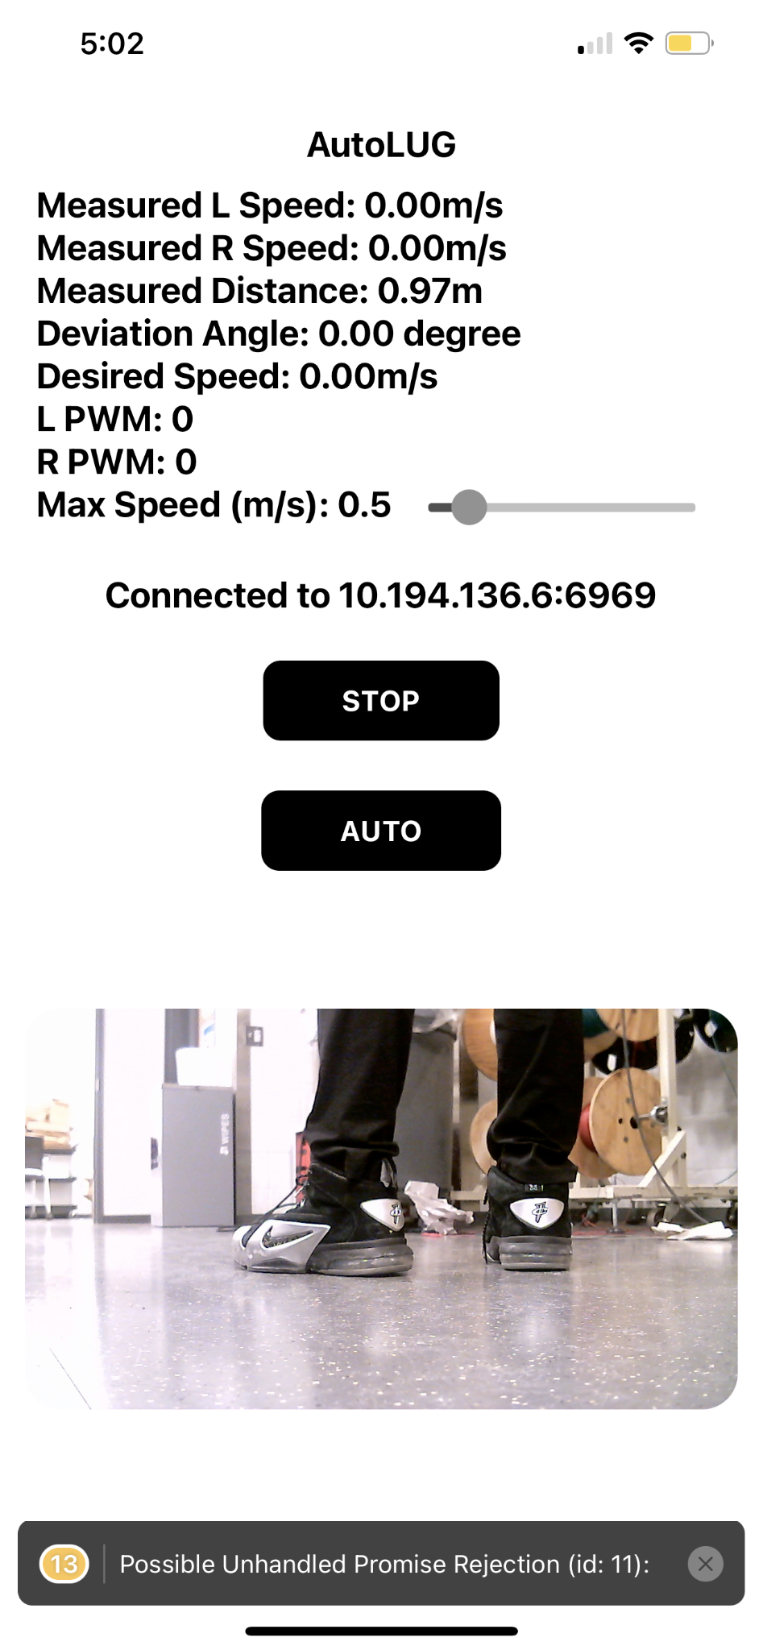
Remote Control Subsystem Verification
Test:
Can read stats from robot
Can send controls to robot
Can receive camera view from robot
Result:
All passed
ELECTRICAL & COMPUTER ENGINEERING
GRAINGER ENGINEERING

Slide 22
Human-body Identification Verification
Test
Is AutoLug able to correctly identify its owner under various settings with above 90% accuracy?
Result:
AutoLug is only capable of correctly identifying its owner with more than 90% accuracy under one scenario.
 | Single Human | Multiple Humans
Non-distracting settings (5m) | 97.89% | 97.72%
Non-distracting settings (10m) | 67.12% | 63.77%
Irrelevant Objects (5m) | 96.63% | 97.02%
Strong Ambient Light (5m) | 81.12% | 79.54%
No Ambient Light (5m) | 74.88% | 66.51%
Note: Accuracy is measured as Accuracy = Corrected Identified Frame / Total processed Frame over a tracking period of 30 seconds with processing rate of 20 FPS, where the target human is always present in the frame. The reported accuracy is averaged over 5 trials.
ELECTRICAL & COMPUTER ENGINEERING
GRAINGER ENGINEERING

Slide 23
Safety Assurance Subsystem Verification
Test
Is AugoLug able to avoid collisions with obstacles (higher than 1 inch) with 90% safety distance away (40 cm) from the target.
Result:
AutoLug is able to ensure safety with concrete obstacles but fail to do so with humans.
Note:
AutoLug is initially placed at 5m away from the test subject for all trails in this test.
All entries are measured stopping distance away from the test subject averaged over 10 trials. (0 cm indicates collision)
Speed (m/s)
 | 0.25 | 0.5 | 1 | 1.5
Human | 0.46 | 0.28 | 0 | 0
Wall | 0.47I | 0.45 | 0.43 | 0.41
Glass Wall | 0.46 | 0.46 | 0.43 | 0.40
Test Subject
ELECTRICAL & COMPUTER ENGINEERING
GRAINGER ENGINEERING

Slide 24
Lesson Learned
ELECTRICAL & COMPUTER ENGINEERING
GRAINGER ENGINEERING

Slide 25
Success and Failures
What we succeeded:
Drivetrain subsystem:
Sufficient torque
Sufficient battery life
Control subsystem:
Small tracking deviation
Correct output speed
What we failed:
Control subsystem:
Unable to actively re-locate the owner (limited moving space)
Human identification subsystem
Unable to identify the owner with more than 90% accuracy (sensitive algorithm, hardware)
Safety assurance subsystem:
Unable to always avoid collisions with humans (limitations of ultrasonic sensor)
ELECTRICAL & COMPUTER ENGINEERING
GRAINGER ENGINEERING

Slide 26
Conclusions
What we learned:
I2C communication channels should be separated (as far as possible) away from the rest of the PCB to avoid signal interference
Always protect transistors from back emf caused by motors using flash back diodes
Deep Learning based object detection is not as reliable as conventional algorithms in embedded systems setting
What we would do differently:
Use wide angle sport camera to achieve less blurry image for better tracking
Incorporate all sensors (ultrasonic sensors buck converter, etc.) in our PCB design
Use LiDAR instead of ultrasonic sensor to have wide range of obstacle sensing scope
ELECTRICAL & COMPUTER ENGINEERING
GRAINGER ENGINEERING

Slide 27
Further Work
Some future work:
Add Kalman Filter to all sensors data to improve the smoothness of PID controls
Use few-shots object detection to actually track real human without the aid of QR code
Implement a depth estimation algorithm to avoid obstacles
Reduce robot size and reduce turn radius
ELECTRICAL & COMPUTER ENGINEERING
GRAINGER ENGINEERING

Slide 28
Thank You For Listening!
Any Questions?
David Chen sc60@illinois.edu
Lyuxing He lyuxing2@illinois.edu
ELECTRICAL & COMPUTER ENGINEERING
GRAINGER ENGINEERING

