Slide 1
Automatic Beverage Bottle Sorter
Group #5 Jiajun Huang, Joe Yu, Jingjie He
Dec. 5th, 2023

Slide 2
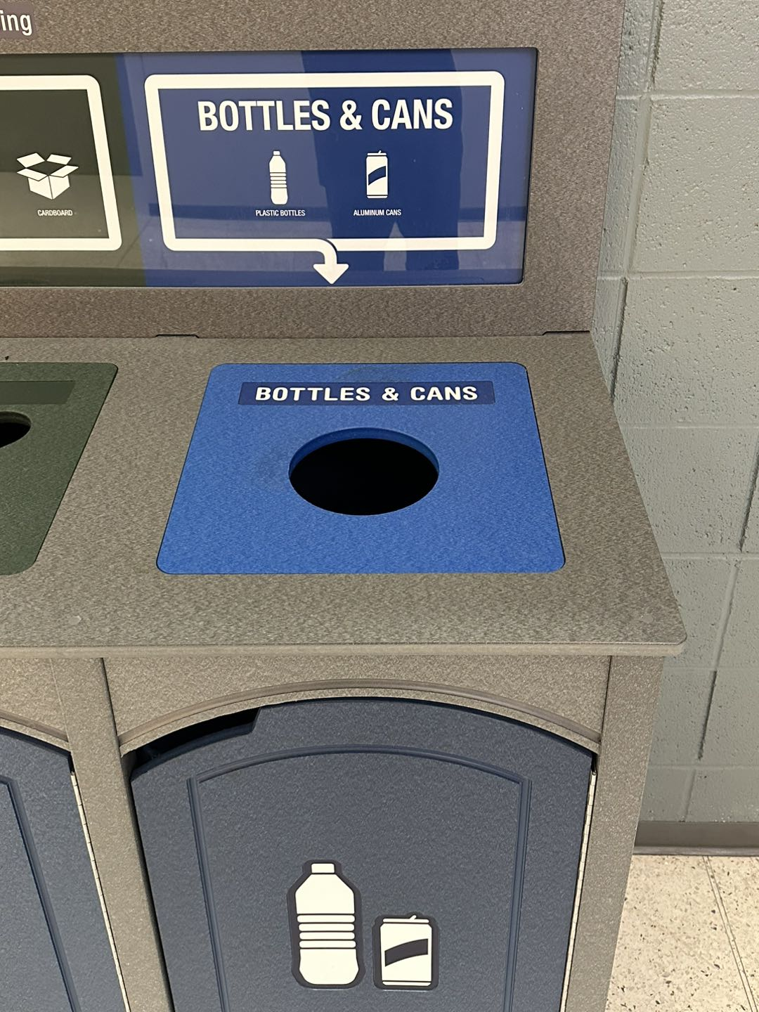
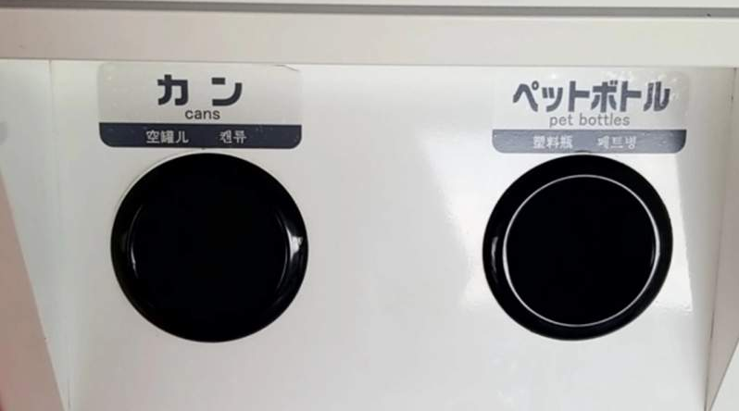
Problem
Garbage bins in ECEB don't separate plastic and metal
People may not follow instructions on the garbage bin

Slide 3
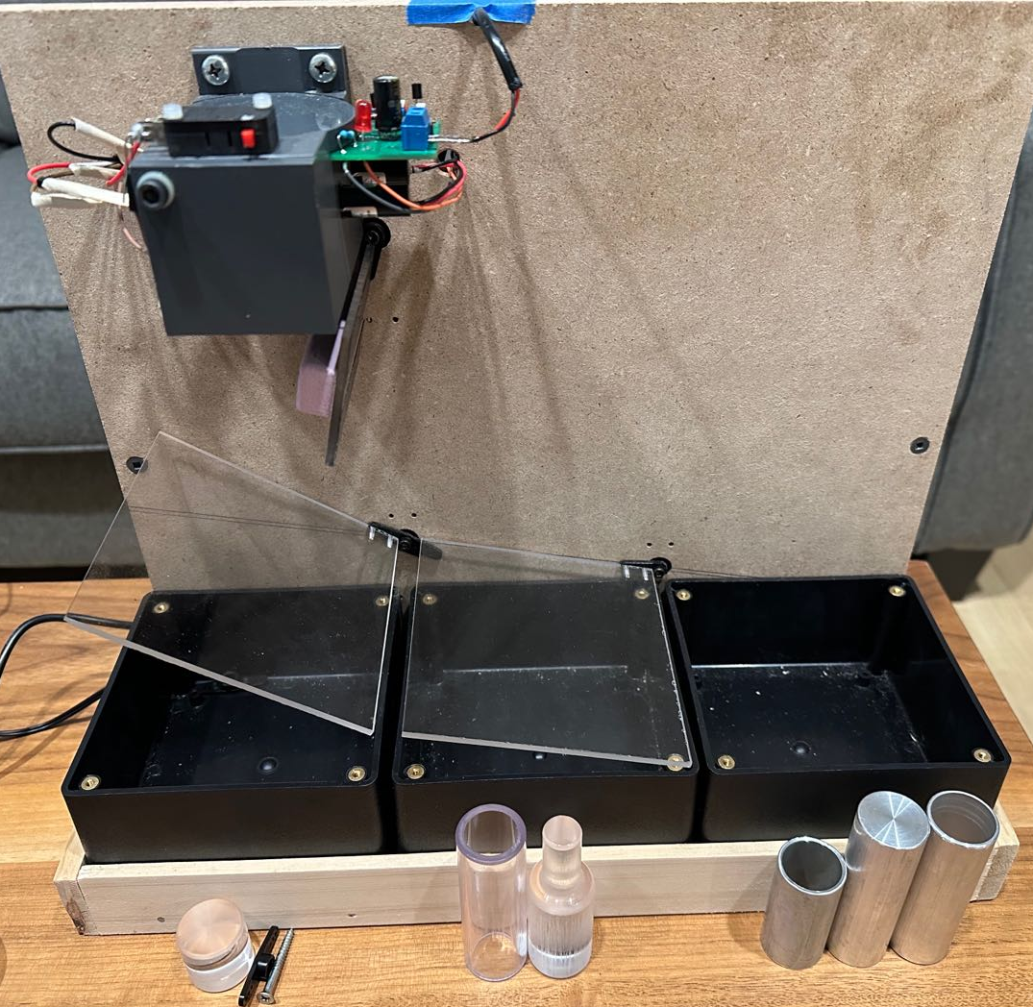
Solution
A garbage bin with an automatic sorting system
Sort metal cans, plastic bottles, or others and sorted into three separate bins
No need for instruction on garbage bins
No need for extra labor for sorting

Slide 4
High level requirements
The system start sorting process after an object is inserted and finished analysis less than 40 seconds.
Our scaled down model should sort objects that are less than 1 inch in diameter and 3 inch in length.
It should correctly sort plastic bottles, metal cans, and others into three different bins.

Slide 5
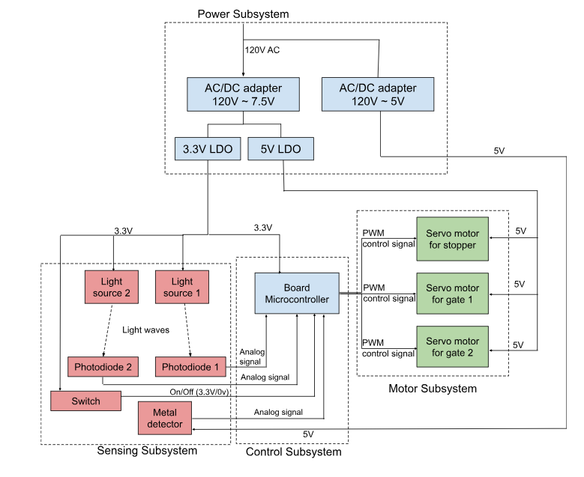
Block Diagram

Slide 7
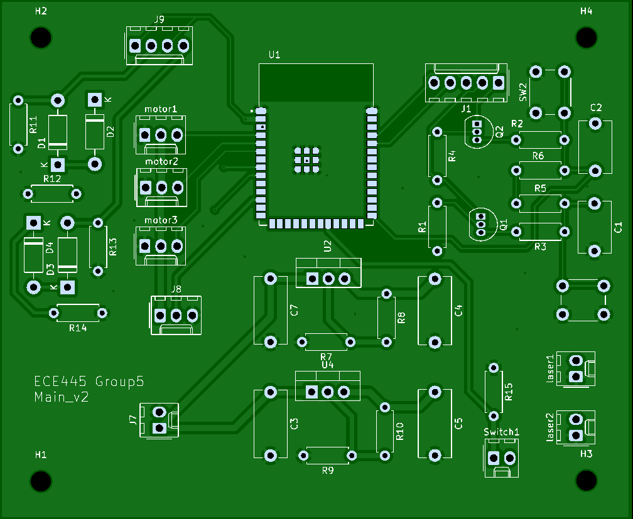
PCB
Motors
ESP-32
Photo diode
Laser diode
Metal Detector
Switch
LDO

Slide 8
PCB Cont.

Slide 9
Subsystems & Verification

Slide 10
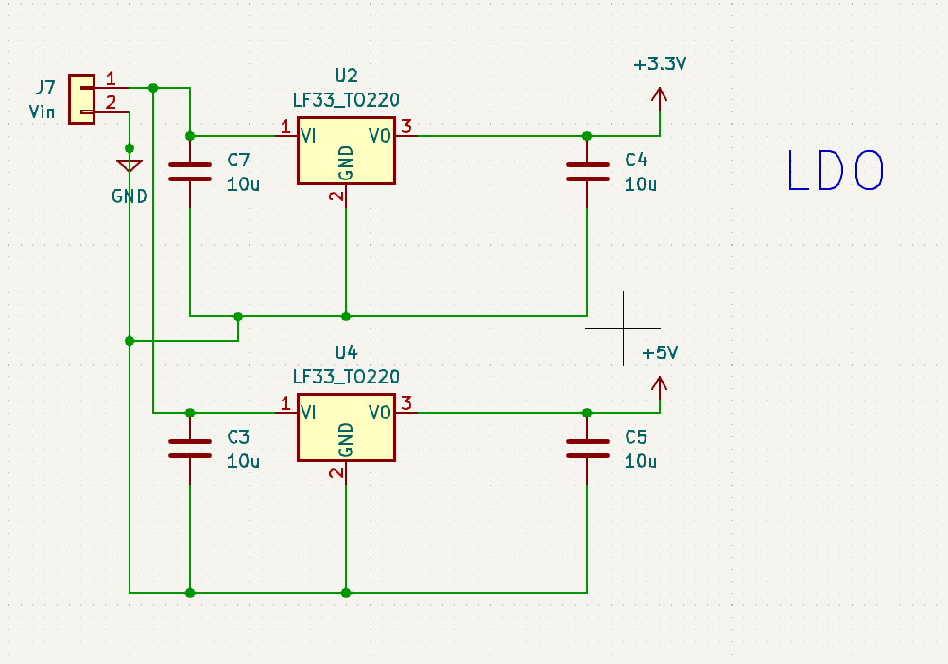
Power subsystem
Power subsystem consisted of a
7.5V AC to DC converter
5V AC to DC converter
LDO with 5V fixed output
LDO with 3.3V fixed output.
The 7.5V AC to DC converter is used to power two LDO and 5V AC to DC converter is used to power the metal detector

Slide 11
Power Subsystem Requirements and Verification
Requirements | Testing Results
A 3.3/5 VDC regulator should provide 3.3/5 VDC +/- 0.1 V with at most 0.5A of current to power the microcontroller and the laser diodes | Output Voltage (3.3V LDO) = 3.3 V Output Voltage (5V LDO) = 5 V
AC/DC converter takes120 VAC as input and outputs 5/7.5VDC +/- 0.2V with 3 A current. | Output Voltage = 5 V Output Voltage = 7.5 V

Slide 12
Challenge of Power subsystem
Why use 2 AC/DC converter?
Future improvements
Operating motor generates noise
Noise affect the performance of metal detector
Use one 7.5 V AC/DC converter with 3 LDOs:
One 3.3 V
Two 5V

Slide 13
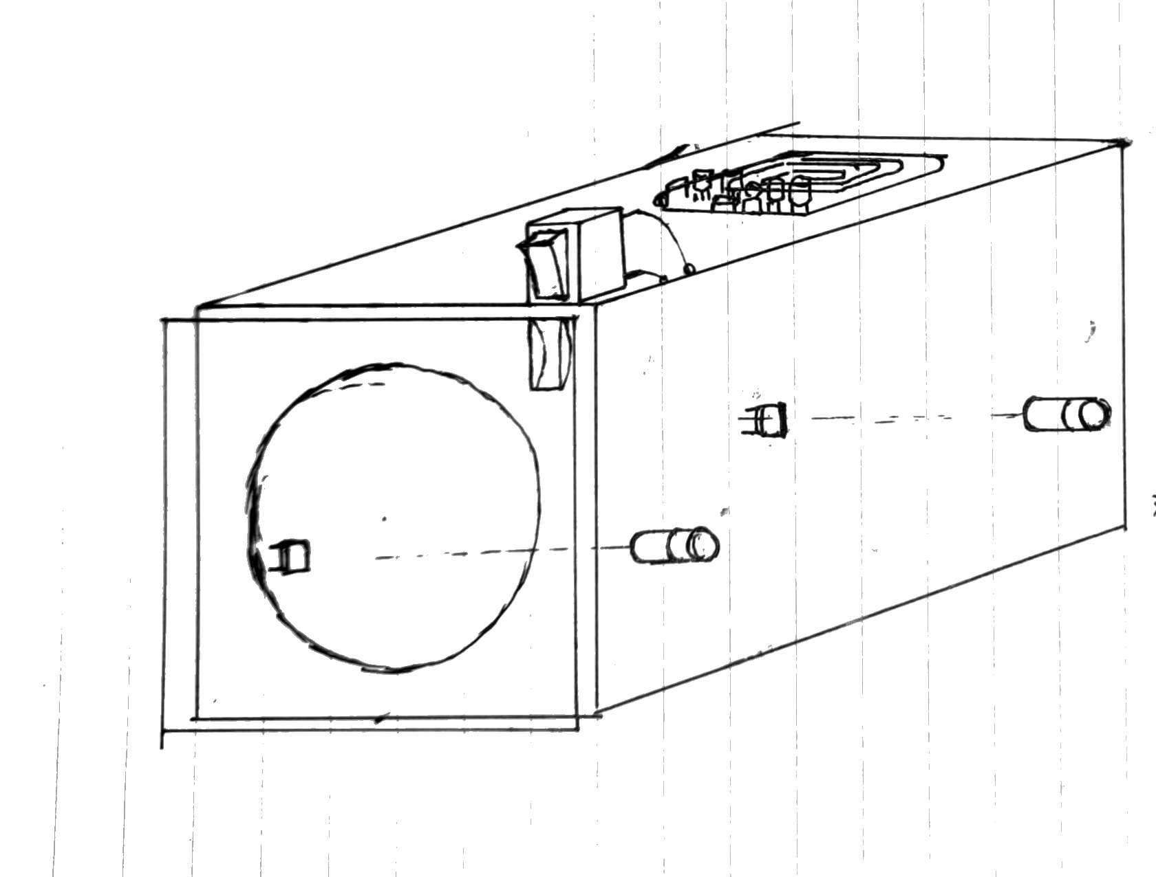
Analysis Chamber Design

Slide 14
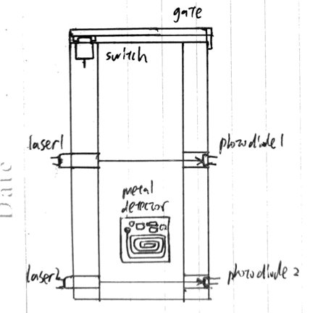
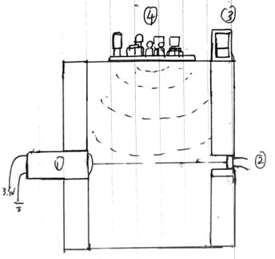
Analysis Chamber Design Cont.
Side View
Top View

Slide 15
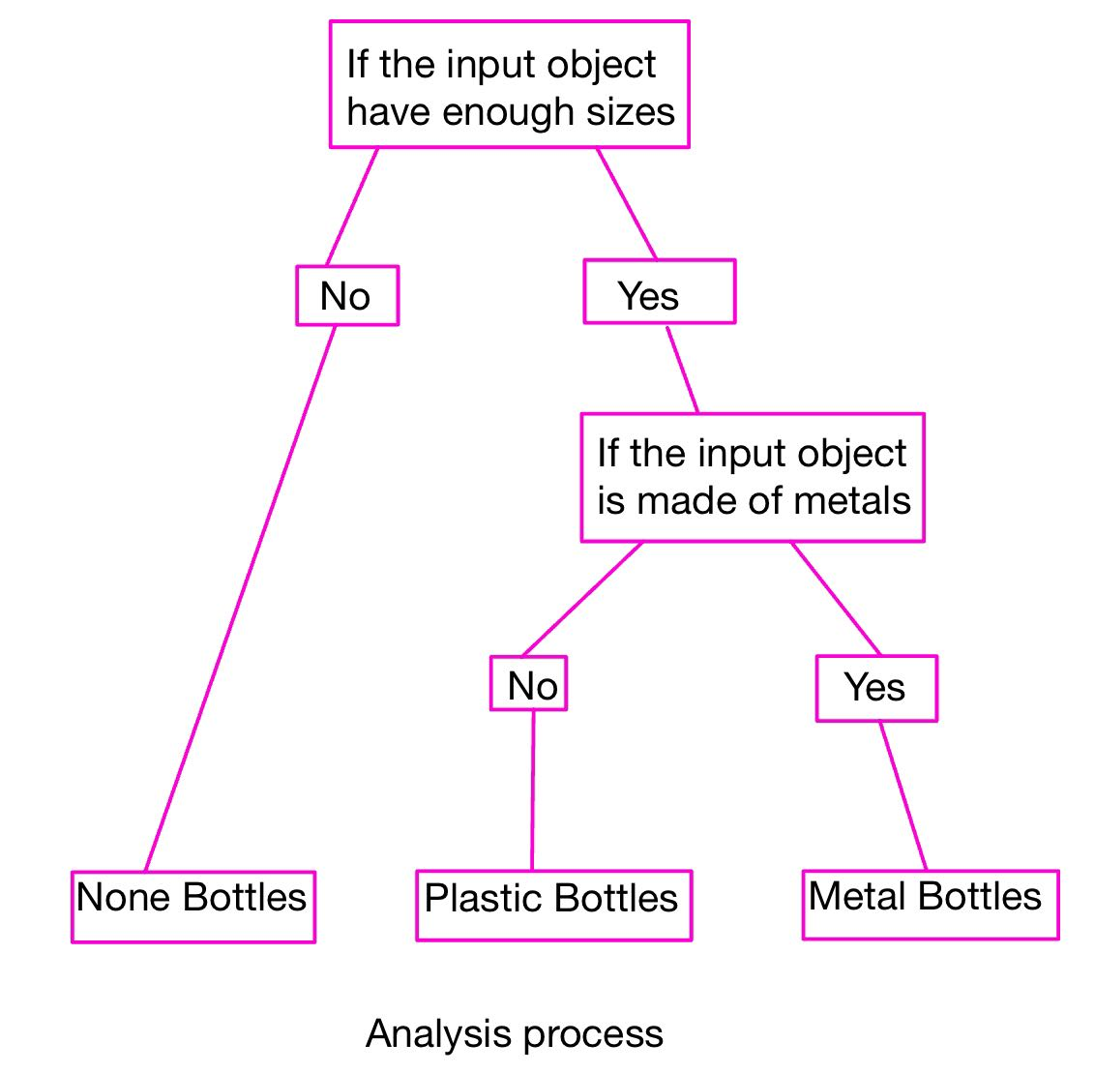
Control Subsystem
ESP32-S3 micro-controller
Mini-usb2UART protocol to load our programs.

Slide 16
Control Subsystem Requirement and Verification
Requirement:
Correctly control the motor with sequential logic
State verification table:

Slide 17
Motor Subsystem
Gate motor is response to close or release the insertion gate,
Ramp Motor 1&2 are carried with ramp that force the bin roll down to the specified location
Driven by pause wave with frequency of 50 HZ
Angle depends on pulse width
We use the <Deneyap_Servo.h> library to send various degree signal to achieve sequential control.

Slide 18
Motor Subsystem Requirement and Verification
Requirements
We expect each motor response to each state with correct angle
The measuring error should stay in requirements ± 1 degree
Angle verification

Slide 19
Sensing Subsystem
.
The sensing subsystem is composed of:
Two photo detector determine the shape of the bottle
The metal detector detect the material of the object
The switch detects the motion of the gate to know something is inserted in

Slide 20
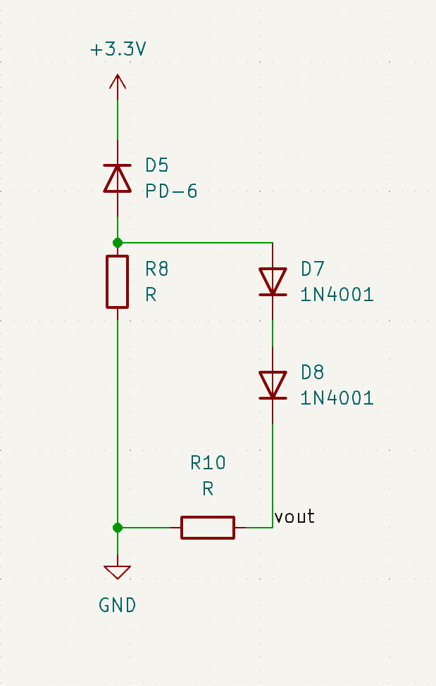
Sensing Subsystem: Photo Sensor
Reversed biased photo diode
The beam of the laser is aligned with the photo diode. The voltage output decreased when the laser is blocked by inserted object.

Slide 21
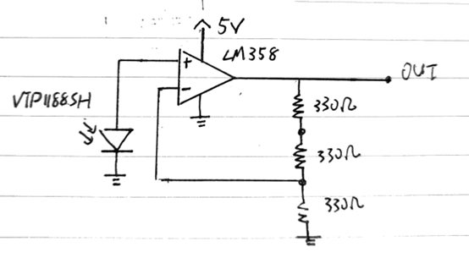
Sensing Subsystem: Photo Sensor (First attempt)
Laser is on | Output voltage
YES | 0.381V
NO | 0.319V

Slide 22
Photodiode Requirements and Verification
Requirements
Light sensing system should have at least 5mV change in its output voltage when blocked by plastic bottles. The lowest resolution for the ADC of our microcontroller is 0.56mV.
Test condition | Vout1 | Vout2
Directly hit by laser | 1.4V | 1.9V
Block by single layer of transparent plastic | 0.8V | 1.1V
Laser off | 47mV | 205mV

Slide 23
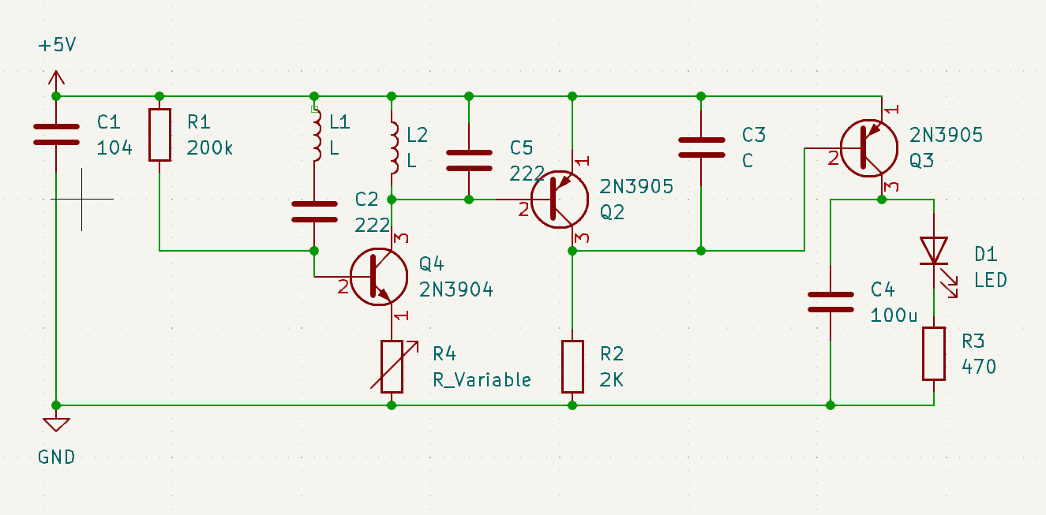
Sensing Subsystem: Metal detector
.
The metal detector produce a AC singal with DC offset. The output value changed when
metal is inserted in and the frequency of AC singal and DC offset will increase. We
processed the output into a DC value within the measurment range of esp32

Slide 24
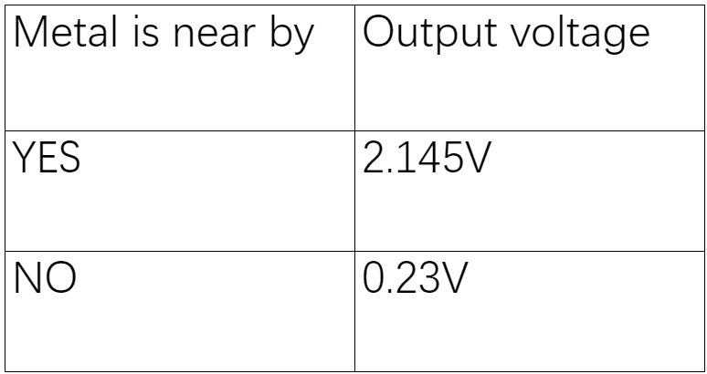
Metal Detector Requirements and Verification
Requirements | Testing Results
Metal detector should have at least 200mV change in its output voltage when metal is inserted. The lowest resolution for the ADC of our microcontroller is 0.56mV.

Slide 25
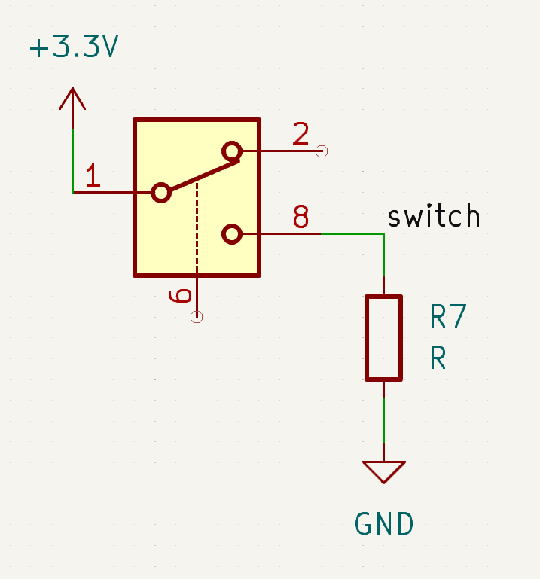
Sensing Subsystem: Switch
The switch connected 3.3 V to a 4700 ohm resistor
The voltage is high when the gate is open.

Slide 26
Thank You!
Question?

