Slide 1
Modular Light Matching Network
ECE 445 Spring 2021:
Group #62: Josh Magid, Elizabeth McKenna, Richard Yan
Notes:
elizabeth

Slide 2
Introduction
At-home employees are at risk of:
Eyestrain
Dysfunctional sleep schedules
Irregular circadian rhythms
Harsh lighting is a major factor
Solution: variable light source
Notes:
elizabeth

Slide 3
Objectives
Automatic color temperature and brightness matching
Cheaper than on-the-market smart lights
User-preference overrides
Master-slave network for modularity and expansion
Notes:
elizabeth

Slide 4
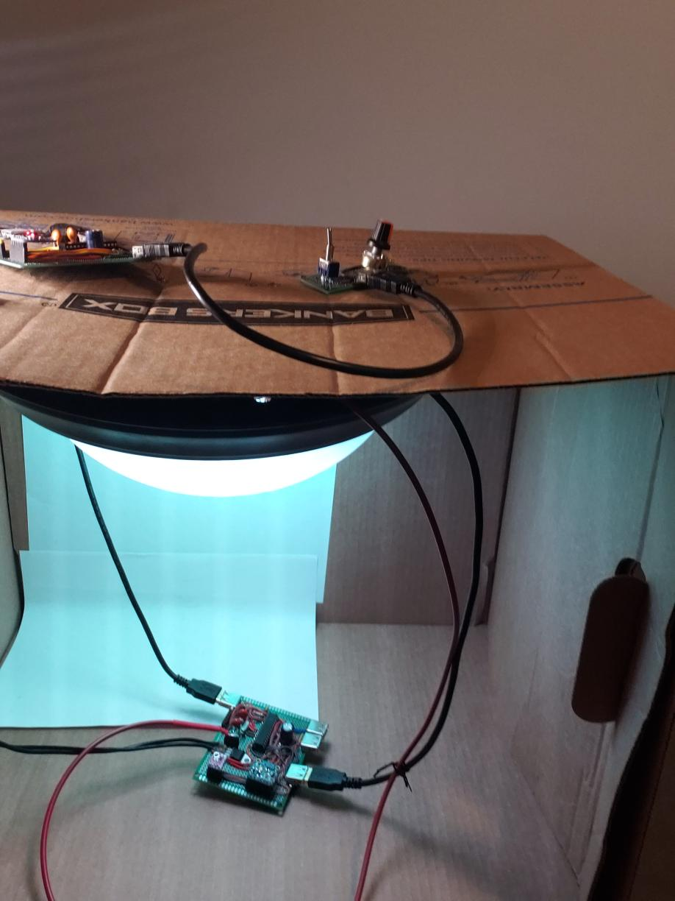
Light Matching Network
Notes:
elizabeth

Slide 5
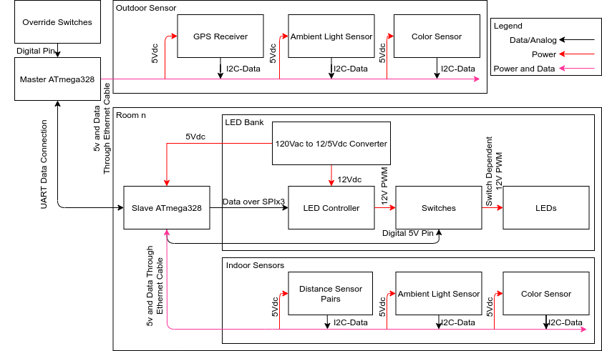
Block Diagram
Notes:
josh

Slide 6
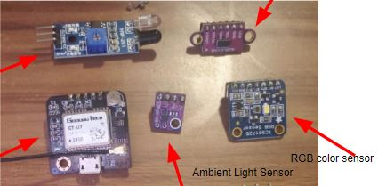
Module: Sensors
Linear regime operation (0 - 10,000 lux)
Be under 1000 lux indoors
Detect real-time
Detect color in RGB
Time of flight sensor
IR Sensor
RGB color sensor
GPS Module
Notes:
richard

Slide 7
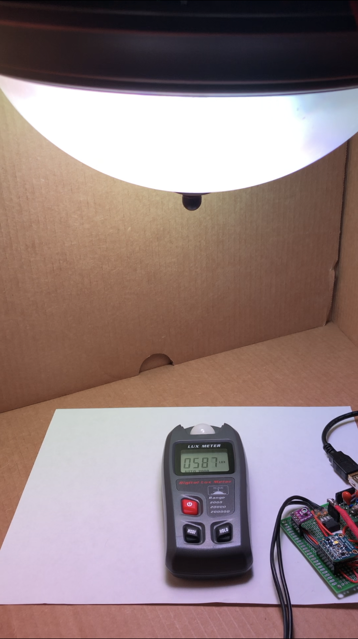
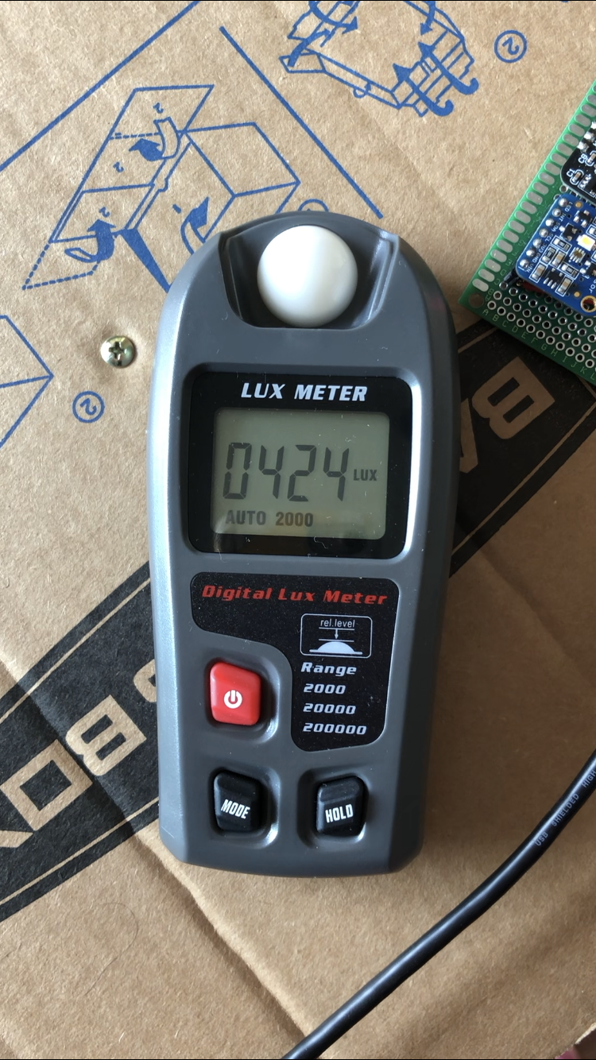
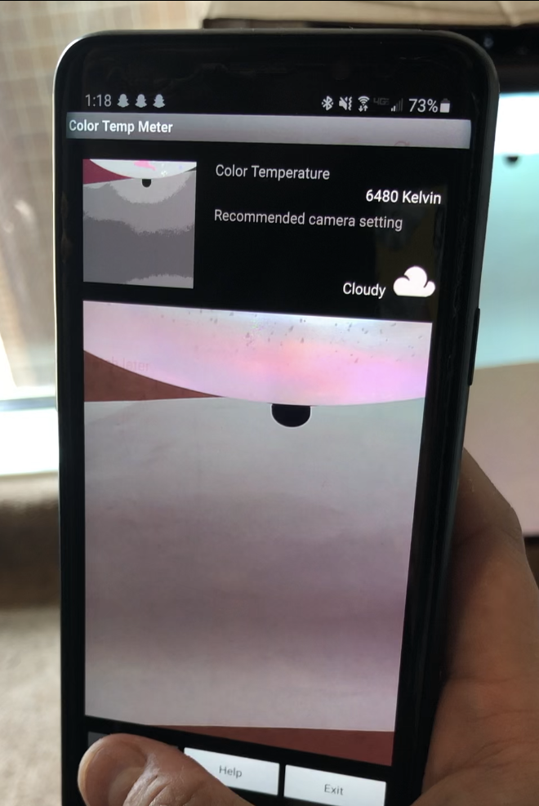
Requirements and Verification - Sensors
Notes:
richard

Slide 8
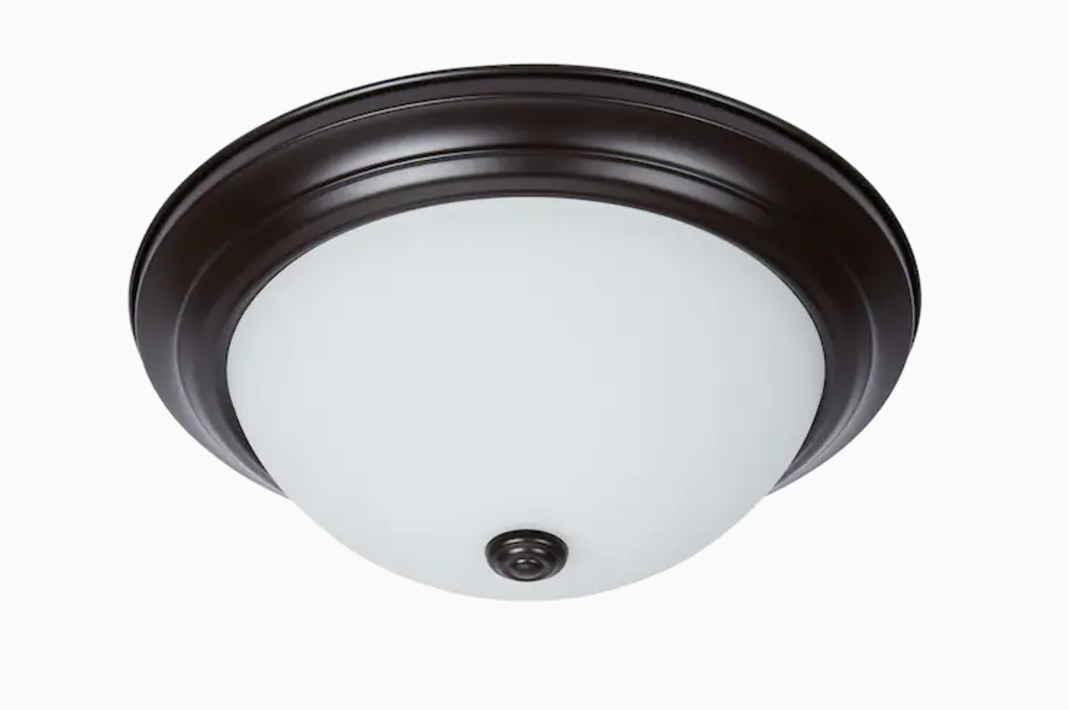
Module: LED Bank
Color temperature and brightness are within ±10% error
Dispersed light will light up an entire room evenly
Notes:
richard

Slide 9
Requirements and Verification - LED Bank
Lux Matching Data (Lux)
Trial Number | Outside Light | Emitted Light | % Error
1 | 626 | 588 | 6.07%
2 | 42.3 | 41.3 | 2.36%
3 | 540 | 575 | 6.48%
4 | 493 | 508 | 3.04%
5 | 193 | 209 | 8.29%
6 | 190 | 191 | 0.52%
7 | 170 | 169 | 0.58%
8 | 441 | 432 | 2.04%
9 | 578 | 544 | 5.88%
10 | 425 | 401 | 5.64%
Average % Error: 4.09% which is within the requirement range of ± 10% lux
| emitted-outside|
% Error =
outside
lux = lumens/m²
Notes:
richard

Slide 10
Requirements and Verification - LED Bank
Color Temperature Matching (Kelvin)
Trial Number | Outside Light | Emitted Light | % Error
1 | 3890 | 3730 | 4.11%
2 | 6490 | 6450 | 0.61%
3 | 6440 | 6490 | 0.77%
4 | 4410 | 4240 | 3.85%
5 | 4480 | 4400 | 1.79%
6 | 4490 | 4350 | 3.11%
7 | 4360 | 4230 | 2.98%
Average % Difference: 2.46% which meets requirement of being with 10% °K
Notes:
richard

Slide 11
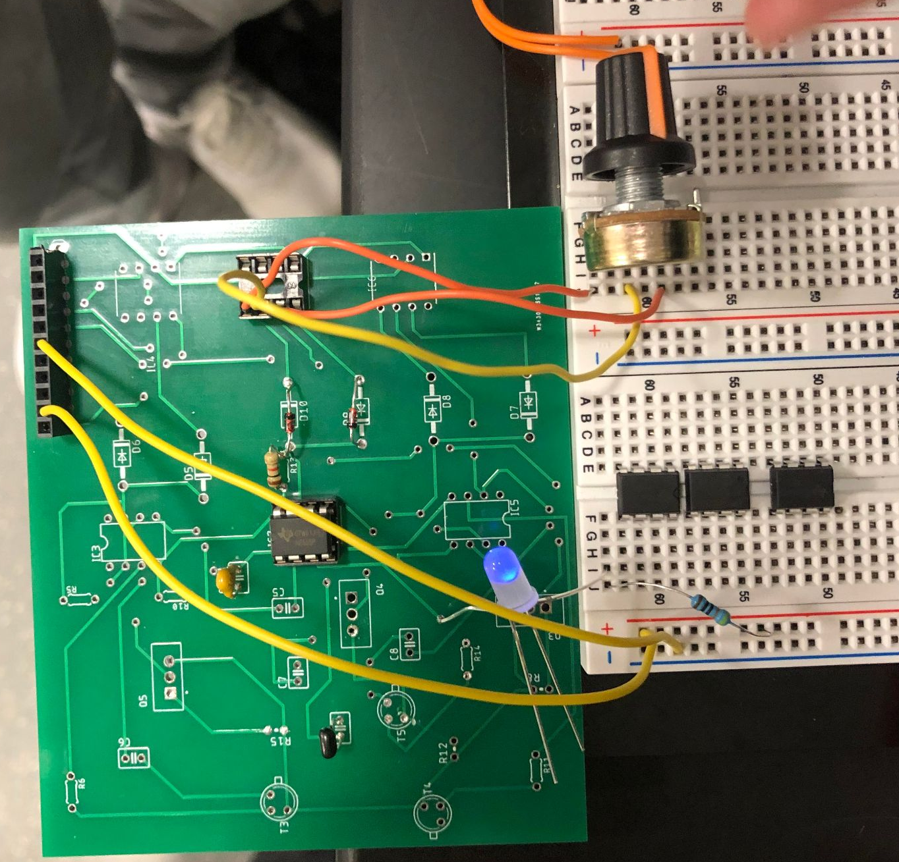
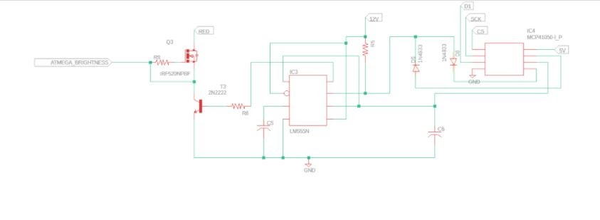
Module: Dimmer Circuit
Operate at above 300 Hz
Change duty cycle for LED control
Notes:
richard

Slide 12
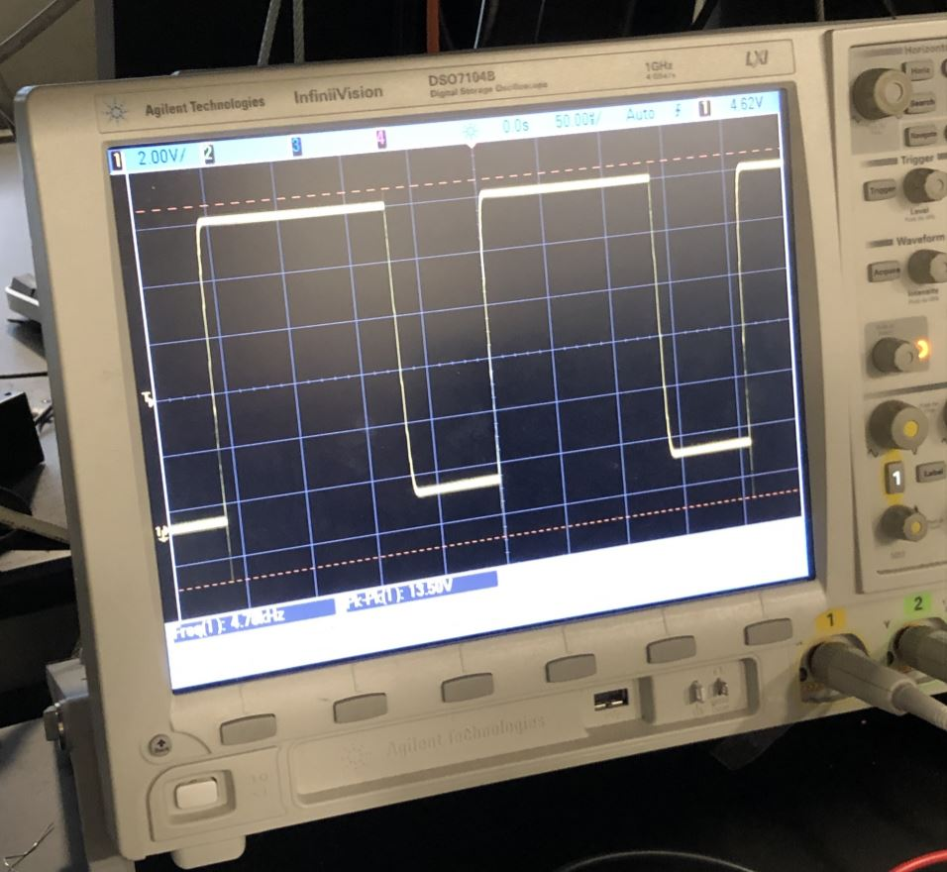
Requirements and Verification - Dimmer Circuit
Notes:
richard

Slide 13
Module: Master ATmega
Communicate with outdoor sensors through I2C, and slave ATMEGAs through UART
UART “splitter” was planned
Would calculate optimal RGB to send
Include master switch to turn off light when user specifies

Slide 14
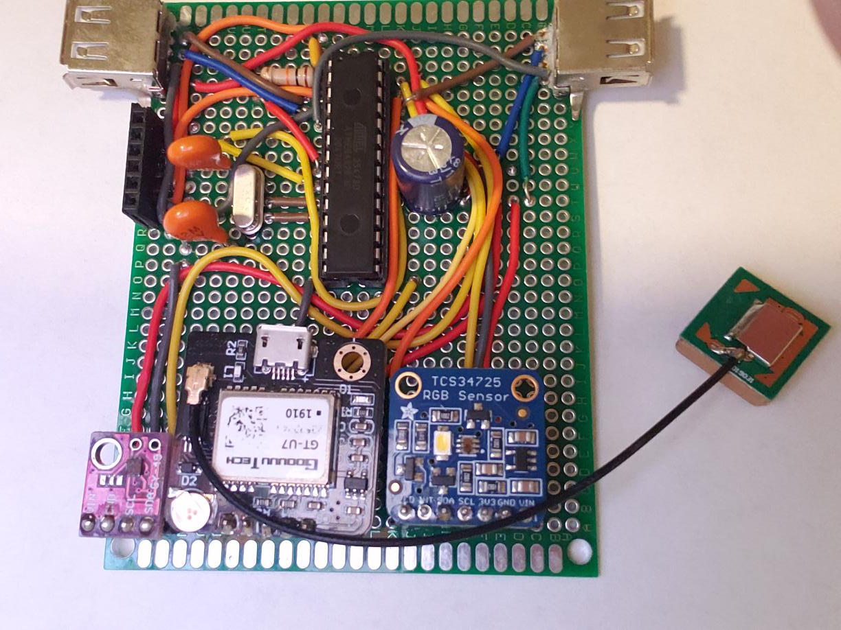
Requirements and Verification - Master ATmega

Slide 15
Module: Slave ATmega
Read data from Master ATMEGA at a delay of 10 ms
When indoor light differs from outdoor light by 10% in brightness or color, change indoor light accordingly
Send back requested room accounting
Laser sensors

Slide 16
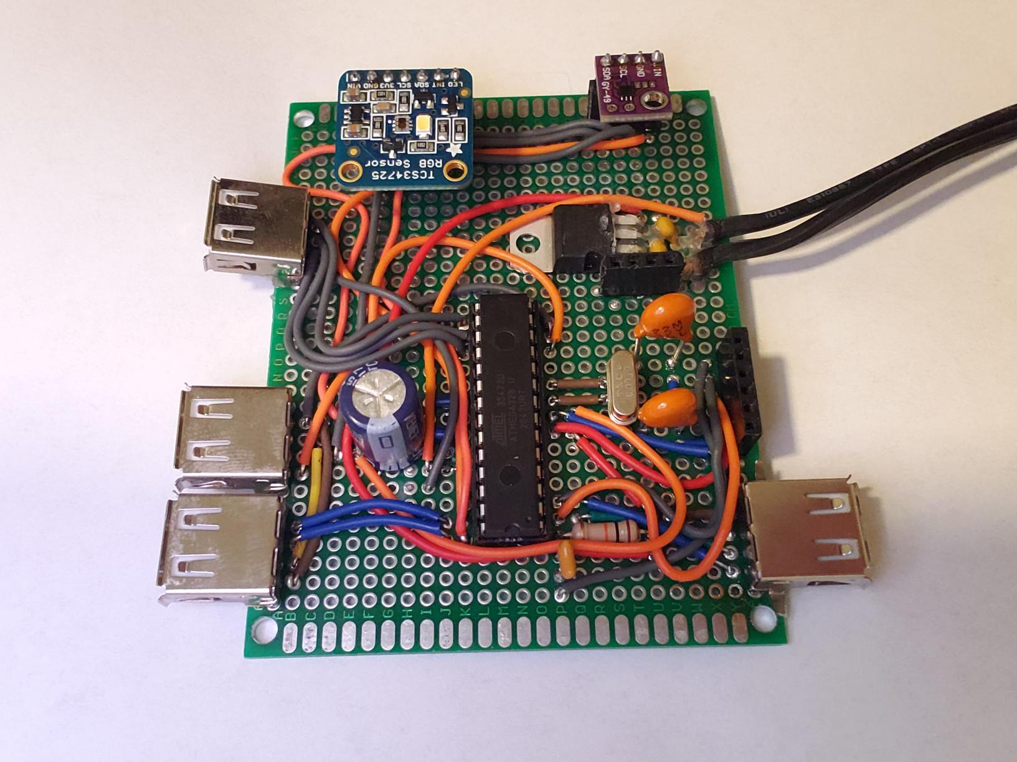
Requirements and Verification - Slave ATmega

Slide 17
Module: Power Supply
120 VAC rectified to 12 VDC
Used 5v regulator for necessary parts
Current limited to 300 mA per color
Used a high power resistor
Calculated current limiting resistor
Can plug into standard wall socket

Slide 18
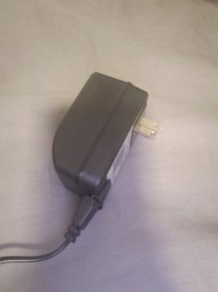
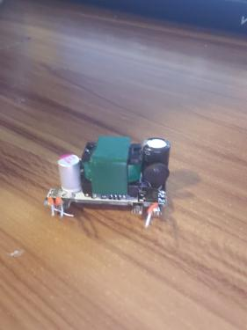
Requirements and Verification - Power Supply

Slide 19
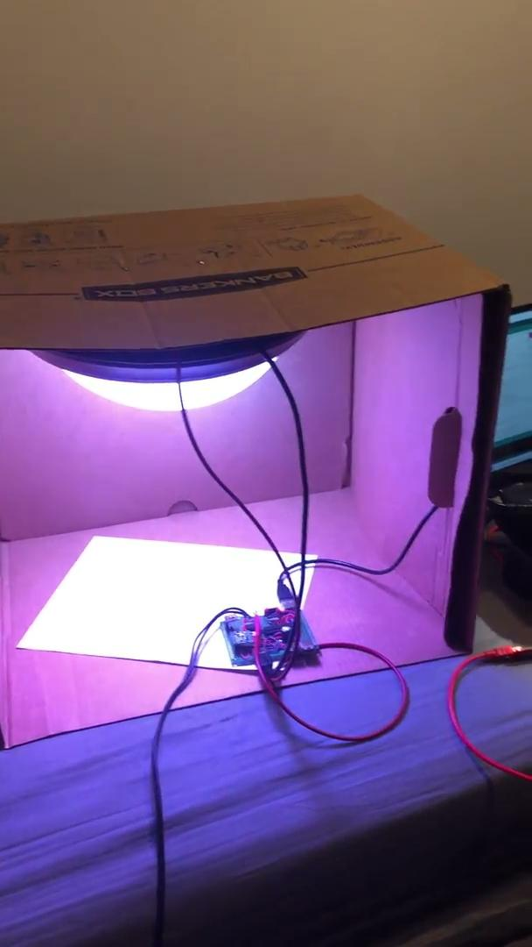
Video Demonstration

Slide 20
Successes and Challenges
Successes:
Working light fixture
Working Master Slave System
Power system adequate for current solution
Challenges:
Shipping delays - PCBs and additional parts
GPS sensor - difficulty using during bad weather

Slide 21
Conclusion
Main desired functionality was achieved
Future work:
Dimmer circuit PCB
Adding additional LED strips
UART “Routing” module for slave devices
Overall - cost effective and realistic for home environments

Slide 22
Thank you!
Questions?

