Slide 1
Team 36: Braille Study Aid
Luis Aragon, Emma Erickson, Aris Karnavas

Slide 2
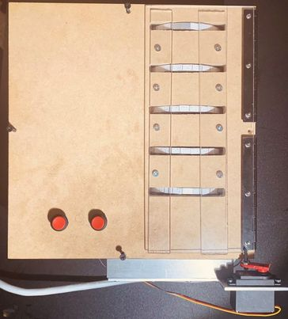
Introduction
Braille study tool that can be used for personal learning
Contains 50 words in code
Provides auditory feedback

Slide 3
Objectives
Student to learn at their own pace without need of teacher
Quick access to new words and confirmation
Easy use and cheaper than market alternatives
Notes:
2500

Slide 4
High Level Requirements
Must display five braille characters.
Must provide audio for the word being displayed upon button push.
Must allow the user to switch to the next word within 10 seconds.

Slide 5
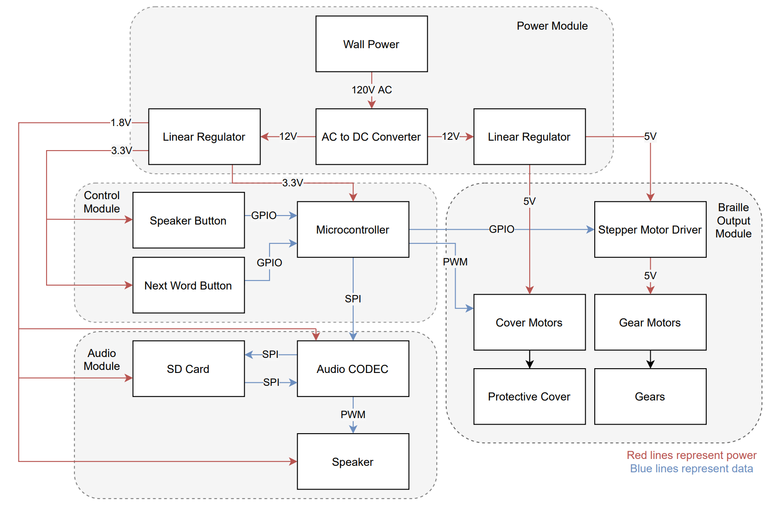
High Level Flowchart
Power Module
Control Module
Audio Module
Braille Output Module
Notes:
ARIS

Slide 6
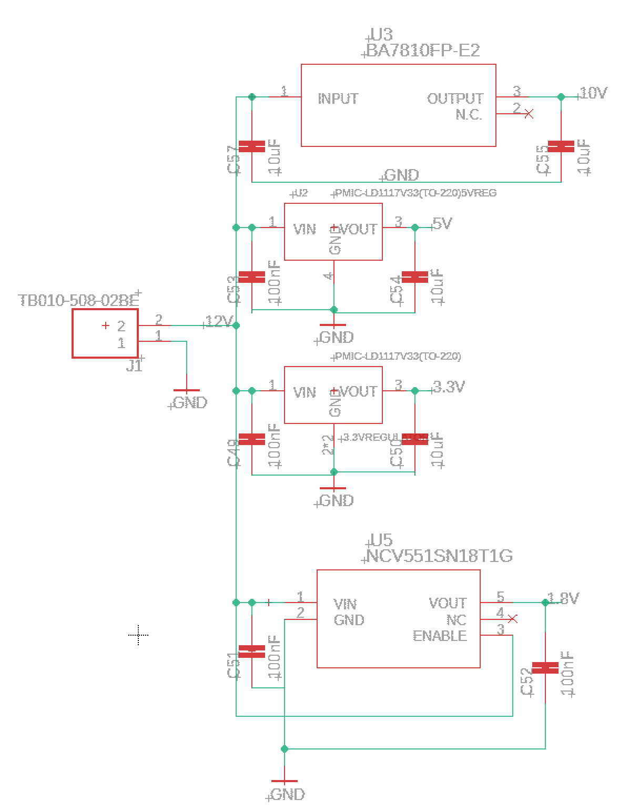
Power Module
Convert wall power to DC
Use various regulators to lower voltage
Notes:
10V-drivers, 5V- Cover motor, 3.3 and 1.8 Codec and Microcontroller
Power Supply - 12V 8.5A 102W

Slide 7
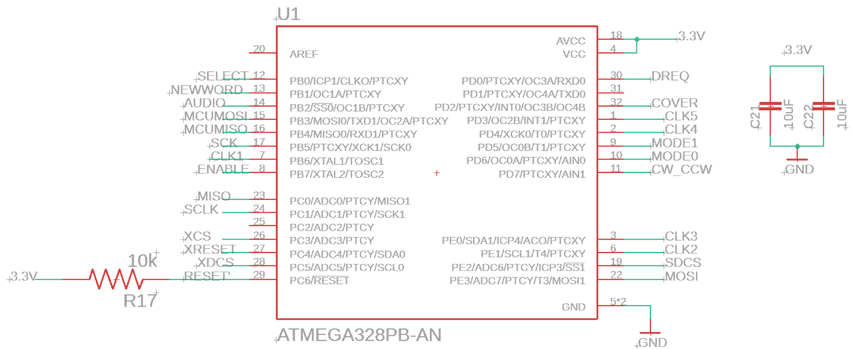
Control Module
Orchestrates communication between devices
Takes inputs from buttons to control audio and Braille output
Notes:
EMMA

Slide 8
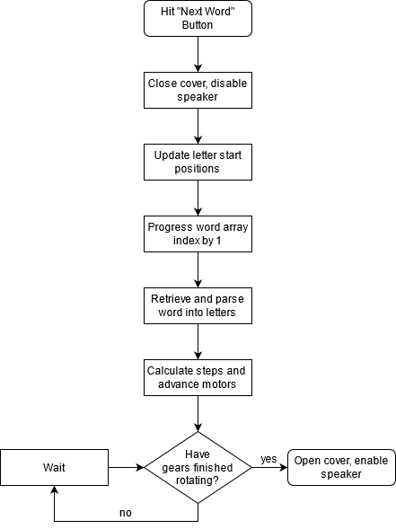
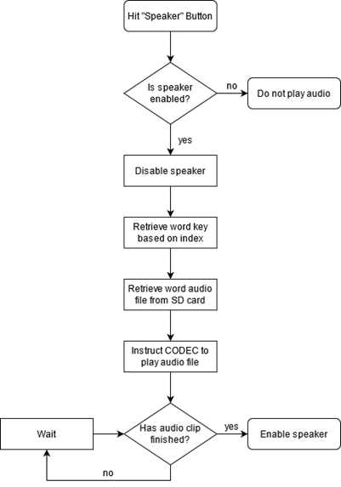
Code Structure
Next Word Speaker
Notes:
EMMA

Slide 9
Audio Module
Speaker button in input signaling to play the current word
Communication is facilitated through CODEC
Audio clips are stored on the microSD
Output to headphones

Slide 10
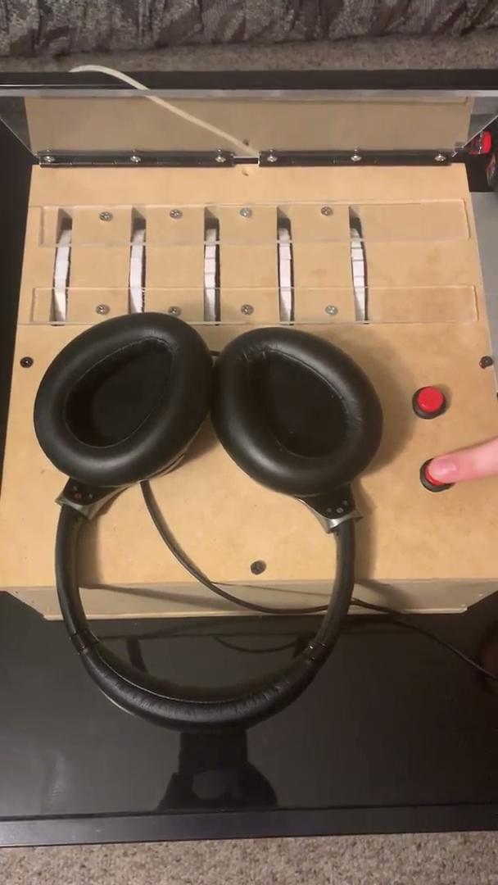
Audio Module Demonstration

Slide 11
Word Bank
Stored on MicroSD
Contains:
Letters
3-Letter Words
4-Letter Words
5-Letter Words
Example: Adult
Notes:
EMMA

Slide 12
Braille Output Module
User interface for reading Braille
Cover for protection
Sequencing of Braille display

Slide 13
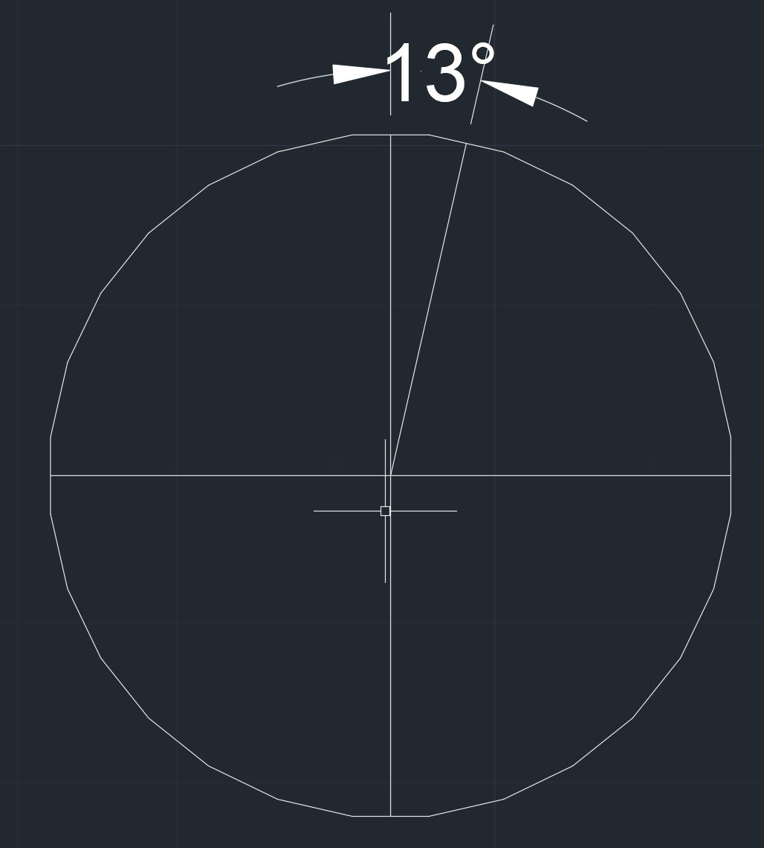
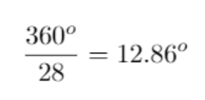
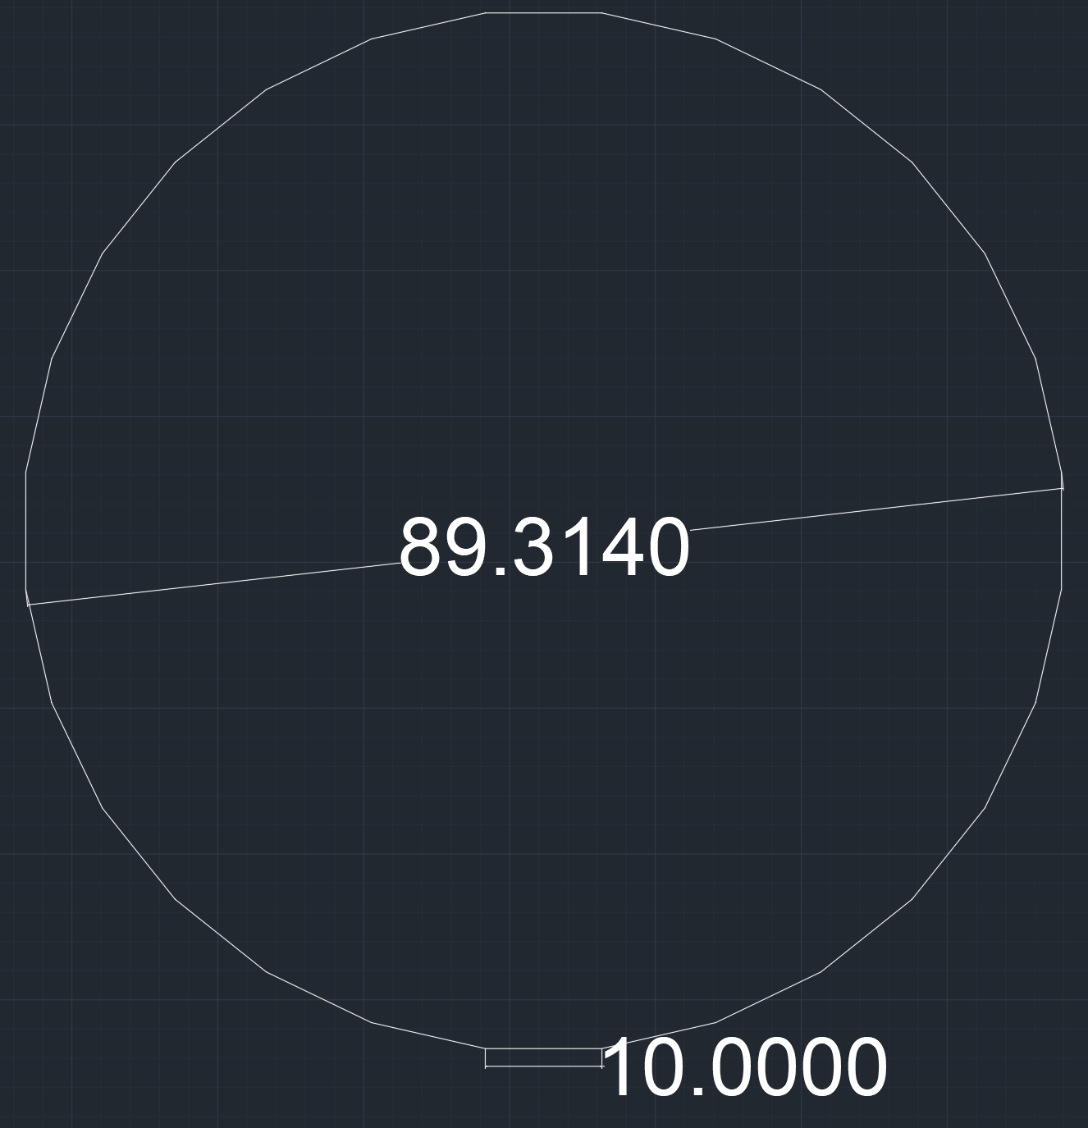
Gears - 28 sided
Braille character height 10mm
3.5in diameter gears
to change to adjacent letter

Slide 14
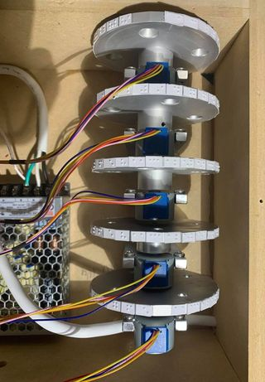
Gear Motors
Stepper Motors
4096 steps/rev
.088°/step
146 steps for one letter change

Slide 15
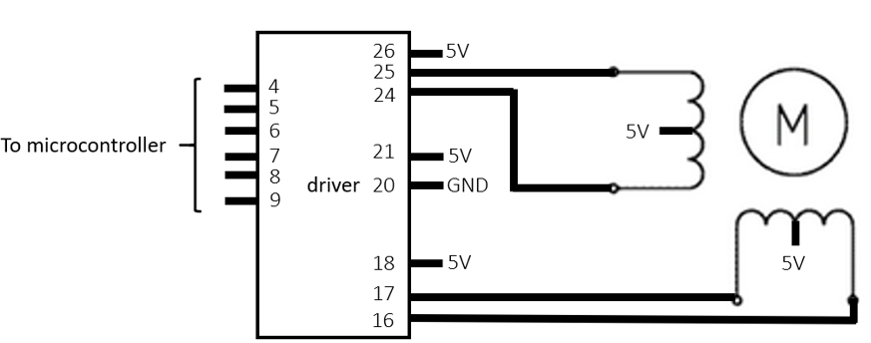
Motor Driver

Slide 16
Verification: Displaying Word Bank

Slide 17
Verification: Gear Movement Timing
From | To | Time
Doors | Final | 9.13
Final | L | 11.16
L | Y | 5.69
Y | A | 7.74
A | C | 3.57
C | Cream | 11.12
Cream | Y | 14.59
Y | Call | 12.24
Call | Final | 10.02
Final | Adult | 9.82
Adult | Day | 11.18
Day | C | 8.41
C | Belly | 13.18
Timed gear movement to randomly chosen words in our dictionary
Average time: 9.83 sec

Slide 18
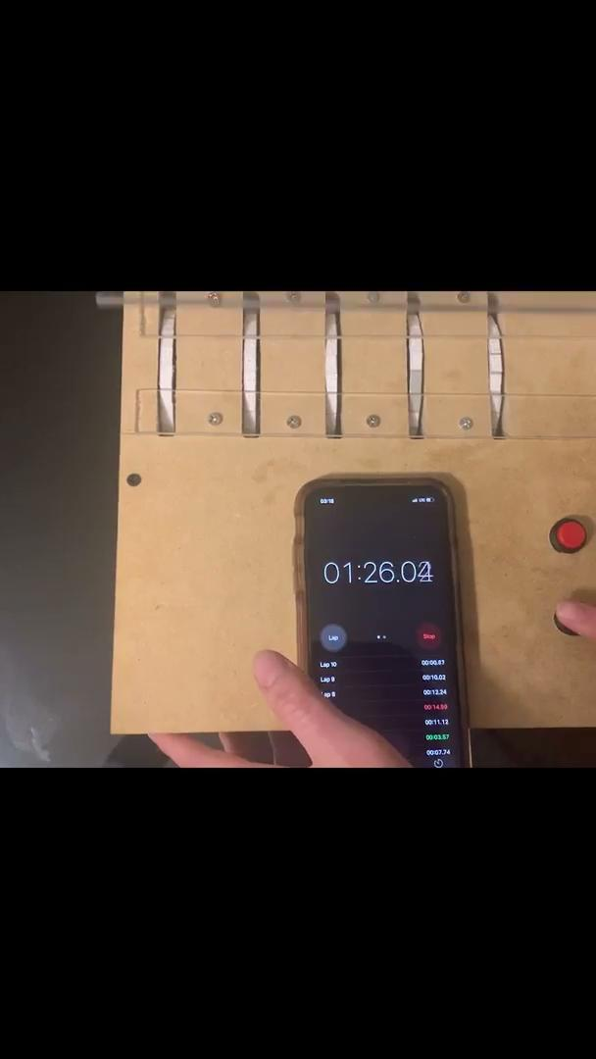
Verification: Gear Movement Timing

Slide 19
Verification: Gear Movement Timing Max
Theoretical maximum is each gear going halfway around the gear.
Test case: AAAAA -> NNNNN
Time: 14.97 sec

Slide 20
What Went Wrong
PCB Issues
MCU Short
Incompatible motor driver
Linear regulators
SD Card Formatting

Slide 21
Future Work
Improving system integration with PCB
More durable characters (3D printed)
Expand the word bank - and make modular
Notes:
EMMA

Slide 22
Conclusion
Final prototype displayed words and played appropriate audio
Notes:
Aris

Slide 23
Questions?
Thank you for listening!

