Slide 1
El Durazno Wind Turbine
Team 12
Saanil Joshi, Ganpath Karl, Alexander Hardiek
TA: AJ Schroeder

Slide 2
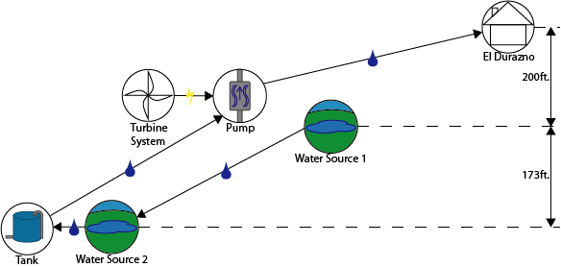
Introduction
El Durazno, remote village in Guatemala
Need access to water
Situated on the top of a hill
Two water sources: 200 feet and 373 feet below the village
Wind Turbine proposed to power a pump

Slide 3
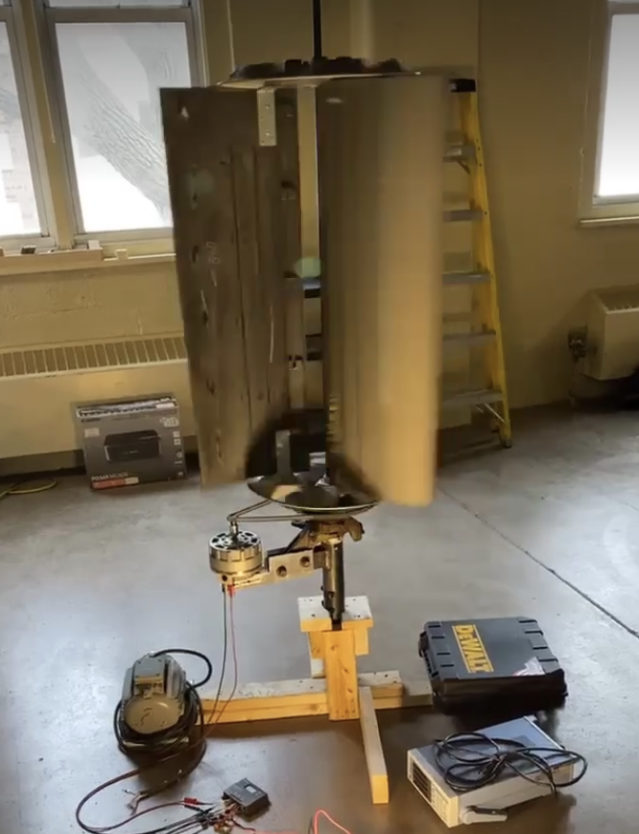
Objectives
Install low-cost, easily-maintained wind turbine
Made up of used car parts
Able to power a battery and also be able to connect to the grid
Able to generate electricity around ~15 mph winds

Slide 4
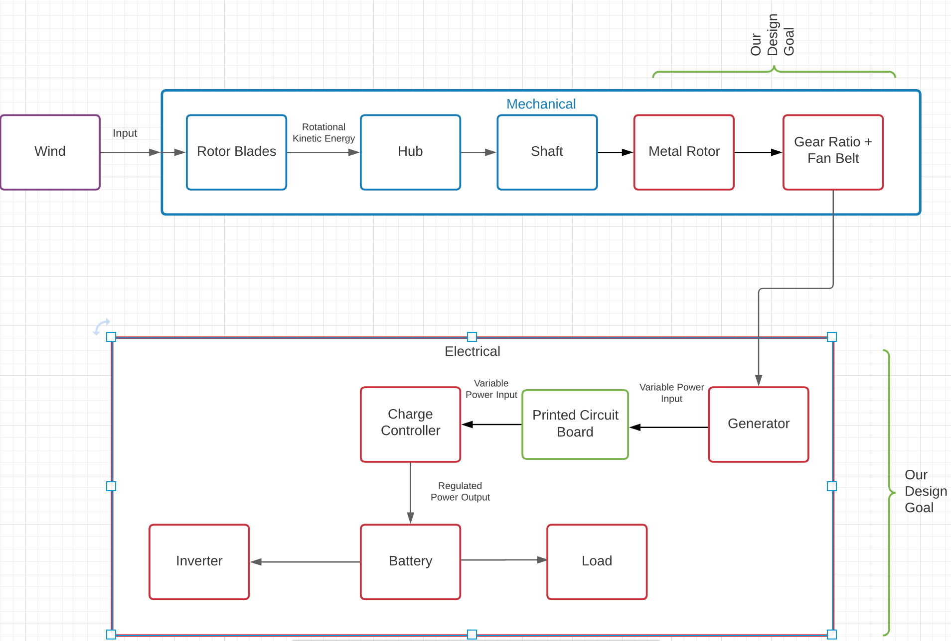

Slide 5
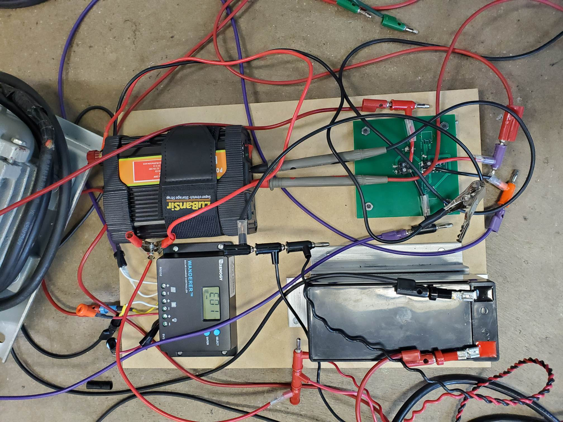

Slide 6
Requirements & Verification
Requirements
Rotor Blades
Aerodynamic Shape to turn easily
Rotating without Opposition
Hub
Interconnects Internal system
Withstands Changing wind speed
Shaft
Central connection of all components
Less Friction to Spin
Verification
Rotor Blades
Wind Tunnel Testing: 8-15mph
Hub
Wind Tunnel Testing: 8-15mph
Shaft
Wind Tunnel Testing: 8-15mph
Visual Inspection

Slide 7
Requirements & Verification
Requirements
Metal Plate
Cut and Threaded appropriately
Connects well with Fan belt
Gear Ratio
1:10 Ratio
Gears identified online
Generator
Minertia P Motor Compatibility
2.5A, 12V, across 9.1 Ohm
Verification
Rotor Blades
Attachment to shaft at Machine Shop
Gear Ratio
Wb = Ra/Rb * Wa
Gear B distanced from Metal rotor
Shaft
Voltage/Current Characteristics testing
Produces desired voltage/current at 1000 RPM

Slide 8
Requirements & Verification
Requirements
Charge Controller
Renogy Wanderer, 10A
High Efficiency
Inverter
Converts 12V DC to 120V AC
Battery
Low Cost
Powers two 9.6W, 12V parallel bulbs
Verification
Charge Controller
Displays appropriate values
88% efficiency lab testing
Inverter
Multi-meter outputs 120V AC
Battery
27$
Bulbs light up
Brightness increased when charging

Slide 9
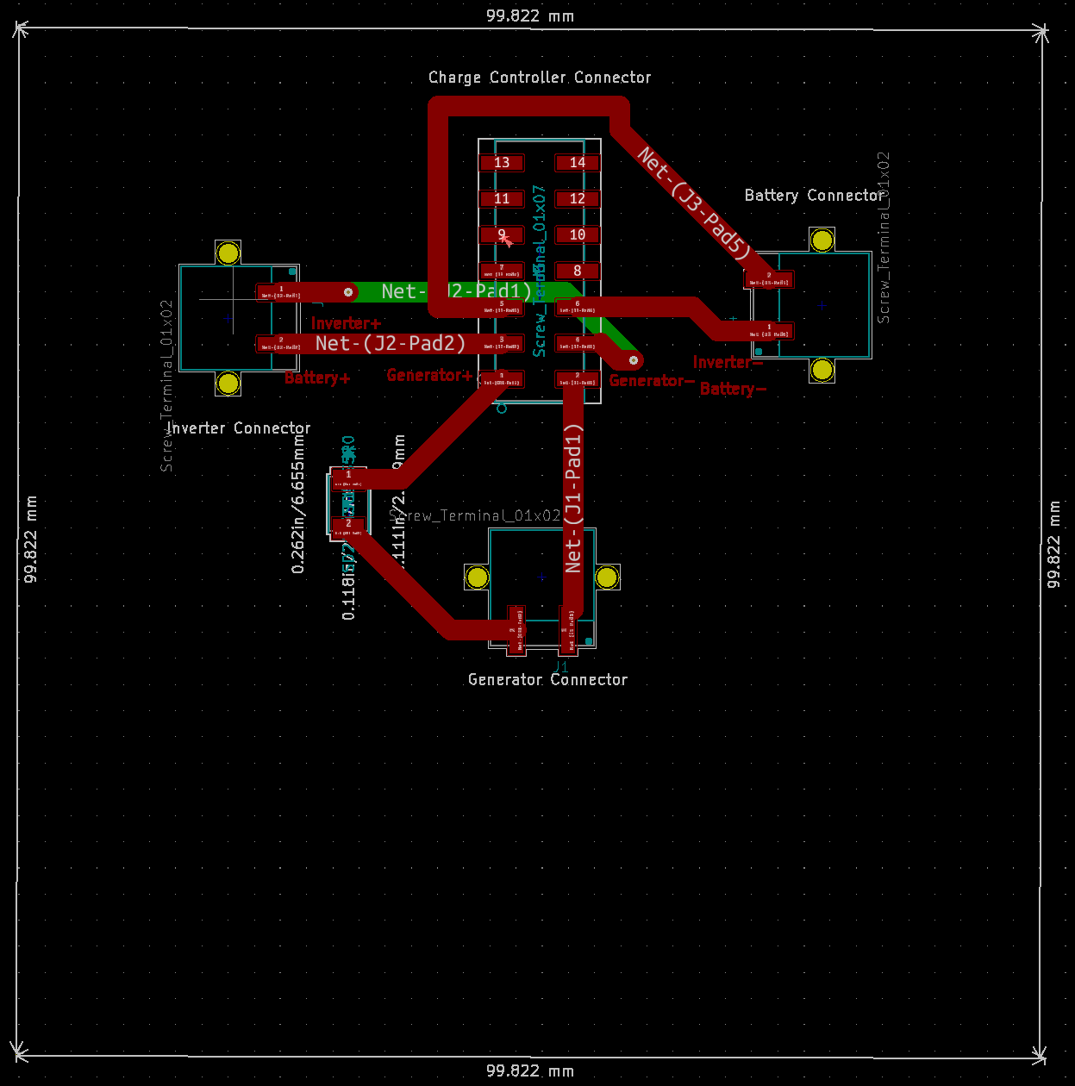
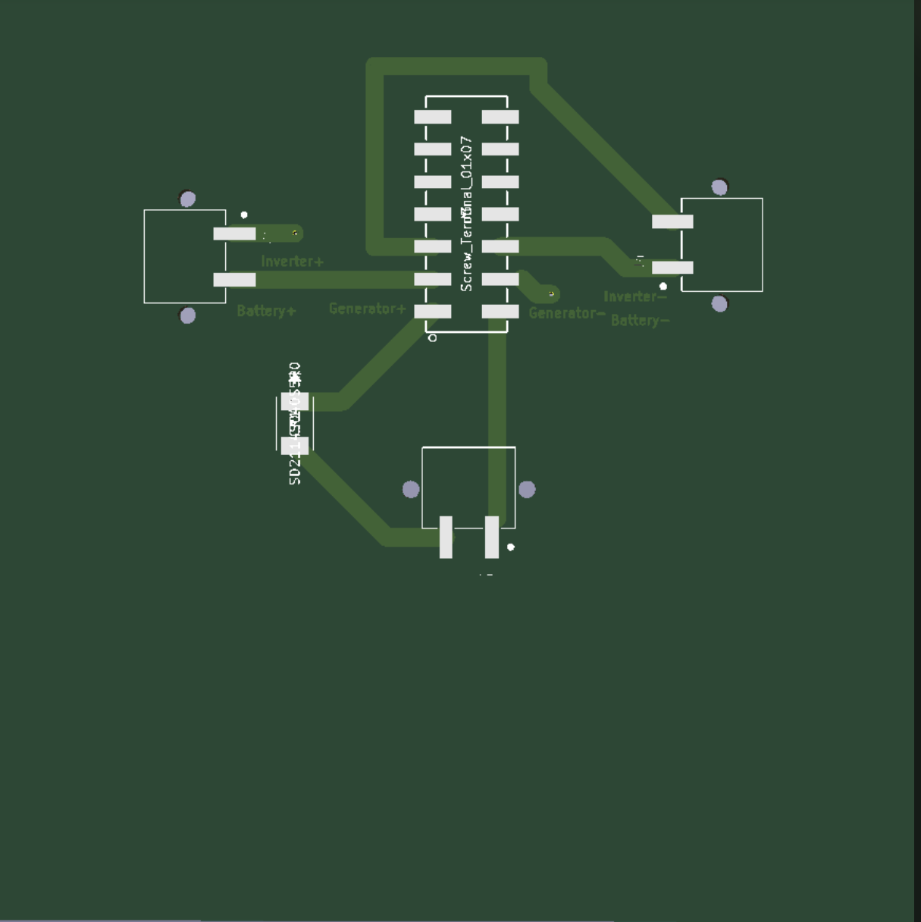
PCB

Slide 10
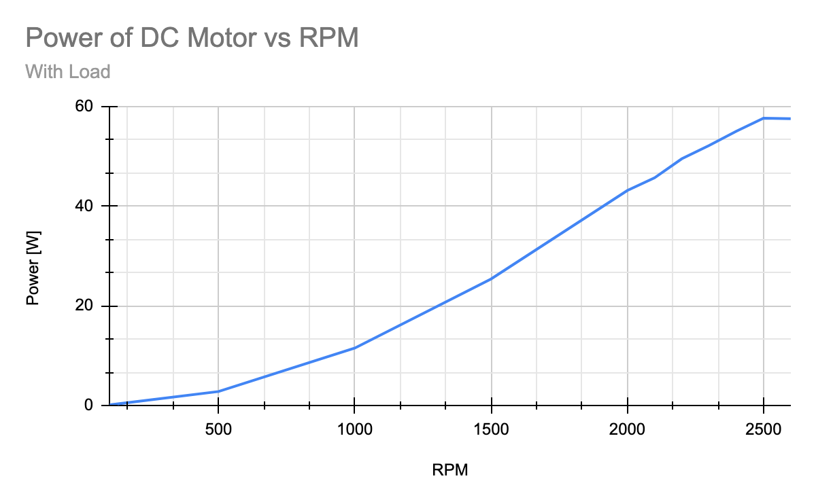
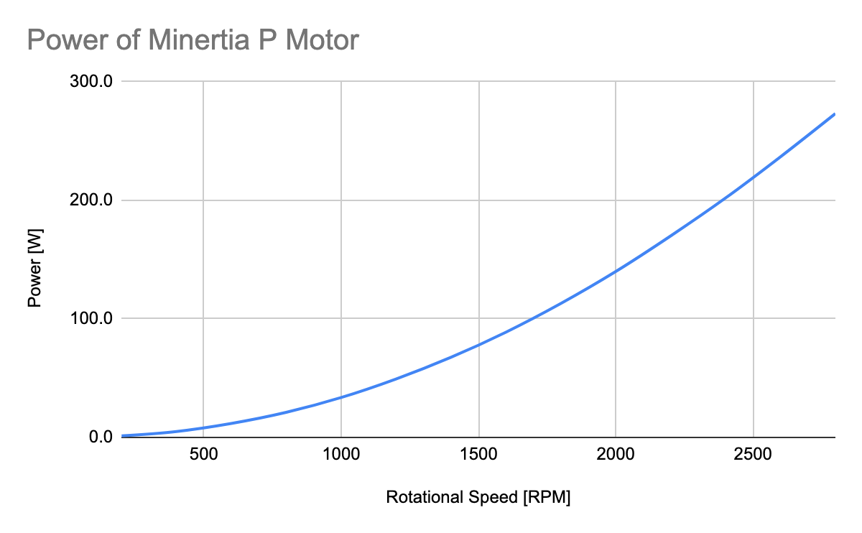
Design
Three “generators” tested
Original DC Motor
Alternator
Minertia P Motor
Original DC Motor with 0.91 Ω load
Minetia P Motor with 6 Ω load

Slide 11
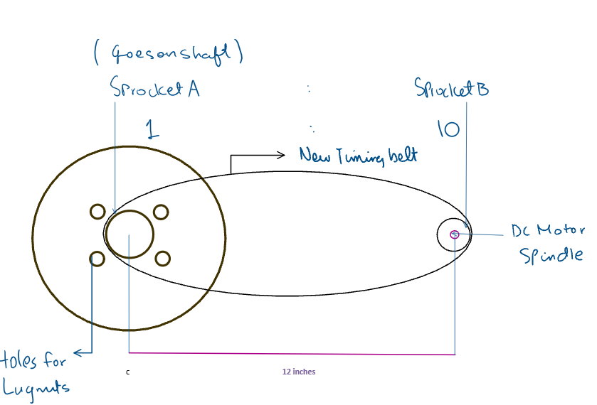
Gear Ratio

Slide 12
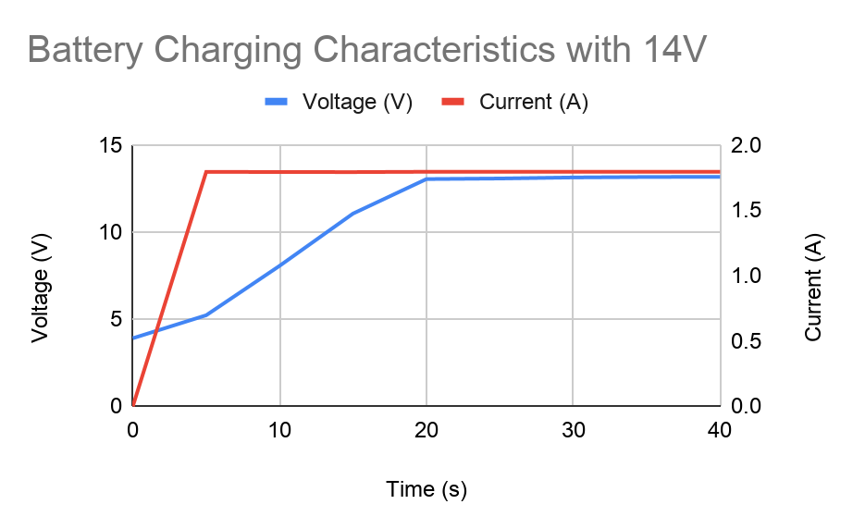
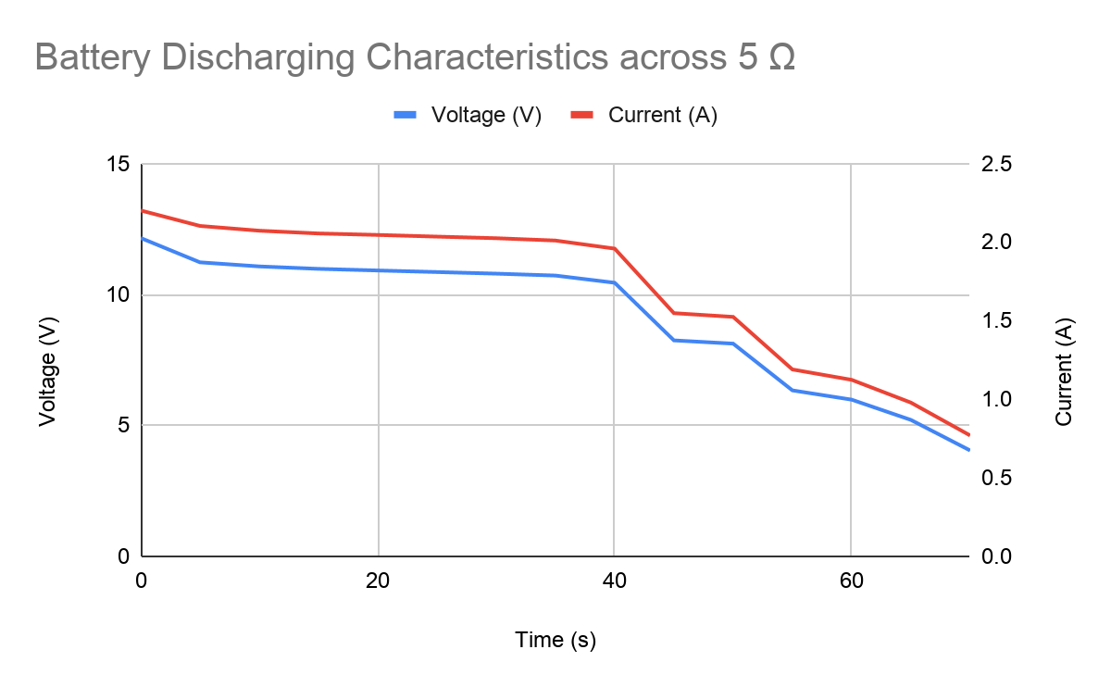
Battery Testing
Testing for the characteristics of the battery
used in the wind turbine

Slide 13
Project Video

Slide 14
Conclusion and Further Work
Wind Turbine is working
Able to power the inverter to charge a phone
Able to power two 12V DC light bulbs in parallel
Able to charge the battery at ~13.5 mph
Future Work: Add a capacitive circuit to prevent flickering of bulbs
Future Work: Test the powering of pump to transport water from one place to another

Slide 15
Thank You!
Questions?

